Slide 1
Exam 1 Review
February 15, 2019

Slide 2





Things You Use To Live
You
Were things more expensive in my parent’s time?
Your Parents

Slide 3
1980
2017

Slide 4

1980
2017
CPI
Common Measurement

Slide 5

1980
1982
2017
247.963
100
86.4

Slide 6
1980
1982
2017
247.963
100
86.4

Slide 7
1980
1982
2017
247.963
*100
=100
247.963
100
Divide by 2017 CPI
86.4
*100
= 34.844
247.963

Slide 8

1980
2017
100
Hey mom! What was the price of gas in 1980?
$1.34
You look outside and see the price of gas is $2.48
34.844

Slide 9

1980
2017
$1.34
$2.48

Slide 10
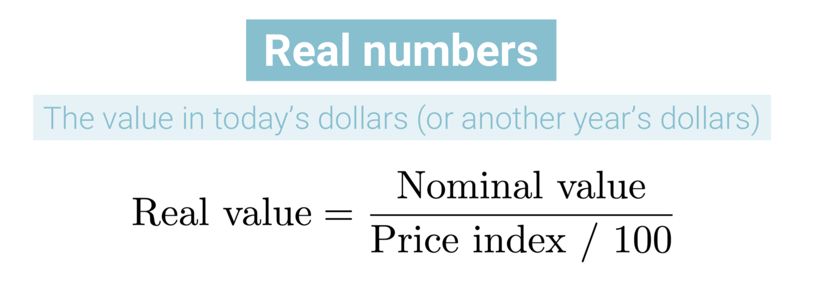
1980
2017
$1.34
$2.48
1980
In 2017 Terms
$1.34
/ (34.844/100)
= $3.85
Turning CPI into Percentage

Slide 11
1980
2017
$1.34
N-O / O
$2.48 - $3.85 / 3.85
$2.48
Percent Change in Gas (Real)
- 35.51 %
1980
In 2017 Terms
$3.85

Slide 12
1980
2017
Compound Annual Growth Rate
LN( )
$1.34
$2.48
2017-1980+1
1980
In 2017 Terms
-1.15 %
$3.85

Slide 13

Hey mom! Guess what? Gas is actually cheaper now than it was in 1980!
Honey. I can’t believe you figured that out! Your MPA degree is sure paying off!

Slide 14
Heuristics
Meg

Slide 15
Income & Substitution Effects
Meg

