Slide 1
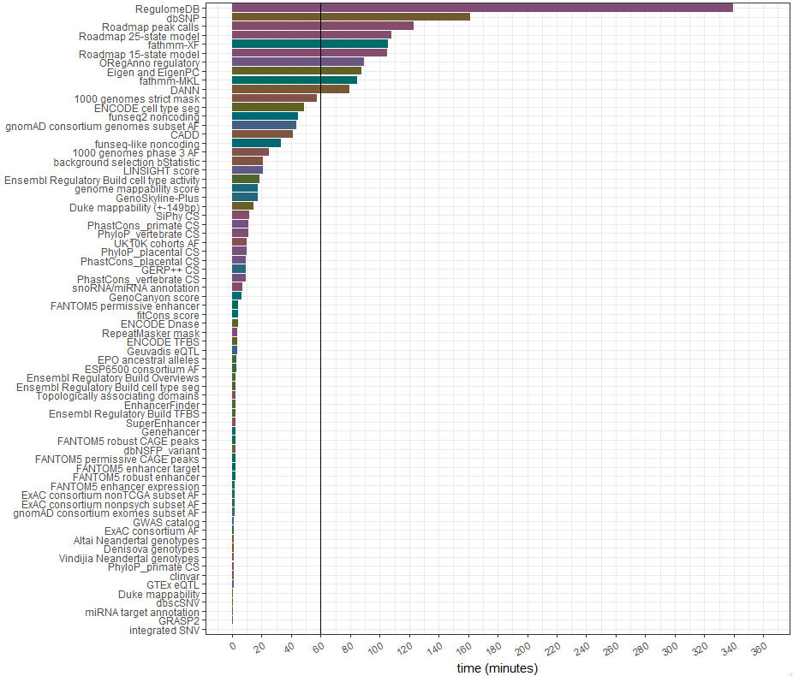
WGSA Benchmark for AA Chip SNPs (N = 815,236)
Time for completion for each SNV component
Top 15 components with longest runtime
 | Step & Component |  | Minutes | % of total
1. | 42. | RegulomeDB | 339.5 | 22.3
2. | 4. | dbSNP | 161.6 | 10.6
3. | 72. | Roadmap peak calls | 123.3 | 8.1
4. | 71. | Roadmap 25-state model | 108.0 | 7.1
5. | 48. | fathmm-XF | 105.9 | 7.0
6. | 70. | Roadmap 15-state model | 104.9 | 6.9
7. | 50. | ORegAnno regulatory | 89.5 | 5.9
8. | 49. | Eigen and EigenPC | 87.8 | 5.8
9. | 47. | fathmm-MKL | 84.7 | 5.6
10. | 46. | DANN | 79.4 | 5.2
11. | 16. | 1000 genomes strict mask | 57.5 | 3.8
12. | 68. | ENCODE cell type seg | 48.7 | 3.2
13. | 44. | funseq2 noncoding | 44.6 | 2.9
14. | 41. | gnomAD genome AF | 43.2 | 2.8
15. | 45. | CADD | 41.2 | 2.7
To speed up pipeline, can turn off components we are not interested in

Slide 2
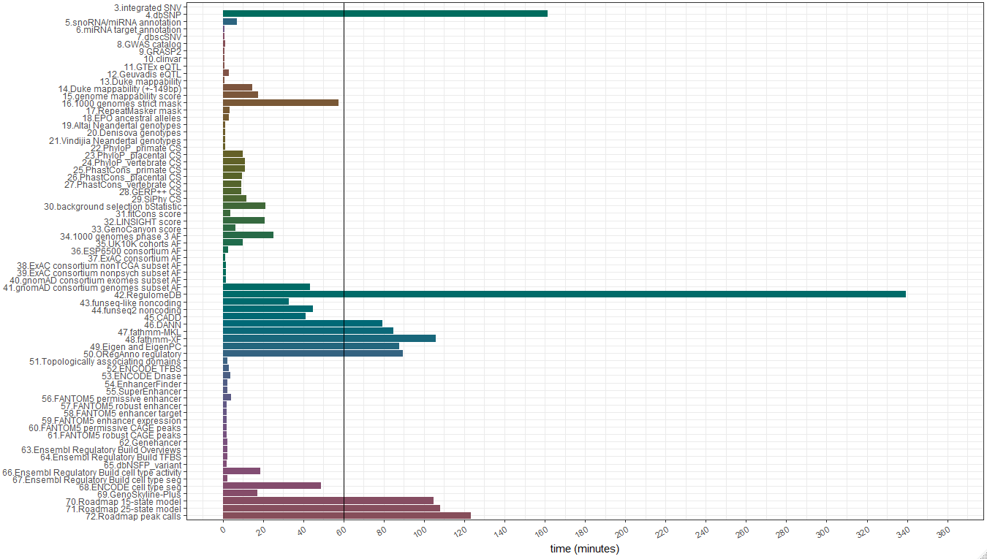
WGSA Benchmark for AA Chip SNPs (N = 815,236)
Step | Component | Minutes | % of total
42. | RegulomeDB | 339.5 | 22.3
4. | dbSNP | 161.6 | 10.6
72. | Roadmap peak calls | 123.3 | 8.1
71. | Roadmap 25-state | 108.0 | 7.1
48. | fathmm-XF | 105.9 | 7.0
70. | Roadmap 15-state | 104.9 | 6.9
50. | ORegAnno reg. | 89.5 | 5.9
49. | Eigen and EigenPC | 87.8 | 5.8
47. | fathmm-MKL | 84.7 | 5.6
46. | DANN | 79.4 | 5.2
16. | 1000G strict mask | 57.5 | 3.8
68. | ENCODE cell type seg | 48.7 | 3.2
44. | funseq2 noncoding | 44.6 | 2.9
41. | gnomAD genome AF | 43.2 | 2.8
45. | CADD | 41.2 | 2.7

Slide 3
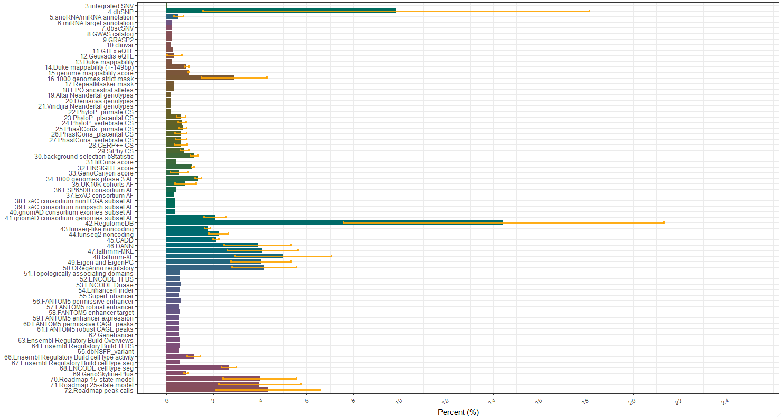
WGSA Benchmark
Step.Component | Mean % (SD) | AA Minutes
42.RegulomeDB | 14.4 (6.9) | 340
4.dbSNP | 9.8 (8.3) | 162
48.fathmm-XF | 5 (2.1) | 106
72.Roadmap peak calls | 4.3 (2.2) | 123
50.ORegAnno regulatory | 4.2 (1.4) | 89
47.fathmm-MKL | 4.1 (1.5) | 85
49.Eigen and EigenPC | 4 (1.3) | 88
70.Roadmap 15-state model | 4 (1.6) | 105
71.Roadmap 25-state model | 4 (1.8) | 108
46.DANN | 3.9 (1.4) | 79
16.1000 genomes strict mask | 2.9 (1.4) | 57
68.ENCODE cell type seg | 2.7 (0.3) | 49
44.funseq2 noncoding | 2.2 (0.4) | 45
45.CADD | 2.1 (0.1) | 41
41.gnomAD genomes AF | 2.1 (0.5) | 13

