Slide 1
Spatio-Temporal Analysis of
Road Traffic Accidents
2022 accidents in the Bangkok Metropolitan Region
Andrew Huang | ISSS626 Take-home Exercise 1

Slide 2
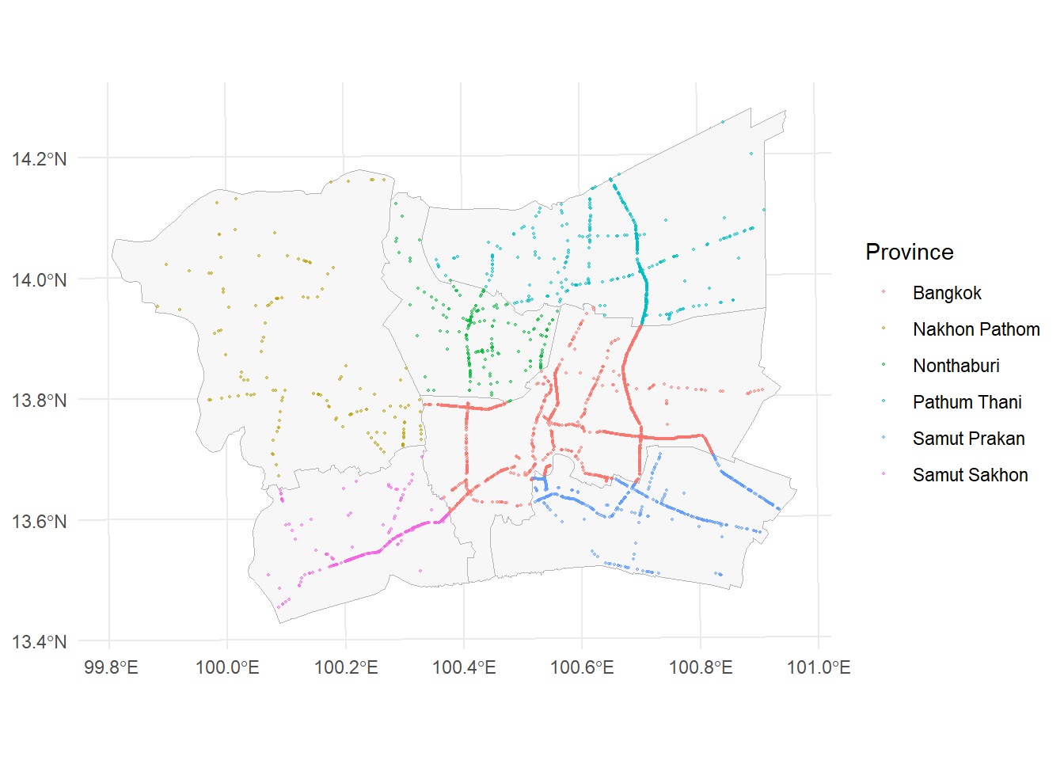
Where this analysis looks
Where are 2022 accidents concentrated?
Is that clustering real, or just coincidence?
Does the cluster's location change with time, month, or weather?
1

Slide 3
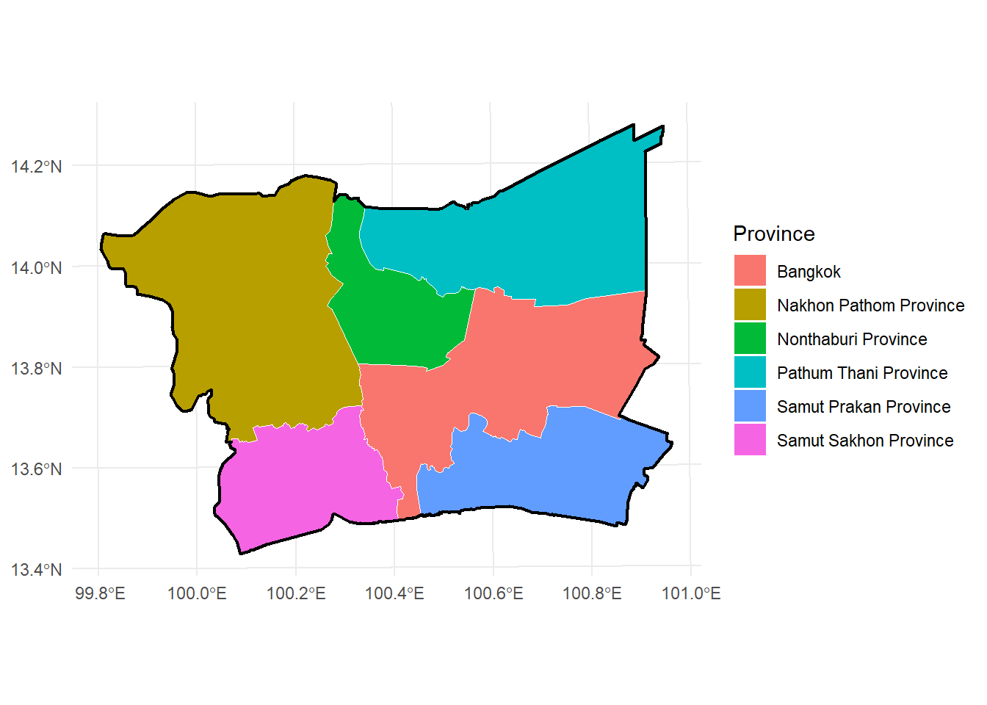
Study Area & Data
Bangkok + 5 surrounding provinces (BMR), 2022
3,590 geolocated accidents after cleaning
Data: Kaggle road accident records + geoBoundaries province polygons
Projected to EPSG:32647 (UTM 47N, metres)
2

Slide 4
Methodology
KDE — where is intensity highest
G / F / K / L + Clark-Evans — is the clustering statistically real
STKDE — does the hotspot move over time
segregation.test() — is a day/night or weather split really different
3

Slide 5
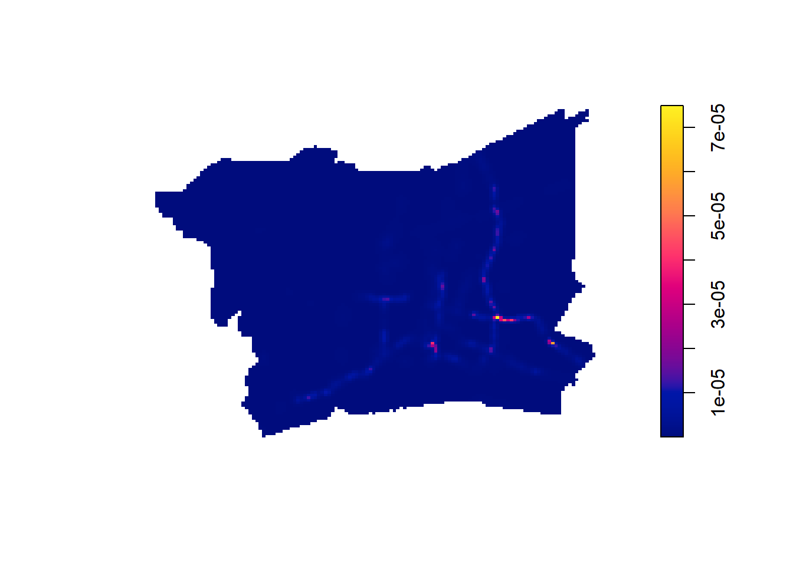
First-Order Analysis: Where
Adaptive KDE, bandwidth chosen with bw.ppl() (≈750m)
Hotspot sits at a major interchange in central-eastern Bangkok
Intensity follows the road network, not spread evenly
4

Slide 6
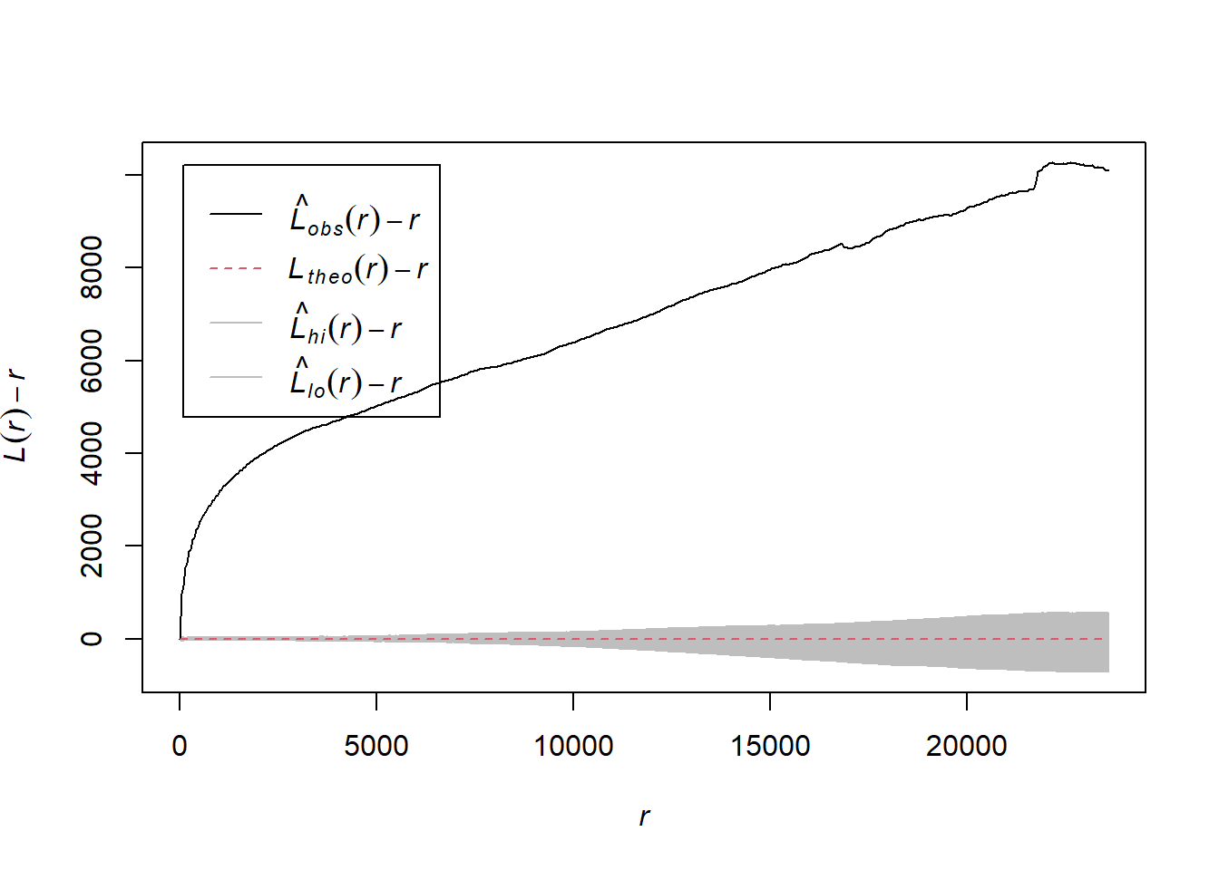
Second-Order Analysis: Is It Real?
G, F, K, L functions all reject CSR (complete spatial randomness)
Clark-Evans R = 0.215, p < 2.2×10⁻¹⁶
Clustering holds from the shortest to the longest distances tested
5

Slide 7
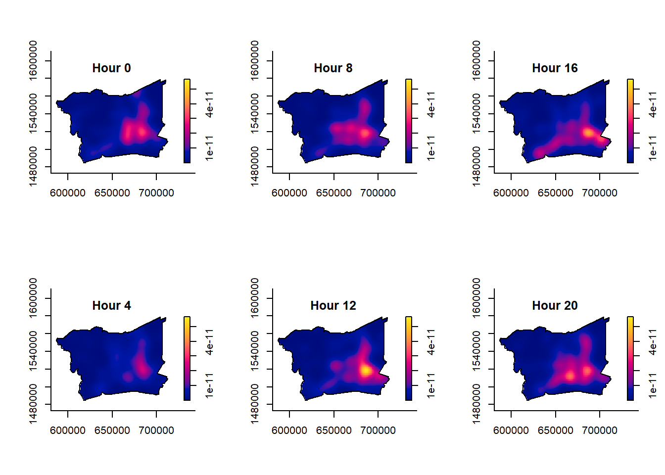
Spatio-Temporal Analysis: The Hotspot Moves
By hour: single peak at night, spreads out during the morning commute, sharpens again at midday
By month: same location all year, but intensity jumps October–December
6

Slide 8
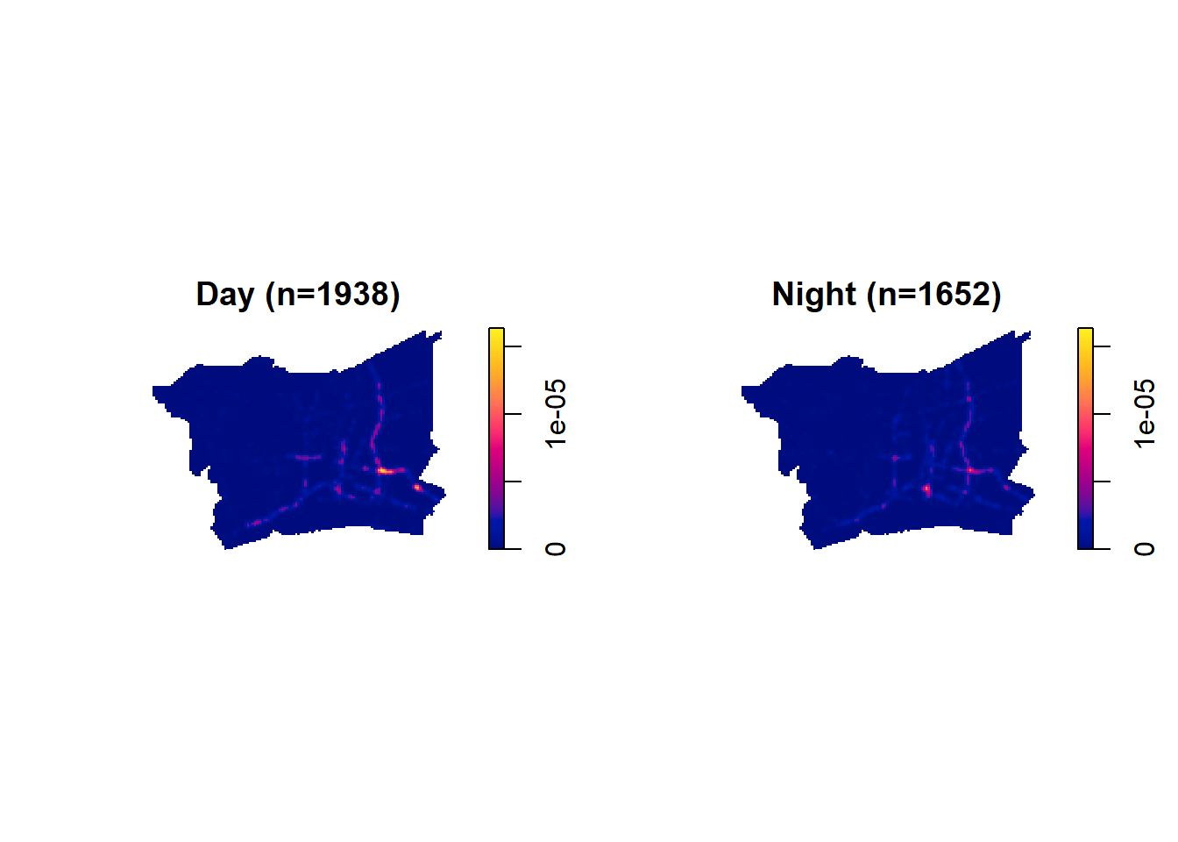
Day vs. Night, Weekday vs. Weekend
Day vs. night: significantly different locations (p = 0.01)
Weekday vs. weekend: same locations, only volume differs (p = 0.34; 2,549 vs. 1,041)
7

Slide 9
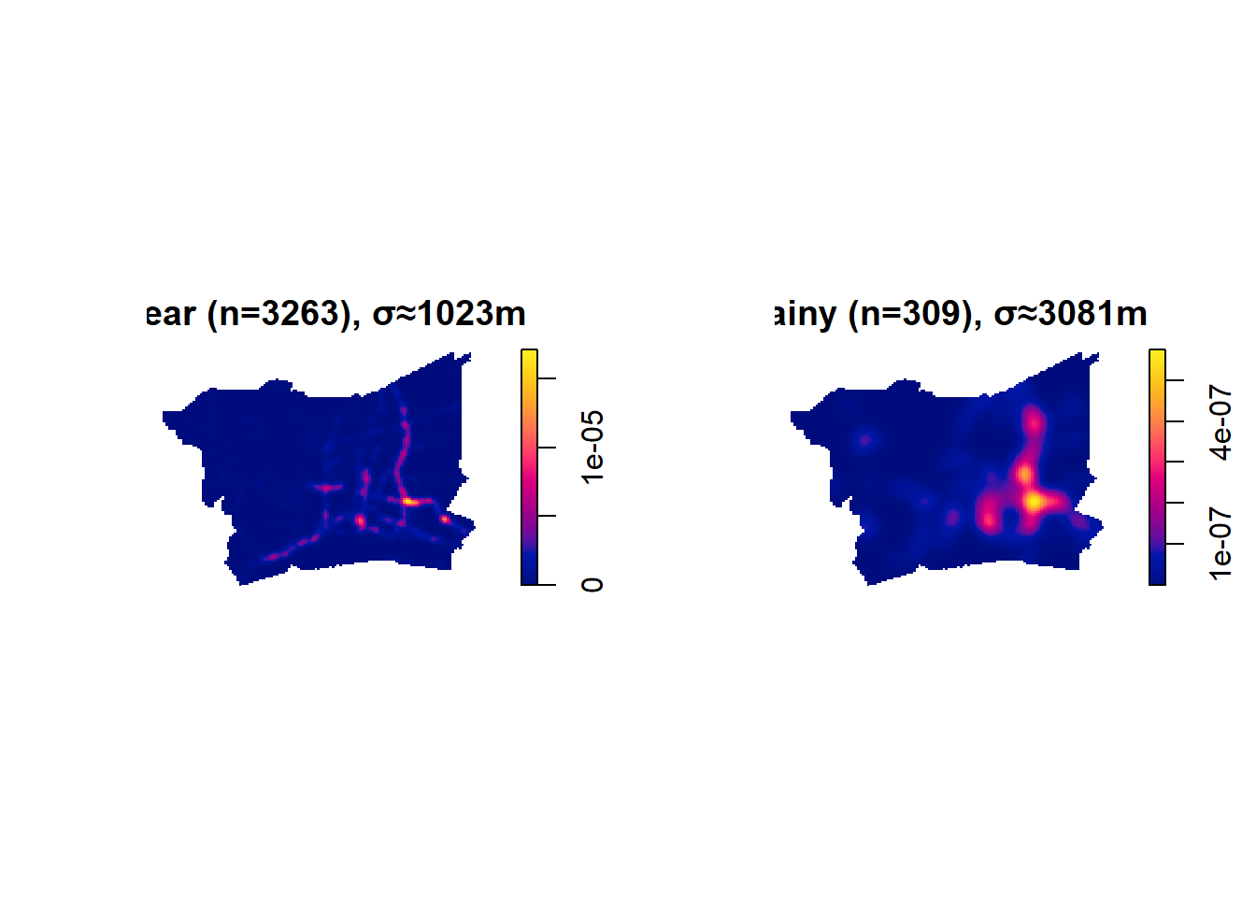
Value-Added: Does Weather Matter?
3,263 clear-weather points vs. 309 rainy-weather points
Locations differ significantly (p = 0.01)
Rainy-weather accidents concentrate in the east-central area — not just a smaller version of the usual hotspot
8

Slide 10
Public Safety Implications
Concentrate enforcement at the central-eastern interchange — the hotspot every analysis points to
Shift patrol locations between day and night, not just add more patrols
Check drainage and signage at the east-central cluster before rainy season
Plan for higher, more concentrated demand October–December
9

Slide 11
Limitations & Conclusion
BMR boundary is a province-name union, not an official metro polygon
5% of records had no coordinates and were dropped
321 duplicate coordinates jittered to fix a statistical issue
Day/night split is a fixed clock boundary, not actual daylight
Conclusion
2022 BMR accidents cluster along the road network, the clustering is statistically real, and where it clusters shifts by time of day, month, and weather — not just how many accidents happen.
10

