Slide 1
Test 2 Review
Sections 4.2, 4.3 & Geometry
Exponentials, Logs, Angles, Areas, Circles & Speed
Math 130: Advanced Technical Mathematics | Unit 2

Slide 2
Test 2 — Topics at a Glance
1
Compound Interest (discrete & continuous)
2
Exponential ↔ Logarithmic form conversions
3
Solving exponential & log equations
4
Angle conversions: DMS ↔ decimal degrees, radians ↔ degrees
5
Arc length (s = rθ) and sector area (A = ½r²θ)
6
Triangle area: ½bh and Heron's formula
7
Trapezoid area: ½(b₁+b₂)h (with Pythagorean Thm for height)
8
Parallel lines & proportional segments
9
Circle theorems: inscribed angles, central angles, intersecting chords
10
Linear & angular speed: v = rω

Slide 3
Compound Interest
Discrete
Continuous
A = P(1 + r/n)^(nt)
A = Pe^(rt)
P = principal, r = rate (decimal), n = compounds/yr, t = years
Same P, r, t. e ≈ 2.71828. Use when "compounded continuously."
Example: $2,500 at 3% for 20 years
Monthly (n=12): A = 2500(1 + 0.03/12)^(240) = 2500(1.0025)^240 ≈ $4,551.89
Continuous: A = 2500·e^(0.6) = 2500 × 1.82212 ≈ $4,555.30
Calculator tip: Use parentheses! Enter (1.0025)^240, not 1.0025^240.

Slide 4
Exponential ↔ Logarithmic Form
b^y = x ⟺ log_b(x) = y The base stays the base!
Exp → Log
Log → Exp
25^(5/2) = 3125 → log₂₅(3125) = 5/2
log₄(2048) = 5.5 → 4^5.5 = 2048
Solve: ln x = 4
Solve: 2^x = 13
x = e⁴ ≈ 54.598
x = ln(13)/ln(2) ≈ 3.700

Slide 5
Angle Conversions
DMS ↔ Decimal
Radians ↔ Degrees
DMS → Dec: D + M/60 + S/3600
37°41'11" = 37 + 41/60 + 11/3600 = 37.6864°
Dec → DMS: take decimal × 60 each step
36.3492° → 36° + 0.3492×60 = 20.952'
→ 20' + 0.952×60 = 57" → 36°20'57"
Deg → Rad: × π/180
163.9° × π/180 ≈ 2.86 rad
Rad → Deg: × 180/π
2.7 rad × 180/π ≈ 154.7°
Common: 30°=π/6 45°=π/4 60°=π/3 90°=π/2 180°=π 360°=2π

Slide 6
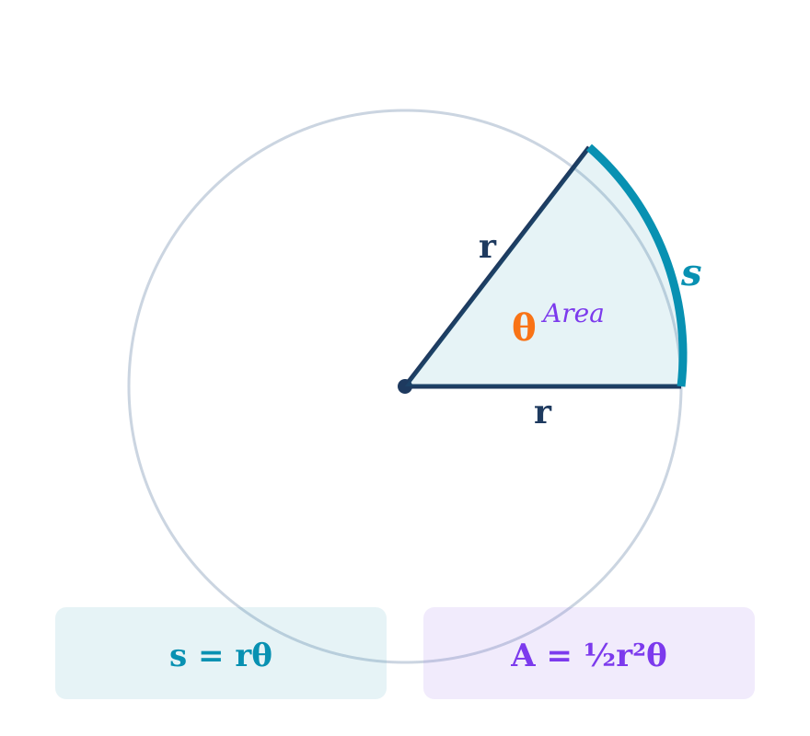
Arc Length & Sector Area
Arc Length
s = rθ
r=5.7, θ=65° → θ=1.1345 rad → s=5.7×1.1345 ≈ 6.5
Sector Area
A = ½r²θ
r=10, θ=3π/5 → A=½×100×(3π/5) ≈ 94.2
⚠ θ MUST be in radians! Convert degrees first: θ_rad = θ_deg × π/180

Slide 7
Triangle Area: Heron's Formula
s = (a+b+c)/2 A = √[s(s−a)(s−b)(s−c)]
Example: a = 1.5 cm, b = 1.3 cm, c = 2.1 cm
s = (1.5 + 1.3 + 2.1)/2 = 4.9/2 = 2.45
s−a = 0.95, s−b = 1.15, s−c = 0.35
A = √(2.45 × 0.95 × 1.15 × 0.35) = √(0.937) ≈ 1.0 cm²
Use Heron's when you know all 3 sides but NOT the height.

Slide 8
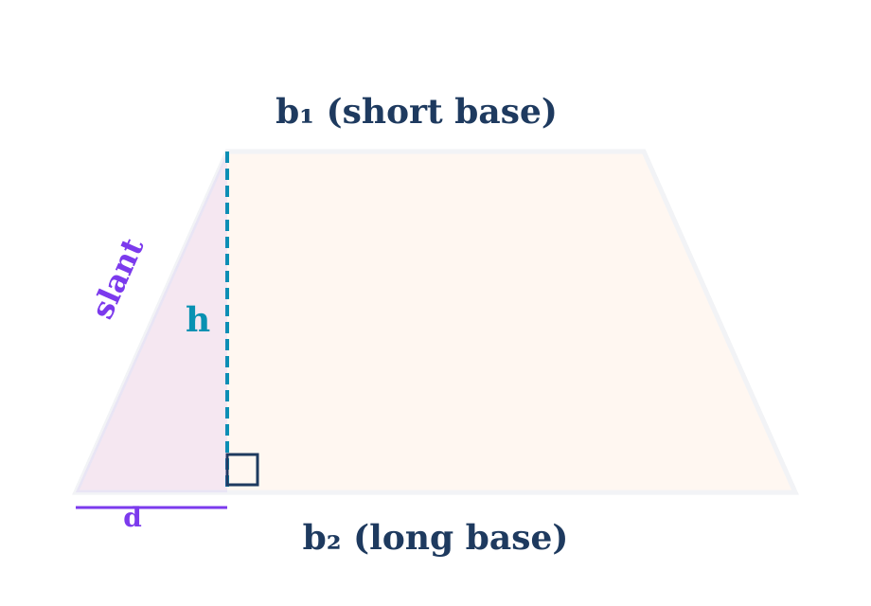
Trapezoid Area (Multi-Step)
A = ½(b₁ + b₂)h (may need Pythagorean Thm for h)
Ex: b₁=4.5, b₂=10.1, slant=7.0 m
Step 1: d = b₂ − b₁ = 5.6 m
Step 2: h² + 5.6² = 7.0²
h² = 49 − 31.36 = 17.64 → h = 4.2 m
Step 3: A = ½(4.5+10.1)(4.2)
A = ½(14.6)(4.2) = 30.66 m²

Slide 9
Parallel Lines & Proportional Segments
If parallel lines cut transversals, corresponding segments are proportional: AB/BD = AC/CE
Example: AB = 40, BD = 45, AC = 37. Find CE and DC.
Set up proportion:
40/45 = 37/CE
CE = 37 × 45/40 = 41.6 m
DC = CE − AC = 41.6 − 37 = 4.6 m

Slide 10
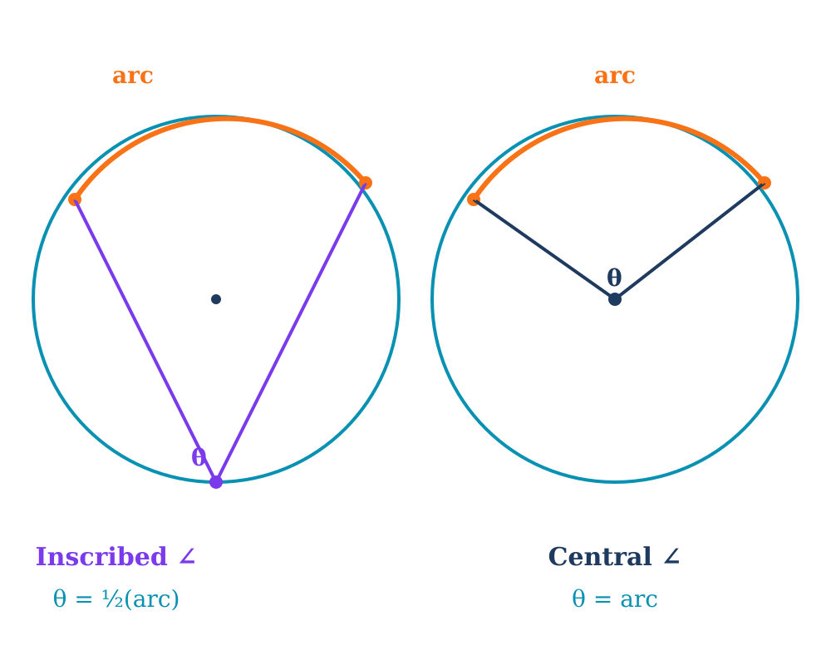
Circle Theorems: Arcs & Angles
Central angle = intercepted arc
Inscribed angle = ½(intercepted arc)
Intersecting chords: ∠ = ½(arc₁ + arc₂)
Semicircle: diameter → arc = 180°

Slide 11
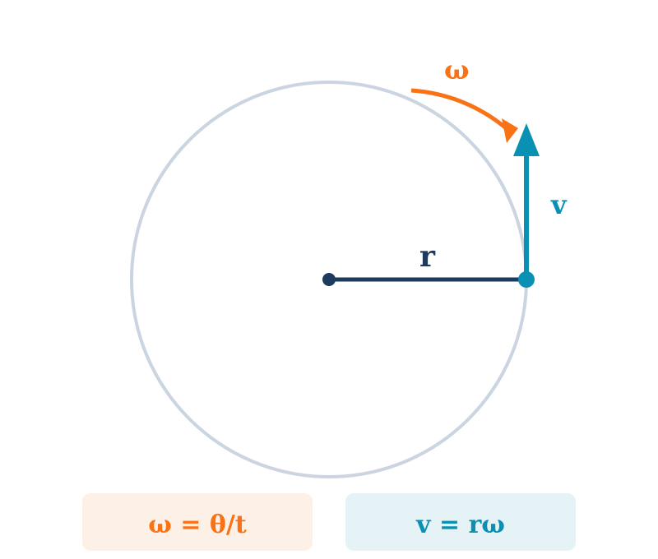
Linear & Angular Speed
Angular speed
ω = θ/t (rad/time)
1 rev = 2π radians
Linear speed
v = rω
distance per unit time at edge
Example: 350 RPM, r = 3 ft
ω = 350 × 2π = 700π rad/min
v = 3 × 700π = 2100π ≈ 6,597 ft/min
→ 6,597 × 60 ÷ 5280 ≈ 75.0 mph

Slide 12
Practice Quiz — Try Before Checking!
1.
$4,000 at 6% for 10 yrs, monthly. Find A.
$7,277.59
6.
Convert 5π/6 to degrees.
150°
2.
Write log₃(81)=4 in exponential form.
3⁴ = 81
7.
Arc length: r=12, θ=40°.
s ≈ 8.4
3.
Solve: e^x = 20 (3 dec places).
x = ln20 ≈ 2.996
8.
Sector area: r=7, θ=2π/3.
A ≈ 51.3
4.
Convert 45°22'18" to decimal degrees.
45.3717°
9.
Heron's: a=5, b=7, c=9.
A ≈ 17.4
5.
Convert 128.75° to DMS.
128°45'00"
10.
600 RPM, r=1.5 ft. Find mph.
≈ 64.3 mph

Slide 13
Formula Cheat Sheet
Interest
A = P(1+r/n)^(nt) | A = Pe^(rt)
Log ↔ Exp
b^y = x ⟺ log_b(x) = y | ln(aⁿ) = n·ln(a)
DMS
D + M/60 + S/3600 | Deg→Rad: ×π/180 | Rad→Deg: ×180/π
Arc/Sector
s = rθ (rad) | A = ½r²θ (rad) | Always convert θ to radians first!
Triangle
A = ½bh | Heron's: s=(a+b+c)/2, A=√[s(s-a)(s-b)(s-c)]
Trapezoid
A = ½(b₁+b₂)h | May need: h²+d²=slant², d=b₂−b₁
Parallel Lines
Proportional segments: AB/BD = AC/CE
Circles
Central ∠ = arc | Inscribed ∠ = ½(arc) | Chords: ∠ = ½(arc₁+arc₂)
Speed
ω = θ/t | v = rω | 1 rev = 2π rad | ft/min → mph: ×60÷5280
Good luck on Test 2! Remember: show all work for full credit.

