Slide 1
Module 10
Sections 5.1 & 5.2
Angles and Right Triangle Trigonometry
Math 130: Advanced Technical Mathematics | Unit 3

Slide 2
Section 5.1
Angles and Their Measure
5 ALEKS Skills

Slide 3
Section 5.1 — Skills Overview
1
Sketching angles with |θ| < 360° in standard position
2
Sketching angles in degrees & finding coterminal angles
3
Sketching angles in radians & finding coterminal angles
4
Sketching angles with |θ| > 360° in standard position
5
Arc length and central angle measure

Slide 4
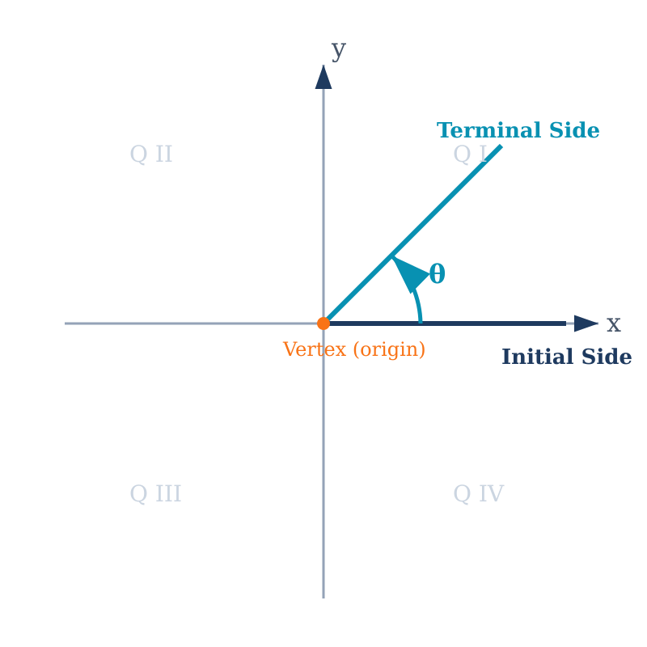
Angles in Standard Position
Standard Position: An angle with its vertex at the origin and its initial side along the positive x-axis.
Positive angles → counterclockwise rotation
Negative angles → clockwise rotation
Terminal side: the ray after rotation
Initial side: always on the positive x-axis

Slide 5
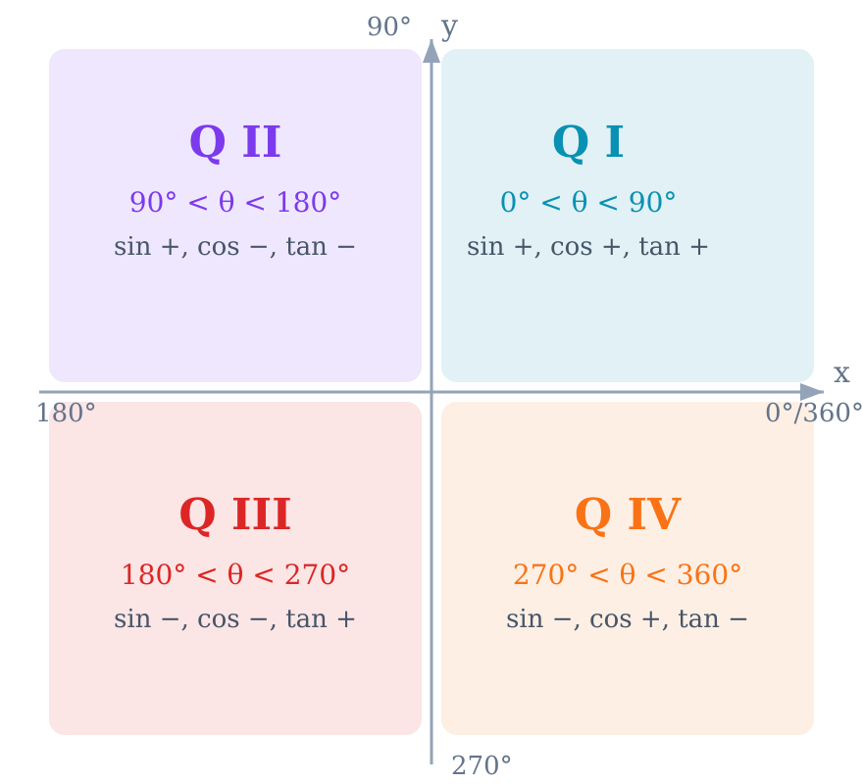
Quadrants and Angle Ranges
Q I:
0° – 90°
All trig values positive
Q II:
90° – 180°
Only sin positive
Q III:
180° – 270°
Only tan positive
Q IV:
270° – 360°
Only cos positive
Mnemonic: All Students Take Calculus

Slide 6
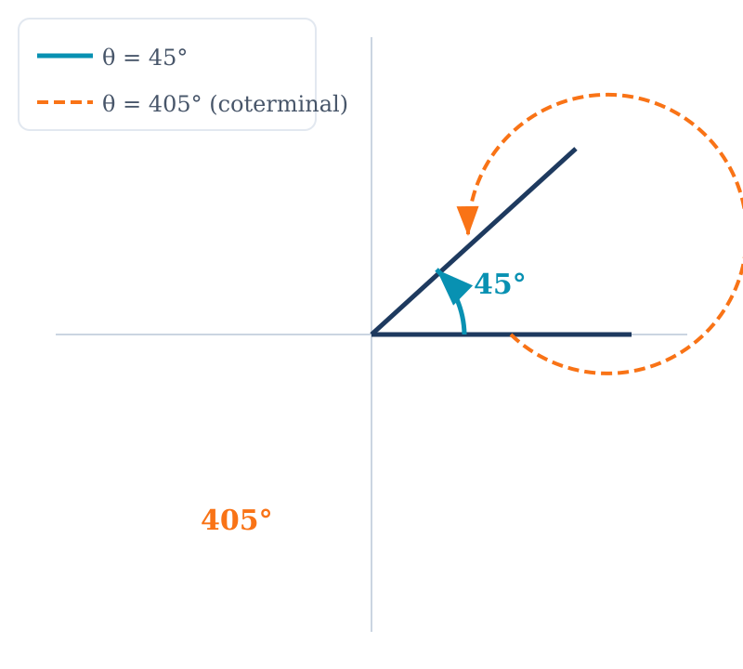
Coterminal Angles — Degrees
Coterminal Angles: Angles that share the same terminal side. Found by adding/subtracting 360°.
Formula: θ ± 360° · n (n = any positive integer)
Example 1: 45° + 360° = 405° (coterminal)
Example 2: −30° + 360° = 330° (coterminal)
Example 3: −97° + 360° = 263° (positive coterminal)
Every angle has infinitely many coterminal angles.

Slide 7
Coterminal Angles — Radians
Formula: θ ± 2πn (n = any positive integer)
Examples
Key Conversions
π/4 + 2π = 9π/4 (coterminal)
−π/3 + 2π = 5π/3 (coterminal)
9π/7 − 2π = 9π/7 − 14π/7 = −5π/7
360° = 2π radians
180° = π radians
Degrees → Radians: deg × (π / 180)
Radians → Degrees: rad × (180 / π)
Test Prep: Be comfortable finding coterminal angles for radians like 9π/7 — this appears on Test 3, Problem 2b.

Slide 8
Sketching Angles with |θ| > 360°
Strategy: Subtract (or add) 360° until the angle is between 0° and 360°, then sketch that coterminal angle.
Example: θ = 495°
Example: θ = −750°
495° − 360° = 135°
One full rotation + 135°
Terminal side is in Quadrant II
(same position as 135°)
−750° + 2(360°) = −750° + 720°
= −30° → add 360° → 330°
Terminal side is in Quadrant IV
(same position as 330°)

Slide 9
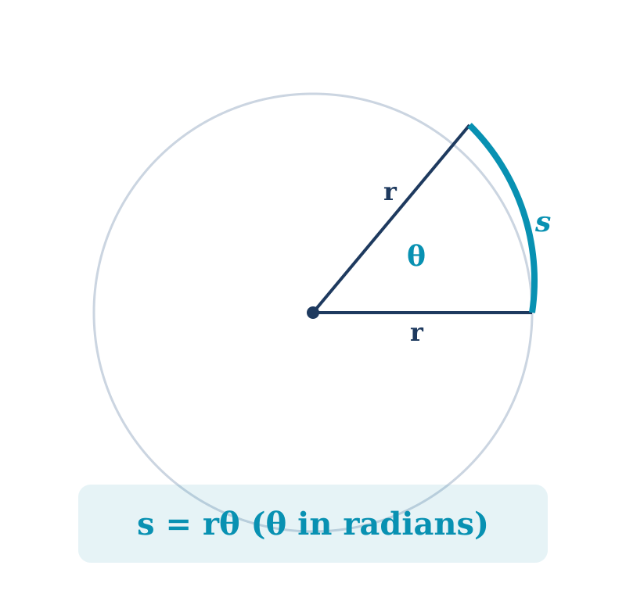
Arc Length and Central Angle
Arc Length
s = rθ
θ must be in radians
Central Angle
θ = s / r
Result is in radians
Conversion
θ(rad) = θ(deg) × π / 180
Always convert first!
Full circle: s = 2πr (when θ = 2π)

Slide 10
Example — Arc Length
A circle has radius 12 cm. Find the arc length subtended by a central angle of 150°.
1
Step 1: Convert to radians
θ = 150° × (π / 180) = 5π/6 ≈ 2.618 rad
2
Step 2: Apply formula
s = rθ = 12 × 5π/6
3
Step 3: Calculate
s = 10π ≈ 31.4 cm

Slide 11
Section 5.2
Right Triangle Trigonometry
8 ALEKS Skills

Slide 12
Section 5.2 — Skills Overview
1
Using a calculator to approximate sin, cos, and tan values
5
Pythagorean Theorem for several trig ratios
2
Trig ratios: Numbers for side lengths
6
Using a trig ratio to find a side length
3
Trig ratios: Variables for side lengths
7
Word problem with one right triangle
4
Pythagorean Theorem to find a trig ratio
8
Word problem with two right triangles

Slide 13
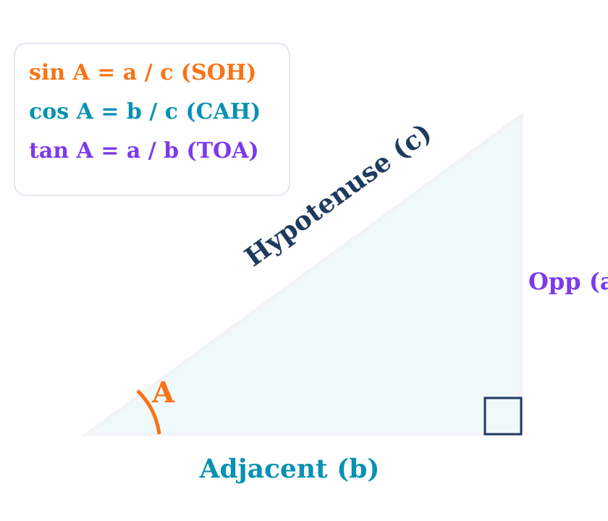
Right Triangle Trigonometry
sin A
= Opposite / Hypotenuse
SOH
cos A
= Adjacent / Hypotenuse
CAH
tan A
= Opposite / Adjacent
TOA
These ratios are identical for all similar right triangles sharing angle A.

Slide 14
Reciprocal Trigonometric Functions
csc A
= 1 / sin A
= Hypotenuse / Opposite
Quotient: tan A = sin A / cos A
sec A
= 1 / cos A
= Hypotenuse / Adjacent
cot A
= 1 / tan A
= Adjacent / Opposite
Quotient: cot A = cos A / sin A
These six functions — sin, cos, tan, csc, sec, cot — form the foundation of trigonometry.

Slide 15
Using a Calculator for Trig Values
Check your mode — set to DEGREE or RADIAN as needed
Use the sin, cos, tan buttons directly
For csc, sec, cot: compute the reciprocal
Round to 4 decimal places unless instructed otherwise
Example: θ = 37°
sin 37° ≈ 0.6018
cos 37° ≈ 0.7986
tan 37° ≈ 0.7536
csc 37° = 1/0.6018 ≈ 1.6616
sec 37° = 1/0.7986 ≈ 1.2521
cot 37° = 1/0.7536 ≈ 1.3270

Slide 16
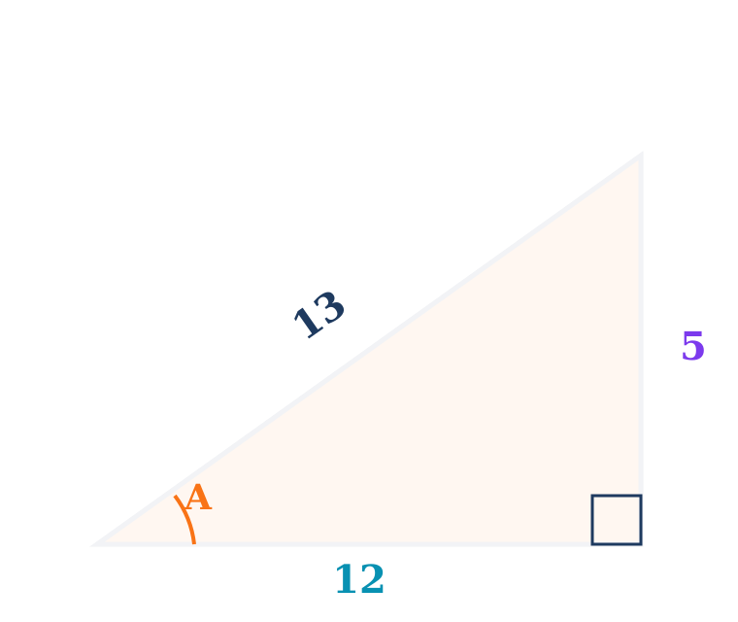
Example — Trig Ratios (Numbers)
Right triangle with legs 5 and 12, hypotenuse 13. Find all six trig ratios for angle A (opposite side 5).
sin A = 5/13
csc A = 13/5
≈ 0.3846
= 2.6
cos A = 12/13
sec A = 13/12
≈ 0.9231
≈ 1.0833
tan A = 5/12
cot A = 12/5
≈ 0.4167
= 2.4
Check: 5² + 12² = 25 + 144 = 169 = 13² ✓

Slide 17
Using Pythagorean Theorem for Trig Ratios
Given one leg = 8 and hypotenuse = 17, find sin A, cos A, and tan A for angle A opposite the unknown leg.
Step 1: Find the missing side
a² + b² = c² → b² = 17² − 8² = 289 − 64 = 225 → b = 15
Step 2: Write the ratios
sin A = 15/17 ≈ 0.8824 (opposite / hypotenuse)
cos A = 8/17 ≈ 0.4706 (adjacent / hypotenuse)
tan A = 15/8 = 1.875 (opposite / adjacent)

Slide 18
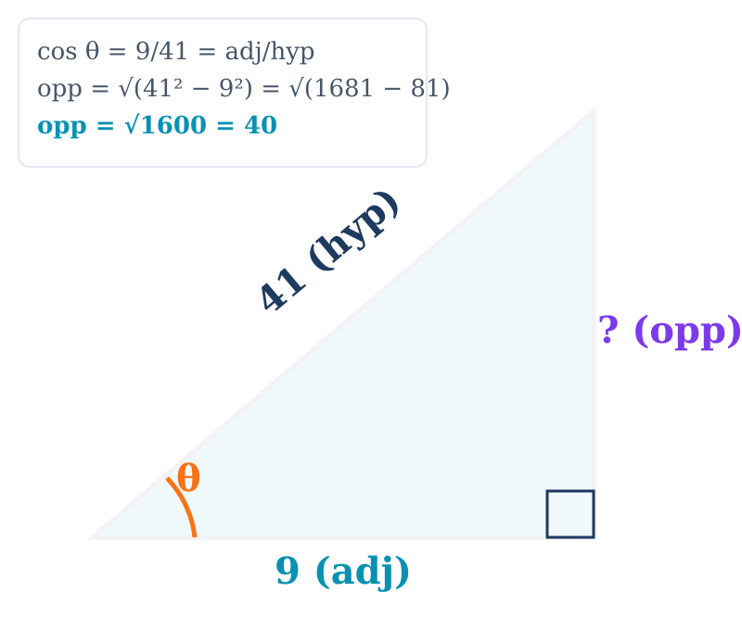
Test Prep — Finding sin θ and tan θ
Test 3, Problem 1: Given cos θ = 9/41, find sin θ and tan θ.
Method: Right Triangle
cos θ = adj/hyp = 9/41
Find opposite side:
opp² = 41² − 9² = 1681 − 81 = 1600
opp = √1600 = 40
Answers:
sin θ = 40/41
tan θ = 40/9

Slide 19
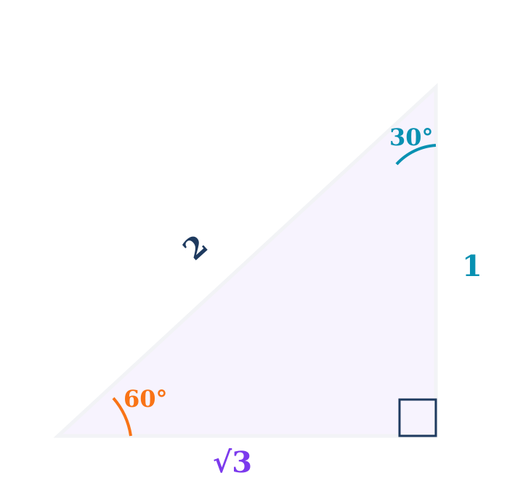
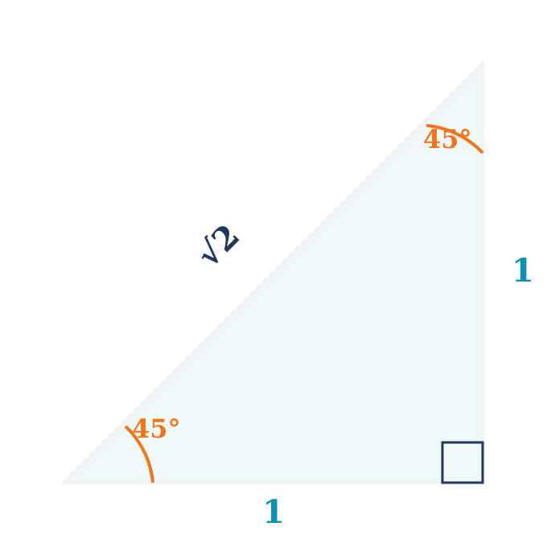
Special Right Triangles
30-60-90 Triangle
45-45-90 Triangle
Ratio: 1 : √3 : 2
sin 30° = 1/2, cos 30° = √3/2
sin 60° = √3/2, cos 60° = 1/2
Ratio: 1 : 1 : √2
sin 45° = cos 45° = √2/2
tan 45° = 1

Slide 20
Finding a Side Length Using Trig
A right triangle has hypotenuse 20 m and one angle of 35°. Find the side opposite the 35° angle.
Identify what you know and what you need:
Know: hypotenuse = 20 m, angle = 35°
Need: opposite side → Use sin (SOH)
Set up and solve:
sin 35° = opposite / 20
opposite = 20 × sin 35° = 20 × 0.5736 ≈ 11.5 m
Tip: Always check — the opposite side should be shorter than the hypotenuse.

Slide 21
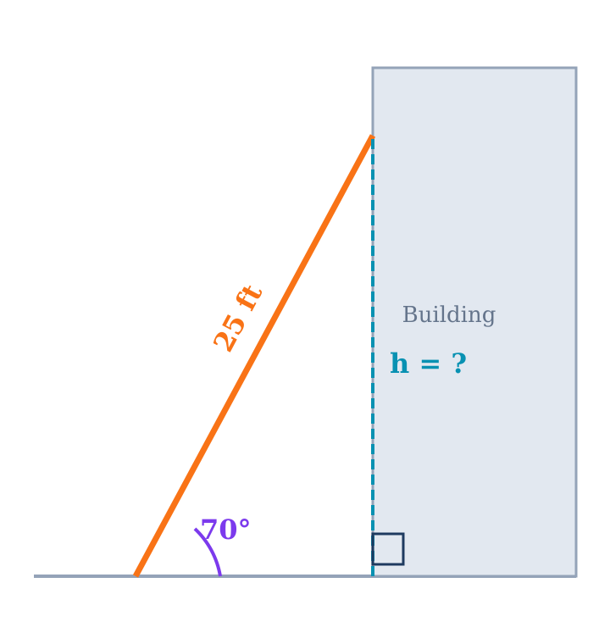
Word Problem — One Right Triangle
A 25 ft ladder leans against a building at 70° with the ground. How high does it reach?
Draw the triangle:
Ladder = hypotenuse = 25 ft, base angle = 70°
Height = side opposite the 70° angle
Solve:
sin 70° = h / 25
h = 25 × sin 70° = 25 × 0.9397
h ≈ 23.5 ft

Slide 22
Word Problem — Two Right Triangles
From a 150 ft cliff, angle of depression to one boat is 20° and to a second boat (farther) is 12°. How far apart are the boats?
Near Boat (20°)
Far Boat (12°)
tan 20° = 150 / d₁
d₁ = 150 / tan 20°
d₁ ≈ 412.1 ft
tan 12° = 150 / d₂
d₂ = 150 / tan 12°
d₂ ≈ 705.5 ft
Distance apart = d₂ − d₁ = 705.5 − 412.1 ≈ 293.4 ft

Slide 23
Trigonometric Identities (Section 5.2)
Reciprocal
csc θ = 1/sin θ sec θ = 1/cos θ cot θ = 1/tan θ
Quotient
tan θ = sin θ / cos θ cot θ = cos θ / sin θ
Pythagorean
sin²θ + cos²θ = 1
Pythagorean (derived)
1 + tan²θ = sec²θ 1 + cot²θ = csc²θ
Co-function
sin(90°−θ) = cos θ cos(90°−θ) = sin θ tan(90°−θ) = cot θ
Test 3 reference sheet provides: sin²x + cos²x = 1, 1 + tan²x = sec²x, Area = ½bc sin A

Slide 24
Finding All Trig Ratios from One
Given sin θ = 3/5, find cos θ, tan θ, csc θ, sec θ, and cot θ.
sin θ = opp/hyp = 3/5
So: opp = 3, hyp = 5
Find adj:
adj = √(5² − 3²) = √(25 − 9) = √16 = 4
All Six Ratios:
cos θ = 4/5 = 0.8
tan θ = 3/4 = 0.75
csc θ = 5/3 ≈ 1.667
sec θ = 5/4 = 1.25
cot θ = 4/3 ≈ 1.333

Slide 25
Test Prep — Exact Lengths from Special Triangles
Test 3, Problem 5: Find exact values using 30-60-90 and 45-45-90 relationships.
30-60-90 Example
45-45-90 Example
Given: vertical side = 17, angle = 30°
Find y (horizontal) and r (hypotenuse)
Side 17 is opposite 30° (short leg)
Hypotenuse = 2 × short leg
r = 2 × 17 = 34
Long leg = short leg × √3
y = 17√3
Given: hypotenuse = 24, angle = 45°
Find x and y (both legs)
In a 45-45-90, both legs are equal
hyp = leg × √2
24 = leg × √2
leg = 24/√2 = 24√2/2 = 12√2
x = y = 12√2

Slide 26
Module 10 Summary
13 ALEKS Topics | Sections 5.1 & 5.2
Section 5.1
Angles in standard position, coterminal angles (degrees & radians), arc length s = rθ
Section 5.2
SOH-CAH-TOA, trig ratios, calculator usage, Pythagorean Theorem with trig, special triangles (30-60-90, 45-45-90), word problems
Key for Test 3
Finding sin/tan given cos θ = 9/41 (Problem 1), coterminal & reference angles (Problem 2), exact values with special triangles (Problem 5)
Next: Module 11 — Section 5.3 (Reference Angles & Trig Values by Quadrant)

