Slide 1
Module 11
Section 5.3
Trigonometric Functions of Any Angle
Math 130: Advanced Technical Mathematics | Unit 3

Slide 2
Section 5.3
Trigonometric Functions of Any Angle
8 ALEKS Skills

Slide 3
Section 5.3 — Skills Overview
1
Sketching angle |θ| < 360° and its reference angle
5
Sketching angle |θ| < 2π and its reference angle
2
Reference angles in degrees: Problem type 1
6
Reference angles in radians: Problem type 1
3
Sketching angle |θ| > 360° and its reference angle
7
Determining terminal point from trig sign info
4
Reference angles in degrees: Problem type 2
8
Finding trig values given angle information

Slide 4
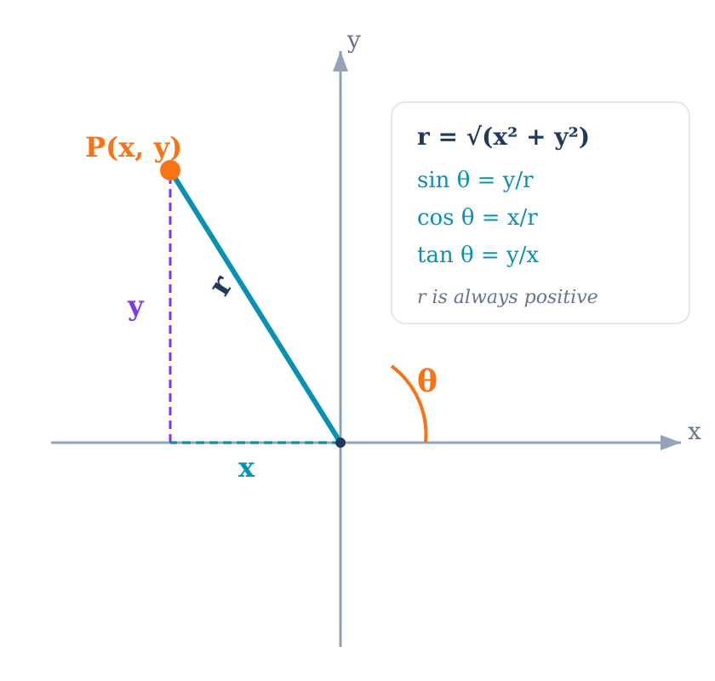
Trig Functions of Any Angle
General Definition: For any angle θ with point P(x, y) on its terminal side at distance r from the origin:
sin θ = y / r
csc θ = r / y
cos θ = x / r
sec θ = r / x
tan θ = y / x
cot θ = x / y
r = √(x² + y²) is always positive — signs depend on x and y

Slide 5
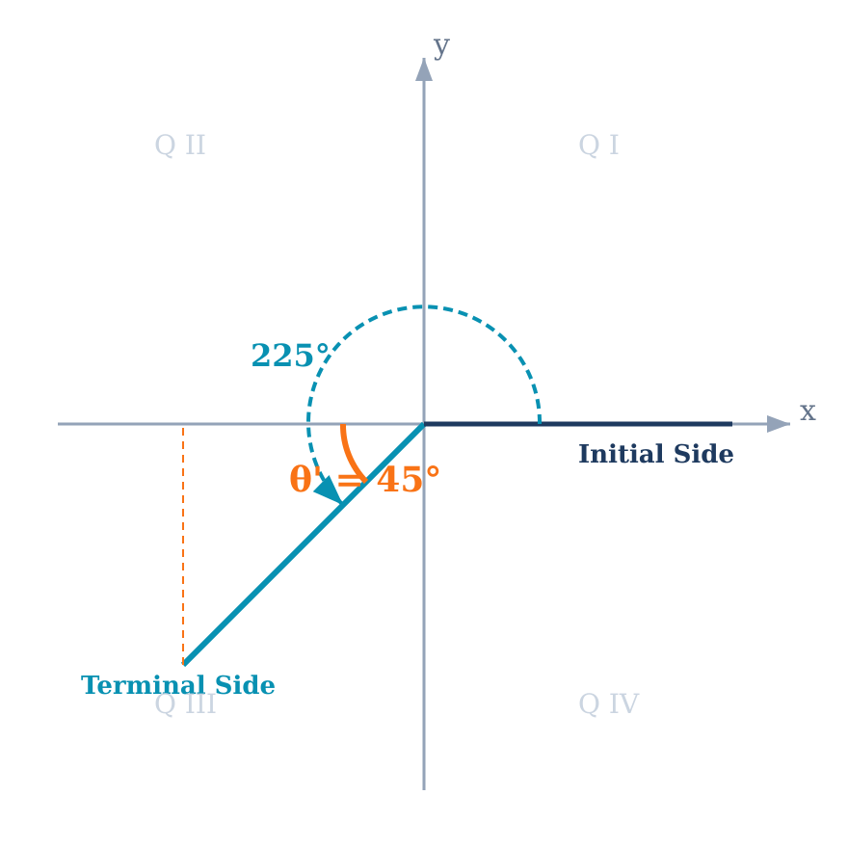
Reference Angles
Reference Angle (θ'): The acute angle (0° to 90°) formed between the terminal side and the x-axis. Always measured to the nearest part of the x-axis.
Q I:
θ' = θ
Q II:
θ' = 180° − θ (or π − θ)
Q III:
θ' = θ − 180° (or θ − π)
Q IV:
θ' = 360° − θ (or 2π − θ)

Slide 6
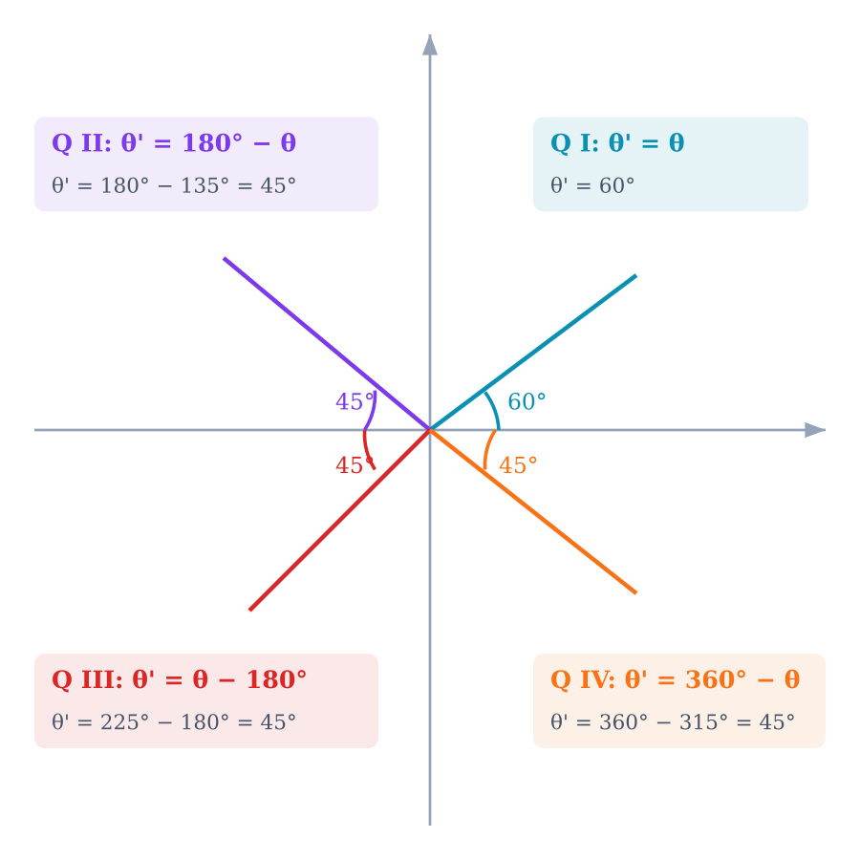
Reference Angles — All Four Quadrants
Key Insight
The reference angle is always the same "core" acute angle — it tells you which special triangle values to use.
The quadrant determines the sign:
trig(θ) = ± trig(θ')
Example: 225° has θ' = 45°
sin 225° = −sin 45° = −√2/2
(negative because sin < 0 in Q III)

Slide 7
Reference Angles in Degrees — Type 1
Find the reference angle for: (a) 150° (b) 310° (c) 240°
(a) 150°
(b) 310°
(c) 240°
Q II
θ' = 180° − 150°
θ' = 30°
Q IV
θ' = 360° − 310°
θ' = 50°
Q III
θ' = 240° − 180°
θ' = 60°

Slide 8
Reference Angles in Degrees — Type 2
Find the reference angle for: (a) −120° (b) 580° (c) −315°
Strategy: First find a coterminal angle between 0° and 360°, then apply the reference angle formula.
(a) −120°
(b) 580°
(c) −315°
−120° + 360° = 240°
Q III → θ' = 240° − 180°
θ' = 60°
580° − 360° = 220°
Q III → θ' = 220° − 180°
θ' = 40°
−315° + 360° = 45°
Q I → θ' = θ
θ' = 45°

Slide 9
Reference Angles in Radians
Find the reference angle: (a) 5π/6 (b) 2π/3 (c) 7π/4 (d) 4π/3
(a) θ = 5π/6
(b) θ = 2π/3
Q II (≈150°)
Q II (≈120°)
θ' = π − 5π/6 = π/6
θ' = π − 2π/3 = π/3
(c) θ = 7π/4
(d) θ = 4π/3
Q IV (≈315°)
Q III (≈240°)
θ' = 2π − 7π/4 = π/4
θ' = 4π/3 − π = π/3
Test Prep: Problem 2b asks for the reference angle of θ = 9π/7. Since 9π/7 > π (Q III): θ' = 9π/7 − π = 9π/7 − 7π/7 = 2π/7

Slide 10
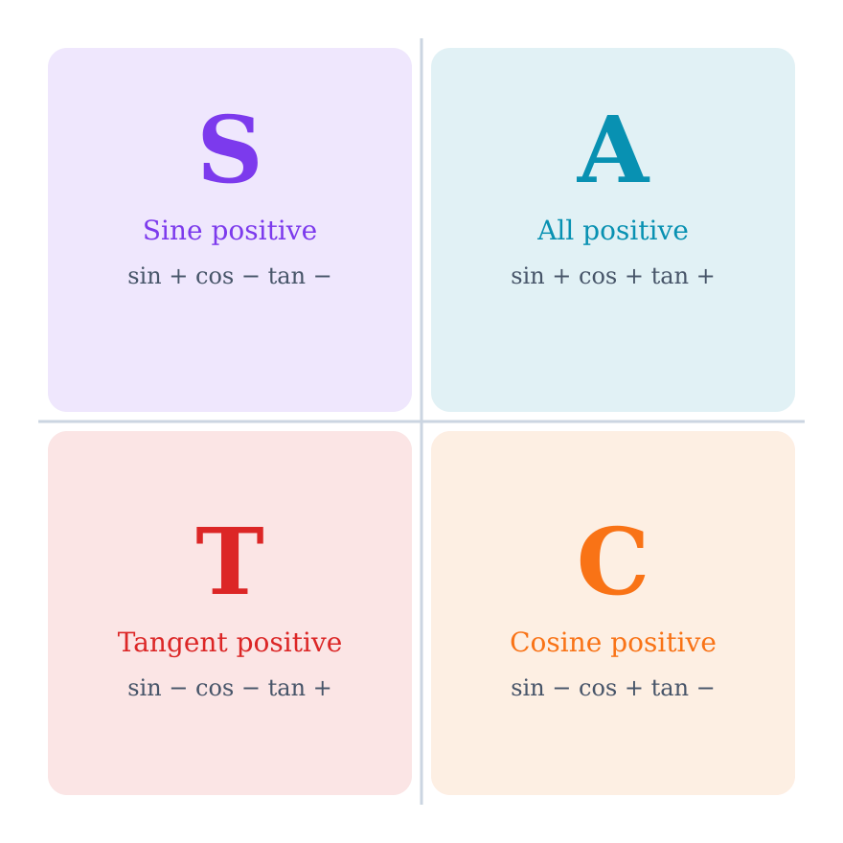
Signs of Trig Functions — ASTC
"All Students Take Calculus"
Q I (A):
All 6 functions positive
Q II (S):
Only sin & csc positive
Q III (T):
Only tan & cot positive
Q IV (C):
Only cos & sec positive
Why? sin = y/r, cos = x/r. The sign depends on whether x and y are positive or negative in that quadrant.

Slide 11
Determining Quadrant from Trig Signs
Strategy: List which quadrants satisfy each condition, then find the intersection.
Given: tan θ > 0 and cos θ < 0
tan > 0 in Q I, Q III
cos < 0 in Q II, Q III
Answer: Quadrant III
Given: sin θ > 0 and sec θ < 0
sin > 0 in Q I, Q II
sec < 0 → cos < 0 in Q II, Q III
Answer: Quadrant II

Slide 12
Finding Trig Values from a Point
Terminal side of θ passes through (−3, 4). Find all six trig values.
x = −3, y = 4
r = √(9 + 16) = √25 = 5
sin θ = 4/5
cos θ = −3/5
tan θ = −4/3
csc θ = 5/4 sec θ = −5/3 cot θ = −3/4
Point is in Q II → sin positive, cos & tan negative ✓

Slide 13
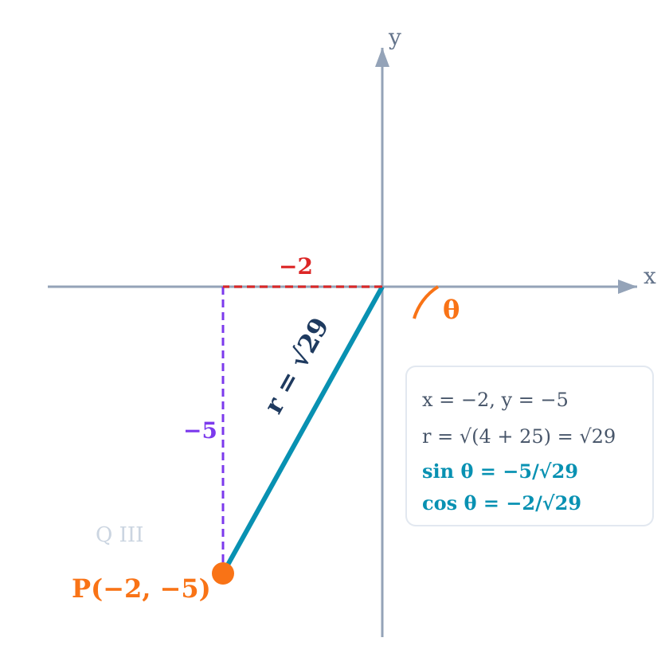
Test Prep — Trig Values from P(−2, −5)
Test 3, Problem 4b: Find the exact trig values of θ with terminal side through P(−2, −5).
Find r:
x = −2, y = −5 → Point is in Q III
r = √(4 + 25) = √29
Answers:
sin θ = −5/√29 = −5√29/29
cos θ = −2/√29 = −2√29/29
tan θ = −5/−2 = 5/2
Q III check: sin −, cos −, tan + ✓

Slide 14
Finding Other Trig Values from One
Given tan θ = −3/4 and sin θ < 0, find sin θ and cos θ.
Step 1: Determine the quadrant
tan < 0 → Q II or Q IV; sin < 0 → Q III or Q IV
Intersection → Quadrant IV (x > 0, y < 0)
Step 2: Set up the point
tan θ = y/x = −3/4 with Q IV signs → x = 4, y = −3
r = √(16 + 9) = √25 = 5
Step 3: Calculate
sin θ = −3/5 cos θ = 4/5

Slide 15
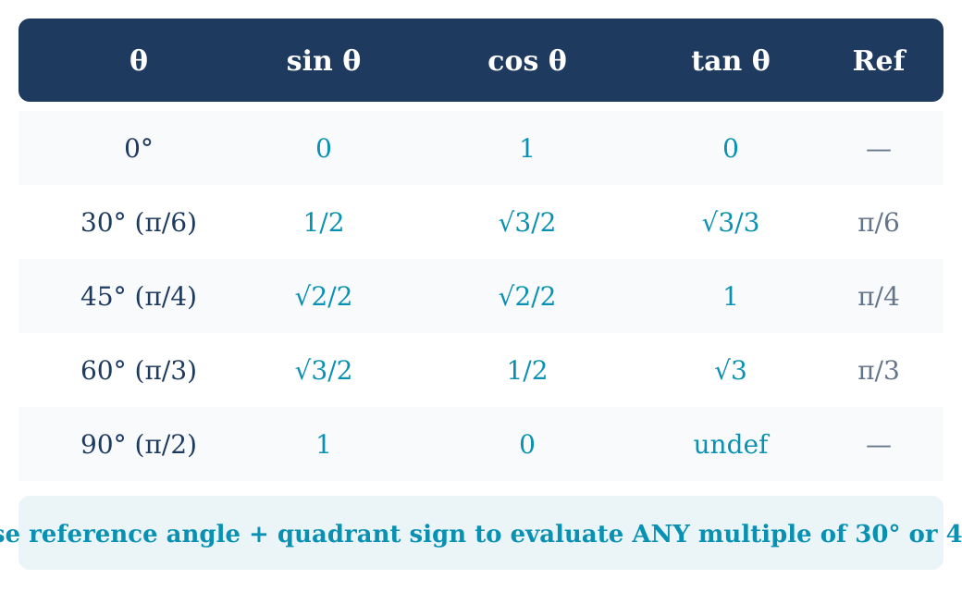
Exact Values at Common Angles

Slide 16
Evaluating with Reference Angles
Find the exact value of: sin 240° and cos 315°
sin 240°
cos 315°
θ' = 240° − 180° = 60°
Q III → sin is negative
sin 240° = −sin 60°
= −√3/2
θ' = 360° − 315° = 45°
Q IV → cos is positive
cos 315° = cos 45°
= √2/2

Slide 17
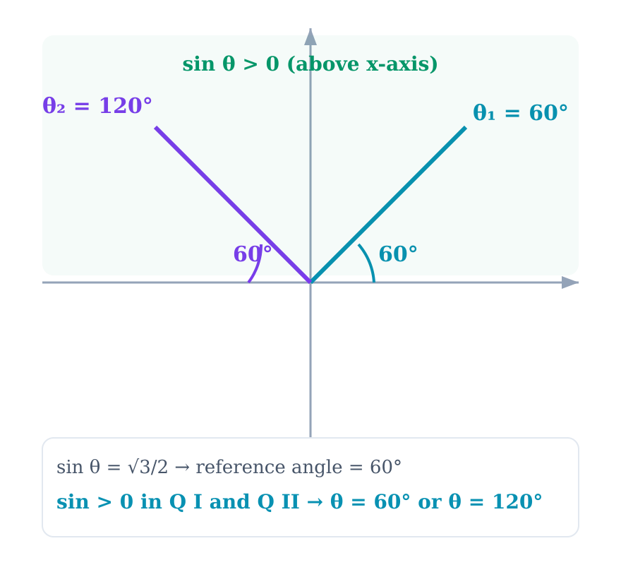
Test Prep — Angles from Trig Values
Test 3, Problem 3: Find two angles between 0° and 360° where sin θ = √3/2.
Step 1: Find the reference angle
sin θ = √3/2 → reference angle = 60°
(from the 30-60-90 triangle: sin 60° = √3/2)
Step 2: Which quadrants?
sin > 0 in Q I and Q II
Step 3: Apply formulas
Q I: θ = 60°
Q II: θ = 180° − 60° = 120°

Slide 18
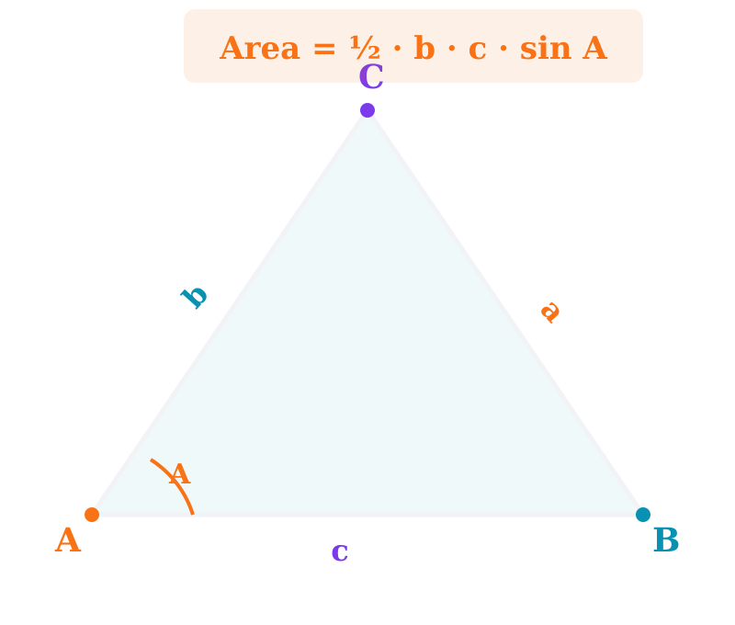
Area of a Triangle Using Trigonometry
Area = ½ · b · c · sin A
Two sides and their included angle
Area = ½ · a · b · sin C
Equivalent with different labeling
Area = ½ · a · c · sin B
Equivalent with different labeling
Works for any triangle (not just right triangles) when you know two sides and the included angle. This formula is on the Test 3 reference sheet.

Slide 19
Test Prep — Triangle Area
Test 3, Problem 7: Find the area of a triangle (not a right triangle). A = 76°, b = 34, c = 21.
Apply the formula:
Area = ½ · b · c · sin A
Substitute:
Area = ½ × 34 × 21 × sin 76°
Area = ½ × 714 × 0.9703
Area = 357 × 0.9703
Area ≈ 346.4 square units

Slide 20
Test Prep — Coterminal & Reference Angles
Test 3, Problem 2: Sketch, find positive & negative coterminal angles, and the reference angle.
(a) θ = −97°
(b) θ = 9π/7
Sketch: 97° clockwise → terminal side in Q III
Positive coterminal:
−97° + 360° = 263°
Negative coterminal:
−97° − 360° = −457°
Reference angle:
263° is in Q III: θ' = 263° − 180° = 83°
Sketch: 9π/7 ≈ 231.4° → Q III
Positive coterminal:
9π/7 + 2π = 9π/7 + 14π/7 = 23π/7
Negative coterminal:
9π/7 − 2π = 9π/7 − 14π/7 = −5π/7
Reference angle:
Q III: θ' = 9π/7 − π = 9π/7 − 7π/7 = 2π/7

Slide 21
Module 11 Summary
8 ALEKS Topics | Section 5.3
Reference Angles
Always acute (0°–90°), always measured to the x-axis. Find coterminal first if needed.
ASTC Signs
All Students Take Calculus — determines which trig functions are positive in each quadrant.
General Definitions
sin θ = y/r, cos θ = x/r, tan θ = y/x. Use point (x, y) on terminal side with r = √(x² + y²).
Key for Test 3
Problem 2 (coterminal/reference for −97° and 9π/7), Problem 3 (sin θ = √3/2), Problem 4b (point P(−2,−5)), Problem 7 (area = ½bc sin A)
Next: Module 12 — Section 7.1 (Solving Right Triangles & Applications)

