Slide 1

Section 4.2
Exponential Functions
College Algebra & Trigonometry
Lecture Notes with Worked Examples
Notes:
Welcome to Section 4.2 on Exponential Functions. This section transitions from polynomial/rational functions (algebraic) to transcendental functions. Key theme: the variable is now in the EXPONENT, not the base. This is the fundamental shift students need to grasp. Prerequisites: Students should be comfortable with exponent rules (product, quotient, power, negative, fractional). If not, spend extra time on the review slide.

Slide 2
LEARNING OBJECTIVES
By the end of this section, you will be able to:
Graph exponential functions and identify key features
1
Understand and work with the natural base e
2
Apply compound interest formulas (periodic & continuous)
3
Model real-world growth and decay with exponential functions
4
Notes:
Read objectives aloud. Emphasize that exponential functions appear everywhere: finance, biology, physics, computer science. Objective 3 (compound interest) tends to be the most tested topic. Objective 4 (modeling) connects to later sections on logarithms.

Slide 3
REVIEW: EXPONENT RULES
Before we begin — make sure you're comfortable with these:
Product Rule
Quotient Rule
aᵐ · aⁿ = aᵐ⁺ⁿ
aᵐ / aⁿ = aᵐ⁻ⁿ
Power Rule
Zero Exponent
(aᵐ)ⁿ = aᵐⁿ
a⁰ = 1 (a ≠ 0)
Negative Exponent
Fractional Exponent
a⁻ⁿ = 1/aⁿ
a^(1/n) = ⁿ√a
Notes:
QUICK WARM-UP: Ask students to simplify 2³ · 2⁵, (3²)⁴, and 5⁻². Watch for these mistakes: • Multiplying bases instead of adding exponents (2³ · 2⁵ ≠ 4⁸) • Confusing negative exponents with negative numbers (2⁻³ ≠ −8, it equals 1/8) • Forgetting a⁰ = 1 for any nonzero a These rules are essential for simplifying exponential expressions throughout this chapter.

Slide 4
DEFINITION
Exponential Function
Let b be a constant with b > 0 and b ≠ 1. Then for any real number x, the function f(x) = bˣ is an exponential function of base b.
Previously vs. Now
Power Function (variable base)
Exponential Function (variable exponent)
f(x) = x²
f(x) = 2ˣ
Base varies, exponent is constant
Base is constant, exponent varies
Notes:
KEY DISTINCTION — ask students: 'What's the difference between x² and 2ˣ?' Answer: In x², the base changes and exponent is fixed. In 2ˣ, the base is fixed and the exponent changes. Why b > 0? Because negative bases cause problems with fractional exponents (e.g., (−4)^(1/2) is not real). Why b ≠ 1? Because 1ˣ = 1 for all x — it's just a constant function, not interesting. COMMON MISTAKE: Students often confuse x² with 2ˣ. Point out that 2³ = 8 but 3² = 9 — the order matters!

Slide 5
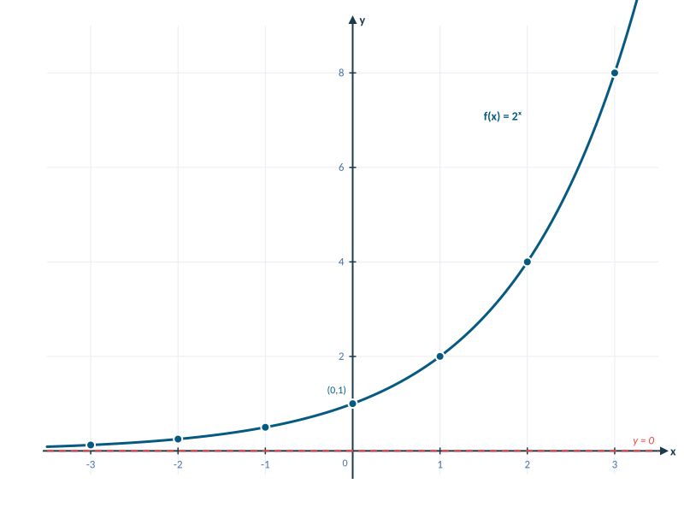
EXAMPLE: GRAPHING f(x) = 2ˣ
x | −3 | −2 | −1 | 0 | 1 | 2 | 3
f(x)=2ˣ | ⅛ | ¼ | ½ | 1 | 2 | 4 | 8
Key Observations
y-intercept: (0, 1)
Horizontal asymptote: y = 0
Always positive (never touches x-axis)
Increasing for all x (b > 1)
Domain: (−∞, ∞)
Range: (0, ∞)
Notes:
GRAPHING WALKTHROUGH: 1. Build the table together — have students compute each value. 2. Plot points on the coordinate grid. 3. Connect with a smooth curve (NOT straight lines between points). 4. Draw the dashed asymptote at y = 0. Emphasize: The graph gets CLOSE to the x-axis on the left but NEVER touches it. Ask: 'Can 2ˣ ever equal 0?' (No — because any positive number raised to any power is positive.) CALCULATOR TIP: For 2⁻³, press 2 ^ (-) 3 ENTER. Common mistake: students forget the negative sign or type 2 × 3.

Slide 6

TRY IT: TABLE FOR AN EXPONENTIAL FUNCTION
The function f is defined by f(x) = (¼)ˣ. Find f(x) for each x-value in the table.
x | −2 | −1 | 0 | 1 | 2
f(x) | ? | ? | ? | ? | ?
Pause and try this before advancing!
Notes:
Give students 2-3 minutes. Walk around the room. HINTS if students are stuck: • 'What does a negative exponent do?' (flips the fraction) • '(¼)⁻² means (4/1)² = 16' • 'What's anything to the 0 power?' COMMON MISTAKES to watch for: • Students computing (¼)(−2) = −½ (multiplying instead of exponentiating) • Forgetting to flip the fraction for negative exponents • Writing (¼)² = ½ instead of 1/16

Slide 7

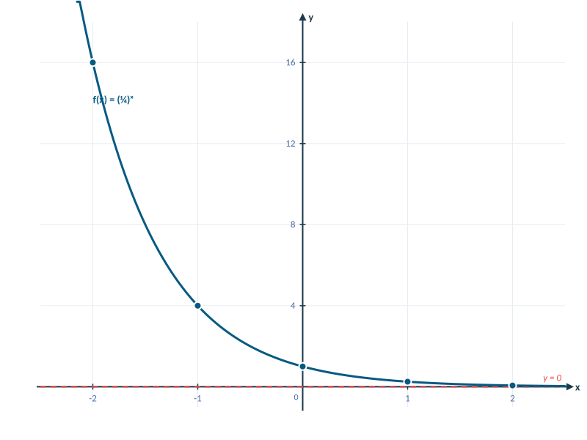
TRY IT: TABLE FOR AN EXPONENTIAL FUNCTION
The function f is defined by f(x) = (¼)ˣ. Find f(x) for each x-value in the table.
x | −2 | −1 | 0 | 1 | 2
f(x) | 16 | 4 | 1 | ¼ | 1/16
Step-by-Step
f(−2) = (¼)⁻² = 4² = 16 f(−1) = (¼)⁻¹ = 4¹ = 4 f(0) = (¼)⁰ = 1
f(1) = (¼)¹ = 0.25 f(2) = (¼)² = 1/16 = 0.0625
Pattern: As x increases, f(x) decreases — this is exponential decay (base 0 < b < 1).
Notes:
Walk through each computation. Emphasize the pattern: • Negative exponents flip the base: (¼)⁻² = (4/1)² = 16 • The function DECREASES because the base is between 0 and 1. • Compare with 2ˣ (growth) — this is a DECAY function. Note the graph is a reflection of 4ˣ over the y-axis: (¼)ˣ = 4⁻ˣ.

Slide 8
TRY IT: GRAPH f(x) = 3ˣ AND ITS ASYMPTOTE
Plot five points on the graph of f(x) = 3ˣ and draw the asymptote.
Build a table of values, plot the points, and identify the horizontal asymptote.
Pause and try this before advancing!
Notes:
Students should choose x-values like −2, −1, 0, 1, 2. Remind them to: 1. Compute y-values first 2. Set up proper scale on the y-axis (values jump fast — 3² = 9) 3. Draw the dashed asymptote at y = 0 4. Draw a smooth curve through the points (not straight line segments)

Slide 9
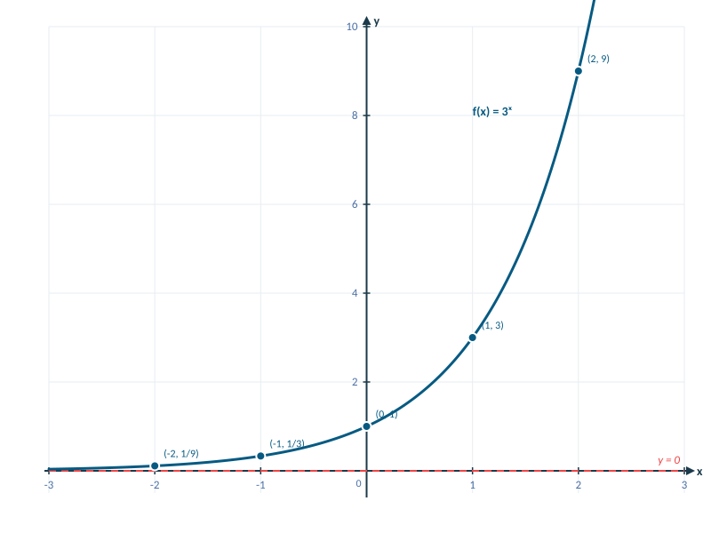
SOLUTION: GRAPH f(x) = 3ˣ
x | −2 | −1 | 0 | 1 | 2
f(x) | 1/9 | 1/3 | 1 | 3 | 9
Key Features
Five points:
(−2, 1/9), (−1, 1/3), (0, 1), (1, 3), (2, 9)
Horizontal asymptote:
y = 0 (the x-axis)
Domain: (−∞, ∞)
Range: (0, ∞)
y-intercept: (0, 1)
Increasing (b = 3 > 1)
Steeper than 2ˣ because the base is larger.
Notes:
Point out the labeled coordinates on the graph. Compare with 2ˣ: 3ˣ grows faster to the right and approaches 0 faster to the left. Ask: 'All exponential functions f(x) = bˣ pass through which point?' → (0, 1) because b⁰ = 1. CALCULATOR: For 3⁻², students should get 1/9 ≈ 0.111. Show them: 3 ^ (−2) ENTER.

Slide 10
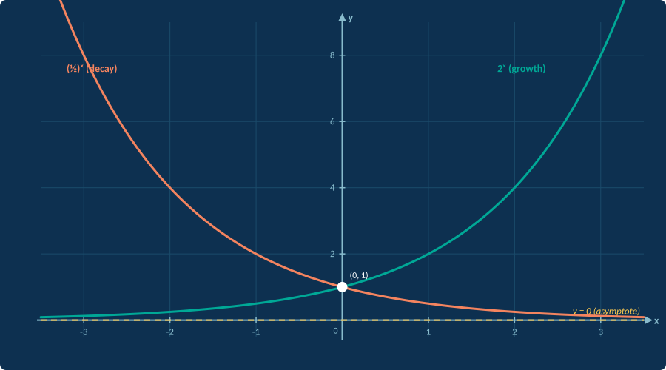
PROPERTIES OF f(x) = bˣ
Both cases: Domain: (−∞, ∞) Range: (0, ∞) y-intercept: (0, 1) Asymptote: y = 0
Notes:
This is the BIG PICTURE slide. Emphasize the visual contrast: • LEFT curve (green, 2ˣ): GROWTH — rises steeply to the right • RIGHT curve (orange, (½)ˣ): DECAY — falls steeply to the right • BOTH pass through (0, 1) — highlighted with white dot • BOTH approach but never reach y = 0 (dashed yellow line) Key question for students: 'If I gave you any exponential function, how would you tell if it's growth or decay just from the equation?' Answer: Look at the base b. If b > 1 → growth. If 0 < b < 1 → decay.

Slide 11
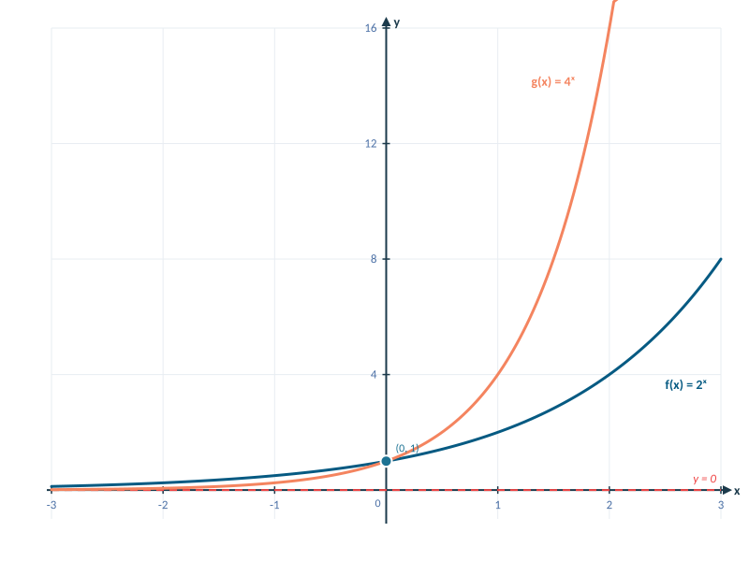
COMPARING EXPONENTIAL FUNCTIONS
How does the graph of f(x) = 2ˣ compare to g(x) = 4ˣ ?
What to Notice
Both pass through (0, 1)
Larger base → steeper growth to the right
Larger base → faster approach to 0 on the left
Note: 4ˣ = (2²)ˣ = 2²ˣ, so 4ˣ is 2ˣ growing twice as fast
Notes:
Good time to ask: 'If we added 10ˣ to this graph, where would it be?' Answer: Even steeper — growing faster right, approaching 0 faster left. Note the algebraic connection: 4ˣ = (2²)ˣ = 2²ˣ. This means 4ˣ at x = 1 equals 2ˣ at x = 2. The larger base 'speeds up' the function.

Slide 12

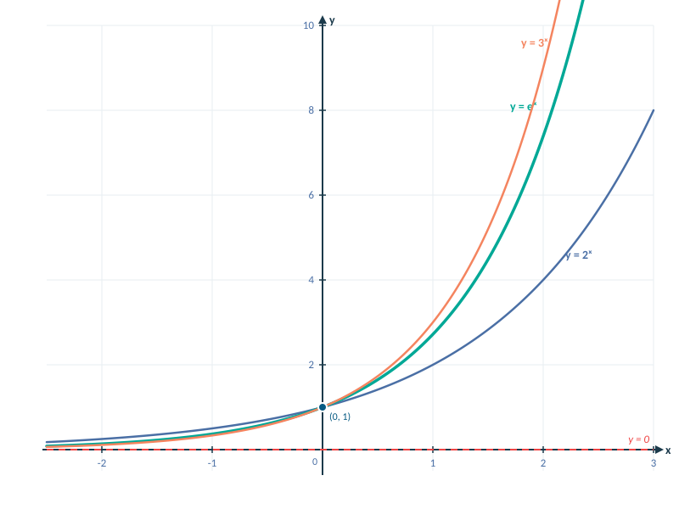
THE NATURAL BASE e
e ≈ 2.71828…
irrational constant (like π)
As n → ∞: (1 + 1/n)ⁿ → e
Watching (1 + 1/n)ⁿ converge:
n | 1 | 10 | 100 | 1,000 | 100,000
(1+1/n)ⁿ | 2.000 | 2.594 | 2.705 | 2.717 | 2.718
Notes:
e is arguably the most important constant in mathematics after π. Where does e come from? It's the limit of (1 + 1/n)ⁿ as n → ∞. This connects directly to compound interest: if you compound more and more frequently, you approach continuous compounding — and e appears. The graph shows eˣ sitting BETWEEN 2ˣ and 3ˣ, which makes sense since 2 < e < 3. CALCULATOR: The 'e' button is usually 2nd + LN. Have students verify: e¹ ≈ 2.71828. Fun fact: e appears in probability, calculus, physics, biology, and finance.

Slide 13
TRY IT: EVALUATING EXPONENTIAL EXPRESSIONS
Use a calculator to evaluate each expression. Round to the nearest thousandth.
3.5¹·⁶ = ?
(¾)⁻⁰·⁹⁵ = ?
Pause and try this before advancing!
Notes:
CALCULATOR KEYSTROKES: • 3.5¹·⁶: Press 3.5 ^ 1.6 ENTER → 7.422 • (¾)⁻⁰·⁹⁵: Press ( 3 ÷ 4 ) ^ (−) 0.95 ENTER → 1.314 OR: Press 0.75 ^ (−) 0.95 ENTER COMMON MISTAKE: Students type 3/4^(−0.95) without parentheses, which computes 3/(4^(−0.95)) due to order of operations. Emphasize: ALWAYS use parentheses around the base fraction!

Slide 14
SOLUTION: EVALUATING EXPONENTIAL EXPRESSIONS
3.5¹·⁶
Enter: 3.5 ^ 1.6 → 7.422
(¾)⁻⁰·⁹⁵
Enter: ( 3 ÷ 4 ) ^ (−0.95) →
Negative exponent flips: (¾)⁻⁰·⁹⁵ = (⁴⁄₃)⁰·⁹⁵ (result > 1)
1.314
Notes:
Reinforce: the negative exponent flips the base, which is why the answer is GREATER than 1 even though (¾) < 1. Sanity check: (¾)⁻¹ = 4/3 ≈ 1.333, so (¾)⁻⁰·⁹⁵ should be slightly less than 1.333. And 1.314 ✓

Slide 15
TRY IT: EVALUATING WITH BASE e
Use a calculator (2nd + LN = eˣ). Round to the nearest thousandth.
e⁻⁰·¹⁵ = ?
175 · e⁰·⁵ = ?
Pause and try this before advancing!
Notes:
CALCULATOR KEYSTROKES: • e⁻⁰·¹⁵: Press 2nd → LN → (−) 0.15 → ENTER → 0.861 • 175·e⁰·⁵: Press 175 × 2nd → LN → 0.5 → ENTER → 288.526 Remind students: The eˣ key is NOT the same as typing e × x. It's a single operation. Sanity check: e⁻⁰·¹⁵ should be slightly less than 1 (negative exponent of a number > 1 gives a result between 0 and 1). ✓

Slide 16
SOLUTION: EVALUATING WITH BASE e
e⁻⁰·¹⁵
2nd → LN → (−0.15) → ENTER
e⁻⁰·¹⁵ ≈ 0.861
175 · e⁰·⁵
175 × 2nd → LN → 0.5 → ENTER
175 · e⁰·⁵ ≈ 288.526
Notes:
Check understanding: 'If the exponent is positive, is eˣ greater or less than 1?' (Greater — always.) 'If negative?' (Between 0 and 1 — always.)

Slide 17

COMPOUND INTEREST FORMULAS
Suppose P dollars is invested (or borrowed) at annual interest rate r for t years.
SIMPLE INTEREST
PERIODIC COMPOUND
CONTINUOUS
I = Prt
A = P(1 + r/n)ⁿᵗ
A = Peʳᵗ
P = principal
r = annual rate (decimal)
t = time in years
I = interest earned
A = future value
n = compounds per year
n=1 annually, n=4 quarterly
n=12 monthly, n=365 daily
As n → ∞, periodic
compounding → continuous
Uses base e
Notes:
TEACHING STRATEGY: Derive the compound interest formula from simple interest. 1. Start: You invest $1000 at 6% for 1 year. A = 1000(1.06) = $1060. 2. Year 2: A = 1060(1.06) = 1000(1.06)². See the pattern? 3. After t years: A = P(1 + r)ᵗ — this is compound interest with n = 1. 4. Now split the year into n periods: each period earns r/n, and there are nt periods total. 5. A = P(1 + r/n)ⁿᵗ 6. Let n → ∞ to get A = Peʳᵗ (this is where e naturally emerges!) COMMON MISTAKES: • Using r = 6 instead of r = 0.06 (must convert % to decimal!) • Confusing n and t (n = times per year, t = years) • Using A = Peʳᵗ for periodic problems (only for continuous!)

Slide 18
TRY IT: SIMPLE vs. COMPOUND INTEREST
Jenny: $70,000 at 3% compounded annually. Frank: $70,000 at 3% simple interest.
Compare the interest earned each year for 3 years.
Year | Jenny (Compound) | Frank (Simple) | Who earns more?
1st | ? | ? | ?
2nd | ? | ? | ?
3rd | ? | ? | ?
Notes:
KEY PROBLEM for understanding the difference between simple and compound interest. Hints if students are stuck: • Frank (simple): interest = P × r × 1 = 70,000 × 0.03 = $2,100 EVERY year (never changes). • Jenny (compound, year 1): same calculation → $2,100. • Jenny (year 2): Now her principal is $72,100 → interest = 72,100 × 0.03 = $2,163. • Jenny (year 3): Principal is $74,263 → interest = 74,263 × 0.03 = $2,227.89. The 'aha moment': Year 1 is the same! The power of compounding only shows in subsequent years.

Slide 19
SOLUTION: SIMPLE vs. COMPOUND INTEREST
Jenny: $70,000 at 3% compounded annually Frank: $70,000 at 3% simple interest
Year | Jenny (Compound) | Frank (Simple) | Who earns more?
1st | $2,100.00 | $2,100.00 | Same
2nd | $2,163.00 | $2,100.00 | Jenny
3rd | $2,227.89 | $2,100.00 | Jenny
Why?
Year 1 — both earn the same because compound interest hasn't had time to accumulate.
Year 2+ — Jenny earns interest on her interest (compounding effect). Frank's base never changes.
The gap grows every year — that's the power of compound interest!
Notes:
Emphasize: The gap ACCELERATES over time. After 30 years the difference becomes dramatic. Year 2 calculation detail: Jenny's balance after Year 1 = $72,100. Year 2 interest = 72,100 × 0.03 = $2,163. The extra $63 comes from earning interest on the $2,100 she earned in Year 1: 2,100 × 0.03 = $63. This is 'interest on interest' — the core idea of compounding.

Slide 20
EFFECT OF COMPOUNDING FREQUENCY
$1,000 invested at 4% for 10 years — how does compounding frequency affect the result?
Frequency | n | Formula | Amount | Interest Earned
Annual | 1 | 1000(1.04)¹⁰ | $1,480.24 | $480.24
Quarterly | 4 | 1000(1.01)⁴⁰ | $1,488.86 | $488.86
Monthly | 12 | 1000(1.00333…)¹²⁰ | $1,490.83 | $490.83
Daily | 365 | 1000(1.0000110)³⁶⁵⁰ | $1,491.79 | $491.79
Continuous | ∞ | 1000·e⁰·⁴ | $1,491.82 | $491.82
Key Insight
More frequent compounding → higher return, but with diminishing gains.
Daily vs. continuous differs by only $0.03 — the jump from annual to quarterly matters most!
Notes:
This slide demonstrates DIMINISHING RETURNS of compounding frequency. Key numbers to highlight: • Annual → Quarterly: +$8.62 gain • Quarterly → Monthly: +$1.97 gain • Monthly → Daily: +$0.96 gain • Daily → Continuous: +$0.03 gain (!) The 'curve of diminishing returns' is why banks don't bother advertising 'every-second compounding.' Continuous is the theoretical maximum, and daily practically reaches it. This is also why the formula A = Peʳᵗ exists — it represents the LIMIT as n → ∞.

Slide 21
TRY IT: COMPOUND INTEREST — ANNUAL
$44,000 is borrowed for 13 years at 3.25% compounded annually. No payments. Find the amount owed. Round to the nearest dollar.
A = P(1 + r/n)ⁿᵗ
P = ?
r = ?
n = ?
t = ?
Principal
Annual rate
Compounds/yr
Time in years
Identify P, r, n, and t, then substitute into the formula.
Pause and try this before advancing!
Notes:
This problem tests whether students can correctly identify all four variables. P = 44,000 (principal borrowed) r = 0.0325 (convert 3.25% → divide by 100!) n = 1 (compounded annually) t = 13 (years) COMMON MISTAKE: Using r = 3.25 instead of 0.0325. This gives an absurdly large answer. If a student gets millions of dollars, they forgot to convert.

Slide 22
SOLUTION: $44,000 AT 3.25% FOR 13 YEARS
Identify Variables
P = $44,000 r = 0.0325 n = 1 (annually) t = 13 years
Substitute & Solve
A = P(1 + r/n)ⁿᵗ
A = 44,000(1 + 0.0325/1)¹⁽¹³⁾ = 44,000(1.0325)¹³
A = 44,000 × 1.51554…
A ≈ $66,684
Notes:
CALCULATOR KEYSTROKES: 44000 × ( 1.0325 ) ^ 13 ENTER OR: 44000 × 1.0325 ^ 13 ENTER (parentheses optional here since there's only multiplication) Sanity check: 3.25% for 13 years should roughly increase the value by about 50%. $44,000 × 1.5 = $66,000. Our answer of $66,684 ✓

Slide 23
TRY IT: COMPOUND INTEREST — SEMIANNUAL
$2,000 is invested at 3.1% compounded semiannually. Find the total after 3 years. Round to the nearest cent.
A = P(1 + r/n)ⁿᵗ
Compounding Frequency Reference
Annually: n = 1 Semiannually: n = 2 Quarterly: n = 4 Monthly: n = 12 Daily: n = 365
Hint: What is n for semiannual? What is the total number of compounding periods (nt)?
Pause and try this before advancing!
Notes:
Common confusion: students mix up 'semiannually' (n = 2) with 'bimonthly' or 'biannually.' Frequency cheat sheet: • Annually = 1 • Semiannually = 2 • Quarterly = 4 • Monthly = 12 • Weekly = 52 • Daily = 365 The exponent is nt = 2 × 3 = 6 (6 compounding periods total).

Slide 24
SOLUTION: $2,000 AT 3.1% SEMIANNUALLY
Identify Variables
P = $2,000 r = 0.031 n = 2 (semiannually) t = 3 years
Substitute & Solve
A = 2,000(1 + 0.031/2)²⁽³⁾ = 2,000(1.0155)⁶
A = 2,000 × 1.09668…
A ≈ $2,193.36
Notes:
Step by step on calculator: 2000 × (1 + 0.031 ÷ 2) ^ (2 × 3) ENTER Note: r/n = 0.031/2 = 0.0155 (the rate per period). The total periods = nt = 6.

Slide 25
TRY IT: CONTINUOUS COMPOUND INTEREST
$1,600 borrowed at 6.5% compounded continuously for 6 years. Find amount owed. Round to nearest cent.
A = Peʳᵗ
Which Formula Do I Use?
"compounded annually / quarterly / monthly / daily" → A = P(1 + r/n)ⁿᵗ
"compounded continuously" → A = Peʳᵗ (no n needed!)
Pause and try this before advancing!
Notes:
KEY: When the problem says 'continuously,' use A = Peʳᵗ — NOT the (1 + r/n) formula. There is no n for continuous compounding! That's the whole point: n → ∞. CALCULATOR: 1600 × e^(0.065 × 6) Keystrokes: 1600 × 2nd → LN → ( 0.065 × 6 ) → ENTER

Slide 26
SOLUTION: $1,600 CONTINUOUS AT 6.5%
Identify Variables
P = $1,600 r = 0.065 t = 6 years (continuous → use A = Peʳᵗ)
Substitute & Solve
A = Peʳᵗ = 1,600 · e⁰·⁰⁶⁵⁽⁶⁾ = 1,600 · e⁰·³⁹
A = 1,600 × 1.47698…
A ≈ $2,363.17
Notes:
Quick mental check: 6.5% for 6 years ≈ 39% growth. So amount ≈ $1,600 × 1.39 ≈ $2,224. Our answer is $2,363 — slightly more because continuous compounding adds extra. ✓ Compare: If this had been compounded annually, A = 1600(1.065)⁶ ≈ $2,339. Continuous gives ~$24 more.

Slide 27
TRY IT: RADIOACTIVE DECAY
Uranium-240 has a half-life of 14 hours. The amount remaining (in grams) after t hours:
A(t) = 3200 · (½)^(t/14)
Find: (a) The initial amount (b) The amount remaining after 40 hours
Pause and try this before advancing!
Notes:
Part (a) is a conceptual check: 'initial amount' means t = 0. Students should recognize that plugging in t = 0 gives (½)⁰ = 1, so A(0) = 3200. Part (b) requires the calculator: 3200 × (0.5) ^ (40/14) Half-life context: After 14 hours, half remains. After 28 hours (2 half-lives), one quarter remains. After 40 hours is about 2.86 half-lives, so the answer should be between ¼ and ⅛ of 3200 (between 400 and 800). Our answer of 442 ✓

Slide 28
SOLUTION: RADIOACTIVE DECAY
(a) Initial Amount (t = 0)
(b) After 40 hours
A(0) = 3200 · (½)⁰⁄¹⁴
= 3200 · (½)⁰ = 3200 · 1
= 3,200 grams
The initial sample is 3,200 g.
A(40) = 3200 · (½)⁴⁰⁄¹⁴
= 3200 · (½)²·⁸⁵⁷
= 3200 × 0.13811…
≈ 442 grams
After 40 hours, ≈ 442 g remain.
The coefficient in front (3200) is always the initial amount. Verify: plug in t = 0.
Notes:
Reinforce the half-life concept: • After 1 half-life (14 hrs): 3200 × ½ = 1600 g • After 2 half-lives (28 hrs): 1600 × ½ = 800 g • After 3 half-lives (42 hrs): 800 × ½ = 400 g • 40 hours is just under 3 half-lives, so answer should be just above 400. Our 442 ✓ General decay model: Q(t) = Q₀ · (½)^(t/h) where h = half-life.

Slide 29

COMMON MISTAKES TO AVOID
✗
Confusing x² with 2ˣ
x² = power function (variable base). 2ˣ = exponential (variable exponent). They grow at completely different rates.
✗
Using r = 5 instead of r = 0.05
Always convert the percentage to a decimal first! Divide by 100. If your answer seems absurdly large, check this.
✗
Wrong n value in A = P(1+r/n)ⁿᵗ
n = 1 annually, 2 semiannually, 4 quarterly, 12 monthly, 365 daily. n is NOT the number of years (that's t).
✗
Using A = P(1+r/n)ⁿᵗ for continuous
If the problem says "compounded continuously," use A = Peʳᵗ. There is no n — that's the point.
✗
Forgetting parentheses on calculator
(3/4)^(−2) ≠ 3/4^(−2). Always parenthesize the base and the exponent. When in doubt, add more parentheses.
Notes:
INSTRUCTOR: This is a great slide to revisit before exams. The #1 mistake across all sections is the percentage-to-decimal conversion (Mistake #2). Consider giving a pop quiz where students must identify r from a word problem. Mistake #3 (wrong n) is the second most common. Students frequently set n = t or n = nt. Mistake #5 (calculator parentheses) causes the most frustration because students think they're doing the math right but get wrong answers. Demonstrate live on the projector. Additional mistakes not listed: • Thinking 2ˣ can equal 0 or be negative (it can't) • Writing the asymptote as x = 0 instead of y = 0 • Confusing growth rate with growth factor (3% rate means factor of 1.03, not 0.03)

Slide 30

KEY TAKEAWAYS
1
f(x) = bˣ is exponential when b > 0, b ≠ 1
The variable is in the exponent — that's what makes it exponential.
2
b > 1 → growth, 0 < b < 1 → decay
All pass through (0, 1) with horizontal asymptote y = 0.
3
e ≈ 2.71828 is the natural base
Appears in continuous compounding, physics, biology, and calculus.
4
A = P(1 + r/n)ⁿᵗ and A = Peʳᵗ
Periodic vs. continuous — more frequent → higher return (diminishing gains).
5
Exponential models describe real-world phenomena
Radioactive decay, population growth, viral spread, and financial growth.
Notes:
WRAP-UP: Review these 5 points. Ask students which concept they found most confusing. LOOKING AHEAD: Section 4.3 will introduce logarithms as the INVERSE of exponential functions. The key connection: if bˣ = y, then log_b(y) = x. HOMEWORK SUGGESTION: Assign a mix of graphing problems, calculator evaluations, and compound interest word problems. Include at least one continuous compounding problem and one decay problem. RESOURCES: ALEKS has additional practice problems that mirror these examples.

Slide 31
PRACTICE PROBLEMS
Test your understanding — try these on your own!
1
Evaluate: 5⁻³ and (⅔)⁻²
Apply exponent rules to simplify.
2
Graph f(x) = (⅓)ˣ. Identify the asymptote, domain, range, and whether it shows growth or decay.
Build a table with x = −2, −1, 0, 1, 2.
3
$8,500 is invested at 4.2% compounded quarterly for 6 years. Find the account balance.
Use A = P(1 + r/n)ⁿᵗ with n = 4.
4
An investment of $12,000 earns 5.8% compounded continuously. Find the value after 10 years.
Use A = Peʳᵗ.
5
A bacteria culture starts with 500 cells and doubles every 3 hours. Write the model B(t) and find the population after 10 hours.
Model: B(t) = 500 · 2^(t/3).
Notes:
ANSWERS: 1. 5⁻³ = 1/125 = 0.008; (⅔)⁻² = (3/2)² = 9/4 = 2.25 2. Decay (base ⅓ < 1). Asymptote: y = 0. Domain: (−∞,∞). Range: (0,∞). Points: (−2,9), (−1,3), (0,1), (1,⅓), (2,1/9). 3. A = 8500(1 + 0.042/4)^(4×6) = 8500(1.0105)²⁴ ≈ $10,870.19 4. A = 12000·e^(0.058×10) = 12000·e^0.58 ≈ $21,415.08 5. B(10) = 500·2^(10/3) = 500·2^3.333 ≈ 5,040 cells

