Slide 1
Module 12
Section 7.1
Applications of Right Triangle Trigonometry
Math 130: Advanced Technical Mathematics | Unit 3

Slide 2
Section 7.1
Applications and Models
7 ALEKS Skills

Slide 3
Section 7.1 — Skills Overview
1
Using a trig ratio to find a side length
2
Word problem with one right triangle
3
Trig functions and d = rt in real-world problems
4
Using a trig ratio to find an angle measure
5
Angles of elevation or depression
6
Solving a right triangle completely
7
Word problem with two right triangles
Note: Skills 1 & 2 also appeared in Module 10 (Section 5.2) — counted once toward your ALEKS total.

Slide 4
Problem-Solving Strategy
1
Read carefully — identify what is given and what is asked
2
Draw a diagram — label all known sides and angles
3
Identify the right triangle(s) in the problem
4
Choose the trig ratio: SOH CAH TOA
5
Set up the equation and solve for the unknown
6
Check — does the answer make sense? Include units.

Slide 5
Finding a Side Length with Trig
Hypotenuse = 20 m, angle = 42°. Find the opposite side.
Step 1: Identify
Know: hypotenuse = 20, angle = 42°. Need: opposite side → use sin (SOH)
Step 2: Set up
sin 42° = opposite / 20
Step 3: Solve
opposite = 20 × sin 42° = 20 × 0.6691 ≈ 13.38 m
Check: 13.38 < 20 ✓ (opposite < hypotenuse)

Slide 6
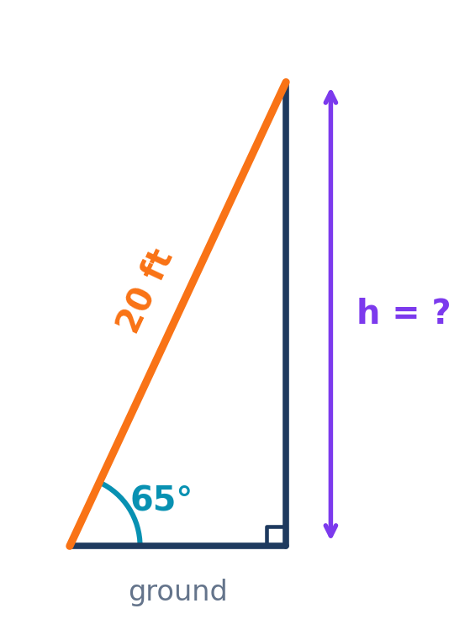
Word Problem — One Right Triangle
A 20 ft ladder leans against a wall at 65° from the ground. How high up the wall does it reach?
Step 1: Identify
Hyp = 20 ft, angle = 65°, find opposite (wall height) → use sin (SOH)
Step 2: Set up
sin 65° = h / 20
Step 3: Solve
h = 20 × sin 65° = 20 × 0.9063 ≈ 18.1 ft
Check:
18.1 < 20 ✓ (opposite < hypotenuse)

Slide 7
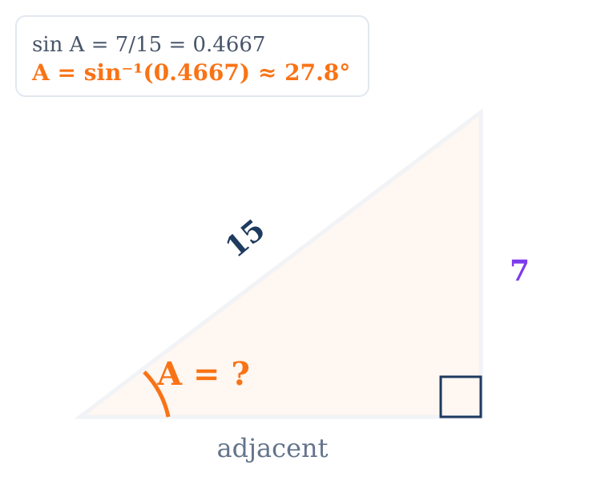
Finding an Angle Using Inverse Trig
Opposite = 7, hypotenuse = 15. Find angle A.
sin A = opp / hyp = 7 / 15 ≈ 0.4667
A = sin⁻¹(0.4667)
A ≈ 27.8°
Use sin⁻¹ (arcsin), cos⁻¹, or tan⁻¹ to find angles.
⚠ Calculator must be in DEGREE mode when using inverse trig!

Slide 8
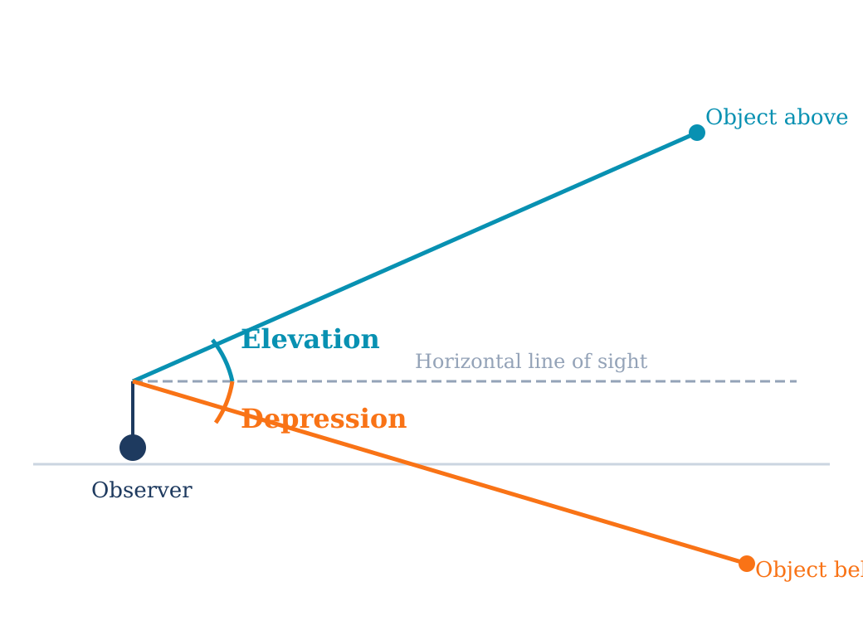
Angles of Elevation and Depression
Key Facts
Elevation: looking UP from horizontal
Depression: looking DOWN from horizontal
Both measured from the horizontal (never from vertical)
Angle of elevation = angle of depression (alternate interior angles)
Always draw the horizontal at the observer's eye level.

Slide 9
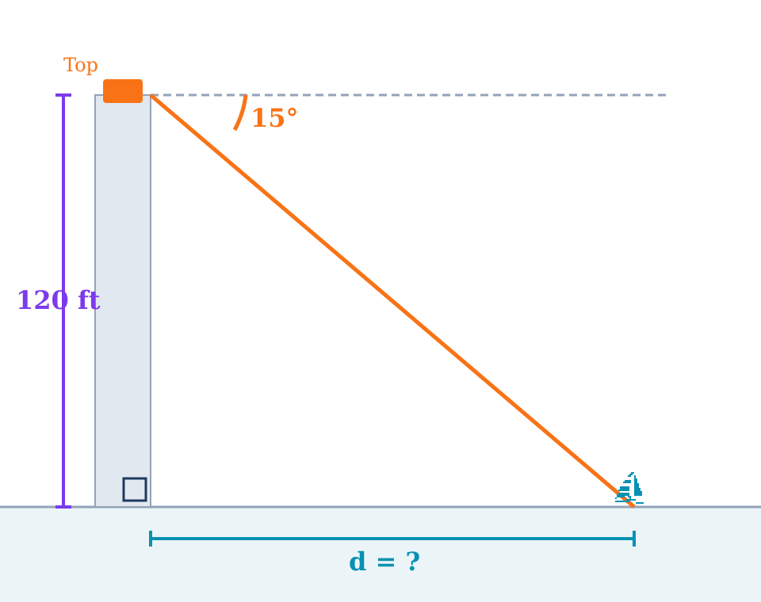
Example — Angle of Depression
From a 120 ft lighthouse top, depression to a ship is 15°. Find the distance.
Depression from top = elevation from ship = 15°
Set up:
tan 15° = opposite / adjacent = 120 / d
Solve:
d = 120 / tan 15°
d = 120 / 0.2679
d ≈ 447.9 ft

Slide 10
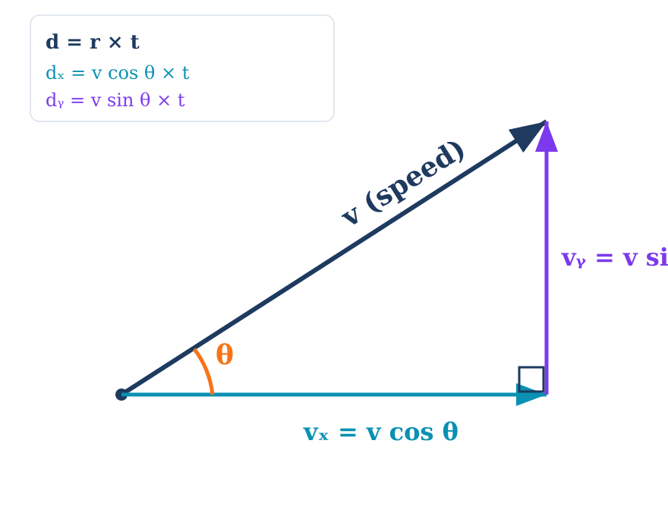
Trig Functions and d = rt
d = rt combined with trig lets us resolve motion into horizontal and vertical components.
Horizontal
dₓ = v cos θ × t
Vertical
dᵧ = v sin θ × t

Slide 11
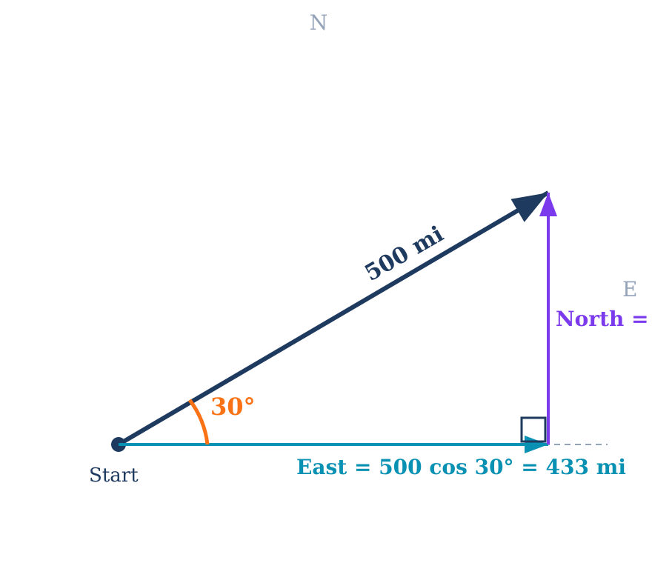
Example — Trig and d = rt
A plane flies at 250 mph, 30° north of east, for 2 hours. How far N and E?
Total distance:
d = rt = 250 × 2 = 500 miles
East (horizontal):
dₓ = 500 cos 30° = 500 × 0.866 ≈ 433 mi
North (vertical):
dᵧ = 500 sin 30° = 500 × 0.5 = 250 mi
Check: √(433² + 250²) = √250,000 = 500 ✓

Slide 12
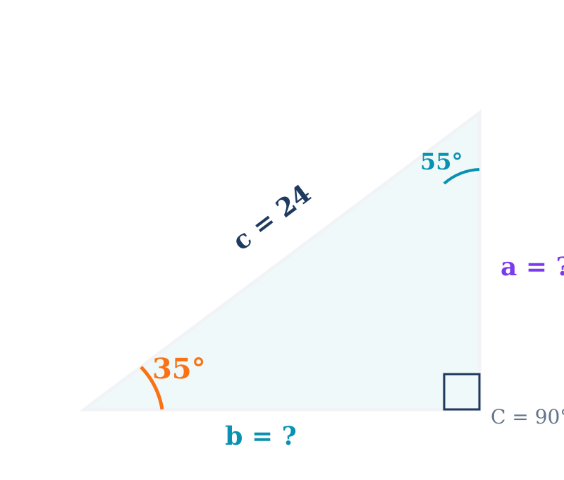
Solving a Right Triangle
"Solve" a triangle: Find all 3 sides and all 3 angles. You need at least one side plus one other known part.
1
Third angle: A + B = 90° → B = 90° − A
2
Use trig ratios to find unknown sides
3
Verify with a² + b² = c²

Slide 13
Example — Solving a Right Triangle
Given: A = 35°, c = 24 (hypotenuse), C = 90°. Find B, a, and b.
Find B:
B = 90° − 35° = 55°
Find a (opposite A):
a = c sin A = 24 × sin 35° = 24 × 0.5736 ≈ 13.77
Find b (adjacent to A):
b = c cos A = 24 × cos 35° = 24 × 0.8192 ≈ 19.66
Check: 13.77² + 19.66² = 189.6 + 386.5 = 576.1 ≈ 24² = 576 ✓
Solution: A = 35°, B = 55°, C = 90°, a ≈ 13.77, b ≈ 19.66, c = 24

Slide 14
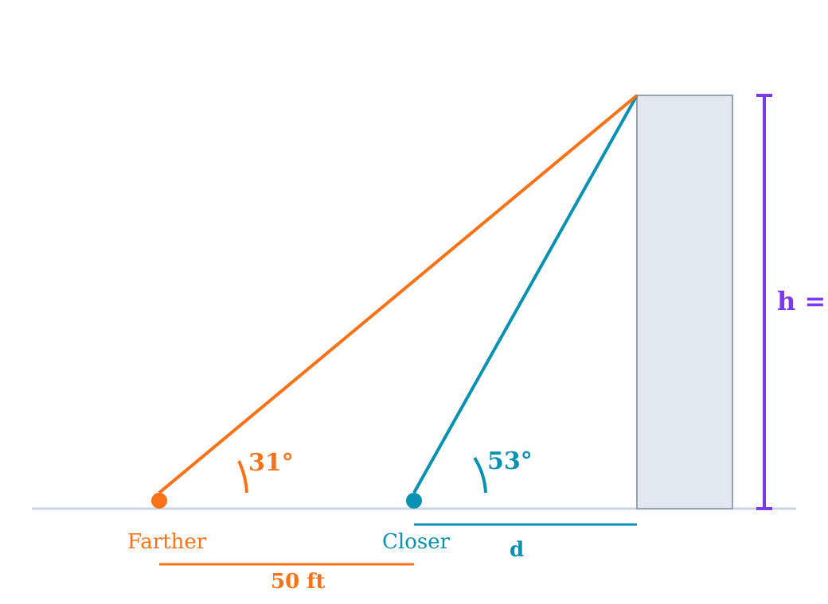
Word Problem — Two Right Triangles
Elevation to a building top is 31° from one point, 53° from 50 ft closer. Find the height.
Set up two equations:
Closer: tan 53° = h / d
Farther: tan 31° = h / (d + 50)
Solve: h = d tan 53° = (d+50) tan 31°
d(1.327) = d(0.601) + 50(0.601)
d(1.327 − 0.601) = 50 × 0.601
d(0.726) = 30.04
d ≈ 41.4 ft
h = 41.4 × tan 53° ≈ 41.4 × 1.327
h ≈ 54.9 ft

Slide 15
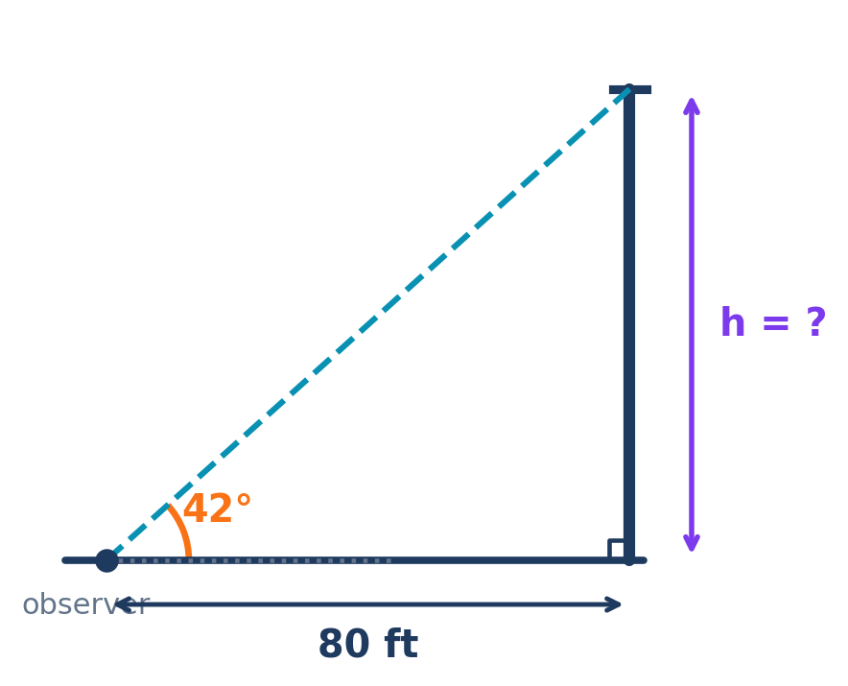
You Try
A surveyor stands 80 ft from a building. The angle of elevation to the roof is 42°. Find the building height.
Set up:
tan 42° = h / 80
Solve:
h = 80 × tan 42°
h = 80 × 0.9004
h ≈ 72.0 ft
Check:
72.0 ft < 80 ft ✓ (height < base distance for 42° < 45°)

Slide 16
Test Prep — Solving Triangles (Exact Values)
Test 3, Problem 5: Use special triangles to find exact side lengths (not decimal approximations).
Example: 30-60-90 with adj = 5, θ = 60°
Example: 45-45-90 with hyp = 14
tan 60° = opp / 5
opp = 5 tan 60° = 5√3
cos 60° = 5 / hyp
hyp = 5 / cos 60° = 5 / (1/2) = 10
Key: Use exact trig values
tan 60° = √3, cos 60° = 1/2
sin 45° = opp / 14
opp = 14 sin 45° = 14 × √2/2 = 7√2
Both legs equal in 45-45-90:
adj = opp = 7√2
Key: Use exact trig values
sin 45° = cos 45° = √2/2

Slide 17
Test Prep — Solve a Right Triangle
Test 3, Problem 6: Given two sides, find all angles and the third side. Example: a = 11, c = 35.
Step 1: Find angle A
sin A = a/c = 11/35 ≈ 0.3143
A = sin⁻¹(0.3143) ≈ 18.3°
Step 2: Find angle B
B = 90° − 18.3° = 71.7°
Step 3: Find side b
b = √(c² − a²) = √(1225 − 121) = √1104 ≈ 33.2
Solution: A ≈ 18.3°, B ≈ 71.7°, C = 90°, a = 11, b ≈ 33.2, c = 35

Slide 18
Test Prep — Elevation & Depression
Test 3, Problem 8: From two points, angles of elevation to a tower give two right triangles with a shared height.
General approach for two-triangle elevation problems:
1. Let h = unknown height, d = closer distance
2. Closer: tan(large angle) = h / d
3. Farther: tan(small angle) = h / (d + gap)
4. Both equal h, so set right sides equal:
d × tan(large) = (d + gap) × tan(small)
5. Solve for d, then h = d × tan(large angle)
This pattern appears on the test — practice setting up the two equations!

Slide 19
Module 12 Summary
7 ALEKS Topics | Section 7.1
Core Skills
Find sides (SOH CAH TOA), find angles (inverse trig), solve complete right triangles
Applications
Elevation/depression word problems, d = rt with trig components, two-triangle problems
Key for Test 3
Problem 5 (exact values with special triangles), Problem 6 (solve right triangle from two sides), Problem 8 (two-triangle elevation)
Next: Module 13 — Section 8.4 (Vectors in Component Form)

