Slide 1
MATH 130
Geometry: Angles
& Polygons
Properties, Measurements, and Formulas for Lines, Angles, and Surfaces
Liberty University | Spring 2026

Slide 2


Slide 3
Learning Goals
By the end of this lesson, you will be able to:
1. Classify and measure angles
Identify acute, obtuse, right, and straight angles; find complements and supplements.
2. Apply parallel line theorems
Use corresponding, alternate interior, and alternate exterior angle relationships to solve for unknowns.
3. Calculate polygon angle sums
Apply interior and exterior angle formulas for convex polygons with n sides.
4. Compute areas of polygons
Find areas of quadrilaterals and triangles using standard formulas including Heron’s Formula.
5. Solve similar triangle problems
Use proportional reasoning to find unknown sides and angles in similar polygons; apply to real-world contexts.
6. Convert between degree formats
Convert angles between decimal degrees and degrees-minutes-seconds (DMS) notation used in navigation.

Slide 4
SECTION 1
Foundations:
Points, Lines & Angles
Every geometric shape begins with points, lines, and angles — the atomic building blocks of all geometry.

Slide 5
Undefined Terms in Geometry
Euclid attempted to define all geometric terms, but some definitions create challenges. We accept that point, line, and plane are undefined terms — we understand them intuitively.
•
↔
▱
Point
Line
Plane
A location in space with no dimension — no length, width, or height.
A straight path extending infinitely in both directions. Has length but no width.
A flat surface that extends infinitely in all directions. Has length and width but no depth.
Why “undefined”? Every definition requires prior terms. Point, line, and plane are the starting primitives — we build all of geometry on top of them.

Slide 6
Geometric Notation Conventions
Line AB
Ray AB
A straight path extending in both directions, no endpoints. Notation: AB with arrows above both ends (AB⇔) or line through AB.
Starts at endpoint A, passes through B, extends forever. Notation: AB with a right-pointing arrow above (AB→). Endpoint listed first.
Segment AB
Angle ∠ABC
A finite path connecting two endpoints A and B. Notation: AB with a bar above (AB̅). Has a definite, measurable length.
Two rays meeting at a vertex. Notation: ∠ABC where B is the vertex. Can abbreviate as ∠B if unambiguous. Measured in degrees.

Slide 7
Congruence & Similarity
Congruence ≅
Similarity ~
Use this notation consistently throughout the course.
Same shape and size. △ABC ≅ △DEF means identical in shape and size.
Same shape, proportional sizes. △ABC ~ △DEF:
corresponding sides proportional. Order of letters in similarity statement matters!

Slide 8
Rays & Angles
Ray
Angle
A half-line — starts at a point (endpoint) and extends infinitely in one direction.
Two rays sharing a common endpoint (vertex). The measure is the rotation from one ray to the other.
One complete rotation = 360° | Measured in degrees or radians | Protractor: tool for measuring angles
Components of an Angle
Initial Side (R₁): The starting ray of the angle
Terminal Side (R₂): The ending ray after rotation
Vertex: The common endpoint where both rays meet

Slide 9
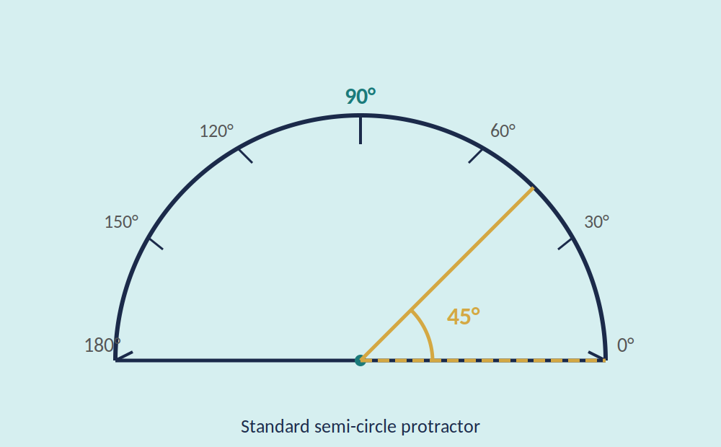
Measuring Angles
Tools & Units
Angles can be measured in degrees or radians.
Protractor
A protractor is an instrument used to measure angles (almost always in degree measure).
Key Benchmarks
Full rotation = 360° | Straight angle = 180°
Right angle = 90° | In radians: 360° = 2π rad

Slide 10
Types of Angles
Right Angle
Straight Angle
Exactly 90°
Exactly 180°
Acute Angle
Obtuse Angle
Between 0° and 90°
Between 90° and 180°
Supplementary Angles
Complementary Angles
Two angles whose measures
add up to 180°
Two angles whose measures
add up to 90°

Slide 11
Adjacent & Vertical Angles
Adjacent Angles
Vertical Angles
Two angles that share a common vertex and a common side, but do not overlap.
Two angles formed by intersecting lines that are on opposite sides of the intersection.
∠AOB and ∠BOC are adjacent angles — they share vertex O and ray OB.
Vertical angles are always equal in measure (congruent).
Key Insight: When two lines intersect, they form two pairs of vertical angles. Each pair consists of congruent angles, and any two adjacent angles are supplementary (sum to 180°).

Slide 12
Angle Relationship Map
RELATIONSHIP
DEFINITION & KEY PROPERTY
Vertical
Formed by intersecting lines; opposite each other; always congruent.
Adjacent
Share a vertex and a side; do not overlap; may or may not be supplementary.
Linear Pair
Adjacent + supplementary; sum = 180°; on a straight line.
Complementary
Any two angles whose measures sum to 90°.
Supplementary
Any two angles whose measures sum to 180°.
Key principle: Vertical angles are always congruent. All other relationships depend on position.

Slide 13
Parallel Lines & Transversals
When a transversal crosses parallel lines, special angle relationships form:
Corresponding
Angles
Alternate
Interior Angles
Alternate
Exterior Angles
Same position at each intersection.
∠1 = ∠5
Opposite sides, between the lines.
∠3 = ∠6
Opposite sides, outside the lines.
∠1 = ∠8
Equal
Equal
Equal
Angles labeled 1–8 at two intersections: t is the transversal, l ∥ m are the parallel lines

Slide 14
Corresponding Segments
When two transversals cross a pair of parallel lines, the segments between those parallel lines are called corresponding segments.
If l₁ ∥ l₂ ∥ l₃ , then segments a, b are corresponding and c, d are corresponding.
a / b = c / d and equivalently a / c = b / d
Example
Assuming the vertical lines are parallel, use proportions to find unknown distances. Worked Example: if a = 6, b = 9, c = 8, find d. Step 1 — Set up: a/b = c/d → 6/9 = 8/d. Step 2 — Cross-multiply: 6d = 9 × 8 = 72. Step 3 — Solve: d = 12.

Slide 15
Solving Angle Equations: Method
Method
Step 1 — Identify the relationship
Are the angles equal, supplementary (180°), or related by position?
Step 2 — Write the equation
Corr./alt.int./alt.ext. → set equal. Co-interior → sum to 180°.
Step 3 — Solve for x, then find the angle
Isolate the variable, then substitute back to get the degree measure.
Step 4 — Check with supplementary if needed
Adjacent angles on a straight line sum to 180°. Use this to find the supplementary angle if asked.
Works for any angle pair from parallel lines:
Corresponding, alt. int., alt. ext. → equal
Co-interior → supplementary (180°)
Quick Reference
Corr./Alt.int./Alt.ext. → set equal
Co-interior → sum to 180°, then solve

Slide 16
Worked Example: Angle Equations
Worked Example
Given: l ∥ m, cut by transversal t.
∠2 = (3x + 10)°, ∠6 = (5x − 20)°
Step 1: ∠2 and ∠6 are corresponding → equal
Step 2: 3x + 10 = 5x − 20
Step 3: 30 = 2x → x = 15
∠2 = 3(15) + 10 = 55°
Step 4: Supplementary → ∠1 = 180° − 55° = 125°

Slide 17
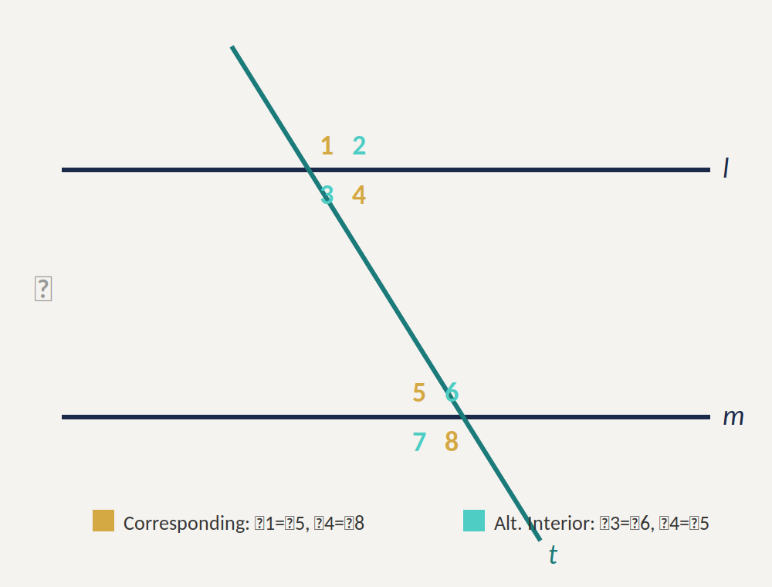
Example: Parallel Lines & Angles
Problem
Lines l and m are parallel, and t is a transversal.
Given ∠2 = 2x + 19° and ∠7 = 3x + 2°, find the measure of ∠1.
Solution Strategy
Step 1: Identify the relationship — ∠2 and ∠7 are alternate exterior angles (equal).
Step 2: Set them equal: 2x + 19 = 3x + 2 → x = 17
Step 3: Find ∠2 = 2(17) + 19 = 53°
Step 4: ∠1 and ∠2 are supplementary → ∠1 = 180° − 53° = 127°

Slide 19
SECTION 2
Polygons &
Quadrilaterals
Polygons & quadrilaterals build on angle relationships from Section 1 — now we measure enclosed area and classify shapes.

Slide 20
Polygons
A polygon is a closed region of a plane bounded by three or more straight line segments. Sides must be non-collinear and non-self-intersecting (no crossings). Formulas below apply to convex polygons.
Triangle
Quadrilateral
Pentagon
Hexagon
Heptagon & beyond
3 sides
4 sides
5 sides
6 sides
8+ sides

Slide 21
Polygon Angle Formulas
These formulas apply to convex polygons with n sides.
Interior & Exterior Angles of Polygons
Sum of Interior Angles = (n − 2) × 180°
where n = number of sides
Sum of Exterior Angles = 360° (always, for any convex polygon)
Each Interior Angle of a Regular Polygon = (n − 2) × 180° / n

Slide 22
Interior Angle Sum Formula
Derivation via Triangulation
Any polygon can be divided into triangles by drawing diagonals from one vertex.
A polygon with n sides produces (n − 2) triangles.
Each triangle has an angle sum of 180°.
Sum of Interior Angles = (n − 2) × 180°
Examples
Triangle (n=3): (3−2) × 180° = 180°
Quadrilateral (n=4): (4−2) × 180° = 360°
Pentagon (n=5): (5−2) × 180° = 540°
Hexagon (n=6): (6−2) × 180° = 720°
Quick Reference — Interior Angle Sums
Triangle (n=3): 180° | Quadrilateral (n=4): 360° | Pentagon (n=5): 540° | Hexagon (n=6): 720°
Heptagon: 900° | Octagon: 1080° | Nonagon: 1260° | Decagon: 1440°
Formula: (n − 2) × 180° where n = number of sides

Slide 23
Exterior Angle Sum
Key Fact: Sum of Exterior Angles = 360° (always, for any convex polygon)
One exterior angle at each vertex. The sum is always 360°, regardless of the number of sides.
Regular Polygon Interior Angle
Each interior angle of a regular n-gon = (n − 2) × 180° / n
Each exterior angle of a regular n-gon = 360° / n
Examples
Regular hexagon (n=6): interior = 120°, exterior = 60°
Regular octagon (n=8): interior = 135°, exterior = 45°
Interior + exterior angle at any vertex = 180° (linear pair)
Regular Polygon Quick Reference
Pentagon (5): interior = 108°, exterior = 72° | Hexagon (6): interior = 120°, exterior = 60°
Octagon (8): interior = 135°, exterior = 45° | Decagon (10): interior = 144°, exterior = 36°
Note: interior + exterior = 180° (always, at every vertex — linear pair)

Slide 24
Types of Quadrilaterals
Trapezoid
Exactly two parallel sides (called bases)
Parallelogram
Both pairs of opposite sides are parallel
Rhombus
Parallelogram with four equal sides
Rectangle
Parallelogram with a right angle (all 90°)
Square
Rectangle with four equal sides
A diagonal of a polygon is a line segment joining any two nonadjacent vertices.

Slide 25
Area of Quadrilaterals
Square
Rectangle
A = s²
A = l × w
s = side length
l = length, w = width
Parallelogram
Trapezoid
A = b × h
A = ½(b₁ + b₂)h
b = base, h = height
b₁, b₂ = bases, h = height
Area is given in square units (ft², m², mi², cm², in²) | Rhombus: A = d₁ × d₂ / 2 (d₁, d₂ = diagonals)

Slide 26
Examples: Area of Quadrilaterals
Parallelogram
Trapezoid
b = 9.2 cm, h = 6.1 cm
b₁ = 3.6 ft, b₂ = 5.5 ft, h = 2.9 ft
A = b × h = 9.2 × 6.1
A = ½(b₁ + b₂)h = ½(3.6 + 5.5)(2.9)
A = 56.12 cm²
A = 13.195 ft²
Always label units: area is always in square units (cm², ft², m²). Forgetting units costs points on the quiz.

Slide 27
Worked Example: Multi-Step Trapezoid
Step 1 — Find the Height
Step 2 — Compute the Area
b₁ = 3.8, b₂ = 9.2, slant = 6.3 cm
A = ½(b₁ + b₂)h
d = 9.2 − 3.8 = 5.4; h² + 5.4² = 6.3²
A = ½(3.8 + 9.2)(3.2) = ½(13.0)(3.2)
h = √10.53 ≈ 3.2 cm
A ≈ 21.1 cm²
Key strategy: when the height is not given, look for a right triangle hidden in the trapezoid. Use the Pythagorean theorem to find h first, then apply A = ½(b₁ + b₂)h.

Slide 28
Compound Shapes Strategy
Procedure for Any Compound Shape
Step 1 — Partition
Identify simple shapes within the compound figure (rectangles, triangles, trapezoids).
Step 2 — Label all dimensions
Ensure all necessary measurements are identified for each part.
Step 3 — Compute individual areas
Apply the correct formula to each piece separately.
Step 4 — Add or subtract
Add areas of parts (or subtract holes/cutouts).
Step 5 — State units
Always express area in square units (cm², ft², m², etc.).

Slide 29
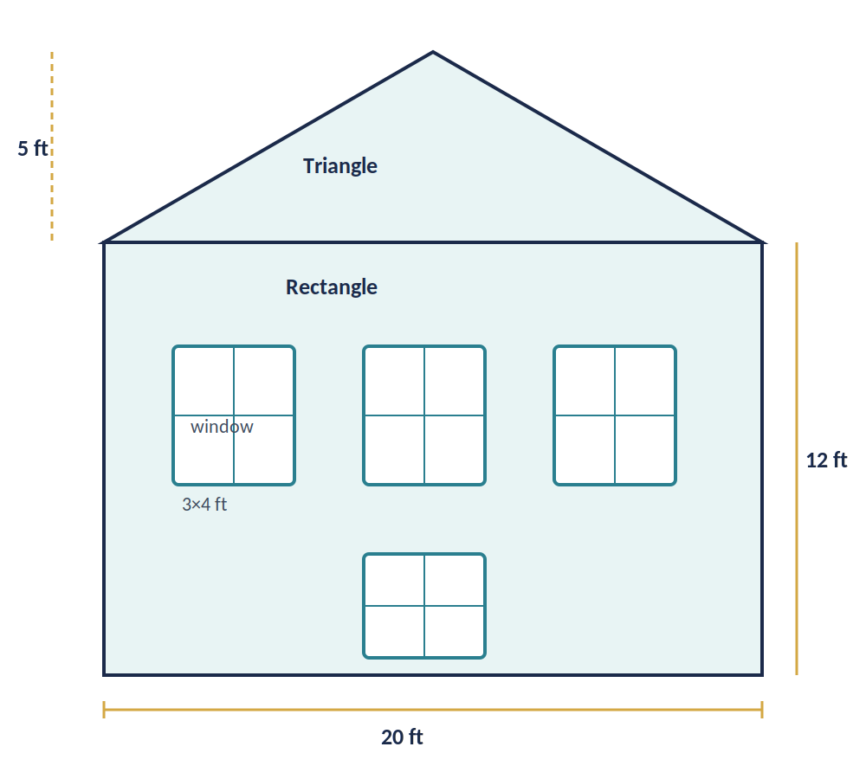

Application: Area of Compound Shapes
Problem
The wall of a living room with a vaulted ceiling has 3 windows as shown.
If a quart of paint covers 80 ft², how much paint is required to paint these walls?
Solution Step
Step 1: Wall = rectangle + triangle on top
Step 2: Find each area, then subtract 4 windows
Step 3: Net wall area ÷ 80 ft² per quart = quarts needed
See diagram for exact dimensions → answer varies by wall size.

Slide 30
SECTION 3
Triangles
The most important polygon — every other polygon can be divided into triangles.

Slide 31
Types of Triangles
Scalene
Isosceles
No two sides are equal in length. No tick marks on sides.
Two sides are equal in length. Shown with single tick marks on equal sides.
Equilateral
Right
All three sides are equal. Shown with double tick marks. All angles = 60°.
Has one right angle (90°). The side opposite the right angle is the hypotenuse; the other sides are legs.

Slide 32



Triangle Properties
Sum of Interior Angles
Perimeter
$$∠A + ∠B + ∠C = 180°$$
$$P = a + b + c$$
The three interior angles of any triangle always sum to exactly 180 degrees.
The total distance around the triangle — sum of all three side lengths.
Area of a Triangle
A triangle is exactly half of a parallelogram with the same base and height. The height (h) is the perpendicular distance from the base to the opposite vertex.
$$A = ½bh$$

Slide 33
Triangle Area: Decision Guide
Which Formula to Use?
A = ½bh — Use when base and height are known
Height must be perpendicular to the base. Works for all triangle types.
A = (s²√3)/4 — Use for equilateral triangles
All three sides equal (s). Derived from the 30-60-90 split.
Heron's Formula — Use when only all three sides are known
A = √[s(s−a)(s−b)(s−c)] where s = (a+b+c)/2
No height needed — powerful when height is unknown.
Decision rule: Know height? → ½bh. All equal? → equilateral. Only sides? → Heron's.
Decision Rule Summary
Know height? → Use ½bh | All sides equal? → Use equilateral formula | Only sides? → Use Heron's
Heron's is the most versatile — it works for any triangle when all three side lengths are known.

Slide 34
Heron's Formula
Use this when the height isn’t known — it only requires the three side lengths. When you know all three side lengths but not the height, use Heron’s Formula to find the area.
s = (a + b + c) / 2
(s = semi-perimeter = half the perimeter)
A = √[ s(s − a)(s − b)(s − c) ]
Example
Triangle with sides a = 4.5 mi, b = 5.6 mi, c = 8.2 mi
s = (4.5 + 5.6 + 8.2) / 2 = 18.3 / 2 = 9.15
s − a = 9.15 − 4.5 = 4.65, s − b = 9.15 − 5.6 = 3.55, s − c = 9.15 − 8.2 = 0.95
A = √[ 9.15 × 4.65 × 3.55 × 0.95 ] = √143.99 ≈ 11.87 mi²

Slide 35

Equilateral Triangle Formula
Deriving the Formula
Formula
For an equilateral triangle with side s:
1. Split into two right triangles
2. Base of each = s/2, hypotenuse = s
3. Height: h² + (s/2)² = s²
h² = s² − s²/4 = 3s²/4
h = (s√3)/2
4. A = ½ × s × (s√3)/2
$$A = \frac{s \sqrt[2]{3}}{4}$$
Height: h = (s√3) / 2
Example: s = 4.4 in
A = (4.4²√3)/4 ≈ 8.39 in²

Slide 36
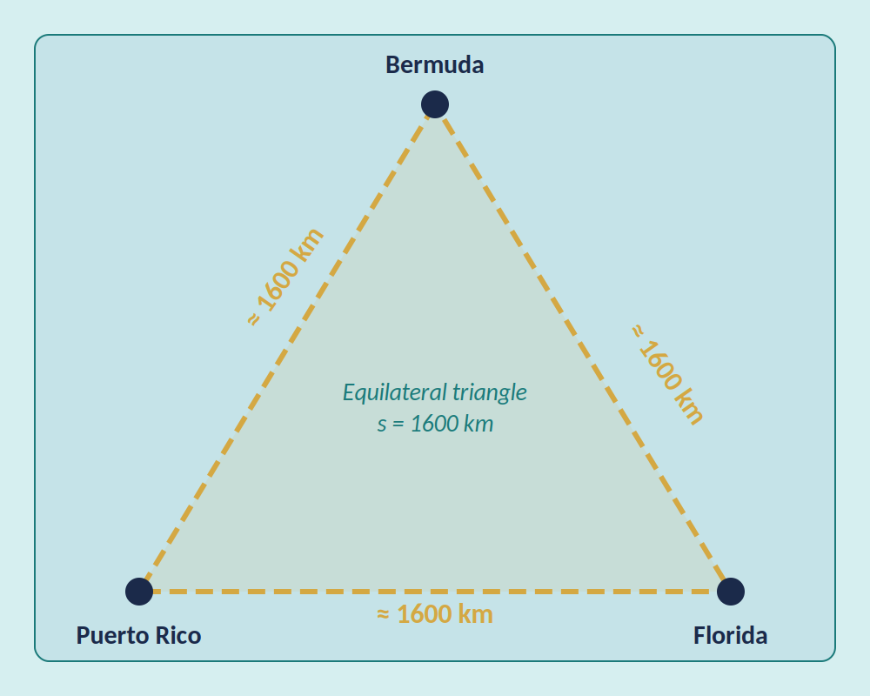
Application: The Bermuda Triangle
Problem
The Bermuda Triangle is sometimes defined as an equilateral triangle 1600 km on a side, with vertices in Bermuda, Puerto Rico, and the Florida coast.
Assuming it is flat, what is its approximate area?
Solution: 1,108,512.5 km²
Method: A = (s²√3) / 4, with s = 1600 km
= (2,560,000 × 1.732) / 4 = 4,434,050 / 4 ≈ 1,108,512.5 km²

Slide 37

The Pythagorean Theorem
$$a² + b² = c²$$
For a right triangle: the square of the hypotenuse equals the sum of the squares of the two legs.
c = hypotenuse
(longest side, opposite the right angle)
a, b = legs (the two shorter sides)
Checking Right Angles
If a² + b² = c² → right angle (opposite c)
If a² + b² > c² → angle opposite c is acute (triangle is acute)
If a² + b² < c² → angle opposite c is obtuse (triangle is obtuse)
Example: Box is 13 × 10 in with diagonal 16.75 in. Is it square? 13² + 10² = 269, but 16.75² = 280.5625. Since 269 < 280.56, the angles are obtuse — not right angles.
Notes:
Diagram: Right Triangle — the two shorter sides are legs a and b; the side opposite the right angle (longest side) is hypotenuse c. Mark the right angle with a small square at the corner.

Slide 38
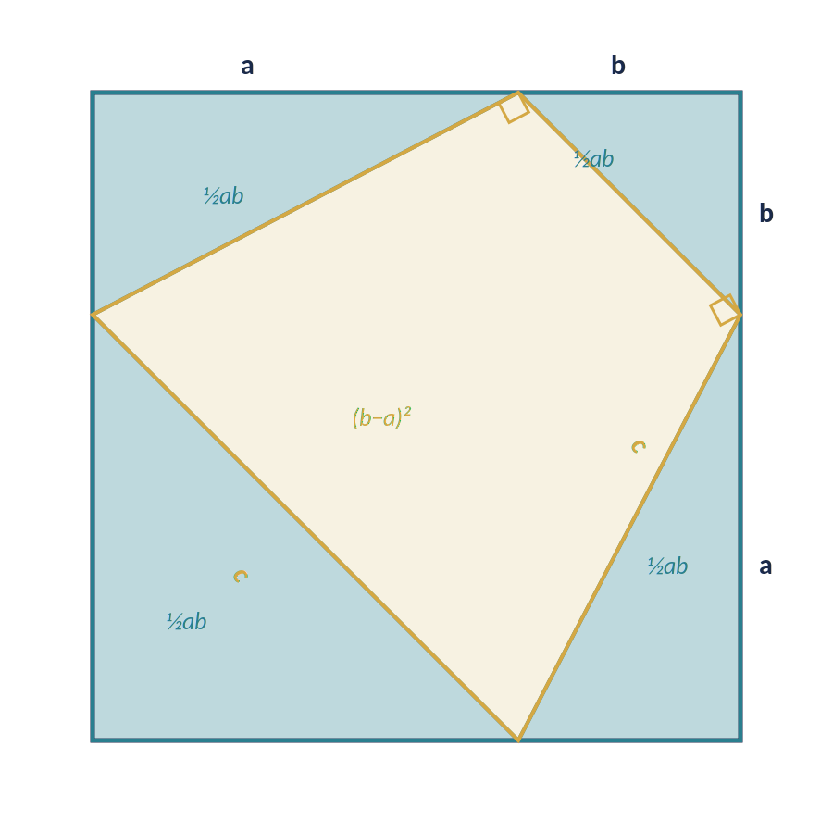
Pythagorean Theorem: A Geometric Proof
Proof by Area
Large square = 4 triangles + inner square
c² = 4(½ab) + (b − a)²
c² = 2ab + b² − 2ab + a²
c² = a² + b² ✓

Slide 39
The Scarecrow’s “Theorem”
From The Wizard of Oz (1939)
The correct theorem (a² + b² = c²) is NOT the Scarecrow’s “theorem” from The Wizard of Oz — he said:
“The sum of the square roots of any two sides of an Isosceles triangle is equal to the square root of the remaining side.”
Counterexample:
If sides are 3, 3, and 1: √3 + √3 = √1 ?
1.732... + 1.732... = 1 ??? What??
He got his diploma anyway — but his geometry was wrong.
Quiz Connection
The Pythagorean Theorem states a² + b² = c² for ANY right triangle — not just isosceles.
On the quiz: identify the hypotenuse first (opposite the right angle), then apply a² + b² = c² correctly.

Slide 40
Error Analysis: Triangle Area
Common Mistakes to Avoid
Mistake 1 — Using the slanted side as height
The height must be perpendicular to the base. A slanted leg is NOT the height unless the triangle is right-angled.
Mistake 2 — Forgetting to square the units
Area is always in square units. 12 cm × 8 cm = 96 cm², not 96 cm.
Mistake 3 — Misidentifying the hypotenuse
The hypotenuse is always opposite the right angle — the longest side.
Mistake 4 — Applying Heron's with the wrong s
s is the semi-perimeter: s = (a+b+c)/2, not a+b+c.

Slide 41
SECTION 4
Similar Polygons
Similarity extends triangle properties to proportional reasoning — two shapes with equal angles have predictable side length ratios.

Slide 42
Similar Triangles
Two polygons are similar if they have the same shape (but not necessarily the same size).
Property 1
Property 2
Corresponding angles are equal in measure.
∠A = ∠D, ∠B = ∠E, ∠C = ∠F
Corresponding sides are proportional.
AB/DE = BC/EF = AC/DF
We write △ABC ~ △DEF to denote similarity. Only 2 pairs of equal angles are needed to prove similarity.
Quiz Tip
Given △MNP ~ △QRS, use corresponding angles to find missing angles (they sum to 180°), and set up proportions like MN/QR = NP/RS = MP/QS to find missing sides.

Slide 43
Similarity: Strategy
Procedure for Solving Similarity Problems
Step 1 — Match corresponding angles
Confirm AA (Angle-Angle) similarity. Order of vertices in the statement matters.
Step 2 — Determine the scale factor
Scale factor = (side of one figure) / (corresponding side of other figure).
Step 3 — Set up the proportion
a/b = c/d — corresponding sides in the same ratio.
Step 4 — Solve for the unknown
Cross-multiply and simplify.
Step 5 — Interpret: label with units, verify the ratio holds.
Key Reminders
Common shortcut: If two angles are known equal, the third must be equal too (angle sum = 180°).
Scale factor > 1: figure is enlarging. Scale factor < 1: figure is shrinking. Always state which direction.

Slide 44
Example: Similar Triangles
Given: △MNP ~ △QRS, ∠P = 41°, ∠R = 85°, MN = 35, QR = 20, RS = 24, MP = 56
Find: ∠N, ∠M, NP, QS
Angles
Sides
∠N corresponds to ∠R = 85°
∠N = 85°
∠M + ∠N + ∠P = 180°
∠M + 85° + 41° = 180°
∠M = 54°
Scale: MN/QR = 35/20 = 7/4
NP/RS = 7/4 → NP/24 = 7/4
NP = 42
MP/QS = 7/4 → 56/QS = 7/4
QS = 32

Slide 45
Applications: Similar Triangles
Shadow Problem
River Width Problem
A 6 ft man stands 10 ft from a flagpole. His 8 ft shadow ends at the same point as the flagpole's shadow.
BC ∥ DE. AB = 50 ft, AD = 180 ft, BC = 60 ft. Find DE (river width).
6/h = 8/18 → h = 13.5 ft
AB/AD = BC/DE
50/180 = 60/DE → DE = 216 ft
(Total shadow = 8 + 10 = 18 ft)
Strategy: Identify the two similar triangles → match corresponding sides → set up the proportion → cross-multiply and solve.

Slide 46
Application: Parallel Segments
Problem
Two parallel lines are cut by two transversals. Segments AB = 9, BC = 6, and DE = 12. Find EF.
Solution
Parallel lines cut transversals proportionally:
AB / BC = DE / EF
9 / 6 = 12 / EF
EF = (12 × 6) / 9 = 72 / 9 = 8
Answer: EF = 8
Strategy: Parallel lines always divide transversals in the same ratio. Identify corresponding segments before setting up the proportion.

Slide 47
Error Analysis: Similarity
Common Mistakes in Similarity Problems
Mistake 1 — Wrong order in similarity statement
△ABC ~ △DEF means A↔D, B↔E, C↔F. Swapping letters changes which sides correspond.
Mistake 2 — Inverting the ratio
If AB/DE = BC/EF, do NOT flip one side: AB/DE ≠ EF/BC.
Mistake 3 — Mixing sides from different triangles
Always keep numerators from one figure and denominators from the other.
Mistake 4 — Confusing the scale factor direction
Larger → smaller: scale factor < 1. Smaller → larger: scale factor > 1.
Self-Check Strategy
Quick check: Write out the similarity statement first, then list corresponding pairs before setting up any ratio.
If your answer gives a scale factor < 0 or makes sides negative, you have a ratio error — flip and retry.

Slide 48
SECTION 5
Degrees, Minutes
& Seconds
Navigation, surveying, and GPS express angles in degrees-minutes-seconds — here we connect that real-world notation to our angle work.

Slide 49
Degrees, Minutes & Seconds
1° = 60 minutes (60′) 1′ = 60 seconds (60″) 1° = 3600″
Reading DMS Notation
45° 30′ 15″
45 = degrees (whole number)
30′ = 30 minutes = 30/60 of a degree
15″ = 15 seconds = 15/3600 of a degree
= 45.504167° in decimal form
Where DMS Is Used
• Navigation & maps (latitude/longitude)
• Astronomy (star positions)
• Aviation approach plates
• Surveying & GPS coordinates
Conversions are on the next two slides.
Angles in navigation, surveying, and GPS use degrees-minutes-seconds (DMS) — here’s how to convert. Used in navigation, latitude/longitude, and aviation approach plates.

Slide 50
Decimal Degrees → DMS
Procedure: Decimal → DMS
Step 1 — The whole number part is the degrees
Step 2 — Multiply the decimal remainder by 60 → minutes
Step 3 — Multiply that decimal remainder by 60 → seconds
Worked Example: Convert 135.721°
Degrees: 135°
Minutes: 0.721 × 60 = 43.26 → 43′
Seconds: 0.26 × 60 = 15.6 → 15.6″
Answer: 135° 43′ 15.6″

Slide 51
DMS → Decimal Degrees
Procedure: DMS → Decimal
Step 1 — Convert minutes: divide by 60
Step 2 — Convert seconds: divide by 3600
Step 3 — Add all three parts together
Worked Example: Convert 120° 48′ 50″
Degrees: 120
Minutes: 48 / 60 = 0.8°
Seconds: 50 / 3600 ≈ 0.01389°
Total: 120 + 0.8 + 0.01389 ≈ 120.814°
Answer: ≈ 120.814°
Common mistake: forgetting to add all three parts. The answer is 120 + 0.8 + 0.01389, not just 120.01389 or 0.81389.

Slide 52
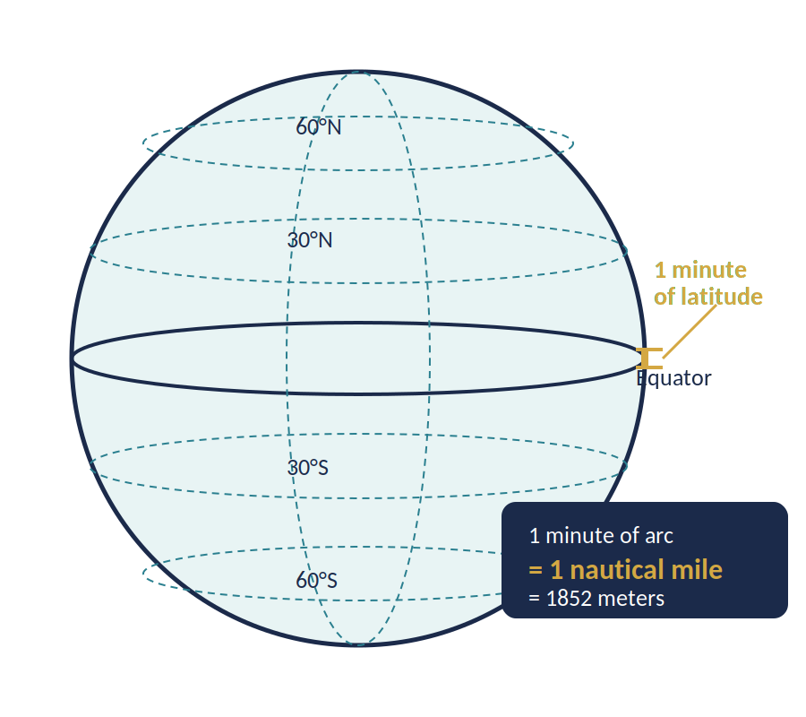
Angles in Navigation: The Nautical Mile
Definition
Historically, one nautical mile was defined as the distance of one minute of latitude (at sea level).
1′ = 60″
If 1′ = 1852 m, then:
1″ = 1852 / 60 ≈ 31 m
Today's official definition (since 1929):
1 nautical mile = 1852 m (exactly)
Practical example:
A ship traveling 10 nautical miles covers 10 × 1852 = 18,520 m ≈ 18.5 km

Slide 53
Core Geometric Competencies
By the end of this unit, you should be able to do all of the following:
Angle Reasoning
Classify angles (acute, right, obtuse, straight). Apply vertical, supplementary, and parallel line relationships. Write and solve angle equations.
Polygon Angle Sums
Derive and apply (n−2)×180° for interior sums. Use 360° for exterior sums. Find individual angles in regular polygons.
Area Computation
Apply formulas for squares, rectangles, parallelograms, trapezoids, and rhombuses. Partition compound shapes. Choose the correct triangle formula (½bh, equilateral, Heron’s).
Similarity
Identify similar polygons using AA. Write correct similarity statements. Determine scale factors and set up proportions to find missing sides.
DMS Conversion
Convert decimal degrees to DMS (multiply remainders by 60 twice). Convert DMS to decimal (divide by 60 and 3600, then add). Understand the nautical mile connection.

Slide 54
Quiz Preparation: Key Skills
1
Similar Triangles
Find missing angles and sides using proportions (△MNP ~ △QRS)
2
Parallel Lines & Angles
Identify corresponding, alternate interior, and alternate exterior angles
3
Triangle Areas
Use A = ½bh, equilateral formula, and Heron's formula
4
Compound Shapes
Break complex shapes into parallelograms and rectangles, sum the areas
5
Polygon Angle Sums
Interior: (n−2)×180°, Exterior: always 360°, Regular: (n−2)×180°/n
6
Trapezoid Area
A = ½(b₁ + b₂)h — identify bases, height, and any diagonal measurements
Remember: Show all work for full credit! Label your units.

Slide 55
Practice Checklist
Before the assessment, make sure you can:
Angle relationships
Identify all parallel line angle pairs by name and state their relationship (equal or supplementary).
Polygon angle sums
Find interior and exterior angle sums for any polygon, and solve for missing angles.
Area computation
Partition compound shapes, apply correct formulas, give answers in square units.
Similarity
Write correct similarity statements, calculate scale factors, set up and solve proportions.
DMS
Convert decimal degrees ↔ DMS accurately. Understand the nautical mile connection.

Slide 56
MATH 130
Questions?
Practice & Review
Worksheet: Covers Sections 1–5 (parallel lines, polygon area, triangles, similar figures, DMS). Due: Next class meeting. Quiz format: 12 problems, no calculator on DMS conversions, calculator permitted for area and similar triangle problems. Show all work for full credit.
Liberty University | Geometry: Angles & Polygons

Slide 57
Reflection & Questions
Three Prompts for Reflection
Prompt 1
Which formulas require geometric justification rather than just memorization? What is the underlying reasoning?
Prompt 2
Where does proportional reasoning appear most often in this unit? Give two specific examples.
Prompt 3
Which concept required the most careful diagram reading to avoid errors?
Questions? Bring them to the next class or office hours.

