Slide 1
Module 13
Section 8.4
Vectors
Math 130: Advanced Technical Mathematics | Unit 3

Slide 2
Why Vectors?
Many real-world quantities need both size AND direction.
• Velocity — wind at 15 mph to the north-east
• Force — 50 N pulling down at 30°
• Displacement — walking 3 blocks east, then 2 north
Scalars (speed, mass, temperature) need only size.

Slide 3
Module 13 — Skills Overview
1
Writing a vector in component form from initial/terminal points
2
Vector addition and scalar multiplication: component form
3
Finding magnitude and direction of a vector from its graph
4
Finding the direction angle of a vector in ai + bj form
5
(Supplementary) Finding the components of a vector given magnitude and angle

Slide 4
Vectors and Scalars
Scalar
Vector
Magnitude only (a single number)
Examples: speed, temperature, mass
Magnitude AND direction
Examples: velocity, force, displacement
Notation
Component form: v = ⟨a, b⟩ = a i + b j
Unit vectors: i = ⟨1, 0⟩, j = ⟨0, 1⟩
Zero vector: 0 = ⟨0, 0⟩ (no magnitude, no direction)
Magnitude: |v| = √(a² + b²) Direction angle: θ (CCW from +x)

Slide 5
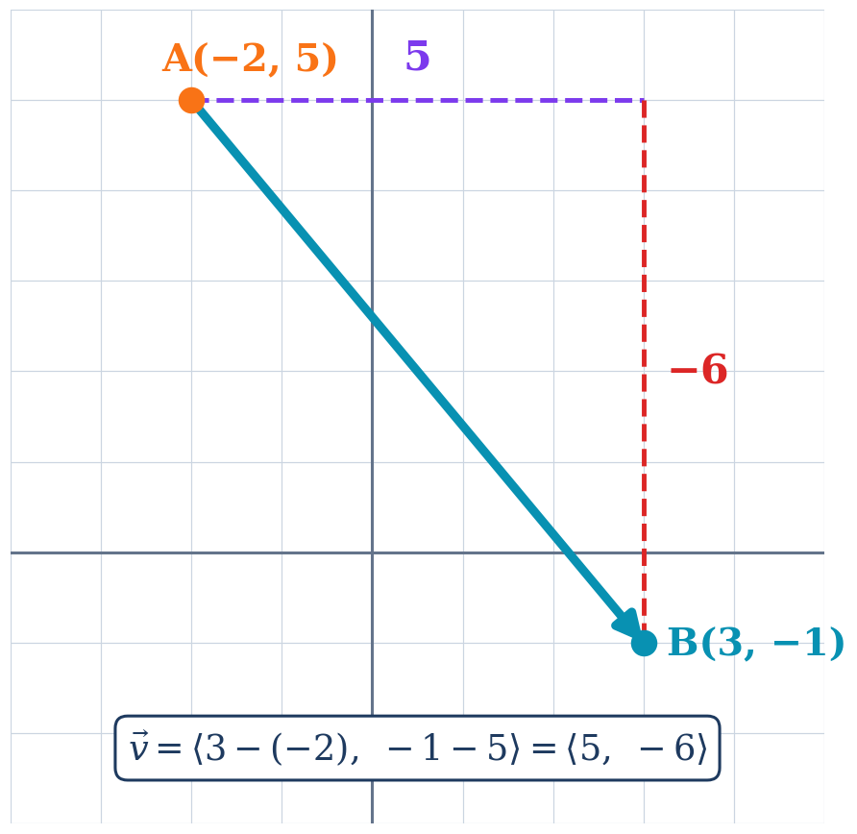
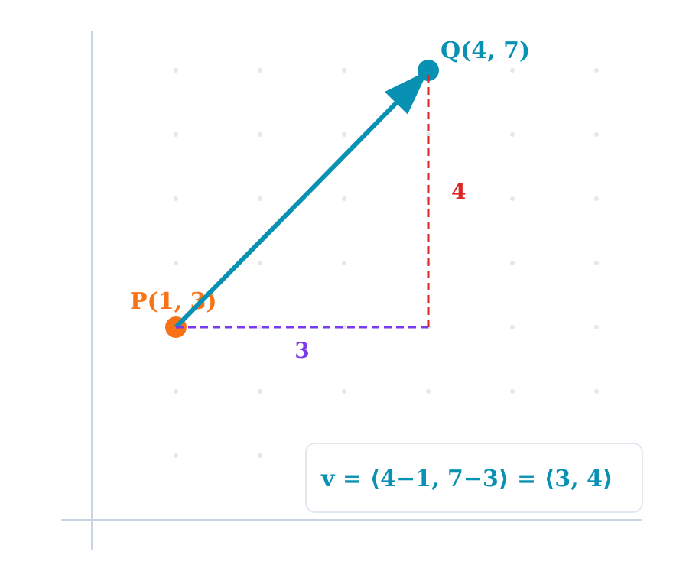
Writing a Vector in Component Form
Formula: v = ⟨x₂ − x₁, y₂ − y₁⟩ (terminal minus initial)
Example: A(−2, 5) to B(3, −1)
v = ⟨3 − (−2), −1 − 5⟩
v = ⟨5, −6⟩
Meaning: 5 units right, 6 units down
Component form is position-independent — only the displacement matters.

Slide 6
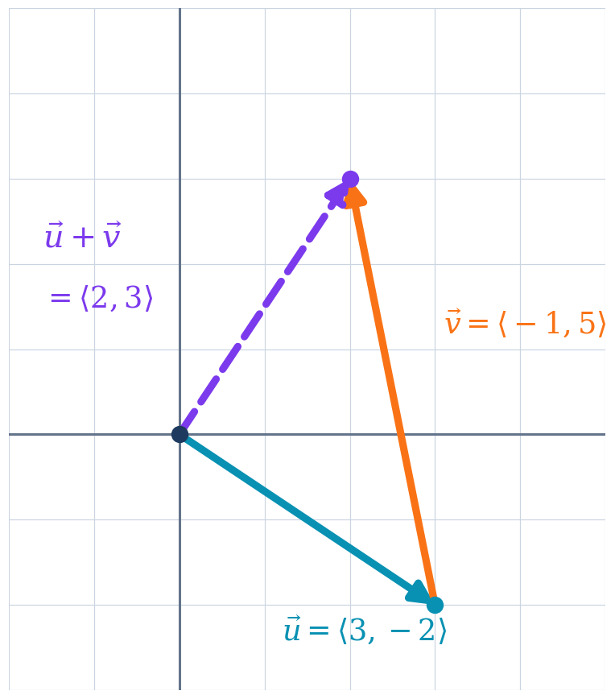
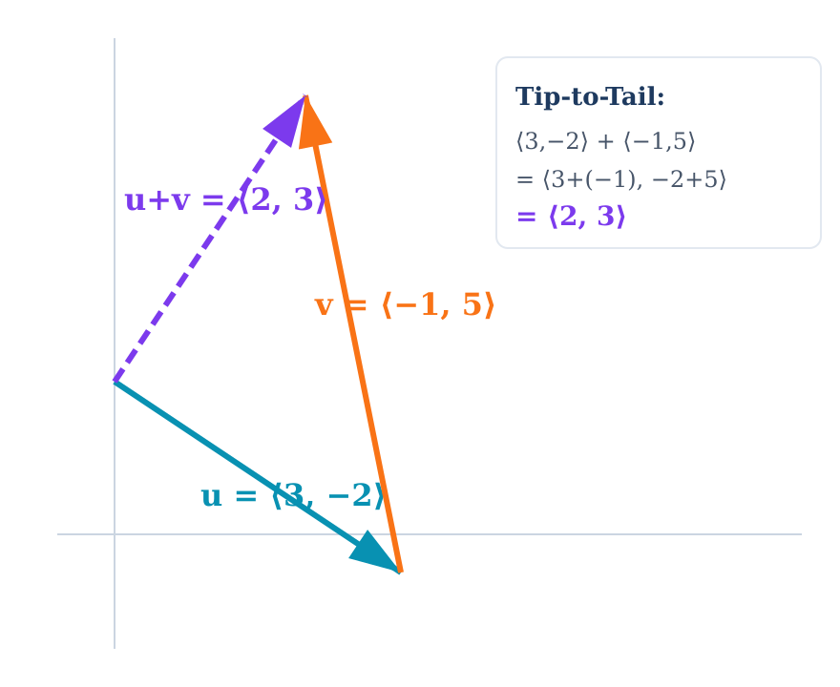
Vector Addition & Scalar Multiplication
Addition
⟨a, b⟩ + ⟨c, d⟩ = ⟨a+c, b+d⟩
Subtraction
⟨a, b⟩ − ⟨c, d⟩ = ⟨a−c, b−d⟩
Scalar ×
k⟨a, b⟩ = ⟨ka, kb⟩
u = ⟨3, −2⟩ and v = ⟨−1, 5⟩
u + v = ⟨3+(−1), −2+5⟩ = ⟨2, 3⟩
3u − 2v:
3⟨3,−2⟩ − 2⟨−1,5⟩ = ⟨9,−6⟩ − ⟨−2,10⟩
= ⟨9−(−2), −6−10⟩ = ⟨11, −16⟩

Slide 7
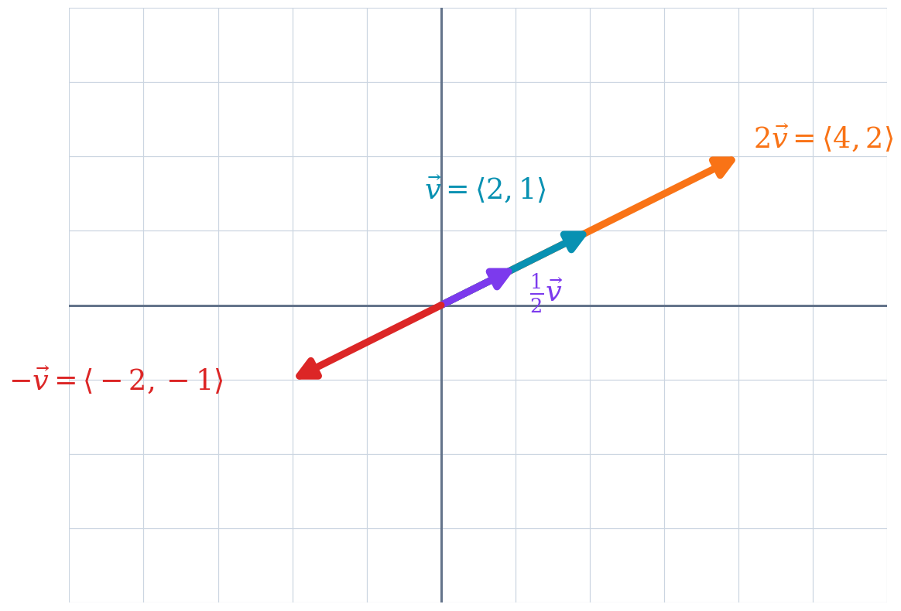
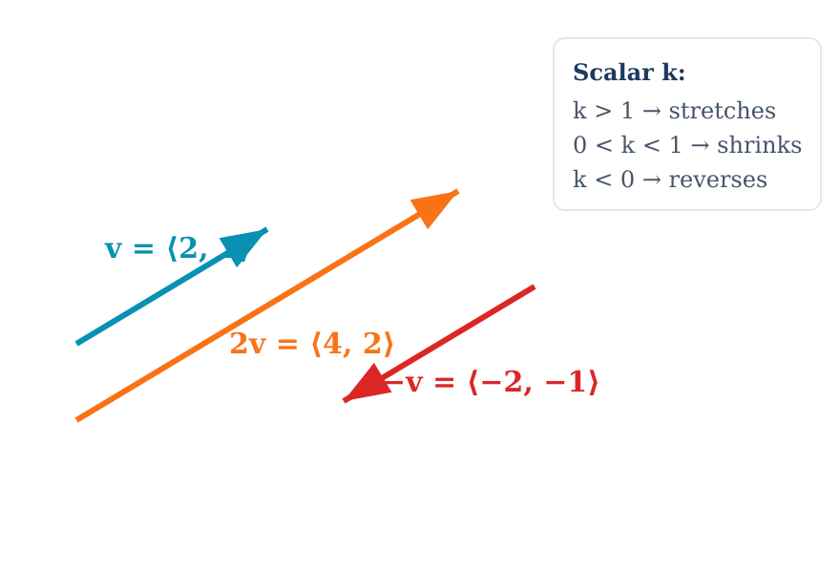
Scalar Multiplication — Visual
Rules
|k| > 1 → stretches the vector
0 < |k| < 1 → shrinks the vector
k < 0 → reverses direction
k⟨a, b⟩ = ⟨ka, kb⟩
Magnitude: |kv| = |k| × |v|

Slide 8
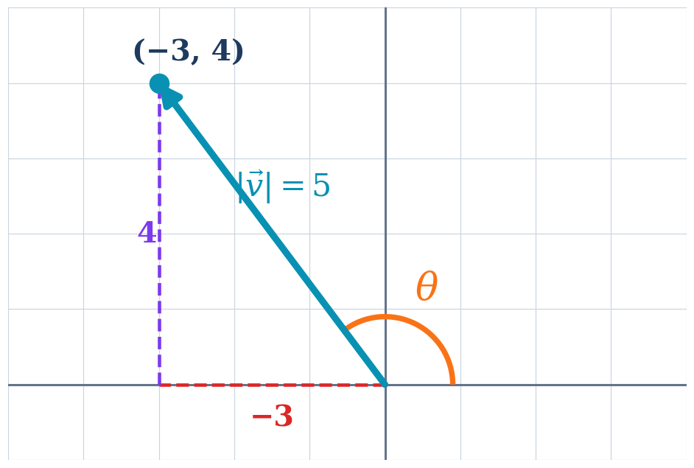
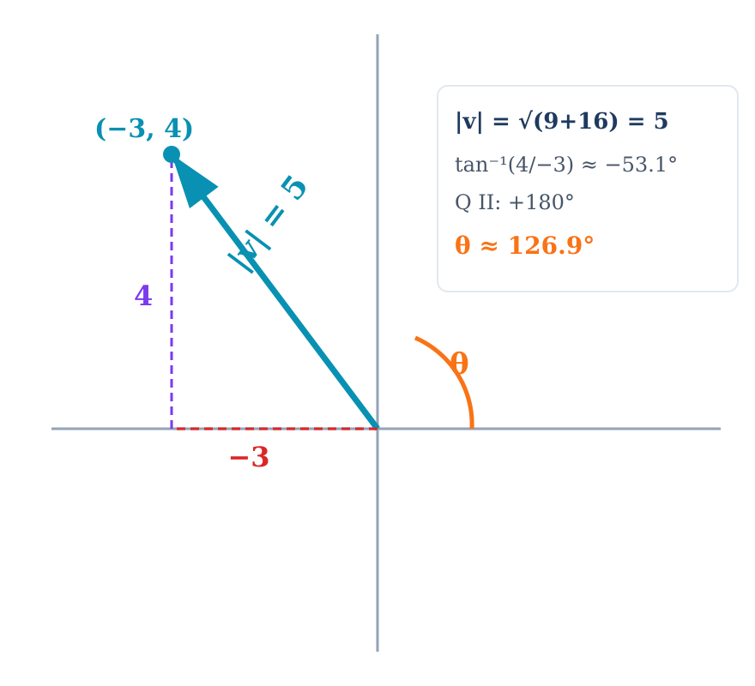
Magnitude and Direction
Magnitude: |v| = √(a² + b²)
Direction: θ = tan⁻¹(b / a) (adjust for quadrant)
Example: v = ⟨−3, 4⟩
|v| = √(9 + 16) = √25 = 5
tan⁻¹(4/−3) ≈ −53.1°
Q II (a < 0, b > 0): add 180°
θ ≈ −53.1° + 180° = 126.9°

Slide 9
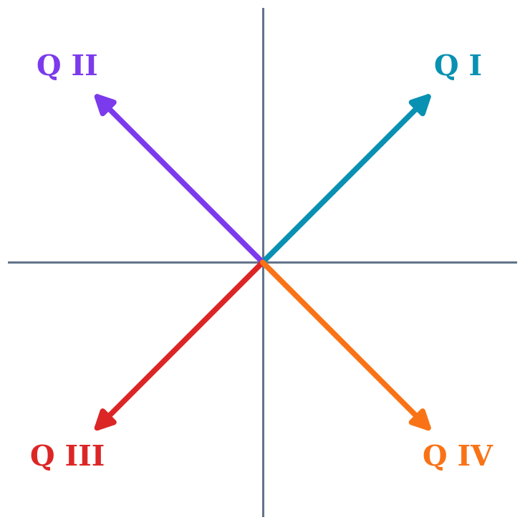
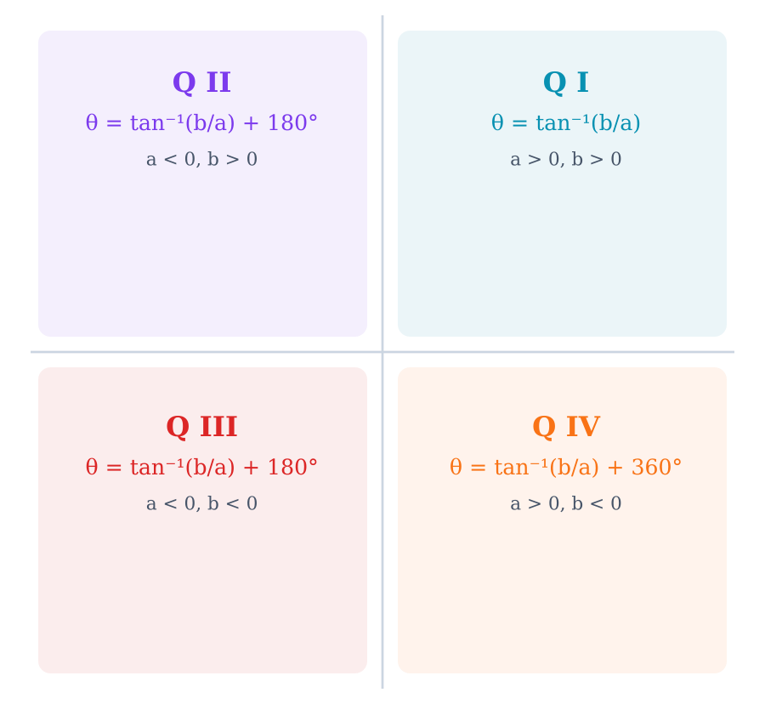
Direction Angle — Quadrant Adjustment
One Rule for θ
Compute α = tan⁻¹(b/a), then:
if a < 0 → θ = α + 180°
(Q II or Q III)
else if b < 0 → θ = α + 360°
(Q IV)
otherwise → θ = α
(Q I)

Slide 10
Direction Angle of ai + bj
Find the direction angle of v = −5i + 12j.
Convert to components:
v = −5i + 12j → ⟨−5, 12⟩ (a = −5, b = 12)
Find magnitude:
|v| = √(25 + 144) = √169 = 13
Find direction:
tan⁻¹(12/−5) ≈ −67.4°
a < 0, b > 0 → Q II: add 180°
θ ≈ −67.4° + 180° = 112.6°

Slide 11
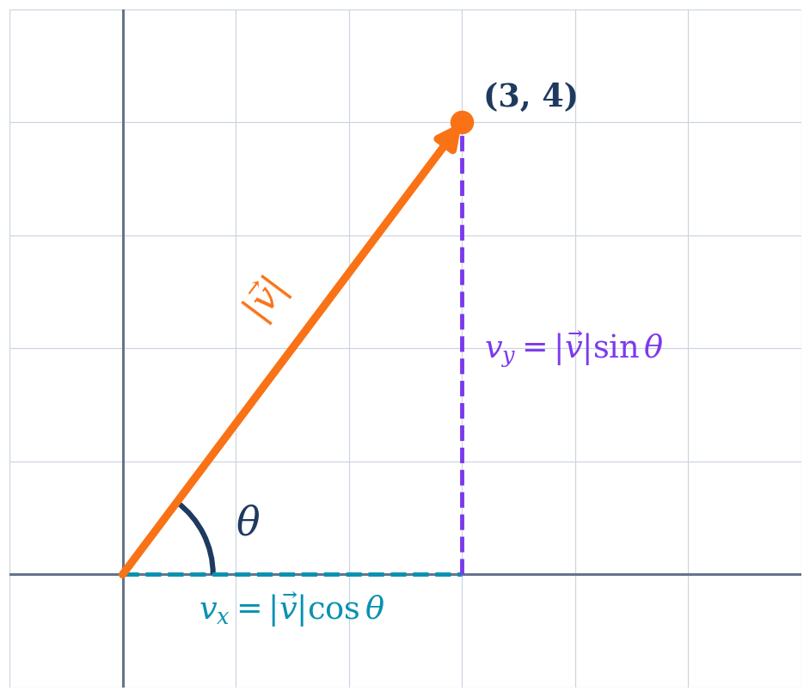
Components from |v| and θ
Given |v| and θ
vₓ = |v| cos θ
vᵧ = |v| sin θ
v = ⟨|v| cos θ, |v| sin θ⟩
Example: |v| = 5, θ = 53.1°
vₓ = 5 cos 53.1° ≈ 3
vᵧ = 5 sin 53.1° ≈ 4
v = ⟨3, 4⟩

Slide 12
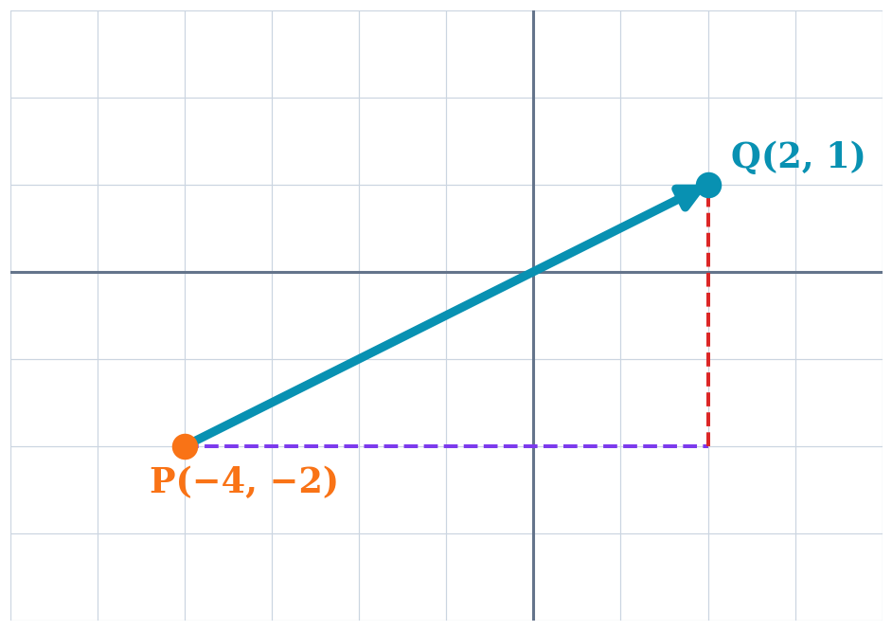
You Try
Vector v goes from P(−4, −2) to Q(2, 1). Find:
(a) component form (b) magnitude (c) direction angle
(a) v = ⟨2 − (−4), 1 − (−2)⟩ = ⟨6, 3⟩
(b) |v| = √(36 + 9) = √45 = 3√5 ≈ 6.71
(c) θ = tan⁻¹(3 / 6) ≈ 26.57° (Q I, no adjustment)

Slide 13
Test Prep — Vector Operations
Test 3, Problem 9: Vector addition, scalar multiplication, magnitude, and direction angle calculations.
Part A: Component form
Part B: Operations
Given: P(3, −1) to Q(−2, 4)
v = ⟨−2−3, 4−(−1)⟩
v = ⟨−5, 5⟩
|v| = √(25+25) = √50 = 5√2
θ = tan⁻¹(5/−5)+180° = −45°+180°
θ = 135°
Given: u = ⟨2, −3⟩, v = ⟨−1, 4⟩
u + v = ⟨1, 1⟩
2u − 3v =
⟨4,−6⟩ − ⟨−3,12⟩ = ⟨7, −18⟩
|2u − 3v| = √(49+324) = √373
≈ 19.3

Slide 14
Module 13 Summary
5 ALEKS Topics | Section 8.4
Components
v = ⟨x₂−x₁, y₂−y₁⟩ from points, or v = ⟨|v|cos θ, |v|sin θ⟩ from magnitude/direction
Operations
Add/subtract component-wise, scalar multiplication multiplies each component
Magnitude & Direction
|v| = √(a²+b²), θ = tan⁻¹(b/a) adjusted for quadrant (Q II/III: +180°, Q IV: +360°)
Key for Test 3
Problem 9: component form, vector operations (2u − 3v), magnitude, and direction angle with quadrant adjustment
Next: Unit 3 Review → Test 3

