Slide 1
M A T H 1 3 0
Geometry: Circles
& Solids
Circumference, Area, Arc Length, Sectors, Radians, Velocity, and Solid Figures
Liberty University | Spring 2026

Slide 2





Learning Goals
By the end of this lesson, you will be able to:
Identify circle components
Calculate areas of basic shapes
Convert angles (DMS & radians)
Name and define radius, diameter, chord, tangent, secant, arc, sector, and segment.
Find areas of triangles, parallelograms, trapezoids, piecewise figures, and concentric circle regions.
Convert between DMS, decimal degrees, and radians.
Arc length, sectors & velocity
Volume & surface area of solids
Apply s = rθ, A = ½r²θ, and v = rω to solve problems.
Use formulas for prisms, cylinders, cones, spheres, and pyramids.

Slide 3
S E C T I O N 1
Course Readiness
& Circle Basics
Area formulas for basic shapes, circumference, and circle terminology.

Slide 4
Area of Basic Shapes
Triangle, parallelogram, and trapezoid — the foundational area formulas you will use throughout this unit.
Triangle
Parallelogram
Trapezoid
A = ½ b h
A = b h
A = ½(b₁ + b₂)h
Example: b = 12 cm, h = 5 cm
A = ½(12)(5) = 30 cm²
Example: b = 9 in, h = 4 in
A = (9)(4) = 36 in²
Example: b₁ = 8, b₂ = 14, h = 6
A = ½(8+14)(6) = 66 units²
Remember: h is always the perpendicular height, not a slanted side.

Slide 5
Piecewise Rectangular Figures
Break complex shapes into rectangles, find each area, then add them together.
Strategy
Worked Example
1. Identify how to split the figure into non-overlapping rectangles.
2. Calculate the area of each rectangle (A = l × w).
3. Add all rectangle areas together for the total.
Tip: You can also find the area of the bounding rectangle and subtract the missing pieces.
An L-shaped room: overall 10 ft × 8 ft with
a 4 ft × 3 ft piece removed from one corner.
Method 1 (subtraction):
Full rectangle: 10 × 8 = 80 ft²
Removed piece: 4 × 3 = 12 ft²
Total area = 80 − 12 = 68 ft²

Slide 6
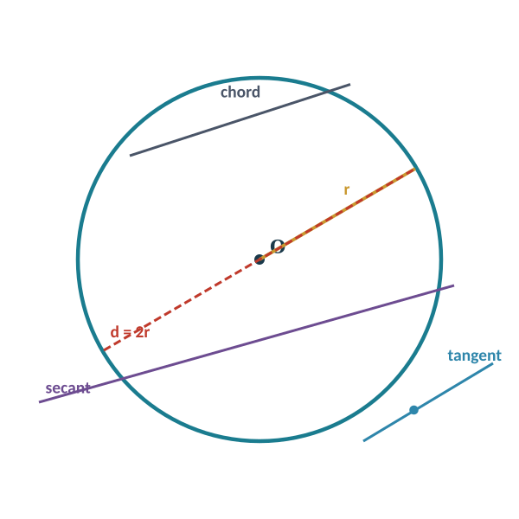
Circle Terminology
A circle is the set of all points in a plane equidistant from a fixed point (the center).
Radius
Diameter
Center to circle. Half the diameter.
Chord through center. Equal to 2r.
Chord
Tangent
Segment with both endpoints on circle.
Line touching circle at exactly one point.
Secant
Center
Line intersecting circle at two points.
Fixed equidistant point.

Slide 7
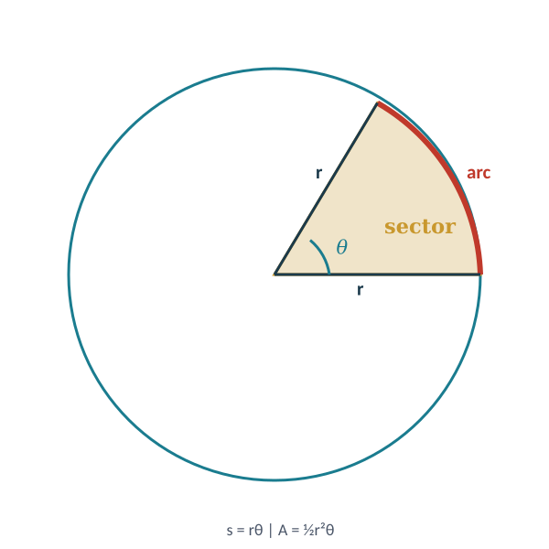
Arcs, Sectors & Segments
Key regions and curves defined within a circle.
Arc
A portion of the circumference. Minor arc < semicircle; major arc > semicircle.
Central Angle
Angle at the center formed by two radii. Its measure equals the intercepted arc.
Sector
The "pie-slice" region between two radii and the arc they intercept.
Segment
The region between a chord and its arc. A chord creates a minor and major segment.

Slide 8
Circumference & Area
Two fundamental measurements of every circle.
Circumference
Area
C = πd = 2πr
A = πr²
The distance around the circle.
The space enclosed by the circle. Always use the radius.
Example: Circumference
Example: Area (exact)
r = 5 → C = 2π(5) = 10π ≈ 31.416
r = 7.6 → C = 2π(7.6) = 15.2π ≈ 47.752
r = 5 → A = π(5²) = 25π
r = 3 → A = π(3²) = 9π ≈ 28.274
Leave answers in terms of π for exact answers. Use π ≈ 3.14159 for decimal approximations.

Slide 9
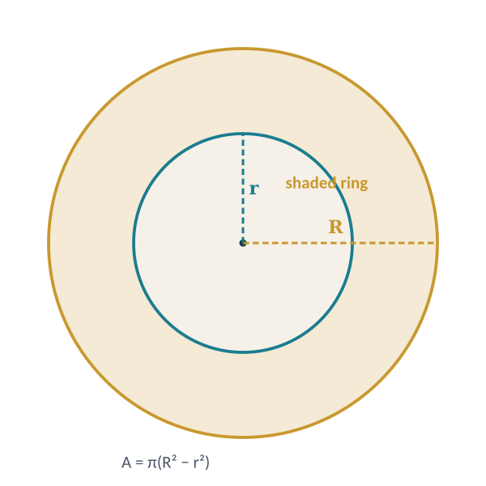
Area Between Concentric Circles
When one circle is inside another sharing the same center, the ring-shaped region between them is called an annulus.
Formula
A = πR² − πr² = π(R² − r²)
R = outer radius, r = inner radius
Worked Example
A circular fountain has radius 4 ft. A walkway 3 ft wide
surrounds it. Find the area of the walkway.
R = 4 + 3 = 7 ft, r = 4 ft
A = π(7² − 4²) = π(49 − 16) = 33π ≈ 103.67 ft²

Slide 10
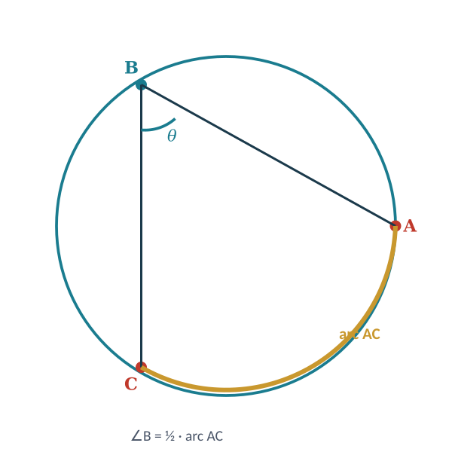
Inscribed Angles
An inscribed angle has its vertex on the circle and its sides are chords.
Inscribed Angle Theorem
The measure of an inscribed angle is exactly one-half the measure of its intercepted arc.
∠ABC = ½ · arc AC
Corollary
An inscribed angle in a semicircle is always 90°, because the intercepted arc is 180°.

Slide 11
Chord & Angle Theorems
When two chords intersect inside a circle, the angles formed relate to the intercepted arcs.
Intersecting Chords Angle
Vertical & Supplementary
∠ = ½(arc₁ + arc₂)
Vertical angles are congruent.
Adjacent angles are supplementary (sum = 180°).
The angle equals half the sum of the two intercepted arcs.
Inscribed Angle ↔ Arc
Diameter = 180° Arc
Inscribed angle → arc = 2 × angle
Arc → inscribed angle = ½ × arc
A diameter divides the circle into two semicircles of 180° each.

Slide 12
Worked Example: Circle Angles
∠AED = 133° and arc AB = 52°. AC is a diameter (BD is not). Find ∠AEB, ∠ACB, and arc CD.
Part (a): Find ∠AEB
∠AEB and ∠AED are supplementary (straight line).
∠AEB = 180° − 133° = 47°
Part (b): Find ∠ACB
∠ACB is inscribed, intercepting arc AB = 52°.
∠ACB = ½ × 52° = 26°
Part (c): Find arc CD
133° = ½(arc AD + arc BC). Arc BC = 180° − 52° = 128°
266° = arc AD + 128° → arc AD = 138°
arc CD = 180° − 138° = 42°
(a) ∠AEB
= 47°
(b) ∠ACB
= 26°
(c) arc CD
= 42°

Slide 13
S E C T I O N 2
Angle Measure
& Arc Length
DMS notation, radians, degree-radian conversion, arc length, and sector area formulas.

Slide 14
Degrees, Minutes & Seconds
Angles in navigation and surveying use DMS notation. 1° = 60′ (minutes), 1′ = 60″ (seconds).
DMS → Decimal Degrees
Decimal → DMS
Decimal = D + M/60 + S/3600
1. Whole part = degrees
2. Decimal × 60 → whole part = minutes
3. Remaining decimal × 60 = seconds
Divide minutes by 60, seconds by 3600, then add all parts.
Example: 37°41′11″ → Decimal
Example: 36.3492° → DMS
= 37 + 41/60 + 11/3600
= 37 + 0.6833 + 0.003056
= 37.6864°
D = 36°. 0.3492 × 60 = 20.952 → M = 20′
0.952 × 60 = 57.12 → S ≈ 57″
Result: 36°20′57″

Slide 15
Degrees & Radians
If a central angle intercepts an arc equal in length to the radius, that angle is exactly 1 radian.
Key Relationship
Degrees → Radians
Radians → Degrees
2π rad = 360°
π rad = 180°
Multiply by π
Divide by 180
Multiply by 180
Divide by π
One radian ≈ 57.296°. Think of it as the angle that "unwraps" one radius-length of arc.

Slide 16
Conversion Examples
Practice converting between degrees and radians in both directions.
Radians → Degrees
Degrees → Radians
π/6 → (π/6)(180/π) = 30°
2.7 rad → (2.7)(180/π) ≈ 154.699°
1 rad → (1)(180/π) ≈ 57.296°
45° → (45)(π/180) = π/4
120° → (120)(π/180) = 2π/3
255° → (255)(π/180) = 17π/12
1° → π/180 ≈ 0.01745 rad
Remember: π rad = 180° is the bridge. Multiply by whichever fraction cancels the unit you want to eliminate.

Slide 17
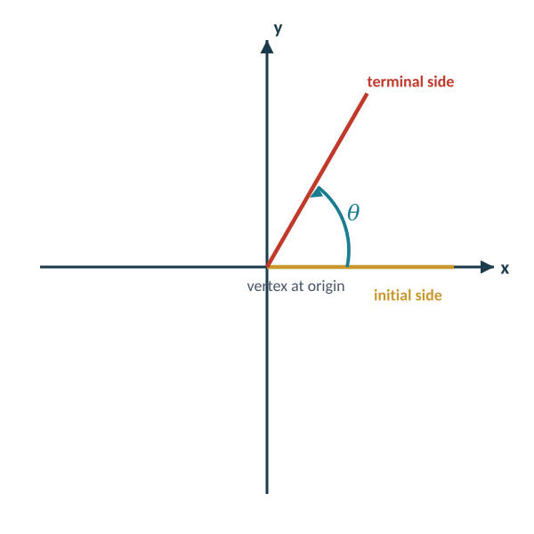
Sketching Angles in Standard Position
Standard position: vertex at origin, initial side along the positive x-axis.
How to Sketch
1. Place the initial side along the positive x-axis.
2. Rotate counterclockwise for positive angles,
clockwise for negative angles.
3. Draw the terminal side at the given angle.
Key Angles to Know
π/6 = 30° π/4 = 45° π/3 = 60°
π/2 = 90° π = 180° 3π/2 = 270°
2π = 360°
Negative: −π/4 is 45° clockwise from x-axis.

Slide 18
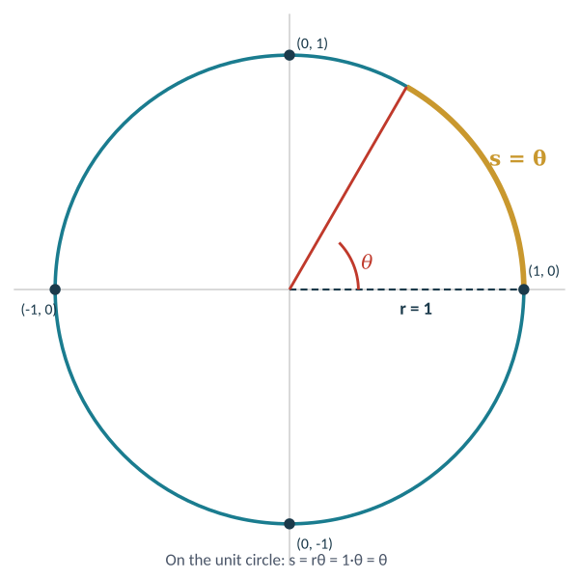
Arc Length on the Unit Circle
On the unit circle (r = 1), the arc length equals the central angle in radians: s = θ.
Why s = θ on the Unit Circle
Since s = rθ and r = 1:
s = (1)θ = θ
The radian measure of an angle IS the arc length on the unit circle.
Example
Central angle = 2π/3. On the unit circle:
Arc length s = 2π/3 ≈ 2.094
On a circle with r = 5:
s = 5 · (2π/3) = 10π/3 ≈ 10.472

Slide 19
Arc Length
The distance along the curved part of a circle between two points. θ must be in radians.
s = rθ
If θ is in degrees:
Convert to radians first by multiplying by π/180,
then apply s = rθ.
s = arc length, r = radius, θ = central angle (radians)
Example 1
Example 2
Central angle = π/3, radius = 10
s = rθ = 10 · (π/3) = 10π/3 ≈ 10.472
Central angle = 45°, radius = 21
Convert: 45° × π/180 = π/4
s = 21 · (π/4) = 21π/4 ≈ 16.493

Slide 20
Area of a Sector
A sector is the "pie-slice" region between two radii and an arc. Its area is proportional to θ.
A = ½r²θ
Alternatively (degrees):
A = (θ/360) · πr²
This is simply the fraction of the full circle's area.
A = area, r = radius, θ = central angle (radians)
Example 1
Example 2
Central angle = π/3, radius = 10
A = ½(10²)(π/3) = 50π/3 ≈ 52.360
Central angle = 45°, radius = 21
Convert: 45° × π/180 = π/4
A = ½(21²)(π/4) = 441π/8 ≈ 173.18

Slide 21
Real-World Sector Problems
Applying arc length and sector area to aviation and everyday scenarios.
Aviation Arc
Sprinkler Coverage
Arc south on 12 NM arc from 090 to 210 radial.
Central angle: 210° − 90° = 120° = 2π/3 rad
Arc length: s = 12(2π/3) = 8π ≈ 25.13 NM
Time at 120 kt: 25.13/120 ≈ 0.209 hr ≈ 12.6 min
TLAR check: 120° is ⅓ of 360°, so ⅓ × 2π(12) ≈ 25 NM ✓
A sprinkler sprays water 20 ft, covering a 150° sector.
Find the area of the watered region.
Convert: 150° × π/180 = 5π/6 rad
Area: A = ½(20²)(5π/6)
= ½(400)(5π/6)
= 1000π/3 ≈ 1047.2 ft²
That is about 150/360 ≈ 41.7% of the full circle.

Slide 22
S E C T I O N 3
Linear & Angular
Velocity
Connecting rotational speed to the speed of a point on a spinning object.

Slide 23
Linear & Angular Velocity
Two ways to describe how fast something spins — and how they connect.
Angular Velocity (ω)
Linear Velocity (v)
ω = θ / t
v = rω = s / t
How fast the angle changes. Measured in rad/s or rad/min.
Speed of a point on the rotating object. Farther from center → faster.
Converting RPM to Radians
1 revolution = 2π radians. So n RPM = n × 2π rad/min. Always convert before using v = rω.
Key insight: v = rω — linear velocity is directly proportional to both radius and angular velocity.

Slide 24
Worked Example: Riverboat Paddles
Radius = 8.50 ft, turning at 20.0 RPM. Find the speed of a paddle tip.
Solution
Answer
Step 1 — Convert RPM to angular velocity:
ω = 20.0 rev/min × 2π rad/rev = 40π rad/min
Step 2 — Apply v = rω:
v = 8.50 ft × 40π rad/min = 340π ft/min
Step 3 — Convert to convenient units:
v = 340π ≈ 1068 ft/min ≈ 12.14 mi/hr
≈ 1068 ft/min
≈ 12.14 mi/hr
The paddle tip moves at about 12 miles per hour through the water.

Slide 25
More Velocity Examples
Drive shaft rotation and wind turbine blade tips.
Drive Shaft Rotation
Wind Turbine Blade Tips
Tachometer reads 3200 RPM. Angle in 1 second?
ω = 3200 × 2π/60 ≈ 335.1 rad/s
In 1 s: θ = 335.1 rad ≈ 53.3 revolutions
Blades 116 ft long at 22.0 RPM. Tip speed?
ω = 22.0 × 2π = 44π rad/min
v = 116 × 44π ≈ 16,035 ft/min
≈ 182.2 mph
Bonus: Turbine Sweep Area
A = πr² = π(116)² = 13,456π ≈ 42,273 ft² ÷ 43,560 ft²/acre ≈ 0.97 acres — nearly a full acre of wind capture.

Slide 26
S E C T I O N 4
Solid Geometric
Figures
Volume and surface area formulas for common three-dimensional shapes.

Slide 27
Volume & Surface Area
B = base area, P = perimeter, l = slant height, h = height, r = radius.
Rectangular Prism
Cylinder
Cone
V = lwh
V = πr²h
V = ⅓πr²h
Surface Area: SA = 2(lw+lh+wh)
Surface Area: SA = 2πr²+2πrh
Surface Area: SA = πr²+πrl
Sphere
Right Pyramid
Triangular Prism
V = ⁴⁄₃πr³
V = ⅓Bh
V = Bh
Surface Area: SA = 4πr²
Surface Area: SA = B+½Pl
Surface Area: SA = 2B+Ph

Slide 28
Worked Example: Drain Pipe
A 12 ft pipe (inner diameter 4 in) is clogged. Will two 5-gallon buckets hold the water? (1 gal = 231 in³)
Step 1 — Convert to consistent units:
Length: 12 ft = 144 in. Radius: 4/2 = 2 in.
Step 2 — Volume of the cylinder:
V = πr²h = π(2²)(144) = 576π ≈ 1809.56 in³
Step 3 — Convert to gallons:
V = 1809.56 ÷ 231 ≈ 7.83 gallons
Step 4 — Compare:
Two 5-gal buckets = 10 gal. Since 7.83 < 10, yes!
Answer
Yes ✓
≈ 7.83 gal
Two 5-gallon buckets provide more than enough capacity (10 gal > 7.83 gal).

Slide 29
Formula Quick Reference
All the key formulas from this unit in one place.
Circle & Area
C = 2πr = πd A = πr²
Annulus: A = π(R² − r²)
Triangle: A = ½bh
Parallelogram: A = bh
Trapezoid: A = ½(b₁+b₂)h
Arc Length & Sector
s = rθ A = ½r²θ (θ in radians)
Conversions
Deg → Rad: multiply by π/180
Rad → Deg: multiply by 180/π
DMS → Dec: D + M/60 + S/3600
Velocity
ω = θ/t v = rω = s/t
RPM → rad/min: n × 2π
Solids
Rect. Prism: V=lwh SA=2(lw+lh+wh)
Cylinder: V=πr²h SA=2πr²+2πrh
Cone: V=⅓πr²h SA=πr²+πrl
Sphere: V=⁴⁄₃πr³ SA=4πr²
Pyramid: V=⅓Bh SA=B+½Pl
Inscribed Angle
∠inscribed = ½ × intercepted arc
Watch out: Always convert to radians before using s = rθ or A = ½r²θ. Always use radius (not diameter) for area.

Slide 30
References
Katz, V. J. (1998). A History of Mathematics: An Introduction (2nd ed.).
New York, NY: Addison-Wesley.
MATH 130 | Liberty University | Spring 2026

