Slide 1

Chapter 1: introduction
Chapter goal:
Get “feel,” “big picture,” introduction to terminology
more depth, detail later in course
Overview/roadmap:
What is the Internet? What is a protocol?
Network edge: hosts, access network, physical media
Network core: packet/circuit switching, internet structure
Performance: loss, delay, throughput
Protocol layers, service models
Security
History

Slide 2
How zookeeper work

Slide 3
Agenda
What is zookeeper
Why zookeeper
Zookeeper cluster architecture
Leader election
How write request is processed
How read request is processed
Parameters worth attentions
A little bit From user’s perspective

Slide 4
What is zookeeper
A system, a highly available, scalable, distributed system.
A service, a configuration, consensus, group membership, leader election, naming, coordination and distributed lock service.
An open-source Apache™ project. created by Yahoo! as sub-project of Hadoop.

Slide 5
Why use zookeeper
Distributed apps need such functions (configuration, consensus, etc.), better implement it as a separate service and reuse and share.
Implementing our own service is difficult, and risky. Luckily, zookeeper is available and open-source.
Zookeeper is simple, it has only one purpose.
Zookeeper is reliable, highly available and scalable.
We use hadoop and haddop uses zookeeper

Slide 6
Zookeeper cluster architecture
ZooKeeper Service
Leader
Server
Server
Server
Server
Server
Server
Client
Client
Client
Client
Client
Client
Client
All servers store a copy of the data (in memory)‏
A leader is elected at startup, the rest will be followers
Followers also service clients, all write go through leader
A client will maintain a session, if the server it connects to crashes, it can failover to a new server and the session will persist.
Latest versions also have observers, but not in scope for this presentation. https://zookeeper.apache.org/doc/r3.9.2/zookeeperObservers.html

Slide 7
Leader election
Server states: LOOKING, FOLLOWING, LEADING, OBSERVING
When will a server start a new election:
Cluster starts up
A server restart, it have to determine who is leader
A server detect leader fails, will start a new leader election
Messages:
2 types
Notification: Inform other nodes about a server‘s current vote for the leader.
Vote: A response to a notification, indicating a server‘s agreement or disagreement.
fields: Zxid(epoch + counter), Epoch, Server id, Proposed leader id, state.
Evaluation: compare fileds-------------------------
Notes:
t2

Slide 8
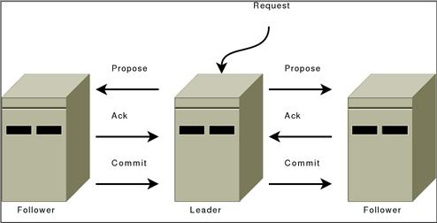
How write request is processed
When a write request arrives, if it’s on a follower, the followerr will send the request to the leader.
Leader first write change to transaction log, then propose to all followers.
On receiving the request, followers first write change to transaction log, then response ack to the leader.
when leader receives ack for proposal from a quorum (more than half nodes including itself), it commit the change(apply to memory data structure).
Now zookeeper response to client and notifies all followers to commit.
Server will also take snapshot and start new log.

Slide 9
How write request is processed continued
Corner cases (say we have 3 nodes):
When Leader gets 2 acks and then it crashes, what will be the result?
2 ack means more than half of the nodes has written change to their log, then the change will persist.
A quorum ack is equivalent to commit for a change

Slide 10
How write request is processed continued
Corner cases (say we have 3 nodes):
Leader proposes but before a quorum ack arrive, leader crashes, what will be the result?
It depends:
if quorum of nodes has written change to log, then the change will persist.
If less than a quorum has persist the change to log, it depends again:
If election quorum includes a node with new change persisted, the change will persist
Else the change will not persist

Slide 11
How read request is processed
Receive request -> access data ->response
Followers can serve read request using its own copy of data. Scalable, high read throughput.
Use in-memory data to serve read request, low latency.
Followers can lag behind.
If it's a strong read (synchronous read that guarantees the most recent data), the follower might forward the request to the leader.
User need to use clients/bindings provided by zookeeper to be correct. why? see following slides

Slide 12
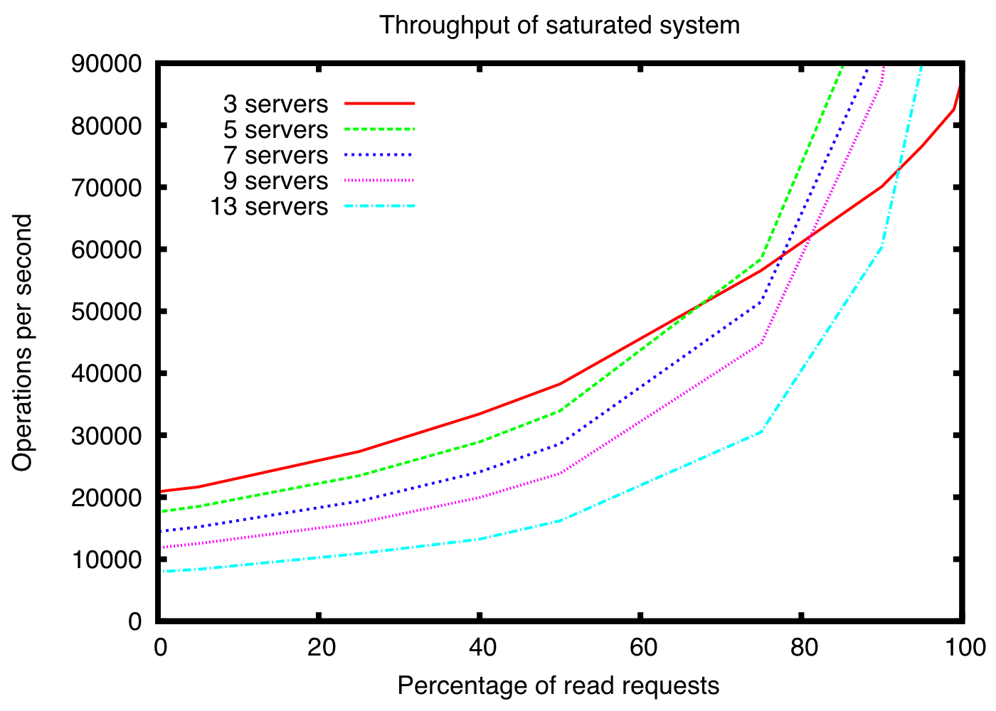
Performance Numbers. (very old chart)

Slide 13
Guarantees (all about maitaining order)
Clients will never detect old data.
All requests from a client will be processed in order.
All results received by a client will be consistent with results received by all other clients.

