Slide 1
Final Project Recommended Inputs
Andrew Imredy

Slide 2
My Best Model
A 12 DoF spline linear model using x1, z, x2, and w, in that order of importance
Adjusted R-squared of .90
RMSE of .727
Other high performers included a spline model on x1, z, and x2, as well as XGBoost and Random Forest on the base inputs

Slide 3
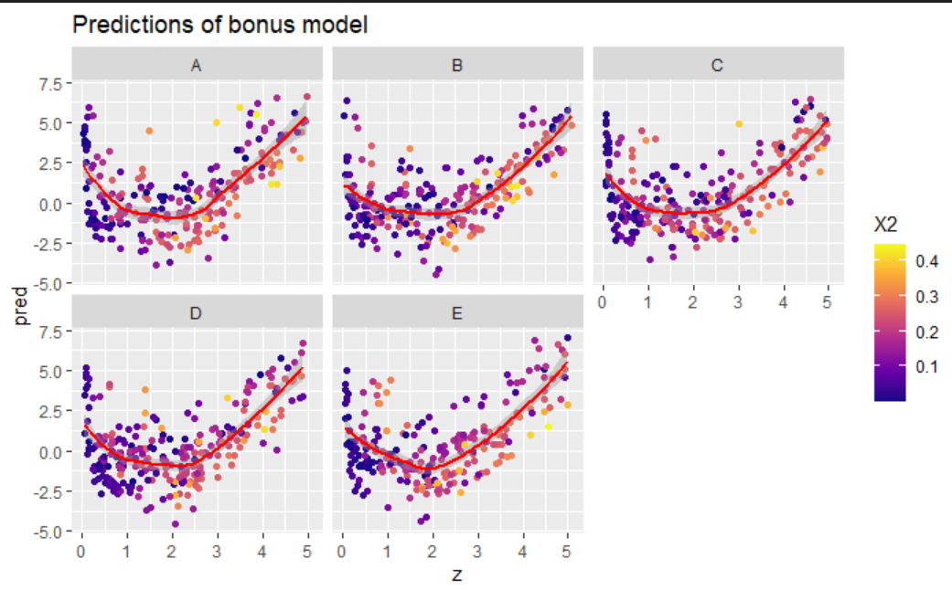
Graphs

Slide 4
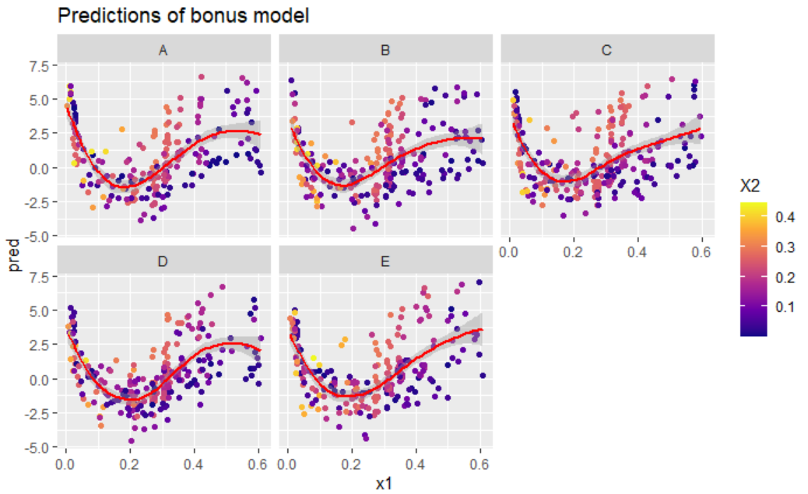
More Graphs

Slide 5
Conclusions
Machine type made no difference in best results, perhaps a little difference in the value of “best” inputs
Z was by far the most important derived feature, x1 was the most important base feature
Recommended inputs:
X1 = .17 - .2
Z = 1.9 – 2.1
W: less significant, bimodal. Recommend around .25 or .7
Thanks! I quite enjoyed the project!

