Slide 1

CSS Layers
Andrew Barbour

Slide 2
Cascade Layers
Major change to the CSS Cascade introduced in 2022 now supported in all browsers
Intended to provide direct control over the CSS cascade to solve common cascade problems at scale
Harnesses the power of the cascade rather than sidestepping it with atomic CSS, selector specificity, BEM, or CSS modules
Separate selecting elements from the prioritizing rule sets

Slide 3
Layer Features
Any style declaration can be in a layer block except for namespaces and charsets
Ordered from lowest to highest priority based on declaration order. Redeclaring an existing layer has no effect.
Higher priority layers always beat selector specificity. All styles in a higher priority layer take priority over those in a lower layer.
Unlayered styles take priority over any layers
Can import stylesheets directly into layers
Layers can have sublayers accessed with dot notation (often useful for importing and overriding library styles)
Best practice to declare all layers at the top of the file
Notes:
Layers only must be uniquely named at the same nesting level (e.g., sublayers can have the same name if they belong to different layers)
Can add styles into existing layers
Anonymous layers also supported

Slide 4
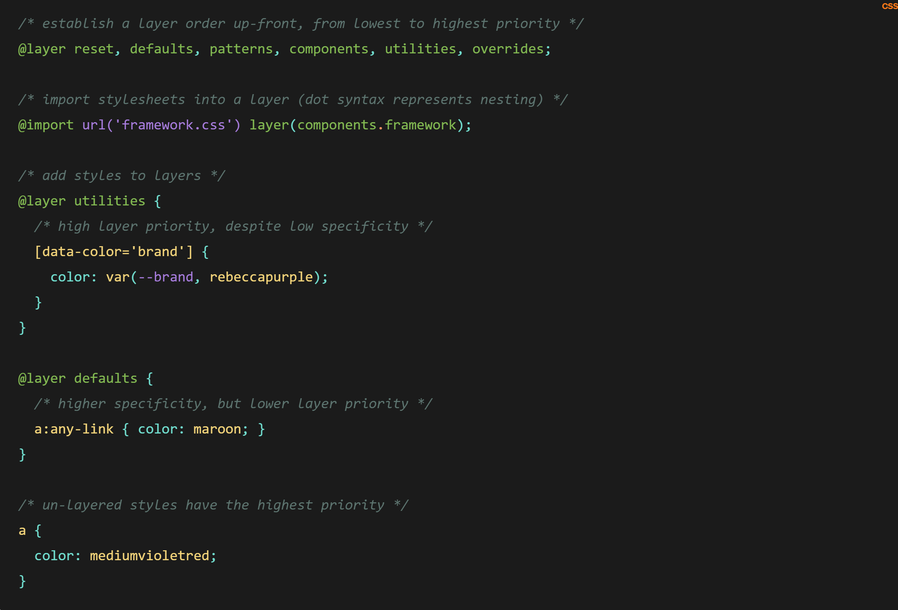
Syntax

Slide 5
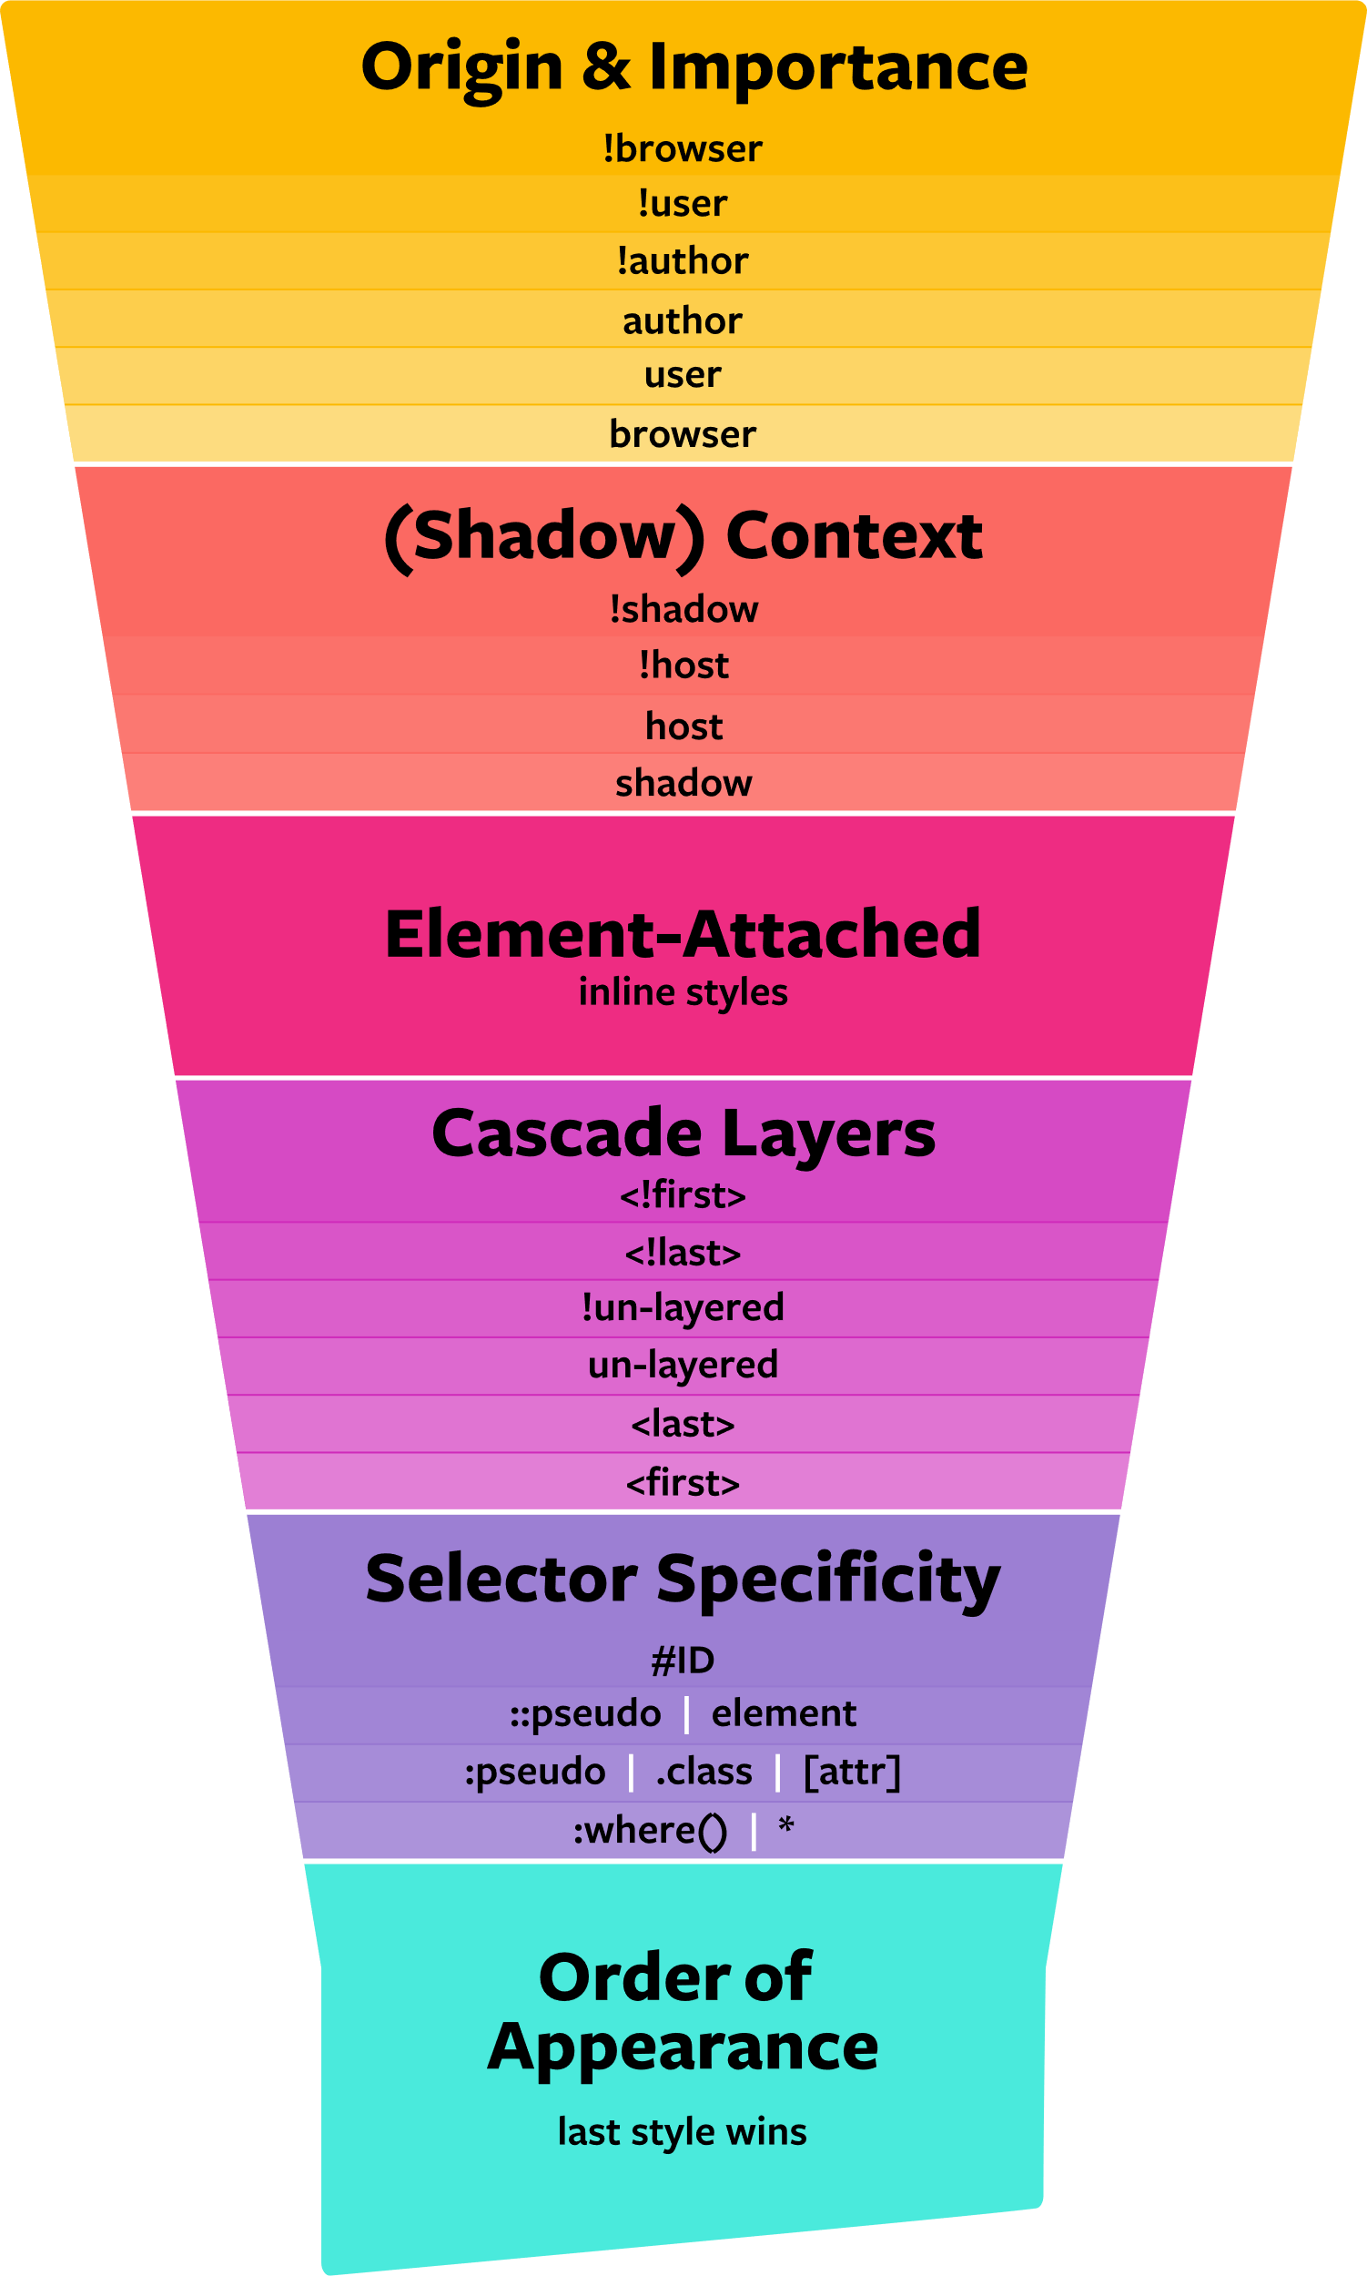
The Cascade
The evaluation order for resolving style conflicts
https://css-tricks.com/css-cascade-layers

Slide 6
Layers and Importance
!Important often viewed as an escape hatch for overriding styles or highly specific selectors to be used sparingly
Importance in fact the highest priority layer of the cascade most useful for resolving style conflicts between author and user styles
Rather than increasing priority like as used with selectors, layer importance inverts the layer priority order
Cascade Step | !important
Cascade Layers | Inverts priority
Origin (user, browser, author) | Inverts priority
Selector specificity | Maximizes priority

Slide 7
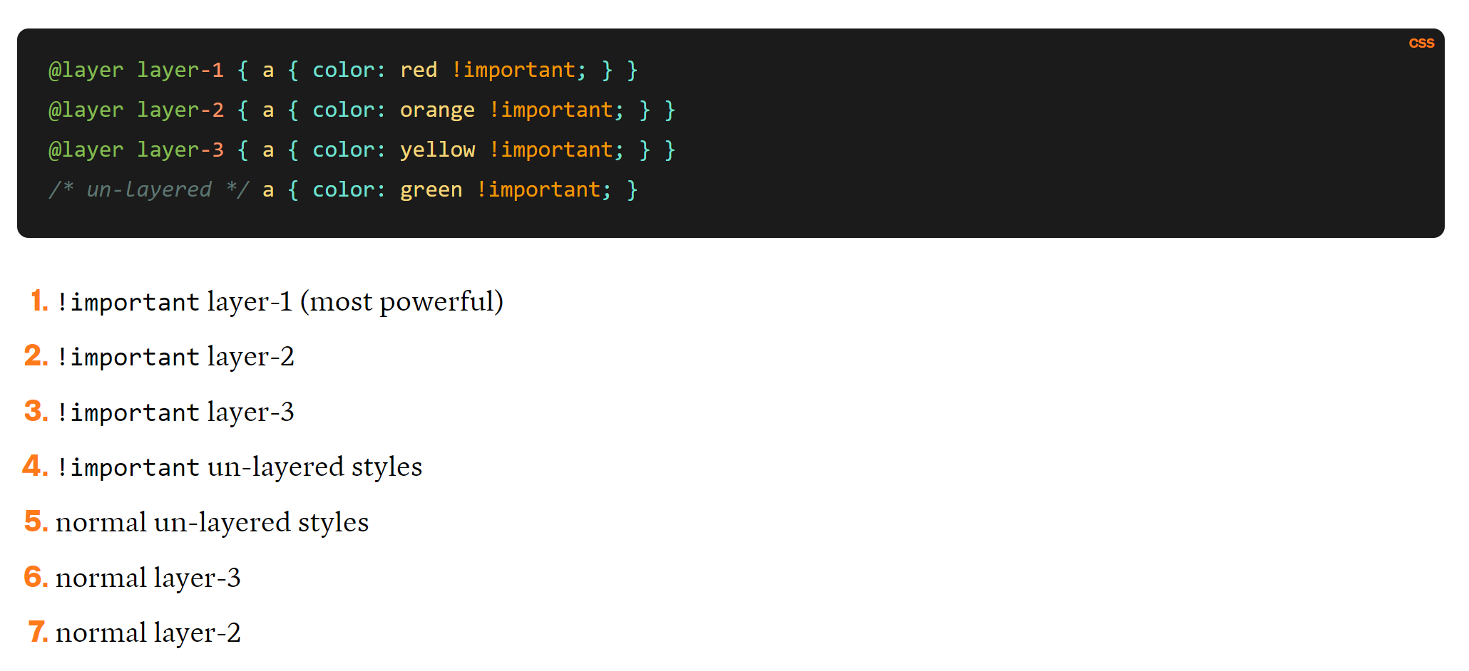
Importance

Slide 8
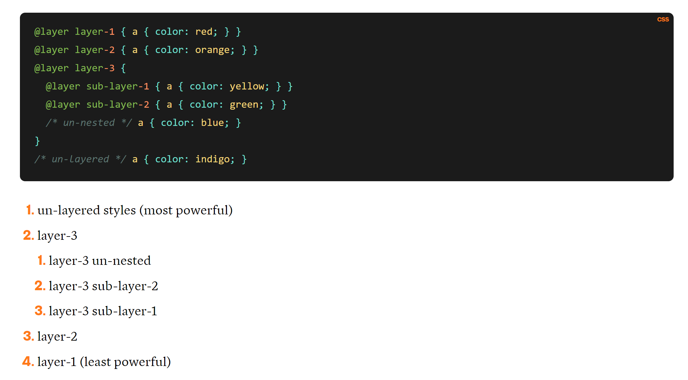
Sublayers

Slide 9
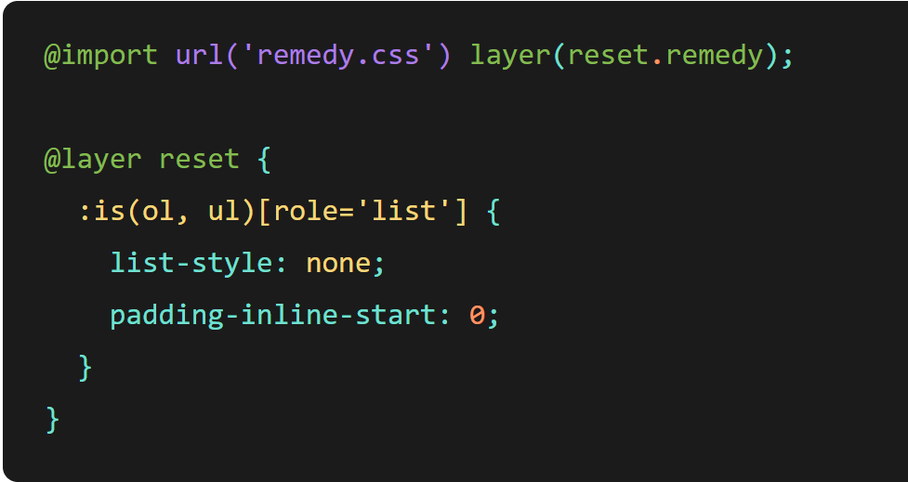
Use Cases
Slotting style frameworks and libraries into a readily overridden sublayer
Creating a CSS library with APIs publicly exposed as layers to allow users to hook into layers to customize or override library styles

Slide 10
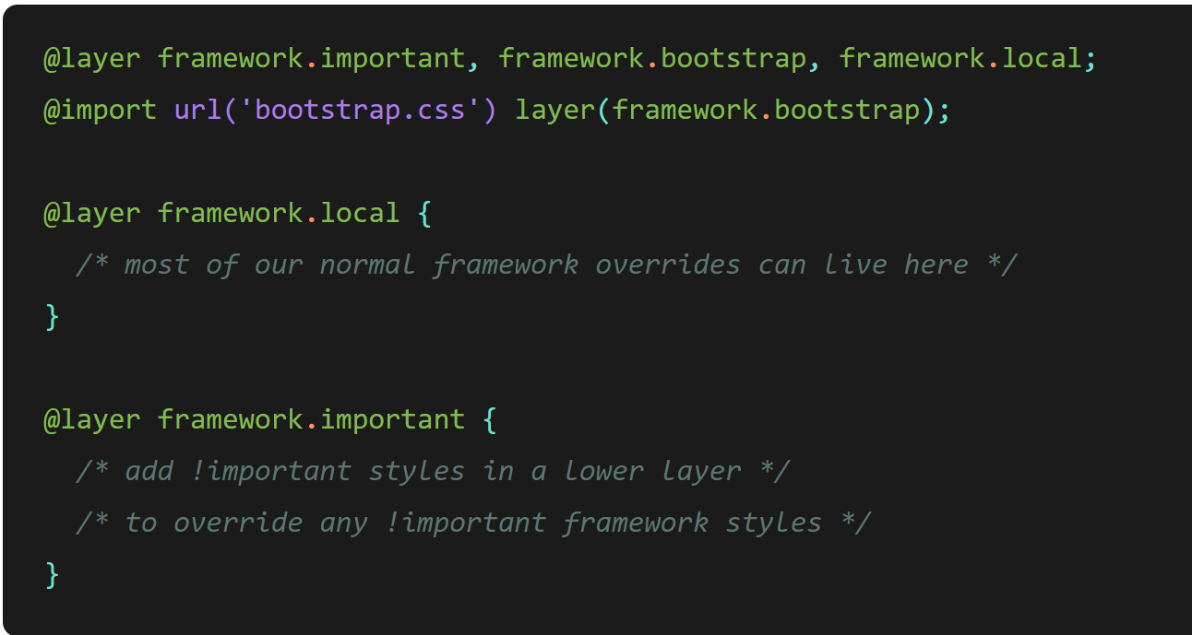
Use Cases
Managing cascade priority with third party libraries
Layers not for escalating specificity, scoping, or namespacing

Slide 11
References
https://developer.mozilla.org/en-US/docs/Learn/CSS/Building_blocks/Cascade_layers
https://developer.mozilla.org/en-US/docs/Web/CSS/@layer
https://css-tricks.com/css-cascade-layers/
https://www.bram.us/2021/09/15/the-future-of-css-cascade-layers-css-at-layer/

