Slide 1
IMWEBs Online Interface Design
By Shawn
July 08, 2019

Slide 2
IMWEBs Online Tool Interface Layout (1) User login & project management
Back ground image or video
User login
or
Project management panel

Slide 3

User login panel design
Sign in to IMWEBs
Email address
Password
Sign in
Forget password or register?
Contact admin
Notes:
getUserGroup()
Input
String emailAddress
String pw # digested using SHA-384
return int groupID # 201 admin, 202 watershed coordinator, 203 producer, 400 invalid email or password, 401 email found but password not matching, 402 email not found

Slide 4
Project management panel
One user, multiple watershed? How a watershed could be registered?
Suggest to move this panel to the left panel as shown in next slide.
New project ^{(?)}
Start from scratch
Registered watershed list
Start ^{(?)}
Saved project ^{(?)}
Date | Name | Mode
2019-07-05 | Modeste budget 1 | Budget
2019-06-21 | Test eco 2 | Ecosystem
2019-06-20 | Indianfarm budget 1 | Budget
2019-05-15 | Broughton budget | Budget
2018-02-11 | Gully eco | Ecosystem
…
Click to
sort by column
Visible when there are saved projects
Load setting ^{(?)}
Load result ^{(?)}
Enable when there is project selected in the list
Warning before deletion
Delete project ^{(?)}
Notes:
getWatershedList()
input
String emailAddress
return List<String>;

Slide 5
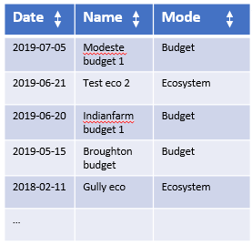
IMWEBs Online Tool Interface Layout (2) Main app
Header panel
 | Map shows all watersheds assigned to the user; Zoom to the watershed on map if one existing project is selected. The watershed is color coded with different color with some rules. | Optimization configuration or result panel
 | Trade-off curve result panel (visible when increment mode is selected)
Create New

Slide 6
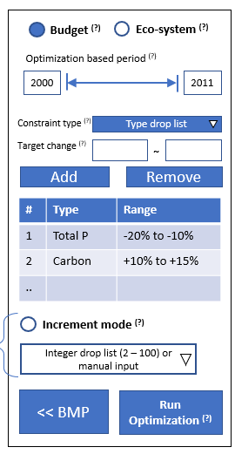
IMWEBs Online Tool Interface Layout (2) Main app
Header panel
 | Map interaction panel | Optimization configuration or result panel
Watershed Name
Show all supported BMP types in a tree. Select on type to show all fields of that type on map and in the table
BMP Type 1
BMP Type 1
BMP Type 1
Table to show all selected fields or just use map

Slide 7
IMWEBs Online Tool Interface Layout (2) Main app
Header panel
 | Map interaction panel | Optimization configuration or result panel
BMPs
Show all supported BMP types in a tree. Select on type to show all fields of that type on map and in the table
BMP Type 1
BMP Type 1
BMP Type 1
Results
Table to show all selected fields or just use map

Slide 8
IMWEBs Online Tool Interface Layout (2) Main app
Header panel
 | Map interaction panel | Optimization configuration or result panel
BMPs
BMP Type 1
BMP Type 1
BMP Type 1
Results
Results tables, Chart in different tabs

Slide 9





Header panel design (not visible in phase 1)
Help
email (user group)
CORPORATION
Search BMP definition, docs, and help
shawn-uoguelph@email.ca (admin)
UNIVERSITY OF GUELPH
Setting
Feedback

Slide 10


Map interaction panel design
Base map
Map | Satellite
Highlight selected BMP location
Layer on/off?
Location could only be field?
N
+
−
zoom to watershed

Slide 11
Optimization configuration panel design
Change to update list and map
BMP drop list
Budget ^{(?)}
Eco-system ^{(?)}
Click to
sort by selected
Select | ID
 | 1
 | 2
 | 3
 | 4
 | 5
 | 6
 | …
Optimization based period ^{(?)}
Click to
sort by ID
2000
2011
Constraint type ^{(?)}
Type drop list
Target change ^{(?)}
~
Add
Remove
# | Type | Range
1 | Total P | -20% to -10%
2 | Carbon | +10% to +15%
..
Select all
Clear
Enable only for single constraint
Increment mode ^{(?)}
Reset all BMP ^{(?)}
Integer drop list (2 – 100) or manual input
<< BMP
Run Optimization ^{(?)}
Optimization config ^{(?)} >>
Notes:
BMP setup panel
getWatershedID()
input
String watershedName
return int watershedID;
getBMPList()
input
int watershedID
return List<String>;
getBMPIDList()
input
int watershedID,
String BMPName
return List<Integer>;
Opt config panel
getOptStartYear()
input
int watershedID
return int;
getOptEndYear()
input
int watershedID
return int;
getConstraintTypeList()
input
int watershedID
return List<String>;
getConstraintRange()
input
int watershedID,
String constraintType,
Map<String, List<Integer>> selectedBMPList,
int returnUnit # 0 as fraction like -0.15, 1 as absolute value, default 0
return float[size 2] # float[0] for lower range, float[1] for upper range
runOptimization()
input
int watershedID,
String modeType,
int startYear,
int endYear,
Map<String, List<Integer>> selectedBMPList,
Map<String, Float[3]> constraintSetup, # float[0] is unit type e.g., 0 for fraction and 1 for absolute value, float[1] for lower range, float[2] for upper range.
int incrementNum #1 for multiple constraint, 1 or more for single constraint
return Map<Integer, OptResult>
OptResult contains
(ResultRecord) WatershedResult
Map<String, Float[size 2]> benefits<type, float[0] as fraction change, float [1] as absolute change>;
Float cost
Map<String, Map<Integer, ResultRecord>> BMPResult

Slide 12
Optimization result panel design
Watershed results ^{(?)}
How benefit is defined?
# | Type | Result ^{(?)}
1 | Total P | -3,200 (-17%)
2 | Carbon | +300 (+12% )
3 | Cost | $24,535
..
Step 1: select benefit to update BMP benefit column
Benefit drop list
Step 2: select BMP type
Update map layer
Prioritized BMP list
ID | Benefit | Cost
1
2
3
4
5
…
Click to
sort by column
Move over to highlight BMP in table and on map
Right click menu
Pan to location
Zoom to location
Popup to ask for project name
Save to server database
Warning if not saved yet
Save ^{(?)}
Start over ^{(?)}

Slide 13
Trade-off curve panel (visible when increment mode is selected)
Click node to switch optimization iteration
Update result panel
Empty map selection

