Slide 1
Ecosystem Services Assessment Tool (ESAT) Interface Design – revision 2
By Shawn
July 21, 2019

Slide 2
User Login & Project Management design

Slide 3

ESAT Layout (1) User login
Back ground image or video
Webpage
ESAT logo
Logo needs to be designed
Sign in to ESAT
Email address
Password
Sign in
Forget password or register?
Contact admin
Notes:
Updates in revision 2:
Logo needs to be designed

Slide 4
Back ground image or video
Webpage
New project ^{(?)}
Registered watershed list
This option is only available for watershed manager. Farmer users don’t see (farmer’s default baseline is existing condition)
Exploration ^{(?)}
Optimization ^{(?)}
Start from scratch
Baseline ^{(?)}
Baseline drop list
Start ^{(?)}
ESAT Layout (1) Project management
Saved project ^{(?)}
Date | Name | Mode
2019-07-05 | Modeste exploration 1 | Exploration
2019-06-21 | Test eco 2 | Optimization - budget
2019-06-20 | Indianfarm budget 1 | Optimization - budget
2019-05-15 | Broughton budget | Optimization - budget
2018-02-11 | Gully eco | Optimization - ecosystem
…
Click to
sort by column
Visible when there are saved projects
Click to see the chart view of different projects
Open project ^{(?)}
Map projects ^{(?)}
Enable when there is project selected in the list
Warning before deletion
Delete project ^{(?)}
Notes:
Updates in revision 2:
Add Exploration option
Add baseline selection option
Keep project management in this panel

Slide 5

ESAT Layout (1) Project management – projects chart view
Use different color to show exploration project (e.g. green) or optimization project (e.g. blue)
Click on bar to select project
Watershed drop list
Baseline drop list
Effect drop list (E.g. TP off-site)
X value is effect, Y value is cost
Drop list can show different effect and update chart
Change watershed to show all projects that are based on the same watershed and baseline
Change effect to change X value
Notes:
Updates in revision 2:
Project chart view is new in revision 2
This chart put all projects that are based on same watershed and baseline

Slide 6
Exploration Mode design

Slide 7





Header panel design for layout (2) and (3)
Help (disable)
email (user group)
CORPORATION
Search BMP definition, docs, and help
shawn-uoguelph@email.ca (admin)
UNIVERSITY OF GUELPH
Search bar (disable)
Setting (disable)
Feedback (disable)
Notes:
Updates in revision 2:
header panel visible but disabled

Slide 8


ESAT Layout (2) Exploration mode – watershed or farm info
Webpage
 | Base map
BMP summary table summarize existing BMPs in this baseline scenario. If no BMP exists, this table is empty
Watershed or farmer Name
Map | Satellite
Existing BMP summary^{(?)}
Item | Value
Cover crop area (ha) | 132
Wetland area (ha) | 15
…
Watershed or farm info
All registered field map are used to show field scale info
BMP Type 1
BMP Type 2
BMP Type 3
N
Hide or unhide BMP panel
Outlet or Farm summary^{(?)}
Outlet (for manager) or Farm (for farmer) summary table summarizes watershed outlet results or average field results in all fields for farmer.
+
−
Item | Value
Total P (kg/yr) | -3,521
Carbon (ton/yr) | 151
Flood mitigation
Soil water
…
Hide or unhide summary panel
ID | Elevation (m) | Slope (%) | Land use | Soil texture | Runoff (mm/yr) | Runoff std (mm/yr) | TSS (ton/yr) | TSS std (ton/yr) | …
1
2
3
…
Save ^{(?)}
Save as ^{(?)}
Export ^{(?)}
Report ^{(?)}
Warning if not saved yet
Right click on attribute column support “Color code map with this attribute” option. This option will change fill color of each field
Start over ^{(?)}
Notes:
Updates in revision 2:
Exploration mode is new in this revision
Exploration mode is similar to what-if scenario analysis, but add sorted effects for BMP selection
Watershed or farm info tab will show field scale basic info, e.g. average elevation, slope, land use, soil, and annual average and standard deviation runoff, sediment, nutrients etc.

Slide 9
ESAT Layout (2) Exploration mode – Individual BMP table selection
Webpage
Summary table auto-update when BMPs selected from map , table or chart are updated
 | Base map
Watershed or farmer Name
Map | Satellite
BMP summary^{(?)}
Item | Value
Cover crop area (ha) | 132
Wetland area (ha) | 15
…
Total cost ($/yr) | 3,840
Watershed info
Highlight selected BMP location
BMP Type 1
BMP Type 2
Cost always at the bottom
BMP Type 3
N
Effectiveness summary^{(?)}
+
−
Effectiveness | Value
Total P (kg/yr) | -3,521
Carbon (ton/yr) | 151
Flood mitigation
Soil water
…
click zoom to watershed
Right click on map, chart or table to SELECT ALL or CLEAR
Select | ID | Effect – 1 | Effect – 2 | Effect – 3 | Cost | …
 | 1
 | 2
 | 3
 | …
Save ^{(?)}
Save as ^{(?)}
Export ^{(?)}
Report ^{(?)}
Warning if not saved yet
If there are existing BMPs in the baseline condition, use different color to indicate in the map and chart (unable to select)
Right click on effectiveness column support “Color code map with this effectiveness” option. This option will change color in the map
Right click on table or chart to switch between table view and sorted chart
Start over ^{(?)}
Notes:
Updates in revision 2:
Exploration mode is new in this revision
Exploration mode is similar to what-if scenario analysis, but add sorted effects for BMP selection
No model run is needed so watershed level summary is real-time update (right panel). Summary include both BMP summary and effectiveness summary.

Slide 10
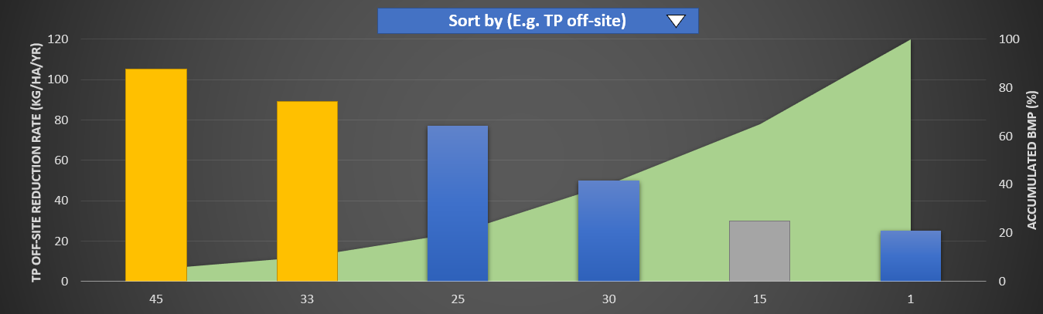
ESAT Layout (2) Exploration mode – Individual BMP sorted chart selection
Webpage
Header panel
 | Base map
BMP summary^{(?)}
Watershed or farmer Name
Map | Satellite
Item | Value
Cover crop area (ha) | 132
Wetland area (ha) | 15
…
Total cost ($/yr) | 3,840
Watershed info
BMP Type 1
BMP Type 2
Table, chart and map are connected. Move over map will highlight table or chart record and vice verse
BMP Type 3
N
Effectiveness summary^{(?)}
+
−
Effectiveness | Value
Total P (kg/yr) | -3,521
Carbon (ton/yr) | 151
Flood mitigation
Soil water
…
Save ^{(?)}
Save as ^{(?)}
Export ^{(?)}
Report ^{(?)}
Right click to switch between sorted chart and table view
Start over ^{(?)}
Notes:
Updates in revision 2:
Sorted selection is designed for each individual BMP
See next slide for more detail on sorted selection

Slide 11
ESAT Layout (2) Exploration mode – Sorted chart
Change the sort item to update the effect and accumulated curve.
Click on each bar to select BMP. Use different color to show selected (e.g. yellow), existing (e.g. gray), and unselected (e.g. blue) BMP locations
Sort by (E.g. TP off-site)
X value is BMP location ID
Y left value is sorted item
Y right value is percentage of accumulated BMP area or count compare to available BMP area or count in this type
Notes:
Updates in revision 2:
User can select high ranked BMP based on different sorting item, e.g. sorted by TP off-site reduction rate (kg/ha/yr)
Bar indicates individual sorted BMP effectiveness from left to right (high to low)
Line (or area) indicates accumulated BMP area or count in percentage to total available area or count in this BMP type.

Slide 12
Optimization Mode design

Slide 13
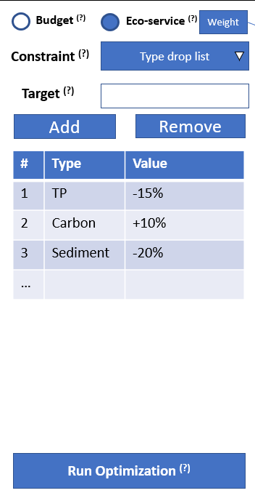
ESAT Layout (3) Optimization mode (manager only) – Setting table select
Webpage
 | Base map
Watershed Name
Map | Satellite
BMP Type 1
Highlight selected BMP location
BMP Type 2
BMP Type 3
N
+
−
Right click on map or table to SELECT ALL or CLEAR
Select | ID | Effect – 1 | Effect – 2 | Effect – 3 | Cost | …
 | 1
 | 2
 | 3
 | …
If there are existing BMPs in the baseline condition, use different color to indicate in the map and chart (unable to select)
Right click on table or chart to switch between table view and sorted chart
Notes:
Updates in revision 2:
Add BMP switch panel to the left
Move BMP selection table to the bottom panel
Add hide and unhide BMP panel and setup panel
Add sort chart selection

Slide 14
ESAT Layout (3) Optimization mode – Setting chart select
Webpage
 | Base map
Watershed Name
Map | Satellite
BMP Type 1
Highlight selected BMP location
BMP Type 2
BMP Type 3
N
+
−
Right click on map or table to SELECT ALL or CLEAR
Right click on table or chart to switch between table view and sorted chart
Notes:
Updates in revision 2:
This is chart BMP selection

Slide 15
Optimization setting panel design
Step 1: select optimization mode and define weights (ES only). Then enable available BMPs on map, and enable constrain setup
Popup
X
Eco-service | Weight ^{(?)}
TP off-site | 30
Carbon | 20
Flood mitigation | 10
… | …
Budget ^{(?)}
Eco-service ^{(?)}
Weight
Budget ^{(?)}
Eco-service ^{(?)}
Weight
Constraint ^{(?)}
Budget
Constraint ^{(?)}
Type drop list
Must add up to 100
Target ^{(?)}
Target ^{(?)}
Step 2 & 3: Select potential BMPs on map or BMP selection table (default all potential BMPs are selected). When BMP selection change, check if user set range is still valid. If not valid, warn user.
Add
Remove
Add
Remove
# | Type | Value
1 | Budget | $ 20,000
# | Type | Value
1 | TP | -15%
2 | Carbon | +10%
3 | Sediment | -20%
…
Step 2 & 3: setup constraint.
Select constraint type
Input lower (left) and upper range (right)
Use Add button to add to list
Select from list and use Remove button to remove.
Step 4: Click Run optimization button to run
Run Optimization ^{(?)}
Run Optimization ^{(?)}
Budget Mode
Eco-service Mode
Notes:
Updates in revision 2:
Remove optimization period. Always based on full optimization period.
Remove Increment Mode
Add weights for ES mode (all weights must add up to 100)
Budget Mode only have budget as constraint
ES model can select constraint type and multiple constraints.

Slide 16
ESAT Layout (3) Optimization mode – Result (scenario selected)
Popup
X
Item | Value
Total P (kg/yr) | -3,521
Carbon (ton/yr) | 151
Cost ($/yr) | 3,840
when BMP is shown in the map, click on BMP can popup a table to show BMP’s effectiveness and cost
Webpage
 | Base map
Map | Satellite
<< Back to setting
Prioritized BMPs
Only show suggested BMP
Save ^{(?)}
Save as ^{(?)}
BMP Type 1
Export ^{(?)}
BMP Type 2
N
BMP Type 3
If multiple BMP suggested in same field, use ‘M’ or other symbol
M
+
−
After select a scenario, map will be updated to show what BMP has been suggested in that scenario
Effect-1 | Effect-2 | Effect-3 | Effect-4 | Cost | …
Start over ^{(?)}
Selected scenario is highlighted in the table or chart
Notes:
Updates in revision 2:
Removed multiple suggested scenarios (increment mode), only one scenario is recommended called “Prioritized BMPs”
Add popup when user click on single BMP location and show cost and effectiveness
Indicate how BMP map will be displayed

Slide 17
ESAT Layout (3) Optimization mode – Result (BMP selected)
Webpage
 | Base map
Map | Satellite
<< Back to setting
Prioritized BMPs
Only show suggested BMP in the selected type
Save ^{(?)}
Save as ^{(?)}
BMP Type 1
Export ^{(?)}
BMP Type 2
N
BMP Type 3
Table and map are connected. Move over map will highlight table record and vice verse
+
−
If BMP is selected, map will only show suggest BMP in that type.
ID | Effect-1 | Effect-2 | Effect-3 | Effect-4 | Cost | …
1
3
4
…
Right click on effectiveness column support “Color code map with this effectiveness” option. This option will change color in the map
Start over ^{(?)}
Table will be updated to show effectiveness and cost of all suggested BMPs locations in selected BMP type
Notes:
Updates in revision 2:
Add “color code map” based on effectiveness
Indicate how table and map will be updated
Map and table are connected.

