Slide 1
SNAIL Photostim Project Update 8/20/24
Andrew Jeon

Slide 2
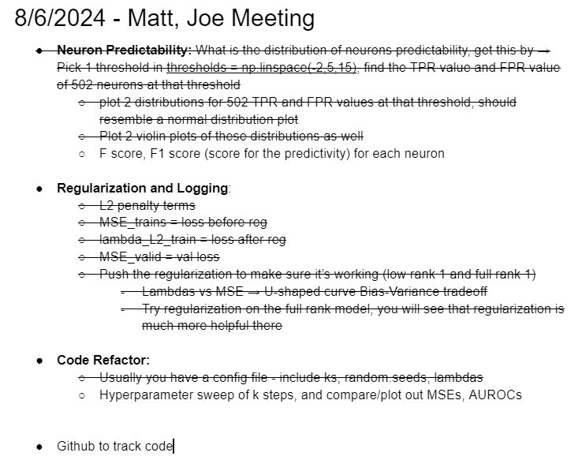

Slide 3
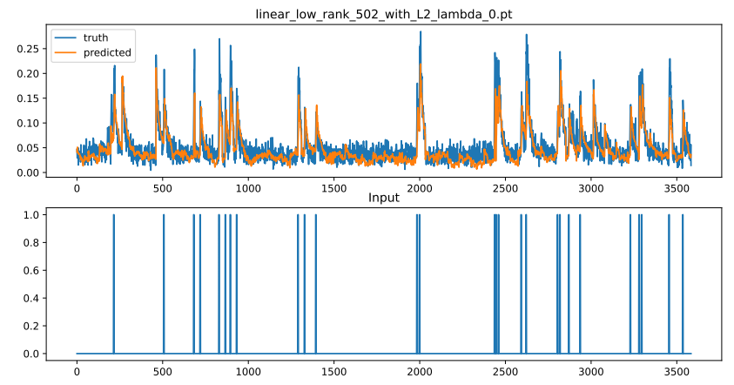
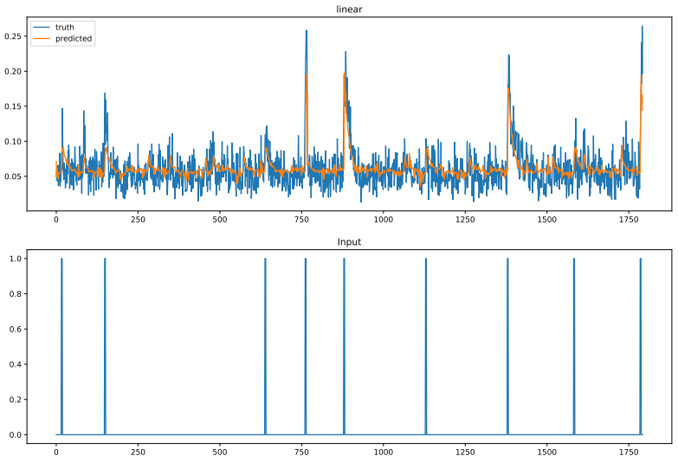
Closed-Form vs Full Rank
Full Rank lambda 0 MSE: 0.000322
Closed-Form MSE: 0.000220

Slide 4
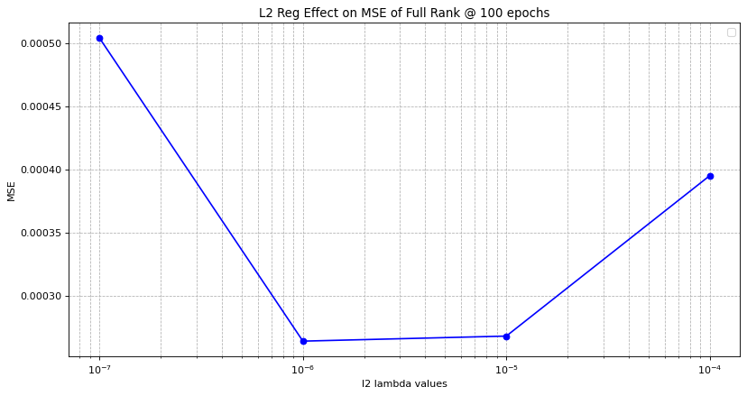
Full Rank Bias-Variance U Curve
Closed-Form MSE: 0.000220
Full Rank lambda 0 MSE: 0.000322
Full Rank lambda 1e-7 MSE: 0.000504
Full Rank lambda 1e-6 MSE: 0.000264
Full Rank lambda 1e-5 MSE: 0.000268
Full Rank lambda 1e-4 MSE: 0.000395
Full Rank lambda 1e-3 MSE: 49646.786335

Slide 6
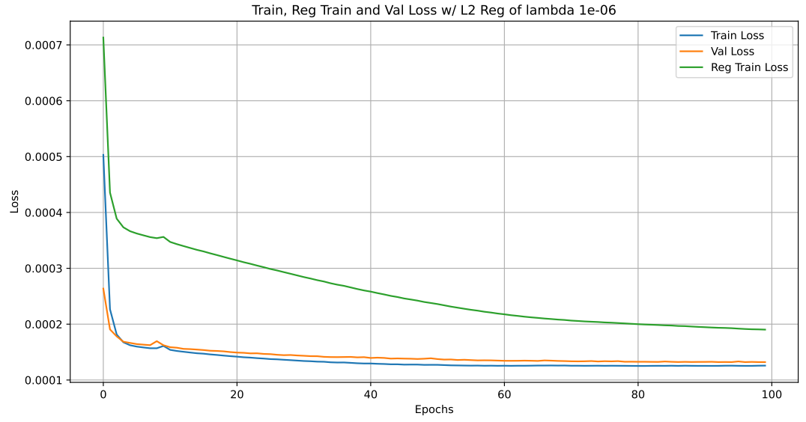

Slide 7
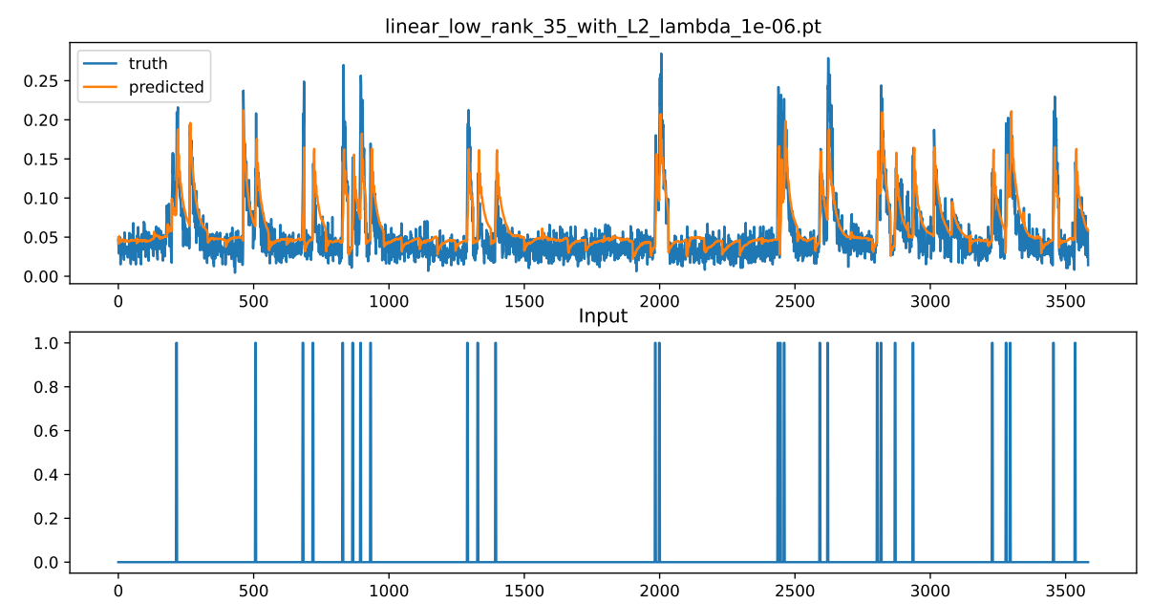
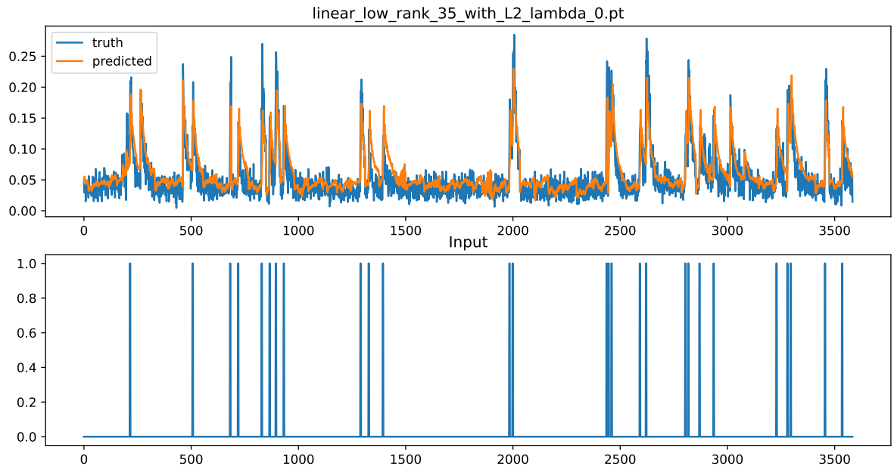

Slide 8
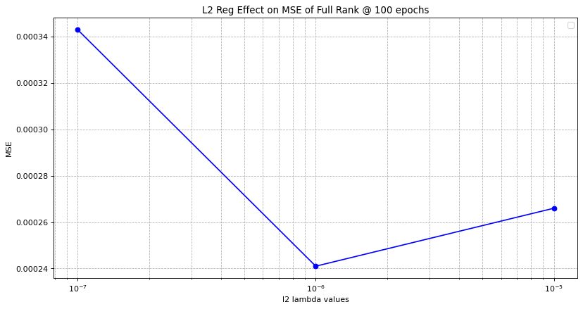
Low Rank 35 Bias-Variance U Curve
Closed-Form MSE: 0.000220
Full Rank lambda 0 MSE: 0.000322
Full Rank lambda 1e-7 MSE: 0.000504
Full Rank lambda 1e-6 MSE: 0.000264
Full Rank lambda 1e-5 MSE: 0.000268
Full Rank lambda 1e-4 MSE: 0.000395
Low Rank 35 lambda 0 MSE: 0.000552
Low Rank 35 lambda 1e-7 MSE: 0.000343
Low Rank 35 lambda 1e-6 MSE: 0.000241
Low Rank 35 lambda 1e-5 MSE: 0.000266
Low Rank 35 lambda 1e-4 MSE: 316036.828274
Low Rank 35 lambda 1e-3 MSE: 268641.949597

Slide 9
Closed-Form MSE: 0.000220
Full Rank lambda 0 MSE: 0.000322
Full Rank lambda 1e-7 MSE: 0.000504
Full Rank lambda 1e-6 MSE: 0.000264
Full Rank lambda 1e-5 MSE: 0.000268
Full Rank lambda 1e-4 MSE: 0.000395
Low Rank 35 lambda 0 MSE: 0.000552
Low Rank 35 lambda 1e-7 MSE: 0.000343
Low Rank 35 lambda 1e-6 MSE: 0.000241
Low Rank 35 lambda 1e-5 MSE: 0.000266

Slide 10
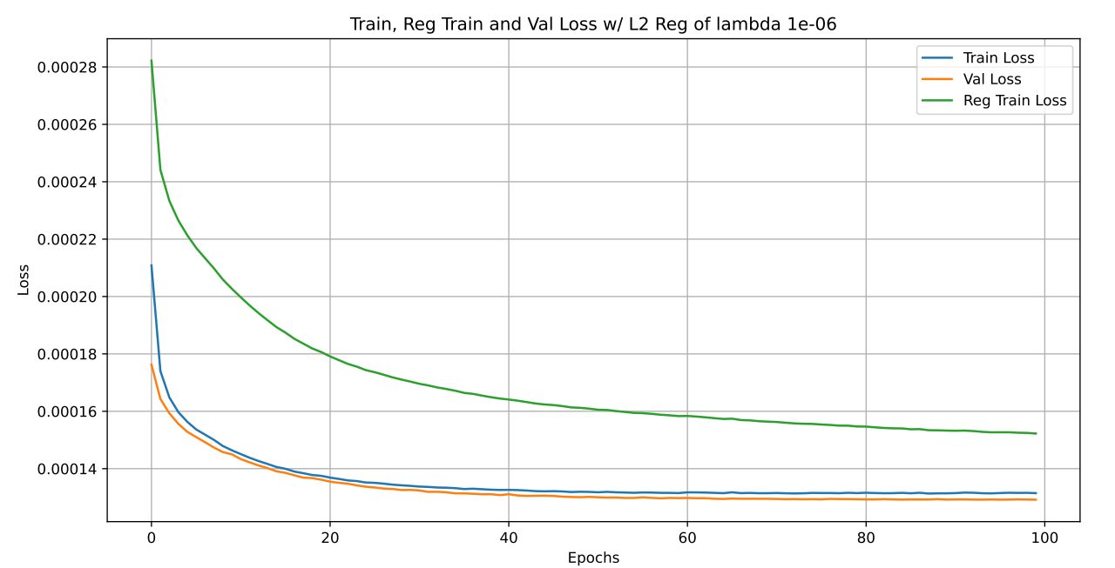
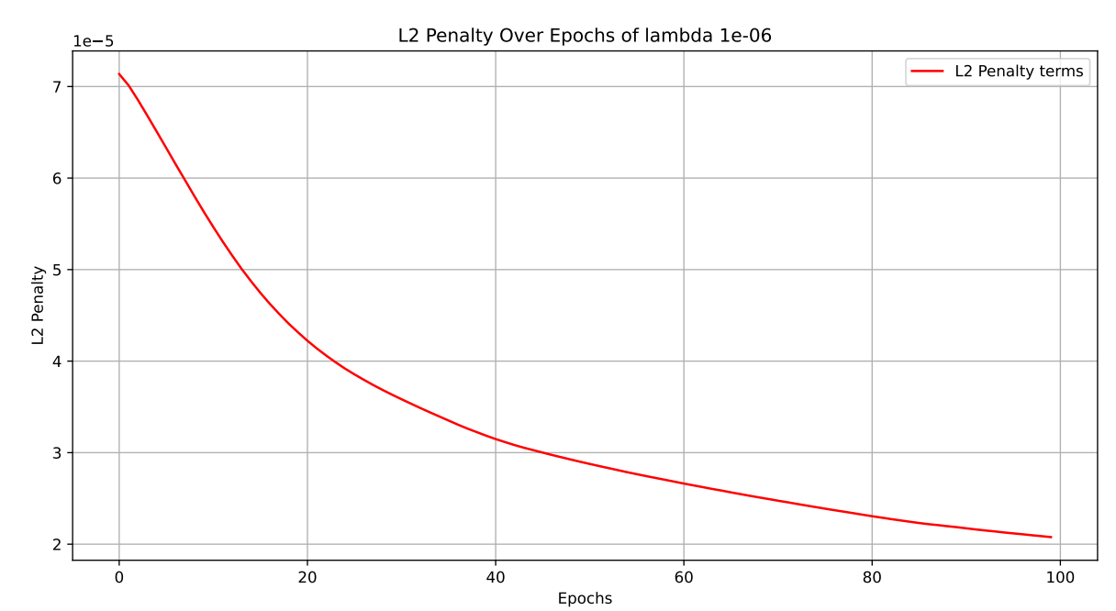

Slide 11
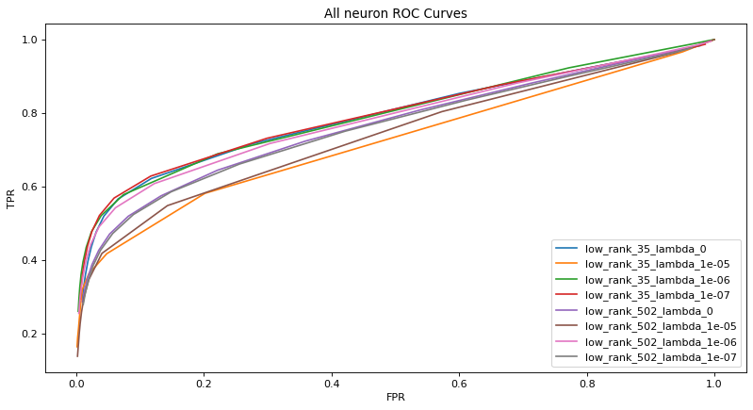
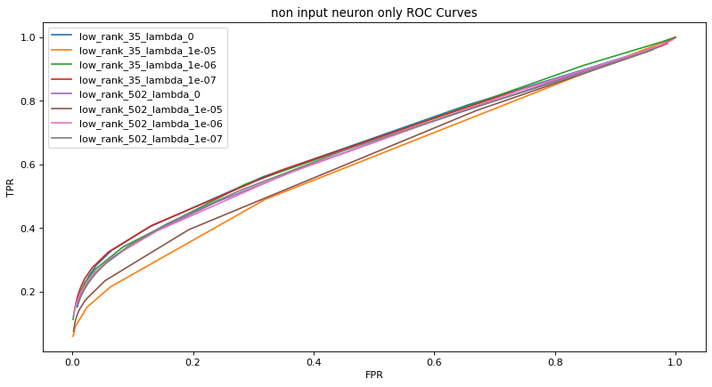
TPR/FPR Full Rank vs Low Rank

Slide 12
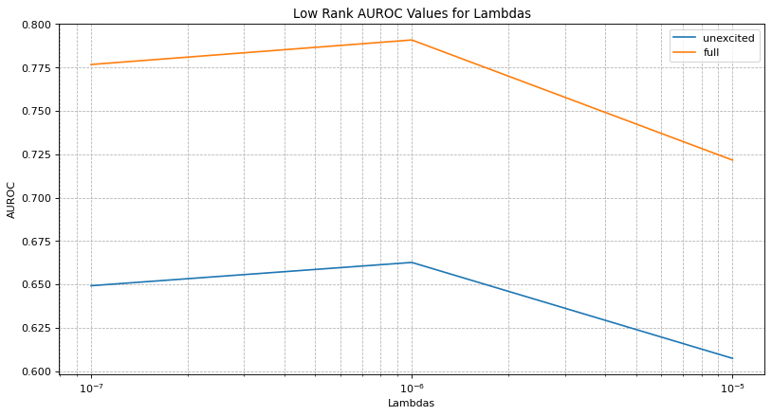
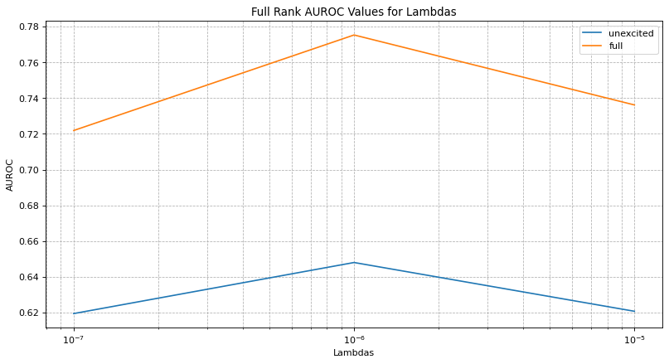
AUROC for Full Rank and Low Rank
Lambdas = 0, 1e-5, 1e-6, 1e-7
AUROC low rank 35 = 0.765, 0.722, 0.791, 0.777 AUROC full rank = 0.717, 0.736, 0.775, 0.722
AUROC_noninput low rank 35 = 0.644, 0.607, 0.663, 0.649
AUROC_noninput full rank = 0.611, 0.621, 0.648, 0.619

Slide 13
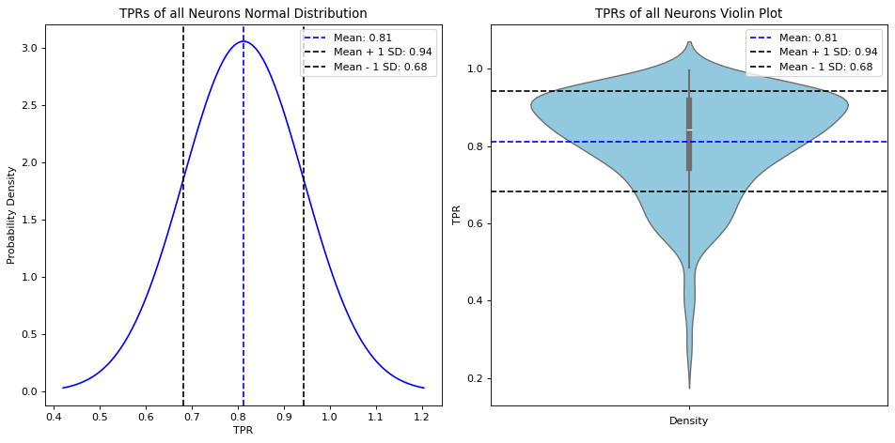
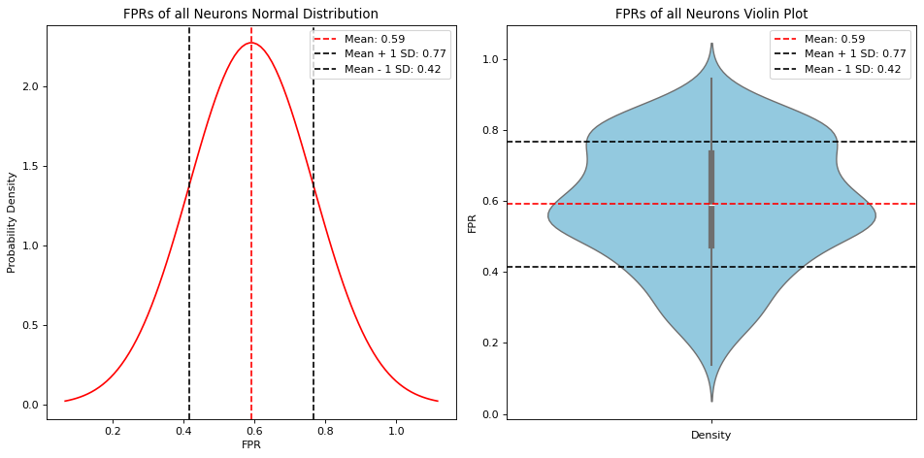
Neuron Sensitivity

Slide 14
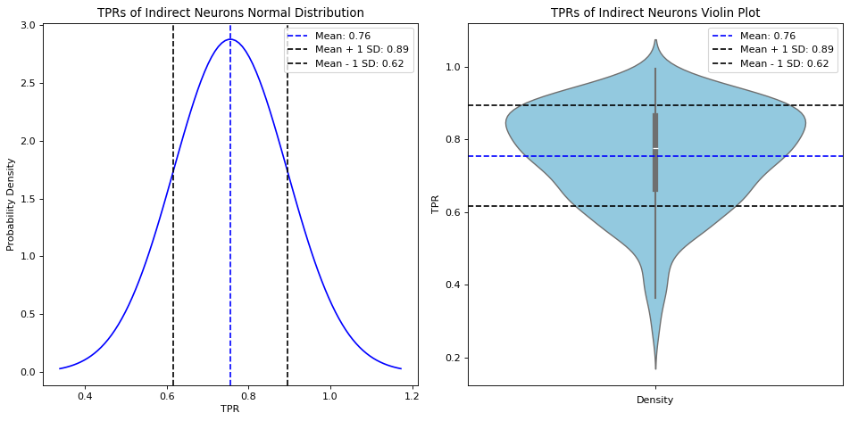
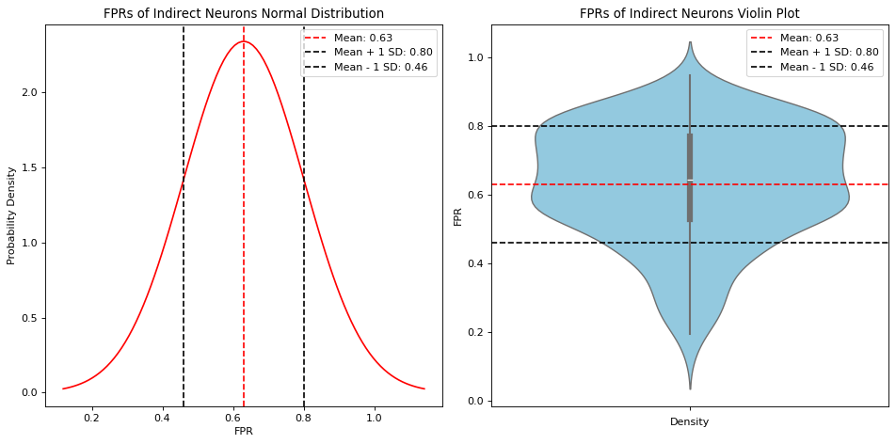
Neuron Sensitivity

Slide 15
Ark_order tuning
Low rank 35, lambda=0, k=4
MSE = 0.000552
AUROC = 0.765
Full rank, lambda=0, k=4
MSE = 0.000322
AUROC = 0.717
Low rank 35, lambda=0, k=7
MSE = 0.00928
AUROC = 0.712
Full rank, lambda=0, k=7
MSE = 0.00252
AUROC = 0.45
higher ark_order → overfitting???? Try Reg

Slide 16
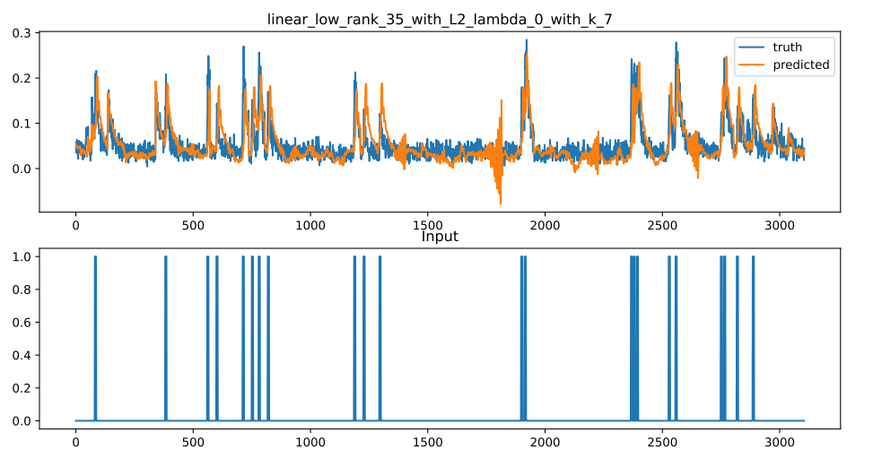
Ark_order tuning

Slide 17
Ark_order tuning

Slide 18
SNAIL Photostim Project Update 9/11/24
Andrew Jeon

Slide 19
Discussion Threads
Done/ongoing
Try Learning rates 1 or 2 order of magnitudes smaller for regularization to address the massive MSEs
Try empty initialization
Closed-Form Ridge Regression
Closed-Form solutions can give us assurance that the torch model should EVENTUALLY converge to this solution with enough epochs and assuming all other hyperparameters are tuned correctly
Make Github Repo
Effect of Regularization on Low Rank models
Next Steps/Direction
Q: If we took the closed-form W/Ahat which is (502,4017), did SVD with rank 502 on it, then initialized the torch model with that SVD’d init_value I expect and want it to stay at the closed-form, It bothers me that it doesn’t.
Take Reduced Rank Ridge Regression closed-form solutions, initialize torch model with that and confirm that the model stays at that closed-form solution.
Nested cross validation loop – Joe Lambda first, then rank
Closed form training MSE for reduced ridge regression, compare to torch reg train loss, torch reg train loss should eventually arrive to this
Gradient Descent w/ rollout vs current approach (predict 4 x_next, instead of 1 x_next)

Slide 20
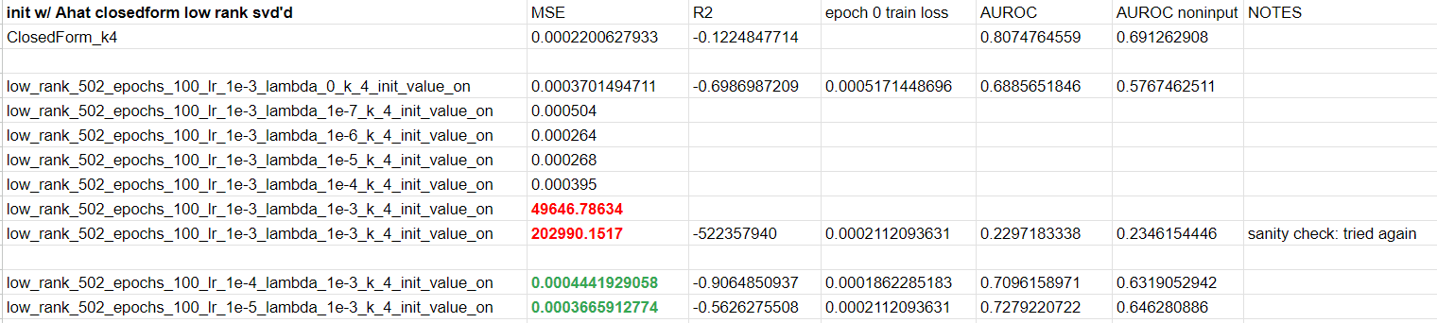
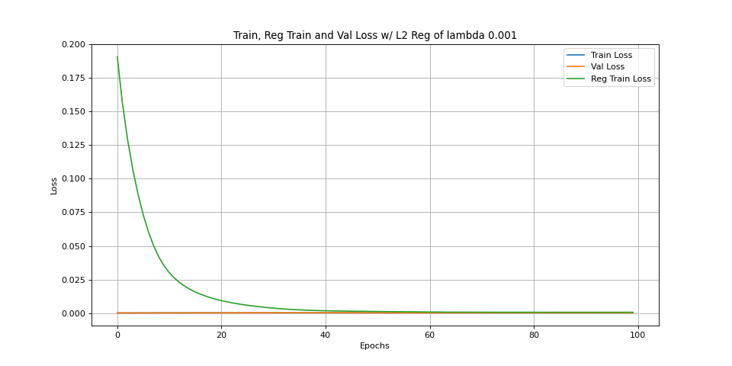
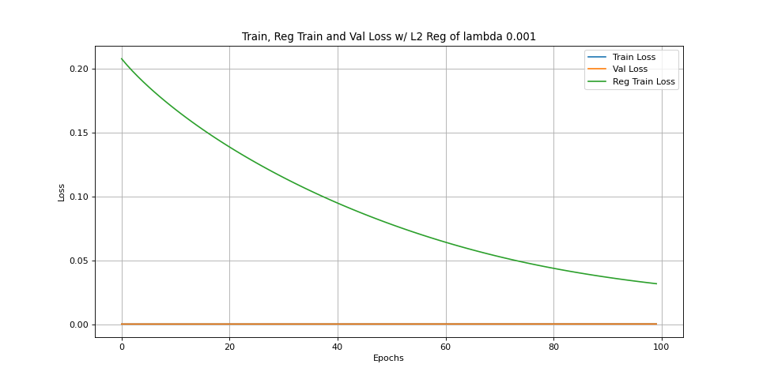
Extremely high MSE?
Decreasing the learning rate resulted in reasonable MSE’s for the full rank model
low_rank_502_epochs_100_lr_0.001_lambda_0.001_k_4_init_value_on_losses
low_rank_502_epochs_100_lr_0.0001_lambda_0.001_k_4_init_value_on_losses

Slide 21
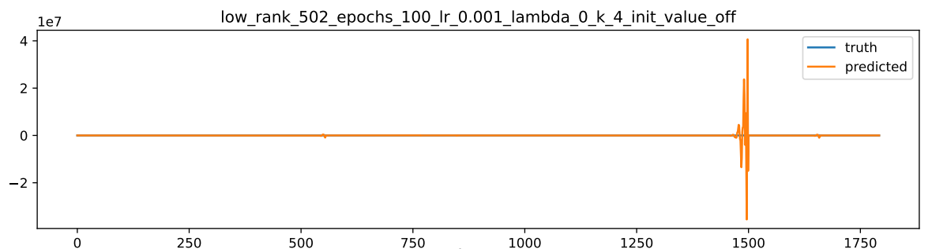
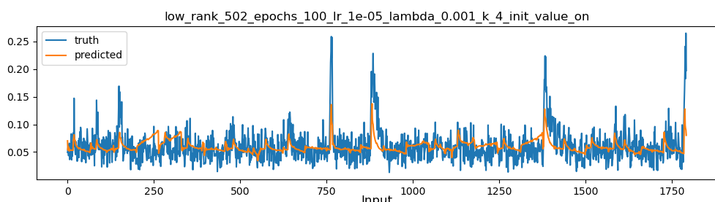

Slide 22
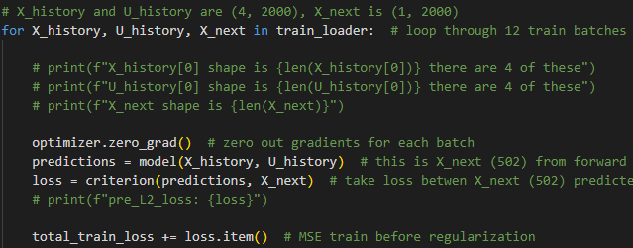
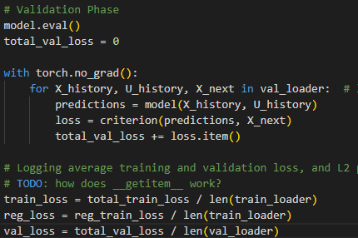
Difference between Val and “Test” MSE
12 batches of ~2000 for train_loader, 4 batches of ~2000 for val_loader → 24000~22968 training t’s, 8000~6340 test t’s
Test and val MSE uses same t’s
Train MSE is the average of 12 batches of 2000 error
Val MSE is the average MSE of 4 batches of 2000 error
Test MSE is the average MSE of 82 segments of uninterrupted test t’s which vary in length (66, 109 etc.)

Slide 23
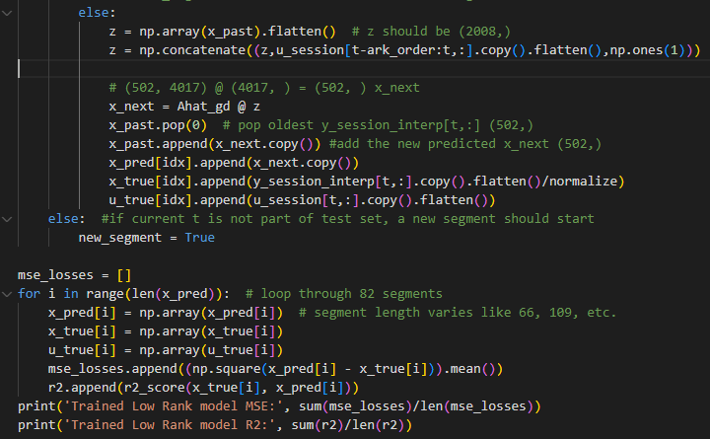
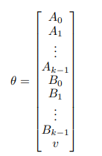
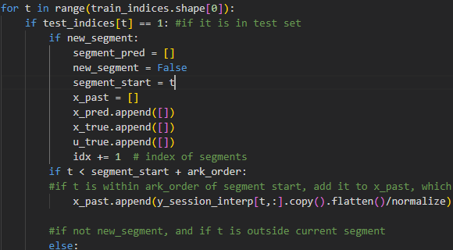
Test MSE
Ahat_gd (4017, 502)
Test MSE is basically average MSE of 82 segments of test t’s each of which are different lengths (66, 109, etc.)

Slide 24
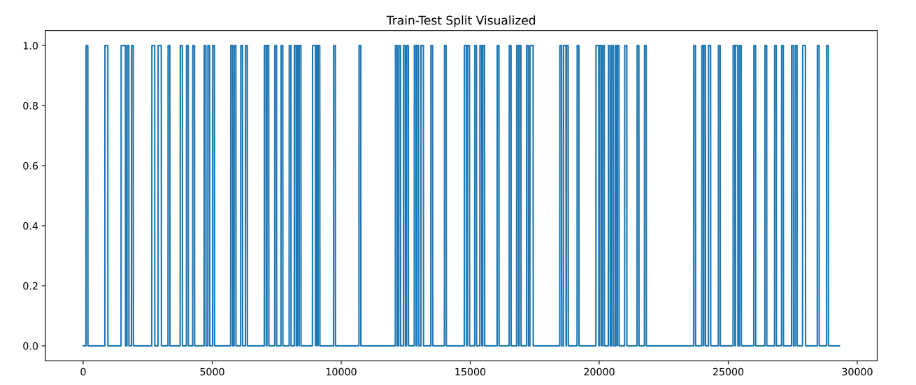

Slide 25
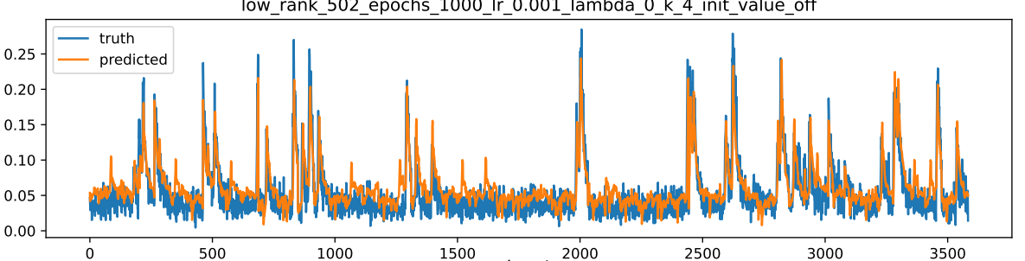
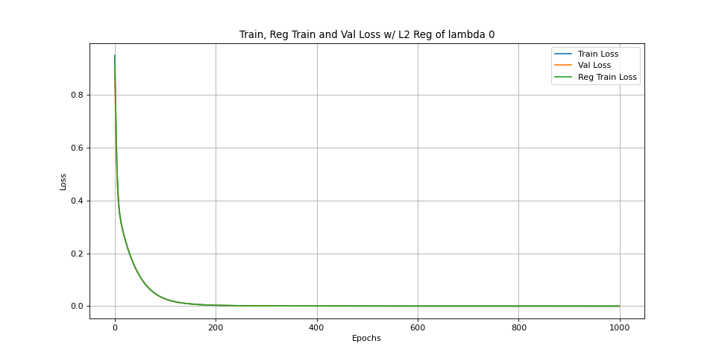
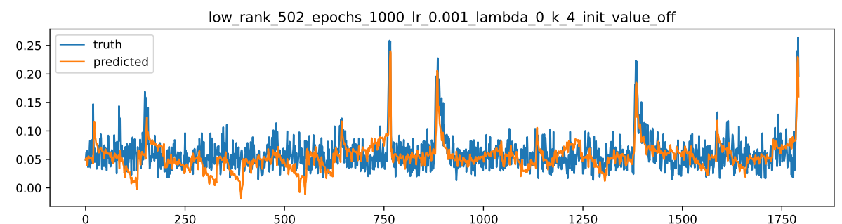
Empty Initialization
As expected, empty initialization starts the solution off at a much higher loss, it takes much longer to get to a good solution.
Init_value none 1000 epochs, converges to a really low MSE but the AUROC is so low??? The MSE goes lower than that of the closed-form solution….

Slide 26
Direction
Take Reduced Rank Ridge Regression closed-form solutions, initialize torch model with that and confirm that the model stays at that closed-form solution.
Nested cross validation loop – Joe Lambda first, then rank

Slide 27
SNAIL Photostim Project Update 9/xx/24
Andrew Jeon

Slide 28
Agenda
Next Steps/Direction
Nested closed-form cross validation loop – Joe Lambda first, then rank
Gradient Descent w/ rollout vs current approach (predict 4 x_next, instead of 1 x_next)
Eventually Non-linear models compare, to confirm/reject that GRU doesn’t help
Try evaluating the initialized SVD’d matrix of torch model on training MSE and compare to the closed-form reduced ridge regression training MSE, they should be the same
Take Reduced Rank Ridge Regression closed-form solutions, initialize torch model with that and confirm that the model stays at that closed-form solution.
Closed-Form training MSE for Reduced Ridge Regression, compare to torch reg train loss
Do a rough sweep of rank and reg, report the best one
Magnitudes of gradients at every step, Loss plots over epochs → use these things to check

