Slide 1

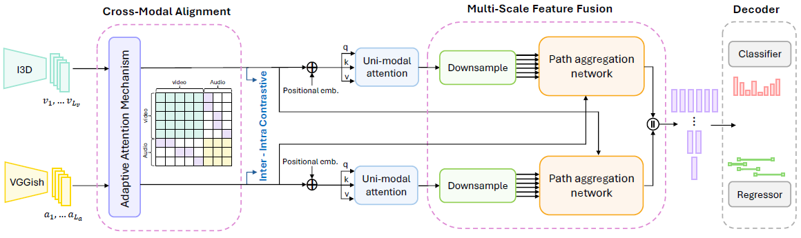


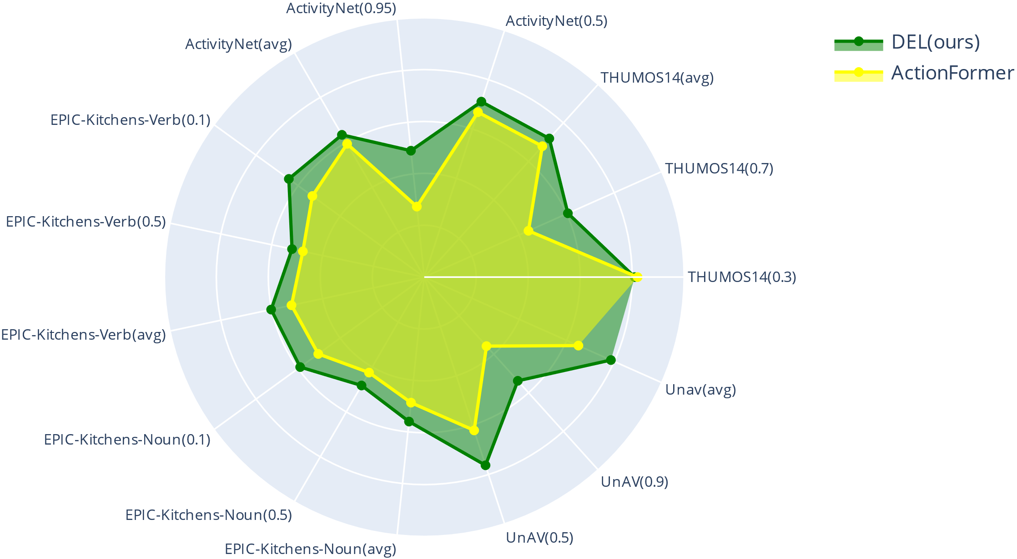
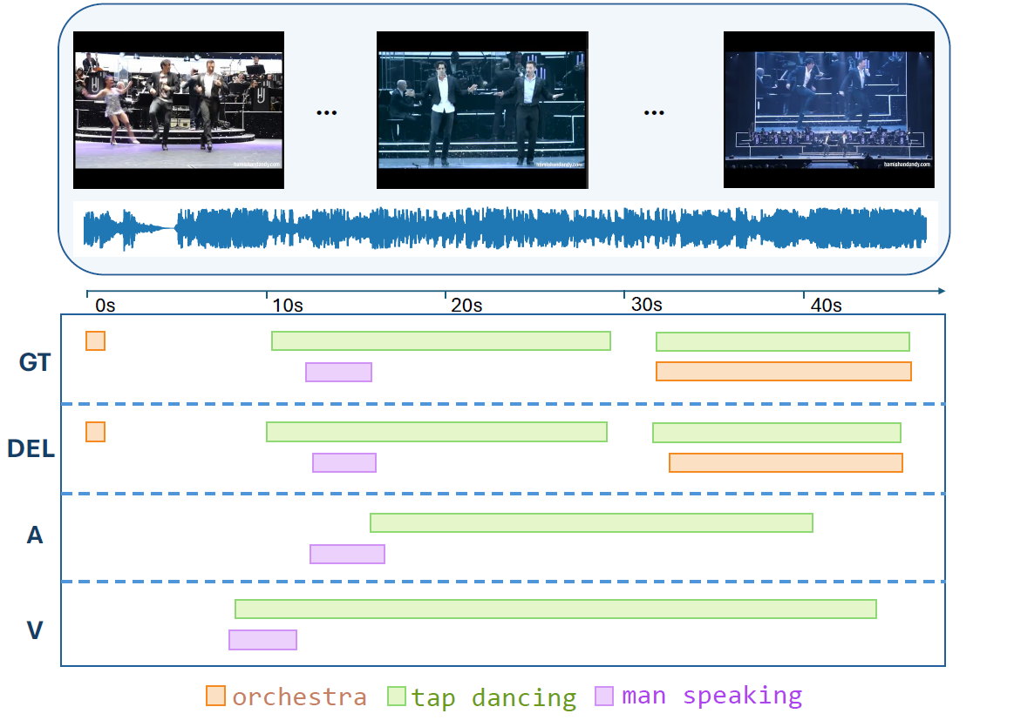
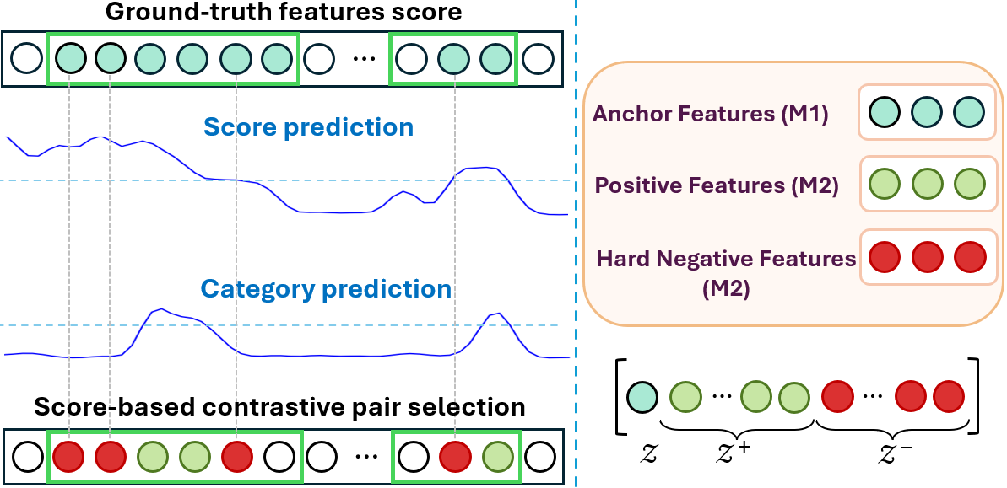
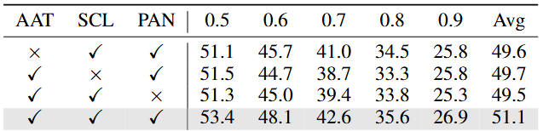
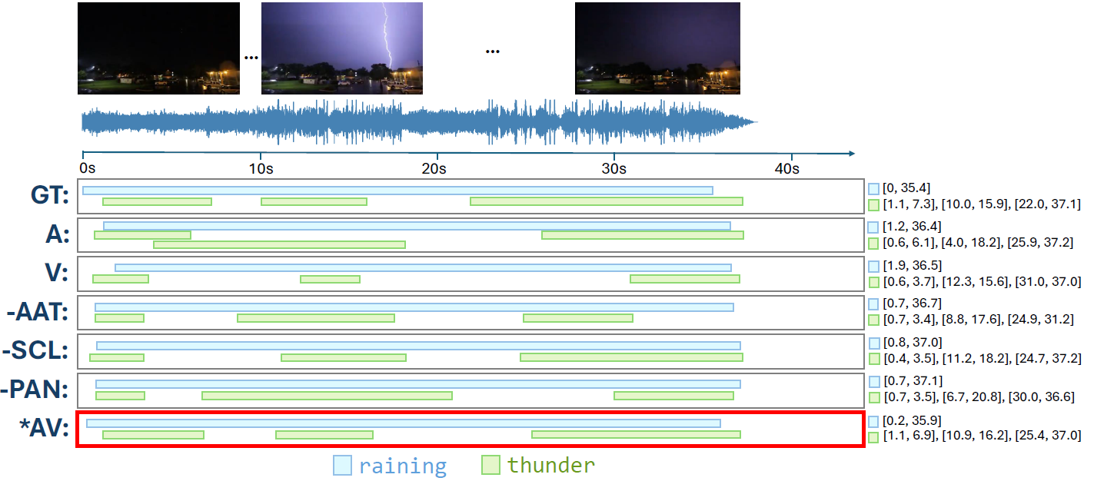
DEL: Dense Event Localization for Multi-modal Audio-Visual Understanding
Mona Ahmadian, Amir Shirian, Frank Guerin, Andrew Gilbert
  Real videos contain dense, overlapping and concurrent multimodal events
  Audio–visual cues are often misaligned
  Need to capture intra-video temporal coherence
  Discover fine-grained cross-modal temporal dependencies
  Unified framework for dense multimodal event localization
  Adaptive attention mechanism for audio-visual alignment, ensuring event-synchronous and noise-robust interactions.
  Score-based contrastive learning with token-level supervision for dynamic selection of positives and hard negatives, enhancing intra-video discrimination.
  Path Aggregation Network (PAN) for multi-scale audio-visual fusion, preserving fine-grained temporal details while integrating high-level semantics.
  State-of-the-art performance onTHUMOS14, ActivityNet, EPIC-Kitchens and UnAV-100. consistently surpassing prior methods using the same encoders.
  Ablation studies, results, and implementation details are provided in our arXiv paper. The DEL code and pretrained models are publicly available on GitHub.
Motivation
Code
arXiv
Contributions
Results
Method
  Cross-Modal Alignment
  Apply a learned event-aligned mask to the attention weights, ensuring temporal coherence and intra-modal consistency
  This guides feature interactions within and across modalities. Unlike standard self-attention, a learned mask matrix that constrains attention based on temporal alignment,
  Emphasising interactions likely to represent the same event while suppressing irrelevant ones.
  Score-based Contrastive Learning
  Standard contrastive learning struggles with fine-grained temporal dynamics in untrimmed videos.
  Heuristic sampling often overlooks concurrent events and intra-video relationships.
  Need for a more adaptive method to align audio-visual features within and across samples.
  We introduce a score-based contrastive learning
  approach that dynamically selects contrastive pairs
  using a learned similarity function.
  Combines inter-sample and intra-sample objectives
  to refine both global and fine-grained audio-visual alignment.
  Capturing contextual similarity and temporal alignment
  across modalities.
  Multi-Scale Feature Fusion
  Events span short to long durations → multi-scale fusion preserves details and context while aggregating high-level semantics.
  Enriches features across both modalities at multiple scale using attention-based fusion.
  Dynamically weight temporal features across scales for better event discrimination.
  Combines top-down and bottom-up pathways to preserve fine details and aggregate context.
Component Ablation
  Evaluating the individual contributions of our proposed modules on UnAV reporting mAP across tIoU thresholds and their average:
Notes:
1

