Slide 1
De Novo Assembly (Pseudomonas aeruginosa MAPO1 )
Henry Wang
hwang@clcbio.com

Slide 2
The data formats we are supporting
Life Technologies
SOLiD (csfasta + QV) / Ion Torrent (SFF, fastq)
Illumina
Txt, fastq
Roche 454 / Junior
SFF, fasta+qual
Pac-Bio
Fasta / fastq (via Illumina Import)

Slide 3
Workflow
Import NGS raw data
QC on reads
De novo assembly
Trim reads
Finding Genes
BLAST

Slide 4
Case Study
Pseudomonas aeruginosa MAPO1 variant re-sequencing
Olivas AD et al., PLoS One, 2012
SRP010152
SRX114601 / SRR396638 – Single reads
SRX114599 / SRR396636 – mate-pair (distance: 2000-3800)
SRX114600/ SRR396637 – paired-end (distance: 150-350)
http://trace.ncbi.nlm.nih.gov/Traces/sra/?study=SRP010152
http://download.clcbio.com/testdata/paeruginosa-reads.zip

Slide 5
Demo Dataset
http://download.clcbio.com/testdata/paeruginosa-reads.zip
Please unzip the file after you download from CLC Bio website

Slide 6
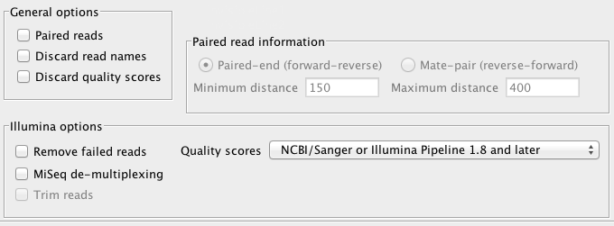
Import Single Reads File
Import NGS raw data
Select “Single_read.fastq” file
Uncheck all items in the “General options”
Confirm the quality score is “NCBI/Sanger or Illumina pipeline 1.8”

Slide 7
Import Mate-Paired Data
Select Mate_pair_1.fastq and Mate_pair_2.fastq files
Check-on “Paired reads” in general option
Select “Mate-pair” in Paired reads information
Set Max distance = 3800
Set Min distance = 2000

Slide 8
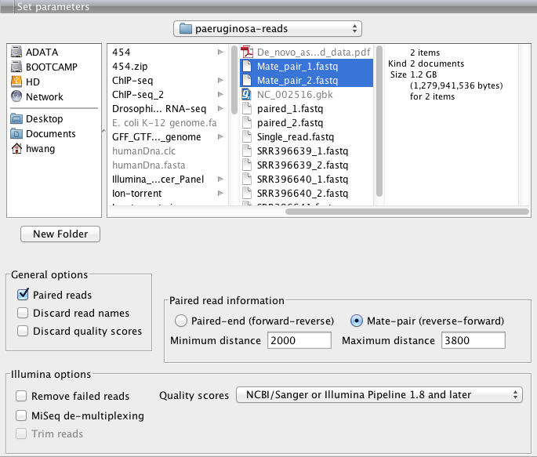

Slide 9
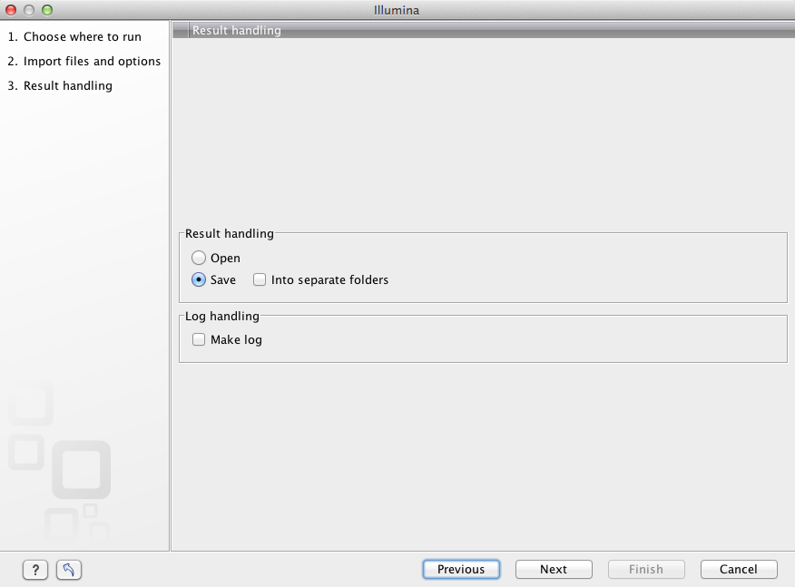

Slide 10
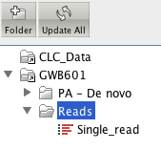
Select the location to save the mate-pair reads → Press “Finish”

Slide 11

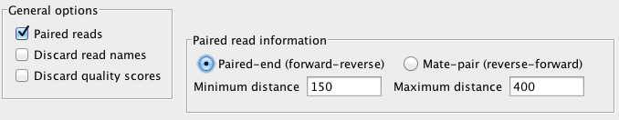
Import Paired-end Data
Check-on “Paired reads” in general option
Select “Paired-end” in Paired reads information
Set Max distance = 350
Set Min distance = 150
Select 2 files:

Slide 12

Please create a new folder and organize your data list

Slide 13
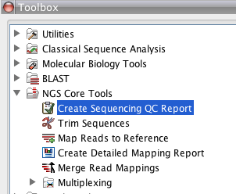
QC on reads
NGS Core Tools → Create Sequencing QC Report

Slide 14
About QC on reads
Please confirm “uncheck” “discard quality score” when you import reads
Process analysis file by file (you can use batch function)
The quality score in CLC GWB is transformed to PHRED score

Slide 15
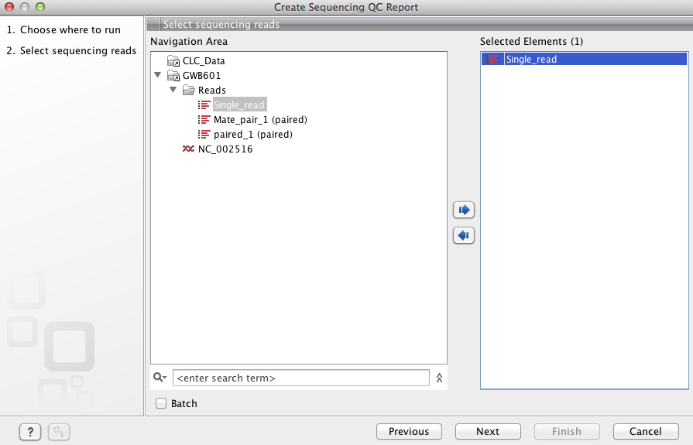

Slide 16
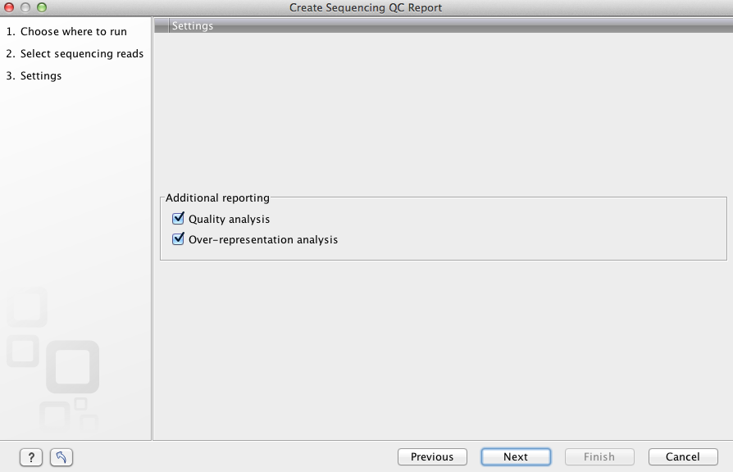
Create report

Slide 17
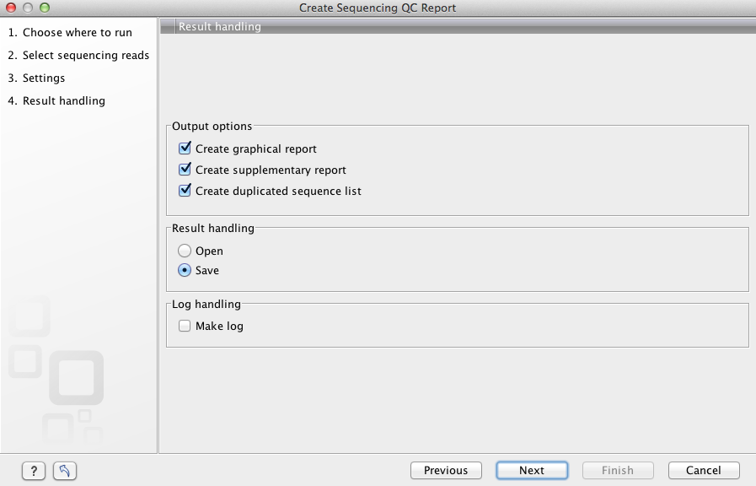
Check-on items, save result

Slide 18
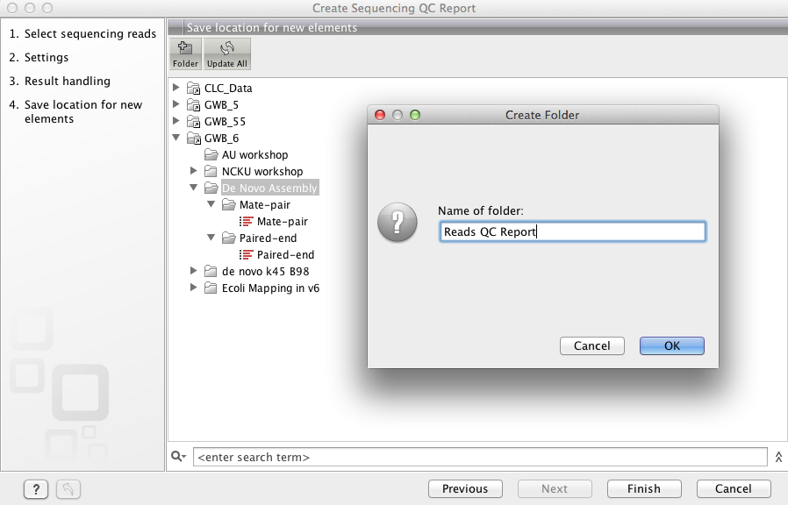

Slide 19
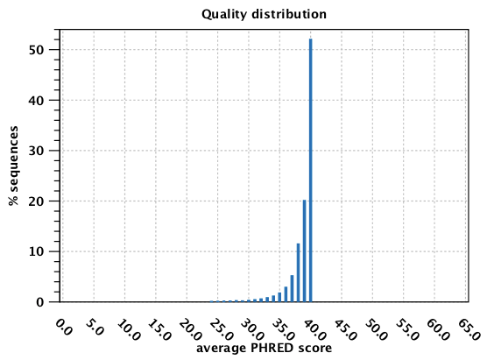
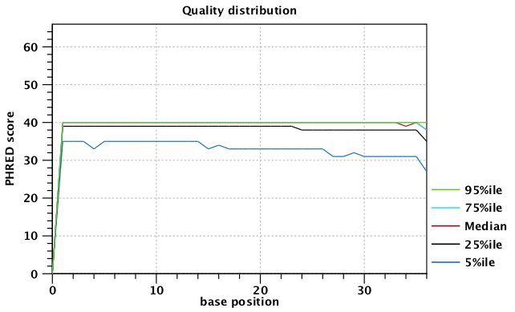

Slide 20
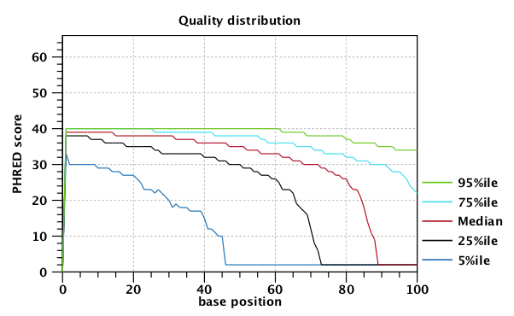
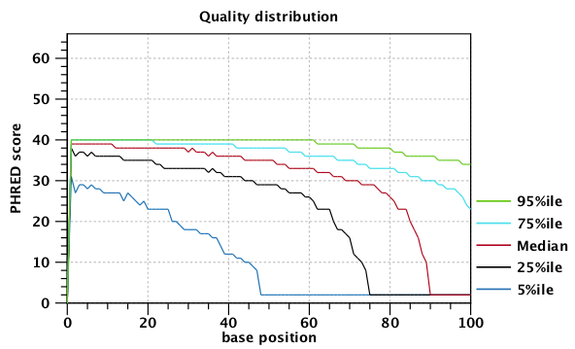
Please repeat the procedure to get the reads QC report for mate-paired reads and paired-end reads

Slide 21

Trim reads
NGS Core Tools → Trim Sequences

Slide 22
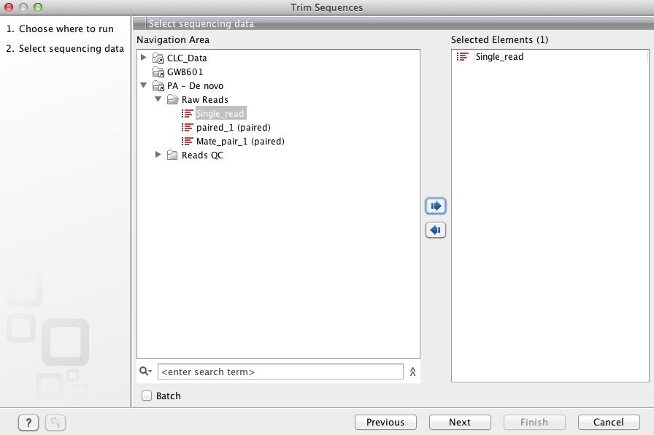

Slide 23
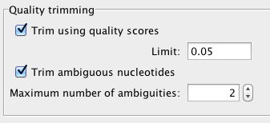
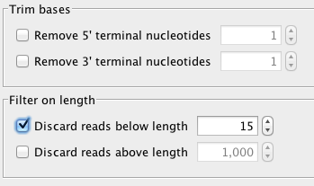
Set p value = 0.05 (default) → Next
Set “discard reads below length” = 15 → Next

Slide 24
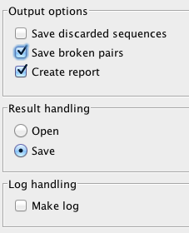
Check on “Save broken pairs”
Save the result
→ Next

Slide 25
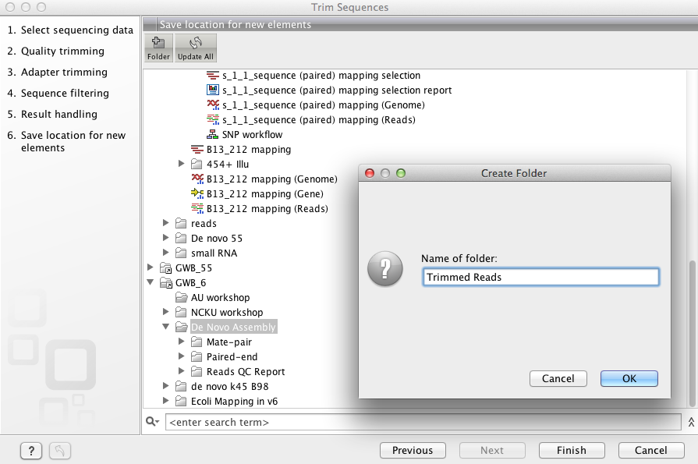

Slide 26
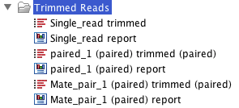

Slide 27

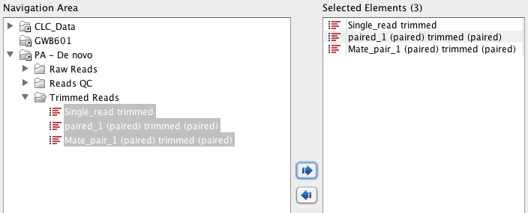
De novo assembly
De Novo Sequencing → De Novo Assembly

Slide 28
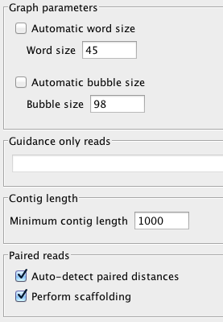
Uncheck “Automatic word size”, set word size = 45
Uncheck “Automatic Bubble size”, set bubble size = 98
Set min contig length = 1000

Slide 29
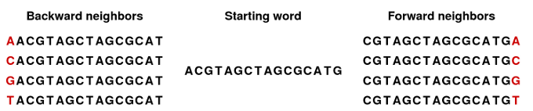
De Brujin Grpah for De novo Assembly
*Word size = k-mer size
e.g k=16

Slide 32
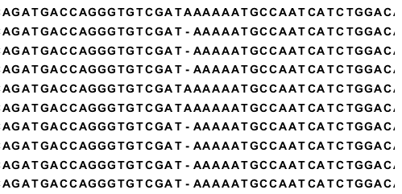
Bubble or sequencing systematic error

Slide 33
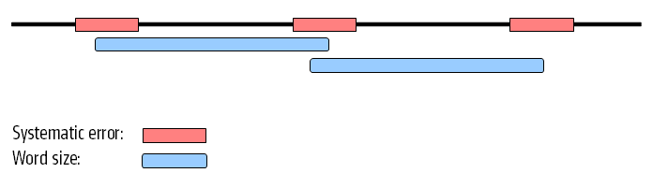


Slide 35
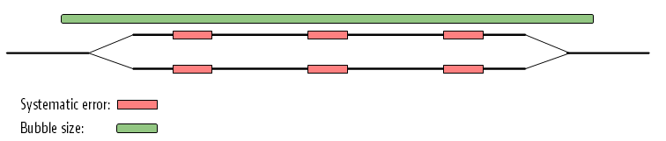

Slide 36
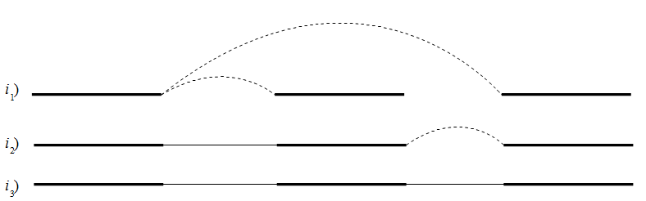
Scaffolding

Slide 37
Deployment for De Novo Assembly
Fast mode :
De novo contig sequences only
Slow Mode :
Take de novo assembled contigs as reference template, then use all reads to process reference mapping (re-mapping) + update contigs

Slide 38
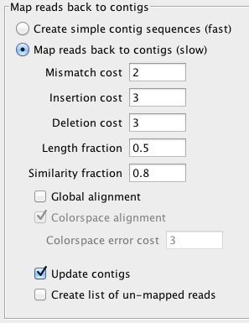

Slide 39
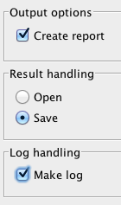
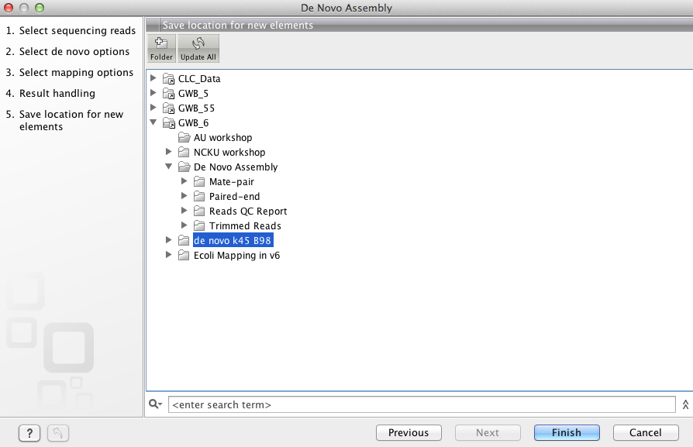
Check-on “Create report”, save the result → Next
Assign the location to save contigs → Finish

Slide 40
BLAST
For BLAST
Extract consensus sequence of contigs
Process BLAST

Slide 41

Extract consensus sequences
Open de novo contig table

Slide 42
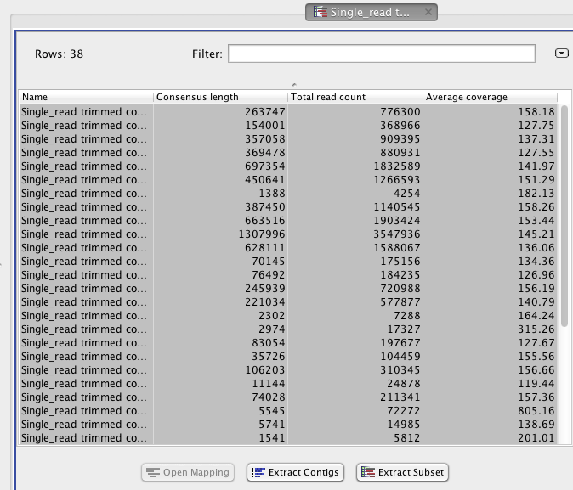
Select all contigs, press “Extract Contigs”

Slide 43
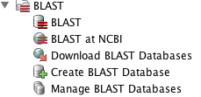
Process BLAST

Slide 44
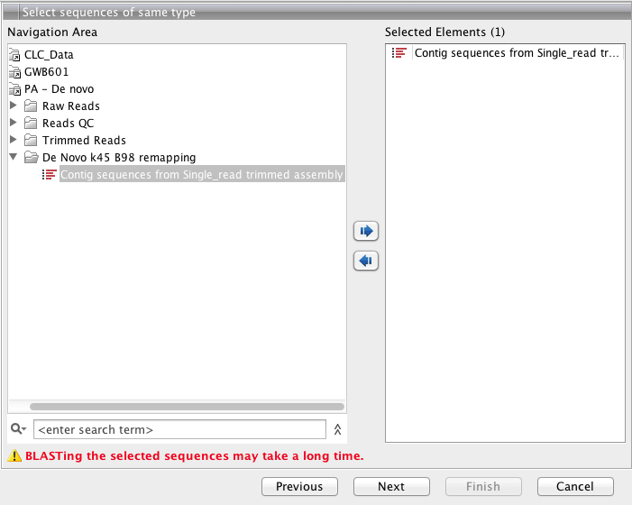
Select the consensus sequence → Next

Slide 45
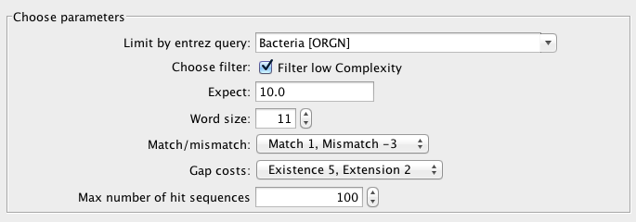
Select query for “Bacteria”

Slide 46
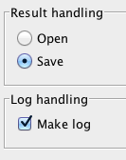
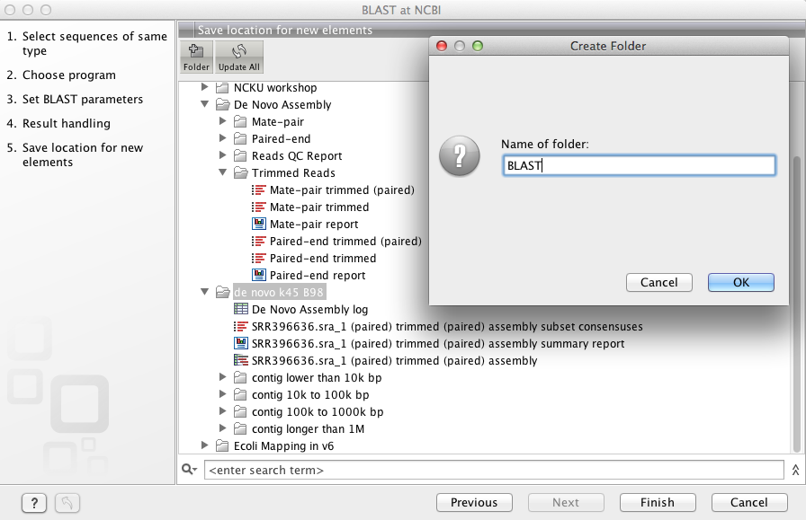
Save the result, assign the location → Press Finish

Slide 47
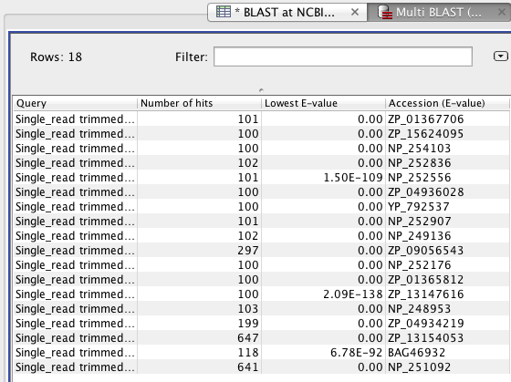
BLAST result

Slide 48
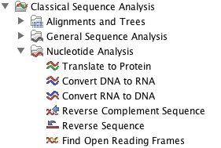
Finding Genes
Classical Sequence Analysis → Nucleotide analysis → find Open Reading Frames

Slide 49
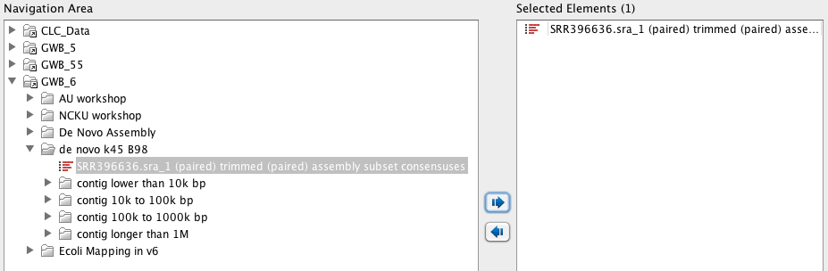
Select extracted de novo contigs

Slide 50
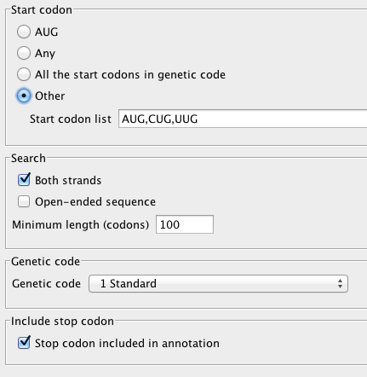
Assign start codon: AUG, CUG, UUG
Set minimum length of ORF

Slide 51
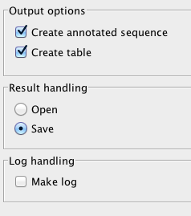
Create annotated sequence and save the result

Slide 52
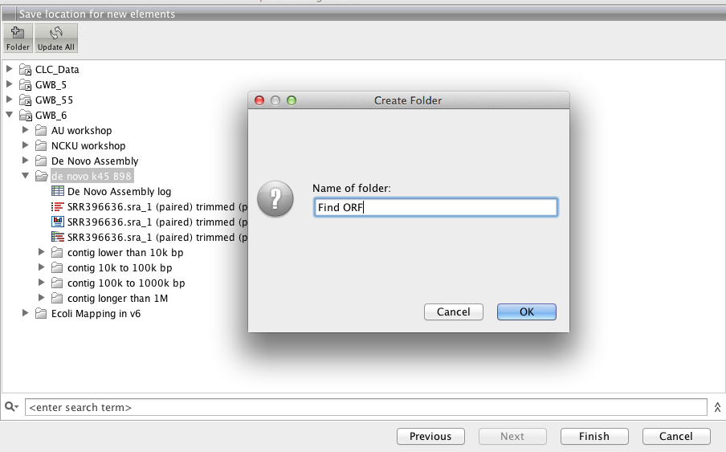
Assign path to save the ORF finding result

Slide 53
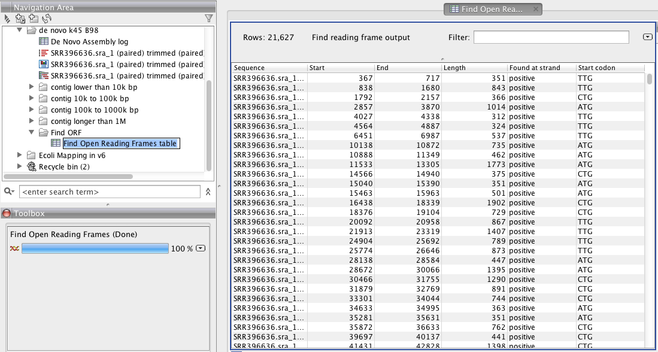
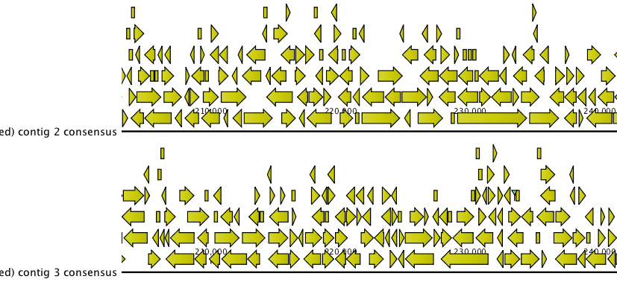

Slide 54
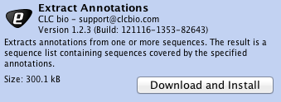
Extract ORF sequence
Go to Plug-ins → Download Plug-ins
Select “Extract Annotations”
Press “Download and Install”
Press close and restart the software

Slide 55

Classical Sequence Analysis → General Sequence Analysis → Extract Annotation

Slide 56
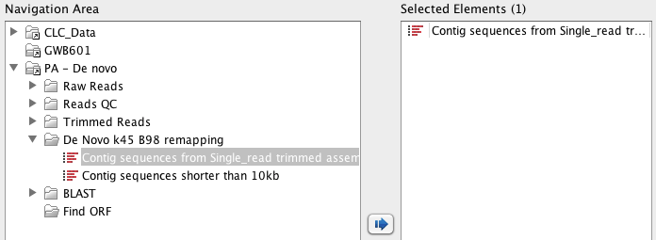
Select annotated ORF sequences

Slide 57
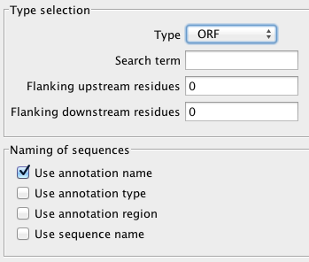
Select Type as “ORF”

Slide 58
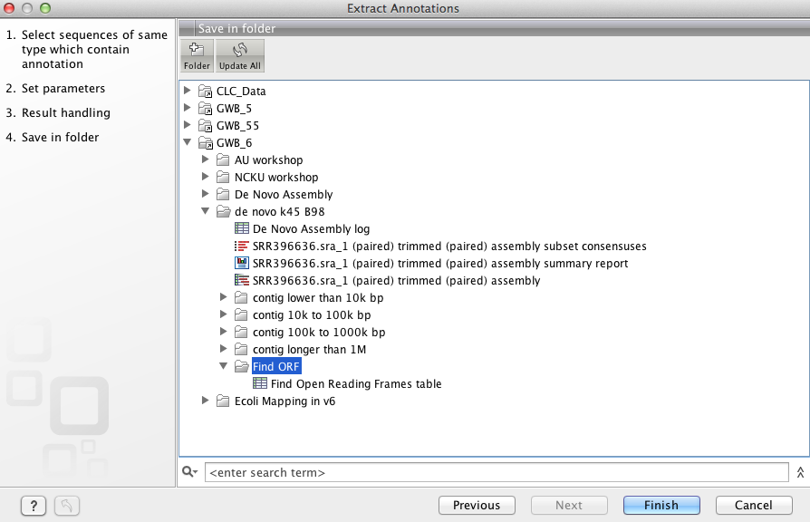
Assign saving path→ Finish

Slide 59


Slide 60
For more information
Please welcome to
www.clcbio.com/tutorial

