Slide 1
Resequencing Analysis (Pseudomonas aeruginosa MAPO1 )
Henry Wang
hwang@clcbio.com

Slide 2
The data formats we are supporting
Life Technologies
SOLiD (csfasta + QV) / Ion Torrent (SFF, fastq)
Illumina
Txt, fastq
Roche 454 / Junior
SFF, fasta+qual
Pac-Bio
Fasta / fastq (via Illumina Import)

Slide 3
Workflow
Import NGS raw data
Trim reads
Reference Mapping
Import Reference Sequence
QC on reads
Variant detection

Slide 4
Case Study
Pseudomonas aeruginosa MAPO1 variant re-sequencing
Olivas AD et al., PLoS One, 2012
SRP010152
SRX114601 / SRR396638 – Single reads
SRX114599 / SRR396636 – mate-pair (distance: 2000-3800)
SRX114600/ SRR396637 – paired-end (distance: 150-350)
Reference sequence
NC_002516
http://trace.ncbi.nlm.nih.gov/Traces/sra/?study=SRP010152
http://download.clcbio.com/testdata/paeruginosa-reads.zip

Slide 5
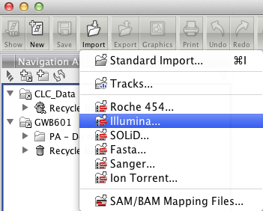
Import NGS raw data
Click Import → Illumina

Slide 6
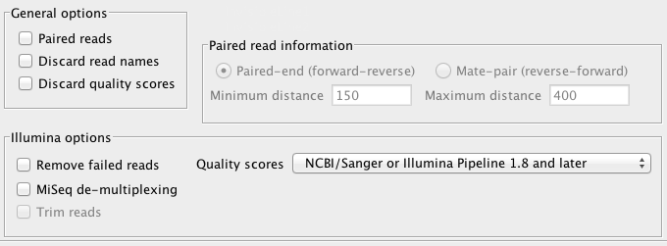
Import Single Reads File
Select “Single_read.fastq” file
Uncheck all items in the “General options”
Confirm the quality score is “NCBI/Sanger or Illumina pipeline 1.8”

Slide 7
Import Mate-Paired Data
Select Mate_pair_1.fastq and Mate_pair_2.fastq files
Check-on “Paired reads” in general option
Select “Mate-pair” in Paired reads information
Set Max distance = 3800
Set Min distance = 2000

Slide 8
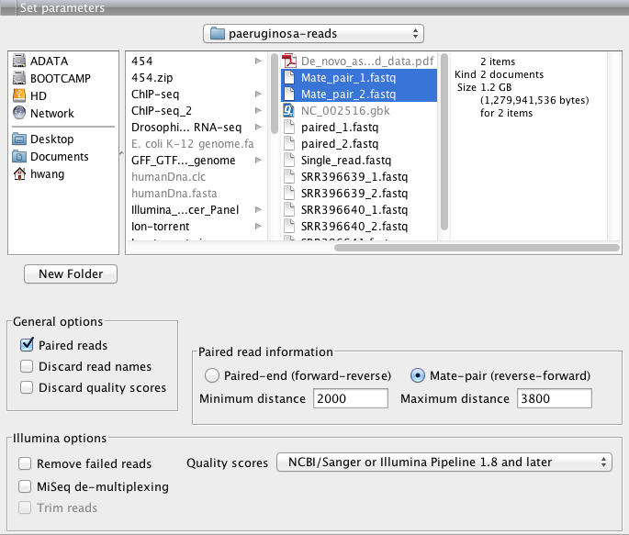

Slide 9
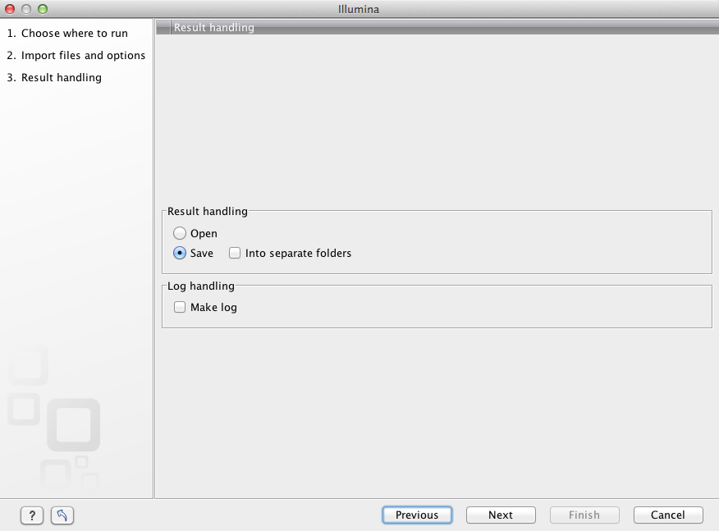

Slide 10
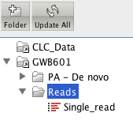
Select the location to save the mate-pair reads → Press “Finish”

Slide 11

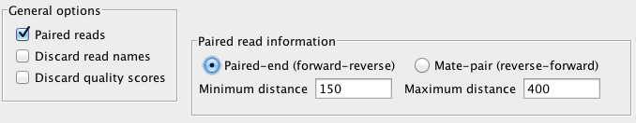
Import Paired-end Data
Check-on “Paired reads” in general option
Select “Paired-end” in Paired reads information
Set Max distance = 350
Set Min distance = 150
Select 2 files:

Slide 12
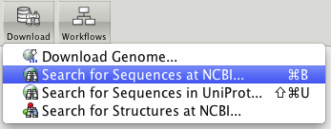
Import Reference Sequence
Click Download → Search for Sequences at NCBI

Slide 13
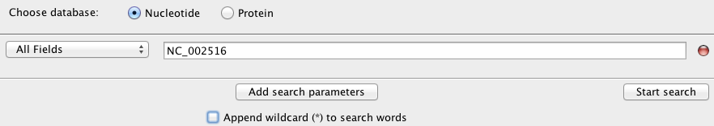

Input “NC_002516”
Press “Start Search”
3. Click NC_002516
4. Press “Download and Save”

Slide 14
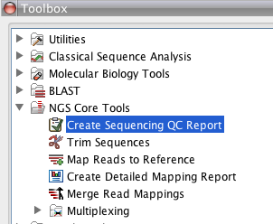
QC on reads
NGS Core Tools → Create Sequencing QC Report

Slide 15
About QC on reads
Please confirm “uncheck” “discard quality score” when you import reads
Process analysis file by file (you can use batch function)
The quality score in CLC GWB is transformed to PHRED score

Slide 16
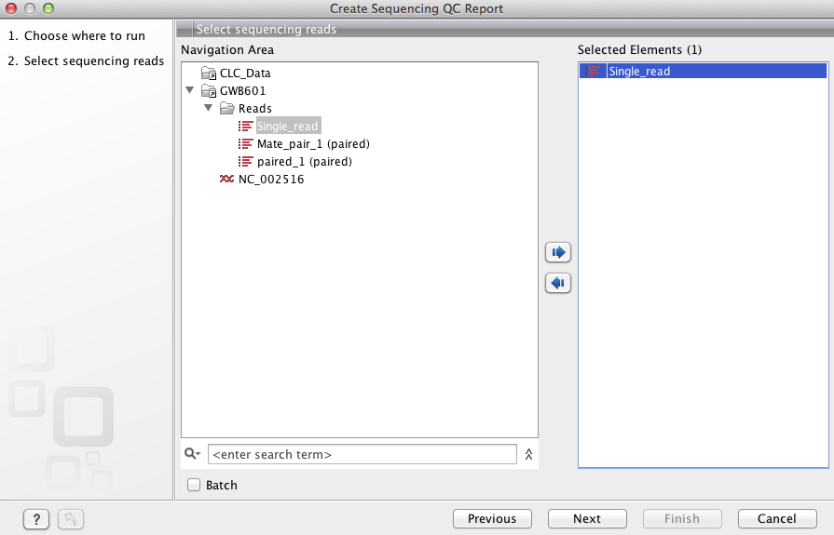

Slide 17
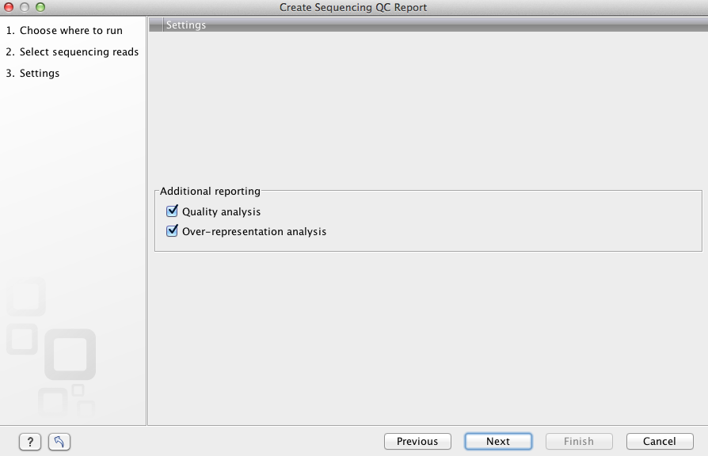
Create report

Slide 18
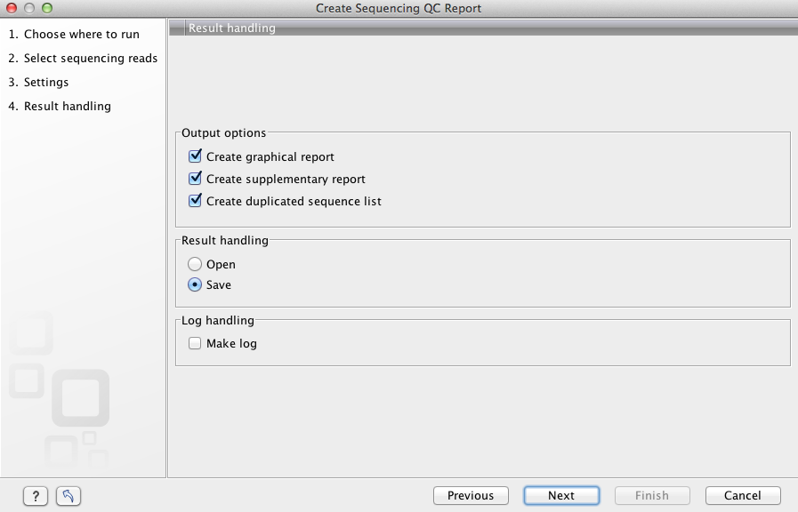
Check-on items, save result

Slide 19
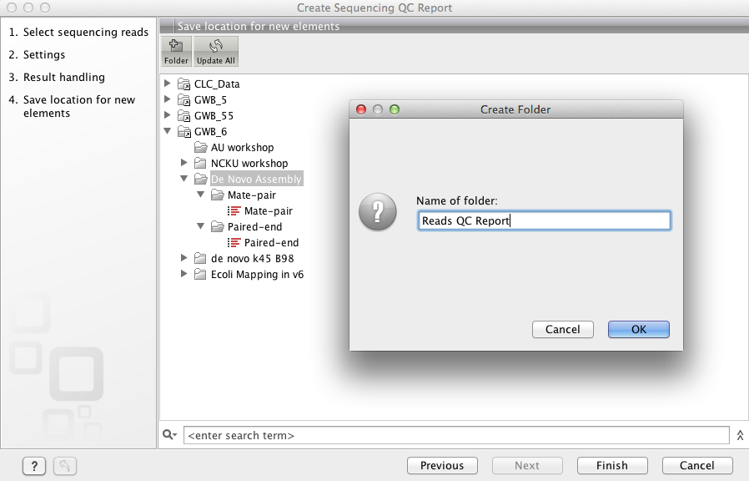

Slide 20
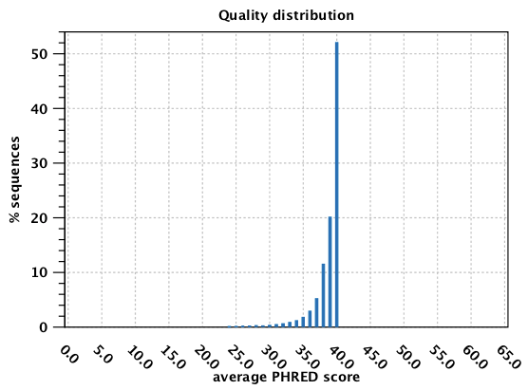
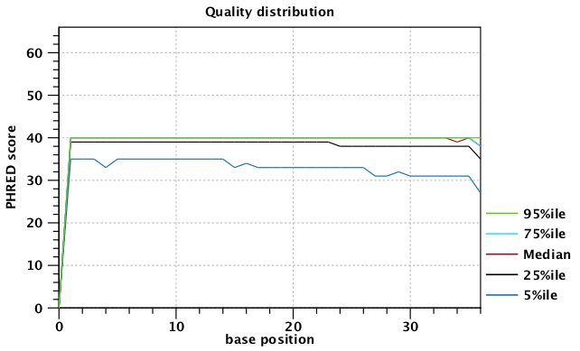

Slide 21
Please repeat the procedure to get the reads QC report for mate-paired reads and paired-end reads

Slide 22

Trim reads
NGS Core Tools → Trim Sequences

Slide 23
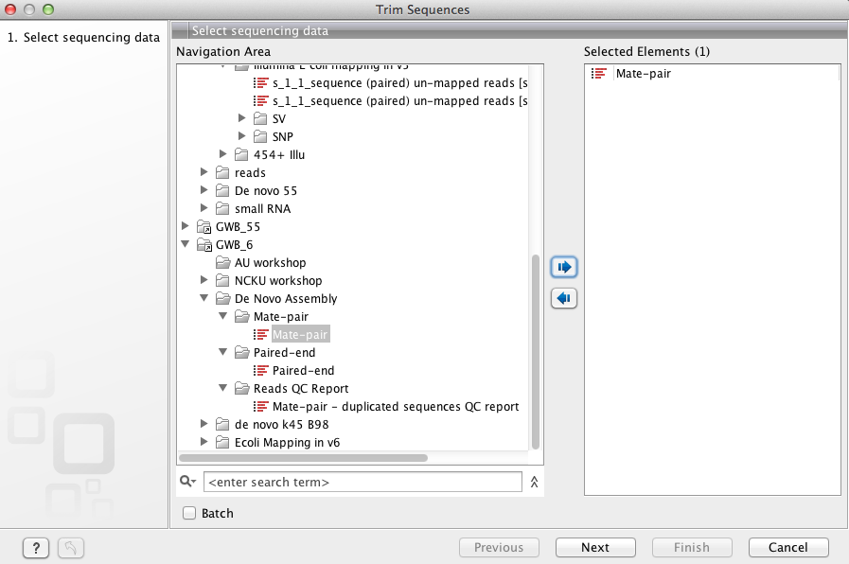

Slide 24
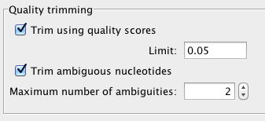
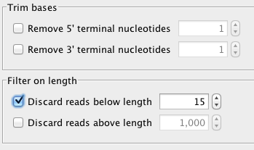
Set p value = 0.05 (default) → Next
Set “discard reads below length” = 15 → Next

Slide 25
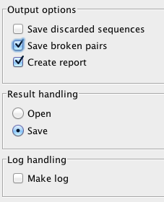
Check on “Save broken pairs”
Save the result
→ Next

Slide 26
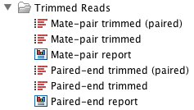
Result

Slide 27

Reference Mapping
NGS Core Tools → Map Reads to Reference

Slide 28
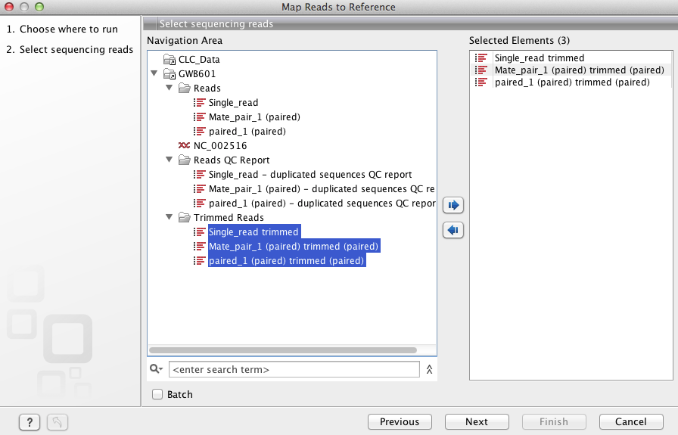
Select Trimmed Reads

Slide 29

Select Reference with NC_002516

Slide 30
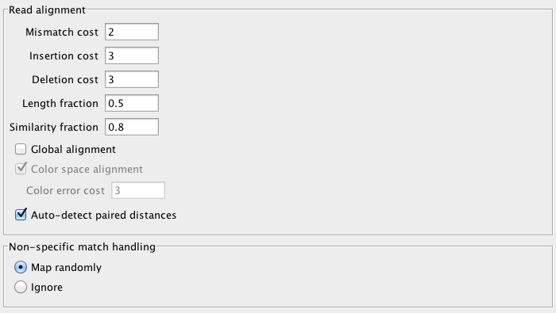
Keep Default configuration for the mapping

Slide 31
Mapping in CLC Bio Genomics WB
Cross platforms
Single reads + paired reads are available be processed together
Different runs can be integrated

Slide 32
Perfect match (PM):
Nucleotide on the read is the same with reference sequence
+1 per base
Miss Match (MM):
Nucleotide on the read is not matched with reference sequence
-2 per base (in default)

Slide 33
CGTATCAATCGATTACGCTATGAATG - Reference
ATCAATCGATTACGCTATGA - Read
+20

Slide 34
CGTATCAATCGATTACGCTATGAATG - Reference
ATCAATCGGTTACGCTATGA - Read
+19 -2 = 17

Slide 35
CGTATCAATCGATTACGCTATGAATG - Reference
CTCAATCGATTACGCTATGA - Read
+19

Slide 36
Local alignment
Allow “free end” in 5’-end or 3’-end of the reads
Free end is not MM
Global alignment
Miss match is calculated on 5’-end or 3’-end of the reads

Slide 37
CGTATCAATCGATTACGCTATGAATG - Reference
CTCAATCGATTACGCTATGA - Read
+19 for local alignment
+17 for global alignment

Slide 38
Length fraction
A given fraction (default 50 %) of the read must be matched the reference
Similarity
Set minimum fraction of identity between the read and the reference sequence (default 80%)

Slide 39
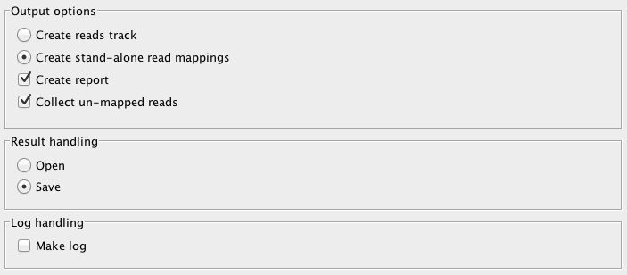

Slide 40

Mapping result
Log file
Mapping list (table for genome) / track
Simple mapping report

Slide 41
Check the mapping report
For the mapping list / track
Adjust view
Find specific position
Find specific gene
Export view
Export sequence

Slide 42



Adjust the view

Slide 43
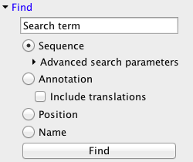
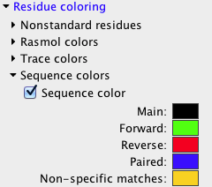
Other basic panel

Slide 44


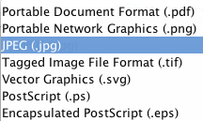
Export Graphic
1. Click Graphic
2. Select Export visible area
3. Select the export format and location

Slide 45
Export Extract
Export sequence in fasta format
Export mapping BAM / SAM file
Export mapping coverage
Extract mapping view only in single reads / paired-end reads
Extract consensus sequence
Find broken pair mated

Slide 46
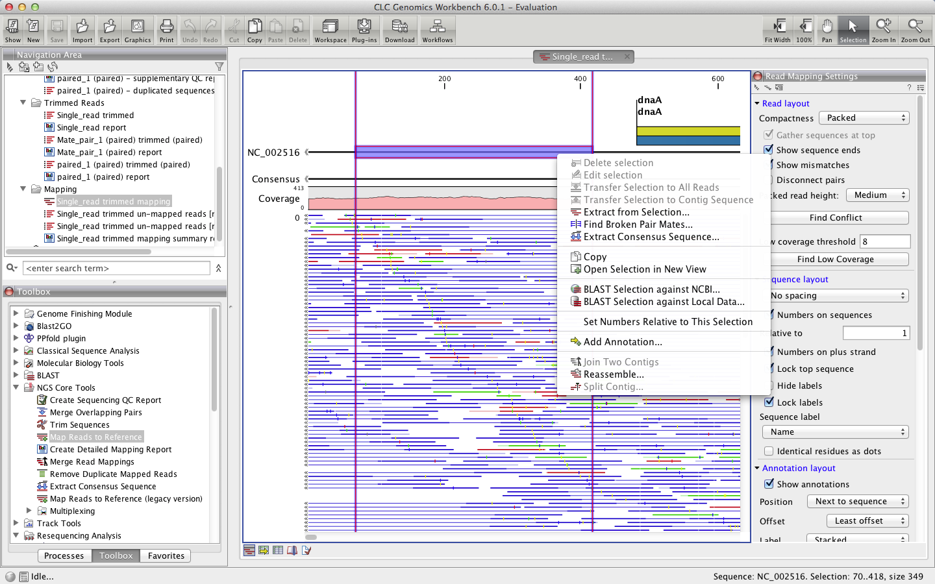

Slide 47

Variant detection
Resequencing Analysis → Probabilistic Variant Detection

Slide 48
About SNP detection
Probabilistic Variant Detection
Single Nucleotide Variants (SNVs)
Insertions
Deletions
MNVs (Multiple Nucleotide Variants)
Can detect variations in datasets from
Haploid (e.g. bacteria)
Diploid (e.g. human) and
Polyploid organisms (e.g. cancer and higher plants)
Quality-Based Variant Detection
Detect SNPs based on reads quality

Slide 49
Probabilistic Variant Detection in GWB
Combines a Bayesian model with a Maximum Likelihood approach.
Calculate prior and error probabilities for the Bayesian model
About the Maximum Likelihood estimation (MLE) can be found at http://en.wikipedia.org/wiki/Maximum_likelihood.

Slide 50
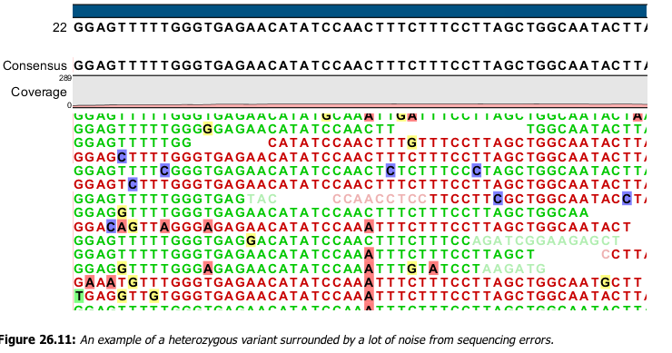

Slide 51
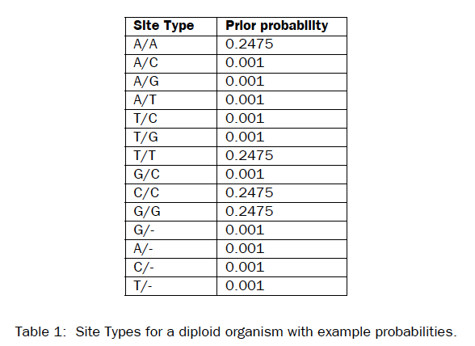

Slide 52
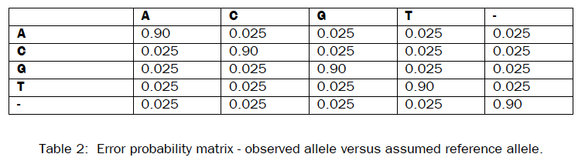

Slide 53
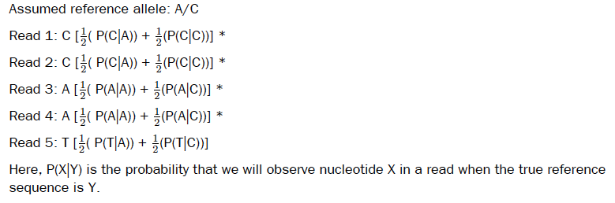
Calculation of the likelihood

Slide 54
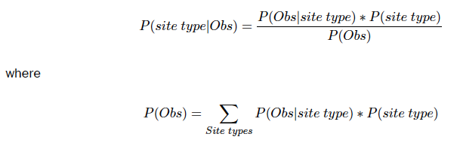
Calculation of the posterior probability for each site type at each position in the genome

Slide 55
Is it a SNV?
P (SNV) ≤ 1 – Variant Probability
e.g. P (SNV) = 0.15 , P (Variant) = 0.9 → NOT a SNV
P (SNV) = 0.15 , P (Variant) = 0.8 → Is a SNV

Slide 56
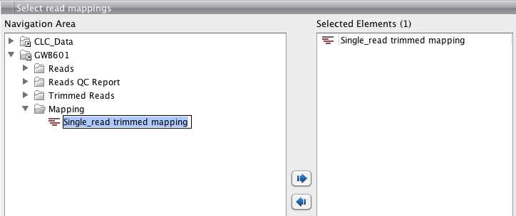
Select mapping list or tracks

Slide 57
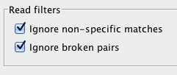
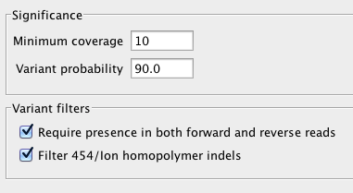
1.
2.

Slide 58
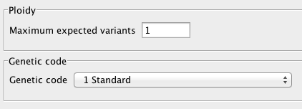
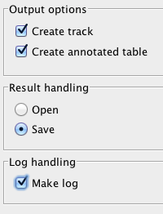
3.
4.

Slide 59
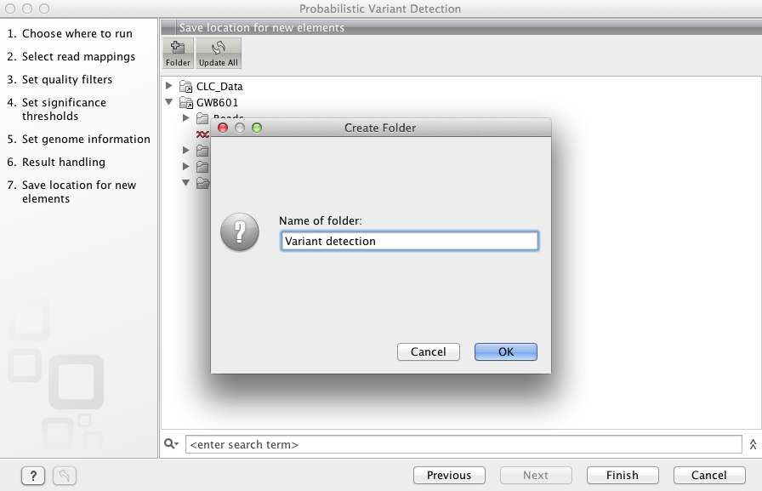
5. Create a new sub-folder and save the variant detection

Slide 60
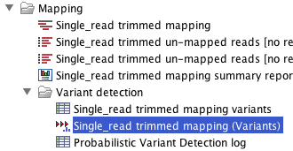
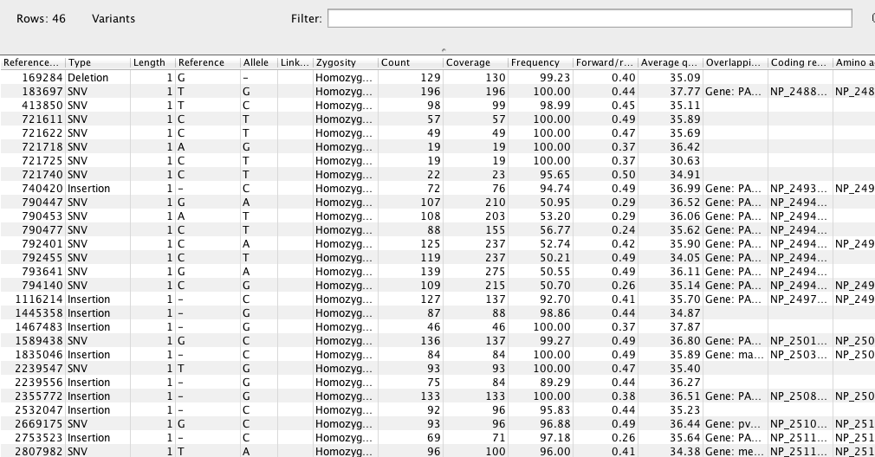
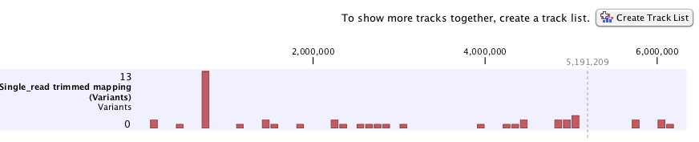

Slide 61
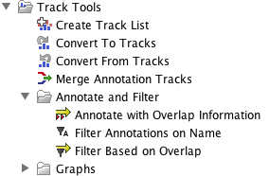
Track Tools

Slide 62
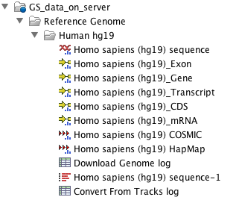
Tracks
List(s)
Individual
Visualization
To be compared & integrated
Integrated sequence + annotation
For mapping and further analyze usage

Slide 63
Advantage for
Tracks
Multi-samples visualization / comparison
Annotation integration
Workflow connection
List
Single sample visualization
ChIP-seq analysis and visualization

Slide 64

Please try…
Transform mapping list to tracks

Slide 65
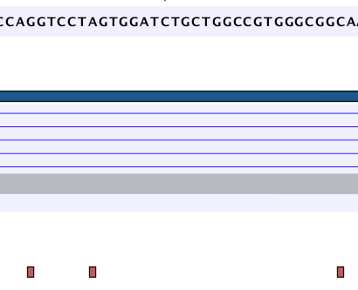
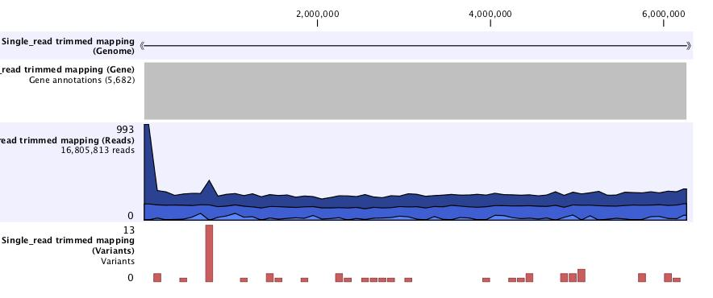

Slide 66
What’s next Step?
Are these SNPs interior of gene
Are these SNPs know or unknown

Slide 67
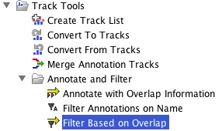
To detect interior of genes
Track Tools → Annotate and Filter → Filter Based on Overlap

Slide 68
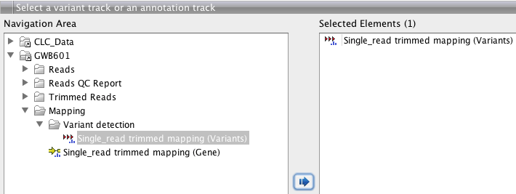
Select variant tracks

Slide 69
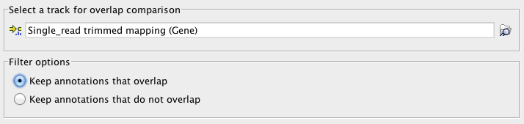
Select gene track
Keep annotation that overlap → SNPs are interior of gene
Keep annotation that do not overlap → SNPs are not on the gene

Slide 70
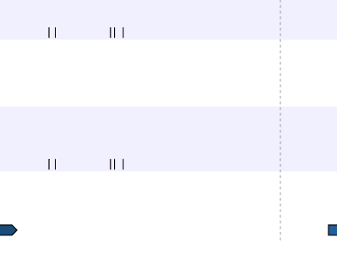

SNPs are not interior of gene
SNP on gene

Slide 71
Workflow Engine

Slide 72
Advantage of Workflow Engine
Connect analysis functionalities in CLC Genomics workbench & Genomics server
Flexible to design
Easy to configure
Convenient to share

Slide 73
Procedure to design workflow
Add Element
Select “Workflow Input”
Select multiple functionalities (press ctrl key + select multiple functionalities)
Select “Workflow output”
Workflow output can be multi-output
Configure & save workflow
Run workflow

Slide 74

Function 1
Function 2
Function 3

Slide 75
Press Element
Press Workflow Input

Slide 76
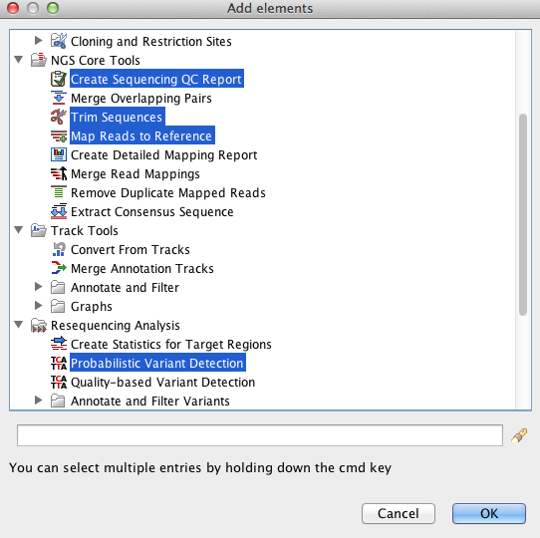
Select functions → Press OK

Slide 77

Drag & drop workflow elements

Slide 78


Add an output element, name as “Reads QC report”
Connect elements between Report and output

Slide 79

Create more “output elements” and connect elements each other

Slide 80


Press “Save” key, assign the name & location for the workflow

Slide 81
Press “Run”, select reads, reference and related track/parameters
Then process the workflow

Slide 82
For more information
Please welcome to
www.clcbio.com/tutorial

