Slide 1
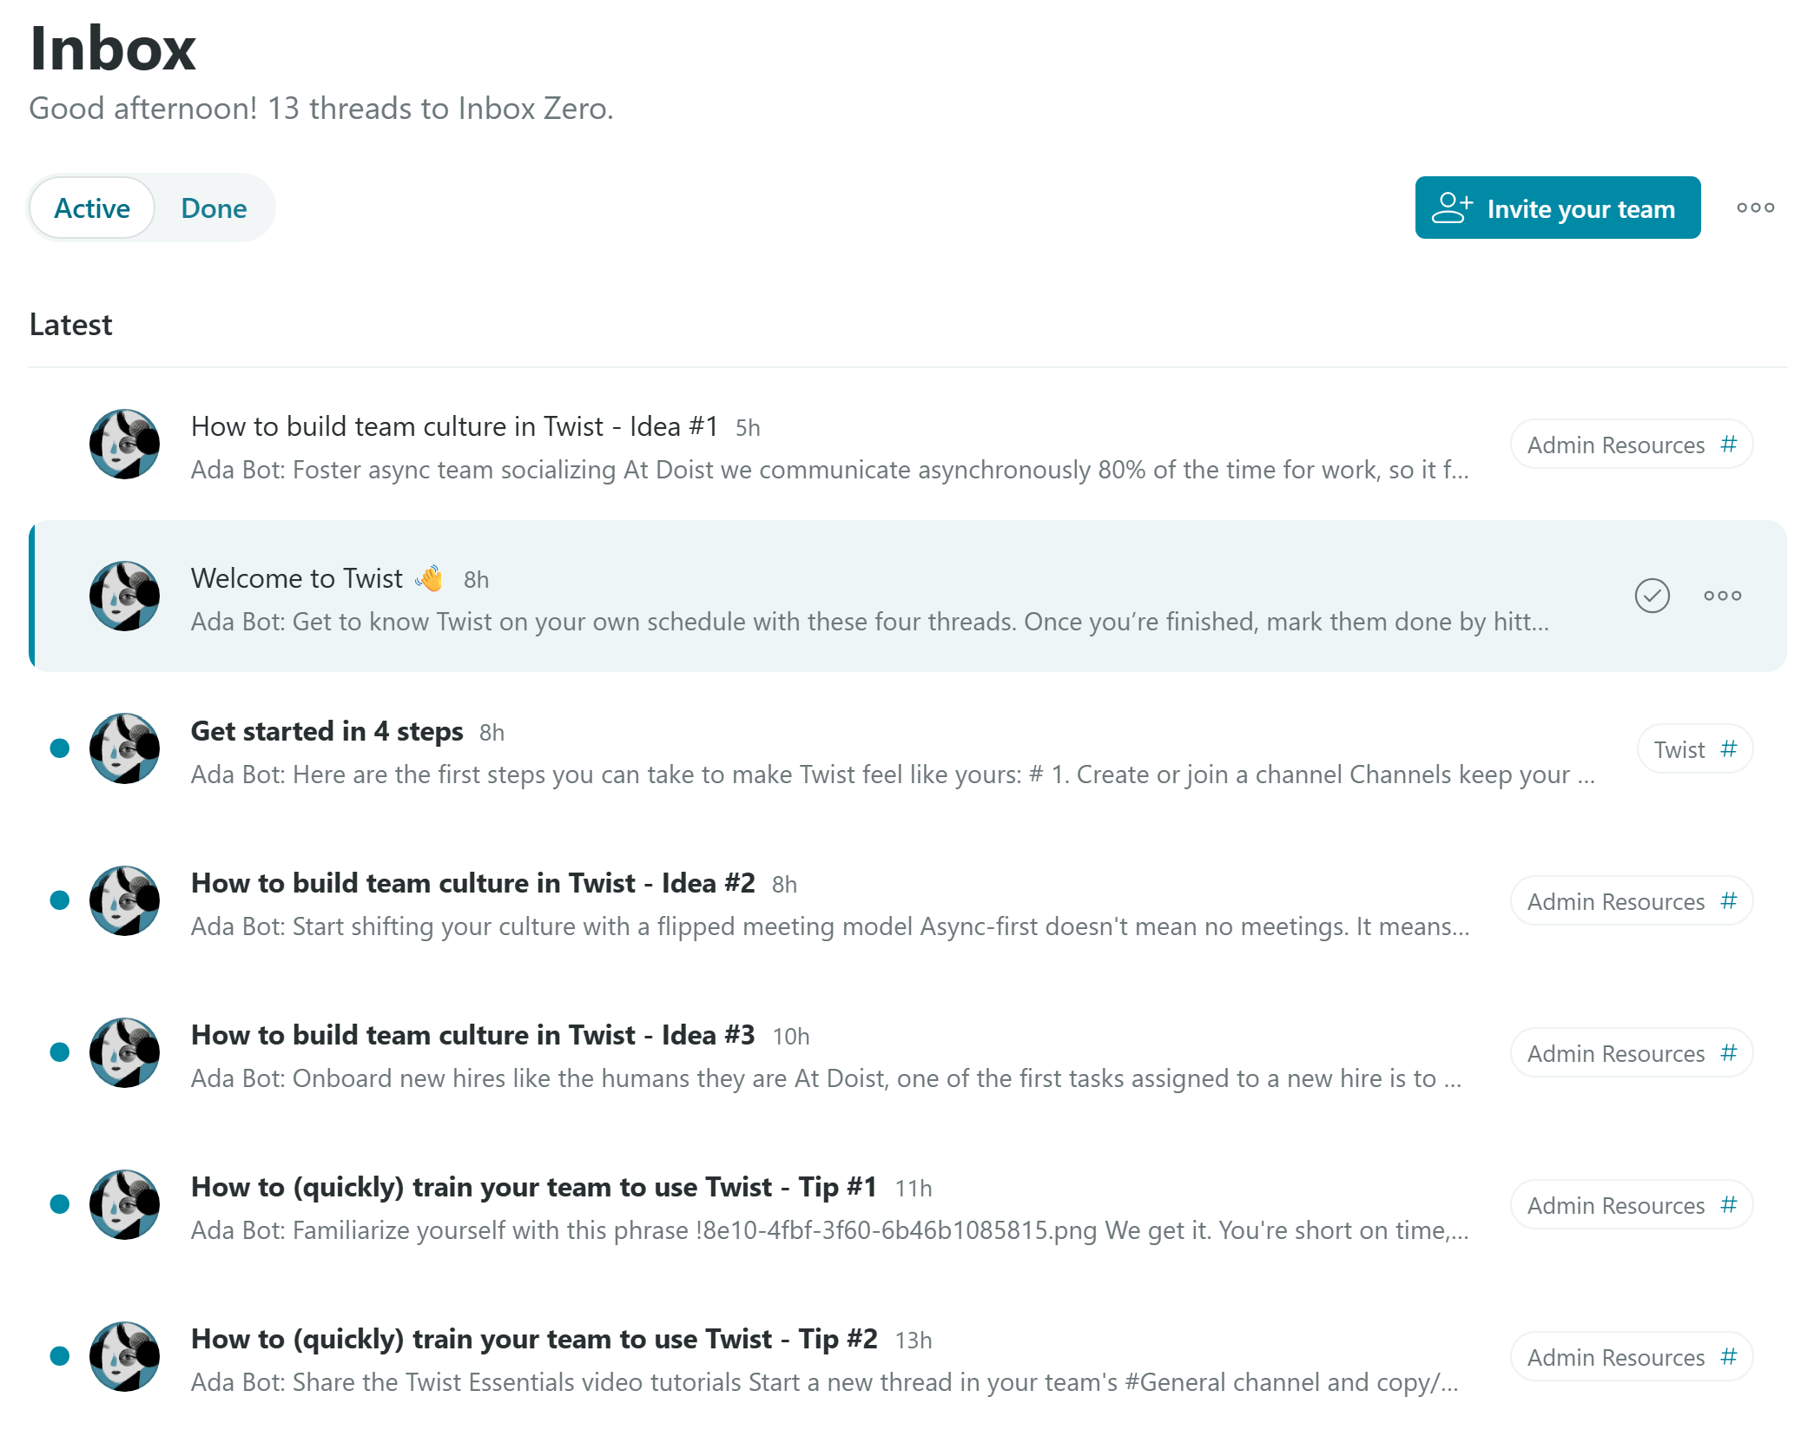

Slide 2
emails
All
Unread
New Email

