Slide 1
Star Preference in the NBA: A test of bias in professional basketball
Andrew Wei

Slide 2
Abstract
NBA refereeing has a large impact on the outcomes of many games, so much so that many NBA players view it as one of the biggest problems facing the sport. The 2007 NBA betting scandal involving former referee Tim Donaghy exposed many issues regarding NBA officiating impartiality.
In previous years, NBA refereeing has been accused of various biases, a charge the league fervently denies. Nevertheless, I find evidence in the data that there does exist a robust "star bias" in the process of awarding fouls in the NBA. This bias persists, though in weaker form, when looking at times when the game is close.
"You can’t get too close to Michael [Jordan] or it’s a foul” - Magic

Slide 3
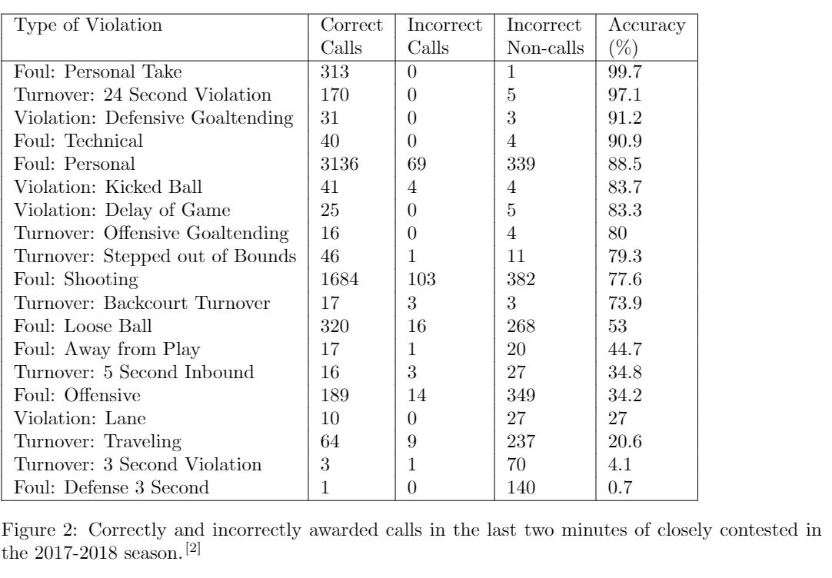
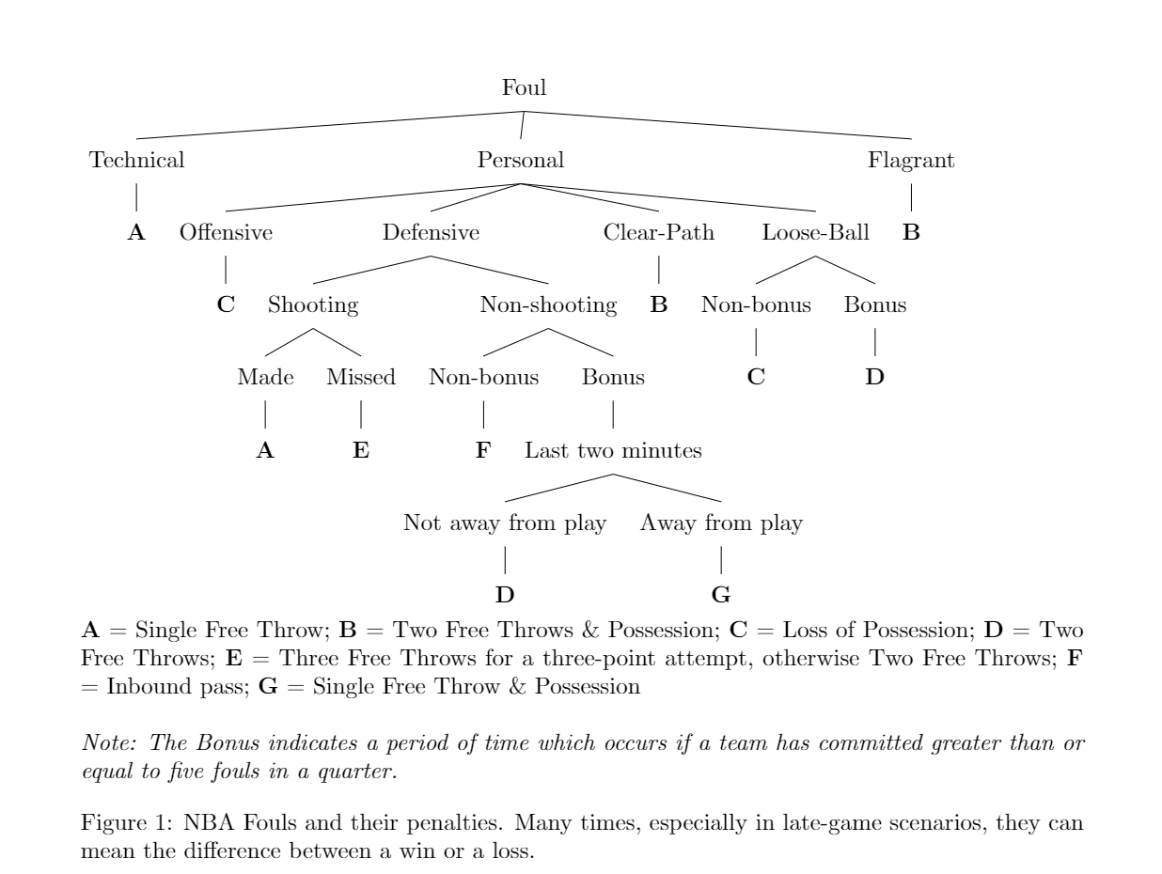
Missed calls happen quite a lot

Slide 4
Existing Literature
Wolfers and Price (2007) demonstrated that there was a significant in-group preference on the part of officials - that "more personal fouls are called against players when they are officiated by an opposite-race refereeing crew than when officiated by an own-race crew.
Price, Remer and Stone (2009) demonstrated that referees favor home teams, teams losing during games, and teams losing in playoff series.
Caudill, Mixon and Wallace (2014) used data during the 2011 NBA Playoffs series star players are awarded a greater amount of free throw attempts during the fourth quarter of NBA Playoff games. In particular, they found that there was an increase in the number of free throw attempts awarded compared to the early-game period, compared to the increase the amount of field goal attempts. This would signify that star players are indeed getting a boost in the number of free throw attempts relative to their production, relative to their non-star peers.
However, their results are opposed by Deutscher (2015). In March 2015, the NBA released data regarding ex-post league evaluation of officials’ calls made in the last two minutes of closely contested games. This data showed that there was no bias for star players on a team.

Slide 5
Gaps in the Literature
Divided on existence of star bias
“Last two minutes" dataset could potentially introduce bias
Potential structural effects in basketball games that lead towards star players drawing fouls during high-stakes games
All focus on late-game only
Sample size small

Slide 6
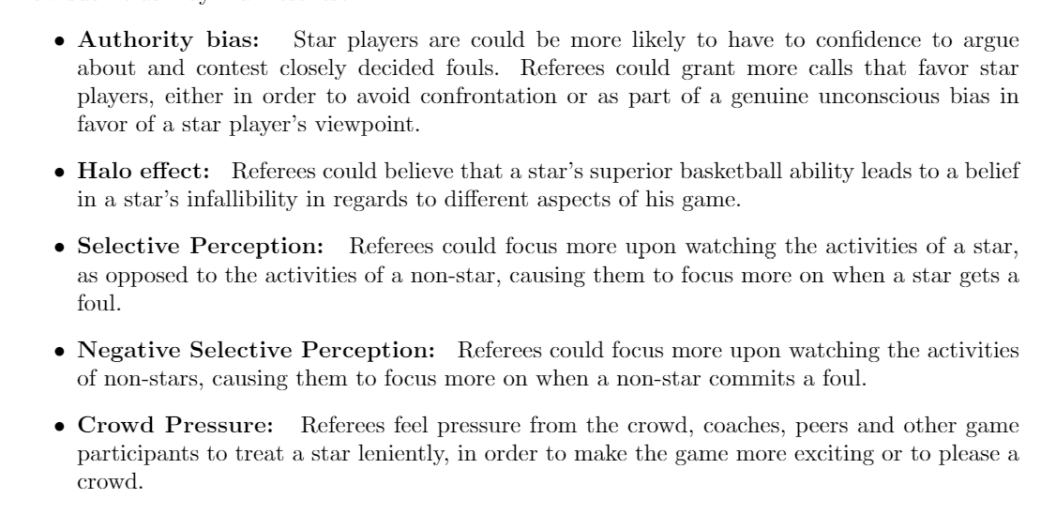
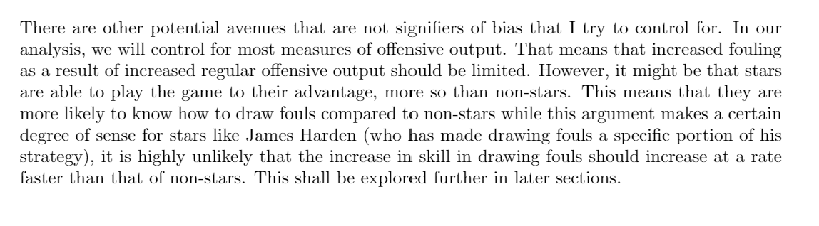
H1: In the course of regular gameplay, NBA star players are more likely to draw fouls

Slide 7
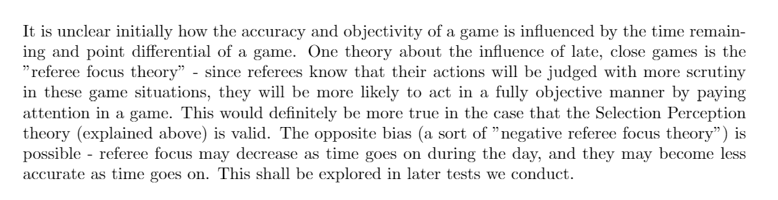
H2 and H3: Impact of late, close games

Slide 8
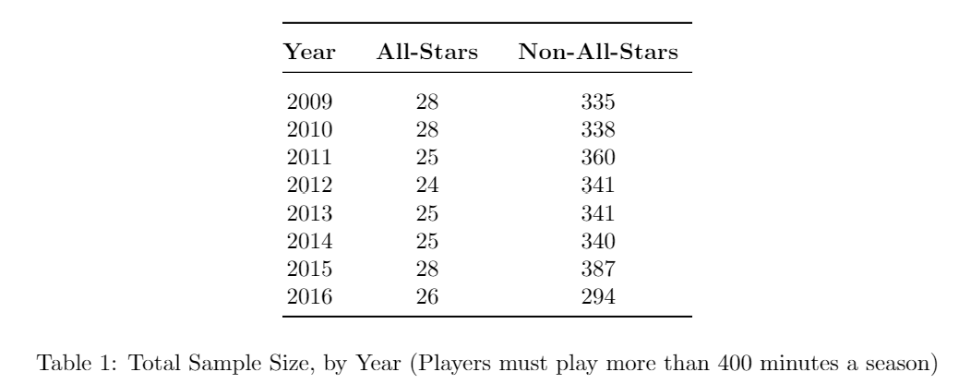
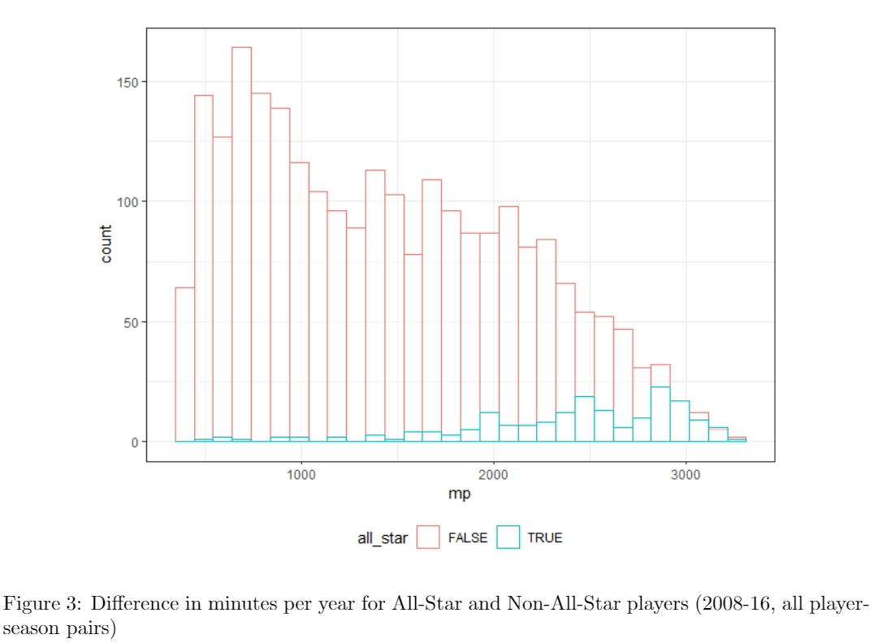
Data Sources
Our primary data source involves play-by-play data from the 2008-09 seasons to the 2015-2016 seasons. This data source was acquired from Eight Thirty-Four, a basketball analytics website.
(player, play, time, date, game)
Furthermore, additional data on player production and box scores was acquired from Basketballreference.com. (player, season, statistics)
Getting rid <400 mins. Look at all_stars

Slide 9
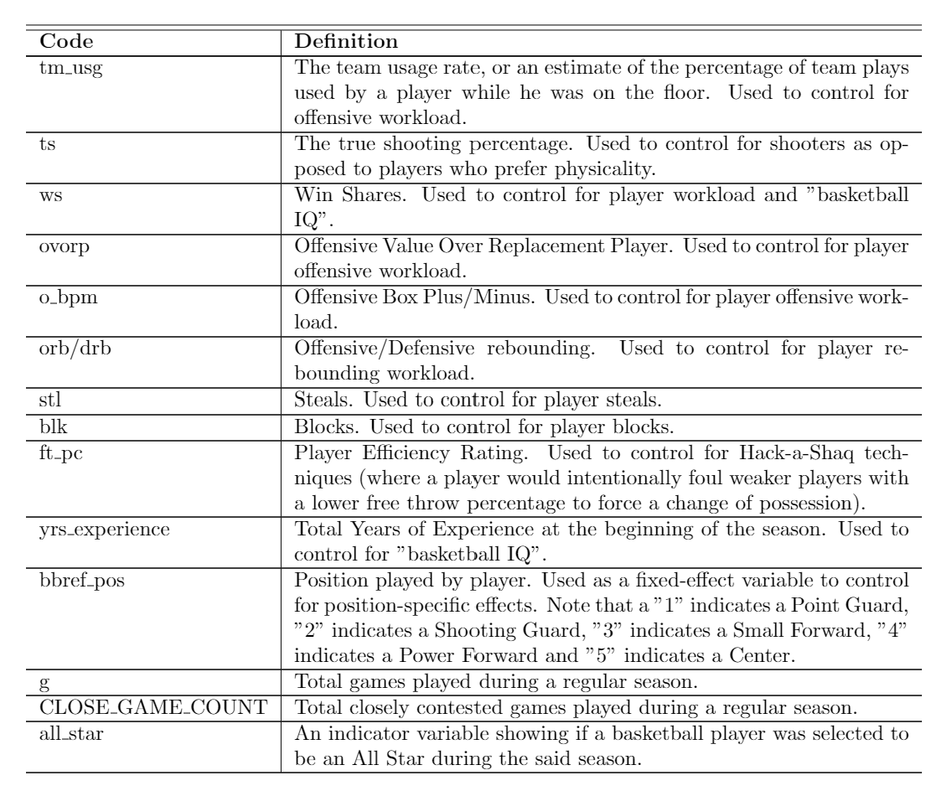
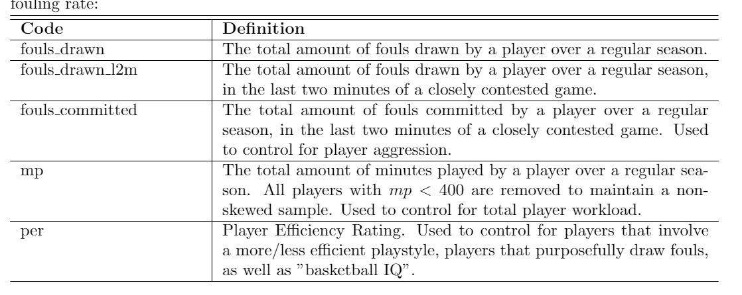
Controls

Slide 10
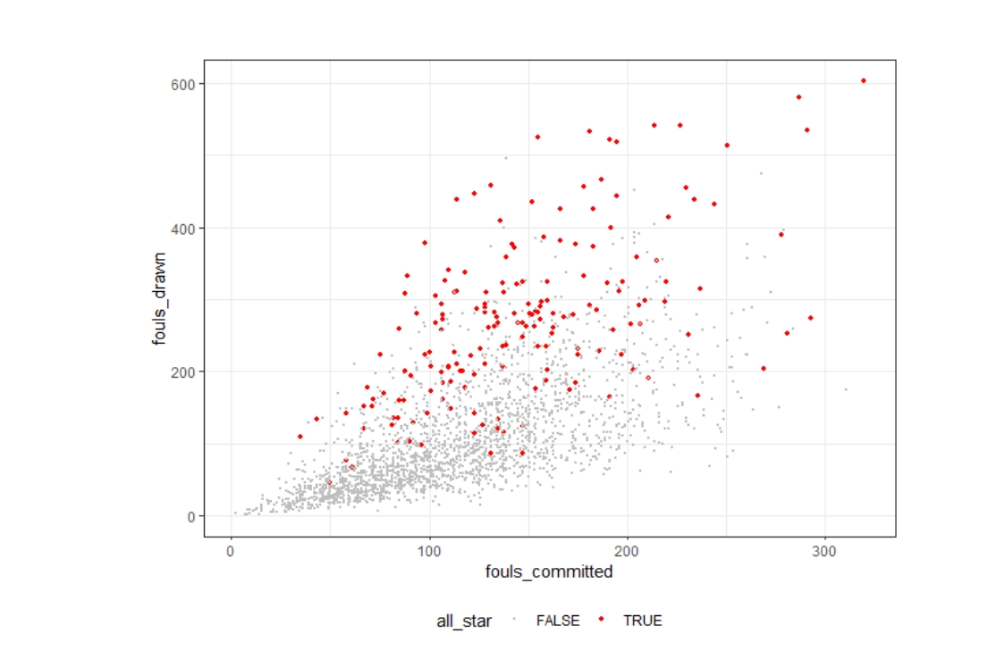
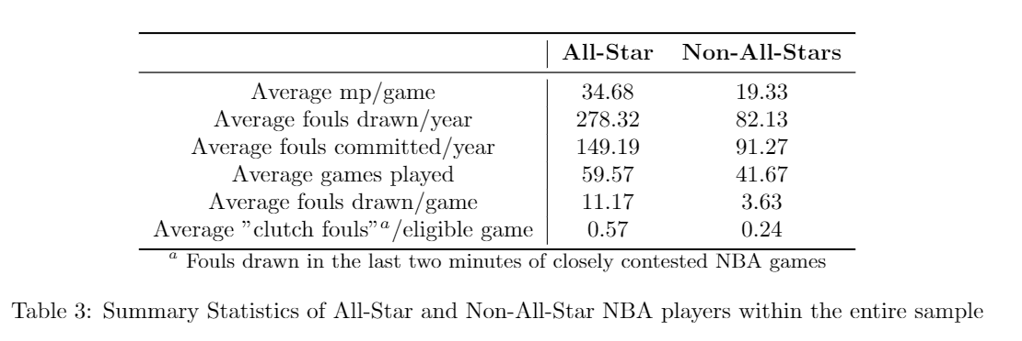
Data Statistics

Slide 11
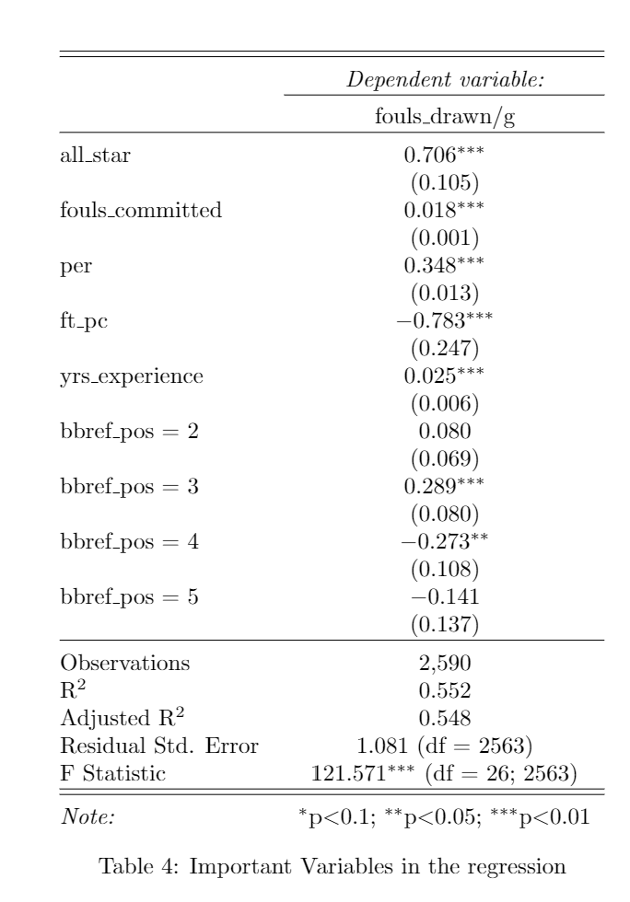
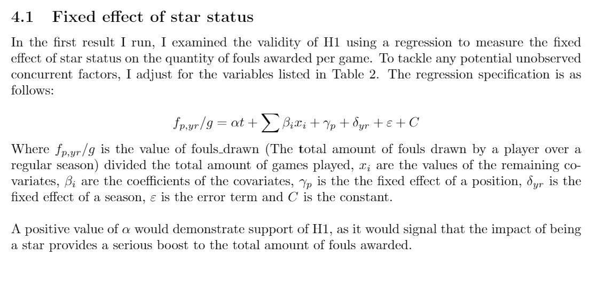
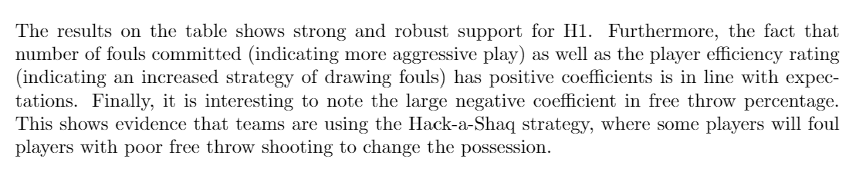
Results: First Regression

Slide 12
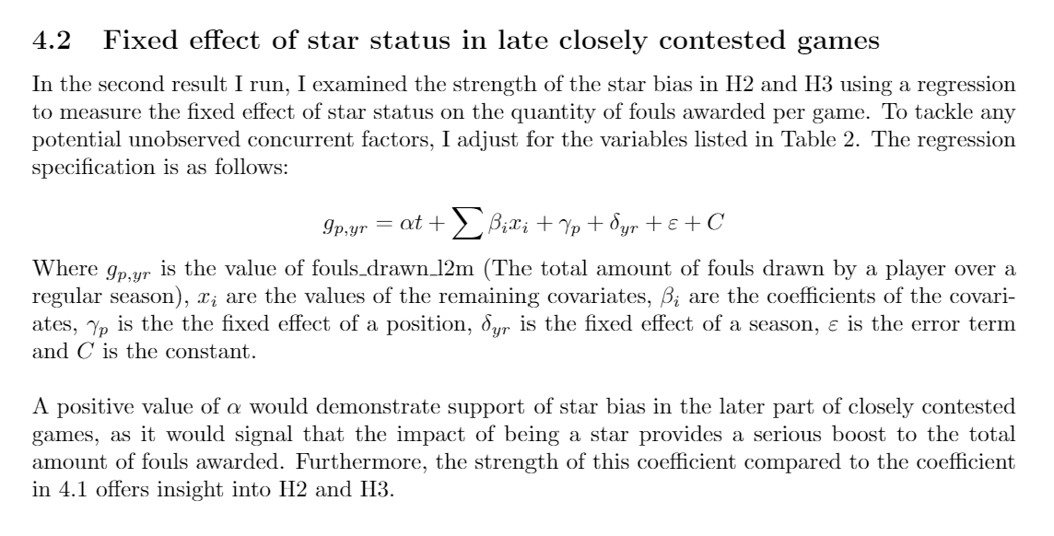
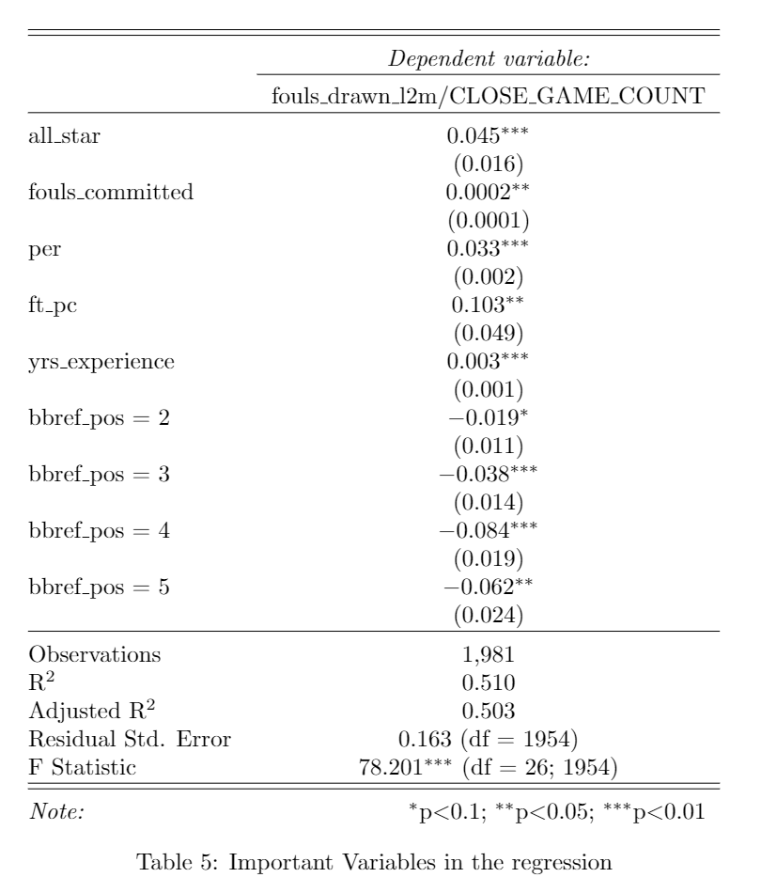
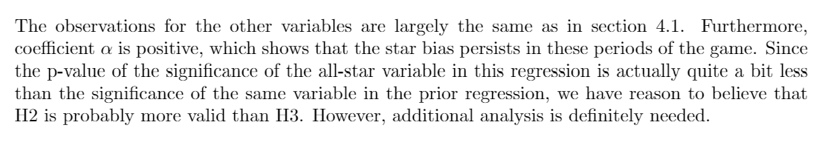
Results: Second Regression

Slide 13
Takeaways (Preliminary)
NBA star bias exists (in line with Wallace 2014. Not Deutcher 2015)
NBA star bias probably decreases as time goes on and the end of the game approaches (in line with Deutcher 2015. Not Wallace 2014)
NBA star bias still exists at the end of the game (in line with Wallace 2014. Not Deutcher 2015)

Slide 14
Things to Do
Test H2/H3.What exactly could I do to do this?
Looking at value of coefficient as we narrow the criteria [various different cutoffs]. ie. last 2 mins, last 5 mins, last quarter, etc.
Chi-sq? (multiple chi-sqs per person or just a single massive one?)
Fixed effect regression (?)
Robustness tests to conduct
Varying variables included
Varying year/by/year results
Varying number of mins cutoff

