Slide 1
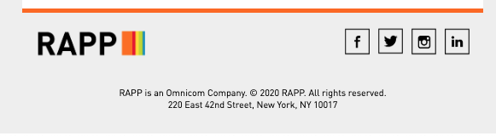
Main Campaign WRAPPER

Slide 2

Header

Slide 3
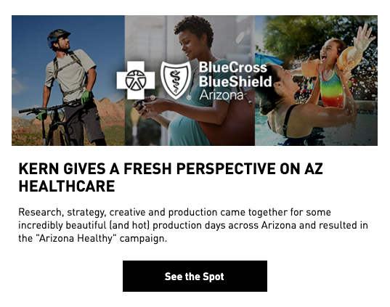
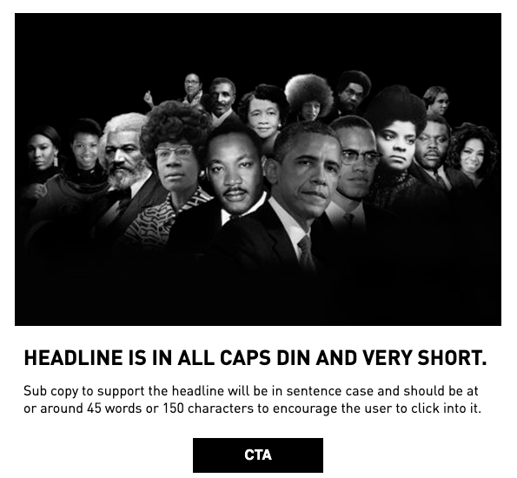

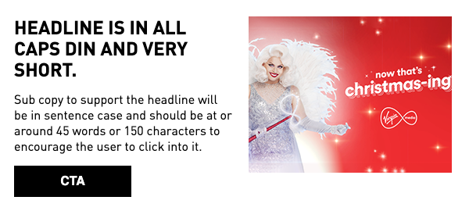
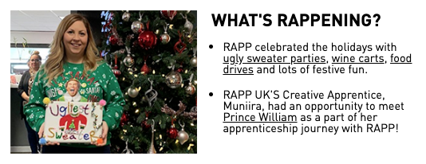
Featured Story Module
Image Ratio is configurable (2 ratios found)
Body copy can be lengthy
CTA Optional
Sub Story Module
With or without CTA
Image right or left aligned

Slide 4
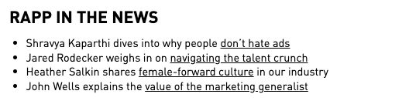
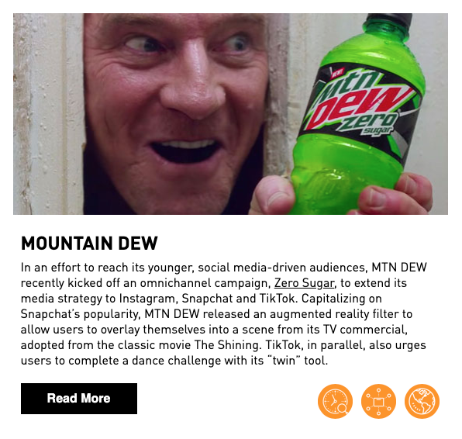
Bullet Listing
CMI Story
Notes:
Image optional
Headline Optional
Body Copy optional

Slide 5
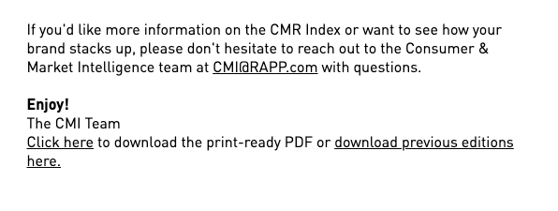
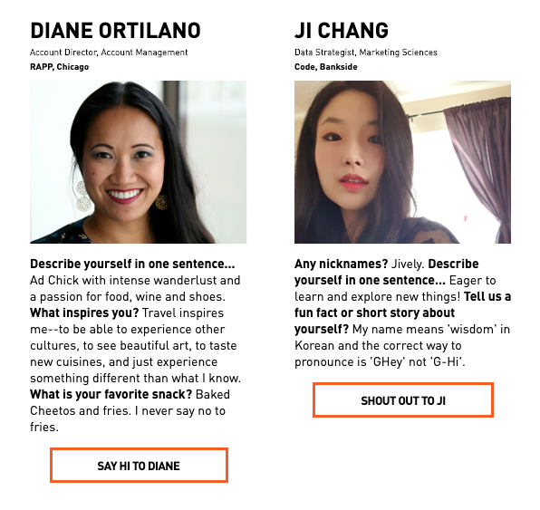
Text only Module
<>
Custom HTML Module
Featured People Collection

