Slide 1
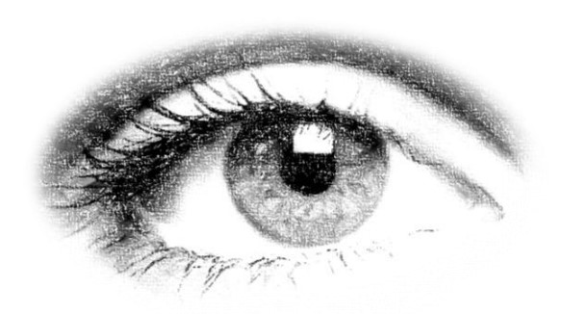

Final Project Computer Vision: from Recognition to Geometry
R06942114 劉彥廷 R07942063 郭冠軒
R07942074 李元顥 R07942077 楊福恩
Jan. 18, 2019

Slide 2
Outline
Preprocessing
Max Disparity Decision
Cost Estimation
Cost Aggregation
Disparity Optimization
Disparity Refinement

Slide 3
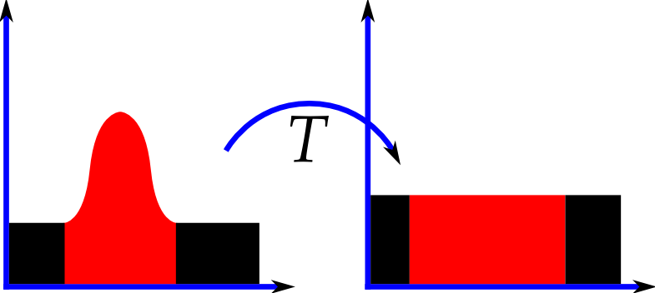
Preprocessing
Histogram Equalization

Slide 4
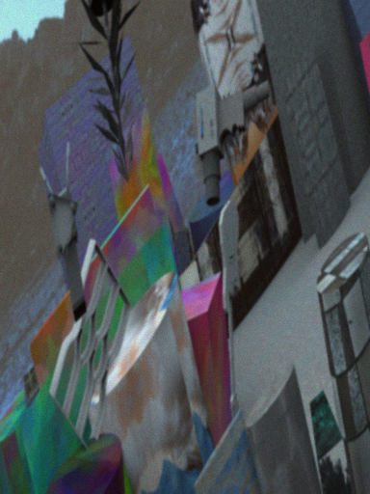
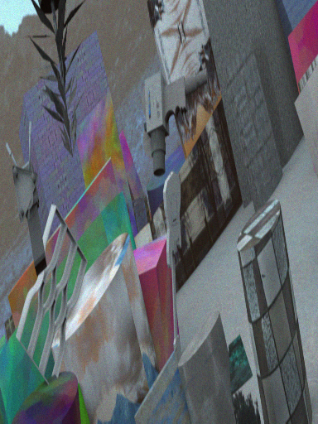
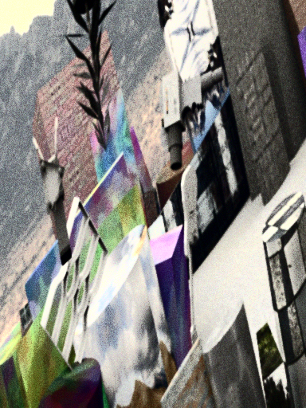
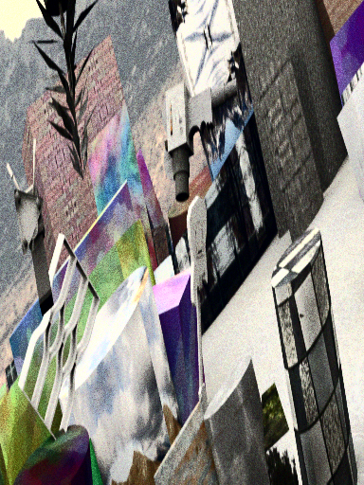
Preprocessing
Histogram Equalization
Left
Right
Before
After

Slide 5
Max Disparity Decision
Matching cost of repetitive patterns should exhibit the following trend

Slide 6
Max Disparity Decision
Pick the median of first two local minima as the max disparity for this pixel
Min1
d_{max}(p)
Min2

Slide 7

Cost Estimation
Truncated $L_{1}$-norm cost
$$C=\min\left(\left|I_{p}−I_{q}\right|, τ\right)\text{, }\text{we} \text{set} τ=15$$

Slide 8
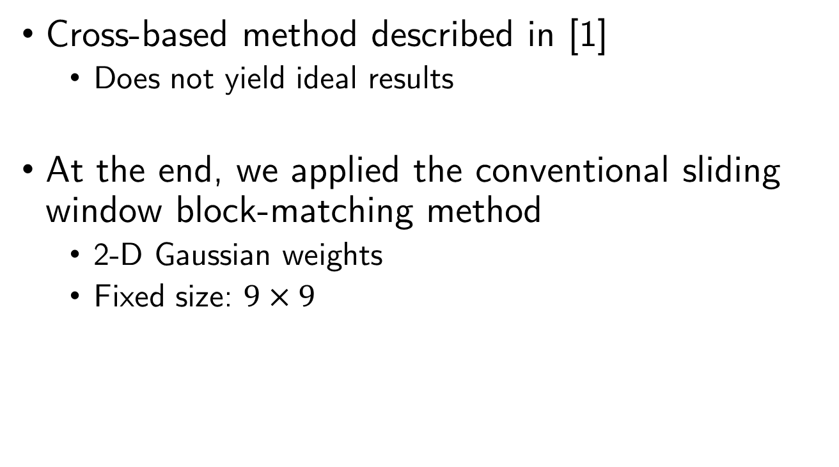
Cost Aggregation
Cross-based method described in [1]
Does not yield ideal results
At the end, we applied the conventional sliding window block-matching method
2-D Gaussian weights
Fixed size: $9×9$
[1] K. Zhang, J. Lu and G. Lafruit, “Cross-Based Local Stereo Matching Using Orthogonal Integral Images,” in IEEE Transactions on Circuits and Systems for Video Technology, vol. 19, no. 7, pp. 1073-1079, July 2009.

Slide 9
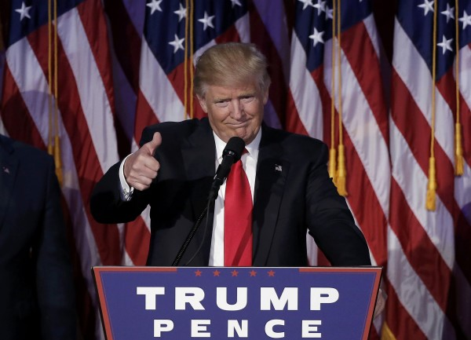
Disparity Optimization
Conventional winner-take-all (WTA) is applied in our method

Slide 10
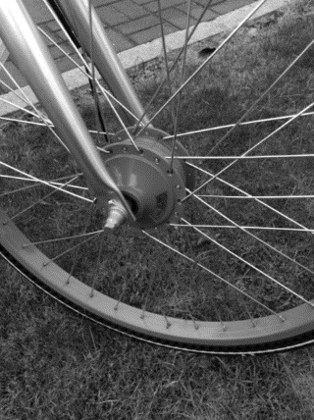
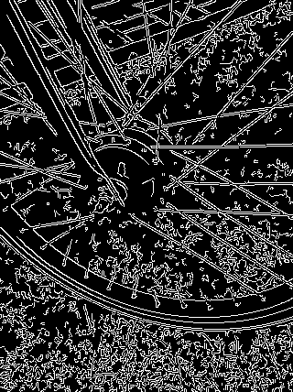
Disparity Refinement
Edge Detection
Perform edge detection algorithm on input images

Slide 11
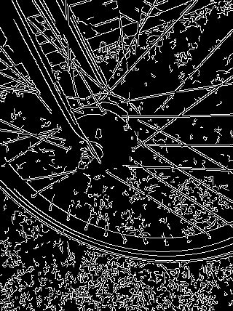
Disparity Refinement
Edge Detection
Perform disparity estimation using edge images as input pairs

Slide 12
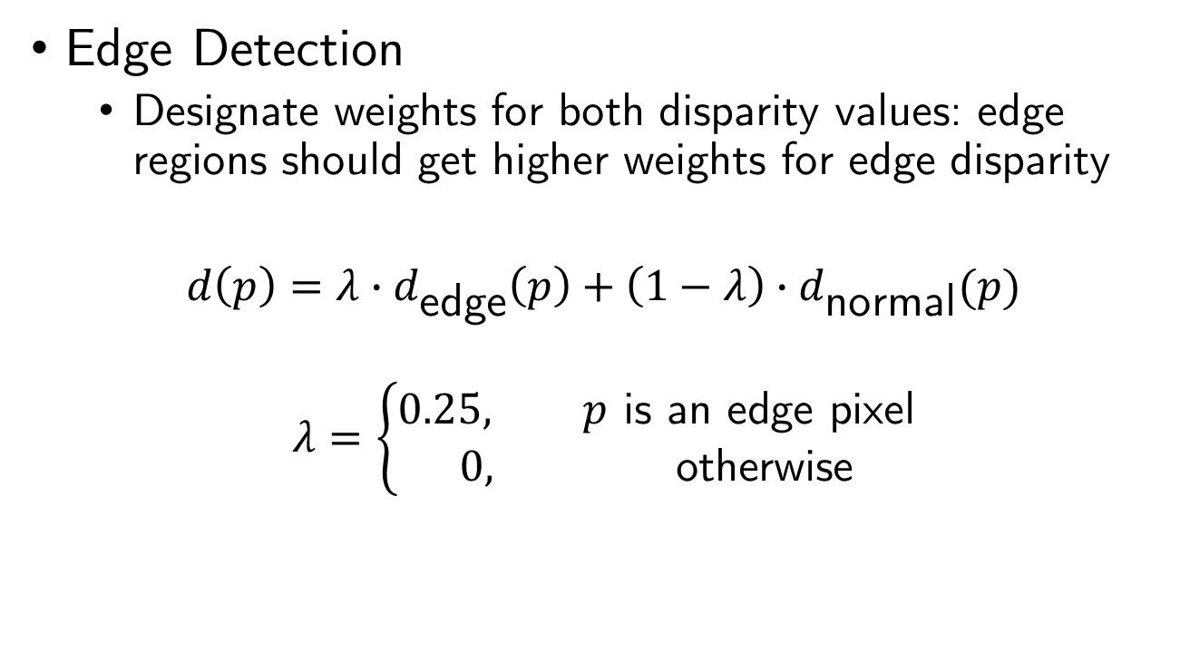
Disparity Refinement
Edge Detection
Designate weights for both disparity values: edge regions should get higher weights for edge disparity
$$d\left(p\right)=λ∙d_{\text{edge}}\left(p\right)+\left(1−λ\right)∙d_{\text{normal}}(p)$$
$$λ=\left\{\begin{aligned}0.25, p \text{is} \text{an} \text{edge} \text{pixel} \\ 0, \text{otherwise}\end{aligned}\right.$$

Slide 13
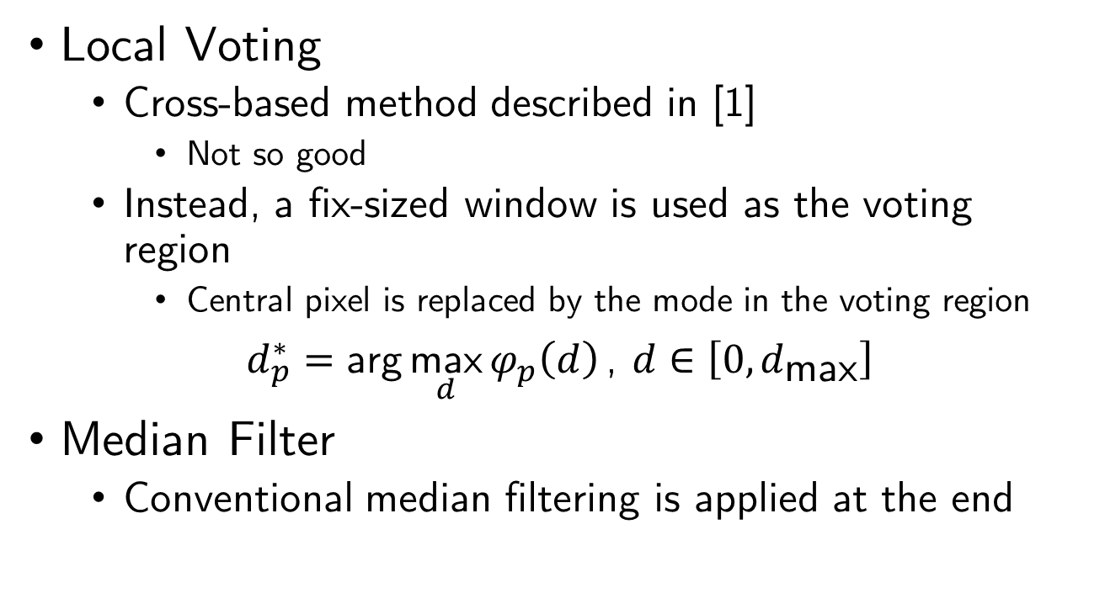
Disparity Refinement
Local Voting
Cross-based method described in [1]
Not so good
Instead, a fix-sized window is used as the voting region
Central pixel is replaced by the mode in the voting region
$$d_{p}^{∗}=\text{arg}{\underset{d}{\text{max}}{φ_{p}\left(d\right)}}\text{, }d∈\left[0, d_{\text{max}}\right]$$
Median Filter
Conventional median filtering is applied at the end
[1] K. Zhang, J. Lu and G. Lafruit, “Cross-Based Local Stereo Matching Using Orthogonal Integral Images,” in IEEE Transactions on Circuits and Systems for Video Technology, vol. 19, no. 7, pp. 1073-1079, July 2009.

Slide 14
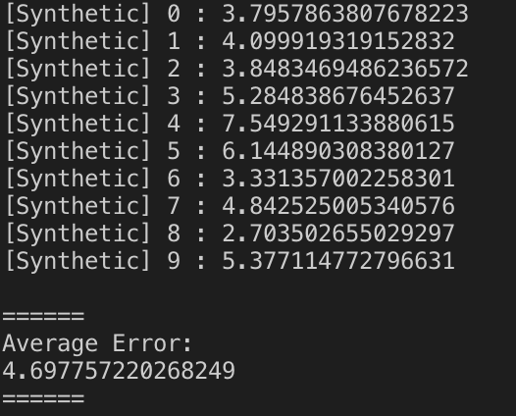
Results (Synthetic)

Slide 15
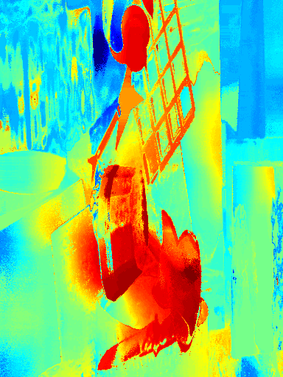
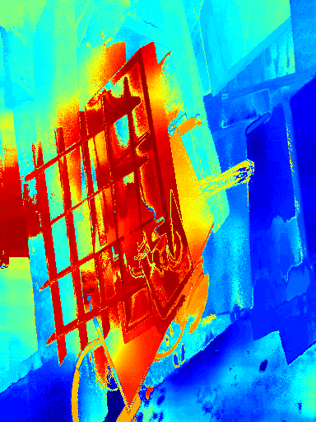
Results (Synthetic)

Slide 16
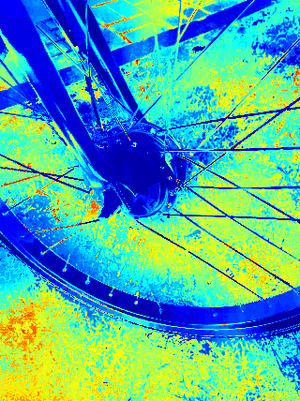
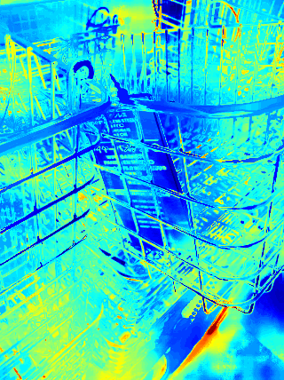
Results (Real)

