Slide 1
University of Padova
Department of Mathematics
Master Thesis in Data Science
Fairness in Rankings via Randomized Algorithms
Supervisor:
Tomaso Erseghe
University of Padova
Master Candidate:
Andrii Kliachkin
15/04/2024 andrii.kliachkin@studenti.unipd.it 1

Slide 2
Presentation Plan
Motivation: Why do we need to promote fairness in ML?
Preliminaries on Algorithmic Fairness
Preliminaries on Ranking
Types of Fairness Algorithms
Our contribution: A Random Approach to Fairness
Experimental comparison
Conclusion
15/04/2024 andrii.kliachkin@studenti.unipd.it 2

Slide 3
Thesis Objectives
Investigate a new algorithm for dealing with fairness in rankings that does not use information about the sensitive attributes
Test the algorithm against state-of-the-art post-processing methods in different experimental settings
15/04/2024 andrii.kliachkin@studenti.unipd.it 2

Slide 4
Motivation: Fair Machine Learning
Machine learning (ML) models are used more and more in areas that impact human lives in a significant way – from university admissions to refugee asylum decisions^{1,2};
Decisions produced by ML models may – and in many cases, have been shown to – be biased against some groups of the population
EXAMPLE 1
EXAMPLE 2
No fairness through unawareness: simply removing the sensitive attributes is not enough
[1] Jasmontaite-Zaniewicz, L., & Zomignani Barboza, J. (2021). Disproportionate Surveillance: Technology-Assisted and Automated Decisions in Asylum Applications in the EU?. International Journal of Refugee Law, 33(1), 89-110.
[2] N. Y. T. Meredith Broussard, “When algorithms give real students imaginary grades,” https : / / web . archive . org / web / 20240223090531 / https : / / www . nytimes . com /2020/09/08/opinion/international-baccalaureate-algorithm-grades.html, [Online; Accessed: 2024-25-03]
15/04/2024 andrii.kliachkin@studenti.unipd.it 2

Slide 5
Sources of Algorithmic Bias
Machine learning (ML) models are used more and more in areas that impact human lives in a significant way – from university admissions to refugee asylum decisions^{1,2};
Decisions produced by ML models may – and in many cases, have been shown to – be biased against some groups of the population.
Talk abt ranking
[1] Jasmontaite-Zaniewicz, L., & Zomignani Barboza, J. (2021). Disproportionate Surveillance: Technology-Assisted and Automated Decisions in Asylum Applications in the EU?. International Journal of Refugee Law, 33(1), 89-110.
[2] N. Y. T. Meredith Broussard, “When algorithms give real students imaginary grades,” https : / / web . archive . org / web / 20240223090531 / https : / / www . nytimes . com /2020/09/08/opinion/international-baccalaureate-algorithm-grades.html, [Online; Accessed: 2024-25-03]
15/04/2024 andrii.kliachkin@studenti.unipd.it 2

Slide 6
Complication: Group vs. Individual Fairness
Approaches to algorithmic fairness are divided into two categories: group and individual fairness
Group:
Individual:
[1] Jasmontaite-Zaniewicz, L., & Zomignani Barboza, J. (2021). Disproportionate Surveillance: Technology-Assisted and Automated Decisions in Asylum Applications in the EU?. International Journal of Refugee Law, 33(1), 89-110.
[2] N. Y. T. Meredith Broussard, “When algorithms give real students imaginary grades,” https : / / web . archive . org / web / 20240223090531 / https : / / www . nytimes . com /2020/09/08/opinion/international-baccalaureate-algorithm-grades.html, [Online; Accessed: 2024-25-03]
15/04/2024 andrii.kliachkin@studenti.unipd.it 2

Slide 7
Complication: Blind Fairness
fuck off google im not giving you my datas
[1] Jasmontaite-Zaniewicz, L., & Zomignani Barboza, J. (2021). Disproportionate Surveillance: Technology-Assisted and Automated Decisions in Asylum Applications in the EU?. International Journal of Refugee Law, 33(1), 89-110.
[2] N. Y. T. Meredith Broussard, “When algorithms give real students imaginary grades,” https : / / web . archive . org / web / 20240223090531 / https : / / www . nytimes . com /2020/09/08/opinion/international-baccalaureate-algorithm-grades.html, [Online; Accessed: 2024-25-03]
15/04/2024 andrii.kliachkin@studenti.unipd.it 2

Slide 8
Fairness Recap
Fairness in ML is necessary but difficult to enforce
Two main approaches to fairness exist: Group and Individual
Sometimes the group membership information is not available
[1] Jasmontaite-Zaniewicz, L., & Zomignani Barboza, J. (2021). Disproportionate Surveillance: Technology-Assisted and Automated Decisions in Asylum Applications in the EU?. International Journal of Refugee Law, 33(1), 89-110.
[2] N. Y. T. Meredith Broussard, “When algorithms give real students imaginary grades,” https : / / web . archive . org / web / 20240223090531 / https : / / www . nytimes . com /2020/09/08/opinion/international-baccalaureate-algorithm-grades.html, [Online; Accessed: 2024-25-03]
15/04/2024 andrii.kliachkin@studenti.unipd.it 2

Slide 9
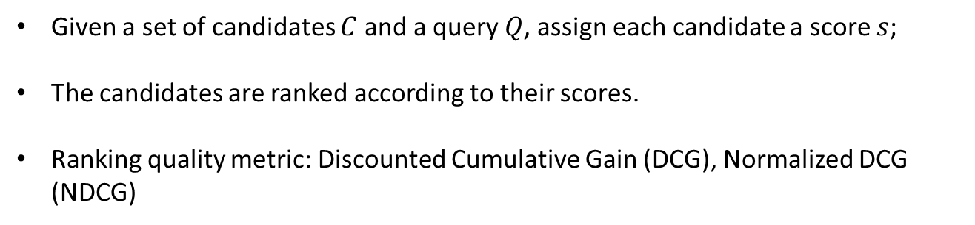

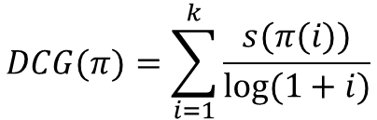
Ranking
Given a set of candidates $C$ and a query $Q$, assign each candidate a score $s$;
The candidates are ranked according to their scores.
Ranking quality metric: Discounted Cumulative Gain (DCG), Normalized DCG (NDCG)
$$DCG(π)=\sum_{i=1}^{k}{\frac{s(π(i))}{log⁡(1+i)}}$$
$$NDCG\left(π\right)=\frac{DCG(π)}{IDCG(π)}$$
where $IDCG(π)$ is the Ideal DCG – DCG of a score-based reordering of $π$.
15/04/2024 andrii.kliachkin@studenti.unipd.it 2

Slide 10
Approaches to Algorithmic Fairness
Pre-processing: modify the training data to remove disparities between groups
Advantages: early intervention, no explicit information on group membership needed
Disadvantages: focus on individual fairness, difficult to deploy
15/04/2024 andrii.kliachkin@studenti.unipd.it 2

Slide 11
Approaches to Algorithmic Fairness
Pre-processing: modify the training data to remove disparities between groups
Advantages: early intervention, no explicit information on group membership needed
Disadvantages: focus on individual fairness, difficult to deploy
In-processing: modify the model’s loss function to reduce discrimination
Advantages: trade-off between accuracy and fairness
Disadvantages: trade-off between accuracy and fairness, difficult to deploy
15/04/2024 andrii.kliachkin@studenti.unipd.it 2

Slide 12
Approaches to Algorithmic Fairness
Pre-processing: modify the training data to remove disparities between groups
Advantages: early intervention, no explicit information on group membership needed
Disadvantages: focus on individual fairness, difficult to deploy
In-processing: modify the model’s loss function to reduce discrimination
Advantages: trade-off between accuracy and fairness
Disadvantages: trade-off between accuracy and fairness, difficult to deploy
Post-processing: modify the model’s output to reduce discrimination
Advantages: guarantees on fairness, ease of implementation, explainability
Disadvantages: substantial loss of performance
15/04/2024 andrii.kliachkin@studenti.unipd.it 2

Slide 13
Approaches to Algorithmic Fairness
Pre-processing: modify the training data to remove disparities between groups
Advantages: early intervention, no explicit information on group membership needed
Disadvantages: focus on individual fairness, difficult to deploy
In-processing: modify the model’s loss function to reduce discrimination
Advantages: trade-off between accuracy and fairness
Disadvantages: trade-off between accuracy and fairness, difficult to deploy
Post-processing: modify the model’s output to reduce discrimination
Advantages: guarantees on fairness, ease of implementation, explainability
Disadvantages: substantial loss of performance
In the case of ranking, modify the scores or reorder the candidates
15/04/2024 andrii.kliachkin@studenti.unipd.it 2

Slide 14
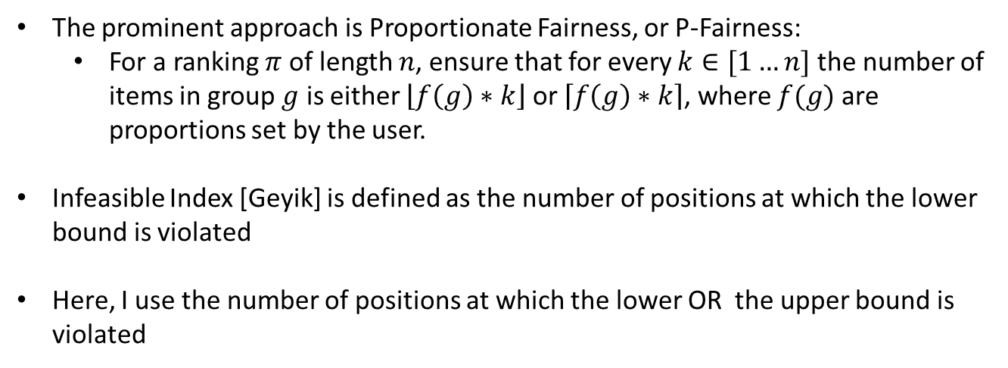
Metrics for Group Fairness in Ranking
The prominent approach is Proportionate Fairness, or P-Fairness:
For a ranking $π$ of length $n$, ensure that for every $k∈[1…n]$ the number of items in group $g$ is either $\left\lfloor f\left(g\right)∗k\right\rfloor$ or $\left\lceil f\left(g\right)∗k\right\rceil$, where $f(g)$ are proportions set by the user.
Infeasible Index [Geyik] is defined as the number of positions at which the lower bound is violated
Here, I use the number of positions at which the lower OR the upper bound is violated
15/04/2024 andrii.kliachkin@studenti.unipd.it 2

Slide 15
State-of-the-art Postprocessing Algorithms
DetConstSort [Geyik]
Approximate Multi-Valued IPF [RAPF]
Both reorder the candidates in the input ranking so that they satisfy p-fairness constraints
15/04/2024 andrii.kliachkin@studenti.unipd.it 2

Slide 16
Approaches to Blind Fairness
A growing body of work exists on blind fairness in classification [EXAMPLES]
To my best knowledge, only two academic works exist on blind fairness in rankings [detection]
Focus is on detecting groups that are performing exceptionally poorly according to some metric (scores, accuracy, false positive rate, etc.)
This still requires information about the protected attributes!
15/04/2024 andrii.kliachkin@studenti.unipd.it 2

Slide 17
Our Approach
No information is available on group membership or sensitive attribute values
Solution: study the impact of randomization on fairness metrics
«Shuffle» the candidates randomly
15/04/2024 andrii.kliachkin@studenti.unipd.it 2

Slide 18
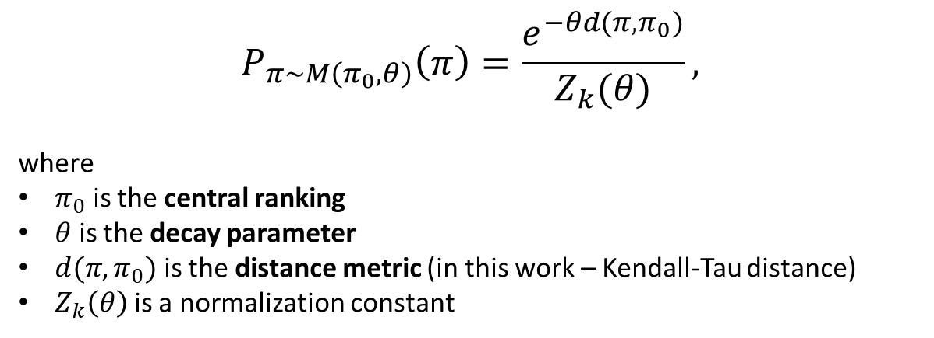
Our Approach
No information is available on group membership or sensitive attribute values
Solution: study the impact of randomization on fairness metrics
«Shuffle» the candidates randomly with Mallows distribution
$$P_{π∼M\left(π_{0},θ\right)}\left(π\right)=\frac{e^{−θd({π,π}_{0})}}{Z_{k}(θ)},$$
where
$π_{0}$ is the central ranking
$θ$ is the decay parameter
$d({π,π}_{0})$ is the distance metric (in this work – Kendall-Tau distance)
$Z_{k}\left(θ\right)$ is a normalization constant
15/04/2024 andrii.kliachkin@studenti.unipd.it 2

Slide 19
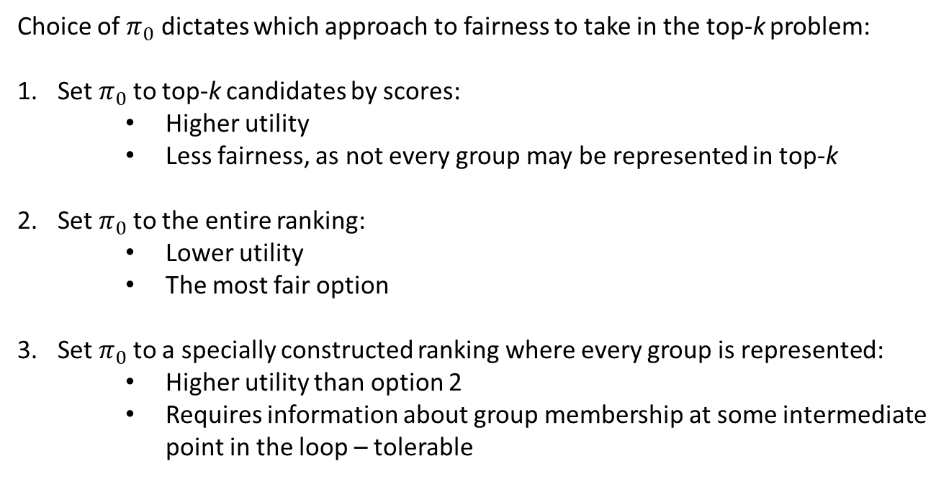
Choice of Parameters
Choice of $π_{0}$ dictates which approach to fairness to take in the top-k problem:
Set $π_{0}$to top-k candidates by scores:
Higher utility
Less fairness, as not every group may be represented in top-k
Set $π_{0}$to the entire ranking:
Lower utility
The most fair option
Set $π_{0}$to a specially constructed ranking where every group is represented:
Higher utility than option 2
Requires information about group membership at some intermediate point in the loop – tolerable
15/04/2024 andrii.kliachkin@studenti.unipd.it 2

Slide 20
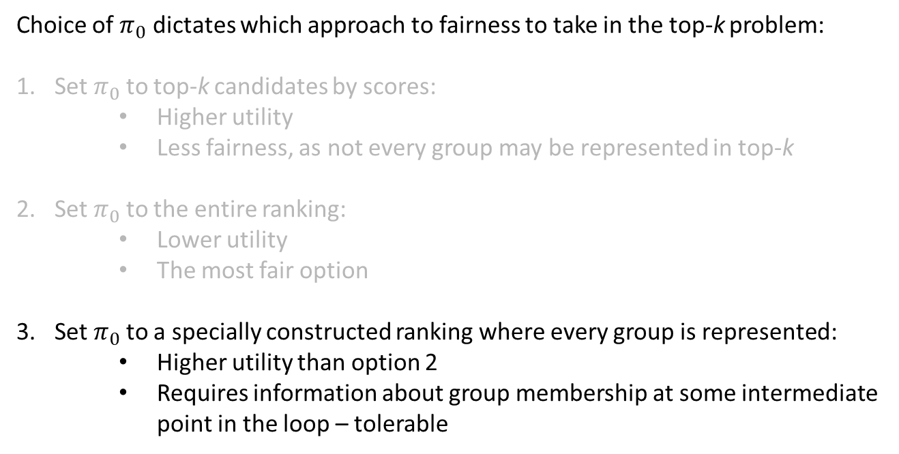
Choice of Parameters
Choice of $π_{0}$ dictates which approach to fairness to take in the top-k problem:
Set $π_{0}$to top-k candidates by scores:
Higher utility
Less fairness, as not every group may be represented in top-k
Set $π_{0}$to the entire ranking:
Lower utility
The most fair option
Set $π_{0}$to a specially constructed ranking where every group is represented:
Higher utility than option 2
Requires information about group membership at some intermediate point in the loop – tolerable
15/04/2024 andrii.kliachkin@studenti.unipd.it 2

Slide 21
Experimental design
I conducted three numerical experiments:
A simple setup to evaluate the impact of Mallows randomization on fairness
A setup with a synthetic dataset with random scores
A setup with a real-world dataset comparing Mallows randomization to state-of-the-art algorithms
15/04/2024 andrii.kliachkin@studenti.unipd.it 2

Slide 22
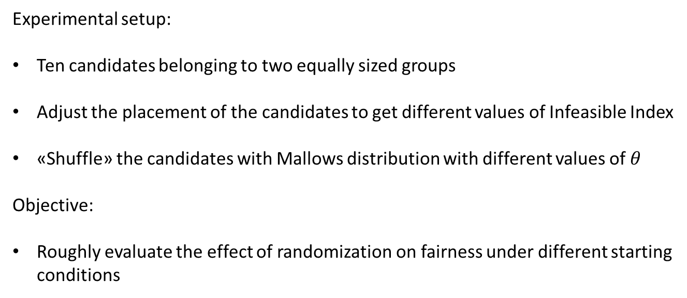
Experiment 1: Setup
Experimental setup:
Ten candidates belonging to two equally sized groups
Adjust the placement of the candidates to get different values of Infeasible Index
«Shuffle» the candidates with Mallows distribution with different values of $θ$
Objective:
Roughly evaluate the effect of randomization on fairness under different starting conditions
15/04/2024 andrii.kliachkin@studenti.unipd.it 2

Slide 23
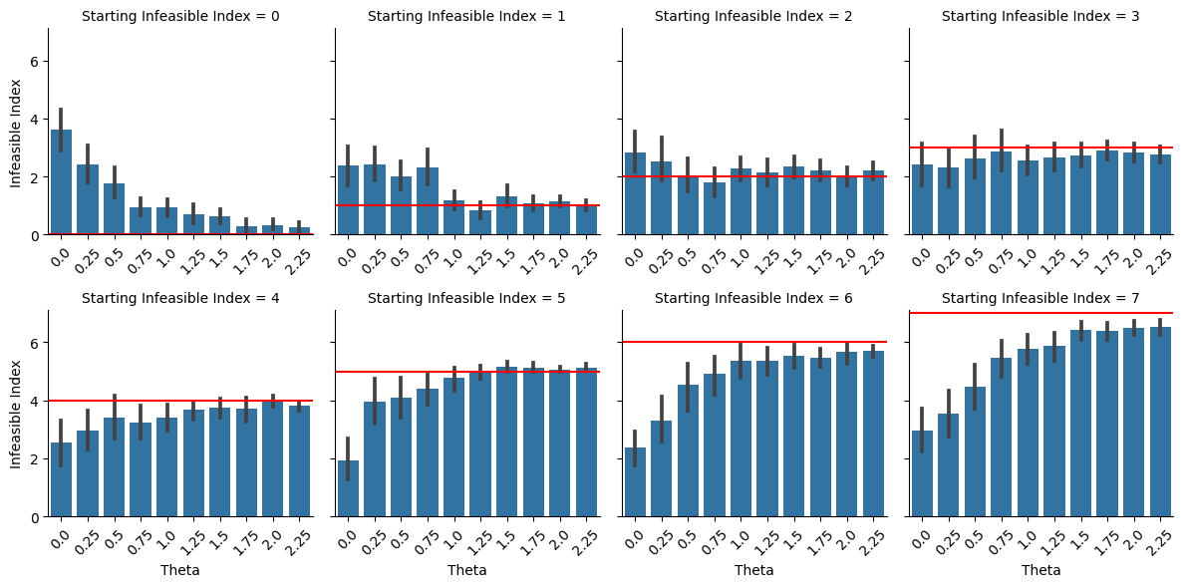
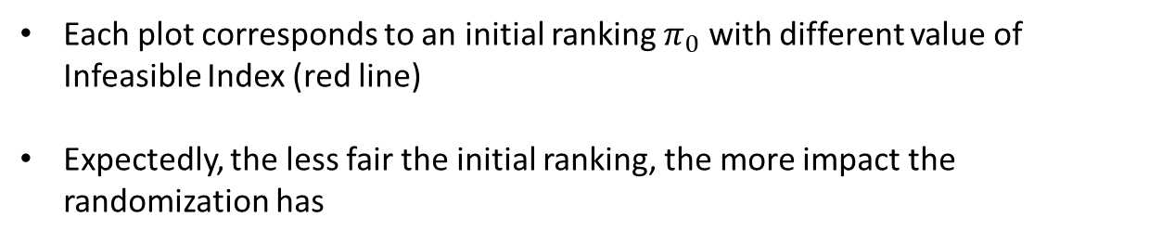
Experiment 1: Results
Each plot corresponds to an initial ranking $π_{0}$ with different value of Infeasible Index (red line)
Expectedly, the less fair the initial ranking, the more impact the randomization has
15/04/2024 andrii.kliachkin@studenti.unipd.it 2

Slide 24
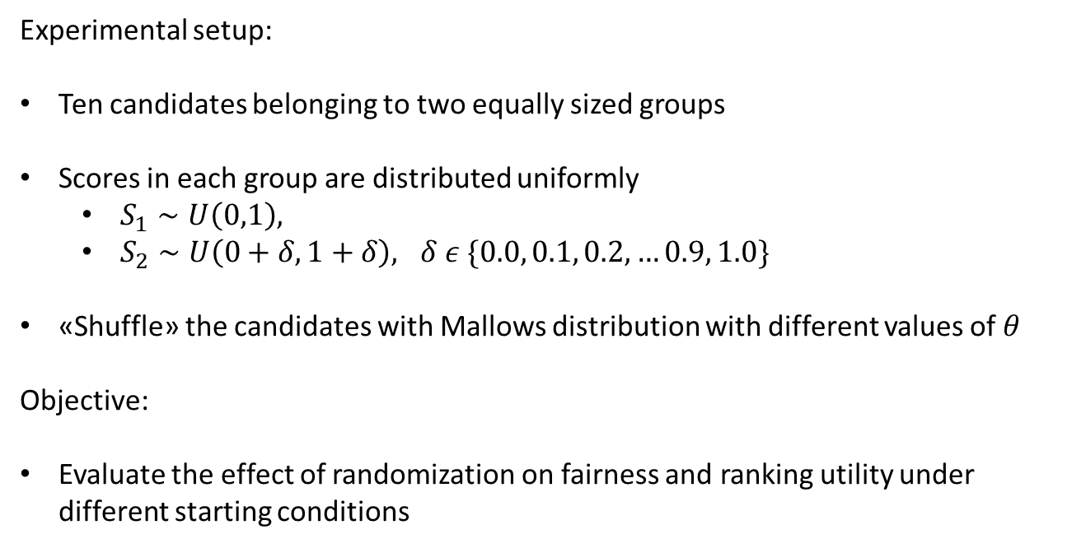
Experiment 2: Setup
Experimental setup:
Ten candidates belonging to two equally sized groups
Scores in each group are distributed uniformly
$S_{1}∼U\left(0,1\right),$
$S_{2}∼U\left(0+δ,1+δ\right), δ ε \{0.0, 0.1, 0.2, …0.9, 1.0\}$
«Shuffle» the candidates with Mallows distribution with different values of $θ$
Objective:
Evaluate the effect of randomization on fairness and ranking utility under different starting conditions
15/04/2024 andrii.kliachkin@studenti.unipd.it 2

Slide 25
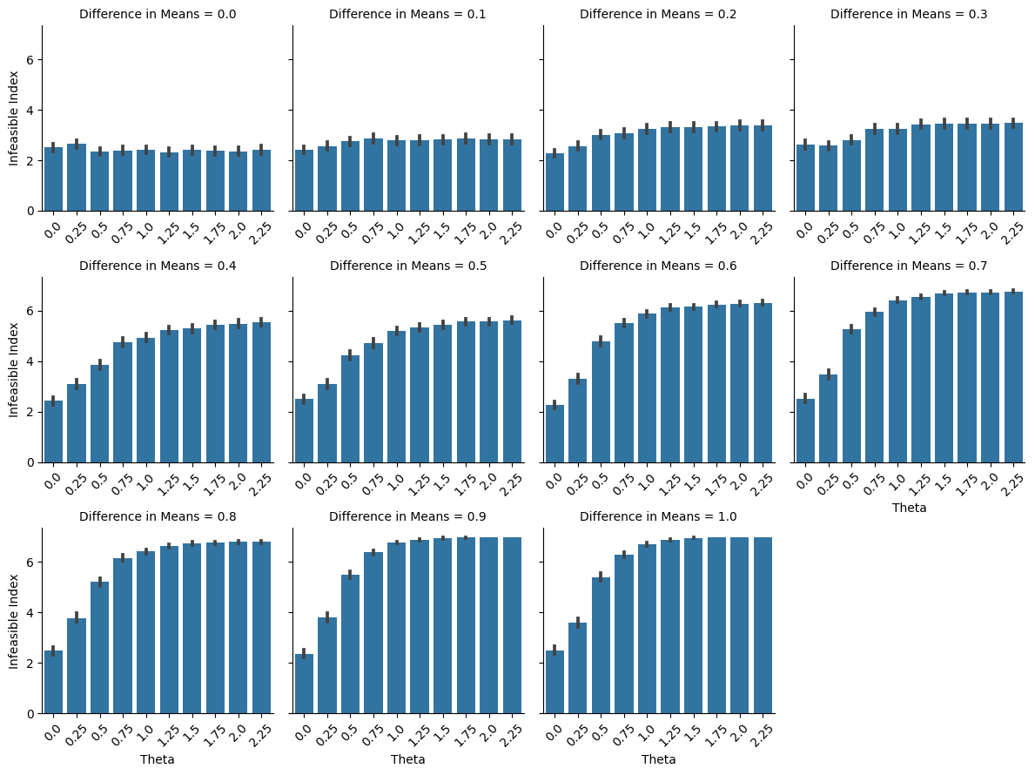
Experiment 2: Results (II)
15/04/2024 andrii.kliachkin@studenti.unipd.it 2

Slide 26
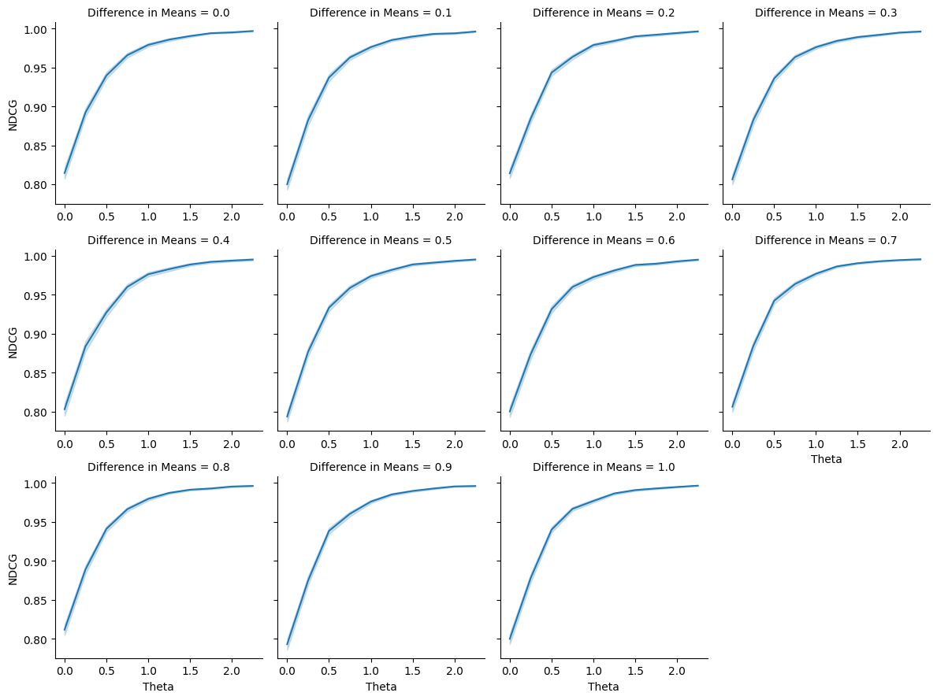
Experiment 2: Results (NDCG)
15/04/2024 andrii.kliachkin@studenti.unipd.it 2

Slide 27
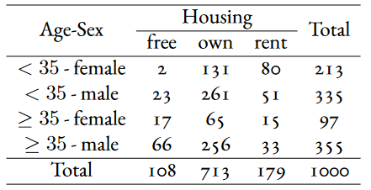
Experiment 3: Setup
Experimental setup:
Use a real-world German Credit dataset
Protected attributes: Age and Sex (both binary, 4 groups)
Add noise to the constraints
Run Mallows, DetConstSort, Approximate Multi-Valued IPF, and an ILP formulation of the fairness problem
Evaluate fairness with respect to Age&Sex, as well as to a previously unknown attribute Housing (3 groups)
15/04/2024 andrii.kliachkin@studenti.unipd.it 2

Slide 28
Experiment 3: Objectives
Objectives:
Evaluate how Mallows compares to state-of-the-art algorithms in a noisy setting and a setting where no information on group membership is available
15/04/2024 andrii.kliachkin@studenti.unipd.it 2

Slide 29
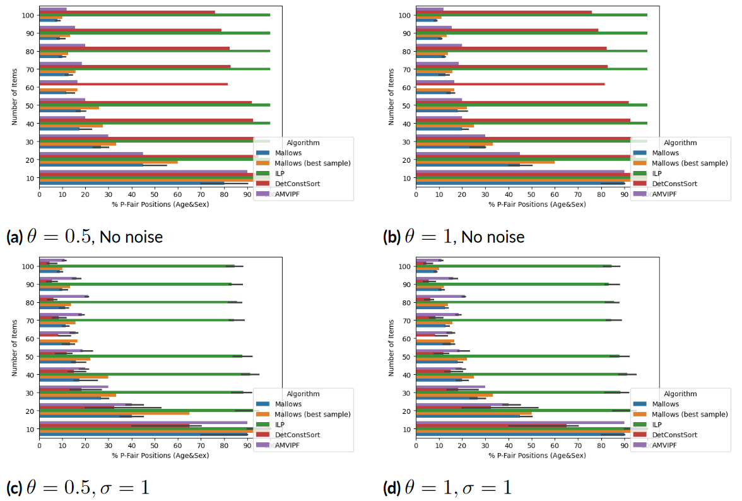
Experiment 3: Results
15/04/2024 andrii.kliachkin@studenti.unipd.it 2

Slide 30
Contributions and Conclusion
Detconst sort implementation
Paper arxiv
15/04/2024 andrii.kliachkin@studenti.unipd.it 2

Slide 31
Motivation: Fair Machine Learning
Sources of bias:
The training data may mirror real-world inequalities;
The training data may be non-representative, contain errors,
or be otherwise flawed
State of the world
Individuals
Measurement
Action
Feedback
Data
Model
Learning
15/04/2024 andrii.kliachkin@studenti.unipd.it 3

Slide 32
Motivation: Fair Machine Learning
Sources of bias:
The training data may mirror real-world inequalities;
The training data may be non-representative, contain errors,
or be otherwise flawed
State of the world
Individuals
Measurement
Action
Feedback
Data
Model
Learning
15/04/2024 andrii.kliachkin@studenti.unipd.it 3

