Slide 1

University of Padova
Department of Mathematics
Master Thesis in Data Science
Fairness in Rankings via Randomized Algorithms
Supervisor:
Tomaso Erseghe
University of Padova
Master Candidate:
Andrii Kliachkin
15/04/2024 andrii.kliachkin@studenti.unipd.it 1

Slide 2
Thesis Objectives
Investigate a new post-processing algorithm for dealing with fairness in rankings that does not use information about the sensitive attributes
Test the algorithm against state-of-the-art post-processing methods in different experimental settings
15/04/2024 andrii.kliachkin@studenti.unipd.it 2
Notes:
The objectives of this thesis are to introduce a post-processing algorithm for fairness in rankings that does not use any information about the sensitive attributes, and to test it against other state-of-the-art methods

Slide 3
Presentation Plan
Motivation: Why do we need to promote fairness in ML?
Preliminaries on Algorithmic Fairness
Preliminaries on Ranking
Our contribution: A Randomized Approach to Fairness
Experimental study
Conclusion
15/04/2024 andrii.kliachkin@studenti.unipd.it 2
Notes:
First, I am going to talk about why fairness in ML is important and introduce some basic concepts and complications that arise when dealing with it. Then, I will talk about the problem of ranking. After that, I will introduce our method, and present the results of experiments I conducted to evaluate it.

Slide 4
Motivation: Fair Machine Learning
Machine learning (ML) models are used more and more in areas that impact human lives in a significant way – from university admissions to visa and asylum decisions^{1,2};
Decisions produced by ML models can be biased against some groups of the population, for example:
Algorithm used by some US healthcare companies to predict health risks was shown to predict less urgency for Black applicants³
GPT4 was shown to be biased towards input in certain dialects⁴
No fairness through unawareness: in most cases, simply removing the sensitive (or protected) features is not enough
[1] Jasmontaite-Zaniewicz, L., & Zomignani Barboza, J. (2021). Disproportionate Surveillance: Technology-Assisted and Automated Decisions in Asylum Applications in the EU?. International Journal of Refugee Law, 33(1), 89-110.
[2] EMN-OECD INFORM, THE USE OF DIGITALISATION AND ARTIFICIAL INTELLIGENCE IN MIGRATION MANAGEMENT (2022) [Online]: https://home-affairs.ec.europa.eu/system/files/2022-02/00_EU_EMN_Digitalisation inform February 2022_EN_0.pdf
[3] Ziad Obermeyer et al. Dissecting racial bias in an algorithm used to manage the health of populations.Science 366,447-453(2019)
[4] Valentin Hofmann, Pratyusha Ria Kalluri, Dan Jurafsky, & Sharese King. (2024). Dialect prejudice predicts AI decisions about people's character, employability, and criminality.
15/04/2024 andrii.kliachkin@studenti.unipd.it 3
Notes:
But why bring up the topic of fairness? Because for years now, ML models have been used in crucial areas to make decisions about humans – from hiring and university admissions to refugee asylum and visa decisions; for example, according to the European Commission, as of 2022, 6 EU member states use ML models in the process of migration management.
However, ML models can be just as biased as humans. For a recent example, a paper published this year claims that GPT4 LLM produces overwhelmingly negative responses to prompts in certain dialects of English.
An important point to state is that simply removing the sensitive attributes from the data is not enough: that is, in most cases, you cannot avoid discrimination by just removing one column from the dataset. This is because many features that are needed to make accurate predictions can be correlated with the attribute – e.g. address, content preferences, or language.

Slide 5
Sources of Algorithmic Bias
Pre-existing bias: originating from any source that is independent of the algorithm
Biased data (training dataset records societal prejudices)
Unbalanced data (less numerous or accurate examples for minority groups)
Technical bias: originating from technical constraints
Rankings have an inherent technical bias: two items with equal relevance can only be displayed with one item above the other – referred to as position bias
Bias may be added purely by the algorithm
Emergent bias: originates in context of user interaction⁵
[5] Friedman, B., & Nissenbaum, H. (1996). Bias in computer systems. ACM Trans. Inf. Syst., 14(3), 330–347.
15/04/2024 andrii.kliachkin@studenti.unipd.it 4
Notes:
Let us briefly talk about where algorithmic bias comes from. There are three general cases.
Pre-existing bias comes from the real world and is reflected in the data: either directly, e.g. women being less likely to get hired for tech jobs, or indirectly, in the form of less examples or less accurate data for minority groups.
Technical bias originates from technical constraints. Rankings have an inherent technical bias, because even if two items have equal relevance predicted by the model, one of them will have to be placed above the other; this is referred to as position bias. Furthermore, bias can be added purely by the algorithm owing to a faulty training process.
Emergent bias is the least important for our discussion today; it arises in the context of user interaction. In rankings, emergent bias can be created when the model puts an item at the top position, leading it to get the most attention from users, which, in turn, leads the model to continue predicting that item as the top result.

Slide 6
Complication: Group vs. Individual Fairness
Approaches to algorithmic fairness are divided into two categories: group and individual fairness
Individual: “similar individuals should be treated similarly”
Issue: real-world biases recorded in data may interfere with the similarity metric⁶
Group: requires that different groups are treated similarly
Issue: requires (some) information on group membership
[6] Cynthia Dwork, Moritz Hardt, Toniann Pitassi, Omer Reingold, & Rich Zemel. (2011). Fairness Through Awareness.
15/04/2024 andrii.kliachkin@studenti.unipd.it 6
Notes:
Now that we know what bias is and where it comes from, we must choose one of the two approaches to fairness: individual or group.
Individual fairness requires that similar individuals be treated similarly – that is, if two individuals are similar according to some metric, the model outcomes for them should also be similar. The issue with this approach is that the metric leaves us vulnerable to pre-existing bias: for example, if the dataset consists of test scores that are known to be biased towards some subgroup, the metric will also be biased.
In this thesis I focus on Group fairness, which requires that all groups in the data should receive similar treatment. It compares statistics such as error rate, false positive rate, or the rate of positive outcomes, across groups. One issue with this approach is that it only looks at group quantities and not at individual performance, which may be seen as “unfair” in itself. The other problem is that it requires information on group membership – which brings me to the next complication.

Slide 7
Complication: Blind Fairness
Information on group membership may be unavailable or limited:
Sensitive information may not be collected in the first place
Sensitive features may be deleted during preprocessing
Privacy issues may arise when openly using group labels – even to impose fairness
15/04/2024 andrii.kliachkin@studenti.unipd.it 7
Notes:
That complication is that information on group membership may be limited or totally unavailable. Such sensitive information may not be recorded in the first place; it also may be removed during preprocessing in order to avoid direct discrimination by the model. Furthermore, openly using such information, even to impose fairness, may also be seen as problematic.

Slide 8
Fairness Recap
Fairness in ML is necessary but difficult to enforce
Two main approaches to fairness exist: Group (this thesis) and Individual
Sometimes the group membership information is not available
15/04/2024 andrii.kliachkin@studenti.unipd.it 2
Notes:
To recap, …

Slide 9
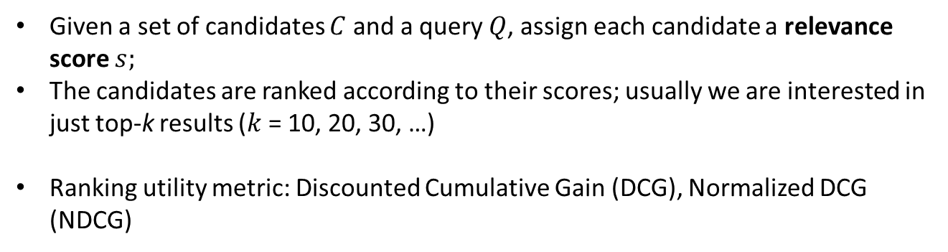
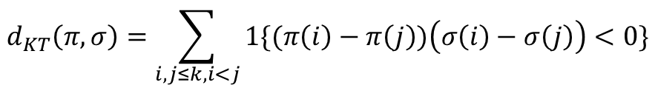


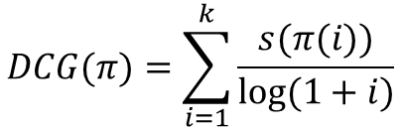
Ranking
Given a set of candidates $C$ and a query $Q$, assign each candidate a relevance score $s;$
The candidates are ranked according to their scores; usually we are interested in just top-k results ($k$ = 10, 20, 30, …)
Ranking utility metric: Discounted Cumulative Gain (DCG), Normalized DCG (NDCG)
$$DCG(π)=\sum_{i=1}^{k}{\frac{s(π(i))}{log⁡(1+i)}}$$
score of candidate at position $i$
position discount
$$NDCG\left(π\right)=\frac{DCG(π)}{IDCG(π)}$$
where $IDCG(π)$ is the Ideal DCG – DCG of a score-based reordering of $π$.
Ranking distance metric: Kendall-Tau (KT) distance
$$d_{KT}\left(π,σ\right)=\sum_{i,j≤k,i<j}{1\{(π\left(i\right)−π\left(j\right))\left(σ\left(i\right)−σ\left(j\right)\right)<0\}}$$
15/04/2024 andrii.kliachkin@studenti.unipd.it 2

Slide 10
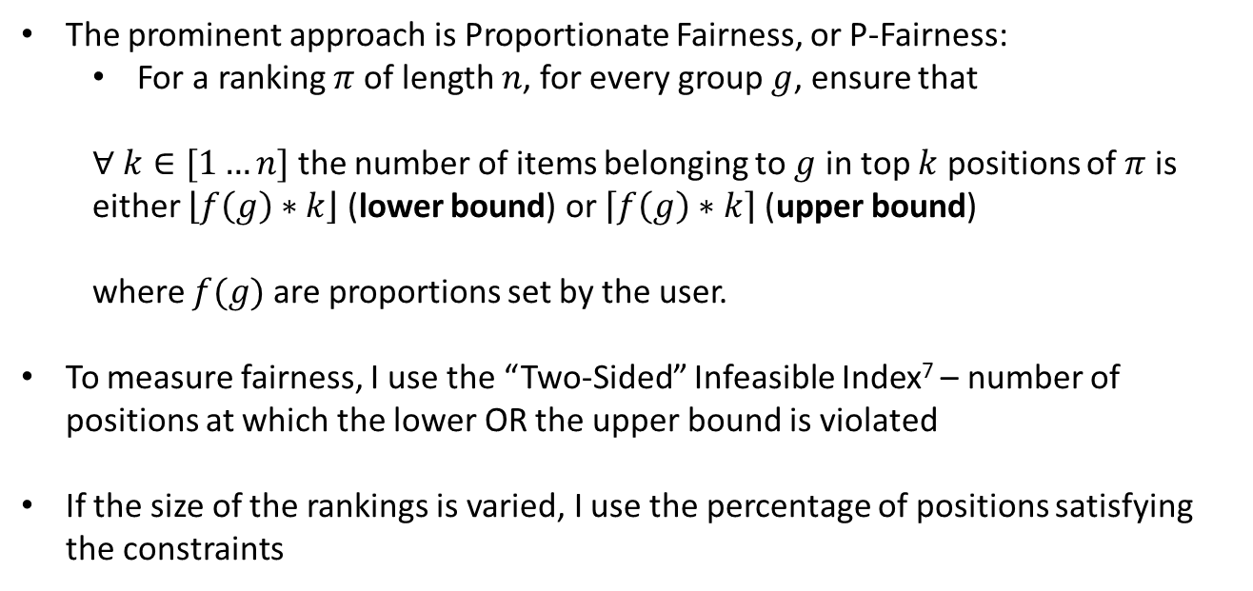
Group Fairness in Ranking
The prominent approach is Proportionate Fairness, or P-Fairness:
For a ranking $π$ of length $n$, for every group $g$, ensure that
$∀ k∈[1…n]$ the number of items belonging to $g$ in top $k$ positions of $π$ is
either $\left\lfloor f\left(g\right)∗k\right\rfloor$ (lower bound) or $\left\lceil f\left(g\right)∗k\right\rceil$(upper bound)
where $f(g)$ are proportions set by the user.
To measure fairness, I use the “Two-Sided” Infeasible Index⁷ – number of positions at which the lower OR the upper bound is violated
If the size of the rankings is varied, I use the percentage of positions satisfying the constraints
[7] Geyik, S., Ambler, S., & Kenthapadi, K. (2019). Fairness-Aware Ranking in Search & Recommendation Systems with Application to LinkedIn Talent Search. In Proceedings of the 25th ACM SIGKDD International Conference on Knowledge Discovery & Data Mining. ACM.
15/04/2024 andrii.kliachkin@studenti.unipd.it 2

Slide 11
Approaches to Algorithmic Fairness
Pre-processing: modify the training data to remove disparities between groups
Advantages: no explicit information on group membership needed
Disadvantages: focus on individual fairness, difficult to deploy
In-processing: modify the model’s loss function to reduce discrimination
Advantages: trade-off between accuracy and fairness
Disadvantages: trade-off between accuracy and fairness, difficult to deploy
Post-processing: modify the model’s output to reduce discrimination
Advantages: guarantees on fairness, easier to deploy, explainability
Disadvantages: substantial loss of performance
15/04/2024 andrii.kliachkin@studenti.unipd.it 2

Slide 12
Approaches to Algorithmic Fairness
Pre-processing: modify the training data to remove disparities between groups
Advantages: no explicit information on group membership needed
Disadvantages: focus on individual fairness, difficult to deploy
In-processing: modify the model’s loss function to reduce discrimination
Advantages: trade-off between accuracy and fairness
Disadvantages: trade-off between accuracy and fairness, difficult to deploy
Post-processing: modify the model’s output to reduce discrimination
Advantages: guarantees on fairness, easier to deploy, explainability
Disadvantages: substantial loss of performance
Ranking: modify the relevance scores or reorder the candidates
15/04/2024 andrii.kliachkin@studenti.unipd.it 2

Slide 13
Approaches to Blind Fairness
A growing body of work exists on blind fairness in classification
To my best knowledge, only two academic works exist on blind fairness in rankings^{8,9}
Focus is on detecting groups that are underrepresented in top-k
This still requires information about the protected attributes!
[8] Eliana Pastor, Luca de Alfaro, & Elena Baralis. (2021). Identifying Biased Subgroups in Ranking and Classification.
[9] Jinyang Li, Yuval Moskovitch, & H. V. Jagadish. (2023). Detection of Groups with Biased Representation in Ranking.
15/04/2024 andrii.kliachkin@studenti.unipd.it 2

Slide 14
Our Approach
Record that no information is available on group membership or sensitive attribute values
Solution: study the impact of randomization on fairness metrics
«Shuffle» the candidates randomly
15/04/2024 andrii.kliachkin@studenti.unipd.it 2

Slide 15
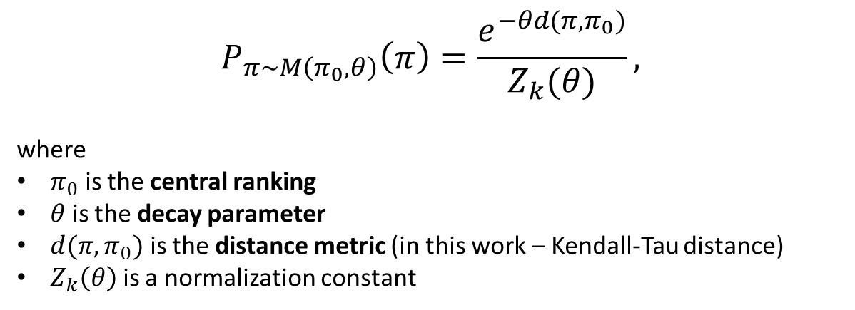
Our Approach
Record that no information is available on group membership or sensitive attribute values
Solution: study the impact of randomization on fairness metrics
«Shuffle» the candidates randomly using the Mallows distribution
$$P_{π∼M\left(π_{0},θ\right)}\left(π\right)=\frac{e^{−θd({π,π}_{0})}}{Z_{k}(θ)},$$
where
$π_{0}$ is the central ranking
$θ$ is the decay parameter
$d({π,π}_{0})$ is the distance metric (in this work – Kendall-Tau distance)
$Z_{k}\left(θ\right)$ is a normalization constant
15/04/2024 andrii.kliachkin@studenti.unipd.it 2

Slide 16
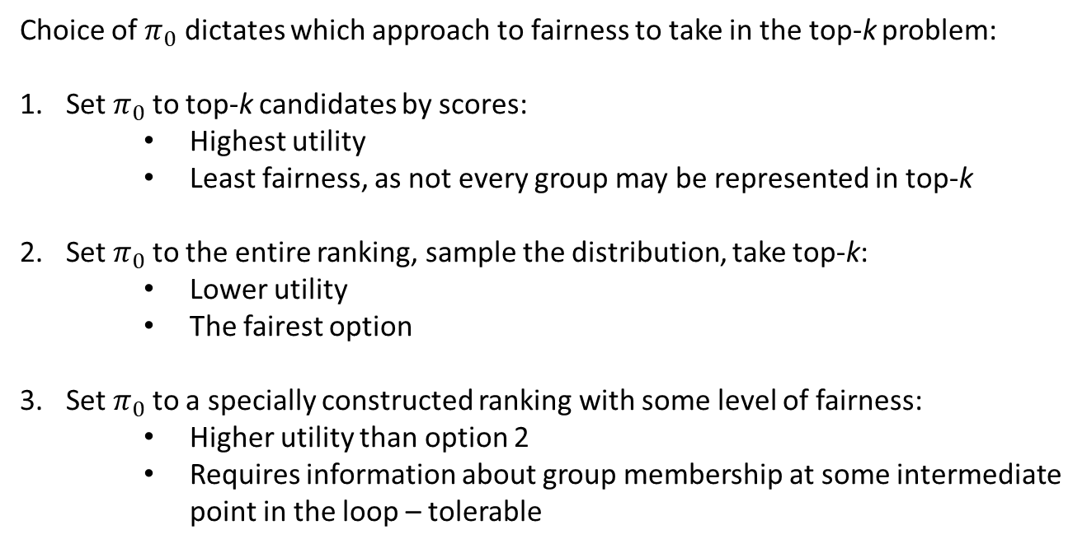
Choice of Parameters
Choice of $π_{0}$ dictates which approach to fairness to take in the top-k problem:
Set $π_{0}$to top-k candidates by scores:
Highest utility
Least fairness, as not every group may be represented in top-k
Set $π_{0}$to the entire ranking, sample the distribution, take top-k:
Lower utility
The fairest option
Set $π_{0}$to a specially constructed ranking with some level of fairness:
Higher utility than option 2
Requires information about group membership at some intermediate point in the loop – tolerable
15/04/2024 andrii.kliachkin@studenti.unipd.it 2

Slide 17
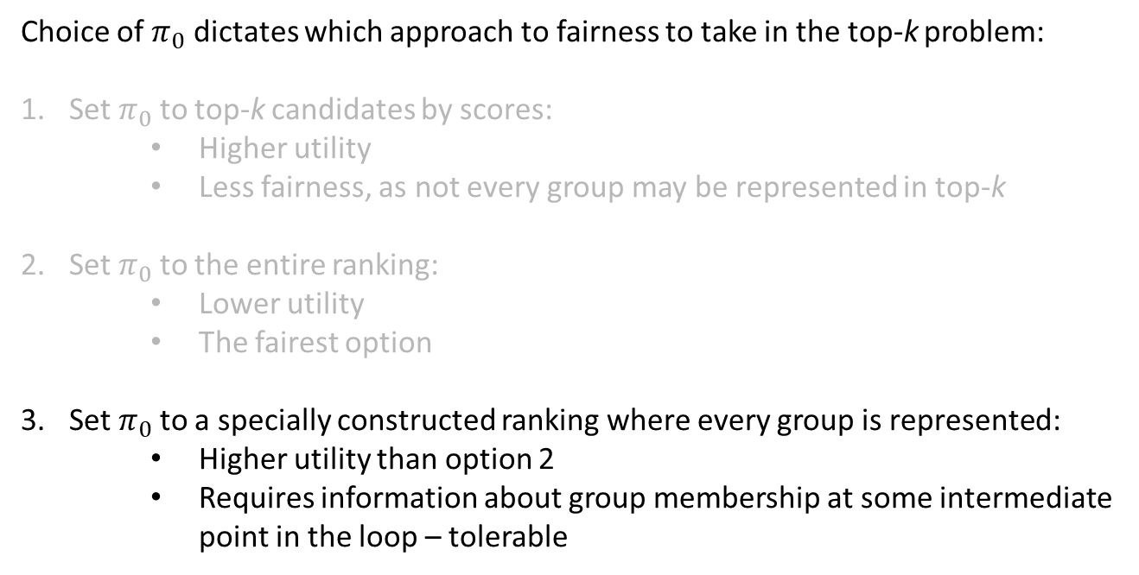
Choice of Parameters
Choice of $π_{0}$ dictates which approach to fairness to take in the top-k problem:
Set $π_{0}$to top-k candidates by scores:
Higher utility
Less fairness, as not every group may be represented in top-k
Set $π_{0}$to the entire ranking:
Lower utility
The fairest option
Set $π_{0}$to a specially constructed ranking where every group is represented:
Higher utility than option 2
Requires information about group membership at some intermediate point in the loop – tolerable
15/04/2024 andrii.kliachkin@studenti.unipd.it 2

Slide 18
State-of-the-art Postprocessing Algorithms
DetConstSort⁷ based on a greedy p-fairness algorithm implemented at LinkedIn
At each iteration, a candidate from an underrepresented group is placed at the bottom of the ranking and propagated (swapped) forward
Propagation stops as soon as the candidate placed above has a higher score or its fairness constraint would be violated by the swap
Approximate Multi-Valued IPF¹⁰ represents the candidates and their potential positions in a fair ranking as two sets of vertices of a weighed bipartite graph
Edges connect each candidate with positions that would not violate p-fairness constraints for their group
Edge weights set to the distance between the candidate’s initial and potential position
Both reorder the candidates in the input ranking so that they satisfy p-fairness constraints
Both require accurate knowledge about the candidates’ group membership
[10] Wei, D., Islam, M., Schieber, B., & Basu Roy, S. (2022). Rank Aggregation with Proportionate Fairness. In Proceedings of the 2022 International Conference on Management of Data (pp. 262–275). Association for Computing Machinery.
15/04/2024 andrii.kliachkin@studenti.unipd.it 2

Slide 19
Experimental design
I conducted three numerical experiments:
A simple setup to evaluate the impact of Mallows randomization on fairness
A setup with a synthetic dataset with random scores
A setup with a real-world dataset comparing Mallows randomization to state-of-the-art algorithms
15/04/2024 andrii.kliachkin@studenti.unipd.it 2

Slide 20
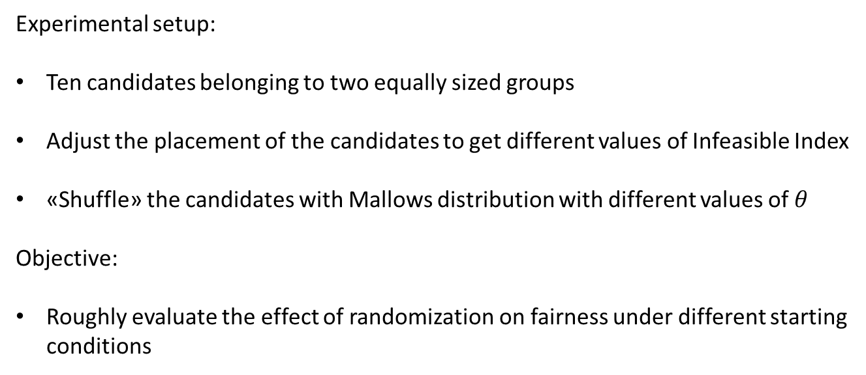
Experiment 1: Setup
Experimental setup:
Ten candidates belonging to two equally sized groups
Adjust the placement of the candidates to get different values of Infeasible Index
«Shuffle» the candidates with Mallows distribution with different values of $θ$
Objective:
Roughly evaluate the effect of randomization on fairness under different starting conditions
15/04/2024 andrii.kliachkin@studenti.unipd.it 2

Slide 21
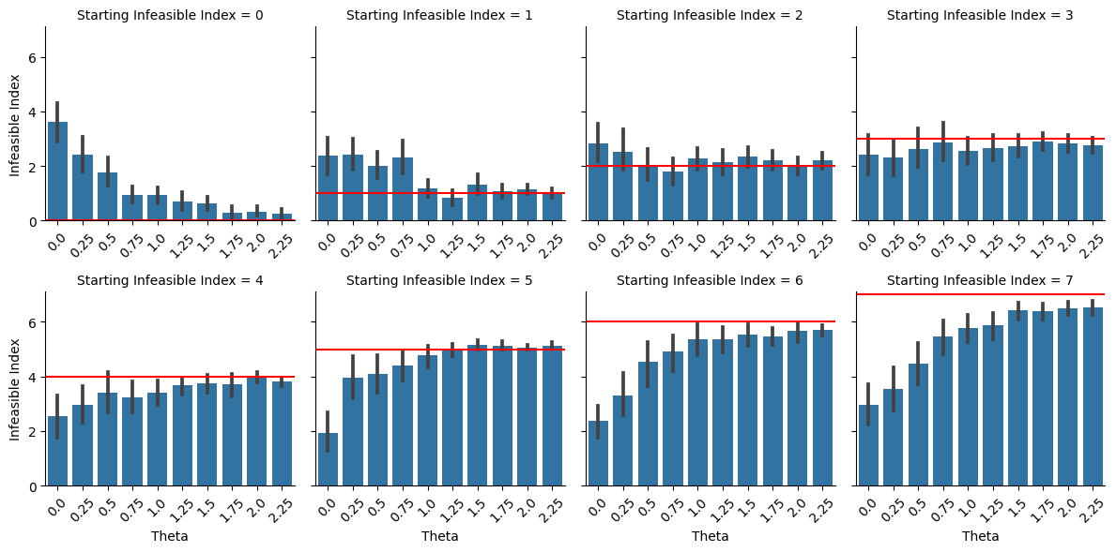
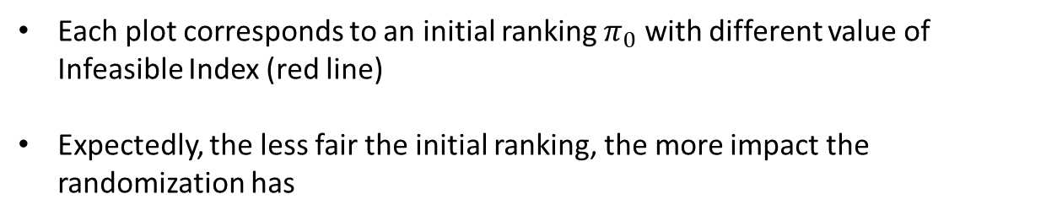
Experiment 1: Results
Each plot corresponds to an initial ranking $π_{0}$ with different value of Infeasible Index (red line)
Expectedly, the less fair the initial ranking, the more impact the randomization has
15/04/2024 andrii.kliachkin@studenti.unipd.it 2

Slide 22
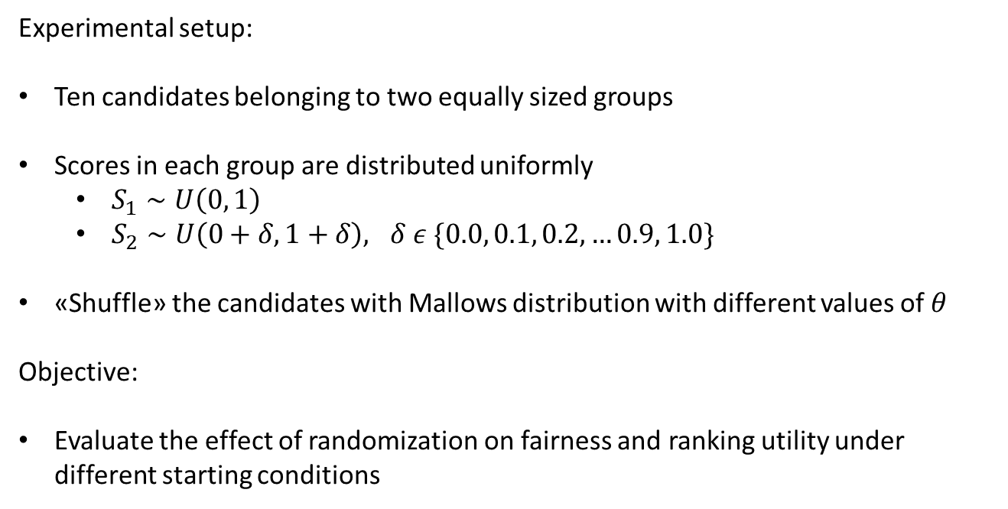
Experiment 2: Setup
Experimental setup:
Ten candidates belonging to two equally sized groups
Scores in each group are distributed uniformly
$S_{1}∼U\left(0, 1\right)$
$S_{2}∼U\left(0+δ,1+δ\right), δ ε \{0.0, 0.1, 0.2, …0.9, 1.0\}$
«Shuffle» the candidates with Mallows distribution with different values of $θ$
Objective:
Evaluate the effect of randomization on fairness and ranking utility under different starting conditions
15/04/2024 andrii.kliachkin@studenti.unipd.it 2

Slide 23
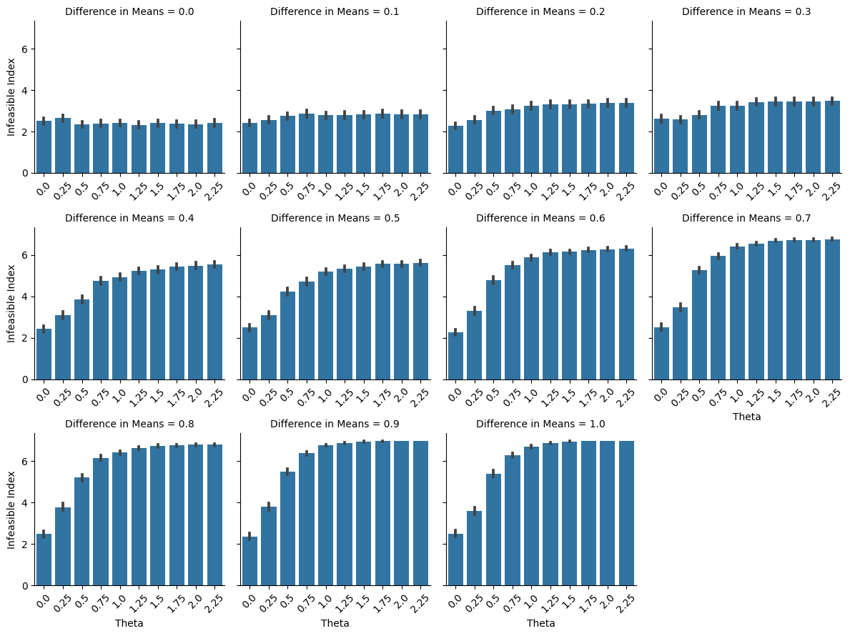
Experiment 2: Results (Fairness)
15/04/2024 andrii.kliachkin@studenti.unipd.it 2

Slide 24
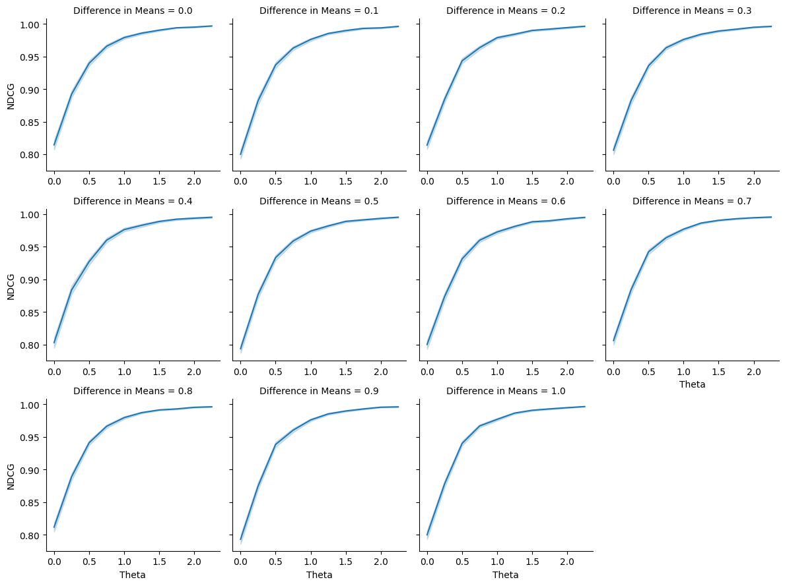
Experiment 2: Results (NDCG)
15/04/2024 andrii.kliachkin@studenti.unipd.it 2

Slide 25
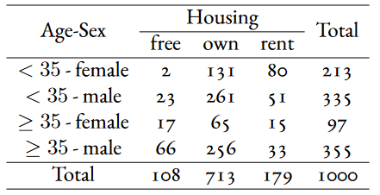
Experiment 3: Setup
Experimental setup:
Use a real-world German Credit dataset
Protected attributes: Age and Sex (both binary => 4 groups)
Housing attribute used to evaluate fairness in a blind setting (next slide)
Run Mallows, DetConstSort, Approximate Multi-Valued IPF, and an ILP formulation of the fairness problem
15/04/2024 andrii.kliachkin@studenti.unipd.it 2

Slide 26
Experiment 3: Objectives
Objective: See how Mallows compares to state-of-the-art algorithms in a noisy setting (1) and a setting where no information on group membership is available (2)
To emulate noisy information, add Gaussian noise to the fairness constraints
For demonstrate performance in a blind fairness setting, additionally evaluate the fairness metrics with respect to a third attribute – Housing, which was not specified in the constraints
15/04/2024 andrii.kliachkin@studenti.unipd.it 2

Slide 27
Experiment 3: Baselines
DetConstSort⁷ based on a greedy p-fairness algorithm implemented at LinkedIn
Approximate Multi-Valued IPF¹⁰
Both methods reorder the candidates in the input ranking so that they satisfy p-fairness constraints
Both require accurate knowledge about the candidates’ group membership
Additional baseline: ILP formulation of the same problem (next slide)
[10] Wei, D., Islam, M., Schieber, B., & Basu Roy, S. (2022). Rank Aggregation with Proportionate Fairness. In Proceedings of the 2022 International Conference on Management of Data (pp. 262–275). Association for Computing Machinery.
15/04/2024 andrii.kliachkin@studenti.unipd.it 2

Slide 28
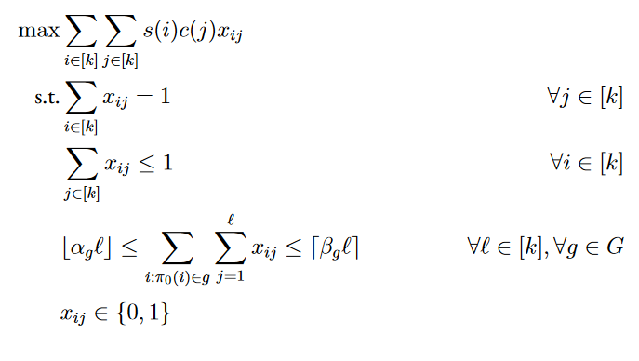
Experiment 3: Baselines
Additional baseline: an ILP formulation
where $α_{g}, β_{g}$ are p-fairness constraints for each group $g$, and $π_{0}$ is the initial ranking.
15/04/2024 andrii.kliachkin@studenti.unipd.it 2

Slide 29
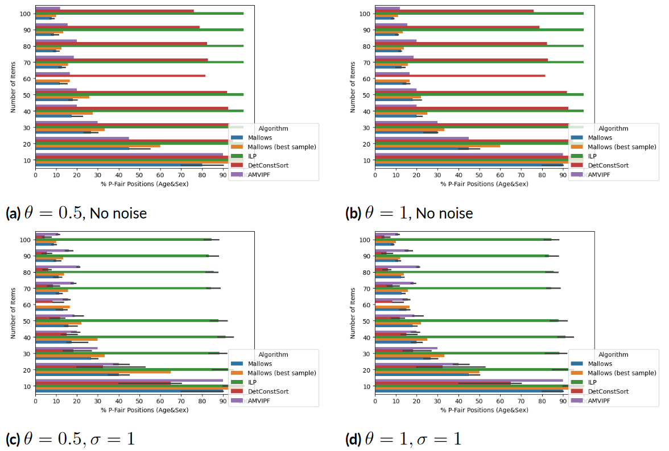
Experiment 3: Results (Noise)
15/04/2024 andrii.kliachkin@studenti.unipd.it 2

Slide 30
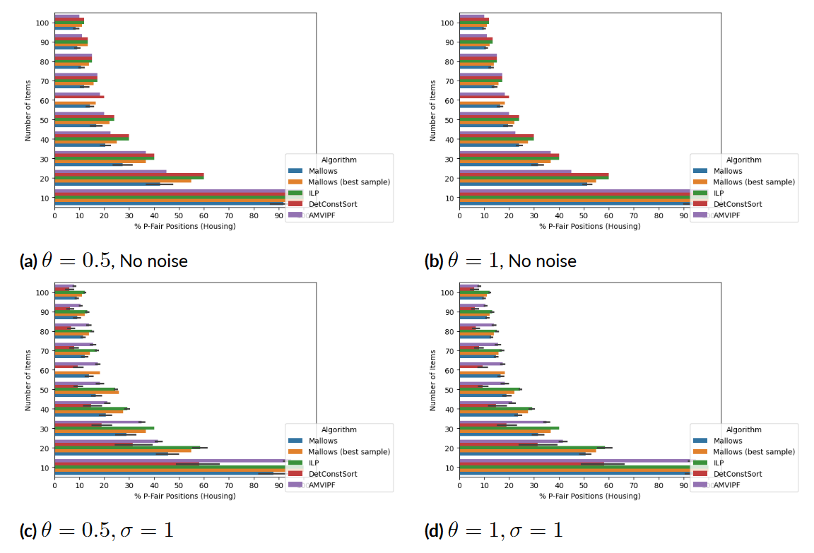
Experiment 3: Results (Unknown Attribute)
15/04/2024 andrii.kliachkin@studenti.unipd.it 2

Slide 31
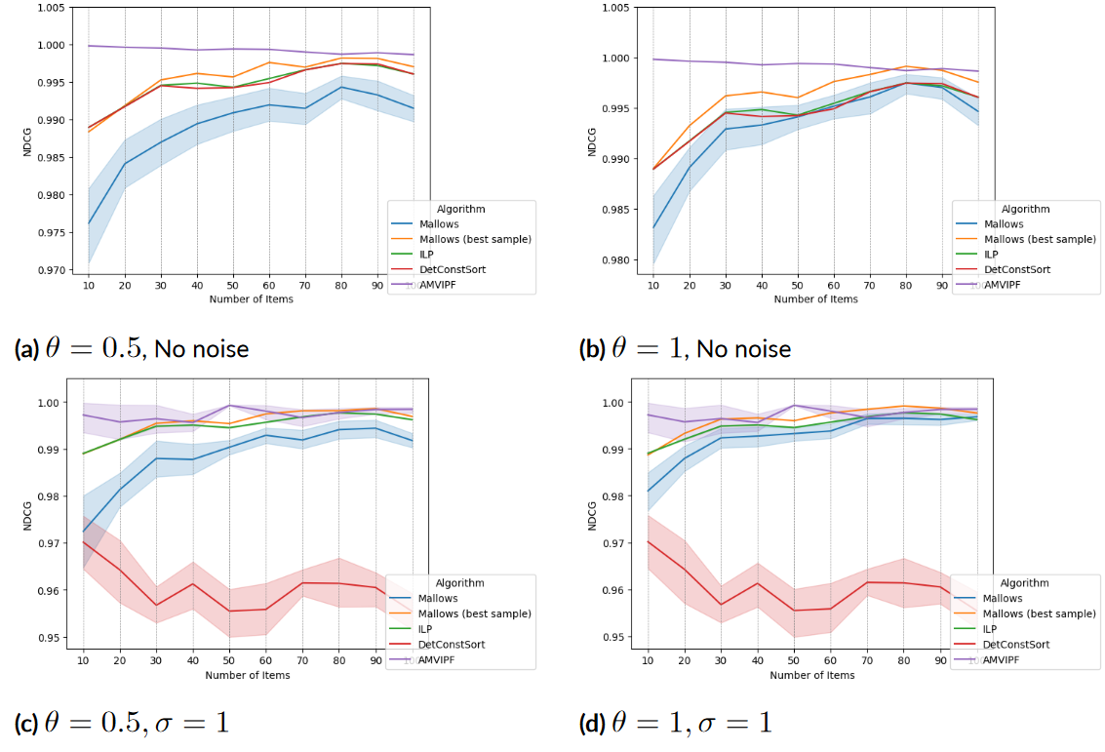
Experiment 3: Results (NDCG)
15/04/2024 andrii.kliachkin@studenti.unipd.it 2

Slide 32
Experiments: Conclusion
Mallows randomization – first studied solution for group fairness in rankings when no information on the protected attributes is available
Improves the ranking in terms of P-fairness to a degree comparable with other algorithms if the information is available, but noisy
Improves the ranking in terms of P-fairness if the information is unavailable
Side effect: randomization helps avoid position bias in rankings – candidates with lower relevance are not “stuck” in low positions, which may lead to a feedback loop of decreasing relevance
15/04/2024 andrii.kliachkin@studenti.unipd.it 2

Slide 33
Contributions
Introduced a new method for fairness in rankings that does not require information about the protected attributes
Conducted a numerical study of the method’s performance
Study due to be presented at the Fairness in AI Workshop held in conjunction with the ICDE 2024 conference (fairnessinai.github.io); arxiv preprint: https://arxiv.org/abs/2403.19419
DetConstSort, as well as three other post-processing algorithms for for fairness in rankings, were implemented and contributed to a widely-used IBM-sponsored Python toolkit AI Fairness 360 (github.com/Trusted-AI/AIF360), along with supporting code
15/04/2024 andrii.kliachkin@studenti.unipd.it 2

Slide 34
Motivation: Fair Machine Learning
Sources of bias:
The training data may mirror real-world inequalities;
The training data may be non-representative, contain errors,
or be otherwise flawed
State of the world
Individuals
Measurement
Action
Feedback
Data
Model
Learning
15/04/2024 andrii.kliachkin@studenti.unipd.it 3

Slide 35
Sources of Algorithmic Bias
Data-to-Algorithm:
Measurement/representation bias: less accurate/numerous examples for minority groups
Algorithm-to-User:
Rankings have an inherent bias: two items with equal relevance can only be displayed with one item above the other – referred to as position bias
Bias may be added purely by the algorithm because of faulty training process
User-to-Data:
Real-world inequalities reflected in the data
[5] Friedman, B., & Nissenbaum, H. (1996). Bias in computer systems. ACM Trans. Inf. Syst., 14(3), 330–347.
15/04/2024 andrii.kliachkin@studenti.unipd.it 2
Notes:
Let us briefly talk about where algorithmic bias comes from. There are three general cases.
Pre-existing bias comes from the real world and is reflected in the data: either directly, e.g. women being less likely to get hired for tech jobs, or indirectly, in the form of less examples or less accurate data for minority groups.
Technical bias originates from technical constraints. Rankings have an inherent technical bias, as they have to place items in a certain order, even if their relevance score, as predicted by the model, is the same; this results in the first item getting much more attention than the second one.
Finally, emergent bias originates when users interact with

