Slide 1
DSO102C – Lesson 10 Final Project
Andrew Stephens

Slide 2
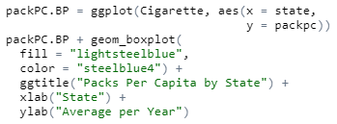
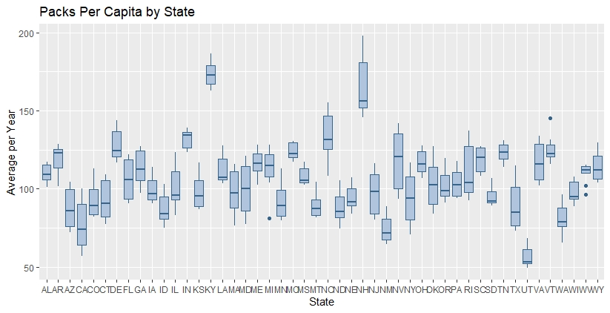
Create a boxplot of the average number of packs per capita by state.

Slide 3
Which states have the highest number of packs? Which have the lowest?
Highest Packs Per Capita:
Kentucky
Lowest Packs Per Capita:
Utah

Slide 4
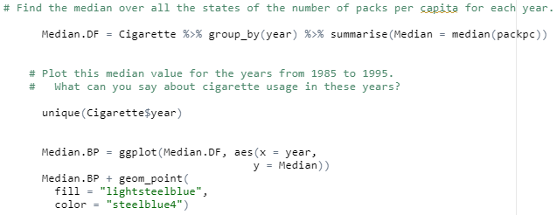
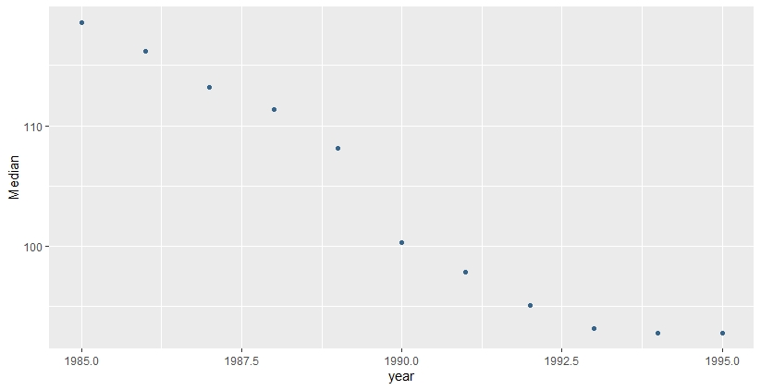
Find the median over all the states of the number of packs per capita for each year.
Plot this median value for the years from 1985 to 1995.
What can you say about cigarette usage in these years?
Cigarette usage has decreased each year; most notably from 1989 to 1990.

Slide 5
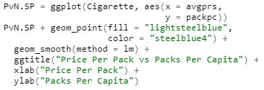
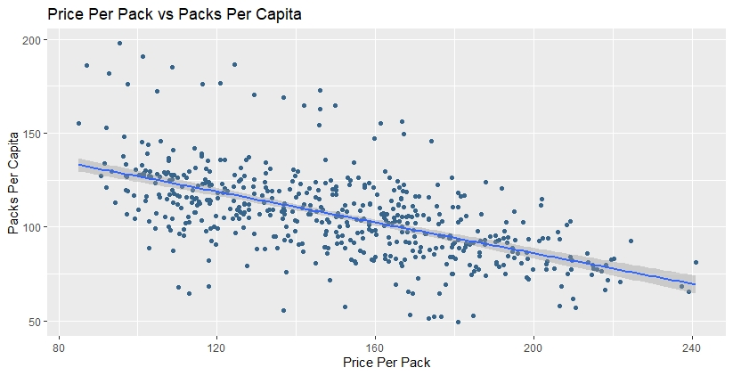
Create a scatter plot of price per pack vs number of packs per capita for all states and years.

Slide 6
Are the price and the per capita packs positively correlated, negatively correlated,
or uncorrelated?
Explain why your answer would be expected.
We can see in the scatter plot that the data trends downward. With a correlation value of 0.59 and a p-value of < 2.2e-16, this negative correlation is somewhat small, but very significant.
Logically, this makes sense. As cigarettes become more expensive, fewer people will be willing to buy them.

Slide 7
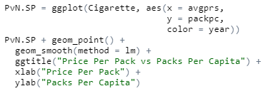
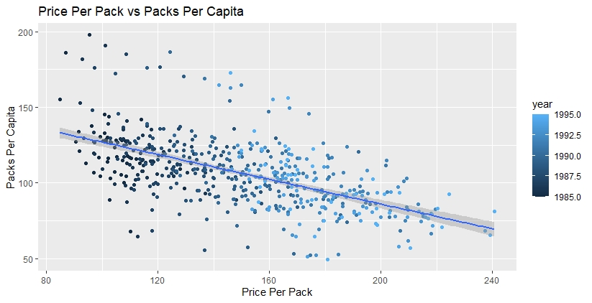
Change your scatter plot to show the points for each year in a different color.
Does the relationship between the two variables change over time?
Yes. As the years pass, the price keeps rising and the packs per capita drops.

Slide 8

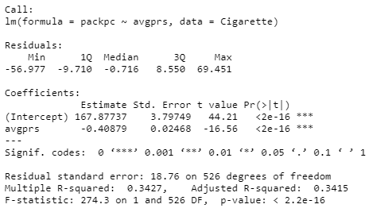
Do a linear regression for these two variables.
How much variability does the line explain?
34% of the variability

Slide 9
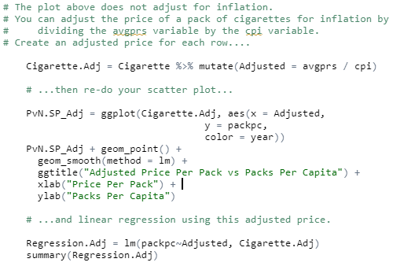
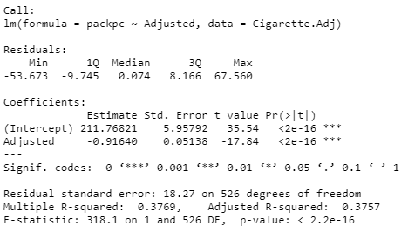
You can adjust the price of a pack of cigarettes for inflation by dividing the avgprs variable by the cpi variable. Create an adjusted price for each row, then re-do your scatter plot and linear regression using this adjusted price.

Slide 10
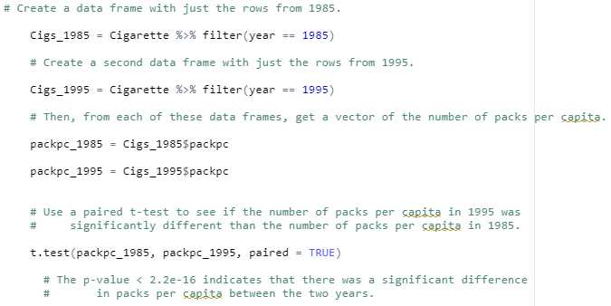
Create a data frame with just the rows from 1985. Create a second data frame with just the rows from 1995. Then, from each of these data frames, get a vector of the number of packs per capita. Use a paired t-test to see if the number of packs per capita in 1995 was significantly different than the number of packs per capita in 1985.
The p-value < 2.2e-16 indicates that there was a significant difference in packs per capita between the two years.

