Slide 1
Texas Crash Data - 2013 DSO104C - Lesson 10 Final Project
Andrew Stephens

Slide 2
Agenda
Review the total number of crashes inside city limits
vs outside city limits.
Look at crashes by county and identify the counties with the
highest number of crashes.
What are the speed limit zones with the highest frequency of crashes?
How many crashes happen at an intersection?
Review the total number of crashes that occurred in a road construction zone and how many of those involved a road construction worker.

Slide 3
Crashes by Time of Day in City Limits

Slide 4
Crashes by Day in City Limits

Slide 5
Crashes by Month in City Limits

Slide 6
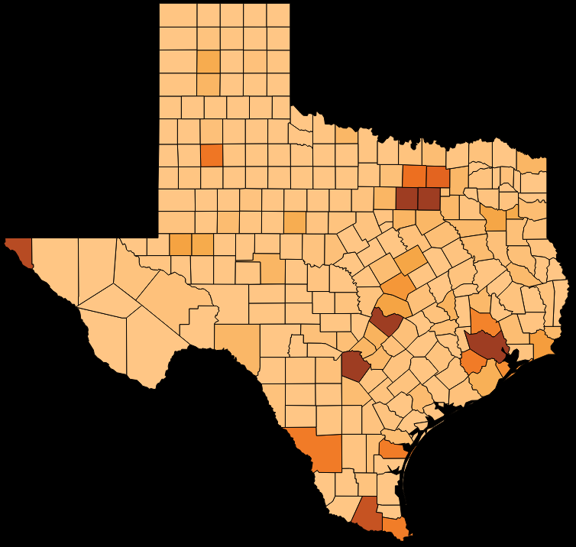

Crashes by County

Slide 7
Crashes by County - Top 10

Slide 8
Crashes by Speed Limit Zones
NOTE:
This graph may be a little misleading. It would be beneficial to have the actual speed of travel of the responsible party. This would give a clearer picture.
It may seem strange that the 30mph and 35mph zones have many more crashes than the higher speed zones. However, it may be the case that drivers are more prone to driving over the limit in the lower speed zones.
Unfortunatley there is no data currently available to help us better understand the issue.

Slide 9
Crashes at Intersections

Slide 10
Crashes in Road Construction Zones
& Involving Road Construction Workers (RCWs)

