Slide 1
Door Sales Invoice Data 2019 – 2021
DSO110C - Final Project
Andrew Sthephens

Slide 2
Introduction
12 years as a Quality Tech in manufacturing
Receiving inspection
Non-conforming material & returns
Internal quality audits for regulatory bodies
Responsible for department metrics and data collection
Learning Excel macros ignited an interest in coding
Moved to Texas in 2019
Found the Data Science program by Woz-U
via Southern Careers Institute

Slide 3
About the Business
Small family owned and operated custom door company
Locations in San Antonio & Austin
Less than 50 employees between both locations
I currently work in production as a Finisher
They currently use Quickbooks for all data collection
Use MS Sharepoint to schedule/monitor production
Most supplier data is in an Excel spreadsheet, but is not usable

Slide 4
Agenda
Look at what data is collected
How is it collected?
How is that data currently used?
Look for potential insights
Identify areas in need of improvement

Slide 5
The Data
How is it collected?
Line items manually entered on invoices in Quickbooks
Manually re-entered into Sharepoint
How is that data currently used?
It’s not
What data is collected

Slide 6
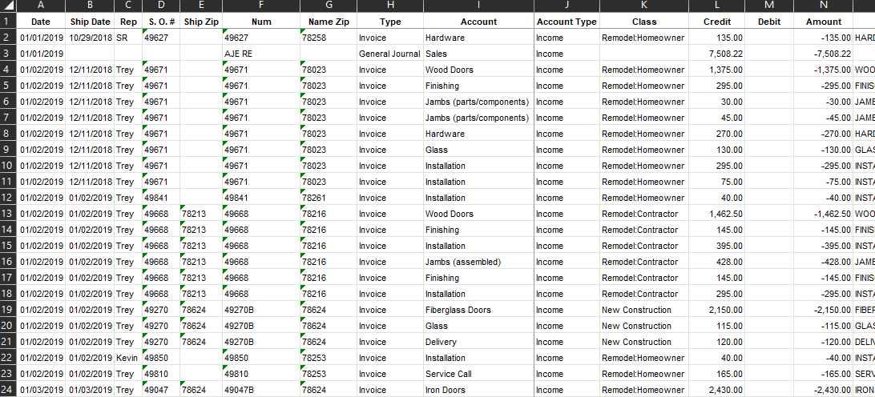
Raw Data

Slide 7
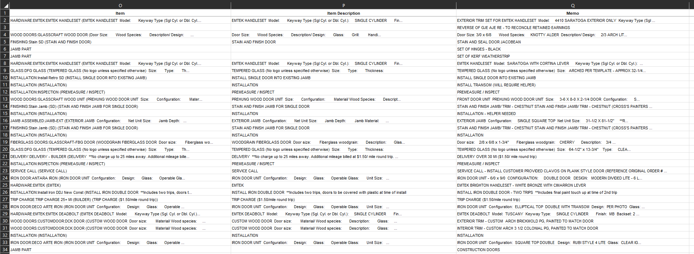
Raw Data

Slide 8
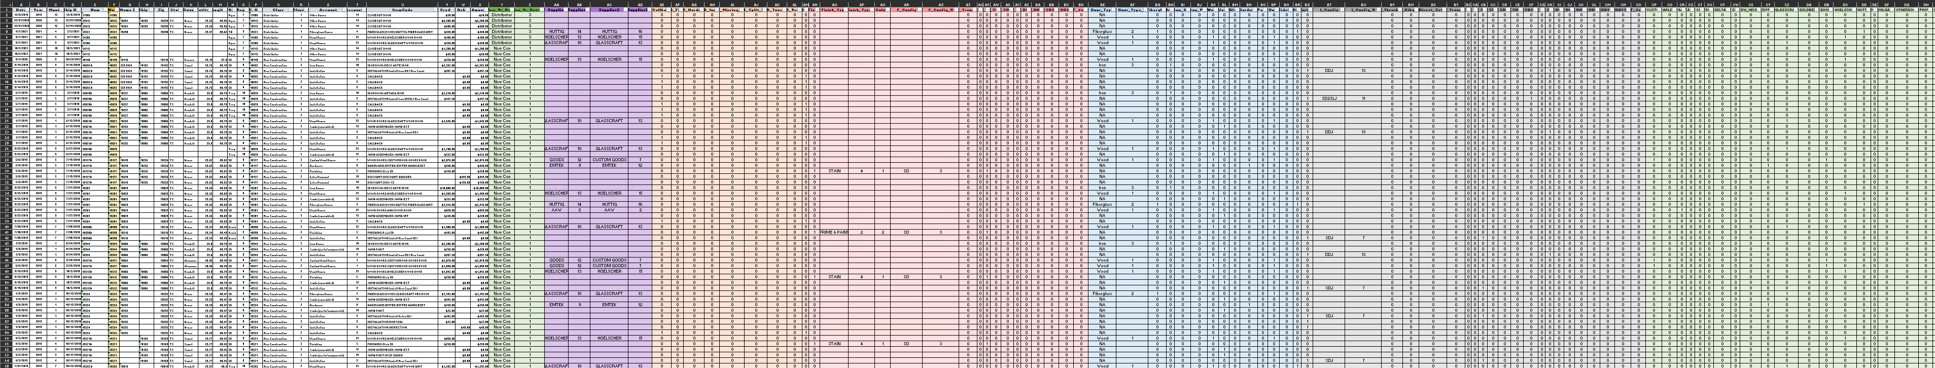
Example of columns extracted from single “Item” column

Slide 9
Potential Insights
Effects of COVID-19
New Construction vs Remodel
Sales by Door Type
Hot Spots

Slide 10
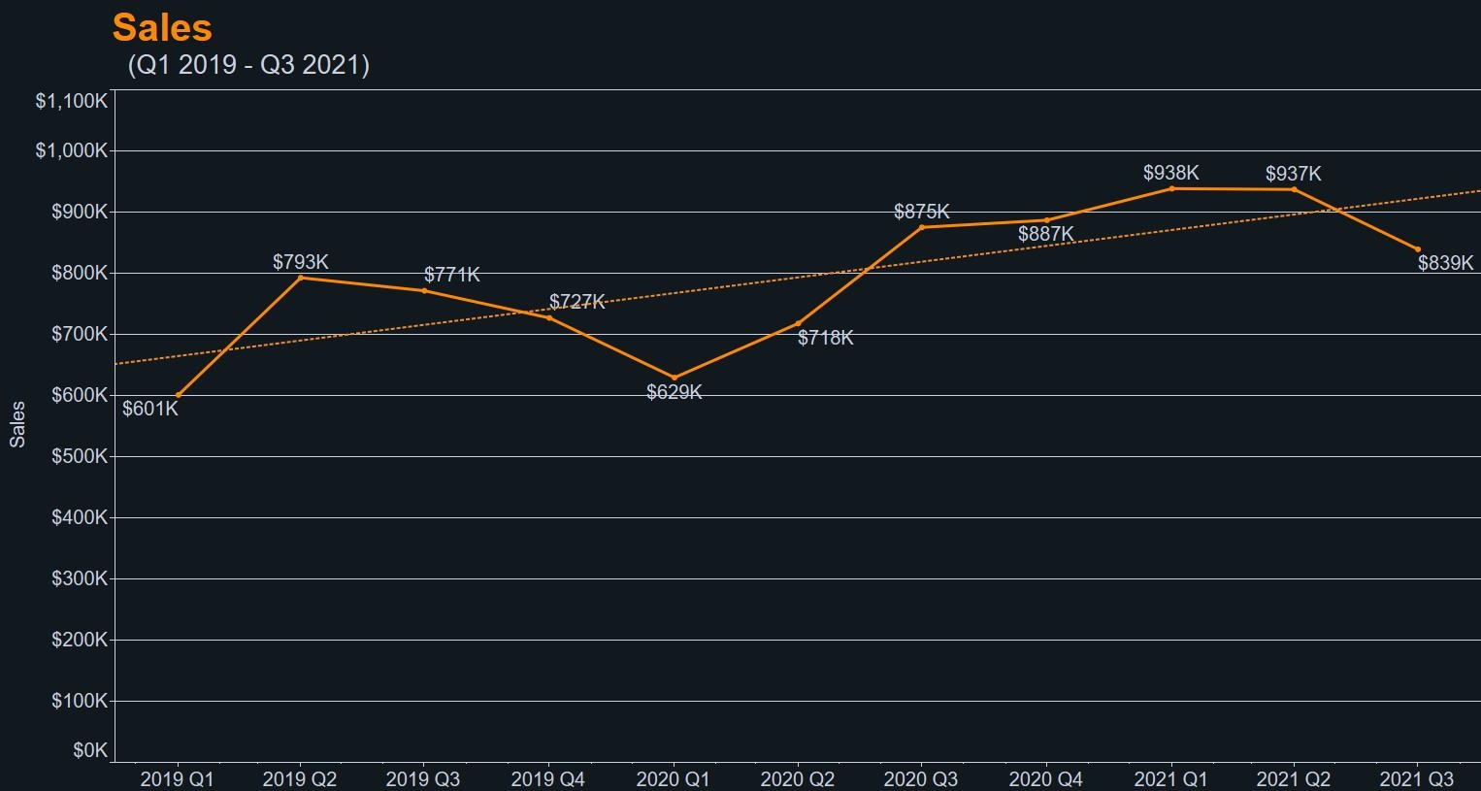

Slide 11
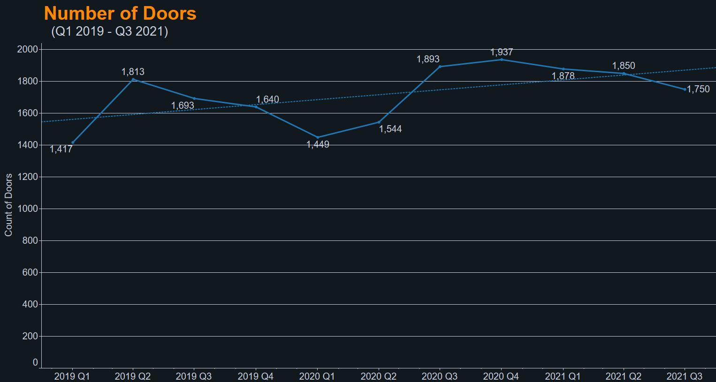

Slide 12
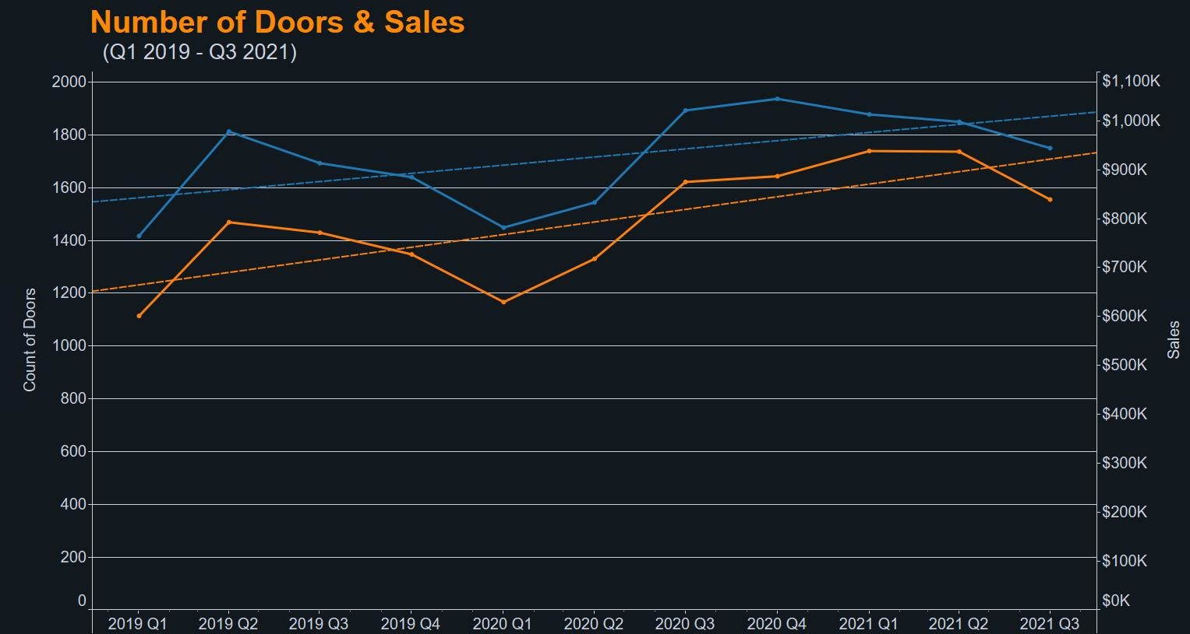


Slide 13
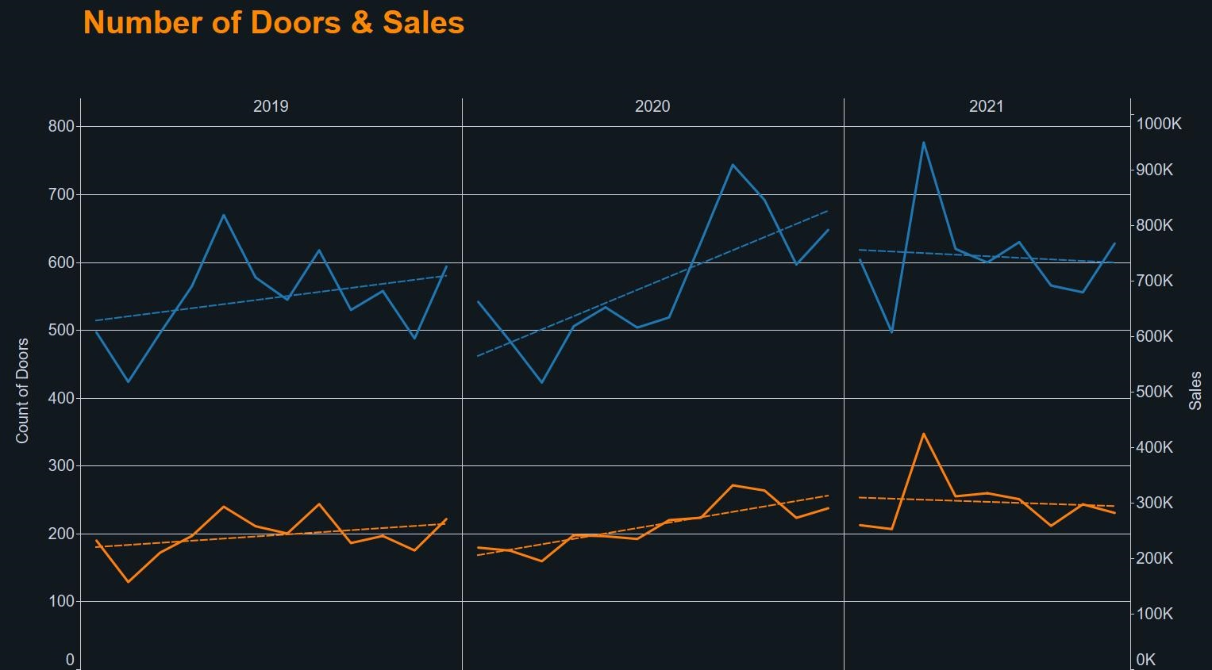

Slide 14
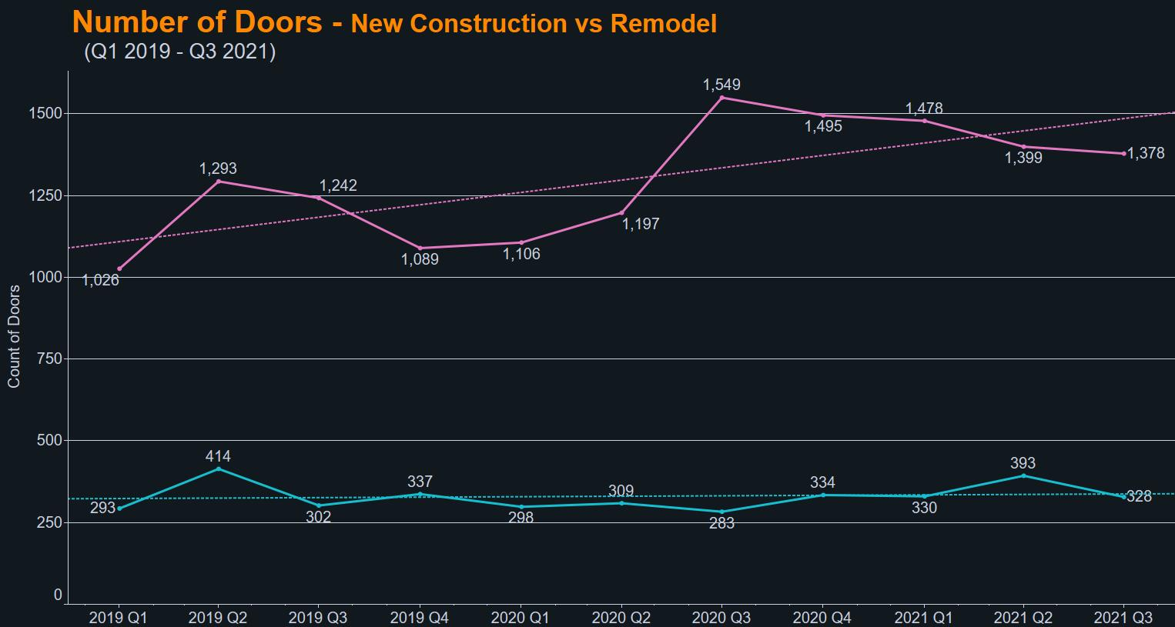


Slide 15
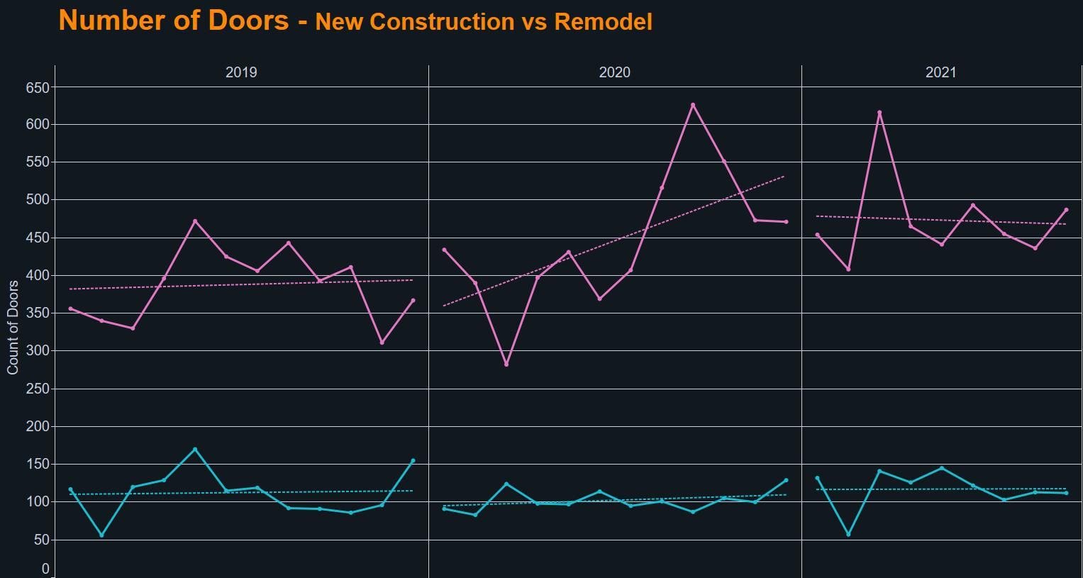

Slide 16
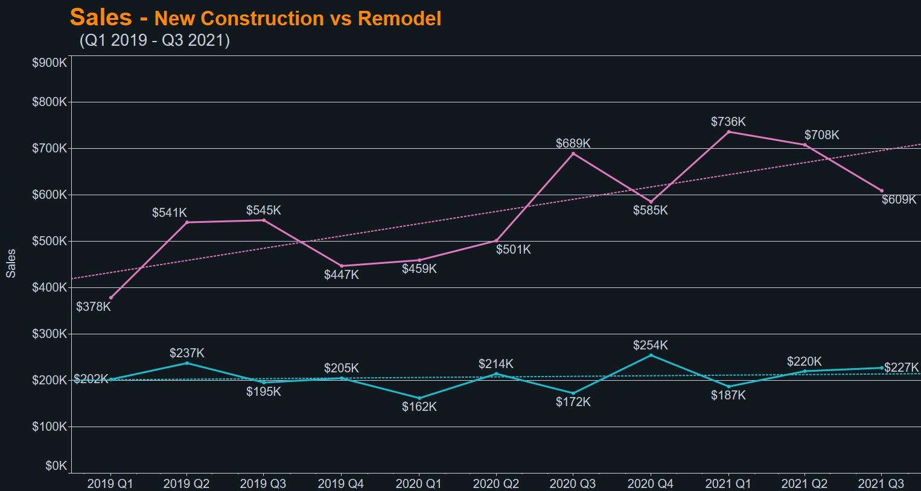

Slide 17
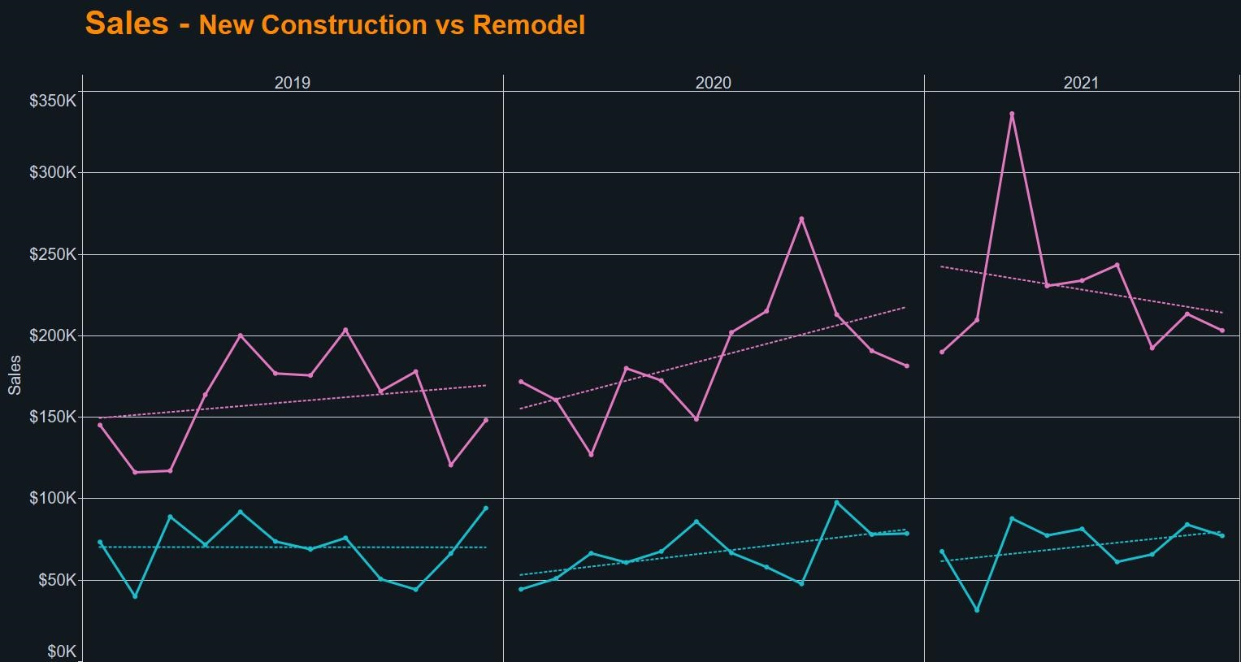

Slide 18

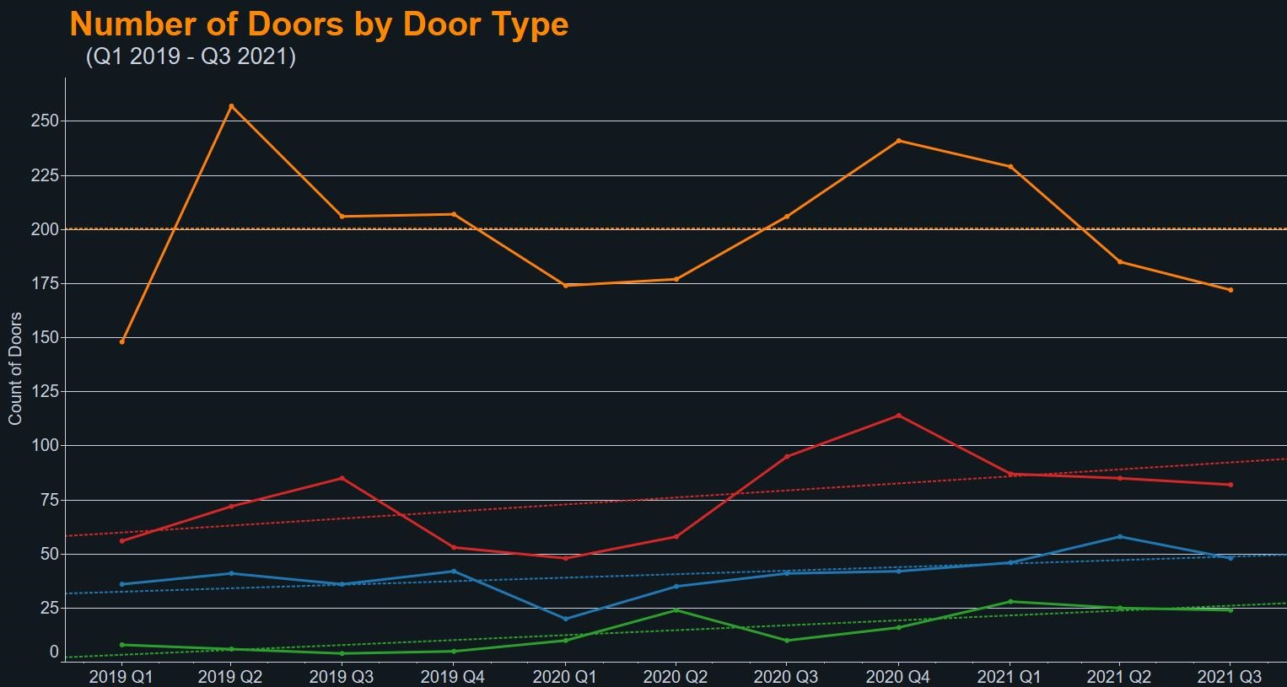

Slide 19
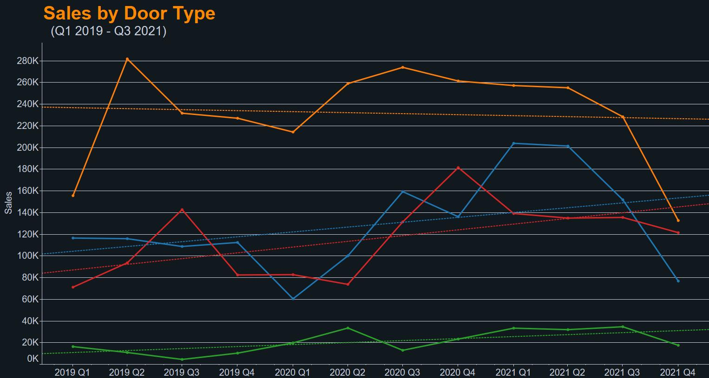

Slide 20
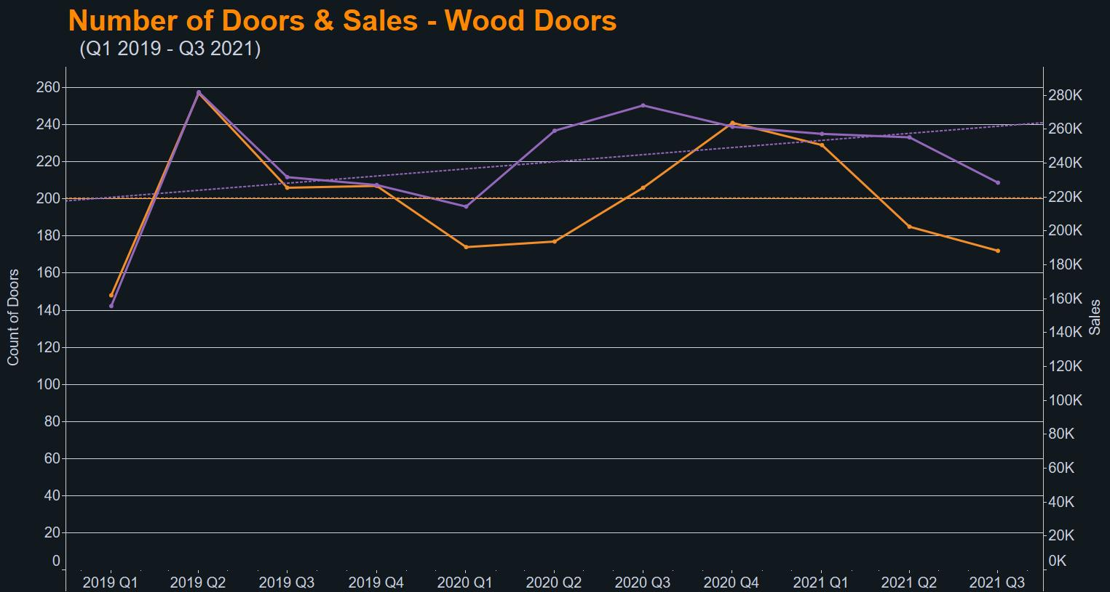


Slide 21
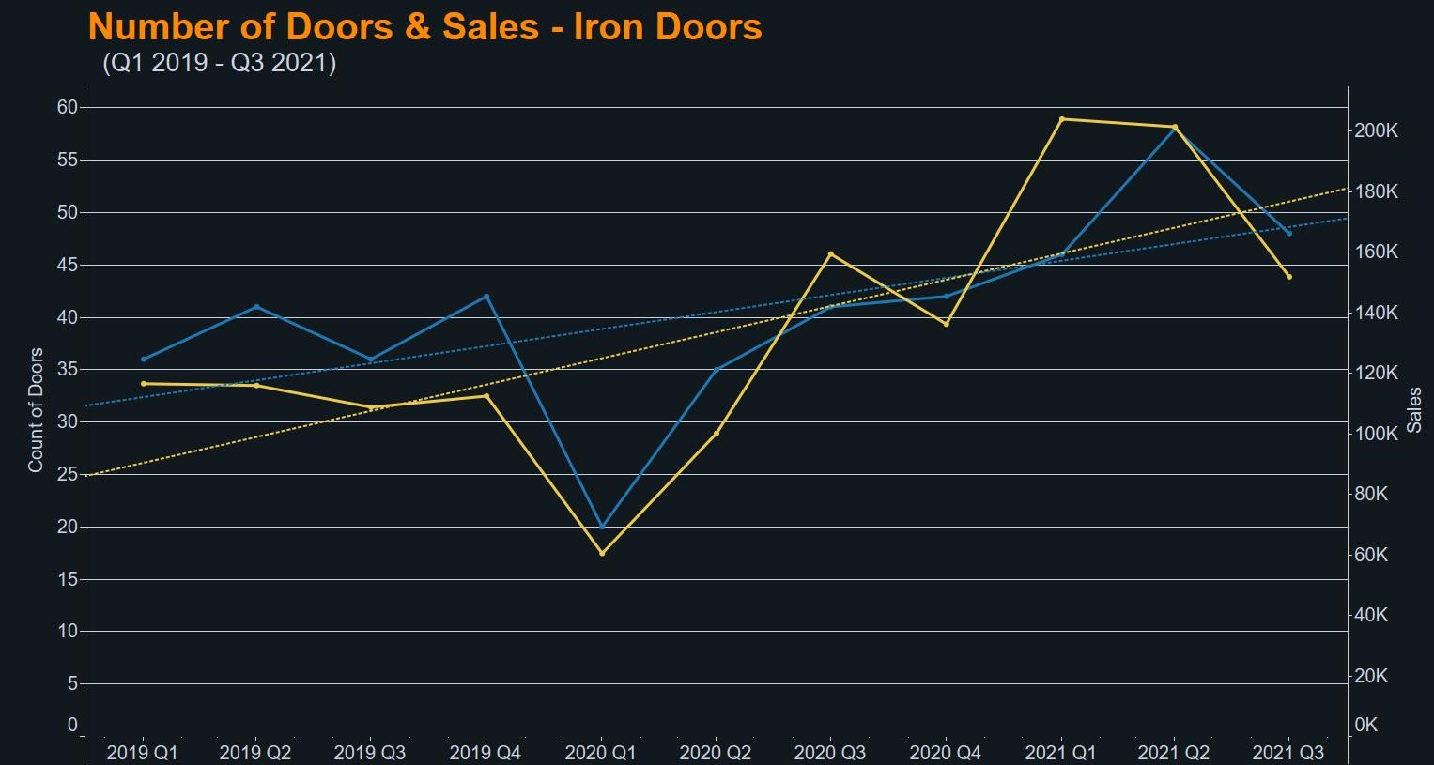


Slide 22
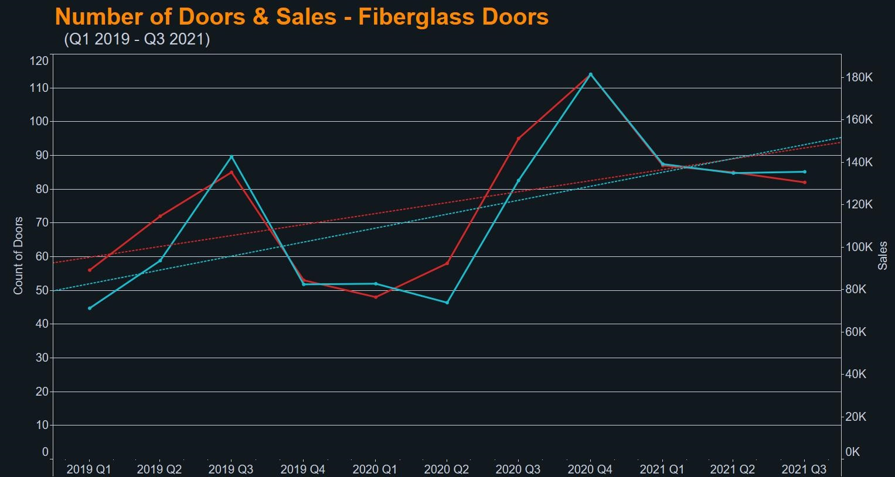


Slide 23
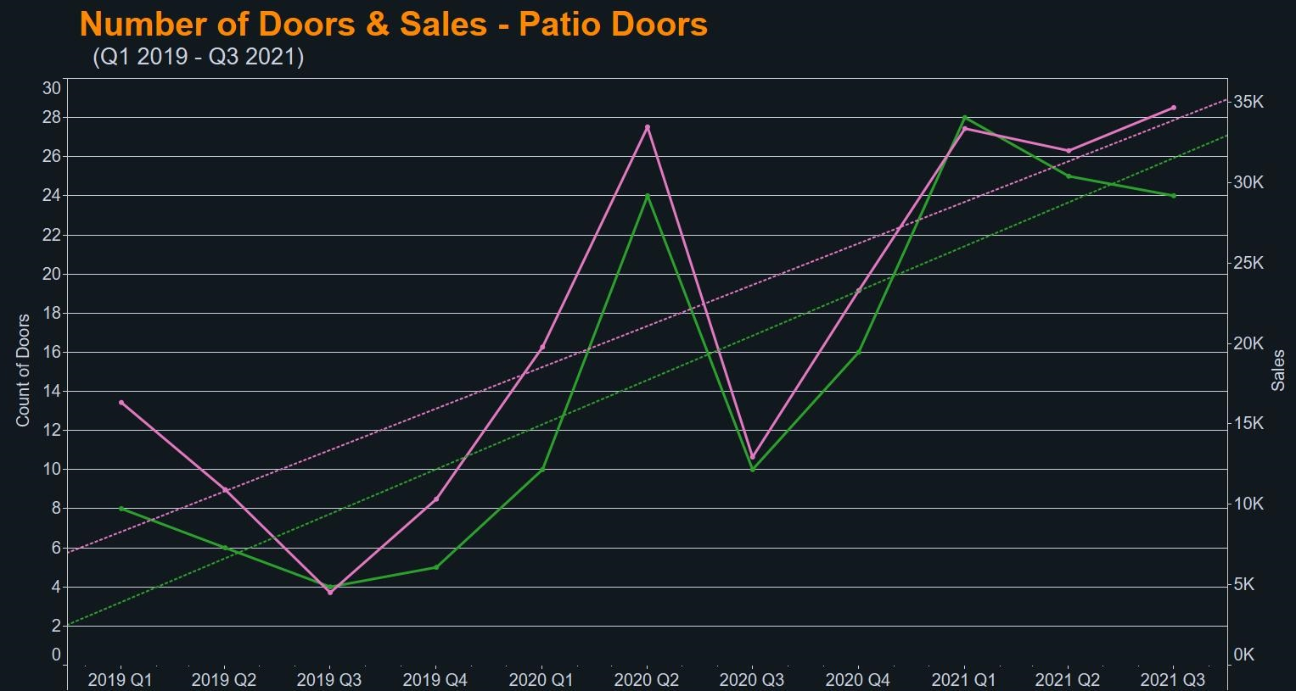


Slide 24
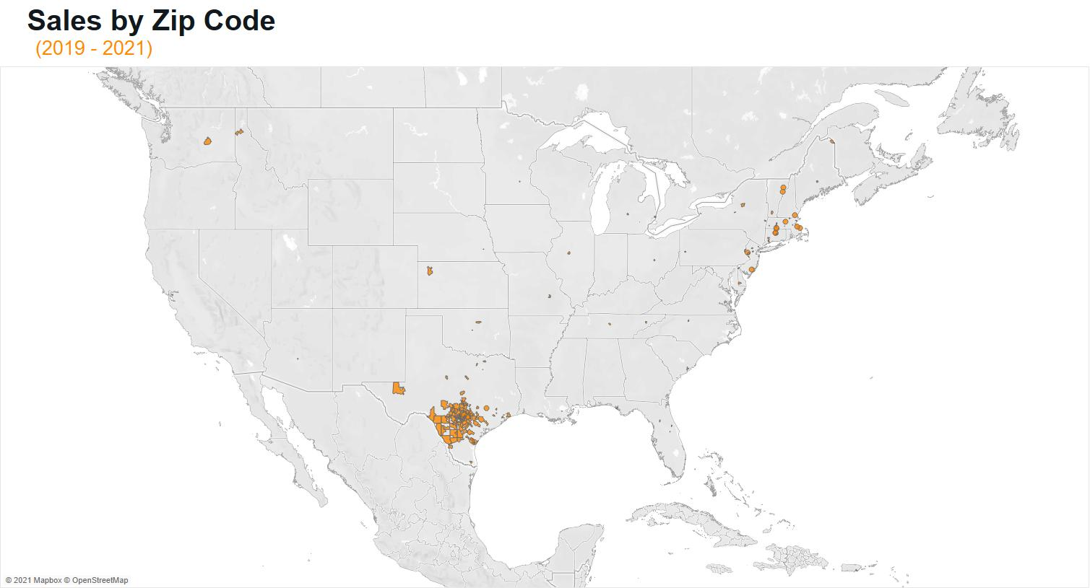

Slide 25
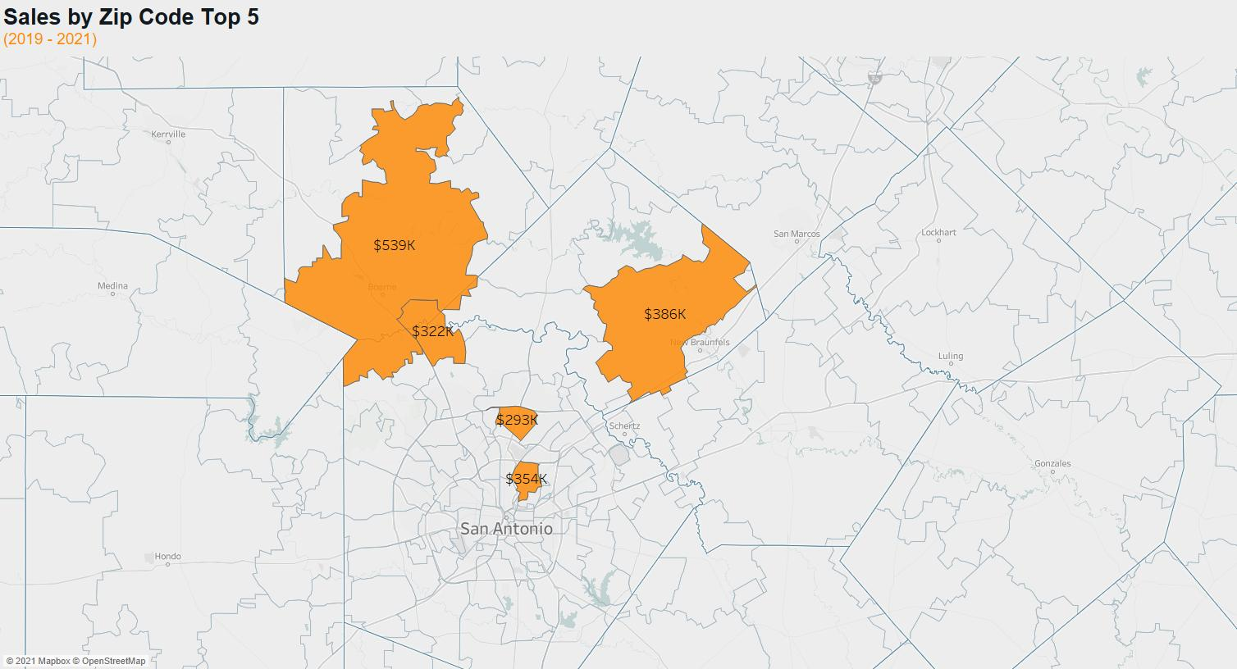

Slide 26
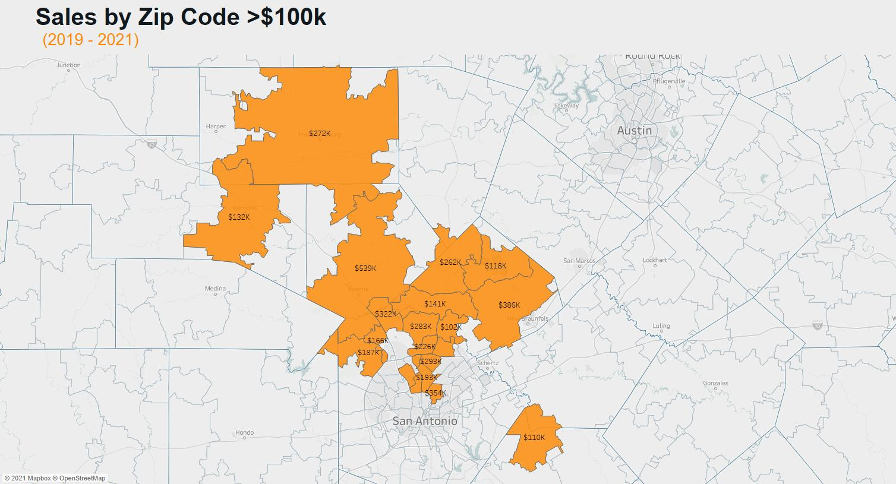

Slide 27
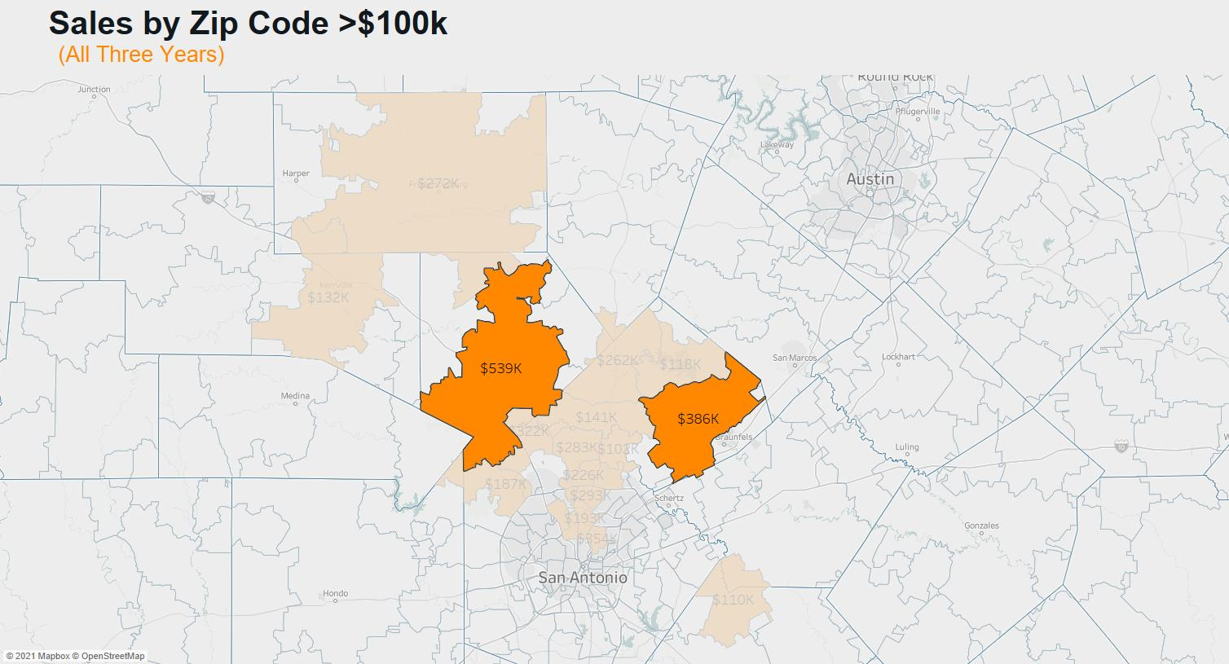

Slide 28
Room for Improvement
A proper ERP system
SAP, Sage, E2 Shop System, Global Shop Solutions
Cloud based
Clean up the current input method
Develop classifications for door styles
Develop a quality system.

Slide 29
Thank You!

