Slide 1
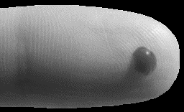




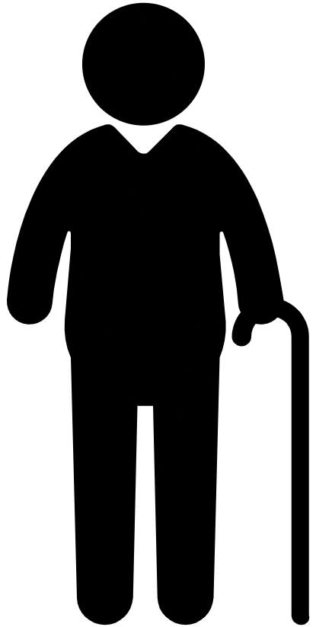












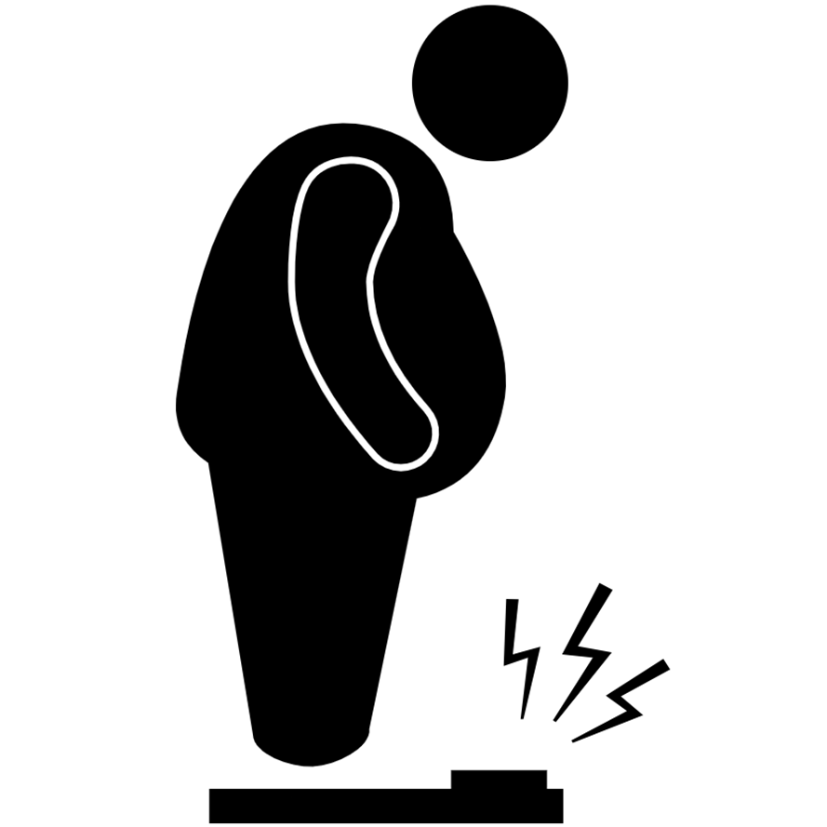






DIABETES
DIABETES IS
ON THE RISE
1.5 MILLION
deaths caused
by diabetes
422 MILLION
3.7 MILLION
deaths due to diabetes
and high blood glucose
adults have diabetes
THAT’S 1 PERSON IN 11
Main types of diabetes
Consequences
Diabetes can lead to complications in many parts of
the body and increase the risk of dying prematurely.
TYPE 1
Body does not produce
enough insulin
Stroke
TYPE 2
Body produces insulin
but can’t use it well
Blindness
Heart Attack
GESTATIONAL
A temporary condition
in pregnancy
Kidney Failure
Risk factors for type 2 diabetes
Genetics, age and family history of diabetes can
increase the likelihood of becoming diabetic and
cannot be changed.
But some behaviors that increase risk can:
Amputation
KEY ACTIONS
Unhealthy
Diet
Eat healthy
Be physically active
Avoid excessive weight gain
Check blood glucose if in doubt
Follow medical advice
1 In 3 Is
Overweight
Physical
Inactivity
1 In 10
Is Obese

