Slide 1
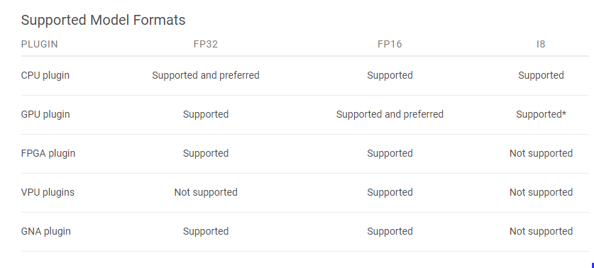

Slide 2
MODEL : RL_LSTM
FP16
Time load network : 16.398818016052246
Time infer network : 0.030910968780517578
FP32
Time load model : 16.543089151382446
Time infer network : 0.02592778205871582
------------------------------------
MODEL : YOLO
FP16
Time load model : 3.0832273960113525
Infer time : 0.373004674911499
FP32
Time load model : 3.3691515922546387
Infer time : 0.3700101375579834
-------------------------------------
MODEL : EAST
FP16
Time load : 0.584754467010498
Time infer : 0.7656238079071045
FP32
Time load : 0.3992044925689697
Time infer : 0.786128044128418
--------------------------------------

