Slide 1
Correct
Zero
Error convert
No result

Slide 2
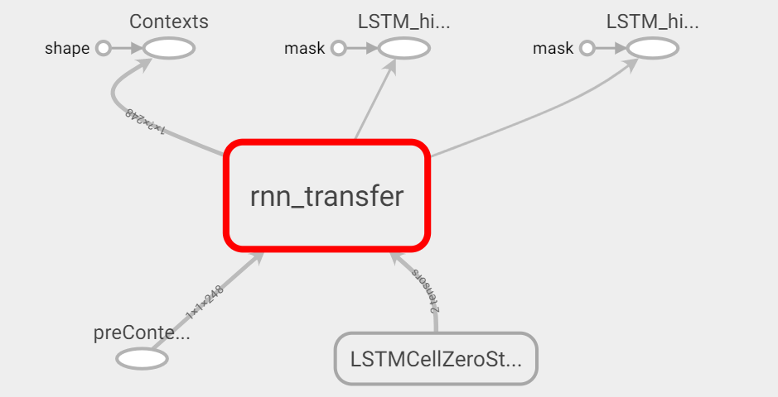
Correct
Zero
Zero
LSTM Model

Slide 3
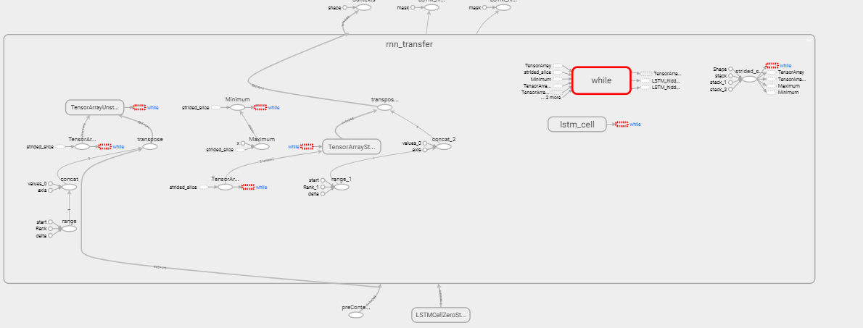
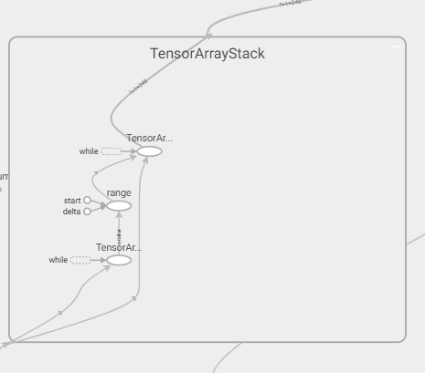
RNN_tranfer
Error convert to IR

Slide 4
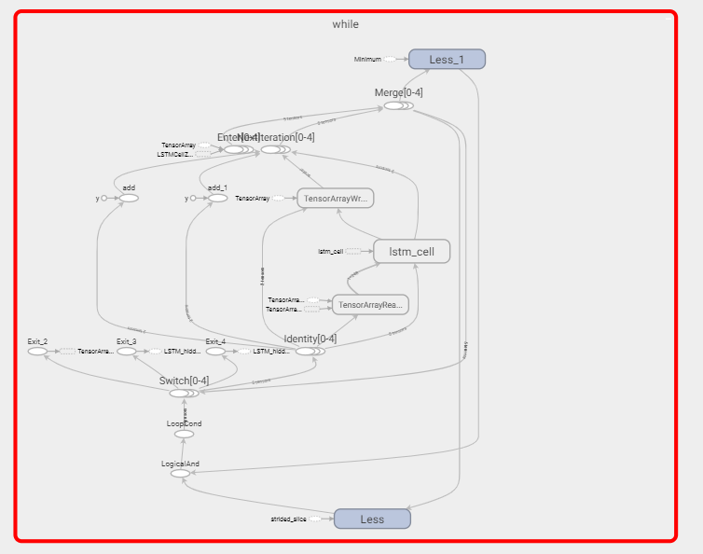
This’s block While

Slide 5
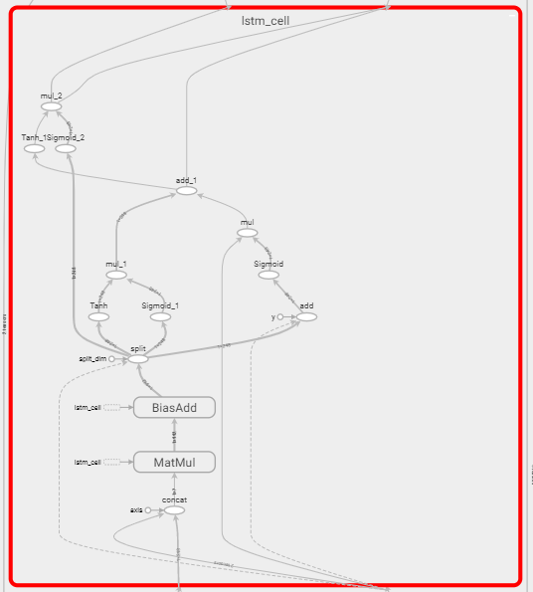
LSTM_Cell inside “While”

