Slide 1
UNIT I · FOUNDATIONS OF MEDICAL-SURGICAL NURSING IN CANADA · CHAPTER 1
Medical-Surgical Nursing in Canada
Adult acute care in Canada, nursing scope of practice, clinical judgment, legal and ethical foundations, patient safety, and care transitions.
Medical-Surgical Nursing: A Canadian Open Text
Aligned with CNO Entry-to-Practice Competencies (RN & RPN), CNA Code of Ethics (2025), NCSBN CJMM, HCCA (1996), PHIPA (2004), and ISMP Canada
opensourcenursing.ca (CC BY-NC-SA 4.0)
Notes:
Welcome to Chapter 1: Medical-Surgical Nursing in Canada. This opening session sets the foundation for the entire 36-chapter textbook.
Every topic in this chapter answers one of three questions that shape every shift on an adult inpatient unit:
1. Who is in the bed, and how does the Canadian health system shape their care before, during, and after hospitalization? (Sections 1.1 and 1.2)
2. How does the nursing and interprofessional team divide the work under CNO's Scope of Practice standard (authority, competence, and context), and how do nurses think through a changing patient using the six skills of the Clinical Judgment Measurement Model? (Sections 1.3 and 1.4)
3. What legal, ethical, patient safety, and communication rules protect the patient at the bedside and across transitions in care? (Sections 1.5 to 1.8).

Slide 2
LEARNING OUTCOMES & CNO COMPETENCY MAPPING
Seven chapter outcomes mapped to entry-to-practice standards
Every learning outcome aligns with CNO RN (2019a) competency roles and RPN (2019b) competency categories.
Outcomes 1 to 4: System, Scope & Judgment
Outcomes 5 to 7: Law, Safety & Transitions
Sections 1.1 to 1.4 · System, Scope and Judgment
Sections 1.5 to 1.8 · Law, Safety and Transitions
Outcome 1: Describe medical-surgical nursing and the settings and transitions in which adults receive care in Canada.
Outcome 2: Explain how the Canada Health Act and provincial delivery shape access to hospital and community care.
Outcome 3: Compare RN, RPN/LPN, NP, and UCP roles using authority, competence, and context.
Outcome 4: Apply the six cognitive skills of the CJMM to a change in an adult patient's condition.
Outcome 5: Explain how the CNO Code of Conduct, CNA Code of Ethics (2025), and consent, privacy, and charting rules guide practice.
Outcome 6: Describe the patient safety systems that protect hospitalized adults and the nurse's part in them.
Outcome 7: Use teach-back, professional interpreters, and discharge planning to partner across care transitions.
Dual-Track Design: Core sections serve all students (NCLEX-RN, REx-PN, CPNRE); Going Deeper boxes add RN-specific depth.
CNO Competency Alignment: Outcomes 1–2 & 4 -> Foundations of Practice | Outcome 3 -> Collaborative & Legal Practice | Outcome 5 -> Ethical, Legal & Professional Practice.
Medical-Surgical Nursing: A Canadian Open Text
Chapter 1 · Medical-Surgical Nursing in Canada
Notes:
Review the seven Chapter 1 Learning Outcomes and how they map to the College of Nurses of Ontario (CNO) Entry-to-Practice Competencies:
- Outcomes 1 & 2: RN Clinician; Coordinator (CNO, 2019a, Pub. No. 41037) | RPN Foundations of Practice (CNO, 2019b, Pub. No. 41042)
- Outcome 3: RN Coordinator; Collaborator; Professional | RPN Collaborative Practice; Legal Practice
- Outcome 4: RN Clinician; Scholar | RPN Foundations of Practice
- Outcome 5: RN Professional; Advocate | RPN Ethical Practice; Legal Practice; Professional Practice
- Outcome 6: RN Leader; Clinician | RPN Professional Practice; Foundations of Practice
- Outcome 7: RN Educator; Communicator; Collaborator | RPN Collaborative Practice

Slide 3
CHAPTER 1 · MEDICAL-SURGICAL NURSING IN CANADA
Three questions behind every shift on an adult unit
Every section in this chapter answers one of these three questions.
Who is in the bed?
Who does what on the team?
What protects the patient?
Adults with an acute illness, a flare-up of a chronic disease, or surgery and recovery
Most older inpatients live with multimorbidity and take many medications at home
Hospital care is publicly insured under the Canada Health Act, but home drugs and supports vary by province
Patients from rural, remote, and northern communities often travel far from family and language for care
RNs, RPNs/LPNs, NPs, and unregulated care providers work together with the interprofessional team
Every nursing action requires three things: legal authority, personal competence, and a supportive context
Any nurse who sees a patient deteriorating acts at once and escalates
The six cognitive skills of the CJMM turn subtle bedside cues into timely action
CNO's Code of Conduct and the 2025 CNA Code of Ethics put the patient's dignity and safety first
Valid consent, capacity assessment, and PHIPA privacy rules govern every treatment and record
Just culture, independent double checks, and ROPs prevent hospital-acquired harm
Plain language, teach-back, professional interpreters, and medication reconciliation make discharge safe
Medical-Surgical Nursing: A Canadian Open Text
Chapter 1 · Medical-Surgical Nursing in Canada
Notes:
Use this three-card slide as the spine of the lecture and return to it at each Part Divider.
Notice how the three pillars connect: a nurse cannot plan a safe discharge on the third card without knowing on the first card that outpatient prescriptions are not universally covered by the Canada Health Act, or without knowing on the second card when to consult an RN, pharmacist, or social worker.

Slide 4
PART ONE
Who is in the bed, and where care happens
Multimorbidity, the illness trajectory, the Canada Health Act, and care far from home.
Notes:
Part One covers Sections 1.1 and 1.2: what medical-surgical nursing is, the demographics of Canadian hospital beds, the five phases of the illness trajectory, patient- and family-centred care, the Canada Health Act, federal/provincial roles, and rural/northern medical travel.

Slide 5
THE CANADIAN CONTEXT · SECTIONS 1.1 & 1.2
Who fills adult medical and surgical beds in Canada
A patient admitted for one acute problem almost always brings several chronic ones and a long medication list.
3.14 M
20.0%
>60%
6.1%
acute inpatient hospital stays in Canada in 2024–2025; led after childbirth by COPD and pneumonia
of people in Canada aged 65 or older as of July 2026 — accounting for 43.2% of health spending
of adults 65 and older living with multimorbidity (two or more chronic conditions) in BC records
of Canadian hospital stays in 2024–2025 that included alternate level of care (ALC) days
Canadian Institute for Health Information (2023, 2026a); Statistics Canada (2026); Public Health Agency of Canada (2020); Ferris et al. (2025).
Medical-Surgical Nursing: A Canadian Open Text
Chapter 1 · Medical-Surgical Nursing in Canada
Notes:
Let these four numbers tell the story of modern Canadian medical-surgical nursing:
- 3.14 million acute stays a year (CIHI, 2026a): after giving birth, the top two medical reasons adults are admitted to a Canadian hospital bed are COPD/bronchitis and pneumonia.
- One in five Canadians (20.0%) is now 65 or older (Statistics Canada, 2026), and over 60% of older adults live with multimorbidity when 25 chronic conditions are counted in health administrative data (Ferris et al., 2025; PHAC, 2020).
- That means the textbook 'single-diagnosis patient' barely exists on an adult ward: the person admitted for a fractured hip or bowel resection also has heart failure, diabetes, chronic kidney disease, or early dementia.

Slide 6
ADULT HEALTH & FAMILY PARTNERSHIP · SECTION 1.1
The illness trajectory and who counts as family
The path of a chronic illness is rarely straight — and every admission is a chance to prevent the next one.
The illness trajectory and the nurse's core work
Essential care partners
Five phases across time: (1) prevention & health promotion, (2) acute illness or surgery, (3) recovery & rehabilitation, (4) chronic disease self-management, and (5) end-of-life care (Ch. 10)
Patients cycle between phases — a person with COPD or heart failure may move from home self-management to an acute ward and back several times a year
Six core nursing functions: assessment, surveillance (catching small changes early), safe medication administration, patient/family teaching, care coordination, and advocacy
RNs and practical nurses (RPNs in Ontario; LPNs in most other jurisdictions) share this work according to authority, competence, and context
Patient- and family-centred care treats the patient as a whole person with values and goals (IPFCC, n.d.; RNAO, 2015)
The patient decides who counts as family — whether a spouse, relative, friend, or chosen family member
An essential care partner (HEC, n.d.-a) is named by the patient or SDM to provide physical, psychological, and emotional support — this role differs from a casual visitor
Include the patient in bedside shift report, ask 'What matters most to you?', and invite the named partner to discharge teaching
Medical-Surgical Nursing: A Canadian Open Text
Chapter 1 · Medical-Surgical Nursing in Canada
Notes:
Draw out the distinction in the dark card on the right (tested in Question 4):
1. Who defines 'family'? The patient does—never the nurse. If a 72-year-old patient names her next-door neighbour as her support person, that neighbour is her family for care planning.
2. What is an 'essential care partner' (Healthcare Excellence Canada, n.d.-a)? Unlike a casual social visitor, an essential care partner is chosen by the patient (or SDM) to provide vital emotional, cognitive, or physical support and participates in care and discharge teaching at the level the patient chooses.

Slide 7

Assessment is the foundation of surveillance
WHAT TO NOTICE
Assessment gathers physical, mental, social, and spiritual data — and asks what the patient wants from their care
Surveillance is watching for small changes over time so that clinical deterioration is caught early (Chapter 6)
On medical and surgical units, the line between 'medical' and 'surgical' blurs: a surgical patient often has multiple chronic medical conditions
The same assessment and surveillance skills apply across inpatient wards, step-down units, day surgery, home care, and virtual follow-up
A single vital sign tells you where the patient is right now. Comparing it with the patient's baseline tells you where the patient is heading.
Figure 1.1 · Credit: “Blood Pressure Monitoring” by NIH Clinical Center/Flickr, CC BY 2.0
Chapter 1 · Medical-Surgical Nursing in Canada
Notes:
Figure 1.1 shows bedside blood pressure monitoring. Use it to distinguish a mechanical task ('taking vitals') from nursing surveillance.
Anyone can write down a blood pressure of 112/64. Surveillance is recognizing that for a patient whose baseline blood pressure is 148/86 and whose respiratory rate just rose from 18 to 28, 112/64 is not 'normal'—it is early shock or sepsis. (Figure 1.1: “Blood Pressure Monitoring” by NIH Clinical Center/Flickr, CC BY 2.0.)

Slide 8
THE CANADA HEALTH ACT · SECTION 1.2 & TABLE 1.1
Five criteria inside the hospital — and the gap at discharge
Insured hospital and physician care is free at the point of care; outpatient drugs and home care depend on provincial rules.
Public administration Run on a non-profit basis by a public authority accountable to government and subject to audit.
Outside the Act Outpatient prescription drugs, home care, dental, vision, and ambulance fees are decided by each province or territory.
Comprehensiveness Covers medically necessary hospital services (bed, nursing, tests, inpatient drugs, OR) and physician care.
Ontario drug coverage Ontario Drug Benefit (ODB) covers adults ≥ 65 and eligible groups; others use private insurance or pay out of pocket (Q1).
Universality & Accessibility Uniform terms for all insured residents, with no extra-billing or user charges at the point of care.
Federal roles & NIHB Health Canada, PHAC, and Indigenous Services Canada (ISC), which runs nursing stations and NIHB for First Nations and Inuit.
Portability New residents wait ≤ 3 months, and the home plan pays when a resident needs emergency care in another province (Q2).
Ontario's structure Ontario Health (6 regions), 58 Ontario Health Teams, public hospitals, LTC, and Ontario Health atHome (June 28, 2024; Q5).
A drug given free in hospital may cost hundreds of dollars at the community pharmacy. Ask early whether the patient can afford their discharge prescriptions.
Medical-Surgical Nursing: A Canadian Open Text
Chapter 1 · Medical-Surgical Nursing in Canada
Notes:
This slide covers Table 1.1 and Questions 1, 2, and 5.
Make sure students can answer the patient in Question 1 ('My pills were free in here—will they be free at home too?'):
- Under the Canada Health Act (1985), drugs administered inside a hospital are insured hospital services.
- Once the patient walks out the hospital door, outpatient prescription drug coverage is NOT mandated by the Canada Health Act—it depends on provincial programs (like Ontario Drug Benefit for those 65+ or on social assistance), federal programs (like NIHB), private insurance, or out-of-pocket payment.
Also note that since June 28, 2024, publicly funded home and community care and long-term care placement in Ontario are coordinated by Ontario Health atHome (Question 5).

Slide 9
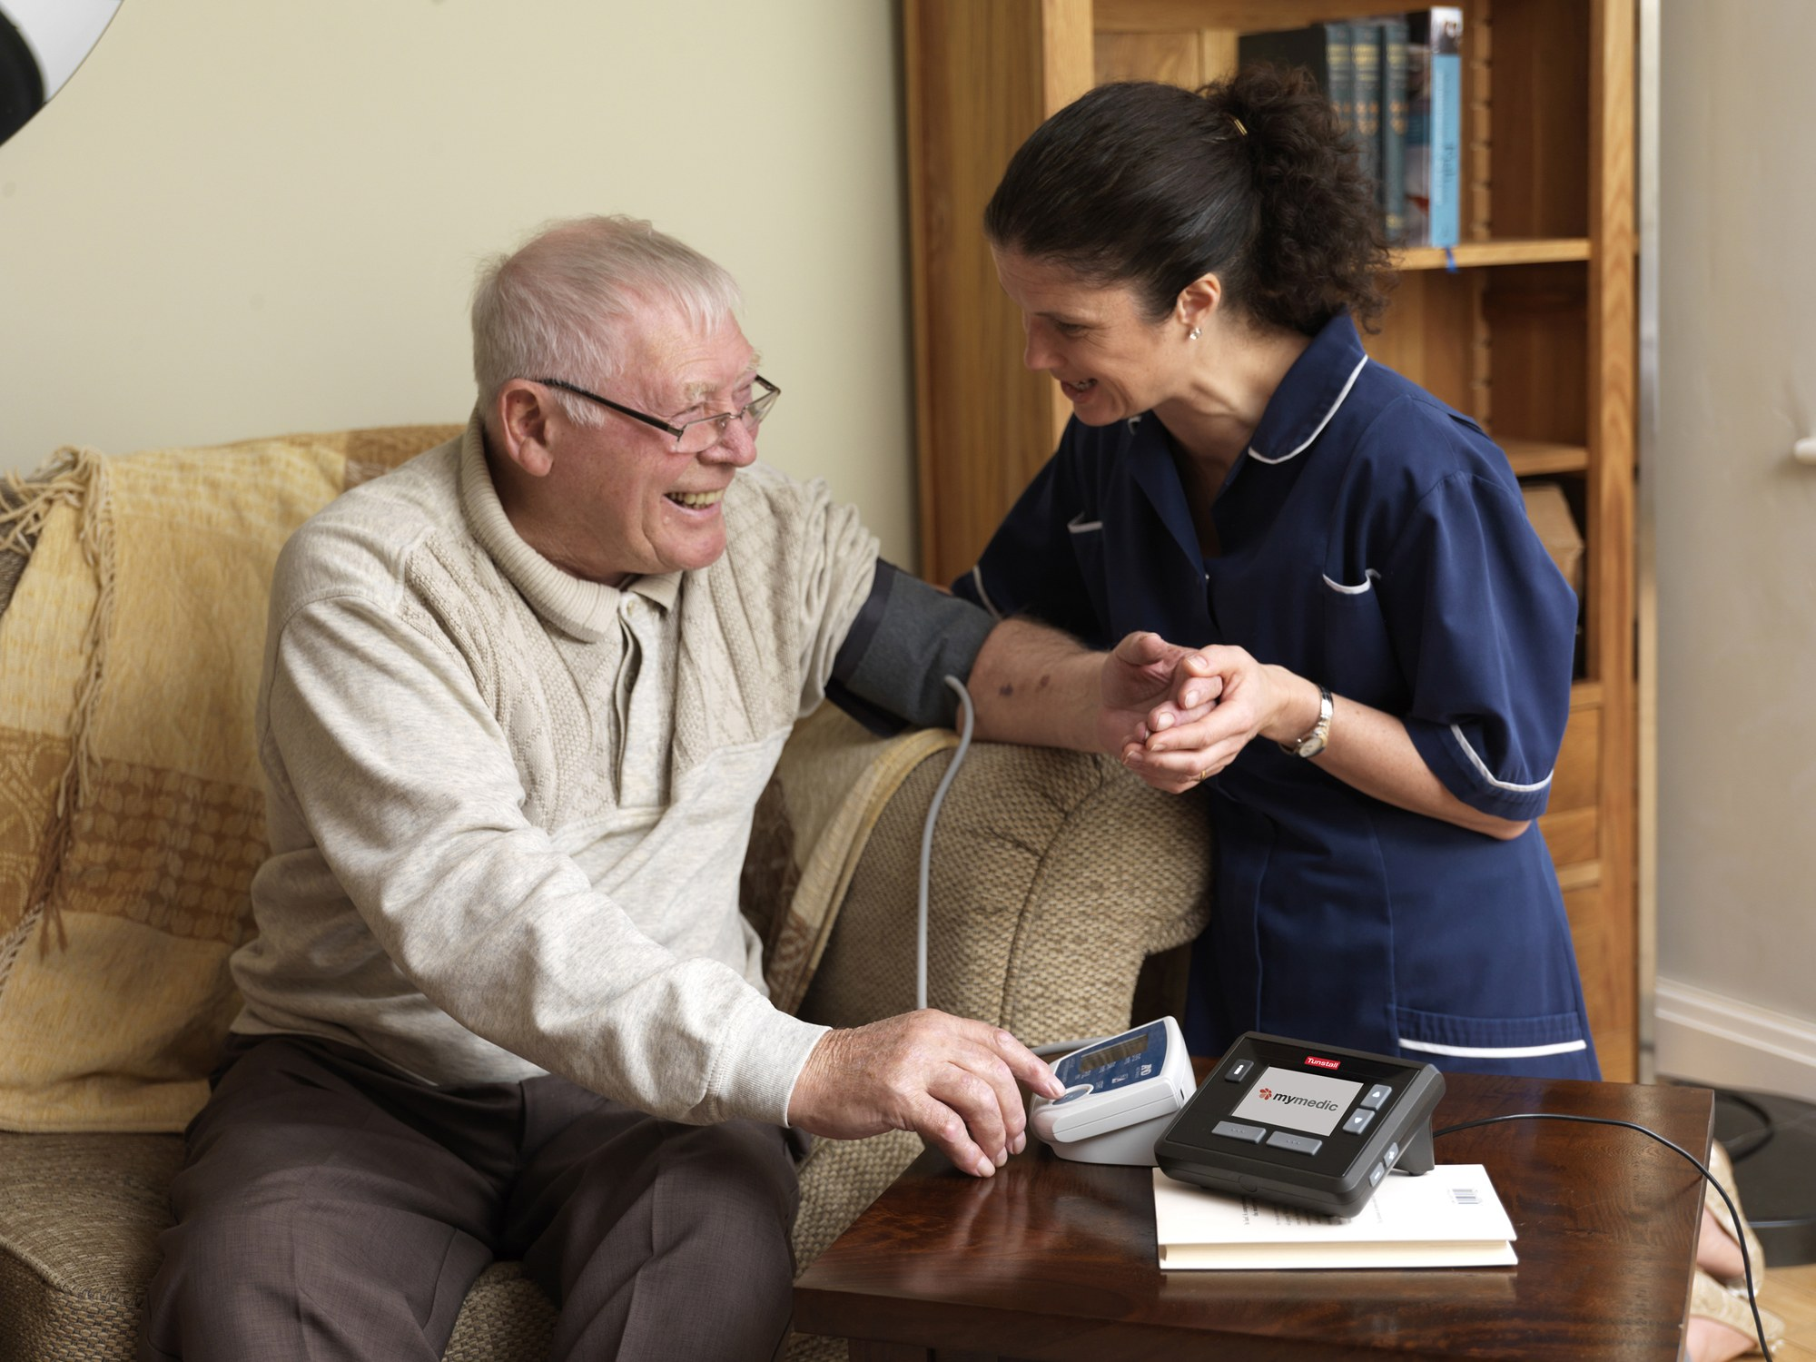
Medical-surgical nursing beyond the hospital walls
WHAT TO NOTICE
Adults receive medical-surgical care in inpatient wards, step-down units, day surgery, emergency departments, rehab, home care, and virtual/remote monitoring
A transition in care is any move between settings or teams (admission, transfer, or discharge) — information and medication changes can easily be lost
Discharge planning starts on the day of admission by asking where the patient lives, who helps at home, and what barriers stand in the way
Alternate level of care (ALC) describes a patient who still occupies an acute bed but no longer needs acute hospital care and is waiting for another setting (6.1% of stays; Q3)
An ALC designation means the patient no longer needs acute hospital intensity and is waiting for home care, rehab, or long-term care — NOT that they no longer need nursing care.
Figure 1.2 · Credit: “Telehealth - Older man and nurse using blood pressure” by Tunstall Telehealthcare/Flickr, CC BY 2.0
Chapter 1 · Medical-Surgical Nursing in Canada
Notes:
Figure 1.2 illustrates blood pressure monitoring in the patient's home. Connect home care directly to Alternate Level of Care (ALC) inside the hospital (Question 3):
When an older adult is medically finished their acute treatment for a hip fracture or pneumonia but cannot safely return home without supports—or is waiting for a rehabilitation or long-term care bed—the physician designates them ALC.
While waiting on an acute ward, ALC patients remain at high risk for delirium, falls, deconditioning, and hospital-acquired infection. They still need active nursing care, mobilization, and discharge advocacy. (Figure 1.2: “Telehealth - Older man and nurse using blood pressure” by Tunstall Telehealthcare/Flickr, CC BY 2.0.)

Slide 10

Care far from home: Qikiqtani General Hospital
WHAT TO NOTICE
Because surgical and specialist services are concentrated in larger cities, adults in rural, remote, and northern communities must often travel far from home
Qikiqtani General Hospital in Iqaluit serves Nunavut's Qikiqtaaluk region, while complex tertiary care or radiation therapy often requires flights south to Ottawa, Winnipeg, Edmonton, or Yellowknife
For registered First Nations and recognized Inuit, ISC's Non-Insured Health Benefits (NIHB) program covers medical transportation, meals, lodging, and an approved escort (Q6)
Ontario's Northern Health Travel Grant partly reimburses eligible northern residents travelling ≥ 100 km one way for specialist or facility care not available locally
Medical travel separates patients from family, language, traditional food, and community support. Start discharge and travel logistics early, because prior approval and flights take time.
Figure 1.3a · Credit: “Qikiqtani General Hospital” by OhanaUnited/Wikimedia Commons, CC BY-SA 4.0
Chapter 1 · Medical-Surgical Nursing in Canada
Notes:
Slides 9, 10, and 11 bring the Canadian Context box ('Care Far from Home') to life using all three photographs from the textbook.
In Figure 1.3a we see Qikiqtani General Hospital in Iqaluit, Nunavut. Remind students of Question 6: when a registered First Nations patient from a remote northern community or a recognized Inuk patient needs to fly to a regional or tertiary hospital—and fly back home at discharge—the Non-Insured Health Benefits (NIHB) program run by Indigenous Services Canada covers medical transportation, lodging, meals, and an approved medical escort. (Figure 1.3a: “Qikiqtani General Hospital” by OhanaUnited/Wikimedia Commons, CC BY-SA 4.0.)

Slide 11
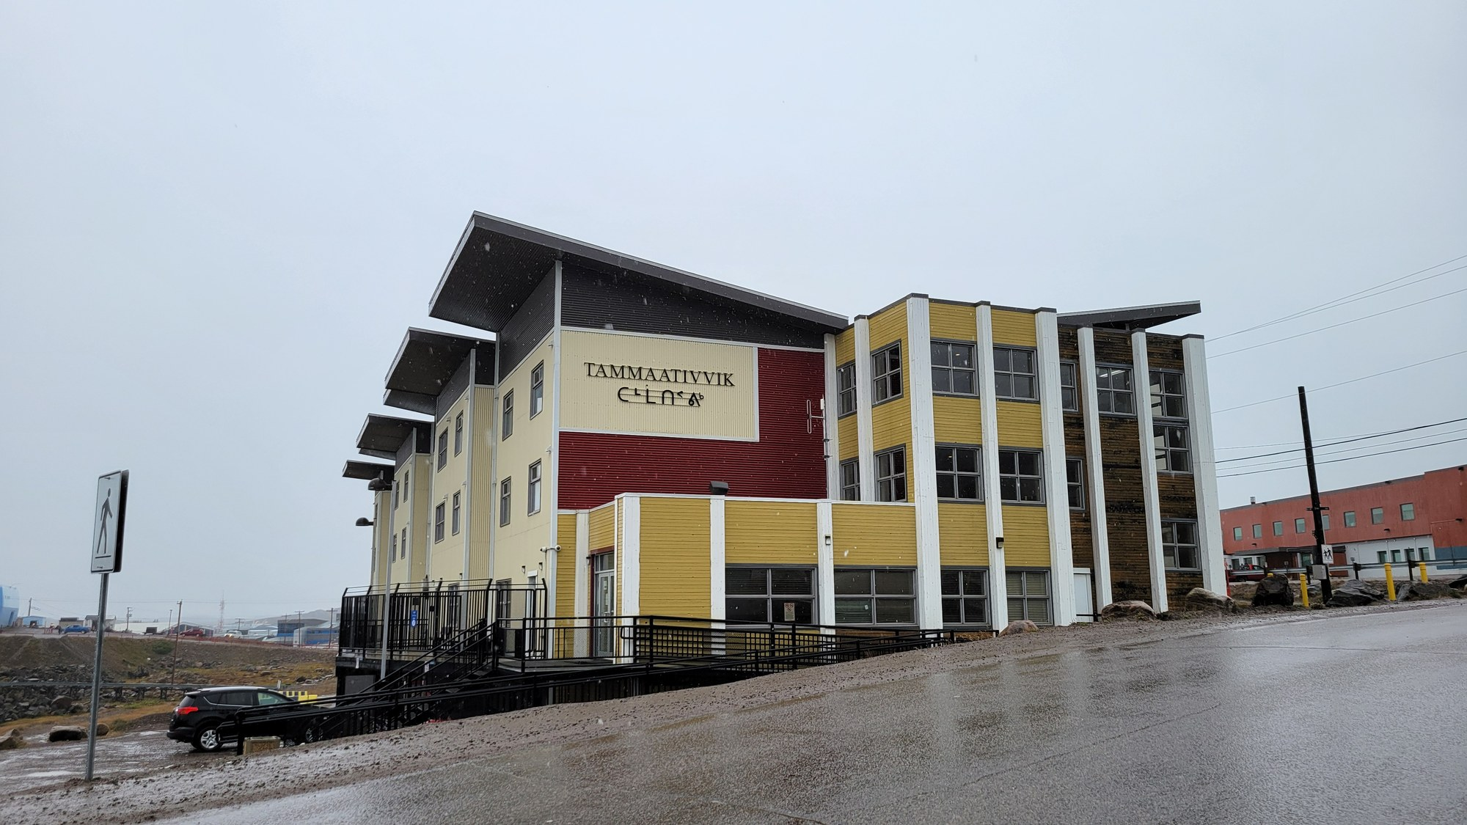
Boarding homes and the role of the medical escort
WHAT TO NOTICE
Tammaativvik in Iqaluit is a boarding home for Inuit patients and their escorts who travel from smaller communities for hospital or specialist appointments
Similar boarding homes operate in southern referral cities (such as Ottawa, Winnipeg, and Edmonton) for patients awaiting tests, surgery, cancer treatment, or flights home
In a study of Inuit patients travelling from Nunavut to Ottawa for cancer care, patients reported having little say or support in decisions and relied heavily on their escorts (Jull et al., 2021)
Ask early who is travelling with the patient, include the escort in teaching with the patient's consent, and arrange a professional interpreter
A patient discharged to a boarding home or a multi-leg flight home does not have their home fridge, family network, or local pharmacy next door. Tailor discharge teaching to where they are sleeping tonight.
Figure 1.3b · Credit: “Tammaativvik boarding home” by OhanaUnited/Wikimedia Commons, CC BY-SA 4.0
Chapter 1 · Medical-Surgical Nursing in Canada
Notes:
Figure 1.3b shows Tammaativvik, the Inuit patient boarding home in Iqaluit.
Students working in urban referral hospitals in Ontario or across Canada often discharge a northern patient 'home' without realizing that 'home tonight' is actually a boarding home or hostel while the patient waits two days for a weather-dependent flight!
Jull and colleagues (2021) documented how isolating southern medical travel can be for Inuit cancer patients, and how essential the accompanying medical escort and interpreter are for safe, shared decision-making. (Figure 1.3b: “Tammaativvik boarding home” by OhanaUnited/Wikimedia Commons, CC BY-SA 4.0.)

Slide 12

Stabilizing and transferring the critically ill patient
WHAT TO NOTICE
An Ornge air ambulance helicopter lifts off from St. Michael's Hospital in Toronto — Ornge provides rotor-wing, fixed-wing, and critical care land transport across Ontario
A nurse in a remote nursing station or rural community hospital often stabilizes an acutely ill or injured adult and prepares them for air evacuation
Every inter-facility transfer is a high-risk transition in care where vital history, medication timing, and family contact details can be lost
Confirm that consent/SDM contact numbers, a complete medication record, allergies, and recent diagnostic results accompany the patient
Before a patient is flown hundreds of kilometres to a tertiary centre, make sure the family knows where the patient is going and how to reach the receiving unit.
Figure 1.4 · Credit: “Ornge Agusta Westland AW 139 C-GYNN” by BriYYZ/Wikimedia Commons, CC BY-SA 2.0
Chapter 1 · Medical-Surgical Nursing in Canada
Notes:
Figure 1.4 shows an Ornge AW139 air ambulance helicopter departing St. Michael's Hospital in Toronto.
Use this image to connect rural/northern stabilization with urban tertiary receiving units: whether you are the nurse packaging the patient in a northern community or the nurse receiving them in Toronto, Kingston, Ottawa, or Thunder Bay, a structured handover and immediate phone contact with the family left behind are core nursing responsibilities. (Figure 1.4: “Ornge Agusta Westland AW 139 C-GYNN” by BriYYZ/Wikimedia Commons, CC BY-SA 2.0.)

Slide 13
PART TWO
The medical-surgical team and scope of practice
RNs, RPNs, NPs, and unregulated care providers — and how authority, competence, and context work together.
Notes:
Part Two covers Section 1.3, including Table 1.2 (the Ontario nursing team), Table 1.3 (authority, competence, and context), the Scope in Practice box (Mr. Desjardins), and the Practice Story ('The Night Mrs. Kowalski Changed').

Slide 14
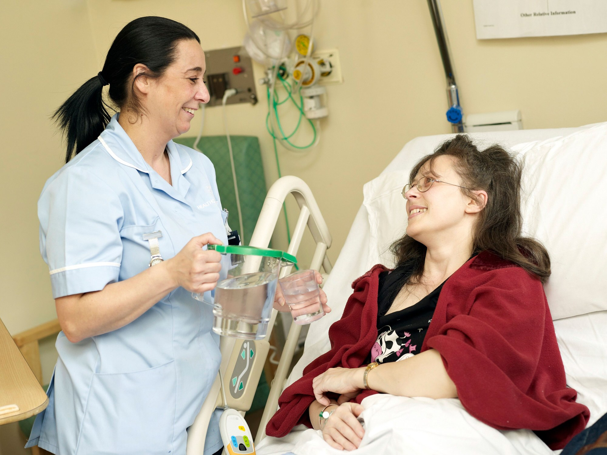
The nursing team and unregulated care providers
WHAT TO NOTICE
In Ontario, CNO regulates three categories: RNs (BScN degree), RPNs (practical nursing diploma; called LPNs in most other provinces), and NPs (graduate education; registered in a single class since July 1, 2026)
In the four western provinces and Yukon, the letters 'RPN' stand for Registered Psychiatric Nurse — a separate regulated profession (CIHI, 2026c)
Personal support workers (PSWs) are unregulated care providers (UCPs) under the RHPA; their voluntary registration with HSCPOA (since Dec 1, 2024) sets no legal scope of practice (CNO, 2024)
Provincial rules differ: since February 2, 2026, Alberta regulates health care aides under its Health Professions Act with a protected title (CLHA, n.d.)
When assigning a task to a UCP, the nurse is accountable for assessing the patient and the risk, confirming the UCP can do the task, supervising if needed, and following up (CNO, n.d.-k).
Figure 1.5 · Credit: “A healthcare assistant pouring water for a patient” by Adrian Wressell, Heart of England NHS FT/Wellcome, CC BY 4.0
Chapter 1 · Medical-Surgical Nursing in Canada
Notes:
Figure 1.5 shows a health care assistant helping a hospitalized adult with oral fluids, representing the vital daily role of unregulated care providers (UCPs) alongside RNs, RPNs/LPNs, NPs, and the interprofessional team (Table 1.2).
Highlight two jurisdictional facts from Section 1.3:
1. In Ontario, voluntary PSW registration with HSCPOA does not make PSWs regulated health professionals under the RHPA—their employer defines their role, and the nurse's accountability when assigning tasks is unchanged.
2. In Alberta, by contrast, health care aides became regulated on February 2, 2026. Always know the rules of the province where you practise. (Figure 1.5: “A healthcare assistant pouring water for a patient” by Adrian Wressell, Heart of England NHS FT/Wellcome Collection, CC BY 4.0.)

Slide 15
THE MEDICAL-SURGICAL TEAM · SECTION 1.3 & TABLE 1.2
Nursing categories and the interprofessional ward team
Nurses are at the bedside around the clock — they notice change first and coordinate the interprofessional team.
Ontario Nursing Team (Table 1.2)
The Interprofessional Team
Education, regulation, and typical ward responsibilities (CNO, 2024)
Early communication and mutual respect protect the patient
Registered Nurse (RN): BScN degree (CNO); manages complex or rapidly changing patients, coordinates care, acts as team resource/charge.
Registered Practical Nurse (RPN): Diploma (CNO; LPN outside ON); cares for assigned patients, consults RN as needs change, directs UCPs.
Nurse Practitioner (NP): RN + graduate NP education (single CNO class since July 1, 2026); diagnoses, orders tests, and prescribes.
Personal Support Worker (PSW): Unregulated under RHPA (voluntary HSCPOA registry); assists with hygiene, mobility, meals, and reports changes.
Physicians & Pharmacists: Hospitalists and surgeons diagnose and direct medical/surgical care; pharmacists verify orders, interactions, and dosing.
PT, OT & Dietitians: Physiotherapists and occupational therapists restore mobility/ADLs for safe discharge; dietitians plan enteral/parenteral nutrition.
Respiratory Therapists (RTs): Manage airways, oxygen delivery, and mechanical ventilation, and respond to rapid response and code calls.
Social Work & Spiritual Care: Social workers support coping, finances, and discharge placement; spiritual care supports patients of any faith or none.
Western Canada & Yukon Note: In BC, Alberta, Saskatchewan, Manitoba, and Yukon, "RPN" stands for Registered Psychiatric Nurse (CIHI, 2026c).
Medical-Surgical Nursing: A Canadian Open Text
Chapter 1 · Medical-Surgical Nursing in Canada
Notes:
This slide presents Table 1.2 (Members of the medical-surgical nursing team in Ontario) on the left and the interprofessional team on the right.
Emphasize how nurses act as the central hub of the ward team: because nurses are at the bedside 24 hours a day, they are almost always the first to spot postoperative delirium, dysphagia, hypoxemia, or financial barriers to discharge medications, and they initiate timely referrals to PT, OT, pharmacy, dietitians, respiratory therapy, and social work.

Slide 16
CNO SCOPE OF PRACTICE STANDARD · SECTION 1.3 & TABLE 1.3
Three questions before every nursing action
A nurse needs all three (CNO, 2025e). Legal authority does not make an activity safe if you lack the skill or the setting forbids it.
1. Authority
2. Competence
3. Context
Comes from the RHPA and Nursing Act, 1991 (5 controlled acts authorized to RNs and RPNs)
Requires an authorizing mechanism: a direct order, a directive, delegation, or initiation
Nurses CANNOT initiate controlled acts in Ontario public hospitals (Public Hospitals Act requires an order; Q13)
RN prescribing (in force Dec 4, 2023) requires CNO-approved education and cannot be used in public hospitals
The individual nurse's knowledge, skill, and judgment to perform the activity safely and manage complications
Changes over time and is maintained through reflection and CNO's Quality Assurance Program
If you are not competent (e.g., assigned an unfamiliar chest tube or epidural, Q14), do not perform it alone
Tell the charge nurse, ask for teaching and support, and consult or transfer care until competent
The patient's needs, the unit environment, staffing, equipment, and employer policy
An employer policy can narrow a nurse's scope, but can NEVER widen it beyond what law and CNO allow (Q15)
When an employer policy conflicts with a CNO standard, your first accountability is to the CNO standard
CNO's revised Scope and Medication standards take effect March 1, 2027 (clarifying orders and delegation)
Medical-Surgical Nursing: A Canadian Open Text
Chapter 1 · Medical-Surgical Nursing in Canada
Notes:
Spend real time on these three cards (Table 1.3), because Questions 13, 14, and 15 test each one directly:
- Card 1 (Authority, Q13): Suppose an RPN in an Ontario public hospital finds an infiltrated IV and knows the Nursing Act regulation allows initiation of venipuncture in some community settings. Can the RPN initiate a new IV in a public hospital without an order or directive? No! The Public Hospitals Act requires an order or directive for treatment in a public hospital.
- Card 2 (Competence, Q14): Reading a manufacturer's pamphlet does not make you competent to manage a chest tube alone—ask for teaching and support or transfer care safely.
- Card 3 (Context, Q15): CNO retired the old 'three-factor framework' (client, nurse, environment) in 2023. Today's framework is authority, competence, and context.

Slide 17
ASSIGNMENT, CONSULTATION & ESCALATION
Who cares for the patient when the numbers change
CNO does not divide patients into 'RN patients' and 'RPN patients' — and every nurse who sees deterioration acts at once.
Scope in Practice: Mr. Desjardins (POD 1 colectomy)
Practice Story: Mrs. Kowalski
CNO's Scope of Practice standard asks every nurse to judge whether the patient's condition calls for consultation or transfer of care — assigning unstable patients to RNs is a common employer policy, not a CNO rule
At 0200, Mr. Desjardins (68, POD 1 open colectomy) has HR 128, BP 88/52, cool hands, and urine output 10 mL/h
Authority: the RPN is authorized to give ordered IV fluids, but any new treatment in a public hospital needs an order
Competence & Context: managing minute-by-minute shock while caring for four other patients exceeds what the RPN can safely do alone, and unit policy assigns rapid-response patients to an RN
Action: the RPN stays with Mr. Desjardins, checks his IV, calls the RN to the bedside, gives an SBAR handover, and helps the team
Nurse Danielle Thériault, RPN (eastern Ontario community hospital, night shift)
Mrs. Kowalski, 86 (day 2 pneumonia on 2 L/min O2), was chatty at 2300 (RR 18)
At 0300 she is picking at her blanket asking for her late husband; RR is 28, SpO2 89%, HR 108, T 38.3 °C, BP 112/64 (below baseline)
None of the numbers looked dramatic alone — together they meant early sepsis
Danielle sat her up, checked her prongs, and used SBAR to bring RN Marco and the rapid response team immediately
Medical-Surgical Nursing: A Canadian Open Text
Chapter 1 · Medical-Surgical Nursing in Canada
Notes:
Compare Mr. Desjardins on the left with Mrs. Kowalski on the right.
In Mrs. Kowalski's story ('The Night Mrs. Kowalski Changed'), notice what Danielle says: 'On their own, none of these numbers looked dramatic. Together, they worried me.' New acute confusion (delirium) plus a respiratory rate climbing from 18 to 28 and an SpO2 of 89% is the classic bedside presentation of sepsis and respiratory deterioration in an older adult. Danielle didn't wait for the RN to discover it—she acted within her scope (sat her up, checked the cannula) and used SBAR to escalate immediately.

Slide 18
PART THREE
Clinical judgment at the bedside
The six cognitive skills of the NCSBN Clinical Judgment Measurement Model (CJMM) and how licensing exams test them.
Notes:
Part Three covers Section 1.4: what clinical judgment is, the six cognitive skills of the NCSBN Clinical Judgment Measurement Model (Table 1.4), how CJMM aligns with the nursing process and Canadian licensure exams (NCLEX-RN, REx-PN, CPNRE), the Going Deeper box on CJMM layers and scoring, and the two postoperative clinical judgment cases (Ms. Okonkwo and Mr. Lindqvist).

Slide 19

Recognizing cues begins with careful observation
WHAT TO NOTICE
Clinical judgment is the reasoning a nurse uses to make sense of a patient's situation and decide how to respond — a repeating loop, not a single act (NCSBN, 2026)
Built by NCSBN (>100 nursing experts and >200,000 candidate responses) to measure decision-making on the Next Generation NCLEX (launched April 1, 2023)
Aligns with the nursing process without replacing it: recognizing and analyzing cues happen in assessment/analysis; prioritizing hypotheses and generating solutions in planning; taking action in implementation; evaluating outcomes in evaluation
Tested across Canadian exams: NCLEX-RN (three 6-item unfolding case studies + stand-alone items), REx-PN in ON/BC (2027 test plan), and CPNRE (40–60% case-based items)
A single abnormal number may mean little, but a pattern of small changes signals trouble. Good clinical judgment links the cues and turns them into timely action.
Figure 1.6 · Credit: “A nurse carrying out observations on a patient” by Adrian Wressell, Heart of England NHS FT/Wellcome, CC BY 4.0
Chapter 1 · Medical-Surgical Nursing in Canada
Notes:
Figure 1.6 shows a nurse recording bedside observations. Reassure students who feel overwhelmed by hearing about both the 'nursing process' (ADPIE) and the 'Clinical Judgment Measurement Model' (CJMM): NCSBN explicitly states that the CJMM does not replace the nursing process (NCSBN, n.d.-a). Rather, it zooms in on the thinking inside the nurse's head between assessment and action—especially the step of ranking competing explanations before acting. (Figure 1.6: “A nurse carrying out observations on a patient” by Adrian Wressell, Heart of England NHS FT/Wellcome Collection, CC BY 4.0.)

Slide 20
THE SIX COGNITIVE SKILLS · TABLE 1.4 & GOING DEEPER [RN]
From noticing a cue to evaluating whether the plan worked
The six skills sit in Layer 3 of the CJMM (Q17) and form a cycle that restarts whenever new cues appear.
1. Recognize cues Separate relevant from irrelevant findings (e.g., 1.8 kg overnight weight gain, ankle edema, and orthopnea in heart failure).
5. Take action Carry out the chosen interventions, communicate with the team using SBAR, and document.
2. Analyze cues Group related cues and link them to the patient's condition (e.g., fever, productive cough, and crackles pointing to pneumonia, Q16).
6. Evaluate outcomes Compare actual results against expected outcomes (e.g., easier breathing and higher urine output) and adjust or escalate.
3. Prioritize hypotheses Rank possible explanations by likelihood, risk, and urgency (e.g., fluid overload affecting breathing outranks poor appetite).
CJMM Layers 0–4 [RN] Layer 0: client needs. Layer 1: overall judgment. Layer 2: hypothesis loop. Layer 3: the 6 cognitive skills (Q17). Layer 4: context/person factors.
4. Generate solutions Set expected outcomes and plan actions within scope (e.g., sit upright, check SpO2, review intake/meds, notify physician).
NGN scoring rules [RN] 6-item unfolding cases (one skill per item in order, Q25) + bow-tie/trend items; scored by plus/minus (Q18), zero/one, or rationale.
In an NGN plus/minus item (Q18), selecting 3 correct options and 1 incorrect option earns 3 − 1 = 2 points. Do not guess past what the cues support.
Medical-Surgical Nursing: A Canadian Open Text
Chapter 1 · Medical-Surgical Nursing in Canada
Notes:
This slide covers Table 1.4, Question 16, and the Going Deeper box for RN students (Questions 17, 18, and 19).
Walk through the three RN exam questions embedded in the right column:
- Question 17: Which layer of the CJMM holds the six cognitive skills where NCLEX items are classified? Layer 3.
- Question 18: Under plus/minus scoring, 3 correct choices (+3) and 1 incorrect choice (−1) yields 2 points (with a floor of 0).
- Question 19: Each NGN unfolding case study has 6 linked items on one patient—one for each cognitive skill in exact order from Recognize Cues to Evaluate Outcomes.

Slide 21
CLINICAL JUDGMENT IN ACTION · SECTION 1.4 & QUESTIONS 7–12
Two postoperative patients, two different problems
See how grouping the cues separates postoperative hypovolemia/bleeding from postoperative pneumonia.
Ms. Okonkwo, 58 (POD 1 sigmoid resection)
Mr. Lindqvist, 79 (POD 2 hip surgery, Q7–Q12)
Recognize cues (1000): HR 118 (was 76), BP 104/66 (was 130/80), RR 22, T 37.8 °C, SpO2 95%; urine output 15 mL/h × 2 h (order says notify if < 30 mL/h); pain 7/10; abdomen more distended; Hb dropped from 131 to 104 g/L
Analyze & Prioritize: tachycardia + falling BP + oliguria + 27 g/L Hb drop point to hypovolemia from bleeding or third-spacing as the top priority (pain alone does not drop BP or Hb)
Generate & Take action: check wound/drains/IV patency, assess for retention, call surgical resident via SBAR -> give ordered fluid bolus, repeat CBC, and treat pain
Evaluate (1100): HR 102, BP 114/70, UO 35 mL/h, repeat Hb 101 g/L — improving but not yet stable; continue close surveillance
Q7 Cues: new confusion (oriented ×1), T 38.2 °C, HR 116, RR 28, SpO2 88% on room air (Hb 112 is stable; pain 3/10 controlled)
Q8–Q9 Analyze & Prioritize: fever, yellow sputum, right basal crackles, and WBC 14.6 fit pneumonia; priority is impaired gas exchange
Q10 Plan: sit upright, coach deep breathing, reassess vitals/LOC, and escalate (never give early opioids or wrist restraints)
Q11–Q12 Action & Evaluate: apply oxygen FIRST; 2 h later RR 20, SpO2 94%, and oriented ×2 confirm improvement
Medical-Surgical Nursing: A Canadian Open Text
Chapter 1 · Medical-Surgical Nursing in Canada
Notes:
Compare these two patients side by side—both are in the first 48 hours after major surgery, both are tachycardic, and both need urgent escalation, yet their cue clusters point in completely different directions:
- Ms. Okonkwo has oliguria (15 mL/h), falling BP, abdominal distension, and a hemoglobin drop from 131 to 104 g/L -> hypovolemia/bleeding.
- Mr. Lindqvist (Questions 7 to 12) has a dry hip dressing and stable hemoglobin (112 vs. 114 g/L), but has fever (38.2 °C), RR 28, SpO2 88%, right basal crackles, yellow sputum, and rising WBC (14.6) -> postoperative pneumonia and impaired gas exchange. When the physician orders oxygen, a chest X-ray, sputum culture, and IV antibiotics (Question 11), you apply oxygen FIRST.

Slide 22
PART FOUR
Professional, legal, and ethical foundations
Self-regulation, the 2025 CNA Code of Ethics, informed consent and capacity, privacy under PHIPA, documentation, and boundaries.
Notes:
Part Four covers Section 1.5: CNO self-regulation and the Code of Conduct, the July 2025 CNA Code of Ethics for Nurses (Table 1.5), Ontario's Health Care Consent Act (HCCA), Unfolding Case 2 (Mr. Paul Lavoie, Q20–Q23), PHIPA privacy and the circle of care, CNO's revised Documentation standard (Feb 1, 2026), and Professional Boundaries (March 1, 2026).

Slide 23
REGULATION & ETHICS · SECTION 1.5 & TABLE 1.5
CNO's Code of Conduct and the 2025 CNA Code of Ethics
CNO exists to protect the public, not to advocate for nurses — and a breach of the Code of Conduct is professional misconduct.
CNO Code of Conduct (6 Principles)
CNA Code of Ethics for Nurses (July 2025)
Applies to every Ontario nurse in every role and setting
Seven values for all regulated nurses in Canada (CNA, 2025b)
1 & 2. Respect dignity, privacy, and informed choices; provide inclusive, culturally safe care through cultural humility
3 & 4. Provide safe care within your competence and scope, and collaborate respectfully with the team (including online)
5. Act with integrity in patients' best interests, maintaining boundaries and protecting patients from abuse
6. Maintain public confidence by reporting errors, unsafe conduct, and system problems whether or not harm occurred
1 & 2. Honouring dignity and autonomy; valuing relationships and humanizing care
3. Maintaining integrity and accountability (reporting a missed antibiotic dose at once)
4. Pursuing truth and reconciliation (supporting Indigenous navigators, smudging, and trauma-informed care)
5, 6 & 7. Promoting social justice; providing competent practice; preserving privacy and confidentiality
Conscientious objection (CNO, 2026c): a nurse may object on grounds of conscience or religion — never fear, prejudice, or convenience — must raise it early, and must never abandon a patient.
Medical-Surgical Nursing: A Canadian Open Text
Chapter 1 · Medical-Surgical Nursing in Canada
Notes:
Highlight the distinction between a regulatory college (CNO) and a professional association (CNA/RNAO):
- CNO governs nurses in the public interest under the RHPA and Nursing Act; its Code of Conduct is an enforceable legal practice standard.
- On July 14, 2025, the Canadian Nurses Association released its revamped Code of Ethics for Nurses (replacing the 2017 edition), structured around seven core values including an explicit value for 'Pursuing truth and reconciliation' (Table 1.5).
Also note CNO's Discontinuing or Declining to Provide Care standard at the bottom: if no alternative provider can be arranged, the patient's right to care comes first.

Slide 24
HEALTH CARE CONSENT ACT, 1996 · QUESTIONS 20–23
Consent, capacity, and who decides when the patient cannot
The practitioner who proposes a treatment obtains the consent — witnessing a signature is not obtaining consent.
Consent, capacity, and the Ontario SDM hierarchy
Case 2: Mr. Paul Lavoie, 72 (Q20–Q23)
Valid consent must relate to the treatment, be informed (nature, benefits, material risks, alternatives, consequences of refusal), be voluntary, and may be withdrawn at any time (CNO, 2025b; HCCA, 1996)
Capacity is presumed, has no minimum age, is treatment-specific, and can fluctuate (a delirious patient may be incapable for surgery yet capable to accept help with a meal)
Ontario SDM rank order: (1) Court-appointed guardian -> (2) Attorney for personal care -> (3) CCB representative -> (4) Spouse/partner -> (5) Child ≥16 or Parent -> (6) Access parent -> (7) Sibling -> (8) Any other relative -> PGT
Emergency exception: treatment without consent is allowed only for severe suffering or risk of serious bodily harm when waiting for an SDM would prolong risk — unless a prior capable wish (age ≥16) refused it
Elective right hip replacement; lives with his wife, while daughter Monique holds Power of Attorney for Personal Care
Q20 Uninformed before surgery: hold the form and notify the surgeon (never explain surgical risks yourself)
Q21 Night 2 delirium (incapable for blood): daughter Monique decides (Attorney for Personal Care outranks spouse)
Q22–Q23 Capable again: stops 2nd unit of blood -> stop transfusion at once; refuses dressing -> explore reasons, inform, and respect
Medical-Surgical Nursing: A Canadian Open Text
Chapter 1 · Medical-Surgical Nursing in Canada
Notes:
Walk through Unfolding Case 2 (Mr. Paul Lavoie, Questions 20 to 23) on the right card—it tests four everyday consent situations on a surgical ward:
1. Question 20: The surgeon asks the RPN to 'get the consent form signed,' and Mr. Lavoie says no one told him what could go wrong. Never explain surgical risks yourself and never let a patient sign an uninformed form—hold the form and call the surgeon.
2. Question 21: When Mr. Lavoie becomes delirious on night 2 and is found incapable for a blood transfusion, who is the legal SDM—his wife at the bedside or his daughter Monique who holds Power of Attorney for Personal Care? Monique! Look at the HCCA hierarchy on the left: Attorney for Personal Care (#2) ranks above Spouse (#4).
3. Question 22: Once his delirium clears and he is capable again, his own voice immediately supersedes the SDM—when he says 'stop the blood,' stop the transfusion at once.
4. Question 23: For nursing care (a dressing change), the nurse is the practitioner proposing the treatment: explore why he is refusing (is it pain?), explain the risks, and respect his capable refusal.

Slide 25
PRIVACY & BOUNDARIES · SECTION 1.5 & QUESTIONS 24, 26
The circle of care, lockboxes, and professional boundaries
Family members are not health information custodians — they are outside the implied 'circle of care.'
PHIPA (2004) & the Circle of Care
Professional Boundaries (March 1, 2026)
Custodians, agents, lockboxes, and snooping
Keeping the relationship therapeutic and zero tolerance
A hospital is a health information custodian; nurses employed there act as its agents (CNO, 2025a)
'Circle of care' allows implied consent ONLY among custodians providing care — you must ask a capable patient before sharing X-ray results with an adult child on the phone (Q24)
Lockbox: a patient can restrict sharing of part of their record; if needed for safety, tell the receiving custodian info is withheld without revealing it (IPC, 2005)
Snooping (opening a neighbour's or colleague's chart) is a reportable privacy breach whatever the motive
Keeping boundaries is always the nurse's responsibility; avoid both under-involvement and over-involvement
Never connect with current or recently discharged patients on personal social media — kindly decline friend requests (Q26)
Zero tolerance for sexual abuse: any sexual remark, touching, or relationship is abuse, and a person remains a 'patient' for 1 year after care ends (CNO, 2025d)
Mandatory RHPA reporting: report reasonable grounds of sexual abuse by another regulated professional to their college in writing within 30 days (or immediately if ongoing)
A mandatory college report of sexual abuse may include the patient's name ONLY if the patient gives written consent (CNO, n.d.-f; RHPA, 1991).
Medical-Surgical Nursing: A Canadian Open Text
Chapter 1 · Medical-Surgical Nursing in Canada
Notes:
This slide covers Questions 24 and 26 plus Ontario's mandatory sexual abuse reporting law:
- Question 24: Students often think 'circle of care' includes the patient's spouse or adult children. Under PHIPA, the circle of care applies ONLY to health information custodians and their agents (IPC, 2015). If a capable patient's son calls for chest X-ray results, ask the patient first whether she agrees to share them.
- Question 26: If a grateful patient discharged last week sends you a personal Instagram or Facebook friend request, decline it kindly—maintaining boundaries is always the nurse's responsibility.

Slide 26
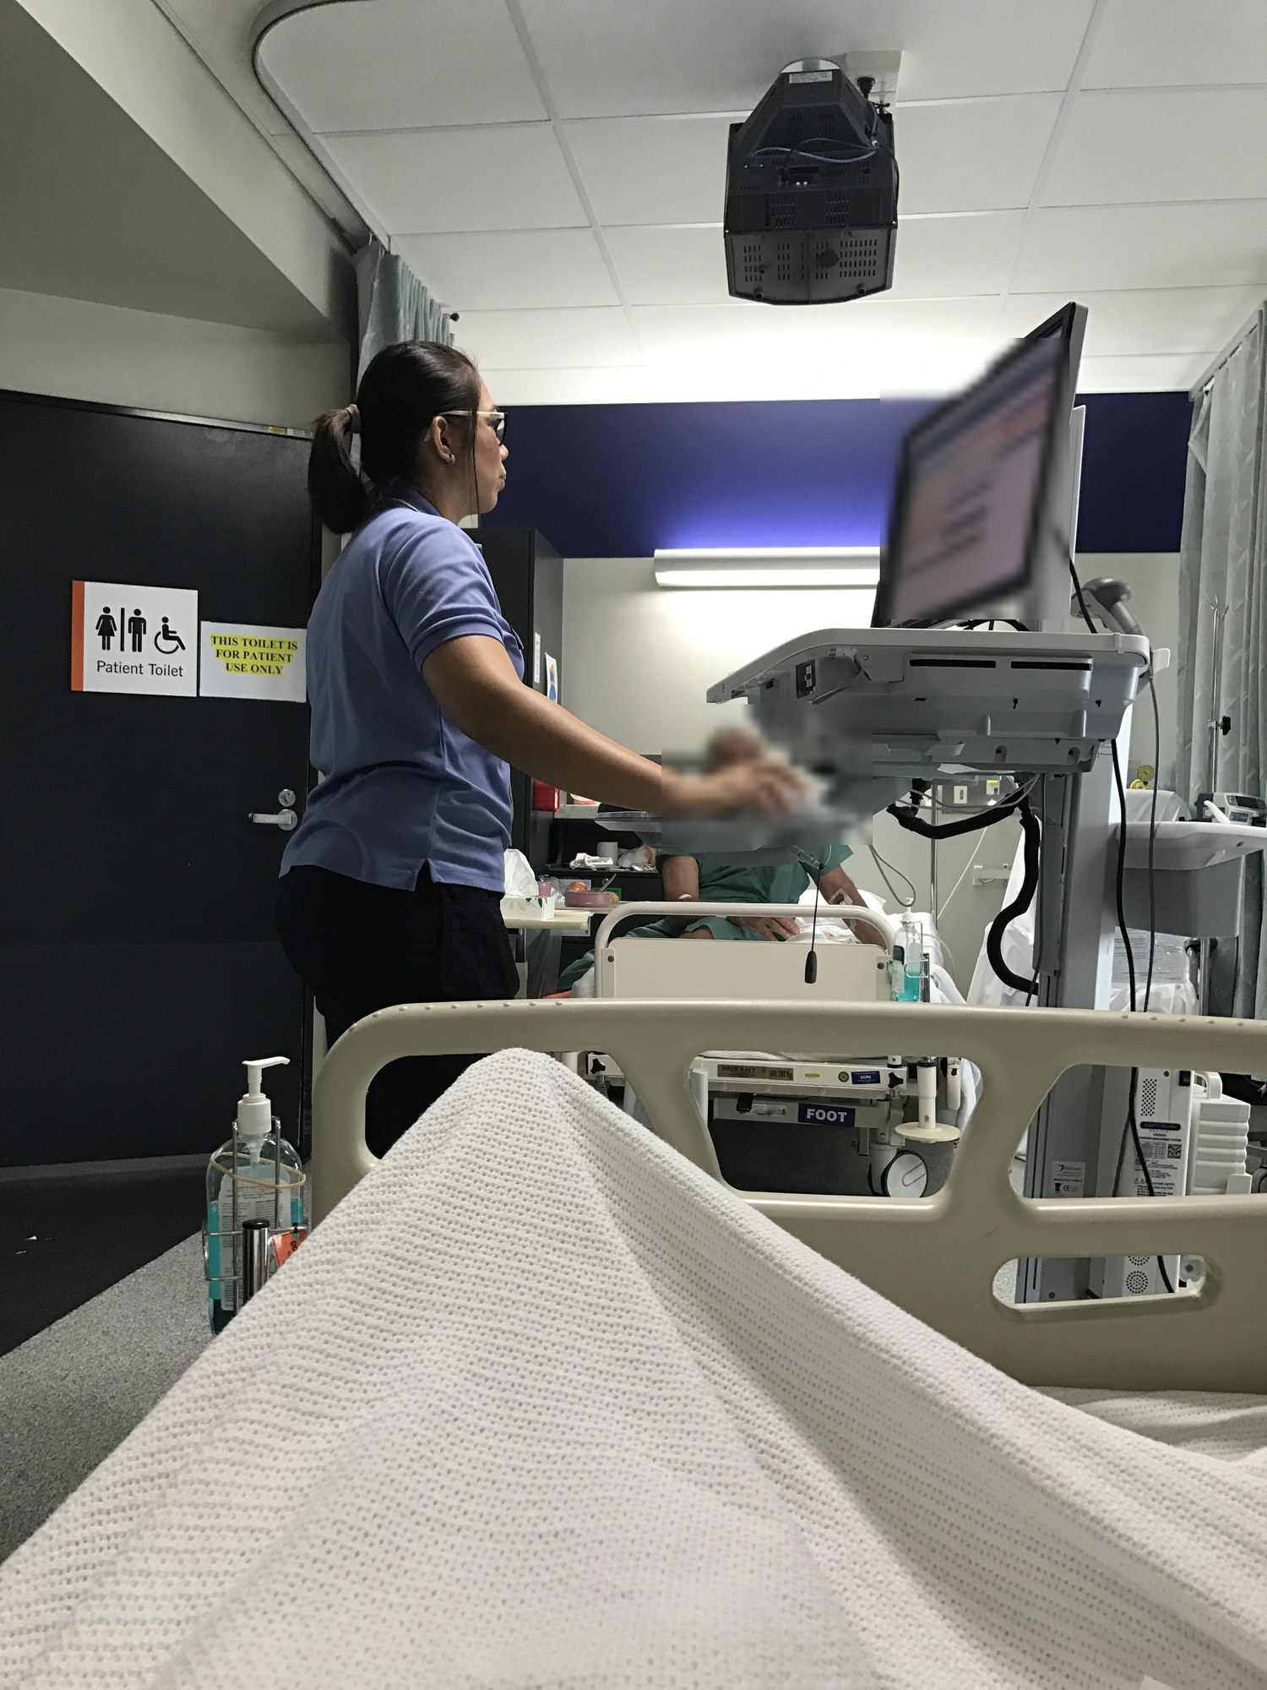
Documenting at the point of care
WHAT TO NOTICE
CNO's revised Documentation standard took effect February 1, 2026, built on three principles: communication, documentation requirements, and information security (CNO, 2025c)
Document at the time of care or as soon after as possible — never before care is given
Record only care you personally gave (unless acting as a designated recorder, such as in a code), never share logins, and correct errors without deleting the original text
Check technology-generated text for accuracy, obtain patient consent before using artificial intelligence (AI) for documentation, and use discrimination-free language
Forgot to chart a 1000 dressing change until 1600 (Q25)? Write a clearly labelled late entry stating the actual time of care — never back-insert it or ask the next shift to chart it.
Figure 1.7 · Credit: Modification of “Princess Alexandra Hospital nurse with mobile computer work station” by Kgbo/Wikimedia, CC BY-SA 4.0 (blurred)
Chapter 1 · Medical-Surgical Nursing in Canada
Notes:
Figure 1.7 shows a nurse documenting at a bedside workstation (with the patient and screen blurred for privacy).
Point out the new AI rule in CNO's February 1, 2026 Documentation standard: nurses must verify any technology-generated text for accuracy and must obtain the patient's consent before using artificial intelligence tools to document care.
Also review Question 25 in the dark box: a late entry is completely legal and appropriate as long as it is labelled as a late entry and states both the time of documentation and the actual time the care was provided. (Figure 1.7: Modification of “Princess Alexandra Hospital nurse with mobile computer work station” by Kgbo/Wikimedia Commons, CC BY-SA 4.0 (patient face and screen blurred for privacy).)

Slide 27
PART FIVE
Patient safety and partnering across transitions
Safety incidents, disclosure, high-alert medications, hospital-acquired harms, teach-back, interpreters, and medication reconciliation.
Notes:
Part Five covers Sections 1.6, 1.7, and 1.8: patient safety incidents, disclosure, just culture, high-alert medication safety, Vanessa's Law, Choosing Wisely, Accreditation Canada ROPs, health literacy, teach-back, professional interpreters, active offer of French, medication reconciliation, and preventing hospitalization-associated disability in older adults.

Slide 28
PATIENT SAFETY INCIDENTS · SECTION 1.6 & QUESTION 27
Three types of safety incidents, and how a just culture responds
In 2025–2026, 1 in 17 Canadian acute hospital stays involved at least one unintended harmful event (CIHI, 2026b).
1
2
3
Harmful incident
No-harm incident
Near miss & Just Culture
The incident reached the patient and caused harm (replaces the older term 'adverse event'). Must ALWAYS be disclosed to the patient or SDM as soon as reasonably possible, sharing known facts, next steps, and an apology. Under Ontario's Apology Act (2009), an apology is not an admission of legal fault.
The incident reached the patient, but no detectable harm occurred — for example, giving a patient the next bed's dose of metoprolol with vital signs remaining normal afterward (Question 27). Providers consider whether a reasonable patient would want to be told, and the nurse reports the incident per policy.
The incident was caught before reaching the patient. Most incidents stem from system flaws (look-alike vials, interruptions, short staffing). A just culture supports staff and learns from honest mistakes while still holding people accountable for reckless choices.
Medical-Surgical Nursing: A Canadian Open Text
Chapter 1 · Medical-Surgical Nursing in Canada
Notes:
Use Question 27 from the chapter review bank to test Card 2:
A nurse accidentally gives a patient a dose of metoprolol ordered for the patient in the next bed, realizes the mistake within minutes, assesses the patient closely, and no harm occurs. Is that a near miss, a no-harm incident, a harmful incident, or an adverse drug reaction?
It is a NO-HARM INCIDENT—because the drug actually reached the patient (so it was not a near miss), but caused no detectable harm.

Slide 29
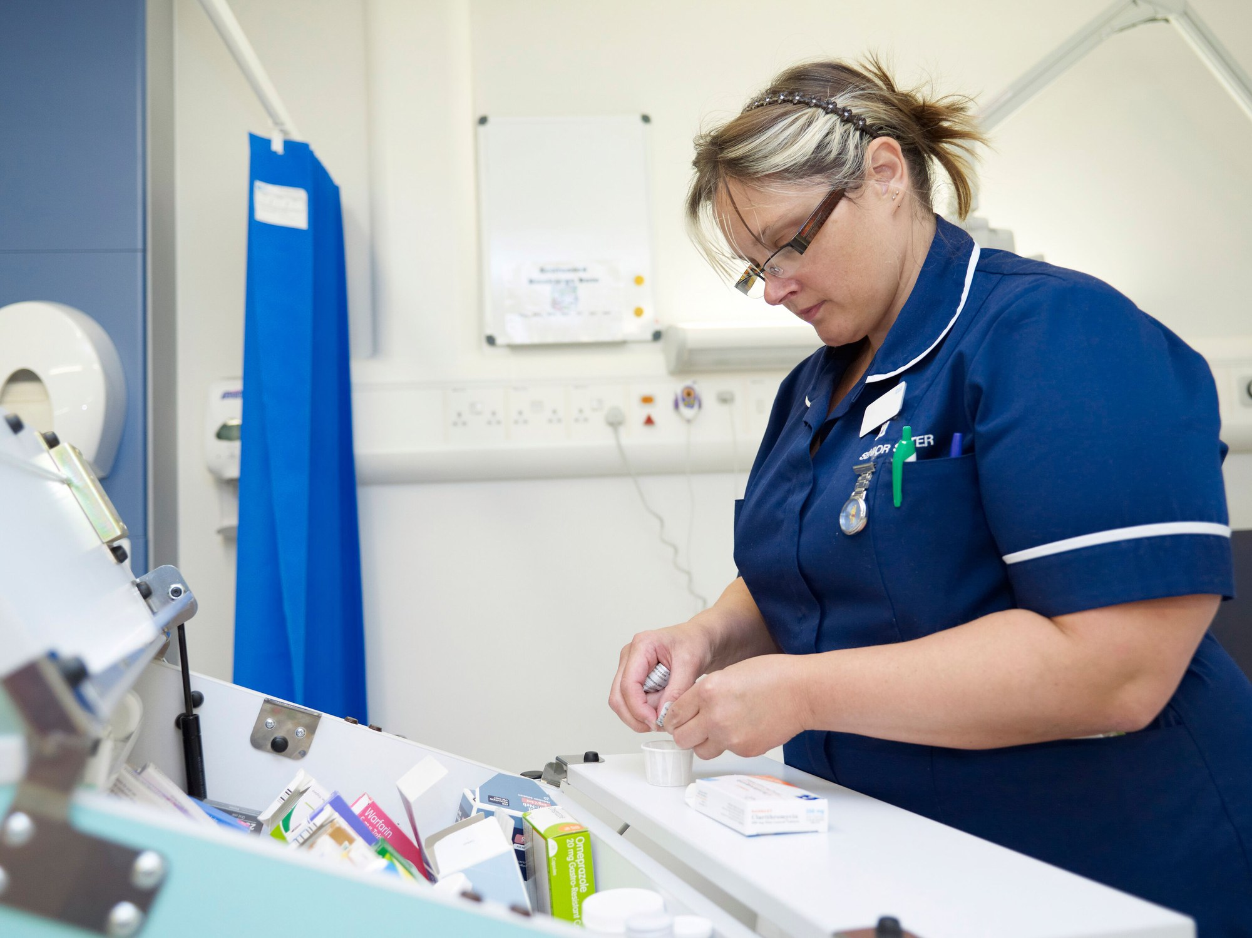
High-alert medications and the true independent double check
WHAT TO NOTICE
High-alert drugs (ISMP Canada) carry catastrophic error risk: insulin, opioids, anticoagulants, chemotherapy, and TPN
True independent double check (Q28): the second nurse verifies the order and calculates the pump rate ALONE before comparing results
ISMP 'Do Not Use' list: write 'unit' (never U/IU), '5 mg' (never 5.0 mg), '0.5 mg' (never .5 mg), 'mcg' (never µg), and full drug names (never MS/MSO4)
Vanessa's Law: hospitals must report serious ADRs (including any reaction that prolongs hospitalization, Q30) and device incidents to Health Canada within 30 days
Watching a colleague program an IV insulin pump or reading their written math is NOT an independent double check (ISMP Canada, 2016). Do the calculation separately first.
Figure 1.8 · Credit: “Nurse during a drug administration on a UK hospital ward” by Adrian Wressell, Heart of England NHS FT/Wellcome, CC BY 4.0
Chapter 1 · Medical-Surgical Nursing in Canada
Notes:
Figure 1.8 shows medication preparation at a ward cart. Highlight three high-yield exam takeaways on this slide:
1. Question 28 (Independent Double Check): If Nurse A shows Nurse B her written calculation and says 'Does this look right to you?', confirmation bias causes Nurse B's brain to agree with the mistake. Nurse B must calculate the dose/rate independently from the order first, then compare.
2. Clinical Safety Box (Do Not Use list): A trailing zero ('5.0 mg') can be misread as '50 mg'; a missing leading zero ('.5 mg') can be misread as '5 mg'; 'U' can be misread as '0'.
3. Question 30 (Vanessa's Law): Any reaction that requires or prolongs hospitalization is 'serious' and must be reported by the hospital to Health Canada within 30 days of first documentation—even if the drug was prescribed and given correctly. (Figure 1.8: “Nurse during a drug administration on a UK hospital ward” by Adrian Wressell, Heart of England NHS FT/Wellcome Collection, CC BY 4.0.)

Slide 30
PREVENTING HOSPITAL HARMS · TABLE 1.6 & CHOOSING WISELY CANADA
Eight hospital-acquired harms nurses prevent every shift
Routine practices — starting with Ontario's four moments for hand hygiene — protect every inpatient.
Falls (Ch. 8) Driven by unfamiliar rooms, sedatives, orthostatic hypotension, urgency, delirium, and tethers (IV tubing/catheters).
Fluid & electrolyte imbalance (Ch. 3) Most common harmful event in Canadian hospitals (CIHI, 2026b); linked to IV fluids, diuretics, NPO status, and kidney changes.
Pressure injuries (Ch. 35) Driven by immobility, long surgeries, friction/shear, moisture, poor nutrition, and reduced sensation.
Venous thromboembolism (Ch. 7 & 19) Deep vein thrombosis and pulmonary embolism from bed rest, surgery, cancer, and dehydration; prevented by early walking and prophylaxis.
Delirium (Ch. 8) Among the most common hospital harms in Canada; triggered by acute illness, age, poor sleep, dehydration, drugs, and catheters.
Medication incidents Prevented by independent double checks, avoiding dangerous abbreviations, and medication reconciliation at every transition.
Health care-associated infections (Ch. 4) Linked to indwelling urinary catheters, central lines, surgical wounds, ventilators, and antibiotics. Follow the 4 Moments for Hand Hygiene.
Functional decline (Ch. 8) Loss of basic ADLs from bed rest, tethers, and restricted mobility (hospitalization-associated disability).
Choosing Wisely Canada (CNA, 2024): do not insert or leave an indwelling urinary catheter without daily reassessment, and do not layer extra pads over a pressure-redistribution mattress.
Medical-Surgical Nursing: A Canadian Open Text
Chapter 1 · Medical-Surgical Nursing in Canada
Notes:
Table 1.6 connects Chapter 1 to the rest of the textbook.
Call special attention to the two Choosing Wisely Canada nursing recommendations at the bottom (CNA, 2024):
1. Indwelling urinary catheters cause UTIs, urosepsis, bladder trauma, immobility, and delirium—question every day whether a catheter can come out.
2. Layering multiple folded draw-sheets and incontinence pads under a patient defeats the engineering of a pressure-redistribution mattress and increases skin moisture and shear.

Slide 31
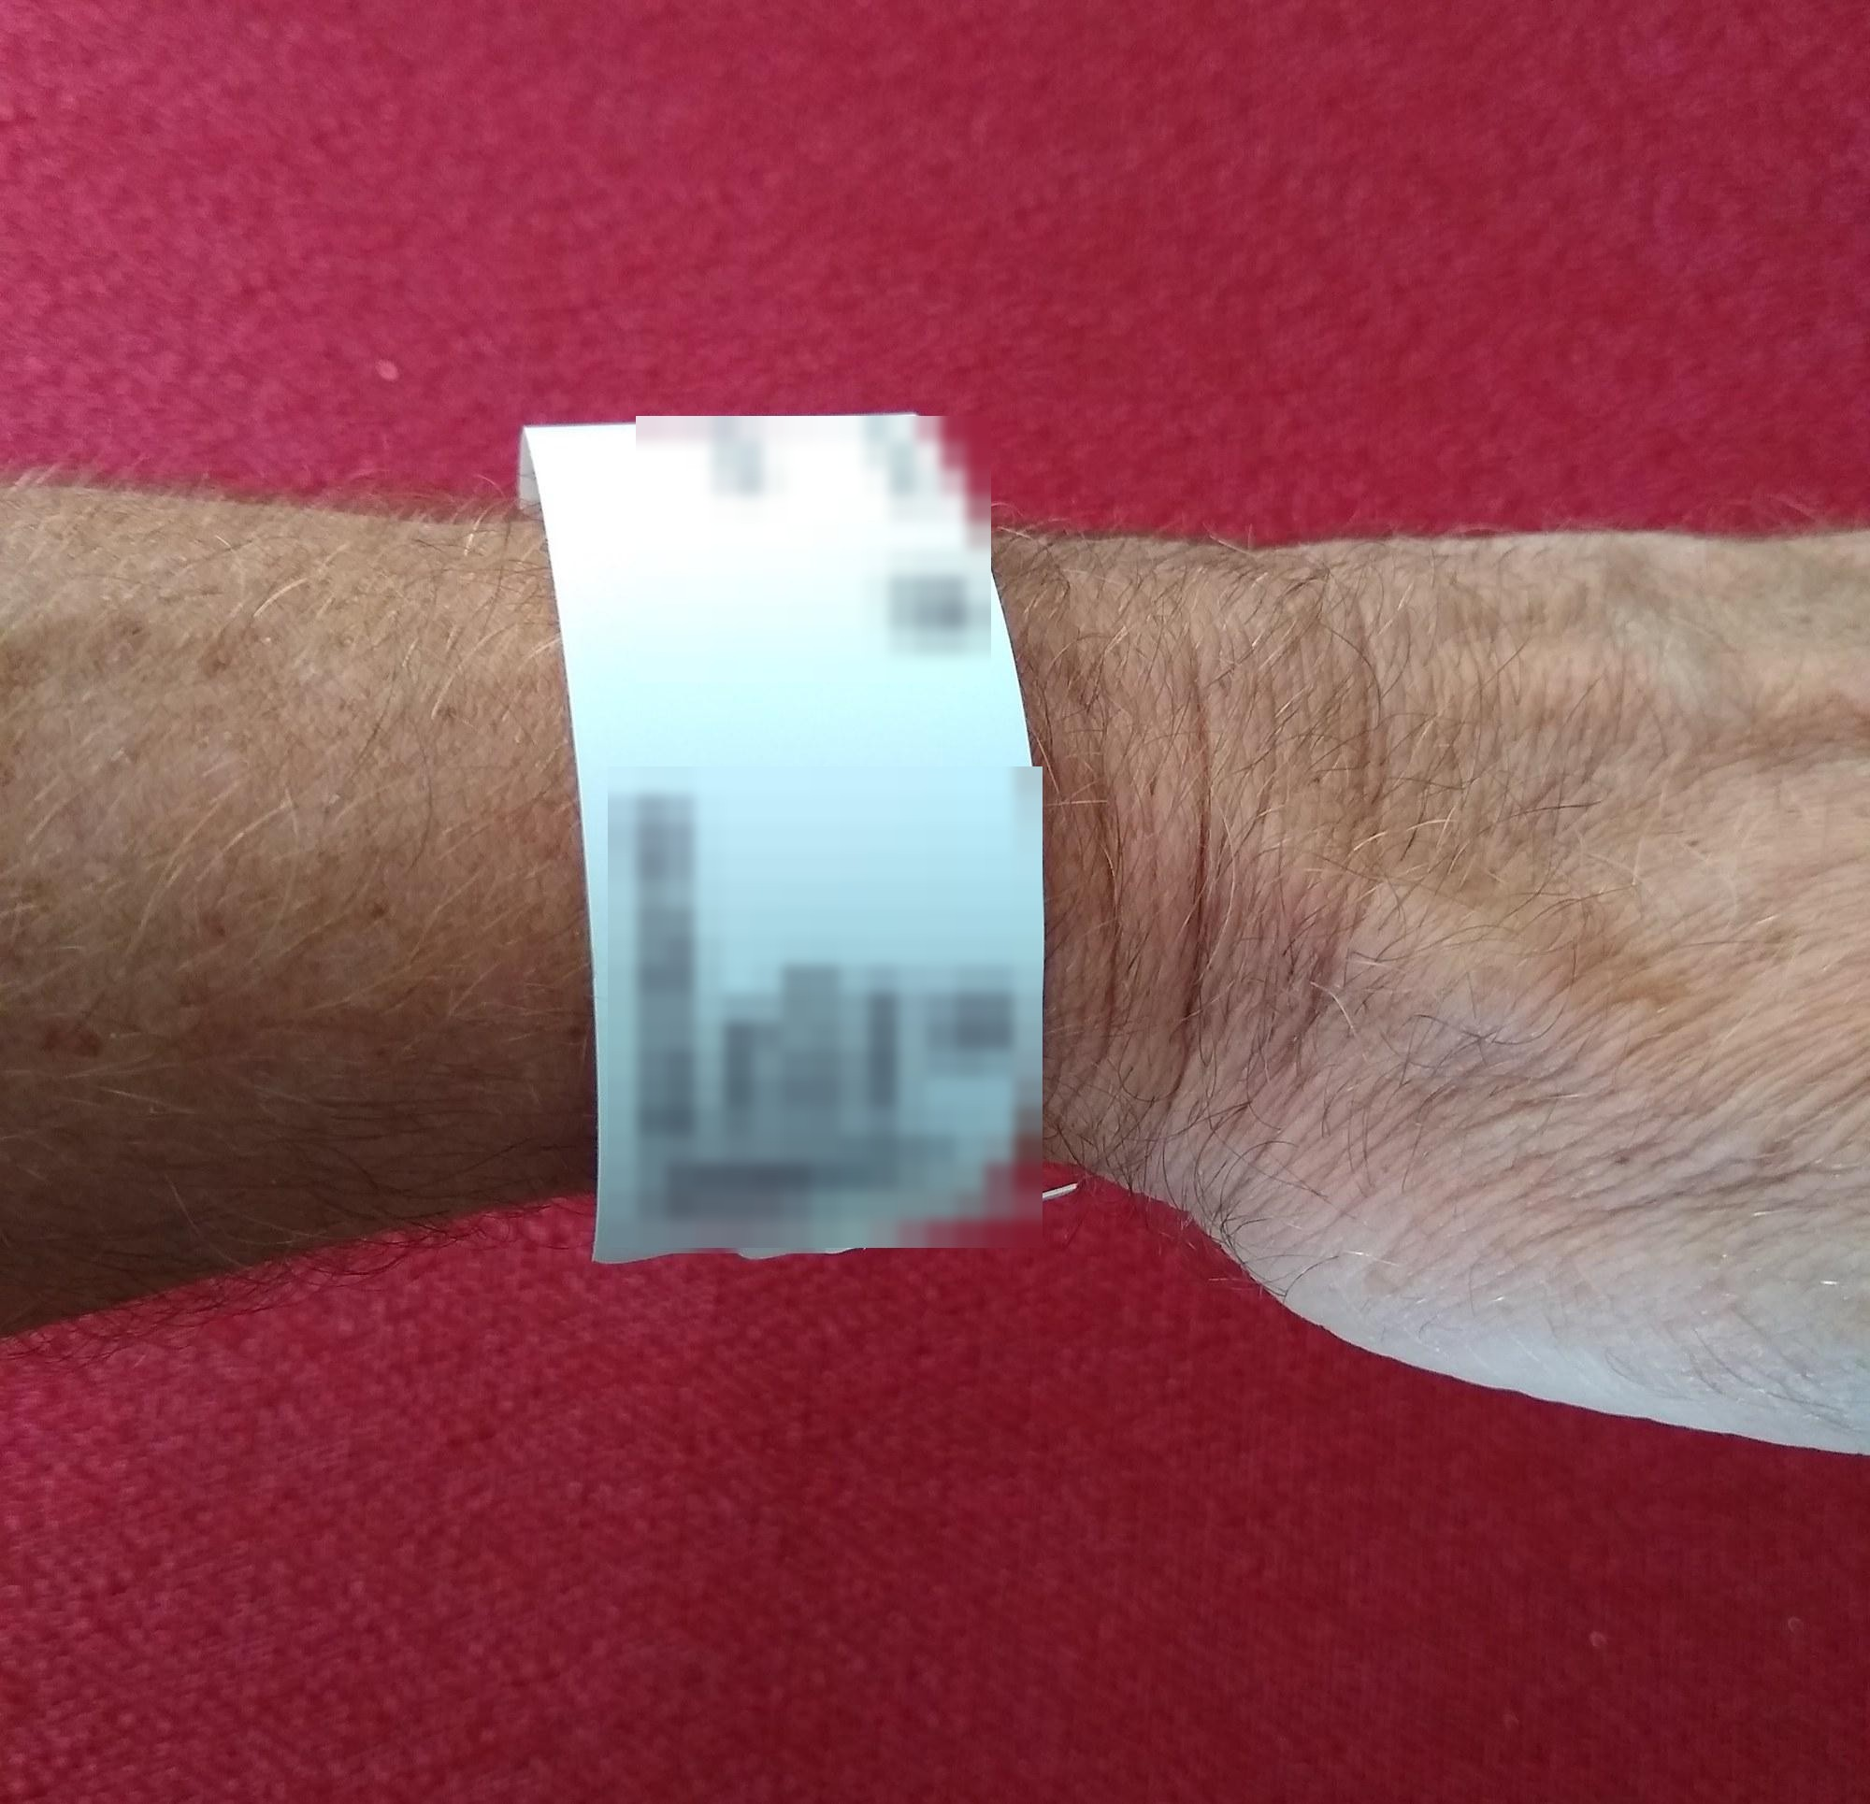
Required Organizational Practices and two identifiers
WHAT TO NOTICE
Accreditation Canada uses Required Organizational Practices (ROPs) — standardized safety practices that accredited hospitals must have in place (HSO, 2024)
Core nursing ROPs include patient identification, the 'Do Not Use' abbreviation list, high-alert medication safeguards, information transfer at transitions, falls/pressure-injury prevention, and medication reconciliation
Before giving any medication, blood product, or treatment, confirm at least TWO person-specific identifiers — such as full name and date of birth or hospital number
Compare the identifiers on the patient's wrist band (and spoken by the patient when able) directly against the medication administration record
A patient's room number or bed location is never a person-specific identifier. Patients move beds; wrist bands and birth dates stay with the person.
Figure 1.9 · Credit: Modification of “Wrist Identification Band” by Whoisjohngalt/Wikimedia Commons, CC BY-SA 4.0 (identifiers blurred)
Chapter 1 · Medical-Surgical Nursing in Canada
Notes:
Figure 1.9 shows a hospital identification wristband. Remind students of Question 27, where a nurse gave metoprolol to the patient in the wrong bed: checking two person-specific identifiers on the wristband against the MAR right at the bedside prevents wrong-patient errors every single time. (Figure 1.9: Modification of “Wrist Identification Band” by Whoisjohngalt/Wikimedia Commons, CC BY-SA 4.0 (identifying details and barcodes blurred for privacy).)

Slide 32
COMMUNICATION ACROSS TRANSITIONS · SECTION 1.7 & QUESTION 29
Plain language, teach-back, and language access
In a 2022 survey, 19% of Canadian adults scored at the two lowest literacy levels — and illness, pain, and fear affect everyone.
Plain language and teach-back
Professional interpreters & Active Offer
Universal precautions for health literacy
Safe consent, teaching, and French-language rights
Use clear, everyday words with every patient ('blood thinner,' then the drug name) and stick to 2 or 3 key points at a time
Teach-back: ask the patient to explain or demonstrate in their own words ('Tell me how you will take this pill when you get home')
Teach-back checks how clearly the nurse explained — it is NOT a test of how smart the patient is (AHRQ, 2023)
Works far better than asking 'Do you understand?' (to which almost every patient nods 'yes')
Use a professional interpreter (in person, video, or phone) for consent, assessments, and teaching (Karliner et al., 2007)
Never use children or family to interpret clinical care (Q29) — they may omit details, lack medical terms, or breach privacy
Active offer of French (Ontario regulation, April 1, 2023): make French visibly available from first contact ('Hello, bonjour')
Greet patients bilingually, wear language-identification badges, and record preferred language
When a 15-year-old granddaughter offers to translate discharge teaching on a new anticoagulant in Punjabi (Q29): book a professional interpreter, and include the granddaughter as a caregiver if the patient wishes.
Medical-Surgical Nursing: A Canadian Open Text
Chapter 1 · Medical-Surgical Nursing in Canada
Notes:
Contrast the two halves of Slide 30:
On the left, teach-back is a habit students can start using on their very first clinical placement. Instead of ending discharge teaching with 'Do you have any questions?', ask: 'Just so I'm sure I explained this clearly, tell me which pills you are going to take tomorrow morning.'
On the right, Question 29 tests a scenario every Canadian nurse encounters: a family member—or a 15-year-old grandchild—offers to translate complex discharge instructions about a high-alert drug like apixaban or warfarin. Always book a professional medical interpreter, while welcoming the family member to participate in the teaching session if the patient agrees.

Slide 33
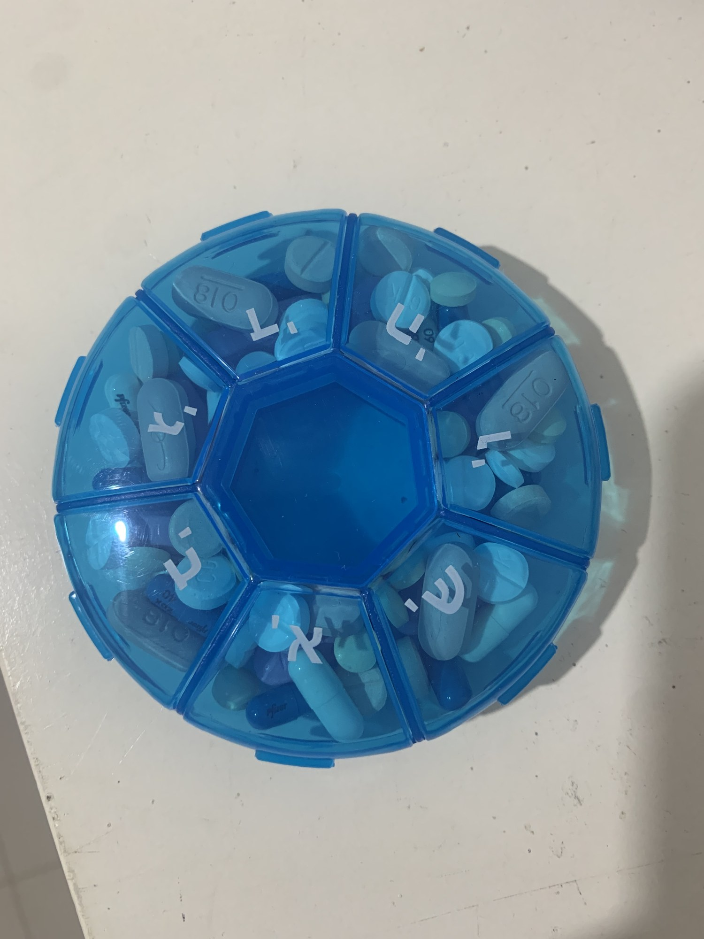
Medication reconciliation and the weekly pill organizer
WHAT TO NOTICE
Medication reconciliation (MedRec) ensures accurate, complete medication information travels with the patient at admission, unit transfer, and discharge (ISMP Canada, n.d.-c)
Starts with a Best Possible Medication History (BPMH): a structured interview with the patient/family PLUS at least one other reliable source (community pharmacy or provincial drug record)
Covers prescribed drugs, over-the-counter medications, vitamins, and herbal products — including how the patient actually loads a weekly pill organizer at home
Patient Education Box: share ISMP Canada's '5 Questions to Ask About Your Medications' (changes, what to continue, proper use, monitoring, and follow-up) and verify with teach-back
Before a patient with a home pill organizer goes home, use teach-back: 'Tell me which of the old pills in your blister pack or organizer you will stop taking, and why.'
Figure 1.10 · Credit: “Heptagonal objects A weekly medicine box” by יוחי טייס/Wikimedia Commons, CC BY-SA 4.0
Chapter 1 · Medical-Surgical Nursing in Canada
Notes:
Figure 1.10 shows a seven-day pill organizer.
Here is a real-world discharge hazard to share with students: a patient has a weekly pill organizer or pharmacy blister pack sitting on their kitchen counter at home. While in hospital, their heart failure or blood pressure medication is changed or stopped, and they are handed a new prescription at discharge. When they get home, they take the new pill bottle AND keep taking the old pills still sitting in their weekly organizer!
That is why a Best Possible Medication History asks whether they use a pill organizer or blister pack, and why discharge teaching explicitly reviews what to remove or have the community pharmacist repackage. (Figure 1.10: “Heptagonal objects A weekly medicine box” by יוחי טייס/Wikimedia Commons, CC BY-SA 4.0.)

Slide 34
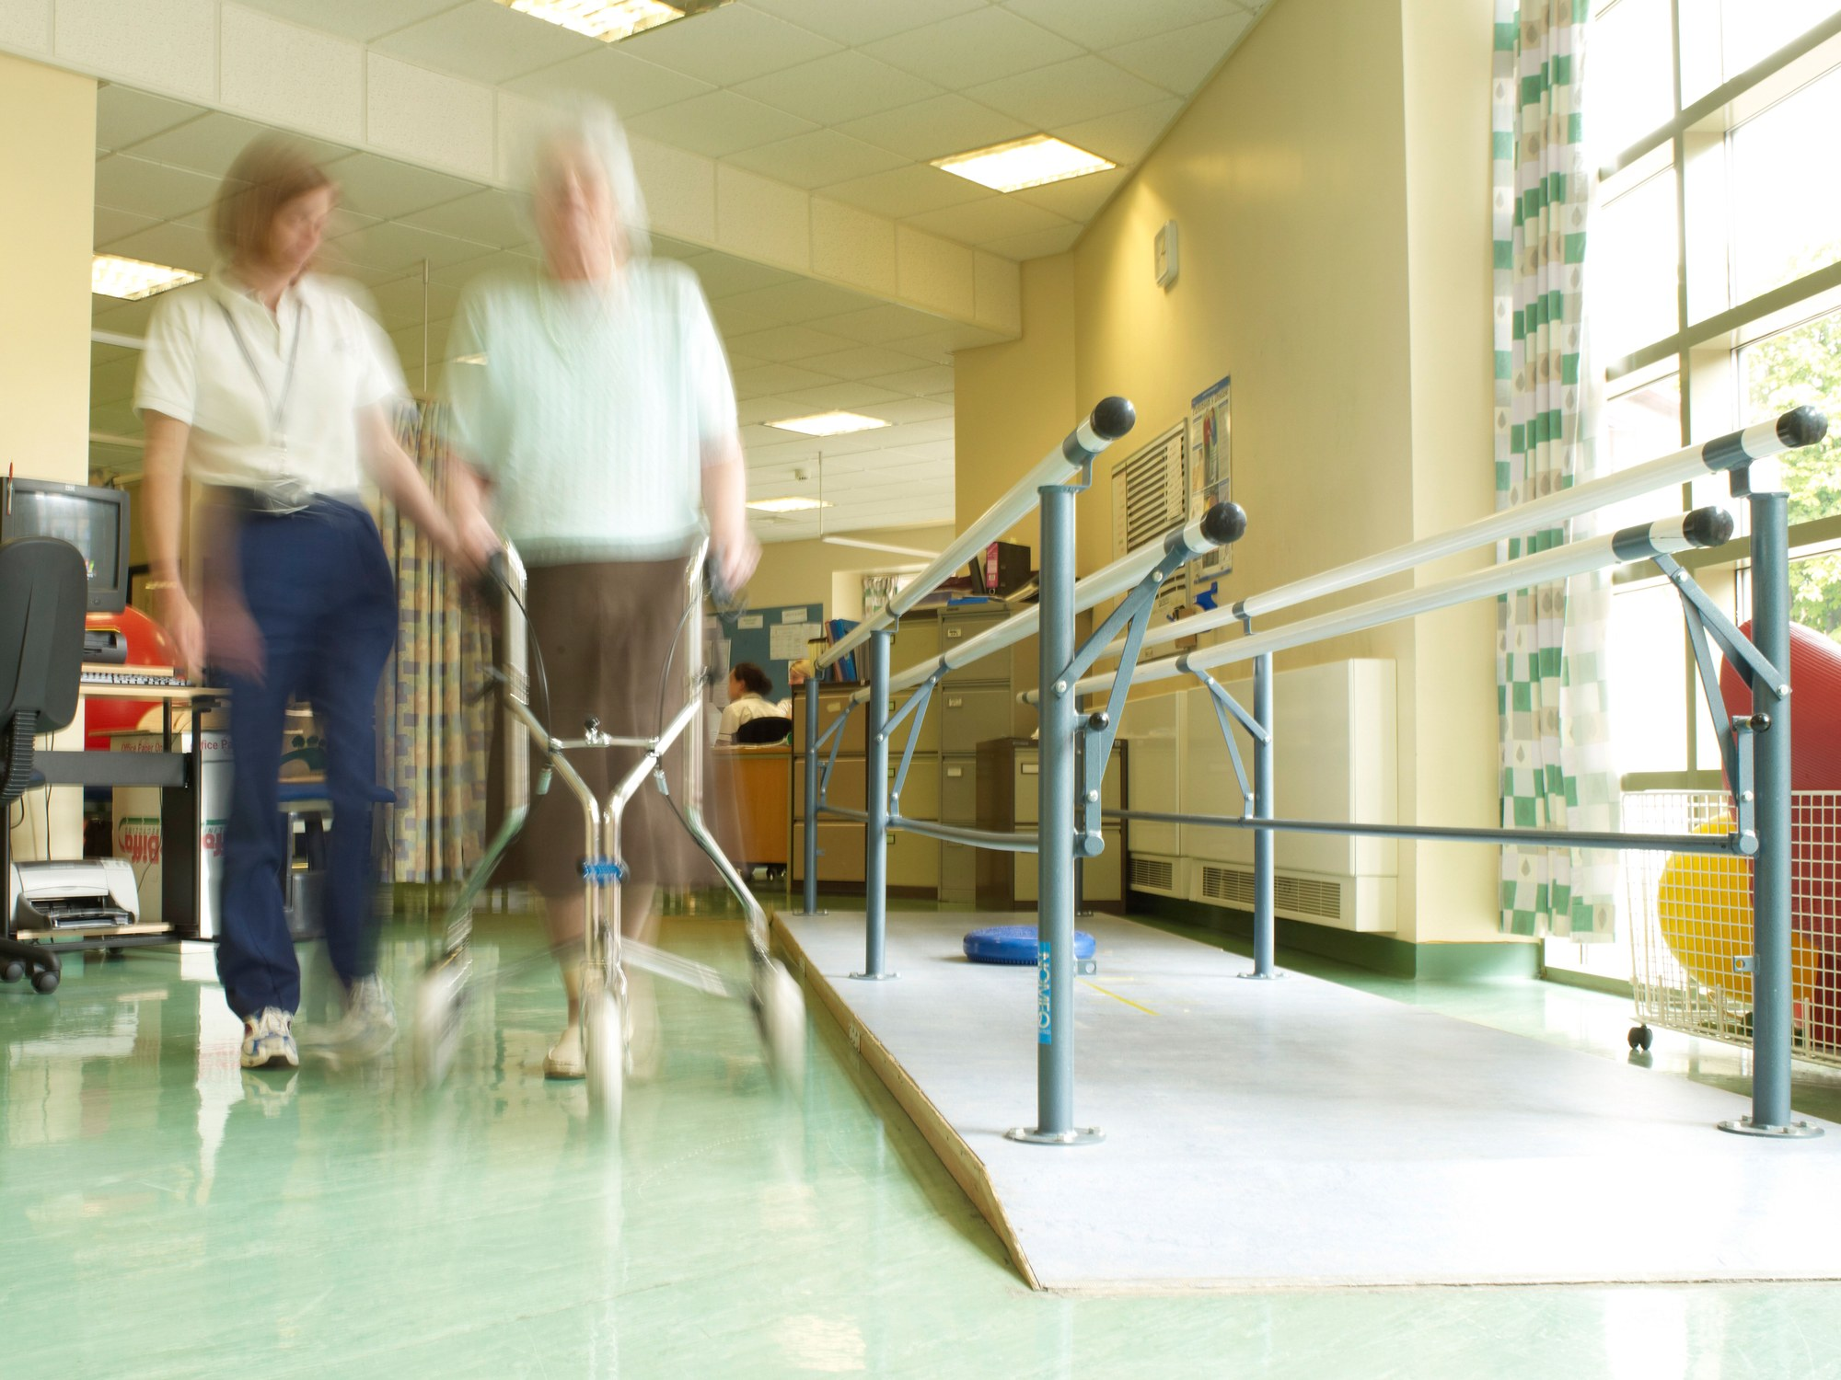
Getting older adults up early and often
WHAT TO NOTICE
Lifespan Considerations: many older adults lose the ability to perform a basic activity of daily living (bathing, dressing, transferring) during an acute stay — called hospitalization-associated disability (Covinsky et al., 2011)
Bed rest, urinary catheters, IV tethers, and waiting for staff help to walk all accelerate muscle loss, delirium, falls, and long ALC waits
Getting the patient up to a chair for meals and walking early and often, as ordered, is one of the most powerful nursing treatments in hospital
Using This Book (Section 1.8): one core text for RN (NCLEX-RN) and PN (REx-PN / CPNRE) students; Going Deeper boxes add RN depth; SI units (mmol/L, g/L) and Canadian generic drug names are used throughout
Employer policy, provincial law, regulatory college standards, and product monographs always take precedence over any textbook. Ontario law is tested on CNO's Jurisprudence Examination.
Figure 1.11 · Credit: “Female physiotherapist with elderly female patient” by Adrian Wressell, Heart of England NHS FT/Wellcome, CC BY 4.0
Chapter 1 · Medical-Surgical Nursing in Canada
Notes:
Figure 1.11 shows an older adult walking with a frame and a physiotherapist.
Covinsky and colleagues (2011) showed in JAMA that roughly one-third of older adults hospitalized for an acute medical illness leave the hospital unable to perform one or more basic activities of daily living that they could do independently before admission—not because of the pneumonia or UTI that brought them in, but because of hospital bed rest, tethers, and deconditioning. Mobilizing your patient is just as important as giving their antibiotics. (Figure 1.11: “Female physiotherapist with elderly female patient” by Adrian Wressell, Heart of England NHS FT/Wellcome Collection, CC BY 4.0.)

Slide 35
Check your understanding
Mr. Lindqvist, 79 (POD 2 hip surgery), is newly restless and oriented ×1 with T 38.2 °C, HR 116, RR 28, SpO2 88%, right basal crackles, WBC 14.6, and stable Hb 112. What is happening, and what do you do first?
A 58-year-old patient in Ontario with no private insurance asks whether his discharge heart medications will be free at home like they were on the ward. How do you explain the Canada Health Act and provincial coverage?
An RPN in an Ontario public hospital finds a patient's only peripheral IV infiltrated (no restart order) — and in the next room is assigned an unfamiliar chest tube. How do authority and competence apply to each room?
A capable patient's adult son phones for her chest X-ray results — and at 1600 you realize you forgot to chart a 1000 dressing change. What do PHIPA's 'circle of care' and CNO's Documentation standard require?
You give the next bed's metoprolol dose (vitals stay normal), and later a colleague asks you to watch her program an IV insulin pump as an 'independent double check.' What is wrong in each situation?
Mr. Lavoie, 72, says the surgeon never explained the risks before asking him to sign; on night 2 he becomes delirious and needs blood (wife at bedside; daughter holds POA for personal care); on day 4 (capable) he says 'Stop the blood.' Walk through your actions.
Medical-Surgical Nursing: A Canadian Open Text — Chapter 1 (Sections 1.1–1.8) | opensourcenursing.ca (CC BY-NC-SA 4.0)
Notes:
Give students 10 minutes in pairs to discuss these six synthesis scenarios (which cover all 30 end-of-chapter questions and both unfolding cases), then debrief together:
1. Mr. Lindqvist (Q7–Q12): Postoperative pneumonia causing impaired gas exchange (fever, moist cough, right basal crackles, rising WBC, SpO2 88%, RR 28, acute confusion; stable Hb rules out bleeding). Raise the head of the bed, coach deep breathing, escalate via SBAR, and when orders arrive, apply and titrate oxygen FIRST.
2. Canada Health Act & discharge drugs (Q1–Q2): The Canada Health Act covers drugs given inside a hospital (Comprehensiveness) and emergency insured care while visiting another province (Portability), but does NOT require provinces to cover outpatient prescriptions. In Ontario, ODB covers those ≥65 and qualifying groups; check early how a 58-year-old will afford discharge meds.
3. Scope of Practice (Q13–Q15): In an Ontario public hospital, nurses cannot initiate controlled acts (Public Hospitals Act requires an order or directive to restart the IV). For the unfamiliar chest tube, lack of competence means the RPN tells the charge nurse, asks for teaching/support, and consults or transfers care until competent.
4. PHIPA & Documentation (Q24–Q25): Family members are not health information custodians, so they are outside the implied 'circle of care'—ask the capable patient before sharing X-ray results with her son. For the missed 1000 note, write a clearly labelled late entry at 1600 stating the actual time the dressing was changed.
5. Safety & Double Checks (Q27–Q28): Because the metoprolol reached the patient without causing harm, it is a 'no-harm incident' (not a near miss). Watching a colleague program an insulin pump is not an independent double check—calculate the rate yourself from the order before comparing.
6. Mr. Lavoie (Q20–Q23): Hold the surgical consent form and notify the surgeon because the proposer must inform the patient; during night-2 delirium, daughter Monique (Attorney for Personal Care) outranks the spouse on the HCCA hierarchy; once Mr. Lavoie is capable again, he can withdraw consent at any time—stop the blood transfusion immediately and notify the prescriber.

