Slide 1
UNIT I · FOUNDATIONS OF MEDICAL-SURGICAL NURSING IN CANADA · CHAPTER 4
Inflammation, Infection, and Sepsis
Acute inflammation & wound healing, infection recognition & culture collection, routine practices & additional precautions, AROs & Clostridioides difficile, antimicrobial stewardship, and 2026 Surviving Sepsis care.
Medical-Surgical Nursing: A Canadian Open Text
Aligned with CNO Entry-to-Practice Competencies (RN & RPN), PIDAC (2025), CNISP (2026), and 2026 Surviving Sepsis Campaign Guidelines
opensourcenursing.ca (CC BY-NC-SA 4.0)
Notes:
Welcome to Chapter 4: Inflammation, Infection, and Sepsis. In a 2024 Canadian Nosocomial Infection Surveillance Program point-prevalence survey across 62 acute care hospitals, 8.1% of adult inpatients had at least one healthcare-associated infection (HAI). This chapter equips nurses to recognize inflammation and infection across all skin tones, prevent transmission, steward antimicrobials, and deliver life-saving first-hour sepsis care.

Slide 2
CHAPTER ORIENTATION · LEARNING OUTCOMES & CNO MAPPING
What you will master in Chapter 4
Eight core outcomes mapped directly to CNO RN (2019a) and RPN (2019b) entry-to-practice competencies.
Inflammation & Diagnostics
IPAC, AROs & Stewardship
Sepsis & Scope of Practice
• Healing Phases (LO 1): Explain acute inflammation, wound healing phases, and factors delaying repair.
• Cues & Cultures (LO 2): Recognize local/systemic infection cues (including in older adults) and collect specimens.
• Skin Tone Equity: Assess colour change, warmth, swelling, firmness, and pain across all skin tones.
• CNO Roles: RN Clinician & Scholar; RPN Foundations of Practice.
• Routine & Precautions (LO 3): Apply PCRA, 4 Moments for Hand Hygiene, PPE doffing, and Additional Precautions.
• Outbreaks & Law (LO 4): Recognize hospital outbreaks and reportable diseases under Ontario law.
• AROs & Stewardship (LO 5–6): Manage MRSA, VRE, CPE, and C. difficile; support IV-to-PO switch and allergy checks.
• CNO Roles: RN Clinician, Leader, Educator & Advocate; RPN Professional & Collaborative.
• Early Recognition (LO 7): Spot subtle sepsis trends, screen with NEWS2/MEWS, and escalate immediately.
• First-Hour Bundle: Execute 2026 Surviving Sepsis Campaign priorities (lactate, cultures, antimicrobials, fluids).
• RN & RPN Scope (LO 8): Distinguish RN and RPN roles using CNO authority, competence, and context.
• CNO Roles: RN Clinician, Coordinator & Communicator; RPN Accountability.
Medical-Surgical Nursing: A Canadian Open Text
Chapter 4 · Inflammation, Infection & Sepsis
Notes:
Review the eight learning outcomes and how they map across College of Nurses of Ontario (CNO) Registered Nurse (RN, 2019a) and Registered Practical Nurse (RPN, 2019b) entry-to-practice competencies, including Point-of-Care Risk Assessment (PCRA) and National/Modified Early Warning Scores (NEWS2/MEWS).

Slide 3
PART ONE · SECTION 4.1
Inflammation and Wound Healing
Vascular and cellular phases of acute inflammation, assessing local and systemic cues across skin tones, the four phases of wound repair, and factors that delay healing.
Medical-Surgical Nursing: A Canadian Open Text
Chapter 4 · Inflammation, Infection & Sepsis
Notes:
Part One covers Section 4.1: Inflammation and Healing.

Slide 4
SECTION 4.1 · INNATE INFLAMMATORY CASCADE (CHEN ET AL., 2018)
Vascular and cellular phases of acute inflammation
How damaged cells and microbes trigger vasodilation, capillary permeability, leukocyte migration, and systemic cytokines.
Vascular Phase, Cellular Phase & Mediators
Acute vs. Chronic Inflammation
• Vascular Phase: Arterioles dilate (increasing blood flow -> heat & colour change) and venule/capillary walls become permeable -> protein-rich fluid leaks out as exudate (swelling).
• Cellular Phase: Neutrophils migrate first through vessel walls to phagocytose microbes; monocytes follow and mature into tissue macrophages.
• Purulent Exudate (Pus): Thick fluid composed of neutrophils, macrophages, necrotic tissue debris, and microorganisms.
• Chemical Mediators: Mast cells release histamine and prostaglandins; immune cells release cytokines (IL-1β, IL-6, TNF-α) that drive fever and leukocytosis.
• Acute Inflammation: Short-lived, neutrophil-dominated protective response; resolves once the trigger is cleared and macrophages shift to repair.
• Chronic Inflammation: Persists when the injurious cause remains or the off-switch fails; dominated by macrophages and lymphocytes.
• Clinical Consequence: Causes ongoing tissue destruction, fibrosis/scarring, chronic disease (e.g., rheumatoid arthritis), and non-healing wounds.
Medical-Surgical Nursing: A Canadian Open Text
Chapter 4 · Inflammation, Infection & Sepsis
Notes:
Walk through the vascular and cellular phases of acute inflammation and contrast acute vs. chronic inflammation.

Slide 5
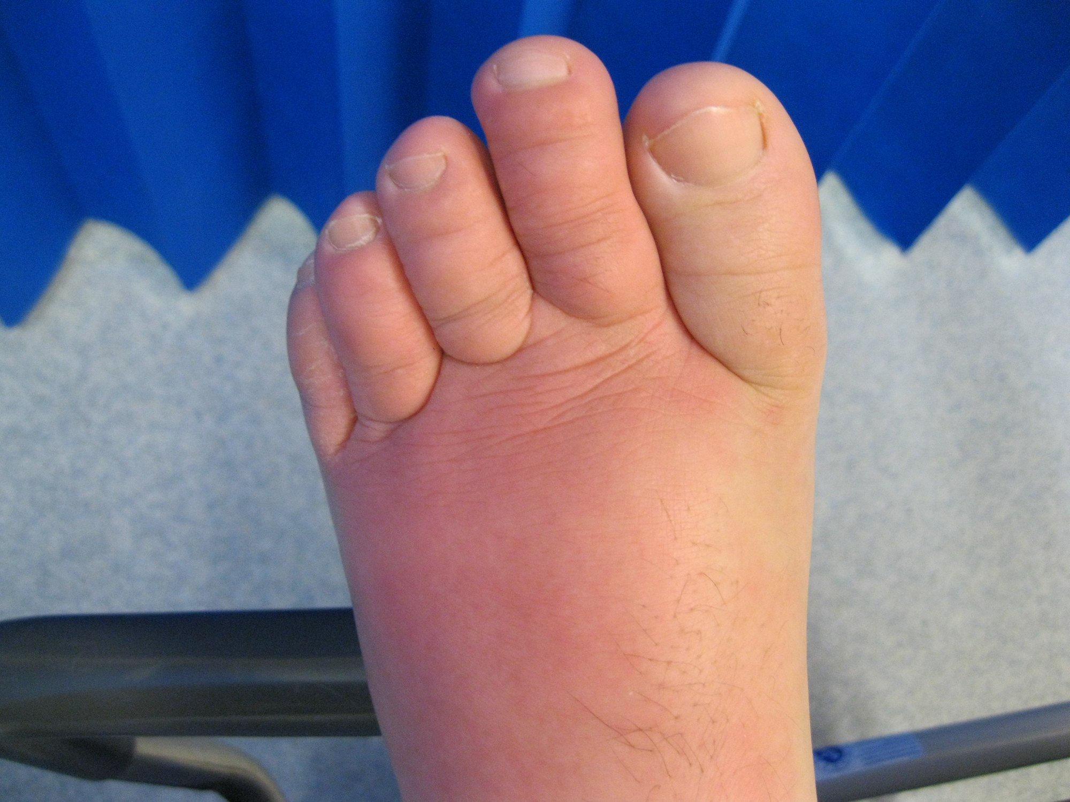
SECTION 4.1 · FIGURE 4.1 & INCLUSIVE SKIN ASSESSMENT
Recognizing local inflammation across all skin tones
On darker skin tones, inflammation often does not look bright red — rely on subtle colour change, warmth, tautness, and pain.
WHAT TO NOTICE
• 5 Classic Local Signs: (1) Colour change/erythema, (2) Heat, (3) Swelling/edema, (4) Pain or tenderness, and (5) Loss of function.
• Assessment on Darker Skin (Wounds Int., 2023): Compare with surrounding skin and the opposite limb in good lighting; ask the patient what is normal for their skin.
• Palpation by Same Hand: Feel warmth by comparing with nearby skin using the back/palm of the same hand, and check for tightness, induration, or shine.
• Exudate Documentation: Record amount, colour, consistency, odour, and type (serous, sanguineous, serosanguineous, or purulent).
Exam & Bedside Rule (Review Question 5)
Local signs stay at the site (warmth, calf swelling, pain on walking); systemic signs reflect circulating cytokines (fever 38.6 °C, WBC 14.2 × 10^9/L, fatigue, anorexia).
Figure 4.1 Cellulitis of the toes and forefoot showing spreading erythema and edema ("Cellulitis of the foot" by John Campbell, Wikimedia Commons, CC0 1.0).
Medical-Surgical Nursing: A Canadian Open Text
Chapter 4 · Inflammation, Infection & Sepsis
Notes:
Figure 4.1 shows forefoot cellulitis. Emphasize Wounds International (2023) guidance on assessing darker skin tones.

Slide 6
SECTION 4.1 · TABLE 4.1 BEDSIDE ASSESSMENT & DOCUMENTATION
Ten local and systemic signs of inflammation and infection
What causes each sign physiologically and what the medical-surgical nurse assesses and documents.
1. Colour Change / Erythema
5. Drainage (Exudate / Pus)
Widened vessels increase blood flow. Compare colour with opposite side; outline borders to track spread.
Fluid, leukocytes, and debris exit tissue. Chart volume, colour, consistency, odour, and dressing saturation.
2. Heat (Local Warmth)
6. Fever (Pyrexia)
Increased arterial perfusion to injured tissue. Compare temperature with nearby skin using the same hand.
Cytokines (IL-6) reset hypothalamic thermostat. Chart route, trend, baseline, and recent antipyretic doses.
3. Swelling (Edema)
7. Leukocytosis & CRP Rise
Fluid and plasma proteins leak into interstitial space. Measure limb circumference, tightness, shine, and firmness.
Marrow releases neutrophils/bands; liver makes CRP. Track WBC, neutrophil differential, and serial trends.
4. Pain & Loss of Function
8. Malaise, HR & RR Rise
Mediators and pressure stimulate nociceptors. Document pain score/character, ROM, and weight-bearing ability.
Whole-body cytokine response and rising O2 demand. Watch for new confusion or falls in older adults and screen for sepsis.
Always check the medication administration record (MAR) for acetaminophen or NSAIDs that can mask an active fever!
Medical-Surgical Nursing: A Canadian Open Text
Chapter 4 · Inflammation, Infection & Sepsis
Notes:
Walk through all 10 rows of Table 4.1 (consolidated into 8 high-yield items).

Slide 7
SECTION 4.1 · WOUND REPAIR & RISK FACTORS (GUO & DIPIETRO, 2010)
Phases of wound healing, closure intentions, and barriers
From immediate fibrin clot formation to collagen remodelling — and why a missing healing ridge is a red flag.
4 Phases of Healing
Healing Ridge & Intentions
Factors Delaying Healing
• 1. Hemostasis: Vasoconstriction, platelet aggregation, and fibrin clot seal the wound.
• 2. Inflammation: Neutrophils and macrophages clear bacteria/debris and release growth factors.
• 3. Proliferation: Fibroblasts deposit collagen, capillaries bud (red granulation), and edges contract.
• 4. Maturation (Remodelling): Collagen reorganizes over months; scar flattens, strengthens, and fades.
• Normal Healing Ridge (BC, 2011): Firm collagen ridge under a closed incision starting Day 2–4 and spanning full length by Day 5–9.
• Missing Ridge Warning: Absence by Day 5–9 signals risk of wound dehiscence or infection!
• Primary vs. Secondary: Primary: edges approximated (sutures/staples). Secondary: open wound granulates from base up.
• Tertiary Intention: Delayed primary closure after 4–6 days for contaminated/infected wounds.
• Diabetes & Perfusion: Hyperglycemia impairs leukocyte function and microvascular circulation.
• Malnutrition (Albumin <35 g/L): Protein, calories, and vitamins are required for fibroblast collagen synthesis.
• Smoking & Hypoxia: Nicotine and carbon monoxide reduce tissue oxygen delivery.
• Drugs & Host Factors: Systemic corticosteroids, NSAIDs, chemotherapy, anticoagulants, older age, obesity, and immobility.
Medical-Surgical Nursing: A Canadian Open Text
Chapter 4 · Inflammation, Infection & Sepsis
Notes:
Highlight the BC Provincial Nursing Skin and Wound Committee (2011) teaching point on the surgical 'healing ridge' (expected along the full incision by postoperative days 5 to 9) and the threshold of serum albumin <35 g/L for impaired wound healing.

Slide 8
PART TWO · SECTION 4.2
Infection: Recognition and Diagnostics
Breaking the six links in the chain of infection, Canadian HAI trends, atypical presentations in older adults, aseptic culture techniques, and inflammatory biomarkers.
Medical-Surgical Nursing: A Canadian Open Text
Chapter 4 · Inflammation, Infection & Sepsis
Notes:
Part Two covers Section 4.2: Infection Recognition and Diagnostics.

Slide 9
SECTION 4.2 · PIDAC (2025) & MITCHELL ET AL. (2025) SURVEILLANCE
The chain of infection and inpatient vulnerability
Transmission requires all six links — breaking any single link stops the spread of infection on the unit.
6 Links in the Chain of Infection
Hospital Risk Factors & Fever Nuances
How nursing actions break each link (PIDAC, 2025)
Why 8.1% of Canadian acute care inpatients have an HAI
• 1. Infectious Agent & 2. Reservoir: Identify early via cultures; clean shared equipment, support housekeeping, stay home when ill.
• 3. Portal of Exit & 4. Transmission: Cover draining wounds, contain body fluids; perform hand hygiene and use PPE/precautions.
• 5. Portal of Entry (Question 6!): Use aseptic technique and remove unnecessary catheters (Choosing Wisely Canada, CNA 2024).
• 6. Susceptible Host: Support vaccination, nutrition, mobilization, skin integrity, and glycemic control.
• Invasive Devices (Mitchell et al., 2025): Between 2017 and 2024, bloodstream infections rose and central line-associated BSIs (CLABSIs) roughly doubled.
• Colonization vs. Infection: Colonized patients have no tissue invasion or illness symptoms, but still transmit organisms to others.
• Older Adult LTC Fever Thresholds: Single oral >37.8 °C, repeated oral >37.2 °C, rectal >37.5 °C, or >1.1 °C rise above baseline (High et al., 2009).
• Antipyretic Masking: Acetaminophen or NSAIDs given for pain can mask fever — normal temperature never rules out infection!
Atypical Presentation in Older Adults (Wester et al., 2013): New confusion, falls, incontinence, or functional decline are often the ONLY early cues.
Medical-Surgical Nursing: A Canadian Open Text
Chapter 4 · Inflammation, Infection & Sepsis
Notes:
Connect Review Question 6 (removing an unnecessary urinary catheter breaks the Portal of Entry link) and the High et al. (2009) fever thresholds for older adults.

Slide 10
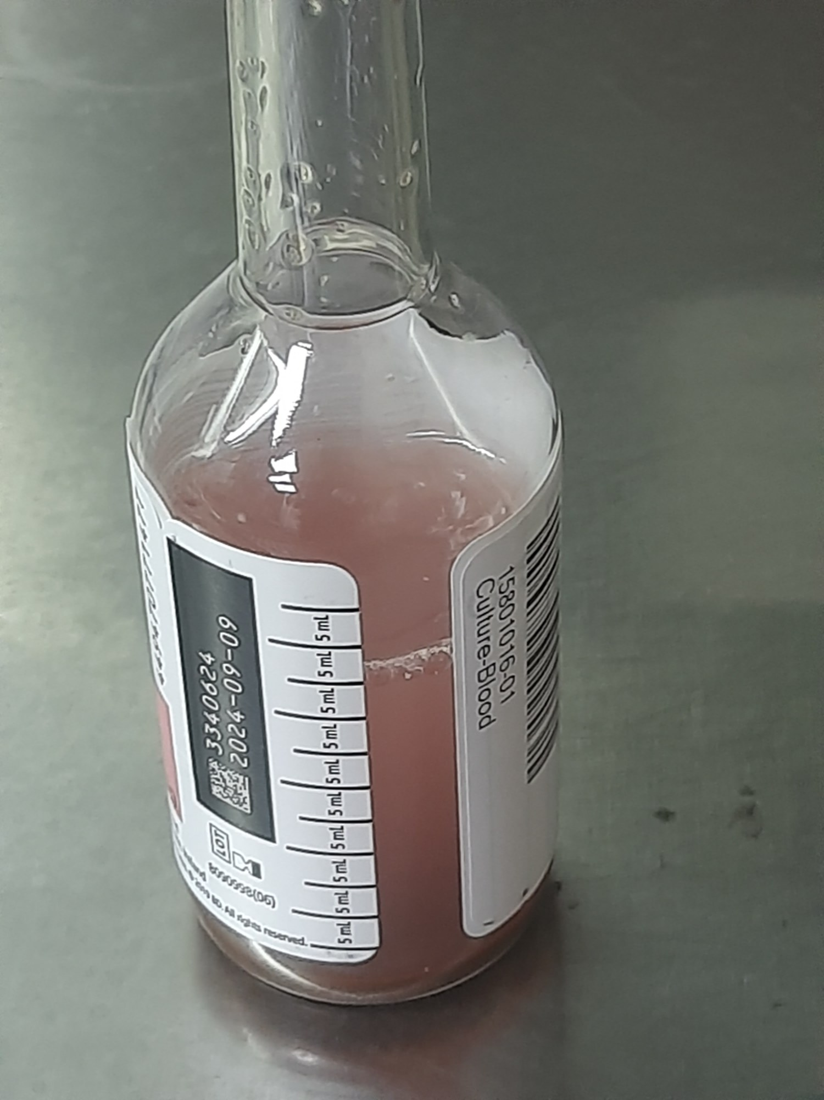
SECTION 4.2 · FIGURE 4.2, CULTURE COLLECTION & BIOMARKERS
Collecting valid cultures and interpreting infection blood tests
Collect cultures BEFORE the first antimicrobial dose whenever it does not delay urgent treatment.
WHAT TO NOTICE
• Blood Cultures (2 Sets, Separate Sites): Draw >=2 sets from separate venipuncture sites to distinguish skin contamination from true bacteremia; blood volume is the #1 yield factor (APL, 2024).
• Catheter Urine & C. difficile Stool: Aspirate urine aseptically from the disinfected sampling port (NEVER the drainage bag). For C. difficile, test ONLY unformed stool.
• Wound Swab — Levine Technique (BC, 2015): Cleanse wound with sterile saline first, then rotate swab for 5 s over 1 cm2 of viable granulation tissue with enough pressure to express fluid (never swab pus or slough).
• Biomarkers (WBC, CRP, Procalcitonin): WBC 3.5–10.5 × 10^9/L (neutrophils 2.0–7.5). Procalcitonin helps guide antibiotic stop dates, but clinical evaluation decides when to start sepsis antibiotics (Prescott et al., 2026).
Why Two Separate Venipuncture Sites Matter (Q7)
Drawing both blood culture sets from a single site cannot distinguish skin flora contamination from true bloodstream infection — always use two separate sites before starting IV antibiotics.
Figure 4.2 Positive blood culture bottle showing turbidity from bacterial growth ("Blood culture bottle" by Ajay Kumar Chaurasiya, Wikimedia Commons, CC0 1.0).
Medical-Surgical Nursing: A Canadian Open Text
Chapter 4 · Inflammation, Infection & Sepsis
Notes:
Figure 4.2 shows a turbid blood culture vial. Walk through the four specimen collection rules (2 separate blood culture sites, catheter sampling port, Levine 1 cm2 viable tissue technique, unformed stool for C. diff).

Slide 11
SECTION 4.2 · CLINICAL JUDGMENT BOX (POSTOPERATIVE DAY 4)
Surgical site infection on medium-brown skin: Mrs. Lucia Mendes
67-year-old woman with type 2 diabetes on POD 4 after open bowel resection.
Recognize, Analyze & Prioritize Cues
Solutions, Action & Evaluation
• Bedside Vital Signs & Pain: Temp 38.4 °C (up from 37.0 °C yesterday), HR 104, RR 20, BP 128/76, SpO2 96% RA, alert and oriented; incision pain rose from 3/10 to 6/10.
• Incision Assessment on Medium-Brown Skin: Lower third of incision is a deeper brown than surrounding skin, swollen, firm, tight, and warmer than upper incision, with cloudy yellow foul-smelling drainage.
• Laboratory Cues: WBC rose from 9.2 to 13.8 × 10^9/L; capillary glucose is 12.4 mmol/L.
• Healing Ridge vs. SSI: A normal healing ridge is firm, but does NOT drain pus, smell foul, or cause rising pain and fever.
• Prioritize Hypotheses: Surgical site infection (SSI) is primary; screen for early sepsis (rising HR & Temp); hyperglycemia slows healing.
• Generate Solutions (SBAR): Report to surgeon via SBAR; request wound swab (Levine technique), 2 sets of blood cultures, and IV antibiotics.
• Take Action Without Delay: Collect wound swab and blood cultures promptly, then infuse the first IV antibiotic dose immediately; apply dry dressing and address glucose 12.4 mmol/L.
• Evaluate at 4 Hours: Temp 37.9 °C, HR 96, mentation intact; outline colour-change border and escalate if BP drops or RR rises.
Medical-Surgical Nursing: A Canadian Open Text
Chapter 4 · Inflammation, Infection & Sepsis
Notes:
Walk through the Clinical Judgment box for Mrs. Lucia Mendes. Highlight how SSI is recognized on medium-brown skin and how a healing ridge is differentiated from an acute wound infection.

Slide 12
PART THREE · SECTION 4.3
Infection Prevention and Control on the Unit
PIDAC routine practices, the Point-of-Care Risk Assessment (PCRA), Ontario's 4 Moments for Hand Hygiene, safe PPE removal, Additional Precautions, and outbreak management.
Medical-Surgical Nursing: A Canadian Open Text
Chapter 4 · Inflammation, Infection & Sepsis
Notes:
Part Three covers Section 4.3: Infection Prevention and Control on the Unit.

Slide 13
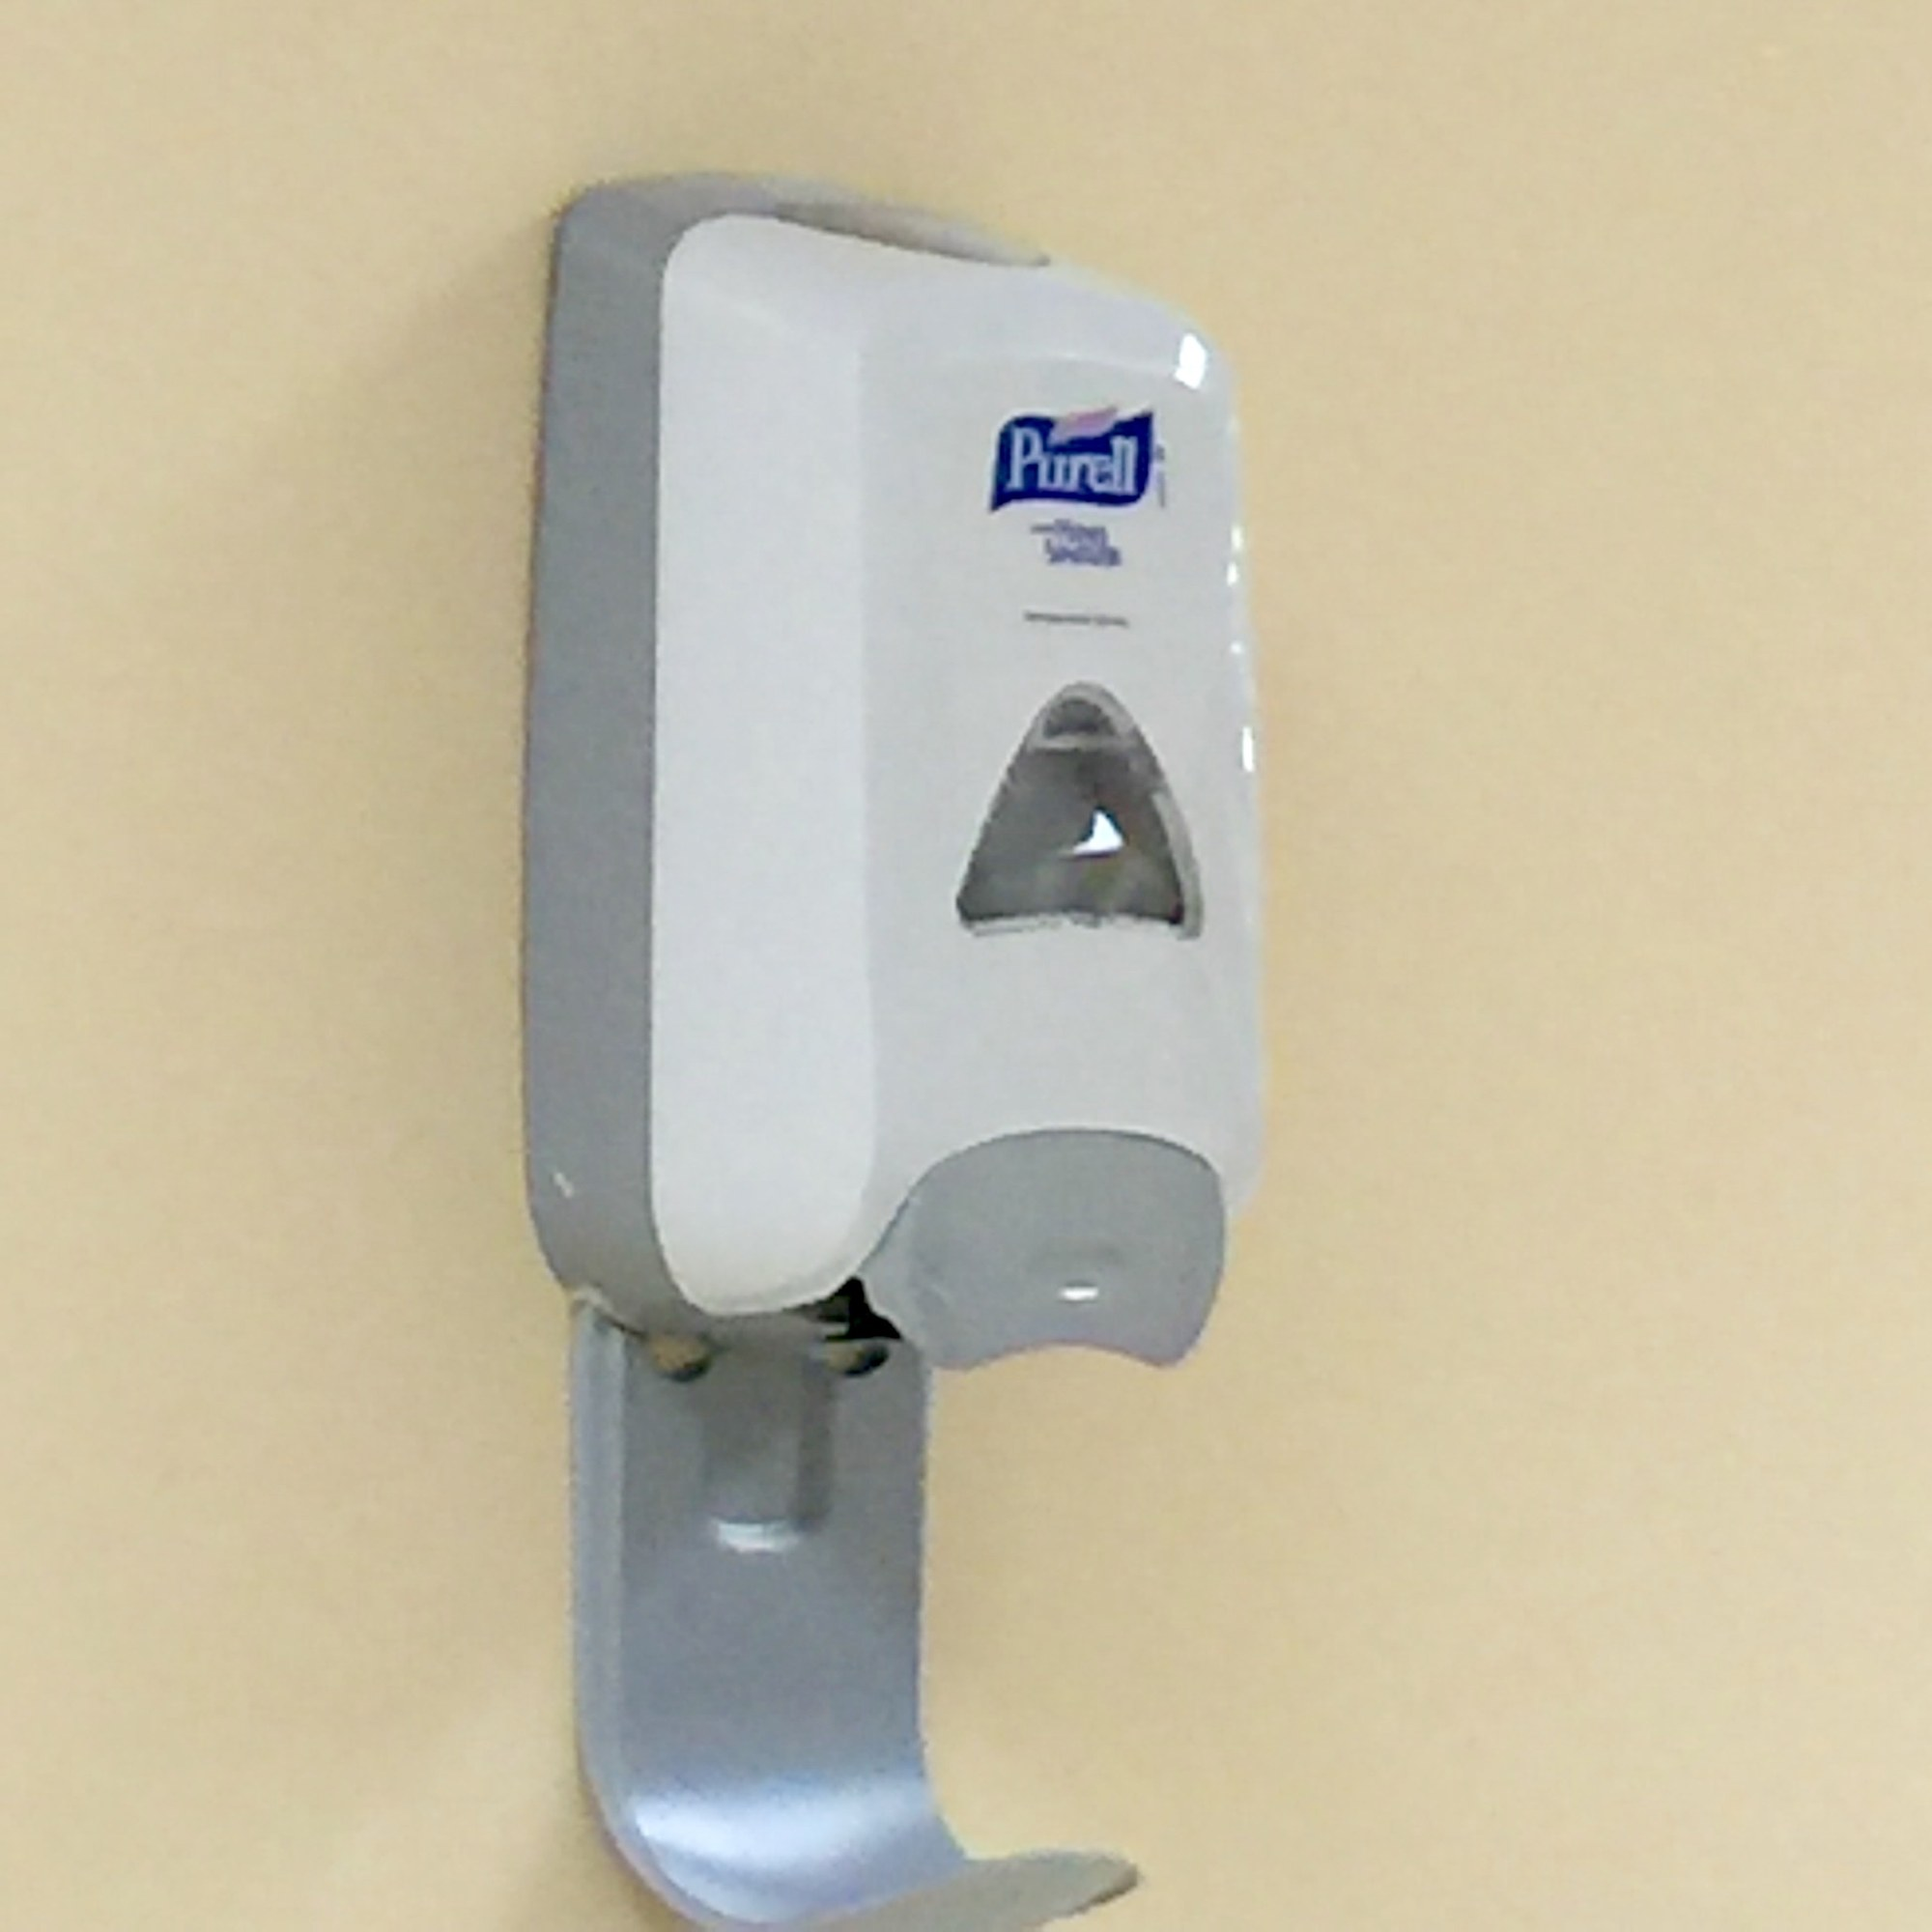
SECTION 4.3 · FIGURE 4.3, ROUTINE PRACTICES & CLINICAL SAFETY (PPE REMOVAL)
Point-of-care risk assessment, 4 Moments, and safe PPE removal
Taking PPE off is the highest-risk moment for self-contamination — follow Public Health Ontario's exact sequence.
WHAT TO NOTICE
• Point-of-Care Risk Assessment (PCRA): Before EVERY interaction, assess task, patient, and environment (splash risk? draining wound? diarrhea? cough?). Emptying a urinary bag with splash risk requires gloves, gown, and mask + eye protection (Q9).
• Ontario's 4 Moments for Hand Hygiene: (1) Before initial contact with patient/environment; (2) Before an aseptic procedure; (3) After body fluid exposure risk; (4) After contact with patient/environment.
• ABHR vs. Soap and Water: ABHR is preferred when hands are not visibly soiled. Wash with soap and water at a STAFF sink (never the patient's sink!) when visibly soiled or after C. difficile care.
• N95 Respirator Rules (PIDAC, 2025): Filters 95% of ~1-micron particles; requires formal fit-testing at least every 2 years and a user seal check every time it is donned.
Clinical Safety: PHO (2024) PPE Removal Sequence
1. Gloves first -> 2. Gown (untie, pull away, roll inside out) -> 3. Hand hygiene -> 4. Eye protection (lift from back/sides) -> 5. Mask or N95 (by straps/loops, pull forward) -> 6. Hand hygiene again.
Figure 4.3 Wall-mounted alcohol-based hand rub dispenser ("Purell hand sanitizer device at Memorial Regional Hospital" by Claudia Brauer, Wikimedia, CC BY 2.0).
Medical-Surgical Nursing: A Canadian Open Text
Chapter 4 · Inflammation, Infection & Sepsis
Notes:
Figure 4.3 shows an ABHR dispenser. Emphasize the PCRA (Question 9), the 4 Moments for Hand Hygiene, why prescription eyeglasses alone are not eye protection, and PHO's 6-step PPE doffing sequence.

Slide 14
SECTION 4.3 · TABLE 4.2 PIDAC & PHO ADDITIONAL PRECAUTIONS
Contact, Droplet, Droplet + Contact, and Airborne Precautions
Start precautions empirically at the onset of suspicious symptoms — never wait for laboratory confirmation.
1. Contact Precautions — Spread & Examples
5. Droplet + Contact — Spread & Examples
Direct/indirect contact: MRSA, VRE, CPE, C. difficile, norovirus, acute infectious gastroenteritis.
Droplets plus contaminated hands/surfaces: influenza, RSV, COVID-19, invasive Group A strep wound infection.
2. Contact — Room & PPE
6. Droplet + Contact — Room & PPE
Single room (own toilet for diarrhea); gown + gloves on entry; dedicated equipment; sporicidal cleaning for C. diff.
Single room; wear ALL four items: gown, gloves, surgical mask, and eye protection.
3. Droplet Precautions — Spread & Examples
7. Airborne Precautions — Spread & Examples
Large droplets travelling <=2 metres: pertussis, invasive meningococcal disease, mumps.
Suspended small aerosols: pulmonary TB, measles (+ droplet/contact), varicella & disseminated zoster (+ contact).
4. Droplet — Room & PPE
8. Airborne — AIIR & N95
Single room (or >=2 m separation + curtain); surgical mask + eye protection within 2 m; patient masked if leaving room.
Negative pressure room (AIIR) with door closed; fit-tested, seal-checked N95; immune staff only for measles/varicella.
Psychological Safety: Isolation can feel stigmatizing — explain precautions clearly, keep the call bell in reach, and visit just as frequently.
Medical-Surgical Nursing: A Canadian Open Text
Chapter 4 · Inflammation, Infection & Sepsis
Notes:
Review Table 4.2. Note that measles requires Airborne + Droplet + Contact precautions per PIDAC Appendix N, and varicella/disseminated zoster require Airborne + Contact precautions with care by immune staff.

Slide 15
SECTION 4.3 · ENVIRONMENTAL CONTROL, OUTBREAKS & CANADIAN CONTEXT
Shared equipment disinfection, hospital outbreaks, and public health law
How nurses recognize unit clusters early and fulfill Ontario reporting mandates.
Environmental Cleaning & Outbreak Role
Canadian Context: Reportable Diseases (ON)
Breaking reservoir transmission on medical-surgical units
Health Protection and Promotion Act (O. Reg. 135/18)
• Shared Equipment Disinfection: Clean vital sign machines, glucometers, and commodes between every patient; never move dirty equipment between rooms.
• Enhanced Sporicidal Cleaning: C. difficile rooms require twice-daily cleaning with a sporicidal agent (>=1,000 ppm chlorine) and double terminal cleaning.
• Ontario Respiratory Outbreak Definition (2024): >=2 patients with healthcare-associated, test-confirmed acute respiratory infection within 48 h sharing an epidemiological link (e.g., same unit).
• 4 Nursing Outbreak Actions: (1) Recognize clusters; (2) Start precautions & collect swabs; (3) Report to Charge & IPAC; (4) Stay home when ill.
• Diseases of Public Health Significance: Legally reportable to the local Medical Officer of Health (examples: pulmonary TB, measles, CPE, invasive Group A strep).
• Institutional Outbreaks Reportable: Hospital outbreaks of respiratory infection, acute gastroenteritis, and C. difficile are legally reportable.
• Who Reports & Timelines: Laboratories, physicians, and hospital administrators report immediately (urgent threats) or by the next working day.
• Bedside Nurse Action: Notify the Charge Nurse and IPAC team immediately when a reportable disease or unit cluster is suspected.
Note: Cases among staff alone do not meet the Ontario public hospital confirmed respiratory outbreak definition, but must be reported to Occupational Health.
Medical-Surgical Nursing: A Canadian Open Text
Chapter 4 · Inflammation, Infection & Sepsis
Notes:
Review the Ontario respiratory outbreak definition (Ontario Ministry of Health, 2024) and the Canadian Context box on O. Reg. 135/18.

Slide 16
PART FOUR · SECTIONS 4.4 & 4.5
AROs, Clostridioides difficile, and Antimicrobial Stewardship
CNISP 2020–2024 resistance trends, managing MRSA, VRE, CPE, and C. difficile spores, IV-to-oral switch criteria, and penicillin allergy delabelling.
Medical-Surgical Nursing: A Canadian Open Text
Chapter 4 · Inflammation, Infection & Sepsis
Notes:
Part Four covers Sections 4.4 and 4.5: Antibiotic-Resistant Organisms, Clostridioides difficile, and Antimicrobial Stewardship.

Slide 17
SECTION 4.4 · CANADIAN NOSOCOMIAL INFECTION SURVEILLANCE PROGRAM (CNISP, 2026)
Healthcare-associated infections and resistance across Canada
Surveillance across 109 sentinel acute care hospitals in 10 provinces and 1 territory (2020 to 2024).
8.1%
~2×
0.42
4× Rise
Adult inpatients in 62 Canadian acute care hospitals with >=1 healthcare-associated infection on survey day in 2024 (Mitchell et al., 2025).
Increase in central line-associated bloodstream infections (CLABSIs) between the 2017 and 2024 national point-prevalence surveys.
VRE bloodstream infections per 10,000 patient days in 2024 — a statistically significant rise from 0.30 in 2020 (MRSA & CDI stayed stable).
CPE infection rate quadrupled from 0.05 to 0.20 per 10,000 patient days (annual cases climbed from 39 to 218 across sentinel sites).
Sources: Mitchell et al. (2025); CNISP (2026). Admission ARO screening targets prior positives, hospitalization in past year, care outside Canada, or outbreak exposure.
Medical-Surgical Nursing: A Canadian Open Text
Chapter 4 · Inflammation, Infection & Sepsis
Notes:
Review the four Canadian surveillance figures from Mitchell et al. (2025) and CNISP (2026).

Slide 18
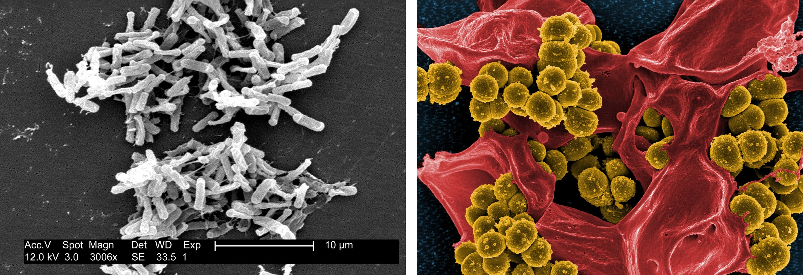
SECTION 4.4 · FIGURE 4.4 & TABLE 4.3 AROS AND CLOSTRIDIOIDES DIFFICILE
Comparing MRSA, VRE, CPE, and C. difficile management
Colonized patients have no symptoms of illness, yet require the exact same Contact Precautions to prevent transmission.
WHAT TO NOTICE
• MRSA & VRE (PIDAC, 2013a): MRSA colonizes nares/skin/wounds; VRE colonizes the bowel. Both require Contact Precautions and dedicated room equipment.
• Carbapenemase-Producing Enterobacterales (CPE): Colonizes lower bowel and sinks/drains; requires single room with dedicated toilet/commode; screen for care outside Canada (Q19).
• C. difficile Spores & Testing (PIDAC, 2013b): Spores survive months and resist alcohol. Start Contact Precautions at first watery stool; test ONLY unformed stool.
• C. difficile Handwashing & Cleaning: Wash with soap and water at a STAFF sink; clean twice daily + terminal double clean with sporicidal chlorine (>=1,000 ppm).
Escalating Severe C. difficile Colitis
Monitor I&O and potassium, protect perineal skin with barrier cream, use disposable bedpans, review PPIs/antibiotics/laxatives, and escalate immediately for worsening abdominal pain, distension, high fever, or sudden stop of diarrhea (toxic megacolon).
Figure 4.4 (a) C. difficile bacilli ("Clostridium difficile", Lois S. Wiggs/CDC PHIL, Public Domain); (b) MRSA cocci with neutrophil (NIAID/Wikimedia, CC BY 2.0).
Medical-Surgical Nursing: A Canadian Open Text
Chapter 4 · Inflammation, Infection & Sepsis
Notes:
Figure 4.4 shows C. difficile and MRSA. Emphasize the comparison in Table 4.3 and why alcohol-based hand rub does not kill C. difficile spores.

Slide 19
SECTION 4.5 · CNA FRAMEWORK, PHO (2016) & OMA (2025)
Antimicrobial stewardship and penicillin allergy assessment
Using antimicrobials only when needed — and investigating inaccurate penicillin allergy labels.
Bedside Antimicrobial Stewardship
Reported Penicillin Allergies (OMA, 2025)
Right drug, dose, route, and duration (Accreditation ROP)
>80% of suspected penicillin labels can be safely delabelled
• Cultures First, On-Time First Dose: Collect cultures aseptically before the first dose without delaying urgent treatment.
• Prompt IV-to-Oral Switch (PHO, 2016): Suggest PO switch when afebrile (e.g., 48 h), WBC normalizing, improving, and able to swallow/absorb (Q20).
• Narrowing & Stop Dates: Flag culture & sensitivity results so therapy can be narrowed; ask 'What is the planned stop date?' at rounds.
• Patient Teaching (PHAC, 2017): No antibiotics for viral colds/flu; never share or save leftovers (return to pharmacy); report rash or watery diarrhea.
• Harm of False Labels: Pushes prescribers to broad-spectrum alternatives that increase AROs and C. difficile.
• True Allergy vs. Intolerance: Allergy: hives, lip/throat swelling, wheezing, severe rash. Intolerance: nausea, stomach upset, headache.
• 4 History Questions: Which drug/when? Exact reaction/timing/treatment? Taken amoxicillin since? Family member's reaction?
• Scope Boundary (Question 21!): Document exact details and notify the prescriber/pharmacist — never delete an allergy label alone.
Stewardship Rule: Never send routine urine cultures from asymptomatic catheterized patients — treating colonization breeds resistance.
Medical-Surgical Nursing: A Canadian Open Text
Chapter 4 · Inflammation, Infection & Sepsis
Notes:
Review PHO's (2016) IV-to-oral conversion criteria (Question 20) and the Ontario Medical Association's (2025) penicillin allergy assessment guidance (Question 21).

Slide 20
PART FIVE · SECTION 4.6
Sepsis and Septic Shock (2026 Surviving Sepsis Campaign)
Sepsis-3 definitions, why NEWS2/MEWS replace single-tool qSOFA screening, first-hour resuscitation bundles, endothelial glycocalyx biology, and post-sepsis recovery.
Medical-Surgical Nursing: A Canadian Open Text
Chapter 4 · Inflammation, Infection & Sepsis
Notes:
Part Five covers Section 4.6: Sepsis and Septic Shock, aligned with Sepsis-3 and the 2026 Surviving Sepsis Campaign guidelines.

Slide 21
SECTION 4.6 · SEPSIS-3 (SINGER ET AL., 2016) & CANADIAN BURDEN
Defining sepsis, septic shock, and inpatient mortality risk
Sepsis is 'life-threatening organ dysfunction caused by a dysregulated host response to infection' (Singer et al., 2016, p. 801).
>=2 SOFA
>40%
1 in 18
64%
Sepsis-3 definition: suspected/confirmed infection + acute rise of >=2 SOFA points (~10% in-hospital mortality). SIRS no longer defines sepsis.
In-hospital mortality in septic shock: requires a vasopressor to maintain MAP >=65 mm Hg AND serum lactate >2 mmol/L despite adequate fluids.
Deaths in Canada involving sepsis (Statistics Canada); death rates rise sharply with age and are highest in adults aged 85+.
Share of bacteremic patients aged 85+ presenting with atypical cues (confusion, falls, functional decline, hypothermia) rather than classic fever.
Screening Update (Prescott et al., 2026): Surviving Sepsis Campaign strongly recommends NEWS/NEWS2, MEWS, or SIRS over qSOFA alone (qSOFA misses ~75% of early sepsis).
Medical-Surgical Nursing: A Canadian Open Text
Chapter 4 · Inflammation, Infection & Sepsis
Notes:
Review Sepsis-3 definitions (Question 27 and Question 30) and explain why the 2026 Surviving Sepsis Campaign strongly recommends NEWS, NEWS2, MEWS, or SIRS over qSOFA as a single screening tool (Question 24).

Slide 22
SECTION 4.6 · TABLE 4.4 & 2026 SURVIVING SEPSIS CAMPAIGN (PRESCOTT ET AL., 2026)
Early bedside sepsis cues and first-hour resuscitation priorities
Trends over a shift matter more than any single number — compare every vital sign with the patient's own baseline.
Bedside Cues of Organ Dysfunction (Table 4.4)
2026 First-Hour Care Bundle
• Respiratory Rate >=22/min & Mentation: Rising RR (count a full minute!) and new confusion/drowsiness ('not themselves' per family) are earliest warnings.
• Temperature — Beware Hypothermia: Fever OR hypothermia (<36.0 °C); hypothermia in sepsis carries higher mortality than fever (Rumbus et al., 2017).
• Perfusion & Mottling Across Skin Tones: Falling SBP/MAP (<65 mm Hg), HR rise, oliguria, and knee mottling (hard to see on dark skin -> check CRT & limb-vs-trunk coolness!).
• Laboratory Red Flags: Lactate >2 mmol/L, rising creatinine, falling platelets, high/low WBC.
• 1. Measure Serum Lactate: Draw in possible/probable sepsis and repeat to guide resuscitation if >2 mmol/L.
• 2. Blood Cultures BEFORE Antibiotics: Draw >=2 sets rapidly before antimicrobials, provided this causes NO delay.
• 3. IV Antimicrobials Within 1 Hour: Give immediately (<=1 h) for septic shock or probable/definite sepsis (<=3 h if sepsis is only possible without shock).
• 4. Balanced Crystalloids & Vasopressors: Give >=30 mL/kg IV crystalloid within 3 h for hypoperfusion (reassess lungs!); start vasopressor for MAP >=65 (60–65 in age 65+); source control <=6 h.
Medical-Surgical Nursing: A Canadian Open Text
Chapter 4 · Inflammation, Infection & Sepsis
Notes:
Walk through Table 4.4 and the 2026 Surviving Sepsis Campaign recommendations.

Slide 23
SECTION 4.6 · GOING DEEPER (RN): MICROVASCULAR BIOLOGY & SOFA
Why capillaries leak, why lactate rises, and how SOFA is scored
Required for RN students — understanding the pathophysiological disconnect between macro-BP and micro-perfusion.
Endothelial Glycocalyx & Capillary Leak
Adrenergic Lactate & The 6 SOFA Systems
Joffre et al. (2020) & Singer et al. (2016)
Garcia-Alvarez et al. (2014) & Sepsis-3 Criteria
• Host Dysregulation: Simultaneous pro- and anti-inflammatory surges injure organs even with minimal direct cell death.
• Glycocalyx Shedding (Question 29!): Protective endothelial sugar layer sheds and intercellular gaps widen -> protein and fluid leak into interstitium.
• Edema + Persistent Hypotension: Explains why a patient given 2 L crystalloid can be generalized edematous yet remain intravascularly depleted and hypotensive.
• Microcirculatory Uncoupling: Microthrombi and stiff RBCs plug capillaries, so a normal MAP >=65 does not guarantee organ perfusion.
• Why Lactate Rises When SpO2 Is Normal (Q28): Alongside tissue hypoxia, epinephrine surges stimulate rapid aerobic glycolysis, producing excess lactate.
• Prognostic Meaning: A high or rising lactate (>2 mmol/L) signals severe metabolic stress and higher mortality; read in clinical context.
• 6 SOFA Organ Systems: (1) Respiratory (PaO2/FiO2), (2) Coagulation (platelets), (3) Liver (bilirubin), (4) Cardiovascular (MAP/pressors), (5) CNS (GCS), (6) Renal (Cr/UO).
• Sepsis-3 Threshold (Question 27): An acute increase of >=2 SOFA points from baseline in a patient with suspected infection defines sepsis.
Clinical Pearl: Because microcirculation can stay plugged despite MAP >=65 mm Hg, always reassess mentation, CRT, skin temperature, urine output, and repeat lactate.
Medical-Surgical Nursing: A Canadian Open Text
Chapter 4 · Inflammation, Infection & Sepsis
Notes:
Review the RN Going Deeper box tested in Questions 27, 28, 29, and 30.

Slide 24
SECTION 4.6 · SCOPE IN PRACTICE, PRACTICE STORY & LIFE AFTER SEPSIS
RPN–RN collaboration in sepsis and supporting survivors
How acting on subtle family and RPN cues saves lives — and preparing survivors for discharge recovery.
Scope in Practice & Mr. Lalonde's Story
Life After Sepsis: Post-Sepsis Syndrome
Nurse Daniel Okafor, RN & Mei-Lin, RPN (POD 3 Bowel Resection)
Prescott & Angus (2018), Mostel et al. (2019) & 2026 Guidelines
• Universal Duty to Escalate: Every nurse (RN or RPN) screens for sepsis and escalates immediately; RPN consults RN as patient complexity increases.
• Medical Directives in Hospital: Authorize trained nurses to draw blood cultures, serum lactate, and start IV access/fluids rapidly.
• Mei-Lin's Early Cues at 1500: Mr. Lalonde (74) called her by his daughter's name, RR 24, UO 80 mL/4 h -> Temp 38.3 °C, HR 116, BP 98/56, CRT 4 s.
• 40-Minute Rescue: RN called RRT via SBAR and drew lactate (3.6) + cultures under directive; RPN started O2 and reassured wife; CT found anastomotic leak.
• 1-Year Outcomes: ~50% recover fully; ~1 in 6 suffer lasting physical or cognitive disability; ~1 in 3 die within the following year.
• 90-Day Readmission (~40%): Most often readmitted for recurrent infection, heart failure exacerbation, or acute kidney injury.
• Post-Sepsis Syndrome Domains: Muscle weakness, dysphagia, ADL limitations, memory/executive dysfunction, anxiety, depression, and PTSD.
• 5 Discharge Nursing Actions: Screen mobility/swallowing/cognition/mood (PT/OT/SLP referrals); reconcile meds; teach infection signs; name 'sepsis' in writing; arrange follow-up.
Family Partnership Lesson: Mr. Lalonde's wife noticed he 'wasn't himself' that morning — always ask family what changes they have noticed!
Medical-Surgical Nursing: A Canadian Open Text
Chapter 4 · Inflammation, Infection & Sepsis
Notes:
Review the Scope in Practice box, Practice Story, and Post-Sepsis Syndrome discharge checklist.

Slide 25
CHAPTER 4 · UNFOLDING CASE STUDY 2 (QUESTIONS 10 TO 15)
Clinical judgment in action: Mrs. Rose Bérubé
84-year-old woman (52 kg) admitted yesterday with UTI and dehydration after a fall; at 0800 daughter says 'Mom isn't making sense.'
Recognize, Analyze & Prioritize Cues (Q10–Q12)
First-Hour Action & Evaluation (Q13–Q15)
• 5 Urgent New Morning Cues (Q10): (1) Hypothermia 35.9 °C; (2) RR 26/min; (3) New disorientation (person only); (4) Oliguria 60 mL/4 h; (5) Lactate 3.8 mmol/L (plus BP 92/54, HR 114, CRT 4 s, Cr 172 up from 94).
• Clinical Analysis (Q11): Urosepsis with acute multi-organ dysfunction (CNS, renal, cardiovascular/metabolic) — NOT simple dehydration or antibiotic side effect.
• Highest Priority Problem (Q12): Poor tissue perfusion from evolving septic shock takes immediate priority over fall risk, skin integrity, and UTI teaching.
• First-Hour RRT Orders (Q13): Blood cultures before IV antibiotic (if no delay), immediate broad-spectrum IV antimicrobial, crystalloid bolus (~30 mL/kg = ~1,500 mL) with frequent reassessment, and repeat lactate.
• Delayed 2nd Blood Culture Set (Q14): When 1 set is drawn and the lab says the 2nd set will take 60 min, GIVE the IV antibiotic now and report the delay — never delay sepsis antibiotics!
• 3-Hour Improvement vs. Overload (Q15): MAP 72, lactate 2.1, UO 30 mL/h, and improved orientation show perfusion recovery; new basilar crackles and SpO2 89% warn of fluid overload!
Medical-Surgical Nursing: A Canadian Open Text
Chapter 4 · Inflammation, Infection & Sepsis
Notes:
Walk through Unfolding Case Study 2 (Mrs. Rose Bérubé, Questions 10 to 15).

Slide 26
CHAPTER 4 · UNFOLDING CASE STUDY 1 (QUESTIONS 1 TO 4)
Hospital-acquired Clostridioides difficile care: Mr. Gérard Fournier
76-year-old man on Day 5 of IV antibiotics for pneumonia in a 4-bed ward room; develops 5 watery stools and positive C. difficile test.
1 · Isolation & Room
2 · Spores & Cleaning
3 · Family Caregivers
Contact Precautions Now
Soap, Water & Sporicides
Teaching Visitors Who Assist
• First RPN Action (Q1): Place Mr. Fournier on Contact Precautions immediately and arrange a single room with a private toilet.
• No Shared Bathroom: Never allow sharing a ward bathroom — spores heavily contaminate toilets and surfaces.
• Symptom-Based Start: Contact Precautions begin at the onset of unexplained diarrhea, never waiting for repeat tests.
• Correct Signage: Post Contact Precautions signage (C. difficile is fecal–oral, not droplet or airborne).
• After Removing PPE (Q2): Wash hands with soap and running water at a dedicated STAFF sink (never the patient's sink!).
• Why Not ABHR Alone: Alcohol does not kill C. difficile spores; soap and water mechanically remove them.
• Dedicated Equipment (Q3): Keep dedicated BP cuff, stethoscope, and commode (if no private bathroom) in the room.
• Sporicidal Disinfection: Ensure twice-daily cleaning of room/bathroom with a sporicidal agent (>=1,000 ppm chlorine).
• Daughter Helps Wash Him: Visitors who assist with direct personal care follow the exact same precautions as staff.
• Required Visitor PPE (Q4): Teach his daughter to wear a gown and gloves while helping him wash.
• Visitor Hand & Bathroom Rules: Instruct her to wash her hands with soap and water when leaving and never use the patient's bathroom.
• Discontinuing Precautions: Maintain precautions until >=48 h diarrhea-free and terminal sporicidal cleaning per IPAC.
Medical-Surgical Nursing: A Canadian Open Text
Chapter 4 · Inflammation, Infection & Sepsis
Notes:
Review Unfolding Case Study 1 (Mr. Gérard Fournier, Questions 1 to 4).

Slide 27
CHAPTER 4 · SYNTHESIS OF CORE TERMINOLOGY
Eight high-yield infection and sepsis concepts for practice
Essential definitions for licensing exams (NCLEX-RN, REx-PN, CPNRE) and daily bedside care.
Healing Ridge vs. Dehiscence
C. difficile Spore Precautions
Firm collagen ridge under a closed incision expected by POD 5–9; absence warns of impending dehiscence or infection.
Contact Precautions from first watery stool; soap & water at staff sink; test unformed stool only; sporicidal cleaning.
Levine Wound Swab Technique
Penicillin Allergy Delabelling
Cleanse with sterile saline, then rotate swab 5 s over 1 cm2 of viable granulation tissue with pressure to express fluid.
>80% of penicillin allergy labels are not true immune allergies; nurse documents detailed history, prescriber delabels.
Colonization vs. Infection
Sepsis-3 & Septic Shock
Colonization is organism presence without tissue invasion or symptoms; still transmits to others and requires precautions.
Sepsis = infection + >=2 SOFA rise. Septic shock = vasopressor needed for MAP >=65 AND lactate >2 mmol/L despite fluids.
Point-of-Care Risk Assessment
Post-Sepsis Syndrome
Pre-interaction check of task, patient, and environment to select PPE and room placement before every patient encounter.
Lasting physical, cognitive, and psychological impairments after sepsis; ~40% readmitted within 90 days.
Next Up in Unit I: Chapter 5 (Pain Assessment and Management) & Chapter 6 (Shock, Rapid Response, and Clinical Emergencies).
Medical-Surgical Nursing: A Canadian Open Text
Chapter 4 · Inflammation, Infection & Sepsis
Notes:
Use Slide 27 as a rapid recap before the closing synthesis questions.

Slide 28
SYNTHESIS & CLINICAL APPLICATION
Check your understanding
Discuss these clinical synthesis questions as a group — full rationales are in Presenter View notes.
1.
You remove an indwelling urinary catheter that is no longer needed. Which link in the chain of infection does this action break?
2.
You are about to empty a full urinary drainage bag for a patient with no known infection and expect splashing. Based on a PCRA, what PPE do you wear?
3.
A patient on Day 4 of IV antibiotics for pneumonia is afebrile for 48 hours, eating well, and has a normalizing WBC. What stewardship action do you take?
4.
On admission, a patient states, 'I'm allergic to penicillin — it upset my stomach as a teenager.' How should you handle this allergy label?
5.
Why does the 2026 Surviving Sepsis Campaign recommend NEWS2, MEWS, or SIRS over qSOFA as a single sepsis screening tool?
6.
After 2 L of crystalloid, a patient in septic shock has generalized edema, yet MAP remains 58 mm Hg and lactate is 4.1 mmol/L. What explains both?
Medical-Surgical Nursing: A Canadian Open Text
Chapter 4 · Inflammation, Infection & Sepsis
Notes:
ANSWERS & RATIONALES FOR PRESENTERS:
1. Chain of Infection (Q6): Portal of entry. An indwelling catheter provides a direct pathway into the bladder; removing unnecessary catheters closes that portal of entry (Choosing Wisely Canada / CNA, 2024).
2. Point-of-Care Risk Assessment (Q9): Gloves, a gown, and a mask with eye protection. Routine practices apply to all patients and all body fluids; an expected splash to skin/clothing and mucous membranes requires full barrier protection.
3. IV-to-Oral Switch (Q20): Ask the prescriber or pharmacist whether an IV-to-oral switch is appropriate. The patient meets PHO (2016) clinical stability and oral absorption criteria, reducing line complications and hospital stay.
4. Penicillin Allergy Assessment (Q21): Document the exact reaction and timing in detail and share it with the prescriber/pharmacist. Stomach upset is an intolerance rather than an immune allergy, but a nurse never deletes an allergy label independently (OMA, 2025).
5. Sepsis Screening Tools (Q24): qSOFA is specific for poor outcomes but has low sensitivity (~25%), missing many patients in early sepsis. The 2026 Surviving Sepsis Campaign strongly recommends NEWS/NEWS2, MEWS, or SIRS when a single screening tool is used (Prescott et al., 2026).
6. Endothelial Glycocalyx & Lactate (Q28 & Q29): Shedding of the endothelial glycocalyx and widened intercellular gaps cause severe capillary leak (edema with persistent intravascular depletion), while epinephrine-driven aerobic glycolysis and tissue hypoperfusion elevate serum lactate.

