Slide 1
UNIT II · CROSS-CUTTING CLINICAL PRIORITIES IN ADULT CARE · CHAPTER 7
Perioperative Nursing
Preoperative assessment and preparation, informed consent, the Surgical Safety Checklist, anesthesia and sedation, PACU care, postoperative complications, VTE prophylaxis, and ERAS pathways.
Medical-Surgical Nursing: A Canadian Open Text
Aligned with CAS (2026), HSO (2024), ORNAC (2023), CNO (2019a/2019b, 2025), ERAS (2019), and Choosing Wisely Canada (2025)
opensourcenursing.ca (CC BY-NC-SA 4.0)
Notes:
Welcome to Chapter 7: Perioperative Nursing. Whether a patient walks into an ambulatory clinic for cataract surgery, arrives under same-day admission for a total joint arthroplasty, or enters the operating room from the emergency department, patient safety depends on rigorous preparation, structured communication, and vigilant monitoring across the entire perioperative continuum.
In this lecture, we trace the patient's surgical journey from section 7.1 through 7.6: preoperative assessment (including STOP-Bang screening, ASA Physical Status, and high-alert medication management for SGLT2 inhibitors and GLP-1 receptor agonists), informed consent and the three-phase Canadian Surgical Safety Checklist, types of anesthesia and intraoperative emergencies (malignant hyperthermia and local anesthetic systemic toxicity), postanesthesia recovery in the PACU, and prevention and early recognition of postoperative complications using Enhanced Recovery After Surgery (ERAS) principles.

Slide 2
CHAPTER 7 · LEARNING OUTCOMES & CNO ENTRY-TO-PRACTICE MAPPING
Learning Outcomes
By the end of this chapter, you will be able to apply these eight perioperative competencies across RN and RPN roles:
• 1. Perioperative Journey & Team: Describe the phases of perioperative care, settings, and team (RN: Clinician, Scholar; RPN: Foundations of Practice).
• 2. Preoperative Assessment: Complete a focused assessment of medications, frailty, OSA, and anesthesia risk (RN: Clinician, Scholar; RPN: Foundations of Practice).
• 3. Preoperative Preparation: Prepare patients for surgery: fasting, skin prep, teaching, and checklist (RN: Clinician, Educator, Coordinator; RPN: Foundations, Collaborative).
• 4. Consent & Safety Checklist: Explain the nurse's role in informed consent and the Surgical Safety Checklist (RN: Advocate, Professional, Collaborator; RPN: Legal, Professional).
• 5. Anesthesia & Emergencies: Compare types of anesthesia and sedation, and recognize anesthesia emergencies (RN: Clinician, Scholar; RPN: Foundations of Practice).
• 6. Postanesthesia Care (PACU): Provide safe PACU care: airway, temperature, PONV, pain, and handover (RN: Clinician, Educator, Coordinator; RPN: Foundations, Collaborative).
• 7. Complications, VTE & ERAS: Prevent, recognize, and escalate postoperative complications using ERAS principles (RN: Clinician, Educator, Coordinator; RPN: Foundations, Collaborative).
• 8. RN and RPN Scope Distinction: Distinguish RN and RPN roles using CNO's authority, competence, and context (RN: Advocate, Professional, Collaborator; RPN: Legal, Professional).
Medical-Surgical Nursing: A Canadian Open Text
Chapter 7 · Perioperative Nursing
Notes:
Slide 2 presents the eight learning outcomes for Chapter 7 alongside the chapter's CNO entry-to-practice competency mapping table (CNO, 2019a, 2019b).
Outcomes 1, 2, and 5 map to the RN Clinician and Scholar roles and RPN Foundations of Practice. Outcomes 3, 6, and 7 engage the RN Clinician, Educator, and Coordinator roles and RPN Foundations of Practice and Collaborative Practice. Outcomes 4 and 8 highlight the RN Advocate, Professional, and Collaborator roles and RPN Legal Practice and Professional Practice.

Slide 3
PART 1 · SECTIONS 7.1 & 7.2
The Perioperative Journey & Preoperative Preparation
Three surgical phases, care settings, interprofessional OR/PACU roles, CIHI wait-time benchmarks, STOP-Bang and ASA risk screening, high-alert medications (Table 7.1), modern fasting, skin prep, and patient teaching.
Medical-Surgical Nursing: A Canadian Open Text
Chapter 7 · Perioperative Nursing
Notes:
Part 1 covers Sections 7.1 and 7.2. We examine how perioperative care is structured across phases and settings, how geographic access and CIHI wait-time benchmarks shape the patient's pre-admission window, and how the preoperative nursing assessment identifies modifiable risks before the patient ever reaches the operating room.

Slide 4
SECTION 7.1 · THE PERIOPERATIVE CONTINUUM
Phases of Surgery, Care Settings & the Surgical Team
Perioperative nursing spans preadmission clinics, same-day units, the OR, the PACU, inpatient surgical wards, and community follow-up.
Three Perioperative Phases
Surgical Care Settings
The Perioperative Team
• Preoperative phase: Starts when the patient and surgeon decide to operate; ends at transfer to the operating room (OR).
• Intraoperative phase: Covers time in the OR from arrival to transfer to the recovery area.
• Postoperative phase: Begins on admission to recovery and continues until full recovery at home or in hospital.
• PACU Phase I vs. II: Phase I is continuous emergence monitoring; Phase II is lighter monitoring nearing discharge criteria (reflects physiology, not room).
• Ambulatory (day) surgery: Patient goes home the same day with written instructions and a responsible adult escort (Dobson et al., 2026).
• Inpatient surgery: Patient stays in hospital after the operation for ongoing monitoring and recovery.
• Same-day admission: Patients having major elective surgery prepare at home, arrive the morning of surgery, and are admitted afterward.
• Day-of-surgery verification: Because teaching happened weeks earlier, the morning nurse confirms home preparation actually occurred.
• Surgeon: Decides with patient to operate, obtains informed consent, and performs the procedure.
• Anesthesiologist & FPA: Plans/gives anesthetic and directs early recovery; includes accredited family practice anesthesia physicians.
• Anesthesia assistant: Formally designated team member with specific training and facility-approved tasks (Dobson et al., 2026).
• Scrub & circulating nurses: Scrub nurse manages sterile field and counts; circulating nurse coordinates room and advocates (ORNAC, 2023).
Medical-Surgical Nursing: A Canadian Open Text
Chapter 7 · Perioperative Nursing
Notes:
Section 7.1 defines the three phases of surgery and clarifies a critical point from the College of Physicians and Surgeons of British Columbia (CPSBC, 2026) and the Canadian Anesthesiologists' Society (Dobson et al., 2026): every facility providing anesthesia must have a postanesthesia care unit (PACU), and Phase I versus Phase II PACU care reflects the patient's physiological stage of recovery, not merely the physical room they occupy.
Notice the distinct roles of perioperative nurses under the Operating Room Nurses Association of Canada (ORNAC, 2023) standards: the scrub nurse works inside the sterile field handling instruments and tracking counts, while the circulating nurse works outside the sterile field managing the room, documenting, and advocating for a patient who cannot speak under anesthesia.

Slide 5
SECTIONS 7.1 & 7.2 · CANADIAN BENCHMARKS & EVIDENCE THRESHOLDS
Wait-Time Benchmarks, Modern Fasting & Prehabilitation
Key Canadian thresholds from CIHI, the Canadian Anesthesiologists' Society (2026), and ERAS guidelines:
26 wks
16 wks
6 h / 2 h
>= 4 wks
CIHI pan-Canadian benchmark (182 days) for planned hip and knee replacement from readiness to treat.
CIHI pan-Canadian benchmark (112 days) for cataract surgery; waiting time is an opportunity for prehabilitation.
CAS (2026) minimum adult elective fasting: 6 h after solid food and 2 h after clear fluids (water, pulp-free juice, black tea/coffee).
ERAS recommended minimum preoperative smoking cessation window to reduce pulmonary and wound-healing complications.
Sources: CIHI (2026a, 2026b); Dobson et al. (2026) CAS Guidelines to the Practice of Anesthesia; Gustafsson et al. (2019) ERAS Colorectal Guideline. Rural, remote, and northern patients (including First Nations, Inuit, and Métis peoples) often travel long distances and require escort and local follow-up planning.
Medical-Surgical Nursing: A Canadian Open Text
Chapter 7 · Perioperative Nursing
Notes:
Slide 5 highlights four essential numerical benchmarks from Sections 7.1 and 7.2:
1. CIHI reports median and 90th-percentile waits for priority procedures: 26 weeks (182 days) for planned hip and knee replacement and 16 weeks (112 days) for cataract surgery.
2. Where a person lives shapes surgical access: patients from rural, remote, and northern communities—including many First Nations, Inuit, and Métis peoples—must travel far from family support. Nurses plan early for medical travel, escorts, and follow-up close to home.
3. CAS (2026) adult elective fasting minimums are 6 hours after a meal containing solids and 2 hours after clear fluids—not routine 'NPO after midnight'.
4. Stopping smoking at least 4 weeks before surgery significantly lowers postoperative lung and wound complications (Gustafsson et al., 2019).

Slide 6
SECTION 7.2 · PREOPERATIVE ASSESSMENT & AIRWAY RISK
Focused Preoperative Assessment & STOP-Bang Screening
Identifying inherited anesthesia reactions, physiological reserve, frailty, and undiagnosed obstructive sleep apnea (OSA).
Core Preoperative Nursing Assessment
STOP-Bang OSA Tool (Chung et al., 2016)
• Anesthesia & family history: Ask specifically: 'Has anyone in your family had a bad reaction to an anesthetic?' (screens for inherited malignant hyperthermia; Dobson et al., 2026).
• Cardiopulmonary & functional reserve: Chest pain, dyspnea, palpitations, recent respiratory infection, baseline vitals/SpO2, and ability to climb a flight of stairs without stopping.
• Substance use & pregnancy screen: Ask about smoking, vaping, alcohol, and substance use without judgment (Ch. 11); pregnancy testing per policy.
• Cognition & frailty vs. age: Record baseline memory, orientation, and decision-making capacity. Assess frailty (reduced physiological reserve; Clinical Frailty Scale, Ch. 8).
• Allergies & social supports: Document exact reaction for every allergy (rash vs. anaphylaxis) and confirm who will drive and assist at home.
• 4 Self-Report Questions: Snoring loudly; Tired/sleepy during the day; Observed breathing pauses/choking; High blood Pressure (treated or untreated).
• 4 Objective Clinical Facts: BMI > 35 kg/m²; Age > 50 years; Neck circumference > 40 cm; Male sex (1 point per 'yes' across all 8 items).
• Risk Stratification: 0–2 = low risk; 3–4 = intermediate risk; 5–8 (or specific combinations) = high risk of moderate-to-severe OSA.
• Clinical Action: Does not diagnose OSA, but flags heightened sensitivity to sedatives/opioids so anesthesia and PACU teams plan CPAP and continuous oximetry.
Medical-Surgical Nursing: A Canadian Open Text
Chapter 7 · Perioperative Nursing
Notes:
In Section 7.2, the preoperative assessment uncovers risks that can be mitigated before anesthesia. Always ask directly about both personal and family history of adverse reactions to anesthesia because malignant hyperthermia is an inherited condition.
Notice the STOP-Bang questionnaire developed at Toronto's University Health Network (Chung et al., 2016). Much obstructive sleep apnea is undiagnosed, and anesthetics, sedatives, and opioids relax pharyngeal muscles and blunt respiratory drive. Practice Question 7 tests this directly: a 62-year-old man who snores loudly and has a neck circumference of 43 cm scores 4 points (Snoring, Age >50, Neck >40 cm, Male sex).

Slide 7
SECTION 7.2 · RISK CLASSIFICATION & DIAGNOSTIC STEWARDSHIP
ASA Physical Status Classification & Choosing Wisely Testing
CAS guidelines direct that an ASA Physical Status class be recorded for every surgical patient (Dobson et al., 2026):
ASA I · Healthy Person
ASA V · Moribund Patient
A normal, healthy patient without systemic disease.
A critically ill patient who is not expected to survive without the operation.
ASA II · Mild Systemic Disease
ASA VI · Organ Recovery & 'E' Modifier
Mild disease without substantive functional limitations (e.g., well-controlled hypertension).
ASA VI: declared brain-dead organ donor. Adding 'E' marks emergency surgery where delay threatens life or limb.
ASA III · Severe Systemic Disease
Choosing Wisely: No Routine Bloods or ECG
Substantive functional limitations (e.g., poorly controlled diabetes or COPD).
Avoid baseline CBC, coagulation tests, biochemistry, or ECG in asymptomatic patients having low-risk non-cardiac surgery.
ASA IV · Constant Threat to Life
Choosing Wisely: No Routine CXR or Echo
Severe systemic disease that is a constant threat to life (e.g., sepsis or unstable angina).
Avoid routine chest X-ray (unless surgical/cancer workup) and resting echo/stress tests in asymptomatic low/intermediate-risk surgery.
Key Distinction: The ASA class describes the patient's overall health status, not the complexity or risk of the surgical procedure itself (CAS, 2025). Preoperative tests should answer a specific clinical question based on history, medications, or surgical complexity (Choosing Wisely Canada, 2025).
Medical-Surgical Nursing: A Canadian Open Text
Chapter 7 · Perioperative Nursing
Notes:
Slide 7 pairs the six-level ASA Physical Status classification (plus the 'E' emergency modifier) with Choosing Wisely Canada's (2025) anesthesiology recommendations.
Emphasize to students that the ASA classification describes the patient's baseline systemic health, not the operative risk. Likewise, routine baseline blood work, ECGs, chest X-rays, and echocardiograms are not ordered by habit for asymptomatic patients undergoing low-risk non-cardiac procedures; a thorough history and physical exam guide targeted testing.

Slide 8
SECTION 7.2 · TABLE 7.1 · HIGH-ALERT PERIOPERATIVE MEDICATIONS
Preoperative Medication Review: What to Ask and Why
The prescriber or anesthesia team sets the hold/continue plan; the nurse identifies, documents, confirms, and teaches:
Anticoagulants (Warfarin, DOACs, Heparins)
GLP-1 Receptor Agonists (Semaglutide, Tirzepatide)
Continuing raises bleeding risk; stopping raises clot/stroke risk (Thrombosis Canada). Document last dose & teach team's plan.
Slow gastric emptying may leave food in stomach despite fasting, raising aspiration risk (CAS, 2023). Ask about weekly/weight-loss doses.
Antiplatelets (ASA, Clopidogrel, Ticagrelor)
Opioids & OAT (Methadone, Buprenorphine)
Bleeding risk must be balanced against coronary stent thrombosis or stroke. Ask about recent stents or MI and confirm plan.
Interruption risks acute withdrawal and poorly controlled pain. Confirm current dose and prescriber; alert the acute pain team.
Insulins (Long-Acting & Rapid-Acting)
Natural Health Products (Herbals, Supplements)
Fasting and surgical stress alter insulin requirements. Confirm usual and last doses, check glucose as ordered, teach hypoglycemia cues.
Patients often omit them unless asked directly; some interact with anesthetics or coagulation. Document for pharmacist/anesthesia review.
SGLT2 Inhibitors (Empa-, Dapa-, Canagliflozin)
Regular Cardiac, BP, Seizure & Mental Health Drugs
Health Canada warning: linked to postoperative diabetic ketoacidosis (DKA). Confirm temporary stop; report if taken; monitor for DKA.
Some are taken with a sip of water on the morning of surgery and some are held. Verify each against anesthesia instructions.
Critical Safety Alerts: Health Canada and the CAS warn that SGLT2 inhibitors carry a perioperative euglycemic/diabetic ketoacidosis risk, while GLP-1 receptor agonists slow stomach emptying and increase pulmonary aspiration risk during general anesthesia or deep sedation.
Medical-Surgical Nursing: A Canadian Open Text
Chapter 7 · Perioperative Nursing
Notes:
Slide 8 covers 100% of Table 7.1 (Preoperative medication review: what to ask and why). Pay special attention to the two newer metabolic drug classes highlighted by Health Canada and the Canadian Anesthesiologists' Society:
1. SGLT2 inhibitors (empagliflozin, dapagliflozin, canagliflozin): linked to perioperative diabetic ketoacidosis (DKA), even when blood glucose is not markedly elevated. They must be temporarily stopped before surgery.
2. GLP-1 receptor agonists (semaglutide, dulaglutide, liraglutide, tirzepatide): taken for diabetes or weight loss (often as a weekly injection), they slow gastric emptying so solid food can remain in the stomach despite standard fasting, raising pulmonary aspiration risk.

Slide 9
SECTION 7.2 · CLINICAL JUDGMENT & EVIDENCE-BASED PREPARATION
Morning Medication Questions, Fasting & Skin Preparation
Applying the NCSBN Clinical Judgment Measurement Model when a preoperative instruction is missed:
Clinical Judgment: Gloria Tremblay (68)
Fasting, Carbs & Skin Prep
Bowel resection · T2DM · Took SGLT2 inhibitor yesterday
CAS (2026), ERAS (2019) & WHO (2018) Guidelines
• Recognize & Analyze Cues: Gloria took her SGLT2 inhibitor yesterday morning inside the hold window and reports thirst after bowel prep; stable vitals, alert.
• Prioritize Hypotheses: Primary risk is perioperative diabetic ketoacidosis (compounded by fasting, bowel prep, and surgical stress), plus dehydration.
• Generate Solutions & Action: Only the anesthesia team and surgeon decide whether to proceed, delay, or order labs. Report promptly via SBAR without blaming Gloria.
• Evaluate Outcomes: Carry out ordered blood/ketone tests, document the plan, and if delayed, explore what made the instructions hard to follow.
• Modern Fasting Minimums: 6 h after solid food; 2 h after clear fluids (water, pulp-free juice, carb drinks, black tea/coffee). Avoid unnecessary overnight NPO.
• ERAS Carbohydrate Drinks: Strongly recommended before surgery to improve well-being and reduce insulin resistance (weak recommendation in diabetes/obesity).
• Preoperative Bathing: WHO (2018) regards a preoperative shower or bath with plain or antimicrobial soap as good clinical practice per hospital policy.
• Hair Removal Rule: Leave hair in place unless removal is required, and then use clippers ONLY. WHO strongly discourages shaving at any time.
Scope & Safety Reminder: When a patient breaches fasting instructions or takes a held medication (such as an SGLT2 inhibitor), the nurse never cancels surgery unilaterally or ignores the finding—record exact times and report immediately to the anesthesia team and surgeon.
Medical-Surgical Nursing: A Canadian Open Text
Chapter 7 · Perioperative Nursing
Notes:
Slide 9 synthesizes the Clinical Judgment box ('A Medication Question on the Morning of Surgery' featuring Gloria Tremblay, 68) alongside the fasting, carbohydrate loading, and WHO (2018) skin preparation guidelines.
Emphasize why shaving is strongly discouraged both the night before and on the morning of surgery: razors create microscopic skin nicks that harbor bacteria and increase surgical site infection risk (Practice Question 6). Only clippers are used, and only when hair removal is genuinely necessary.

Slide 10
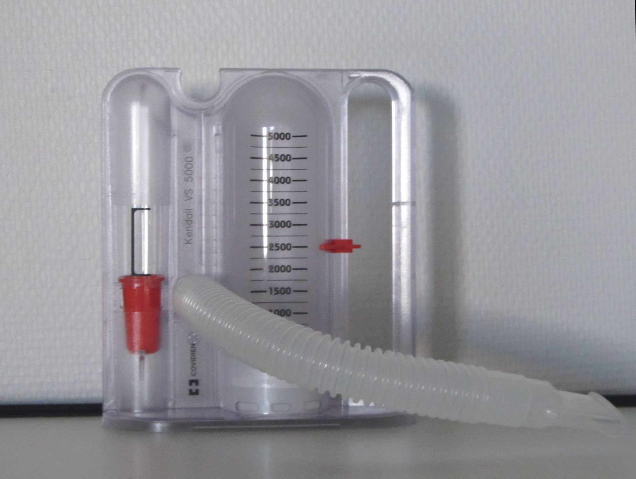
SECTION 7.2 · PREHABILITATION & PATIENT EDUCATION · FIGURE 7.1
Preoperative Teaching & Incentive Spirometry
ERAS guidelines strongly recommend dedicated preoperative counselling using plain language, demonstration, and teach-back.
WHAT TO NOTICE
• Deep breathing & splinted coughing: Coach slow, deep breaths and effective coughs while pressing a pillow firmly over the incision (splinting) to reduce pain.
• Incentive spirometer technique: Visual piston feedback encourages slow, sustained inhalation (Figure 7.1), used alongside upright positioning and walking.
• Venous return leg exercises: Demonstrate ankle pumps and foot circles to keep venous blood moving in the calves while in bed.
• Early mobilization & pain plan: Prepare the patient to sit up, dangle, and walk early with assistance, and to report pain early before it limits breathing.
• Expectations, literacy & interpreters: Explain PACU lines/drains, verify skills via teach-back, and use a qualified interpreter (never family) when needed.
Prehabilitation & Smoking Cessation
Multimodal prehabilitation (exercise, nutrition, psychological support) builds functional reserve before surgery. Stopping smoking >= 4 weeks pre-op has strong evidence for reducing pulmonary and wound complications.
Figure 7.1 An incentive spirometer encourages slow, deep breaths (credit: “Incentive spirometer” by Stefan Bellini / Wikimedia Commons, CC0 1.0).
Medical-Surgical Nursing: A Canadian Open Text
Chapter 7 · Perioperative Nursing
Notes:
Slide 10 integrates Figure 7.1 (an incentive spirometer) with the preoperative teaching curriculum in Section 7.2. Practice Question 5 tests these exact teaching points: holding a pillow firmly over the incision when coughing, pumping the ankles and circling the feet regularly in bed, taking slow deep breaths (with an incentive spirometer if provided), and telling the nurse early when pain makes it hard to breathe deeply or walk.

Slide 11
PART 2 · SECTION 7.3
Informed Consent, Day of Surgery & The Surgical Safety Checklist
The nurse's legal and advocacy role in surgical consent, the morning preoperative checklist, cultural safety with personal items, the three-phase Canadian Surgical Safety Checklist (Table 7.2), and CNO Scope in Practice.
Medical-Surgical Nursing: A Canadian Open Text
Chapter 7 · Perioperative Nursing
Notes:
Part 2 examines Section 7.3: Consent and the Day of Surgery. Here we distinguish the surgeon's legal duty to obtain informed consent from the nurse's professional responsibility to verify understanding and advocate for the patient, review the morning preoperative checklist, and analyze the international and Ontario evidence behind the Surgical Safety Checklist.

Slide 12
SECTION 7.3 · LEGAL & CLINICAL PREPARATION ON THE MORNING OF SURGERY
The Nurse's Role in Informed Consent & Pre-Op Checklist
Checking understanding, respecting cultural and religious items, and communicating changes before OR transfer.
Informed Consent: Check, Do Not Obtain
Morning Preoperative Checklist
• Surgeon's legal duty: The surgeon explains the procedure, risks, benefits, alternatives, and consequences of declining (Ontario HCCA, 1996; Ch. 1).
• Nurse's verification question: Confirm the signed form matches the booking and ask: 'Can you tell me in your own words what operation you are having today?'
• When doubts or questions arise: If the patient cannot describe the operation, has new questions about risks/alternatives, or feels pressured, notify the surgeon before transfer.
• Withdrawal & capacity: Consent can be withdrawn at any time (even outside the OR). Report new confusion or sedative effects so capacity/SDM can be assessed.
• Witnessing & interpreters: Witnessing a signature confirms identity only, not understanding. Document participation of a qualified interpreter.
• Identity, allergies & site mark: Verify two identifiers with patient, allergy band, and operative site marking done with the patient awake and participating.
• Fasting, meds & baseline vitals: Record exact times of last food/clear fluid, held/given medications, baseline vitals, weight, and blood glucose.
• Prostheses & sensory aids: Remove jewellery, dentures, and prostheses per policy; keep hearing aids and glasses in place until anesthesia induction.
• Cultural & religious items: Respect medicine bundles, religious medals, turbans, or kirpans; collaborate on safe securing and prompt return (Ch. 2).
• Structured OR handover: Report any new change (chest pain, new fast/irregular pulse, confusion) BEFORE transfer—never leave it for the OR team to discover.
Medical-Surgical Nursing: A Canadian Open Text
Chapter 7 · Perioperative Nursing
Notes:
Slide 12 covers the nurse's role in informed consent and the morning preoperative checklist. Emphasize that neither an RN nor an RPN obtains surgical consent; if a patient says 'The surgeon was in a hurry—I'm not really sure what they are taking out or why' (as in Ms. Mei-Ling Chen's case, Question 1), the nurse does not use a teaching sheet to explain surgical risks or rely on the signed form—the nurse notifies the surgeon before the patient goes to the OR.
Also note the cultural safety guidance for sacred or religious items (medicine bundles, turbans, kirpans, medals) and the sensory principle of leaving hearing aids and glasses with the patient until induction so they can communicate during the briefing.

Slide 13
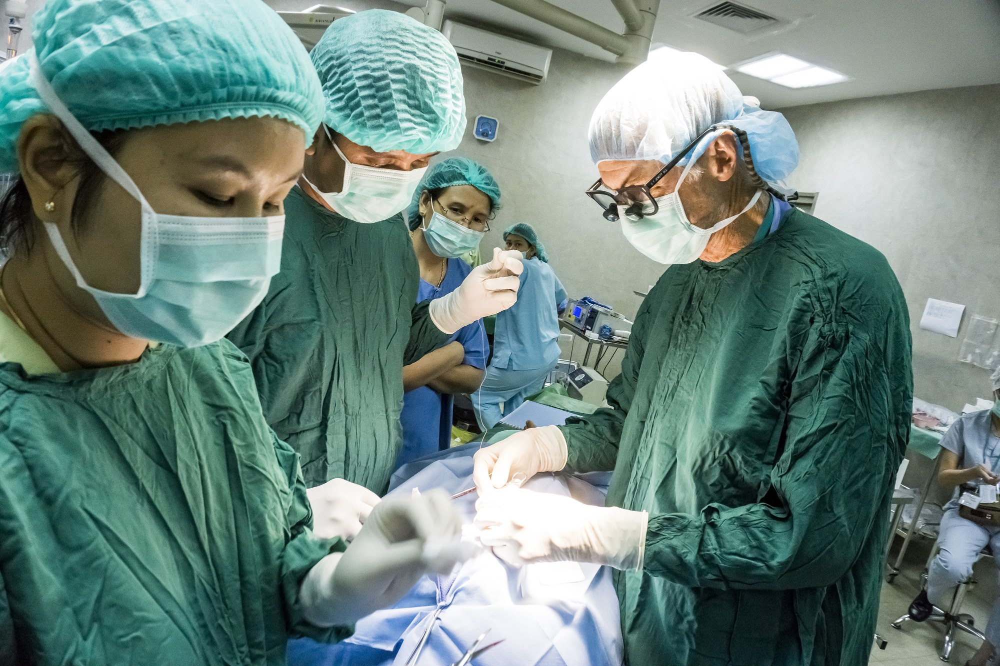
SECTION 7.3 · TABLE 7.2 & CANADIAN CONTEXT · FIGURE 7.2
The Three-Phase Canadian Surgical Safety Checklist
An Accreditation Canada / HSO (2024) Required Organizational Practice (ROP) completed aloud by the whole team.
WHAT TO NOTICE
• 1. Briefing (Before anesthesia): With patient awake, confirm identity, procedure, site, consent, allergies, fasting, airway/aspiration risk, and equipment.
• 2. Time-out (Before skin incision): Team members state names/roles; surgeon, anesthesiologist, and nurse confirm patient, procedure, and site aloud; review critical events, antibiotic/VTE prophylaxis, and imaging.
• 3. Debriefing (Before leaving OR): Confirm exact procedure done, sponge/needle/instrument counts, specimen labels, equipment issues, and PACU recovery plan.
• Global Trial (Haynes et al., 2009): Across 8 hospitals (3,733 before vs. 3,955 after), 30-day inpatient mortality fell from 1.5% to 0.8% and complications fell from 11.0% to 7.0%.
• Ontario Study (Urbach et al., 2014): Across 101 Ontario hospitals (~215,000 procedures), mortality (0.71% to 0.65%) and complications (3.86% to 3.82%) did not change significantly.
Why Team Culture & Speaking Up Matter
Urbach et al. (2014) showed that merely mandating a checklist on paper is not enough—how genuinely the team pauses, speaks up across hierarchy, and acts on HSO (2024) audit results determines patient safety.
Figure 7.2 A surgical team pauses for the time-out before skin incision (credit: “Operation Theater 2” by Almondbite3 / Wikimedia Commons, CC BY-SA 4.0).
Medical-Surgical Nursing: A Canadian Open Text
Chapter 7 · Perioperative Nursing
Notes:
Slide 13 combines Figure 7.2, Table 7.2 (the three phases of the Canadian Surgical Safety Checklist: Briefing, Time-out, and Debriefing), and the Canadian Context callout box comparing the landmark WHO 8-city study (Haynes et al., 2009) with the Ontario hospital study (Urbach et al., 2014).
Make sure students can distinguish the timing of each phase (Practice Question 8): Briefing happens before anesthesia begins; Time-out happens just before the skin incision; Debriefing happens at the end of the operation before the patient leaves the OR.

Slide 14
SECTION 7.3 · SCOPE IN PRACTICE · CNO THREE-FACTOR FRAMEWORK
Consent, Checklists & Perioperative Roles: RN and RPN Scope
The College of Nurses of Ontario (CNO, 2025) frames every perioperative role through authority, competence, and context:
1. Authority
2. Competence
3. Context
• Informed consent duty: The surgeon holds the legal authority and duty to obtain informed consent for surgery.
• Shared RN & RPN role: Neither RNs nor RPNs obtain surgical consent, but both verify that consent is documented and understood.
• Witnessing & stopping: Both may witness signatures where policy allows, report doubts about capacity or understanding, and stop preparation if consent is withdrawn.
• Checklist authority: Every member of the perioperative team has the authority and obligation to call a pause during the Surgical Safety Checklist.
• Added education required: Perioperative nursing (scrub/circulating) and PACU care require specialized post-basic education and demonstrated competence.
• RPN perioperative practice: Whether an RPN practices in the scrub role, a preadmission clinic, or the PACU depends on that nurse's education, competence, employer policy, and patient complexity.
• Recognizing deterioration: Every nurse who notices a falling SpO2, new confusion, or hemodynamic instability acts immediately and escalates.
• Provincial & facility rules: Regulatory and accreditation rules vary across jurisdictions and care settings.
• BC PACU standard example: CPSBC (2026) non-hospital surgical facility accreditation standards require two RNs in the PACU whenever a patient is receiving care there.
• Stability & collaboration: Assigning patients by stability is an employer practice, not a CNO rule. The RPN consults the RN as a patient's needs become more complex or unstable.
Medical-Surgical Nursing: A Canadian Open Text
Chapter 7 · Perioperative Nursing
Notes:
Slide 14 presents the complete Scope in Practice box from Section 7.3 (tested in Practice Questions 9 and 26; CNO, 2025). Students often hold the misconception that CNO rules prohibit RPNs from ever working in a PACU or that 'RPNs only care for stable patients' is a statutory CNO rule. In reality, CNO uses the three-factor framework of authority, competence, and context: employer policies, specialized education, provincial facility accreditation standards (such as CPSBC's two-RN PACU rule in BC non-hospital facilities), and evolving patient complexity govern role assignment and RN consultation.

Slide 15
PART 3 · SECTION 7.4
Anesthesia, Procedural Sedation & Intraoperative Emergencies
General, neuraxial (spinal and epidural), regional, and local anesthesia (Table 7.3), the procedural sedation continuum, capnography monitoring, Malignant Hyperthermia (MH), Local Anesthetic Systemic Toxicity (LAST), and laryngospasm.
Medical-Surgical Nursing: A Canadian Open Text
Chapter 7 · Perioperative Nursing
Notes:
Part 3 covers Section 7.4: Anesthesia and Sedation. We compare the major modalities in Table 7.3, examine the nurse's dedicated monitoring role during procedural sedation, and go deeper into life-threatening anesthesia emergencies: malignant hyperthermia (MH), local anesthetic systemic toxicity (LAST), and laryngospasm.

Slide 16
SECTION 7.4 · TABLE 7.3 · ANESTHESIA MODALITIES & NURSING CARE
Comparing General, Neuraxial & Regional Anesthesia
Anesthesiologists tailor anesthesia to the operation, the patient's health, and patient preference—often combining modalities:
General Anesthesia
Spinal & Epidural (Neuraxial)
Peripheral Block & Local
• Mechanism: Drug-induced unconsciousness from which the patient cannot be roused, even by painful stimulation (ASA, 2024).
• Airway & muscle support: Endotracheal tube (ETT) or supraglottic airway supports ventilation; neuromuscular blockers added when needed.
• Post-op nursing focus: Airway patency, breathing, SpO2, drowsiness, sore throat/hoarseness, PONV, shivering, and emergence confusion.
• Accidental awareness: Rare (~1 in 19,000 in UK NAP5 audit; Cook et al., 2014). Listen empathetically without dismissing and notify anesthesia.
• Spinal vs. Epidural: Spinal: single CSF injection gives dense lower-body numbness/weakness. Epidural: catheter in epidural space allows continuous analgesia.
• Autonomic & bladder effects: Sympathetic blockade causes vasodilation/hypotension; impaired detrusor tone causes urinary retention.
• Post-block checks: Track expected sensory/motor return; check BP and dangle legs before first standing; monitor voiding.
• Red-flag escalation: Report a rising block level, return of weakness after resolution, or new severe back pain immediately (epidural hematoma/abscess).
• Peripheral nerve block: Local anesthetic injected near nerves supplying a limb/area (single shot or continuous catheter infusion).
• Protect the numb limb: Numb limbs cannot sense pressure, heat, or injury—pad bony prominences, position carefully, and inspect skin.
• Fall & pain prevention: Walk only with assistance after a lower-limb block; give scheduled analgesia before the block wears off.
• Local infiltration: Injected directly into tissue for minor procedures; record total local anesthetic dose from all sources to prevent LAST.
Medical-Surgical Nursing: A Canadian Open Text
Chapter 7 · Perioperative Nursing
Notes:
Slide 16 covers Table 7.3 for General, Spinal, Epidural, Peripheral Nerve Block, and Local Infiltration anesthesia.
Highlight Practice Question 16: when a patient wants to walk to the washroom 2 hours after a knee arthroscopy under spinal anesthesia, the nurse's first action is to check the return of movement and sensation in his legs and check his blood pressure before helping him sit up and dangle—preventing orthostatic syncope or a fall from residual motor weakness.

Slide 17
SECTION 7.4 · PROCEDURAL SEDATION & CAPNOGRAPHY
The Sedation Continuum & Dedicated Nursing Surveillance
Because patients can slip deeper than intended, providers must be able to rescue from the next deeper level (ASA, 2024).
ASA (2024) Depth of Sedation Continuum
The Monitoring Nurse's Role
• Minimal sedation (anxiolysis): Patient is relaxed and responds normally to verbal commands; coordination/cognition may slow, but airway, ventilation, and circulation are unaffected.
• Moderate sedation (conscious): Patient is drowsy but responds purposefully to voice or light tactile stimulation; maintains patent airway and adequate spontaneous ventilation.
• Deep sedation: Patient is not easily roused; responds purposefully only to repeated or painful stimulation (e.g., sternal rub). Airway and ventilation may become inadequate.
• General anesthesia transition: Complete loss of arousal even to pain; requires full airway and hemodynamic rescue capability.
• Authority, competence & context: Whether an RN may administer sedating medications depends on provincial/territorial regulation, employer policy, and specialized competence.
• Single dedicated duty: The nurse monitoring procedural sedation has NO other task during the procedure.
• Pre-procedure readiness: Confirm baseline vitals/SpO2/LOC, fasting, allergies, consent, working oxygen, suction, airway kit, and resuscitation cart.
• Continuous parameters: Track airway patency, respiratory rate/depth, SpO2, sedation scale, HR/BP/ECG, and continuous capnography (end-tidal CO2, required by CAS 2026 for moderate/deep sedation).
• Immediate rescue action: If patient responds only to sternal rub, snores, desaturates, or ETCO2 flattens: stimulate patient, open airway, tell provider to STOP, and call for help.
Medical-Surgical Nursing: A Canadian Open Text
Chapter 7 · Perioperative Nursing
Notes:
Slide 17 details the ASA (2024) sedation continuum and the CAS (2026) monitoring standards for procedural sedation.
Walk students through Practice Question 17: during a colonoscopy under moderate sedation, the patient responds only to a sternal rub (meaning he has slipped into deep sedation), his SpO2 drops from 96% to 89%, and his capnography waveform flattens. The nurse must immediately stimulate the patient, open the airway, tell the physician to stop the procedure, and call for help—never silence the capnography alarm or wait 5 minutes.

Slide 18
SECTION 7.4 · GOING DEEPER · LIFE-THREATENING INTRAOPERATIVE EMERGENCIES
Malignant Hyperthermia (MH), LAST & Laryngospasm
CAS (2026) mandates an MH kit wherever triggering agents are used and 20% lipid emulsion wherever nerve blocks/infusions occur:
Malignant Hyperthermia (MH)
LAST & Laryngospasm
Inherited muscle hypermetabolism (Glahn et al., 2024)
Sodium-channel toxicity (Neal et al., 2021) & Airway Spasm
• Triggers & mechanism: Volatile gases & succinylcholine cause uncontrolled muscle calcium release, contraction, CO2, and heat.
• Early vs. late cues: Early: unexplained rise in ETCO2, tachycardia, tachypnea, jaw/muscle rigidity, sweating/mottled skin. Late: rapid temp rise, high K+/CK, dark urine.
• Immediate priority actions: Stop triggering agents, hyperventilate with 100% O2, call help, give IV dantrolene, and apply active cooling.
• Post-crisis follow-up: Monitor in ICU >= 24 h (recrudescence risk); MHAUS 1-800-644-9737; genetic testing, family alert, and medical bracelet.
• LAST mechanism & risk: Toxic local anesthetic blood levels block CNS/cardiac sodium channels; higher risk in older age, low muscle mass, heart/liver disease, or infusions.
• Prodromal & severe cues: Early CNS: metallic taste, tinnitus (ringing ears), agitation -> seizures -> dysrhythmias/arrest (up to 60 min post-injection or days into infusion).
• LAST priority rescue: 1. Stop local anesthetic infusion & call help; 2. Protect airway & give 100% O2 first; 3. Treat seizures (benzodiazepine) & give 20% lipid emulsion; watch 2–6 h.
• Laryngospasm: Sustained vocal cord closure on emergence causing stridor or silent chest with hypoxemia/bradycardia -> call anesthesia & give 100% O2.
Exam & Clinical Pearl (Questions 27–30): In MH, rising end-tidal CO2 and tachycardia appear BEFORE hyperthermia; stopping triggers and ventilating with 100% O2 come first. In LAST, stop the local anesthetic infusion and secure the airway/oxygenation FIRST before lipid emulsion.
Medical-Surgical Nursing: A Canadian Open Text
Chapter 7 · Perioperative Nursing
Notes:
Slide 18 captures the entire Going Deeper box on Malignant Hyperthermia (MH) and Local Anesthetic Systemic Toxicity (LAST), plus laryngospasm (tested in RN Practice Questions 27–30).
Key takeaways for RN students:
- In MH, hyperthermia is often a LATE sign; the earliest cues are an unexplained rise in end-tidal CO2, unexplained tachycardia, jaw/muscle rigidity after succinylcholine, and diaphoresis/mottled skin.
- In LAST, a patient 15 minutes after a shoulder block reporting a metallic taste, ringing in the ears (tinnitus), and restlessness is showing classic early CNS toxicity. If a patient on a continuous femoral nerve block has a seizure on Day 2, the nurse's first action is to stop the local anesthetic infusion, call for help, and support the airway and oxygenation.

Slide 19
PART 4 · SECTION 7.5
Postanesthesia Care Unit (PACU) Recovery
Phase I and Phase II PACU staffing and handover, managing airway obstruction and laryngospasm, preventing inadvertent perioperative hypothermia (<36.0 °C), Apfel PONV risk scoring, emergence delirium, and Aldrete discharge readiness.
Medical-Surgical Nursing: A Canadian Open Text
Chapter 7 · Perioperative Nursing
Notes:
Part 4 covers Section 7.5: Care After Anesthesia (PACU). We examine how patients transition safely from unconsciousness or neuraxial blockade to physiological stability, focusing on airway protection, active warming, multimodal PONV control, emergence delirium, and objective discharge scoring.

Slide 20
SECTION 7.5 · IMMEDIATE POSTANESTHESIA SURVEILLANCE
PACU Handover, Airway Protection & Normothermia
Continuous pulse oximetry, audible alarms, and active warming equipment are mandatory Canadian PACU standards (Dobson et al., 2026):
Phase I/II & Handover
Airway & Breathing
Circulation & Hypothermia
• Anesthesiologist handover: The anesthesiologist accompanies the patient and gives a structured verbal handover covering operative events, OSA/risks, fluid balance, and pain/PONV plans.
• Phase I staffing ratios: BC Ministry of Health (2024) minimum Phase I ratios range from 2 nurses : 1 critically ill/unstable patient to 1 nurse : 2 conscious, stable patients.
• Mandatory monitoring: Continuous pulse oximetry for all early recovery patients; continuous capnography for intubated or deeply sedated patients; alarms kept active.
• Pharyngeal obstruction: Relaxed tongue falls back in drowsy patients -> snoring, diminished airflow, falling SpO2. Rouse patient, perform jaw thrust, insert oral airway if trained, apply O2, escalate.
• Emergence laryngospasm: Noisy stridor or silent chest efforts with rapid desaturation and bradycardia -> call anesthesia team immediately and apply oxygen.
• Hypoventilation & OSA care: Driven by residual anesthetic, opioids, or incomplete neuromuscular reversal. Keep OSA/high STOP-Bang patients upright or side-lying on continuous oximetry + home CPAP.
• Blood pressure & bleeding: Hypotension may reflect residual anesthetics, neuraxial block, or hypovolemia, but ALWAYS check dressings, drains, and underneath the patient for bleeding.
• Inadvertent hypothermia: Defined as unplanned core temperature < 36.0 °C (NICE, 2016); anesthesia blunts thermoregulation and causes shivering.
• Active warming protocol: Target 36.0–37.0 °C. Check temp on arrival and q15min; apply forced-air warming if < 36.0 °C; do NOT transfer to ward until core temp >= 36.0 °C.
Medical-Surgical Nursing: A Canadian Open Text
Chapter 7 · Perioperative Nursing
Notes:
Slide 20 covers PACU phases, airway/breathing emergencies, and circulation/temperature management in Section 7.5.
Highlight Practice Question 19: when a patient arrives in the PACU after a 3-hour bowel resection with a temperature of 35.6 °C and shivering, a single cotton blanket and a 4-hour recheck is unsafe. Following NICE (2016) and CAS (2026) guidelines, the nurse initiates active forced-air warming and rechecks temperature every 15 minutes, holding ward transfer until the core temperature reaches at least 36.0 °C.

Slide 21
SECTION 7.5 · SYMPTOM CONTROL, DELIRIUM & PACU DISCHARGE
PONV (Apfel Score), Emergence Delirium & Aldrete Criteria
Proactive multimodal antiemetics, reversible-cause screening for confusion, and validated recovery scoring:
PONV & Emergence Delirium
Readiness to Leave the PACU
Apfel Risk Score (Gan et al., 2020) & Zhang et al. (2020)
Aldrete Score (Aldrete, 1995; Aldrete & Kroulik, 1970)
• Simplified Apfel Score (0–4): 1. Female sex; 2. Non-smoker; 3. Prior PONV or motion sickness; 4. Post-op opioids. Risk rises from ~10% (0 factors) to ~80% (all 4 factors).
• PONV prevention & rescue: Combine multimodal prophylaxis; if PONV occurs within 6 h, rescue with a DIFFERENT drug class; turn drowsy vomiting patient onto side.
• Emergence delirium (37%): Occurred in 37% of adults aged 65–90 in PACU (most often quiet/hypoactive) and predicted later postoperative delirium (Zhang et al., 2020).
• First actions for confusion: Check reversible causes FIRST: hypoxemia, pain, hypothermia, urinary retention (full bladder), hypotension, and hypoglycemia; reorient & protect lines.
• 5 Aldrete domains (0–2 pts): 1. Activity (moving 4, 2, or 0 limbs); 2. Respiration; 3. Circulation (BP vs. baseline); 4. Consciousness; 5. Oxygenation.
• Discharge threshold: Total score >= 9 (typically), PLUS controlled pain/nausea, core temperature >= 36.0 °C, and regressing sensory/motor block.
• When NOT to transfer (Q20): A patient whose SpO2 drops to 88% on room air whenever he dozes off is NOT ready for ward transfer regardless of limb movement or BP.
• Day surgery & SBAR handover: Day surgery uses modified PADSS. Ward transfer uses SBAR covering PACU events, trends, last analgesic/antiemetic, I&O, drains, and block.
Clinical Judgment Pearl (Questions 18 & 20): A 34-year-old non-smoking woman with motion sickness receiving opioids after laparoscopic surgery carries all 4 Apfel factors (~80% PONV risk). In the PACU, desaturation during sleep (SpO2 88%) requires immediate anesthesia reassessment before transfer.
Medical-Surgical Nursing: A Canadian Open Text
Chapter 7 · Perioperative Nursing
Notes:
Slide 21 covers PONV risk stratification via the simplified Apfel score, emergence delirium in older adults, and the 5-domain Aldrete recovery score.
Emphasize two high-yield clinical points:
1. When PONV breaks through prophylaxis within the first 6 hours after surgery, administering another dose of the same drug class is ineffective—choose a rescue antiemetic from a different pharmacological class (Elvir-Lazo et al., 2020).
2. In Zhang et al.'s (2020) cohort of 915 older adults, 37% experienced emergence delirium in the PACU, most commonly the quiet (hypoactive) form. Always rule out hypoxia, pain, cold, a distended bladder, hypotension, and hypoglycemia before attributing agitation or lethargy to anesthesia alone.

Slide 22
PART 5 · SECTION 7.6
Postoperative Care, Complications, VTE Prophylaxis & ERAS
First postoperative day priorities, preventing atelectasis and VTE, silent urinary retention, postoperative ileus, surgical wound dehiscence and evisceration, Enhanced Recovery After Surgery (ERAS), older adult care, and unfolding clinical cases.
Medical-Surgical Nursing: A Canadian Open Text
Chapter 7 · Perioperative Nursing
Notes:
Part 5 covers Section 7.6: Postoperative Care and Complications, including Figures 7.3 and 7.4, Table 7.4, the Clinical Safety box on wound evisceration, Lifespan Considerations for older adults, Patient Education for day surgery discharge, Tanya Beaulieu's RPN Practice Story, and both unfolding case studies.

Slide 23
SECTION 7.6 · PULMONARY & THROMBOEMBOLIC PREVENTION
Atelectasis, Pneumonia & Three-Part VTE Prophylaxis
Mobilization, multimodal analgesia, mechanical compression, and timely anticoagulation prevent life-threatening complications:
Atelectasis & Pneumonia
3-Part VTE Prophylaxis
DVT & Pulmonary Embolism
• Atelectasis cues: Alveolar collapse at lung bases from shallow breathing, pain, opioids, and recumbency -> reduced basal breath sounds, tachypnea, falling SpO2.
• Post-op pneumonia cues: Fever, productive cough, crackles, rising RR, falling SpO2, or acute confusion in an older adult (Ch. 13).
• Evidence on spirometry: Cochrane review (2014) found low-quality evidence that incentive spirometry alone prevents lung complications no better than deep breathing or physio.
• Nursing priority: Treat the spirometer as an adjunct—never a substitute for upright positioning, splinted coughing, analgesia, and walking.
• 1. Mobilization & hydration: Early ambulation, ankle pumps/foot circles, and avoiding dehydration keep venous blood moving (NICE, 2019).
• 2. Mechanical prophylaxis: IPC sleeves worn continuously while immobile; fitted stockings removed daily for skin checks (avoid in PAD, neuropathy, fragile skin).
• 3. Anticoagulant prophylaxis: LMWH when VTE risk outweighs bleeding risk; extended up to 28 days after major abdominal cancer surgery.
• Ethical/religious disclosure: Because heparins derive from animal sources, tell the prescriber if a patient objects for religious/ethical reasons so alternatives are used.
• Recognizing DVT: Unilateral calf/thigh swelling, pain, warmth, and redness. On darker skin, compare both legs for swelling, warmth, and tenderness.
• Never massage the leg: Massaging a swollen or tender calf can dislodge a thrombus and trigger a fatal pulmonary embolism.
• Recognizing acute PE: Sudden dyspnea, pleuritic chest pain, tachycardia, tachypnea, falling SpO2, anxiety, hemoptysis, or syncope.
• Immediate PE actions: Stay with patient, raise head of bed, apply O2 as ordered, call Rapid Response / MRP, and report via SBAR.
Medical-Surgical Nursing: A Canadian Open Text
Chapter 7 · Perioperative Nursing
Notes:
Slide 23 synthesizes respiratory complications (atelectasis and pneumonia) and venous thromboembolism (VTE) from Section 7.6.
Point out two nuanced evidence pearls from the textbook:
1. The Cochrane review by do Nascimento Junior et al. (2014) showed that an incentive spirometer alone does not replace sitting upright and walking.
2. Under NICE (2019) guidelines, heparins are animal-derived, so nurses respect religious or ethical objections by alerting the prescriber to select a synthetic alternative. Furthermore, on darker skin tones, erythema from DVT may not be visible, making bilateral comparison of leg circumference, warmth, and tenderness essential.

Slide 24
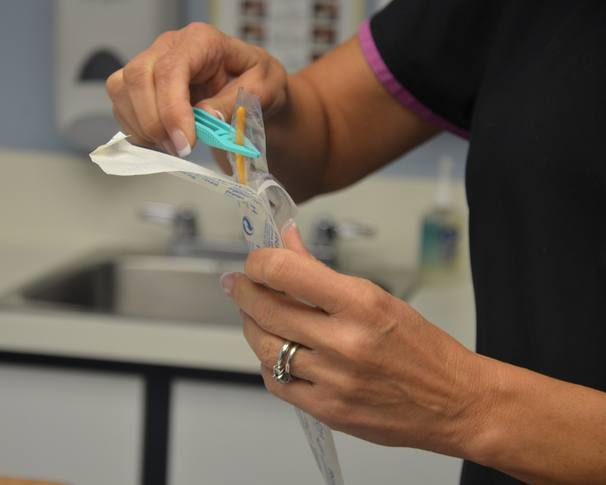
SECTION 7.6 · GENITOURINARY & GASTROINTESTINAL RECOVERY · FIGURE 7.3
Postoperative Urinary Retention, Bladder Scanning & Ileus
71% of surgical patients requiring catheterization for retention felt no urge to void (Brouwer et al., 2021).
WHAT TO NOTICE
• High-risk POUR profile: Spinal/epidural anesthesia, surgery >= 60 min, age >= 60, male sex, pelvic surgery, small bladder capacity, and first PACU scan >= 250 mL.
• Silent retention cues: Because 71% feel no urge, track time since last void, suprapubic fullness/discomfort, restlessness, and new confusion in older adults.
• Bladder scan & early removal: Scan per policy; catheterize as ordered to prevent permanent detrusor damage. Remove indwelling catheters early (Day 1 in low-risk colorectal ERAS).
• Postoperative ileus cues: Temporary slowing of bowel motility -> abdominal distension, nausea/vomiting, absence of flatus/stool, and poor food tolerance.
• Managing & preventing ileus: Report cues, keep NPO and manage NG tube if ordered, monitor fluids and potassium (K+). ERAS prevents ileus via opioid-sparing analgesia and early feeding (within 4 h).
ERAS Myth-Buster: Chewing Gum & Routine NG Tubes
The ERAS colorectal guideline (Gustafsson et al., 2019) recommends AGAINST routine nasogastric tubes and notes that chewing gum is NOT routinely recommended after a large multicentre trial showed no benefit.
Figure 7.3 Sterile indwelling catheter: inserted on order, removed early (credit: “2108_Urinary_Catheter.jpg” by Doyle & McCutcheon / BCcampus, CC BY 4.0).
Medical-Surgical Nursing: A Canadian Open Text
Chapter 7 · Perioperative Nursing
Notes:
Slide 24 pairs Figure 7.3 (sterile urinary catheter preparation) with the evidence on postoperative urinary retention (POUR) and postoperative ileus.
Emphasize Brouwer et al.'s (2021) striking finding: 71% of postoperative patients who required catheterization for retention felt no urge to urinate! That is why an older adult who becomes restless and tries to climb out of bed 6 hours after hip surgery under spinal anesthesia (Practice Question 21 and Tanya Beaulieu's Practice Story) needs a bladder scan—not a sedative or an extra litre of water. Also highlight Practice Question 22: chewing gum is not a routine ERAS treatment for established Day 3 ileus with vomiting; the nurse reports the findings, keeps the patient fasting as ordered, and monitors fluids and electrolytes.

Slide 25
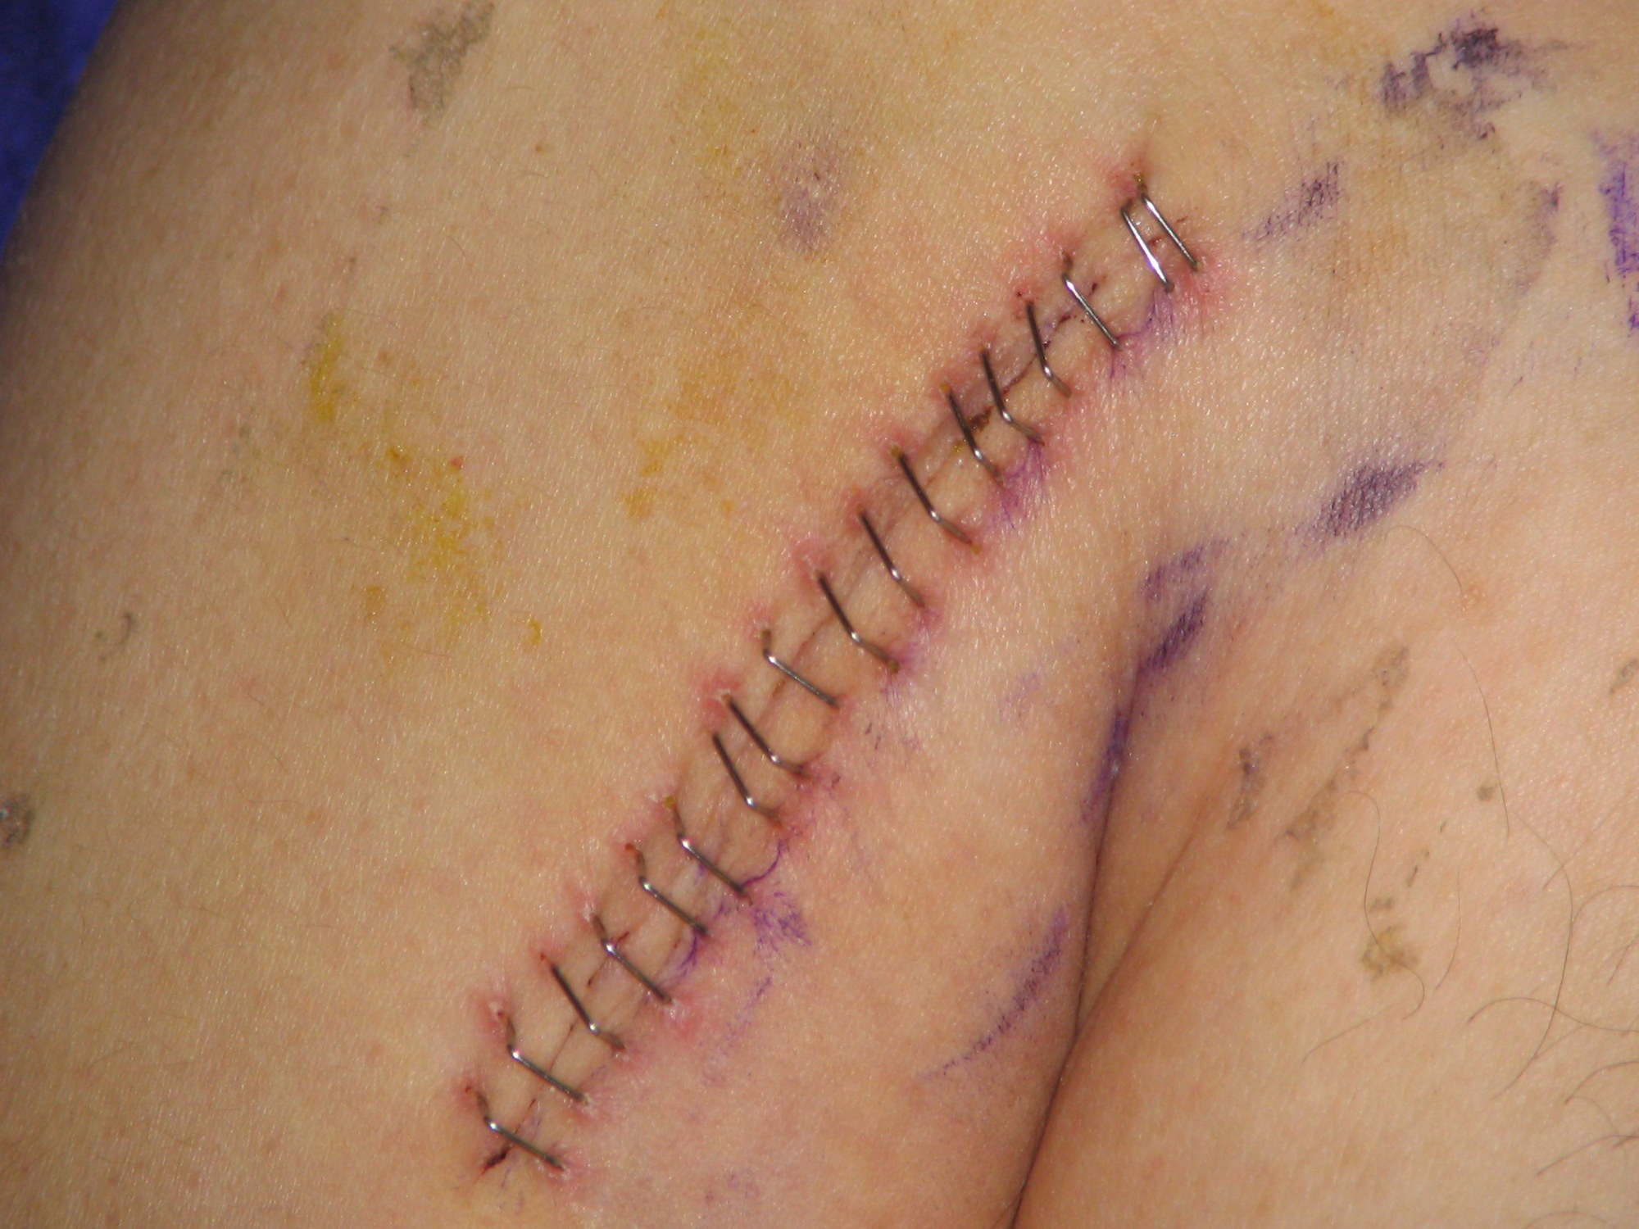
SECTION 7.6 · SURGICAL WOUND INTEGRITY & CLINICAL SAFETY · FIGURE 7.4
Hematoma, Wound Dehiscence & Surgical Evisceration
The nurse inspects the surgical incision at every assessment and acts immediately if wound edges separate.
WHAT TO NOTICE
• Incisional hematoma: Collection of blood under the incision causing swelling, bruising, tightness, and throbbing pain. Mark borders and report.
• Neck surgery airway emergency: After thyroid or neck surgery, a hematoma can rapidly compress and obstruct the airway—report any neck swelling immediately (Iliff et al., 2022).
• Wound dehiscence (Days 4–14): Separation of closed incision edges (WUWHS, 2018). Warning cue: sudden increase in pain or gush of thin, pink serosanguineous drainage.
• Dehiscence risk factors: Obesity, diabetes, smoking, emergency surgery, age > 65, prolonged surgery, perioperative hypothermia, and surgical site infection.
• Wound evisceration: Protrusion of abdominal organs (loops of bowel) through a dehisced incision—an immediate life-threatening surgical emergency.
Clinical Safety Protocol: Wound Evisceration (Question 24)
1. Stay with patient & call for help (colleague pages surgeon/RRT); 2. Cover exposed bowel with sterile dressings moistened with sterile normal saline (NEVER push organs back); 3. Position low Fowler's with knees bent; 4. Keep NPO, monitor vitals/SpO2 for shock, and prepare for OR.
Figure 7.4 A surgical incision closed with staples 7 days post-op (credit: “Surgical staples1” by Llywrch / Wikimedia Commons, CC BY-SA 2.5).
Medical-Surgical Nursing: A Canadian Open Text
Chapter 7 · Perioperative Nursing
Notes:
Slide 25 integrates Figure 7.4 (surgical incision closed with staples) with wound hematoma, dehiscence, and the Clinical Safety box on wound evisceration.
Walk through Practice Question 24 step by step: on Day 6 after a laparotomy, a patient coughs, says 'Something just gave way,' and loops of bowel appear in the open incision. The nurse stays with the patient, calls for help, covers the exposed bowel with sterile normal-saline-moistened dressings, positions the patient with the head of the bed slightly raised and knees flexed to reduce abdominal wall tension, keeps the patient NPO, monitors for shock, and never attempts to push the organs back into the abdomen.

Slide 26
SECTION 7.6 · TABLE 7.4 · POSTOPERATIVE SURVEILLANCE MATRIX
Common Postoperative Complications: Timing, Cues & First Actions
Rapid reference across the major postoperative complications in Table 7.4:
Hypoxemia & Atelectasis (PACU / First Days)
Postoperative Ileus (First Days)
Falling SpO2, tachypnea, reduced basal breath sounds. Sit upright, coach deep breathing/coughing, give O2, report trend.
Abdominal distension, nausea/vomiting, no flatus or stool. Report, keep NPO, manage NG tube if ordered, check fluids/K+.
Postoperative Pneumonia (After First Few Days)
SSI & Dehiscence / Evisceration (Days 4–14+)
Fever, productive cough, crackles, rising RR, new confusion. Assess, report, obtain ordered tests, mobilize, give O2.
SSI: redness, warmth, drainage, fever. Evisceration: pink gush/open wound -> stay, call help, sterile saline dressing, NPO.
Postoperative Hemorrhage (First 24 Hours)
DVT & Pulmonary Embolism (Days to Weeks)
Rising HR, narrow pulse pressure, soaked dressing/drains, oliguria. Call help, direct pressure, lie flat, IV access, SBAR.
DVT: unilateral calf swelling/warmth -> never massage, report. PE: sudden dyspnea, pleuritic pain, low SpO2 -> HOB up, O2, RRT.
Urinary Retention (First Hours / Post-Catheter)
Postoperative Delirium (First Days)
No void, suprapubic fullness, restlessness, often no urge (71%). Bladder scan per policy, report, catheterize as ordered.
Acute inattention, fluctuating confusion, agitation or drowsiness. Search for causes (O2, pain, bladder, infection), keep safe.
Hemodynamic Warning: In postoperative hemorrhage (visible in drains/dressings or hidden in abdomen/chest), tachycardia, narrowing pulse pressure, restlessness, and falling urine output appear BEFORE blood pressure drops (Chapter 6).
Medical-Surgical Nursing: A Canadian Open Text
Chapter 7 · Perioperative Nursing
Notes:
Slide 26 summarizes all rows of Table 7.4 (Common postoperative complications: timing, cues, and first nursing actions). Use this slide as a comprehensive rapid-review matrix connecting timing after surgery to bedside pattern recognition and immediate nursing escalation.

Slide 27
SECTION 7.6 · ERAS, OLDER ADULT CARE & SAFE DISCHARGE
ERAS Pathways, Delirium Prevention & Going Home Safely
Nurses drive daily ERAS milestones, protect older adults from preventable delirium, and tailor discharge teaching:
Enhanced Recovery (ERAS)
Older Adults & Practice Story
Going Home & Rural Equity
• Pre-op elements: Dedicated counselling, prehabilitation, avoiding overnight fasting, and carbohydrate loading per anesthesia instructions.
• Intra-op & PACU elements: Minimally invasive approaches, active warming (normothermia), multimodal PONV prophylaxis, and goal-directed fluid therapy.
• Post-op nursing drivers: Opioid-sparing multimodal analgesia, avoiding routine NG tubes, oral diet within 4 h, early mobilization, Day 1 catheter removal, VTE prophylaxis, and pathway auditing.
• Frailty & physiology: Frailty (not age alone) predicts surgical recovery. Lower renal reserve affects drug/fluid clearance; age > 65 raises dehiscence and hypothermia risk.
• Delirium & fall prevention: Keep glasses/hearing aids on, protect sleep, mobilize early, avoid deliriogenic sedatives/anticholinergics, keep call bell/walker in reach.
• Tanya Beaulieu RPN Story: Mr. Zielinski (84, post-hip repair) became restless at 2200 calling nurse by his late wife's name. Bladder scan found 850 mL silent retention -> RN/MD SBAR & catheter resolved agitation.
• Day-surgery rules (24 h): Responsible adult escort home; no driving, power tools/machinery, alcohol, or signing legal documents for 24 h (Dobson et al., 2026).
• When to call surgeon vs 9-1-1: Call surgeon for fever, wound redness/drainage, persistent vomiting, or inability to void. Call 9-1-1 for sudden dyspnea, chest pain, hemoptysis, or heavy bleeding.
• Rural, remote & Indigenous care: Arrange local dressing/med supplies, community nursing station handover, medical travel coordination, and virtual follow-up before discharge.
Medical-Surgical Nursing: A Canadian Open Text
Chapter 7 · Perioperative Nursing
Notes:
Slide 27 brings together the Enhanced Recovery After Surgery (ERAS) pathway, the Lifespan Considerations box ('Older Adults and Surgery'), the Practice Story ('He Just Wasn't Himself' featuring Tanya Beaulieu, RPN, and 84-year-old Mr. Walter Zielinski), and the Patient Education box ('Going Home After Day Surgery').
Reflect on Tanya Beaulieu's story with the class: Mr. Zielinski's catheter came out at 1000, and at 2200 he was pulling at his blanket, trying to climb over the bed rail, and disoriented. His vitals were near baseline and his hip pain was mild, but his lower abdomen felt firm and he had not voided in 12 hours. Within her RPN competence and hospital policy, Tanya performed a bladder scan (850 mL), lowered the bed, had an assistant stay with him, consulted RN Priya Nair, reported via SBAR to the surgical resident, and drained >800 mL via in-and-out catheterization—treating the root cause rather than masking behaviour with a sedative.

Slide 28
SECTIONS 7.2 & 7.3 · UNFOLDING CASE STUDY 1 (QUESTIONS 1–4)
Case Study 1: Ms. Mei-Ling Chen (58) — Morning of Cholecystectomy
Arrives at 0700 for a 1000 laparoscopic cholecystectomy. History of type 2 diabetes on metformin and weekly semaglutide.
1 · Consent Check
2 · Fasting & GLP-1
3 · Final Checklist
Consent Gap (Q1)
Aspiration Risk (Q2–Q3)
Pre-OR Pulse Change (Q4)
• Patient statement: 'The surgeon was in a hurry. I'm not really sure what they are taking out or why.'
• Correct nursing action: Inform the surgeon BEFORE transfer to the OR that Ms. Chen does not understand the planned procedure.
• Why other options fail: A signed form alone does not prove informed consent; the nurse's teaching sheet or a spouse's explanation cannot substitute for the surgeon's legal duty.
• Fasting breach at 0600 (Q2): She ate toast with peanut butter at 0600 and drank water at 0630 for a 1000 surgery—violating the CAS 6-hour minimum for solid food.
• Weekly semaglutide (Q3): Took her GLP-1 receptor agonist injection 2 days ago. Semaglutide slows gastric emptying, so food may remain despite standard fasting (aspiration risk).
• Nursing action: Record exact intake and last semaglutide dose and report both to the anesthesia team immediately; the nurse does not unilaterally cancel surgery.
• New arrhythmia cue (Q4): At final check, her pulse is 122 bpm and irregular, compared with 76 bpm and regular at 0700.
• Immediate escalation: Report the new fast, irregular pulse to the anesthesia team and surgeon BEFORE transfer—never leave a new change for the OR team to discover.
• Normal checklist findings: Voiding at 0915 without a catheter, taping a wedding ring per hospital policy, and a stable glucose of 6.8 mmol/L do not require urgent escalation.
Medical-Surgical Nursing: A Canadian Open Text
Chapter 7 · Perioperative Nursing
Notes:
Slide 28 covers Unfolding Case Study 1 (Questions 1 to 4): Ms. Mei-Ling Chen, 58, arriving at 0700 for a 1000 laparoscopic cholecystectomy.
This case integrates four critical morning-of-surgery safety checks:
1. Informed consent (Q1): When she cannot state what is being removed or why, the nurse alerts the surgeon before transfer.
2. Fasting minimum (Q2): Toast with peanut butter at 0600 is only 4 hours before a 1000 surgery (breaching the 6-hour CAS solid food minimum); the nurse reports the exact food and time to anesthesia.
3. GLP-1 receptor agonist warning (Q3): Weekly semaglutide slows stomach emptying and increases pulmonary aspiration risk under general anesthesia.
4. Pre-transfer clinical change (Q4): A new irregular pulse of 122 bpm (up from 76 regular) must be reported before wheeling the patient to the OR.

Slide 29
SECTION 7.6 · UNFOLDING CASE STUDY 2 (QUESTIONS 10–15)
Case Study 2: Mrs. Lucille Arsenault (71) — Post-TKA Dyspnea
Day 1 after right total knee arthroplasty (BMI 34, stayed in bed, IPC sleeves left off since 1100). At 1530: sudden dyspnea & right pleuritic chest pain.
1 · Recognize & Analyze
2 · Take Action
3 · Evaluate Outcomes
1530 Acute Change (Q10–Q12)
Priority Actions (Q13–Q14)
2-Hour Evaluation (Q15)
• Immediate follow-up cues (Q10): SpO2 drop from 95% to 89% on room air, HR 118 and RR 28, sudden right chest pain worse on inspiration, and new tenderness/enlargement of the LEFT calf.
• Expected vs. baseline: Right leg swelling below the dressing is expected post-TKA; Temp 37.6 °C is a mild post-op rise; BMI 34 is a baseline risk factor.
• PE vs. Atelectasis (Q11–Q12): Sudden pleuritic pain + acute dyspnea + contralateral calf DVT signs point strongly to Pulmonary Embolism (priority life-threatening hypothesis).
• First action while waiting (Q14): Apply oxygen as authorized by medical directive and recheck SpO2 immediately to address life-threatening hypoxemia.
• Core care plan actions (Q13): Stay with Mrs. Arsenault, call Rapid Response / MRP, raise head of bed, report via SBAR (including SpO2 trend and left calf), and prepare for imaging.
• Actions to AVOID: NEVER massage the tender left calf, NEVER walk a hypoxic patient with suspected PE, do NOT reapply IPC sleeves over a suspected DVT, and avoid early opioids.
• Effective response (Q15): SpO2 95% on ordered oxygen, HR decreased to 96 bpm, RR decreased to 20 breaths/min, and reduced chest pain show improving gas exchange.
• Persistent distress cues: An SpO2 of 92% with HR 120 or RR 30 indicates ongoing cardiopulmonary compromise even if she says she feels 'a bit calmer.'
• Deterioration toward shock: A falling BP (100/62 mm Hg) with new drowsiness signals obstructive shock from massive PE requiring urgent escalation.
Medical-Surgical Nursing: A Canadian Open Text
Chapter 7 · Perioperative Nursing
Notes:
Slide 29 walks through Unfolding Case Study 2 (Questions 10 to 15): Mrs. Lucille Arsenault, 71, on Day 1 after right total knee arthroplasty under spinal anesthesia.
Notice how each step of the clinical judgment model builds logically:
- Recognize cues (Q10): SpO2 89%, HR 118/RR 28, sudden pleuritic chest pain, and new left calf tenderness/swelling.
- Analyze & Prioritize (Q11–Q12): Acute pleuritic pain + new left calf DVT signs distinguish pulmonary embolism from basal atelectasis or opioid drowsiness.
- Take action (Q13–Q14): Stay with her, call Rapid Response, raise the head of the bed, apply oxygen FIRST while waiting for the team, and never massage the calf or reapply IPC sleeves to a leg with a suspected clot.
- Evaluate outcomes (Q15): Two hours after starting PE treatment, SpO2 95% on ordered O2, HR 96, RR 20, and less chest pain confirm clinical improvement.

Slide 30
SYNTHESIS & CLINICAL APPLICATION
Check your understanding
Discuss these perioperative clinical judgment questions before reviewing the rationales in Presenter View.
1.
STOP-Bang & Pre-Op Skin Prep (Q6–Q7): Why does a 62-year-old man who snores loudly with a 43 cm neck score 4 points on STOP-Bang, and how should heavy abdominal hair be managed before surgery?
2.
Surgical Safety Checklist & CNO Scope (Q8–Q9): Exactly when does the 'time-out' take place, and what determines whether an Ontario RPN can practice in the PACU?
3.
Post-Spinal Mobilization & Sedation Rescue (Q16–Q17): What must the nurse check before a patient stands 2 hours after spinal anesthesia, and what is the first action if capnography flattens during moderate sedation?
4.
Intraoperative Emergencies (Q27–Q30): Which early cues distinguish Malignant Hyperthermia (MH) from Local Anesthetic Systemic Toxicity (LAST), and what is the nurse's first priority in each?
5.
PACU Hypothermia & Discharge Readiness (Q19–Q20): How should the PACU nurse manage a core temperature of 35.6 °C, and why does desaturation to 88% when dozing off preclude ward transfer?
6.
Postoperative Complications & Discharge (Q21, Q23–Q25): What should the nurse do first for wound evisceration on Day 6, for restlessness 6 hours post-spinal without voiding, and for a cataract patient planning to drive that evening?
Medical-Surgical Nursing: A Canadian Open Text
Chapter 7 · Perioperative Nursing
Notes:
Presenter View Rationales & Answer Key for 'Check Your Understanding':
1. STOP-Bang & Skin Prep (Q6–Q7): The 62-year-old man scores 4 points on STOP-Bang: loud Snoring (1), Age > 50 (1), Neck circumference > 40 cm (1), and Male sex (1). For heavy abdominal hair, WHO (2018) recommends leaving hair in place or, if removal is required by the surgical team, using clippers only—shaving with a razor is strongly discouraged at any time because microscopic skin nicks increase surgical site infection risk.
2. Time-Out & CNO Scope (Q8–Q9): The time-out phase occurs in the operating room just before the skin incision, with team members stating their names/roles and confirming the patient, procedure, and site aloud. Under CNO's Scope of Practice standard (authority, competence, context), whether an RPN works in the PACU depends on that nurse's education and competence, employer policy, and the patient's needs (assigning by stability is an employer practice, not a CNO rule).
3. Post-Spinal & Sedation Rescue (Q16–Q17): Before helping a post-spinal patient stand to use the washroom, the nurse checks the return of leg movement/sensation and measures blood pressure to prevent falls from motor block or orthostatic hypotension. During colonoscopy sedation, if the patient responds only to sternal rub, SpO2 drops to 89%, and capnography flattens, the nurse immediately stimulates the patient, opens the airway, tells the physician to stop the procedure, and calls for help.
4. MH vs. LAST (Q27–Q30): Early MH cues (triggered by volatile anesthetics/succinylcholine) are an unexplained rise in end-tidal CO2, unexplained tachycardia, masseter/muscle rigidity, and sweating/mottled skin; first action is to stop triggering agents and ventilate with high-flow 100% O2 while preparing IV dantrolene. Early LAST cues (15 min post-block or during continuous infusion) are metallic taste, tinnitus, agitation, and seizures; first action is to stop the local anesthetic infusion, call for help, and protect/support the airway and oxygenation before physician-led 20% lipid emulsion.
5. PACU Hypothermia & Transfer (Q19–Q20): A temperature of 35.6 °C is inadvertent perioperative hypothermia (<36.0 °C); the nurse starts active forced-air warming, rechecks temperature every 15 minutes, and holds ward transfer until core temperature is >= 36.0 °C. A patient whose SpO2 drops to 88% on room air whenever he dozes off cannot maintain adequate ventilation/oxygenation unassisted and is not ready to leave the PACU.
6. Evisceration, Retention & Day-Surgery Discharge (Q21, Q23–Q25): For wound evisceration, stay with the patient, call for help, cover protruding bowel with sterile normal-saline-moistened dressings (never push organs back), position low Fowler's with knees bent, and keep NPO. For a restless 78-year-old 6 hours post-spinal who hasn't voided, perform a bladder scan per policy (71% feel no urge) rather than giving a sedative or extra fluids. After cataract surgery with sedation, patients must not drive for 24 hours, and after abdominal cancer surgery, prescribed home LMWH injections must be completed for the full course.

