Slide 1
UNIT III · RESPIRATORY NURSING CARE · CHAPTER 14
Obstructive and Restrictive Lung Disease
Spirometry, asthma and inhaled therapy devices, chronic obstructive pulmonary disease (COPD), smoking and vaping cessation, bronchiectasis, interstitial lung disease, and obstructive sleep apnea.
Medical-Surgical Nursing: A Canadian Open Text
Aligned with CNO Entry-to-Practice Competencies (RN & RPN), CTS Asthma & COPD Guidelines (2021, 2023), GINA (2026), GOLD (2025), and ERS (2025)
opensourcenursing.ca (CC BY-NC-SA 4.0)
Notes:
Welcome to Chapter 14. Asthma (~3.8 million Canadians) and COPD (~2.0 million Canadians aged 35+) are chronic lung diseases that nurses meet in almost every practice setting, and COPD/bronchitis is the #2 reason for a hospital stay in Canada after childbirth (76,968 admissions in 2023–2024; CIHI, 2025).
Walk through the six sections of the chapter: Section 14.1 contrasts obstructive and restrictive patterns and explains spirometry; Section 14.2 covers asthma; Section 14.3 teaches inhaled medications and device technique; Section 14.4 covers COPD; Section 14.5 covers smoking and vaping cessation; and Section 14.6 covers bronchiectasis, interstitial lung disease (IPF), and obstructive sleep apnea.

Slide 2
CHAPTER 14 · OBSTRUCTIVE & RESTRICTIVE LUNG DISEASE
Three clinical domains across chronic lung care
From spirometry ratios and inhaler mechanics to exacerbation rescue and long-term self-management.
Spirometry, Asthma & Inhalers
COPD & Tobacco Cessation
Bronchiectasis, ILD & Sleep Apnea
Obstructive (low FEV1/FVC, air trapping) vs. restrictive (low FVC and TLC, normal/high ratio) patterns
Asthma reversibility (FEV1 rise ≥ 12% and ≥ 200 mL), wildfire smoke (PM2.5), and occupational triggers (~36% of adult-onset asthma)
CTS 2021 & GINA 2026 controller ladder: why SABA-only treatment increases exacerbations and mortality
Device mastery: pMDI + valved holding chamber (slow breath) vs. DPI (fast, forceful breath) and observed teach-back
Chronic bronchitis + centrilobular emphysema -> loss of elastic recoil, air trapping, and hyperinflation
CTS 2023 stable COPD pharmacotherapy (LAMA or LABA -> LAMA/LABA -> LAMA/LABA/ICS triple therapy)
Acute COPD exacerbation (GOLD): SpO2 88–92%, short-acting bronchodilators, ≤ 5 d steroids/antibiotics, and acute-on-chronic ABGs
Ottawa Model smoking cessation, NRT patch + short-acting combo, varenicline, bupropion, and respecting sacred tobacco
Bronchiectasis (ERS 2025): permanent bronchial widening on CT; daily airway clearance breaks the infection–damage cycle
Idiopathic pulmonary fibrosis (IPF): restrictive scarring, basal 'Velcro' crackles, and antifibrotics (nintedanib, pirfenidone)
Obstructive sleep apnea (OSA): STOP-Bang screening, sleep study diagnosis, and bringing home CPAP into hospital
Clinical safety: high risk of opioid/sedative respiratory depression in OSA and CNO scope for inhalation therapy
Medical-Surgical Nursing: A Canadian Open Text
Chapter 14 · Obstructive & Restrictive Lung Disease
Notes:
Use this slide to orient students to the three parts of the lecture. Point out that up to 70% of patients use their inhalers incorrectly (Yang et al., 2021)—meaning that watching a patient demonstrate their puffer is often more effective than prescribing a stronger medication.

Slide 3
PART ONE
Obstructive and restrictive patterns, and spirometry
How airways narrow or lungs stiffen, and how FVC, FEV1, and peak flow measure the difference.
Notes:
Part One covers Section 14.1 and Table 14.1, Figure 14.1 (hospital spirometry), and Figure 14.2 (peak flow meter).

Slide 4
TWO WAYS BREATHING GETS HARDER · TABLE 14.1
Obstructive versus restrictive lung disease patterns
In obstruction, air has trouble getting OUT; in restriction, the lungs have trouble filling IN.
Obstructive pattern (air trapping)
Restrictive pattern (small volumes)
Asthma, COPD, and bronchiectasis
Interstitial lung disease (IPF), chest wall, or neuromuscular disease
Mechanism: airways narrowed by inflammation, smooth muscle bronchoconstriction, mucus, or loss of elastic recoil
Air gets in, but small airways close early during exhalation -> prolonged expiration, wheezing, air trapping, and chest hyperinflation
Spirometry (Question 5): reduced FEV1/FVC ratio (below the lower limit of normal [LLN], or < 0.70 post-bronchodilator in COPD)
FVC is normal or reduced; trapped air can raise residual volume and total lung capacity
Mechanism: stiff, scarred lung parenchyma (ILD/IPF) or extrinsic limitation from a rigid chest wall (kyphoscoliosis) or weak respiratory muscles
Lungs cannot expand fully -> rapid, shallow breathing, reduced chest expansion, and fine basal crackles in fibrotic lung disease
Spirometry (Question 13): reduced FVC and reduced FEV1 together, so the FEV1/FVC ratio stays normal or high
A low FVC alone does not prove restriction — confirmation requires full lung volume testing showing total lung capacity (TLC) below normal
A person can have both patterns at once. International ERS/ATS standards discourage fixed race-based adjustments on spirometry (Stanojevic et al., 2022).
Medical-Surgical Nursing: A Canadian Open Text
Chapter 14 · Obstructive & Restrictive Lung Disease
Notes:
Contrast Table 14.1's two patterns clearly:
- Question 5: What does a reduced FEV1/FVC ratio mean? Air leaves the lungs slowly because the airways are narrowed (airflow obstruction).
- Question 13: What spirometry pattern suggests pulmonary fibrosis (restriction)? A reduced FVC with a normal or high FEV1/FVC ratio, confirmed by measuring total lung capacity (TLC).

Slide 5
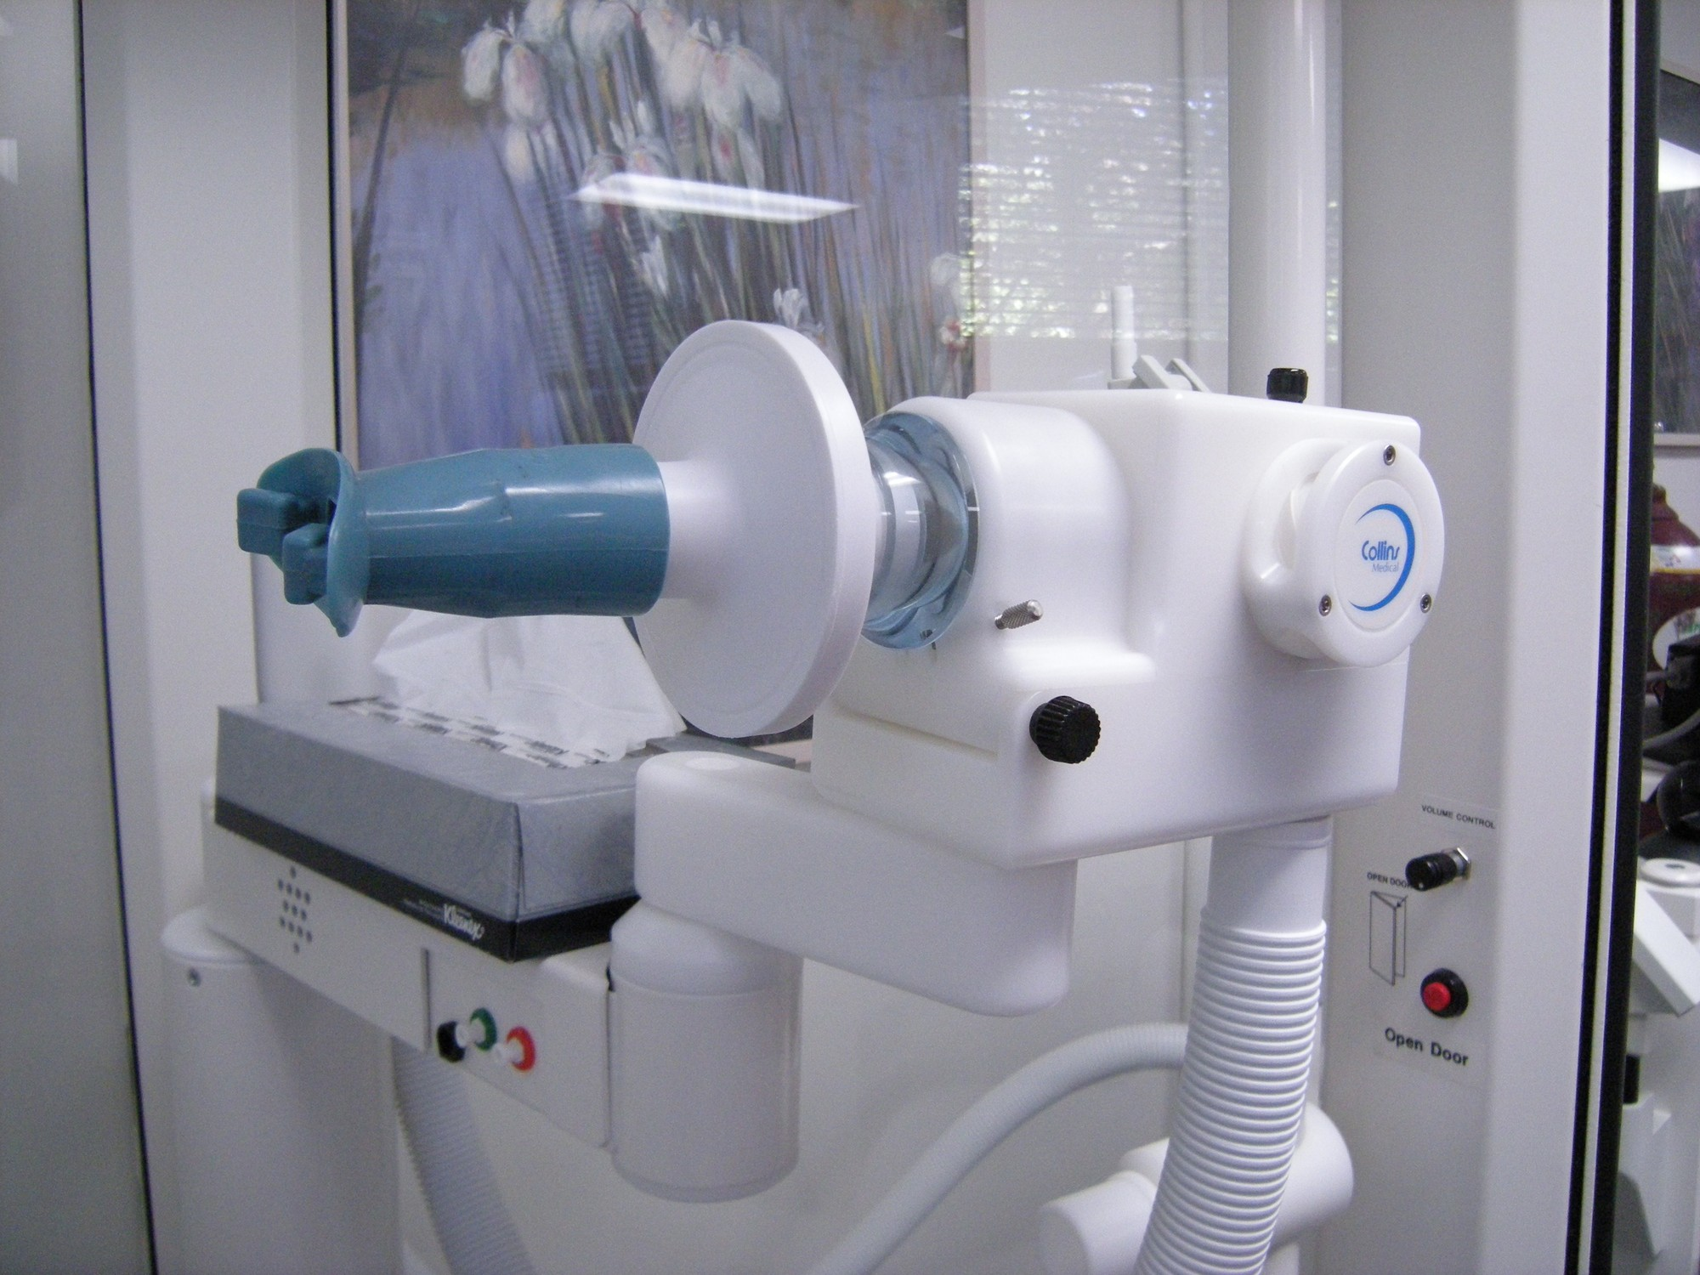
Spirometry: FVC, FEV1, and bronchodilator reversibility
WHAT TO NOTICE
The patient inhales maximally, seals their lips on the mouthpiece, blasts air out as hard and fast as possible, and keeps blowing until empty
Three core numbers: Forced Vital Capacity (FVC = total volume blown out), FEV1 (volume blown out in the 1st second), and the FEV1/FVC ratio
Reversibility (CTS asthma criterion): an FEV1 increase of ≥ 12% AND ≥ 200 mL after an inhaled bronchodilator (or controller trial) supports asthma
Patient prep (Question 12): measure height accurately; hold bronchodilators ONLY as the lab/prescriber instructs; no smoking for 1 h, no large meal for 2 h, no heavy exercise for 30 min, and wear loose clothing
Report contraindications before testing: recent eye, chest, or abdominal surgery, recent myocardial infarction, hemoptysis, or confusion (Coates et al., 2013). Diffusing capacity (DLCO) is low in emphysema and ILD.
Medical-Surgical Nursing: A Canadian Open Text
Chapter 14 · Obstructive & Restrictive Lung Disease
Notes:
Show Figure 14.1 and highlight the nurse's preparation role (Coates et al., 2013; Question 12):
- Why must height be measured accurately without shoes? Because predicted normal spirometry values depend on age, sex, and standing height.
- Why report recent cataract/eye, thoracic, or abdominal surgery or a recent MI? Because a maximal forced expiration generates high intrathoracic, intra-abdominal, and intraocular pressures. (Source: Joe Mabel/Wikimedia Commons, CC BY-SA 3.0.)

Slide 6
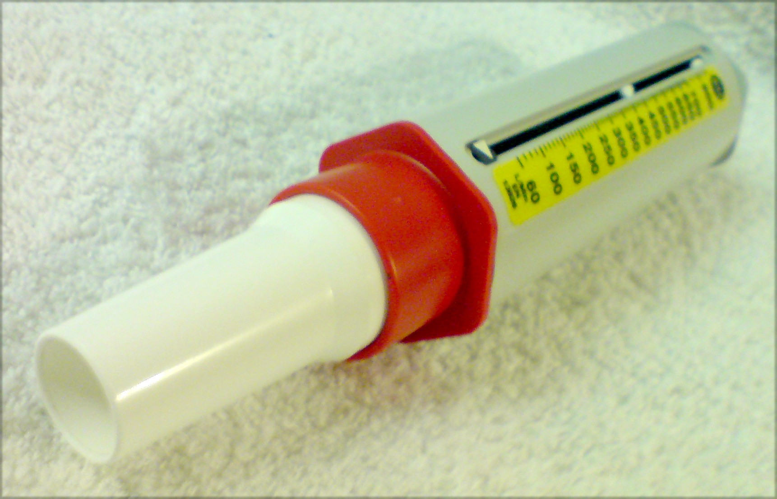
Tracking asthma with a peak flow meter
WHAT TO NOTICE
Peak expiratory flow (PEF) measures the fastest speed of air (L/min) during a single short, sharp blow into a hand-held meter
Less precise than laboratory spirometry, so it is NOT the preferred first-line test for diagnosis when spirometry is available
When spirometry is normal or unavailable, a PEF rise of ≥ 20% (and ≥ 60 L/min) after a bronchodilator or wide diurnal variability supports asthma (Yang et al., 2021)
Most useful for home self-monitoring against the patient's own personal best (always on the same meter) and for grading acute exacerbations in hospital
In an acute asthma attack, PEF 33–50% of best/predicted signals acute severe asthma, and PEF < 33% signals life-threatening asthma (BTS & SIGN, 2019) — but never delay bronchodilator rescue to get a PEF!
Medical-Surgical Nursing: A Canadian Open Text
Chapter 14 · Obstructive & Restrictive Lung Disease
Notes:
Show Figure 14.2 and connect it to Question 2: when Ms. Marisol Vega arrives in acute respiratory distress at 28 breaths/min speaking in short phrases, you give the ordered salbutamol with a spacer immediately while staying with her—you do NOT delay rescue bronchodilators to hunt for a peak flow meter or teach technique. (Source: “Peak flow meter horiz” by Tomhannen/Wikimedia Commons, public domain.)

Slide 7
PART TWO
Asthma: triggers, control, and acute exacerbations
Airway inflammation, wildfire smoke, controller therapy, and recognizing 'the quiet chest.'
Notes:
Part Two covers Section 14.2, Figure 14.3 (wildfire smoke), and the Clinical Judgment box ('The Quiet Chest' — Daniel Okafor, 24).

Slide 8

What happens in asthma — and why wildfire smoke matters
WHAT TO NOTICE
Three changes narrow the airways during a flare: smooth muscle tightening (bronchoconstriction), mucosal swelling/inflammation, and mucus plugging
Airway hyperresponsiveness causes rapid narrowing to viral infections, allergens (dust mites, pets, pollen), cold air, exercise, beta-blockers, and ASA/NSAIDs
Wildfire smoke (Question 10): invisible fine particulate matter (PM2.5) travels hundreds of kilometres and triggers severe asthma attacks even when smoke cannot be seen or smelled (Health Canada, 2026b)
Occupational asthma: the CTS estimates ~36% of adult-onset asthma is probably or possibly work-related — take a work exposure history in every adult (Yang et al., 2021)
Normal spirometry on a single good day never rules out asthma (Yang et al., 2021). When spirometry is normal, a methacholine challenge or exercise challenge can confirm airway hyperresponsiveness.
Medical-Surgical Nursing: A Canadian Open Text
Chapter 14 · Obstructive & Restrictive Lung Disease
Notes:
Show Figure 14.3 (June 2023 Quebec wildfire smoke plume) and discuss equity: outdoor workers, rural/remote residents, and people in lower-income housing without HEPA filtration face higher PM2.5 exposure during Canadian wildfire seasons (Health Canada, 2026b). Teach patients with asthma or COPD to check the Air Quality Health Index (AQHI). (Source: Marc A. Hermann/MTA, CC BY 2.0.)

Slide 9
ASTHMA CONTROL & LONG-TERM TREATMENT · SECTION 14.2
How to judge control, and why SABA-only care is unsafe
Using more than 2 SABA canisters a year signals poor control — and SABA-only treatment increases death risk.
CTS criteria for well-controlled asthma (all 5 required)
CTS 2021 & GINA 2026 therapy
Daytime symptoms ≤ 2 days/week, AND night-time symptoms < 1 night/week and mild (waking ≥ 1 night/week means poor control; Question 15)
Normal physical activity with zero days missed from work or school
Only mild, infrequent exacerbations
Reliever needed ≤ 2 times/week (excluding 1 puff before exercise) and ≤ 2 SABA canisters per year (Question 8)
FEV1 or PEF ≥ 90% of personal best, with minimal diurnal PEF variation
Every patient needs a written asthma action plan (symptom- or PEF-based) and a check of adherence and inhaler technique before any step-up
GINA 2026: never treat asthma with a SABA alone; SABA relieves bronchospasm but leaves airway inflammation untreated
Mild uncontrolled on SABA (or after any severe exacerbation): start daily ICS + PRN SABA, or PRN budesonide–formoterol (for age ≥ 12 if daily adherence is poor)
Uncontrolled on low-dose ICS: step up to ICS–LABA, or use budesonide–formoterol as Maintenance And Reliever Therapy (MART) in one inhaler
Never use a LABA alone in asthma! Add-ons include LTRA (montelukast — watch for serious mental health effects), tiotropium, or specialist biologics (anti-IgE / anti-IL-5; CTS, 2026)
Medical-Surgical Nursing: A Canadian Open Text
Chapter 14 · Obstructive & Restrictive Lung Disease
Notes:
Emphasize Questions 4, 8, and 15 on this slide:
- If a patient says 'I only use my blue salbutamol puffer and go through four canisters a year' (Question 8), their asthma is poorly controlled and they are at elevated risk of a severe or fatal exacerbation.
- Explain MART (Maintenance And Reliever Therapy): budesonide–formoterol combines an anti-inflammatory ICS with a fast-onset LABA (formoterol), so every reliever puff also treats the underlying airway inflammation.

Slide 10
HOSPITAL EXACERBATIONS & CLINICAL JUDGMENT · SECTION 14.2
Recognizing life-threatening asthma and 'the quiet chest'
A 'normal' or rising PaCO2 in a breathless asthma patient means the breathing muscles are tiring.
Acute severe vs. life-threatening asthma
Clinical Judgment: Daniel Okafor, 24
BTS/SIGN (2019) & GINA (2026) emergency criteria
'He's finally settling down' at 0200 — or is he?
Acute severe (any 1; Question 1): cannot finish sentences in one breath, RR ≥ 25/min, HR ≥ 110/min, or PEF 33–50% of best/predicted
Life-threatening (any 1; Question 11): PEF < 33%, SpO2 < 92%, a 'silent chest' (too little airflow to make a wheeze), central cyanosis, poor effort, arrhythmia/hypotension, exhaustion, or drowsiness/confusion
ABG trap [RN] (Question 16): tachypnea normally blows off CO2 (low PaCO2); a 'normal' PaCO2 (35–45 mm Hg) or rising PaCO2 signals muscle fatigue and near-fatal asthma
Treatment: sit upright, O2 to target (92–95% GINA / 94–98% BTS), repeated SABA + ipratropium, early systemic steroids, IV magnesium sulfate if refractory (watch BP/flushing), and ZERO sedatives
Recognize cues: at 0200, Daniel's loud wheeze has faded; he lies back with eyes closed, answers in single words, RR dropped 32 -> 20, SpO2 89% on O2, and air entry is faint bilaterally
Analyze cues: a quieter chest + faint air entry + drowsiness means air movement is failing from exhaustion, NOT that bronchospasm resolved
Take action: stay with Daniel, sit him upright, press call bell and trigger rapid response via SBAR, continue O2 and bronchodilators, and prepare for ABG and ICU transfer
Discharge (after recovery): step up ICS controller, check device technique, provide written action plan, and book follow-up within 2–7 days
Question 3 check: True improvement looks like speaking in full sentences with RR slowing to 20 and good air entry — never drowsiness with a fading wheeze!
Medical-Surgical Nursing: A Canadian Open Text
Chapter 14 · Obstructive & Restrictive Lung Disease
Notes:
Contrast Question 3 and Question 11 using Daniel Okafor's story ('The Quiet Chest'):
- Why do family members (and sometimes clinicians) mistake life-threatening asthma for improvement? Because the loud wheeze disappears and the respiratory rate slows from 32 to 20.
- How do you tell the difference in 5 seconds? Listen with your stethoscope and check level of consciousness: if air entry is loud and clear and the patient speaks in full sentences, they are better; if air entry is faint/absent ('silent chest') and the patient is drowsy, they are moments away from respiratory arrest.

Slide 11
PART THREE
Inhaled medications, devices, and technique
Relievers, controllers, spacers, dry powder inhalers, and why up to 70% of patients miss the lungs.
Notes:
Part Three covers Section 14.3, the Medications box, Figure 14.4 (dry powder inhalers), Table 14.2, the Patient Education box, and the Lifespan Considerations box on older adults.

Slide 12
MEDICATIONS BOX · SECTION 14.3
Relievers, controllers, and bedside safety rules
Up to 70% of patients use their inhaler incorrectly — check technique before stepping up any prescription.
SABA (salbutamol) Ventolin HFA relaxes airway smooth muscle within minutes. Expected effects: tremor, tachycardia, palpitations. Monitor serum potassium during frequent inpatient doses.
ICS (fluticasone, budesonide) Main anti-inflammatory controller in asthma (takes days to weeks). Rinse mouth with water and spit (and clean dentures) after every dose to prevent oral thrush and hoarseness (Q7).
SAMA (ipratropium) Blocks cholinergic nerve signals that tighten airway muscle; added to SABA in moderate-to-severe asthma flares and used in COPD.
Paradoxical bronchospasm If wheezing and chest tightness worsen immediately after any inhaled puff, stop the inhaler at once, assess the patient, and call for help.
LABA (formoterol) Long-acting bronchodilator; in asthma, ALWAYS combined with an ICS (e.g., budesonide–formoterol in Symbicort Turbuhaler). Never use LABA monotherapy in asthma.
Empty canister trap Some pMDIs (including Ventolin HFA) have no dose counter — shaking or floating the canister in water is unreliable! Track doses; Respimat locks when empty.
LAMA (tiotropium) Spiriva Respimat is a mainstay in COPD and an add-on in asthma. Watch for dry mouth and urinary retention; keep mist out of eyes (narrow-angle glaucoma risk!).
Casing & spacer care Rinse the plastic pMDI actuator weekly with warm water (never submerge the metal canister), and clean valved holding chambers per manufacturer instructions.
Question 7 check: Rinsing with water and spitting after an inhaled corticosteroid prevents oral candidiasis (thrush) and dysphonia (hoarse voice).
Medical-Surgical Nursing: A Canadian Open Text
Chapter 14 · Obstructive & Restrictive Lung Disease
Notes:
Review the Medications box across these eight items. Highlight two high-yield safety points:
1. Anticholinergics (ipratropium, tiotropium) can precipitate acute angle-closure glaucoma if sprayed into the eyes (report eye pain, blurred vision, or visual halos immediately) and can cause urinary retention in older adults with prostatic hypertrophy.
2. Always teach patients to rinse and spit after any ICS-containing inhaler (Question 7).

Slide 13
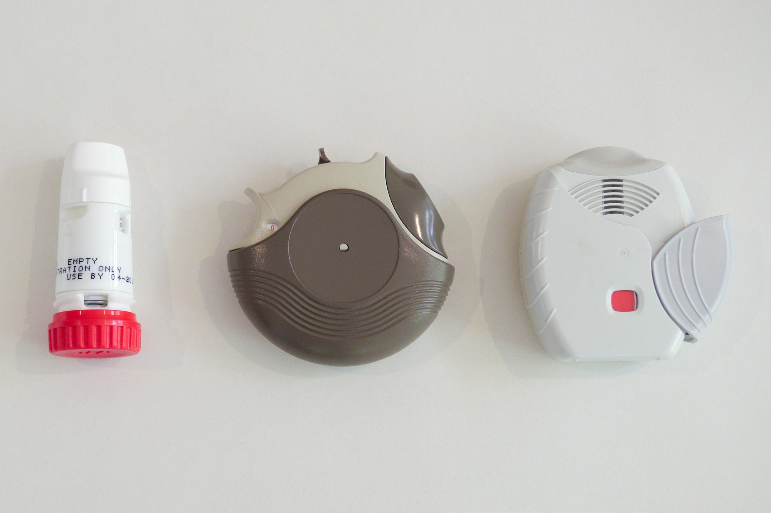
Matching the breath to the device: DPI versus pMDI
WHAT TO NOTICE
Dry powder inhalers (DPIs — Turbuhaler, Diskus/Accuhaler, Ellipta shown here) have NO propellant: the patient's own FAST, deep, forceful breath pulls the powder in (Question 14)
Never breathe out into a DPI mouthpiece (moisture clumps the powder), and warn patients they may not taste or feel the tiny powder dose
Pressurized metered-dose inhalers (pMDIs) need the opposite breath: shake, exhale away, start a SLOW, deep breath, press once, and hold the breath (Question 6)
Valved holding chamber (spacer; Question 9): holds the pMDI aerosol so precise hand–breath coordination is not needed and cuts oropharyngeal deposition — recommended by CTS for all ages
Climate & device choice (Gupta et al., 2023): DPIs and soft mist inhalers have ~1/10th the greenhouse-gas footprint of pMDI propellants — but never switch a well-controlled pMDI user without shared decision-making.
Medical-Surgical Nursing: A Canadian Open Text
Chapter 14 · Obstructive & Restrictive Lung Disease
Notes:
Show Figure 14.4 (Turbuhaler, Diskus, Ellipta) and drill the #1 contrast tested on nursing exams (Questions 6, 9, and 14):
- pMDI (with or without spacer) + Soft Mist (Respimat) = SLOW, deep breath over 3–5 seconds.
- Dry Powder Inhaler (DPI) = FAST, deep, forceful breath from the very start.
Ask students what happens when Mr. Leblanc in the Practice Story shakes his DPI, breathes out into the mouthpiece, and inhales slowly: he blows the loaded powder out into the room and fails to disaggregate the rest! (Source: Brett Montgomery/Wikimedia Commons, CC BY-SA 4.0.)

Slide 14
DEVICE TECHNIQUE & LIFESPAN · TABLE 14.2
Four device rules and choosing for older adults
An 82-year-old recovering from an acute exacerbation needs a pMDI with a spacer — not a dry powder inhaler.
Key steps and common errors by device (Table 14.2)
Older adults (Lifespan Box & Q17)
pMDI alone: shake -> exhale away -> seal lips -> start slow deep breath and press once -> hold breath -> wait ~30 s between puffs (prime if new or unused)
pMDI + valved holding chamber (spacer): shake -> attach -> exhale -> seal lips on spacer -> spray ONE puff into chamber -> inhale slowly and deeply -> hold breath -> repeat one puff at a time
Dry powder inhaler (DPI): load dose per device -> exhale away from mouthpiece -> seal lips -> breathe in FAST and hard -> hold breath -> close device
Soft mist inhaler (Respimat): turn clear base until it clicks -> open cap -> exhale -> seal lips without covering side air vents -> press button while inhaling slowly -> hold ~10 s
Observed teach-back: ask the patient to show you with their own home device, correct errors with demonstration, and recheck up to 2–3 times (GINA, 2026)
Inspiratory flow (Question 17): during recovery from an exacerbation or in frail older age, inspiratory effort may be too weak to activate a DPI — choose a pMDI with a valved holding chamber!
Arthritis & weak grip: pressing a canister, twisting a Turbuhaler, or turning a Respimat base can be difficult; involve the pharmacist for device selection or aids
Cognition & coordination: multi-step loading or hand–breath timing leads to missed doses; spacers and caregiver teach-back help
Vision, cost & disposal: use large-print instructions, check drug coverage (provincial plans / NIHB) so patients don't ration controllers, and return used inhalers to a pharmacy
Medical-Surgical Nursing: A Canadian Open Text
Chapter 14 · Obstructive & Restrictive Lung Disease
Notes:
Use the right-hand card to teach Question 17: an 82-year-old woman being discharged after a severe asthma exacerbation is weak and short of breath. Why is a pMDI with a valved holding chamber the best choice right now? Because she only needs to take a slow breath through the chamber valve, with zero hand–lung timing and no need for high peak inspiratory flow.

Slide 15
PART FOUR
Chronic obstructive pulmonary disease (COPD)
Emphysema, chronic bronchitis, the CTS 2023 treatment ladder, and acute exacerbations.
Notes:
Part Four covers Section 14.4, Figure 14.5 (centrilobular emphysema), the Canadian Context box, Table 14.3, the Going Deeper box on chronic CO2 retention, and the Practice Story ('Second Time This Month').

Slide 16
CANADIAN CONTEXT · SECTION 14.4
The hospital and community footprint of COPD
COPD exacerbations lead all chronic conditions as a cause of acute hospital stays among Canadian adults.
76,968
2.0 million
~81%
≤ 3 weeks
hospitalizations for COPD and bronchitis in Canada in 2023–2024 (#2 overall after childbirth; 7.1-day mean stay)
Canadians aged ≥ 35 living with diagnosed COPD in national surveillance
of people whose spirometry shows COPD globally have never received a diagnosis (GOLD, 2025)
recommended window after hospital discharge to start pulmonary rehabilitation and reduce readmissions
CIHI (2025); PHAC (2018); Bourbeau et al. (2023); GOLD (2025); Rochester et al. (2023); Bird et al. (2017). Tele-rehabilitation helps bridge rural access gaps.
Medical-Surgical Nursing: A Canadian Open Text
Chapter 14 · Obstructive & Restrictive Lung Disease
Notes:
Walk through these four numbers from Section 14.4 and the Canadian Context box:
- Notice that COPD and bronchitis (76,968 stays) rank even higher than pneumonia (66,128 stays from Ch. 13) as the #2 reason for hospitalization in Canada!
- Highlight the 3-week pulmonary rehabilitation window (Question 26; Rochester et al., 2023): starting supervised exercise and self-management rehab within 3 weeks of discharge after an exacerbation significantly reduces hospital readmissions, and virtual/tele-rehab is endorsed for rural and remote patients.

Slide 17
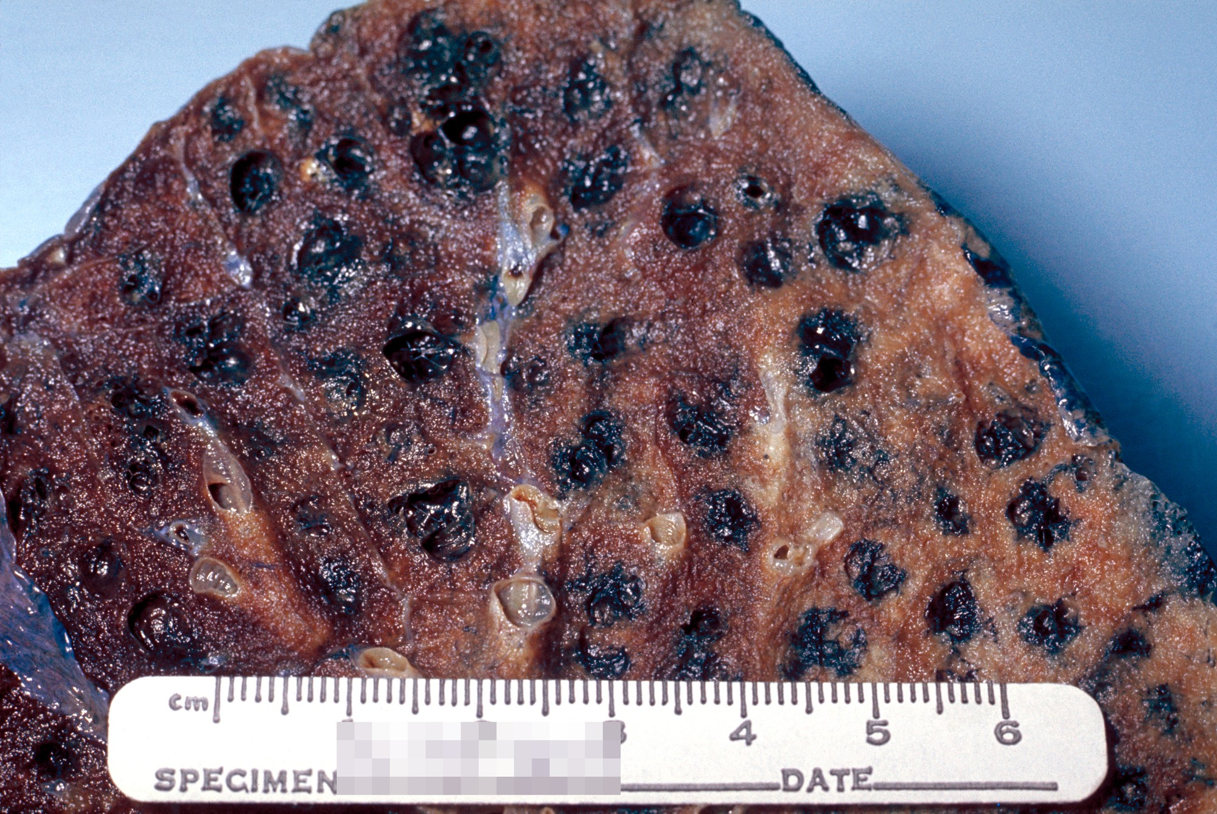
Chronic bronchitis, emphysema, and air trapping
WHAT TO NOTICE
Two processes combine in COPD: (1) Chronic bronchitis — inflamed, thickened airways with goblet cell hyperplasia and daily productive cough; (2) Emphysema — destroyed alveolar walls (shown here with black carbon deposits)
Alveolar destruction shrinks the capillary surface for gas exchange (low DLCO) and destroys elastic recoil — the spring that holds small airways open during exhalation
Without elastic tether support, small airways collapse early on exhalation, trapping air behind them (air trapping)
During exertion or a flare, faster breathing leaves less time to exhale -> progressive hyperinflation flattens the diaphragm and puts breathing muscles at a severe mechanical disadvantage
Besides tobacco smoke, ask about occupational dusts/fumes, biomass fuel smoke, outdoor/wildfire pollution, childhood disadvantage, and genetic alpha-1 antitrypsin deficiency (GOLD, 2025).
Medical-Surgical Nursing: A Canadian Open Text
Chapter 14 · Obstructive & Restrictive Lung Disease
Notes:
Show Figure 14.5 (centrilobular emphysema specimen) and explain why COPD patients feel they 'cannot get a breath IN' when their actual problem is getting air OUT: because dynamic hyperinflation leaves their lungs already nearly full at the end of exhalation, flattening the diaphragm so it can barely contract downward for the next breath. (Source: CDC/Edwin P. Ewing, Jr., public domain.)

Slide 18
DIAGNOSIS & LONG-TERM CARE · CTS 2023 GUIDELINE
Confirming COPD and matching therapy to symptoms and risk
Every symptomatic patient with spirometry-confirmed COPD needs maintenance long-acting bronchodilator therapy.
Diagnosis, mMRC & CAT
CTS 2023 Inhaled Ladder
Core Non-Drug & Home O2
Confirm diagnosis with post-bronchodilator FEV1/FVC < 0.70 (Bourbeau et al., 2023)
Grade symptom burden with mMRC (≥ 2 = moderate–severe) or COPD Assessment Test (CAT ≥ 10 = moderate–high impact)
High exacerbation risk = ≥ 2 moderate flares (antibiotics/prednisone) OR ≥ 1 severe flare (ED visit/hospitalization) in past year
Record baseline mMRC, SpO2, activity, and sputum colour/volume when stable
All patients receive a short-acting bronchodilator PRN
Mild symptoms + low risk + mildly reduced FEV1: single LAMA or LABA
Moderate–high symptoms (CAT ≥ 10 / mMRC ≥ 2) + low risk: LAMA/LABA dual therapy
High exacerbation risk + moderate–high symptoms (Question 35): LAMA/LABA/ICS triple therapy (lowers mortality vs. dual therapy!)
Avoid ICS monotherapy, oral theophylline, or maintenance prednisone; warn ICS users to report pneumonia signs
Smoking cessation counselling + pharmacotherapy at every visit (Sec. 14.5)
Vaccines: annual flu & COVID-19, Pneu-C-20/21, and RSV (Ch. 13)
Pulmonary rehabilitation (within 3 weeks after a hospitalized flare; Question 26) and written COPD action plan
Ontario long-term home O2 criteria (stable, optimized): resting room-air PaO2 ≤ 55 mm Hg or SaO2 ≤ 88% (CRTO, 2022) + early palliative approach
Medical-Surgical Nursing: A Canadian Open Text
Chapter 14 · Obstructive & Restrictive Lung Disease
Notes:
Test RN students on Question 35 using the middle pillar:
- Which patient is the best candidate for LAMA/LABA/ICS triple therapy under the 2023 CTS guideline? A patient with a CAT score of 18, FEV1 55% predicted, and 1 hospitalization for an exacerbation in the past year (because ≥ 1 hospitalization places them in the high exacerbation risk group, where triple therapy reduces mortality!).
- Contrast Asthma (where ICS is the foundation and LABA is never used alone) with COPD (where LAMA and LABA bronchodilators are the foundation and ICS is never used alone).

Slide 19
HOSPITAL EXACERBATIONS & GOING DEEPER [RN] · SECTION 14.4
Managing acute COPD flares and reading chronic CO2 blood gases
Titrate oxygen to 88–92% — and recognize acute-on-chronic respiratory acidosis when pH drops.
Acute COPD exacerbation care (GOLD & Table 14.3)
Going Deeper [RN]: Chronic CO2 retention
Worsening dyspnea, sputum volume, or purulence over ≤ 14 days
How kidney bicarbonate compensation reveals the timeline
Target SpO2 88–92% (Questions 21, 25): never withhold O2 from a hypoxemic patient, and if SpO2 is too high (e.g., 97% with drowsiness in Q20/Q22), titrate DOWN to 88–92% and call for help — never shut O2 completely off!
First-line bronchodilators: inhaled SABA with or without SAMA via spacer or nebulizer
Systemic corticosteroids for ≤ 5 days (check blood glucose!), plus a 5-day antibiotic course if sputum is purulent (yellow-green; Q19, Q21)
Position upright leaning forward, coach pursed-lip breathing, pace care, give VTE prophylaxis, and prepare for NIV (Ch. 15) if acidemic
In chronic CO2 retention, the kidneys retain ~4 mmol/L of HCO3− per 10 mm Hg rise in PaCO2 (vs. ~1 mmol/L in acute retention), keeping pH near normal (Farley & Licari, 2019)
Compensated chronic baseline example: pH 7.35, PaCO2 60 mm Hg, HCO3− 32 mmol/L (both PaCO2 and HCO3− high, pH normal)
Acute-on-chronic respiratory acidosis (Question 33): pH 7.25, PaCO2 82 mm Hg, HCO3− 35 mmol/L — high HCO3− proves chronic retention, while the low pH proves a dangerous new acute CO2 surge!
Recheck ABGs 30–60 minutes after oxygen changes or if drowsiness develops (O'Driscoll et al., 2017)
Question 33 check: pH 7.25, PaCO2 82 mm Hg, HCO3− 35 mmol/L is acute-on-chronic respiratory acidosis requiring immediate escalation and possible NIV.
Medical-Surgical Nursing: A Canadian Open Text
Chapter 14 · Obstructive & Restrictive Lung Disease
Notes:
Walk through Case Study 2 (Mrs. Agnes Kowalczyk, 76, Questions 18–23) and Question 33 here:
- When Mrs. Kowalczyk is placed on 4 L/min nasal cannula and becomes hard to rouse with an SpO2 of 97% (Q20, Q22), why does she have hypercapnic narcosis? Because over-oxygenation above 88–92% worsened V/Q matching and raised her PaCO2. Your first action is to turn the oxygen DOWN within the order to reach 88–92%, assess her, and call for urgent help (anticipating an ABG and possible NIV)—never yank the cannula off completely (rebound hypoxemia!).

Slide 20
PRACTICE STORY · SECTION 14.6
Second time this month (RN Ngozi Eze, RPN Daniel & Mr. Leblanc)
Why asking 'Do you know how to use your puffer?' is never a substitute for watching the patient do it.
1
2
3
1. Watch the inhaler in action
2. Treat withdrawal without blame
3. Book rehab within 3 weeks
Mr. Leblanc returns to the medical unit just 19 days after a COPD discharge with SpO2 86% (titrated to 88–92% under directive). When RN Ngozi Eze asks him to demonstrate his dry powder inhaler, he shakes it, breathes OUT into the mouthpiece, and inhales slowly and gently. On his last stay, staff had only asked if he knew how to use it — no one had watched him demonstrate it.
That evening Mr. Leblanc is restless and irritable and admits he has been smoking 10 cigarettes a day. Using stigma-free language, Ngozi asks how he is managing cravings. Under the hospital's Ottawa Model directive, she starts a nicotine patch, the physician adds nicotine gum for breakthrough cravings (Question 27), and Mr. Leblanc enrolls in post-discharge follow-up calls.
Before discharge, RPN Daniel coaches Mr. Leblanc and his daughter through the written action plan and watches two return demonstrations of his DPI. Ngozi ensures the pulmonary rehabilitation referral is sent and books his intake for the following week (within the 3-week post-discharge window). Six weeks later, after 8 rehab classes, he is walking to the corner store again.
Medical-Surgical Nursing: A Canadian Open Text
Chapter 14 · Obstructive & Restrictive Lung Disease
Notes:
Use Mr. Leblanc's story to tie together Sections 14.3, 14.4, and 14.5:
1. Always observe a return demonstration with the patient's own home inhaler before discharge.
2. Treat inpatient nicotine withdrawal proactively with NRT under unit directives rather than letting restlessness derail care.
3. Ensure pulmonary rehabilitation starts within 3 weeks of discharge.

Slide 21
PART FIVE
Smoking and vaping cessation
The Ottawa Model, cessation pharmacotherapy, and respecting sacred traditional tobacco.
Notes:
Part Five covers Section 14.5, Figure 14.6 (nicotine patch), and Table 14.4 on Canadian cessation medications.

Slide 22
HOSPITAL CESSATION & CULTURAL SAFETY · SECTION 14.5
The Ottawa Model and keeping sacred tobacco distinct
Hospital-initiated cessation cut 30-day readmissions nearly in half across 14 Ontario hospitals.
Tobacco, vaping, and the Ottawa Model
Traditional vs. commercial tobacco
In 2022, 10.9% of Canadians ≥ 15 (~3.5M people) smoked cigarettes; 30-day vaping reached 13.6% in youth (15–19) and 19.7% in young adults (20–24) (Health Canada, 2023)
Canadian Task Force suggests against e-cigarettes for cessation except in specific circumstances due to lacking long-term safety data (Thombs et al., 2025)
Ottawa Model for Smoking Cessation (Mullen et al., 2017): reduced 30-day hospital readmissions from 13.3% to 7.1% and lowered 1- and 2-year mortality!
Three bedside steps (Question 24): (1) Ask & document all tobacco/vaping on admission; (2) Advise kindly without blame ('a person who smokes,' never 'a smoker'); (3) Offer NRT/medication now + discharge follow-up
For many First Nations, traditional tobacco is a sacred medicine burned in ceremony (smudging, pipe ceremonies), placed as an offering, and given to Elders and Knowledge Keepers (FNHA, n.d.)
Commercial tobacco (cigarettes, chew, snuff with chemical additives) causes addiction, COPD, heart disease, and cancer
Question 32: Cessation support addresses commercial tobacco, NEVER sacred ceremonial practices — ask rather than assume, and support inpatient smudging via the Indigenous health team
Connect Indigenous patients with Talk Tobacco (1-833-998-8255), a free, culturally tailored service for First Nations, Inuit, Métis, and urban Indigenous people
Medical-Surgical Nursing: A Canadian Open Text
Chapter 14 · Obstructive & Restrictive Lung Disease
Notes:
Highlight Questions 24 and 32 on this slide:
- Question 24: Use person-first, non-stigmatizing language ('a person who smokes'), normalize past relapses as learning steps toward quitting, treat acute nicotine withdrawal with NRT, and arrange discharge follow-up.
- Question 32: When a First Nations patient says 'I use tobacco in ceremony; I don't want to give that up,' clarify warmly that cessation support is about commercial cigarettes, never sacred ceremonial tobacco.

Slide 23
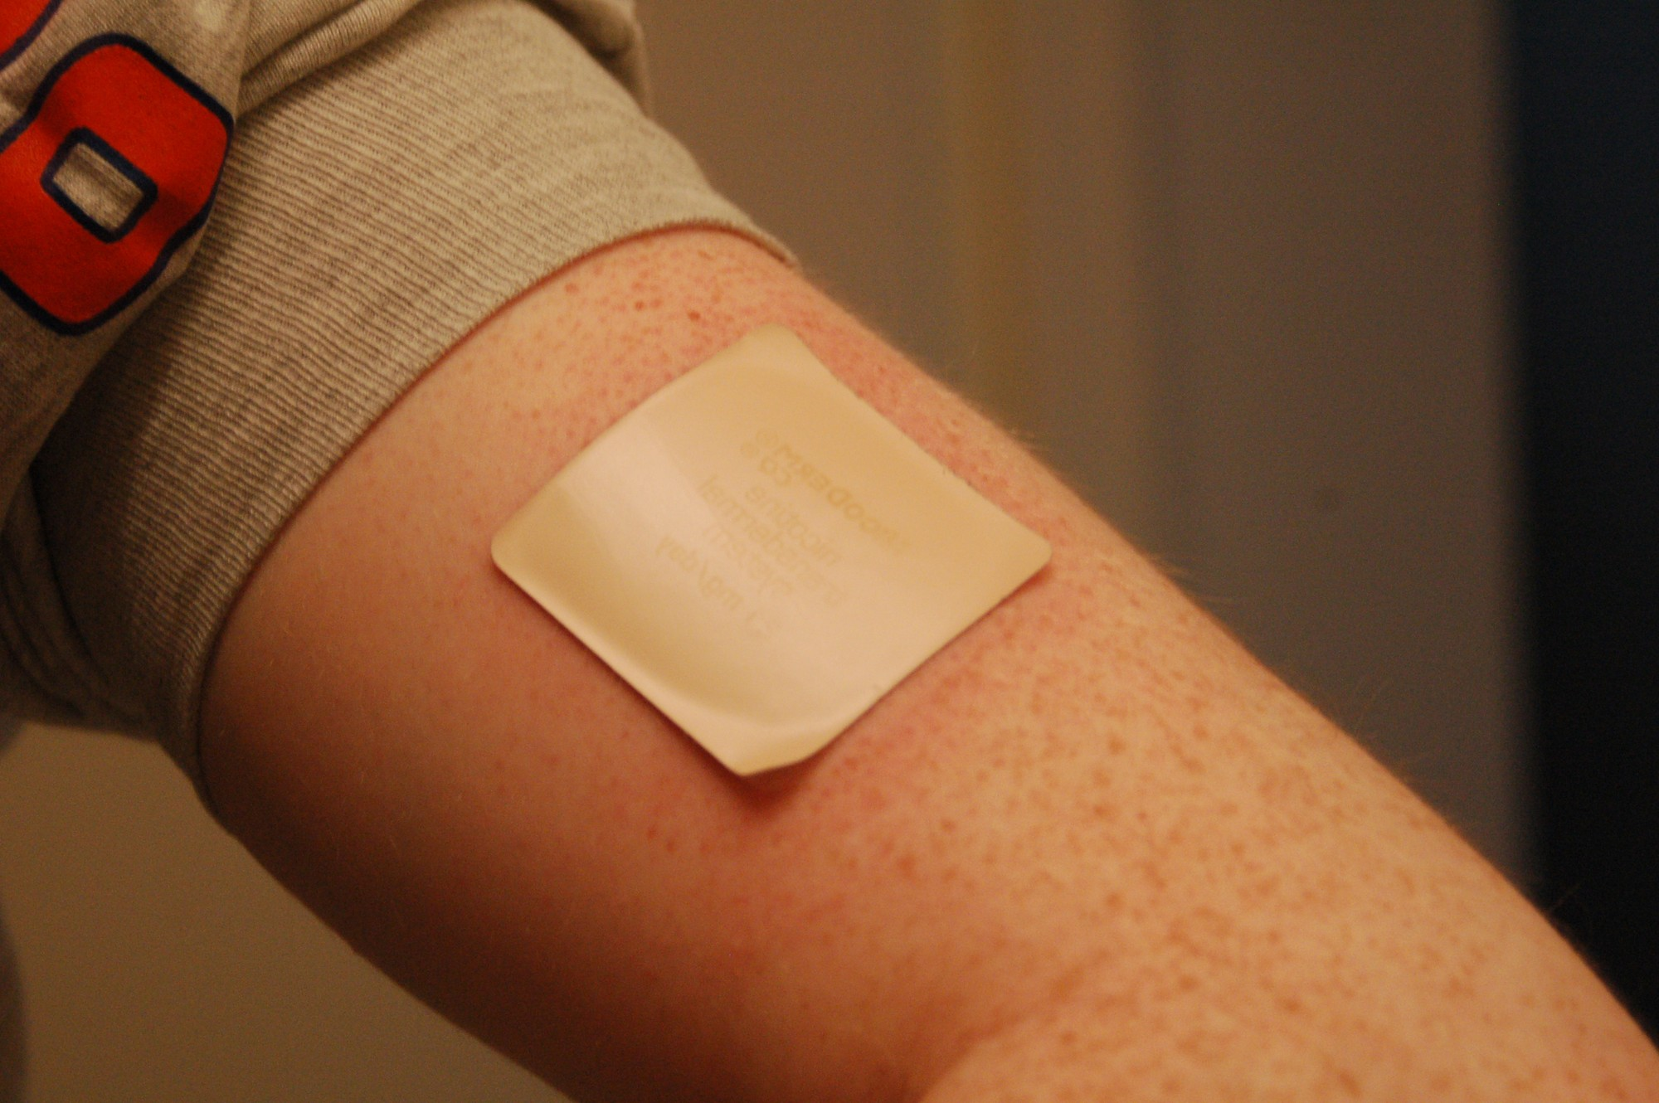
Four recommended cessation medications in Canada
WHAT TO NOTICE
1. Nicotine replacement therapy (NRT): long-acting patch gives steady baseline nicotine; pair with a short-acting form (gum, lozenge) for breakthrough cravings (AHS, 2025; Question 27)
2. Varenicline: partial nicotine receptor agonist; start 1–2 weeks before quit date (or flexible quit); nausea is most common; watch for neuropsychiatric symptoms and reduce dose in severe CKD
3. Bupropion (Zyban): non-nicotine tablet started while still smoking; CONTRAINDICATED with any seizure history (Question 34), bulimia/anorexia nervosa, MAOIs, other bupropion (Wellbutrin), or abrupt alcohol/sedative withdrawal
4. Cytisine: licensed natural health product strongly recommended by the Canadian Task Force (Thombs et al., 2025), though it lacks public drug coverage
Combining cessation medication with behavioural counselling works better than either alone (Thombs et al., 2025). Always check for seizure history before bupropion is ordered!
Medical-Surgical Nursing: A Canadian Open Text
Chapter 14 · Obstructive & Restrictive Lung Disease
Notes:
Show Figure 14.6 (nicotine patch) and review Table 14.4 (Questions 27 and 34):
- Question 27: If an inpatient wearing a nicotine patch still has strong cravings every couple of hours, do not remove the patch and do not tell them to vape—check the directive or ask the prescriber to add a short-acting NRT form (gum or lozenge) on top of the patch!
- Question 34: Always screen for a history of seizures or eating disorders (bulimia/anorexia) before starting bupropion (Zyban), and make sure the patient isn't already taking bupropion (Wellbutrin) for depression. (Source: RegBarc/Wikimedia Commons, CC BY 2.5.)

Slide 24
PART SIX
Bronchiectasis, interstitial lung disease, and sleep apnea
Daily airway clearance, antifibrotic therapy in IPF, STOP-Bang screening, and CPAP safety with opioids.
Notes:
Part Six covers Section 14.6, Figure 14.7 (home CPAP machine), the Clinical Safety box on OSA and opioids/sedation, and the Scope in Practice box.

Slide 25
CHRONIC AIRWAY VS. INTERSTITIAL DISEASE · SECTION 14.6
Bronchiectasis and idiopathic pulmonary fibrosis (IPF)
Bronchiectasis traps mucus in widened bronchi; IPF scars the alveolar interstitium into a stiff lung.
Bronchiectasis (ERS 2025 Guideline)
Interstitial lung disease & IPF
Permanent bronchial widening on CT + chronic daily sputum
Restrictive scarring, 'Velcro' crackles & antifibrotic drugs
Vicious cycle (Question 31): damaged, widened airways clear mucus poorly -> mucus pools -> bacterial colonization (e.g., P. aeruginosa) -> inflammation -> more airway damage
ERS 2025 (Chalmers et al., 2025): daily airway clearance techniques for most patients (even when feeling well!) + pulmonary rehabilitation for reduced exercise capacity
High exacerbation risk: long-term macrolides, or long-term inhaled antibiotics if colonized with P. aeruginosa (routine ICS is NOT recommended)
Compare sputum with the patient's own daily baseline; TSANZ includes bronchiectasis in the 88–92% acute SpO2 target group
Inflammation/scarring of the alveolar–capillary interstitium (some linked to systemic sclerosis; IPF has unknown cause); causes exertional dyspnea, dry cough, clubbing, and fine basal 'Velcro' crackles
Antifibrotics slow lung function decline (do NOT reverse scarring), require liver enzyme checks, and are taken with food
Nintedanib (Ofev): for IPF and progressive fibrosing ILDs; diarrhea is very common, raises bleeding risk, teratogenic (avoid in pregnancy)
Pirfenidone (Question 29): for IPF; causes nausea and photosensitivity rash — avoid sun, use high-SPF sunscreen, and stop smoking (smoking lowers drug levels!)
In ILD/IPF, SpO2 often drops sharply during walking even when normal at rest — check SpO2 during ambulation, titrate O2, and integrate early palliative care.
Medical-Surgical Nursing: A Canadian Open Text
Chapter 14 · Obstructive & Restrictive Lung Disease
Notes:
Highlight Questions 29 and 31 on this slide:
- Question 31 (Bronchiectasis): Why do airway clearance exercises every day even when feeling well? Because damaged, permanently widened bronchi cannot clear mucus normally; daily clearance breaks the cycle of mucus pooling, infection, and further airway destruction.
- Question 29 (Pirfenidone in IPF): Take with food, use high-protection sunscreen and avoid sunlight (photosensitivity), monitor liver tests, stop smoking (smoking induces metabolism and lowers pirfenidone levels), and set realistic expectations (slows decline; does not reverse fibrosis).

Slide 26
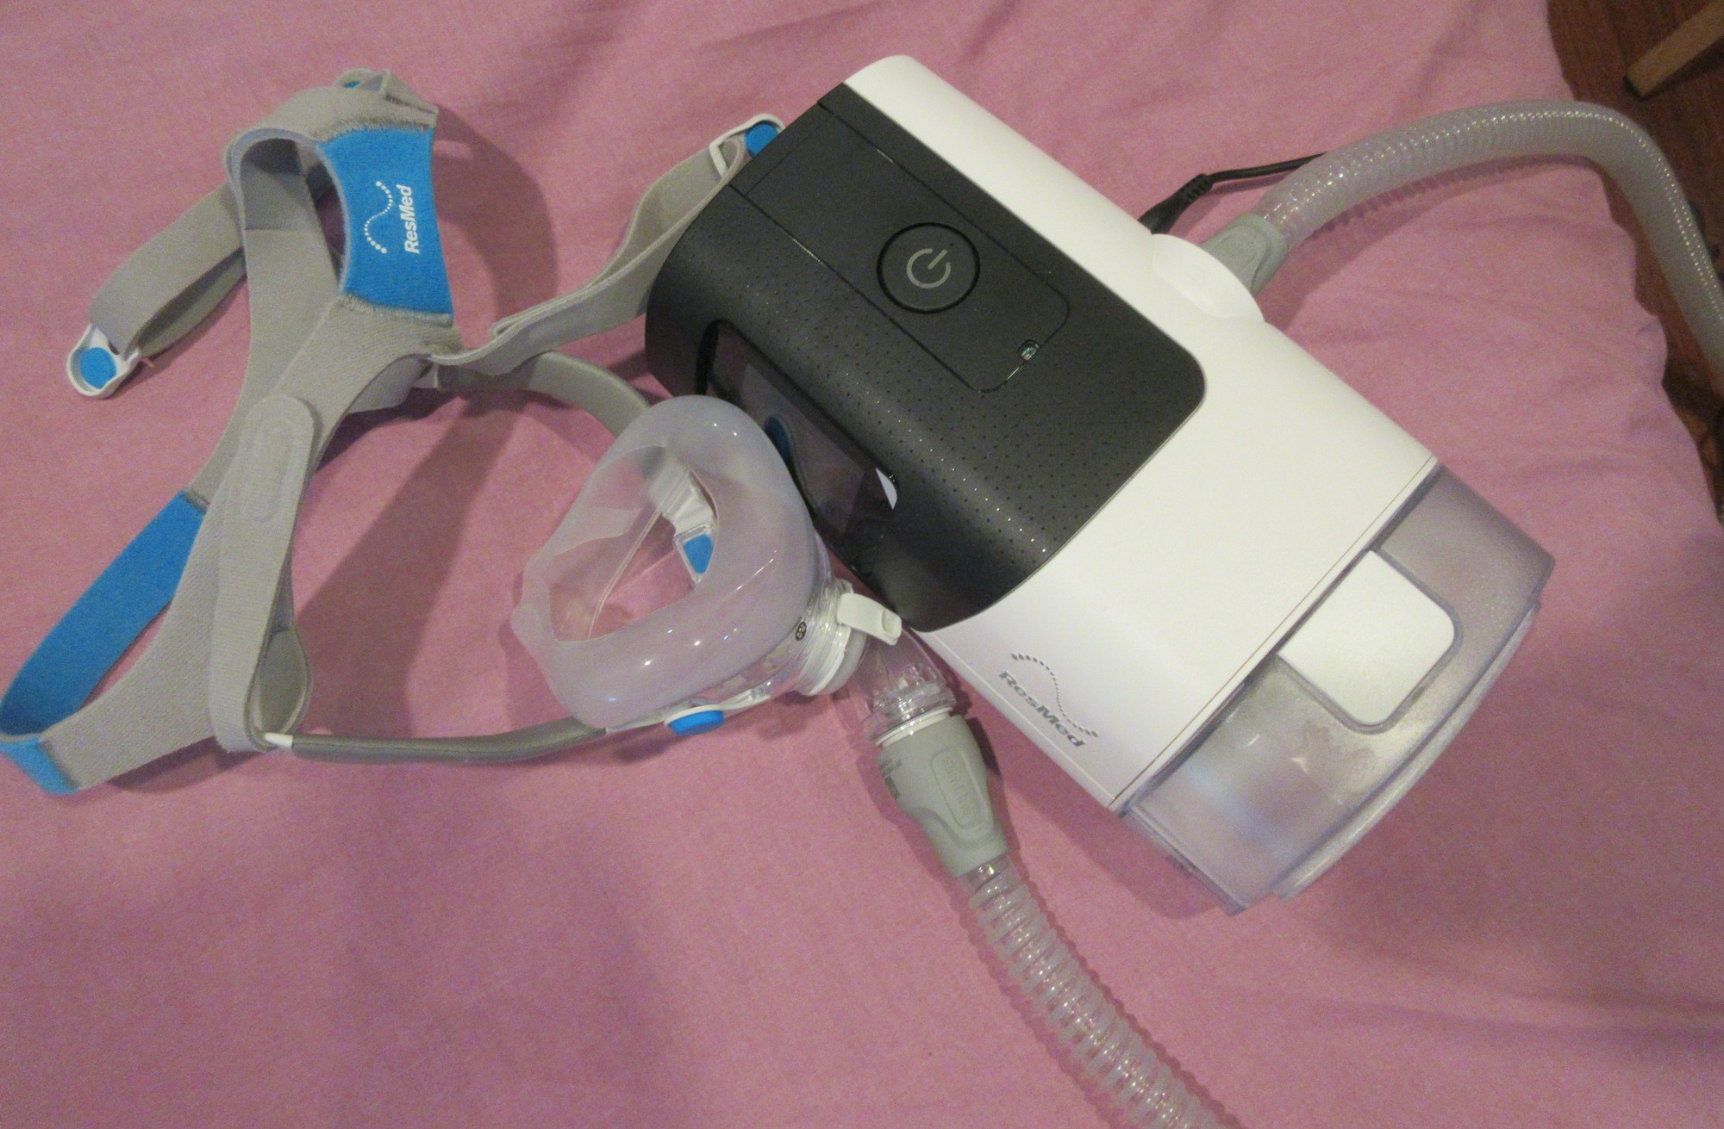
Obstructive sleep apnea, STOP-Bang, and opioid safety
WHAT TO NOTICE
In OSA (~24% of middle-aged men, ~9% of middle-aged women; Ayas et al., 2014), the upper airway collapses repeatedly during sleep, causing micro-arousals, daytime sleepiness, and crash risk
STOP-Bang screen (1 pt each; Chung et al., 2016): Snoring, Tiredness, Observed apnea, high BP, BMI > 35 kg/m², Age > 50, Neck > 40 cm, Male sex (0–2 low, 3–4 moderate, 5–8 high risk); sleep study confirms diagnosis
CPAP blows pressurized air through a mask to splint the pharynx open — patients bring their home CPAP to hospital and wear it whenever they sleep, including naps (Question 28)
Clinical Safety Box (Question 28): opioids, propofol, and benzodiazepines worsen upper-airway collapse and blunt CO2/O2 drive — check sedation scale and RR before and at peak of every opioid dose!
Never rely on SpO2 alone in a patient with OSA on supplemental oxygen — watch for snoring followed by silent apneic pauses, use capnography as ordered, and hold opioids if drowsy.
Medical-Surgical Nursing: A Canadian Open Text
Chapter 14 · Obstructive & Restrictive Lung Disease
Notes:
Show Figure 14.7 (home CPAP machine and mask) and emphasize Question 28 and the Clinical Safety box:
- When a patient with OSA is admitted for hip replacement and receives postoperative opioids, never pack their CPAP away in the closet! Have the RT/nurse check the machine per policy, apply CPAP whenever the patient sleeps (night or daytime naps), and monitor sedation and respiratory rate around every opioid dose. (Source: Infrogmation/Wikimedia Commons, CC BY-SA 4.0.)

Slide 27
SCOPE IN PRACTICE & CASE SYNTHESIS · QUESTIONS 1–4 & 18–23
CNO authority for inhalation and two unfolding cases
Administering a substance by inhalation is a controlled act — and every nurse escalates deterioration at once.
CNO Scope in Practice
Case 1: Ms. Marisol Vega, 41 (Asthma)
Case 2: Mrs. Agnes Kowalczyk, 76 (COPD)
Authority (CNO, 2025): administering a substance by inhalation (inhalers, nebulizers, oxygen) is a controlled act in Ontario
RNs and RPNs perform it with an order or medical directive (nurses cannot initiate controlled acts in public hospitals)
RTs hold independent authority to start, titrate, and stop oxygen without an order (CRTO, 2024)
Competence & Context (Q11, Q30): follow IPAC for aerosol-generating nebulizers; when a patient's O2 need rises or drowsiness appears, the RPN acts at once, escalates, and consults the RN
Admitted after a viral cold; used salbutamol daily and stopped ICS due to cost; RR 28, HR 112, short phrases, neck muscles, SpO2 92%
Q1: RR 28 (≥ 25), HR 112 (≥ 110), and incomplete sentences = acute severe asthma
Q2: Give ordered salbutamol via spacer + O2 immediately while staying with her (don't delay for PEF or teaching)
Q3–Q4: Speaking full sentences with RR 20 shows response; at discharge on budesonide–formoterol, rinse/spit, review action plan, involve pharmacist for drug coverage, and never go back to SABA-only!
3 days of worse dyspnea + thick yellow-green sputum; smokes 10/day; tripod posture, RR 30, HR 108, T 37.9 °C, SpO2 85% on room air
Q18–19: Immediate threats are SpO2 85%, RR 30, and neck muscle use; purulent sputum + dyspnea = infective COPD exacerbation
Q20–22: On 4 L/min O2, SpO2 hits 97% and she becomes drowsy/mumbling -> CO2 narcosis! Lower O2 within order to 88–92%, assess, and call for urgent help (expect ABG, SABA/SAMA, ≤ 5 d steroid + antibiotic)
Q23: Discharge success = observed inhaler demo, action plan, rehab referral, and cessation support
Medical-Surgical Nursing: A Canadian Open Text
Chapter 14 · Obstructive & Restrictive Lung Disease
Notes:
Review the Scope in Practice box alongside both unfolding cases (Ms. Marisol Vega and Mrs. Agnes Kowalczyk) so students see how RPNs, RNs, and RTs collaborate on medical units.

Slide 28
Check your understanding
How do the FEV1/FVC ratio and FVC differ between COPD (obstructive) and idiopathic pulmonary fibrosis (restrictive) — and what FEV1 change after a bronchodilator confirms reversibility in asthma?
At 0200, a 24-year-old admitted for acute asthma has a fading wheeze, RR dropping from 32 to 20, SpO2 89% on oxygen, drowsiness, and a PaCO2 of 42 mm Hg. Why is this a life-threatening emergency rather than recovery?
How does the breathing technique for a dry powder inhaler (Turbuhaler, Diskus, Ellipta) differ from a pMDI with a spacer — and which device fits a weak 82-year-old being discharged after an exacerbation?
Mrs. Kowalczyk (COPD, target SpO2 88–92%) is placed on 4 L/min nasal cannula; 2 hours later her SpO2 is 97%, she is hard to rouse, and her ABG shows pH 7.25, PaCO2 82 mm Hg, HCO3− 35 mmol/L. What is happening, and what do you do first?
An inpatient wearing a nicotine patch reports strong breakthrough cravings every 2 hours, while another patient with a seizure history asks for bupropion (Zyban), and a First Nations patient asks about ceremonial tobacco. How do you respond to each?
Why must a patient with bronchiectasis perform daily airway clearance even when feeling well, what sun/smoking teaching belongs with pirfenidone in IPF, and how do you manage CPAP and opioids after surgery in a patient with OSA?
Medical-Surgical Nursing: A Canadian Open Text — Chapter 14 (Sections 14.1–14.6) | opensourcenursing.ca (CC BY-NC-SA 4.0)
Notes:
Use these six clinical synthesis prompts for final review:
1. Spirometry (Q5, Q13): Obstruction reduces FEV1/FVC (< LLN or < 0.70 in COPD); restriction reduces FVC and TLC while keeping FEV1/FVC normal or high. Asthma reversibility = FEV1 increase ≥ 12% and ≥ 200 mL.
2. Quiet chest & normal PaCO2 (Q3, Q11, Q16): Drowsiness + faint air entry + 'normal' PaCO2 (42 mm Hg after hours of tachypnea) signals respiratory muscle exhaustion and impending arrest. Stay with the patient, sit upright, call the rapid response/ICU team, and never give sedatives.
3. Inhaler physics (Q6, Q9, Q14, Q17): DPI = fast, deep, forceful breath (never exhale into device); pMDI + spacer = slow, deep breath with no timing hurdle (best for a weak 82-year-old post-exacerbation).
4. COPD over-oxygenation & ABG (Q33, Q20, Q22): High HCO3− (35) + low pH (7.25) + PaCO2 82 = acute-on-chronic respiratory acidosis triggered by over-oxygenation (SpO2 97%). Titrate O2 DOWN to 88–92% (never remove completely!) and escalate immediately for ABG/NIV.
5. Cessation & cultural safety (Q27, Q32, Q34): Add short-acting NRT (gum/lozenge) to the patch per directive/order; report seizure history as a contraindication to bupropion; affirm that cessation targets commercial cigarettes while respecting sacred ceremonial tobacco (and offer Talk Tobacco).
6. Bronchiectasis, IPF & OSA (Q28, Q29, Q31): Daily airway clearance breaks the mucus–infection–damage cycle in bronchiectasis; pirfenidone requires sun avoidance/sunscreen, taking with food, and stopping smoking; OSA patients use their CPAP during all sleep/naps and require close sedation/respiratory monitoring around opioids.

