Slide 1
UNIT IV · CARDIOVASCULAR & VASCULAR NURSING CARE · CHAPTER 19
Hypertension and Vascular Disorders
2025 Hypertension Canada guidelines, hypertensive emergencies and acute aortic dissection, peripheral arterial disease and acute limb ischemia, abdominal aortic aneurysm, VTE, chronic venous insufficiency, and high-alert anticoagulation.
Medical-Surgical Nursing: A Canadian Open Text
Aligned with CNO Entry-to-Practice Competencies (RN & RPN), Hypertension Canada (2025), CCS PAD (2022), ACC/AHA Aortic (2022), ASH/CHEST VTE, and ISMP Canada
opensourcenursing.ca (CC BY-NC-SA 4.0)
Notes:
Welcome to Chapter 19: Hypertension and Vascular Disorders. High blood pressure is one of the most common chronic conditions in adults—usually silent, yet progressively damaging the arteries, heart, brain, kidneys, and eyes. In 2025, Hypertension Canada updated its primary care definition of hypertension to a single universal threshold of >= 130/80 mm Hg across all validated measurement methods (Goupil et al., 2025). This chapter also serves as the textbook's primary reference for peripheral arterial disease (PAD), acute limb ischemia, abdominal aortic aneurysm (AAA), venous thromboembolism (VTE), chronic venous insufficiency (CVI), and high-alert anticoagulant therapy (UFH, LMWH, fondaparinux, warfarin, and DOACs).

Slide 2
CHAPTER 19 · LEARNING OUTCOMES & CNO COMPETENCIES
Learning outcomes across hypertension & vascular care
Mapped to College of Nurses of Ontario (CNO) Entry-to-Practice Competencies for Registered Nurse (RN, 2019a) and Registered Practical Nurse (RPN, 2019b) practice.
Hypertension & Emergencies
Arterial, Aortic & Venous Care
Anticoagulation & CNO Scope
1. Measure blood pressure accurately in clinic, hospital, and home settings, and classify it using Hypertension Canada's 2025 thresholds.
2. Explain the causes and risk factors of hypertension using Canadian data, naming structural causes.
3. Support treatment of hypertension (lifestyle, drug classes, single-pill combinations, adherence, and older adult safety).
4. Recognize a hypertensive emergency and an acute aortic syndrome, and escalate immediately.
CNO mapping: Clinician, Scholar, Educator & Advocate (RN 2019a); Foundations & Collaborative Practice (RPN 2019b).
5. Assess and care for patients with peripheral arterial disease (PAD) and acute limb ischemia across a range of skin tones.
Understand CTFPHC abdominal aortic aneurysm (AAA) screening, rupture recognition, and post-EVAR/open repair monitoring.
6. Recognize, prevent, and help manage venous thromboembolism (DVT/PE) and chronic venous insufficiency (CVI).
CNO mapping: Clinician & Scholar (RN 2019a); Foundations of Practice (RPN 2019b).
7. Give and monitor anticoagulants safely (UFH, LMWH, fondaparinux, warfarin, and direct oral anticoagulants [DOACs]), including bleeding recognition and reversal.
Apply Going Deeper [RN] principles for titrated IV antihypertensives, arterial lines, HIT (4Ts score), and anti-Xa monitoring.
8. Distinguish RN and RPN roles in vascular care and anticoagulation using CNO's authority, competence, and context.
CNO mapping: Clinician, Educator, Advocate, Professional & Coordinator (RN 2019a); Foundations, Legal & Collaborative Practice (RPN 2019b).
Medical-Surgical Nursing: A Canadian Open Text
Chapter 19 · Hypertension & Vascular Disorders
Notes:
Review the eight chapter learning outcomes and the Learning Outcomes table's CNO Entry-to-Practice Competency mapping:
- Outcomes 1, 2, 4, 5, 6 map to RN Clinician & Scholar roles (CNO, 2019a) and RPN Foundations of Practice (CNO, 2019b).
- Outcomes 3, 7 map to RN Clinician, Educator & Advocate roles and RPN Foundations of Practice & Collaborative Practice.
- Outcome 8 maps to RN Professional & Coordinator roles and RPN Legal Practice & Collaborative Practice.

Slide 3
CANADIAN SURVEILLANCE & EQUITY DATA
Hypertension thresholds, sodium sources, and amputation disparities
Hypertension Canada's 2025 guideline adopts 130/80 mm Hg for all methods, while structural inequities drive PAD amputation gaps.
130/80
51%
> 70%
3–5x Higher
2025 Hypertension Canada universal threshold (mm Hg) defining hypertension across office, home, and ambulatory methods
Share of Canadian adults aged 60–79 with stage 2 HTN (>= 140/90 or on meds) in CHMS — 29% across all ages were unaware
Proportion of dietary sodium in a typical Western diet that comes from processed and restaurant foods rather than the salt shaker
Lower-extremity amputation rate in Ontario First Nations adults with diabetes vs. other Ontarians (> 6x higher at age <= 44)
Sources: Goupil et al. (2025, Hypertension Canada); Statistics Canada (2021, CHMS 2016–2019); Shah et al. (2019, Chiefs of Ontario study).
Medical-Surgical Nursing: A Canadian Open Text
Chapter 19 · Hypertension & Vascular Disorders
Notes:
Highlight the four epidemiological anchors from Sections 19.1 and 19.4:
1. 130/80 mm Hg: Hypertension Canada's 2025 primary care guideline replaces older method-specific cut-offs (135/85 home/AOBP, 140/90 office) with a single threshold of >= 130/80 mm Hg across all validated methods (Goupil et al., 2025).
2. CHMS 2016–2019 (Statistics Canada, 2021): 23% of adults aged 20–79 (and 51% aged 60–79) met the older 140/90 definition; nearly 3 in 10 were unaware, and among those with 130–139/80–89 mm Hg, nearly three-quarters were unaware.
3. > 70% processed sodium: Explains why food environments, northern food prices, and income shape BP as strongly as personal choice.
4. 3–5x higher amputation rate (Shah et al., 2019; de Mestral et al., 2020): Designed with the Chiefs of Ontario (OCAP®), showing First Nations adults with diabetes had 3–5x higher amputation rates (> 6x at age <= 44) and > 4-fold regional variation tied to rurality, income, and vascular specialist access.

Slide 4
PART ONE · SECTIONS 19.1 & 19.2
Hypertension Regulation, 2025 Thresholds & Treatment
Physiological BP control, Table 19.1 universal 130/80 mm Hg threshold, manual and home measurement, lifestyle targets, single-pill combinations, and inpatient safety.
Notes:
Part One covers Sections 19.1 and 19.2: How cardiac output and systemic vascular resistance regulate blood pressure, how to measure blood pressure accurately by AOBP, manual, HBPM, and ABPM methods, how to spot white-coat and masked hypertension, and how to implement Hypertension Canada's 2025 lifestyle and single-pill combination drug recommendations.

Slide 5
SECTION 19.1 · BP REGULATION & TABLE 19.1 THRESHOLDS
How blood pressure is regulated and defined in Canada (2025)
Blood pressure equals Cardiac Output x Systemic Vascular Resistance (SVR); sustained hypertension thickens and stiffens arterioles.
Three Regulatory Systems
Table 19.1: 2025 Thresholds
White-Coat vs. Masked HTN
1. Sympathetic Nervous System (SNS): Carotid and aortic baroreceptors sense stretch; falling BP triggers rapid HR/contractility rise and arteriolar vasoconstriction (pain, anxiety, or a full bladder acutely raise BP).
2. Renin–Angiotensin–Aldosterone System (RAAS): Low renal perfusion releases renin -> angiotensin II constricts arterioles + stimulates adrenal aldosterone -> Na+ and water retention.
3. Kidneys & Sodium Balance: Long-term BP set-point depends on renal sodium and water excretion.
Universal threshold: >= 130/80 mm Hg defines hypertension across ALL validated methods (Goupil et al., 2025; Question 10).
Automated Office BP (AOBP — preferred): 1–5 min seated rest, then 3 automated readings 1 min apart averaged.
Standardized Manual (Auscultatory): Preferred when persistent arrhythmias (e.g., AF) make automated oscillometric devices inaccurate.
Out-of-Office Confirmation: Home BP (HBPM: 2 readings AM & PM x 7 days) or 24-h Ambulatory BP (ABPM q20–30 min).
Confirm elevated office BP with out-of-office readings (HBPM or ABPM) before diagnosing hypertension.
White-Coat Hypertension (9–30% prevalence; Question 13): Office BP >= 130/80 (e.g., 148/92) with normal home/ABPM readings (e.g., 122/76); avoids overtreatment.
Masked Hypertension (~20% of untreated adults): Normal office BP (e.g., 124/78) with elevated home/ABPM readings (e.g., 142/88).
Masked HTN risk factors: High-normal office BP, diabetes, obesity, smoking, or heavy alcohol use.
Medical-Surgical Nursing: A Canadian Open Text
Chapter 19 · Hypertension & Vascular Disorders
Notes:
Review Section 19.1 and Table 19.1 (Goupil et al., 2025; Rabi et al., 2020):
- Stress the major 2025 shift (Question 10): Older 2020 guidelines used 135/85 mm Hg for AOBP/home and 140/90 mm Hg for manual office readings. The 2025 Hypertension Canada guideline uses **130/80 mm Hg or higher** for every validated method (AOBP, manual office, HBPM, and ABPM).
- Drill Question 13: Office 148/92 mm Hg with home average 122/76 mm Hg = White-coat hypertension; Office 124/78 mm Hg with home average 142/88 mm Hg = Masked hypertension.

Slide 6
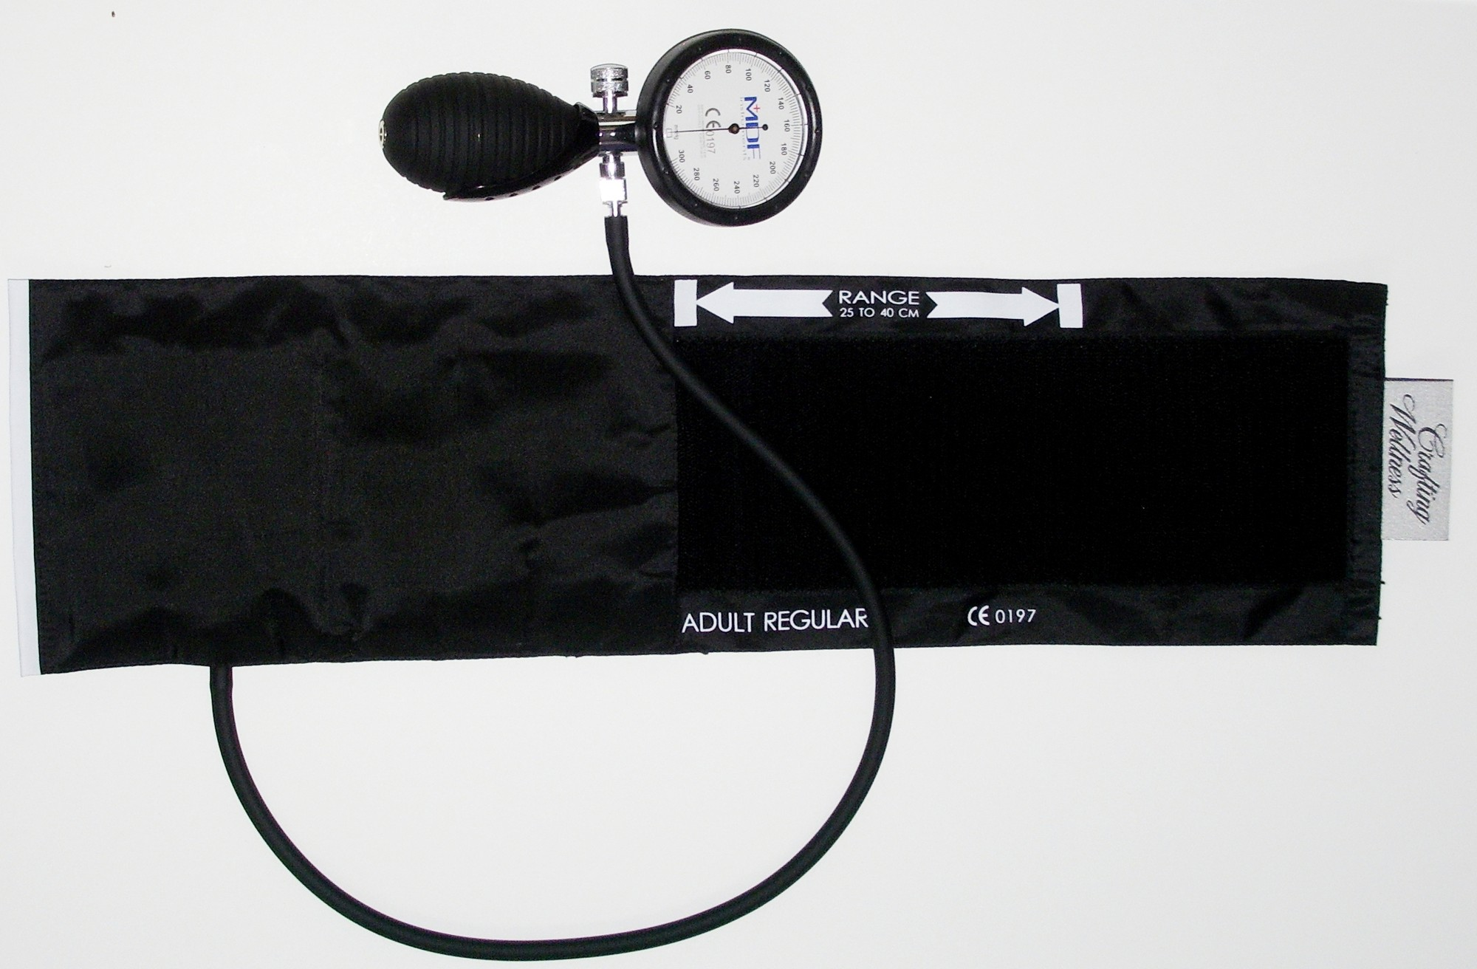
Figure 19.1 · Manual Blood Pressure Technique
WHAT TO NOTICE
Aneroid sphygmomanometer components (Fig 19.1):
Calibrated dial gauge, inflation bulb with release valve, and adult cuff showing index line and 'RANGE 25 TO 40 CM' fit markers.
Patient preparation & positioning:
Avoid caffeine, tobacco, and exercise for 30 min; empty bladder; sit quietly for 5 min with back supported, feet flat, legs uncrossed, and bare arm supported at heart level (no talking).
Avoiding the auscultatory gap:
Palpate the radial pulse, inflate until it disappears, then inflate 30 mm Hg higher before auscultating over the brachial artery — prevents missing a silent auscultatory gap.
Deflation & bilateral baseline:
Deflate slowly at ~2 mm Hg per heartbeat (1st Korotkoff sound = SBP; disappearance = DBP). Wait >= 1 min before repeating; check both arms initially and use the higher-reading arm.
Clinical Indication: Manual auscultatory measurement is preferred over automated oscillometric cuffs whenever a patient has a persistent or frequent arrhythmia (Goupil et al., 2025).
Medical-Surgical Nursing: A Canadian Open Text
Chapter 19 · Hypertension & Vascular Disorders
Notes:
Examine Figure 19.1 (aneroid sphygmomanometer with range markers) and review the standardized BC/Hypertension Canada manual measurement protocol:
- Explain what an auscultatory gap is: a temporary disappearance of Korotkoff sounds during the latter part of phase I that can cause a nurse who does not palpate the radial obliteration pressure first to underestimate systolic blood pressure by 20–40 mm Hg.

Slide 7
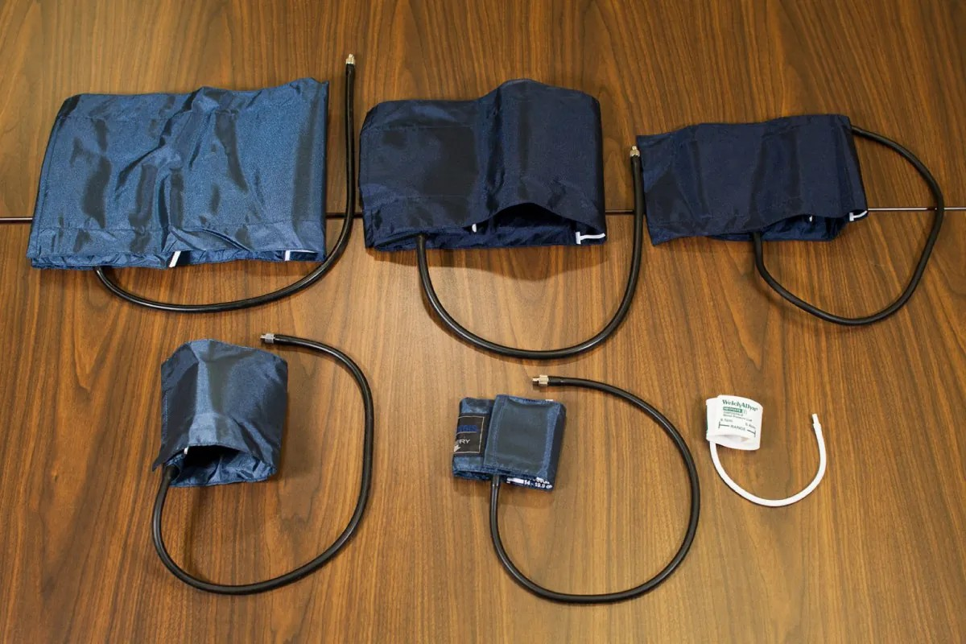
Figure 19.2 · Cuff Sizing, Errors & Home BP Protocol
WHAT TO NOTICE
Exact cuff bladder sizing rule (Fig 19.2; Question 7):
Measure mid-upper arm circumference: bladder width must be ~40% of arm circumference and length 80–100% (e.g., a 40 cm arm requires a 16 cm wide x 32–40 cm long bladder).
How positioning & technique errors skew BP (Question 8):
Arm hanging below heart level gives FALSELY HIGH systolic and diastolic readings. Unsupported back, crossed legs, cuff over clothing, or talking also distort readings.
Deflation speed & venous congestion errors:
Deflating > 2 mm Hg/beat misses true SBP/DBP; leaving a cuff partially inflated too long congests forearm veins and muffles Korotkoff sounds.
Home BP Monitoring (HBPM) protocol (Question 9):
Use a Hypertension Canada–validated upper-arm cuff; after 5 min seated rest, take 2 readings 1 minute apart each morning and evening for 7 days and bring the log to clinic.
Exam Calculation (Question 7): For a 40 cm mid-upper arm circumference, 40% x 40 cm = 16 cm cuff bladder width (a 10 cm regular cuff is too narrow and overestimates BP).
Medical-Surgical Nursing: A Canadian Open Text
Chapter 19 · Hypertension & Vascular Disorders
Notes:
Examine Figure 19.2 (six blood pressure cuff sizes from neonatal to thigh cuff) and the Patient Education box on Home BP Monitoring:
- Make sure students can calculate the 40% bladder width rule on exams (Question 7: 40 cm arm x 0.40 = 16 cm bladder width) and know that an arm hanging below heart level adds hydrostatic pressure, overestimating both systolic and diastolic BP (Question 8).
- Review the HBPM 7-day schedule (Question 9): 2 readings, 1 minute apart, morning and evening for 1 week before clinic visits or after medication changes.

Slide 8
SECTION 19.1 · ETIOLOGIES & CANADIAN EQUITY CONTEXT
Primary vs. secondary hypertension and structural determinants
Screen patients with resistant hypertension for secondary causes — especially primary aldosteronism (Goupil et al., 2025).
Primary vs. Identifiable Secondary Causes
Canadian Context: Nunavik & OCAP®
Primary (essential) hypertension (~90%+): Develops gradually from interacting genetic, ageing, and environmental/lifestyle factors. In CHMS data, diabetes was the strongest predictor, and CKD was a key risk factor for women (Statistics Canada, 2019).
Medical secondary causes: Chronic kidney disease (Ch 27), renovascular disease (renal artery stenosis), primary aldosteronism (adrenal aldosterone excess), and obstructive sleep apnea (Ch 12).
Medications & substances that raise BP (Rabi et al., 2020): NSAIDs (ibuprofen, naproxen), corticosteroids, sympathomimetic decongestants (pseudoephedrine), stimulants (amphetamines, cocaine), calcineurin inhibitors (cyclosporine, tacrolimus), erythropoietin, and black licorice.
When to refer to a specialist (Goupil et al., 2025): Resistant hypertension, unexplained sudden BP worsening, spontaneous hypokalemia, or an incidental adrenal nodule (check aldosterone-to-renin ratio before starting spironolactone).
High-unawareness gap (CHMS): Nearly 75% of Canadians with readings of 130–139/80–89 mm Hg did not know their BP was elevated (Statistics Canada, 2021).
Nunavik Inuit Health Survey (n = 1,177; Allaire et al., 2024): 23% had hypertension (29% of men, 18% of women), and only 34% of those with hypertension were taking medication.
Structural & colonial determinants: Remote geography, travel for primary care, unstable housing, racism, and high cost of fresh low-sodium food in northern communities.
Data sovereignty: Apply First Nations OCAP® principles and distinctions-based Indigenous health data.
Medical-Surgical Nursing: A Canadian Open Text
Chapter 19 · Hypertension & Vascular Disorders
Notes:
Review Primary vs. Secondary Hypertension and the Canadian Context box (Goupil et al., 2025; Rabi et al., 2020; Allaire et al., 2024):
- Emphasize medication reconciliation: always ask patients with elevated BP about OTC NSAIDs, nasal decongestants, stimulants, and herbal products/licorice.
- Note that Hypertension Canada 2025 specifically highlights screening resistant hypertension for primary aldosteronism (aldosterone and renin levels) ideally before starting spironolactone.

Slide 9
SECTION 19.2 · 2025 LIFESTYLE & PHARMACOTHERAPY THRESHOLDS
Evidence-based lifestyle targets and when to start antihypertensives
Lifestyle modification is recommended for every adult with hypertension; drug therapy starts at >= 140/90 or >= 130/80 in high-risk groups.
2025 Lifestyle Targets (WHO & HTN Canada)
When to Start Drugs & Treatment Targets
Practical, patient-centred coaching one or two changes at a time
2025 Hypertension Canada primary care algorithm (Goupil et al., 2025)
Dietary sodium < 2 g/day (Question 12):
Over 70% comes from processed/restaurant foods — teach Nutrition Facts label reading and swapping convenience items rather than just hiding the salt shaker.
Dietary potassium > 3.5 g/day from food:
Vegetables, fruit, beans, and lentils; check eGFR, K+, and meds (ACEi, ARB, MRA) first before encouraging high-K+ foods or KCl salt substitutes!
Activity, weight, alcohol & tobacco:
150–300 min/week moderate aerobic exercise; weight loss (GLP-1 RAs also lower BP); cut back alcohol (especially if >= 3 drinks/day); smoking cessation.
Start drugs for ALL adults at >= 140/90 mm Hg:
Immediate pharmacotherapy alongside lifestyle changes.
Start drugs at SBP 130–139 mm Hg if HIGH RISK:
1. Established CVD; 2. Diabetes mellitus; 3. CKD (eGFR < 60 or ACR >= 3 mg/mmol); 4. 10-year Framingham risk >= 20%; OR 5. Age >= 75 years. (Low-risk 130–139: lifestyle + recheck in 3–6 mo).
Universal treatment target — SBP < 130 mm Hg:
Aim for systolic BP < 130 mm Hg if well tolerated (no specific diastolic target). Individualize to lowest safe SBP in frailty, high fall risk, or orthostatic hypotension.
Lifespan Nuance: Age >= 75 yr qualifies as high CV risk (consider drugs at SBP >= 130), but frailty, polypharmacy, and orthostatic falls always guide the individualized target.
Medical-Surgical Nursing: A Canadian Open Text
Chapter 19 · Hypertension & Vascular Disorders
Notes:
Walk through the 2025 Hypertension Canada treatment thresholds and targets (Goupil et al., 2025):
- Clarify the difference between the **diagnostic threshold** (>= 130/80 mm Hg for everyone) and the **pharmacotherapy initiation threshold**:
* BP >= 140/90 mm Hg -> start drugs in all adults.
* SBP 130–139 mm Hg -> start drugs if high CV risk (CVD, diabetes, CKD, Framingham >= 20%, or age >= 75 yr); otherwise lifestyle for 3–6 months.
* Treatment target -> **SBP < 130 mm Hg** if well tolerated (no diastolic target).

Slide 10
SECTION 19.2 · FIRST-LINE DRUGS & INPATIENT NURSING CARE
Single-pill combinations, resistant hypertension, and ward safety
Initial therapy usually combines low doses of two first-line classes in a single-pill combination (Goupil et al., 2025).
3 First-Line Drug Classes
Stepwise Combination Algorithm
Inpatient Ward Nursing Safety
1. ACE Inhibitor (ramipril, perindopril) OR ARB (irbesartan, candesartan, telmisartan): Block RAAS; check K+ & Cr; watch for dry cough (ACEi) or emergency angioedema. NEVER combine ACEi + ARB! Avoid in pregnancy.
2. Thiazide / Thiazide-like Diuretic (HCTZ, chlorthalidone, indapamide): Monitor Na+, K+, and dehydration.
3. Long-Acting Dihydropyridine CCB (amlodipine): Relaxes arterial smooth muscle; watch for dose-dependent ankle edema, flushing, and headache.
Step 1 (Initial Single-Pill Combination): Start 2 of the 3 first-line classes in one tablet (2025 guideline names irbesartan + HCTZ as preferred initial SPC for cost/coverage/supply; monotherapy if hypotensive risk).
Step 2 (Triple therapy): Combine all 3 classes (ACEi/ARB + thiazide + DHP CCB) if SBP stays >= 130 mm Hg.
Step 3 (Resistant HTN — 4th drug): Add spironolactone (recheck K+ in 2–4 weeks; counsel on gynecomastia) after verifying adherence, cuff accuracy, interfering drugs, and screening for primary aldosteronism.
Beta-blockers: Used only when another indication exists (HF, angina, post-MI, AF).
Pre-dose checks & hold parameters (Question 14): Check BP/HR; if SBP is 92 mm Hg with light-headedness (order: hold if SBP < 100), HOLD dose, institute fall precautions, report, and document.
Orthostatic hypotension (Question 11): Measure lying, then standing within 3 min — sustained drop >= 20 mm Hg SBP (e.g., 142/84 -> 120/80) or >= 10 mm Hg DBP.
Acute pain/stress elevation (Question 15): In a post-op knee patient with BP 176/98, 8/10 pain, and no organ damage cues, treat the pain first and recheck BP after rest.
Medical-Surgical Nursing: A Canadian Open Text
Chapter 19 · Hypertension & Vascular Disorders
Notes:
Review the Medications box and Inpatient Care rules (Goupil et al., 2025; Freeman et al., 2011):
- Drill Questions 11, 14, and 15:
* Question 11: Lying BP 142/84 -> Standing BP 120/80 at 3 minutes is a 22 mm Hg systolic drop, meeting the consensus definition of orthostatic hypotension (>= 20 mm Hg systolic or >= 10 mm Hg diastolic within 3 minutes).
* Question 14: Never split a tablet or give amlodipine when SBP is below the ordered hold parameter (92 mm Hg < 100 mm Hg) and the patient is light-headed.
* Question 15: Postoperative BP 176/98 mm Hg with 8/10 pain and zero neurological/cardiac symptoms is a sympathetic pain response—treat the pain as ordered and recheck after rest rather than requesting IV antihypertensives.

Slide 11
PART TWO · SECTION 19.3
Hypertensive Emergencies & Acute Aortic Syndromes
Distinguishing hypertensive urgency from emergency, controlled MAP reduction targets, recognizing tearing aortic dissection, and arterial line management.
Notes:
Part Two covers Section 19.3: How to differentiate severe asymptomatic hypertension (urgency) from life-threatening target-organ damage (hypertensive emergency), why mean arterial pressure (MAP) is lowered gradually by 20–25% in most emergencies, and why acute aortic dissection requires immediate rapid heart-rate and blood-pressure reduction (and never anticoagulants!).

Slide 12
SECTION 19.3 · TABLE 19.2: URGENCY VS. EMERGENCY
Target-organ injury—not the BP number alone—defines an emergency
Assess anyone with BP >= 180/110 mm Hg for acute injury to the brain, eyes, heart, kidneys, or aorta (McEvoy et al., 2024).
Hypertensive Urgency (No Organ Injury)
Hypertensive Emergency (Acute Organ Injury)
Severe BP elevation without acute target-organ damage
Encephalopathy, stroke, ACS, pulmonary edema, AKI, or dissection
Clinical presentation:
BP often >= 180/110 mm Hg with no acute organ injury (may have mild headache or no symptoms at all); often triggered by missed home meds, pain, anxiety, or sympathomimetics.
Treatment & setting:
Managed in clinic, ED, or ward with oral antihypertensives (restart or adjust home regimen) and gradual BP reduction over days.
Observation & follow-up:
Observe for at least 2 hours after an oral dose before discharge and arrange close outpatient follow-up (van den Born et al., 2019).
Red-flag organ injury cues (Questions 1–3):
Severe headache, blurred vision/retinal hemorrhage, new confusion/disorientation, seizures, focal weakness, chest pain, dyspnea/crackles, oliguria, or rising creatinine (e.g., 94->171 umol/L).
Controlled IV lowering in ICU (Questions 4 & 6):
Admit to monitored setting for titrated IV infusion (labetalol, esmolol, hydralazine, nitroprusside). Lower MAP by ~20–25% over several hours — dropping BP to normal too fast causes cerebral/renal/coronary ischemia!
Going Deeper [RN] MAP calculation (Question 18):
MAP = (SBP + 2 x DBP) / 3. For BP 220/130, MAP = (220 + 260) / 3 = 160 mm Hg; a max 25% drop in 1 h equals a minimum MAP of 120 mm Hg.
Exception to Gradual Lowering: In acute aortic dissection, heart rate (60–80 bpm) and systolic BP (< 120 mm Hg) are lowered RAPIDLY to prevent aortic rupture.
Medical-Surgical Nursing: A Canadian Open Text
Chapter 19 · Hypertension & Vascular Disorders
Notes:
Compare Hypertensive Urgency and Hypertensive Emergency (Table 19.2; van den Born et al., 2019; McEvoy et al., 2024):
- Walk through the math in Practice Question 25 [RN]:
* Baseline BP = `220/130 mm Hg`.
* `MAP = (220 + 2 * 130) / 3 = 480 / 3 = 160 mm Hg`.
* Lowering MAP by no more than 25% in the first hour: `160 * 0.75 = 120 mm Hg` (lowest acceptable MAP at 1 hour).
- Contrast safe vs. unsafe response in Question 6: Dropping from 224/132 to 178/106 mm Hg at 2 hours with restored orientation to date shows safe, effective brain protection, whereas dropping to 118/74 mm Hg with new drowsiness indicates cerebral hypoperfusion from over-rapid lowering!

Slide 13
SECTION 19.3 · ACUTE AORTIC DISSECTION & ARTERIAL LINES [RN]
Recognizing tearing aortic dissection and managing titrated IV infusions
An intimal tear allows blood to track between the layers of the aortic wall — hypertension is the most common predisposing condition.
Acute Aortic Dissection (2022 ACC/AHA Guideline)
Going Deeper [RN]: Infusions & Art Lines
Three high-risk clinical features (Isselbacher et al., 2022; Question 16): 1. Abrupt, severe 'ripping' or 'tearing' pain in the chest, back, or abdomen; 2. Pulse deficit or inter-arm systolic BP difference > 20 mm Hg (e.g., R arm 168/94 vs. L arm 136/80); 3. New focal neurologic deficit (stroke or paraplegia) accompanying pain.
Deadly ACS mimic trap (Question 17; Zschaler et al., 2018): Dissection can mimic MI on presentation — giving heparin, antiplatelets, or fibrinolytics in error causes catastrophic, fatal hemorrhage! Speak up about tearing pain and unequal arm pressures BEFORE any anticoagulant is given.
Drug sequence & targets (Question 19): Give IV beta-blocker (esmolol or labetalol) FIRST to reduce shear force and bring HR to 60–80 bpm and SBP < 120 mm Hg (plus opioid analgesia); add IV vasodilator (nitroprusside) ONLY after HR is controlled.
Definitive care: Confirm with CT angiography; ascending (Type A) dissection requires emergency surgery.
Canadian IV antihypertensives (Health Canada, 2026): Labetalol (alpha/beta blocker — treats most emergencies), esmolol (ultra-short beta-1 blocker), hydralazine, and sodium nitroprusside (Note: IV nicardipine is not marketed in Canada).
Titration safety: Use a programmed infusion pump; adjust rate strictly within ordered parameters; monitor neuro status, chest pain, and urine output as BP falls.
Arterial line troubleshooting (Question 20): Recommended in acute aortic syndromes for beat-to-beat BP.
If an art line suddenly reads 88/50 mm Hg in an alert, talking patient whose cuff BP is 148/88 mm Hg, check the transducer level (phlebostatic axis), zeroing, and waveform damping FIRST before stopping the infusion!
Medical-Surgical Nursing: A Canadian Open Text
Chapter 19 · Hypertension & Vascular Disorders
Notes:
Review Acute Aortic Dissection (Isselbacher et al., 2022; Zschaler et al., 2018) and the Going Deeper [RN] box:
- Drill Questions 16, 17, 19, and 20:
* Why must an IV beta-blocker (esmolol) always precede a pure vasodilator (sodium nitroprusside) in aortic dissection (Question 26)? Because giving nitroprusside alone triggers reflex sympathetic tachycardia and increases left ventricular ejection velocity ($dP/dt$), which shears the dissecting aortic wall further!
* Why check the arterial line transducer level, zero, and waveform first when the monitor reads 88/50 mm Hg but the patient is alert with a cuff BP of 148/88 mm Hg (Question 27)? Always treat the patient and verify equipment alignment before reacting to a discrepant monitor number.

Slide 14
PART THREE · SECTIONS 19.4 & 19.5
Peripheral Arterial Disease, Acute Limb Ischemia & AAA
Intermittent claudication, chronic limb-threatening ischemia, ABI interpretation, the 'Six Ps' of acute limb ischemia, and abdominal aortic aneurysm screening and rupture.
Notes:
Part Three covers Sections 19.4 and 19.5: Recognizing peripheral arterial disease (PAD) across skin tones, interpreting the ankle-brachial index (ABI), implementing 2022 CCS PAD guidelines, escalating acute limb ischemia within the 6-hour limb-salvage window, and caring for patients with abdominal aortic aneurysms (AAA).

Slide 15
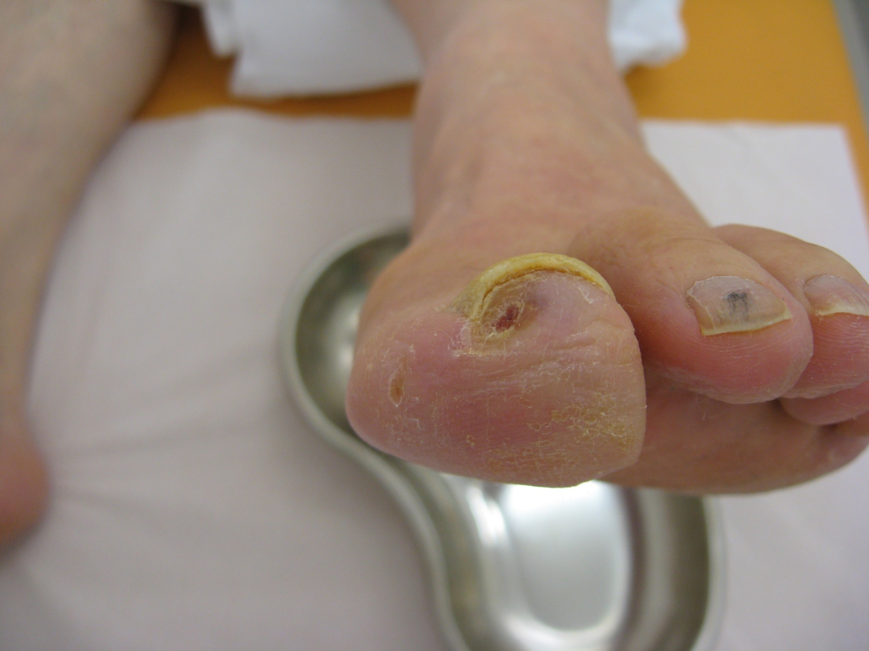
Figure 19.3 · Peripheral Arterial Disease & ABI
WHAT TO NOTICE
Intermittent claudication vs. CLTI (Fig 19.3):
Claudication is reproducible calf aching with walking that eases in ~10 min of rest. CLTI causes forefoot rest pain (worse flat, eased dangling) and punched-out, dry distal toe ulcers (Fig 19.3).
Physical & dark-skin assessment cues:
Weak/absent pedal pulses (use Doppler), cool hairless skin, thickened nails, elevation pallor, and dependent rubor. On dark skin, pallor looks ash-grey or yellow-brown — check warmth, pulses, and refill.
Ankle-Brachial Index (ABI) cut-offs (Question 26):
Higher ankle SBP / higher arm SBP. ABI < 0.9 suggests PAD (e.g., 0.7 = PAD). Calcified arteries in diabetes/CKD give falsely normal or > 1.4 readings -> use toe-brachial index.
Indigenous & rural amputation equity (Shah et al., 2019):
Diabetes + PAD increases mortality 3–4x and amputation 5x; Ontario First Nations people with diabetes face 3–5x higher amputation rates due to structural care barriers.
Positioning Rule in PAD (Question 25): Keep legs level or slightly dependent (lower than the heart) so gravity assists arterial perfusion — NEVER elevate an ischemic arterial limb!
Medical-Surgical Nursing: A Canadian Open Text
Chapter 19 · Hypertension & Vascular Disorders
Notes:
Examine Figure 19.3 (dry, punched-out arterial ulcer on the distal great toe with thickened dystrophic nails) and review the 2022 CCS PAD guideline (Abramson et al., 2022):
- Emphasize why arterial rest pain worsens at night when lying flat in bed and eases when hanging the foot over the mattress edge: gravity increases hydrostatic perfusion pressure to the ischemic foot.
- Review ABI interpretation (Question 33): `ABI < 0.9` indicates PAD; `ABI > 1.4` indicates non-compressible calcified arteries.

Slide 16
SECTION 19.4 · PAD MANAGEMENT & ACUTE LIMB ISCHEMIA
2022 CCS guideline therapy and the 6-hour acute limb ischemia window
PAD treatment prevents MI, stroke, and amputation; acute sensory or motor loss signals an immediately threatened limb.
2022 CCS PAD Management & Revascularization
Acute Limb Ischemia Emergency (NCEPOD, 2025)
Smoking cessation, supervised exercise, statin & dual pathway
Sudden arterial occlusion from cardioembolism (AF) or thrombosis
Core medical therapy (Abramson et al., 2022):
1. Smoking cessation (counselling + pharmacotherapy); 2. High-intensity statin for EVERY patient with PAD; 3. BP (< 130 SBP) and glycemic control + daily foot care.
Supervised walking & antithrombotics:
First-line for claudication is supervised walking >= 2x/week for >= 30 min over >= 12 weeks. For symptomatic PAD at low bleeding risk: low-dose (vascular-dose) rivaroxaban + low-dose ASA (single antiplatelet if high bleeding risk; none if asymptomatic).
Post-endovascular / bypass graft nursing care:
Compare distal pulses, warmth, colour, refill, sensation, and movement to baseline; report a lost pulse or rising pain, tense calf swelling, and numbness immediately (compartment syndrome; NCEPOD, 2025).
The Classic 'Six Ps' of Acute Limb Ischemia:
1. Pain; 2. Pallor; 3. Pulselessness; 4. Paresthesia (numbness/tingling); 5. Paralysis (motor weakness); 6. Poikilothermia (cold limb). Not all 6 must be present!
Recognizing a threatened limb (Question 27):
New numbness extending above the toes and motor weakness (foot drop/weak movement) mark an immediately threatened limb that requires revascularization ideally within 6 hours to prevent permanent nerve/muscle death.
Immediate nursing actions:
Escalate at once, document exact symptom onset time, keep the limb level and protected (never elevated, no ice/heat), and prepare for IV unfractionated heparin, imaging, and urgent vascular surgery.
Exam Priority (Question 27): Among all ischemic signs, new sensory loss beyond the toes and motor weakness indicate nerve/muscle ischemia that cannot wait.
Medical-Surgical Nursing: A Canadian Open Text
Chapter 19 · Hypertension & Vascular Disorders
Notes:
Contrast chronic PAD management with Acute Limb Ischemia (Abramson et al., 2022; NCEPOD, 2025):
- Highlight the 2022 CCS antithrombotic recommendation for symptomatic PAD: vascular-dose rivaroxaban (2.5 mg BID) plus low-dose ASA (verify that the low vascular dose matches the PAD indication!).
- Drill Question 34 on Acute Limb Ischemia: while coolness, weak pulses, rest pain, and elevation pallor occur in chronic PAD, **new numbness above the toes and weak foot movement** (paresthesia + paralysis) mean the limb is immediately threatened and needs revascularization within 6 hours.

Slide 17
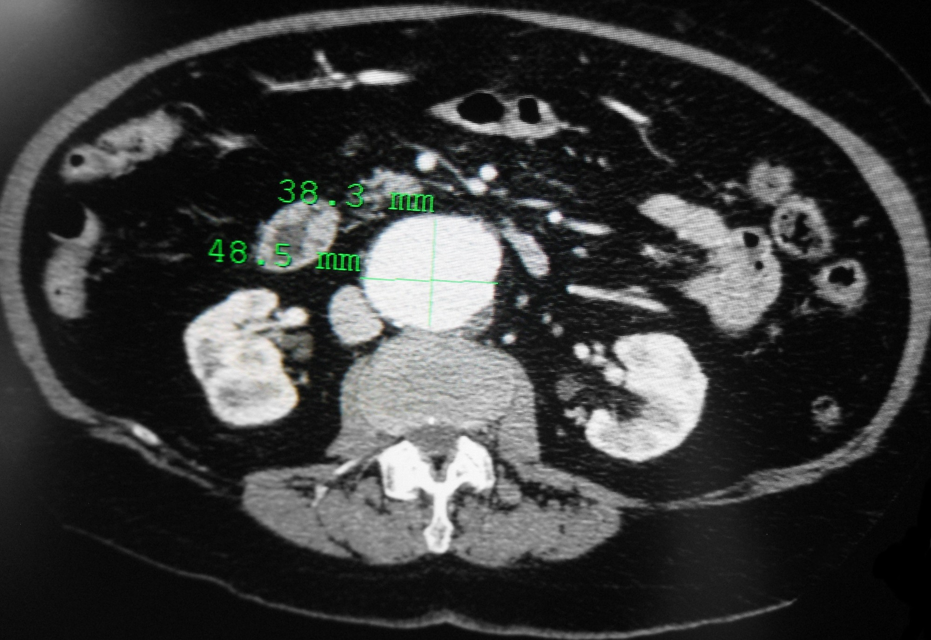
Figure 19.4 · Abdominal Aortic Aneurysm (AAA) Care
WHAT TO NOTICE
Contrast CT of AAA (Fig 19.4) & risk factors:
CT shows a 4.8 x 3.8 cm AAA anterior to the spine (~20,000 diagnosed/yr in Canada). Top risks: male sex, smoking (doubles rupture risk!), older age, and family history.
CTFPHC (2017) Canadian screening rules (Question 29):
One-time ultrasound for MEN aged 65–80 (not men > 80 yr or women). Elective repair threshold (ACC/AHA 2022): >= 5.5 cm in men or >= 5.0 cm in women (or symptomatic).
Recognizing AAA rupture emergency (Question 28):
Sudden severe back/flank/abdominal pain + shock (BP 86/50, HR 124) +/- pulsatile mass -> call rapid response immediately, start large-bore IVs, and NEVER palpate firmly!
Post-EVAR & open repair nursing checks:
Check bilateral pedal pulses/limb perfusion (distal embolization), groin access sites (EVAR), urine output/creatinine (contrast + cross-clamp AKI), and bloody diarrhea/abdominal pain after open repair (ischemic colitis).
Exam Alert (Questions 28 & 29): Under CTFPHC guidelines, screen a 70-year-old man once by ultrasound; if a patient with a known AAA develops back pain and hypotension, call rapid response first!
Medical-Surgical Nursing: A Canadian Open Text
Chapter 19 · Hypertension & Vascular Disorders
Notes:
Examine Figure 19.4 (contrast-enhanced CT showing a 48.5 x 38.3 mm AAA) and review Section 19.5 (CTFPHC, 2017; Isselbacher et al., 2022):
- Drill Question 36: The Canadian Task Force on Preventive Health Care (2017) recommends one-time ultrasound screening for **men aged 65 to 80** (so a 70-year-old never-screened man qualifies, whereas a 68-year-old woman who smoked, an 84-year-old man, or a 55-year-old man do not meet the routine CTFPHC criteria—though shared decision-making applies).
- Drill Question 35: Sudden severe back pain with BP 86/50 mm Hg and HR 124 bpm in a 74-year-old man with a known AAA is retroperitoneal/intraperitoneal rupture until proven otherwise—call rapid response immediately and never palpate the abdomen deeply.

Slide 18
PART FOUR · SECTIONS 19.6 & 19.7
Venous Disease, VTE & High-Alert Anticoagulation
Virchow's triad, DVT diagnostic pathways, chronic venous insufficiency, compression rules, and safe management and reversal of heparins, warfarin, and DOACs.
Notes:
Part Four covers Sections 19.6 and 19.7: How venous clots form (Virchow's triad), how pretest probability guides D-dimer and compression ultrasound testing, why early ambulation is safe in anticoagulated DVT, how to differentiate arterial from venous leg ulcers, and how nurses safely administer, monitor, and reverse high-alert anticoagulants.

Slide 19
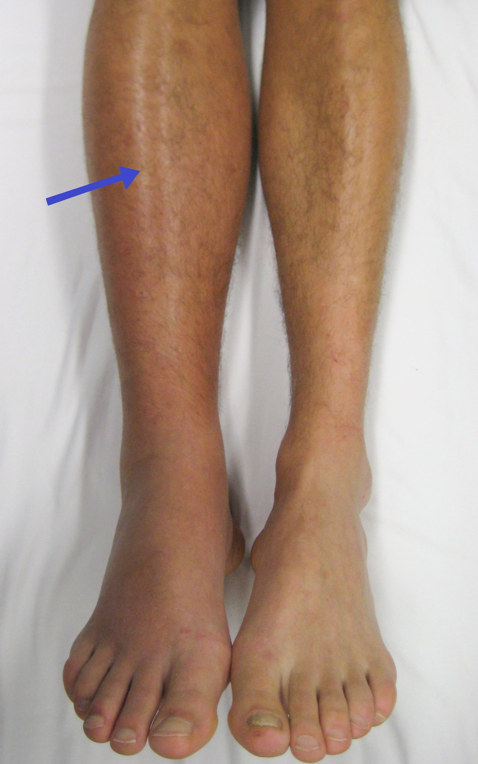
Figure 19.5 · Deep Vein Thrombosis (DVT) & Diagnosis
WHAT TO NOTICE
Virchow's Triad of VTE pathogenesis:
1. Venous stasis (surgery, bed rest, cast, paralysis, long travel); 2. Endothelial vein wall injury (trauma, orthopedic/pelvic surgery, central lines); 3. Hypercoagulability (cancer, estrogen therapy, pregnancy/postpartum, inherited thrombophilia, prior VTE).
Unilateral leg cues across skin tones (Fig 19.5; Question 30):
Unilateral calf/leg swelling (measure both calves at a marked level), deep tenderness, warmth, and dilated superficial veins. Redness shows on light skin; on dark skin it looks darker, purplish, or subtle. NEVER massage the calf! Report promptly.
Pretest probability (Wells score) & testing (Question 31):
1. LOWER pretest probability -> D-dimer blood test FIRST (negative D-dimer rules out DVT without ultrasound; use age-adjusted cut-off > 50 yr). 2. HIGHER pretest probability -> Compression ultrasound FIRST (non-collapsible vein = clot; repeat in 1 wk if negative).
When D-dimer is less useful (Lim et al., 2018):
Hospitalized, post-surgical, and pregnant patients often have elevated D-dimer without a clot — go directly to ultrasound.
Bedside Safety (Question 30): In a post-op Day 4 hip replacement patient with new unilateral calf swelling and warmth, report promptly to the prescriber and never massage the leg.
Medical-Surgical Nursing: A Canadian Open Text
Chapter 19 · Hypertension & Vascular Disorders
Notes:
Examine Figure 19.5 (swollen, erythematous right leg with DVT) and review the ASH 2018 diagnostic algorithm (Lim et al., 2018):
- Drill Question 18: Why do we order a **D-dimer first** in a patient with **lower** pretest probability of DVT, but a **compression ultrasound first** when pretest probability is **higher**? Because D-dimer has high sensitivity (a negative test safely rules out DVT in low-probability outpatients) but low specificity.

Slide 20
SECTION 19.6 · DVT MANAGEMENT, AMBULATION & SVT
Evidence-based anticoagulation, early walking, and stocking trials
Once anticoagulation is started, early ambulation is safe and eases leg pain faster without increasing pulmonary embolism risk.
DVT Treatment & Post-Thrombotic Syndrome
Superficial Vein Thrombosis (SVT / Phlebitis)
ASH 2020 & CHEST 2021 VTE guidelines (Ortel et al., 2020; Stevens et al., 2021)
Clot and inflammation in a superficial vein near the skin surface
DOACs preferred over warfarin:
For most patients with DVT/PE, ASH suggests a DOAC (apixaban, rivaroxaban, edoxaban, dabigatran) over warfarin (exceptions: severe renal impairment, moderate-severe liver disease, or antiphospholipid syndrome).
Home treatment & early ambulation (Liu et al., 2015):
Uncomplicated DVT is treated at home. Strict bed rest is NOT routine — a 13-trial meta-analysis (n = 3,269) showed early walking on anticoagulation does NOT increase PE and relieves acute pain faster.
Post-thrombotic syndrome (PTS) & SOX trial (Kahn et al., 2014):
Canadian SOX RCT (n = 806) found elastic compression stockings did not prevent PTS (14.2% vs. 12.7%); CHEST advises against routine stockings solely for PTS prevention.
Clinical recognition across skin tones:
Tender, warm, firm, palpable cord along a superficial vein, with overlying erythema on light skin or darker/purplish hyperpigmentation on dark skin.
Ultrasound evaluation for extension:
Lower-limb SVT (especially in the great saphenous vein) can extend into the deep venous system — prescribers often order ultrasound to rule out concomitant DVT.
CHEST 2021 SVT treatment (Stevens et al., 2021):
For lower-extremity SVT at increased risk of clot progression toward the deep veins, CHEST suggests 45 days of anticoagulation (subcutaneous fondaparinux preferred, or oral rivaroxaban).
Clinical Takeaway: Encourage patients with DVT to walk as tolerated once therapeutic anticoagulation has begun, while watching for sudden dyspnea, pleuritic chest pain, or tachycardia (PE).
Medical-Surgical Nursing: A Canadian Open Text
Chapter 19 · Hypertension & Vascular Disorders
Notes:
Review DVT treatment, early mobilization, the Canadian SOX trial, and Superficial Vein Thrombosis (Ortel et al., 2020; Liu et al., 2015; Kahn et al., 2014; Stevens et al., 2021):
- Bust two common clinical myths:
1. Myth: Patients with a new DVT must stay on strict bed rest for days so the clot doesn't break loose. Fact: Meta-analysis of 3,269 anticoagulated patients (Liu et al., 2015) proved early ambulation does not increase PE or clot extension and reduces pain faster!
2. Myth: Every DVT patient needs routine compression stockings for 2 years to prevent post-thrombotic syndrome. Fact: The Canadian SOX randomized controlled trial (Kahn et al., 2014) and CHEST 2021 guidelines recommend against routine stockings for PTS prevention (though stockings are used for chronic venous insufficiency or symptomatic swelling).

Slide 21
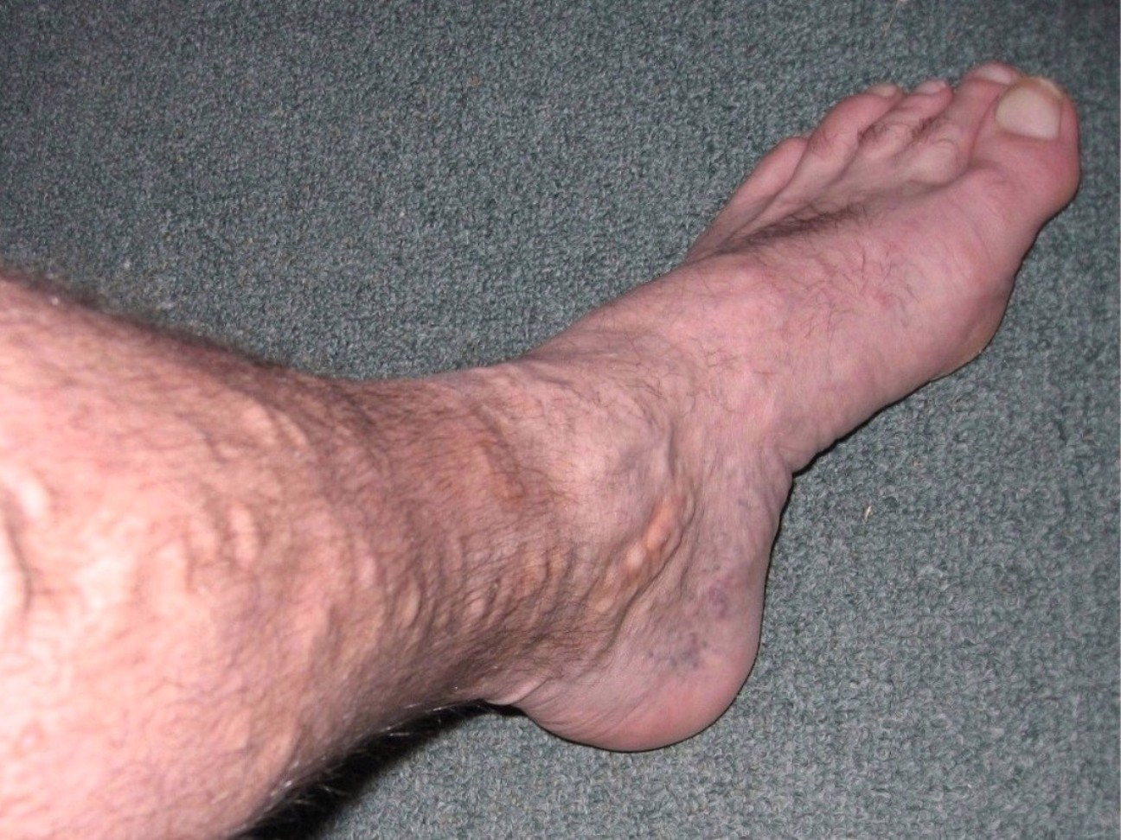
Figure 19.6 · Varicose Veins & Venous Insufficiency
WHAT TO NOTICE
Tortuous varicose veins (Fig 19.6):
Dilated, twisted, raised superficial veins over the lower leg and medial ankle caused by incompetent venous valves allowing retrograde reflux.
How Chronic Venous Insufficiency (CVI) develops:
Primary valve failure or post-thrombotic vein obstruction/valve destruction after DVT causes sustained ambulatory venous hypertension in the lower legs.
Predisposing risk factors:
Older age, prior DVT, obesity, prolonged standing or sitting at work, multiple pregnancies, weak calf-muscle pump (ankle immobility), and family history.
Symptom pattern (opposite of PAD!):
Dull aching, throbbing, or heaviness in the calves/ankles that worsens at the end of the day after prolonged standing and eases with leg elevation and walking.
Pathophysiological Contrast: PAD is an inflow problem (too little arterial blood reaching tissues); CVI is an outflow problem (venous blood pooling under high pressure).
Medical-Surgical Nursing: A Canadian Open Text
Chapter 19 · Hypertension & Vascular Disorders
Notes:
Examine Figure 19.6 (varicose veins over the lower leg and medial malleolus) and review Chronic Venous Insufficiency (CVI) pathophysiology (Evans et al., 2025):
- Explain how the calf muscle pump normally squeezes deep veins during walking while one-way bicuspid valves prevent backflow; when valves fail, venous pressure stays high during standing and walking.

Slide 22
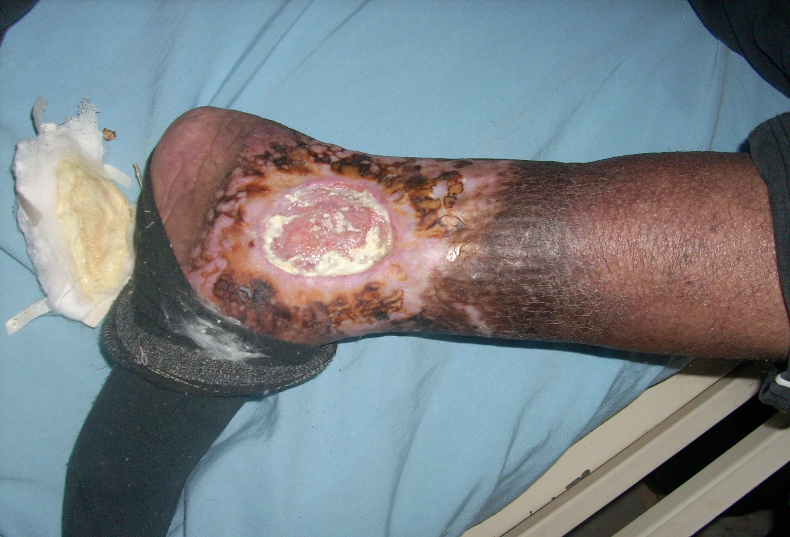
Figure 19.7 · CVI & Venous Ulcers on Darker Skin
WHAT TO NOTICE
Gaiter-area venous ulcer (Fig 19.7):
Shallow, irregularly bordered ulcer over the medial ankle/lower leg with a pink granulating base, fibrinous slough, and moderate-to-heavy exudate (note saturated dressing on left).
Hemosiderin staining across skin tones:
High venous pressure forces RBCs out of capillaries; iron pigment from lysed RBCs causes grey-brown staining on lighter skin and dark brown or black hyperpigmented patches on darker skin (Fig 19.7).
Lipodermatosclerosis & stasis dermatitis:
Chronic inflammation makes the skin above the ankle indurated (hard, woody, tight 'inverted champagne bottle' leg) with pruritic scaling and weeping stasis dermatitis.
Equitable skin inspection:
Compare both legs in good lighting, palpate for induration, warmth, and woody fibrosis, and ask the patient about progressive darkening or tightness around the ankle.
Wound Assessment Pearl: Venous ulcers are typically medial/gaiter-area, shallow, and heavily exudative; arterial ulcers (Fig 19.3) are distal/toe, punched-out, pale/black, and dry.
Medical-Surgical Nursing: A Canadian Open Text
Chapter 19 · Hypertension & Vascular Disorders
Notes:
Examine Figure 19.7 (chronic venous insufficiency on darker skin showing dark hyperpigmentation, lipodermatosclerosis, and an open gaiter-area venous ulcer with exudate on the removed dressing):
- Point out how clearly Figure 19.7 demonstrates hemosiderin hyperpigmentation and thickened, fibrotic skin above the ankle on darker skin tones.

Slide 23
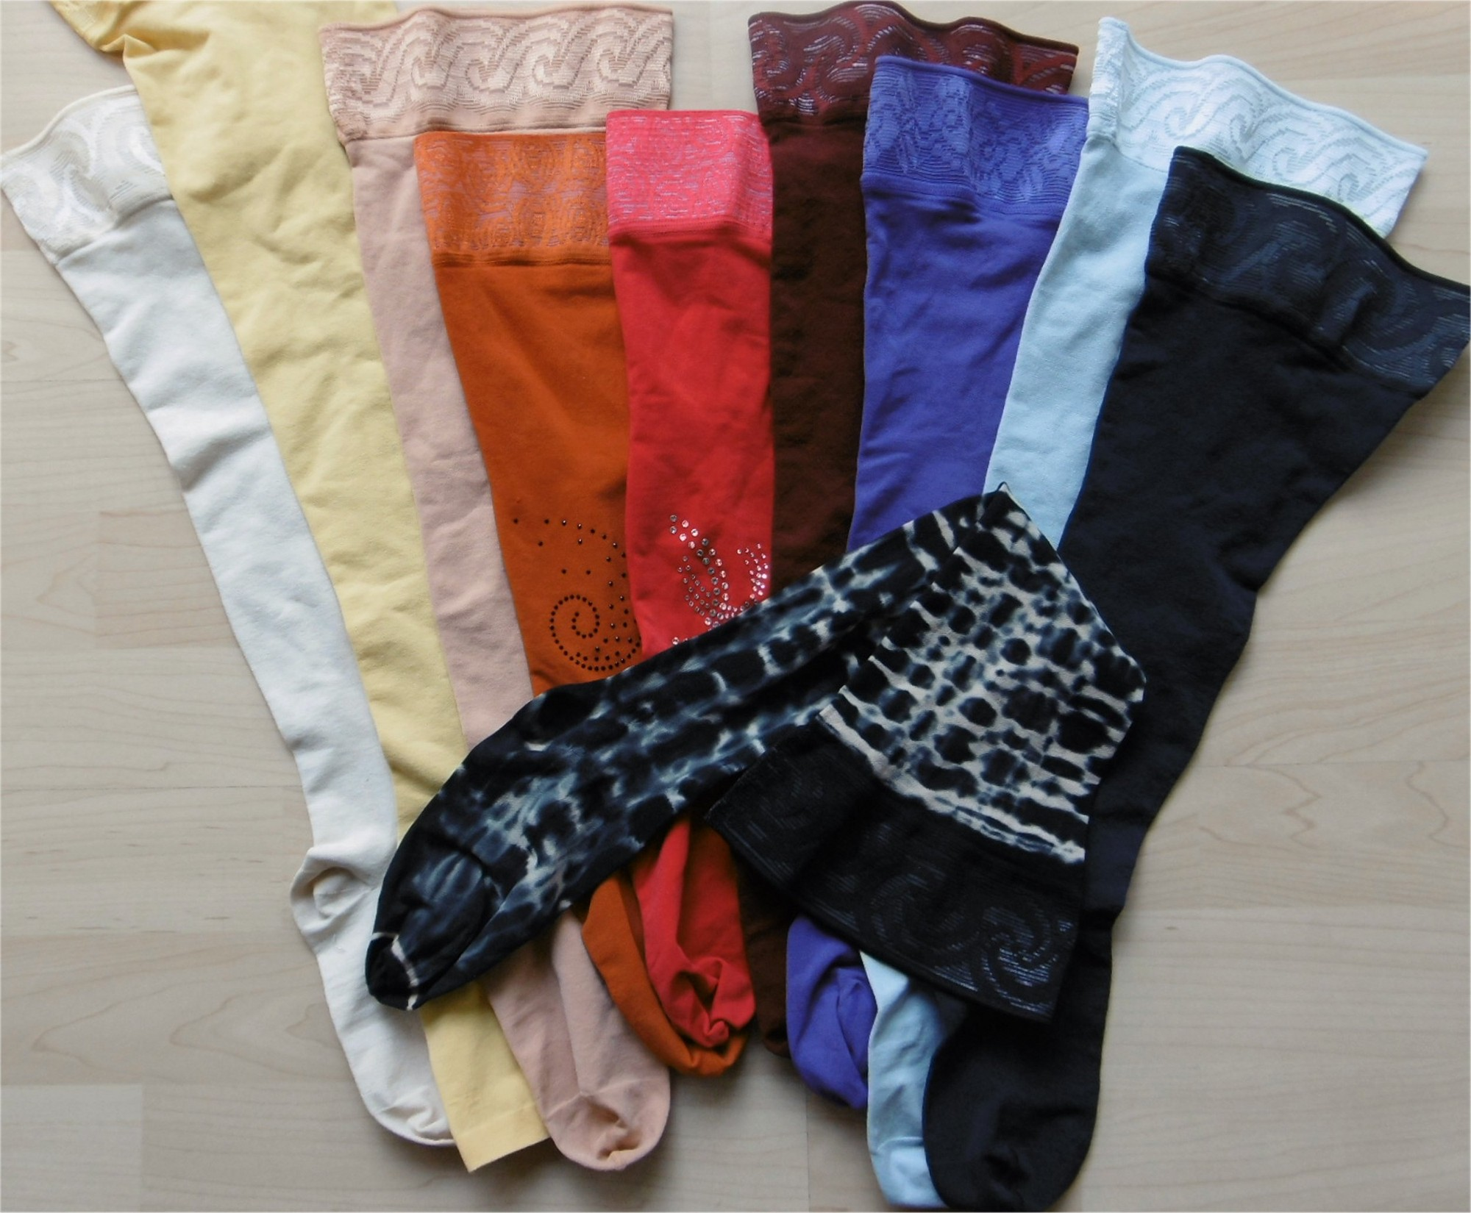
Figure 19.8 · Compression Therapy & Table 19.3
WHAT TO NOTICE
Mandatory ABI check BEFORE compression (Fig 19.8):
Graduated compression is the cornerstone of CVI and venous ulcer healing, but applying compression to an ischemic arterial leg can cause necrosis and amputation!
Wounds Canada 2025 ABI cut-offs (Evans et al., 2025):
1. ABI >= 0.9: Safe for high-strength therapeutic compression; 2. ABI 0.5–0.89: Modified/reduced compression only under specialist guidance; 3. ABI < 0.5: Compression is CONTRAINDICATED!
Table 19.3 — Positioning & daily care:
In venous disease, elevate legs ABOVE heart level (e.g., 30 min 3x/day), walk, and perform ankle dorsiflexion/plantarflexion exercises; continue compression lifelong after ulcer healing to prevent recurrence.
Table 19.3 — Arterial vs. Venous summary:
Arterial: claudication/rest pain worse elevated, absent pulses, cool hairless skin, dry punched-out toe ulcer, keep legs level/dependent. Venous: aching worse dependent, pulses present, warm stained/edematous skin, wet ankle ulcer, elevate & compress.
Golden Rule of Leg Ulcers: Never apply a compression wrap or stocking (Fig 19.8) until a Doppler Ankle-Brachial Index (ABI) confirms adequate arterial inflow (ABI >= 0.5; >= 0.9 for high compression).
Medical-Surgical Nursing: A Canadian Open Text
Chapter 19 · Hypertension & Vascular Disorders
Notes:
Examine Figure 19.8 (medical compression stockings) and review Table 19.3 comparing Arterial and Venous disease at the bedside (Abramson et al., 2022; Evans et al., 2025):
- Make sure students memorize the Wounds Canada 2025 ABI rules for compression therapy: never compress if `ABI < 0.5`, and reserve full high compression for `ABI >= 0.9`.

Slide 24
SECTION 19.7 · TABLE 19.4: ANTICOAGULANTS & MONITORING
Comparing heparins, fondaparinux, warfarin, and DOACs
Anticoagulants prevent clot extension and new clot formation while endogenous fibrinolysis dissolves the thrombus.
UFH, LMWH & Fondaparinux
Warfarin (Vitamin K Antagonist)
Direct Oral Anticoagulants (DOACs)
Unfractionated Heparin (UFH): IV infusion or SC; boosts antithrombin (inactivates IIa & Xa). Short half-life, safe in renal failure. Monitor aPTT or anti-Xa per protocol + platelets (HIT) + Hb.
Low-Molecular-Weight Heparins (LMWH — enoxaparin, dalteparin, tinzaparin): Weight-based SC; mainly anti-Xa. Renal clearance — accumulates in CKD! Monitor platelets, Cr, and Hb.
Fondaparinux: Synthetic SC factor Xa inhibitor; NOT recommended for VTE treatment when CrCl <= 30 mL/min (Aspen, 2019).
Neuraxial warning: Watch for spinal/epidural hematoma (leg numbness/weakness, bowel/bladder dysfunction) after epidural/LP.
Mechanism: Inhibits hepatic synthesis of vitamin K–dependent clotting factors (II, VII, IX, X). Takes several days for full effect -> overlap with parenteral heparin initially for acute thrombosis.
INR monitoring (Question 33; GPAC, 2023): Target INR 2.5 (range 2.0 to 3.0) for VTE and atrial fibrillation (mechanical valves require 2.5 or 3.0 per Ch 18).
Frequency: Check INR q2–4 days when starting or changing dose, less often when stable, and more often during illness, diet shifts, or new drugs.
Cautions: Extensive drug/food interactions; teratogenic (generally avoided in pregnancy).
Direct Factor Xa inhibitors: Apixaban, rivaroxaban, edoxaban. Direct thrombin (IIa) inhibitor: Dabigatran.
Dosing & onset: Rapid onset within hours; fixed oral doses without routine coagulation testing.
Crucial lab rule (Question 22): The INR does NOT measure apixaban/DOAC activity! A normal INR does not mean a patient on a DOAC is un-anticoagulated.
Renal & Hb monitoring: Estimate Cockcroft-Gault CrCl before starting and >= yearly (more often with dehydration, HF, or diuretics); dabigatran is most kidney-dependent.
Medical-Surgical Nursing: A Canadian Open Text
Chapter 19 · Hypertension & Vascular Disorders
Notes:
Walk through Table 19.4 (Section 19.7):
- Drill Questions 22 and 33:
* An INR of 2.4 in a patient taking warfarin for DVT is right inside the therapeutic target range of **2.0 to 3.0** (target 2.5; Question 20).
* For a patient starting apixaban (Question 29), routine coagulation blood tests (INR or aPTT) are not used to monitor its effect, but **kidney function (Cockcroft-Gault CrCl)** and hemoglobin are monitored.

Slide 25
SECTION 19.7 · BLEEDING, REVERSAL & HIGH-ALERT SAFEGUARDS
Hidden bleeding cues, Canadian reversal protocols, and ISMP safety
When major bleeding occurs, stop/hold the anticoagulant, apply direct pressure, support ABCs, and report drug, dose, and time of last dose via SBAR.
1. Hidden GI & Retroperitoneal Bleeds: Watch for black tarry stools (melena; Question 21), coffee-ground emesis, or back/flank/groin pain with falling BP, rising HR, dizziness, and dropping Hb (Question 36).
5. Factor Xa Inhibitor Reversal (Canada): For apixaban, rivaroxaban, and edoxaban bleeds, usual Canadian care is off-label PCC + resuscitation (Andexanet alfa is marketed but not publicly reimbursed/listed by CADTH or CBS, 2024).
2. Post-Fall Intracranial Bleed Rule: Any head strike on an anticoagulant requires SAME-DAY urgent medical/CT assessment even if the patient is alert with zero headache (Question 35)!
6. ISMP Canada Duplication Hazard: ISMP Canada (2016) reported a fatal incident when a home LMWH was continued on admission while an IV heparin infusion was also started — always reconcile home DOACs/LMWHs!
3. Warfarin & UFH Reversal: Warfarin: Oral/IV Vitamin K + 4-factor Prothrombin Complex Concentrate (PCC) for life-threatening bleeds. UFH: IV Protamine sulfate (infuse slowly to avoid severe hypotension/anaphylaxis).
7. High-Alert Infusion Safeguards: Use standard pre-mixed heparin bags, smart pumps with hard dose limits, and truly independent 2-nurse double-checks of order, product, concentration, and pump settings.
4. Dabigatran Reversal: Idarucizumab (Praxbind) is a specific monoclonal antibody fragment that binds and reverses ONLY dabigatran (Boehringer Ingelheim, 2019).
8. Protocol-Driven Titration: Respond promptly to aPTT or anti-Xa lab results and adjust UFH infusion rates strictly according to the hospital nomogram.
Canadian Reversal Nuance (CADTH, 2024; CBS, 2024): Know both specific reversal agents (protamine, vitamin K + PCC, idarucizumab) and why PCC is standard Canadian care for Xa inhibitors.
Medical-Surgical Nursing: A Canadian Open Text
Chapter 19 · Hypertension & Vascular Disorders
Notes:
Review Section 19.7 on Bleeding, Reversal, and the Clinical Safety box (ISMP Canada, 2016; CADTH, 2024; Canadian Blood Services, 2024):
- Make sure students know every reversal agent:
* **Warfarin**: Vitamin K + Prothrombin Complex Concentrate (PCC) for life-threatening bleeding.
* **Unfractionated Heparin (UFH)**: Protamine sulfate (give slowly IV—rapid administration causes severe hypotension and anaphylactoid reactions).
* **Dabigatran**: Idarucizumab.
* **Apixaban / Rivaroxaban / Edoxaban**: Prothrombin Complex Concentrate (PCC) is usual care in Canada (explain the CADTH 2024 / CBS 2024 context regarding andexanet alfa).

Slide 26
SECTION 19.7 · GOING DEEPER [RN]: HIT (4TS SCORE) & ANTI-XA
Heparin-induced thrombocytopenia & anti-Xa monitoring
HIT is an immune-mediated prothrombotic emergency where antibodies activate platelets, causing thrombocytopenia AND severe clotting.
Heparin-Induced Thrombocytopenia (ASH 2018)
Anti-Xa vs. aPTT Heparin Monitoring [RN]
Pathophysiology (Cuker et al., 2018): Autoantibodies form against heparin–PF4 complexes, activating platelets and generating microparticles -> platelet count drops while 33% to 50% of patients develop venous, arterial, or microvascular thrombosis!
Classic hallmark (Question 38): Platelet count drop > 50% (e.g., 240 -> 95 x 10^9/L) typically beginning 5 to 10 days after starting heparin (sooner if recent heparin exposure), often accompanied by a new swollen DVT limb or clot.
The 4Ts Pretest Probability Score (Question 39): 1. Thrombocytopenia (magnitude of platelet fall); 2. Timing of platelet fall relative to heparin start; 3. Thrombosis or other sequelae; 4. oTher causes of thrombocytopenia unlikely. (Low 4Ts rules out HIT without lab testing).
Immediate management of Intermediate/High 4Ts (Question 38): 1. STOP ALL HEPARIN (flush lines, LMWH, UFH); 2. Start a non-heparin anticoagulant (argatroban, fondaparinux, or a DOAC); 3. Avoid routine platelet transfusions; 4. Hold warfarin until platelets recover!
Two laboratory methods for adjusting IV unfractionated heparin (UFH) infusions (Question 40):
1. Activated Partial Thromboplastin Time (aPTT): Clotting time assay; widely used, but can be skewed by acute-phase reactants (factor VIII, fibrinogen), lupus anticoagulant, or liver disease.
2. Anti-Factor Xa (Anti-Xa) Level: Chromogenic assay that measures heparin's inhibition of Factor Xa directly; less affected by biological confounders.
Nursing practice rule: Each hospital selects one method with a standardized titration nomogram — never mix targets across protocols.
Medical-Surgical Nursing: A Canadian Open Text
Chapter 19 · Hypertension & Vascular Disorders
Notes:
Review the Going Deeper [RN] box on HIT and Anti-Xa monitoring (Cuker et al., 2018; Questions 38, 39, and 40):
- Drill Question 22: When a patient on IV UFH for 7 days drops platelets from 240 to 95 x 10^9/L (~60% fall) and develops a newly swollen left arm, anticipate **stopping all heparin immediately and starting a non-heparin anticoagulant** (never switch to enoxaparin/LMWH, never transfuse platelets routinely, and never start warfarin until platelets recover!).
- Drill Question 23: The **4Ts score** evaluates (1) magnitude of platelet fall, (2) timing relative to heparin, (3) new thrombosis, and (4) likelihood of other causes (NOT hemoglobin or heparin infusion rate).

Slide 27
SECTION 19.7 · PATIENT TEACHING, CNO SCOPE & PRACTICE STORY
Living safely with anticoagulants and community nursing judgment
Anticoagulants are safe only when taken consistently, reconciled across transitions, and backed by clear patient teaching.
Patient Education: Anticoagulant Safety
CNO Scope & Practice Story (Maya Nwosu, RPN)
Missed doses, interactions, vitamin K steady intake & affordability
Authority, competence, context & Mrs. Rose Thibault (84yo)
Missed apixaban dose rule (Question 34):
Take the missed dose as soon as remembered and continue the regular twice-daily schedule — NEVER take two tablets at once to catch up!
Drug, OTC & herbal interactions (Question 23):
Avoid NSAIDs (ibuprofen, naproxen) and extra ASA; ask a pharmacist before starting any OTC drug or supplement. Antifungals/HIV drugs raise apixaban; rifampin, some anticonvulsants, and St. John's wort lower it.
Warfarin diet & rural access (Questions 24 & 32):
Keep weekly vitamin K (leafy greens) intake consistent. Ask directly about drug cost and pharmacy/lab access before discharge (DOACs cost more than warfarin).
CNO Scope of Practice (Question 37):
RNs and RPNs give SC LMWH and do Doppler checks when authorized and competent; employer policy governs IV heparin infusions. If Hb drops 128->101 g/L with dizziness on LMWH, hold dose and consult RN/prescriber now (Q36).
Practice Story — Maya Nwosu, RPN & Mrs. Thibault (84yo):
Mrs. Thibault (on apixaban for AF) bumped her head on the sink last night; on Sunday morning she was alert and oriented with no headache and a normal exam.
Why Maya insisted on same-day ED care (Question 35):
Intracranial bleeding on an anticoagulant can appear hours after a head bump — arrange urgent same-day ED assessment even when the exam is normal!
Community Nursing Takeaway: Send the anticoagulant bottle and exact time of last dose with the patient to the ED, phone a concise handover, and remove home fall hazards (bath mats).
Medical-Surgical Nursing: A Canadian Open Text
Chapter 19 · Hypertension & Vascular Disorders
Notes:
Review the Patient Education box, Scope in Practice box, and Maya Nwosu's RPN Practice Story ("A Sunday Morning Visit"):
- Highlight Questions 23, 24, 34, 35, 36, and 37: every single one of these practical clinical situations comes directly from Section 19.7.
- Emphasize Maya Nwosu's clinical advocacy with Mrs. Thibault and her daughter Claire: older adults often say they "don't want to make a fuss" after a head bump when they feel fine, so explaining *why* anticoagulants cause delayed silent intracranial bleeding saves lives.

Slide 28
SECTION 19.3 · CLINICAL JUDGMENT & UNFOLDING CASE 1
Managing hypertensive emergencies on the medical ward
When severe hypertension is accompanied by new confusion, visual changes, or acute kidney injury, immediate escalation is mandatory.
Clinical Judgment: Mrs. Leila Haddad (66yo)
Unfolding Case 1: Mr. Samuel Mensah (58yo)
Admitted for pneumonia · Home antihypertensive omitted on admission
Practice Questions 1 to 6 · Ran out of home BP meds 5 days ago
Recognize & Analyze Cues at 2300:
Automated BP 220/130 -> manual recheck with proper cuff after rest confirms 218/128 (R) and 214/126 (L), HR 92, severe headache, blurry vision, slow responses, and new disorientation to date.
Prioritize & Take Action:
Equal arm BPs and absence of tearing pain make dissection unlikely -> Hypertensive emergency (encephalopathy/stroke risk). Stay with patient, elevate head of bed, perform neuro/stroke screen, and call rapid response via SBAR (do NOT give an un-ordered extra oral dose!).
Evaluate Outcomes in ICU:
Controlled IV titration lowers BP to 176/104 mm Hg at 2 hours with full recovery of orientation to date.
Target-organ injury cues (Questions 1–3):
BP 224/132 (R) and 220/130 (L) at 2200 with: 1. Severe headache + blurred vision; 2. New disorientation to date (brain/eye injury — highest priority!); 3. Creatinine jump from 94 to 171 umol/L with oliguria (90 mL/4 h = AKI).
RPN immediate action & team plan (Questions 4–5):
Stay with Mr. Mensah and call rapid response / MRP immediately (do NOT give PRN acetaminophen and wait 1 hour). Anticipate transfer to ICU for controlled IV BP lowering over hours.
Evaluating safe ICU response at 2 hours (Question 6):
BP 178/106 mm Hg with restored orientation to date shows safe, controlled perfusion (whereas BP 118/74 with drowsiness or 120/80 with 10 mL/h urine indicates ischemic over-correction).
Medication Reconciliation Lesson: Both cases were precipitated by interrupted home antihypertensives — always reconcile and bridge chronic cardiovascular medications on admission and discharge.
Medical-Surgical Nursing: A Canadian Open Text
Chapter 19 · Hypertension & Vascular Disorders
Notes:
Compare the Clinical Judgment box (Mrs. Leila Haddad, 66yo) and Unfolding Case 1 (Mr. Samuel Mensah, 58yo, Questions 1–6):
- Both cases illustrate how quickly omitted or unaffordable home antihypertensives can escalate into a hypertensive emergency with acute encephalopathy and acute kidney injury on a general medical ward.

Slide 29
CHAPTER 19 · UNFOLDING CASE 2 & HIGH-YIELD EXAM TRAPS
Synthesizing DVT anticoagulation safety and vascular priorities
Review Gordon's rural DVT transition (Questions 21–24) and top NCLEX-RN / REx-PN clinical traps.
1
2
3
Case 2: Gordon (71yo — DVT)
Aortic & Arterial Exam Traps
Venous & Heparin Exam Traps
Admitted with left-leg DVT and started on apixaban; also takes low-dose ASA (prior MI) and OTC ibuprofen for knee pain; lives alone rurally.
• Priority finding to report first (Q21): Black, tarry stool (melena = upper GI bleed from triple antithrombotic/NSAID exposure).
• Lab monitoring teaching (Q22): Apixaban's effect is not checked routinely with INR/aPTT, but kidney function (CrCl) is monitored.
• Pain & discharge safety (Q30–24): Ask pharmacist before taking any pain reliever (stop ibuprofen!); confirm he can afford and obtain apixaban locally before discharge.
• Tearing chest/back pain + inter-arm SBP difference > 20 mm Hg (168/94 vs. 136/80) = Aortic Dissection (Q16). Speak up BEFORE anyone starts heparin or ASA (Q17)! Give IV beta-blocker (esmolol) BEFORE nitroprusside (Q19).
• Known AAA + sudden back pain + BP 86/50 = Rupture -> call rapid response immediately; never palpate firmly (Q28).
• PAD legs stay level/slightly dependent (never elevated; Q25); new numbness above toes + motor weakness = threatened acute limb ischemia (Q27).
• Post-op unilateral swollen warm calf = suspected DVT -> report promptly, never massage (Q30). Low probability -> D-dimer first (Q31).
• Never apply compression stockings if ABI < 0.5 (confirm arterial inflow first!).
• Platelets falling > 50% (240->95) on Day 7 of UFH + new arm swelling = HIT -> stop ALL heparin and start a non-heparin anticoagulant (Q38).
Medical-Surgical Nursing: A Canadian Open Text
Chapter 19 · Hypertension & Vascular Disorders
Notes:
Review Unfolding Case 2 (Gordon, 71-year-old rural patient with DVT on apixaban, Questions 21–24) and the high-yield exam synthesis cards:
- Point out why Gordon bled: combining a DOAC (apixaban) + antiplatelet (ASA) + OTC NSAID (ibuprofen) creates a massive synergistic risk for upper gastrointestinal bleeding (black, tarry stool).

Slide 30
Check your understanding
1. What universal blood pressure threshold defines hypertension across all validated methods in Hypertension Canada's 2025 guideline, and how do you size a manual cuff for a 40 cm arm?
2. When does Hypertension Canada (2025) recommend starting antihypertensive drugs at a systolic BP of 130–139 mm Hg, and what are the three first-line drug classes?
3. How do you distinguish a hypertensive emergency from hypertensive urgency, and why is MAP lowered by no more than 20–25% over the first hours (except in aortic dissection)?
4. Why do we keep legs level or slightly dependent in peripheral arterial disease (PAD) but elevated with compression in chronic venous insufficiency (CVI), and what ABI rules govern compression?
5. For a patient on warfarin, an LMWH, dabigatran, or apixaban who develops life-threatening bleeding, what specific reversal agents or Canadian care protocols apply?
6. What clinical findings on Day 7 of an IV heparin infusion point to heparin-induced thrombocytopenia (HIT), and what four immediate actions must the team take?
Chapter 19 Synthesis · Complete rationales for all 6 review questions are provided in the Presenter View notes.
Notes:
ANSWERS & RATIONALES FOR CHECK YOUR UNDERSTANDING:
1. 2025 Threshold & Cuff Sizing: Hypertension Canada (2025) defines hypertension as **>= 130/80 mm Hg** across all validated methods (AOBP, manual, HBPM, ABPM). The cuff bladder width should be **~40% of mid-upper arm circumference** (16 cm wide for a 40 cm arm) and length 80–100% (32–40 cm).
2. Starting Drugs & First-Line Classes (Goupil et al., 2025): Drugs start for all adults at >= 140/90 mm Hg, and at **SBP 130–139 mm Hg** for high-risk patients (established CVD, diabetes, CKD [eGFR < 60 or ACR >= 3], 10-yr Framingham risk >= 20%, or age >= 75 yr), aiming for **SBP < 130 mm Hg**. The 3 first-line classes (started as a 2-drug single-pill combination) are: (1) ACE inhibitor or ARB (never combined), (2) thiazide/thiazide-like diuretic, and (3) long-acting dihydropyridine CCB.
3. Hypertensive Emergency vs. Urgency: Emergency involves acute target-organ damage (brain, eyes, heart, kidneys, or aorta) and requires ICU titrated IV lowering of MAP by **<= 20–25% over hours** because autoregulation is shifted upward and sudden normalization causes cerebral, renal, or coronary ischemia. The exception is **acute aortic dissection**, where IV beta-blockers (esmolol) rapidly lower HR to 60–80 bpm and SBP < 120 mm Hg.
4. PAD vs. CVI Positioning & ABI Rules: In PAD, keeping legs level/slightly dependent lets gravity assist arterial inflow (elevation worsens ischemia). In CVI, leg elevation and graduated compression reduce venous hypertension. Per Wounds Canada (2025), **never apply compression if ABI < 0.5**, and reserve high compression for **ABI >= 0.9**.
5. Anticoagulant Reversal in Canada: Warfarin -> **Vitamin K + 4-factor PCC**; UFH -> **Protamine sulfate** (slow IV); Dabigatran -> **Idarucizumab**; Factor Xa inhibitors (apixaban, rivaroxaban, edoxaban) -> **PCC** is standard Canadian care (andexanet alfa is marketed but not publicly reimbursed/listed by CADTH or CBS).
6. HIT Recognition & Management (ASH 2018): A platelet drop **> 50%** occurring **5–10 days** after heparin initiation (often with new thrombosis; evaluated by the **4Ts score**). Immediate actions: (1) Stop ALL heparin (infusions, flushes, LMWH), (2) start a non-heparin anticoagulant (argatroban, fondaparinux, or DOAC), (3) avoid routine platelet transfusions, and (4) hold warfarin until platelets recover.

