Slide 1
UNIT V · HEMATOLOGIC, IMMUNOLOGIC & ENDOCRINE NURSING CARE · CHAPTER 20
Hematologic Disorders and Transfusion
Hematopoiesis and CBC interpretation in SI units, iron and megaloblastic anemias, sickle cell disease and thalassemia, thrombocytopenia, hemophilia, VWD and DIC, blood cancers, and safe blood transfusion.
Medical-Surgical Nursing: A Canadian Open Text
Aligned with CNO Entry-to-Practice Competencies (RN & RPN), Ontario Health Sickle Cell Standard (2023), CSTM & Canadian Blood Services (2026), and Choosing Wisely Canada
opensourcenursing.ca (CC BY-NC-SA 4.0)
Notes:
Welcome to Chapter 20: Hematologic Disorders and Transfusion, the opening chapter of Unit V (Hematologic, Immunologic & Endocrine Nursing Care). Blood disorders and blood component transfusions occur on every medical, surgical, obstetric, oncology, and critical care unit.
Walk through the six chapter sections: Section 20.1 (Blood Production, the CBC, Iron Studies & Clotting Tests in SI Units), Section 20.2 (Iron Deficiency, Vitamin B12/Folate & Other Anemias), Section 20.3 (Sickle Cell Disease & Thalassemia), Section 20.4 (Thrombocytopenia, ITP, Hemophilia, von Willebrand Disease & DIC), Section 20.5 (Leukemia, Lymphoma & Multiple Myeloma), and Section 20.6 (Blood Components, Pre-Transfusion Checks, Safe Administration, Transfusion Reactions & Massive Hemorrhage Protocols).

Slide 2
CHAPTER 20 · LEARNING OUTCOMES & CNO COMPETENCIES
Seven learning outcomes across hematology & transfusion care
Mapped to College of Nurses of Ontario (CNO) Entry-to-Practice Competencies for Registered Nurse (RN, 2019a) and Registered Practical Nurse (RPN, 2019b) practice.
Labs, Anemias & Hemoglobinopathies
Hemostasis & Blood Cancers
Transfusion Safety & CNO Scope
1. Explain how blood cells are made and interpret the complete blood count (CBC), iron studies, and basic clotting tests in International System of Units (SI) units.
2. Recognize and care for adults with iron deficiency, vitamin B12, folate, and other anemias across diverse skin tones and in older adults.
3. Provide safe, equitable care for people with sickle cell disease and thalassemia, including timely vaso-occlusive crisis analgesia.
CNO mapping: Clinician, Scholar, Advocate (RN 2019a); Foundations & Ethical Practice (RPN 2019b).
4. Recognize and respond to bleeding and clotting disorders (thrombocytopenia, immune thrombocytopenia [ITP], hemophilia, von Willebrand disease [VWD], and disseminated intravascular coagulation [DIC]) and teach bleeding precautions.
5. Describe leukemia, lymphoma, and multiple myeloma (CRAB), managing infection (neutropenia), bleeding, and anemia risks.
Apply Going Deeper [RN] red cell indices (MCV, RDW, reticulocytes) and ISTH overt DIC scoring.
CNO mapping: Clinician & Scholar (RN 2019a); Foundations of Practice (RPN 2019b).
6. Give blood components safely: consent, pre-transfusion testing, positive bedside identification, slow start, and managing transfusion reactions.
Differentiate transfusion-associated circulatory overload (TACO) from transfusion-related acute lung injury (TRALI) [RN] and support massive hemorrhage protocols.
7. Distinguish RN and RPN roles in transfusion and hematologic care using CNO's authority, competence, and context.
CNO mapping: Clinician, Advocate, Educator, Professional & Coordinator (RN 2019a); Foundations, Ethical, Legal & Collaborative Practice (RPN 2019b).
Medical-Surgical Nursing: A Canadian Open Text
Chapter 20 · Hematologic Disorders & Transfusion
Notes:
Review the seven chapter learning outcomes and the Learning Outcomes table's CNO Entry-to-Practice Competency mapping:
- Outcomes 1, 2, 3, 4, 5 map to RN Clinician & Scholar roles (CNO, 2019a) and RPN Foundations of Practice (CNO, 2019b).
- Outcomes 3, 6 map to RN Clinician, Advocate & Educator roles and RPN Foundations of Practice & Ethical Practice.
- Outcome 7 maps to RN Professional & Coordinator roles and RPN Legal Practice & Collaborative Practice.

Slide 3
CANADIAN SURVEILLANCE & CLINICAL BENCHMARKS
Iron deficiency, sickle cell care, blood cancers & transfusion risk
Canadian data highlight iron deficiency in women, sickle cell ED wait gaps, and transfusion safety.
1 in 4
~6,500
24,250
1 in 2,600
Canadian women aged 14–50 affected by low iron in CHMS — risk is 2x higher among people new to Canada (Health Canada, 2025)
Canadians living with sickle cell disease (~3,500 in Ontario); Ontario ED analgesia target is <= 30 min from triage (<= 60 min from arrival)
Projected 2026 Canadian diagnoses across NHL (12,100), leukemia (6,500), multiple myeloma (4,400) & Hodgkin lymphoma (1,250)
Approximate risk of an adverse transfusion reaction per blood component unit transfused in Canadian national surveillance
Sources: Health Canada (2025); Ontario Health (2023); Chan et al. (2020); Brenner et al. (2026, CMAJ); Laureano et al. (2022, Canadian Blood Services).
Medical-Surgical Nursing: A Canadian Open Text
Chapter 20 · Hematologic Disorders & Transfusion
Notes:
Highlight the four epidemiological anchors from Chapter 20:
1. 1 in 4 women aged 14–50 have low iron in CHMS (2012–2019), and the likelihood is twice as high among newcomers to Canada (Health Canada, 2025).
2. ~6,500 Canadians live with sickle cell disease (~3,500 in Ontario; Ontario Health, 2023). In an Ontario study (Chan et al., 2020), adults in vaso-occlusive crisis waited an average of ~90 minutes to see a physician—exceeding the quality standard of <= 30 minutes from triage / <= 60 minutes from arrival.
3. 24,250 projected 2026 blood cancer diagnoses in Canada (Brenner et al., 2026): 12,100 non-Hodgkin lymphoma, 6,500 leukemia, 4,400 multiple myeloma, and 1,250 Hodgkin lymphoma.
4. 1 reaction per ~2,600 blood component units transfused in Canadian national hemovigilance surveillance (Laureano et al., 2022).

Slide 4
PART ONE · SECTIONS 20.1 & 20.2
Hematopoiesis, Complete Blood Count & Anemias
Bone marrow stem cell lineages, CBC and red cell indices in SI units, serum ferritin, iron deficiency, vitamin B12/folate deficiency, and hemolytic/aplastic anemias.
Notes:
Part One covers Sections 20.1 and 20.2: How myeloid and lymphoid blood cells are produced in the bone marrow, how nurses interpret the CBC, MCV, RDW, reticulocytes, ferritin, and clotting tests in SI units, and how to assess and manage iron deficiency, vitamin B12/folate deficiency, and other anemias across diverse skin tones and in older adults.

Slide 5
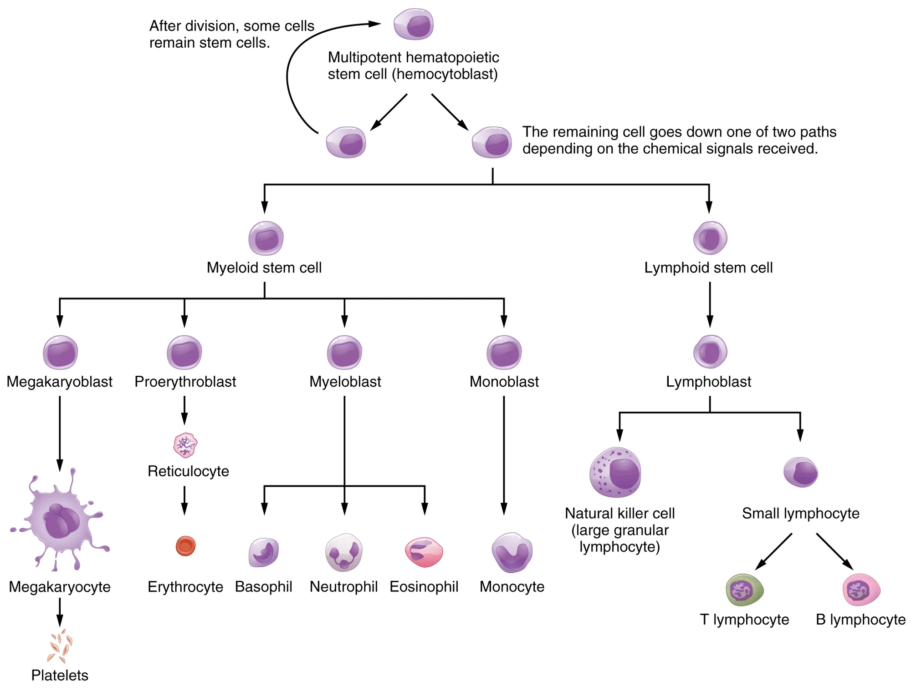
Figure 20.1 · Hematopoiesis & Bone Marrow Lineages
WHAT TO NOTICE
Multipotent stem cell hierarchy (Fig 20.1):
Adult hematopoiesis occurs in the bone marrow from self-renewing hemocytoblasts that divide into myeloid and lymphoid stem cell lines.
Myeloid vs. Lymphoid branches:
Myeloid stem cells produce erythrocytes (RBCs), platelets (budded from megakaryocytes), neutrophils, monocytes, eosinophils, and basophils; lymphoid stem cells produce T, B, and NK lymphocytes.
Renal erythropoietin & raw materials:
Renal hypoxia triggers erythropoietin release; building RBCs requires iron (for hemoglobin) plus vitamin B12 and folate (for DNA synthesis during cell division).
Reticulocytes & 120-day RBC lifespan:
Immature RBCs enter blood as reticulocytes; mature RBCs circulate ~120 days before splenic macrophages recycle their iron.
Clinical Connection: Because all blood cells share one marrow stem cell pool, marrow disorders (aplastic anemia, acute leukemia, chemotherapy) often lower RBCs, WBCs, and platelets together.
Medical-Surgical Nursing: A Canadian Open Text
Chapter 20 · Hematologic Disorders & Transfusion
Notes:
Examine Figure 20.1 (OpenStax Hematopoietic System of Bone Marrow):
- Point out why a single bone marrow insult (such as acute myeloid leukemia or aplastic anemia) causes simultaneous anemia (low RBCs), infection risk (low neutrophils), and bleeding risk (low platelets from megakaryocytes).
- Connect kidney function to erythropoiesis: damaged kidneys in CKD produce insufficient erythropoietin (Chapter 27).

Slide 6
SECTION 20.1 · TABLE 20.1: CBC, FERRITIN & CLOTTING TESTS IN SI UNITS
Reading Canadian hematology labs and red cell indices [RN]
Always interpret results against the patient's own lab report range and act immediately on phoned critical values.
Core CBC & Critical Values
Going Deeper [RN]: Indices
Ferritin & Clotting Tests
Hemoglobin (g/L): Example adult female 120–160, male 135–175 g/L; inpatient critical value < 70 g/L (Question 9).
Hematocrit (L/L): Female 0.36–0.48, male 0.40–0.52 L/L; RBC count reported as x 10^12/L.
WBC & Differential (x 10^9/L): Total WBC 4.0–11.0; always check Absolute Neutrophil Count (1.8–7.5 x 10^9/L) for bacterial infection risk!
Platelets (x 10^9/L): Example range 140–400 x 10^9/L; inpatient critical value < 10 x 10^9/L.
Mean Corpuscular Volume (MCV, 80–100 fL): Sorts anemia into Microcytic (< 80 fL: iron deficiency, thalassemia trait), Normocytic (80–100 fL: acute bleed, inflammation, CKD, hemolysis, marrow failure), or Macrocytic (> 100 fL: B12/folate deficiency, reticulocytosis, hydroxyurea; Q18).
RDW (< 16.0%): High RDW shows mixed cell sizes (anisocytosis), classic in early/evolving iron deficiency.
Reticulocyte count: Low in production failure (iron/B12/folate lack); high in bleeding/hemolysis; surges 5–7 days after starting treatment (Q20).
Serum Ferritin (ug/L): Preferred screening test for iron deficiency (< 45 ug/L in anemia supports deficiency; Q5). Acute-phase reactant — rises with inflammation/infection!
INR: Standardized PT for warfarin, liver disease, or vitamin K deficiency.
aPTT (seconds): Rises with UFH, hemophilia A/B, or inhibitors; range shifts with lab reagent lots (e.g., 26–36 s to 28–38 s).
Fibrinogen (g/L) & D-dimer: Fibrinogen falls and D-dimer rises when clots form and break down in DIC (Q38).
Medical-Surgical Nursing: A Canadian Open Text
Chapter 20 · Hematologic Disorders & Transfusion
Notes:
Review Table 20.1 and the Going Deeper [RN] box on Red Cell Indices (Alberta Health Services, 2023; APL & DynaLIFE, 2021):
- Drill Questions 5, 9, 18, 19, and 20:
* Question 5: Hb 94 g/L + MCV 71 fL (microcytic) + RDW 18.5% (high) + ferritin 6 ug/L (depleted stores) = **Iron deficiency anemia**.
* Question 9: When the lab phones a critical Hb of 66 g/L at 0300 (down from 92 g/L yesterday) in a light-headed patient, repeat back the critical value, **assess the patient and vital signs immediately, and notify the prescriber at once**.
* Question 18 [RN]: Hb 98 g/L + MCV 114 fL (macrocytic) + low reticulocyte count = **Vitamin B12 or folate deficiency**.

Slide 7
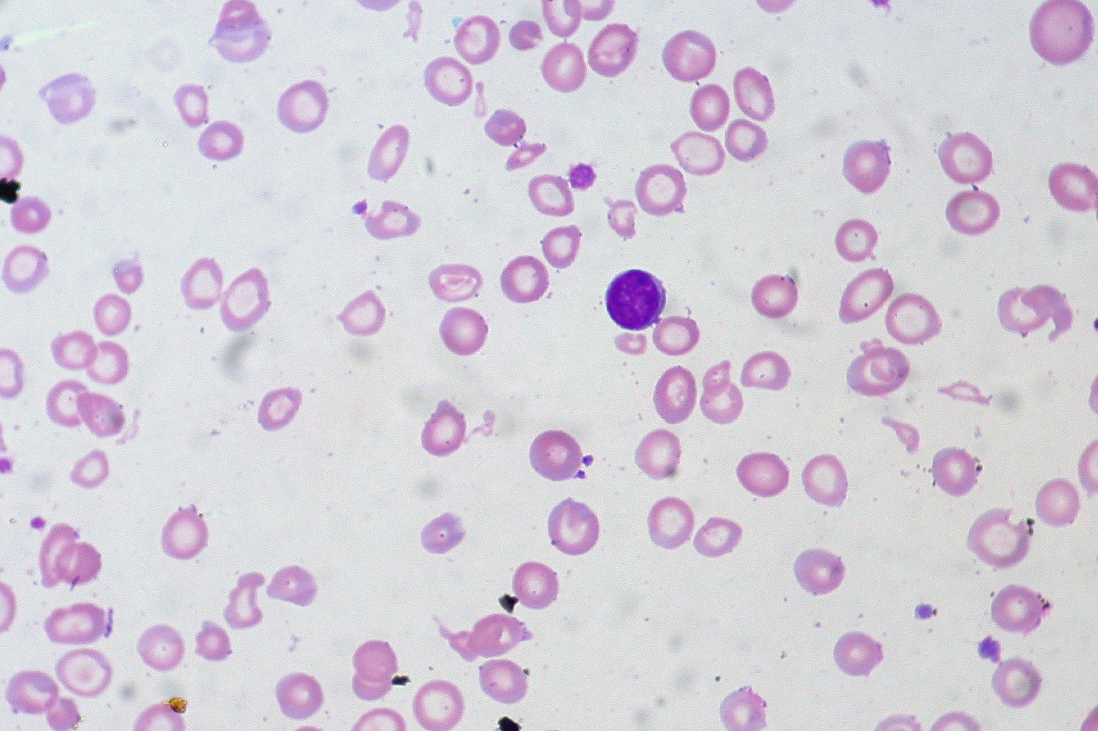
Figure 20.2 · Iron Deficiency Anemia & GI Workup
WHAT TO NOTICE
Microcytic, hypochromic blood smear (Fig 20.2; Q5):
Red cells are small (low MCV < 80 fL) and pale (low MCHC) with wide central pallor and variable sizes (high RDW). Iron stores (ferritin) drop first before Hb falls.
Common causes of iron loss & malabsorption:
Heavy menstrual bleeding, occult GI bleeding (ulcers, polyps, colorectal/gastric cancer, NSAIDs), pregnancy, malabsorption (celiac disease, IBD, bariatric/gastric surgery), or low heme-iron intake.
Mandatory GI malignancy & celiac workup (Ko et al., 2020; Q11):
In men and postmenopausal women with newly diagnosed iron deficiency anemia (ferritin < 45 ug/L), AGA guidelines recommend bidirectional endoscopy (upper endoscopy + colonoscopy) and celiac screening!
Older adults (Lifespan box; Patel & Guralnik, 2009):
Never dismiss anemia as 'normal aging' — it increases falls, frailty, HF decompensation, and mortality. Always investigate the source and review NSAIDs/anticoagulants.
Exam Priority (Question 11): In a 68-year-old postmenopausal woman with new iron deficiency anemia, anticipate upper endoscopy and colonoscopy to rule out occult GI cancer.
Medical-Surgical Nursing: A Canadian Open Text
Chapter 20 · Hematologic Disorders & Transfusion
Notes:
Examine Figure 20.2 (peripheral blood smear in severe iron deficiency anemia showing microcytic, hypochromic cells with wide pale centres):
- Emphasize Practice Question 11: Iron deficiency anemia is a sign, not a final diagnosis. In men and postmenopausal women, starting oral iron without investigating the GI tract (upper endoscopy and colonoscopy) can allow a colon or gastric carcinoma to progress undetected (Ko et al., 2020).

Slide 8
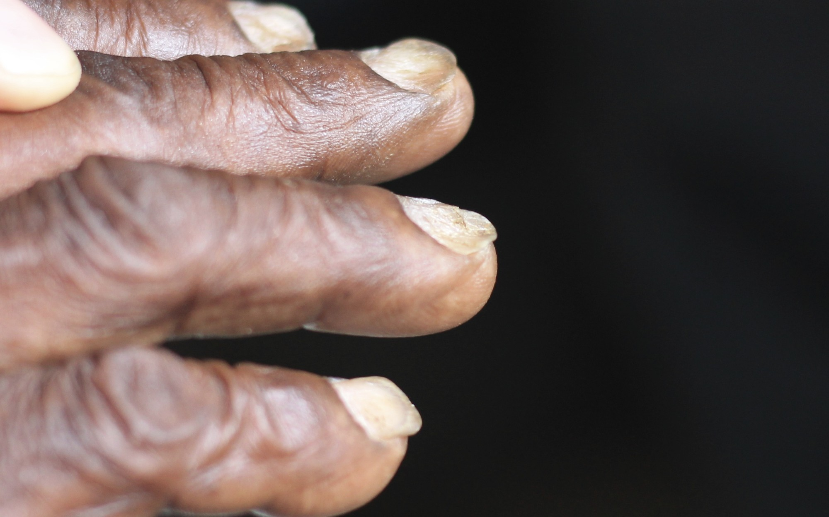
Figure 20.3 · Koilonychia, Pallor & Iron Therapy
WHAT TO NOTICE
Koilonychia in chronic iron deficiency (Fig 20.3):
Thin, brittle fingernails that flatten and curve upward at the edges into a concave 'spoon' shape — a classic nail cue visible across all skin tones.
Assessing pallor on darker skin tones (Question 6):
Inspect sites where melanin does not mask capillary colour: lower palpebral conjunctiva, oral mucosa/lips, nail beds, and palmar creases. Remember: SpO2 measures % saturation of available Hb, so SpO2 is often 98–100% even in severe anemia!
Oral iron patient teaching (Question 7; Health Canada, 2025):
Take with vitamin C (orange juice/fruit) to boost absorption; wait 1–2 hours before having tea, coffee, calcium supplements, or antacids. Expect dark stools, nausea, or constipation (lock away from children!). Hb should rise after ~1 month.
Intravenous iron safety (Question 12; Health Canada, 2024):
Anaphylaxis can occur with ANY IV iron dose even if prior doses were tolerated. If flushing or chest tightness occurs, STOP the infusion, stay with the patient, monitor vitals, and call the prescriber. (Note: ferric carboxymaltose can cause severe hypophosphatemia).
Escalation Cues (Question 10): If a stable anemia patient develops HR 124 bpm, new chest discomfort, and melena, the RPN stays with the patient, checks vitals, and consults the RN at once.
Medical-Surgical Nursing: A Canadian Open Text
Chapter 20 · Hematologic Disorders & Transfusion
Notes:
Examine Figure 20.3 (Koilonychia / spoon-shaped nails on dark skin) and review the Patient Education and Medications boxes:
- Drill Questions 6, 7, 10, and 12:
* Question 6: Assess pallor on dark brown skin by inspecting the **inner lower eyelids (conjunctiva), mouth, nail beds, and palms** (and never rely on SpO2 to rule out anemia).
* Question 7: Take oral iron with **orange juice (vitamin C)** and **wait 1–2 hours before drinking tea or coffee or taking calcium**.
* Question 12: If facial flushing and chest tightness develop during an IV iron infusion, **stop the infusion immediately, stay with the patient, monitor closely, and notify the prescriber**.

Slide 9
SECTION 20.2 · TABLE 20.2: MEGALOBLASTIC & OTHER ANEMIAS
Vitamin B12, folate, inflammatory & hemolytic anemias
Vitamin B12 is essential for both DNA synthesis and myelin maintenance — untreated deficiency causes permanent spinal cord injury.
Vitamin B12 & Folate Deficiency (Macrocytic)
Inflammation, Hemolytic & Aplastic Anemias
Large RBCs (MCV > 100 fL) with low reticulocytes (Question 18)
Hepcidin iron trapping, premature RBC lysis & marrow failure
Causes of B12 deficiency (Question 13):
Pernicious anemia (autoimmune loss of gastric intrinsic factor -> lifelong B12 therapy!), gastrectomy/bariatric surgery, ileal Crohn disease/resection, long-term metformin or PPI therapy, strict vegan diet, and older age.
Neurologic cues of B12 lack (Question 8):
Paresthesias (numbness/tingling in hands and feet), ataxia (unsteady gait), cognitive 'brain fog', and depression; spinal cord damage becomes irreversible if untreated > 3 months. Never give folic acid alone without checking B12!
Early potassium drop during B12 therapy [RN] (Q20):
As brisk erythropoiesis restarts (reticulocytes peak at days 5–7), proliferating cells uptake potassium rapidly -> monitor serum K+ closely in the first 48 hours of treating severe B12 deficiency!
Anemia of inflammation (Weiss et al., 2019):
Most common anemia in hospitalized/chronically ill adults; inflammatory cytokines raise hepcidin, blocking gut iron absorption and trapping iron in macrophages -> low serum iron with NORMAL or HIGH ferritin.
Hemolytic anemia (Phillips & Henderson, 2018):
Premature RBC destruction (inherited HbS/thalassemia/G6PD, autoimmune, drugs, transfusion reaction, DIC) -> scleral/palatal jaundice, dark urine, high reticulocytes, high LDH & unconjugated bilirubin, and low haptoglobin.
Aplastic anemia (Young, 2018):
Immune/toxic bone marrow failure causing pancytopenia (anemia + neutropenic infections + thrombocytopenic bleeding); treated with immunosuppression or stem cell transplant.
Clinical Pearl: Always check scleral icterus, the hard palate, and palms in natural light when assessing for hemolytic jaundice on darker skin tones.
Medical-Surgical Nursing: A Canadian Open Text
Chapter 20 · Hematologic Disorders & Transfusion
Notes:
Review Table 20.2 (Patel & McGuirk, 2025; Eugia Pharma, 2023; Weiss et al., 2019; Phillips & Henderson, 2018; Young, 2018):
- Drill Questions 8, 13, and 20:
* Question 8: Untreated pernicious anemia presents with **numbness/tingling in the feet (peripheral neuropathy) and an unsteady gait (ataxia)**—whereas spoon nails/ice craving are iron deficiency, and jaundice/dark urine are hemolysis.
* Question 13: Risk factors for B12 deficiency include **long-term metformin, previous gastric surgery, and long-term PPIs** (whereas heavy menses and NSAIDs cause iron deficiency).
* Question 20 [RN]: Starting cyanocobalamin in severe pernicious anemia triggers a **reticulocyte surge within 5–7 days and a risk of acute hypokalemia in the first 48 hours**.

Slide 10
PART TWO · SECTION 20.3
Sickle Cell Disease & Thalassemia
Hemoglobin S polymerization, vaso-occlusive crises, acute chest syndrome, functional asplenia, confronting anti-Black racism, hydroxyurea, and iron chelation.
Notes:
Part Two covers Section 20.3: How Hemoglobin S causes chronic hemolysis and vaso-occlusion, how to recognize life-threatening sickle cell emergencies (acute chest syndrome, febrile asplenia, stroke, splenic sequestration, priapism), how to deliver rapid, equitable analgesia within 30 minutes of triage, and how to manage hydroxyurea and thalassemia iron overload.

Slide 11
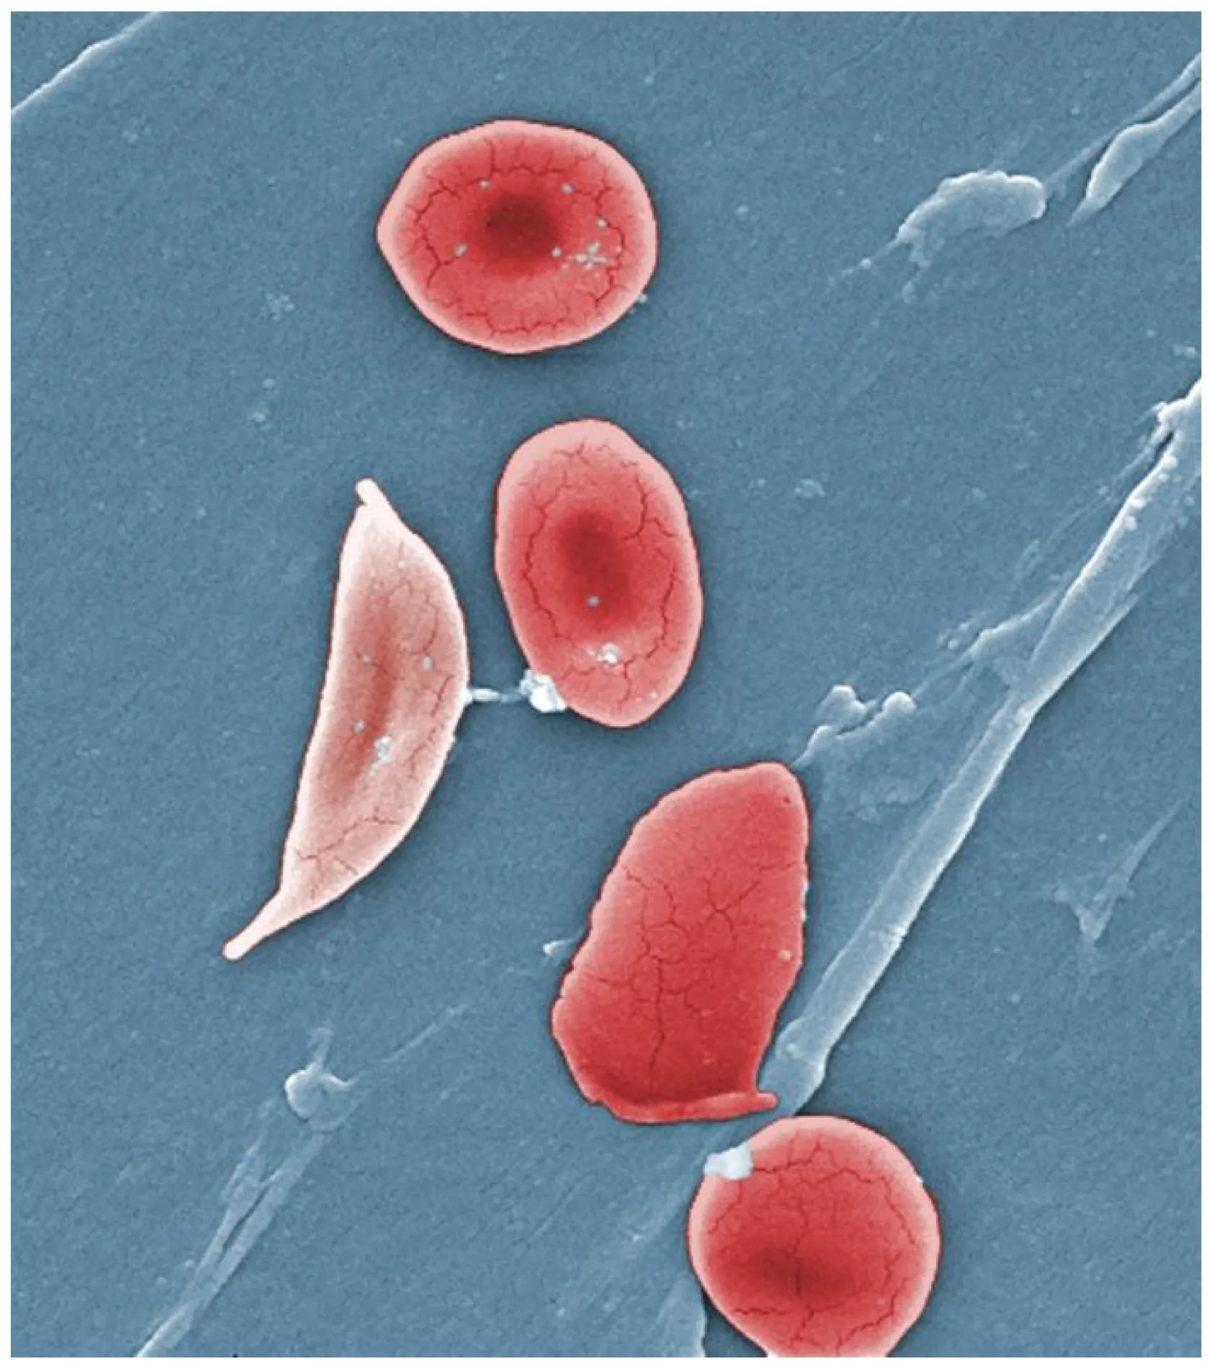
Figure 20.4 · Sickle Cell Disease & Emergencies
WHAT TO NOTICE
HbS sickling vs. Sickle Cell Trait (Fig 20.4; Q16):
Deoxygenated HbS polymerizes into rigid rods, distorting RBCs into sticky crescents that lyse early (hemolysis) and plug microvessels (vaso-occlusion). Sickle cell trait (1 HbS gene) is a carrier state — carriers generally do not have the disease (never progresses to SCD!) but can pass the gene on; occurs across all ancestries.
Acute Chest Syndrome — #1 cause of death (Q14 & Q3):
Defined by a NEW pulmonary infiltrate on CXR plus >= 1 of: fever, chest pain, tachypnea, wheezing, or cough. Can evolve during a pain crisis -> keep SpO2 >= 95%, careful fluids, incentive spirometry (Q4), urgent hematology consult, and simple/exchange transfusion.
Functional asplenia & fever emergency (Question 15):
Repeated splenic infarction leaves patients vulnerable to encapsulated bacteria (give pneumococcal, meningococcal, Hib, annual flu & Hep B vaccines). Fever >= 38.0 °C is an emergency: instruct outpatients to go to the ED immediately for parenteral antibiotics within 30 minutes (do not wait for culture results!).
Other acute SCD emergencies (Ontario Health, 2023):
Stroke (focal weakness/speech change), splenic sequestration (rapidly enlarging painful spleen + sharp Hb drop), priapism >= 4 hours, or acute anemia (Hb drop >= 20 g/L below baseline).
Exam Alert (Questions 3, 14, 15): New chest pain, fever (38.5 °C), and falling SpO2 (91%) during a vaso-occlusive crisis signal Acute Chest Syndrome — notify the physician immediately!
Medical-Surgical Nursing: A Canadian Open Text
Chapter 20 · Hematologic Disorders & Transfusion
Notes:
Examine Figure 20.4 (scanning electron micrograph comparing normal biconcave erythrocytes with a rigid crescent sickle cell) and review CanHaem (2014) and Ontario Health (2023):
- Drill Questions 3, 4, 14, 15, and 16:
* Any fever in a person with sickle cell disease requires immediate emergency department evaluation and IV/IM antibiotics within 30 minutes of arrival because of functional asplenia (Question 15).
* Incentive spirometry (10 breaths every 1–2 hours while awake) keeps alveoli expanded and prevents atelectasis and acute chest syndrome in patients admitted with back or chest vaso-occlusive pain (Question 4).

Slide 12
SECTION 20.3 · VASO-OCCLUSIVE CRISIS & HEALTH EQUITY
Ontario Health (2023) quality standards and anti-racist care
In an Ontario study of ED visits for sickle cell crises, adults waited ~90 minutes on average to see a physician (Chan et al., 2020).
Vaso-Occlusive Crisis Care (Ontario Health, 2023)
Challenging Stigma & Anti-Black Racism
Rapid triage & analgesia target (Question 1): Triage at CTAS Level 2 (or higher); start analgesia within <= 30 minutes of triage (or <= 60 minutes of arrival) guided by the patient's individualized sickle cell care plan!
Frequent reassessment: Monitor pain score, sedation scale, respiratory rate, and SpO2 closely to titrate opioids effectively while catching hypoventilation early.
Fluid & oxygen rules (Question 1): Encourage oral fluids or ordered maintenance IV fluids — AVOID overhydration (triggers pulmonary edema and acute chest syndrome!). Do NOT apply routine oxygen in an uncomplicated crisis if SpO2 is normal.
Adjunctive care & discharge planning: Use heat packs (never ice, which vasoconstricts and worsens sickling!), incentive spirometry (Question 4), and a written home pain/follow-up plan.
Canadian Context (Ontario Health, 2023): ~6,500 Canadians live with SCD (~3,500 in Ontario), predominantly Black and other racialized people. Statement 1 of the Ontario Quality Standard mandates care free from racism, anti-Black racism, and stigma.
Unfolding Case 1 — Ms. Abena Owusu, 27yo (Questions 1–4): Arrives at 0215 with 9/10 back/thigh pain and her clinic care plan; a staff member says, 'She's in here every month looking for opioids.'
How the nurse responds (Question 2): Challenge the biased remark respectfully ('Her frequent visits reflect her disease'), never order a urine drug screen before analgesia, never chart 'drug-seeking' labels, and give her care-plan analgesia within 30 minutes!
Clinical Judgment Case (Mr. Daniel Boateng, 24yo): First opioid dose given 20 min after triage; at 6 hours, new left chest pain + T 38.4 °C + SpO2 90% -> O2, upright position, SBAR for acute chest syndrome.
Medical-Surgical Nursing: A Canadian Open Text
Chapter 20 · Hematologic Disorders & Transfusion
Notes:
Review the Canadian Context box, Clinical Judgment case (Mr. Daniel Boateng, 24yo), and Unfolding Case 1 (Ms. Abena Owusu, 27yo, Questions 1–4):
- Emphasize why routine oxygen and aggressive IV fluid boluses are avoided in an uncomplicated vaso-occlusive crisis with normal SpO2 (Question 1), and why challenging stigmatizing "drug-seeking" comments from colleagues (Question 2) is an essential professional competency.

Slide 13
SECTION 20.3 · HYDROXYUREA, THALASSEMIA & IRON CHELATION
Hydroxyurea therapy and managing transfusion iron overload
Each transfused unit of red cells adds 200–250 mg of iron that the body cannot excrete without iron chelation therapy.
Long-Term Sickle Cell Care & Hydroxyurea
Thalassemia & Iron Overload Chelation
Fetal hemoglobin induction and hazardous-drug precautions
Globin chain deficiency in South Asian, Mediterranean & N. African populations
How hydroxyurea works (CanHaem, 2014):
Increases fetal hemoglobin (HbF), which prevents HbS polymerization; strongly recommended for adults with >= 3 pain crises/year or after even 1 episode of acute chest syndrome (note: causes macrocytosis on CBC).
Hazardous drug & contraception rules (Question 17):
Myelosuppressive (monitor CBC regularly) and teratogenic -> use reliable contraception during therapy and for >= 6 months (women) or >= 1 year (men) after stopping. Wear gloves when handling capsules and NEVER open capsules (Eugia Pharma, 2024)!
Pediatric-to-adult transition (ages 15–24):
High-risk period; Ontario Health (2023) recommends a designated transition coordinator.
Thalassemia trait vs. iron deficiency [RN] (Question 19):
Both cause microcytosis (low MCV, e.g., 64 fL), but thalassemia trait shows a normal/elevated RBC count (e.g., 6.1 x 10^12/L) and NORMAL ferritin (110 ug/L) — do NOT give iron unless iron deficiency is proven!
Transfusion-dependent beta-thalassemia major:
Lifelong regular transfusions + increased gut iron absorption cause lethal iron overload in the heart (HF, arrhythmias), liver (cirrhosis), and endocrine glands (diabetes, hypothyroidism).
Three iron chelators in Canada (CADTH, 2016):
1. Deferoxamine (slow overnight SC infusion); 2. Deferasirox (oral); 3. Deferiprone (oral — can cause severe neutropenia/agranulocytosis; monitor CBC and report fever or sore throat immediately!).
Clinical Distinction [RN] (Question 19): Always check serum ferritin before prescribing iron for microcytic anemia — giving iron to a patient with thalassemia trait worsens iron overload.
Medical-Surgical Nursing: A Canadian Open Text
Chapter 20 · Hematologic Disorders & Transfusion
Notes:
Compare Hydroxyurea management and Thalassemia care (CanHaem, 2014; Eugia Pharma, 2024; CADTH, 2016):
- Drill Question 17: Anyone handling hydroxyurea capsules wears gloves, capsules are never opened or sprinkled on food, regular blood counts are required, and reliable contraception is mandatory.
- Drill Question 19 [RN]: A 30-year-old man with Hb 122 g/L, very low MCV (64 fL), elevated RBC count (6.1 x 10^12/L), and normal ferritin (110 ug/L) has **thalassemia trait**, not iron deficiency anemia.

Slide 14
PART THREE · SECTIONS 20.4 & 20.5
Bleeding & Clotting Disorders & Blood Cancers
Thrombocytopenia, ITP, hemophilia A/B, von Willebrand disease, disseminated intravascular coagulation (DIC), leukemia, lymphoma, and multiple myeloma (CRAB).
Notes:
Part Three covers Sections 20.4 and 20.5: Recognizing and protecting patients with thrombocytopenia and ITP, delivering immediate FactorFirst replacement in hemophilia, identifying DIC consumption labs, and caring for patients with acute/chronic leukemias, Hodgkin and non-Hodgkin lymphomas, and multiple myeloma.

Slide 15
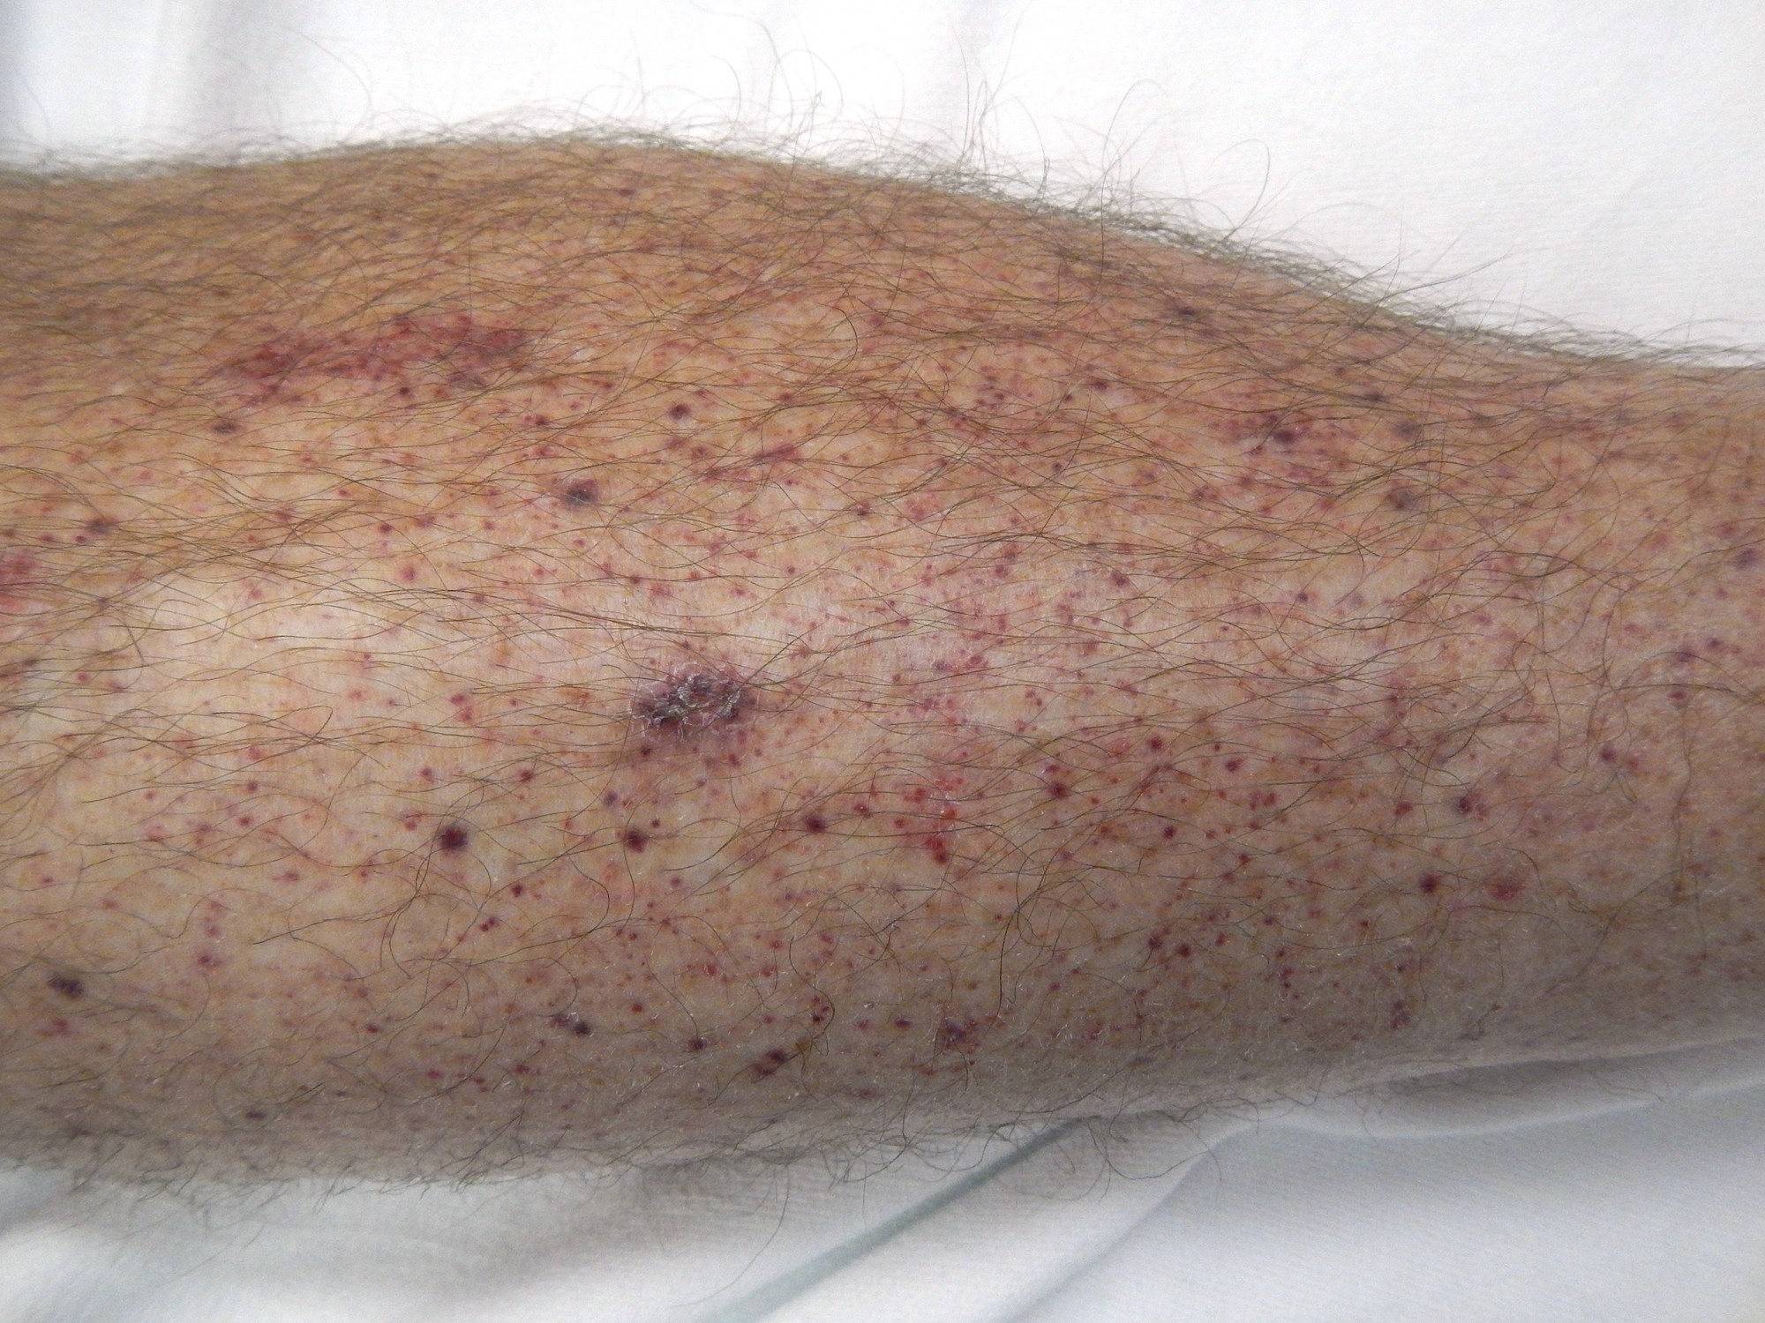
Figure 20.5 · Thrombocytopenia, ITP & Bleeding Care
WHAT TO NOTICE
Petechiae & purpura across skin tones (Fig 20.5; Q28):
Pinpoint non-blanching petechiae (Fig 20.5), purpura, ecchymoses, epistaxis, gingival oozing, hematuria, or melena. On dark skin, bruises look darker (not blue) and fluorescent light adds a bluish cast -> use natural/indirect light and inspect oral mucosa, gums, palate, and conjunctivae!
Immune Thrombocytopenia (ITP; ASH 2019):
Autoimmune platelet destruction; treat newly diagnosed adult ITP < 30 x 10^9/L with short-course corticosteroids or IVIG. Reserve platelet transfusions in ITP for life-threatening bleeding!
Inpatient bleeding precautions (Question 27):
Extra-soft toothbrush, electric razor, NO rectal thermometers/suppositories/enemas, check with prescriber before any IM injection, prevent constipation/straining, hold firm pressure on venipunctures, prevent falls, and avoid ASA/NSAIDs.
Prophylactic platelet transfusion threshold (CSTM, 2026):
For therapy-induced hypoproliferative thrombocytopenia, transfuse 1 dose of platelets when count is < 10 x 10^9/L (higher for procedures, active bleeding, or APL < 30–50 x 10^9/L).
Neurologic Emergency: In any patient with severe thrombocytopenia, a new headache, blurred vision, or change in LOC signals intracranial hemorrhage — escalate immediately!
Medical-Surgical Nursing: A Canadian Open Text
Chapter 20 · Hematologic Disorders & Transfusion
Notes:
Examine Figure 20.5 (petechiae and purpura on the lower leg in severe immune thrombocytopenia) and review Questions 27 and 28:
- Drill Question 27: For a chemotherapy patient with platelets of 18 x 10^9/L, use an extra-soft toothbrush, offer an electric razor, check before any IM injection, and prevent straining at stool—never take a rectal temperature or give ASA!
- Drill Question 28: To assess petechiae in a patient with dark skin, inspect the **oral mucosa and conjunctiva in natural or indirect light** (avoid relying on room fluorescent light).

Slide 16
SECTION 20.4 · HEMOPHILIA, VON WILLEBRAND DISEASE & DIC [RN]
Inherited factor deficiencies and disseminated intravascular coagulation
In hemophilia, factor replacement comes FIRST at the earliest aura of a joint, head, or throat bleed — never delay for imaging.
Hemophilia A & B and von Willebrand Disease
Disseminated Intravascular Coagulation (DIC)
Factor VIII/IX deficiency, FactorFirst cards & mucosal VWD
Systemic microvascular thrombosis + factor/platelet consumption
Hemophilia A (Factor VIII, 80–85%) & B (Factor IX):
X-linked (~3,900 Hemophilia A & ~800 B in Canada; female carriers can bleed). Severe < 1 IU/dL, moderate 1–5, mild > 5.
Joint bleed priority & FactorFirst card (Question 29):
Joint bleed (hemarthrosis) or head/throat bleed: follow the FactorFirst card and infuse factor concentrate IMMEDIATELY (pair with rest/ice; no heat, ROM, or IM shots!; Q29). Prophylaxis uses factor or emicizumab.
Von Willebrand Disease (VWD — 1 in 1,000):
Most common inherited bleeding disorder; mucosal/menstrual bleeding treated with DDAVP (not type 2B), VWF/FVIII concentrates, and tranexamic acid (no cryoprecipitate).
Triggers & dual clinical picture (Question 36):
Sepsis, trauma, OB, or cancer triggers microthrombi (mottled digits, oliguria) + consumptive oozing from IV sites. If oozing + BP 86/50 occurs in sepsis, call rapid response via SBAR (Q36)!
Going Deeper [RN]: DIC Lab Pattern & ISTH Score (Q38–39):
Falling platelets (140->62) & fibrinogen (2.8->1.1 g/L), rising D-dimer, and prolonged PT. ISTH overt DIC score >= 5 = overt DIC.
Treatment & PCC contraindication:
Treat the underlying trigger first; replace platelets, fibrinogen, or plasma as needed. PCC is CONTRAINDICATED in DIC!
Exam Trap (Questions 29, 36, 38, 39): Never give PCC in DIC, never use cryoprecipitate for hemophilia A/VWD, and never delay factor replacement in a hemophilia joint or head bleed.
Medical-Surgical Nursing: A Canadian Open Text
Chapter 20 · Hematologic Disorders & Transfusion
Notes:
Review Hemophilia, VWD, and DIC (Poon et al., 2022; Srivastava et al., 2020; Popescu et al., 2022):
- Drill Question 29: When a man with severe hemophilia A arrives with a warm, swollen, painful knee and a FactorFirst card, the priority is to **follow the card and notify the prescriber so factor VIII replacement starts without delay** (never apply heat, never force ROM, and never give an IM analgesic).
- Drill Questions 36, 38, and 39 on DIC: Know the 4 ISTH overt DIC score parameters (platelets, PT, fibrinogen, D-dimer; score >= 5 = overt DIC) and why PCC is strictly contraindicated.

Slide 17
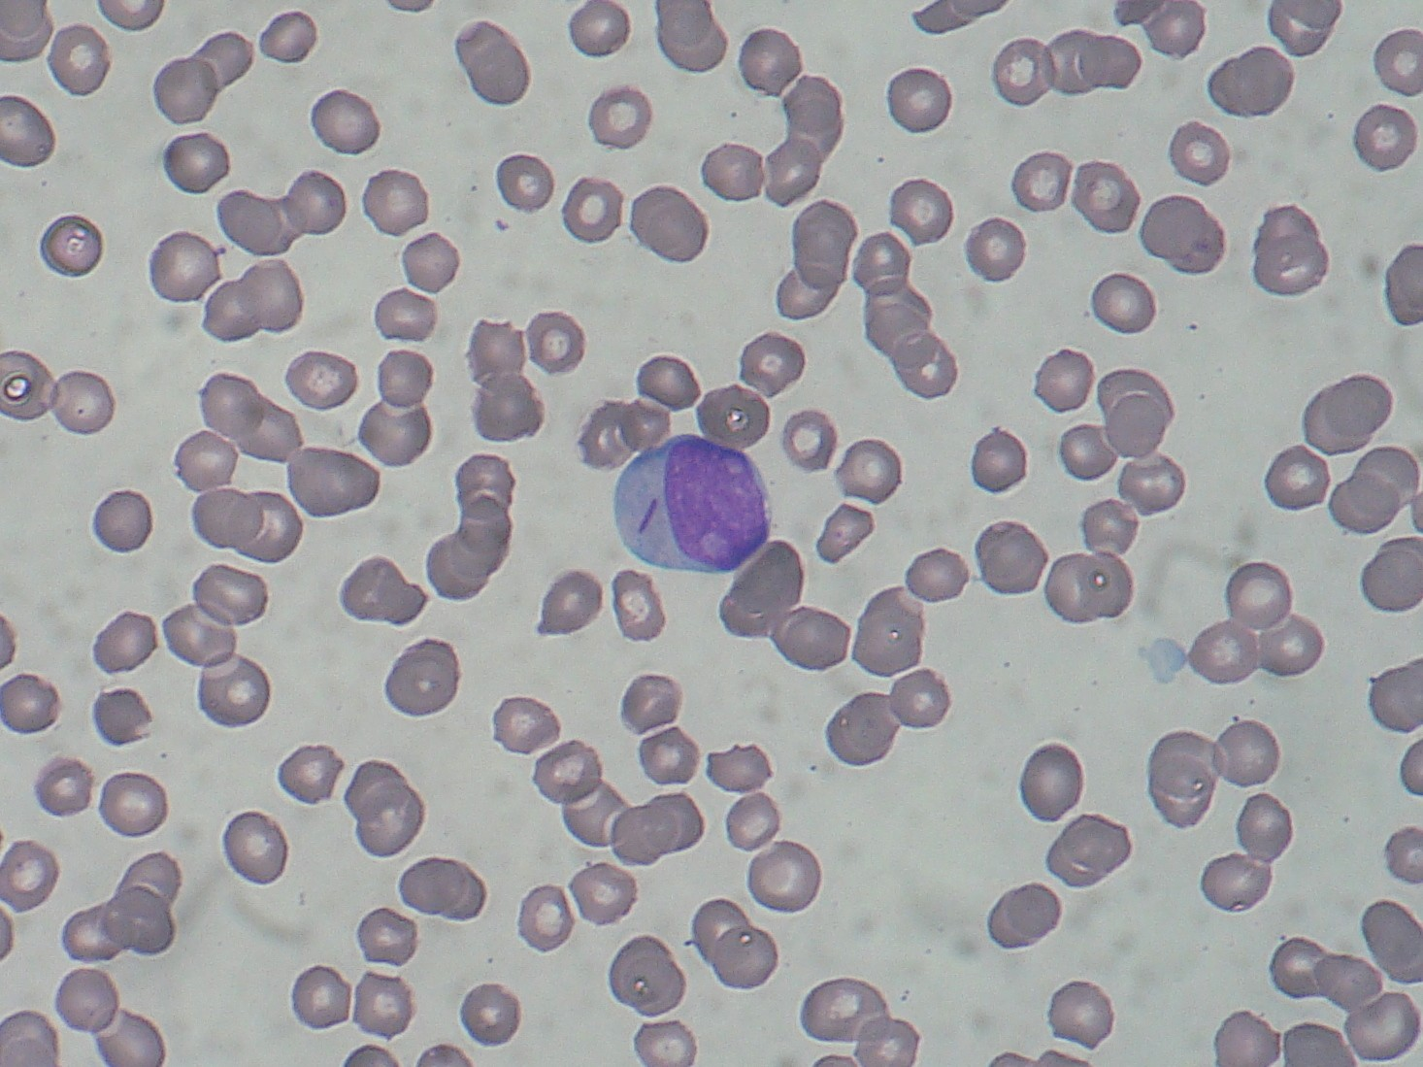
Figure 20.6 · Leukemias & Auer Rods in AML
WHAT TO NOTICE
Myeloblast with Auer rod (Fig 20.6):
Peripheral blood smear shows a large immature myeloblast containing a needle-like cytoplasmic Auer rod — a classic diagnostic hallmark of Acute Myeloid Leukemia (AML).
Four major leukemia classifications (6,500 cases/yr in Canada):
Classified by acuity (Acute = rapid immature blast proliferation over days/weeks; Chronic = slower over months/years) and cell lineage: AML, ALL, CML, and CLL.
Clinical triad of bone marrow crowding:
1. Anemia (fatigue, dyspnea, pallor); 2. Functional neutropenia (fever and recurrent severe infections despite high or low total WBC); 3. Thrombocytopenia (petechiae, gingival bleeding, epistaxis).
Acute Promyelocytic Leukemia (APL) exception:
A subtype of AML with high early risk of DIC-like hemorrhage and thrombosis — Canadian Blood Services sets a higher platelet threshold (< 30–50 x 10^9/L) and routine preventive fibrinogen replacement.
Clinical Priority (Question 31): In any patient with leukemia and neutropenia, strict hand hygiene and teaching the patient to report the very first fever immediately are life-saving.
Medical-Surgical Nursing: A Canadian Open Text
Chapter 20 · Hematologic Disorders & Transfusion
Notes:
Examine Figure 20.6 (Myeloblast with an Auer rod in AML) and review Section 20.5 (Canadian Cancer Society, 2022, 2026b):
- Point out why a patient with leukemia can have a total WBC count of 80 x 10^9/L and still die of overwhelming bacterial sepsis: the circulating cells are non-functional leukemic blasts that crowd out mature neutrophils.

Slide 18
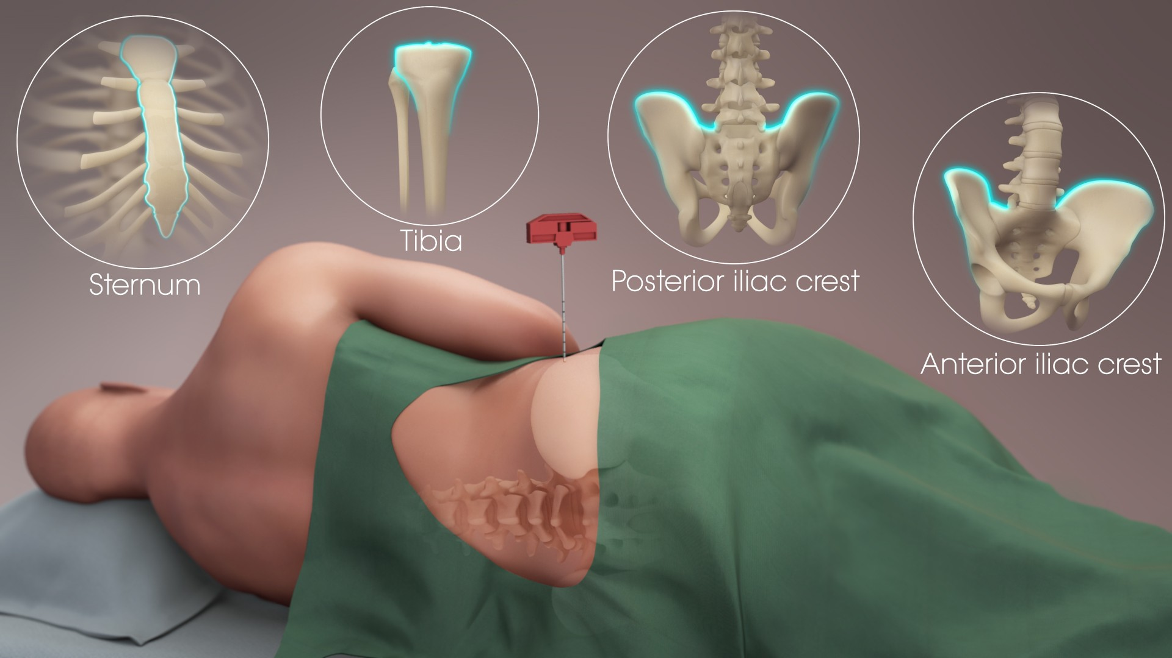
Figure 20.7 · Marrow Biopsy, Lymphoma & Myeloma
WHAT TO NOTICE
Bone marrow aspiration & biopsy sites (Fig 20.7):
Posterior iliac crest (most common in adults), anterior iliac crest, sternum (aspiration only), and tibia (infants). Post-procedure nursing priority: apply pressure and monitor site closely for bleeding/hematoma, especially when platelets are low.
Hodgkin (1,250/yr) vs. Non-Hodgkin Lymphoma (12,100/yr):
Presents with painless, firm lymphadenopathy (neck, axilla, groin), pruritus, and 'B symptoms' (NAACCR, 2025): 1. Unexplained fever > 38 °C; 2. Drenching night sweats (soaking bedclothes); 3. Unexplained weight loss > 10% over 6 months.
Multiple Myeloma (4,400/yr) — 'CRAB' features:
Malignant plasma cells in marrow cause: Calcium elevation (thirst, polyuria, constipation, nausea, confusion/drowsiness), Renal failure, Anemia, and Bone lytic lesions/pathologic fractures (back, ribs, hips, skull).
Myeloma emergencies & bone safety (Question 30):
New confusion + constipation + thirst = hypercalcemia -> check serum calcium and report immediately! New back pain + leg weakness/numbness or urinary retention = spinal cord compression emergency. Prevent falls and avoid twisting/lifting.
Exam Alert (Question 30): When a patient with multiple myeloma develops new confusion, constipation, and extreme thirst, check the latest calcium level and report to the prescriber immediately.
Medical-Surgical Nursing: A Canadian Open Text
Chapter 20 · Hematologic Disorders & Transfusion
Notes:
Examine Figure 20.7 (Bone marrow biopsy sites) and review Lymphomas and Multiple Myeloma (Brenner et al., 2026; NAACCR, 2025; Canadian Cancer Society, n.d.-c, n.d.-d):
- Drill the **B symptoms** of lymphoma (fever > 38 °C, drenching night sweats, > 10% weight loss in 6 months) and the **CRAB** mnemonic of multiple myeloma (Calcium elevated, Renal failure, Anemia, Bone lytic lesions).
- Connect Question 30 directly to CRAB: confusion, constipation, and extreme thirst in myeloma are classic cues of acute hypercalcemia of malignancy.

Slide 19
SECTION 20.5 · BLOOD CANCER NURSING CARE & HEALTH EQUITY
Managing pancytopenia, stem cell transplant, and northern travel gaps
Patients from remote and Inuit communities often travel thousands of kilometres to southern cities for blood cancer care (Jull et al., 2021).
Managing Pancytopenia, TLS & Transplant
Inuit & Northern Cancer Equity (Jull et al., 2021)
Neutropenic infection prevention (Question 31): Meticulous hand hygiene and IPAC practices, avoiding visitors with respiratory/contagious illnesses, and treating any fever in neutropenia as a medical emergency (never wait for a second fever!).
Tumour Lysis Syndrome (TLS; Ch 9): Rapid destruction of abundant leukemia/lymphoma cells after chemotherapy releases intracellular potassium, phosphate, and uric acid (causing hypocalcemia and acute kidney injury) -> aggressive hydration, allopurinol/rasburicase, and electrolyte monitoring.
Stem cell transplant (Canadian Cancer Society, n.d.-e): Autologous (patient's own stem cells) vs. Allogeneic (donor stem cells).
Graft-versus-Host Disease (GVHD) & fertility: After allogeneic transplant, donor T cells can attack recipient skin, gut, and liver (GVHD). Ensure reproductive-age patients discuss fertility preservation BEFORE starting gonadotoxic therapy.
Geographic & structural reality: Specialized leukemia, myeloma, and transplant centres are located in major urban hospitals, forcing rural, remote, and northern patients to leave home for weeks or months.
Experiences of Inuit patients & medical escorts (Jull et al., 2021): Described feeling directed without adequate explanation of treatment options and isolated from family and community supports.
Culturally safe nursing actions: Explain every diagnostic and treatment step in plain language, arrange a professional Inuktitut interpreter whenever wanted, actively include the medical escort and family in shared decision-making, and connect patients with Indigenous patient navigators (e.g., Mamisarvik Healing Centre / Ottawa supports).
Medical-Surgical Nursing: A Canadian Open Text
Chapter 20 · Hematologic Disorders & Transfusion
Notes:
Review pan-hematologic cancer nursing care and the qualitative study by Jull et al. (2021) with Inuit patients and medical escorts:
- Emphasize how nurses bridge communication and cultural safety gaps when patients from Nunavut, Nunavik, Inuvialuit, or Nunatsiavut must relocate to southern tertiary centres for acute leukemia induction or stem cell transplantation.

Slide 20
PART FOUR · SECTION 20.6
Blood Components, Safe Transfusion & Transfusion Reactions
Canadian Blood Services and Héma-Québec components, restrictive thresholds, positive bedside identification, TACO vs. TRALI, and massive hemorrhage protocols.
Notes:
Part Four covers Section 20.6: How blood components and plasma protein products are regulated and prepared in Canada, when restrictive hemoglobin thresholds apply, how to perform the bedside identification check and 15-minute slow start, and how to respond immediately to any transfusion reaction.

Slide 21
SECTION 20.6 · TABLE 20.3: BLOOD COMPONENTS & RESTRICTIVE THRESHOLDS
Blood components, ABO/Rh rules, and Choosing Wisely
In a stable, non-bleeding adult, transfuse one unit of red cells at a time and reassess the patient and hemoglobin before giving another (CSTM, 2026).
4 Core Blood Components
Plasma Products & Emergency ABO
Restrictive RBC Thresholds
1. Red Blood Cell Concentrate: Leukoreduced; stored refrigerated; 1 unit raises Hb by ~10 g/L in a 70 kg non-bleeding adult (Rotin & Mack, 2025).
2. Platelets: Pooled or apheresis; stored at room temp (20–24 °C) with gentle agitation — NEVER refrigerate! Generally avoided in ITP, HIT, and TTP.
3. Frozen Plasma: Contains all clotting factors; thawed before use; must be ABO-compatible (not for volume or mildly raised INR).
4. Cryoprecipitate / Fibrinogen Concentrate: Replaces fibrinogen in bleeding (< 1.5–2.0 g/L); fibrinogen concentrate increasingly preferred in Canada.
Manufactured Plasma Protein Products: Albumin (not for routine volume), IVIG (start slow; watch for headache, chills & thrombosis up to 8 days post-infusion!), 4-factor PCC (contraindicated in DIC!), and Factor VIII/IX/VWF concentrates.
Emergency uncrossmatched RBCs (Trudeau et al., 2021; CSTM, 2026): Group O RhD-negative reserved for females <= 45 yr (child-bearing potential), children, and anti-D patients; Group O RhD-positive acceptable for adult males and postmenopausal females.
Group AB plasma: Universal plasma donor; conserve for AB patients and unknown-group emergencies.
Hb < 70 g/L: Most hospitalized patients, including ICU and oncology (Rotin & Mack, 2025).
Hb < 75 g/L: Post-cardiac surgery patients.
Hb < 80 g/L: Patients with acute cardiac ischemia or undergoing orthopedic surgery.
Choosing Wisely Canada (Question 37; CSTM, 2026): Give 1 unit at a time in stable non-bleeding patients and reassess; do NOT transfuse stable iron deficiency when iron works; standard 70 g/L cut-offs do NOT apply in sickle cell disease!
Medical-Surgical Nursing: A Canadian Open Text
Chapter 20 · Hematologic Disorders & Transfusion
Notes:
Review Table 20.3 (Rotin & Mack, 2025; Gabarin & Yan, 2024; Rutledge Harding et al., 2024; CSTM, 2026; Trudeau et al., 2021):
- Drill Question 37: When two units of RBCs are ordered for a stable, non-bleeding inpatient with Hb 66 g/L, **ask the prescriber whether one unit can be given and the patient and hemoglobin reassessed before giving the second unit** (preventing TACO, as illustrated in Mariam Haddad's Practice Story!).
- Note IVIG thrombosis risk (Rutledge Harding et al., 2024): watch for thromboembolic events during or up to 8 days after an IVIG infusion.

Slide 22
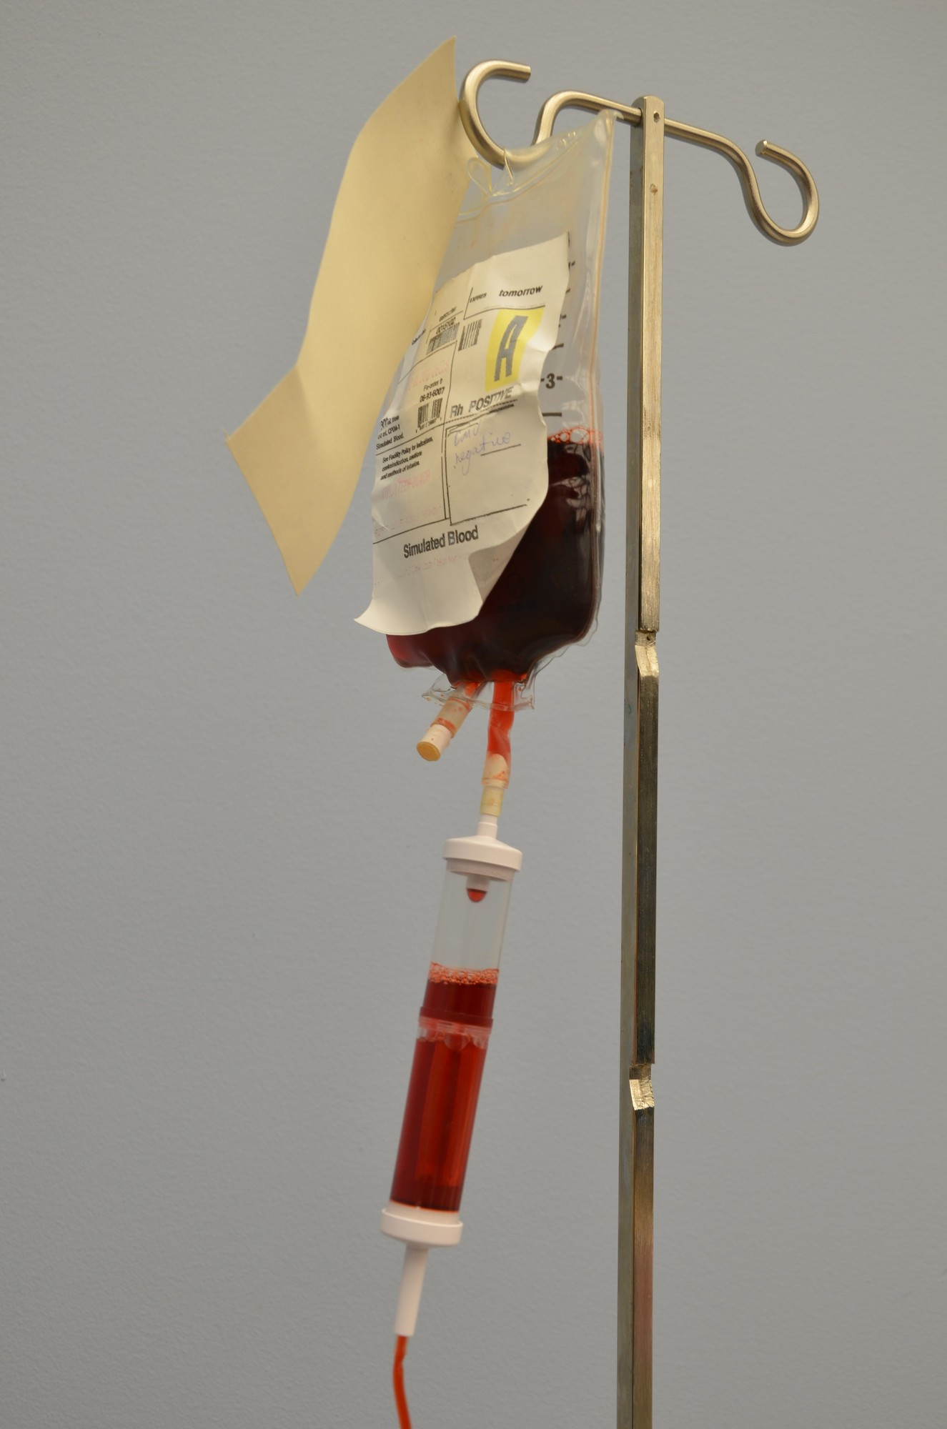
Figure 20.8 · Safe Blood Administration Protocol
WHAT TO NOTICE
Informed consent & respectful refusal (Question 34):
Document informed consent (benefits, risks, alternatives). A capable adult may refuse some or all blood products — never pressure or assume religious reasons; ask specifically which products/alternatives (e.g., IV iron, erythropoietin) they will accept and document.
Group & screen, crossmatch & dedicated IV line (Fig 20.8; Q33):
Label type & screen at the bedside in the patient's presence (must be drawn within 96 hours if transfused or pregnant in the past 3 months). Use a dedicated IV line (20–22G routine; 16–18G rapid) with a 170–260 micron in-line filter primed ONLY with 0.9% sodium chloride (NEVER D5W, Ringer's lactate, or medications!).
Positive bedside identification check (Question 32; O'Reilly, 2020):
In the patient's presence, have the patient state and spell their full name and state their birth date; match to the ID band, unit tag, and order (ABO/Rh, unit number, expiry, bag visual inspection). If any discrepancy exists, DO NOT START!
Rate, 15-minute observation & 4-hour rule:
Record baseline vitals within <= 30 min of start -> begin slowly at 50 mL/h for the first 15 minutes while staying with/closely observing the patient -> recheck vitals at 15 min and increase rate -> complete within 4 hours of issue from blood bank!
Golden Rule of Blood Administration: Every unit must finish within 4 hours of leaving the transfusion service refrigerator, and any change within 6 hours post-transfusion is treated as a possible reaction.
Medical-Surgical Nursing: A Canadian Open Text
Chapter 20 · Hematologic Disorders & Transfusion
Notes:
Examine Figure 20.8 (unit of red blood cells attached to a blood administration set with a 170–260 micron in-line filter) and review O'Reilly (2020) and Duncan (2020):
- Drill Questions 32, 33, and 34:
* Question 32: Have the patient **spell their name and give their birth date** at the bedside, matching these to the identification band, unit label, and order (never rely on room/bed numbers, a check at the desk, or a passive nod).
* Question 33: Only **0.9% sodium chloride** is infused with red cells (D5W causes hemolysis; Ringer's lactate contains calcium that clots citrated blood).
* Question 34: When a capable patient declines blood for Hb 68 g/L, ask **"Can you tell me what you will and will not accept, so the team can talk with you about other options?"**

Slide 23
SECTION 20.6 · TABLE 20.4: TRANSFUSION REACTIONS & TACO VS. TRALI [RN]
Immediate nursing actions and differentiating transfusion reactions
Most transfusion reactions begin within 1 to 30 minutes of starting the unit — initial nursing steps are identical for all reactions.
1. Universal First Actions (Q24–25, Q35): STOP transfusion; keep vein open with 0.9% NaCl on NEW tubing; stay with patient; recheck ID/tag; notify MD & blood bank; return bag.
5. TACO (Circulatory Overload): Within 12 h from excess volume -> dyspnea, crackles, JVD, hypertension, and rapid improvement after IV diuretics (Practice Story).
2. Acute Hemolytic Reaction (Q21–26): ABO incompatibility (ID error); early fever, chills, low back pain, hypotension, tachycardia, and dark red-brown urine (Q26).
6. TRALI (Acute Lung Injury): Within 6 h from non-cardiogenic pulmonary edema -> severe hypoxemia, bilateral infiltrates, fever, and hypotension.
3. Febrile & Minor Allergic: FNHTR: Temp rise > 1 °C / > 38 °C + chills without hemolysis. Minor Allergic: hives/itching (may restart within 4 h if ordered).
7. TACO vs. TRALI [RN] (Q40): Hypertension (BP 178/96), elevated BNP, and diuretic response favour TACO; fever, hypotension, and normal BNP favour TRALI.
4. Anaphylactic & Septic (Q35): Anaphylactic: wheeze, throat tightness, shock -> stop, rapid response, epinephrine! Septic: high fever, shock -> culture patient & bag.
8. Delayed Hemolytic & Reporting: Appears 1–2 weeks later with falling Hb, jaundice, and low-grade fever. Report all reactions to transfusion service hemovigilance.
Scope Priority (Question 35): If an RPN notices wheezing, hives, and throat tightness 20 minutes into a transfusion started by an RN, the RPN stops the transfusion, stays with the patient, and calls for urgent help!
Medical-Surgical Nursing: A Canadian Open Text
Chapter 20 · Hematologic Disorders & Transfusion
Notes:
Review Table 20.4 and the Going Deeper [RN] box on TACO vs. TRALI (Laureano et al., 2022; Shared Health, 2024; Yan, 2020):
- Drill Unfolding Case 2 (Ms. Diane Martel, Questions 21–26), Question 35, and Question 40 [RN]:
* Never flush existing blood tubing when stopping a reaction—disconnect the blood tubing at the hub and attach brand-new tubing primed with 0.9% sodium chloride so the 30–50 mL of blood inside the old tubing is not pushed into the patient!
* Never discard the blood bag or tubing in the biohazard bin—clamp, cap, and return the bag and attached tubing to the transfusion service for culture and crossmatch investigation (Question 25).

Slide 24
SECTION 20.6 · MASSIVE HEMORRHAGE, CNO SCOPE & PRACTICE STORY
Balanced resuscitation, citrate/calcium monitoring, and preventing TACO
The bedside critical administration threshold for massive hemorrhage is needing >= 3 red cell units within 1 hour (Trudeau et al., 2021).
Massive Hemorrhage Protocol (MHP)
CNO Scope & Practice Story (Mariam Haddad, RN)
Balanced ratios, tranexamic acid, warming & ionized calcium
Authority, competence, context & Mr. Lucien Thibodeau (86yo)
Balanced resuscitation & TXA (Trudeau et al., 2021):
Delivers uncrossmatched Group O RBCs, plasma, and platelets in balanced whole-blood ratios plus early fibrinogen replacement; in trauma, give IV tranexamic acid (TXA) within 3 hours of injury.
Preventing the lethal triad (hypothermia < 35 °C):
Run all components through an approved blood warmer, monitor core temperature continuously or >= q1h (temp < 35 °C impairs coagulation), and keep pressure bags <= 300 mm Hg.
Citrate toxicity & q1h labs:
Citrate preservative in blood products binds ionized calcium -> check labs (CBC, INR, fibrinogen, lactate, K+, and ionized Ca2+) at least every hour and replace calcium as ordered!
CNO Scope of Practice in Transfusion:
Employer policy governs who checks/hangs blood via authority, competence, and context. EVERY nurse who spots a reaction stops the unit, keeps the line open with new saline tubing, and escalates!
Practice Story — Mariam Haddad, RN & Mr. Thibodeau (86yo):
86yo man with HF and resolved GI bleed (Hb 64 g/L) received Unit 1 smoothly; Unit 2 was started after supper without rechecking his Hb or reassessing need.
Recognizing & treating TACO:
1 h into Unit 2, he developed dyspnea, crackles, SpO2 88%, and BP 138/74->172/90 (TACO). Stopping the unit, sitting upright, O2, and IV furosemide resolved it.
Practice Story Takeaway (Choosing Wisely Canada): Always question a multi-unit RBC order in a stable, non-bleeding patient, especially an older adult with heart failure or renal impairment.
Medical-Surgical Nursing: A Canadian Open Text
Chapter 20 · Hematologic Disorders & Transfusion
Notes:
Review Massive Hemorrhage Protocols (Trudeau et al., 2021), the Scope in Practice box, and Mariam Haddad's RN Practice Story ("One Unit at a Time"):
- Point out how the Practice Story brings together Chapter 18 (Heart Failure), Choosing Wisely Canada (Question 37), and TACO vs. TRALI (Question 40): Mr. Thibodeau's blood pressure climbed from 138/74 to 172/90 mm Hg with crackles and rapid response to an IV loop diuretic—classic TACO triggered by giving two units back-to-back without reassessment.

Slide 25
CHAPTER 20 · NCLEX-RN & REX-PN UNFOLDING CASES
Synthesizing sickle cell crises, transfusion reactions, and lab traps
Review the chapter's two unfolding question sets and high-yield exam priorities.
1
2
3
Case 1: Ms. Abena Owusu (27yo HbSS)
Case 2: Ms. Diane Martel (62yo AML)
High-Yield Lab & Safety Traps
Arrives at 0215 with 9/10 back/thigh vaso-occlusive pain and her clinic care plan; SpO2 97% RA; colleague makes a stigmatizing 'looking for opioids' comment (Questions 1–4).
• First 30 min (Q1): Start analgesia per her individualized care plan within 30 min of triage (no drug screen, no routine O2 at 97%, no fluid overload).
• Anti-racist advocacy (Q2): State that frequent visits reflect her disease and treat pain promptly.
• At 4 hours (Q3–4): New chest pain + T 38.5 °C + SpO2 91% = Acute Chest Syndrome -> notify MD immediately! Teach incentive spirometry to keep lungs open.
Hb 66 g/L; 10 min after starting 1 unit of RBCs, develops chills, lower back pain, T 37.1->38.8 °C, HR 88->122, and BP 128/76->92/54 mm Hg (Questions 21–26).
• Cues & interpretation (Q21–22): Back pain + hypotension + tachycardia = Acute hemolytic transfusion reaction (ABO incompatibility); circulation is top priority (Q23).
• Immediate actions (Q24–25): Stop transfusion, keep vein open with 0.9% NaCl on NEW tubing, call urgent help, recheck ID band vs. unit label, and save bag/tubing for blood bank.
• 1 hour later (Q26): Dark red-brown urine = hemoglobinuria from ongoing hemolysis -> report immediately!
• Microcytic (MCV 64) + high RBC count (6.1) + normal ferritin (110) = Thalassemia trait -> do NOT give iron (Q19).
• Severe B12 replacement -> reticulocytes surge at days 5–7 + risk of acute hypokalemia in first 48 h (Q20).
• Hemophilia knee bleed -> follow FactorFirst card and infuse factor VIII immediately; no heat/ROM/IM shots (Q29).
• Myeloma confusion + constipation + thirst = hypercalcemia -> check Ca2+ first (Q30).
Medical-Surgical Nursing: A Canadian Open Text
Chapter 20 · Hematologic Disorders & Transfusion
Notes:
Walk through the two multi-question unfolding cases from the Practice Questions (Case 1: Ms. Abena Owusu, Questions 1–4; Case 2: Ms. Diane Martel, Questions 21–26) and the high-yield exam traps.

Slide 26
Check your understanding
1. How do MCV, RDW, reticulocyte count, and serum ferritin distinguish iron deficiency anemia, thalassemia trait, and vitamin B12 deficiency, and why must postmenopausal iron deficiency be investigated by endoscopy?
2. How should a patient take oral iron to maximize absorption, why is potassium monitored in the first 48 hours of treating severe B12 deficiency, and how do you assess pallor and petechiae on dark skin?
3. What are Ontario Health's (2023) triage and analgesia time standards for a sickle cell vaso-occlusive crisis, and what clinical findings signal acute chest syndrome or febrile functional asplenia?
4. What are the bedside nursing priorities for a patient with severe hemophilia A who presents with a warm, swollen knee, and why is prothrombin complex concentrate (PCC) contraindicated in DIC?
5. What do 'B symptoms' in lymphoma and 'CRAB' in multiple myeloma stand for, and what should the nurse suspect when a myeloma patient develops new confusion, constipation, and thirst?
6. Walk through the exact steps of safe red blood cell administration (priming fluid, bedside ID check, starting rate, 15-minute check, 4-hour rule) and the universal first actions for any suspected transfusion reaction.
Chapter 20 Synthesis · Complete rationales for all 6 review questions are provided in the Presenter View notes.
Notes:
ANSWERS & RATIONALES FOR CHECK YOUR UNDERSTANDING:
1. Lab Patterns & GI Workup: Iron deficiency anemia has low MCV (< 80 fL), high RDW, low reticulocytes, and low ferritin (< 45 ug/L in anemia); in men and postmenopausal women, upper endoscopy and colonoscopy are required to rule out occult GI cancer (Ko et al., 2020). Thalassemia trait has very low MCV with a normal/elevated RBC count and normal ferritin (iron is not indicated). Vitamin B12 deficiency has high MCV (> 100 fL) and low reticulocytes.
2. Iron/B12 Teaching & Dark-Skin Assessment: Take oral iron with vitamin C (orange juice) and wait 1–2 hours before tea, coffee, calcium, or antacids. In severe B12 deficiency, rapid uptake of potassium by newly dividing red cell precursors can cause dangerous hypokalemia in the first 48 hours (reticulocytes rise at days 5–7). On dark skin, inspect the palpebral conjunctiva, oral mucosa, palate, nail beds, and palms in natural or indirect light.
3. Sickle Cell Standards & Emergencies: Triage at CTAS <= 2 and administer the first analgesic dose within <= 30 minutes of triage (<= 60 minutes of arrival) using the individualized care plan, free from anti-Black racism and stigma. Acute chest syndrome presents with a new CXR infiltrate plus fever, chest pain, cough, tachypnea, or falling SpO2. Any fever >= 38.0 °C requires emergency parenteral antibiotics within 30 minutes due to functional asplenia.
4. Hemophilia & DIC: Follow the patient's FactorFirst card and infuse Factor VIII concentrate immediately (pair with rest, ice, compression, elevation; avoid heat, passive ROM, and IM injections). In DIC (falling platelets and fibrinogen, rising D-dimer, prolonged PT; ISTH score >= 5), treat the underlying trigger first; PCC is contraindicated because it promotes widespread thrombosis.
5. Blood Cancers: Lymphoma 'B symptoms' = unexplained fever > 38 °C, drenching night sweats, and > 10% weight loss in 6 months. Multiple myeloma 'CRAB' = Calcium elevation, Renal failure, Anemia, and Bone lytic lesions. Confusion, constipation, and extreme thirst indicate acute hypercalcemia — check serum calcium and report immediately.
6. Safe Transfusion & Reactions: Prime a dedicated 170–260 micron filter line ONLY with 0.9% NaCl; have the patient spell their name and state their DOB at the bedside matched to band, tag, and order; record baseline vitals within 30 min; start at 50 mL/h and stay with the patient for 15 min; recheck vitals at 15 min; finish within 4 hours of issue (1 unit at a time in stable patients). For ANY suspected reaction: STOP the transfusion, keep the vein open with 0.9% NaCl on NEW tubing, stay with the patient, recheck ID/labels, notify the prescriber and transfusion service, and return the clamped/capped bag and tubing.

