Slide 1
UNIT V · HEMATOLOGIC, IMMUNOLOGIC & ENDOCRINE NURSING CARE · CHAPTER 21
Immunity, Allergy, and HIV
Innate and adaptive immunity, hypersensitivity and penicillin delabelling, immunodeficiency, HIV testing, PrEP/PEP and antiretroviral therapy, autoimmunity, and adult immunization.
Medical-Surgical Nursing: A Canadian Open Text
Aligned with CNO Entry-to-Practice Competencies (RN & RPN), NACI/CIG, PHAC Surveillance, 2025 Canadian PrEP/PEP Guidelines, and DHHS OI Guidelines
opensourcenursing.ca (CC BY-NC-SA 4.0)
Notes:
Welcome to Chapter 21: Immunity, Allergy, and HIV (Unit V: Hematologic, Immunologic & Endocrine Nursing Care, authored by Andrew Lee, BEd, BN, MN, RN, CCN(C)). Every adult inpatient and community setting cares for patients whose immune systems shape the plan of care. An allergy entry sits at the top of almost every medication record—a vague or inaccurate entry can steer a patient away from the safest first-line antibiotic, while a missed allergy can cause a fatal never event. In this lecture, we review innate and adaptive immunity, the four hypersensitivity mechanisms, penicillin delabelling, angioedema, severe cutaneous adverse reactions across all skin tones, care of immunocompromised adults, HIV testing, prevention (PrEP, PEP, U=U), antiretroviral therapy, opportunistic infections, autoimmunity, and adult vaccination under the Canadian Immunization Guide.

Slide 2
INTRODUCTION · WHY THIS CHAPTER MATTERS
The Plan of Care Across Three Clinical Domains
Learning Outcomes 1–8 & CNO Mapping (CNO, 2019a, 2019b, 2023): Outcomes 1–4, 6 → RN Clinician/Scholar & RPN Foundations; Outcomes 5–7 → RN Educator/Advocate & RPN Foundations/Ethical; Outcome 8 → RN Professional/Coordinator & RPN Legal/Collaborative.
1. Allergy Safety & Severe Reactions
2. Immunocompromised & Vaccine Care
3. Stigma-Free HIV Prevention & ART
Distinguish True Allergy from Side Effects
Separate immune-mediated reactions from intolerance or gastrointestinal (GI) side effects; support penicillin delabelling.
Recognize Angioedema & SCARs Early
Identify bradykinin-driven angiotensin-converting enzyme (ACE) inhibitor swelling and Stevens-Johnson syndrome/toxic epidermal necrolysis (SJS/TEN) or drug reaction with eosinophilia and systemic symptoms (DRESS) across all skin tones.
Prevent Anaphylaxis & Never Events
Verify allergies at every transition and teach dual epinephrine autoinjector self-management.
Spot Subtle Infection Cues
Fever and purulence may be absent; escalate new confusion, tachypnea, or falls immediately.
Screen Before Biologic Therapy
Confirm active/latent tuberculosis (TB) and hepatitis B screening before starting tumour necrosis factor (TNF) inhibitors such as adalimumab.
Deliver Safe Adult Immunization
Apply Canadian Immunization Guide schedules, cold chain rules (+2 °C to +8 °C), and live-vaccine precautions.
Normalize Routine Human Immunodeficiency Virus (HIV) Screening
Offer voluntary testing with verbal consent, explaining the 12-week window period and anonymous options.
Promote Pre-/Post-Exposure Prophylaxis (PrEP, PEP) & U=U
Start PEP within 72 hours, offer oral or injectable PrEP, and teach Undetectable = Untransmittable (<200 copies/mL).
Protect Uninterrupted Antiretroviral Therapy (ART)
Never pause ART without an order; screen every new medication for cation, proton pump inhibitor (PPI), or CYP3A interactions.
Medical-Surgical Nursing: A Canadian Open Text
Chapter 21 · Immunity, Allergy, and HIV
Notes:
Chapter 21 integrates three everyday nursing domains: (1) taking and documenting precise allergy histories, supporting penicillin delabelling, and recognizing life-threatening angioedema and severe cutaneous adverse reactions (SCARs) across all skin tones; (2) protecting adults with primary or secondary immunodeficiency and administering adult vaccines safely under the Canadian Immunization Guide and CNO scope standards; and (3) offering routine HIV testing, prevention (PrEP, PEP, U=U, harm reduction), and uninterrupted, stigma-free antiretroviral care. Learning Outcomes & CNO Entry-to-Practice Competency Mapping (CNO, 2019a, 2019b, 2023): Outcomes 1, 2, 3, 4, and 6 map to RN Clinician and Scholar and RPN Foundations of Practice; Outcomes 5, 6, and 7 map to RN Educator and Advocate and RPN Foundations of Practice and Ethical Practice; Outcome 8 maps to RN Professional and Coordinator and RPN Legal Practice and Collaborative Practice.

Slide 3
CANADIAN EPIDEMIOLOGY · KEY CLINICAL BENCHMARKS
Allergy, Shingles, HIV, and Autoimmunity in Canada
Key Canadian surveillance and clinical benchmarks that guide nursing assessment and patient education:
98.0%
Up to 30%
65,270
10.2%
Penicillin labels removed (697 of 711 patients) across five Vancouver hospital delabelling programs
Estimated lifetime risk of herpes zoster (shingles) in the general Canadian population
People living with HIV in Canada at end of 2022 (~1 in 10 undiagnosed; 89–85–95 progress)
Population prevalence of 19 autoimmune diseases (13.1% of women vs. 7.4% of men)
Sources: Saravanabavan et al. (2023); Krishnan et al. (2026); Public Health Agency of Canada (2024a, 2026c); Conrad et al. (2023).
Medical-Surgical Nursing: A Canadian Open Text
Chapter 21 · Immunity, Allergy, and HIV
Notes:
These four epidemiological benchmarks anchor our clinical priorities: (1) Roughly 10% of patients carry a penicillin allergy label, yet >80% have negative skin tests, ~90% of adult inpatients tolerate penicillin, and five Vancouver hospitals successfully delabelled 697 of 711 evaluated patients (98.0%; Saravanabavan et al., 2023). (2) Up to 30% of Canadians develop herpes zoster (shingles) in their lifetime due to varicella-zoster reactivation with immunosenescence or immunosuppression (Krishnan et al., 2026). (3) At the end of 2022, an estimated 65,270 people were living with HIV in Canada, with ~1 in 10 unaware of their status and 95-95-95 cascade estimates at 89% diagnosed, 85% on ART, and 95% virally suppressed (PHAC, 2024a). (4) In a 22-million-person UK cohort, 19 autoimmune disorders affected 10.2% of individuals—13.1% of women and 7.4% of men (Conrad et al., 2023).

Slide 4
PART 1 · SECTION 21.1
The Immune System: A Focused Review
Innate and adaptive layers, lymphocyte and antibody classes, active versus passive immunity, immune laboratory tests, and immunosenescence
Notes:
Part 1 reviews Section 21.1: how innate and adaptive immunity work together, the five classes of immunoglobulins, CD4+ and CD8+ T cells, active versus passive immunity, bedside immune diagnostic tests, and how immunosenescence alters infection presentation and vaccine effectiveness in older adults.

Slide 5
SECTION 21.1 · INNATE AND ADAPTIVE IMMUNITY
Two Connected Layers of Host Defence
Innate immunity responds within minutes without memory; adaptive immunity targets specific antigens and builds memory.
Innate Immunity (Rapid, No Memory)
Adaptive Immunity (Specific With Memory)
Inborn defence acting within minutes to hours identically each time
Targeted lymphocyte response against specific antigens that strengthens on re-exposure
Physical & Chemical Barriers
Intact skin and mucous membranes, plus body temperature, acidity, and antimicrobial secretions.
Phagocytes (Neutrophils & Macrophages)
Neutrophils arrive first and live briefly; macrophages persist for months to years and present antigens to T cells.
Complement Cascade
Blood proteins that coat (opsonize) microbes for phagocytosis and directly lyse some microbes and infected cells.
B Cells, Plasma Cells & Antibodies
Activated B cells mature into plasma cells secreting antigen-specific immunoglobulins (IgG, IgM, IgA, IgE, IgD).
CD4+ Helper & CD8+ Cytotoxic T Cells
CD4+ T cells release cytokines to coordinate B cells and macrophages; CD8+ T cells kill virus-infected and tumour cells.
Immunologic Memory
Long-lived memory B and T cells mount a faster, stronger response on repeat exposure—the basis of vaccination.
Active vs. Passive Immunity: Active immunity (infection or vaccine) builds lasting memory cells; passive immunity (placental IgG or IVIG) gives immediate, temporary borrowed antibodies without memory.
Medical-Surgical Nursing: A Canadian Open Text
Chapter 21 · Immunity, Allergy, and HIV
Notes:
Innate and adaptive immunity work as two connected layers. Innate immunity acts within minutes to hours and has no memory: physical and chemical barriers, phagocytes (short-lived neutrophils and antigen-presenting macrophages), and complement proteins. Adaptive immunity is slower on first encounter but antigen-specific and forms memory via B cells and T cells. Active immunity (natural infection or artificial vaccination) trains the host's own lymphocytes to form memory cells, taking time to develop but lasting years. Passive immunity (maternal IgG across the placenta or intravenous immune globulin [IVIG]) supplies ready-made antibodies that protect immediately but wear off because no memory cells are created (Marshall et al., 2018).

Slide 6
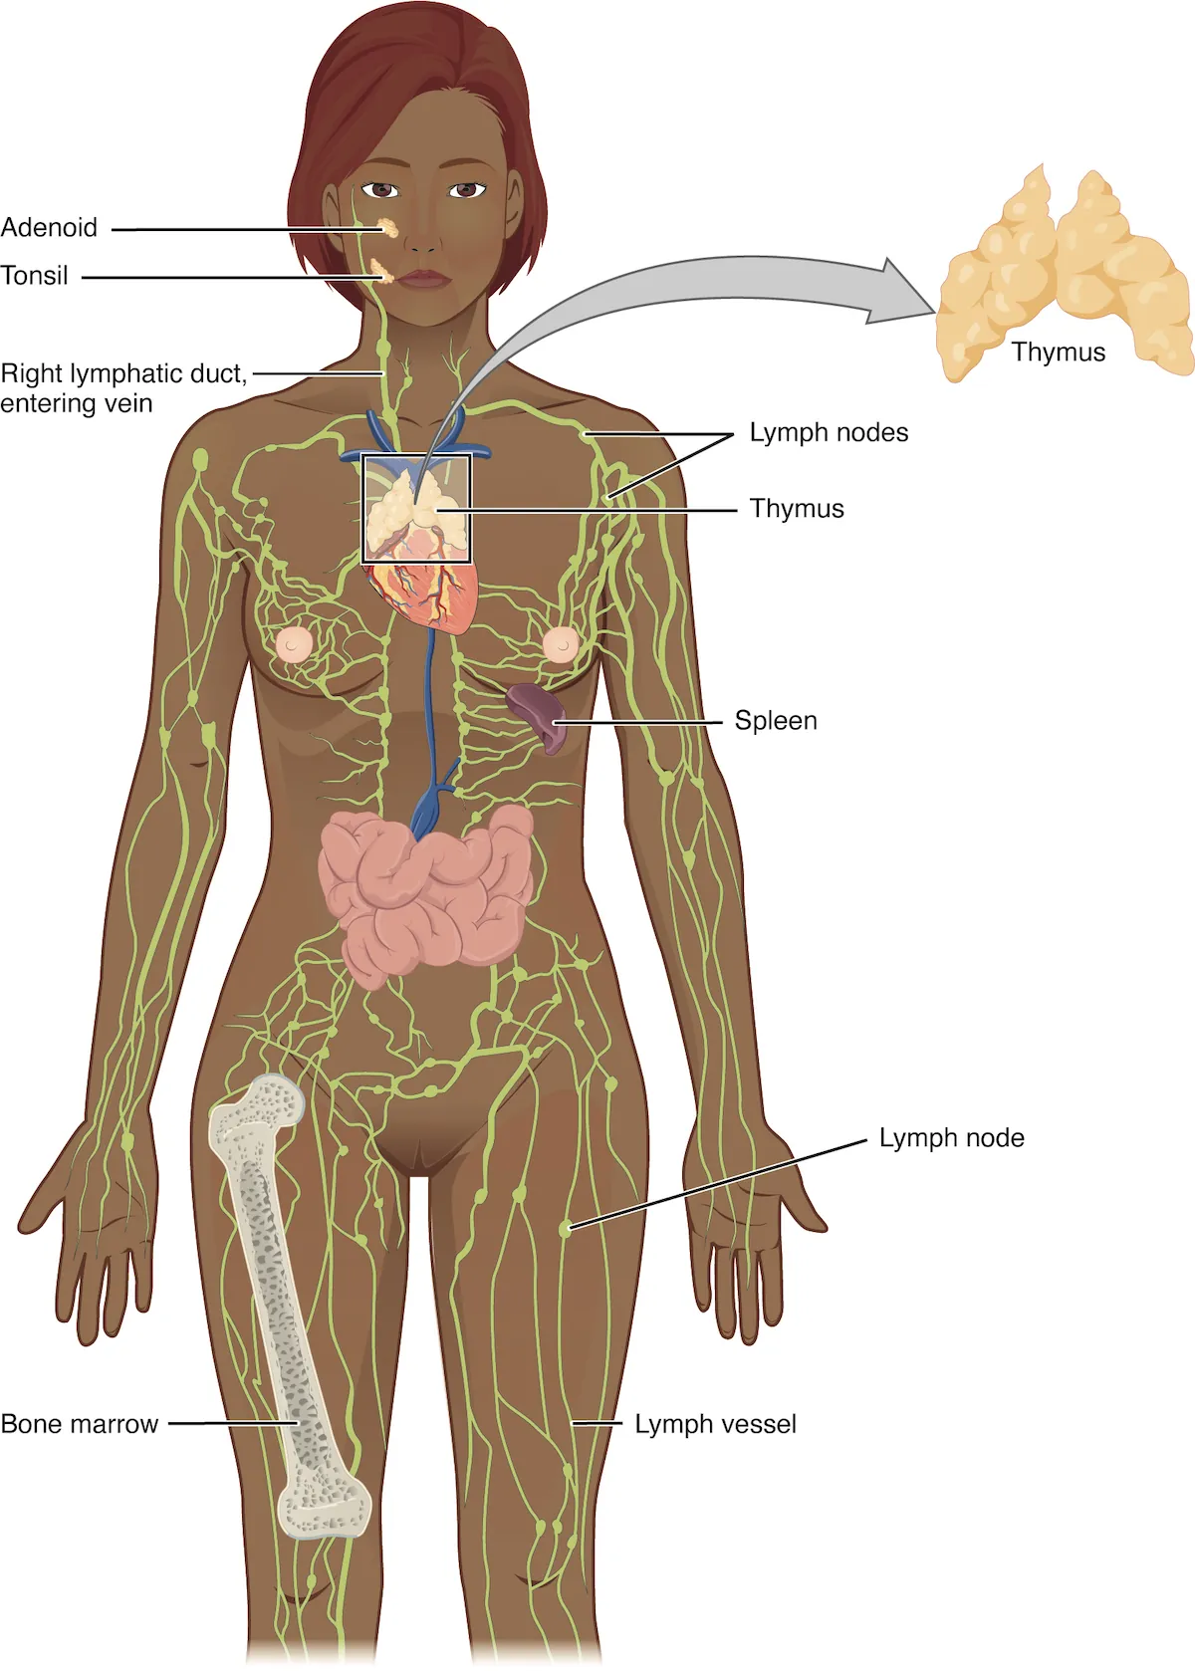
Figure 21.1: The Lymphatic System and Lymphocyte Maturation
WHAT TO NOTICE
Primary Lymphoid Organs (Origin & Maturation)
All lymphocytes originate in bone marrow; B cells mature in bone marrow while T cells migrate to mature in the thymus.
Secondary Lymphoid Organs (Antigen Encounter)
Mature B and T cells gather in lymph nodes, spleen, tonsils, and adenoids where they encounter antigens carried in lymph and blood.
Five Immunoglobulin Classes (IgG, IgM, IgA, IgE, IgD)
IgG is the main secondary-response antibody and only class crossing the placenta; IgM is first in a new response; IgA guards mucosa; IgE drives Type I allergy and parasite defence.
CD4+ T-Cell Vulnerability in HIV
Because CD4+ helper T cells direct both B-cell antibody production and macrophage/CD8+ responses, HIV depletion of CD4+ cells cripples adaptive immunity.
Clinical Takeaway: Compare the five antibody classes: IgM = 1st responder; IgG = memory responder & placental transfer; IgA = mucosal guard; IgE = mast-cell allergy & parasites.
Medical-Surgical Nursing: A Canadian Open Text
Chapter 21 · Immunity, Allergy, and HIV
Notes:
Figure 21.1 illustrates the anatomy of the lymphatic system (credit: 'Anatomy of the Lymphatic System' [OpenStax Figure 21.2], in Anatomy and Physiology 2e by J. Gordon Betts et al./OpenStax, CC BY 4.0). Point out the bone marrow (where B and T cell precursors originate), the thymus (where T cells mature), and the network of lymph vessels, lymph nodes, spleen, tonsils, and adenoids where lymphocytes encounter antigens. Review the five antibody classes secreted by plasma cells: IgG (main antibody on second exposure, neutralizes toxins/viruses, opsonizes, and is the ONLY immunoglobulin that crosses the placenta), IgM (first antibody produced in a primary response), IgA (protects airway and GI mucous membranes), IgE (binds mast cells and basophils in Type I allergy and defends against parasites), and IgD.

Slide 7
SECTION 21.1 · IMMUNE DIAGNOSTICS
Immune Tests the Nurse Reads at the Bedside
Always interpret immune laboratory values against the patient's own lab report, clinical history, and medications.
WBC & Differential: First look at immune cells; check absolute neutrophil and lymphocyte counts and trends.
Skin Prick Testing: Introduces tiny allergen amounts to watch for a raised IgE wheal; read with clinical history.
Serum IgG, IgA & IgM: Measured when antibody deficiency (e.g., CVID) is suspected in recurrent sinus or lung infections.
Allergen-Specific IgE: Safe blood test screening many allergens without skin prick risk or skin-colour confounding.
CD4 T-Cell Count: Key HIV immune marker; 200 cells/µL equals 0.2 × 10⁹/L in SI units.
Acute Serum Tryptase: Going Deeper: Draw within 2 h of anaphylaxis onset and compare with later baseline.
HIV Viral Load: Measures HIV RNA in copies/mL; shows viral replication and whether ART is working.
Biphasic Anaphylaxis: Going Deeper: Symptoms return within 48 h after settling in a median of 6.5% of adults.
Going Deeper (RN): A serum tryptase rise of at least 20% + 2 µg/L above baseline supports mast cell activation, but a normal tryptase never rules out anaphylaxis—record symptom onset and draw times.
Medical-Surgical Nursing: A Canadian Open Text
Chapter 21 · Immunity, Allergy, and HIV
Notes:
This slide summarizes the bedside immune tests and the Section 21.1 Going Deeper box on Type I reactions. Key unit conversion: treatment guidelines report CD4 counts in cells/µL, whereas some Canadian laboratories report SI units of × 10⁹/L—200 cells/µL is identical to 0.2 × 10⁹/L. In Going Deeper (required for RN students), review sensitization (first exposure primes IgE on mast cells and basophils with no symptoms) and re-exposure cross-linking (histamine, leukotrienes, prostaglandins released within minutes). Biphasic anaphylaxis occurs within 48 hours after initial resolution in a median of 6.5% of adults (Golden et al., 2024). Acute serum tryptase should be drawn as early as possible—ideally within 2 hours of symptom onset—and compared with a later baseline (>24 h); a rise of >=20% + 2 µg/L supports mast cell activation, though a normal level does not rule out anaphylaxis.

Slide 8
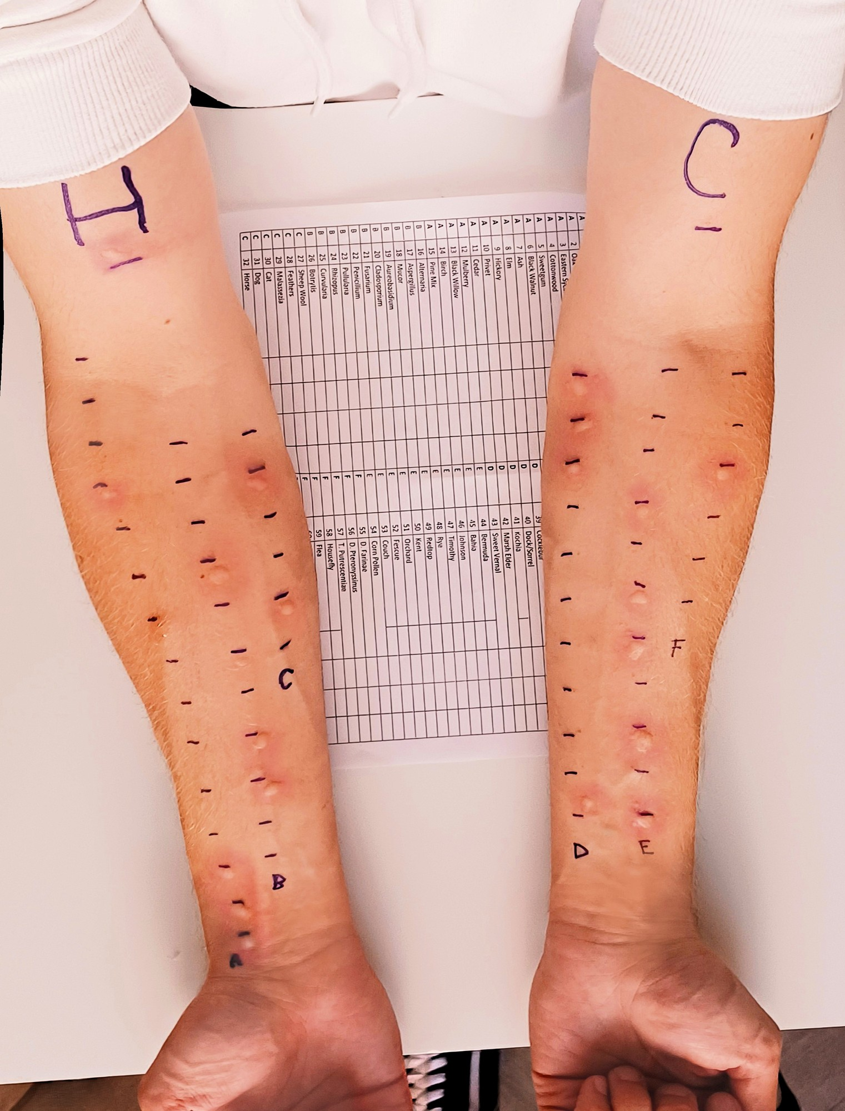
Figure 21.2: Forearm Skin Prick Testing for IgE Allergy
WHAT TO NOTICE
Numbered Allergen Grid & Controls
Each pen mark labels a specific allergen extract plus positive (histamine) and negative controls introduced by a light epicutaneous prick.
Wheal-and-Flare Interpretation
A raised, indurated wheal within 15–20 minutes indicates allergen-specific IgE bound to cutaneous mast cells.
Skin-of-Colour Assessment Nuance
Surrounding erythema (redness) is harder to judge on darker skin tones because melanin masks redness—palpate and measure the raised wheal in good light.
Sensitization vs. Clinical Allergy
A positive skin prick or serum-specific IgE test proves only sensitization (IgE presence); it must always be interpreted alongside the clinical reaction history.
Clinical Takeaway: Never order or interpret allergy tests in isolation—positive IgE without clinical symptoms is sensitization, not true clinical allergy (Ellis et al., 2024).
Medical-Surgical Nursing: A Canadian Open Text
Chapter 21 · Immunity, Allergy, and HIV
Notes:
Figure 21.2 shows forearm skin prick testing across multiple numbered allergens. Emphasize three nursing points: (1) Skin prick testing requires trained personnel and carries a small risk of systemic reaction, and antihistamines must be held beforehand. (2) On darker skin tones, erythema is masked by melanin, so clinicians rely on the raised wheal diameter rather than redness. (3) Allergen-specific serum IgE testing is a safe blood-draw alternative that screens multiple allergens at once and is unaffected by skin colour or antihistamines (Ellis et al., 2024). In both tests, a positive result shows only that IgE is present (sensitization) and must be interpreted with the patient's clinical history.

Slide 9
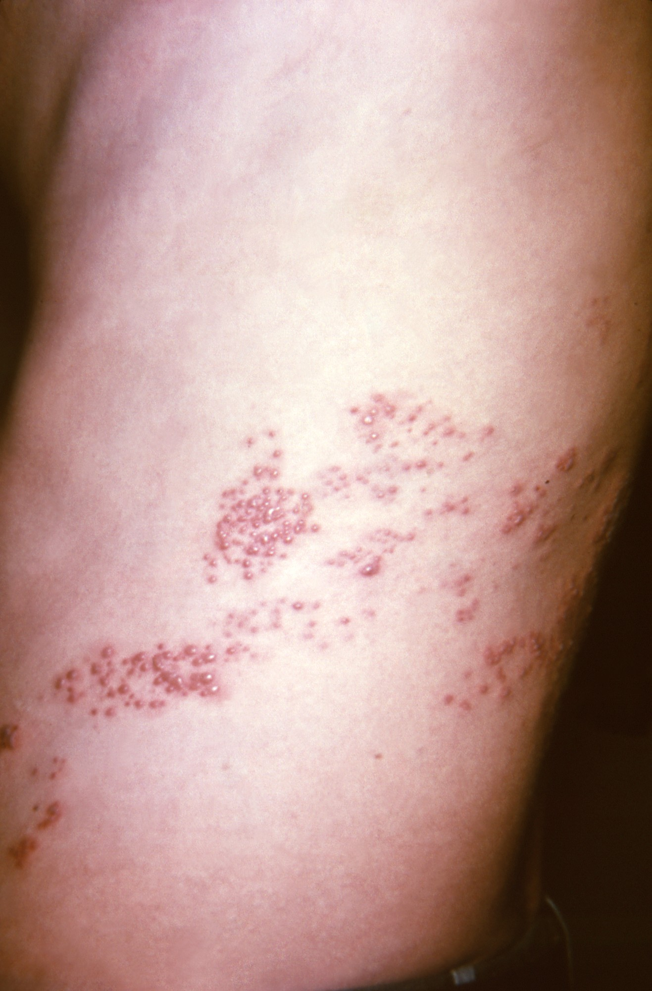
Figure 21.3: Herpes Zoster (Shingles) and Immunosenescence
WHAT TO NOTICE
Unilateral Dermatomal Vesicular Rash
Clustered papules and vesicles on an erythematous or hyperpigmented base follow 1–2 dermatomes on one side of the trunk without crossing the midline.
Mechanism of VZV Reactivation
After childhood varicella (chickenpox), VZV remains latent in dorsal root ganglia and reactivates when cell-mediated T-cell immunity declines with age or immunosuppression.
Atypical Infection Presentation in Older Adults
Immunosenescence blunts the fever response: serious infection in an older adult often presents first as new confusion (delirium), a fall, or anorexia rather than fever.
NACI Recombinant Zoster Vaccine (RZV) Guidance
Unlike the older live vaccine whose efficacy drops sharply after age 70, non-live RZV stays effective across age groups; NACI recommends 2 doses for adults >=50 and immunocompromised adults >=18.
Clinical Takeaway: Never rule out infection in an older adult because temperature is normal (e.g., 37.4 °C)—new confusion or functional decline requires an immediate infection workup.
Medical-Surgical Nursing: A Canadian Open Text
Chapter 21 · Immunity, Allergy, and HIV
Notes:
Figure 21.3 shows classic herpes zoster (shingles) along a thoracic dermatome (credit: CDC/K.L. Herrmann, Public Health Image Library, public domain). Immunosenescence—the natural, gradual decline in immune function with age—has three major nursing implications (NACI, 2018): (1) Higher susceptibility to reactivated infections like shingles (up to 30% lifetime risk in Canada; Krishnan et al., 2026); (2) Blunted fever and atypical infection presentations such as acute confusion, falls, or loss of appetite; and (3) Reduced vaccine efficacy with older live zoster vaccines, which is why NACI recommends the 2-dose non-live recombinant zoster vaccine (RZV) for all adults >=50 without contraindications and for adults >=18 who are or will be immunocompromised.

Slide 10
PART 2 · SECTION 21.2
Hypersensitivity, Drug Allergy, and Anaphylaxis Prevention
Type I–IV mechanisms, allergy histories, penicillin delabelling, latex allergy, angioedema, SCARs on diverse skin tones, and EpiPen teaching
Notes:
Part 2 covers Section 21.2: the four Gell and Coombs hypersensitivity types (Table 21.1), how to take and document a high-reliability allergy history, penicillin allergy delabelling, latex allergy, histamine versus bradykinin angioedema, severe cutaneous adverse reactions (SJS/TEN and DRESS) on lighter and darker skin tones, and anaphylaxis prevention.

Slide 11
SECTION 21.2 · HYPERSENSITIVITY CLASSIFICATION
The Four Types of Hypersensitivity (Table 21.1)
Hypersensitivity reactions are classified by immune mechanism and timing from minutes (Type I) to weeks (Type IV).
Type I (Immediate, IgE): Allergen cross-links IgE on mast cells/basophils within minutes (anaphylaxis, hives, rhinitis).
Type III (Immune Complex): Antigen-antibody complexes settle in vessels, joints, and kidneys over days to weeks.
Type I Nursing Focus: Check allergies before every drug, blood product, contrast study, or meal; treat anaphylaxis fast.
Type III Examples & Care: Serum sickness and systemic lupus erythematosus (SLE); monitor joints, skin, and renal function.
Type II (Cytotoxic Ab): IgG or IgM binds host cell surfaces and activates complement lysis within hours.
Type IV (Delayed, T-Cell): Sensitized T cells and macrophages drive inflammation after >=2 days without antibodies.
Type II Examples & Care: Hemolytic transfusion reaction, autoimmune hemolytic anemia, ITP; stop transfusion at once.
Type IV Examples & Care: Contact dermatitis, TB skin test, SJS/TEN, and DRESS (2–6 wk); inspect skin and mucosa.
Memory Hook (ACID): Type I = Allergic/Anaphylactic (IgE, minutes); Type II = Cytotoxic (IgG/IgM on cells, hours); Type III = Immune-complex deposition (days–weeks); Type IV = Delayed T-cell (days–weeks).
Medical-Surgical Nursing: A Canadian Open Text
Chapter 21 · Immunity, Allergy, and HIV
Notes:
Slide 11 converts Table 21.1 into a structured clinical reference. Type I (immediate) is IgE-mediated on mast cells and basophils, occurring within minutes (hives, allergic rhinitis, food/venom/drug anaphylaxis). Type II (antibody against cells) involves IgG or IgM binding cells with complement destruction over hours (hemolytic transfusion reactions, autoimmune hemolytic anemia, ITP). Type III (immune complex) involves antigen-antibody clumps depositing in tissues over days to weeks (serum sickness, SLE). Type IV (delayed) is mediated by T cells and macrophages without antibodies, appearing 2 or more days after exposure (allergic contact dermatitis, tuberculin skin test induration) or 1–6 weeks after starting a medication in severe T-cell drug reactions (SJS/TEN and DRESS).

Slide 12
SECTION 21.2 · ALLERGY HISTORY & PENICILLIN LABELS
Accurate Allergy Documentation and Delabelling
An inaccurate allergy label harms patients in both directions: missed warnings cause never events; false labels drive resistant infections.
Taking & Documenting the Allergy History
Penicillin Allergy Delabelling
Three Essential Clinical Distinctions
Allergy = immune-mediated (hives, angioedema, wheeze, anaphylaxis). Intolerance = non-immune effect at low dose. Side effect = expected effect at normal dose (e.g., antibiotic diarrhea or nausea).
Six Elements of a Complete Allergy Entry
Record generic (and brand) name without abbreviations, exact reaction details, timing after dose, severity and treatment required, date/age of reaction, and whether taken or tolerated since.
ISMP Canada Allergy 'Never Event' Prevention
Giving a medication to which a patient has a known allergy is a preventable never event—verify allergies on admission, at every transition/handover, and before every new drug.
The True Prevalence of Penicillin Allergy
~10% of patients report penicillin allergy, yet >80% have negative skin tests and ~90% of adult inpatients tolerate penicillin.
Harms of False Penicillin Labels
Linked to broader-spectrum alternatives, surgical site infections, +69% higher MRSA risk, and +26% higher C. difficile risk (Blumenthal et al., 2018).
PEN-FAST & Delabelling Pathways
Vancouver hospitals delabelled 98.0% of evaluated patients (697/711). PEN-FAST <3 indicates low risk; pathways include direct history delabelling, supervised oral challenge, or skin testing.
Nursing Role in Delabelling
Never delete a label alone—take the precise history, monitor during ordered challenges, and teach the patient once delabelled.
Medical-Surgical Nursing: A Canadian Open Text
Chapter 21 · Immunity, Allergy, and HIV
Notes:
Review the Clinical Safety box ('The Allergy Label') and Section 21.2 on Penicillin Allergy Labels. Emphasize the exemplar documentation from the chapter: 'Amoxicillin, 2019: itchy raised rash on trunk 2 hours after first dose, treated with an oral antihistamine; no breathing problems.' Contrast that with Mr. Thomas Leblanc (Unfolding Case 1, Questions 1–2), who had loose stools for 2 days on amoxicillin at age 16—a classic GI side effect, documented as: 'Amoxicillin, age 16: loose stools for 2 days; no rash, swelling or breathing problems; no treatment.' Remember that removing a label is a prescriber or allergist decision following employer policy, never an independent nursing deletion.

Slide 13
SECTION 21.2 · LATEX ALLERGY & ANGIOEDEMA
Latex-Safe Care and Histamine vs. Bradykinin Swelling
Distinguish irritant skin dryness from Type IV/Type I latex allergy, and histamine hives from ACE-inhibitor bradykinin angioedema.
Natural Rubber Latex Allergy
Histamine vs. Bradykinin Angioedema
High-risk groups, cross-reactive foods, and spectrum of reactions
Deep dermal/mucosal swelling—why ACE-inhibitor swelling is an airway emergency
Populations at Highest Risk (CCOHS, 2023)
Health care and laboratory workers, patients with multiple surgeries (e.g., >=10), and people with spina bifida or repeated mucosal catheterization.
Latex–Fruit Cross-Reactive Syndrome
Cross-reacts with banana, avocado, kiwi, passion fruit, and chestnut proteins.
Three Reaction Patterns & Nursing Care
Irritant dermatitis (dry, itchy skin—not allergy), Type IV delayed contact rash (48+ h), or Type I IgE hives/wheeze/anaphylaxis. Screen before procedures and communicate with the OR team.
Histamine-Mediated Angioedema
Allergic/IgE-driven; usually accompanied by itchy hives (urticaria) that fade within ~24 h; responds to epinephrine, antihistamines, and corticosteroids.
Bradykinin-Mediated (ACEi & Hereditary/Acquired C1-INH)
Occurs in 0.1%–6% of patients on ACE inhibitors (up to 1/3 appear months to years after starting); hives are ABSENT.
Refractory to Standard Allergy Drugs
Epinephrine, antihistamines, and steroids have NOT been shown to reverse ACEi angioedema (Rosenbaum et al., 2020); stop the ACEi (swelling can recur for ~1 month).
Airway Emergency & Skin Tone Alert: Tongue/lip swelling, muffled voice, stridor, or drooling requires immediate RRT/airway call. On darker skin, melanin masks redness—palpate for wheals/warmth and inspect lips/tongue.
Medical-Surgical Nursing: A Canadian Open Text
Chapter 21 · Immunity, Allergy, and HIV
Notes:
Slide 13 contrasts latex allergy with the two mechanisms of angioedema. For latex allergy, highlight the cross-reactive foods (banana, avocado, kiwi, passion fruit, chestnut) and high-risk groups (operating room nurses, laboratory workers, patients with >=10 surgeries). For angioedema, emphasize that ACE inhibitor angioedema is bradykinin-driven, presents WITHOUT hives, and can occur up to years after starting an ACE inhibitor (1/3 of cases occur months to years later). Because histamine is not the mediator, antihistamines, corticosteroids, and epinephrine cannot be relied upon to reverse airway swelling—call the rapid response or anesthesia team immediately at the first sign of tongue swelling, voice change, dysphagia, or stridor.

Slide 14
SECTION 21.2 · SEVERE CUTANEOUS ADVERSE REACTIONS
SJS/TEN, DRESS, and Anaphylaxis Prevention
Early mucosal ulcers, ocular grittiness, or fever with dusky/violet lesions after starting a high-risk drug require immediate drug hold and escalation.
Severe Cutaneous Adverse Reactions (SCARs)
Anaphylaxis Prevention & EpiPen
Stevens-Johnson Syndrome (SJS) & TEN
Epidermal necrosis and detachment within 4 weeks of drug start: SJS <10% BSA, overlap 10–30%, TEN >30% BSA (mortality up to 30%; ocular involvement in up to 75%; transfer >10% BSA to burn unit/ICU).
DRESS Syndrome (2 to 6 Weeks After Drug Start)
Widespread rash, fever, facial/ear edema, lymphadenopathy, eosinophilia, and liver/kidney/lung injury (mortality up to 10%); symptoms can persist weeks after stopping the culprit drug.
High-Risk Culprit Drugs & Darker Skin Assessment
Allopurinol, carbamazepine, lamotrigine, phenytoin, nevirapine, and sulfonamides. On darker skin, lesions look dusky, grey-purple, or hyperpigmented rather than bright red—inspect mouth and eyes in good light.
Priority Nursing Action (Clinical Judgment Box)
Hold the next dose per employer policy, notify the RN and prescriber immediately via SBAR, document as an allergy, and never wait for redness.
Hospital Prevention & Allergist Referral
Verify allergies before every medication, blood product, contrast study, and meal tray; advocate for allergist referral (only ~50% are currently referred).
Epinephrine Autoinjector Teaching (EpiPen)
Use FIRST at first sign of anaphylaxis (never delay with antihistamines). Inject into outer thigh (through clothing if needed) and hold for 3 seconds; never inject into buttock.
Second Dose, 9-1-1 & Canadian Products
Give a 2nd dose after 5–15 min if no improvement; call 9-1-1 and go to hospital even if better (biphasic risk). Carry 2 devices at room temperature + medical ID; EpiPen and neffy nasal spray are marketed in Canada (Allerject/Emerade discontinued).
Medical-Surgical Nursing: A Canadian Open Text
Chapter 21 · Immunity, Allergy, and HIV
Notes:
Slide 14 covers SJS/TEN, DRESS, the Clinical Judgment box ('A New Rash on Day 9' — Mr. Daniel Osei on carbamazepine), and the Patient Education box ('Carrying and Using an Epinephrine Autoinjector'). Highlight skin-of-colour assessment (Akinbisehin et al., 2026): on dark brown skin, early SJS/TEN patches appear dusky grey-purple or darker than surrounding skin, and sore mouth or gritty/watery eyes are often the earliest clear cues. In DRESS (as in Mr. Thomas Leblanc in Unfolding Case 1, Questions 3–4), look for the classic triad 2–6 weeks after starting an anticonvulsant, sulfonamide, or allopurinol: fever, facial/ear edema with lymphadenopathy, and eosinophilia with elevated liver enzymes. Also note current Canadian market availability as of October 2026: EpiPen autoinjectors and epinephrine nasal spray (neffy) are marketed in Canada, while Allerject and Emerade are no longer marketed.

Slide 15
PART 3 · SECTION 21.3
Immunodeficiency and the Immunocompromised Patient
Primary (CVID) and secondary immunodeficiencies, subtle infection cues, pre-biologic screening, and immunization timing
Notes:
Part 3 explores Section 21.3: primary immunodeficiencies diagnosed in adulthood (common variable immunodeficiency [CVID]), secondary immunodeficiencies caused by drugs, biologic therapies, HIV, and chronic illnesses (Table 21.2), why infection signs are blunted when immunity is low, and vaccine timing rules for immunocompromised adults.

Slide 16
SECTION 21.3 · PRIMARY AND SECONDARY IMMUNODEFICIENCY
Causes of Weakened Immunity and Nursing Priorities
More than half of primary antibody deficiencies are diagnosed in adults, while secondary immunodeficiency is common across inpatient units.
Primary Immunodeficiency (CVID)
Drugs & Biologics (Table 21.2)
Disease, Age & TB Progression
Adult-Onset Antibody Deficiency
Over 50% of antibody deficiencies are diagnosed in adults; CVID usually begins after age 10 with low serum IgG/IgA/IgM.
Adult Warning Signs (McCusker et al.)
>=2 new sinus infections/year without allergy, annual pneumonia for >1 year, repeated IV antibiotics, persistent thrush, or chronic diarrhea with weight loss.
Lifelong IVIG/SCIG & Vaccine Rules
Treated with lifelong immunoglobulin replacement; avoid live vaccines in severe defects (can cause fatal disseminated infection).
Corticosteroids & Transplant Drugs
Mute fever and inflammation; raise TB progression risk. Never stop long-term steroids or transplant drugs abruptly; give transplant meds on time, every time.
Biologics (TNF Inhibitors: Adalimumab)
Screen for active/latent TB and hepatitis B BEFORE starting; treat latent TB first. Hold dose and report any fever or new cough before injecting.
Chemotherapy & Neutropenia
Bone marrow suppression causes neutropenia; any fever in a neutropenic patient is a medical emergency (Chapter 9).
Canadian TB Standards Risk Tiers
Risk that latent TB progresses to active disease: Very high in HIV; High in transplant, stage 4–5 CKD, TNF inhibitors, or steroids; Moderate in diabetes.
Diabetes, Advanced CKD & Asplenia
Hyperglycemia and uremia impair phagocytes and T cells; inspect feet/wounds daily and keep glucose in target.
Immunosenescence After Age 50
Weakens T-cell and vaccine responses; expect confusion or falls as first sign of infection and offer RZV from age 50.
Medical-Surgical Nursing: A Canadian Open Text
Chapter 21 · Immunity, Allergy, and HIV
Notes:
Slide 16 synthesizes Section 21.3, Table 21.2, and the Lifespan Considerations box. Note that more than half of patients with primary antibody deficiencies are diagnosed as adults—common variable immunodeficiency (CVID) presents with recurrent sinopulmonary infections, autoimmune cytopenias, GI disease, and increased lymphoma risk, and is managed with lifelong IVIG or SCIG. For secondary immunodeficiency, emphasize the adalimumab (Humira) Canadian monograph requirements: screen for both active and latent TB and hepatitis B prior to initiation, never start during an active infection, and hold/report if a patient arrives for a dose with a new cough and low-grade temperature (e.g., 37.9 °C in Question 15).

Slide 17
SECTION 21.3 · PROTECTING IMMUNOCOMPROMISED ADULTS
Subtle Infection Cues and Vaccine Timing Rules
Because immunocompromised adults may not mount fever, redness, or pus, nurses track subtle trends and time vaccines carefully.
Recognizing Infection & Bedside Protection
Canadian Immunization Guide Timing Rules
When classic inflammatory signs (fever, erythema, purulence) are blunted
Coordinating live and non-live vaccines around immunosuppressive therapy (PHAC, 2026e)
Watch Subtle Vital Sign & Functional Trends
Escalate new confusion, lethargy, rising respiratory rate or heart rate, falling BP, oliguria, or a vague report of 'not feeling right.'
Strict IPAC, Device Stewardship & Food Safety
Enforce hand hygiene for all staff and visitors, remove unnecessary urinary catheters and IV lines daily, and reinforce safe food handling.
Same-Day Patient Reporting Triggers
Teach patients to report fever, chills, new cough, dysuria, wound drainage, or malaise the same day, and never skip transplant or biologic doses without calling the prescriber.
Contraindication to Live Vaccines
Severely immunocompromised patients (and those on TNF inhibitors like adalimumab) must NOT receive live vaccines (e.g., MMR, varicella).
Pre-Treatment Timing Windows
Give non-live vaccines >=2 weeks before starting therapy in blood cancers; give live vaccines >=4 weeks before solid organ transplant; wait >=6 months after anti-B-cell antibody therapy before live vaccines.
Recombinant Zoster & Household Contacts
Give 2 doses of non-live RZV to immunocompromised adults >=18 (2nd dose as early as 4 weeks before therapy); keep household contacts up to date including annual influenza vaccine.
RPN–RN Collaboration: All nurses monitor for subtle signs of sepsis; an RPN who detects early deterioration reports at once and consults the RN as complexity increases.
Medical-Surgical Nursing: A Canadian Open Text
Chapter 21 · Immunity, Allergy, and HIV
Notes:
Slide 17 details bedside nursing care and the exact Canadian Immunization Guide timing windows for immunocompromised adults (PHAC, 2026e; Krishnan et al., 2026). Memorize the four timing rules: (1) Non-live vaccines at least 2 weeks before immunosuppressive therapy in hematologic malignancy; (2) Live vaccines at least 4 weeks before solid organ transplantation; (3) Wait at least 6 months after B-cell-depleting antibody therapy (e.g., rituximab) before giving live vaccines; and (4) Two doses of non-live RZV for adults >=18 who are or will be immunocompromised, with the second dose accelerated to 4 weeks after the first when given prior to planned immunosuppression. Also remind families to keep their own vaccines—including annual influenza—up to date to form a protective ring around the patient.

Slide 18
PART 4 · SECTION 21.4
HIV: Infection, Testing, and Prevention
Retroviral replication, clinical stages, Canadian epidemiology and structural equity, routine testing, PrEP, PEP, and U=U
Notes:
Part 4 covers Section 21.4: how HIV infects and depletes CD4+ T helper cells, the retroviral replication cycle, stages of untreated infection, Canadian surveillance data and structural determinants (including OCAP® principles), routine voluntary HIV testing, and the prevention toolkit (condoms, PrEP, PEP, U=U, and harm reduction).

Slide 19
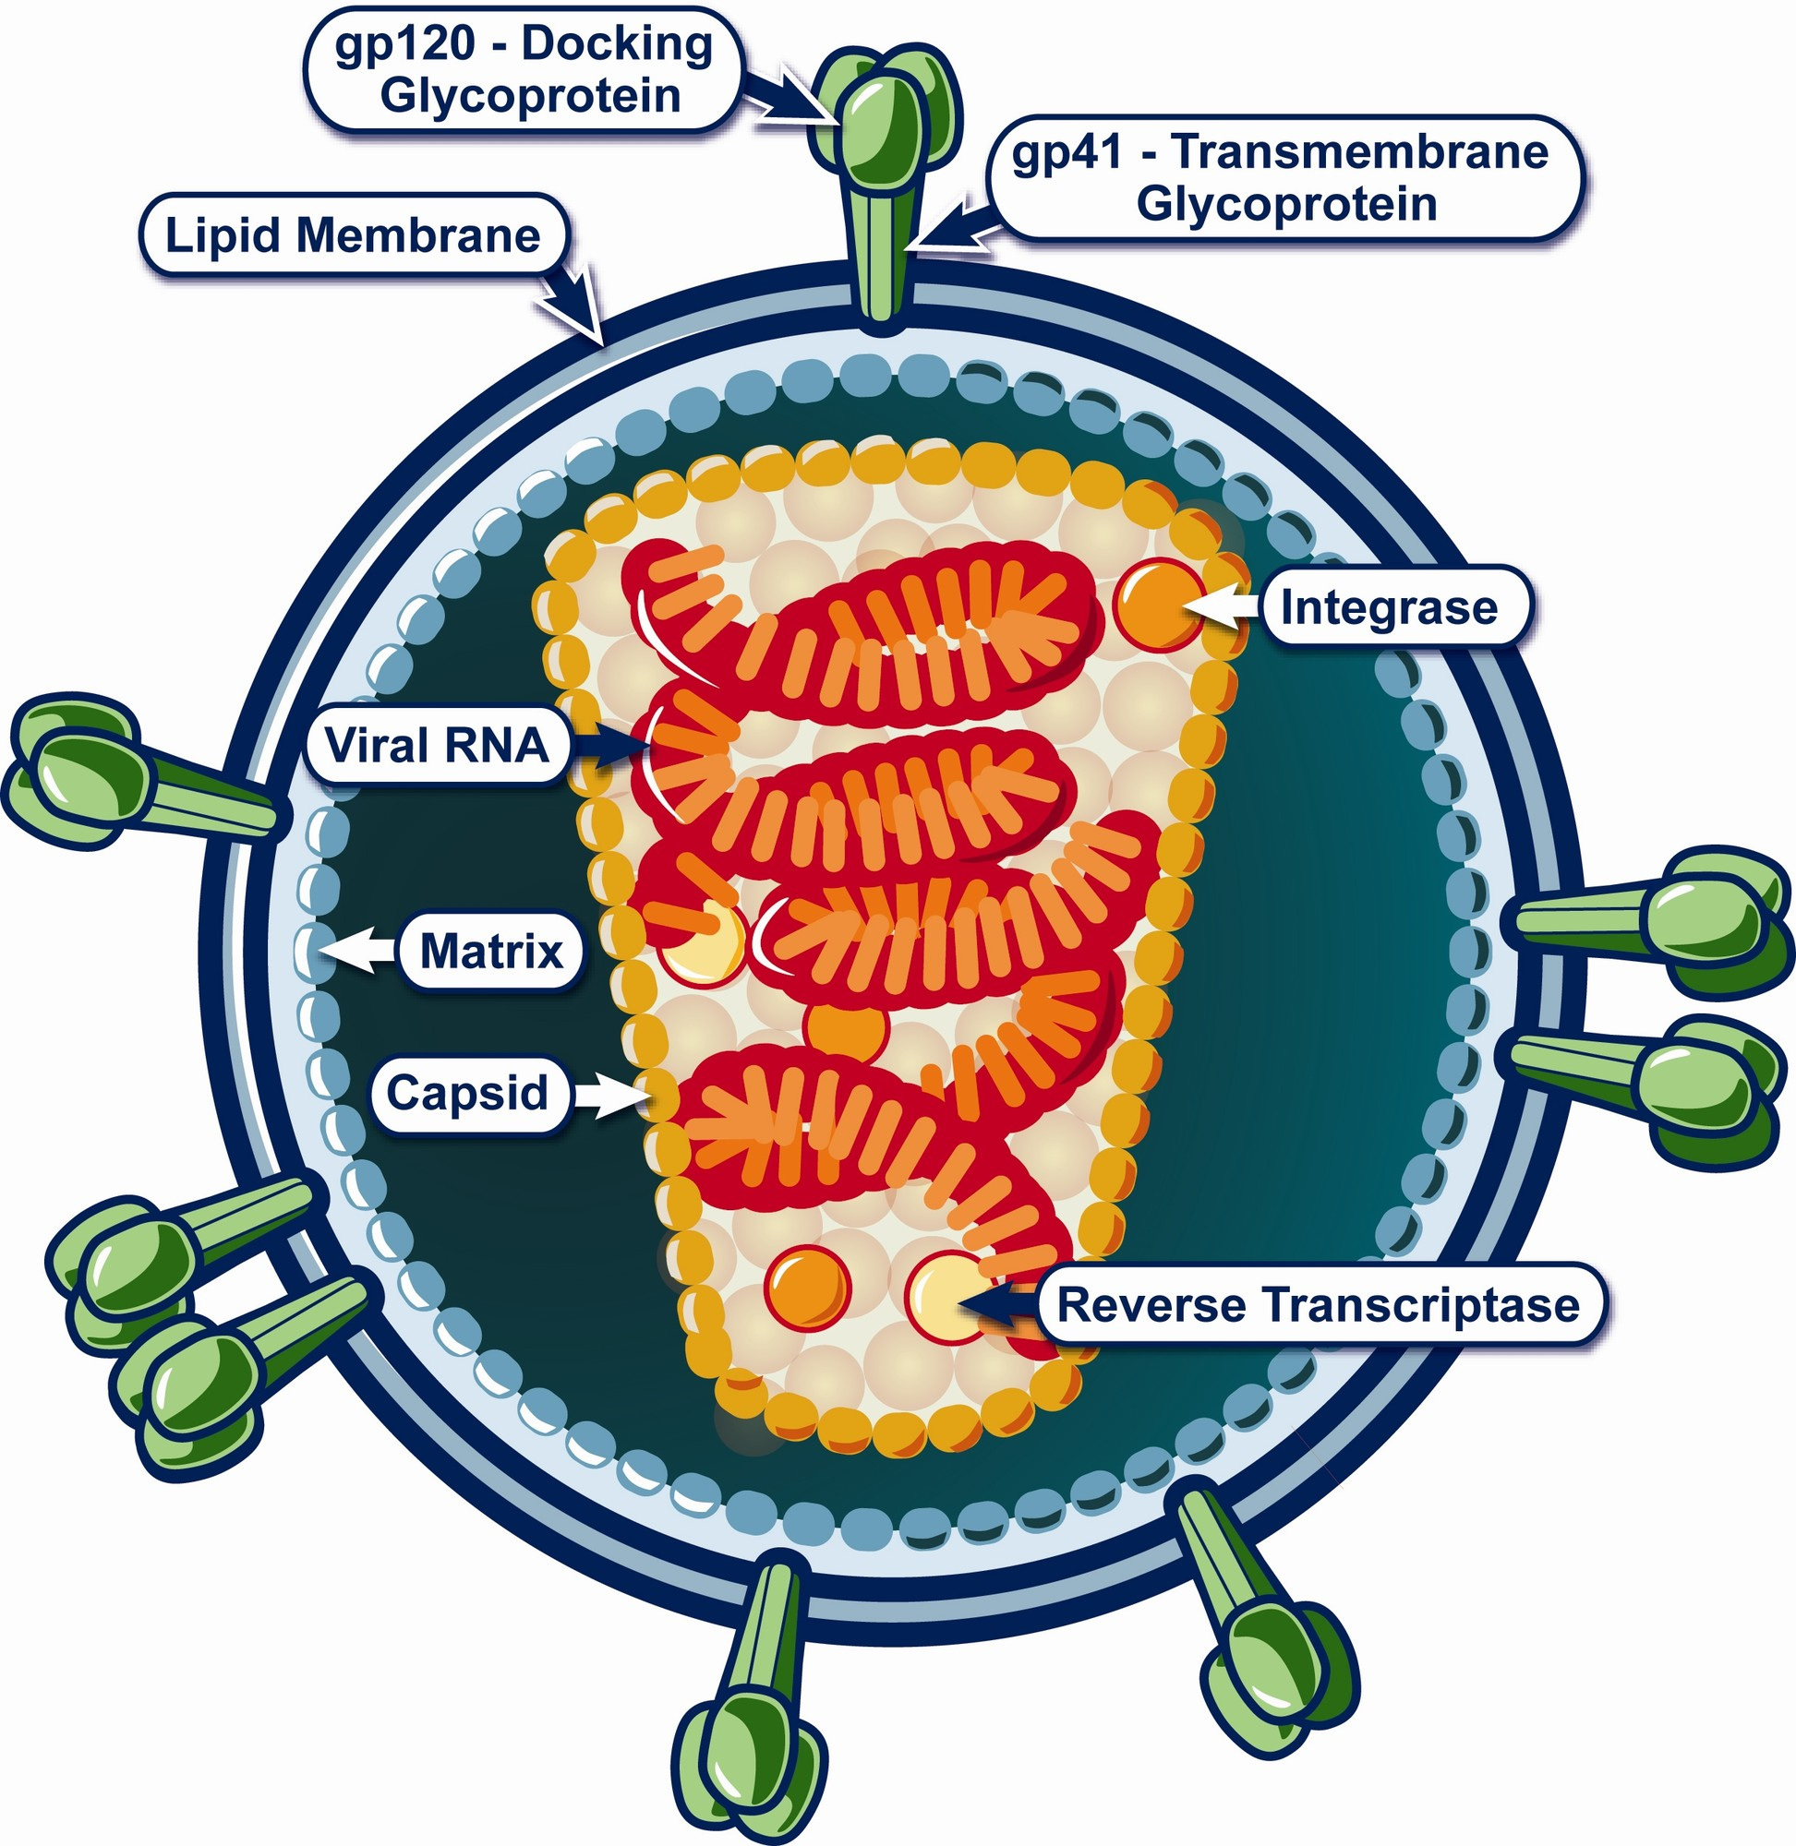
Figure 21.4: Structure of the Human Immunodeficiency Virus
WHAT TO NOTICE
Envelope Glycoproteins (gp120 & gp41)
Outer lipid membrane spikes (gp120 docking protein and gp41 transmembrane protein) bind the host cell's CD4 receptor and CCR5/CXCR4 co-receptor.
Viral Capsid, RNA & Retroviral Enzymes
The cone-shaped capsid holds two copies of single-stranded viral RNA plus reverse transcriptase, integrase, and protease.
Routes of Transmission vs. Casual Contact
Transmitted ONLY via blood, semen/pre-seminal fluid, vaginal fluid, rectal fluid, and human milk—never by unbroken skin, hugging, kissing, food, toilet seats, or mosquitoes.
Three Stages of Untreated HIV
1. Acute HIV (2–4 wk: very high viral load, highly infectious, flu-like illness in >=50%, antibody test may be negative); 2. Chronic HIV (years); 3. Advanced HIV/Stage 3 AIDS (CD4 <200 cells/µL, <14%, or AIDS-defining illness).
Clinical Takeaway: Because viral DNA integrates permanently into host chromosomes, ART suppresses HIV replication to undetectable levels and restores lifespan, but does not cure the latent reservoir.
Medical-Surgical Nursing: A Canadian Open Text
Chapter 21 · Immunity, Allergy, and HIV
Notes:
Figure 21.4 shows the cross-sectional anatomy of HIV (credit: National Institute of Allergy and Infectious Diseases, public domain). Walk students through the gp120/gp41 docking complex, lipid envelope, matrix, capsid, viral RNA, reverse transcriptase, and integrase. Review the three clinical stages of untreated HIV: (1) Acute HIV infection in the first weeks (viral load is extremely high, patient is highly infectious, >=50% experience a mononucleosis/flu-like syndrome 2–4 weeks post-exposure with fever, pharyngitis, rash, or lymphadenopathy, and antibody-only tests may still be in the window period); (2) Chronic asymptomatic HIV where CD4 cells gradually decline; and (3) Advanced HIV disease / Stage 3 (AIDS), defined as CD4 <200 cells/µL (0.2 × 10⁹/L), CD4 percentage <14%, or an AIDS-defining opportunistic illness (Selik et al., 2014).

Slide 20
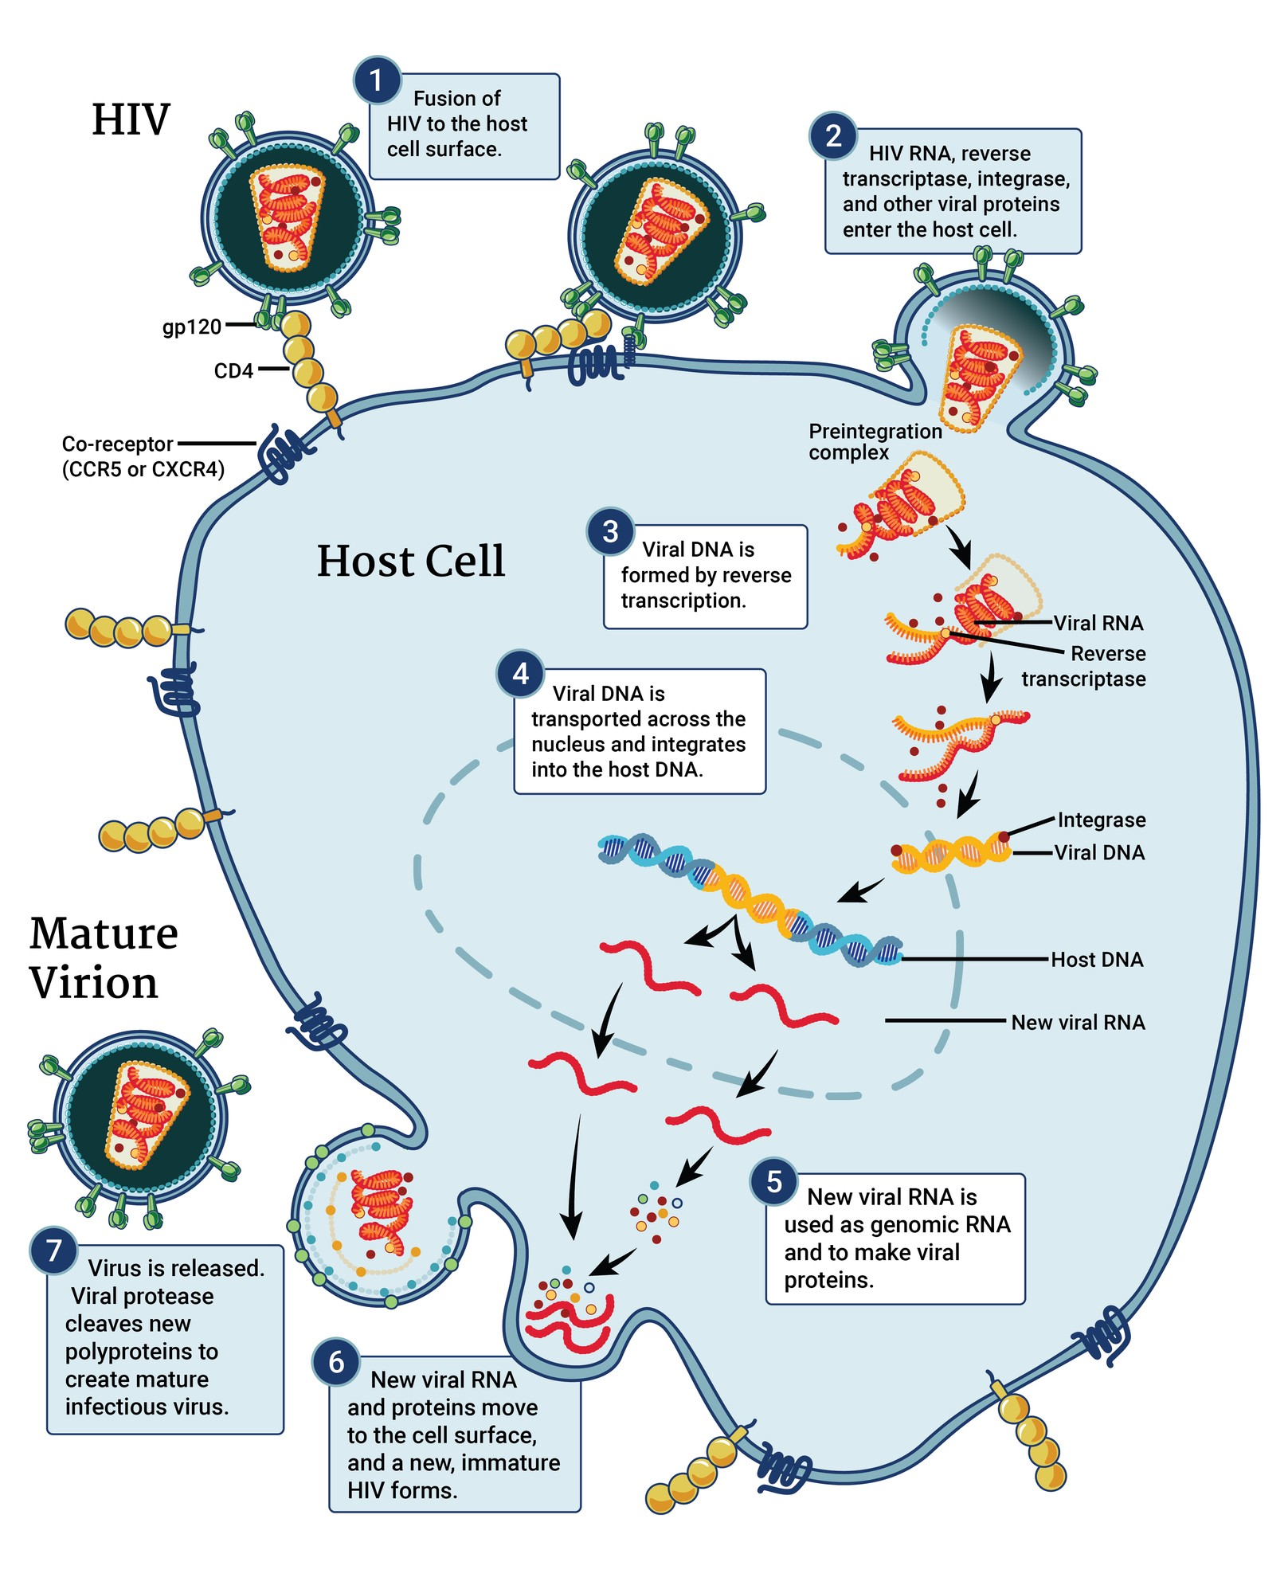
Figure 21.5: The HIV Replication Cycle and Drug Targets
WHAT TO NOTICE
Steps 1–2: Binding, Fusion & Uncoating
HIV gp120 binds CD4 and a co-receptor (CCR5 or CXCR4), fusing with the T-cell membrane to release viral RNA and enzymes into the cytoplasm.
Step 3: Reverse Transcription (NRTI & NNRTI Target)
Reverse transcriptase copies viral RNA into double-stranded viral DNA with frequent copying errors; blocked by NRTIs (emtricitabine, tenofovir, lamivudine, abacavir) and NNRTIs (rilpivirine).
Step 4: Integration Into Host DNA (INSTI Target)
Integrase splices viral DNA into the host cell's chromosome inside the nucleus; blocked by INSTIs (bictegravir, dolutegravir, cabotegravir).
Steps 5–7: Transcription, Budding & Protease Maturation
Host machinery makes new viral RNA and polyproteins; after budding, HIV protease cleaves polyproteins into mature infectious virions (blocked by darunavir + cobicistat/ritonavir).
Clinical Takeaway: Because reverse transcriptase makes frequent errors when drug levels drop, missed ART doses allow drug-resistant viral mutants to emerge rapidly.
Medical-Surgical Nursing: A Canadian Open Text
Chapter 21 · Immunity, Allergy, and HIV
Notes:
Figure 21.5 illustrates the 7 steps of the HIV replication cycle (credit: 'HI-Virus Replication Cycle' by NIAID/Wikimedia Commons, CC BY 2.0). Connecting each step directly to an antiretroviral class makes pharmacology intuitive: Step 3 (reverse transcription of RNA to DNA) is blocked by NRTIs (the nucleoside 'backbone') and NNRTIs; Step 4 (integration of viral DNA into host nuclear DNA) is blocked by INSTIs (the 'anchor' of most modern first-line regimens); and Step 7 (cleavage of immature polyproteins into infectious virions after budding) is blocked by boosted protease inhibitors.

Slide 21
SECTION 21.4 · HIV IN CANADA & ROUTINE TESTING
Canadian Epidemiology, Equity, and HIV Testing
Patterns of HIV in Canada reflect structural inequities, racism, colonialism, and stigma—nurses help close the gap by normalizing routine testing.
HIV in Canada & Structural Context
Routine Voluntary Testing & Window Period
2022 Prevalence & 95–95–95 Cascade (PHAC, 2024a)
65,270 people living with HIV (~1 in 10 undiagnosed); 2022 cascade reached 89% diagnosed, 85% on ART, and 95% virally suppressed (1,848 estimated new infections).
2024 First-Time Diagnoses (PHAC, 2026c)
2,288 first diagnoses (5.5 per 100,000 nationally); highest in Manitoba (19.5) and Saskatchewan (18.6), lowest in Atlantic region (1.7). Exposures: male-to-male sex (49.9% of males), heterosexual (58.1% of females), injection drug use (16.9% overall).
Structural Drivers & First Nations OCAP® Principles
Race/ethnicity reported for 38.1% of 2024 diagnoses (31.6% Black, 25.4% white, 7.1% Indigenous). Reflects anti-Black and colonial anti-Indigenous racism, criminalization, and housing/care barriers; First Nations data follow OCAP® (ownership, control, access, possession).
Offer Routine Screening With Verbal Consent
Offer in a non-stigmatizing, matter-of-fact way during routine care; explain the window period (up to 12 weeks), privacy, public health reporting, and the right to decline.
Three HIV Test Modalities (PHAC, 2020, 2026a)
1. 4th-gen lab blood screen (p24 antigen + Ab; reactive in 15–20 d); 2. Point-of-care rapid finger-prick (Ab only; reactive in 20–30 d); 3. Approved self-tests (finger-prick or oral swab). All reactive rapid/self-tests require confirmatory lab testing.
Ontario Nominal vs. Anonymous Testing
In Ontario, patients can choose name-based or code-based anonymous testing (no name or OHIP needed; Sexual Health Infoline Ontario 1-800-668-2437). Positive results require public health notification of sexual/drug-sharing partners.
Medical-Surgical Nursing: A Canadian Open Text
Chapter 21 · Immunity, Allergy, and HIV
Notes:
Slide 21 combines the Canadian Context box ('HIV in Canada'), surveillance statistics (PHAC, 2024a, 2026c), and testing guidance. Emphasize that a negative test within 12 weeks of a potential exposure does NOT rule out HIV because the window period lasts up to 12 weeks—repeat testing must be scheduled (and if the exposure was within 72 hours, assess urgently for PEP). Note the difference between a 4th-generation lab test (detects both p24 antigen and HIV antibodies, turning reactive 15–20 days post-exposure) and a point-of-care or self-test (detects antibodies only, turning reactive later and always requiring standard venous lab confirmation if reactive).

Slide 22
SECTION 21.4 · HIV PREVENTION OPTIONS
PrEP, PEP, U=U, and Harm Reduction (Table 21.3)
Nurses actively offer prevention options tailored to each person's life, exposures, and goals.
Pre-Exposure Prophylaxis (PrEP)
Post-Exposure Prophylaxis (PEP)
U=U, Condoms & Harm Reduction
2025 Canadian Guideline Regimens
Daily oral TDF/FTC for any eligible HIV-negative adult/adolescent; on-demand TDF/FTC only for cisgender men and trans women whose risk is sex with cisgender men; daily TAF/FTC or long-acting injectable cabotegravir for sexual risk in cis men/trans women.
Baseline & Ongoing Monitoring
Confirm HIV-negative at baseline, 30 days, then q3m (oral) or q2m (cabotegravir injection).
Renal, STI & Hepatitis Screening
Check serum creatinine q3–12m, gonorrhea/chlamydia/syphilis q3–4m, and baseline/annual HBV & HCV if susceptible.
72-Hour Emergency Window
Start ASAP and NO LATER than 72 hours after a potential non-occupational or occupational exposure; take for 28 days.
Preferred 2025 Canadian Regimens
Bictegravir/emtricitabine/tenofovir alafenamide (BIC/FTC/TAF) OR dolutegravir + TDF/FTC.
Follow-Up & When PEP Is Not Needed
Repeat HIV test at 4–6 weeks and final test at 12 weeks. PEP is NOT indicated after sex with a partner who has a sustained undetectable viral load.
Undetectable = Untransmittable (U=U)
A person on ART with a viral load <200 copies/mL (checked q4–6m) CANNOT transmit HIV through sex (PHAC, 2023b).
Important Boundaries of U=U
U=U applies to sexual transmission only—not to shared injection equipment or pregnancy/chestfeeding—and does not prevent other STIs or pregnancy.
Condoms & Harm Reduction
External/internal condoms prevent HIV, STIs, and pregnancy; sterile needles/syringes and supervised consumption prevent blood-borne transmission.
Medical-Surgical Nursing: A Canadian Open Text
Chapter 21 · Immunity, Allergy, and HIV
Notes:
Slide 22 translates Table 21.3 and the 2025 Canadian PrEP/PEP guideline update (Tan et al., 2025) into three clear clinical pillars. Highlight key exam and clinical points: (1) On PrEP, HIV testing is required before starting, at 30 days, and then every 3 months for oral pills or every 2 months for injectable cabotegravir (CD4 counts are NOT monitored on PrEP). (2) PEP is a 28-day emergency regimen started as soon as possible and within 72 hours of exposure (at 30 hours post-exposure, the patient must come in immediately; at 10 days post-exposure, it is too late for PEP). (3) U=U (<200 copies/mL measured every 4–6 months) means zero risk of sexual transmission, so a partner does not need PrEP or PEP for sexual exposure to a sustained undetectable partner.

Slide 23
PART 5 · SECTION 21.5
Living With HIV: Treatment and Nursing Care
Antiretroviral regimens, critical drug interactions, viral load and CD4 monitoring, opportunistic infections, hospital care, and stigma
Notes:
Part 5 covers Section 21.5: modern antiretroviral therapy (ART), preventing resistance and dangerous drug-drug interactions in hospital, monitoring viral load and CD4 recovery, recognizing and preventing opportunistic infections (PJP, candidiasis, toxoplasmosis, TB, CMV, Kaposi sarcoma), aging with HIV, routine infection control practices, and Canadian HIV disclosure law.

Slide 24
SECTION 21.5 · ANTIRETROVIRAL THERAPY & INTERACTIONS
ART Classes, Single-Tablet Regimens, and Interactions
Start ART immediately on diagnosis; in hospital, never interrupt ART without a prescriber's order and check every new drug.
Antiretroviral Classes & Safety Pearls
High-Alert Interactions & Lab Monitoring
Combining 2–3 drugs across classes to achieve durable viral suppression
Canadian monograph contraindications and viral load / CD4 trajectories
NRTI Backbone (FTC, 3TC, TAF, TDF, Abacavir)
Screen HLA-B*5701 before abacavir (never restart after hypersensitivity). Never abruptly stop TDF, TAF, FTC, or 3TC in HBV co-infection—can trigger a severe hepatitis B flare.
INSTI Anchors & NNRTIs / Boosted PIs
INSTIs (bictegravir, dolutegravir, cabotegravir) anchor most regimens; NNRTIs (rilpivirine, take with a meal); PIs (darunavir boosted with cobicistat or ritonavir).
Single-Tablet & Long-Acting Injectable Options
Once-daily tablets (BIC/FTC/TAF, DTG/3TC, DTG/ABC/3TC) or monthly/q2m gluteal IM cabotegravir + rilpivirine in virally suppressed adults (observe 10 min post-injection).
INSTIs (Bictegravir, Dolutegravir) + Polyvalent Cations
Al/Mg antacids, laxatives, calcium, and iron chelate INSTIs and lower absorption: space BIC 2 h before/after (or with food, never together fasted); space DTG 2 h before or 6 h after (or with food for Ca/Fe).
Rilpivirine + PPIs & Bictegravir + Rifampin
Proton pump inhibitors (e.g., pantoprazole) are CONTRAINDICATED with rilpivirine (space H2 blockers 12 h before/4 h after). Rifampin is contraindicated with bictegravir; cobicistat inhibits CYP3A.
Viral Load, Blips vs. Rebound & CD4 Lag
Check viral load q4–8w until undetectable, then q3–6m. A single detectable result that returns to undetectable is a blip; confirmed >=200 copies/mL is virologic rebound (order resistance test while on regimen). CD4 rises slowly (~50–150 cells/µL in year 1).
NPO Surgical Patient Rule: If an inpatient on ART is made NPO for surgery, never skip the 0800 ART dose—consult the RN, prescriber, and pharmacist beforehand so doses are given safely on time.
Medical-Surgical Nursing: A Canadian Open Text
Chapter 21 · Immunity, Allergy, and HIV
Notes:
Slide 24 covers the Medications box ('Antiretroviral Classes'), the Going Deeper box ('Viral Load, CD4 Count and Resistance Testing'), and high-yield drug interactions tested on licensing exams. Emphasize four pharmacology traps: (1) Pantoprazole and other PPIs are strictly contraindicated with rilpivirine (Question 40) because gastric acid is required for rilpivirine absorption; (2) Polyvalent cations (calcium, iron, Mg/Al antacids) bind integrase inhibitors (bictegravir, dolutegravir) in the gut; (3) Abacavir requires HLA-B*5701 genetic screening before initiation and can never be re-challenged after hypersensitivity; and (4) Stopping tenofovir (TDF/TAF), emtricitabine, or lamivudine can precipitate fulminant hepatitis B reactivation in co-infected patients.

Slide 25
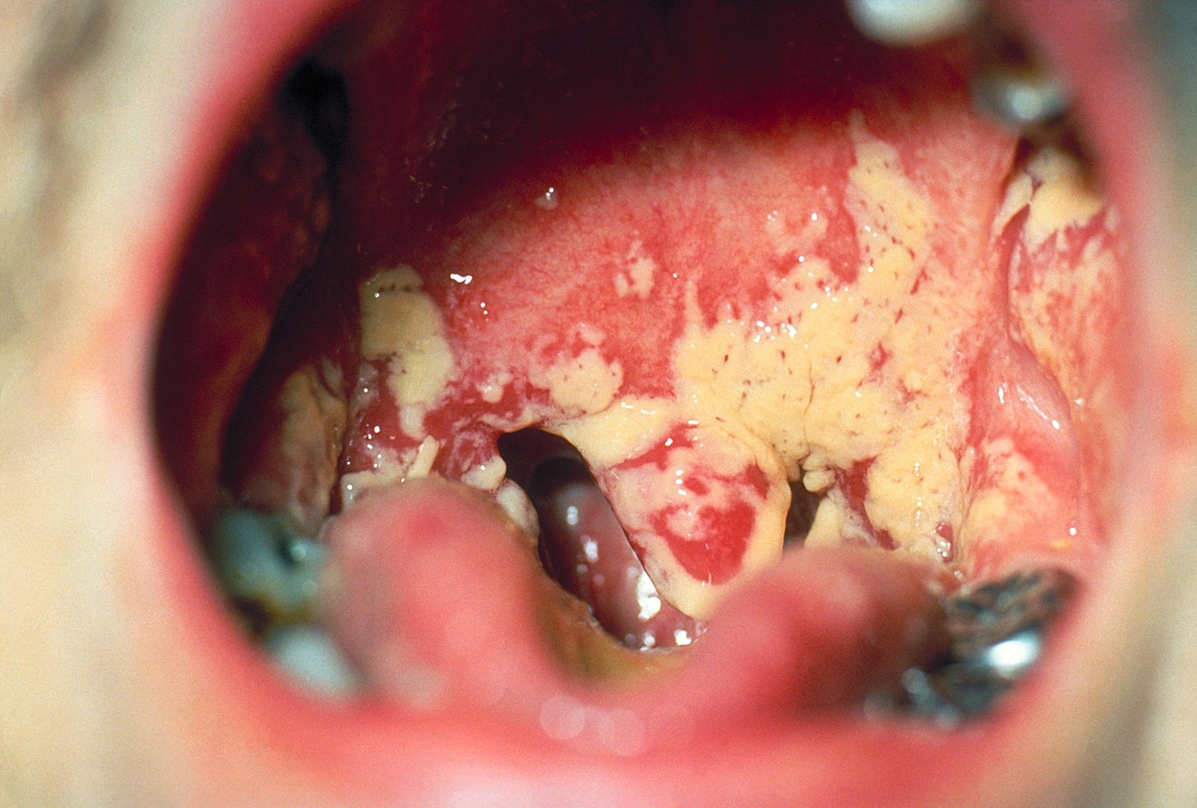
Figure 21.6: Oral Candidiasis and Opportunistic Infections
WHAT TO NOTICE
Oral & Esophageal Candidiasis (Figure 21.6)
Creamy white plaques on inflamed oral mucosa that do NOT rinse away; odynophagia or dysphagia signals esophageal extension requiring systemic antifungal therapy.
Pneumocystis Pneumonia (PJP — Pneumocystis jirovecii)
Subacute progressive dyspnea over days–weeks, fever, dry non-productive cough, resting tachypnea, and marked exertional SpO2 desaturation; diagnosis requires induced sputum or bronchoscopy (not routine expectorated sputum).
TMP-SMX Primary Prophylaxis Thresholds (DHHS, May 2026)
Start TMP-SMX if CD4 <200 cells/µL when not on ART or starting ART (or on ART if CD4 <100, or 100–200 with rising viral load); stop once ART holds CD4 >=200 cells/µL for >=3 months.
Toxoplasmosis, CMV Retinitis (CD4 <50) & IRIS
At CD4 <50 cells/µL, watch for CNS toxoplasmosis (headache, focal weakness, seizures) and CMV retinitis (floaters, blind spots, vision loss); report new fever or worsening inflammation after starting ART (IRIS).
Clinical Takeaway: In Mr. Martin Leclerc's case (Unfolding Case 2, Questions 21–26; CD4 80 cells/µL, SpO2 93% dropping to 85% after walking 30 m), exertional desaturation plus oral thrush is the classic presentation of PJP.
Medical-Surgical Nursing: A Canadian Open Text
Chapter 21 · Immunity, Allergy, and HIV
Notes:
Figure 21.6 shows oral candidiasis (thrush) with adherent creamy white plaques over erythematous palatal and pharyngeal mucosa (credit: CDC, Public Health Image Library, public domain). Review the major opportunistic infections in Section 21.5: (1) Pneumocystis pneumonia (PJP), presenting with subacute dry cough, fever, weight loss, respiratory alkalosis with hypoxemia on ABG, and exertional desaturation; diagnosed via induced sputum or bronchoscopy and prevented/treated with trimethoprim-sulfamethoxazole (always check sulfonamide allergy first); (2) Toxoplasma gondii encephalitis (CD4 <50 cells/µL: headache, focal deficits, seizures); (3) CMV retinitis (CD4 <50 cells/µL: floaters, scotomata); (4) Tuberculosis (high risk at any CD4 count); and (5) Immune reconstitution inflammatory syndrome (IRIS) in the first weeks to months after starting ART.

Slide 26
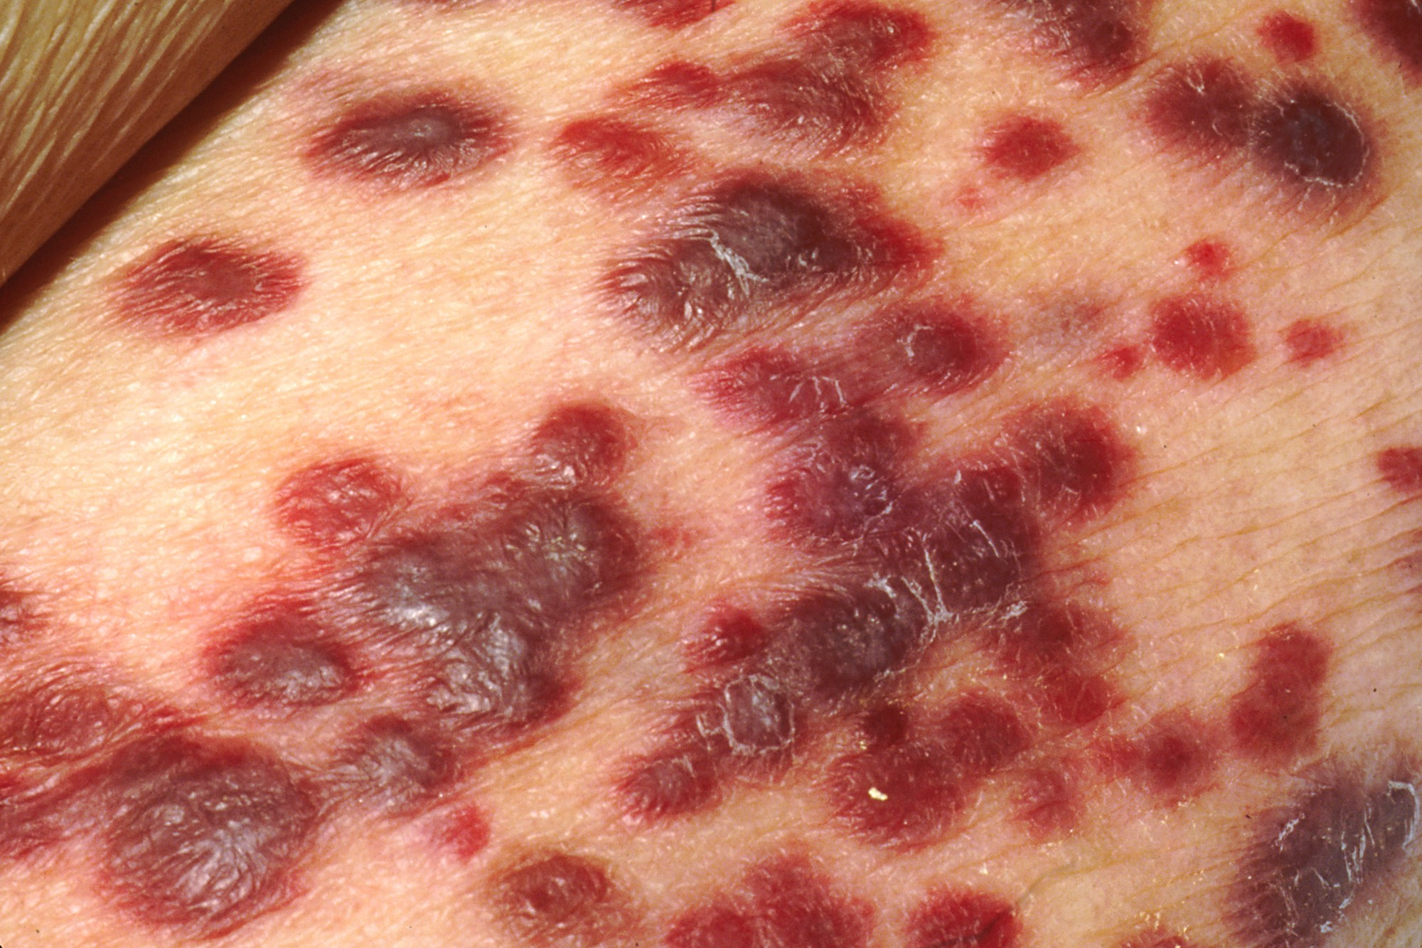
Figure 21.7: Kaposi Sarcoma, Hospital Care, and Anti-Stigma
WHAT TO NOTICE
Kaposi Sarcoma Across Skin Tones (Figure 21.7)
HHV-8 vascular tumour causing flat or raised skin and oral plaques/nodules; classically red-purple or violet on lighter skin, but often brown or black on darker skin—inspect skin and mouth in good light.
Routine Practices Only & Strict Confidentiality
HIV requires Routine Practices only—never post door signs, wear double gloves for meal trays, or use separate dishes (Practice Story: The Sign on the Door). Never disclose HIV status to family or visitors without consent.
Aging With HIV & Polypharmacy (Baribeau et al., 2022)
In a Quebec cohort of 3,905 adults on ART, cardiovascular, bone, and renal comorbidities occurred more often and at younger ages; screen for falls, fracture risk, renal function, and drug interactions.
Canadian Criminal Law Outline (R v Mabior & 2018 Directive)
Nurses give legal information, never legal advice: disclosure is required legally only when there is a 'realistic possibility of transmission'; federal prosecutorial directives bar prosecution when viral load is suppressed (<200 copies/mL).
Clinical Takeaway: 45% to 83% of people living with HIV report health care stigma (Pelletier et al., 2022)—address breaches of privacy or unnecessary precautions immediately and privately.
Medical-Surgical Nursing: A Canadian Open Text
Chapter 21 · Immunity, Allergy, and HIV
Notes:
Figure 21.7 shows Kaposi sarcoma nodules and plaques (credit: Wikimedia Commons, public domain). Connect this visual to three essential nursing responsibilities in Section 21.5: (1) Skin-of-colour inspection—Kaposi sarcoma lesions may look brown or black rather than violet on darker skin, and oral palatal lesions are common; (2) Countering health care stigma, illustrated by RPN Amira Mansour's Practice Story ('The Sign on the Door'), where a colleague taped 'Blood and body fluid precautions – HIV' to a patient's door and wore double gloves to deliver a breakfast tray; and (3) Understanding disclosure privacy and the outline of Canadian criminal law (R v Mabior, 2012, and the December 2018 federal directive recognizing that a viral load <200 copies/mL poses no realistic possibility of transmission).

Slide 27
PART 6 · SECTION 21.6
Autoimmunity and Adult Immunization
Breakdown of self-tolerance, Canadian Immunization Guide adult schedules, cold chain and injection safety, CNO scope, and vaccine hesitancy
Notes:
Part 6 covers Section 21.6: how breakdown of self-tolerance causes autoimmune disease, why autoimmune treatments create secondary immunodeficiency, the Canadian Immunization Guide adult vaccine schedule and Ontario publicly funded examples (Table 21.4), cold chain and intramuscular injection safety, CNO scope of practice for immunization, and motivational interviewing for vaccine hesitancy.

Slide 28
SECTION 21.6 · AUTOIMMUNITY & ADULT VACCINES
Self-Tolerance Breakdown and Adult Vaccine Schedule
Autoimmune disease affects 10.2% of people (13.1% of women); review adult immunization status at every routine encounter.
Autoimmunity & Adult Vaccines (Table 21.4)
Safe Administration & Hesitancy
Loss of Self-Tolerance & Co-Occurrence
Failure to delete or suppress self-reactive T/B cells leads to autoantibodies or T-cell tissue injury (T1D, Hashimoto/Graves, celiac/IBD, MS, RA, SLE, ITP); having one autoimmune disease raises the risk of another.
Td / Tdap, MMR & Varicella (CIG / Ontario Schedule)
Td booster every 10 years + 1 adult Tdap dose + Tdap in EVERY pregnancy (ideally 27–32 weeks; Ontario funded). Live MMR (born >=1970 or HCWs/students/travellers) and live Varicella (susceptible ages 18–49) are avoided in pregnancy and severe immunosuppression.
Recombinant Zoster, HPV, Hepatitis A & B
Non-live RZV (2 doses): NACI recommends >=50 yr and >=18 yr if immunocompromised (Ontario funds ages 65–70, completed before 71st birthday). Non-live HPV (<=26 yr or shared decision-making; ON funds high-risk MSM <=26) and Hep A / Hep B for at-risk adults.
Pre-Vaccine Screening & Cold Chain (+2 °C to +8 °C)
Screen contraindications, allergies (including latex), pregnancy, and (for live vaccines) immunosuppression, live vaccines in past 4 wk, or blood products in past year. If fridge goes out of +2 to +8 °C range (e.g., 11 °C), label 'DO NOT USE', keep refrigerated, and call public health/supplier.
Deltoid IM Technique, Observation & AEFI Reporting
90° deltoid injection without aspiration: needle 2.5 cm (1 in) for most adults, 1.6–2.5 cm (<60 kg), or 3.8 cm (1.5 in, larger adults). Observe 15 min (30 min if higher risk); report AEFIs to the local public health unit in Ontario.
Vaccine Hesitancy Conversations (PHAC, 2025a)
Ask open questions ('Can you tell me more about what worries you?'), listen without judgment, avoid jargon, use motivational interviewing, and practise cultural safety.
Medical-Surgical Nursing: A Canadian Open Text
Chapter 21 · Immunity, Allergy, and HIV
Notes:
Slide 28 integrates Autoimmunity, Table 21.4 ('Adult vaccines at a glance'), safe vaccine administration, cold chain excursion management, AEFI reporting, and vaccine hesitancy communication. Emphasize the cold chain rule (Question 34): if the clinic vaccine refrigerator reads 11 °C, NEVER discard the vaccines, freeze them, or administer them—quarantine them inside the working refrigerator (or an monitored cold container at +2 °C to +8 °C), label them 'DO NOT USE', and contact the local public health unit or manufacturer to assess stability. Also review needle selection by adult weight (1.6–2.5 cm under 60 kg; 2.5 cm standard; 3.8 cm larger adults) and no aspiration at 90 degrees into the deltoid.

Slide 29
CLINICAL INTEGRATION · SCOPE & CASE STUDIES
CNO Scope of Practice and Chapter Case Studies
Applying CNO authority, competence, and context alongside the two longitudinal clinical case studies in Chapter 21.
1
2
3
CNO Scope in Immunization
Case 1: Mr. Thomas Leblanc, 58 (Q1–Q4)
Case 2: Mr. Martin Leclerc, 44 (Q21–Q26)
Giving a vaccine by injection is a controlled act in Ontario. Both RNs and RPNs require an order (direct order or directive from a physician/NP), competence (including anaphylaxis management), and employer support with epinephrine on hand. RNs with additional prescribing education may prescribe vaccines outside public hospitals. An RPN finding a contraindication or reaction consults the RN or prescriber.
Admitted with pneumonia and a 'penicillin allergy' label from having loose stools for 2 days on amoxicillin at age 16—a common side effect, documented precisely without abbreviations for delabelling review (Q1–Q2). On Day 4 (4 weeks after starting a new anticonvulsant), he develops fever (38.9 °C), facial/ear edema, trunk/arm rash, cervical lymphadenopathy, eosinophilia (1.6 × 10⁹/L), and rising liver enzymes—classic DRESS (Q3). Hold next dose per policy and report at once (Q4).
Presents with 3 weeks of dry cough, fever (38.4 °C), 6-kg weight loss, oral thrush, bilateral chest x-ray haziness, and SpO2 dropping from 93% to 85% after walking 30 m (Q21). ABG shows respiratory alkalosis with hypoxemia (pH 7.48, PaCO2 30, PaO2 58; Q22). 4th-gen HIV test is reactive (CD4 80 cells/µL) and induced sputum confirms PJP (Q23). Started on IV TMP-SMX (check sulfa allergy) and O2 (Q24); escalated via RRT on Day 2 (Q25); walking SpO2 95% on Day 9 shows recovery (Q26).
Medical-Surgical Nursing: A Canadian Open Text
Chapter 21 · Immunity, Allergy, and HIV
Notes:
Slide 29 synthesizes the Scope in Practice box ('Who Gives Vaccines, and on Whose Authority', CNO, 2023, 2025) and the two multi-part unfolding case studies in Chapter 21: Case 1 (Mr. Thomas Leblanc, Questions 1–4, covering amoxicillin side-effect documentation, penicillin delabelling, and anticonvulsant DRESS syndrome) and Case 2 (Mr. Martin Leclerc, Questions 21–26, covering undiagnosed HIV with CD4 80 cells/µL, Pneumocystis pneumonia, and oral candidiasis). Walk students through why Mr. Martin Leclerc's Day 9 recovery is best shown by maintaining SpO2 at 95% on room air while walking the hallway (Question 26)—whereas CD4 recovery takes months to years (~50–150 cells/µL in the first year).

Slide 30
CHAPTER 21 REVIEW · CHECK YOUR UNDERSTANDING
Six High-Yield Clinical Judgment Questions
Q1 (Ch21 Q5). Why does a vaccine protect for years whereas intravenous immune globulin (IVIG) protects only temporarily?
Q4 (Ch21 Q28 & Q29). A patient calls 30 hours after condomless sex with a partner of unknown HIV status. Another patient has a non-reactive 4th-gen test 10 days post-exposure. How do you advise each?
Q2 (Ch21 Q9 & Q20). A patient on an ACE inhibitor for 6 years develops lip and tongue swelling without hives. Why are antihistamines and steroids unreliable, and what is your priority?
Q5 (Ch21 Q38 & Q40). A patient on rilpivirine is ordered IV pantoprazole for GI bleeding. A patient on ART for 2 years has confirmed viral loads of 640 and 710 copies/mL. What is the action for each?
Q3 (Ch21 Q11 & Q12). On Day 12 of a sulfonamide, a patient with dark brown skin reports a sore mouth and gritty eyes without obvious skin redness. What should the nurse do?
Q6 (Ch21 Q33 & Q34). The clinic vaccine fridge reads 11 °C at 0800. What should the nurse do with the vaccines, and what does an Ontario RPN need before giving an adult Tdap injection?
Bottom Line: Precise allergy histories, skin-of-colour vigilance, routine HIV screening, uninterrupted ART, and safe adult vaccination save lives every day.
Notes:
Complete Rationales for Check Your Understanding:
Q1: Vaccines stimulate active immunity, training the patient's own B and T lymphocytes to form long-lived memory cells. Immune globulin provides passive immunity (borrowed antibodies) that works immediately but wears off as the antibodies are cleared without forming memory cells (Question 5).
Q2: Up to one-third of ACE inhibitor angioedema cases occur months to years after starting the drug. Because the mechanism is bradykinin-mediated (not histamine-mediated), hives are absent and antihistamines, corticosteroids, and epinephrine cannot be relied upon to reverse swelling. Call the rapid response or anesthesia team immediately for airway protection and stop the ACE inhibitor (Questions 9 & 20).
Q3: On darker skin, melanin masks erythema so early SJS/TEN lesions may look dusky, grey-purple, or hyperpigmented rather than red, and oral mucosal ulcers or ocular grittiness are often the first clear signs. Inspect the mouth, eyes, and skin in good light, hold the next dose per policy, and report immediately to the RN and prescriber (Questions 11 & 12).
Q4: At 30 hours post-exposure, the patient is within the 72-hour emergency window for post-exposure prophylaxis (PEP, taken for 28 days) and should come in immediately. At 10 days post-exposure, it is too late for PEP (>72 h), and a negative test does not rule out HIV because the window period lasts up to 12 weeks—schedule repeat testing (Questions 28 & 29).
Q5: Proton pump inhibitors (including IV pantoprazole) are strictly contraindicated with rilpivirine because raising gastric pH blocks rilpivirine absorption—hold pantoprazole and contact the prescriber and pharmacist. Two confirmed viral loads >=200 copies/mL after suppression represent virologic rebound (not a single blip)—assess adherence and drug/cation interactions and expect genotypic resistance testing while still on the regimen (Questions 38 & 40).
Q6: For a cold chain break (11 °C, outside +2 °C to +8 °C), label the vaccines 'DO NOT USE', keep them refrigerated, and contact public health or the supplier for stability guidance. In Ontario, administering a vaccine by injection is a controlled act requiring an order (direct order or directive) from an authorized prescriber, nursing competence (including anaphylaxis management), and employer support (Questions 33 & 34).

