Slide 1
UNIT V · HEMATOLOGIC, IMMUNOLOGIC & ENDOCRINE NURSING CARE · CHAPTER 22
Diabetes
Glucose regulation and SI diagnostic criteria, POC and CGM monitoring, high-alert insulin and cardiorenal pharmacotherapy, hypoglycemia protocols, DKA and HHS, and diabetic foot care.
Medical-Surgical Nursing: A Canadian Open Text
Aligned with CNO Entry-to-Practice Competencies (RN & RPN), Diabetes Canada Clinical Practice Guidelines (2018–2025 Updates), and ISMP Canada High-Alert Safeguards
opensourcenursing.ca (CC BY-NC-SA 4.0)
Notes:
Welcome to Chapter 22: Diabetes, in Unit V (Hematologic, Immunologic & Endocrine Nursing Care). Nurses encounter diabetes on every inpatient and community unit. In 2023–2024, about 3.9 million Canadians aged 1 year and older (9.7%) were living with diagnosed diabetes, and roughly 260,000 people were newly diagnosed that year (PHAC, 2025). Acute illness, hospital meal schedules, NPO procedures, and medications like corticosteroids can rapidly destabilize blood glucose. In this lecture, we cover islet hormone physiology, Type 1 and Type 2 diabetes, Diabetes Canada SI diagnostic criteria, point-of-care and continuous glucose monitoring (CGM), high-alert insulin safety, cardiorenal non-insulin medications (SGLT2 inhibitors and GLP-1 receptor agonists), Level 1–3 hypoglycemia, diabetic ketoacidosis (DKA) and hyperglycemic hyperosmolar state (HHS), inpatient basal-bolus management, neuropathy and foot care, and sick-day medication guidance.

Slide 2
INTRODUCTION · WHY THIS CHAPTER MATTERS
The Plan of Care Across Three Clinical Domains
Every unit cares for adults with diabetes whose glucose is shaped by acute illness, hospital routines, and social determinants.
1. SI Diagnosis, CGM & A1C Targets
2. High-Alert Insulin & Drugs
3. Emergencies, Feet & Equity
Apply Canadian SI (mmol/L) Criteria
Interpret fasting glucose (>=7.0 mmol/L), A1C (>=6.5%), and 2-h/random glucose (>=11.1 mmol/L).
Use Point-of-Care (POC) & CGM Safely
Wash and dry hands before fingersticks, recognize interstitial CGM lag, and read 14-day Time in Range (>70%).
Individualize Glycated Hemoglobin (A1C)
Target <=7.0% for most adults, but relax to 7.1%–8.5% for frail older adults or those with dementia.
Prevent High-Alert Insulin Errors
Spell out 'units', never share pens, use 4 mm needles at 90°, rotate sites, and verify food is at the bedside.
Advance Cardiorenal Protection
Use metformin first-line plus sodium-glucose cotransporter-2 (SGLT2) inhibitors and glucagon-like peptide-1 (GLP-1) receptor agonists with proven cardiovascular (CV), heart failure (HF), and kidney benefit.
Watch High-Risk Drug Cues
Link sulfonylureas to hypoglycemia, SGLT2 inhibitors to euglycemic DKA, and metformin to contrast holds.
Treat Lows, DKA & HHS by Protocol
Act immediately for glucose <3.9 mmol/L, and follow diabetic ketoacidosis (DKA) and hyperglycemic hyperosmolar state (HHS) fluid, potassium (>=3.3 mmol/L), and anion gap rules.
Protect Neuropathic Feet
Screen yearly with a 10 g monofilament and inspect across all skin tones to prevent ulcers and amputations.
Support Equity & Sick-Day Care
Address cost, food insecurity, diabetes distress, and First Nations, Inuit, and Métis strengths-based programs.
Medical-Surgical Nursing: A Canadian Open Text
Chapter 22 · Diabetes
Notes:
Chapter 22 organizes adult diabetes nursing around three pillars: (1) accurate Canadian SI diagnosis, point-of-care and continuous glucose monitoring, blood ketone testing, and individualized A1C targets; (2) high-alert insulin safety and modern non-insulin pharmacotherapy (including SGLT2 inhibitors and GLP-1 receptor agonists for cardiovascular, heart failure, and renal protection); and (3) rapid management of hypoglycemia (<3.9 mmol/L), DKA, and HHS, alongside proactive inpatient basal-bolus therapy, foot care, sick-day medication holds, and culturally safe support. CNO Entry-to-Practice Competency Mapping (Learning Outcomes 1–8): Outcomes 1, 2, 4, 5, and 6 map to RN Clinician and Scholar (CNO, 2019a) and RPN Foundations of Practice (CNO, 2019b); Outcomes 3, 6, and 7 map to RN Educator and Advocate and RPN Foundations of Practice and Ethical Practice; Outcome 8 maps to RN Professional and Coordinator and RPN Legal Practice and Collaborative Practice.

Slide 3
CANADIAN EPIDEMIOLOGY · KEY CLINICAL BENCHMARKS
Diabetes Burden and Complications in Canada
Key Canadian surveillance and clinical benchmarks that guide diabetes screening and care:
3.9 Million
19.2%
20×
36%
Canadians aged >=1 year (9.7%) living with diagnosed diabetes in 2023–2024 (~260,000 new/year)
Age-standardized prevalence among First Nations adults on reserve (RHS Phase 3; governed by OCAP®)
Higher likelihood of hospitalization for nontraumatic lower-limb amputation in adults with diabetes
Prevalence of diabetes distress—the emotional burden of daily self-management—in adults with diabetes
Sources: Public Health Agency of Canada (2025); First Nations Information Governance Centre (2018); Embil et al. (2018); Robinson et al. (2023).
Medical-Surgical Nursing: A Canadian Open Text
Chapter 22 · Diabetes
Notes:
Review these four Canadian benchmarks: (1) PHAC (2025) reports ~3.9 million Canadians aged >=1 year (9.7%) living with diagnosed diabetes in 2023–2024, plus an estimated 1.9% of adults aged 20–79 with undiagnosed diabetes and 6.3% with prediabetes. (2) In the First Nations Regional Health Survey (RHS) Phase 3 (2015–2016), governed under First Nations OCAP® principles, age-standardized diabetes prevalence among First Nations adults on reserve was 19.2% (FNIGC, 2018); Diabetes Canada names colonization as the most significant social determinant of health (Crowshoe et al., 2018). (3) Adults with diabetes in Canada are 20 times more likely to be hospitalized for nontraumatic lower-limb amputation (Embil et al., 2018). (4) About one-third (36%) of people with diabetes experience clinically significant diabetes distress (Robinson et al., 2023).

Slide 4
PART 1 · SECTION 22.1
Glucose Regulation, Types of Diabetes, and Diagnosis
Insulin, glucagon, and incretins; Type 1, Type 2, and other types; Canadian risk factors and Indigenous health equity; and SI diagnostic criteria
Notes:
Part 1 covers Section 22.1: how pancreatic beta cells (insulin), alpha cells (glucagon), stress hormones, and gut incretins (GLP-1 and GIP) regulate blood glucose; how Type 1, LADA, Type 2, gestational, and secondary diabetes develop; who is at risk in Canada; and how prediabetes and diabetes are diagnosed in SI units.

Slide 5
SECTION 22.1 · HORMONAL GLUCOSE REGULATION
Pancreatic Islet Hormones and Diabetes Types
Insulin and glucagon pull in opposite directions to keep blood glucose within a narrow band day and night.
Islet Hormones, Stress & Incretins
Classification of Diabetes Mellitus
How beta cells, alpha cells, gut hormones, and stress regulate fuel
Autoimmune destruction versus insulin resistance and beta-cell decline
Insulin (Pancreatic Beta Cells)
Released after meals: moves glucose into muscle and fat, tells the liver to store glycogen and stop glucose output, and suppresses fat breakdown (lipolysis) and ketone production.
Glucagon (Alpha Cells) & Stress Hormones
Glucagon rises between meals and overnight to trigger hepatic glycogenolysis and gluconeogenesis. Catecholamines (infection, MI, stroke) and corticosteroids also raise blood glucose.
Gut Incretins (GLP-1 & GIP)
Secreted by the intestine after meals to boost glucose-dependent insulin release; GLP-1 also suppresses glucagon and slows gastric emptying.
Type 1 Diabetes & LADA
Autoimmune destruction of pancreatic beta cells causing absolute insulin deficiency and DKA risk; requires lifelong insulin (~75% diagnosed before age 20; includes adult-onset LADA).
Type 2 Diabetes
Combines peripheral insulin resistance with a progressive beta-cell secretory defect (>80% diagnosed after age 40); DKA is less common, and many eventually require insulin.
Prediabetes, Gestational & Other Types
Prediabetes (IFG, IGT, or A1C 6.0–6.4%); gestational diabetes in pregnancy; and secondary diabetes from pancreatitis, cystic fibrosis, glucocorticoids, or monogenic beta-cell defects.
Bedside Pathophysiology Link: Without insulin (and with high glucagon/stress hormones), unrestrained lipolysis floods the liver with fatty acids that become acidic ketone bodies (DKA).
Medical-Surgical Nursing: A Canadian Open Text
Chapter 22 · Diabetes
Notes:
Slide 5 contrasts normal islet and incretin physiology with the pathophysiology of Type 1 and Type 2 diabetes. Emphasize why Type 1 diabetes is uniquely prone to diabetic ketoacidosis (DKA): insulin is the brake on hormone-sensitive lipase in adipose tissue. When insulin is absent and glucagon/catecholamines are high, fat breaks down rapidly and the liver converts free fatty acids into ketoacids (beta-hydroxybutyrate and acetoacetate). In Type 2 diabetes, endogenous insulin is usually sufficient to restrain lipolysis except during severe stress or SGLT2 inhibitor therapy.

Slide 6
SECTION 22.1 · RISK FACTORS & SI DIAGNOSIS
Screening, Equity, and Diagnostic Criteria (Table 22.1)
Higher diabetes rates in Indigenous and racialized communities reflect structural determinants and colonization—not biology.
Risk Factors, Screening & Indigenous Equity
Adult Diagnostic Criteria (Table 22.1)
Diabetes Canada Screening & CANRISK (Ekoé et al.)
Assess risk yearly; screen adults >=40 yr (or high risk on CANRISK) with FPG and/or A1C every 3 years, or every 6–12 months if very high risk.
Key Risk Factors & Acanthosis Nigricans
Age >=40, 1st-degree relative, high-risk populations, prediabetes/GDM, PCOS, OSA, HIV, steroids/atypical antipsychotics, and acanthosis nigricans (velvety neck/axillary plaques—palpate texture in good light on darker skin; never mistake for poor hygiene).
Indigenous Peoples, Colonization & OCAP®
Diabetes Canada cites colonization (residential schools, forced relocation) as the primary determinant. Report distinct figures (First Nations 19.2% on reserve under OCAP®; Métis 7.3%; Inuit ~4%) and support community-led models like the Kahnawake Schools Diabetes Prevention Project.
Fasting Plasma Glucose (FPG — >=8 h Fast)
Prediabetes (IFG): 6.1–6.9 mmol/L · Diabetes: >=7.0 mmol/L.
Glycated Hemoglobin (A1C — Standardized Lab)
Prediabetes: 6.0%–6.4% · Diabetes: >=6.5% (do not use for suspected T1D; can mislead in hemoglobinopathies, anemias, or severe renal/liver disease).
2-Hour PG (75 g OGTT) & Random PG
2-h OGTT: Prediabetes (IGT) 7.8–11.0 mmol/L; Diabetes >=11.1 mmol/L. Random PG: Diabetes >=11.1 mmol/L with classic symptoms (polyuria, polydipsia, weight loss).
Confirmation Rule (Punthakee et al., 2018)
One diabetes-range test is enough if symptomatic; if asymptomatic, confirm on another day (never delay T1D treatment).
Medical-Surgical Nursing: A Canadian Open Text
Chapter 22 · Diabetes
Notes:
Slide 6 integrates Diabetes Canada's screening recommendations, the Canadian Context box ('Diabetes in First Nations, Inuit and Métis Communities'), skin-of-colour assessment of acanthosis nigricans (Pusey-Reid et al., 2023), and Table 22.1 ('Diagnosing diabetes and prediabetes in adults'). Make sure students memorize the exact SI cutoffs: Prediabetes = FPG 6.1–6.9 mmol/L, 2-h OGTT 7.8–11.0 mmol/L, or A1C 6.0%–6.4%. Diabetes = FPG >=7.0 mmol/L, A1C >=6.5%, 2-h OGTT >=11.1 mmol/L, or Random PG >=11.1 mmol/L. If the patient has no hyperglycemic symptoms (e.g., an asymptomatic 52-year-old with FPG 7.4 mmol/L in Question 5), a confirmatory test must be repeated on another day.

Slide 7
PART 2 · SECTION 22.2
Monitoring Glucose: POC Meters, CGM, A1C, and Ketones
Bedside capillary testing accuracy, real-time and flash CGM, Ambulatory Glucose Profile targets, individualized A1C goals, and beta-hydroxybutyrate testing
Notes:
Part 2 covers Section 22.2: accurate point-of-care capillary glucose testing, continuous glucose monitoring (CGM) and the 14-day Ambulatory Glucose Profile (Going Deeper), individualized A1C targets across the adult lifespan, and blood beta-hydroxybutyrate ketone testing.

Slide 8
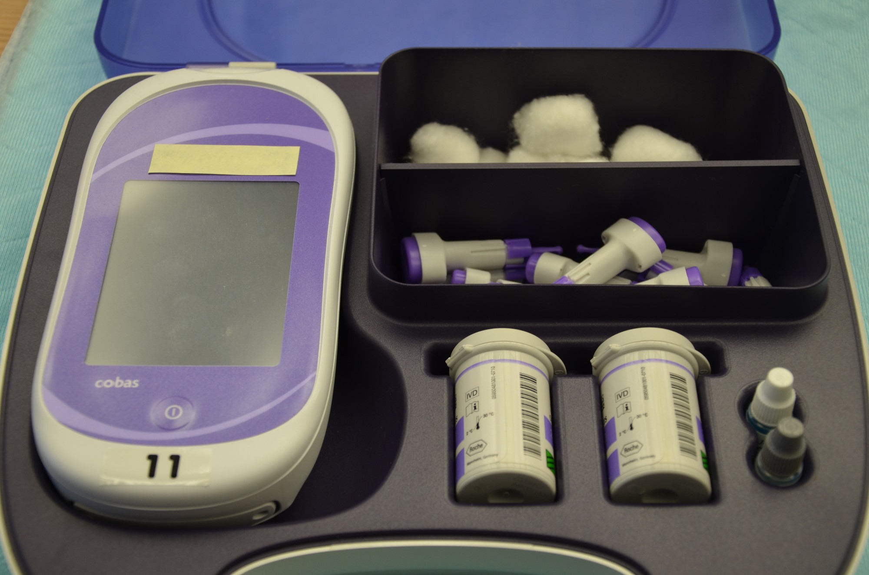
Figure 22.1: Point-of-Care Capillary Glucose Testing
WHAT TO NOTICE
Lab-Approved Hospital Meter & Quality Control
Bedside point-of-care (POC) meters must be approved and quality-checked under laboratory and employer policy, with immediate reporting of critical highs and lows.
Handwashing & First-Drop Technique (Hortensius et al.)
Sugar left on fingers after touching fruit falsely elevates capillary readings, and hard squeezing dilutes/distorts the sample—have the patient wash and dry hands and use the first drop.
Fingertip vs. Alternate-Site Lag
Always use the fingertip when glucose is changing rapidly (after meals, after exercise, or during suspected hypoglycemia) because forearm or thigh samples lag behind blood glucose.
Meter Accuracy vs. Simultaneous Lab Glucose
Diabetes Canada accepts <15% difference between meter and fasting lab glucose at values >4.2 mmol/L; if a reading does not match how the patient looks, treat the patient, retest, and send a lab sample.
Clinical Takeaway: If a patient has just peeled or eaten an orange (Question 8), do not rely on an alcohol swab—have them wash and dry their hands with soap and water and test the first drop.
Medical-Surgical Nursing: A Canadian Open Text
Chapter 22 · Diabetes
Notes:
Figure 22.1 shows a hospital point-of-care blood glucose meter kit with test strips, single-use safety lancets, quality-control solutions, and cotton balls (credit: Glynda Rees Doyle and Jodie Anita McCutcheon/BCcampus, CC BY 4.0). Highlight the study by Hortensius et al. (2011): fruit sugar on unwashed fingers caused falsely elevated first-drop readings in most participants, and milking/squeezing the finger also distorted values. Also note that patients using multiple daily insulin injections should check capillary glucose at least 3 times daily, including before and after meals.

Slide 9
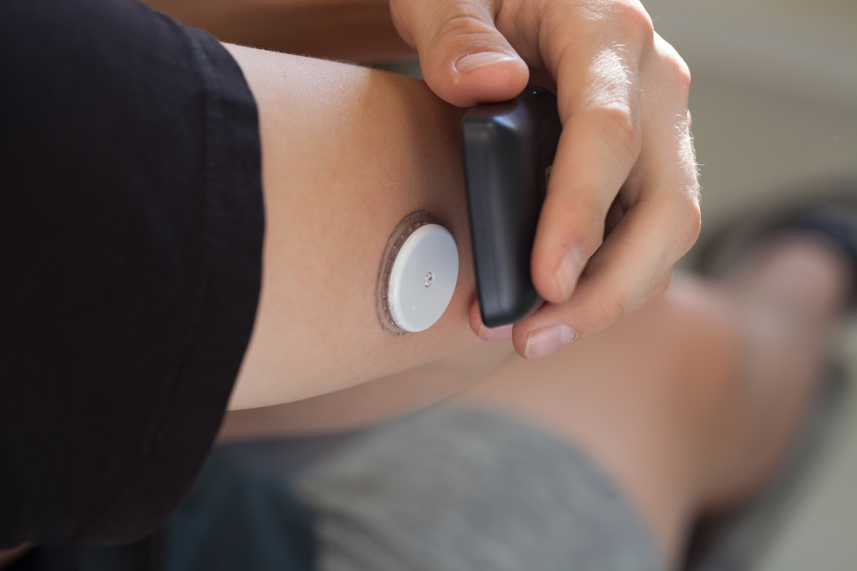
Figure 22.2: Continuous Glucose Monitoring and AGP Targets
WHAT TO NOTICE
Real-Time vs. Intermittently Scanned ('Flash') CGM
Subcutaneous sensors measure interstitial fluid glucose every few minutes; recommended for all adults with T1D (Halperin et al., 2025) and for T2D on basal-bolus insulin to reduce hypoglycemia (Cheng et al., 2021).
Physiological Lag Time (5–6 Minutes or More)
Interstitial glucose trails blood glucose by ~5–6 min in fasting adults (and more when glucose rises or falls rapidly)—if a sensor reads 4.8 mmol/L but the patient is shaky/sweaty, check a capillary POC fingerstick immediately.
Going Deeper (RN): 14-Day AGP Consensus Targets
Requires >=70% sensor wear over 14 days: Time in Range (3.9–10.0 mmol/L) >70% (~16 h 48 m/day; >50% in frail/high-risk); Time Below Range <3.9 mmol/L <4% (<1% in frail) and <3.0 mmol/L <1%; CV <=36%. Address hypoglycemia FIRST.
Hospital CGM Precautions (Korytkowski et al., 2022)
Confirm CGM readings with a POC meter before adjusting insulin; poor perfusion, vasopressors, skin infection, and certain drugs distort readings, and sensors must be removed for MRI.
Clinical Takeaway: When reading a 14-day CGM report (Question 18), always address Time Below Range (<3.9 mmol/L >4% or <3.0 mmol/L >1%, especially overnight) BEFORE increasing insulin for highs.
Medical-Surgical Nursing: A Canadian Open Text
Chapter 22 · Diabetes
Notes:
Figure 22.2 shows an intermittently scanned ('flash') CGM sensor on the upper arm being scanned with a reader (credit: Thirunavukkarasye-Raveendran/Wikimedia Commons, CC BY 4.0). Walk students through the Going Deeper box ('Reading a CGM Report', required for RN students): the Ambulatory Glucose Profile (AGP) overlays 14 days of data (valid when worn >=70% of the time). Each 5% increase in Time in Range (3.9–10.0 mmol/L) brings clinically meaningful benefit, and 70% TIR corresponds to an A1C of ~7.0%. Emphasize that hypoglycemia (<3.9 mmol/L target <4%; <3.0 mmol/L target <1%) is always addressed first—for example, a cluster of lows between 0200 and 0500 points to the evening basal or bedtime dose.

Slide 10
SECTION 22.2 · A1C TARGETS & KETONE TESTING
Individualized Glycemic Targets and Blood Ketones
A1C reflects 8 to 12 weeks of average glucose, while blood beta-hydroxybutyrate detects acute ketosis early.
A1C & Individualized Adult Targets
Blood Beta-Hydroxybutyrate Ketone Testing
Balancing microvascular protection against hypoglycemia danger (Imran et al., 2018)
Early detection of insulin deficiency and impending ketoacidosis
What A1C Measures & Testing Frequency
Percentage of glycated hemoglobin over the past 8–12 weeks (~50% from the last 30 days); check q3m when not at target, or q6m once stable (rely on meter/CGM if anemia or hemoglobin variants distort A1C).
Standard Adult Target (Most T1D & T2D)
A1C <=7.0%, with fasting/premeal glucose 4.0–7.0 mmol/L and 2-hour post-meal glucose 5.0–10.0 mmol/L (<=6.5% may be considered in low-risk T2D).
Relaxed Targets for Functionally Dependent or Frail Adults
A1C 7.1%–8.0% if functionally dependent; 7.1%–8.5% for recurrent severe hypoglycemia, limited life expectancy, frailty, or dementia (premeal 6.0–9.0 mmol/L).
Why Blood Ketones Are Preferred Over Urine Strips
Capillary blood ketone meters measure beta-hydroxybutyrate—the predominant ketone body in DKA—detecting ketosis earlier and more accurately than nitroprusside urine strips.
When People With Type 1 Diabetes Must Check Ketones
During any acute illness with elevated glucose, whenever premeal glucose stays >14.0 mmol/L, or if DKA symptoms (nausea, vomiting, abdominal pain, tachypnea) appear.
SGLT2 Inhibitor Ketone Action Threshold
Anyone with T1D taking an SGLT2 inhibitor must have a blood ketone meter and a written action plan for blood ketones >1.0 mmol/L (Halperin et al., 2025); ketones >1.5 mmol/L on sick days require DKA evaluation.
Lifespan Pearl: For an 84-year-old resident with moderate dementia and frailty whose A1C is 7.9% (Question 11), 7.1%–8.5% is at goal—tightening to <=7.0% invites dangerous hypoglycemia and falls.
Medical-Surgical Nursing: A Canadian Open Text
Chapter 22 · Diabetes
Notes:
Slide 10 pairs individualized A1C targets (Imran et al., 2018; Meneilly et al., 2018) with blood ketone monitoring (Berard et al., 2018; Halperin et al., 2025). Reinforce why blood beta-hydroxybutyrate testing is preferred over urine ketone dipsticks: urine strips measure acetoacetate, whereas beta-hydroxybutyrate is the main circulating ketoacid in DKA and rises much earlier.

Slide 11
PART 3 · SECTION 22.3
Insulin and Non-Insulin Medications
Basal, bolus, and correction insulin profiles; high-alert insulin safety; injection technique and lipohypertrophy; and cardiorenal non-insulin therapies
Notes:
Part 3 covers Section 22.3: basal, bolus (prandial), and correction insulin regimens; pharmacokinetics of all insulin classes marketed in Canada (Table 22.2); ISMP Canada high-alert insulin safeguards; pen technique and lipohypertrophy prevention; and non-insulin medications including metformin, SGLT2 inhibitors, GLP-1 receptor agonists, GIP/GLP-1 dual agonists, DPP-4 inhibitors, sulfonylureas, meglitinides, and thiazolidinediones.

Slide 12
SECTION 22.3 · INSULIN PHARMACOKINETICS
Insulin Types, Action Profiles, and Nursing Points (Table 22.2)
Know whether each insulin is clear or cloudy, when it peaks, and how to time it safely with meals.
Faster-Acting (Fiasp): Clear bolus; onset 4 min, peak 0.5–1.5 h, duration 3–5 h; confirm food is at bedside.
Long-Acting Basal (Clear): Glargine U-100 (Lantus/Basaglar/Semglee, 24 h), U-300 (Toujeo, >30 h), Degludec (Tresiba, 42 h); no peak.
Rapid-Acting (Aspart, Lispro): Clear bolus (NovoRapid/Trurapi/Kirsty; Humalog/Admelog); onset 10–20 min, peak 1–3 h, dur 3–5 h.
Premixed Insulins (Cloudy): Humulin 30/70, Novolin ge 30/70, NovoMix 30, Humalog Mix25; give with meals (missed meal = low).
Short-Acting (Regular): Clear bolus/IV (Humulin R, Novolin ge Toronto); onset 30 min, peak 2–3 h, duration 6.5 h.
Concentrated Insulins: Lispro U-200, Glargine U-300, Degludec U-200, Regular U-500 (Entuzity: peak 4–8 h, dur 17–24 h).
Intermediate (NPH — Cloudy): Basal (Humulin N, Novolin ge NPH); onset 1–3 h, peak 5–8 h, dur <=18 h; afternoon low risk.
Once-Weekly Basal (Icodec): Awiqli authorized in Canada; stop sulfonylureas/meglitinides when bolus insulin is added.
Peak Hypoglycemia Timing (Question 19): An 0800 dose of NPH (Humulin N) peaks 5 to 8 hours later—putting the patient at highest risk for hypoglycemia between 1300 and 1600, especially if lunch is late.
Medical-Surgical Nursing: A Canadian Open Text
Chapter 22 · Diabetes
Notes:
Slide 12 summarizes Table 22.2 ('Insulin types and what the nurse watches for'). Point out the exact NovoRapid (aspart) Canadian monograph numbers: onset within 10–20 minutes, maximum effect 1–3 hours, duration 3–5 hours, administered immediately before a meal (no more than 5–10 minutes ahead). Lispro onset is 10–15 minutes, peak 1–2 hours, duration 3–4.75 hours. Short-acting Regular insulin has a 30-minute onset, 2–3 hour peak, and 6.5-hour duration, and is the class used for IV insulin infusions. Intermediate-acting NPH is cloudy, starts in 1–3 hours, peaks at 5–8 hours, and lasts up to 18 hours. Long-acting basal analogues (glargine U-100/U-300, degludec U-100/U-200) are clear, have a 90-minute onset, NO peak, and last 24 to 42 hours.

Slide 13
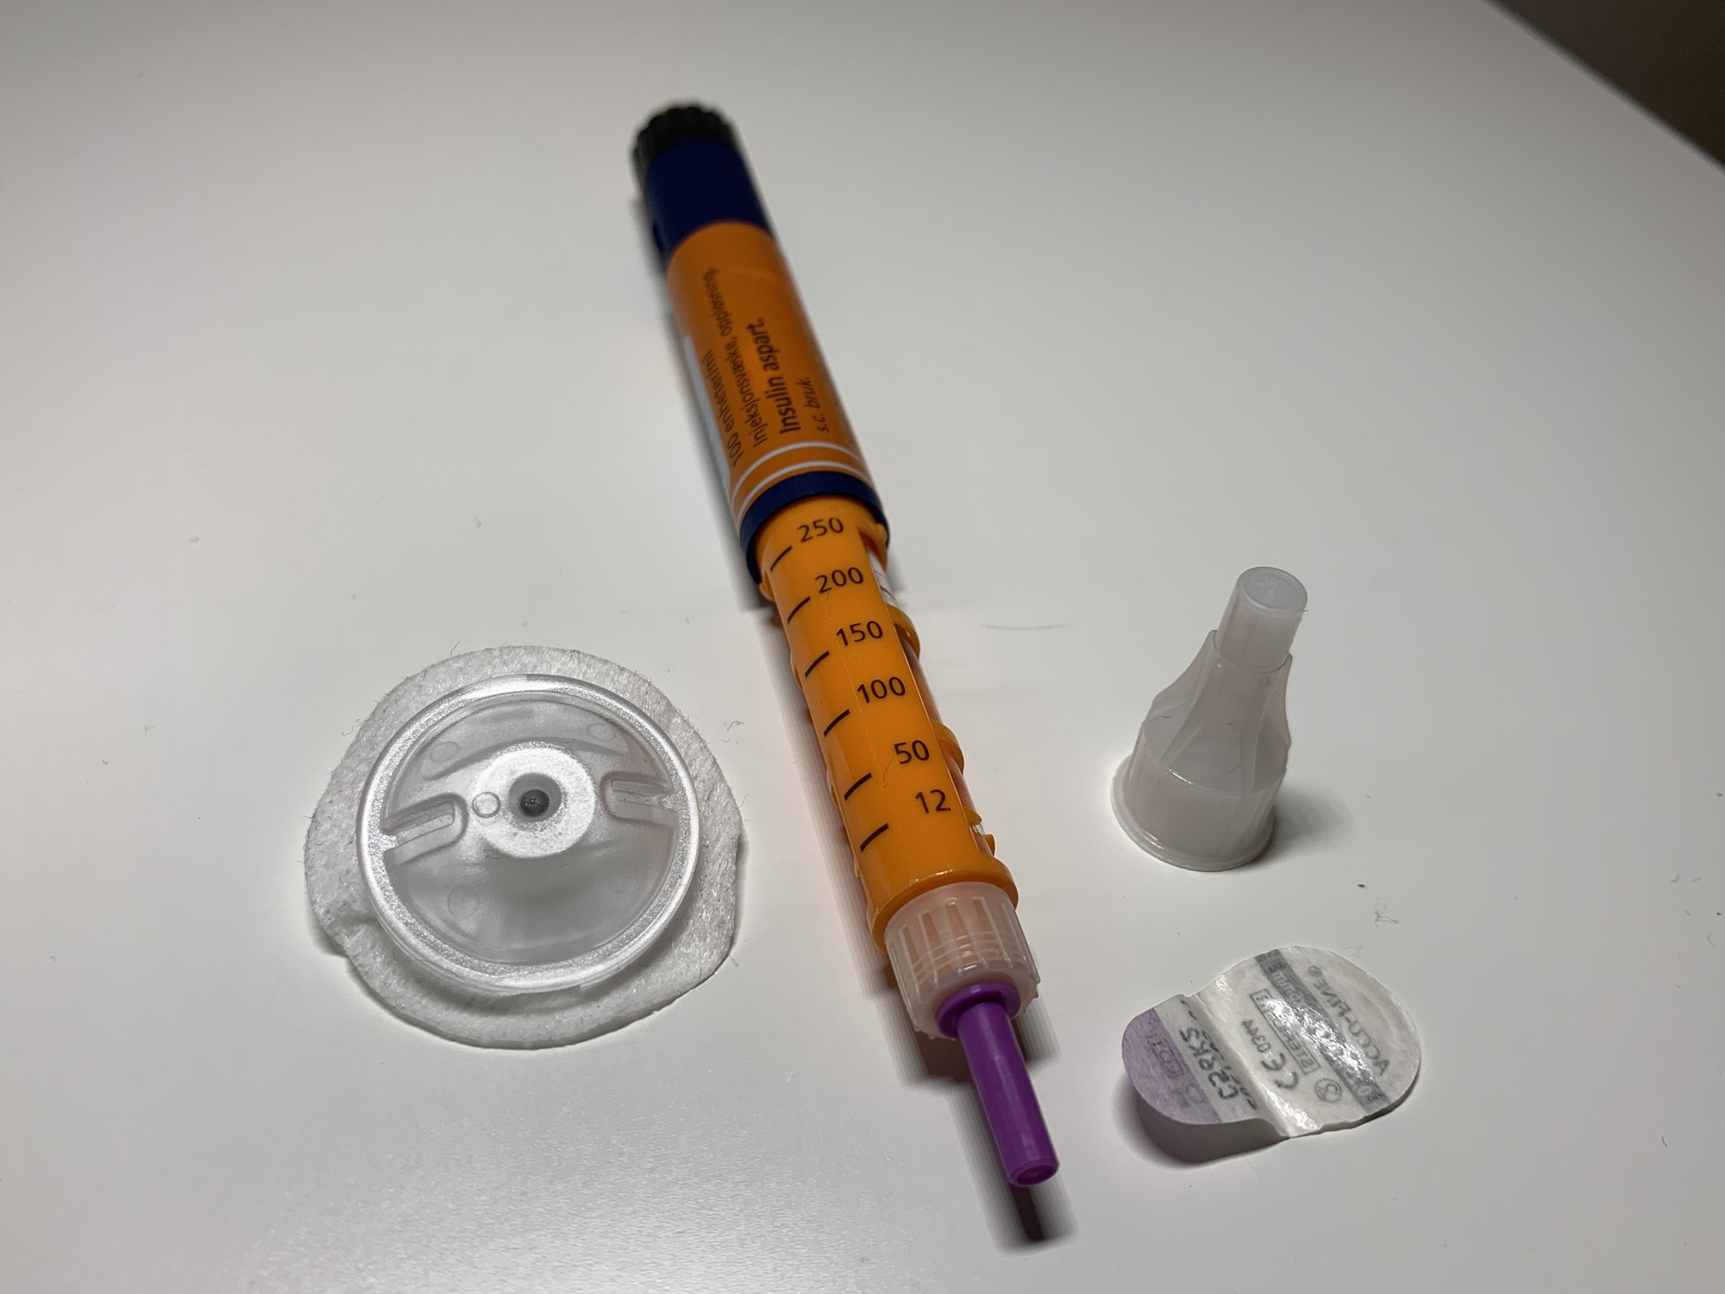
Figure 22.3: High-Alert Insulin Safety and Pen Technique
WHAT TO NOTICE
Spell Out 'Units' & Read Full Product Names Aloud
Never accept 'U' (14U can be misread as 140 units—clarify with prescriber) or doses in mL. Read full name, type, and concentration aloud (never confuse Humulin N with Humulin R, or clear glargine with clear aspart).
One Pen, One Patient & Never Withdraw With a Syringe
Label the pen barrel (never the cap) for one patient only—sharing a pen even with a new needle transmits bloodborne pathogens (remove pen and file an incident report). Never draw insulin from a pen/cartridge with a syringe.
4 mm Pen Needle at 90° & Lipohypertrophy Inspection
Attach a new 4 mm needle for each injection, inserted at 90° in adults of any body size (Bari et al., 2020). Inspect and palpate sites for rubbery lipohypertrophy lumps (37% of Canadians with lumps still injected into them) and rotate widely.
Meal Tray at Bedside Rule (Practice Story)
In RN Tomasz Nowak's story (caring for Mrs. Evelyn Mercier, 76), giving insulin aspart when hearing a hallway cart led to hypoglycemia (3.6 mmol/L) when the tray was delayed—confirm the tray is at the bedside and the patient can eat before giving bolus insulin.
Clinical Takeaway: Insulin is a high-alert medication in both hospital and community—every pen is strictly single-patient, every dose is in 'units', and bolus insulin waits until food is in front of the patient.
Medical-Surgical Nursing: A Canadian Open Text
Chapter 22 · Diabetes
Notes:
Figure 22.3 shows an insulin aspart (NovoRapid) pen, a single-use pen needle with its outer cover, and an I-Port Advance subcutaneous injection port (credit: Marius Vassnes/Wikimedia Commons, CC BY-SA 4.0). Integrate the Clinical Safety box ('Insulin Is a High-Alert Medication'), the Practice Story ('The Supper Tray Came Late'), and the first case study (Mr. Gérald Beaulieu, Questions 1–4). Emphasize that injecting into the same spot near the navel every night causes lipohypertrophy, which makes absorption erratic and causes both unexplained highs and sudden lows.

Slide 14
SECTION 22.3 · NON-INSULIN MEDICATIONS
First-Line, Cardiorenal, and Secretagogue Therapies
Diabetes Canada's 2024 update pairs first-line metformin with targeted SGLT2 inhibitors and GLP-1 receptor agonists.
Metformin (First-Line Biguanide)
SGLT2i & GLP-1 RA (Cardiorenal)
Secretagogues, DPP-4i & TZDs
Mechanism & Weight/Hypoglycemia Profile
Improves insulin sensitivity and lowers hepatic glucose output; weight-neutral and rarely causes hypoglycemia on its own.
Iodinated Contrast Hold Rule (Question 16)
Stop metformin at or before procedures using iodinated contrast, hold for 48 hours afterward, and restart ONLY after kidney function is rechecked and normal.
GI Tolerance & Vitamin B12 Monitoring
Start low to limit diarrhea/nausea; check serum vitamin B12 at least every 1 to 2 years during long-term therapy.
2024 Cardiorenal Indications
Proven CV benefit: liraglutide, dulaglutide, injectable semaglutide. Proven HF & CKD benefit: canagliflozin, dapagliflozin, empagliflozin (whatever the A1C).
SGLT2 Inhibitor Safety Cues
Teach genital hygiene (yeast/UTI risk), watch for dehydration, hold when ill/fasting/pre-op, and report vomiting or tachypnea (euglycemic DKA).
GLP-1 RA & Tirzepatide Cues
Titrate slowly for nausea; slow gastric emptying (pre-op aspiration risk); avoid in medullary thyroid cancer history; do not combine with DPP-4i.
Sulfonylureas & Meglitinides
Gliclazide (preferred over glyburide), glimepiride, and repaglinide release insulin regardless of glucose—high hypoglycemia and weight-gain risk.
DPP-4 Inhibitors (Gliptins)
Alogliptin, linagliptin, saxagliptin, sitagliptin: oral, weight-neutral, low hypoglycemia risk; rare risk of pancreatitis.
Thiazolidinedione (Pioglitazone)
Improves insulin sensitivity but causes weight gain and fluid retention—watch for edema and heart failure.
Medical-Surgical Nursing: A Canadian Open Text
Chapter 22 · Diabetes
Notes:
Slide 14 covers the Medications box ('Non-Insulin Drug Classes') and the 2024 Diabetes Canada pharmacologic update (Shah et al., 2024; Butalia et al., 2024). Stress the three high-yield nursing cues tested in Questions 12, 15, 16, and 17: (1) Sulfonylureas (gliclazide, glyburide) and meglitinides (repaglinide) are insulin secretagogues and carry the highest risk of hypoglycemia among oral agents; (2) SGLT2 inhibitors (dapagliflozin, empagliflozin, canagliflozin) can cause euglycemic DKA—if a patient on dapagliflozin has nausea, abdominal pain, and rapid breathing with a glucose of 9.8 mmol/L (Question 15), report immediately and check blood ketones; and (3) Metformin is held at/before iodinated contrast and for 48 hours after, restarting only once renal function is confirmed normal.

Slide 15
PART 4 · SECTION 22.4
Hypoglycemia: Recognition, Protocol Treatment, and Prevention
2023 Diabetes Canada alert value (<3.9 mmol/L) and Levels 1–3, autonomic versus neuroglycopenic cues across skin tones, 15-g/20-g and glucagon protocols, and safe driving rules
Notes:
Part 4 covers Section 22.4: Diabetes Canada's 2023 hypoglycemia update (Lega et al., 2023), the <3.9 mmol/L alert value and Levels 1–3 classification, inpatient causes of lows, recognizing autonomic and neuroglycopenic symptoms across all skin tones, nurse-initiated oral carbohydrate and nasal/injectable glucagon protocols, and safe driving rules.

Slide 16
SECTION 22.4 · RECOGNIZING HYPOGLYCEMIA
Levels 1–3, Inpatient Triggers, and Skin-of-Colour Cues
Diabetes Canada's 2023 update sets the hypoglycemia alert value below 3.9 mmol/L; Level 3 is defined by needing help, not by a number.
2023 Classification & Hospital Triggers
Cues, Skin Tone & Impaired Awareness
Three Severity Levels (Lega et al., 2023)
Alert value <3.9 mmol/L: Level 1 = 3.0–3.9 mmol/L with autonomic symptoms; Level 2 = <3.0 mmol/L with neuroglycopenic symptoms; Level 3 (severe) = ANY glucose with mental/physical change requiring another person's help to treat.
Five Common Hospital Triggers
1. Missed, delayed, or partially eaten meals after bolus insulin; 2. NPO status while insulin or secretagogues continue; 3. Interrupted enteral/parenteral nutrition without IV dextrose; 4. Falling renal function slowing sulfonylurea clearance; 5. Tapering corticosteroids without lowering insulin.
Structural & Clinical Risk Factors
Prior severe lows, impaired awareness, long insulin duration, autonomic neuropathy, CKD, frailty/cognitive impairment, low literacy, and food insecurity.
Autonomic vs. Neuroglycopenic Symptoms
Autonomic (adrenergic): tremor, palpitations, sweating, anxiety, hunger, nausea, tingling. Neuroglycopenic (brain fuel deprivation): confusion, drowsiness, weakness, blurred vision, slurred speech, dizziness.
Skin-of-Colour & Clinical Judgment (Mr. Mensah)
Sweating feels cool, damp, and clammy on every skin tone; on dark brown skin, pallor looks ash grey or yellow-brown rather than pale—inspect lips, oral mucosa, and conjunctiva in good light.
Impaired Awareness, Beta-Blockers & Older Adults
Screen at-risk patients with Gold/Clarke scores and screen for fear of hypoglycemia (~30%). Beta-blockers mask tachycardia and delay recovery; in older adults, always check glucose first for new confusion or drowsiness.
Medical-Surgical Nursing: A Canadian Open Text
Chapter 22 · Diabetes
Notes:
Slide 16 synthesizes Section 22.4 and the Clinical Judgment box ('Sweaty and Confused at 0400' — Mr. Samuel Mensah, 71). Walk through Mr. Mensah's case: he takes evening basal insulin and gliclazide, ate little at supper, had rising creatinine yesterday, and at 0400 is found picking at his sheets with cool, damp dark-brown skin, ash-grey lips/mucosa, HR 104, and POC glucose 2.6 mmol/L. Because he requires someone else's help due to confusion, this is Level 3 (severe) hypoglycemia—even though he can sit up and safely swallow 20 g of glucose tablets.

Slide 17
SECTION 22.4 · HYPOGLYCEMIA TREATMENT & DRIVING
Nurse-Initiated Treatment Protocols and Prevention
Treat first and investigate after: choose 15 g carb, 20 g carb, or glucagon/IV dextrose based on severity and ability to swallow.
Diabetes Canada 2023 Treatment Protocol
Glucagon Supply, CGM & Driving Rules
Step-by-step management by level and swallowing ability (Lega et al., 2023)
Preventing recurrence at home and on the road (Houlden et al., 2018)
Level 1 or 2 (Conscious & Able to Swallow)
Give 15 g of fast-acting carbohydrate (preferably glucose or sucrose tablets/solution). Recheck in 15 minutes; repeat 15 g if still <3.9 mmol/L.
Level 3 (Conscious & Able to Swallow — e.g., Mr. Mensah)
Give 20 g of oral fast-acting carbohydrate (glucose tablets). Recheck in 15 minutes and give another 15 g if still <3.9 mmol/L (glucagon is an alternative).
Unable to Swallow or Unconscious (Never Give Anything by Mouth)
With IV access: give IV dextrose per protocol. Without IV access: give glucagon 3 mg intranasally (Baqsimi—no inhalation needed) or 1 mg SC/IM, turn on side, and call RRT / 9-1-1. Once corrected, give next meal or a 15 g carb + protein snack if meal is >1 h away.
Canadian Glucagon Products & Limits
Nasal glucagon (Baqsimi 3 mg) is marketed in Canada; injectable glucagon relied on US imports after 2023–2024 discontinuations until a new Canadian injectable was authorized in June 2026. Glucagon is less effective after >2 alcoholic drinks, prolonged fasting, or advanced liver disease.
Preventing Recurrent Severe Lows
Prescribe glucagon and train support persons; recommend CGM + structured education for high-risk adults; teach medical alert ID and carrying fast-acting glucose everywhere.
Diabetes Canada Driving Safety Rules
On insulin or secretagogues: check glucose before driving and q4h on long trips. NEVER drive if glucose is <4.0 mmol/L; after treating a low, wait until glucose is >=5.0 mmol/L AND at least 40 minutes have passed.
Scope Pearl (Question 36): When an RPN finds a patient at 2.8 mmol/L who can swallow, the RPN treats immediately under the unit's nurse-initiated hypoglycemia protocol, then notifies the RN and prescriber.
Medical-Surgical Nursing: A Canadian Open Text
Chapter 22 · Diabetes
Notes:
Slide 17 details the exact 2023 Diabetes Canada hypoglycemia treatment protocol (Lega et al., 2023), the Canadian glucagon supply landscape (Health Canada, 2026), and driving guidelines (Houlden et al., 2018). Make sure students distinguish: Level 1/2 conscious = 15 g fast-acting carbohydrate; Level 3 conscious/swallowing = 20 g fast-acting carbohydrate; Unconscious/unable to swallow without IV = 3 mg nasal glucagon (Baqsimi) or 1 mg SC/IM glucagon, NEVER oral gel or juice in the cheek (aspiration hazard, Question 29). And once glucose is >=4.0 mmol/L (e.g., 5.1 mmol/L in Question 28), if the next meal is >60 minutes away (e.g., 90 minutes), give a snack containing 15 g carbohydrate + protein.

Slide 18
PART 5 · SECTION 22.5
Hyperglycemic Emergencies: DKA and HHS
Pathophysiology of ketogenesis and hyperosmolality, euglycemic DKA, bedside comparison (Table 22.3), potassium and anion gap rules, and IV-to-subcutaneous transition
Notes:
Part 5 covers Section 22.5: how diabetic ketoacidosis (DKA) and hyperglycemic hyperosmolar state (HHS) develop, euglycemic DKA with SGLT2 inhibitors, bedside diagnostic criteria and clinical features (Table 22.3), protocol priorities (fluids first, potassium gate of 3.3 mmol/L, IV insulin until anion gap closure, dextrose addition at ~14.0 mmol/L), and overlapping subcutaneous insulin before stopping the IV infusion.

Slide 19
SECTION 22.5 · COMPARING DKA AND HHS
DKA and HHS Compared at the Bedside (Table 22.3)
DKA is driven by absolute insulin deficiency and ketoacidosis; HHS is driven by extreme hyperglycemia, hyperosmolality, and dehydration.
Diabetic Ketoacidosis (DKA)
Hyperglycemic Hyperosmolar State (HHS)
Rapid onset; mainly Type 1 diabetes (4.6–8.0/1,000 patient-yr) or SGLT2i use
Gradual onset over days–weeks; mainly older adults with T2D (up to 20% undiagnosed)
Pathophysiology & Triggers
Insulin deficiency + high glucagon -> unrestrained lipolysis -> hepatic ketoacids (beta-hydroxybutyrate, acetoacetate) + osmotic diuresis (K+ deficit 2–5 mmol/kg). Triggered by missed insulin, new T1D, infection, MI, or SGLT2 inhibitors.
Diagnostic Criteria (Goguen & Gilbert, 2018)
Glucose usually >=14.0 mmol/L (near-normal in euglycemic DKA), arterial/venous pH <=7.30, serum HCO3- <=15 mmol/L, anion gap >12 mmol/L, and positive serum/capillary ketones (POC beta-hydroxybutyrate is sensitive/specific).
Classic Bedside Cues
Polyuria, polydipsia, nausea, vomiting, abdominal pain, Kussmaul respirations (deep, rapid respiratory compensation), acetone breath, tachycardia, hypotension, and drowsiness.
Pathophysiology & Triggers
Enough residual insulin to restrain ketogenesis, but prolonged hyperglycemia + inadequate fluid intake causes massive osmotic diuresis (K+ deficit 4–6 mmol/kg). Infection is present in 40%–60% of cases; also triggered by diuretics, steroids, or MI/stroke.
Diagnostic Criteria & Effective Osmolality Formula
Plasma glucose >=34.0 mmol/L, effective plasma osmolality >320 mmol/kg, severe dehydration, and minimal/no acidosis or ketosis. Formula: Effective Osmolality = (2 × Na) + Glucose.
Classic Bedside Cues
Profound volume depletion (dry/ash-grey mucosa, orthostatic hypotension, oliguria) and marked neurologic depression (confusion, stupor, coma, seizures, or stroke-like focal deficits).
Calculation Check (Question 40): If Na+ is 150 mmol/L and glucose is 48.0 mmol/L, effective osmolality = (2 × 150) + 48.0 = 348 mmol/kg (>320 mmol/kg threshold for HHS).
Medical-Surgical Nursing: A Canadian Open Text
Chapter 22 · Diabetes
Notes:
Slide 19 converts Table 22.3 ('DKA and HHS compared at the bedside') into a side-by-side clinical comparison. Emphasize three testing nuances from Section 22.5: (1) Venous blood gas pH and bicarbonate are usually sufficient to guide DKA care without repeated arterial punctures; (2) Point-of-care capillary beta-hydroxybutyrate is sensitive and specific for DKA, whereas negative urine ketones do not rule it out; and (3) Capillary blood glucose meters become unreliable in severe acidosis and hypotension, so laboratory plasma glucose guides DKA/HHS protocol adjustments.

Slide 20
SECTION 22.5 · DKA & HHS PROTOCOL MANAGEMENT
Fluids, Potassium, Anion Gap, and Subcutaneous Overlap
About half of DKA and HHS deaths occur in the first 48 to 72 hours from the triggering illness, hypokalemia, or cerebral edema.
Protocol Priorities at the Bedside
Going Deeper (RN): Closing the Gap
1. IV Fluids First (0.9% Sodium Chloride)
Restore intravascular volume and renal perfusion first; monitor BP, HR, urine output, and lung sounds (watch for fluid overload in older adults or heart/kidney disease).
2. The Potassium Gate (3.3 mmol/L Rule)
Total body K+ is depleted even when initial serum K+ looks normal. Add K+ to IV fluids once urine output is established and serum K+ is <5.0–5.5 mmol/L. If K+ is <3.3 mmol/L, HOLD insulin and replace K+ until >=3.3 mmol/L.
3. IV Short-Acting Insulin & Dextrose at ~14.0 mmol/L
Run IV regular insulin until the anion gap closes. Once glucose falls to ~14.0 mmol/L, add IV dextrose to hold glucose at 12.0–14.0 mmol/L while continuing insulin to clear ketones.
4. Osmolality Rate Limit (<=3 mmol/kg/h) & Trigger Search
Lower osmolality no faster than ~3 mmol/kg/h; report headache, recurrent vomiting, or falling LOC (cerebral edema risk). Identify and treat infection, MI, or missed-insulin barriers.
Why the Anion Gap Is the DKA Endpoint
Glucose falls faster than ketoacids clear. Stopping IV insulin when glucose reaches 9.8 mmol/L while the anion gap is still raised restarts ketogenesis.
Calculating the Anion Gap (Question 38)
Anion Gap = Na+ − (Cl− + HCO3−). Example: 138 − (104 + 14) = 20 mmol/L (>12 mmol/L means unmeasured ketoacids remain, so IV insulin + dextrose must continue).
Overlapping Subcutaneous Insulin Before Stopping IV
Once the anion gap is normal (<=12) and the patient can eat, give subcutaneous short/rapid-acting insulin 1–2 hours OR intermediate/long-acting basal insulin 2–3 hours BEFORE stopping the IV insulin infusion.
Medical-Surgical Nursing: A Canadian Open Text
Chapter 22 · Diabetes
Notes:
Slide 20 covers Section 22.5 treatment priorities and the Going Deeper box ('Closing the Gap — Potassium and the Anion Gap in DKA'). Walk students through the two most tested safety rules in DKA (Questions 24, 25, 26, 38, and 39): (1) Never start insulin if serum potassium is <3.3 mmol/L because insulin drives K+ into cells and will precipitate lethal hypokalemic dysrhythmias; and (2) Never stop the IV insulin infusion just because blood glucose drops below 14.0 mmol/L—instead, add IV dextrose to keep glucose at 12.0–14.0 mmol/L and keep the insulin infusion running until the anion gap (Na − [Cl + HCO3]) normalizes.

Slide 21
PART 6 · SECTION 22.6
Hospital Management, Chronic Complications, Foot Care, and Self-Management
Inpatient glycemic targets, basal-bolus-correction vs. sliding scale, neuropathy and Inlow's 60-second foot screen, SADMANS sick-day guidance, CNO scope, and case studies
Notes:
Part 6 covers Section 22.6: inpatient glycemic targets for non-critically ill and critically ill adults, why proactive basal-bolus-correction regimens replace reactive sliding-scale orders, chronic microvascular and macrovascular complications (peripheral and autonomic neuropathy), annual foot screening and diabetic vs. arterial ulcers, sick-day medication holds (Table 22.4), CNO scope of practice, and the chapter's two longitudinal case studies.

Slide 22
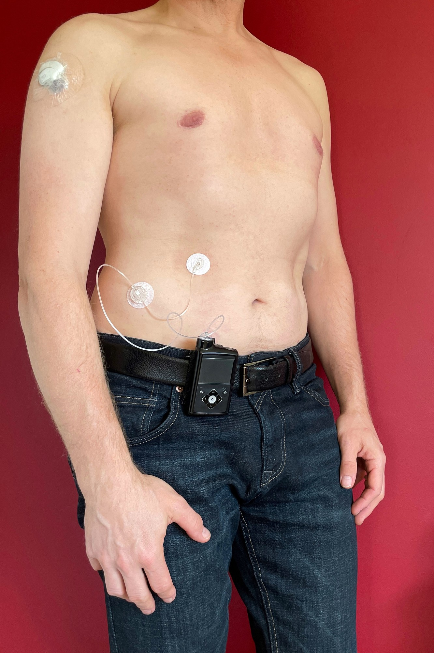
Figure 22.4: Inpatient Glycemic Management and Pump Care
WHAT TO NOTICE
Diabetes Canada Inpatient Glucose Targets (Malcolm et al.)
Non-critically ill adults: 5.0–8.0 mmol/L before meals and <10.0 mmol/L at random times. Critically ill adults: 6.0–10.0 mmol/L using an IV insulin infusion. Check admission A1C if none in past 3 months.
Basal-Bolus-Correction vs. Sliding-Scale Alone (Question 30)
Proactive basal + mealtime bolus + correction insulin is recommended. Correction-only ('sliding scale') insulin is discouraged as sole therapy, and withholding basal insulin in a fasting T1D patient precipitates DKA—always question an order that holds all basal insulin.
Corticosteroids & Interrupted Enteral Feeds
Monitor glucose for 48 h after starting steroids; use basal-bolus-correction and reduce insulin as steroids are tapered. If continuous tube feeds are stopped, start IV dextrose per protocol to prevent hypoglycemia.
Inpatient Self-Management & Continuous Insulin Pumps
Mentally competent patients may self-manage or continue wearing their insulin pump (delivering continuous rapid-acting basal + meal boluses) and CGM under hospital policy; remove/shield pumps per radiology policy for MRI/CT.
Clinical Takeaway: Never withhold basal insulin when a patient with Type 1 diabetes is NPO—without background insulin, DKA can develop within hours even when the patient is not eating.
Medical-Surgical Nursing: A Canadian Open Text
Chapter 22 · Diabetes
Notes:
Figure 22.4 shows an adult with Type 1 diabetes wearing a continuous subcutaneous insulin infusion pump on his belt with an abdominal infusion set and an upper-arm CGM sensor (credit: Medtd1/Wikimedia Commons, CC BY-SA 4.0). Emphasize that insulin pumps infuse ONLY rapid-acting insulin (both as a continuous basal rate and as user-triggered meal/correction boluses)—so if a pump malfunctions, disconnects, or is removed for imaging without alternative insulin, the patient has zero depot basal insulin and can develop DKA rapidly.

Slide 23
SECTION 22.6 · NEUROPATHY & OLDER ADULT TARGETS
Peripheral and Autonomic Neuropathy and Lifespan Care
Long-term hyperglycemia damages peripheral sensory nerves and visceral autonomic nerves while raising fall risk in older adults.
Peripheral & Autonomic Neuropathy
Lifespan Considerations: Older Adults
Annual screening and multi-system autonomic cues (Bril et al., 2018)
Tailoring targets and regimens to functional status, not age alone (Meneilly et al., 2018)
Distal Symmetric Peripheral Neuropathy
Causes numbness, tingling, burning/shooting pain, and loss of protective sensation in the toes and feet. Screen yearly (at T2D diagnosis; 5 yr post-puberty in T1D) using a 10 g monofilament or 128 Hz tuning fork at the great toe.
Cardiovascular & GI Autonomic Neuropathy
Orthostatic hypotension (>20 mm Hg systolic drop on standing without heart rate rise—check lying/standing BP and teach slow position changes), resting tachycardia (>100 bpm), gastroparesis (unpredictable meal absorption), constipation, and nocturnal diarrhea.
Genitourinary, Sudomotor & Hypoglycemia Risk
Incomplete bladder emptying, overflow incontinence, recurrent UTIs, erectile dysfunction, anhidrosis of feet (dry cracked skin) with gustatory sweating, and blunted awareness of hypoglycemia.
Functionally Independent Older Adults
Target A1C <=7.0% and premeal glucose 4.0–7.0 mmol/L when treated with low-hypoglycemia-risk medications.
Frail Older Adults or People With Dementia
Target A1C <8.5% on low-risk drugs, or 7.1%–8.5% if taking insulin or a sulfonylurea, with premeal glucose 6.0–9.0 mmol/L to prevent falls, fractures, and neuroglycopenia.
End-of-Life & Long-Term Care (LTC) Best Practices
At end of life, stop A1C testing and focus on avoiding symptomatic highs or any lows. In LTC, prefer gliclazide/glimepiride over glyburide, eliminate sliding-scale-only orders, and serve regular rather than restrictive 'diabetic' diets.
Clinical Connection: Autonomic neuropathy both causes gastroparesis (mismatching bolus insulin with delayed food absorption) and blunts adrenergic warning signs of hypoglycemia.
Medical-Surgical Nursing: A Canadian Open Text
Chapter 22 · Diabetes
Notes:
Slide 23 covers peripheral and autonomic neuropathy (Bril et al., 2018) and the Lifespan Considerations box ('Older Adults With Diabetes', Meneilly et al., 2018). Highlight how autonomic neuropathy affects every system at the bedside: orthostatic hypotension (>20 mm Hg drop in systolic BP on standing) increases fall risk; gastroparesis slows stomach emptying and causes postprandial hypoglycemia followed by late hyperglycemia; neurogenic bladder leads to urinary retention and UTIs; and loss of foot sweating causes dry, fissured skin that invites ulceration.

Slide 24
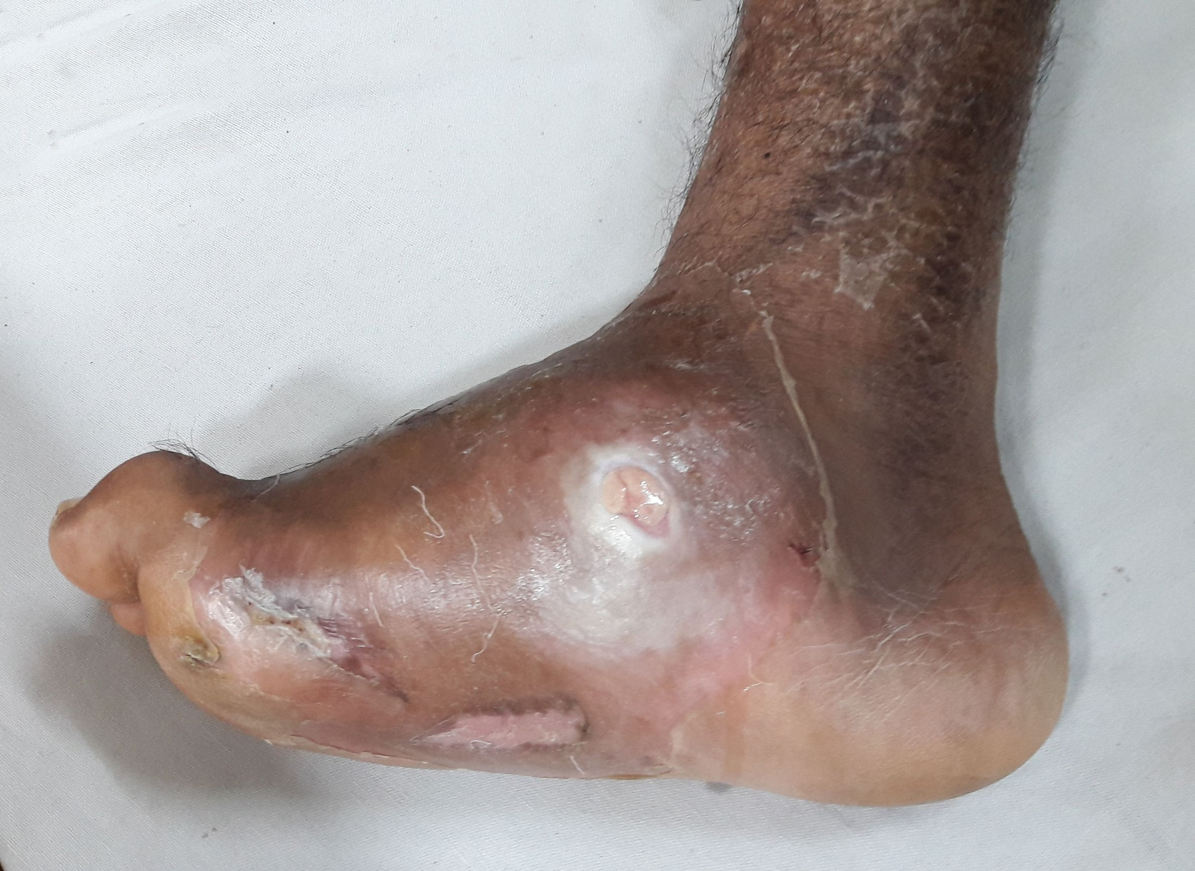
Figure 22.5: Diabetic Neuropathic Ulcer and Charcot Foot
WHAT TO NOTICE
Plantar Pressure Ulcer Over Charcot Midfoot Collapse
Figure 22.5 shows a plantar ulcer over a 'rocker-bottom' Charcot neuropathic arthropathy deformity—where progressive midfoot bone and joint collapse concentrates weight-bearing pressure on an insensate foot.
Inlow's 60-Second Diabetic Foot Screen
Wounds Canada's tool scores 12 elements per foot (neuropathy via 10 g monofilament, skin/callus/ulcer, nails, deformity/ROM, pedal pulses/temperature, footwear) to guide follow-up frequency.
Assessing Inflammation on Darker Skin Tones
Erythema does not look bright red on brown or black skin—look for darker, purple, or grey discoloration compared with the other foot, palpate for warmth with the back of the same hand, and check swelling or induration (Wounds International, 2023).
Uninfected Ulcer Offloading vs. Acute Charcot Immobilization
Uninfected neuropathic ulcers do NOT need antibiotics: debride necrotic tissue, maintain moisture balance, and offload pressure. A hot, swollen foot without an open wound may be acute Charcot foot requiring months of immobilization.
Clinical Takeaway: Because peripheral neuropathy dulls pain, a deep foot ulcer or limb-threatening infection may be completely painless—every open sore requires prompt interprofessional care.
Medical-Surgical Nursing: A Canadian Open Text
Chapter 22 · Diabetes
Notes:
Figure 22.5 shows a plantar diabetic foot ulcer overlying a Charcot midfoot deformity on darkly pigmented skin (credit: Medicalpal/Wikimedia Commons, CC BY-SA 4.0). Emphasize the equity and skin-of-colour insights in Section 22.6: adults with diabetes have a 20-fold higher risk of nontraumatic lower-limb amputation in Canada, with disproportionately higher rates among First Nations communities in Ontario and rural/remote regions. On darker skin tones, periwound cellulitis appears darker brown, violaceous/purple, or grey rather than red—so palpating skin temperature bilaterally and checking swelling and induration are essential.

Slide 25
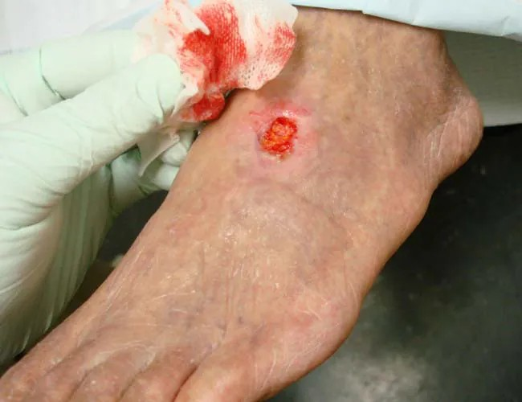
Figure 22.6: Arterial Ulcer Comparison and Daily Foot Care
WHAT TO NOTICE
Arterial vs. Neuropathic Ulcer Appearance (Figure 22.6)
Arterial ulcers are round, 'punched-out' wounds on the dorsum, toes, or lateral foot with pale/necrotic bases and minimal drainage, caused by ischemia (PAD) rather than plantar pressure—many patients have mixed neuroischemic disease.
Vascular Assessment Before Debridement or Compression
Always palpate dorsalis pedis and posterior tibial pulses and check foot temperature; signs of poor perfusion require prompt referral to a vascular specialist.
Patient Education: Daily Foot Inspection & Water Safety
Inspect soles and between toes daily (use a mirror or family help if needed); test bath water with the hand (never the foot) before stepping in; never soak feet in hot water (burn and maceration risk).
Footwear & Nail/Callus Safety (Question 33)
Wear properly fitted shoes at all times indoors and outdoors; never cut corns, calluses, or ingrown nails at home with a blade or chemical remover—refer to a foot care nurse, chiropodist, or podiatrist.
Clinical Takeaway: Loss of sensation to a 10 g monofilament (Question 34) means loss of protective sensation—teach daily visual inspection, hand-testing bath water, and professional callus care.
Medical-Surgical Nursing: A Canadian Open Text
Chapter 22 · Diabetes
Notes:
Figure 22.6 shows a round, punched-out arterial ulcer on the dorsum of the foot caused by peripheral arterial disease (credit: Jonathan Moore/Wikimedia Commons, CC BY 3.0). Contrast Figure 22.5 (plantar pressure neuropathic ulcer over a weight-bearing prominence with callused borders) with Figure 22.6 (ischemic arterial ulcer with punched-out margins, pale base, little exudate, cool hairless skin, and diminished/absent pedal pulses). Review the Patient Education box ('Caring for Your Feet') tested in Questions 33 and 34.

Slide 26
SECTION 22.6 · SICK-DAY GUIDANCE & EQUITY
Sick-Day Medication Rules (Table 22.4) and Self-Management
When acute illness and vomiting prevent fluid intake, pause dehydrating/renally cleared drugs—but NEVER stop insulin.
Pause SGLT2 Inhibitors: Hold canagliflozin, dapagliflozin, and empagliflozin when unable to keep fluids down (prevents euglycemic DKA).
Continue Insulin (Never Omit): Keep taking basal insulin and adjust doses per the sick-day plan; omitting insulin triggers DKA.
Pause ACEi, ARBs & Renin Inhibitors: Hold ramipril, candesartan, etc. during dehydration to prevent acute kidney injury.
Frequent Glucose & Ketone Checks: Check glucose q2–4h; in T1D check blood ketones if glucose >14.0 mmol/L (>1.5 mmol/L needs DKA workup).
Pause Diuretics & NSAIDs: Hold furosemide/thiazides and avoid OTC ibuprofen/naproxen cold or pain remedies.
Screen for Diabetes Distress (36%): Use DDS or PAID scales; normalize the emotional burden of daily care and refer for support.
Pause Metformin & Sulfonylureas: Hold metformin (lactic acidosis risk in AKI) and gliclazide/glyburide (hypoglycemia risk).
Address Cost & Food Insecurity: Ask about rationing insulin/strips, link to provincial coverage (e.g., Ontario ADP/ODB), and tailor to food access.
Sick-Day Memory Aid (Question 32): A patient with the flu who cannot keep fluids down pauses metformin, ramipril (ACEi), and empagliflozin (SGLT2i)—but continues insulin glargine with team guidance.
Medical-Surgical Nursing: A Canadian Open Text
Chapter 22 · Diabetes
Notes:
Slide 26 summarizes Table 22.4 ('Sick-day guidance for adults with diabetes', Diabetes Canada Appendix 8) alongside self-management education, financial access, food insecurity, and diabetes distress (Robinson et al., 2023). Emphasize the classic SADMANS medication pause list when a patient is vomiting or dehydrated: Sulfonylureas, ACE inhibitors, Diuretics/Direct renin inhibitors, Metformin, ARBs, NSAIDs, and SGLT2 inhibitors—while insulin is NEVER stopped (doses may need adjustment based on q2–4h glucose and blood ketone checks).

Slide 27
CLINICAL INTEGRATION · SCOPE & CASE STUDIES
CNO Scope of Practice and Chapter Case Studies
Integrating CNO authority, competence, and context with the two longitudinal case studies in Chapter 22.
1
2
3
CNO Scope: Insulin & Directives
Case 1: Mr. Gérald Beaulieu, 76 (Q1–Q4)
Case 2: Mr. Jordan Tremblay, 22 (DKA, Q21–Q26)
In Ontario, administering insulin by injection is a controlled act authorized for RNs and RPNs with a client-specific order or a medical directive. Nurses adjust insulin doses ONLY as an order or directive allows (never inventing a home titration rule). Ontario RN prescribing does NOT include diabetes medications. Nurse-initiated hypoglycemia protocols empower RNs and RPNs to treat lows immediately; RPNs consult the RN when glucose is unstable or IV insulin is needed.
T2D for 14 years on metformin and gliclazide, admitted with a leg infection and A1C 9.6%; starting bedtime insulin glargine pen. The RPN assesses hand arthritis/vision, teaches that glargine provides steady 24-h background control without a peak, corrects him when he plans to inject into the same spot near his navel every night (lipohypertrophy risk), warns of additive hypoglycemia risk with gliclazide, and ensures he has a written prescriber titration plan.
T1D for 10 years; stopped insulin during 2 days of vomiting. Presents drowsy with Kussmaul respirations (RR 30, deep), HR 118, BP 98/60, glucose 28.4 mmol/L, venous pH 7.12, HCO3- 9 mmol/L, beta-hydroxybutyrate 5.8 mmol/L, and K+ 4.8 mmol/L. Priority 1 is IV 0.9% NaCl for volume depletion. At 6 hours (glucose 13.6, anion gap 18), add IV dextrose while continuing IV insulin. Next morning, AG 11 and RR 18 show resolution, but K+ 3.1 mmol/L requires immediate replacement.
Medical-Surgical Nursing: A Canadian Open Text
Chapter 22 · Diabetes
Notes:
Slide 27 synthesizes the Scope in Practice box ('Insulin, Medical Directives and Who Adjusts Doses') and the two multi-part case studies from the Practice Questions (Mr. Gérald Beaulieu, Questions 1–4; Mr. Jordan Tremblay, Questions 21–26). Highlight how CNO scope applies in Question 4 and Question 37: neither an RPN nor an RN may change a patient's scheduled basal insulin dose without an order or medical directive, nor tell a patient at discharge to 'just add 2 units each night' without a written titration plan from the prescriber.

Slide 28
CHAPTER 22 REVIEW · CHECK YOUR UNDERSTANDING
Six High-Yield Clinical Judgment Questions
Q1. A patient has just eaten an orange before a pre-lunch fingerstick. Another patient's CGM reads 4.8 mmol/L, but she is shaky and sweaty. What should the nurse do in each case?
Q4. Compare Diabetes Canada's 2023 treatment for: (a) alert patient at 3.4 mmol/L; (b) drowsy Level 3 patient at 2.6 mmol/L who can swallow; and (c) unresponsive patient at 1.9 mmol/L without IV access.
Q2. An order reads 'insulin glargine 14U subcut at bedtime.' A colleague borrows another patient's insulin pen and attaches a new needle. What is your action for each?
Q5. In DKA, why is insulin held if K+ is 3.0 mmol/L, and why is IV insulin continued (with dextrose added) when glucose reaches 9.8 mmol/L if Na is 138, Cl is 104, and HCO3- is 14?
Q3. A patient on dapagliflozin has nausea, abdominal pain, tachypnea, and a glucose of 9.8 mmol/L. Another patient on metformin is booked for a contrast CT. How do you act?
Q6. A patient with the flu cannot keep fluids down and takes metformin, ramipril, empagliflozin, and insulin glargine. Which drugs should she pause, and which must continue?
Bottom Line: Treat insulin as a high-alert drug, act on symptoms over sensor lag, treat lows immediately by protocol, and close the anion gap in DKA.
Notes:
Complete Rationales for Check Your Understanding:
Q1: Fruit sugar on unwashed fingers falsely raises capillary glucose—have the patient wash and dry her hands with soap and water and use the first drop (Question 8). Interstitial CGM glucose lags behind blood glucose by 5–6+ minutes, especially when falling rapidly—check a capillary point-of-care glucose immediately (Question 9).
Q2: Never administer insulin from an order using 'U' because '14U' can be misread as '140'—contact the prescriber to rewrite the order with 'units' spelled out (Question 14). Insulin pens are strictly single-patient devices because microscopic blood regurgitation into the cartridge can transmit bloodborne pathogens even with a new needle—quarantine/remove the pen, file an incident report, and notify the charge nurse and prescriber (Question 13).
Q3: SGLT2 inhibitors (dapagliflozin, empagliflozin) can cause euglycemic DKA with a near-normal glucose (9.8 mmol/L)—report nausea, abdominal pain, and tachypnea immediately and check blood beta-hydroxybutyrate ketones (Questions 15 & 20). Hold metformin at or before iodinated contrast and for 48 hours after, restarting only once renal function is rechecked and normal (Question 16).
Q4: (a) Level 1/2 conscious: give 15 g fast-acting carbohydrate and recheck in 15 min (Question 27). (b) Level 3 conscious and able to swallow safely (Mr. Samuel Mensah): give 20 g oral glucose tablets and recheck in 15 min. (c) Unresponsive without IV access: give nothing by mouth; administer glucagon 3 mg intranasally (Baqsimi) or 1 mg SC/IM, turn on side, and call RRT / 9-1-1 (Question 29). Once corrected, provide a 15 g carb + protein snack if the next meal is >60 min away (Question 28).
Q5: Insulin shifts potassium into cells; starting insulin when serum K+ is <3.3 mmol/L (e.g., 3.0 mmol/L) can cause lethal hypokalemic dysrhythmias—hold insulin and replace K+ until >=3.3 mmol/L (Question 39). At glucose 9.8 mmol/L with Na 138, Cl 104, and HCO3- is 14, the anion gap is 138 − (104 + 14) = 20 mmol/L (>12), proving ketoacids are still present—continue IV insulin with IV dextrose until the anion gap closes (Questions 25 & 38).
Q6: Under Diabetes Canada's sick-day guidance (SADMANS), pause metformin, ramipril (ACE inhibitor), and empagliflozin (SGLT2 inhibitor) while dehydrated, but NEVER stop basal insulin glargine—continue insulin with sick-day dose adjustments and check glucose q2–4h (Question 32).

