Slide 1
UNIT V · HEMATOLOGIC, IMMUNOLOGIC & ENDOCRINE NURSING CARE · CHAPTER 23
Thyroid, Parathyroid, Adrenal, and Pituitary Disorders
Endocrine feedback and SI laboratory testing, hypothyroidism, hyperthyroidism and thyroid emergencies, thyroid/parathyroid surgery and calcium care, adrenal crisis and Cushing syndrome, and SIADH vs. AVP deficiency.
Medical-Surgical Nursing: A Canadian Open Text
Aligned with CNO Entry-to-Practice Competencies (RN & RPN), Choosing Wisely Canada, ATA/Endocrine Society Guidelines, and Difficult Airway Society SCOOP Guidance
opensourcenursing.ca (CC BY-NC-SA 4.0)
Notes:
Welcome to Chapter 23: Thyroid, Parathyroid, Adrenal, and Pituitary Disorders, the concluding chapter of Unit V (Hematologic, Immunologic, and Endocrine Nursing Care). Hormones from small glands in the neck, abdomen, and base of the brain set the pace of metabolism, keep calcium and water within narrow limits, and enable the body to survive acute physiological stress. Many chronic endocrine conditions develop gradually and mimic normal ageing or depression, whereas myxedema coma, thyroid storm, post-thyroidectomy neck hematoma, acute hypocalcemia, adrenal crisis, pituitary apoplexy, and severe water-balance disorders are time-critical emergencies. In this lecture, we cover negative feedback loops, SI laboratory testing, thyroid and parathyroid disorders and surgery, adrenal insufficiency and Cushing syndrome, and pituitary and water-balance disorders (SIADH and arginine vasopressin deficiency).

Slide 2
LEARNING OUTCOMES · CNO ENTRY-TO-PRACTICE COMPETENCIES
The Plan of Care Across Three Clinical Domains
CNO Mapping (CNO, 2019a, 2019b): Outcomes 1–5 -> RN Clinician; Scholar / RPN Foundations | Outcomes 4, 6 -> RN Educator; Advocate / RPN Foundations; Ethical | Outcome 7 -> RN Professional; Coordinator / RPN Legal; Collaborative.
1. Thyroid Function & Emergencies
2. Neck Surgery, Calcium & Adrenals
3. Pituitary Care & Water Balance
Interpret Feedback & Lab Pairs
Use thyroid-stimulating hormone (TSH) as the single first screen in International System of Units (SI), add free thyroxine (T4) when needed, and hold biotin >=2 days before sampling.
Support Safe Thyroid Pharmacology
Space levothyroxine >=4 h from calcium/iron, and stop methimazole/propylthiouracil (PTU) immediately for fever or sore throat.
Escalate Myxedema & Thyroid Storm
Rewarm myxedema coma passively with blankets; in thyroid storm, give PTU/methimazole 30–60 min before iodine.
Spot Post-Op Neck Hematoma Early
Check hourly for 6 h; treat neck swelling, tightness, or hoarseness as an airway emergency—even if the dressing is dry.
Detect Hypocalcemia & Parathyroid Disease
Ask about perioral/fingertip tingling after thyroidectomy and read ionized calcium alongside albumin and parathyroid hormone (PTH).
Prevent & Treat Adrenal Crisis
Never stop long-term steroids abruptly; give 100 mg IV/IM hydrocortisone + 1 L 0.9% NaCl immediately in crisis.
Monitor Pituitary Mass Effects
Check for bitemporal visual field loss and escalate sudden headache with vision change (pituitary apoplexy).
Protect Transsphenoidal Repairs
Report clear watery nasal drainage (cerebrospinal fluid [CSF] leak), avoid nose blowing/straining, and track hourly urine output.
Distinguish SIADH from AVP Deficiency
Contrast euvolemic hyponatremia (syndrome of inappropriate antidiuretic hormone secretion [SIADH]) with dilute polyuria (arginine vasopressin deficiency [AVP-D]).
Medical-Surgical Nursing: A Canadian Open Text
Chapter 23 · Thyroid, Parathyroid, Adrenal & Pituitary
Notes:
Chapter 23 Learning Outcomes (1–7) and College of Nurses of Ontario (CNO) Entry-to-Practice Competency Mapping (CNO, 2019a, 2019b):
• Outcomes 1–5 (Explain endocrine feedback and SI tests; care for hypothyroidism, hyperthyroidism, myxedema coma, and thyroid storm; care after thyroid/parathyroid surgery including neck hematoma and hypocalcemia; recognize adrenal insufficiency, adrenal crisis, and Cushing syndrome; care for pituitary tumours, transsphenoidal surgery, SIADH, and AVP-D): RN Clinician; Scholar (CNO, 2019a) | RPN Foundations of Practice (CNO, 2019b).
• Outcomes 4 & 6 (Teach safe glucocorticoid use, sick-day rules, endocrine medications, monitoring, and emergency identification with attention to older adults): RN Educator; Advocate (CNO, 2019a) | RPN Foundations of Practice; Ethical Practice (CNO, 2019b).
• Outcome 7 (Distinguish Registered Nurse [RN] and Registered Practical Nurse [RPN] roles in endocrine emergencies using CNO's authority, competence, and context): RN Professional; Coordinator (CNO, 2019a) | RPN Legal Practice; Collaborative Practice (CNO, 2019b).

Slide 3
CANADIAN EPIDEMIOLOGY · KEY CLINICAL BENCHMARKS
Thyroid, Parathyroid, and Adrenal Care in Canada
Key Canadian epidemiological and clinical benchmarks that guide endocrine nursing assessment:
9.6%
6,100
75%
>=1%
Estimated prevalence of hypothyroidism in Canadians aged >=65 years (Canadian Study of Health and Aging)
Estimated 2026 Canadian thyroid cancer diagnoses (97% 5-year net survival; falling 5.4%/yr in females)
Proportion of hypoparathyroidism cases caused by neck surgery (70%–80% recover within 1 month)
Population taking long-term glucocorticoids at risk for HPA axis suppression and adrenal crisis
Sources: Krueger et al. (2001); Canadian Cancer Society (2026, n.d.); Demers et al. (2022); Khan et al. (2022); Beuschlein et al. (2024).
Medical-Surgical Nursing: A Canadian Open Text
Chapter 23 · Thyroid, Parathyroid, Adrenal & Pituitary
Notes:
Review these four clinical benchmarks: (1) In the Canadian Study of Health and Aging, an estimated 9.6% of older adults aged >=65 had hypothyroidism (Krueger et al., 2001). (2) The Canadian Cancer Society (2026) estimates 6,100 new thyroid cancer diagnoses in 2026 (4,400 in women, 1,750 in men) with a 97% 5-year net survival; incidence outside Quebec fell by 5.4% per year in females after 2013 as overdiagnosis of small papillary cancers declined (Demers et al., 2022). (3) Neck surgery causes ~75% of all hypoparathyroidism cases, though 70%–80% of postoperative parathyroid failure resolves within 1 month (Khan et al., 2022). (4) At least 1% of the population takes long-term glucocorticoids (oral, inhaled, topical, or intra-articular) that can suppress the HPA axis (Beuschlein et al., 2024).

Slide 4
PART 1 · SECTION 23.1
Endocrine Feedback Loops and Diagnostic Testing
Hypothalamic–pituitary–target gland axes, Choosing Wisely Canada thyroid testing, ionized versus total calcium, morning cortisol, and biotin interference
Notes:
Part 1 covers Section 23.1: how negative feedback regulates the hypothalamic–pituitary–thyroid and hypothalamic–pituitary–adrenal axes, how direct sensors regulate parathyroid hormone and arginine vasopressin, how to interpret SI endocrine lab tests, and how nurses prepare patients for time-sensitive draws.

Slide 5
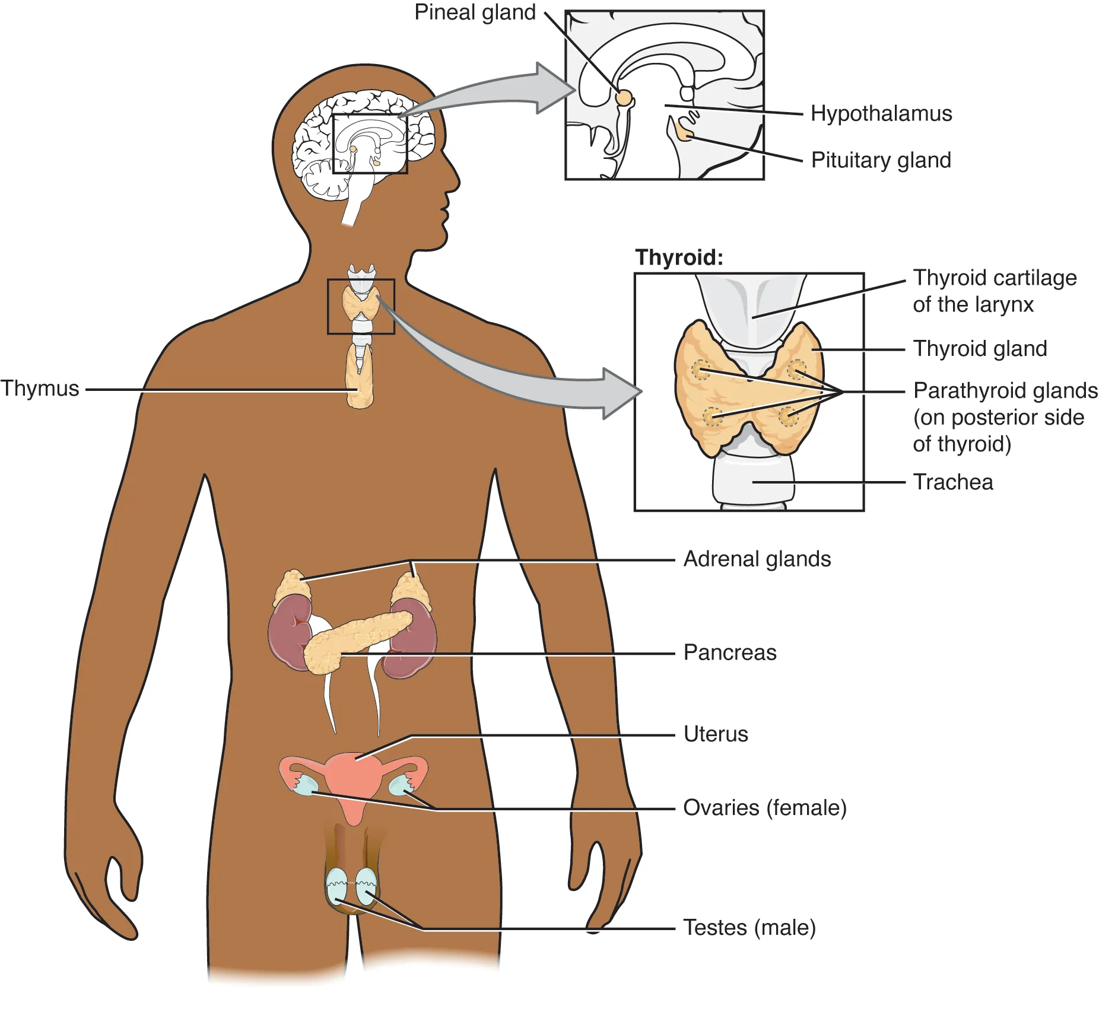
Figure 23.1: Endocrine Glands and Negative Feedback
WHAT TO NOTICE
Hypothalamic–Pituitary–Target Gland Axis
The hypothalamus signals the anterior pituitary to release trophic hormones (TSH, ACTH) that drive target glands (thyroid -> T4/T3; adrenal cortex -> cortisol).
Negative Feedback Thermostat
Rising free T4 or cortisol inhibits the hypothalamus and anterior pituitary; falling levels stimulate them—making TSH the most sensitive single test in primary thyroid disease.
When the Axis Breaks (Central Pituitary Disease)
In pituitary or hypothalamic disease, the pituitary fails to raise TSH despite a low free T4 (TSH is low, normal, or mildly raised)—so free T4, not TSH, must guide diagnosis and levothyroxine dosing.
Direct Non-Axis Feedback (Parathyroids & Posterior Pituitary)
Four posterior parathyroid glands respond directly to blood ionized calcium (low Ca2+ -> PTH release); the posterior pituitary releases arginine vasopressin (ADH) in response to plasma osmolality.
Clinical Takeaway: In a patient with a pituitary tumour whose TSH is 0.6 mIU/L (normal) and free T4 is 6.1 pmol/L (low), recognize central hypothyroidism (Question 18).
Medical-Surgical Nursing: A Canadian Open Text
Chapter 23 · Thyroid, Parathyroid, Adrenal & Pituitary
Notes:
Figure 23.1 illustrates the anatomical locations of the pineal gland, hypothalamus, pituitary gland, thyroid and posterior parathyroid glands, thymus, adrenal glands, pancreas, and gonads (credit: Figure 17.2 in Anatomy and Physiology 2e by J. Gordon Betts et al./OpenStax, CC BY-NC-SA 4.0). Emphasize the contrast between primary thyroid disease (where TSH and free T4 move in opposite directions) and central pituitary/hypothalamic disease (where TSH cannot be trusted and free T4 guides care).

Slide 6
SECTION 23.1 · ENDOCRINE DIAGNOSTICS
SI Reference Values and Preparation Rules
Always interpret results against the local lab range and check timing, albumin, and supplements.
TSH (0.4–5.0 mU/L): Choosing Wisely Canada: single 1st test for primary thyroid screening and levothyroxine titration.
Morning Cortisol (185–624 nmol/L): Cortisol peaks in early morning; draw at exact ordered time and record collection time.
Free T4 (8.5–15.2 pmol/L): Unbound active T4; add when TSH is abnormal or when central pituitary disease is suspected.
Na+ & Osmolality: Serum Na+ 136–144 mmol/L and osmolality 275–295 mOsm/kg, paired with urine osmolality/Na+.
Calcium (Total vs. Ionized): Total 2.12–2.52 mmol/L; ionized 1.14–1.28 mmol/L. Low albumin lowers total Ca2+ with normal ionized Ca2+.
Biotin (Vitamin B7) Hold: Hair/skin/nail biotin distorts thyroid immunoassays; stop biotin >=2 days before blood draw.
PTH + Simultaneous Ca2+: High Ca2+ + high/normal PTH = primary hyperparathyroidism; low Ca2+ + low/normal PTH = hypoparathyroidism.
Going Deeper (6–8 Wk Rule): Wait 6–8 weeks after any levothyroxine change before rechecking TSH; high TSH + normal fT4 = subclinical.
Albumin Pearl (Question 20): A patient with total calcium 1.98 mmol/L, albumin 22 g/L, and ionized calcium 1.20 mmol/L has normal active calcium and needs NO calcium replacement.
Medical-Surgical Nursing: A Canadian Open Text
Chapter 23 · Thyroid, Parathyroid, Adrenal & Pituitary
Notes:
Slide 6 summarizes Section 23.1 reference values (University of Ottawa, 2022), Choosing Wisely Canada guidance, and the Going Deeper box ('Reading Thyroid Function Tests'). Highlight three high-yield points: (1) Biotin (vitamin B7) in hair, skin, and nail supplements interferes with thyroid immunoassays and should be stopped at least 2 days before testing (Question 8); (2) Low serum albumin lowers total serum calcium without reducing physiologically active ionized calcium (Question 20); and (3) After starting or adjusting levothyroxine, TSH takes 6 to 8 weeks to reach a new steady state.

Slide 7
PART 2 · SECTION 23.2
Thyroid Disorders: Hypothyroidism, Hyperthyroidism, and Emergencies
Hashimoto thyroiditis and levothyroxine teaching, myxedema coma, Graves disease and antithyroid drugs, thyroid storm, and thyroid nodules
Notes:
Part 2 covers Section 23.2: primary and subclinical hypothyroidism, levothyroxine administration and patient education, myxedema coma, Graves disease and toxic nodular goitre, thyroid eye disease, methimazole and propylthiouracil safety, thyroid storm, and thyroid nodules and cancer in Canada.

Slide 8
SECTION 23.2 · HYPOTHYROIDISM VS. HYPERTHYROIDISM
Comparing Hypothyroidism and Hyperthyroidism (Table 23.1)
Thyroid hormone sets the metabolic rate across every organ system—deficiency slows the body down; excess speeds it up.
Hypothyroidism (High TSH, Low Free T4)
Hyperthyroidism (Low TSH, High Free T4/T3)
Slowed metabolism; most often Hashimoto autoimmune thyroiditis
Accelerated metabolism and adrenergic excess
Causes & Autoimmune Antibodies
Hashimoto thyroiditis (~75% have anti-TPO antibodies), prior RAI or thyroidectomy, head/neck radiation, amiodarone, lithium, interferon alfa, or tyrosine kinase inhibitors (iodine deficiency worldwide).
Clinical Cues & Skin-of-Colour Assessment
Fatigue, cold intolerance, weight gain, constipation, bradycardia, dry cool rough skin, hoarse voice, muscle cramps, delayed ankle reflex, and hyponatremia. Check inner eyelids, lips, and nail beds for pallor on darker skin; palpate neck contour for goitre.
Subclinical Hypothyroidism (Going Deeper)
Elevated TSH with normal free T4 confirmed over weeks; positive TPO antibodies predict higher progression to overt disease.
Main Causes (Graves, Toxic Nodules, Thyroiditis)
Graves disease (TSH receptor antibodies [TRAb] stimulate gland), toxic nodular goitre (common in older adults), or thyroiditis (painless [6% in Toronto series], subacute viral, or amiodarone-induced release of stored hormone).
Clinical Cues & Cardiac/Bone Risks
Weight loss despite increased appetite, heat intolerance, warm moist skin (palpate warmth/moisture on darker skin), tremor, anxiety, diarrhea, tachycardia, atrial fibrillation (embolic stroke risk), and bone loss.
Graves Thyroid Eye Disease (Burch et al., 2022)
Eyelid retraction, proptosis, periorbital edema, diplopia, and grittiness/pain; worsened by smoking and RAI. Support smoking cessation, lubricating drops, nighttime eye masks, and urgent referral if vision is threatened.
Diagnostic Workup in Hyperthyroidism: Suppressed/undetectable TSH with elevated free T4 and/or T3; differentiate etiology using TRAb antibodies, radioactive iodine uptake scan, or thyroid ultrasound.
Medical-Surgical Nursing: A Canadian Open Text
Chapter 23 · Thyroid, Parathyroid, Adrenal & Pituitary
Notes:
Slide 8 converts Table 23.1 ('Hypothyroidism and hyperthyroidism compared') into a structured side-by-side comparison. Emphasize skin-of-colour assessment principles from Section 23.2: pallor in hypothyroidism is checked on the conjunctivae, lips, and nail beds; flushing in hyperthyroidism is assessed by palpating skin warmth and moisture; periorbital erythema in Graves eye disease may be subtle on darker skin, so always ask about orbital pain, pressure, grittiness, and diplopia; and goitre is assessed by inspecting and palpating neck contour across all skin tones.

Slide 9
SECTION 23.2 · THYROID MEDICATIONS & OLDER ADULTS
Levothyroxine, Antithyroid Drugs, and Lifespan Care
Levothyroxine has a narrow therapeutic index, while antithyroid drugs require immediate action for fever or sore throat.
Thyroid Pharmacology & Patient Teaching
Lifespan: Older Adults
Levothyroxine (Synthroid) Administration Rules
Take once daily on an empty stomach 30–60 min before breakfast with water, at least 4 hours apart from calcium, iron, or antacids (high-fibre foods, walnuts, and calcium-fortified juice also impair absorption). Do not switch brands without retesting TSH in 6–8 weeks.
Critical Levothyroxine Contraindications & Warnings
Treat adrenal insufficiency BEFORE starting levothyroxine (can precipitate adrenal crisis). Never use thyroid hormone for weight loss; overtreatment causes atrial fibrillation and bone loss. Liothyronine (Cytomel, T3) is avoided in heart disease.
Methimazole (Tapazole), PTU & Radioactive Iodine (RAI)
Methimazole is first-line; PTU is reserved for 1st trimester pregnancy, thyroid storm, or methimazole intolerance due to severe hepatotoxicity risk (report jaundice/dark urine). For BOTH drugs, report fever or sore throat immediately—hold drug and check WBC + differential for agranulocytosis. RAI is contraindicated in pregnancy/lactation and causes hypothyroidism in 2–6 months.
Subtle Hypothyroidism in Later Life
Fatigue, constipation, dry skin, and cognitive slowing easily mimic normal ageing, depression, or dementia; screen TSH when memory or function declines.
Apathetic Hyperthyroidism & New Atrial Fibrillation
Older adults often lack classic tremor or heat intolerance—unexplained weight loss, weakness, or new-onset atrial fibrillation (e.g., HR 112 irregular in an 84-year-old, Question 13) may be the ONLY clue, with a low TSH.
Safe Dosing & Monitoring in Older Adults
Start levothyroxine at a low dose in older adults and patients with CAD; monitor closely for angina, palpitations, and atrial fibrillation.
Medical-Surgical Nursing: A Canadian Open Text
Chapter 23 · Thyroid, Parathyroid, Adrenal & Pituitary
Notes:
Slide 9 integrates the Patient Education box ('Taking Levothyroxine'), the Medications box ('Thyroid and Adrenal Medications'), and the Lifespan Considerations box ('Thyroid Disease in Older Adults'). Highlight the three classic exam questions from this material: (1) Taking levothyroxine together with a morning calcium tablet blocks absorption—space by at least 4 hours (Question 9); (2) A patient on methimazole who develops a sore throat and fever of 38.6 °C must hold methimazole and come in the same day for a STAT WBC count and differential to rule out agranulocytosis (Question 11); and (3) In an 84-year-old man with 5-kg weight loss and new atrial fibrillation without tremor or heat intolerance, expect a LOW TSH from apathetic hyperthyroidism (Question 13).

Slide 10
SECTION 23.2 · THYROID EMERGENCIES
Myxedema Coma and Thyroid Storm
Both thyroid emergencies carry high mortality and begin ICU treatment on clinical suspicion without waiting for lab results.
Myxedema Coma (Decompensated Hypothyroidism)
Thyroid Storm (Decompensated Thyrotoxicosis)
~30% mortality; typically an older woman in winter with a precipitating stressor
~11% mortality; 1%–2% of thyrotoxicosis admissions (Burch-Wartofsky >=45)
Precipitants & Clinical Cues (Coma Not Required)
Triggered by cold exposure, pneumonia/infection, sedatives/opioids, or stopping levothyroxine. Cues: lethargy to coma (or seizures), hypothermia (e.g., 34.8 °C—masks infection fever), bradycardia, hypoventilation with CO2 retention (RR 8), hyponatremia, hypoglycemia, ileus, and edema.
ICU Treatment Protocol (Ylli et al., 2019)
Support airway/ventilation first; give IV thyroid hormone (lower doses in older adults/CAD) + IV hydrocortisone (after drawing baseline cortisol, to prevent adrenal crisis) + empiric broad-spectrum antibiotics.
Passive Rewarming & Slow Sodium Correction
Rewarm PASSIVELY with ordinary blankets—NEVER use an electric warming blanket (causes vasodilation and cardiovascular collapse/shock). Give nothing by mouth if drowsy and correct hyponatremia slowly.
Precipitants & Exaggerated Cues
Triggered by stopping methimazole/PTU, pneumonia/infection, trauma, RAI, iodine loads, or unprepared surgery. Cues: high fever (e.g., 39.8 °C), severe tachycardia/AF (HR >140–150), agitation/delirium/coma, heart failure, vomiting/diarrhea, jaundice, and shock.
Strict Medication Sequence (PTU/Methimazole BEFORE Iodine)
1. Give high-dose PTU or methimazole FIRST to block new synthesis; 2. Wait at least 30–60 minutes before giving iodine solution to block hormone release (giving iodine first fuels new hormone synthesis!).
Beta-Blockade, Steroids & Fever Care (Avoid Aspirin)
Give a beta-blocker (propranolol) for heart rate, IV hydrocortisone, dextrose-containing IV fluids, and acetaminophen + cooling for fever—NEVER give aspirin (ASA displaces T4 from binding proteins and raises free thyroid hormone).
Sequencing Rule (Question 19): In thyroid storm, always administer propylthiouracil or methimazole at least 30 to 60 minutes BEFORE the iodine solution, and never use ASA for fever.
Medical-Surgical Nursing: A Canadian Open Text
Chapter 23 · Thyroid, Parathyroid, Adrenal & Pituitary
Notes:
Slide 10 contrasts the two life-threatening thyroid emergencies: myxedema coma and thyroid storm (Ylli et al., 2019; Satoh et al., 2016). Walk students through Question 10 (82-year-old woman in January with T 34.8 °C, HR 46, RR 8, Na+ 124 mmol/L: call for help, support ventilation, prepare for ICU, never give oral pills/fluids or an electric warming blanket) and Questions 15 & 19 (Graves patient with pneumonia who missed methimazole, T 39.8 °C, HR 154 irregular, confused: activate RRT, give PTU/methimazole 30–60 min before iodine, beta-blocker, hydrocortisone, and acetaminophen without ASA).

Slide 11
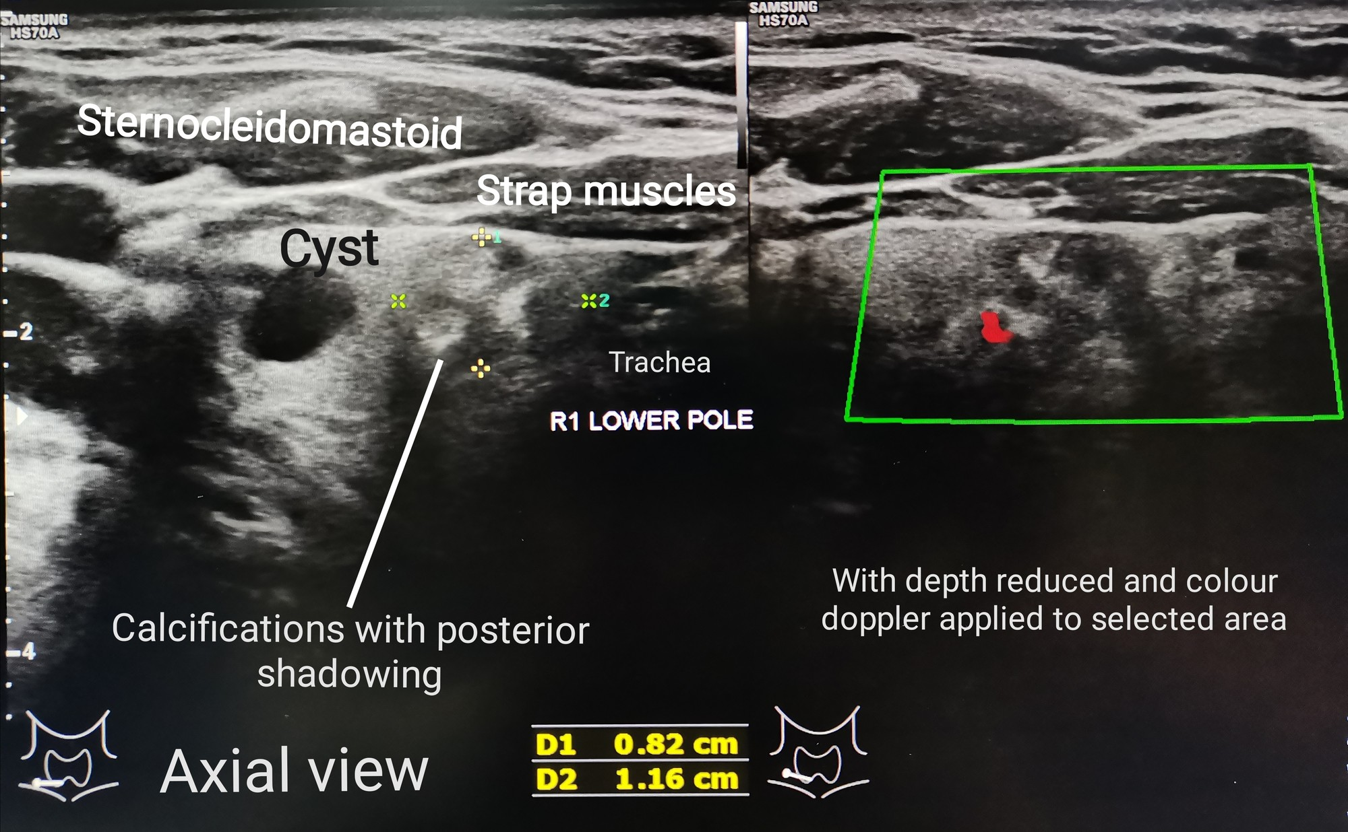
Figure 23.2: Thyroid Ultrasound, Nodules, and Cancer
WHAT TO NOTICE
Ultrasound Differentiation of Thyroid Nodules
Cross-sectional neck ultrasound distinguishes a simple fluid-filled cyst from a solid lower-pole nodule with bright microcalcifications and posterior shadowing.
Targeted Fine-Needle Aspiration (FNA) Biopsy
Ultrasound features and nodule size guide which nodules undergo fine-needle aspiration (FNA) cytology rather than biopsying every incidental nodule (Haugen et al., 2016).
Canadian Thyroid Cancer Trends (Canadian Context Box)
In 2026, ~6,100 Canadians are diagnosed (4,400 women; 1,750 men) with 97% 5-year net survival. After rising from 1984 to 2013 due to papillary overdiagnosis, incidence has fallen by 5.4%/yr in females (Demers et al., 2022).
Rural, Remote & Northern Care Coordination
Patients from rural, remote, and northern First Nations, Inuit, and Métis communities often travel far for thyroid surgery or endocrinology—discharge plans must confirm local laboratory access before the patient leaves.
Clinical Takeaway: Most thyroid nodules are benign, and differentiated thyroid cancer carries a 97% five-year net survival in Canada.
Medical-Surgical Nursing: A Canadian Open Text
Chapter 23 · Thyroid, Parathyroid, Adrenal & Pituitary
Notes:
Figure 23.2 shows a transverse thyroid ultrasound demonstrating a simple cyst alongside a 0.82 × 1.16 cm solid nodule with calcifications and colour Doppler flow (credit: Cerevisae/Wikimedia Commons, CC BY-SA 4.0). Review the Canadian Context box ('Thyroid Disease and Thyroid Cancer in Canada'), noting both the 2026 Canadian Cancer Society statistics and the practical discharge-planning responsibility for patients returning to rural, northern, or Indigenous communities.

Slide 12
PART 3 · SECTION 23.3
Thyroid and Parathyroid Surgery and Calcium Disorders
Post-thyroidectomy airway vigilance, SCOOP neck hematoma protocol, recurrent laryngeal nerve and hypocalcemia monitoring, and parathyroid disorders
Notes:
Part 3 covers Section 23.3: preoperative preparation for Graves thyroidectomy, hourly postoperative neck and airway surveillance, recognizing and escalating an expanding neck hematoma (including the Difficult Airway Society SCOOP bedside decompression sequence), recurrent laryngeal nerve injury, postoperative hypocalcemia, primary hyperparathyroidism, and chronic hypoparathyroidism.

Slide 13
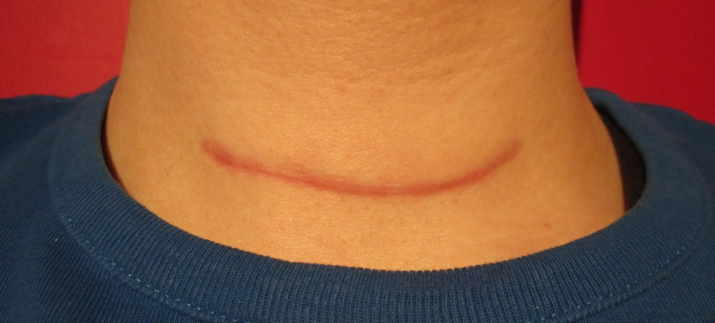
Figure 23.3: Post-Thyroidectomy Care and Neck Hematoma
WHAT TO NOTICE
Preoperative Preparation & Hourly Post-Op Checks
Before Graves surgery, render the patient euthyroid with antithyroid drugs + pre-op iodine and correct Ca2+/vitamin D. Post-op: observe at least hourly for the first 6 hours (wound, early warning score, pain, voice).
Expanding Neck Hematoma Cues (Dry Dressing Trap!)
Blood collecting in the closed deep neck space compresses the trachea even when the outer dressing looks dry: watch for neck swelling/fullness, tightness/pressure, dysphagia, new hoarse/quiet voice, stridor, tachypnea, agitation, or falling SpO2.
Immediate Nursing Action (Case 1: Ms. Amira Haddad)
Call RRT/emergency team and surgeon immediately, stay with the patient, position head-up (sitting upright), apply oxygen, and bring the bedside emergency box—NEVER apply a tight pressure bandage.
Bedside SCOOP Protocol & Recurrent Laryngeal Nerve
Difficult Airway Society bedside evacuation: Skin exposure, Cut sutures, Open skin, Open muscles, Pack wound (performed per employer policy, directive, and training). Also assess voice for recurrent laryngeal nerve injury.
Clinical Takeaway: In Ms. Haddad's case (1500 check: neck tightness, visible swelling, hoarse voice, SpO2 97% -> 93%, dry dressing), act immediately for a life-threatening neck hematoma (Questions 1–3).
Medical-Surgical Nursing: A Canadian Open Text
Chapter 23 · Thyroid, Parathyroid, Adrenal & Pituitary
Notes:
Figure 23.3 shows a healed low anterior collar incision 2 months after total thyroidectomy. Pair this with the Clinical Safety box ('Swelling in the Neck After Thyroid Surgery', Iliff et al., 2021, 2022) and Case 1 (Ms. Amira Haddad, Questions 1–3, and Question 14). Emphasize that a small, unchanged spot of dried blood on the dressing NEVER rules out a deep subplatysmal hematoma—and applying a pressure dressing would worsen tracheal compression.

Slide 14
SECTION 23.3 · POST-OP HYPOCALCEMIA & PARATHYROID
Postoperative Hypocalcemia and Parathyroid Disorders
The parathyroid glands sit directly behind the thyroid and regulate blood calcium through bone, kidneys, and active vitamin D.
Post-Op Hypocalcemia & Hypoparathyroidism
Primary Hyperparathyroidism
Low calcium with low or inappropriately normal PTH (Khan et al., 2022)
High calcium with high or inappropriately normal PTH (Bilezikian et al., 2022)
Surgical Cause & Recovery Timeline
Parathyroid bruising, devascularization, or removal during neck surgery causes ~75% of all hypoparathyroidism; 70%–80% recover within 1 month (permanent if >12 months).
Early Neuromuscular Cues & Acute IV Treatment
Numbness and tingling around the mouth (perioral) and in fingertips/toes, muscle cramps, positive Trousseau/Chvostek signs, tetany, laryngospasm, and seizures. Treat symptomatic worsening hypocalcemia with IV calcium gluconate under ECG monitoring (check Mg2+ too).
Chronic Management & Avoiding Renal Harm (Question 17)
Oral calcium + calcitriol (active vitamin D) targeting low-normal calcium; recheck Ca2+ within days of dose changes because overtreatment causes hypercalciuria, nephrocalcinosis, kidney stones, and renal failure.
Pathophysiology & Diagnostic Confirmation
~85% of sporadic cases arise from a single benign parathyroid adenoma; confirmed by elevated albumin-adjusted (or ionized) calcium with high or inappropriately normal PTH on 2 occasions >=2 weeks apart.
Classic 'Stones, Bones, and Groans' Manifestations
Stones = kidney stones (present silently in up to 22% of asymptomatic patients); Bones = cortical/vertebral osteoporosis and fractures; Groans = polyuria, polydipsia, nausea, constipation, lethargy, and confusion.
Surgical Cure Criteria & Non-Surgical Monitoring
Parathyroidectomy is the only cure (indicated if symptomatic, or if asymptomatic with age <50, Ca2+ >0.25 mmol/L above ULN, osteoporosis/vertebral fracture, kidney stones, or eGFR decline; cinacalcet if non-operative).
Total Thyroidectomy Discharge Rule: After total thyroidectomy for Graves disease, antithyroid drugs stop at surgery, beta-blockers are tapered, and oral levothyroxine is required for life.
Medical-Surgical Nursing: A Canadian Open Text
Chapter 23 · Thyroid, Parathyroid, Adrenal & Pituitary
Notes:
Slide 14 covers the second half of Case 1 (Ms. Haddad at 0700 on Day 1 post-op with lip/fingertip tingling, hand cramping, and ionized calcium 0.98 mmol/L, Questions 4–6) alongside primary hyperparathyroidism and chronic hypoparathyroidism (Questions 16–17). Emphasize that in symptomatic postoperative hypocalcemia, IV calcium gluconate with continuous ECG monitoring is the immediate priority (oral levothyroxine does not raise calcium, and IV magnesium sulfate alone does not treat acute hypocalcemic tetany).

Slide 15
PART 4 · SECTION 23.4
Adrenal Disorders: Adrenal Insufficiency, Crisis, and Cushing Syndrome
Primary, secondary, and glucocorticoid-induced adrenal insufficiency, emergency hydrocortisone in adrenal crisis, sick-day rules, Cushing syndrome, and adrenal hypertension
Notes:
Part 4 covers Section 23.4: adrenal cortex (cortisol, aldosterone) and medulla (catecholamines) physiology; primary (Addison), secondary, and glucocorticoid-induced adrenal insufficiency; immediate management of adrenal crisis; steroid sick-day rules; Cushing syndrome across skin tones; primary aldosteronism; and pheochromocytoma.

Slide 16
SECTION 23.4 · ADRENAL INSUFFICIENCY & SICK-DAY RULES
Primary, Secondary, and Steroid-Induced Insufficiency
Never stop long-term glucocorticoids abruptly—and remember that inhalers, creams, and joint injections can also suppress the HPA axis.
Primary vs. Secondary & Steroid-Induced AI
Replacement & Sick-Day Rules
Primary AI (Addison Disease — Up to 90% Autoimmune)
Adrenal cortex destruction lowers BOTH cortisol and aldosterone (ACTH and renin rise): fatigue, weight loss, orthostatic hypotension, hyponatremia, HYPERKALEMIA, salt craving, and ACTH hyperpigmentation.
Assessing Hyperpigmentation on Darker Skin (Question 26)
Inspect palmar creases, buccal mucosa/gums, scars, and sun-exposed skin in natural light and compare with the patient's own baseline—general facial darkening is easy to miss on dark brown skin.
Secondary (Pituitary) & Glucocorticoid-Induced AI
Low ACTH leaves aldosterone intact (no hyperkalemia, no hyperpigmentation; skin may look pale). HPA suppression can follow oral steroids >=3–4 weeks, long-term high-dose inhalers or topical creams, or intra-articular steroid injections within the past 2 months.
Daily Replacement & Never Stopping Abruptly
Hydrocortisone in 2–3 daily doses (largest on waking; dexamethasone is avoided); add fludrocortisone + unrestricted salt in primary AI. Never stop long-term steroids abruptly—prescriber taper is required.
Fever Sick-Day Dosing (Endocrine Society)
For fever >=38 °C, illness keeping the patient in bed, or starting antibiotics: DOUBLE the oral hydrocortisone replacement dose for 2–3 days. For fever >=39 °C: TRIPLE the oral dose and drink salt-containing fluids.
Vomiting, Surgery, Emergency Kit & ID
If vomiting/unable to keep pills down or after major trauma, inject emergency IM hydrocortisone immediately and go to hospital. Carry a steroid emergency card and wear medical alert ID at all times.
Medical-Surgical Nursing: A Canadian Open Text
Chapter 23 · Thyroid, Parathyroid, Adrenal & Pituitary
Notes:
Slide 16 synthesizes Section 23.4 on adrenal insufficiency and the Patient Education box ('Steroid Sick-Day Rules and Medical Identification'). Highlight the three key distinctions tested in Questions 24, 25, 26, 27, and 28: (1) Hyperkalemia (e.g., K+ 5.8 mmol/L) and palmar crease/gingival hyperpigmentation occur ONLY in primary adrenal insufficiency (Addison disease), where aldosterone is lost and ACTH is high; (2) Long-term fluticasone inhalers, potent steroid creams, and recent knee steroid injections (within 2 months) all put a patient at risk for glucocorticoid-induced adrenal insufficiency; and (3) On sick days with vomiting, oral pills cannot be relied upon—the patient needs their emergency IM hydrocortisone injection and immediate hospital transport.

Slide 17
SECTION 23.4 · ADRENAL CRISIS & ADRENAL HYPERTENSION
Adrenal Crisis Protocol, Aldosteronism, and Pheochromocytoma
More than half of patients with primary adrenal insufficiency are first diagnosed when they arrive in life-threatening adrenal crisis.
Adrenal Crisis (Medical Emergency)
Adrenal Causes of Hypertension
Immediate parenteral hydrocortisone and isotonic saline—never delay for tests
Primary aldosteronism and pheochromocytoma (Adler et al., 2025; Lenders et al., 2014)
Triggers & Clinical Picture
Triggered by GI gastroenteritis/vomiting (most common), infection, surgery, trauma, or missed/stopped steroids. Cues: refractory hypotension/shock (or >=20 mm Hg orthostatic drop), vomiting, severe abdominal pain, fever, confusion/delirium, hyponatremia, hyperkalemia (primary), and hypoglycemia.
Immediate Adult Treatment Protocol (Bornstein et al.)
1. **Hydrocortisone 100 mg IV or IM STAT**, followed by **200 mg per 24 hours** (continuous IV infusion or 50 mg IV/IM q6h); 2. **1,000 mL of 0.9% NaCl** within the first hour; 3. Correct hypoglycemia and treat the trigger.
Diagnostic Rule (Case 2: Mr. Harold Nakamura, 81)
Draw baseline cortisol/ACTH only if it causes ZERO delay—never wait for lab results or a stimulation test before giving hydrocortisone.
Primary Aldosteronism (Conn Syndrome)
Renin-independent aldosterone excess causing resistant hypertension (uncontrolled on 3 drugs) and/or hypokalemia (<3.5 mmol/L, or <3.0 on a diuretic). Screen with seated morning **aldosterone-to-renin ratio**; treat unilateral adenoma with adrenalectomy or bilateral disease with **spironolactone**.
Pheochromocytoma (Adrenal Medulla Catecholamine Tumour)
Paroxysmal or severe hypertension with headaches, palpitations, diaphoresis, pallor, or panic attacks; diagnose with supine plasma free metanephrines or 24-h urine fractionated metanephrines.
Pheochromocytoma Preoperative Alpha-Blockade Rule (Q40)
Prepare for surgery with an **alpha-adrenergic blocker for 7 to 14 days** plus a high-sodium diet and liberal fluids—NEVER give a beta-blocker alone (unopposed alpha constriction precipitates a hypertensive crisis).
Critical Rule: In a patient with untreated adrenal insufficiency and hypothyroidism, always start glucocorticoid replacement BEFORE levothyroxine to prevent precipitating adrenal crisis.
Medical-Surgical Nursing: A Canadian Open Text
Chapter 23 · Thyroid, Parathyroid, Adrenal & Pituitary
Notes:
Slide 17 pairs the Endocrine Society adrenal crisis protocol (Bornstein et al., 2016; Arlt et al., 2016) with primary aldosteronism and pheochromocytoma (Questions 21–24, 30, 39, and 40). Emphasize the exact emergency doses for adrenal crisis: Hydrocortisone 100 mg IV or IM immediately, followed by 200 mg/24 h (or 50 mg IV/IM q6h) and 1,000 mL of 0.9% sodium chloride in the first hour. For pheochromocytoma (Question 40), memorize that alpha-adrenergic blockade for 7–14 days with a high-sodium diet and volume expansion comes FIRST—giving a beta-blocker without prior alpha-blockade triggers a lethal catecholamine crisis.

Slide 18
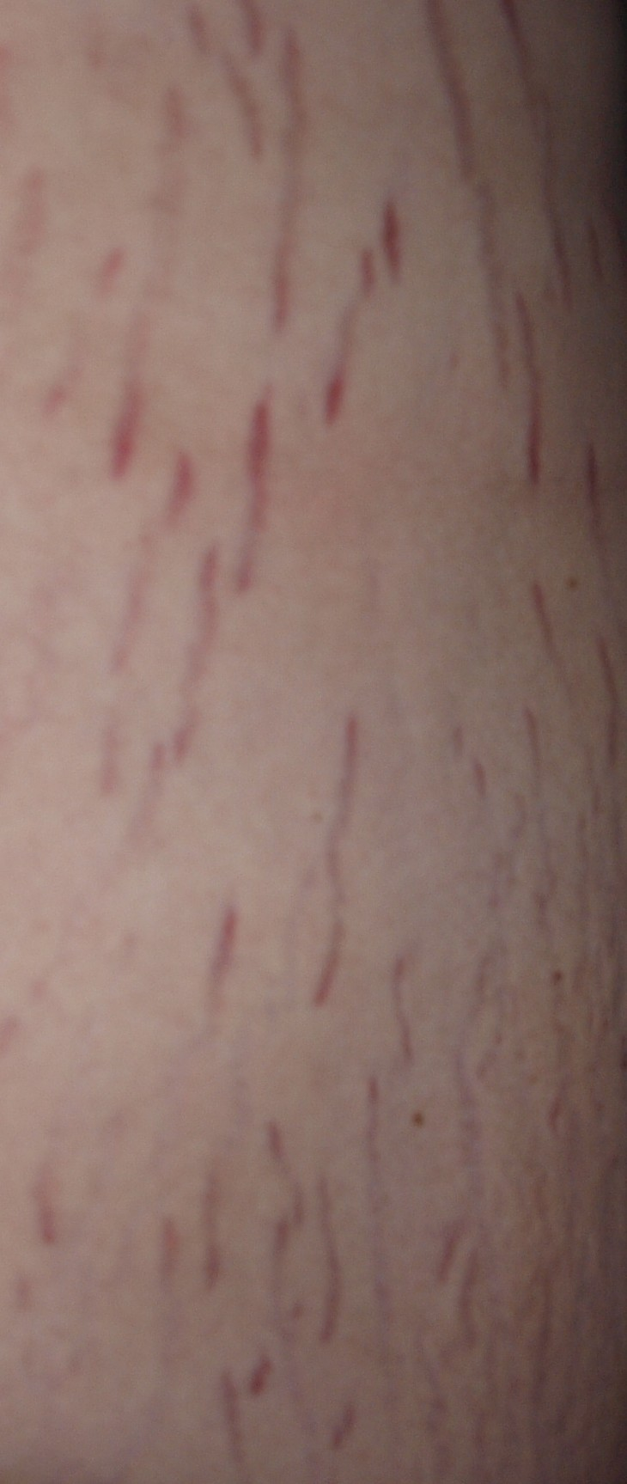
Figure 23.4: Cushing Syndrome Across Skin Tones
WHAT TO NOTICE
Exogenous Steroids vs. Endogenous ACTH/Adrenal Tumours
Prescribed glucocorticoids are the most common cause of Cushing syndrome; endogenous causes include an ACTH-secreting pituitary adenoma (Cushing disease), ectopic ACTH tumour, or adrenal adenoma.
Four Most Discriminating Clinical Features (Question 29)
Easy bruising, facial plethora (full flushed face), proximal muscle weakness (difficulty rising from a chair or climbing stairs), and wide striae (>1 cm)—alongside truncal weight gain, dorsocervical fat pad, thin skin, hypertension, hyperglycemia, hypokalemia, and vertebral osteoporosis.
Striae Assessment Across Skin Tones (Elbuluk et al., 2025)
New striae appear reddish-purple on lighter skin (Figure 23.4), but are often brown to black, white, or skin-coloured on darker skin—assess width (>1 cm), number, and new onset rather than colour alone.
First-Line Screening Tests & Nursing Care
Confirm after drug history with two 24-h urine free cortisol collections, two late-night salivary cortisols (2300–2400 h), or 1-mg overnight dexamethasone suppression (morning cortisol >50 nmol/L is abnormal). Protect fragile skin, prevent falls, and watch for masked infection.
Clinical Takeaway: When comparing a patient with weight gain, trouble rising from a chair (proximal myopathy) and easy bruising point to Cushing syndrome over simple obesity (Question 29).
Medical-Surgical Nursing: A Canadian Open Text
Chapter 23 · Thyroid, Parathyroid, Adrenal & Pituitary
Notes:
Figure 23.4 shows wide cutaneous striae in Cushing syndrome (credit: PanaromicTiger/Wikimedia Commons, CC BY-SA 3.0). Connect this slide to Table 23.2 ('Adrenal insufficiency and Cushing syndrome compared') and Elbuluk et al. (2025) on how striae appear across diverse skin tones. Also remind students that glucocorticoids mask fever and inflammation while raising blood glucose and blood pressure and causing mood/sleep disturbances.

Slide 19
PART 5 · SECTION 23.5
Pituitary Disorders, Transsphenoidal Surgery, SIADH, and AVP Deficiency
Pituitary adenomas and bitemporal hemianopsia, transsphenoidal postoperative care, SIADH versus AVP-D/AVP-R (Table 23.3), and CNO scope in endocrine emergencies
Notes:
Part 5 covers Section 23.5: functioning and nonfunctioning pituitary adenomas, optic chiasm compression and pituitary apoplexy, nursing care after transsphenoidal pituitary surgery, SIADH versus arginine vasopressin deficiency (AVP-D) and resistance (AVP-R), CNO scope of practice, and the chapter's longitudinal case studies.

Slide 20
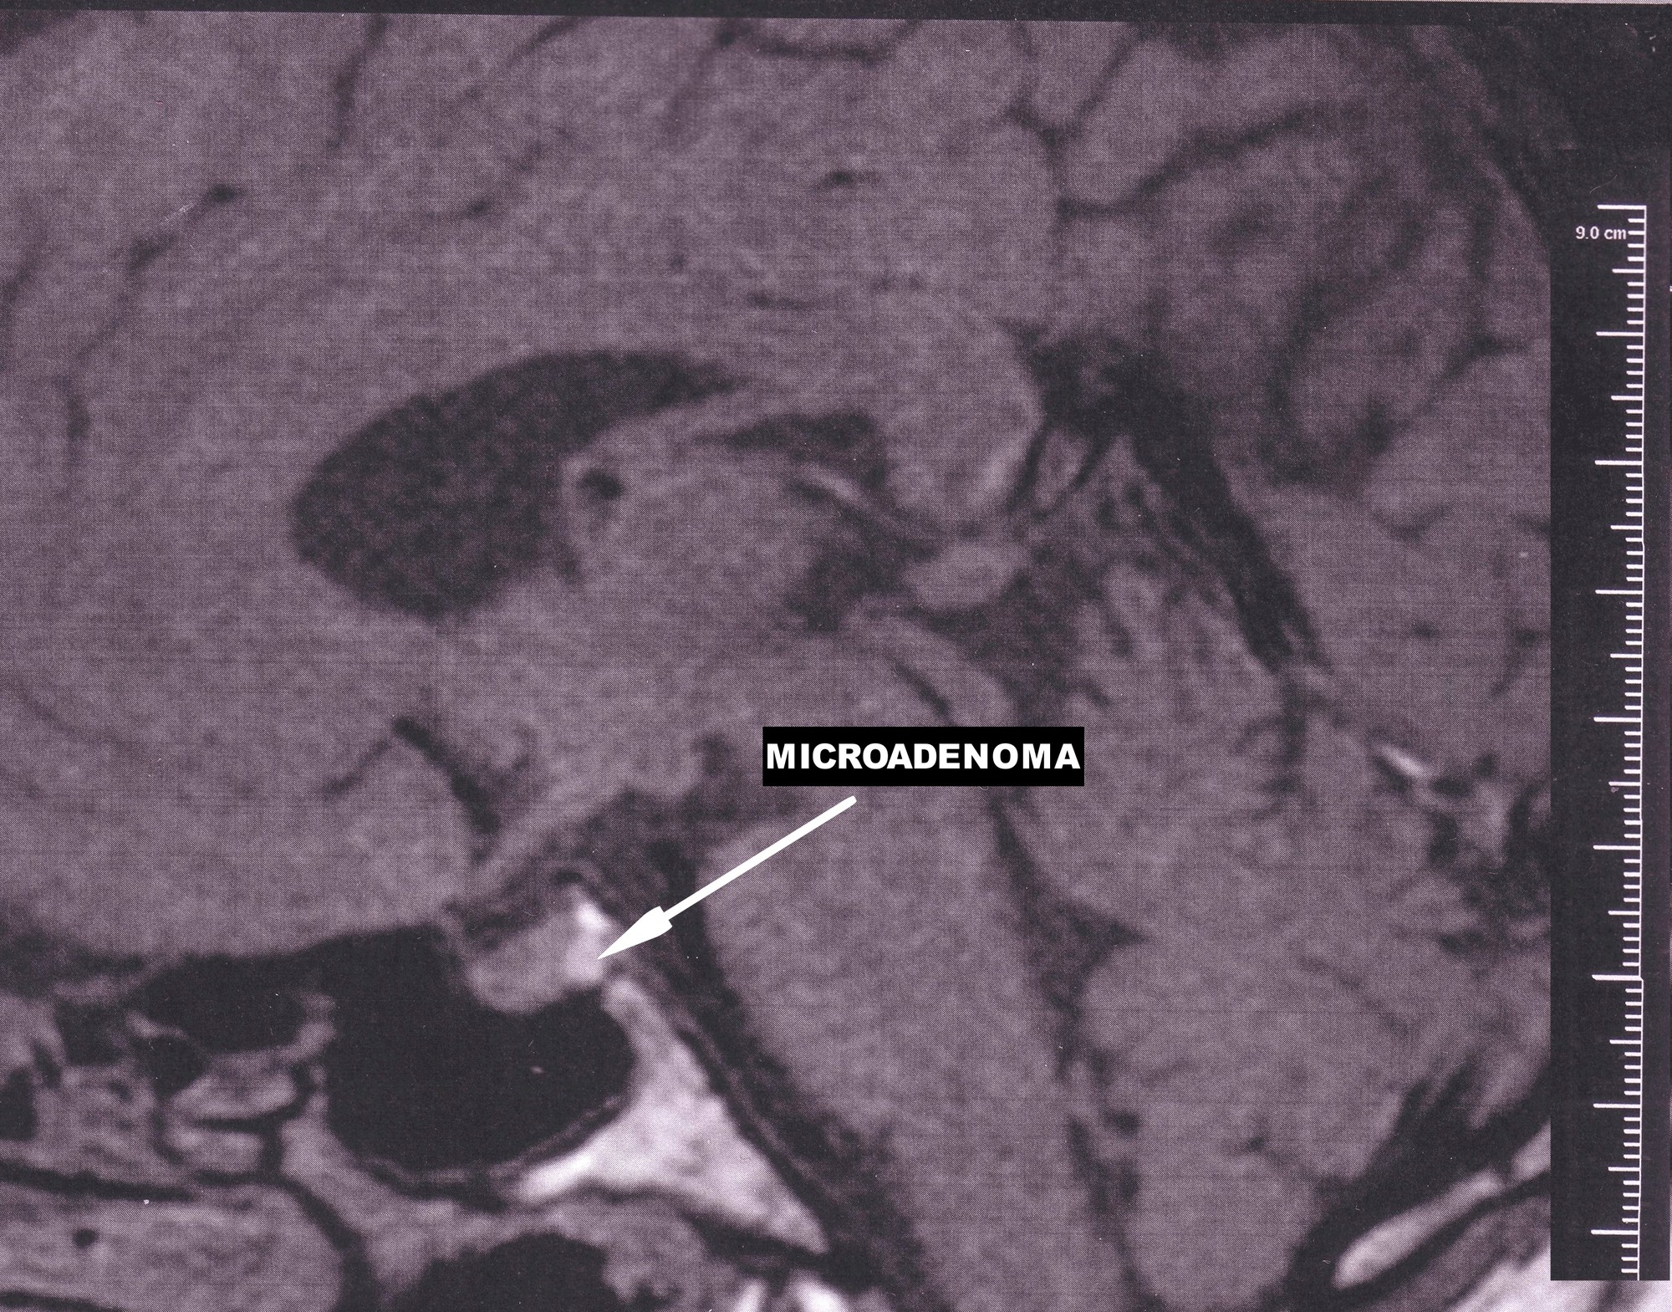
Figure 23.5: Pituitary Adenomas and Transsphenoidal Care
WHAT TO NOTICE
Mass Effects: Optic Chiasm & Pituitary Apoplexy
Optic chiasm compression causes bitemporal visual field loss (~85%; bumping into door frames, Q31) and hypopituitarism (~80%). Sudden headache + vision loss = pituitary apoplexy.
Functioning Adenomas: Prolactinoma & Acromegaly
Prolactinomas (~50% of adenomas) are treated first-line with dopamine agonists (report compulsive gambling/shopping). GH excess causes acromegaly (enlarged hands/feet/jaw; surgery first-line).
Transsphenoidal Surgery: Vision & CSF Leak Vigilance
Compare vision with baseline. Report clear, watery nasal drip (especially leaning forward, Q32) or salty throat taste as a CSF leak, and report headache with fever or stiff neck.
Protecting the Sellar Repair & Post-Op Hormones
No nose blowing for 2 weeks and no heavy lifting, bending, or straining (give stool softeners). Track hourly urine output for AVP-D, give ordered hydrocortisone, and recheck Na+ 5–7 days post-discharge.
Clinical Takeaway: Clear, watery fluid dripping from the nose after transsphenoidal surgery is a CSF leak until proven otherwise—never tell the patient to blow their nose (Question 32).
Medical-Surgical Nursing: A Canadian Open Text
Chapter 23 · Thyroid, Parathyroid, Adrenal & Pituitary
Notes:
Figure 23.5 shows a sagittal brain MRI with an arrow pointing to a pituitary microadenoma (<1 cm) in the sella turcica (credit: Yakafaucon/Wikimedia Commons, CC BY-SA 4.0). Review both preoperative pituitary mass effects (bitemporal hemianopsia from optic chiasm compression, Question 31, and CSF rhinorrhea in Question 32) and postoperative transsphenoidal nursing priorities (CSF rhinorrhea recognition, no nose blowing/straining, visual checks, glucocorticoid replacement, and hourly urine output monitoring).

Slide 21
SECTION 23.5 · SIADH VS. AVP DEFICIENCY
Comparing SIADH and Arginine Vasopressin Deficiency (Table 23.3)
In 2022, diabetes insipidus was renamed arginine vasopressin deficiency (AVP-D) and resistance (AVP-R) to prevent fatal confusion with diabetes mellitus.
SIADH (Excess ADH Action)
AVP Deficiency (AVP-D) & Resistance (AVP-R)
Euvolemic hyponatremia with inappropriately concentrated urine
Large volumes of dilute urine with risk of severe dehydration and hypernatremia
Causes & Pathophysiology (Spasovski et al., 2014)
Continued ADH release despite dilute plasma (<275 mOsm/kg) from small cell lung cancer, pneumonia, stroke/TBI/meningitis, SSRIs, carbamazepine, opioids, or post-op pain/nausea/anesthesia.
Diagnostic Pattern & Symptoms
Low serum Na+ (<136 mmol/L) and low serum osmolality (<275 mOsm/kg) with urine osmolality >100 mOsm/kg and urine Na+ >30 mmol/L in a euvolemic patient (no edema, moist mucosa). Causes headache, nausea, confusion, falls, seizures, or coma.
First-Line Fluid Restriction & Safe Correction
Treat cause and restrict fluids first-line (use hypertonic 3% NaCl in a monitored setting for severe/moderately severe symptoms). Track daily weights, I&O, and neuro status; report a sudden rise in urine output (risk of over-rapid Na+ rise).
AVP-D (Pituitary) vs. AVP-R (Nephrogenic / Lithium)
AVP-D follows pituitary surgery, tumours, or head trauma; AVP-R occurs when kidneys do not respond to AVP (e.g., long-term lithium therapy). Both cause massive polyuria (can exceed 10 L/24 h) of pale, dilute urine.
When Life-Threatening Hypernatremia Develops
Intact thirst + free water access keeps Na+ normal; hypernatremia (>144 mmol/L) and dehydration develop rapidly if the patient is NPO, drowsy, confused, frail/older, or if desmopressin is omitted.
Desmopressin (DDAVP) Safety & Inpatient Rules
Desmopressin treats AVP-D (ineffective in AVP-R). Never omit or delay inpatient doses, keep water within reach, check Na+ q12–24h, and teach patients to report headache, nausea, or sudden weight gain (water-intoxication hyponatremia).
Why the Name Changed (Arima et al., 2022): Hospital staff mistook 'diabetes insipidus' for diabetes mellitus and withheld desmopressin—causing fatal hypernatremic dehydration.
Medical-Surgical Nursing: A Canadian Open Text
Chapter 23 · Thyroid, Parathyroid, Adrenal & Pituitary
Notes:
Slide 21 converts Table 23.3 ('SIADH and arginine vasopressin deficiency compared') into a clear clinical comparison. Highlight Question 34 (patient with small cell lung cancer, Na+ 128 mmol/L, moist mucosa, no edema, concentrated urine, asymptomatic -> anticipate fluid restriction with daily weights and I&O) and Question 35 (patient starting home desmopressin -> report headache, nausea, or sudden weight gain as signs of water retention and hyponatremia; desmopressin does not treat lithium-induced AVP-R).

Slide 22
SECTION 23.5 · OSMOLALITY & CLINICAL JUDGMENT
Reading Urine Against Blood After Pituitary Surgery
Always interpret urine osmolality (50–1,200 mOsm/kg) against simultaneous serum sodium and serum osmolality (275–295 mOsm/kg).
Going Deeper (RN): Three Water-Balance Patterns
Clinical Judgment: Mr. Daniel Okeke, 54
1. SIADH (Urine Too Concentrated for Dilute Blood)
Serum osmolality <275 mOsm/kg and low serum Na+ paired with urine osmolality >100 mOsm/kg and urine Na+ >30 mmol/L in a euvolemic patient with normal renal, adrenal, and thyroid function.
2. AVP-D or AVP-R (Urine Too Dilute for Concentrated Blood)
High-normal or elevated serum Na+ (e.g., 151 mmol/L) and high serum osmolality (e.g., 310 mOsm/kg) paired with high-volume polyuria and low urine osmolality (e.g., 120 mOsm/kg, Question 38).
3. Primary Polydipsia / Excess Water Intake
Low serum Na+ and low serum osmolality paired with maximally dilute urine (<100 mOsm/kg), because the kidneys are appropriately excreting the excess water.
Unmasking AVP-D With Cortisol Replacement
Starting hydrocortisone after pituitary surgery can unmask AVP deficiency because cortisol is required for the kidneys to excrete free water (Baldeweg et al., 2018).
Recognize Cues (18 Hours Post-Transsphenoidal Surgery)
Passed 6,050 mL of pale urine in 18 h (420, 450, and 480 mL/h over the last 3 h); intensely thirsty ('parched'); Na+ rose from 142 to 148 mmol/L; serum osmolality 304 mOsm/kg; urine osmolality 130 mOsm/kg.
Analyze Cues & Prioritize Hypotheses
Postoperative arginine vasopressin deficiency (normal post-op IV fluid diuresis would not raise serum Na+ to 148 mmol/L). Immediate danger is severe dehydration and hypernatremia.
Take Action & Evaluate Outcomes
Report via SBAR, keep water at bedside, measure hourly I&O, give ordered desmopressin and hydrocortisone, and recheck Na+ in 4 h (urine falls to 90 mL/h and Na+ improves to 145 mmol/L; then watch for hyponatremia).
Medical-Surgical Nursing: A Canadian Open Text
Chapter 23 · Thyroid, Parathyroid, Adrenal & Pituitary
Notes:
Slide 22 combines the Going Deeper box ('Osmolality and Urine Tests in Water-Balance Disorders') with the Clinical Judgment box ('Six Litres of Urine After Pituitary Surgery' — Mr. Daniel Okeke, 54) and Questions 33, 37, and 38. Point out how easy it is to distinguish postoperative AVP-D from normal postoperative diuresis of IV fluids: in AVP-D, the serum sodium and serum osmolality climb above normal (148–151 mmol/L and 304–310 mOsm/kg) while urine osmolality stays low (120–130 mOsm/kg).

Slide 23
PHARMACOLOGY REVIEW · THYROID & ADRENAL MEDICATIONS
High-Yield Endocrine Medications at the Bedside
Every endocrine medication requires specific timing, laboratory monitoring, and emergency patient teaching.
Thyroid & Parathyroid Medications
Adrenal & Pituitary Medications
Canadian monographs and bedside administration rules
Glucocorticoids, mineralocorticoids, and vasopressin analogues
Levothyroxine (Synthroid) & Liothyronine (Cytomel)
Levothyroxine (T4): empty stomach 30–60 min before breakfast, >=4 h apart from Ca2+/Fe/antacids; check TSH 6–8 wk after dose change; start low in older adults/CAD. Liothyronine (T3): rapid onset, short duration; avoid in cardiac disease.
Methimazole (Tapazole) & Propylthiouracil (PTU)
Methimazole is preferred; PTU is reserved for 1st trimester pregnancy, thyroid storm, or methimazole intolerance (hepatotoxicity risk—report jaundice/dark urine). For BOTH: stop drug and check STAT WBC + differential if fever or sore throat occurs (agranulocytosis).
Beta-Blockers, Calcium & Calcitriol
Propranolol controls adrenergic symptoms in thyrotoxicosis (avoid nonselective beta-blockers in asthma). Oral calcium + calcitriol treat hypoparathyroidism (recheck Ca2+ within days of dose changes).
Hydrocortisone (Solu-Cortef / Oral) & Prednisone
Hydrocortisone is the preferred daily replacement (2–3 doses/day) and the emergency injection (100 mg IV/IM STAT) for adrenal crisis. Never stop long-term prednisone or hydrocortisone abruptly; double/triple oral replacement for fever.
Dexamethasone & Fludrocortisone (Florinef)
Dexamethasone is long-acting/potent and avoided for routine replacement (Cushing-like effects). Fludrocortisone replaces aldosterone in primary AI—monitor BP, weight, edema, and potassium, and do not restrict salt.
Desmopressin (DDAVP) & Dopamine Agonists
Desmopressin treats AVP-D (never omit in hospital; watch for water-intoxication hyponatremia). Dopamine agonists treat prolactinomas (warn about impulse-control/compulsive behaviours).
Medication Reconciliation Pearl: Always ask about inhalers, topical steroid creams, recent joint injections, and biotin supplements during admission reconciliation.
Medical-Surgical Nursing: A Canadian Open Text
Chapter 23 · Thyroid, Parathyroid, Adrenal & Pituitary
Notes:
Slide 23 consolidates the Medications box ('Thyroid and Adrenal Medications') along with parathyroid and pituitary pharmacotherapy into a high-yield pharmacology reference slide.

Slide 24
SECTION 23.5 · CNO SCOPE & PRACTICE STORY
RN and RPN Roles in Endocrine Emergencies
Every nurse who recognizes cues of an endocrine emergency acts at once, stays with the patient, and escalates via SBAR.
CNO Authority, Competence & Context
Practice Story: RPN Mei-Lin Arsenault
Authority for Emergency Injections (CNO, 2025a, 2025b)
Administering a substance by injection (e.g., IM hydrocortisone or IV calcium/hydrocortisone) is a controlled act authorized to both RNs and RPNs when ordered by a client-specific order or medical directive.
Why Emergency Injections Are Never Delegated to a PSW
In an unstable resident in adrenal crisis (Question 36), an emergency IM hydrocortisone injection is not a routine activity of living—the RPN holds the order and competence and administers the injection directly while the PSW calls 9-1-1.
Competence, Context & RPN–RN Collaboration
In long-term care, the RPN is often the first regulated nurse at the bedside and acts immediately under standing orders while calling 9-1-1, the NP/MD, and the RN supervisor. In hospital, the RPN escalates and consults the RN as complexity rises (updated CNO standards take effect March 1, 2027).
Mrs. Ruth Halvorsen, 84 (Long-Term Care, Ontario)
Took morning prednisone for 6 years for polymyalgia rheumatica; vomited twice overnight and brought up her 0800 and 0900 prednisone doses.
Recognizing Adrenal Crisis Over Simple Gastroenteritis
By 1000 she was confused, holding her abdomen, with HR 112 and BP 86/50 mm Hg (baseline 140/80) and glucose 4.6 mmol/L.
Immediate Action Under Standing Order & SBAR
Mei-Lin had the PSW call 9-1-1 and page the RN supervisor, gave IM hydrocortisone from the resident's ordered emergency kit, phoned the NP with a crisp SBAR report, and sent her steroid card with paramedics.
Medical-Surgical Nursing: A Canadian Open Text
Chapter 23 · Thyroid, Parathyroid, Adrenal & Pituitary
Notes:
Slide 24 covers the Scope in Practice box ('Endocrine Emergencies and the Nurse's Role') and the Practice Story ('The Missed Prednisone' — RPN Mei-Lin Arsenault caring for Mrs. Ruth Halvorsen, 84), which directly underpins Practice Question 36.

Slide 25
CLINICAL INTEGRATION · LONGITUDINAL CASE STUDIES
Applying the CJMM to Chapter 23 Case Studies
Synthesizing cue recognition, prioritization, and action across the chapter's longitudinal cases.
1
2
3
Case 1A: Ms. Haddad (1500 Hematoma)
Case 1B: Ms. Haddad (0700 Low Ca2+)
Case 2: Mr. Harold Nakamura, 81 (Crisis)
Ms. Amira Haddad, 41, had a total thyroidectomy this morning for Graves disease (arrived at 1100). At 1500 her neck feels tight, the anterior neck is visibly fuller than at 1400, her voice is hoarse and quieter, RR is 24, and SpO2 fell from 97% to 93% on room air, with an unchanged small dried blood spot on the dressing. This is an expanding neck hematoma: call RRT and the surgeon immediately, sit her upright, and give oxygen (never apply a pressure bandage).
After operative hematoma evacuation, at 0700 on Day 1 Ms. Haddad reports tingling and numbness of her lips and fingertips with bilateral hand cramping; ionized calcium is 0.98 mmol/L (normal 1.14–1.28 mmol/L). Cause: low PTH from intraoperative parathyroid injury. Priority order: IV calcium gluconate with continuous ECG monitoring, followed by scheduled oral calcium and calcitriol plus lifelong levothyroxine.
Takes daily prednisone for 2 years for polymyalgia rheumatica; after 2 days of vomiting and diarrhea with missed prednisone doses, he arrives confused with T 37.9 °C, HR 116, BP 82/50 mm Hg (baseline 135/80), Na+ 129 mmol/L, K+ 4.6 mmol/L, and creatinine 148 µmol/L. Cause: acute adrenal crisis from HPA axis suppression and missed steroid during GI illness. Priority: give IV/IM hydrocortisone + 0.9% NaCl immediately without waiting for cortisol results.
Medical-Surgical Nursing: A Canadian Open Text
Chapter 23 · Thyroid, Parathyroid, Adrenal & Pituitary
Notes:
Slide 25 walks through the two multi-question case studies from the end-of-chapter Practice Questions: Ms. Amira Haddad (Questions 1–6) and Mr. Harold Nakamura (Questions 21–24).

Slide 26
CHAPTER 23 REVIEW · CHECK YOUR UNDERSTANDING
Six High-Yield Clinical Judgment Questions
Q1. A patient with a pituitary tumour has TSH 0.6 mIU/L (normal) and free T4 6.1 pmol/L (low). Another patient takes biotin and calcium with morning levothyroxine. How do you interpret and teach each?
Q4. A patient on methimazole calls with a sore throat and fever of 38.6 °C. Another patient with a pheochromocytoma is 2 weeks from surgery. What is the priority plan for each?
Q2. Why is an electric warming blanket dangerous in myxedema coma (T 34.8 °C, HR 46, RR 8), and why must propylthiouracil be given 30–60 minutes BEFORE iodine in thyroid storm?
Q5. Which lab and skin findings distinguish primary Addison disease from steroid-induced adrenal insufficiency, and what is the immediate treatment for adrenal crisis (BP 78/44, Na+ 126, K+ 5.9)?
Q3. Three hours after thyroidectomy, a patient develops neck fullness, a hoarse voice, dysphagia, and SpO2 93% with a dry dressing. Next morning, her lips tingle (ionized Ca2+ 0.98 mmol/L). What is your action at each time?
Q6. After transsphenoidal pituitary surgery, a patient has clear watery nasal drip when leaning forward, and another passes 5 L/24 h of urine (Na+ 151, serum Osm 310, urine Osm 120). How do you act?
Bottom Line: Check free T4 in pituitary disease, protect the post-thyroidectomy airway, never delay hydrocortisone in adrenal crisis, and never omit desmopressin in AVP-D.
Notes:
Complete Rationales for Check Your Understanding:
Q1: A normal or low TSH in the face of a low free T4 indicates central (pituitary/hypothalamic) hypothyroidism, where free T4 guides treatment (Question 18). Biotin must be held >=2 days before thyroid blood tests to avoid assay interference (Question 8), and levothyroxine must be taken on an empty stomach 30–60 min before breakfast and >=4 hours apart from calcium or iron (Question 9).
Q2: In myxedema coma, rapid active warming with an electric blanket causes peripheral vasodilation and cardiovascular collapse/shock—support airway/breathing, prepare for ICU, give IV thyroid hormone + hydrocortisone, and rewarm passively with blankets (Question 10). In thyroid storm, PTU or methimazole must block hormone synthesis at least 30–60 minutes before iodine is given, because iodine given first fuels new thyroid hormone synthesis; also avoid ASA (Questions 15 & 19).
Q3: At 3 hours post-op, neck fullness, hoarseness, dysphagia, and falling SpO2 indicate an expanding deep neck hematoma even with a dry dressing—stay with the patient, call RRT and the surgeon immediately, sit upright, and give oxygen (Questions 1–3 & 14). Next morning, perioral/fingertip tingling with ionized Ca2+ 0.98 mmol/L is hypocalcemia from parathyroid injury—expect IV calcium gluconate with ECG monitoring (Questions 4 & 5).
Q4: Fever and sore throat on methimazole or PTU require holding the drug and obtaining a same-day WBC count with differential to rule out agranulocytosis (Question 11). Before pheochromocytoma resection, give an alpha-adrenergic blocker for 7–14 days with a high-sodium diet and liberal fluids; never give a beta-blocker alone (Question 40).
Q5: Primary Addison disease causes aldosterone loss (hyperkalemia, salt craving) and high ACTH (hyperpigmentation of palmar creases, gums, and scars—inspect in natural light on darker skin), whereas steroid-induced AI preserves aldosterone (Questions 25 & 26). In adrenal crisis, give hydrocortisone 100 mg IV/IM immediately (never wait for cortisol labs) plus 1,000 mL 0.9% NaCl in the first hour and treat hypoglycemia (Questions 21, 22, 39).
Q6: Clear watery nasal drainage after transsphenoidal surgery suggests a CSF leak—report promptly and instruct the patient never to blow their nose (Question 32). Passing 5 L/24 h of dilute urine (urine Osm 120 mOsm/kg) with serum Na+ 151 mmol/L and serum Osm 310 mOsm/kg indicates postoperative arginine vasopressin deficiency (AVP-D)—report immediately, keep water within reach, and anticipate desmopressin (Questions 33 & 38).

