Slide 1
UNIT VI · GASTROINTESTINAL, HEPATIC, BILIARY & PANCREATIC NURSING CARE · CHAPTER 24
Upper Gastrointestinal Disorders and Nutrition
Malnutrition screening and refeeding syndrome, enteral and parenteral nutrition safety, dysphagia and IDDSI framework, GERD, H. pylori and peptic ulcer disease, upper GI bleeding, and obesity and bariatric surgery.
Medical-Surgical Nursing: A Canadian Open Text
Aligned with CNO Entry-to-Practice Competencies (RN & RPN), CMTF/INPAC, ASPEN, IDDSI v2.2, Toronto Consensus, International UGIB Consensus, and Obesity Canada Guidelines
opensourcenursing.ca (CC BY-NC-SA 4.0)
Notes:
Welcome to Chapter 24: Upper Gastrointestinal Disorders and Nutrition (Unit VI: Gastrointestinal, Hepatic, Biliary & Pancreatic Care; Author: Andrew Lee, BEd, BN, MN, RN, CCN(C)). Illness often takes away eating first, and in a landmark Canadian Malnutrition Task Force study of 18 hospitals, 45% of adults admitted to medical and surgical units were already malnourished on arrival (Allard et al., 2016). Nurses notice the half-eaten tray, the cough during a drink of water, and the black tarry stool, and nurses verify feeding tube placement and administer enteral and parenteral nutrition safely. In this lecture, we cover upper GI digestion, Canadian malnutrition screening (CNST, INPAC, GLIM) and refeeding syndrome, enteral and parenteral nutrition, dysphagia and the IDDSI framework, GERD, gastritis, H. pylori and peptic ulcer disease, PPI deprescribing, upper GI bleeding across skin tones, and weight-inclusive obesity and bariatric surgery care.

Slide 2
INTRODUCTION · WHY THIS CHAPTER MATTERS
The Plan of Care Across Three Clinical Domains
Protecting airway, nutritional status, and hemodynamic stability requires vigilant bedside nursing across every shift.
1. Nutrition, Tubes & Swallowing
2. Acid Disorders, H. pylori & UGIB
3. Weight-Inclusive & Bariatric Care
Screen With CNST, INPAC & GLIM
Screen every admission with the 2-question Canadian Nutrition Screening Tool (CNST), act when intake is <=50%, and watch for refeeding syndrome.
Verify Tube Placement & Meds
Confirm blind nasogastric (NG) tubes by X-ray before first use, check the external cm mark, keep head of bed (HOB) 30°–45°, and never crush extended-release/enteric-coated (ER/EC) pills.
Manage Dysphagia & IDDSI Safely
Screen swallowing before any oral intake after stroke, watch for silent aspiration, and apply International Dysphagia Diet Standardisation Initiative (IDDSI) Levels 0–7.
Spot Gastroesophageal Reflux Disease (GERD) Alarm Features Early
Report dysphagia, unplanned weight loss, bleeding, anemia, or persistent vomiting for prompt endoscopy.
Eradicate H. pylori & Deprescribe PPIs
Hold proton pump inhibitors (PPIs) 2 wk before H. pylori testing, teach full 14-day quadruple therapy, and deprescribe unneeded long-term PPIs.
Escalate Perforation & Upper GI Bleeds
Recognize rigid-abdomen perforation and upper GI bleeding (UGIB) melena/hematemesis (even when beta-blockers mask tachycardia).
Practise Weight-Inclusive Nursing
Ask permission before weighing, use person-first language, pair body mass index (BMI) with Edmonton Obesity Staging System (EOSS) staging, and prepare right-sized equipment.
Support Chronic Obesity Medications
Teach long-term use and GI titration for Health Canada–approved GLP-1, GIP/GLP-1, naltrexone-bupropion, and orlistat therapies.
Monitor After Bariatric Surgery
Escalate tachycardia + left shoulder pain (anastomotic leak), prevent dumping syndrome, and teach lifelong supplementation.
Medical-Surgical Nursing: A Canadian Open Text
Chapter 24 · Upper GI Disorders and Nutrition
Notes:
Chapter 24 brings together three everyday nursing domains: (1) screening for malnutrition and refeeding syndrome, administering enteral and parenteral nutrition safely under CNO scope standards, and managing dysphagia with the IDDSI framework; (2) caring for adults with GERD, gastritis, H. pylori, peptic ulcer perforation, and acute upper GI bleeding; and (3) providing respectful, stigma-free obesity and bariatric surgical care.
Chapter 24 Learning Outcomes & CNO Entry-to-Practice Competency Mapping (CNO, 2019a; CNO, 2019b):
1. Screen adults for malnutrition and refeeding risk using Canadian tools (CNST, INPAC, GLIM), and recognize the signs and causes of malnutrition.
2. Give enteral and parenteral nutrition safely, including feeding tube placement verification and medications by tube.
3. Recognize dysphagia, support screening and assessment, and apply texture-modified diets using the IDDSI framework.
4. Care for adults with GERD, gastritis and peptic ulcer disease, including H. pylori treatment and safe use and deprescribing of acid-suppressing drugs.
5. Recognize an upper GI bleed early on a range of skin tones, escalate it, and support resuscitation and endoscopy using the CJMM.
6. Provide respectful, weight-inclusive care for people living with obesity, and care for patients before and after bariatric surgery.
7. Distinguish RN and RPN roles in feeding tube and nutrition care using CNO's authority, competence and context.
• Outcomes 1, 2, 3, 4, 5 -> RN: Clinician; Scholar (CNO, 2019a) | RPN: Foundations of Practice (CNO, 2019b).
• Outcomes 4, 6 -> RN: Educator; Advocate (CNO, 2019a) | RPN: Foundations of Practice; Ethical Practice (CNO, 2019b).
• Outcome 7 -> RN: Professional; Coordinator (CNO, 2019a) | RPN: Legal Practice; Collaborative Practice (CNO, 2019b).

Slide 3
CANADIAN EPIDEMIOLOGY · KEY CLINICAL BENCHMARKS
Malnutrition, H. pylori, Upper GI Bleeds, and Obesity
Key Canadian surveillance and clinical benchmarks that guide nutrition and upper GI nursing care:
45%
58%
Up to 11%
~30%
Adults malnourished at admission across 18 Canadian hospitals (stays 34%–53% longer)
Active H. pylori prevalence in Aklavik, NWT study vs. ~30% in multicentre Canadian dyspepsia study
30-day mortality in upper GI bleeding (and 23.5% 30-day mortality in perforated peptic ulcer)
Adjusted obesity prevalence in Canadian adults in 2022 (up from 21% in 2003; 26% BC to 43% NB)
Sources: Allard et al. (2016); Eckert & Cahill (2018); Cheung et al. (2014); Barkun et al. (2019); Tarasconi et al. (2020); Statistics Canada (2024).
Medical-Surgical Nursing: A Canadian Open Text
Chapter 24 · Upper GI Disorders and Nutrition
Notes:
Review these four Canadian clinical benchmarks: (1) In the Canadian Malnutrition Task Force cohort of 1,015 medical and surgical inpatients across 18 Canadian hospitals, 45% were malnourished on admission by Subjective Global Assessment, resulting in stays 34%–53% longer and costs 31%–55% higher (Allard et al., 2016; Eckert & Cahill, 2018). (2) While ~30% of Canadian adults with dyspepsia have H. pylori, prevalence reaches 58% in Aklavik, Northwest Territories, reflecting crowded housing, water/sanitation challenges, and distance from care (Cheung et al., 2014). (3) Non-variceal upper GI bleeding carries up to 11% 30-day mortality (Barkun et al., 2019), and perforated peptic ulcer averages 23.5% 30-day mortality (Tarasconi et al., 2020). (4) Adjusted 2022 Canadian Community Health Survey data show ~30% of Canadian adults live with obesity (Statistics Canada, 2024).

Slide 4
PART 1 · SECTION 24.1
Digestion, Malnutrition Screening, and Refeeding Syndrome
Upper GI anatomy and mucosal defence, the Canadian Nutrition Screening Tool (CNST) and INPAC, GLIM diagnostic criteria, and refeeding syndrome
Notes:
Part 1 covers Section 24.1: upper GI anatomy and mucosal protection, why the stomach's reservoir function shapes tube feeding, the Canadian Nutrition Screening Tool (CNST) and Integrated Nutrition Pathway for Acute Care (INPAC), GLIM diagnostic criteria, why serum albumin reflects inflammation rather than nutrition, and refeeding syndrome.

Slide 5
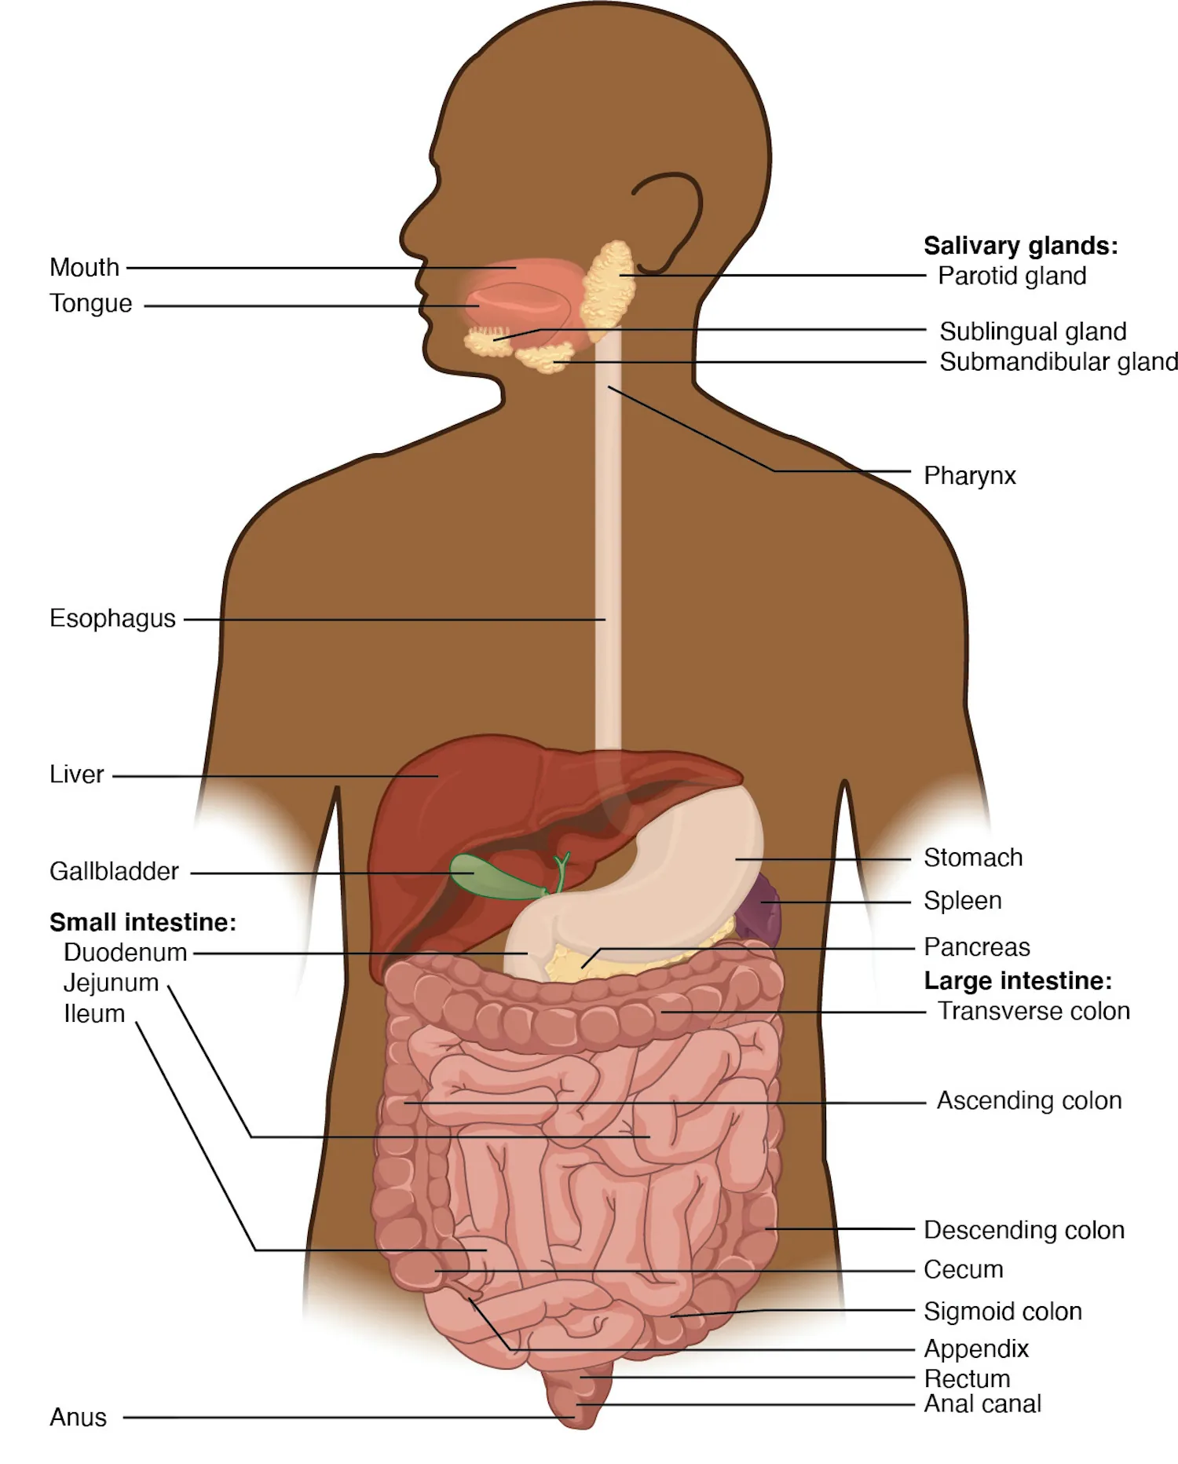
Figure 24.1: Upper GI Anatomy and Mucosal Defence
WHAT TO NOTICE
Swallowing Reflex & Lower Esophageal Sphincter (LES)
The tongue shapes chewed food into a bolus; during swallowing, the soft palate rises, the larynx lifts, the epiglottis covers the airway, and the LES relaxes briefly before closing to block acid reflux.
Gastric Acid, Intrinsic Factor & Mucosal Defence
Gastric parietal and chief cells secrete HCl, pepsin, and intrinsic factor (essential for ileal vitamin B12 absorption). A mucus-bicarbonate barrier, rich blood flow, rapid epithelial repair, and prostaglandins protect the mucosa.
Gastric Reservoir vs. Small Bowel (Tube Feeding Link)
The stomach acts as a expandable reservoir that tolerates bolus, intermittent, or continuous feeds; the duodenum and jejunum lack a reservoir and require slow, continuous pump infusions.
Why Albumin & Prealbumin Do Not Diagnose Malnutrition
ASPEN states that serum albumin and prealbumin are negative acute-phase reactants that fall with inflammation and capillary leak during illness—rely on weight change, intake, and muscle mass instead (Evans et al., 2021).
Clinical Takeaway: A low albumin (e.g., 26 g/L in a patient with pneumonia, Question 6) reflects acute inflammation—never use albumin to diagnose malnutrition or measure muscle mass.
Medical-Surgical Nursing: A Canadian Open Text
Chapter 24 · Upper GI Disorders and Nutrition
Notes:
Figure 24.1 illustrates the alimentary canal and accessory digestive organs (credit: Figure 23.2 in Anatomy and Physiology 2e by J. Gordon Betts et al./OpenStax, CC BY-NC-SA 4.0). Connect the anatomy to three clinical principles: (1) Prostaglandins maintain the stomach's mucus-bicarbonate barrier and mucosal blood flow, explaining why NSAIDs cause ulcers; (2) Intrinsic factor from the stomach is required for vitamin B12 absorption, explaining B12 deficiency after gastrectomy/bariatric surgery; and (3) Serum albumin falls during acute infection or surgery due to inflammation, not malnutrition (Question 6).

Slide 6
SECTION 24.1 · MALNUTRITION SCREENING & REFEEDING
CNST, INPAC, GLIM Criteria, and Refeeding Syndrome
A person in a larger body can lose substantial weight and muscle while BMI stays above 30 kg/m²—always ask about recent weight loss.
CNST, INPAC Pathway & GLIM Criteria
Going Deeper: Refeeding Syndrome
Canadian Nutrition Screening Tool (CNST — Question 5)
Ask every adult on admission: 1. Over the last 6 months, have you lost weight without meaning to? 2. For >1 week, have you been eating less than usual? 'Yes' to BOTH = nutrition risk (regained weight does not count).
Integrated Nutrition Pathway for Acute Care (INPAC)
Classify at-risk patients with Subjective Global Assessment (SGA). Eating <=50% of meals triggers action (remove mealtime barriers, check dentures/pain, advance nutrition care, refer to dietitian, weigh on admission and weekly, Question 8).
GLIM Diagnostic Criteria (Question 7 & Question 20)
Requires >=1 Phenotypic criterion (>5% weight loss within 6 mo or >10% longer; low BMI <20 if <70 yr or <22 if >=70 yr; or reduced muscle mass/handgrip) PLUS >=1 Etiologic criterion (<=50% intake for >1 wk or any reduction >2 wk; or chronic malabsorption/inflammation).
ASPEN Definition & Insulin Shift Mechanism
A >=10% fall in serum phosphate, potassium, or magnesium within 5 days of starting/increasing nutrition (>30% fall = severe, e.g., PO4 dropping from 1.05 to 0.62 mmol/L in Question 18). Carbohydrate triggers insulin release, driving PO4, K+, and Mg2+ into cells and consuming thiamine.
High-Risk Patients & Organ Dangers
Very low BMI (e.g., 15.5 kg/m²), >=5–10 d of minimal intake, eating disorders, alcohol/substance use, cancer, malabsorption, prior bariatric surgery, or food insecurity. Severe hypophosphatemia impairs respiratory muscles and the heart.
Prevention & Monitoring Protocol (da Silva et al., 2020)
Check K+, Mg2+, and PO4 before feeding; give thiamine BEFORE starting feeds or IV dextrose; start calories low and advance slowly; check electrolytes q12h × 3 days and vitals q4h × 24 hours.
Medical-Surgical Nursing: A Canadian Open Text
Chapter 24 · Upper GI Disorders and Nutrition
Notes:
Slide 6 synthesizes the Canadian Context box ('Malnutrition in Canadian Hospitals'), CNST/INPAC, GLIM criteria, and the Going Deeper box ('Refeeding Syndrome'). Highlight Questions 5, 7, 8, 18, and 33: (1) Under CNST, both answers must be 'yes' (unintended weight loss in past 6 months AND eating less for >1 week); (2) A patient with a BMI of 31 kg/m² who lost 10 kg unintentionally over 4 months on chemotherapy is at high nutrition risk despite a high BMI (Question 7); (3) Under GLIM, a 72-year-old who lost 7% body weight in 3 months (phenotypic) and ate <50% of needs for 2 weeks (etiologic) meets both criteria (Question 20); and (4) A ~40% drop in phosphate (1.05 to 0.62 mmol/L) 24 hours after starting tube feeds in a patient with BMI 15.5 kg/m² is severe refeeding syndrome—report promptly for electrolyte replacement and slower feeding (Question 18).

Slide 7
PART 2 · SECTION 24.2
Enteral and Parenteral Nutrition and CNO Scope
NG, NJ, PEG, and jejunostomy tubes; radiograph and external mark placement checks; ENFit and tube medications; central parenteral nutrition; and CNO controlled acts
Notes:
Part 2 covers Section 24.2: short-term nasal and long-term gastrostomy/jejunostomy tubes (Table 24.1), confirming placement before first use and every subsequent use, safe administration of enteral feeds and medications by tube, central and peripheral parenteral nutrition, and CNO scope of practice for feeding tubes.

Slide 8
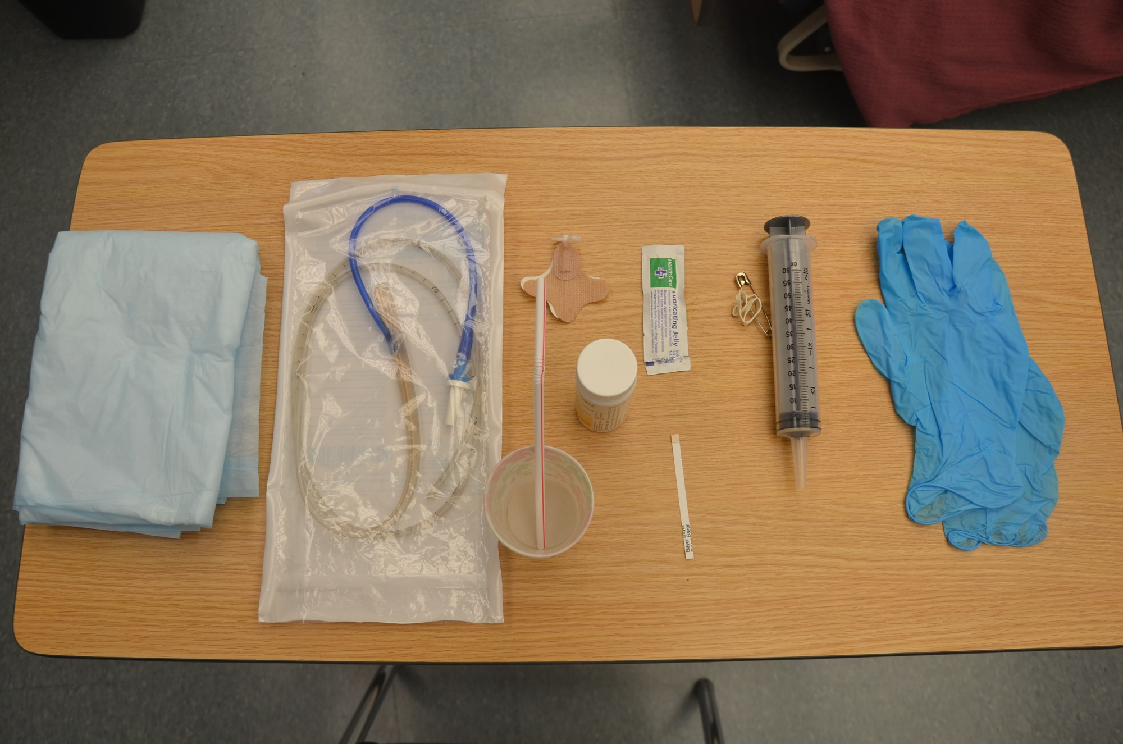
Figure 24.2: Nasogastric Tube Insertion and Verification
WHAT TO NOTICE
Airway Misplacement Hazard
A blindly inserted tube can enter the trachea without causing coughing—especially in patients with stroke, sedation, or weak gag/cough reflexes—causing pneumothorax or fatal aspiration pneumonia if used.
First Use Rule: Mandatory Radiograph Confirmation
Canadian guidance requires radiograph (X-ray) confirmation that a blindly placed tube tip is in the intended position BEFORE any feed, fluid, or medication is given—with no exceptions (Lortie & Charbonney, 2016).
Every Subsequent Use: External Mark & pH Checks
Record the external cm mark at the nostril after X-ray confirmation and verify it q12h and before every feed/medication pass (if a 60 cm mark is found at 52 cm, hold the feed, do not push the tube back in, and report! Q9). Gastric aspirate is typically pH <=5 (PPIs raise pH).
Never Rely on Air Auscultation ('Whoosh Test')
Injecting air while listening over the epigastrium is NEVER a valid placement check—transmitted sounds from the bronchus, pleural space, or esophagus mimic gastric gurgling (Question 1).
Clinical Takeaway: If the external nostril mark shifts (e.g., from 60 cm to 52 cm) or the patient develops coughing, retching, or desaturation, stop the feed immediately and never advance the tube blindly.
Medical-Surgical Nursing: A Canadian Open Text
Chapter 24 · Upper GI Disorders and Nutrition
Notes:
Figure 24.2 shows the supplies gathered for nasogastric tube insertion and verification, including the tube, water-soluble lubricant, nasal securement device, pH test strips, large enteral syringe, and cup of water with straw (credit: Glynda Rees Doyle and Jodie Anita McCutcheon/BCcampus, CC BY 4.0). Review the Clinical Safety box ('Is the Tube in the Right Place?') and Questions 9 and 1.

Slide 9
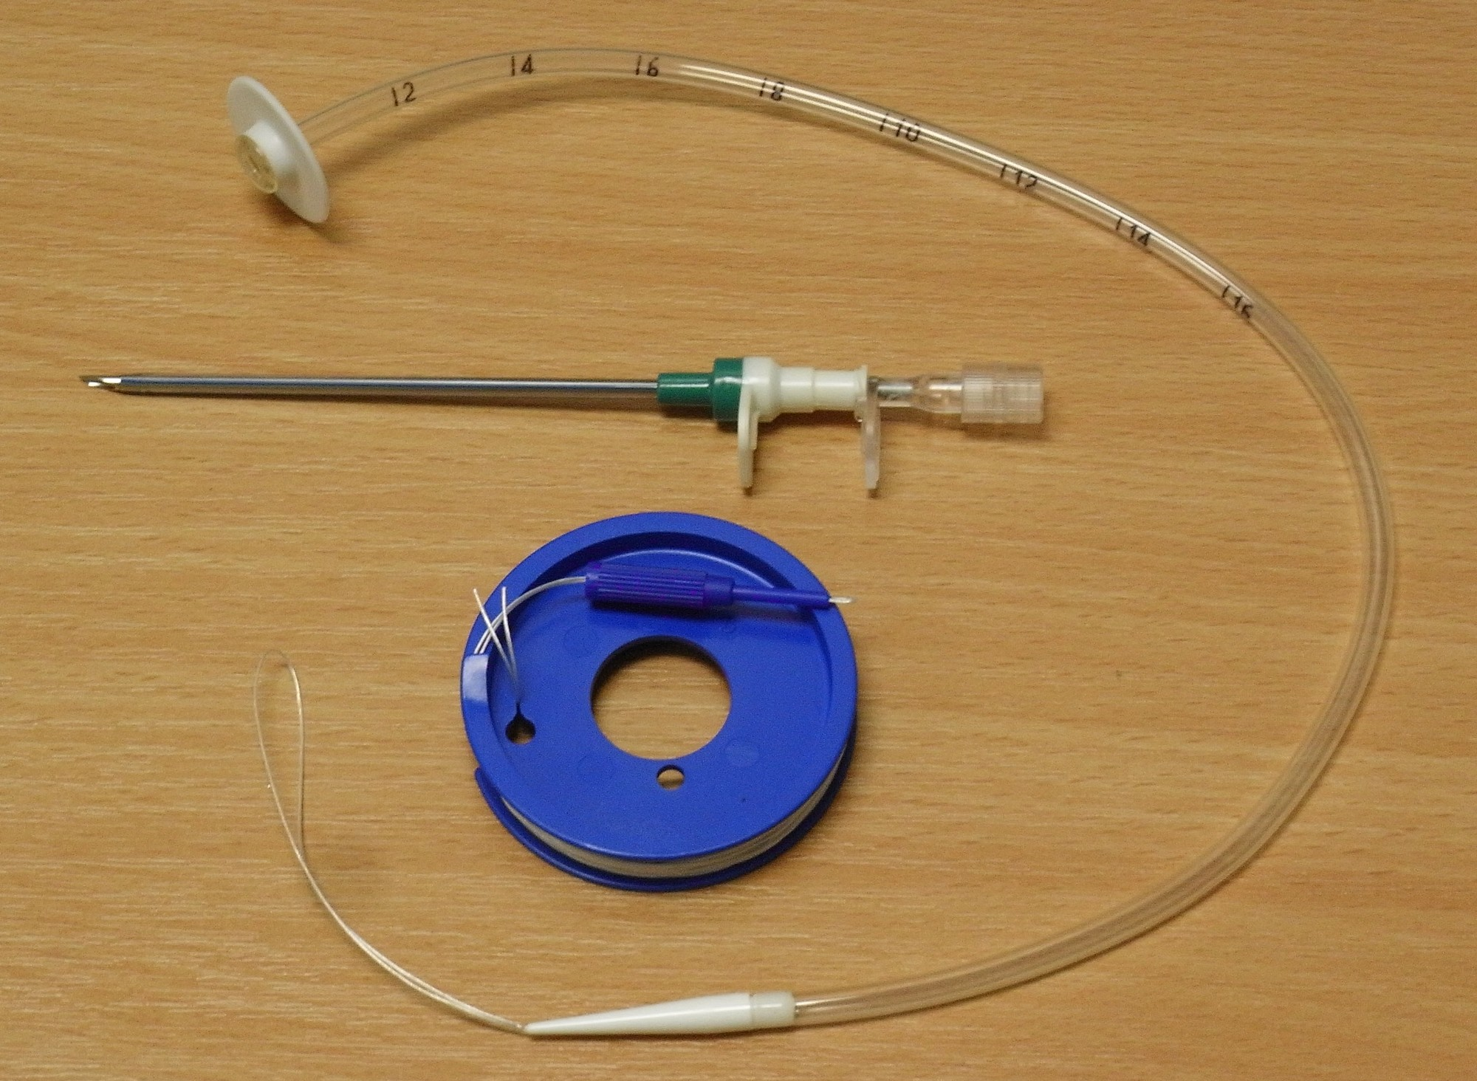
Figure 24.3: Gastrostomy (PEG) and Enteral Tubes
WHAT TO NOTICE
Comparing NG, NJ, PEG & Jejunostomy Tubes (Table 24.1)
Short-term: Nasogastric (NG—stomach) or Nasojejunal (NJ—jejunum, when gastric feeding is not tolerated or aspiration risk is high). Longer-term: Gastrostomy/PEG (stomach, held by internal bumper disc) or Jejunostomy (jejunum, continuous pump feed only).
Shared Decision-Making & Post-Stroke Timing
Deciding whether to place a feeding tube weighs the patient's goals, prognosis, and wishes; after acute stroke, tube-feeding decisions are made early, usually within the first 3 days of admission (Heart and Stroke Foundation of Canada, 2019).
Daily Stoma Inspection & Dislodgement Protocol
Inspect and clean gastrostomy/jejunostomy sites daily for redness, swelling, leakage, pain, or tube migration. Report a dislodged tube at once—new stoma tracts close rapidly and often require surgical/interventional replacement.
CNO Scope of Practice: Controlled Acts (Question 34)
In Ontario, passing an NG tube (beyond the nasal narrowing) and reinserting a G-tube (into an artificial opening) are controlled acts authorized to BOTH RNs and RPNs with a prescriber order or directive, nursing competence, and employer policy support.
Clinical Takeaway: In an Ontario hospital, an RPN may insert a nasogastric tube when there is an order or directive, the RPN is competent, and employer policy permits it (Question 34).
Medical-Surgical Nursing: A Canadian Open Text
Chapter 24 · Upper GI Disorders and Nutrition
Notes:
Figure 24.3 shows a percutaneous endoscopic gastrostomy (PEG) tube kit with its internal retention bumper disc, introducer cannula, and looped guidewire (credit: Gilo1969/Wikimedia Commons, CC BY-SA 3.0). Combine Table 24.1 ('Enteral feeding tubes compared') with the Scope in Practice box ('Feeding Tubes and the Nurse') and Question 34.

Slide 10
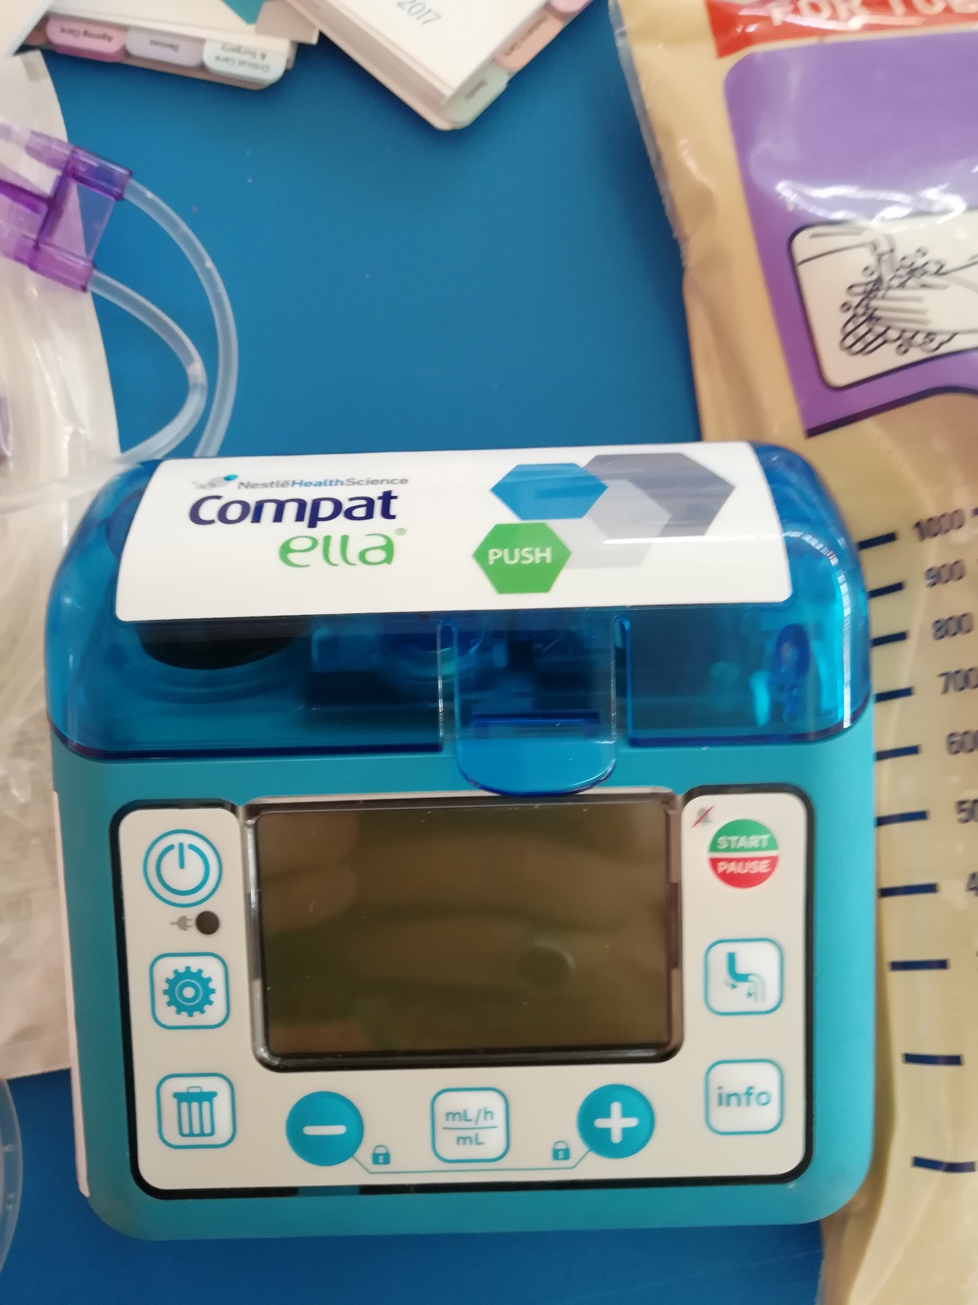
Figure 24.4: Safe Enteral Feeding and Tube Medications
WHAT TO NOTICE
Head-of-Bed Elevation (30° to 45°) & Hang Times
Keep the HOB at 30°–45° during continuous feeds and for >=1 hour after intermittent feeds (pause the pump if the patient must lie flat for care, Q2). Closed ready-to-hang bags hang <=24 h; open poured formula hangs <=8 h.
Gastric Residual Volumes (GRV) & Water Flushes
Routine q4h GRV checks are no longer performed unless ordered or signs of intolerance (distension, nausea, vomiting) appear (Q11). Flush with >=30 mL water before and after intermittent feeds (unless fluid-restricted).
ENFit Connectors & Line Tracing (Question 12)
ENFit connectors are physically incompatible with luer-lock IV ports so enteral formula/syringes cannot be accidentally connected to an IV line; still trace every line from patient to source.
Medications by Feeding Tube (ISMP Canada — ~15% Blockage Rate)
Consult the pharmacist first (some liquids are thick/granular and clog tubes). NEVER crush extended-release, delayed-release, or enteric-coated drugs or open beaded capsules (Q3). Give each drug separately, flushing with >=15 mL water before, between, and after.
Clinical Takeaway: Never mix medications together, never add medications to the enteral formula bag, and flush with at least 15 mL of water before, between, and after each drug.
Medical-Surgical Nursing: A Canadian Open Text
Chapter 24 · Upper GI Disorders and Nutrition
Notes:
Figure 24.4 shows an enteral feeding pump with its dedicated purple ENFit administration set (credit: Ahmed Shawky Mohammedin, MD/Wikimedia Commons, CC BY-SA 3.0). Highlight the high-yield rules tested in Questions 11, 12, 2, and 3, and remind students that on Day 6 of Case 1 (Mr. Gurdev Sandhu: RR 28, SpO2 89%, T 38.2 °C, right lower lobe crackles without cough, Question 4), the priority is to stop the feed immediately, keep the head of the bed elevated, assess the airway, and escalate via RRT.

Slide 11
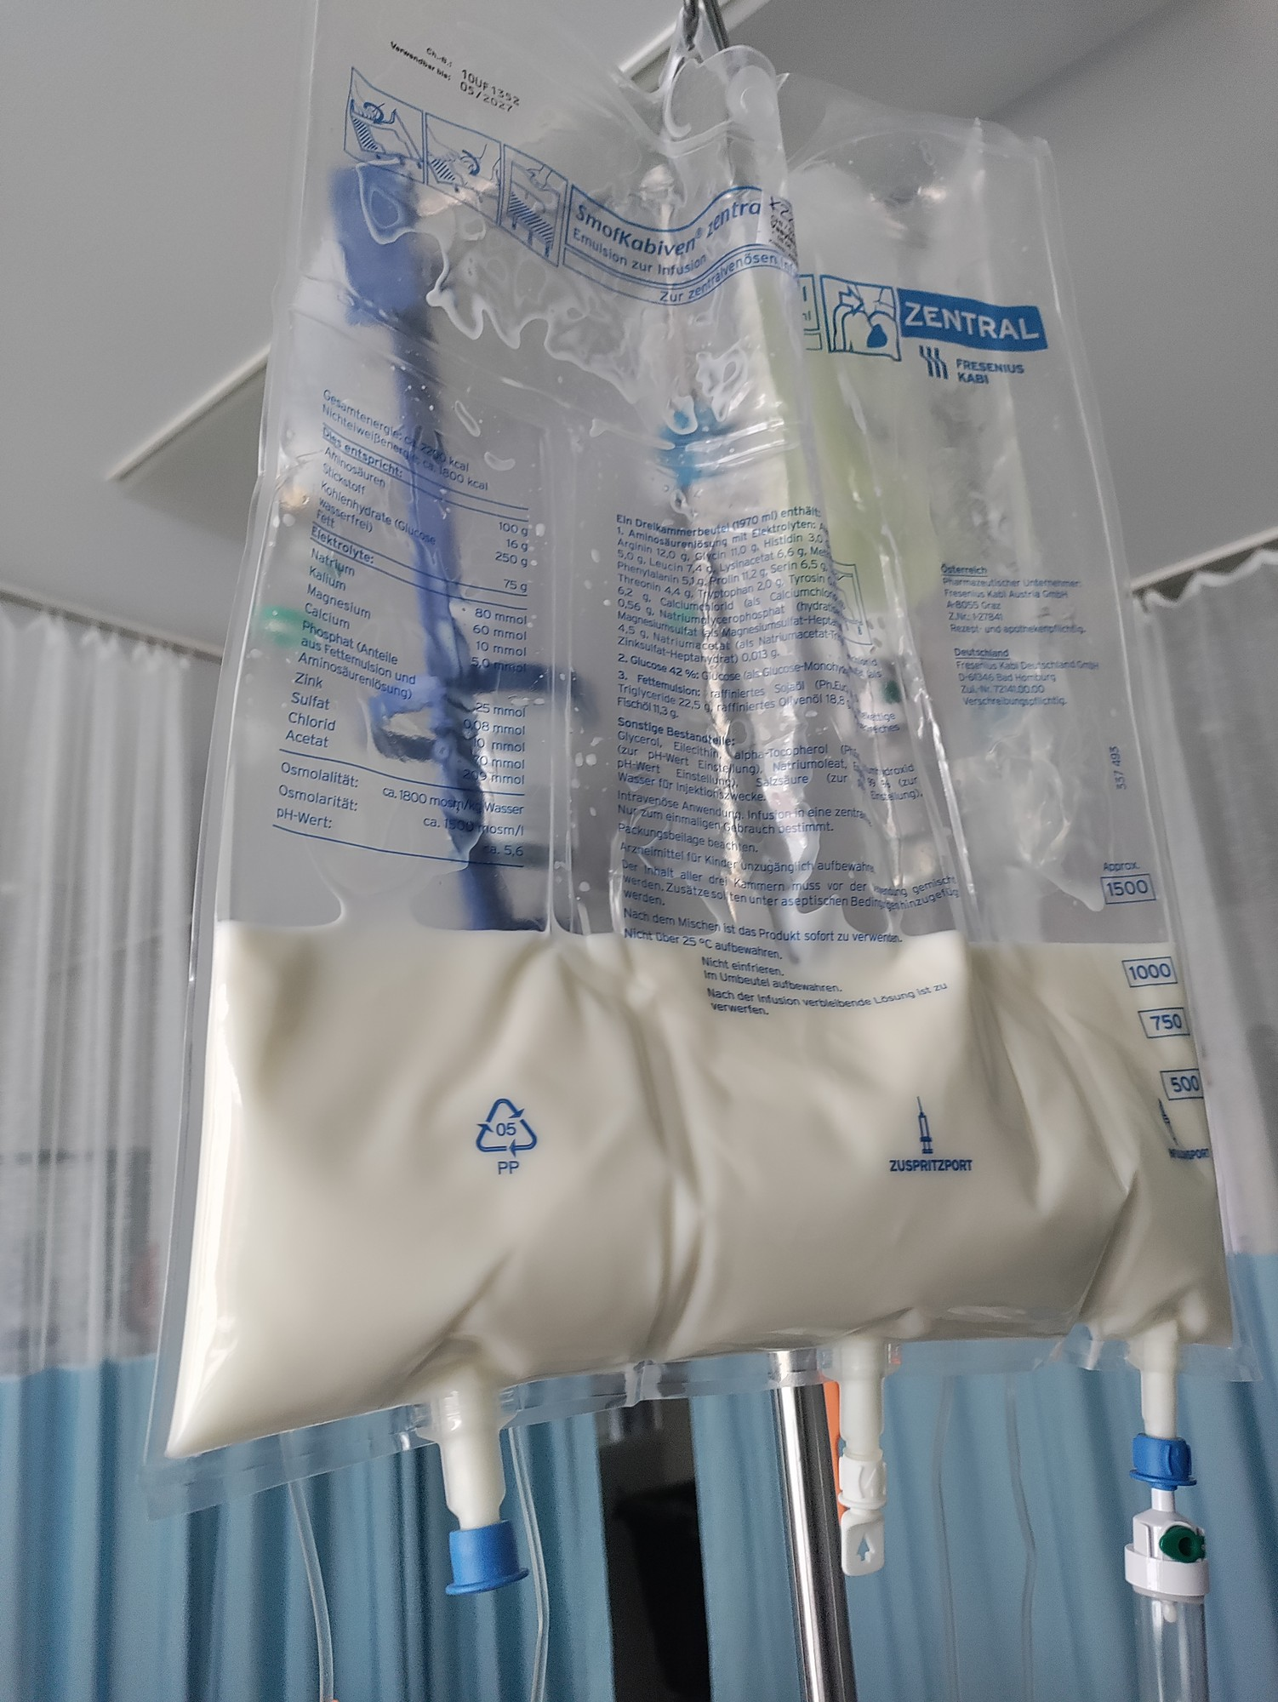
Figure 24.5: Parenteral Nutrition Safety and Monitoring
WHAT TO NOTICE
Indications & Three-Chamber Bag Design
Used only when the GI tract is non-functional (prolonged obstruction, severe malabsorption) or enteral nutrition cannot meet needs. Amino acids, dextrose, and lipids are separated until mixed just before hanging.
Central Venous Access & Dedicated Lumen / Filter
Concentrated high-osmolarity PN requires a central venous catheter (e.g., PICC tip in the superior vena cava) infused by pump through the specified in-line filter and a dedicated lumen.
Hyperglycemia & Electrolyte / Refeeding Vigilance
Monitor capillary glucose, electrolytes, daily weights, and I&O; IV dextrose counts toward calorie limits in patients at refeeding risk. If glucose is 14.6 mmol/L (Q13), report and follow glucose orders—never stop or slow PN without an order.
Catheter-Related Bloodstream Infection (CRBSI — Question 19)
Strict aseptic line/dressing/tubing care is vital. New fever (e.g., 38.7 °C) and chills in a patient on PN via a central line suggest CRBSI—report immediately and prepare for blood cultures and sepsis workup.
Clinical Takeaway: Never abruptly stop, slow down, or speed up a parenteral nutrition infusion without a prescriber's order—and treat any new fever or chills on a central line as sepsis until proven otherwise.
Medical-Surgical Nursing: A Canadian Open Text
Chapter 24 · Upper GI Disorders and Nutrition
Notes:
Figure 24.5 shows a three-chamber central parenteral nutrition bag (SmofKabiven central) after the internal seals have been broken to mix the amino acids, dextrose, and white lipid emulsion (credit: Ibrahim Husain Meraj/Wikimedia Commons, CC BY-SA 4.0). Review Questions 13 and 19.

Slide 12
PART 3 · SECTION 24.3
Dysphagia, Silent Aspiration, and the IDDSI Framework
Bedside dysphagia cues, post-stroke swallowing screening, speech-language pathologist assessment, IDDSI Levels 0–7, and older-adult meal care
Notes:
Part 3 covers Section 24.3: recognizing oropharyngeal and esophageal dysphagia, why silent aspiration occurs without coughing, mandatory post-stroke swallowing screening before food, drink, or oral pills, speech-language pathologist (SLP) clinical and instrumental evaluations, the 8-level IDDSI framework (Table 24.2), and older-adult mealtime safety.

Slide 13
SECTION 24.3 · DYSPHAGIA & SILENT ASPIRATION
Recognizing Dysphagia, Screening, and Older-Adult Care
Absence of a cough when drinking water does NOT prove a safe swallow—silent aspiration enters the airway without a cough.
Dysphagia Cues, Screening & SLP Role
Mealtime Safety & Older Adults
Bedside Signs of Dysphagia (ASHA — Question 14)
Coughing or throat clearing during/after eating or drinking, a wet or gurgly voice after sips, drooling or pocketing food in the cheeks, taking much longer to finish meals, unexplained weight loss/dehydration, and repeated chest infections.
Silent Aspiration & Post-Meal Respiratory Cues (Q15)
Material can enter the trachea below the vocal folds with ZERO cough. Watch for delayed cues: wet voice, tachypnea, new basal crackles, falling SpO2, or fever.
Post-Stroke Swallowing Screen & SLP Assessment
After a stroke, keep the patient NPO (including oral medications!) until a trained clinician completes a validated swallowing screen. A failed screen prompts SLP referral for clinical assessment and videofluoroscopy (VFSS) or endoscopic evaluation (FEES).
Positioning, Pacing & Hidden Thin Liquids
Sit 90° upright (ideally in a chair), give small mouthfuls at a steady pace, and avoid mixed-consistency foods (cereal with milk) or transitional foods that melt into thin liquid (ice cream, gelatin/jelly) when thin liquids are restricted.
Post-Meal Mouth Checks, Oral Care & Medications
Check cheeks for pocketed food and perform thorough oral care after meals to reduce aspiration pneumonia. Never give whole pills with thin water if thin fluids are restricted; never crush enteric-coated or ER tablets (consult pharmacist, Q17).
Informed Choice & Managed-Risk Agreements (Q10)
If a capable patient on IDDSI Level 5/Level 2 requests plain coffee and toast, explain the risks, offer safe alternatives, and involve the SLP and team in a shared/managed-risk discussion.
Medical-Surgical Nursing: A Canadian Open Text
Chapter 24 · Upper GI Disorders and Nutrition
Notes:
Slide 13 integrates Section 24.3 and the Lifespan Considerations box ('Nutrition and Swallowing in Older Adults'). Highlight Questions 10, 14, 15, and 19: (1) After a stroke, if a family member gives water to a patient awaiting SLP assessment and says 'He didn't cough, so he's fine,' explain silent aspiration and keep the patient NPO per plan (Question 15); (2) Ice cream and jelly melt into thin fluid in the mouth and must be avoided on thickened-fluid orders; and (3) If a patient on IDDSI Level 4 (pureed) is ordered an enteric-coated tablet, never crush or split it and never give it with thin water—contact the pharmacist for an alternative formulation (Question 17).

Slide 14
SECTION 24.3 · IDDSI FRAMEWORK
IDDSI Drink and Food Levels 0 to 7 (Table 24.2)
The International Dysphagia Diet Standardisation Initiative (IDDSI) uses 8 levels (0–4 drinks; 3–7 foods) with syringe, spoon, and fork tests.
Level 0 — Thin (Drinks): Flows like water through any cup or straw; for people who swallow all liquids safely.
Level 4 — Extremely Thick / Pureed: Holds its shape on a spoon; cannot be poured, sipped, or sucked through a straw; no chewing needed.
Level 1 — Slightly Thick: Slightly thicker than water; still flows through a straw when thin drinks move too fast.
Level 5 — Minced & Moist: Soft, moist food with small lumps (<=4 mm wide in adults) that the tongue can squash.
Level 2 — Mildly Thick: Maps to 'nectar-thick': pours off a spoon and can be sipped, but flows slower than water (Q16).
Level 6 — Soft & Bite-Sized: Tender, moist pieces <=1.5 cm in adults; requires chewing but no biting.
Level 3 — Moderately Thick: Maps to 'honey-thick' / liquidised food: smooth, no lumps, drunk from cup, drips slowly through a fork.
Level 7 — Easy to Chew / Regular: Everyday soft foods (7 Easy to Chew) or all textures including hard/mixed foods (7 Regular).
Diet & Fluid Intake Alert: Pureed foods and thickened drinks are less appealing and increase dehydration and protein-calorie malnutrition risk—monitor intake closely and involve the dietitian.
Medical-Surgical Nursing: A Canadian Open Text
Chapter 24 · Upper GI Disorders and Nutrition
Notes:
Slide 14 summarizes Table 24.2 ('IDDSI drink and food levels in brief', IDDSI v2.2, 2026; Cichero et al., 2017). Point out the overlap at Levels 3 and 4 (where drink thickness and food texture share identical flow/spoon-tilt properties) and the older Canadian terminology mapping used in provinces like Alberta (Level 2 = nectar-thick; Level 3 = honey-thick; Level 4 = pudding-thick/pureed).

Slide 15
PART 4 · SECTION 24.4
GERD, Gastritis, Peptic Ulcer Disease, and PPI Deprescribing
GERD alarm features and Barrett esophagus, H. pylori and NSAID ulcers, ulcer perforation, 14-day Toronto Consensus therapy, and 5-step PPI deprescribing
Notes:
Part 4 covers Section 24.4: gastroesophageal reflux disease (GERD), alarm features requiring prompt endoscopy, Barrett esophagus, gastritis and peptic ulcer disease (H. pylori and NSAIDs), perforated peptic ulcer emergency care, the Toronto Consensus 14-day H. pylori regimens, and the Canadian 5-step PPI deprescribing guideline.

Slide 16
SECTION 24.4 · GERD, GASTRITIS & PEPTIC ULCERS
GERD Alarm Features, Peptic Ulcer Disease, and Perforation
Distinguish uncomplicated heartburn or dyspepsia from red-flag alarm features and surgical ulcer perforation.
GERD, Alarm Features & Barrett Esophagus
Gastritis, Peptic Ulcer Disease & Perforation
LES barrier failure, lifestyle measures, and red flags (Katz et al., 2022)
H. pylori and NSAIDs/ASA—recognizing a lethal surgical emergency
Classic Symptoms & Lifestyle Measures (Question 28)
Heartburn (retrosternal burning) and effortless sour/bitter regurgitation. Lifestyle: avoid eating within 2–3 hours of bedtime, elevate the head of the bed for nocturnal reflux, stop tobacco, avoid personal trigger foods, and offer weight-inclusive support if desired.
Alarm Features Requiring Prompt Endoscopy (Question 27)
Dysphagia (food sticking), unintended weight loss, GI bleeding (hematemesis/melena), iron-deficiency anemia, persistent vomiting, or new epigastric pain at age >=60 years.
Barrett Esophagus (Precancerous Metaplasia)
Chronic reflux can cause intestinal metaplasia of the lower esophagus, which increases esophageal adenocarcinoma risk and requires ongoing PPI therapy and endoscopic surveillance.
Two Leading Causes & Canadian Indigenous Context
1. Helicobacter pylori (~30% of Canadian dyspepsia; 58% in Aklavik, NWT community-requested study due to housing/water/care inequities, Cheung et al., 2014); 2. NSAIDs and ASA (independent ulcer/bleed risk).
Three Major Ulcer Complications
1. Upper GI bleeding (most common, Section 24.5); 2. Perforation into the peritoneal cavity; 3. Gastric outlet obstruction (scar stenosis causing recurrent vomiting).
Perforated Peptic Ulcer Emergency (Question 31)
Sudden, severe abdominal pain + tender, rigid ('board-like') abdomen + tachycardia (peritonitis). Carries 23.5% 30-day mortality and every hour of surgical delay increases death—keep NPO and escalate via SBAR immediately!
Perforation Trap (Question 31): Never give oral antacids, oral acetaminophen, a warm compress, or ambulation to a patient with sudden severe abdominal pain and a rigid abdomen.
Medical-Surgical Nursing: A Canadian Open Text
Chapter 24 · Upper GI Disorders and Nutrition
Notes:
Slide 16 covers GERD, Barrett esophagus, gastritis, peptic ulcer disease, the Aklavik NWT community-partnered H. pylori study (Cheung et al., 2014), and perforated peptic ulcer (Tarasconi et al., 2020). Emphasize Questions 27, 28, and 24.

Slide 17
SECTION 24.4 · H. PYLORI & PPI DEPRESCRIBING
Toronto Consensus H. pylori Regimens and PPI Stewardship
Every H. pylori eradication regimen runs a full 14 days, and PPIs must be held 2 weeks before breath or stool testing.
H. pylori Testing & 14-Day Therapy
Acid Drugs & 5-Step PPI Deprescribing
Pre-Test Washout to Prevent False Negatives (Question 29)
Before a urea breath test, stool antigen test, or endoscopic biopsy: stop PPIs >=2 weeks before, and stop bismuth and antibiotics >=4 weeks before (antacids or H2 blockers like famotidine can be used for symptoms in the interim).
Toronto Consensus 14-Day First-Line Regimens (Fallone et al.)
1. Bismuth quadruple therapy for 14 days: PPI + bismuth + metronidazole + tetracycline (preferred 1st choice in penicillin allergy). 2. Concomitant non-bismuth quadruple therapy for 14 days: PPI + amoxicillin + metronidazole + clarithromycin.
Adherence & Test of Cure (Question 30)
Take every dose for the full 14 days (use pharmacy blister packs; report severe diarrhea/rash). Confirm eradication >=4 weeks after completing therapy using a urea breath or stool antigen test (serology cannot confirm cure).
PPI Administration & Long-Term Harms (Question 32)
Take PPIs 30–60 min before breakfast and swallow delayed-release tablets whole. Long-term PPI use is linked to vitamin B12 deficiency, hypomagnesemia, hip/spine fractures, C. difficile infection, and community-acquired pneumonia.
Who Must STAY on a PPI (Do Not Deprescribe — Q39)
Barrett esophagus, severe (Grade C/D) esophagitis, documented history of a bleeding ulcer, or chronic NSAID/antiplatelet users at high bleeding risk.
5-Step Deprescribing Algorithm (Farrell et al., 2017)
For resolved heartburn/mild esophagitis (>4 wk use) or post-ICU stress ulcer prophylaxis: 1. Confirm indication; 2. Exclude high-risk conditions; 3. Lower dose or switch to on-demand use; 4. Follow up at 4 & 12 wk; 5. Use lifestyle/antacids/alginates for rebound symptoms.
Medical-Surgical Nursing: A Canadian Open Text
Chapter 24 · Upper GI Disorders and Nutrition
Notes:
Slide 17 integrates Table 24.3 ('Drugs for acid-related disorders'), the Patient Education box ('Taking and Stopping a Proton Pump Inhibitor'), the Toronto Consensus on H. pylori (Fallone et al., 2016), and the Canadian PPI deprescribing guideline (Farrell et al., 2017; Bruyère Research Institute, 2018). Walk through Questions 29, 30, 32, and 35.

Slide 18
PART 5 · SECTION 24.5
Upper Gastrointestinal Bleeding (UGIB)
Recognizing hematemesis and melena, skin-of-colour and beta-blocker traps, parallel resuscitation and endoscopy within 24 hours, and the Glasgow-Blatchford score
Notes:
Part 5 covers Section 24.5: non-variceal upper GI bleeding causes and risk factors, recognizing hematemesis, coffee-ground emesis, melena, and brisk hematochezia, assessing pallor on darker skin tones, why beta-blockers and older age mask compensatory tachycardia, parallel resuscitation and endoscopic hemostasis within 24 hours, and the pre-endoscopy Glasgow-Blatchford score.

Slide 19
SECTION 24.5 · RECOGNIZING UPPER GI BLEEDING
Bleeding Presentations, Skin Tone, and Beta-Blocker Traps
Hypotension is a late sign of failing compensation—and beta-blockers can hide the early heart-rate rise during a major bleed.
Causes & Four Bleeding Presentations
Skin-of-Colour & Beta-Blocker Traps
Leading Non-Variceal Causes & Medication Risks
Peptic ulcer disease is #1, followed by erosive esophagitis/gastritis, Mallory-Weiss gastroesophageal junction tear (after forceful retching), and upper GI malignancy. Triggered by NSAIDs/ASA and H. pylori; made heavier by anticoagulants (apixaban) and antiplatelets.
Hematemesis & Coffee-Ground Emesis
Vomiting bright red blood/clots indicates brisk active bleeding; dark granular 'coffee-ground' emesis reflects blood oxidized by gastric acid.
Melena & Brisk Hematochezia
Melena is black, sticky, tar-like, foul-smelling stool from digested blood; hematochezia (red/maroon rectal blood) is usually lower GI, but 11%–15% of apparent lower bleeds come from a brisk upper GI source (especially if hemodynamically unstable).
Assessing Pallor on Dark Brown & Black Skin (Q33)
General skin pallor looks yellow-brown on brown skin or ash grey on very dark skin, and fluorescent light distorts colour—inspect the conjunctivae, lips, oral mucosa, and nail beds in natural light against the patient's baseline, paired with vitals and Hb.
Why Beta-Blockers Mask Tachycardia (Questions 22 & 25)
Metoprolol and bisoprolol blunt sympathetic beta-1 tachycardia (and older adults mount a weaker heart-rate response). A 'normal' HR of 92–94 bpm with postural dizziness, a 25-mm Hg BP drop, and falling Hb signals dangerous blood loss!
Elevated Blood Urea Nitrogen (Urea) in UGIB
Digestion of blood proteins in the upper GI tract plus renal hypoperfusion causes blood urea to rise (e.g., 6.8 to 11.2 mmol/L in Case 2: Mr. Ernest Kowalczyk).
Medical-Surgical Nursing: A Canadian Open Text
Chapter 24 · Upper GI Disorders and Nutrition
Notes:
Slide 19 covers Section 24.5 on recognizing UGIB across skin tones (Pusey-Reid et al., 2023) and in patients taking beta-blockers (Schiller et al., 2017; Oakland et al., 2019). Emphasize how this is tested in Case 2 (Mr. Ernest Kowalczyk, Questions 21–26), the Clinical Judgment box (Mrs. Rosa Delgado), the Practice Story (Mr. Leblanc), and Question 33.

Slide 20
SECTION 24.5 · UGIB RESUSCITATION & ENDOSCOPY
Parallel Resuscitation, Endoscopy, and Risk Scoring
Protect the airway, establish large-bore IV access, transfuse restrictively (<80 g/L), and perform endoscopy within 24 hours.
Parallel Resuscitation & Pre-Endoscopy Care
Endoscopy, Rebleeding & Risk Scores
International Consensus Group recommendations (Barkun et al., 2019)
Definitive hemostasis within 24 hours and secondary prevention
Airway Protection & Immediate Escalation (Question 25)
If the patient vomits blood or is drowsy, turn them onto their side immediately with suction ready, stay at the bedside, and activate the rapid response team (hold beta-blockers and antihypertensives).
Large-Bore IVs, Blood Work & Restrictive Transfusion
Insert two large-bore IV lines; draw CBC, group and screen, coagulation profile, urea, and creatinine; start crystalloid resuscitation if unstable. Transfuse RBCs at Hb <80 g/L (or a higher threshold in cardiovascular disease; thresholds do not apply in massive bleeding).
NPO, IV PPI & Anticoagulant Management (Question 24)
Keep NPO; give an IV PPI if ordered (must not delay endoscopy; H2 blockers and routine prokinetics are not recommended); hold anticoagulants/NSAIDs per prescriber without delaying endoscopy.
Endoscopy Within 24 Hours & Post-Endoscopy PPI
Endoscopy within 24 h identifies and treats high-risk ulcers (active bleeding or visible vessel), followed by high-dose IV PPI for 3 days, then twice-daily oral PPI through Day 14.
Monitoring for Rebleeding & Secondary Prevention (Q26)
Steady hemoglobin on repeat checks + normalized HR/BP show hemostasis (melena may persist briefly from old blood). Test/treat H. pylori, stop OTC NSAIDs permanently, and co-prescribe a PPI if ASA/anticoagulants must resume.
Going Deeper (RN): Glasgow-Blatchford Score (Question 38)
Pre-endoscopy score using urea, Hb, HR, SBP, melena/syncope, and liver/heart failure history. A score of <=1 identifies very low-risk patients (<1% false-negative rate) who may be managed as outpatients (AIMS65 is not recommended).
Rural & Remote Transfer Pearl: In hospitals without on-site endoscopy, early nursing recognition and SBAR reporting initiate patient transport so the 24-hour endoscopy window is met.
Medical-Surgical Nursing: A Canadian Open Text
Chapter 24 · Upper GI Disorders and Nutrition
Notes:
Slide 20 details the International Consensus UGIB management pathway (Barkun et al., 2019) and the Going Deeper box ('Risk Scores in Upper GI Bleeding', Blatchford et al., 2000). Highlight Questions 24, 25, 26, and 34.

Slide 21
PART 6 · SECTION 24.6
Obesity and Bariatric Surgery
Obesity as a chronic disease, weight-inclusive nursing care, Health Canada pharmacotherapy (2025 update), sleeve gastrectomy versus Roux-en-Y bypass, and leak/dumping care
Notes:
Part 6 covers Section 24.6: the Canadian Adult Obesity Clinical Practice Guideline definition of obesity as a complex chronic disease, the Edmonton Obesity Staging System (EOSS), respectful weight-inclusive bedside care, the 2025 CMAJ pharmacotherapy update, sleeve gastrectomy versus Roux-en-Y gastric bypass (Table 24.4), and postoperative vigilance for anastomotic leaks, dumping syndrome, and lifelong nutrient deficiencies.

Slide 22
SECTION 24.6 · OBESITY AS A CHRONIC DISEASE
Weight-Inclusive Nursing Care and 2025 Pharmacotherapy
Obesity is a complex chronic disease—weight bias in health care harms patients and delays diagnosis of acute conditions.
Staging & Weight-Inclusive Bedside Care
2025 Canadian Obesity Pharmacotherapy
Beyond BMI: Waist Size & EOSS Staging (Wharton et al.)
BMI (Class 1: 30–34.9; Class 2: 35–39.9; Class 3: >=40 kg/m²) does not show fat distribution or health impact. Clinicians add waist circumference, ethnicity-specific cutoffs, and the 5-stage Edmonton Obesity Staging System (EOSS) (which predicts mortality better than BMI).
Four Principles of Respectful Nursing Care (Question 35)
1. Use person-first language ('a person living with obesity', never 'morbidly obese'); 2. Ask permission before discussing weight or weighing in private; 3. Never assume a new complaint (e.g., cellulitis) is caused by weight; 4. Have right-sized BP cuffs, gowns, chairs, beds, and lifts ready beforehand.
Eligibility & Six Health Canada–Approved Drugs
Supported alongside nutrition, activity, and psychological care for BMI >=30, or >=27 with an obesity-related complication (Pedersen et al., 2025):
GLP-1 & Dual GIP/GLP-1 Receptor Agonists
1. Semaglutide (Wegovy) (also approved to reduce non-fatal MI in adults with established CVD and BMI >=27); 2. Liraglutide (Saxenda); 3. Tirzepatide (Zepbound, GIP/GLP-1).
Oral Agents & Long-Term Use Principles
4. Naltrexone–bupropion (Contrave); 5. Orlistat (Xenical) (blocks gut fat absorption -> oily stools/urgency); 6. Setmelanotide (rare genetic obesity). Intended for long-term maintenance (stopping leads to weight regain); avoid compounded products.
Medical-Surgical Nursing: A Canadian Open Text
Chapter 24 · Upper GI Disorders and Nutrition
Notes:
Slide 22 covers Section 24.6 on obesity epidemiology (Statistics Canada, 2024), EOSS staging, weight-inclusive nursing practice (Wharton et al., 2020; Question 35), and the 2025 Canadian obesity pharmacotherapy guideline update (Pedersen et al., 2025).

Slide 23
SECTION 24.6 · BARIATRIC SURGERY & POST-OP CARE
Sleeve Gastrectomy, Roux-en-Y Bypass, and Leak Vigilance
A persistently high heart rate after bariatric surgery is never dismissed as pain or anxiety—suspect an anastomotic leak even if imaging is normal.
Indications, Operations & Anastomotic Leak
Diet, Dumping, Supplements & Medications
Sleeve gastrectomy vs. Roux-en-Y gastric bypass (Table 24.4)
Preventing dumping syndrome, ulcers, and micronutrient deficiencies
Canadian Eligibility Criteria & Outcomes (Obesity Canada)
BMI >=40, BMI >=35 with >=1 obesity-related disease, or BMI 30–35 with poorly controlled T2D. Yields 20%–40% long-term weight loss with <0.1% mortality (adjustable gastric banding is no longer offered).
Sleeve Gastrectomy vs. Roux-en-Y Gastric Bypass
Sleeve removes most of the stomach leaving a narrow tube (leaks 0%–7%, often after discharge). Roux-en-Y creates a small gastric pouch joined to the jejunum (leaks 0.1%–8.3%). Walk early on Day 0 for VTE prophylaxis.
Anastomotic Leak Warning Signs (Question 40)
Tachycardia (e.g., HR 124), fever, and abdominal pain often radiating to the left shoulder. Imaging/contrast studies can be falsely normal—hold discharge and notify the surgeon urgently!
Staged Diet & Dumping Prevention (Question 36)
Advance clear -> full -> pureed -> soft -> regular foods (>=60 g/d protein). For dumping syndrome (10–90 min post-meal): avoid sweets/fats, eat small meals, and wait 30 min to drink.
Lifelong Vitamin & Mineral Supplementation
Daily multivitamin with minerals, vitamin B12, calcium citrate + vitamin D, and iron as needed (space calcium and iron >=2 hours apart; monitor labs yearly).
Medication, Alcohol & Pregnancy Rules (Question 37)
Use acetaminophen for pain (never NSAIDs); use immediate-release/liquid meds (ask pharmacist before crushing); avoid alcohol; delay pregnancy 12–18 months.
Discharge Safety (Question 40): On Day 2 post-sleeve gastrectomy, HR 124, T 38.3 °C, and left shoulder pain require immediate surgical escalation—even when yesterday's contrast swallow was normal.
Medical-Surgical Nursing: A Canadian Open Text
Chapter 24 · Upper GI Disorders and Nutrition
Notes:
Slide 23 synthesizes Table 24.4 ('Sleeve gastrectomy and Roux-en-Y gastric bypass compared') and postoperative bariatric nursing care (Mechanick et al., 2020; Kim et al., 2015; Obesity Canada, 2020a, 2020b; The Ottawa Hospital, 2023). Highlight Questions 36, 37, and 36.

Slide 24
SECTION 24.5 · CLINICAL JUDGMENT & PRACTICE STORY
Recognizing Upper GI Bleeds Before Shock Develops
In both narratives, RPNs and RNs connected melena or coffee-ground emesis, OTC NSAIDs, apixaban, and beta-blocker masking to escalate early.
Clinical Judgment: Mrs. Rosa Delgado, 81
Practice Story: RN Jasleen Brar & RPN Kwame
Recognize Cues ('Melena on Day 2')
Admitted for pneumonia; takes apixaban, metoprolol, and OTC naproxen × 3 weeks. On Day 2 the RPN reports two black, tarry stools and postural light-headedness. HR is 92 (baseline 70s), BP 108/64 (baseline 135/80), conjunctivae/lips pale, Hb 98 g/L (down from 121).
Analyze Cues & Prioritize Hypotheses
Naproxen caused peptic ulceration, apixaban amplified bleeding, and metoprolol blunted compensatory tachycardia. Priority is preventing hypovolemic shock (while keeping her in bed to prevent falls).
Take Action & Evaluate Outcomes
Immediate SBAR call, 2 IVs, group & screen, NPO, IV PPI, apixaban/naproxen held. One hour later HR rises to 104 and BP drops to 96/58 -> RN activates RRT; endoscopic hemostasis + H. pylori testing.
Mr. Leblanc, 76 ('Coffee Grounds at Midnight')
Admitted with heart failure on apixaban and bisoprolol; his wife brought in OTC ibuprofen for back pain. At midnight RPN Kwame finds dark, gritty coffee-ground emesis and learns of black stools yesterday.
Connecting the Masked Cues on Dark Brown Skin
HR is 96 (masked by bisoprolol), BP dropped from 128/74 to 106/62, and conjunctivae/gums look pale under exam light. Kwame stays at the bedside keeping Mr. Leblanc on his side while Jasleen calls the on-call MD with SBAR.
Timely RRT Escalation & Endoscopic Cure
Stat Hb returns at 89 g/L (from 117); at 0200 HR 108 and BP 94/56 trigger RRT activation, leading to morning endoscopic treatment of a bleeding duodenal ulcer.
Medical-Surgical Nursing: A Canadian Open Text
Chapter 24 · Upper GI Disorders and Nutrition
Notes:
Slide 24 pairs the Clinical Judgment box ('Melena on Day 2' — Mrs. Rosa Delgado, 81) and the Practice Story ('Coffee Grounds at Midnight' — RN Jasleen Brar and RPN Kwame caring for Mr. Leblanc, 76). Both stories model exemplary RPN–RN teamwork, skin-of-colour mucosal inspection, recognition of beta-blocker heart-rate blunting, lateral airway positioning, and proactive RRT activation.

Slide 25
CLINICAL INTEGRATION · LONGITUDINAL CASE STUDIES
Applying the CJMM to Chapter 24 Case Studies
Synthesizing cue recognition, prioritization, and action across the chapter's two longitudinal cases.
1
2
3
Case 1: Mr. Gurdev Sandhu, 82 (Q1–Q4)
Case 2A: Mr. Kowalczyk (1000 Melena, Q21–Q24)
Case 2B: Mr. Kowalczyk (1130 Emesis, Q25–Q26)
Mr. Gurdev Sandhu, 82, Day 4 post-ischemic stroke; failed swallow screen, aspirates thin fluids, small-bore NG tube confirmed at 60 cm by X-ray. Before 0900 meds (Q1): verify the 60 cm nostril mark + policy bedside checks (never air auscultation). At 1400 if found flat (Q2), raise HOB to 30°–45°. Hold extended-release BP tablet (Q3) and consult pharmacist for a tube-safe form. On Day 6 (Q4: RR 28, SpO2 89%, T 38.2 °C, right basal crackles without cough = silent aspiration): stop feed, keep HOB up, assess airway, and escalate immediately.
Mr. Ernest Kowalczyk, 79, admitted 2 days ago with a UTI, takes apixaban, metoprolol, and OTC naproxen (3 wk). At 1000 he reports two black, sticky, foul-smelling stools and new postural dizziness (Q21). HR is 94 (blunted by metoprolol, Q22), BP 112/66 (from 138/80), pale conjunctivae/lips on dark brown skin, Hb 101 g/L (from 124), and urea 11.2 mmol/L (from 6.8). Priority (Q23): hypovolemic shock risk. Plan (Q24): NPO, IV access, group & screen, IV PPI, hold apixaban/naproxen, and endoscopy within 24 hours.
At 1130 Mr. Ernest Kowalczyk vomits ~200 mL of bright red blood; he is drowsy with HR 112 and BP 90/54 mm Hg. Priority action (Q25): turn him onto his side to prevent aspiration, stay with him, and call the rapid response team (hold metoprolol!). After endoscopic hemostasis of a bleeding gastric ulcer and high-dose IV PPI, next-morning HR 80, BP 128/74, and steady Hb at 92 g/L on two checks confirm that bleeding has stopped (Q26).
Medical-Surgical Nursing: A Canadian Open Text
Chapter 24 · Upper GI Disorders and Nutrition
Notes:
Slide 25 walks through the two multi-question unfolding case studies in chronological textbook order: Case 1: Mr. Gurdev Sandhu (Questions 1–4, post-stroke dysphagia and nasogastric tube feeding) and Case 2: Mr. Ernest Kowalczyk (Questions 21–26, NSAID/apixaban upper GI bleed with metoprolol heart-rate masking).

Slide 26
CHAPTER 24 REVIEW · CHECK YOUR UNDERSTANDING
Six High-Yield Clinical Judgment Questions
Q1. A patient with pneumonia has an albumin of 26 g/L. Another patient (BMI 15.5) started tube feeds yesterday and her phosphate fell from 1.05 to 0.62 mmol/L. How do you interpret each?
Q4. A patient on daily pantoprazole is booked for an H. pylori urea breath test in 10 days. Another patient with PUD develops sudden severe abdominal pain, a rigid abdomen, and HR 118. How do you act?
Q2. Before restarting an NG feed, the RPN sees the 52 cm mark at the nostril (documented at 60 cm after X-ray). Another patient on IDDSI Level 4 is ordered an enteric-coated pill. What should the nurse do?
Q5. An older adult on apixaban, metoprolol, and OTC naproxen passes two black tarry stools (HR 94, BP 112/66, Hb 101), then vomits 200 mL red blood (BP 90/54). Why was HR only 94, and what is your first action at 1130?
Q3. A stroke patient awaiting SLP assessment drinks water without coughing; his daughter says he swallows safely. How do you respond, and what defines IDDSI Level 2 vs. Level 4?
Q6. Two days after sleeve gastrectomy, a patient has HR 124, T 38.3 °C, and abdominal pain radiating to the left shoulder; yesterday's contrast study was normal. Six weeks post-bypass, another patient has cramping and sweating 20 min after meals. What do you do?
Bottom Line: Verify every feeding tube mark, respect silent aspiration, hold PPIs before H. pylori testing, recognize beta-blocker–masked GI bleeds, and escalate post-bariatric tachycardia.
Notes:
Complete Rationales for Check Your Understanding:
Q1: Serum albumin falls with acute inflammation and does not diagnose malnutrition—rely on weight change, intake, and muscle mass (Question 6). A ~40% drop in phosphate (1.05 to 0.62 mmol/L) within 24 hours of starting feeds in a severely undernourished patient is severe refeeding syndrome—report promptly for electrolyte replacement and a slower feeding rate (Question 18).
Q2: A change in the external nostril mark from 60 cm to 52 cm indicates tube migration—hold the feed, keep the tube secured without advancing it blindly or using air auscultation, and report to the RN/prescriber (Question 9). Never crush or split an enteric-coated or extended-release tablet—keep it whole and consult the pharmacist for an alternative form suitable for IDDSI Level 4 or tube administration (Questions 17 & 3).
Q3: Silent aspiration occurs without coughing, so the patient must remain NPO until the SLP completes the swallowing assessment (Question 15). IDDSI Level 2 (mildly thick) pours off a spoon and can be sipped but flows slower than water; Level 4 (extremely thick / pureed) holds its shape on a spoon and cannot be poured, sipped, or drunk through a straw (Question 16).
Q4: PPIs suppress H. pylori and cause false-negative breath/stool tests, so they must be stopped >=2 weeks before testing—contact the prescriber since the test is in 10 days (Question 29). Sudden severe abdominal pain with a rigid abdomen and tachycardia indicates ulcer perforation—keep NPO and notify the physician urgently via SBAR (Question 31).
Q5: Metoprolol blunts compensatory sympathetic tachycardia during blood loss (Question 22). When the patient vomits 200 mL of bright red blood with BP 90/54 mm Hg, turn him onto his side immediately to protect the airway, stay with him, and call the rapid response team (Question 25).
Q6: Tachycardia (HR 124), fever, and abdominal pain radiating to the left shoulder after sleeve gastrectomy indicate an anastomotic leak even when a prior contrast study was normal—hold discharge and notify the surgeon urgently (Question 40). Cramping, nausea, diaphoresis, and tachycardia 20 minutes after eating represent dumping syndrome—teach the patient to avoid concentrated sweets, eat small meals, and separate liquids from solids by ~30 minutes (Question 36).

