Slide 1
UNIT VII · RENAL, UROLOGIC & REPRODUCTIVE NURSING CARE · CHAPTER 27
Acute Kidney Injury and Chronic Kidney Disease
Nephron physiology and 2021 race-free CKD-EPI eGFR in SI units, KDIGO AKI staging and nephrotoxin safety, CKD CGA classification and renoprotective therapy, hemodialysis and peritoneal dialysis, kidney transplant, and Indigenous kidney health.
Medical-Surgical Nursing: A Canadian Open Text
Aligned with CNO Entry-to-Practice Competencies (RN & RPN), KDIGO (2012, 2024), Diabetes Canada (2025), CIHI CORR (2025/2026), ISPD (2022), and CAR (2022)
opensourcenursing.ca (CC BY-NC-SA 4.0)
Notes:
SLIDE 1 — TITLE & UNIT VII CLINICAL SCOPE
• Welcome to Chapter 27: Acute Kidney Injury and Chronic Kidney Disease, the opening chapter of Unit VII (Renal, Urologic & Reproductive Health Care) in Medical-Surgical Nursing: A Canadian Open Text (1st ed., October 2026) by Andrew Lee, BEd, BN, MN, RN, CCN(C).
• Clinical Burden in Canada: The Kidney Foundation of Canada (2025) reports that chronic kidney disease (CKD) affects 1 in 10 Canadians, projected to grow from 4.5 million in 2024 to over 6.2 million by 2050. More than 50,000 Canadians live with kidney failure, including 30,213 receiving dialysis at year-end 2024 (CIHI CORR, 2025a, 2025b).
• In acute care, Scheuermeyer et al. (2017) found that 10.7% of emergency department patients in Vancouver who had serum creatinine measured met criteria for acute kidney injury (AKI), with a median age of 74 years.

Slide 2
Learning Outcomes & CNO Entry-to-Practice Roles
01
Kidney Tests, AKI & CKD Care
02
Dialysis, Transplant & Equity
03
CNO Entry-to-Practice Competencies
Renal Function & SI Lab Interpretation
• Interpret creatinine, race-free estimated GFR (eGFR), urea, urine albumin-to-creatinine ratio (ACR), and urine output in SI (International System) units.
Acute Kidney Injury (AKI)
• Recognize/stage AKI (Kidney Disease: Improving Global Outcomes [KDIGO] 1–3) and escalate via the Clinical Judgment Measurement Model (CJMM).
Chronic Kidney Disease (CKD)
• Describe CKD Cause-GFR-Albuminuria (CGA) staging, systemic complications, renoprotective drugs, sick-day rules, and diet.
Hemodialysis & Peritoneal Dialysis
• Protect arteriovenous (AV) fistulas/grafts and dialysis catheters, and recognize/treat peritoneal dialysis (PD) peritonitis.
Transplant & Conservative Care
• Support kidney transplant recipients and discuss conservative kidney management (CKM) and advance care planning.
First Nations, Inuit & Métis Health
• Apply a distinctions-based, strengths-based lens to Indigenous and remote Canadian kidney care.
Clinician & Scholar (Outcomes 1–4)
• Aligns with Registered Nurse (RN) Clinician/Scholar roles and Registered Practical Nurse (RPN) Foundations of Practice (College of Nurses of Ontario [CNO], 2019a, 2019b).
Educator & Advocate (Outcomes 3, 5, 6)
• Aligns with RN Educator/Advocate and RPN Foundations & Ethical Practice in kidney replacement therapy (KRT) and OCAP® (ownership, control, access, possession) care.
Professional, Collaborator & Legal Scope (Outcome 7)
• RN Professional/Collaborator & RPN Legal/Collaborative Practice: post-basic education and employer authorization govern dialysis care.
Medical-Surgical Nursing: A Canadian Open Text | Chapter 27: Acute Kidney Injury & CKD
2 / 28
Notes:
SLIDE 2 — LEARNING OUTCOMES & CNO ENTRY-TO-PRACTICE COMPETENCIES
• Review the 7 chapter learning outcomes and their mapping to the College of Nurses of Ontario (CNO) Entry-to-Practice Competencies for Registered Nurses (CNO, 2019a) and Registered Practical Nurses (CNO, 2019b):
– Outcomes 1–4 map to RN Clinician & Scholar roles and RPN Foundations of Practice.
– Outcomes 3, 5, and 6 map to RN Educator & Advocate roles and RPN Foundations of Practice & Ethical Practice.
– Outcome 7 maps to RN Professional & Collaborator roles and RPN Legal Practice & Collaborative Practice.
• Emphasize that all laboratory values in Canadian nursing practice are interpreted in International System of Units (SI) units (µmol/L for creatinine, mmol/L for urea and potassium, mg/mmol for urine albumin-to-creatinine ratio [ACR], and mL/min/1.73 m² for eGFR).

Slide 3
PART 1 | SECTION 27.1
Kidney Function and
Kidney Tests in SI Units
Renal Macro-Anatomy, Nephron Filtration, GFR, Race-Free 2021 CKD-EPI eGFR, Urine ACR & Hourly Output
Key Focus: Figures 27.1–27.3; six core kidney functions; why low muscle mass masks renal decline; Alberta's 2026 move to race-free CKD-EPI eGFR; cystatin C; and timed mL/kg/h urine output.
3 / 28
Notes:
SLIDE 3 — PART 1 DIVIDER: KIDNEY FUNCTION AND KIDNEY TESTS IN SI UNITS (SECTION 27.1)
• Section 27.1 establishes the physiological link between nephron filtration and the six systemic homeostatic jobs of the kidneys, then walks through SI interpretation of creatinine, race-free 2021 CKD-EPI eGFR, urea, urine ACR, urinalysis/microscopy, and timed mL/kg/h urine output.

Slide 4
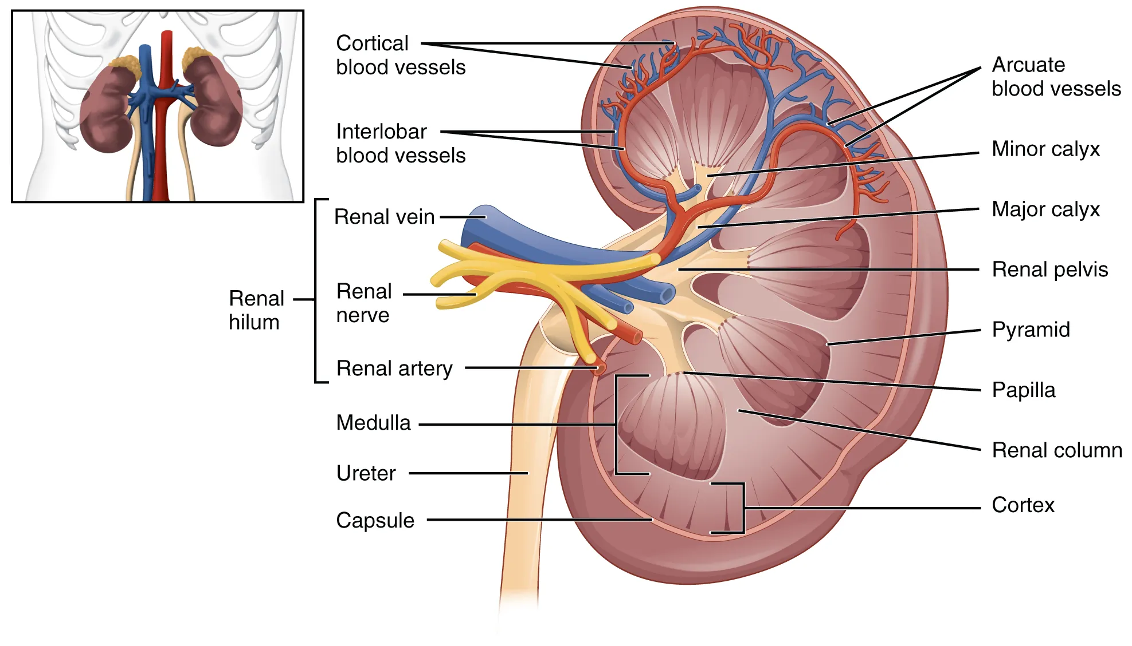
Figure 27.1: Kidney Anatomy & Core Functions
WHAT TO NOTICE
1. Clearing Wastes & Drugs
• Excretes urea, creatinine, metabolic acids, and water-soluble drugs; falling GFR causes uremia and drug toxicity.
2. Fluid, Electrolyte & Acid-Base Balance
• Regulates water, sodium, potassium, calcium, phosphate, and daily acid excretion—preventing hyperkalemia and metabolic acidosis.
3. Blood Pressure & Erythropoietin
• Controls extracellular volume and renin-angiotensin hormones, and secretes erythropoietin to stimulate bone marrow RBC production.
4. Active Vitamin D (Calcitriol) & Bone Health
• Converts vitamin D into active calcitriol needed for intestinal calcium absorption and bone mineralization.
CLINICAL LINK TO CKD COMPLICATIONS
When nephron mass is lost, all six functions slip together—explaining why kidney failure produces fluid overload, hyperkalemia, acidosis, hypertension, anemia, and mineral-bone disorder.
Figure 27.1 Frontal section of the left kidney showing the outer cortex, medullary pyramids, calyces, renal pelvis, and ureter (OpenStax, CC BY-NC-SA 4.0).
Medical-Surgical Nursing: A Canadian Open Text | Chapter 27: Acute Kidney Injury & CKD
4 / 28
Notes:
SLIDE 4 — FIGURE 27.1: KIDNEY ANATOMY & SIX CORE FUNCTIONS
• Trace urine flow on Figure 27.1 from the outer cortex and medullary pyramids through the minor and major calyces into the renal pelvis and ureter (NIDDK, 2018).
• Highlight the six core kidney functions and what happens when glomerular filtration rate (GFR) falls:
1) Clearing wastes (urea, creatinine, uric acid) and water-soluble medications.
2) Balancing water, sodium, potassium, calcium, and phosphate (Chapter 3).
3) Excreting daily metabolic acid loads to prevent metabolic acidosis (Section 3.7).
4) Regulating blood pressure via extracellular volume and the renin-angiotensin-aldosterone system (Chapter 19).
5) Producing erythropoietin to stimulate bone marrow red blood cell synthesis (Section 20.2).
6) Converting vitamin D into active calcitriol (1,25-dihydroxyvitamin D) to maintain bone mineralization (NIDDK, 2021).

Slide 5
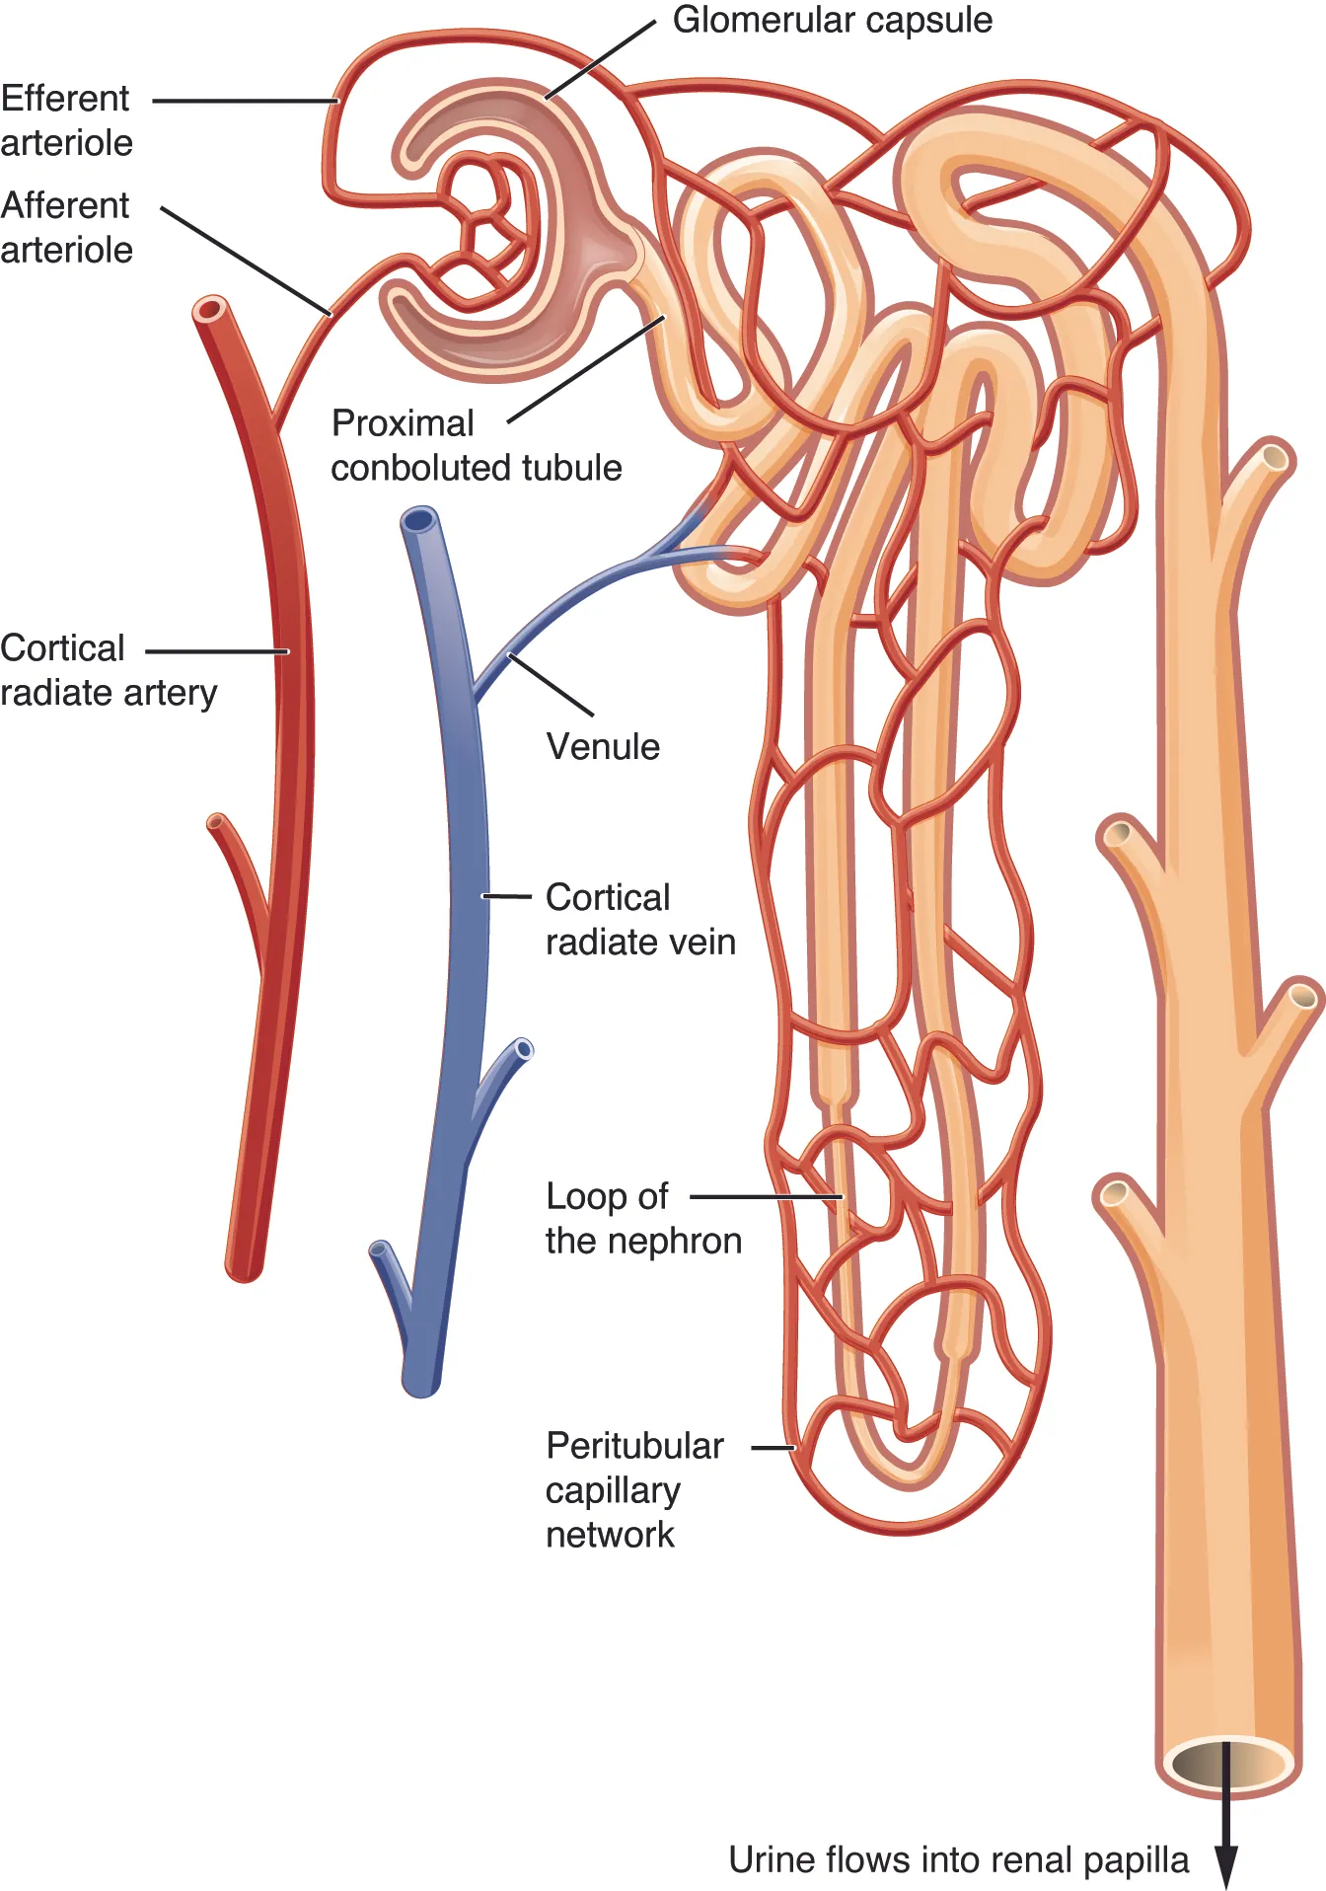
Figure 27.2: The Nephron & Race-Free eGFR
WHAT TO NOTICE
Glomerular Filtration & Tubular Reabsorption
• Each kidney contains ~1 million nephrons; glomeruli filter water and small solutes while retaining RBCs and albumin.
2021 Race-Free CKD-EPI Equation
• Reported in mL/min/1.73 m²; Canadian labs (e.g., Alberta Precision Labs, Jan 2026) use the race-free 2021 CKD-EPI formula per KDIGO.
Going Deeper: Muscle Mass & Sarcopenia Trap
• Creatinine comes from muscle—in frail older adults with sarcopenia, a 'normal' creatinine (e.g., 70 µmol/L) overestimates true GFR and risks drug overdose.
Unsteady State in AKI & Cystatin C
• Single eGFR values mislead when creatinine is rapidly changing in AKI; KDIGO advises combined creatinine + cystatin C when muscle mass skews results.
PHARMACIST PARTNERSHIP IN RENAL DRUG DOSING
For narrow-therapeutic-index drugs or frail patients, consult the pharmacist—some Canadian monographs still specify creatinine clearance (mL/min) rather than eGFR.
Figure 27.2 Blood is filtered in the glomerulus, and the tubule reclaims water and solutes into peritubular capillaries (OpenStax, CC BY-NC-SA 4.0).
Medical-Surgical Nursing: A Canadian Open Text | Chapter 27: Acute Kidney Injury & CKD
5 / 28
Notes:
SLIDE 5 — FIGURE 27.2: THE NEPHRON, RACE-FREE 2021 CKD-EPI eGFR & SARCOPENIA TRAP
• Each kidney contains roughly 1 million nephrons (Figure 27.2). The glomerulus filters plasma while retaining blood cells and albumin; the tubule reclaims needed water and solutes.
• Race-Free eGFR in Canada: Following KDIGO (2024a) and Parekh et al. (2022), Canadian laboratories have removed race coefficients and adopted the race-free 2021 CKD-EPI equation (Inker et al., 2021; implemented by Alberta Precision Laboratories on January 20, 2026).
• Licensure Review Link (Q7 [Core]): An 88-year-old woman weighing 44 kg has a serum creatinine of 70 µmol/L. Because creatinine derives from skeletal muscle, low muscle mass (sarcopenia) keeps serum creatinine deceptively low (c), causing creatinine-based eGFR to overestimate true kidney function and risking drug overdose. KDIGO recommends combined creatinine + cystatin C testing when muscle mass skews eGFR.

Slide 6
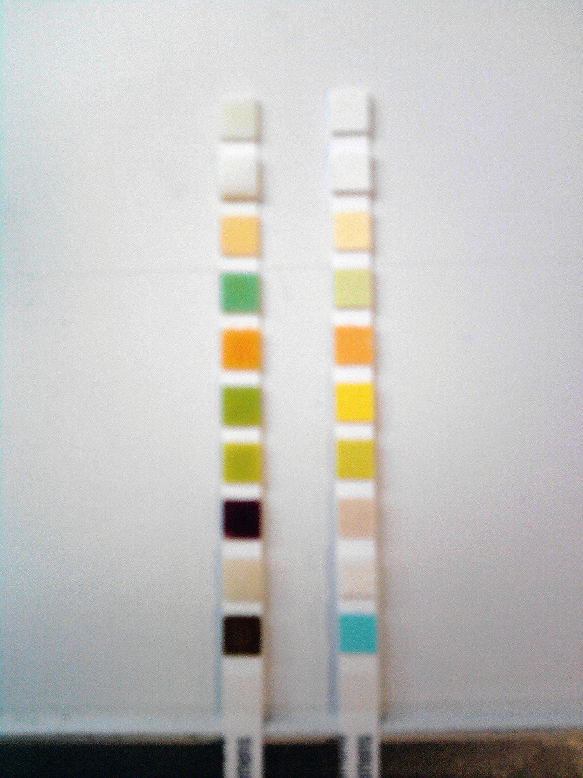
Figure 27.3: Kidney Tests, ACR & Urine Output
WHAT TO NOTICE
Serum Creatinine & Urea in SI Units
• Adult creatinine ~35–88 µmol/L (female) and 62–106 µmol/L (male); urea ~2.5–8.0 mmol/L. Compare every result with the patient's own baseline!
Urine Albumin-to-Creatinine Ratio (ACR, mg/mmol)
• Detects early glomerular damage while eGFR is still normal: KDIGO normal <3 mg/mmol; Diabetes Canada uses >=2.0 mg/mmol (2 of 3 samples over >=3 mo).
Urinalysis Dipstick & Sediment Microscopy
• Screens for protein, blood, glucose, and concentration; microscopy identifies dysmorphic RBCs, WBCs, and cellular/granular casts.
Hourly Urine Output (<0.5 mL/kg/h Threshold)
• Measure in a graduated container (never estimate by eye) and relate to weight: for a 70 kg adult, 0.5 mL/kg/h is 35 mL/h—report a 3–4 h low trend early!
TRANSIENT CAUSES OF ELEVATED URINE ACR
Urinary tract infection, recent vigorous exercise, menstruation, fever, or marked hyperglycemia/hypertension can transiently elevate a single ACR—always confirm with repeat testing.
Figure 27.3 Urine dipsticks showing pad colour changes compared against the container chart at the specified read time (J3D3, CC BY-SA 3.0).
Medical-Surgical Nursing: A Canadian Open Text | Chapter 27: Acute Kidney Injury & CKD
6 / 28
Notes:
SLIDE 6 — FIGURE 27.3: KIDNEY TESTS IN SI UNITS, URINE ACR & HOURLY URINE OUTPUT
• Typical adult SI intervals (University of Ottawa, 2022): serum creatinine ~35–88 µmol/L (females) and 62–106 µmol/L (males); serum urea ~2.5–8.0 mmol/L. Always compare against the patient's individual baseline.
• Urine Albumin-to-Creatinine Ratio (ACR, mg/mmol): KDIGO defines normal-to-mildly increased ACR as <3 mg/mmol (Levin et al., 2024). Diabetes Canada (Tobe et al., 2025) uses a lower threshold of >=2.0 mg/mmol and requires at least 2 of 3 abnormal ACR samples over >=3 months after excluding transient causes (UTI, exercise, menstruation, fever, marked hyperglycemia).
• Licensure Review Link (Q9 [Core]): Accurate urine output assessment requires measuring every void in a graduated container, recording the exact time, and calculating mL/kg/h against current weight (a)—never estimating by eye or waiting until shift end.

Slide 7
PART 2 | SECTION 27.2
Acute Kidney Injury (AKI):
Causes, Staging & Nursing Care
Prerenal, Intrinsic & Postrenal AKI, KDIGO Staging, Nephrotoxic Medications, Urgent Dialysis & CJMM
Key Focus: KDIGO (2012) diagnostic & staging criteria (Table 27.2); the 'Triple Whammy' (Lapi et al., 2013); Canadian contrast guidance (Macdonald et al., 2022); and CJMM Case (Grace Mensah).
7 / 28
Notes:
SLIDE 7 — PART 2 DIVIDER: ACUTE KIDNEY INJURY (SECTION 27.2)
• Section 27.2 covers prerenal, intrinsic, and postrenal AKI causes (Table 27.1), KDIGO diagnostic and staging criteria (Table 27.2), nephrotoxic medication stewardship, urgent dialysis triggers, and the Section 27.2 CJMM Case (Ms. Grace Mensah).

Slide 8
Prerenal, Intrinsic & Postrenal AKI (Table 27.1)
01
Prerenal AKI (Low Perfusion)
02
Intrinsic AKI (Renal Damage)
03
Postrenal AKI (Obstruction)
Common Causes
• Hemorrhage, vomiting, diarrhea, poor intake, hypotension, sepsis, heart failure, and 'triple whammy' drugs (diuretic + ACEi/ARB + NSAID).
Clinical Clues
• Hypovolemia (hypotension, tachycardia, dry mucosa, weight loss) with low, concentrated urine output.
Nursing Focus
• Report early, track strict I&O and daily weight, infuse prescribed isotonic crystalloids, and hold drugs lowering glomerular pressure.
Common Causes
• Acute tubular injury from prolonged ischemia or sepsis; nephrotoxins (NSAIDs, aminoglycosides, contrast if eGFR <30); glomerulonephritis.
Clinical Clues
• Rising creatinine with cellular/granular casts or hematuria on microscopy; urine output may be oliguric or normal.
Nursing Focus
• Medication review, timely aminoglycoside trough/peak levels, and close monitoring for fluid overload, hyperkalemia, and acidosis.
Common Causes
• Benign prostatic hyperplasia, calculi, pelvic tumours, blood clots, anticholinergic retention, or a kinked/blocked catheter.
Clinical Clues
• Anuria or severe oliguria, suprapubic discomfort, high bladder scan volume, or hydronephrosis on renal ultrasound.
Nursing Focus
• Inspect catheter tubing for kinks/clots, perform a bladder scan, relieve obstruction per order, and monitor for post-obstructive diuresis.
Medical-Surgical Nursing: A Canadian Open Text | Chapter 27: Acute Kidney Injury & CKD
8 / 28
Notes:
SLIDE 8 — PRERENAL, INTRINSIC & POSTRENAL AKI COMPARED (TABLE 27.1)
• KDIGO (2012) stresses identifying the specific cause of AKI rather than reflexively labelling every case 'prerenal'.
• Prerenal AKI: Reduced renal perfusion from hypovolemia (bleeding, vomiting, diarrhea), hypotension, sepsis, or heart failure, compounded by drugs that alter glomerular hemodynamics.
• Intrinsic AKI: Direct parenchymal injury—most often acute tubular injury from prolonged ischemia, sepsis, or nephrotoxins (aminoglycosides, NSAIDs, or iodinated contrast when eGFR <30 mL/min/1.73 m²).
• Postrenal AKI: Outflow obstruction from BPH, calculi, clots, tumours, or a kinked catheter.
• Licensure Review Link (Q10 [Core]): A 76-year-old man with 8 hours of anuria, suprapubic discomfort, and a bladder scan of 850 mL has postrenal AKI from blocked urine outflow (d).

Slide 9
KDIGO AKI Staging & Medication Safety
KDIGO AKI Definition & Stages 1–3 (Table 27.2)
Clinical Safety: Protecting Kidneys From Drugs
Diagnostic Threshold (Any 1 of 3 Criteria)
• 1) Cr rise >=26.5 µmol/L within 48 h; 2) Cr >=1.5× baseline within 7 days; OR 3) urine output <0.5 mL/kg/h for 6 hours.
Stage 1 vs. Stage 2 AKI
• Stage 1: Cr 1.5–1.9× baseline (or +>=26.5 µmol/L) OR output <0.5 mL/kg/h for 6–12 h. Stage 2: Cr 2.0–2.9× baseline OR output <0.5 mL/kg/h for >=12 h.
Stage 3 AKI (Assign Highest Stage Reached)
• Cr >=3.0× baseline, Cr >=353.6 µmol/L, initiation of dialysis, OR output <0.3 mL/kg/h for >=24 h (or anuria for >=12 h).
Avoid NSAIDs & The 'Triple Whammy' (Lapi, 2013)
• Adding an NSAID to a diuretic + ACEi/ARB spikes AKI risk (highest in first 30 days); Choosing Wisely Canada advises against NSAIDs in HTN, HF, or CKD.
Canadian Contrast Guidance (Macdonald, 2022)
• Consider IV fluid prophylaxis and holding metformin ONLY when eGFR <30 mL/min/1.73 m²; never delay an emergency CT scan waiting for creatinine.
Sick-Day Rules & Documented Restart Plan
• Temporarily hold SADMANS drugs (SGLT2i, ACEi, Diuretics, Metformin, ARBs, NSAIDs, Sulfonylureas) during dehydrating illness and document a clear restart plan.
CJMM CASE: MS. GRACE MENSAH (79, 60 KG): After 3 d of emesis/diarrhea on ramipril + furosemide + ibuprofen, 4-h urine is 60 mL (0.25 mL/kg/h) and Cr is 142 (baseline 88): bladder scan (70 mL), escalate via SBAR before 6 h, start isotonic IV fluids, and stop/hold all 3 drugs.
Medical-Surgical Nursing: A Canadian Open Text | Chapter 27: Acute Kidney Injury & CKD
9 / 28
Notes:
SLIDE 9 — KDIGO AKI STAGING (TABLE 27.2), MEDICATION SAFETY & CJMM CASE (MS. GRACE MENSAH)
• Licensure Review Links:
– Q11 [Core]: KDIGO defines AKI by a creatinine rise >=26.5 µmol/L within 48 h, >=1.5× baseline within 7 days, or urine output <0.5 mL/kg/h for 6 h; a creatinine rise from 80 to 110 µmol/L (+30 µmol/L) in 36 hours meets the definition (c).
– Q13 [Core]: Per Canadian Association of Radiologists guidance (Macdonald et al., 2022), preventive IV fluids and holding metformin are considered only when eGFR is <30 mL/min/1.73 m² (e.g., eGFR 25) (d); emergency CT scans are never delayed.
– Q14 [Core, SATA]: High-risk AKI exposures/susceptibilities include the 'triple whammy' (furosemide + ramipril + ibuprofen; Lapi et al., 2013) (a), aminoglycosides (b), severe diarrhea/poor intake (c), sepsis with hypotension (e), and CKD with major surgery (f).
– Q19 [RN]: Baseline Cr 90 µmol/L rising to 280 µmol/L (3.1× baseline) with 10 h of output at 0.4 mL/kg/h is staged at the highest criterion reached = KDIGO Stage 3 (c).

Slide 10
AKI Nursing Care, Urgent Dialysis & Recovery
Fluid Balance Swing & Isotonic Crystalloids
• KDIGO suggests isotonic crystalloids (not albumin) for hypovolemia and advises against diuretics to treat AKI except to manage volume overload.
• 1 L of fluid equals ~1 kg body weight; once oliguria sets in, fluid therapy can rapidly tip the patient into pulmonary edema (crackles, hypoxia).
Hyperkalemia Emergency Sequence (Section 3.5)
• For K+ >=6.0 mmol/L with ECG changes (peaked T waves, wide QRS): 1) IV calcium gluconate first to stabilize myocardium; 2) IV insulin + dextrose to shift K+ into cells; 3) potassium binder (e.g., sodium zirconium cyclosilicate) or dialysis to remove K+.
Post-Obstructive Diuresis & 3-Month Follow-Up
• Relief of urinary obstruction can trigger diuresis >200 mL/h for >=2 consecutive hours—monitor closely for hypovolemia and electrolyte depletion.
• ~30% of AKI survivors face long-term CKD/CVD risk—book a 3-month kidney follow-up (missed in 27 of 31 ED patients in Scheuermeyer et al., 2017).
URGENT KRT (BAGSHAW, 2021)
When to Start Acute Dialysis
Refractory Fluid Overload
• Pulmonary edema compromising oxygenation despite diuretic therapy.
Refractory Hyperkalemia & Acidosis
• Persistent K+ >=6.0 mmol/L after medical shifting/binders, or severe metabolic acidosis (pH <7.20 or HCO3- <12 mmol/L).
Uremic Complications & Toxins
• Uremic pericarditis, encephalopathy, bleeding, or dialyzable poisonings (salicylates, methanol, ethylene glycol, metformin).
Medical-Surgical Nursing: A Canadian Open Text | Chapter 27: Acute Kidney Injury & CKD
10 / 28
Notes:
SLIDE 10 — AKI NURSING CARE, URGENT DIALYSIS INDICATIONS & RECOVERY
• Fluid resuscitation in hypovolemic AKI uses isotonic crystalloids rather than colloids (KDIGO, 2012). Diuretics do not prevent or treat AKI and are used only for volume overload.
• Licensure Review Links:
– Q12 [Core]: When an RPN notes post-op urine output of 10 mL/h for 3 hours and K+ 6.3 mmol/L, the RPN assesses the patient and escalates at once to the RN and surgical team using SBAR (a)—never waiting for the 6-hour mark.
– Q20 [RN]: Urgent dialysis indications (Bagshaw et al., 2021) include refractory fluid overload with hypoxia, severe acidosis (pH <7.20 or HCO3- <12 mmol/L), uremic pericarditis/encephalopathy, or persistent K+ >=6.0 mmol/L (e.g., 6.4 mmol/L) despite medical shifting and binders (a).
• Post-obstructive diuresis (>200 mL/h for >=2 consecutive hours; Khara et al., 2019) requires close volume/electrolyte replacement, and all AKI survivors need a 3-month kidney follow-up.

Slide 11
PART 3 | SECTION 27.3
Chronic Kidney Disease (CKD):
Staging, Complications & Care
KDIGO 2024 CGA Classification, Systemic Complications, Renoprotective Pharmacology, Diet & Vaccines
Key Focus: Kidney Foundation of Canada (2025) projections; G1–G5 & A1–A3 staging; Figure 27.4; CKD-MBD & anemia; SGLT2i, ACEi/ARB & finerenone (Medications Box); and older adult care (Lifespan Considerations Box).
11 / 28
Notes:
SLIDE 11 — PART 3 DIVIDER: CHRONIC KIDNEY DISEASE (SECTION 27.3)
• Section 27.3 presents the KDIGO (2024) Cause-GFR-Albuminuria (CGA) classification, systemic CKD complications, renoprotective pharmacology (Medications Box), diet and immunization guidance, and older adult considerations (Lifespan Considerations Box).

Slide 12
Chronic Kidney Disease in Canada & KDIGO Staging
CKD is a kidney structure or function abnormality lasting >3 months (KDIGO, 2024):
1 in 10
G1 to G5
A1 to A3
Canadians Living With CKD
Six eGFR Categories (mL/min)
Three Albuminuria Categories
4.5 million Canadians in 2024, projected to exceed 6.2 million by 2050; >50,000 have kidney failure (diabetes is the #1 cause at 36%).
G1 >=90; G2 60–89 (CKD only if damage marker present); G3a 45–59; G3b 30–44; G4 15–29 (severely decreased); G5 <15 (kidney failure).
Based on urine ACR: A1 <3 mg/mmol (normal/mild); A2 3–30 mg/mmol (moderately increased); A3 >30 mg/mmol (severely increased).
CONFIRMING CHRONICITY & NEPHROLOGY REFERRAL
Always rule out AKI and confirm a low eGFR (<60) or elevated ACR (>=3 mg/mmol) with repeat testing after 3 months. Diabetes Canada (2025) recommends annual eGFR + ACR screening and nephrology referral when 5-year Kidney Failure Risk Equation (KFRE) is >=5%.
Medical-Surgical Nursing: A Canadian Open Text | Chapter 27: Acute Kidney Injury & CKD
12 / 28
Notes:
SLIDE 12 — CHRONIC KIDNEY DISEASE IN CANADA & KDIGO CGA STAGING
• CKD is defined by markers of kidney damage (such as ACR >=3 mg/mmol, hematuria/sediment abnormalities, structural imaging findings, or prior transplant) OR eGFR <60 mL/min/1.73 m² persisting for >3 months (KDIGO CKD Work Group, 2024).
• Diabetes is the leading cause of kidney failure in Canada (36%; Kidney Foundation of Canada, 2022). Diabetes Canada (Tobe et al., 2025) recommends annual eGFR + urine ACR screening and nephrology referral when the 5-year Kidney Failure Risk Equation (KFRE) is >=5%.
• Licensure Review Links:
– Q8 [Core]: A persistent urine ACR of 12 mg/mmol over 4 months is classified as KDIGO category A2 (3–30 mg/mmol, moderately increased) (b).
– Q15 [Core]: A persistent eGFR of 52 mL/min/1.73 m² over 4 months is classified as KDIGO category G3a (45–59 mL/min/1.73 m², mildly to moderately decreased) (b).

Slide 13
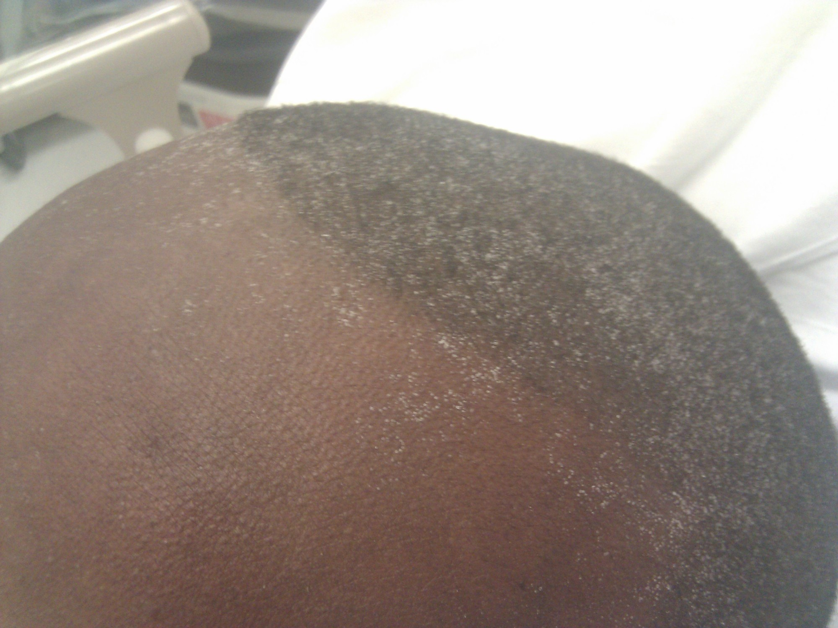
Figure 27.4: CKD Complications & Uremic Frost
WHAT TO NOTICE
Uremic Symptoms & Uremic Frost
• Fatigue (~70%), pruritus (~46%), anorexia, and nausea are common in advanced CKD; uremic frost is a rare sign of severe untreated uremia.
Anemia of CKD (CSN Choosing Wisely, 2025)
• Caused by erythropoietin deficiency and iron loss; inspect conjunctivae and oral mucosa on all skin tones. Treat with iron + ESAs without targeting a normal Hb.
CKD–Mineral and Bone Disorder (CKD-MBD)
• Phosphate retention + low calcitriol -> hypocalcemia -> secondary hyperparathyroidism -> bone resorption (renal osteodystrophy) and vascular calcification.
Cardiovascular Risk, Acidosis & Hyperkalemia
• CVD is the leading cause of death; manage metabolic acidosis (keep HCO3- in normal range) and use potassium binders so RAASi therapy can continue.
SYMPTOM ASSESSMENT AT EVERY VISIT (KDIGO, 2024)
Directly ask patients about fatigue, itching, appetite, nausea, and sleep at every clinic or inpatient encounter, and inspect skin under good lighting for dryness and excoriations.
Figure 27.4 Uremic frost on the forehead and scalp of a young Black man: crystallized urea left on skin after sweat evaporates (Fythrion, CC BY-SA 3.0).
Medical-Surgical Nursing: A Canadian Open Text | Chapter 27: Acute Kidney Injury & CKD
13 / 28
Notes:
SLIDE 13 — FIGURE 27.4: CKD COMPLICATIONS & UREMIC FROST
• Figure 27.4 illustrates uremic frost—crystallized urea deposited on the forehead and scalp after sweat evaporates in severe untreated uremia.
• Even before end-stage uremia, KDIGO (2024b) reports fatigue (~70%) and pruritus/itch (~46%) as the most prevalent symptoms; nurses directly ask about appetite, nausea, fatigue, and itch at every visit.
• Anemia of CKD: Assess conjunctivae and oral mucosa across all skin tones (Pusey-Reid et al., 2023). Per Canadian Society of Nephrology Choosing Wisely recommendations (2025), erythropoiesis-stimulating agents (ESAs) should not target a normal hemoglobin.
• Licensure Review Link (Q18 [Core]): If an inpatient with CKD G4 develops acute dyspnea, bilateral crackles, SpO2 89%, and a 3 kg weight gain, the RPN stays with the patient, sits them upright, and immediately calls the RN and physician/rapid response team (d).

Slide 14
Slowing CKD Progression: BP, Diet & Vaccines
Blood Pressure, Renoprotective Pillars & Lifestyle
Nutrition, Vaccines & Transition Planning
Standardized Systolic BP Target (<120 mm Hg)
• KDIGO (2024) suggests standardized office SBP <120 mm Hg when tolerated; individualize targets in frail older adults or orthostatic hypotension.
Four Renoprotective Drug Pillars in T2D + CKD
• 1) ACEi or ARB (never combine both); 2) SGLT2 inhibitor (start if eGFR >=20; continue until dialysis); 3) finerenone (if eGFR >25 & normal K+); 4) GLP-1 RA.
Physical Activity & Tobacco Cessation
• Build up to >=150 minutes/week of moderate physical activity and support complete tobacco cessation.
Dietitian-Guided Plant-Forward Nutrition
• Target protein 0.8 g/kg/day in G3–G5 (avoid >1.3 g/kg/day), limit sodium <2 g/day, and favour plant-based over ultra-processed foods (highly absorbable K+/PO4).
Immunization Priorities (PHAC, 2026)
• Annual influenza and COVID-19 vaccines, pneumococcal conjugate vaccine, higher-dose Hepatitis B series (check anti-HBs titres), and RSV vaccine if age >=65.
Early Shared KRT / CKM Education
• Teach patients their eGFR, ACR, and BP numbers; avoid PICC lines and unnecessary venipunctures in G3–G5 to preserve arm veins for future AV fistula creation.
EXPECTED EGFR DIP RULE: A rise in creatinine up to 30% within 4 weeks of starting an ACEi, ARB, or SGLT2i reflects expected glomerular pressure reduction—continue the drug unless rise exceeds >30%!
Medical-Surgical Nursing: A Canadian Open Text | Chapter 27: Acute Kidney Injury & CKD
14 / 28
Notes:
SLIDE 14 — SLOWING CKD PROGRESSION: BLOOD PRESSURE, DIET & VACCINES
• Blood Pressure & Renoprotective Drugs: KDIGO (2024) suggests a standardized office systolic BP target <120 mm Hg when tolerated. First-line therapy includes an ACE inhibitor or ARB (never combined) for albuminuria, plus an SGLT2 inhibitor (started at eGFR >=20 mL/min/1.73 m² and continued until dialysis; Levin et al., 2024; Tobe et al., 2025), finerenone (when eGFR >25 and K+ is normal), and GLP-1 receptor agonists.
• Licensure Review Links:
– Q16 [Core]: A creatinine rise from 120 to 138 µmol/L (+15%) 2 weeks after starting ramipril with K+ 5.0 mmol/L is an expected hemodynamic dip; continue ramipril unless creatinine rises >30% within 4 weeks (c).
– Q17 [Core]: KDIGO nutrition guidance targets protein 0.8 g/kg/day in G3–G5 (avoiding >1.3 g/kg/day), sodium <2 g/day, and more plant-based foods with fewer ultra-processed foods containing highly absorbable potassium and phosphate additives (a).

Slide 15
CKD Pharmacology & Older Adult Care
ACE Inhibitors (Ramipril) & ARBs (Candesartan)
First-line for albuminuria (never combine ACEi + ARB). Check BP, creatinine, and K+ within 2–4 weeks of initiation or dose increase; continue unless Cr rises >30%; hold on sick days.
OLDER ADULTS (LIFESPAN BOX)
1
Lifespan Considerations
SGLT2 Inhibitors (Dapagliflozin) & Finerenone
SGLT2i slows CKD progression down to eGFR 20 (teach perineal hygiene, watch for euglycemic DKA, hold on sick days). Finerenone reduces albuminuria in T2D—monitor serum K+ closely.
Sarcopenia & Overdosing Risk
• Low muscle mass keeps serum creatinine deceptively low; always verify renal drug dosing with the pharmacist.
Falls, Orthostasis & Delirium
• Renally cleared opioids/sedatives accumulate; check orthostatic BP and avoid overly strict BP targets that trigger falls.
Aligning Care With Priorities
• Discuss KRT vs. Conservative Kidney Management (CKM) early based on the older adult's goals and functional status.
2
ESAs (Darbepoetin Alfa) & IV Iron Sucrose
Correct iron deficiency first; ESAs treat symptomatic renal anemia but must NOT target a normal hemoglobin (increases stroke, thrombosis, and cardiovascular risk).
3
Phosphate Binders (Sevelamer) & Calcitriol
Take sevelamer WITH meals to bind dietary phosphate (space interacting oral drugs >=1 h before or 3 h after). Calcitriol replaces active vitamin D—monitor serum Ca2+ and PO4.
4
Medical-Surgical Nursing: A Canadian Open Text | Chapter 27: Acute Kidney Injury & CKD
15 / 28
Notes:
SLIDE 15 — CKD PHARMACOLOGY (MEDICATIONS BOX) & OLDER ADULTS (LIFESPAN BOX)
• Review key nursing administration and monitoring principles from the Chapter 27 Medications Box:
– ACE inhibitors (ramipril) & ARBs (candesartan): Check BP, Cr, and K+ within 2–4 weeks; hold on sick days (Section 22.6).
– SGLT2 inhibitors (dapagliflozin, empagliflozin): Teach genital hygiene; monitor for euglycemic ketoacidosis; hold on sick days.
– Phosphate binders (sevelamer; Sanofi-aventis Canada, 2026): Must be taken WITH meals to bind dietary phosphate in the gut; space interacting oral medications >=1 hour before or 3 hours after.
– Potassium binders (sodium zirconium cyclosilicate): Enable continuation of lifesaving RAASi therapy (Levin et al., 2024).
• Older Adults (Lifespan Considerations Box): Watch for sarcopenia masking low GFR (Q7), accumulation of renally cleared opioids/sedatives, orthostatic hypotension, and align KRT vs. CKM with patient priorities.

Slide 16
PART 4 | SECTION 27.4
Dialysis: Hemodialysis, Vascular
Access & Peritoneal Dialysis
Choosing KRT in Canada, AV Fistula/Graft Surveillance, Intradialytic Shifts & ISPD Peritonitis Protocol
Key Focus: CIHI CORR (2025) Canadian dialysis statistics; Figure 27.5; AV fistula Look-Feel-Listen exam; Teresa Bouchard RPN Practice Story; Table 27.3; and ISPD (2022) cloudy effluent steps.
16 / 28
Notes:
SLIDE 16 — PART 4 DIVIDER: DIALYSIS — HEMODIALYSIS, VASCULAR ACCESS & PERITONEAL DIALYSIS (SECTION 27.4)
• Section 27.4 examines Canadian Organ Replacement Register (CORR) dialysis statistics, shared decision-making across the five KRT/CKM pathways, hemodialysis principles and vascular access protection, and peritoneal dialysis exchange and peritonitis protocols.

Slide 17
Kidney Replacement Therapy in Canada (CORR)
CIHI Canadian Organ Replacement Register 2024 benchmarks (excluding Quebec):
30,213
88.4%
28.6%
Canadians on Dialysis (2024)
Start HD With a Central Catheter
Late Nephrology Referrals (<90d)
77.7% received in-centre hemodialysis, 11.4% automated PD, 6.8% CAPD, and 4.1% home hemodialysis (plus 19,940 living with a functioning transplant).
Up from 82.4% in 2015, while incident AV fistula use fell to 10.6%—highlighting the need to protect arm veins in G3–G5 and avoid late referral.
Nearly 3 in 10 patients starting dialysis saw a nephrologist <90 days beforehand, leaving little time for fistula maturation (4–6+ wk) or home training.
SHARED DECISION-MAKING ACROSS FIVE PATHS
Patients approaching kidney failure weigh five paths with decision aids: 1) In-centre HD, 2) Home HD, 3) Peritoneal dialysis (CAPD/APD), 4) Pre-emptive or post-dialysis kidney transplant, and 5) Conservative kidney management (CKM).
Medical-Surgical Nursing: A Canadian Open Text | Chapter 27: Acute Kidney Injury & CKD
17 / 28
Notes:
SLIDE 17 — KIDNEY REPLACEMENT THERAPY IN CANADA (CIHI CORR, 2025a)
• At the end of 2024 (excluding Quebec), 30,213 Canadians were receiving dialysis (77.7% in-centre HD, 11.4% APD, 6.8% CAPD, 4.1% home HD) and 19,940 were living with a functioning kidney transplant (CIHI, 2025a).
• Among incident dialysis patients in 2024, 88.4% started hemodialysis with a central venous catheter (up from 82.4% in 2015) while AV fistula starts fell to 10.6%, and 28.6% were referred to nephrology <90 days before starting dialysis.
• Vessel Preservation Rule (KDOQI; Lok et al., 2020): In patients with CKD G3–G5, protect arm veins for future fistula creation by avoiding PICC lines and unnecessary venipunctures.

Slide 18
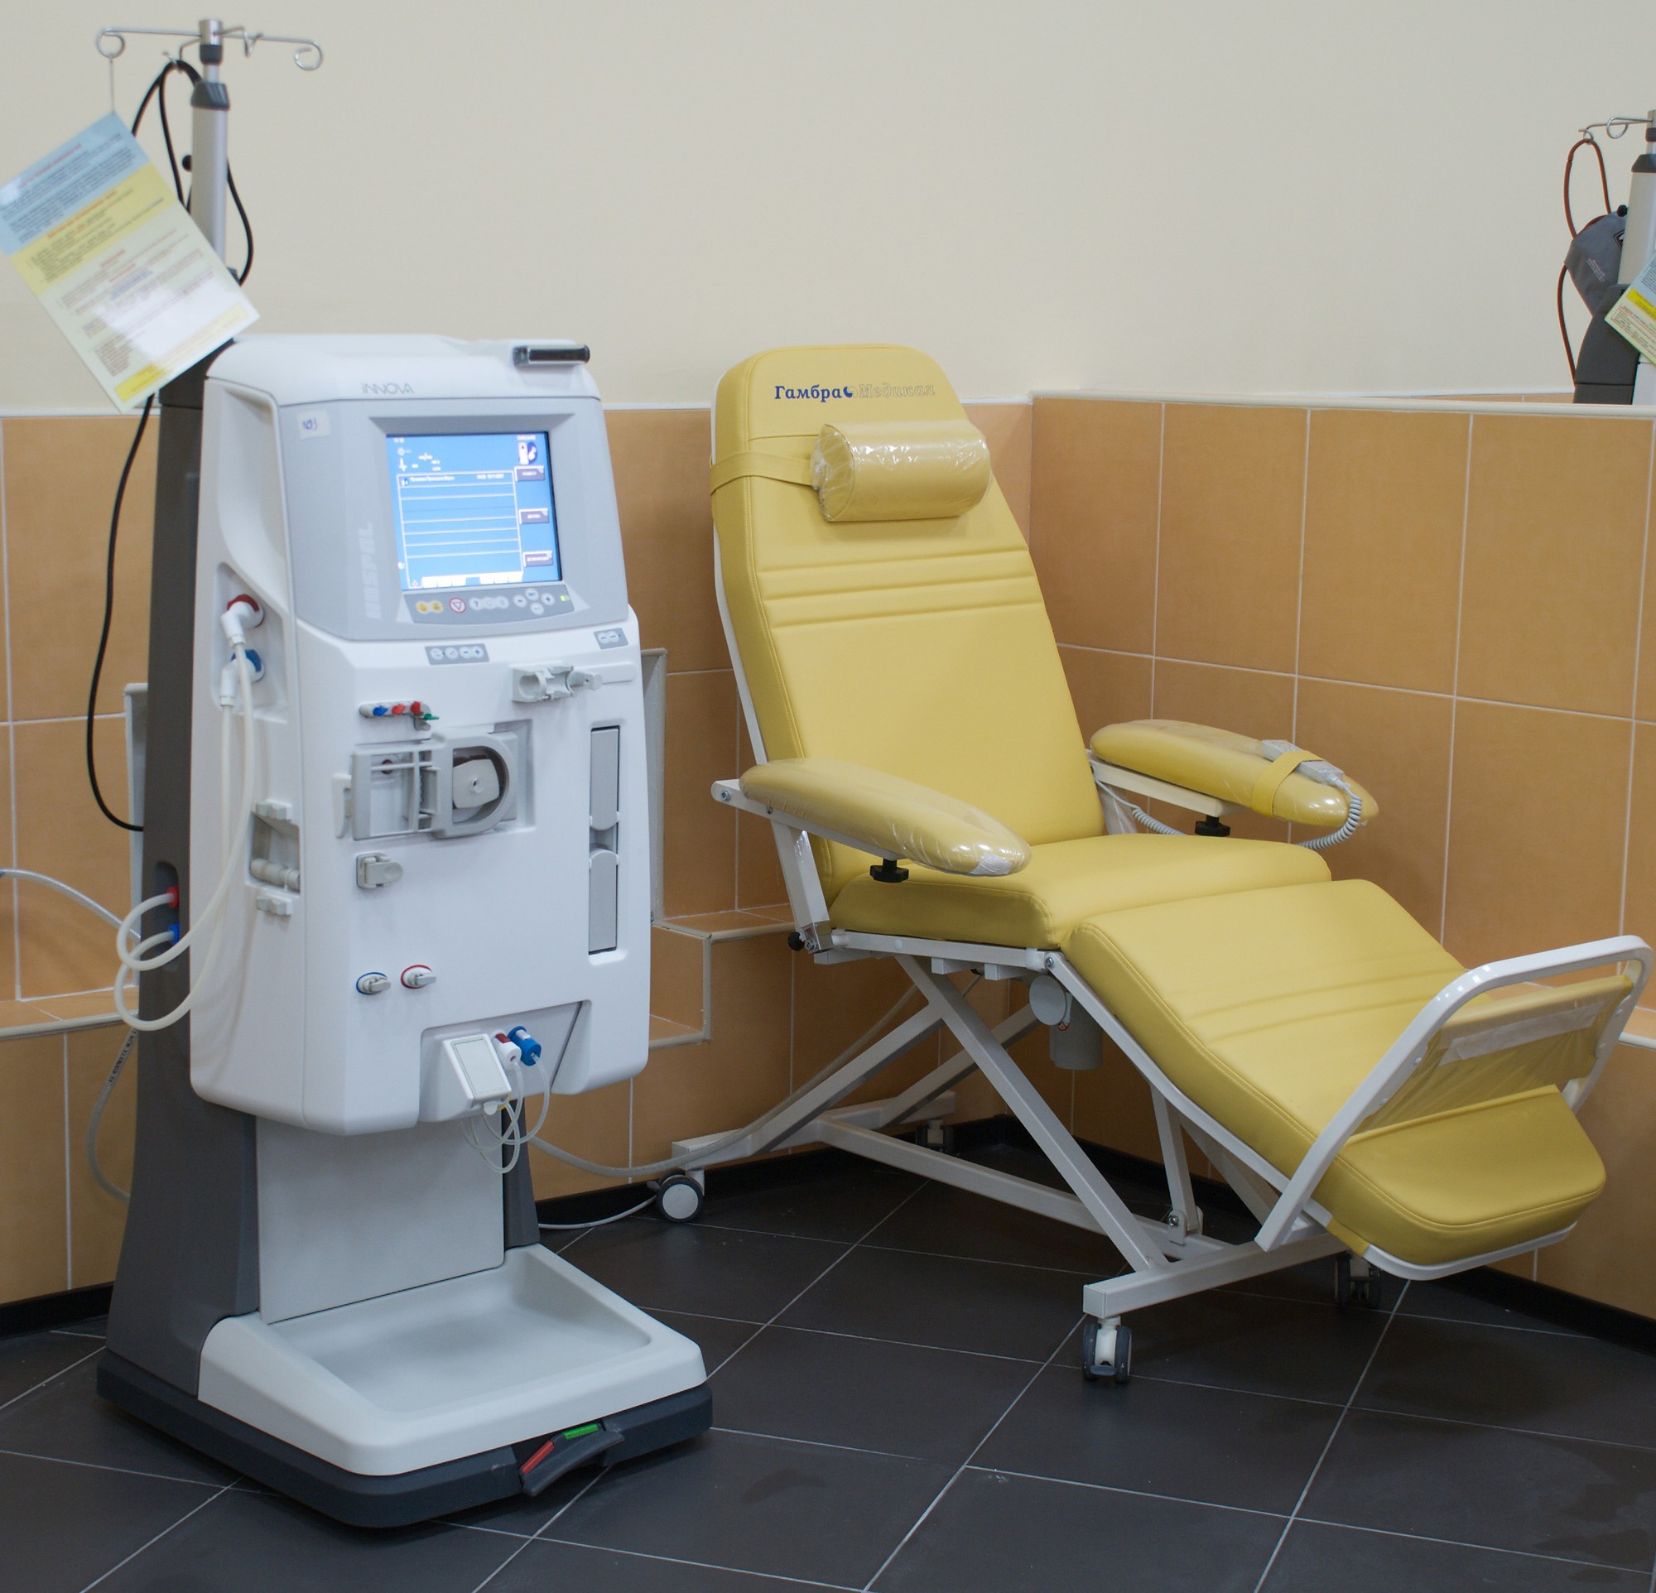
Figure 27.5: Hemodialysis & Fluid/Solute Shifts
WHAT TO NOTICE
Diffusion & Ultrafiltration Principles
• Urea and potassium diffuse across the semipermeable dialyzer membrane into dialysate; hydrostatic pressure (ultrafiltration) removes excess water.
Pre- and Post-Dialysis Nursing Care
• Weigh on the same scale before/after, check BP on non-access arm, verify which antihypertensives/water-soluble drugs to hold, and assist slowly to stand.
Intradialytic Hypotension (Going Deeper)
• Large interdialytic weight gain requires rapid ultrafiltration that outpaces vascular refilling (worsened by pre-HD BP meds), causing hypotension, cramps, and nausea.
Dialysis Disequilibrium Syndrome (Mistry, 2019)
• Rapid urea removal during initial HD treatments draws water into the brain, causing headache, nausea/vomiting, restlessness, confusion, or seizures.
POST-DIALYSIS NEEDLE-SITE BLEEDING
Inspect access needle sites after treatment; if bleeding occurs, apply light direct pressure for ~10 minutes (20 minutes at home) without occluding fistula flow, and report persistent bleeding immediately.
Figure 27.5 A hemodialysis machine beside a treatment chair; the blood pump circulates blood through the dialyzer (Vitaly Pospelov, CC BY-SA 3.0).
Medical-Surgical Nursing: A Canadian Open Text | Chapter 27: Acute Kidney Injury & CKD
18 / 28
Notes:
SLIDE 18 — FIGURE 27.5: HEMODIALYSIS PRINCIPLES, FLUID SHIFTS & POST-DIALYSIS CARE
• In hemodialysis (Figure 27.5; PRHC, 2024), solutes (urea, potassium) diffuse across the semipermeable dialyzer membrane while hydrostatic pressure (ultrafiltration) removes excess fluid.
• Licensure Review Links:
– Q28 [Core]: When a patient returns from hemodialysis, bright red blood soaking through a needle-site dressing takes highest priority (d)—apply light direct pressure for ~10 minutes and report if bleeding persists (Kidney Foundation of Canada, 2020).
– Q29 [Core]: When an antihypertensive is due at 0800 before an 0900 hemodialysis run, check with the prescriber or dialysis unit whether to give or hold it (c).
– Q38 [RN]: A patient with a 4.5 kg interdialytic weight gain who took a pre-HD antihypertensive and drops BP from 148/86 to 84/50 mm Hg with cramps and nausea has intradialytic hypotension because ultrafiltration outpaces vascular refilling from tissues (a) (Chou et al., 2017).

Slide 19
Vascular Access Assessment & Protection
AV Fistula vs. AV Graft vs. Central Venous Catheter
• AV fistula (surgical artery-to-vein anastomosis) has the lowest infection/thrombosis rates and longest patency but needs 4–6+ weeks to mature.
• Tunnelled central venous catheters are direct lines to the heart—reserved strictly for trained dialysis staff except in a life-threatening emergency.
Look, Feel & Listen Access Assessment Every Shift
• LOOK: inspect in good ambient light for redness, swelling, pus, aneurysm skin thinning, or a cold/pale/numb hand ('steal syndrome').
• FEEL: palpate for a soft, continuous buzzing THRILL; LISTEN: auscultate for a low-pitched, continuous whooshing BRUIT.
• EMERGENCY: Absent thrill and absent bruit (or a high-pitched systolic-only bruit) indicates thrombosis/stenosis—notify the dialysis team AT ONCE!
PRACTICE STORY (RPN)
Ms. Teresa Bouchard, RPN & Mr. Arsenault
Absolute Limb Protection Rule
• NEVER perform blood pressures, venipunctures, or IV starts on an AV fistula or graft arm (Health PEI, 2022).
System-Level Safeguards
• Post the bedside limb-alert sign, record access location on the handover tool and whiteboard, and review at safety huddles.
Patient & Family Self-Advocacy
• Encourage carrying the access wallet card, checking the thrill daily, avoiding tight sleeves/watches or sleeping on the arm, and speaking up.
Medical-Surgical Nursing: A Canadian Open Text | Chapter 27: Acute Kidney Injury & CKD
19 / 28
Notes:
SLIDE 19 — VASCULAR ACCESS ASSESSMENT (LOOK, FEEL, LISTEN) & LIMB PROTECTION
• Every shift, assess an AV fistula or graft by Looking (redness, pus, aneurysm skin thinning, or hand ischemia/'steal'), Feeling (soft, continuous thrill), and Listening (low-pitched, continuous whooshing bruit; Lok et al., 2020; Salman & Beathard, 2013).
• Practice Story (Ms. Teresa Bouchard, RPN & Mr. Lucien Arsenault): Highlights bedside limb-alert signage, handover communication, and patient self-advocacy.
• Licensure Review Links:
– Q25 [Core]: Expected AV fistula finding is a low-pitched, continuous whooshing bruit with a soft vibration (thrill) along the access (b).
– Q26 [Core]: Never take BP, draw blood, or start an IV in a fistula arm, even if the opposite arm is bruised (c) (Health PEI, 2022).
– Q27 [Core]: Absent thrill and bruit at 0600 (present at 2200) indicates possible thrombosis—report to the dialysis team or prescriber at once (a).
– Q31 [Core]: Leave a tunnelled IJ dialysis catheter strictly for trained dialysis staff (except in a life-threatening emergency) and seek peripheral/IV team access (d).
– Q37 [Core, SATA]: Fistula teaching includes daily thrill checks (a), no tight watches/sleeves (b), not sleeping on the arm (d), reporting redness/pain/thrill change (e), and 10-min light needle-site pressure post-HD (f).

Slide 20
Peritoneal Dialysis & Peritonitis Care (ISPD)
Peritoneal Dialysis Principles & Exit-Site Care
ISPD (2022) PD-Related Peritonitis Protocol
CAPD vs. Automated Peritoneal Dialysis (APD)
• Uses the peritoneal membrane as the filter via fill, dwell, and drain exchanges: manual daytime exchanges (CAPD) or overnight cycler (APD).
Dialysate Glucose & Fluid Balance
• Hypertonic glucose draws water across the peritoneum; monitor blood glucose closely in diabetes and report poor drain volume or weight gain.
Daily Exit-Site Care & Bathing Rules
• Wash hands before/after exchanges, keep dressing dry, apply prescribed topical antibiotic cream, never pick scabs, and avoid soaking in baths (TOH, 2015).
Diagnostic Criteria (Need >=2 of 3 Features)
• 1) Abdominal pain or cloudy effluent; 2) effluent WBC >100/µL (0.1 × 10⁹/L) with >50% neutrophils after >=2 h dwell; 3) positive effluent culture.
Golden Rule: Cloudy Effluent = Peritonitis
• Treat cloudy effluent as peritonitis until proven otherwise (and consider peritonitis even with clear effluent if abdominal pain is present).
Immediate Specimen & Antibiotic Sequence
• Notify PD unit at once, send effluent within 6 h for cell count, Gram stain, and blood-culture bottles, and start intraperitoneal antibiotics immediately after sampling.
CONTAMINATION ACTION RULE: If a break in sterile technique occurs during an exchange (e.g., pet touches tubing or cap falls off), do NOT wait for symptoms—contact the PD unit immediately for prophylaxis!
Medical-Surgical Nursing: A Canadian Open Text | Chapter 27: Acute Kidney Injury & CKD
20 / 28
Notes:
SLIDE 20 — PERITONEAL DIALYSIS & ISPD (2022) PERITONITIS PROTOCOL
• Peritoneal dialysis uses the peritoneal membrane as an internal filter via manual daytime exchanges (CAPD) or an overnight cycler (APD). Dialysate glucose is partially absorbed, requiring close glycemic monitoring in diabetes (Law & Davenport, 2021).
• Exit-Site Care (Li et al., 2022; TOH, 2015): Perform strict hand hygiene, keep dressing dry, apply prescribed topical antibiotic cream, never pick crusts/scabs, and never soak the exit site in a bath.
• ISPD 2022 Peritonitis Criteria (Li et al., 2022) & Case 2 (Mr. Daniel Osei, Q21–Q24):
– Diagnose peritonitis when >=2 of 3 criteria are present: 1) abdominal pain or cloudy effluent; 2) effluent WBC >100/µL (0.1 × 10⁹/L) with >50% neutrophils after >=2 h dwell; 3) positive effluent culture.
– Treat cloudy effluent as peritonitis until proven otherwise (Q21 [c]), notify the PD unit at once and save the cloudy bag for Gram stain, cell count, and culture (Q22 [a]), start empirical intraperitoneal antibiotics immediately after sampling without waiting for culture results (Q23 [d]), and contact the PD unit immediately if tubing contamination occurs (e.g., pet contact) (Q24 [b]).

Slide 21
Hemodialysis vs. Peritoneal Dialysis (Table 27.3)
Side-by-side comparison to support shared KRT decision-making and inpatient nursing care:
HD Filter & Access: External dialyzer filter; uses AV fistula (preferred), AV graft, or tunnelled central venous catheter.
PD Filter & Access: Peritoneal membrane acts as internal filter; uses a soft silicone catheter through the abdominal wall.
HD Schedule & Setting: Usually 3+ sessions/week (~4+ h each) in a dialysis unit (77.7%), or home hemodialysis (4.1%).
PD Schedule & Setting: Done daily at home via manual daytime exchanges (CAPD, 6.8%) or overnight cycler (APD, 11.4%).
HD Primary Risks: Catheter bloodstream infection, access thrombosis/bleeding, intradialytic hypotension, disequilibrium.
PD Primary Risks: PD-related peritonitis, catheter exit-site/tunnel infection, dialysate glucose absorption/hyperglycemia.
HD Core Nursing Checks: Look-feel-listen (thrill/bruit), strict limb protection, pre/post weight & BP, hold pre-HD BP meds as ordered.
PD Core Nursing Checks: Inspect every drained bag for cloudiness, assess abdominal pain & exit site, track net ultrafiltration & glucose.
CNO Scope Note: On a medical unit, only nurses educated and authorized by the employer perform PD exchanges; otherwise, request an authorized nurse promptly so exchanges are never missed.
Medical-Surgical Nursing: A Canadian Open Text | Chapter 27: Acute Kidney Injury & CKD
21 / 28
Notes:
SLIDE 21 — HEMODIALYSIS VS. PERITONEAL DIALYSIS COMPARED (TABLE 27.3)
• Walk through Table 27.3 comparing filter mechanism, access type, schedule/setting, 2024 Canadian CORR prevalence (77.7% in-centre HD, 4.1% home HD, 11.4% APD, 6.8% CAPD), primary infection risks, and core nursing checks.
• Licensure Review Links:
– Q30 [Core]: Accurate patient teaching on PD vs. HD is that PD is performed daily at home using the lining of the abdomen as the filter via an abdominal catheter (a).
– Q36 [Core]: Under CNO's Scope of Practice standard (authority, competence, and context; CNO, 2025), an RPN on a medical unit who has never been taught PD exchanges must notify the charge nurse promptly to arrange a competent, authorized nurse so the 1400 exchange is completed on time (c).

Slide 22
PART 5 | SECTIONS 27.5 & 27.6
Kidney Transplant, Indigenous
Kidney Health & Conservative Care
Post-Transplant Rejection & Skin Cancer Prevention, First Nations OCAP® Screening, and CKM
Key Focus: CIHI (2026) transplant statistics; The Ottawa Hospital rejection cues; Samuel et al. (2014) & FINISHED project (Harasemiw et al., 2021); remote relocation (Tonelli et al., 2015); and CKM.
22 / 28
Notes:
SLIDE 22 — PART 5 DIVIDER: KIDNEY TRANSPLANT, INDIGENOUS KIDNEY HEALTH & CONSERVATIVE CARE (SECTIONS 27.5 & 27.6)
• Sections 27.5 and 27.6 cover Canadian kidney transplant statistics and post-transplant nursing priorities, distinctions-based Indigenous kidney care and rural/remote dialysis relocation, and Conservative Kidney Management (CKM).

Slide 23
Kidney Transplantation in Canada & Nursing Care
Canadian Transplant Landscape (CIHI, 2025/2026)
• Kidneys accounted for 59% of Canada's 3,174 organ transplants in 2025; 31% of the 678 people removed from wait-lists died waiting (median kidney wait 3.4 yr).
• Living donors (related or unrelated) provide ~26% of kidneys and enable pre-emptive transplant (3.1% of new KRT); average graft survival is ~18 yr (living) vs. ~12 yr (deceased).
Five Post-Transplant Nursing Priorities
• 1) Immunosuppression adherence: never skip doses or run out; check with transplant pharmacist before starting any OTC/herbal product.
• 2) Infection prevention: immunosuppression blunts fever; practice strict hand hygiene and report early symptoms.
• 3) Skin cancer prevention (KDIGO, 2009): lifelong UV protection, sunscreen, protective clothing, no tanning beds, and regular skin/lip checks.
OTTAWA HOSPITAL CUES
Recognizing Graft Rejection
Often Asymptomatic at First
• Acute rejection is most common in Year 1 and may show only as a rising creatinine on routine bloodwork—never miss lab appointments!
Cardinal Warning Signs to Report
• Temperature >=38.0 °C or flu-like symptoms.
• Decreased urine output, dark urine, or hematuria.
• Sudden weight gain, edema (legs/periorbital), or new dyspnea.
• Pain or tenderness over the transplanted kidney or rising BP.
Medical-Surgical Nursing: A Canadian Open Text | Chapter 27: Acute Kidney Injury & CKD
23 / 28
Notes:
SLIDE 23 — KIDNEY TRANSPLANTATION IN CANADA & POST-TRANSPLANT NURSING CARE (SECTION 27.5)
• Canadian Landscape (CIHI, 2024, 2025a, 2026): Kidneys represented 59% of Canada's 3,174 organ transplants in 2025. On Dec 31, 2025, 4,344 Canadians were waiting for an organ, and 31% of those removed from wait-lists in 2025 died waiting (median deceased-donor kidney wait 3.4 years). In Ontario, Ontario Health (Trillium Gift of Life Network, 2026) coordinates donation at beadonor.ca.
• Licensure Review Links:
– Q32 [Core]: Because lifelong immunosuppression markedly increases skin cancer risk (KDIGO Transplant Work Group, 2009), teach recipients lifelong UV protection, sunscreen, protective clothing, avoiding tanning beds, and reporting any new skin or lip lesion (b).
– Q33 [Core]: If a recipient 6 months post-transplant skips evening immunosuppressant doses because he 'feels great', explain that acute rejection is often asymptomatic and explore barriers to adherence (d).
– Q39 [RN]: Five months post-transplant, rising creatinine, decreased urine output, a 2 kg weight gain over 3 days, and graft tenderness strongly indicate acute rejection and require immediate reporting to the transplant team (c) (The Ottawa Hospital, n.d.).

Slide 24
Indigenous Kidney Health & Remote Care in Canada
Distinctions-Based Structural Context (Section 27.6)
Dialysis Far From Home (Canadian Context Box)
Structural Inequities, Not Biology (Samuel et al., 2014)
• In Alberta, First Nations adults progressed to kidney failure at 2–3× the rate of non-First Nations adults at the same eGFR/ACR, and 53.8% lacked urine ACR testing.
Root Causes of Disparity
• Colonial policies disrupting traditional food systems, water/food insecurity, geographic distance from labs/nephrologists, and systemic racism in health care.
FINISHED Project & OCAP® Principles (Harasemiw, 2021)
• Mobile point-of-care screening (HbA1c, eGFR, ACR, BP) in rural/remote Manitoba First Nations under OCAP® increased specialist care and diabetes treatment.
The Burden of Forced Relocation (Tonelli et al., 2015)
• Remote patients forced to relocate to a city for in-centre HD valued 6 years of life at home with family/community equal to 10 years in a referral city (giving up ~4 yr).
System Solutions to Shrink Distance
• Early nephrology referral, supported home dialysis (especially PD), rural satellite HD units, and transplant prioritization when local dialysis is unavailable.
Culturally Safe Nursing Practice
• Never apply First Nations data to Inuit or Métis patients; ensure urine ACR is ordered, use interpreters/navigators, and name structural barriers rather than blaming patients.
POINT-OF-CARE TESTING NOTE (KDIGO, 2024): Quality-assured point-of-care creatinine and urine ACR testing is accurate enough to guide CKD diagnosis and treatment in rural and remote communities.
Medical-Surgical Nursing: A Canadian Open Text | Chapter 27: Acute Kidney Injury & CKD
24 / 28
Notes:
SLIDE 24 — INDIGENOUS KIDNEY HEALTH, OCAP® SCREENING & REMOTE RELOCATION (SECTION 27.6)
• Distinctions-Based Structural Context: First Nations, Inuit, and Métis peoples have distinct histories, governance, and health priorities—never generalize First Nations data to Inuit or Métis patients.
• Licensure Review Link (Q35 [Core]): In an Alberta cohort (Samuel et al., 2014), First Nations adults progressed to kidney failure at 2–3× the rate of non-First Nations adults at the same eGFR/ACR, and 53.8% had no urine albumin measurement (vs. 38.5% of other adults). These disparities reflect structural inequities (quality of care, specialist access, food/water insecurity, colonial policies, and racism), not genetics (b).
• Community-Led Success (Harasemiw et al., 2021): Manitoba's FINISHED mobile point-of-care screening project, governed under First Nations OCAP® principles, significantly increased complete lab testing, diabetes therapy, and nephrology follow-up.
• Forced Relocation Burden (Tonelli et al., 2015; Trachtenberg & Goldberg, 2021): Remote patients who had to relocate for in-centre HD traded off ~4 years of life (valuing 6 years at home with supports equal to 10 years in a referral city).

Slide 25
Conservative Kidney Management & CNO Scope
Conservative Kidney Management (CKM)
Scope in Practice: Dialysis & Renal Care (CNO, 2025)
Active Person-Centred Care, Not 'Giving Up'
• Planned, comprehensive care for G5 kidney failure without dialysis (KSCRG); patients may choose CKM when dialysis burdens outweigh benefits.
Informing Shared Decisions in Older Adults
• Among Canadians aged >=75 starting dialysis, unadjusted survival is 72.9% at 1 year and 24.6% at 5 years (CIHI, 2025a)—helping families weigh time spent in treatment.
Five Pillars of CKM & Right to Change Mind
• Slows renal decline, manages complications, treats symptoms (itch, dyspnea, nausea, fatigue), provides psychosocial/spiritual support, and integrates advance care planning.
Authority & Post-Basic Competence
• Cannulating an AV fistula/graft, accessing a dialysis CVC, or running HD requires post-basic nephrology education (e.g., Confederation College) and employer authorization.
Peritoneal Dialysis on Medical Units
• An RN or RPN who has NOT been trained and authorized in PD must never follow bag instructions alone—notify the charge nurse early so an authorized nurse performs the exchange.
Universal Nursing Responsibilities
• Every nurse protects the access arm, assesses thrill/bruit, recognizes cloudy PD effluent or hyperkalemia/fluid overload, and escalates deterioration immediately.
ETHICAL & LEGAL PRINCIPLE: A patient with capacity may choose CKM from the outset or decide to discontinue dialysis later, shifting care to comfort—and may change their mind at any time.
Medical-Surgical Nursing: A Canadian Open Text | Chapter 27: Acute Kidney Injury & CKD
25 / 28
Notes:
SLIDE 25 — CONSERVATIVE KIDNEY MANAGEMENT (CKM) & CNO SCOPE IN PRACTICE (SECTION 27.6)
• Conservative Kidney Management (CKM; KSCRG, n.d.; Kidney Foundation of Canada, n.d.; KDIGO CKD Work Group, 2024): Planned, holistic, person-centred care for Stage G5 kidney failure without dialysis.
• Among Canadians aged >=75 starting dialysis, unadjusted survival is 72.9% at 1 year and 24.6% at 5 years (CIHI, 2025a)—context that helps frail older adults weigh treatment burden against personal goals.
• Licensure Review Links:
– Q34 [Core]: CKM is active, planned care that slows kidney decline, manages complications and symptoms, and integrates advance care planning, and the person can change their decision at any time (a).
– Q40 [RN]: When the son of an 86-year-old woman choosing CKM asks, 'So we're just giving up on her?', reassure him that CKM is active care that treats her symptoms, slows kidney decline, plans ahead with her, and supports the family—and that she may change her mind (b).

Slide 26
Key Quantitative Thresholds in Kidney Care
Essential SI unit benchmarks and clinical action thresholds across Chapter 27:
AKI Creatinine Criteria: Rise >=26.5 µmol/L within 48 h OR >=1.5× baseline within 7 days (Stage 3: >=3.0× or >=353.6 µmol/L).
CKD Definition & ACR Cut-Offs: >3 months of eGFR <60 OR ACR >=3 mg/mmol (Diabetes Canada uses >=2.0 mg/mmol on 2 of 3 tests).
AKI Urine Output Criterion: <0.5 mL/kg/h for 6 h (35 mL/h in a 70 kg adult); report a 3–4 h low trend before the 6-hour mark.
ACEi / ARB / SGLT2i eGFR Dip: Continue medication unless serum creatinine rises >30% (or eGFR drops >30%) within 4 weeks of initiation.
Post-Obstructive Diuresis: Urine output >200 mL/h for >=2 consecutive hours after relieving retention -> monitor volume/electrolytes.
Urgent Acute Dialysis Triggers: Refractory fluid overload/hypoxia, K+ >=6.0 mmol/L, pH <7.20 or HCO3- <12 mmol/L, or uremic pericarditis/encephalopathy.
Contrast AKI Prevention: Consider IV fluids and holding metformin ONLY when eGFR <30 mL/min/1.73 m² (never delay emergency CT).
ISPD Peritonitis Threshold: Cloudy effluent or pain + effluent WBC >100/µL (0.1 × 10⁹/L) with >50% neutrophils after >=2 h dwell.
Always interpret serum creatinine against the individual patient's baseline and muscle mass rather than relying on the laboratory reference interval alone.
Medical-Surgical Nursing: A Canadian Open Text | Chapter 27: Acute Kidney Injury & CKD
26 / 28
Notes:
SLIDE 26 — KEY QUANTITATIVE THRESHOLDS IN KIDNEY CARE (SYNTHESIS)
• Review the 8 high-yield SI quantitative benchmarks on this slide before tackling the two unfolding case studies on Slides 27 and 28:
1) KDIGO AKI Creatinine: +>=26.5 µmol/L in 48 h or >=1.5× baseline in 7 d (Stage 3: >=3.0× or >=353.6 µmol/L).
2) KDIGO AKI Urine Output: <0.5 mL/kg/h for 6 h (35 mL/h in a 70 kg adult).
3) Post-Obstructive Diuresis: >200 mL/h for >=2 consecutive hours.
4) CAR Contrast Prophylaxis: eGFR <30 mL/min/1.73 m².
5) CKD Chronicity & ACR: >3 months of eGFR <60 or ACR >=3 mg/mmol (>=2.0 mg/mmol in diabetes).
6) Expected eGFR Dip on ACEi/ARB/SGLT2i: <=30% creatinine rise within 4 weeks.
7) Urgent Dialysis Triggers: Refractory pulmonary edema, K+ >=6.0 mmol/L, pH <7.20, HCO3- <12 mmol/L, or uremic pericarditis/encephalopathy.
8) ISPD Peritonitis: Cloudy effluent/pain + effluent WBC >100/µL (0.1 × 10⁹/L) with >50% neutrophils.

Slide 27
Check Your Understanding: Case 1 (Post-Op AKI)
CASE 1 — RECOGNIZING PRERENAL AKI (Q1–Q2)
Mr. Harjit Gill, 81 (70 kg, Day 2 post-hip repair, taking ramipril + post-op ibuprofen), has 12-h urine 300 mL, BP 102/60 (usual 138/82), bladder scan 70 mL, Cr 168 (baseline 82), and K+ 6.1 mmol/L. Cause?
Output is 0.36 mL/kg/h (<0.5) and Cr doubled (Stage 2 AKI). Low intake + hypotension + ibuprofen & ramipril caused prerenal AKI (bladder scan 70 mL rules out retention).
CASE 1 — HIGHEST PRIORITY & SBAR PLAN (Q3–Q4)
Which problem is the highest immediate priority for Mr. Gill, and what should the nurse propose when calling the surgical team?
Risk of life-threatening arrhythmia from K+ 6.1 mmol/L comes first! Request an immediate ECG, review/holding of ibuprofen and ramipril, repeat electrolytes/Cr, and hourly output.
CASE 1 — PEAKED T WAVES SEQUENCE (Q5 [RN])
Mr. Gill's ECG shows tall, peaked T waves. The prescriber orders IV calcium gluconate, IV insulin with dextrose, oral sodium zirconium cyclosilicate, and IV furosemide. Which is given FIRST?
Give IV calcium gluconate FIRST to stabilize the cardiac membrane against arrhythmia, followed immediately by IV insulin + dextrose to shift K+ into cells.
CASE 1 — EVALUATING RECOVERY (Q6 & Q19 [RN])
Which findings 24 hours later show recovery? And what KDIGO stage applies if a patient's Cr rises from 90 to 280 µmol/L with output 0.4 mL/kg/h for 10 h?
Recovery: urine output 45 mL/h (>0.5 mL/kg/h), Cr falling to 131 µmol/L, K+ 4.9 mmol/L, and BP 126/74. A Cr rise from 90 to 280 is 3.1× baseline = KDIGO Stage 3 AKI.
Medical-Surgical Nursing: A Canadian Open Text | Chapter 27: Acute Kidney Injury & CKD
27 / 28
Notes:
SLIDE 27 — CHECK YOUR UNDERSTANDING: UNFOLDING CASE 1 (MR. HARJIT GILL, Q1–Q6) & STAGE 3 AKI (Q19)
• Walk through Unfolding Case 1 (Mr. Harjit Gill, 81, 70 kg, Day 2 post-hip repair, taking home ramipril + post-op ibuprofen):
– Q1 [Core, SATA]: Priority cues are 12-h urine 300 mL (25 mL/h = 0.36 mL/kg/h) (a), Cr 168 µmol/L up from 82 (2.05× baseline = Stage 2 AKI) (b), K+ 6.1 mmol/L (c), and BP 102/60 down from 138/82 (d). Bladder scan of 70 mL (f) rules out retention.
– Q2 [Core]: Best explanation is prerenal AKI from poor intake and lower BP, worsened by ibuprofen + ramipril (b).
– Q3 [Core]: Highest immediate priority is risk of life-threatening cardiac dysrhythmia from K+ 6.1 mmol/L (d).
– Q4 [Core]: SBAR recommendation is reviewing/holding ibuprofen and ramipril, obtaining a 12-lead ECG, repeating electrolytes/Cr, and monitoring hourly output (c).
– Q5 [RN]: With tall peaked T waves on ECG, administer IV calcium gluconate FIRST to stabilize the myocardium (a), followed by IV insulin + dextrose to shift K+ intracellularly.
– Q6 [Core] & Q19 [RN]: Recovery at 24 h is shown by output 45 mL/h, Cr 131 µmol/L, K+ 4.9 mmol/L, and BP 126/74 (b). In Q19, Cr rising from 90 to 280 µmol/L (3.1×) is KDIGO Stage 3 AKI (c).

Slide 28
Check Your Understanding: Case 2 (PD) & Synthesis
CASE 2 — CLOUDY EFFLUENT & FIRST ACTION (Q21–Q22)
Mr. Daniel Osei, 58 (on home CAPD), reports abdominal ache since last night and 'milky' drained fluid this morning (his cat brushed the tubing 4 days ago; exit site is dry). Priority?
Cloudy effluent + abdominal pain = PD peritonitis until proven otherwise! Call the PD unit/nephrologist AT ONCE and save the cloudy bag for cell count, Gram stain, and culture.
CASE 2 — ANTIBIOTIC TIMING & PREVENTION (Q23–Q24)
Does Mr. Osei wait for culture results before starting antibiotics, or have his catheter removed today? How can he prevent future episodes?
Start intraperitoneal antibiotics immediately after effluent specimens are collected (without waiting for culture results). Wash hands, keep pets away, never soak in a bath, and call immediately if contamination occurs.
SYNTHESIS — ACCESS PROTECTION & CLOTTED GRAFT (Q26, Q27, Q31)
1) Right arm bruised—can student take BP on left AV fistula arm? 2) Absent thrill/bruit over AV graft at 0600? 3) Difficult veins in patient with IJ dialysis catheter?
1) NEVER use the fistula arm for BP, blood draws, or IVs. 2) Report absent thrill/bruit immediately (thrombosis). 3) Leave dialysis CVC for dialysis staff only; seek peripheral/IV team help.
SYNTHESIS — TRANSPLANT, INDIGENOUS EQUITY & CKM (Q33, Q35, Q40 [RN])
1) Transplant patient skips evening dose because he 'feels great'? 2) Why did First Nations adults have 2–3× higher ESKD in Alberta? 3) Family says CKM is 'giving up'?
1) Rejection is often symptomless—never skip doses. 2) Structural gaps (53.8% lacked ACR testing, specialist distance, racism), not genetics. 3) CKM is active symptom/kidney care, and she can change her mind.
Medical-Surgical Nursing: A Canadian Open Text | Chapter 27: Acute Kidney Injury & CKD
28 / 28
Notes:
SLIDE 28 — CHECK YOUR UNDERSTANDING: UNFOLDING CASE 2 (MR. DANIEL OSEI, Q21–Q24) & SYNTHESIS (Q26, Q27, Q31, Q33, Q35, Q40)
• Walk through Unfolding Case 2 (Mr. Daniel Osei, 58, home CAPD, abdominal ache + milky effluent 4 days after his cat brushed the tubing):
– Q21 [Core]: Most important cue is cloudy drained fluid with abdominal pain = PD peritonitis until proven otherwise (c).
– Q22 [Core]: First action is calling the PD unit/nephrologist now and keeping the cloudy bag for cell count, Gram stain, and culture (a).
– Q23 [Core]: Empirical intraperitoneal antibiotics start right away after fluid sampling, before culture results return (d).
– Q24 [Core]: Prevention includes hand hygiene before/after exchanges and after touching pets, never soaking in a bath, and calling the PD unit immediately if tubing is touched (b).
• Synthesis Review (Q26, Q27, Q31, Q33, Q35, Q40 [RN]):
– Q26 [Core]: Never use a fistula arm for BP even if the other arm is bruised (c).
– Q27 [Core]: Report absent thrill/bruit over an AV graft immediately (a).
– Q31 [Core]: Leave a tunnelled IJ dialysis catheter for dialysis staff only (d).
– Q33 [Core]: Never skip transplant immunosuppressants because rejection is often symptomless (d).
– Q35 [Core]: Higher ESKD progression in First Nations adults in Alberta reflects structural care/testing gaps (53.8% lacked ACR), not genetics (b).
– Q40 [RN]: CKM is active person- and family-centred care, not 'giving up', and the patient can change her mind (b).

