Slide 1
UNIT VII · RENAL, UROLOGIC & REPRODUCTIVE NURSING CARE · CHAPTER 28
Urinary Tract and Prostate Disorders
Urinary tract infection and asymptomatic bacteriuria, 'Lose the Tube' CAUTI prevention, urinary retention and incontinence, urolithiasis and obstructive pyelonephritis, BPH, TURP and continuous bladder irrigation, and prostate/bladder cancer and urostomy care.
Medical-Surgical Nursing: A Canadian Open Text
Aligned with CNO Entry-to-Practice Competencies (RN & RPN), Choosing Wisely Canada, IDSA (2019, 2025), CUA Guidelines (BPH, Stones, OAB, PSA, ADT, Bladder Cancer), and NSWOCC
opensourcenursing.ca (CC BY-NC-SA 4.0)
Notes:
Welcome to Chapter 28: Urinary Tract and Prostate Disorders, in Unit VII (Renal, Urologic & Reproductive Health Care) of Medical-Surgical Nursing: A Canadian Open Text (1st ed., October 2026) by Andrew Lee, BEd, BN, MN, RN, CCN(C). This chapter covers lower urinary tract infections (cystitis, pyelonephritis, urosepsis) and asymptomatic bacteriuria (Section 28.1); indwelling, intermittent, and external urinary catheters and Choosing Wisely Canada's 'Lose the Tube' CAUTI prevention toolkit (Section 28.2); acute and chronic urinary retention, portable bladder ultrasound scanning, and the five types of urinary incontinence (Section 28.3); urolithiasis, renal colic, obstructive pyelonephritis, and recurrence prevention (Section 28.4); benign prostatic hyperplasia (BPH), transurethral resection of the prostate (TURP), continuous bladder irrigation (CBI), and transurethral resection (TUR) syndrome (Section 28.5); and prostate and bladder cancer, PSA screening recommendations, live intravesical BCG precautions, ileal conduit urostomy care, and CNO RN/RPN scope (Section 28.6).

Slide 2
Learning Outcomes & CNO Entry-to-Practice Roles
01
UTI, Catheters & Continence
02
Stones, BPH, TURP & Cancer
03
CNO Scope of Practice & Roles
Urinary Tract Infection (UTI) vs. ASB
• Collect midstream and catheter urine specimens accurately and distinguish asymptomatic bacteriuria from true UTI.
Safe Catheter Care & CAUTI Prevention
• Insert and maintain urinary catheters only when indicated and apply daily 'Lose the Tube' catheter-associated UTI (CAUTI) removal protocols.
Retention & Incontinence
• Assess post-void residual (PVR) and manage the 5 types of urinary incontinence while preserving dignity.
Kidney Stones (Urolithiasis)
• Manage renal colic with nonsteroidal anti-inflammatory drugs (NSAIDs), teach 2.5 L/day recurrence prevention, and escalate obstructed infected kidneys.
BPH, TURP & Continuous Bladder Irrigation
• Support benign prostatic hyperplasia (BPH) & transurethral resection of the prostate (TURP) care, CBI, and transurethral resection (TUR) syndrome.
Prostate & Bladder Cancer
• Support prostate-specific antigen (PSA) shared decision-making, androgen deprivation therapy (ADT), live bacillus Calmette-Guérin (BCG), and urostomy care.
Clinician & Scholar (Outcomes 1–5)
• Aligns with Registered Nurse (RN) Clinician/Scholar and Registered Practical Nurse (RPN) Foundations roles (College of Nurses of Ontario [CNO], 2019a, 2019b) in urologic and postoperative care.
Educator & Advocate (Outcomes 3, 6)
• Antimicrobial stewardship in long-term care, continence promotion, and equitable prostate cancer discussions.
Authority, Competence & Context (Outcome 7)
• Passing an instrument beyond the urethral meatus is a controlled act requiring an order or directive in hospital.
Medical-Surgical Nursing: A Canadian Open Text | Chapter 28: Urinary Tract & Prostate Disorders
2 / 27
Notes:
Slide 2 maps Chapter 28's seven learning outcomes to the College of Nurses of Ontario (CNO, 2019a, 2019b) Entry-to-Practice Competencies for Registered Nurses (RNs) and Registered Practical Nurses (RPNs). Outcomes 1 to 5 align with the RN Clinician and Scholar roles and RPN Foundations of Practice. Outcomes 3 and 6 align with the RN Educator and Advocate roles and RPN Foundations of Practice and Ethical Practice. Outcome 7 aligns with the RN Professional and Coordinator roles and RPN Legal Practice and Collaborative Practice, applying CNO's authority, competence, and context framework (CNO, 2025c) to urinary catheterization, portable bladder scanning (CNO, 2025b), and post-TURP continuous bladder irrigation (tested in Q17 and Q33).

Slide 3
PART 1 | SECTION 28.1
Urinary Tract Infection, Specimens
& Asymptomatic Bacteriuria
Cystitis, Pyelonephritis, Urosepsis, Clean-Catch vs. Port Sampling & Antimicrobial Stewardship
Key Focus: Comparing ASB, cystitis, pyelonephritis, and urosepsis (Table 28.1); Going Deeper urinalysis/culture rules; and Choosing Wisely Canada rules for older adults with confusion.
3 / 27
Notes:
Part 1 covers Section 28.1: Urinary Tract Infection, Specimens, and Asymptomatic Bacteriuria. Key clinical priorities include distinguishing asymptomatic bacteriuria (ASB), acute uncomplicated cystitis, acute pyelonephritis, and urosepsis (Table 28.1; Q1–Q9, Q16, Q18); teaching midstream clean-catch collection versus aseptic sampling-port aspiration from an indwelling catheter; and applying Choosing Wisely Canada's antimicrobial stewardship criteria for older adults and long-term care residents.

Slide 4
ASB, Cystitis, Pyelonephritis & Urosepsis (Table 28.1)
Asymptomatic Bacteriuria (ASB)
Significant bacteria (>=10⁸ CFU/L) without urinary or systemic symptoms (pyuria may be present). Do NOT screen or treat—except in pregnancy or before mucosal-bleeding urologic procedures.
GOING DEEPER (RN)
1
Reading Urinalysis & Culture
Acute Uncomplicated Cystitis
Bladder-limited: new dysuria, urgency, frequency, suprapubic pain, hematuria, or new incontinence (no fever/flank pain). First-line: nitrofurantoin, fosfomycin, or TMP-SMX (reserve fluoroquinolones).
Why Nitrite Can Be Negative
• Gram-negative bacteria need ~4 h bladder dwell to convert nitrate to nitrite; Enterococcus does NOT produce nitrite.
Leukocyte Esterase & Pyuria
• Detects WBCs, which occur in both ASB and UTI—negative LE + nitrite rules out UTI, but positive dipstick does NOT prove UTI!
Colony Count & Stewardship
• >=10⁸ CFU/L (10⁵ CFU/mL) is significant; reassess at ~3 days to narrow or stop antibiotics if culture is negative.
2
Acute Pyelonephritis
Kidney infection: fever, rigors, and flank pain or costovertebral angle (CVA) tenderness. Always send urine culture + susceptibility; treat ~7 days (IV or oral, switching to PO as improving).
3
Urosepsis & Obstructed Infected Kidney
UTI with organ dysfunction (hypotension, tachycardia, tachypnea, new delirium, oliguria). Escalate via rapid response, draw cultures, start IV antibiotics immediately, and rule out stone obstruction.
4
Medical-Surgical Nursing: A Canadian Open Text | Chapter 28: Urinary Tract & Prostate Disorders
4 / 27
Notes:
Slide 4 synthesizes Table 28.1 comparing asymptomatic bacteriuria (ASB), cystitis, pyelonephritis, and urosepsis, alongside the Going Deeper box on urinalysis and urine cultures. Emphasize that ASB (>=10^8 CFU/L or >=10^5 CFU/mL without urinary or systemic symptoms) is never screened for or treated in non-pregnant adults, including those with diabetes (Q8), long-term care residents (Q1–Q4), or patients with indwelling catheters—the only two main exceptions are pregnancy and urologic procedures that breach the mucosa (Nicolle et al., 2019). In pyelonephritis, fever, rigors, and flank or costovertebral angle (CVA) tenderness indicate upper tract involvement (Q7; Trautner et al., 2025). For RN students (Q18), highlight why a negative nitrite pad never rules out UTI: gram-negative bacteria require ~4 hours in the bladder to convert dietary nitrate to nitrite, and gram-positive organisms such as Enterococcus faecalis do not produce nitrite at all.

Slide 5
Specimen Collection & Older Adult Stewardship
Accurate Urine Specimen Collection (Section 28.1)
Lifespan: Older Adults, Delirium & Urine Tests
Midstream Clean-Catch Technique
• Wash hands, spread labia (wipe front-to-back) or retract foreskin (wipe glans), void first stream into toilet, catch middle stream (1/2–3/4 full), and deliver to lab within 2 h (or refrigerate).
Indwelling Catheter Port Sampling
• Disinfect the needleless sampling port, briefly clamp tubing below port, and aspirate with a sterile syringe—NEVER collect culture urine from the drainage bag or break the closed system!
Minimum Criteria in Long-Term Care (No Catheter)
• Send culture ONLY for acute dysuria alone, OR >=2 new findings: fever, urgency, frequency, suprapubic pain, flank pain, gross hematuria, or new incontinence.
Up to 50% of LTC Residents Have ASB
• Choosing Wisely Canada advises AGAINST using urine dipsticks in adults >65 or LTC residents—a positive test does not prove UTI caused a fall or delirium.
Delirium Without Urinary or Systemic Signs
• When an older adult is newly confused with dark/smelly urine but no fever, hypotension, or dysuria, search for dehydration, constipation, retention, pain, or medication changes first.
Partnering With Families & Cranberry Evidence
• Validate family concerns while explaining C. difficile and resistance risks; Cochrane (2023) supports cranberry for women with recurrent UTIs, not institutionalized older adults.
STEWARDSHIP RULE: Dark, cloudy, or foul-smelling urine alone is NEVER an indication for a urine dipstick, culture, or antibiotic—offer oral fluids and assess the whole patient.
Medical-Surgical Nursing: A Canadian Open Text | Chapter 28: Urinary Tract & Prostate Disorders
5 / 27
Notes:
Slide 5 details urine specimen collection (Q5, Q6) and the Lifespan Considerations box on older adults, delirium, and urine tests (Q1–Q4, Q9). For a midstream clean-catch urine specimen (Q5), the patient cleans the meatus (front-to-back with labia separated, or glans wiped with foreskin retracted), voids the initial stream into the toilet to flush urethral flora, catches the midstream portion in the sterile container, and delivers it within 2 hours (or refrigerates it; APL, 2020). For an indwelling catheter (Q6), disinfect the needleless sampling port, clamp briefly below the port, and aspirate with a sterile syringe—never take culture urine from the drainage bag! In long-term care (Q1–Q4), up to 50% of residents have ASB; dipsticks should not be used in adults >65, and a confused older adult without dysuria or systemic signs should be assessed for dehydration, constipation, retention, pain, and medications rather than started on empiric antibiotics (Choosing Wisely Canada, n.d.). Also review antibiotic teaching (Q9).

Slide 6
PART 2 | SECTION 28.2
Urinary Catheters and
CAUTI Prevention
Appropriate Indications, 'Lose the Tube' Nurse-Driven Removal, Closed Drainage Maintenance & CAUTI
Key Focus: Sunnybrook 'Lose the Tube' toolkit (Leis & Soong, 2019); CDC/SHEA maintenance bundle; Figure 28.1; intermittent & external catheters; and recognizing CAUTI.
6 / 27
Notes:
Part 2 introduces Section 28.2: Urinary Catheters and Catheter-Associated Urinary Tract Infection (CAUTI) Prevention. We examine appropriate versus inappropriate indications for indwelling catheters (Q10), Choosing Wisely Canada's 'Lose the Tube' toolkit (Q19), closed-drainage maintenance (Figure 28.1; Q11), intermittent and external catheter alternatives, and recognizing CAUTI versus urosepsis (Q12, Q16).

Slide 7
Indwelling Catheter Indications & 'Lose the Tube'
Why Catheter Duration Matters Most
• Duration of catheterization is the single strongest risk factor for CAUTI; at Sunnybrook (Toronto), 18% of inpatients had a catheter and 69% lacked an appropriate indication (Leis & Soong, 2019).
Appropriate Indications (CDC, 2009; Choosing Wisely)
• 1) Acute urinary retention or bladder outlet obstruction; 2) accurate hourly output in critically ill patients; 3) selected surgeries (remove within 24 h whenever possible).
• 4) Stage 3–4 sacral/perineal pressure injuries in incontinent patients; 5) prolonged trauma immobilization; 6) end-of-life comfort; 7) continuous bladder irrigation for gross hematuria.
Inappropriate Uses (Never Insert for These!)
• Incontinence management in place of nursing care, specimen collection in a patient who can void, PVR measurement, delirium/dementia, or staff convenience.
CLINICAL SAFETY BOX
Lose the Tube Protocol
Daily Indication Review
• Ask every day on rounds whether each catheter still meets a listed indication (physicians are unaware of catheters in up to 40% of cases).
Nurse-Driven Removal Directive
• Empowers nurses to remove catheters without a valid indication—cutting medical ward catheter use in half at Sunnybrook.
Post-Removal Bladder Algorithm
• Monitor voiding and bladder scan after removal, using intermittent catheterization if needed rather than reinserting an indwelling tube.
Medical-Surgical Nursing: A Canadian Open Text | Chapter 28: Urinary Tract & Prostate Disorders
7 / 27
Notes:
Slide 7 contrasts appropriate and inappropriate indwelling urinary catheter indications (CDC, 2009; Leis & Soong, 2019) and highlights the Clinical Safety box on 'Lose the Tube'. The single strongest risk factor for CAUTI is catheter duration (Patel et al., 2023). At Sunnybrook Health Sciences Centre in Toronto, 18% of medical inpatients had a catheter and 69% had no guideline-based indication. Appropriate indications (tested in Q10) are: 1) acute urinary retention or bladder outlet obstruction; 2) hourly urine output monitoring in critically ill patients; 3) selected perioperative use (removed within 24 hours); 4) healing open Stage 3 or 4 sacral/perineal wounds in incontinent patients; 5) prolonged immobilization (e.g., unstable spine/pelvic trauma); 6) end-of-life comfort care; and 7) continuous bladder irrigation for gross hematuria. Never catheterize for incontinence, urine culture collection in a patient who can void, or delirium! Under a nurse-driven catheter removal directive (Q19), a stable, ambulating pneumonia patient whose catheter was placed in the ED 'to monitor output' should have the catheter removed.

Slide 8
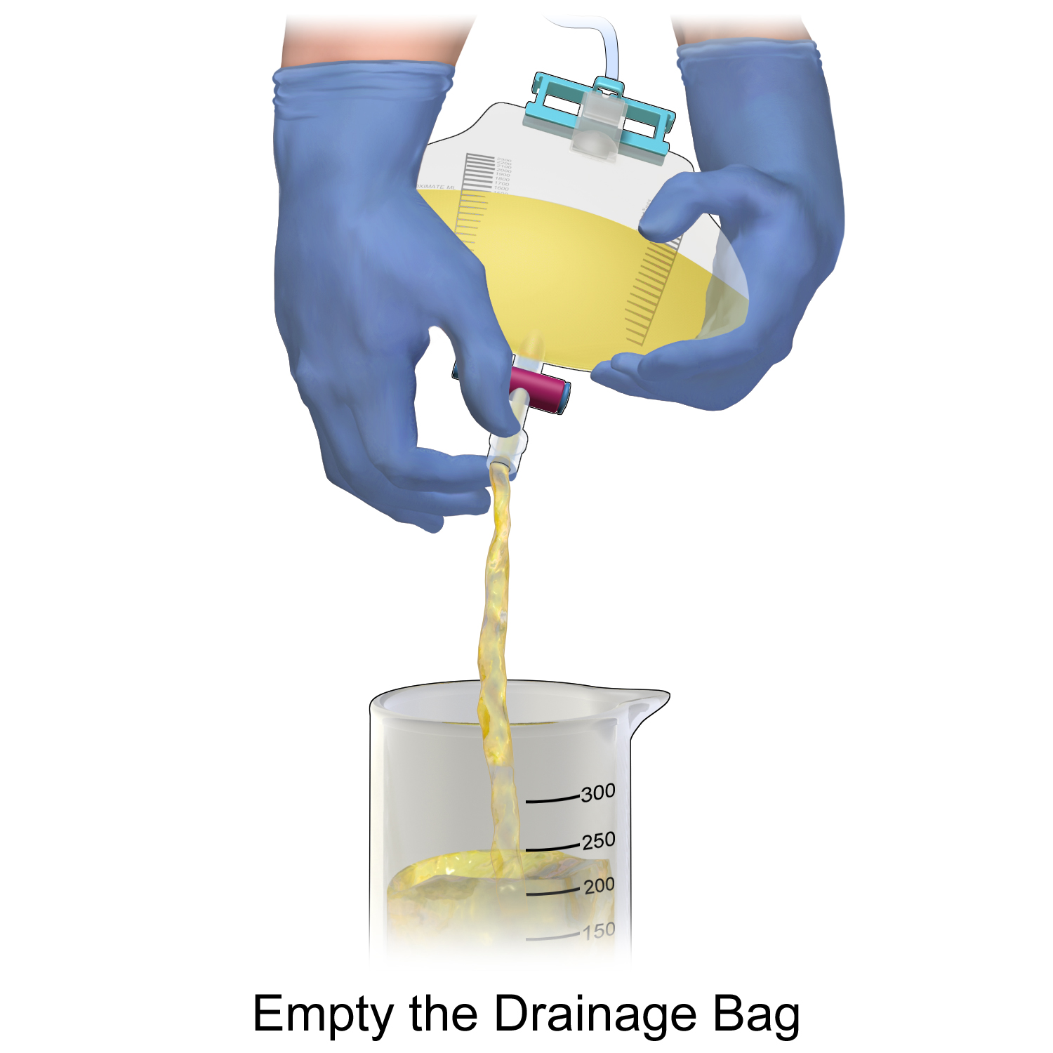
Figure 28.1: Catheter Maintenance & CAUTI Care
WHAT TO NOTICE
Aseptic Insertion & Closed System Rules
• Use smallest functional size, single-use sterile lubricant, and a new kit per attempt; replace catheter and bag if the closed system opens.
Unobstructed Gravity Flow & Meatal Care
• Keep bag below bladder level at all times (including walks) and off the floor; prevent kinks/loops; clean meatus during routine bathing.
Intermittent & External Catheter Alternatives
• Prefer intermittent catheterization (sterile in hospital, clean at home) for retention; use external catheters with regular skin checks.
Recognizing CAUTI (Patel et al., 2023)
• Requires bacteriuria PLUS fever, suprapubic tenderness, flank pain, rigors, or new delirium (after ruling out other causes).
CNO CONTROLLED ACT RULE
Passing a catheter beyond the urethral meatus is an authorized controlled act for RNs and RPNs—in public hospitals, it always requires an order or medical directive (CNO, 2025c).
Figure 28.1 Emptying a urinary drainage bag into a dedicated clean container without touching the spout, keeping the bag below bladder level (BruceBlaus, CC BY-SA 4.0).
Medical-Surgical Nursing: A Canadian Open Text | Chapter 28: Urinary Tract & Prostate Disorders
8 / 27
Notes:
Slide 8 presents Figure 28.1 and the core CAUTI maintenance bundle (CDC, 2009; Patel et al., 2023). Emphasize keeping the drainage system closed, keeping the tubing free of dependent loops or kinks, and keeping the drainage bag below bladder level at all times—including when ambulating in the hallway (carrying the bag at waist height causes reflux and requires immediate correction; Q11). CAUTI recognition (Q12) requires significant bacteriuria plus a clinical sign such as fever (e.g., 38.6 °C), suprapubic tenderness, or CVA pain/tenderness—cloudy or foul-smelling urine or sediment alone is never an indication to send a culture. If a catheterized patient develops fever (39.1 °C), tachycardia (122 bpm), hypotension (88/52 mm Hg), and new confusion (Q16), escalate immediately via the rapid response process and inform the RN.

Slide 9
PART 3 | SECTION 28.3
Urinary Retention and
Urinary Incontinence
Acute vs. Chronic Retention, Post-Void Residual (PVR) Bladder Scanning, and the Five Types of Incontinence
Key Focus: Causes of retention; PVR thresholds (>300 mL symptomatic / >500 mL asymptomatic); Table 28.2 incontinence types; pelvic floor & bladder training; and antimuscarinic vs. mirabegron safety.
9 / 27
Notes:
Part 3 covers Section 28.3: Urinary Retention and Urinary Incontinence. Key learning points include acute versus chronic urinary retention, portable ultrasound bladder scanning and post-void residual (PVR) action thresholds (Q13, Q20), the five clinical types of urinary incontinence (Table 28.2; Q14), conservative behavioural therapies, and pharmacologic safety with antimuscarinics (Q15) and beta-3 agonists.

Slide 10
Urinary Retention & Post-Void Residual Scanning
Acute vs. Chronic Retention & Etiologies
Bladder Scanning & Drainage Management
Acute vs. Chronic Retention (AUA Definition)
• Acute retention is sudden inability to void (often painful, though painless after spinal anesthesia); chronic retention is painless PVR >300 mL on >=2 occasions for >=6 months.
Five Major Precipitants
• 1) Benign prostatic hyperplasia/obstruction; 2) anticholinergic drugs & opioids; 3) spinal/general anesthesia & pelvic surgery; 4) fecal impaction; 5) neurogenic bladder.
Bedside Cues of Retention
• No voiding for several hours, frequent small voids, suprapubic firmness/fullness, overflow dribbling, or new restlessness/delirium in an older adult.
Portable Ultrasound Bladder Scanner
• Non-invasive PVR check right after voiding (authorized to RNs and RPNs for routine assessment); disinfect probe between patients and record voided + scanned volumes.
Action Thresholds (Patel, 2023; CUA, 2017)
• Post-op retention protocols typically act at PVR >300 mL (with symptoms) or >500 mL (without symptoms); check PVR >250–300 mL before starting antimuscarinics.
Intermittent Drainage & Decompression
• Prefer intermittent catheterization + constipation relief + ambulation post-op; rapid complete drainage did not increase hematuria or collapse in meta-analysis (Wu et al., 2022).
UPPER TRACT WARNING: Escalate retention accompanied by fever, flank pain, rising creatinine, or hydronephrosis immediately—high-pressure retention causes postrenal AKI!
Medical-Surgical Nursing: A Canadian Open Text | Chapter 28: Urinary Tract & Prostate Disorders
10 / 27
Notes:
Slide 10 reviews acute and chronic urinary retention and post-void residual (PVR) bladder scanning (Q13, Q20). The American Urological Association (Stoffel et al., 2016) defines chronic urinary retention as a painless PVR >300 mL on >=2 occasions persisting for >=6 months. After catheter removal (Q13), if a patient has not voided for 7 hours and has suprapubic fullness, the nurse scans the bladder per unit protocol rather than immediately reinserting an indwelling catheter or forcing fluids. After spinal anesthesia (Q20), patients often feel no urge despite bladder overdistension; a PVR of 560 mL exceeds the >500 mL asymptomatic threshold (Patel et al., 2023) and warrants intermittent catheterization per protocol.

Slide 11
Types of Urinary Incontinence & Care (Table 28.2)
Affects ~3.3 million Canadians (30%–60% of adults >65) but is NEVER a normal part of aging (Bettez et al., 2012):
Stress Incontinence: Leaks with coughing, sneezing, or lifting (weak pelvic floor or post-prostatectomy) -> supervised pelvic floor muscle training (PFMT) first.
Functional Incontinence: Intact bladder function but unable to reach toilet in time (arthritis, dementia) -> prompted/scheduled voiding, commode, grab bars, easy clothing.
Urgency (Urge) Incontinence: Leaks with sudden strong urge, frequency & nocturia (overactive bladder) -> bladder training, cut caffeine, PFMT, then meds if needed.
First-Line Workup (8–12 wk Trial): 3-day bladder diary, urinalysis, PVR check, and ruling out reversible causes (delirium, infection, drugs, diuretics, constipation/impaction).
Mixed Incontinence: Combination of stress and urgency leakage (common in older women) -> combine PFMT, bladder training, and lifestyle measures.
Antimuscarinics (Oxybutynin): Dry mouth, constipation, retention, and cognitive decline/delirium in frail older adults; contraindicated in uncontrolled narrow-angle glaucoma.
Overflow Incontinence: Frequent small leaks from an overfull bladder (BPH or weak detrusor) -> measure PVR, relieve obstruction, or use intermittent catheterization.
Beta-3 Agonist (Mirabegron): Relaxes detrusor for urgency incontinence without anticholinergic cognitive load; contraindicated in severe uncontrolled hypertension (check BP).
Dignity & Skin Care: Never use an indwelling catheter as a substitute for continence care; answer call bells promptly and protect skin.
Medical-Surgical Nursing: A Canadian Open Text | Chapter 28: Urinary Tract & Prostate Disorders
11 / 27
Notes:
Slide 11 summarizes Table 28.2 on the five types of urinary incontinence (Bettez et al., 2012; Corcos et al., 2017): stress, urgency, mixed, overflow, and functional. Incontinence affects ~3.3 million Canadians (30%–60% of adults >65) but is never a normal part of aging. In Q14, an 80-year-old woman with severe hip arthritis who recognizes the need to void but leaks before reaching the bathroom with her walker has functional incontinence; scheduled toileting assistance, a bedside commode, and a call bell within reach address the mobility barrier. In Q15, an 84-year-old man started on oxybutynin who develops new confusion and 4 days of constipation is experiencing serious central and peripheral anticholinergic toxicity that must be reported promptly.

Slide 12
PART 4 | SECTION 28.4
Kidney Stones (Urolithiasis):
Renal Colic, Procedures & Prevention
Calcium, Uric Acid, Struvite & Cystine Stones, NSAID Analgesia, Obstructive Pyelonephritis & 2.5 L/Day Output
Key Focus: CUA ureteral calculi & medical management guidelines (Lee et al., 2021; Bhojani et al., 2022); Figures 28.2 & 28.3; why obstructed infected stones require urgent stent/nephrostomy.
12 / 27
Notes:
Part 4 examines Section 28.4: Kidney Stones (Urolithiasis), integrating the Canadian Urological Association (CUA) guidelines on ureteral calculi (Lee et al., 2021) and medical management/prevention of kidney stones (Bhojani et al., 2022), alongside Canadian epidemiology (Ordon et al., 2024).

Slide 13
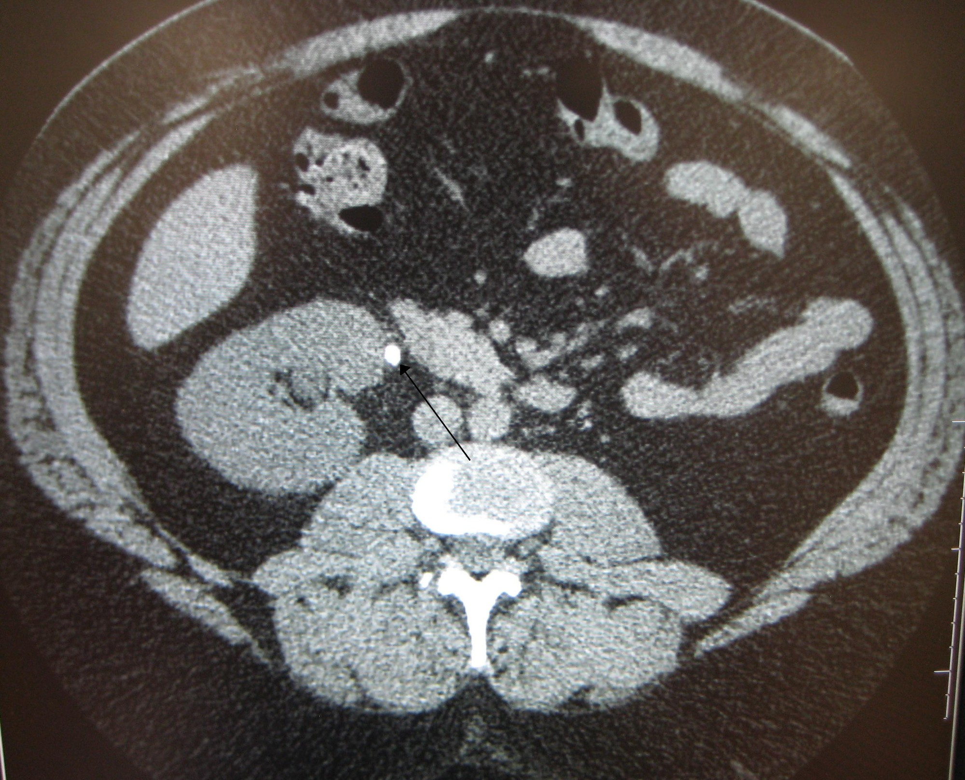
Figure 28.2: Urolithiasis & Renal Colic Care
WHAT TO NOTICE
Four Stone Types & Systemic Links (CUA, 2022)
• Calcium (oxalate/phosphate, most common), uric acid (acidic urine), struvite (infection stones), and cystine; 30%–50% recur within 10 yr.
Renal Colic Cues & Imaging
• Wave-like flank-to-groin pain, nausea/emesis, and hematuria; CUA advises ultrasound + KUB X-ray first, or low-dose non-contrast CT.
NSAIDs Outperform Morphine for Renal Colic
• CUA reports NSAIDs (ketorolac, ibuprofen) relieve renal colic better than morphine and advises minimizing opioids (check eGFR first).
Medical Expulsive Therapy (MET) & Straining Urine
• Stones <5 mm usually pass on their own; MET benefits 5–10 mm distal ureteral stones; strain urine and send stones for analysis.
EMERGENCY: OBSTRUCTED, INFECTED KIDNEY (LEE ET AL., 2021)
Fever, rigors, tachycardia, hypotension, or rising creatinine with a ureteral stone indicates obstructive pyelonephritis—antibiotics alone cannot penetrate trapped pus; prepare for URGENT ureteral stent or percutaneous nephrostomy!
Figure 28.2 Non-contrast CT showing a radiopaque stone (arrow) in the upper right ureter causing mild obstruction (James Heilman, MD, CC BY-SA 3.0).
Medical-Surgical Nursing: A Canadian Open Text | Chapter 28: Urinary Tract & Prostate Disorders
13 / 27
Notes:
Slide 13 displays Figure 28.2 (non-contrast CT showing an upper right ureteral calculus) and CUA acute renal colic management (Lee et al., 2021). First-line imaging is ultrasound plus a KUB radiograph, or low-dose non-contrast CT. For acute renal colic analgesia (Q27), the CUA guideline emphasizes that NSAIDs (ketorolac, ibuprofen) relieve renal colic more effectively than morphine and recommends minimizing opioid use (after verifying kidney function and bleeding risk). Most importantly, an obstructed, infected kidney (obstructive pyelonephritis) is a life-threatening urologic emergency (Q39 [RN]): when a patient with a 6-mm upper ureteral stone develops T 39.2 °C, rigors, HR 124 bpm, BP 88/52 mm Hg, and rising creatinine, antibiotics alone cannot drain pus trapped above the stone—the nurse anticipates sepsis care plus urgent decompression via a ureteral stent or percutaneous nephrostomy tube (Lee et al., 2021).

Slide 14
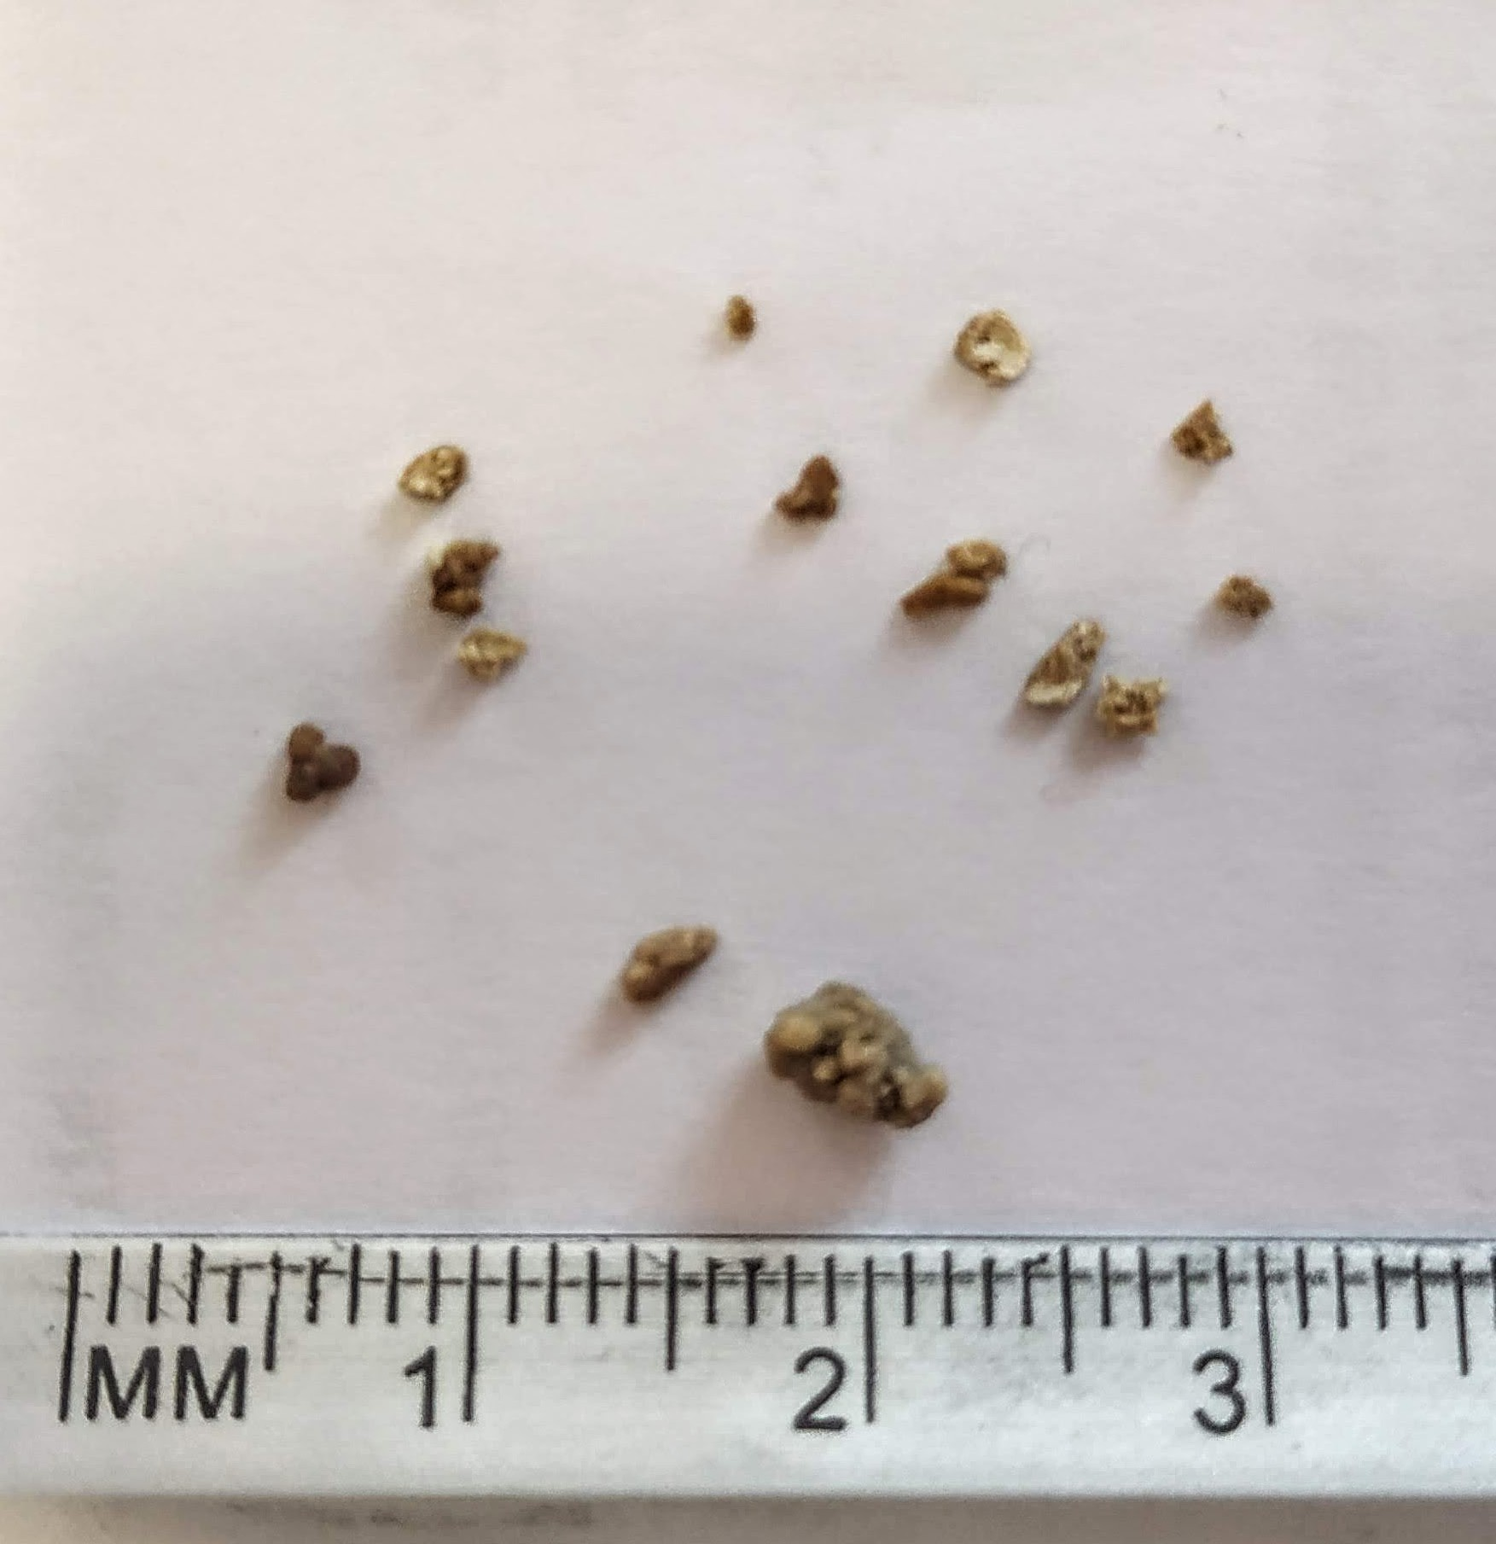
Figure 28.3: Lithotripsy, Stents & Prevention
WHAT TO NOTICE
Ureteroscopy (73.5%) vs. Shock Wave Lithotripsy
• Ureteroscopy passes a scope to laser/basket stones (most common in Canada); SWL uses external acoustic waves to fragment stones (fewer complications, more retreatments).
Ureteral Stent Teaching
• Placed for ureteral injury, stricture, solitary kidney, or AKI; causes expected urgency, frequency, and hematuria (eased by alpha-blockers)—ensure patient knows removal date!
1st-Line Prevention: Urine Output >=2.5 L/Day
• Drink water throughout the day to produce >=2.5 L/day of urine (>=3.0 L/day for cystine stones); every extra 200 mL/day lowers stone risk by 13%.
Normal Dietary Calcium & Low Sodium (Bhojani, 2022)
• Do NOT restrict dietary calcium (aim for 1,000–1,200 mg/day with meals to bind gut oxalate); restrict sodium to 1,500 mg/day (<2,300 mg), moderate animal protein, and avoid vitamin C >1,000 mg/day.
WHY CUTTING DIETARY CALCIUM BACKFIRES
Restricting dietary calcium leaves unbound oxalate in the intestine to be absorbed and excreted in the urine, paradoxically increasing calcium oxalate stone formation and bone loss!
Figure 28.3 Kidney stone fragments passed after shock wave lithotripsy (SWL) beside a millimetre scale (Arconsoli, CC BY-SA 4.0).
Medical-Surgical Nursing: A Canadian Open Text | Chapter 28: Urinary Tract & Prostate Disorders
14 / 27
Notes:
Slide 14 shows Figure 28.3 (stone fragments after shock wave lithotripsy beside a millimetre scale) and CUA stone procedures and recurrence prevention (Bhojani et al., 2022; Lee et al., 2021). Ureteroscopy accounts for 73.5% of initial stone procedures in Canada (Ordon et al., 2024). When a patient goes home with a temporary ureteral stent after ureteroscopy (Q29), teach that urinary frequency, urgency, and mild hematuria are expected while the stent is in place, and ensure the patient knows the scheduled removal date so the stent is never forgotten. For recurrence prevention in calcium oxalate stone formers (Q28), the CUA recommends drinking enough water to produce >=2.5 L of urine daily (>=3.0 L/day for cystine stones), maintaining normal dietary calcium (1,000–1,200 mg/day with meals to bind dietary oxalate in the gut), limiting sodium to 1,500 mg/day (<2,300 mg/day), and avoiding vitamin C supplements >1,000 mg/day.

Slide 15
PART 5 | SECTION 28.5
Benign Prostatic Hyperplasia
and Prostate Surgery (TURP & CBI)
BPH Pharmacology, Transurethral Resection of the Prostate, Continuous Bladder Irrigation & TUR Syndrome
Key Focus: CUA BPH guideline (Elterman et al., 2022); alpha-blockers vs. 5-ARIs (Table 28.3); CBI true urine output & clot retention steps; TUR syndrome; and Practice Story (Camille Marchand, RN).
15 / 27
Notes:
Part 5 covers Section 28.5: Benign Prostatic Hyperplasia (BPH) and Prostate Surgery, including the 2022 CUA MLUTS/BPH guideline (Elterman et al., 2022), alpha-blockers and 5-alpha reductase inhibitors (Table 28.3), transurethral resection of the prostate (TURP), continuous bladder irrigation (CBI), clot retention, transurethral resection (TUR) syndrome, and the Practice Story featuring Camille Marchand, RN, and her RPN colleague Priya caring for Mr. Bernard Lavoie.

Slide 16
Benign Prostatic Hyperplasia (BPH) & Medications
BPH Symptoms (Fig. 28.4), IPSS & Indications
BPH Drug Classes (Table 28.3)
Voiding vs. Storage LUTS (Elterman et al., 2022)
• Voiding (obstructive): weak/interrupted stream, hesitancy, straining, incomplete emptying. Storage (irritative, most bothersome): urgency, frequency, nocturia.
Assessment & Does BPH Cause Cancer?
• Track severity with the International Prostate Symptom Score (IPSS); BPH does NOT increase prostate cancer risk, though both can coexist.
CUA Indications for BPH Surgery
• Refractory/recurrent urinary retention, recurrent UTIs, bladder calculi, recurrent gross hematuria, or obstructive renal insufficiency.
Alpha-Blockers (Tamsulosin, Silodosin)
• Relax prostate/bladder neck smooth muscle quickly; warn of orthostatic hypotension/falls (no driving for 12 h after 1st dose; swallow CR whole) and retrograde ejaculation.
Intraoperative Floppy Iris Syndrome (IFIS)
• Tamsulosin causes iris billowing during cataract or glaucoma surgery—patients must inform their ophthalmologist, and avoid starting before planned eye surgery.
5-Alpha Reductase Inhibitors (Finasteride, Dutasteride)
• Shrink prostate 25%–30% over >=6 months and lower serum PSA by ~50%; pregnant people must NEVER touch crushed or broken finasteride tablets (teratogenic to male fetus).
COMBINATION THERAPY: Combining an alpha-blocker + 5-ARI reduces acute urinary retention and need for surgery in men with larger prostates.
Medical-Surgical Nursing: A Canadian Open Text | Chapter 28: Urinary Tract & Prostate Disorders
16 / 27
Notes:
Slide 16 reviews BPH pathophysiology (referencing Figure 28.4 in the textbook), lower urinary tract symptoms (LUTS) assessed via the International Prostate Symptom Score (IPSS), surgical indications, and BPH pharmacology (Table 28.3; Q30, Q31). For alpha-blockers such as tamsulosin (Q30; Teva Canada, 2021), teach patients to rise slowly, avoid driving or hazardous tasks for 12 hours after the first dose due to orthostatic hypotension, swallow controlled-release capsules whole, and inform their ophthalmologist before cataract or glaucoma surgery because of intraoperative floppy iris syndrome (IFIS). For 5-alpha reductase inhibitors such as finasteride (Q31; Sanis Health, 2020), teach that prostate shrinkage takes >=6 months, serum PSA falls by ~50%, and pregnant individuals can safely handle intact coated tablets but must never touch crushed or broken tablets due to teratogenicity to a male fetus.

Slide 17
TURP, Continuous Bladder Irrigation & Clots
Three-Way Catheter & Room-Temperature 0.9% NaCl
• After TURP, continuous bladder irrigation (CBI) instills sterile room-temperature 0.9% NaCl (cold fluid triggers spasms) to prevent blood clots from obstructing the catheter.
• Titrate inflow rate to keep drainage light pink without clots per protocol.
Calculating True Urine Output
• True Urine Output = Total Drainage Out − Irrigation Volume Instilled (e.g., 4,650 mL out − 4,200 mL in = 450 mL true urine).
Recognizing & Acting on Clot Retention (In Order!)
• Cues: drainage < inflow, dark red clots, firm/distended suprapubic bladder, severe urgency/pain, and urine bypassing onto the bed pad.
• Action Sequence: 1) STOP irrigation inflow immediately; 2) check tubing for kinks; 3) palpate/scan bladder; 4) perform authorized sterile manual irrigation per protocol or call urology.
PRACTICE STORY (RN/RPN)
Camille Marchand, RN & Clot Retention
Rule Out Blockage Before Spasm Meds
• Bladder spasms and clot retention feel identical—always verify free drainage before giving an antispasmodic!
Never Reposition a Urologic Catheter
• Nurses never deflate, reposition, or replace a post-TURP catheter without explicit urologist authorization.
Escalating Post-TURP Hemorrhage
• Bright red drainage refractory to increased CBI with tachycardia, hypotension, and pallor requires immediate rapid response escalation.
Medical-Surgical Nursing: A Canadian Open Text | Chapter 28: Urinary Tract & Prostate Disorders
17 / 27
Notes:
Slide 17 details post-TURP nursing care during continuous bladder irrigation (CBI) with room-temperature 0.9% sodium chloride through a three-way catheter (ACI, 2026) and highlights the Section 28.5 Practice Story ('Bright Red and Clotted' with Camille Marchand, RN, and Priya, RPN, caring for Mr. Bernard Lavoie, 81) and Clinical Judgment box (Mr. Wilfred Osei-Bonsu, 79). True urine output equals total drainage minus instilled irrigation volume (Q24: 4,650 mL − 4,200 mL = 450 mL). When clot retention occurs (Q21–Q23)—signalled by dark red clots, drainage less than inflow (50 mL/h), a firm distended suprapubic bladder, bypassing around the catheter, and worsening urgency—the nurse FIRST stops the irrigation inflow (Q23), checks the tubing for kinks/clots, assesses the bladder, and follows the unit's manual irrigation protocol or contacts urology. If an RPN is caring for a blocked CBI patient where employer policy restricts post-urologic manual irrigation to RNs (Q33), the RPN clamps inflow, checks tubing/bladder, and involves the RN and urology team immediately. If drainage remains bright red with large clots despite increased CBI and the patient develops tachycardia (HR 118), hypotension (BP 98/60), pallor, and clammy skin (Q38), escalate immediately via rapid response for hemorrhagic shock!

Slide 18
TUR Syndrome (Going Deeper) & Discharge Care
Transurethral Resection (TUR) Syndrome (RN)
Post-TURP Patient Discharge Teaching (TOH, 2010)
Pathophysiology in Monopolar TURP
• Monopolar cautery requires electrolyte-free irrigation (e.g., glycine); absorption through open prostatic venous sinuses causes acute dilutional hyponatremia and fluid overload.
Rate of Sodium Drop & Bipolar Advantage
• Absorbing 1 L in 1 hour drops serum Na+ by ~5–8 mmol/L (higher risk if resection >60 min or large gland); bipolar TURP uses normal saline and reduces TUR syndrome.
Cardinal Clinical Cues & Urgent Escalation
• Nausea/vomiting, headache, blurred vision, restlessness, confusion, hypertension with reflex bradycardia (e.g., HR 52, BP 176/96, Na+ 124)—escalate via SBAR immediately!
Fluid Intake & Activity Restrictions
• Drink 1–2 L/day of fluid (more if urine turns pink); avoid heavy lifting (>7 kg), strenuous exercise, and long car rides for 2 weeks.
Preventing Straining & Retrograde Ejaculation
• Eat high-fibre foods to prevent straining at stool (straining triggers prostatic bleeding); explain that retrograde ejaculation (cloudy urine after sex) is harmless.
Warning Signs Requiring Immediate Care
• Call urologist or go to ED for fever >38.5 °C, chills, inability to void, large blood clots, or worsening flank/suprapubic pain.
CLINICAL PEARL: Unlike hypovolemic shock (tachycardia + hypotension), TUR syndrome classically presents with hypertension, bradycardia, confusion, vomiting, and acute hyponatremia!
Medical-Surgical Nursing: A Canadian Open Text | Chapter 28: Urinary Tract & Prostate Disorders
18 / 27
Notes:
Slide 18 covers the Going Deeper box on transurethral resection (TUR) syndrome (Q25 [RN], Q26) and post-TURP discharge teaching (Q32; TOH, 2010). Monopolar TURP uses electrolyte-free irrigation fluid (such as glycine); absorption through open prostatic venous sinuses causes acute dilutional hyponatremia (dropping serum Na+ by 5–8 mmol/L per litre absorbed) and fluid overload (Gupta et al., 2010). In Q25 [RN], Mr. Gerald Fontaine develops restlessness, confusion ('at the train station'), vomiting, bradycardia (HR 52 bpm), hypertension (BP 176/96 mm Hg), and a serum sodium drop from 139 to 124 mmol/L—classic cues of TUR syndrome. In Q26, the nurse's priority action is urgent SBAR escalation to the surgeon with the sodium, vital signs, mental status, and CBI totals. At discharge after TURP (Q32), teach the patient to drink 1–2 L/day, eat high-fibre foods to avoid straining, expect harmless retrograde ejaculation, and avoid lifting >7 kg or strenuous exercise for 2 weeks.

Slide 19
Medications for Urinary & Prostate Care (Table 28.3)
Core pharmacological classes, mechanisms, and nursing safety checks across Chapter 28:
Alpha-Blockers (Tamsulosin): Relaxes prostate/bladder neck; orthostatic drop (no driving 12 h after 1st dose), swallow CR whole, alert eye surgeon (IFIS).
NSAIDs (Ketorolac, Ibuprofen): First-line for acute renal colic (superior to morphine); verify renal function (eGFR), volume status, and GI/bleeding risk first.
5-ARIs (Finasteride, Dutasteride): Shrinks prostate over >=6 mo; halves PSA (~50%); pregnant people must never touch crushed/broken tablets; report breast changes.
GnRH Agonist/Antagonist (ADT): Leuprolide/degarelix lower testosterone in prostate cancer; causes hot flashes, osteoporosis, metabolic syndrome, and loss of libido.
Antimuscarinics (Oxybutynin): Treats urge incontinence; causes dry mouth, constipation, retention, and delirium/falls in older adults; avoid in narrow-angle glaucoma.
Intravesical Live BCG: VERITY-BCG for non-muscle-invasive bladder cancer; biohazard PPE, hold 2 h, void sitting, bleach toilet 6 h, report T >39 °C.
Beta-3 Agonist (Mirabegron): Treats urge incontinence without anticholinergic cognitive risk; can raise BP (check baseline & periodic BP; avoid in severe HTN).
Antibiotics for Cystitis: Nitrofurantoin, fosfomycin, or TMP-SMX for acute uncomplicated cystitis; reassess at 72 h and never treat asymptomatic bacteriuria.
Always check post-void residual (PVR) before initiating antimuscarinics or beta-3 agonists in patients with significant bladder outlet obstruction.
Medical-Surgical Nursing: A Canadian Open Text | Chapter 28: Urinary Tract & Prostate Disorders
19 / 27
Notes:
Slide 19 synthesizes Table 28.3 across all seven urologic and prostate medication classes in Chapter 28: alpha-blockers (tamsulosin, silodosin; Q30), 5-alpha reductase inhibitors (finasteride, dutasteride; Q31), antimuscarinics (oxybutynin, solifenacin; Q15), beta-3 agonists (mirabegron), NSAIDs (ketorolac, ibuprofen; Q27), androgen deprivation therapy (leuprolide, degarelix; Q40), and live intravesical BCG (VERITY-BCG; Q36), plus first-line cystitis antimicrobials (nitrofurantoin, fosfomycin, TMP-SMX; Q9).

Slide 20
PART 6 | SECTION 28.6
Prostate and Bladder Cancer,
Urostomy Care & CNO Scope
PSA Screening Debate, Active Surveillance, Androgen Deprivation Therapy, Live BCG & Ileal Conduit Care
Key Focus: 2026 Canadian prostate & bladder cancer statistics; CTFPHC (2014) vs. CUA (2022) PSA screening (Table 28.4); ADT management; Figure 28.5; intravesical BCG; and urostomy care.
20 / 27
Notes:
Part 6 covers Section 28.6: Prostate and Bladder Cancer, Urostomy Care, and CNO Scope of Practice. We review 2026 Canadian cancer projections (Brenner et al., 2026), thePSA screening debate between the Canadian Task Force on Preventive Health Care (2014) and the Canadian Urological Association (2022; Table 28.4; Q34), active surveillance (Q35), androgen deprivation therapy (Q40), bladder cancer and Figure 28.5 (gross hematuria), live intravesical BCG precautions (Q36), ileal conduit urostomy care (Q37), and CNO scope (Q17, Q33).

Slide 21
Prostate Cancer & PSA Screening (Table 28.4)
Canadian Burden, Risk Factors & Equity (CCS, 2026)
PSA Screening Debate: CTFPHC vs. CUA (Table 28.4)
Most Common Cancer in Men in Canada
• 29,300 new diagnoses projected in 2026 (23% of male cancers; 1 in 9 lifetime risk) and 5,300 deaths (#2 cause of male cancer death; 1 in 34).
Non-Modifiable & Disparate Risk Factors
• Age >60, first-degree family history (especially <65), BRCA2/HOXB13 mutations, obesity, and higher incidence/mortality in Black men (African/Caribbean ancestry).
Inclusive Care for Transgender Women
• Transgender women retain the prostate after gender-affirming vaginoplasty; estrogen/anti-androgens lower PSA—use affirming language and individualize discussions.
Canadian Task Force (CTFPHC, 2014): Do Not Screen
• Recommends AGAINST PSA screening at all ages: strong against <55 and >=70; weak against ages 55–69 (harms of overdiagnosis/biopsy/incontinence/ED outweigh mortality benefit).
Canadian Urological Association (CUA, 2022): Shared Choice
• Offer PSA screening via shared decision-making to men with >10 yr life expectancy starting at age 50 (age 45 if higher risk: Black men, family history, BRCA2).
CUA Screening Intervals & Pre-Biopsy MRI
• Repeat q4y if PSA <1 mcg/L, q2y if 1–3 mcg/L, stop at age 70 (or 60 if PSA <1); use multiparametric MRI before biopsy.
NURSING ROLE IN PSA DISCUSSIONS: Present both Canadian guidelines neutrally, clarify whether the patient takes a 5-ARI (which halves PSA), and help him weigh his personal values with his primary care provider.
Medical-Surgical Nursing: A Canadian Open Text | Chapter 28: Urinary Tract & Prostate Disorders
21 / 27
Notes:
Slide 21 presents 2026 Canadian prostate cancer epidemiology (29,300 new cases, 23% of male cancers; 5,300 deaths; Brenner et al., 2026), equity considerations for Black men and transgender women (Ismail et al., 2025), and Table 28.4 comparing the CTFPHC (Bell et al., 2014) and CUA (Mason et al., 2022) PSA screening guidelines. When a 57-year-old asymptomatic man asks whether he should have a PSA test (Q34), the nurse explains that Canadian guidelines differ—CTFPHC recommends against screening, whereas CUA recommends shared decision-making for men with >10 years life expectancy—and helps him weigh the potential benefits and harms before discussing the choice with his primary care provider.

Slide 22
Prostate Cancer: Surveillance, Surgery & ADT
01
Active Surveillance
02
Radical Prostatectomy & RT
03
Androgen Deprivation (ADT)
Preferred for Low-Risk Disease
• Standard for localized Grade Group 1 (Gleason <=6) prostate cancer with curative intent if progression occurs.
Monitoring Protocol (Morash, 2015)
• PSA every 3–6 months, annual DRE, confirmatory biopsy within 6–12 months, and repeat biopsies every 3–5 years.
Distinct From Watchful Waiting
• Watchful waiting is non-curative symptom-based care for men with limited life expectancy.
Post-Prostatectomy Incontinence
• Catheter remains briefly post-op; stress leakage is common after removal and usually improves over months.
Pelvic Floor & Containment Care
• Teach pelvic floor exercises, provide pads/briefs, protect perineal skin, and address erectile dysfunction (Chapter 29).
Pelvic Radiation Effects
• Can cause acute or delayed radiation cystitis (dysuria, hematuria, urgency) and radiation proctitis (diarrhea, rectal bleeding).
Leuprolide & Degarelix Effects
• Lowers testosterone -> hot flashes, loss of libido (up to 90%), sarcopenia, fatigue, depression, and cognitive changes.
Bone Protection (CUA, 2022)
• Baseline DEXA bone density scan, 1,200 mg/day calcium + vitamin D from day 1, and bone-targeted drugs if fracture risk is high.
Cardiometabolic & Exercise Plan
• Screen BP, glucose/HbA1c, and lipids q6–12m; prescribe supervised aerobic and resistance exercise for fatigue and muscle preservation.
Medical-Surgical Nursing: A Canadian Open Text | Chapter 28: Urinary Tract & Prostate Disorders
22 / 27
Notes:
Slide 22 outlines active surveillance (Morash et al., 2015), radical prostatectomy and radiation therapy, and androgen deprivation therapy (ADT; Kokorovic et al., 2022). In Q35, a man with low-risk localized prostate cancer (Grade Group 1 / Gleason <=6) who chooses active surveillance understands that he will undergo scheduled PSA tests (every 3–6 months), annual digital rectal exams, and repeat prostate biopsies, with curative treatment offered if the cancer is reclassified as higher risk—distinguishing it from non-curative watchful waiting. In Q40 [RN], a 71-year-old man starting long-term ADT requires a baseline DEXA bone mineral density scan, calcium (1,200 mg/day) and vitamin D supplementation from the start, supervised resistance and aerobic exercise (to combat fatigue and sarcopenia), and cardiometabolic screening (BP, glucose, lipids) every 6 to 12 months.

Slide 23
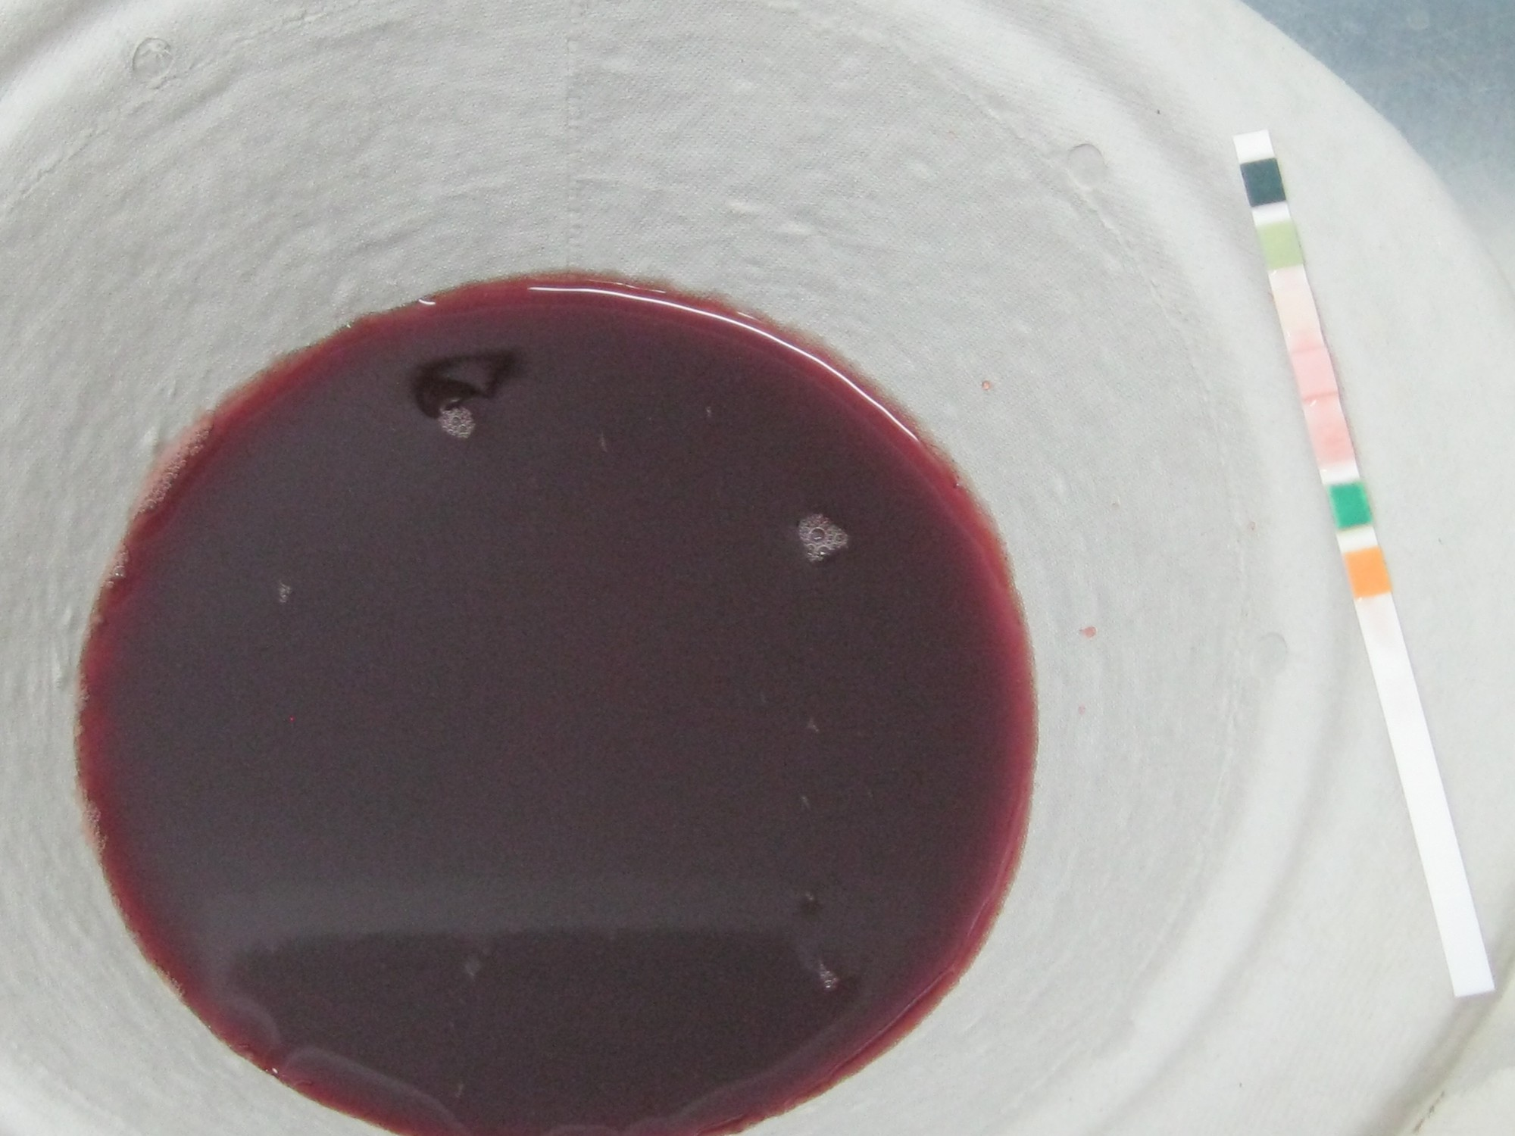
Figure 28.5: Bladder Cancer & Intravesical BCG
WHAT TO NOTICE
Canadian Burden & Risk Factors (13,200 Cases in 2026)
• Smoking is the #1 modifiable cause; other risks include occupational chemicals (paint, dye, rubber, metal, exhaust), well-water arsenic, cyclophosphamide, and chronic catheters.
Painless Gross Hematuria & Diagnostic Workup
• Visible or microscopic hematuria is the hallmark cue; CUA recommends contrast CT urogram + cystoscopy, followed by transurethral resection of bladder tumour (TURBT).
Live Intravesical BCG Protocol (Verity, 2021)
• Start 2–3 wk post-TURBT (delay if traumatic catheterization, gross hematuria, UTI, or fever); NPO fluids 4 h before and 2 h after; hold in bladder for 2 hours.
Post-BCG Toilet Bleaching & Systemic Sepsis Alert
• Void sitting down; add household bleach to toilet for 15 min before flushing for 6 hours post-void; use condoms/abstain for 1 wk; report fever >39 °C lasting >12 h immediately!
WHY FEVER >39 °C AFTER BCG IS AN EMERGENCY
Because intravesical BCG contains live attenuated Mycobacterium bovis, a fever >39 °C lasting >12 hours or haemodynamic instability can indicate life-threatening systemic BCG sepsis!
Figure 28.5 Visible blood in the urine (gross hematuria) with a positive dipstick—always investigate in an adult.
Medical-Surgical Nursing: A Canadian Open Text | Chapter 28: Urinary Tract & Prostate Disorders
23 / 27
Notes:
Slide 23 presents Figure 28.5 (visible blood in the urine / gross hematuria with a positive dipstick), Canadian bladder cancer epidemiology (13,200 new cases and 2,500 deaths projected in 2026; smoking is the #1 modifiable risk factor), diagnostic evaluation (contrast CT urogram + cystoscopy + TURBT; Bhindi et al., 2021), and live attenuated intravesical BCG precautions (Verity Pharmaceuticals, 2021; Q36). For Q36 (SATA), verify that students select all five correct BCG precautions: 1) hold the instilled suspension in the bladder for 2 hours; 2) sit down to void; 3) add undiluted household bleach to the toilet bowl for 15 minutes before flushing for 6 hours after treatment; 4) report a fever >39 °C lasting >12 hours immediately (risk of fatal systemic BCG sepsis); and 5) abstain from sexual intercourse for 1 week after each instillation or use a condom throughout treatment. Remind students that fluids are restricted for 4 hours before and 2 hours after instillation.

Slide 24
Ileal Conduit (Urostomy) Care & CNO Scope
Radical Cystectomy & Ileal Conduit Care (NSWOCC, 2022)
Scope in Practice: Catheters, CBI & Scans
How an Ileal Conduit Works
• Ureters are anastomosed to a short segment of ileum brought to the RLQ skin as a urostomy stoma; drains continuously with no voluntary sphincter control.
Expected Post-Op Findings: Mucus & Ureteral Stents
• Stoma is moist and pink-red (shrinks over 6–8 wk); mucus shreds in urine are NORMAL (produced by intestinal goblet cells); 2 small ureteral stents drain for 5–14+ days.
Pouching & Red Flags to Report Immediately
• Empty pouch at 1/3–1/2 full and connect to night drainage bag; report dark/pale/black stoma, absent urine output for >=2 h, heavy bleeding, cloudy foul urine with fever, or peristomal crystals.
Controlled Act: Beyond the Urethral Meatus
• Inserting or manually irrigating a urinary catheter is a controlled act authorized to RNs and RPNs—requires an order or medical directive in public hospitals (CNO, 2025c).
Bladder Ultrasound Scanning Authority
• Both RNs and RPNs have legal authority to apply ultrasound energy for routine portable bladder volume scanning (CNO, 2025b).
Competence, Context & Post-TURP Irrigation
• If an RPN has not performed catheterization recently, seek supervision; if employer policy restricts post-TURP manual clot irrigation or BCG instillation to RNs, the RPN clamps inflow and consults the RN.
UROSTOMY TEACHING PEARL: Reassure patients that mucus threads in ileal conduit urine are permanent and normal—not a sign of infection—and encourage high fluid intake.
Medical-Surgical Nursing: A Canadian Open Text | Chapter 28: Urinary Tract & Prostate Disorders
24 / 27
Notes:
Slide 24 covers radical cystectomy with an ileal conduit urostomy (NSWOCC, 2022; Q37) and the Section 28.6 Scope in Practice box (CNO, 2025a, 2025b, 2025c, 2026; Q17, Q33). On postoperative day 3 after an ileal conduit (Q37), mucus threads in the urine, a moist pinkish-red stoma with slight oozing on cleaning, and two small ureteral stents draining urine are expected findings; a dark purple-black stoma (stomal necrosis) with no urine output for 2 hours must be reported to the surgeon immediately! In the Scope in Practice box, review how CNO's authority, competence, and context framework governs urethral catheterization (Q17), portable bladder ultrasound scanning (CNO, 2025b), and post-TURP manual clot irrigation (Q33).

Slide 25
Key Clinical Thresholds in Urologic Care
Essential quantitative benchmarks and safety rules across Chapter 28:
Significant Bacteriuria: >=10⁸ CFU/L (10⁵ CFU/mL); do NOT screen or treat asymptomatic bacteriuria except in pregnancy or mucosal urologic procedures.
True Urine Output on CBI: Total Volume Drained Out minus Irrigation Volume Instilled; if drainage < inflow, clamp inflow FIRST and check for clots.
Specimen Transport Window: Deliver midstream or sampling-port urine to lab within <=2 hours of collection, or refrigerate immediately.
TUR Syndrome Hyponatremia: Electrolyte-free irrigation absorption drops Na+ by 5–8 mmol/L per L absorbed -> confusion, vomiting, HTN, and bradycardia.
Post-Void Residual (PVR): Chronic retention: >300 mL on >=2 checks over >=6 mo; post-op retention: >300 mL (symptomatic) or >500 mL (asymptomatic).
Tamsulosin & Finasteride Rules: Tamsulosin: no driving 12 h after 1st dose + warn eye surgeon (IFIS). Finasteride: halves PSA (~50%) after 6 mo + teratogenic if crushed.
Kidney Stone Prevention: Drink water to produce >=2.5 L/day of urine (>=3.0 L/day for cystine); keep dietary Ca2+ 1,000–1,200 mg/day; Na+ 1,500 mg/day.
Intravesical BCG Safety: Retain 2 h, void sitting, bleach toilet 15 min for 6 h post-void, and report fever >39.0 °C lasting >12 hours immediately.
Never use a urine dipstick to diagnose UTI in older adults (>65) or long-term care residents, and never use an indwelling catheter for incontinence.
Medical-Surgical Nursing: A Canadian Open Text | Chapter 28: Urinary Tract & Prostate Disorders
25 / 27
Notes:
Slide 25 consolidates Chapter 28's essential quantitative clinical thresholds for rapid exam and bedside review: significant bacteriuria (>=10^8 CFU/L or 10^5 CFU/mL; Q8, Q18), urine specimen transport (<=2 hours or refrigerate; Q5), post-void residual thresholds (>300 mL chronic or symptomatic post-op; >500 mL asymptomatic post-op; Q20), kidney stone prevention targets (>=2.5 L/day urine output, 1,000–1,200 mg/day dietary calcium, 1,500 mg/day sodium; Q28), CBI true urine output formula (Total Out minus Irrigation In; Q24), TUR syndrome sodium drop (5–8 mmol/L per litre absorbed; Q25), tamsulosin and finasteride safety windows (12-hour driving restriction; ~50% PSA reduction after 6 months; Q30, Q31), and live intravesical BCG protocols (2-hour dwell, 6-hour bleach disinfection, fever >39 °C alert; Q36).

Slide 26
Check Your Understanding: Case 1 (ASB) & First-Half Review
CASE 1 — POSITIVE DIPSTICK IN LONG-TERM CARE (Q1–Q2)
Mrs. Dorothy Kowalchuk, 86 (LTC resident), is sleepier and more confused since yesterday, with dark smelly urine, positive LE/nitrite dipstick, no BM for 4 days, poor fluid intake, T 37.2 °C, and no dysuria. Next step?
Up to 50% of LTC residents have asymptomatic bacteriuria; a positive dipstick does NOT confirm UTI! Assess abdomen/bowels (4 days constipated), hydration, medications, and delirium causes first.
CASE 1 — FAMILY COMMUNICATION & SBAR TO NP (Q3–Q4)
Her daughter asks for a urine culture and antibiotics right away. How should the LPN respond to the daughter and report to the nurse practitioner (NP)?
Validate the daughter's concern, explain that bacteria without urinary/systemic signs are common and other causes (constipation/dehydration) are being checked, and give a complete SBAR report to the NP.
FIRST-HALF REVIEW — SPECIMENS, ASB & PYELONEPHRITIS (Q5–Q9, Q18 [RN])
1) Catheter urine culture collection (Q6)? 2) Cystitis vs. pyelonephritis cue (Q7)? 3) Diabetes with >10⁸ CFU/L ASB (Q8)? 4) Why is nitrite negative in Enterococcus UTI (Q18 [RN])?
1) Disinfect sampling port, clamp briefly, aspirate with sterile syringe. 2) Fever 38.9 °C, chills & CVA tenderness. 3) No antibiotic for ASB. 4) Enterococcus does not convert nitrate to nitrite.
FIRST-HALF REVIEW — CATHETERS, RETENTION & SCOPE (Q10–Q17, Q19–Q20 [RN])
1) RPN asked to do intermittent catheterization not done since school (Q17)? 2) 'Lose the Tube' removal candidate (Q19 [RN])? 3) Post-spinal knee surgery void 150 mL with PVR 560 mL (Q20 [RN])?
1) Request supervision to build competence (CNO authority, competence, context). 2) Stable walking pneumonia patient. 3) Perform intermittent catheterization per protocol (PVR >500 mL asymptomatic).
Medical-Surgical Nursing: A Canadian Open Text | Chapter 28: Urinary Tract & Prostate Disorders
26 / 27
Notes:
Slide 26 walks through Unfolding Case 1: Mrs. Dorothy Kowalchuk, 86 (Questions 1–4 in the Textbook and HTML), an 86-year-old long-term care resident in Nova Scotia with moderate dementia who is sleepier and more confused since yesterday, with dark, strong-smelling urine, a positive care-aide dipstick (leukocyte esterase and nitrites), no bowel movement for 4 days, poor fluid intake, no dysuria, and stable vital signs (T 37.2 °C, BP 118/70, HR 84, RR 18), followed by first-half review questions (Q5–Q20). In Q1, the positive dipstick cannot distinguish infection from asymptomatic bacteriuria (present in up to 50% of LTC residents). In Q2, the LPN's next step is to assess her abdomen/bowels, hydration, medications, and delirium causes. In Q3, the LPN validates her daughter's concern and explains why non-urinary causes are checked first. In Q4, the LPN gives a structured SBAR report to the NP requesting an assessment rather than an antibiotic or culture order. We also review Q17 on CNO competence when an RPN is asked to perform intermittent catheterization not done since school.

Slide 27
Check Your Understanding: Case 2 (TURP/CBI) & Synthesis
CASE 2 — CLOT RETENTION & TRUE URINE OUTPUT (Q21–Q24)
Mr. Gerald Fontaine, 76 (3 h post-monopolar TURP on CBI), has worsening urgency, dark red clots, 50 mL drained in 1 h, firm bladder, and bypassing (Q21–Q23). Later, 4,200 mL runs in and 4,650 mL drains (Q24).
Clot retention! STOP irrigation inflow first and check tubing (never deflate/reposition balloon). True urine output = 4,650 mL − 4,200 mL = 450 mL over 4 h (~112.5 mL/h).
CASE 2 — TUR SYNDROME, HEMORRHAGE & DISCHARGE (Q25 [RN], Q26, Q32, Q38)
At 21:00, Mr. Fontaine is confused ('at the train station'), vomits, HR 52, BP 176/96, Na+ 124 mmol/L (Q25–Q26). What if drainage stays bright red with HR 118, BP 98/60 (Q38)? Discharge lifting rule (Q32)?
TUR syndrome (dilutional hyponatremia from absorbed glycine)—escalate urgently via SBAR! Bright red drainage + shock = rapid response (Q38). Avoid lifting >7 kg or gym weights for 2 wk (Q32).
SYNTHESIS — OBSTRUCTED STONE & INTRAVESICAL BCG (Q27–Q29, Q36, Q39 [RN])
1) Patient with 6-mm ureteral stone develops T 39.2 °C, rigors, HR 124, BP 88/52, and rising Cr (Q39 [RN])? 2) Teaching after live intravesical BCG instillation (Q36)?
1) Obstructed infected kidney with urosepsis—start sepsis care/IV antibiotics AND prepare for urgent stent or nephrostomy decompression (Q39). 2) Hold 2 h, void sitting, bleach toilet 6 h, report T >39 °C (Q36).
SYNTHESIS — BPH MEDS, PSA, ADT, ILEAL CONDUIT & SCOPE (Q30–Q31, Q33–Q35, Q37, Q40)
1) Day 3 ileal conduit: mucus threads vs. purple-black stoma with 0 mL/2 h (Q37)? 2) Blocked CBI when only RNs hand-irrigate (Q33)? 3) Long-term ADT care plan (Q40 [RN])?
1) Mucus is normal; purple-black stoma/anuria is an emergency (Q37)! 2) RPN clamps inflow, checks tubing/bladder, and consults RN/urology (Q33). 3) Baseline DEXA, Ca/Vit D, supervised exercise & metabolic checks (Q40).
Medical-Surgical Nursing: A Canadian Open Text | Chapter 28: Urinary Tract & Prostate Disorders
27 / 27
Notes:
Slide 27 walks through Unfolding Case 2: Mr. Gerald Fontaine, 76 (Questions 21–26 in the Textbook and HTML), 3 hours after monopolar TURP on continuous bladder irrigation (CBI), followed by second-half clinical synthesis questions (Q32, Q33, Q36, Q37, Q38, Q39 [RN]). In Q21–Q23, Mr. Fontaine's dark red clotted drainage, 50 mL/h output, firm suprapubic bladder, catheter bypassing, and worsening urgency indicate clot retention; the nurse stops the irrigation inflow first and checks the tubing. In Q24, after urology clears the clots, 4,650 mL total drainage minus 4,200 mL instilled irrigation equals 450 mL of true urine output over 4 hours. In Q25 [RN] and Q26 [Core], at 21:00 he develops confusion ('at the train station'), vomiting, bradycardia (HR 52), hypertension (BP 176/96), and acute hyponatremia (Na+ 124 mmol/L from 139 mmol/L)—classic TUR syndrome requiring immediate SBAR escalation to the surgeon. Finally, review post-TURP hemorrhage (Q38) vs. discharge lifting limits (Q32), blocked CBI scope (Q33), obstructive pyelonephritis (Q39 [RN]), BCG (Q36), and ileal conduit ischemia (Q37).

