Slide 1
Cancer Care
CHAPTER 9 · LECTURE
Cancer is the loss of the controls that tell cells when to divide, when to stop and when to die. This lecture follows that loss from the first mutation to the bedside.
Andrew Lee, BEd, BN, MN, RN, CCN(C)
Aligned with CNO entry-to-practice competencies, Ontario screening programs, and ASCO/IDSA, MASCC/ESMO and WHO guidance
opensourcenursing.ca (CC BY-NC-SA 4.0)
Notes:
Welcome. This lecture covers Chapter 9, Cancer Care, of Pathophysiology for Nurses: A Canadian Open Text. Frame the session around one idea: every manifestation of cancer at the bedside traces back to the loss of normal cell controls, or to the treatments used to restore them. We will move from cancer biology to screening and diagnosis, then treatment and its effects, and finish with oncologic emergencies and supportive care. Students should have the chapter open; figures and questions in the deck come straight from it.

Slide 2
By the end of this chapter you will be able to
LEARNING OUTCOMES
Seven outcomes, grouped into three themes and mapped to the CNO entry-to-practice competencies
Cancer biology and spread
Screening, staging, treatment
Emergencies and support
Explain how proto-oncogene, tumour suppressor and DNA repair mutations create a malignant cell
Compare benign and malignant tumours; link invasion, angiogenesis and metastasis to local and systemic effects
CNO RN Clinician, Scholar · RPN Foundations of Practice
Teach modifiable risk and Ontario's screening programs
Interpret grade and TNM stage in plain language
Relate each treatment's mechanism to its effects; handle hazardous drugs safely
CNO RN Educator, Clinician, Professional · RPN Foundations, Legal Practice
Recognize febrile neutropenia, TLS, hypercalcemia, SIADH, SVC syndrome, cord compression
Act within scope and consult early
Plan culturally safe supportive, palliative and survivorship care
CNO RN Clinician, Coordinator, Advocate · RPN Foundations, Collaborative, Ethical Practice
Notes:
Walk through the three groups. The first is the biology: how mutations create a malignant cell and how tumours invade and spread. The second is the Canadian context of prevention and screening, how to explain grade and stage, and how each treatment works and why it causes its side effects, including safe handling of hazardous drugs. The third is recognizing the six oncologic emergencies early and planning supportive, palliative and survivorship care. Each card ends with the CNO mapping: RN roles from CNO (2019a) and RPN categories from CNO (2019b).

Slide 3
Why cancer care is everyone's work
CANCER IN CANADA
Projected for 2026, excluding non-melanoma skin cancer
254,100
87,900
~1 in 4
4 in 10
projected new cancer diagnoses in Canada in 2026 (Canadian Cancer Society, 2026)
projected cancer deaths in Canada in 2026 (Canadian Cancer Society, 2026)
cancer deaths caused by lung cancer, the leading cause in both sexes
cancer cases that could be prevented by healthy living and protective policies (Canadian Cancer Society, 2019)
Why early detection matters: five-year net survival is above 90% for stage 1 breast, prostate, colon and rectal cancers, and falls as stage rises (Canadian Cancer Society, 2026).
Notes:
These four numbers come from the chapter introduction and section 9.3. The Canadian Cancer Society projects about 254,100 new diagnoses and 87,900 cancer deaths in 2026 (Canadian Cancer Society, 2026). Lung cancer is the leading cause of cancer death in both sexes and accounts for almost one-quarter of cancer deaths. The ComPARe study estimated that about 4 in 10 cancer cases could be prevented through healthy living and protective policies (Canadian Cancer Society, 2019). The callout is the reason screening matters: five-year net survival is above 90% for stage 1 breast, prostate, colon and rectal cancers, and survival falls as stage at diagnosis rises.

Slide 4
Cancer Biology and Spread
PART 1
The normal baseline · from mutation to malignancy · invasion, metastasis and systemic effects (Introduction, 9.1, 9.2)
Notes:
Part 1 covers the chapter introduction and sections 9.1 and 9.2. Start with how healthy tissue keeps cell numbers steady, because every later section describes one of these controls breaking.

Slide 5
Four control systems keep cell numbers steady
NORMAL BASELINE
In adult tissue, cell production is balanced by cell loss
1
2
3
4
Checkpoints
Growth signals
Apoptosis
Differentiation
G1, G2/M and spindle checkpoints halt division until DNA is intact; p53 stops the cycle or triggers death.
Cells divide only when growth factors tell them to, and stop when crowded (contact inhibition).
Orderly, non-inflammatory cell death removes damaged or unneeded cells.
Mature cells specialize and divide slowly; shortening telomeres limit total divisions.
Key idea: every bedside manifestation of cancer traces back to the loss of one of these controls, or to the treatments used to restore them.
Notes:
Introduce the four controls from the normal baseline. The cell cycle moves through G1, S, G2 and M and is policed at checkpoints; p53 sits at the G1 checkpoint and halts the cycle when DNA is damaged or triggers death if it cannot be repaired. Normal cells divide only when growth factors tell them to and stop when they touch their neighbours, which is contact inhibition. Apoptosis removes damaged cells quietly without inflammation, and it is also how many cancer treatments kill cells. Mature, differentiated cells divide slowly, and telomeres shorten with each division to limit lifespan. Ask students to predict what happens when each control fails; the answers preview section 9.1.

Slide 6
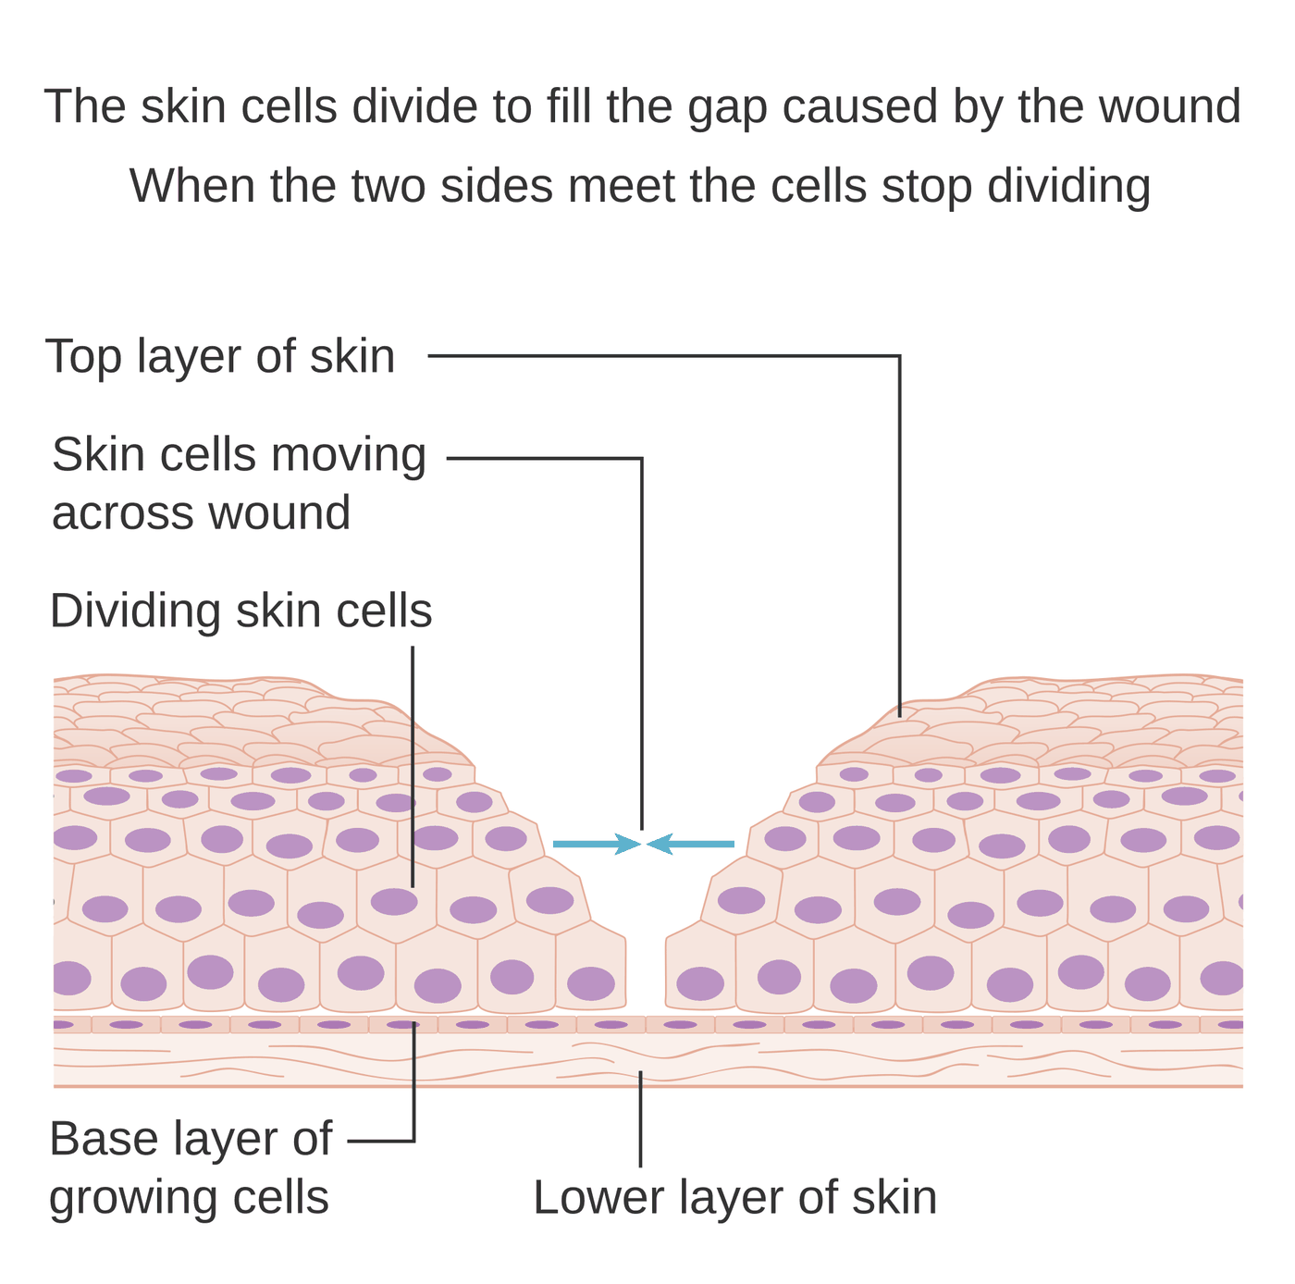
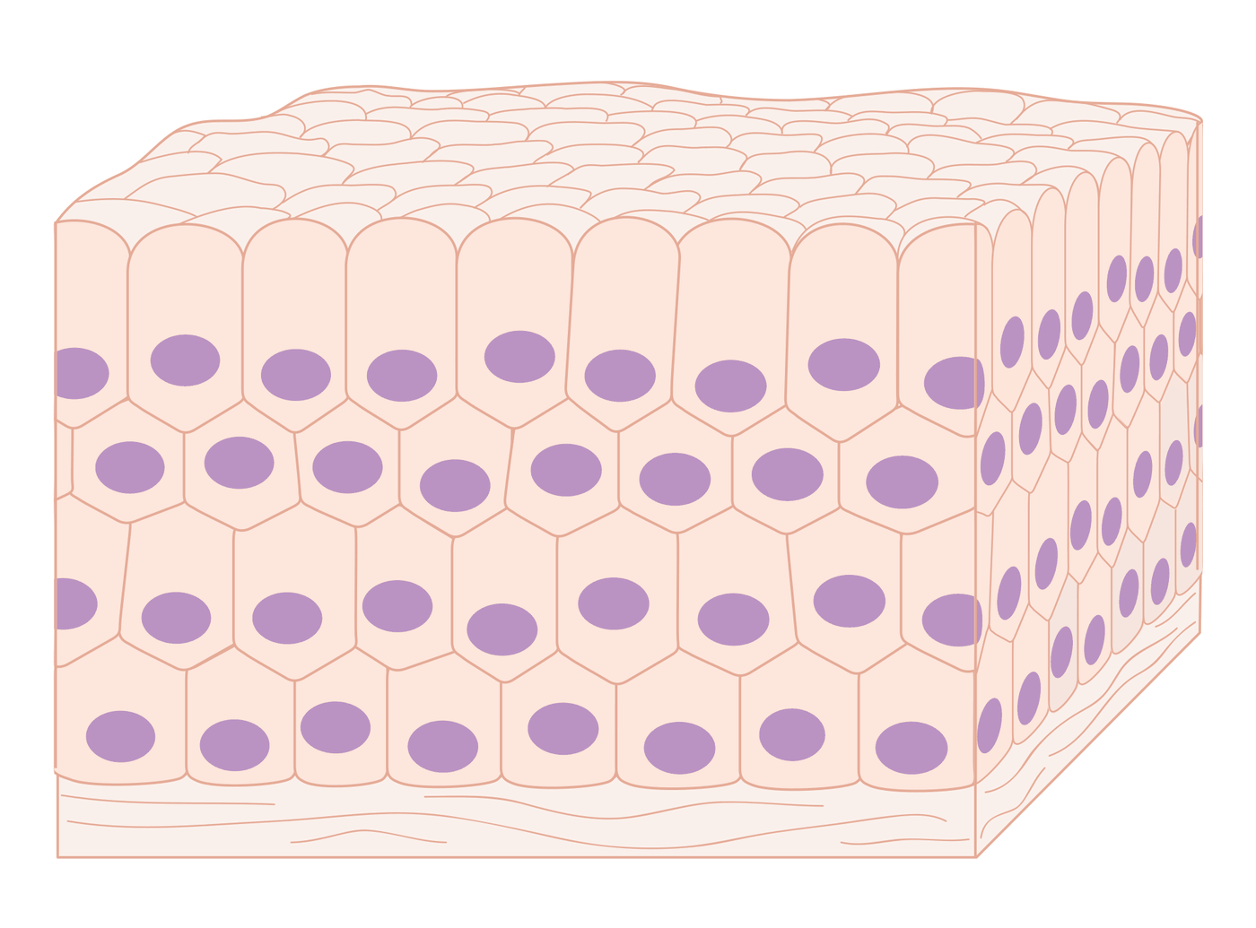
Figures 9.1–9.2 · Normal tissue and contact inhibition
WHAT TO NOTICE
Figure 9.1 uniform cells, one regular nucleus each, in orderly layers
Figure 9.2 skin cells divide to close a wound, then stop when the two sides meet
In cancer both the orderly architecture and the stop signal are lost
Figure 9.1. "Diagram showing how normal cells make up the tissue in our body CRUK 135" by Cancer Research UK, via Wikimedia Commons, CC BY-SA 4.0.
Figure 9.2. "Diagram showing how cells know when to stop dividing CRUK 128" by Cancer Research UK, via Wikimedia Commons, CC BY-SA 4.0.
Use these as the baseline: dysplasia and cancer are recognized by how far tissue departs from this order.
Notes:
Figure 9.1 shows normal epithelial tissue: cells of similar size and shape, each with one regular nucleus, in orderly layers above connective tissue. Figure 9.2 shows contact inhibition during wound healing: cells beside a wound divide and migrate, then stop dividing when the two sides meet. Point out that cancer cells lose this stop signal and keep dividing.
Figure credit: Figure 9.1: "Diagram showing how normal cells make up the tissue in our body CRUK 135" by Cancer Research UK, via Wikimedia Commons, CC BY-SA 4.0. Figure 9.2: "Diagram showing how cells know when to stop dividing CRUK 128" by Cancer Research UK, via Wikimedia Commons, CC BY-SA 4.0.

Slide 7
Baseline laboratory values used in this chapter
NORMAL BASELINE
Adult SI reference ranges (Medical Council of Canada, 2020); always use your own laboratory's ranges
ANC 2.0–7.5 × 10⁹/L · defines neutropenia
Potassium 3.5–5.1 mmol/L · high in TLS
Hemoglobin F 115–155; M 125–170 g/L · anemia
Calcium, total 2.12–2.52 mmol/L (ionized 1.14–1.28)
Platelets 130–380 × 10⁹/L · bleeding risk
Phosphate 0.81–1.58 mmol/L · high in TLS
Sodium 136–146 mmol/L · low in SIADH
Uric acid F 155–400; M 208–400 µmol/L · high in TLS
Albumin trap: much plasma calcium is bound to albumin; a low albumin lowers total calcium, so use ionized or albumin-corrected calcium.
Notes:
These are the values from Table 9.2 that recur throughout the chapter. The ANC defines neutropenia and infection risk; hemoglobin and platelets fall with marrow suppression; sodium falls in SIADH; potassium, phosphate and uric acid rise and calcium falls in tumour lysis syndrome; and calcium rises in hypercalcemia of malignancy. Source: Medical Council of Canada (2020). Emphasize the albumin point in the callout: a large share of plasma calcium is bound to albumin, and malnourished patients often have low albumin, so the total calcium can look normal or low even when the active ionized calcium is high.

Slide 8
The genes that go wrong: accelerators, brakes and mechanics
9.1 CANCER BIOLOGY
Cancer arises when enough of these genes are damaged in the same cell
Proto-oncogenes
Tumour suppressor genes
DNA repair genes
The accelerators
The brakes
The mechanics
Normal role growth factors, receptors, signalling proteins
Mutated an oncogene is permanently on; one copy is enough
Examples HER2 amplification; BCR-ABL in CML
Normal role stop the cycle or trigger apoptosis (p53, RB1)
Lost usually both copies must fail
Inherited one bad copy means earlier, sometimes multiple, cancers
Normal role repair thousands of DNA lesions a day
Lost mutations pile up across the genome
Inherited BRCA1/2: breast, ovarian; Lynch: colorectal, endometrial
Big picture: cancer is a stepwise accumulation of mutations, which is why most cancers become more common with age.
Notes:
Three gene groups. Proto-oncogenes code for growth signals; a mutation, extra copies or a chromosome rearrangement turns them into oncogenes that are permanently on, and one altered copy is enough. Examples from the chapter: HER2 amplification in some breast cancers and the BCR-ABL fusion gene in chronic myeloid leukemia. Tumour suppressor genes such as p53 and RB1 are brakes; usually both copies must be lost, which is why people who inherit one damaged copy develop cancer younger and sometimes in more than one organ. DNA repair genes such as BRCA1, BRCA2 and the mismatch-repair genes keep the genome stable; when they fail, mutations pile up across the genome (Hanahan, 2022). Inherited BRCA variants raise breast and ovarian cancer risk; Lynch syndrome raises colorectal and endometrial cancer risk.

Slide 9
The hallmarks of cancer are also treatment targets
9.1 GOING DEEPER [RN]
Going Deeper · RN required, PN optional (Hanahan, 2022)
The hallmarks, grouped
Each hallmark is a target
Grow sustain growth signalling; evade growth suppressors
Survive resist cell death; enable replicative immortality
Spread induce angiogenesis; activate invasion and metastasis
Adapt reprogram energy metabolism; avoid immune destruction
Growth signalling trastuzumab [HER2 antibody]
BCR-ABL enzyme imatinib [tyrosine kinase inhibitor]
Blood supply angiogenesis inhibitors
Immune evasion pembrolizumab [PD-1 checkpoint inhibitor]
Bedside question: which hallmark is this drug aimed at? The answer usually predicts both the expected effect and the typical toxicity.
Notes:
Going Deeper box from section 9.1, RN required and PN optional. Hanahan's 2022 update lists the capabilities every cancer acquires: sustaining growth signalling, evading growth suppressors, resisting cell death, replicative immortality, angiogenesis, invasion and metastasis, reprogramming energy metabolism and avoiding immune destruction, with phenotypic plasticity as an emerging hallmark. Genome instability, tumour-promoting inflammation, non-mutational epigenetic reprogramming and the microbiome are enabling characteristics. The practical point: trastuzumab [HER2-targeted monoclonal antibody] blocks growth signalling, imatinib [tyrosine kinase inhibitor] blocks BCR-ABL, angiogenesis inhibitors starve the blood supply, and pembrolizumab [immune checkpoint inhibitor (PD-1)] removes immune evasion. Asking which hallmark a drug targets predicts its effect and its toxicity.

Slide 10
Carcinogenesis: initiation, promotion and progression
9.1 CARCINOGENESIS
Three overlapping stages, usually over years to decades
Initiation
Promotion
Progression
What first permanent change to DNA
Causes tobacco carcinogens, UV, ionizing radiation, viruses, copying errors
Key point cell looks normal; change is irreversible
What initiated cell pushed to divide repeatedly
Promoters hormones, chronic inflammation, alcohol, excess body fat
Key point often reversible early: the basis of risk reduction
What further mutations and genetic instability
Result the ability to invade and spread
Key point the cells are now clearly malignant
Viruses: high-risk HPV disables p53 and RB; chronic hepatitis B and C promote liver cancer; H. pylori promotes gastric cancer.
Notes:
Initiation is the first permanent DNA change, caused by carcinogens such as tobacco smoke chemicals, UV or ionizing radiation, certain viruses, or a random copying error; the cell looks normal and the change is irreversible. Promotion encourages the initiated cell to divide repeatedly; hormones, chronic inflammation, alcohol and excess body fat are promoters, and promotion is often reversible early, which is the biological basis for risk reduction even after initiation. Progression is the stage of further mutation, genetic instability and the ability to invade. The callout gives the viral examples from the chapter: high-risk HPV disables p53 and the retinoblastoma protein, chronic hepatitis B and C promote liver cancer, and H. pylori promotes gastric cancer.

Slide 11
From abnormal growth to invasive cancer
9.1 TISSUE CHANGES
Not every lesion progresses, but the sequence explains why screening works
1
2
3
4
5
Hyperplasia
Metaplasia
Dysplasia
Carcinoma in situ
Invasive cancer
More cells; normal appearance and architecture.
One mature cell type replaced by another after irritation.
Disordered growth and abnormal nuclei: precancerous.
Has not crossed the basement membrane; stage 0.
Through the membrane into tissue with vessels.
Why screening works: finding dysplasia or carcinoma in situ allows treatment before the cancer can invade or spread.
Notes:
Walk the pathology sequence. Hyperplasia is more cells with normal appearance. Metaplasia replaces one mature cell type with another after chronic irritation: squamous cells in a smoker's airways, intestinal-type cells in Barrett esophagus. Dysplasia is disordered growth and a true precancerous change; abnormal cervical cells on screening are dysplasia. Carcinoma in situ has not crossed the basement membrane, so it cannot spread and is staged as stage 0 (Canadian Cancer Society, n.d.-a). Invasive cancer has crossed it into tissue where blood and lymph vessels give it a route to spread.

Slide 12
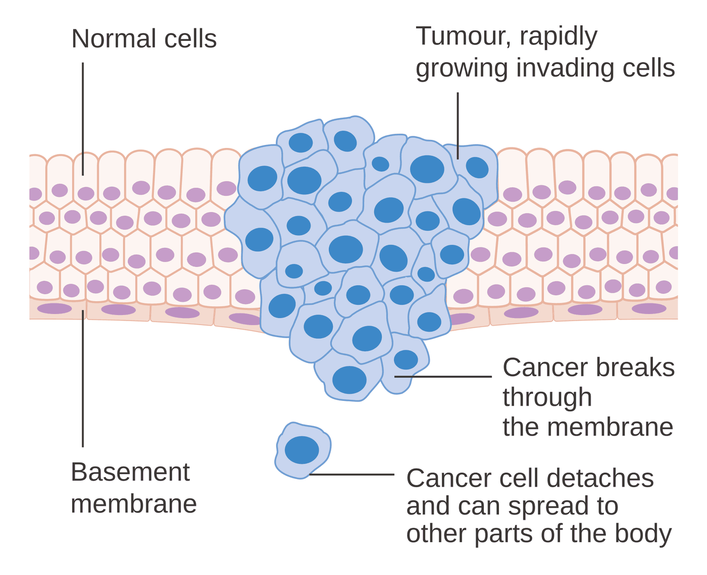
Figure 9.3 · Invasion through the basement membrane
WHAT TO NOTICE
Normal cells sit on an intact basement membrane
Tumour larger, irregular cells with big dark nuclei
Invasion cells break through the membrane
Detached cell can now reach blood or lymph vessels
Crossing the basement membrane is what separates invasive cancer from carcinoma in situ.
Figure 9.3. "Diagram showing a malignant tumour CRUK 069" by Cancer Research UK, via Wikimedia Commons, CC BY-SA 4.0.
Notes:
Figure 9.3 shows a mass of abnormal cells that has broken through the basement membrane beneath normal epithelium, and a detached cancer cell that can now reach blood or lymph vessels. Link back to the previous slide: before this point the lesion is carcinoma in situ and cannot spread.
Figure credit: Figure 9.3: "Diagram showing a malignant tumour CRUK 069" by Cancer Research UK, via Wikimedia Commons, CC BY-SA 4.0.

Slide 13
Benign and malignant tumours
9.1 TUMOUR CLASSIFICATION
The distinction is about behaviour, not size
Benign
Malignant
Cells well differentiated; resemble tissue of origin
Growth usually slow; often encapsulated; pushes tissue aside
Spread never invades or metastasizes
Naming tissue + -oma: lipoma, adenoma, fibroma
Cells well differentiated to anaplastic; frequent mitoses
Growth relentless; infiltrates surrounding tissue
Spread invades and metastasizes; can recur after removal
Naming carcinoma, sarcoma, leukemia, lymphoma
Grade is not stage: grade describes how abnormal the cells look; stage describes how far the cancer has spread. Both guide treatment.
Notes:
Based on Table 9.3. A benign tumour in the skull can still kill by compression, while a small malignant tumour may already have spread. Benign tumours are well differentiated, often encapsulated, do not invade or metastasize, and are named with -oma. Malignant tumours range from well differentiated to anaplastic, infiltrate tissue, invade, metastasize, can recur after apparently complete removal, and often cause systemic effects. Most adult cancers are carcinomas from epithelium; adenocarcinomas arise from glands and squamous cell carcinomas from layered epithelium. Close with grade versus stage: grade describes how abnormal the cells look; stage describes spread.

Slide 14
Cancer across the lifespan
9.1 LIFESPAN CONSIDERATIONS
Lifespan Considerations
Children and adolescents
Older adults
Types leukemias, brain tumours, lymphomas, embryonal tumours
Cause rarely linked to lifestyle exposures
Treatment often highly sensitive to chemotherapy
Survivors lifelong late effects: growth, fertility, heart, learning
Risk most cancers are diagnosed here: mutations accumulate
Biology DNA repair and immune surveillance decline
Reserve less reserve, more illness and medications
Decisions function, cognition, nutrition and goals (Chapter 8)
Takeaway: chronological age alone should never decide treatment.
Notes:
Lifespan box from section 9.1. Childhood cancers are mostly leukemias, brain tumours, lymphomas and embryonal tumours from developing tissues and are rarely linked to lifestyle. They are often very sensitive to chemotherapy, but survivors face lifelong late effects on growth, fertility, the heart and learning. Most cancers are diagnosed in older adults because carcinogenesis needs many mutations, and DNA repair and immune surveillance decline with age. Older adults have less reserve, more chronic illness and more medications. Chronological age alone should never decide treatment; function, cognition, nutrition and goals matter more. Connect to Chapter 8.

Slide 15
Metastasis happens in steps, and most cells fail
9.2 INVASION AND METASTASIS
Most deaths from cancer are caused by metastatic disease
1
2
3
4
5
Local invasion
Intravasation
Survival
Arrest and exit
Colonization
Cells loosen attachments and digest membrane and matrix.
Cells squeeze into blood or lymph vessels.
Platelet coating shields cells and raises VTE risk.
Cells lodge in a distant capillary bed and leave it.
Cells build a blood supply; some lie dormant for years.
Angiogenesis: hypoxic tumours release VEGF to sprout new, leaky vessels; without them a tumour stays very small.
Notes:
Section 9.2. Metastasis is inefficient: millions of cells may enter the circulation but very few survive every step. Local invasion: cells loosen their attachments and digest the basement membrane and matrix. Intravasation: cells squeeze into vessels. Survival: many coat themselves with platelets, which shields them and helps explain the higher VTE risk in cancer. Arrest and extravasation: cells lodge in a distant capillary bed and exit. Colonization: cells must survive, build a blood supply and grow, and some stay dormant for years, which is why cancer can recur long after treatment. Angiogenesis, in the callout, is driven mainly by VEGF from hypoxic tumour cells; tumour vessels are leaky and disorganized.

Slide 16
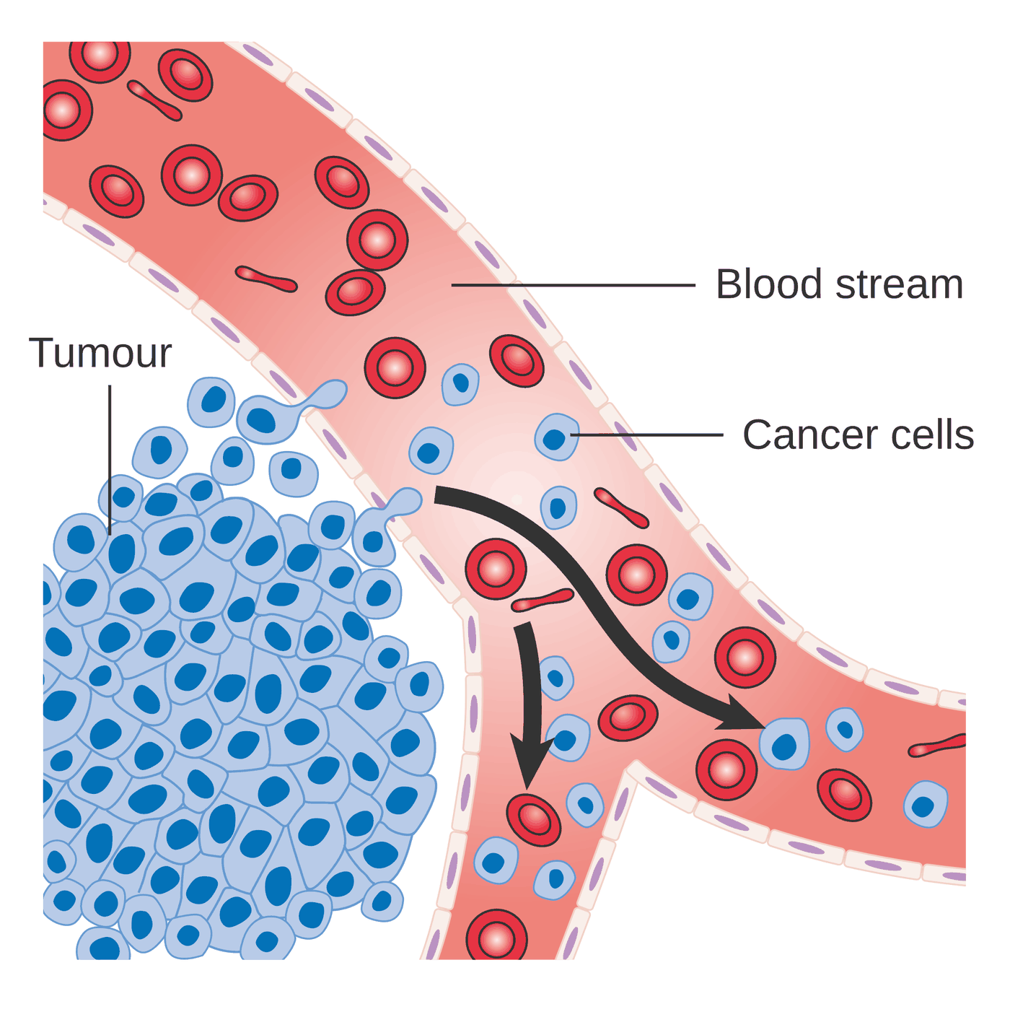
Figure 9.4 · Intravasation
WHAT TO NOTICE
Tumour tightly packed abnormal cells beside a vessel
Intravasation cells squeeze through the vessel wall
Circulation cells travel among red cells toward distant capillary beds
This is the first step of hematogenous metastasis, and metastasis, not the primary tumour, causes most cancer deaths.
Figure 9.4. "Diagram showing cancer cells spreading into the blood stream CRUK 448" by Cancer Research UK, via Wikimedia Commons, CC BY-SA 4.0.
Notes:
Figure 9.4 shows cancer cells at the edge of a tumour passing through the wall of a nearby blood vessel and being carried away in the circulation, the first step of hematogenous metastasis.
Figure credit: Figure 9.4: "Diagram showing cancer cells spreading into the blood stream CRUK 448" by Cancer Research UK, via Wikimedia Commons, CC BY-SA 4.0.

Slide 17
Three routes of spread
9.2 ROUTES OF SPREAD
The usual route and site for a cancer focus your assessment
Lymphatic
Hematogenous
Seeding
Typical of carcinomas
First stop regional nodes; the sentinel node is biopsied in breast cancer and melanoma
Staging the basis of the N category
Typical of sarcomas and later-stage carcinomas
Gut to liver portal drainage: colorectal cancer to liver
Lungs nearly all venous blood passes through them
Route cells shed into peritoneal or pleural space
Example ovarian cancer across the peritoneum
Result malignant ascites or effusion
Same cancer, new place: breast cancer in bone is still breast cancer, made of breast cells, and is treated as breast cancer.
Notes:
Lymphatic spread is typical of carcinomas; cells reach regional nodes first, so the sentinel node is biopsied to stage breast cancer and melanoma. Hematogenous spread is typical of sarcomas and later-stage carcinomas; gut venous blood drains through the portal vein to the liver, so colorectal cancer commonly spreads to the liver, and nearly all venous blood passes through the lungs. Seeding of body cavities occurs when cells shed into the peritoneal or pleural space, as with ovarian cancer causing malignant ascites. Breast cancer in bone is still breast cancer and is treated as breast cancer.

Slide 18
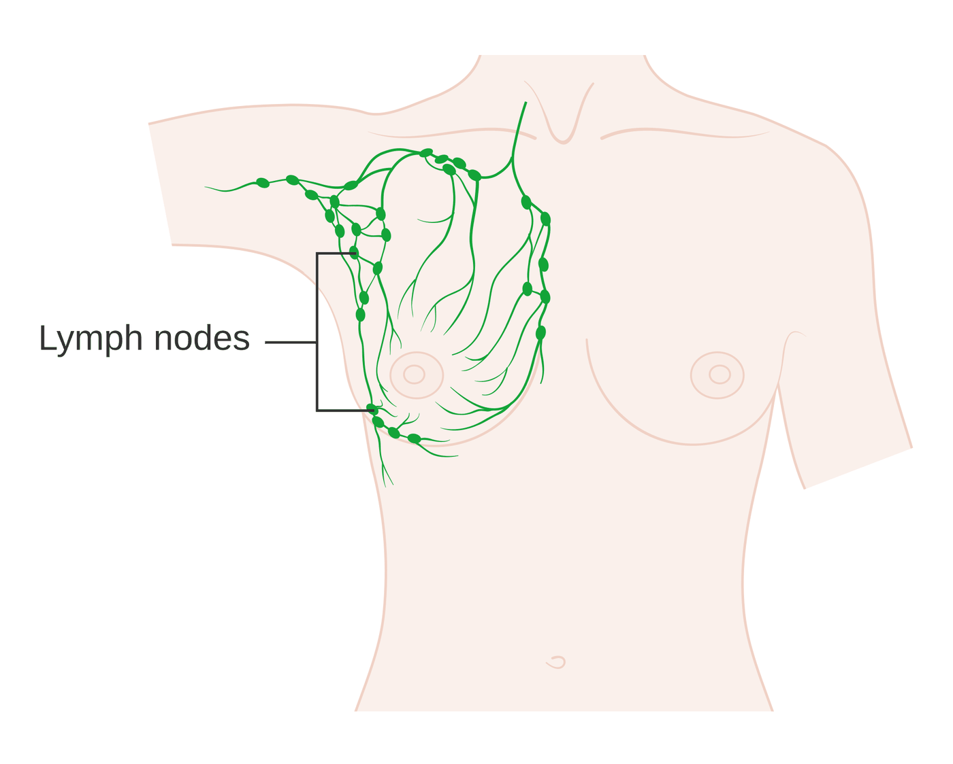
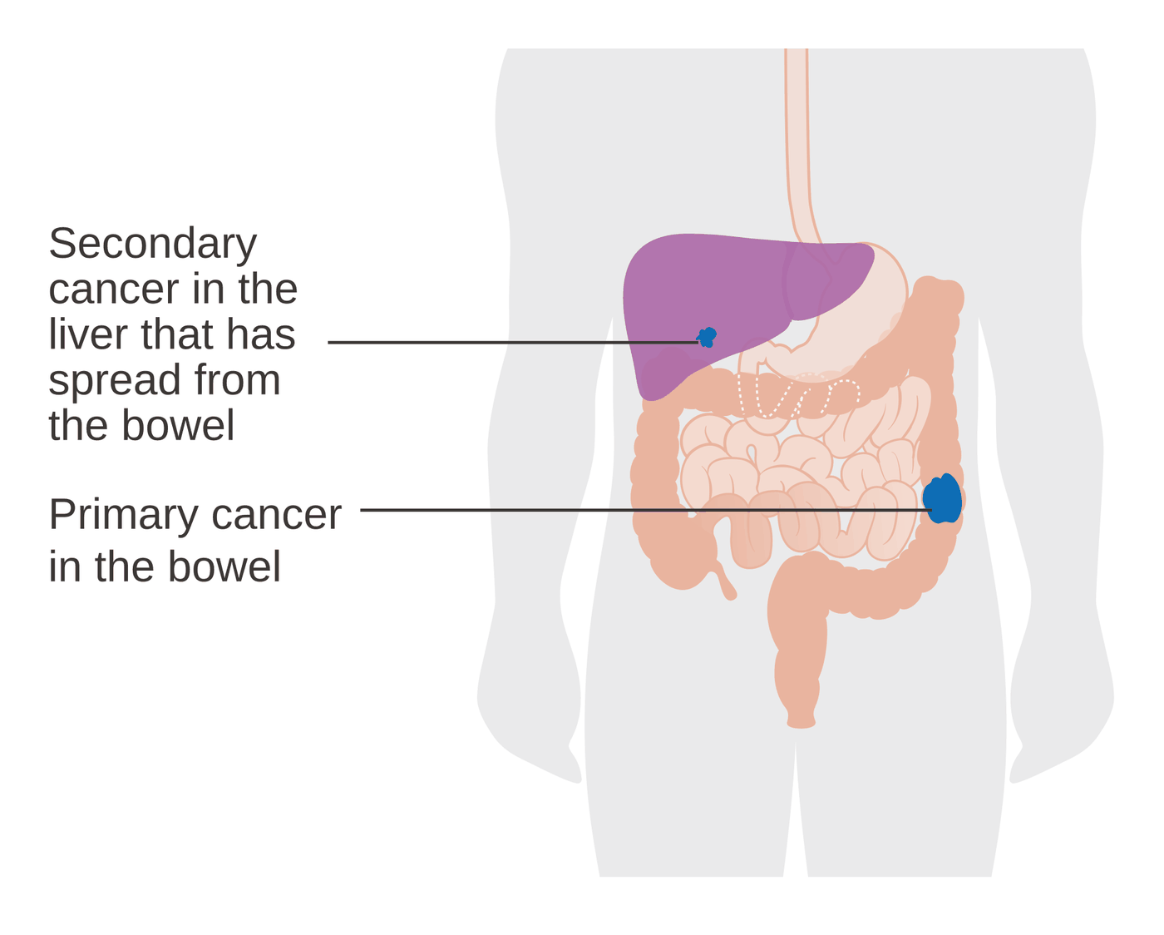
Figures 9.5–9.6 · Lymphatic and hematogenous spread
WHAT TO NOTICE
Figure 9.5 breast lymph drains to nodes in the armpit, under the collarbone and beside the breastbone
Sentinel node the first node to receive drainage; sampled to stage breast cancer
Figure 9.6 a bowel primary with a secondary cancer in the liver
Figure 9.5. "Diagram showing the network of lymph nodes in and around the breast CRUK 315" by Cancer Research UK, via Wikimedia Commons, CC BY-SA 4.0.
Figure 9.6. "Diagram showing a primary and secondary cancer CRUK 074" by Cancer Research UK, via Wikimedia Commons, CC BY-SA 4.0.
The liver tumour is made of bowel cancer cells and is treated as bowel cancer.
Notes:
Figure 9.5 shows lymph vessels carrying fluid from the breast to chains of nodes in the armpit, beneath the collarbone and beside the breastbone; the first node to receive drainage is the sentinel lymph node. Figure 9.6 shows a primary cancer in the bowel that has spread to form a secondary cancer in the liver, consistent with portal venous drainage.
Figure credit: Figure 9.5: "Diagram showing the network of lymph nodes in and around the breast CRUK 315" by Cancer Research UK, via Wikimedia Commons, CC BY-SA 4.0. Figure 9.6: "Diagram showing a primary and secondary cancer CRUK 074" by Cancer Research UK, via Wikimedia Commons, CC BY-SA 4.0.

Slide 19
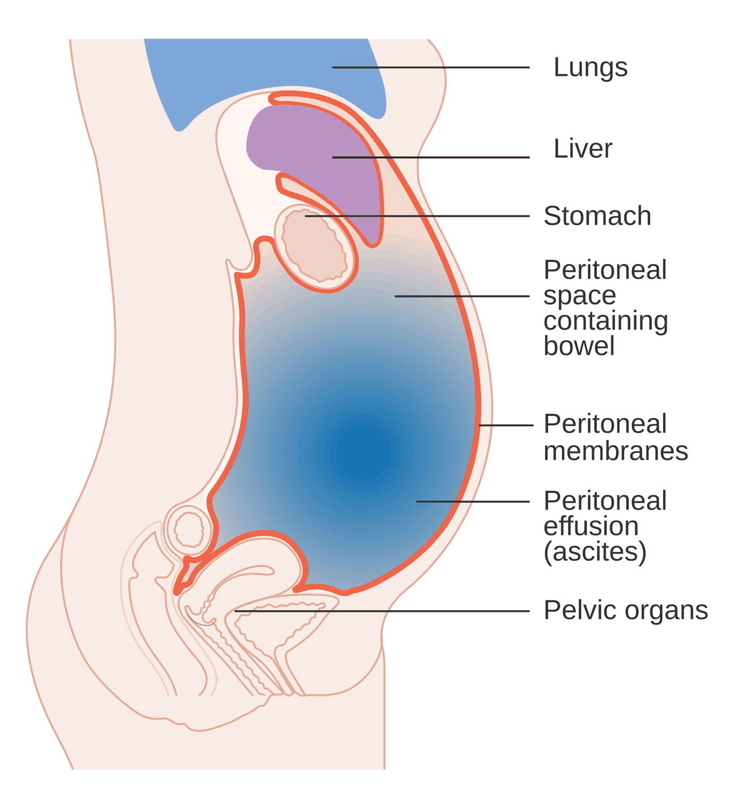
Figure 9.7 · Malignant ascites
WHAT TO NOTICE
Cause peritoneal seeding plus blocked lymphatic drainage
Effect fluid fills the peritoneal space and distends the abdomen
Symptoms early satiety and dyspnea
Nursing girth, weight, positioning; prepare for paracentesis per orders
Fluid pressing up toward the lungs explains the breathlessness.
Figure 9.7. "Diagram showing fluid in the abdomen CRUK 123" by Cancer Research UK, via Wikimedia Commons, CC BY-SA 4.0.
Notes:
Figure 9.7 shows malignant ascites: when cancer seeds the peritoneum and blocks lymphatic drainage, fluid collects in the peritoneal space, distending the abdomen and pressing up toward the lungs. Link to Table 9.4: measure girth and weight, position for comfort and prepare for paracentesis per orders.
Figure credit: Figure 9.7: "Diagram showing fluid in the abdomen CRUK 123" by Cancer Research UK, via Wikimedia Commons, CC BY-SA 4.0.

Slide 20
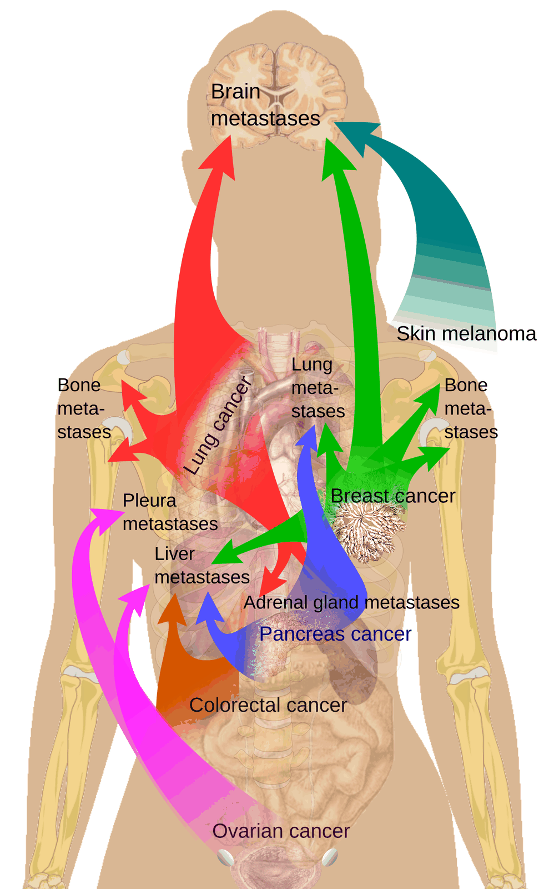
Figure 9.8 · Common sites of metastasis
WHAT TO NOTICE
Lung cancer brain, bones, adrenal glands
Breast cancer brain, lungs, bones, liver
Colorectal cancer liver
Melanoma brain
Ovarian cancer pleura, liver
New bone pain, new headache or confusion, or new jaundice in a person with known cancer deserves prompt reporting.
Figure 9.8. "Metastasis sites for common cancers" by Mikael Häggström, via Wikimedia Commons, CC0 1.0.
Notes:
Figure 9.8 links several primary cancers to the organs they often spread to. Use it to focus assessment: new bone pain in breast or prostate cancer, new headache or confusion in lung cancer or melanoma, and new jaundice or right upper quadrant pain in colorectal cancer all deserve prompt reporting.
Figure credit: Figure 9.8: "Metastasis sites for common cancers" by Mikael Häggström, via Wikimedia Commons, CC0 1.0.

Slide 21
Cachexia and paraneoplastic syndromes
9.2 SYSTEMIC EFFECTS
Cancer changes the metabolism of the whole body
Cancer cachexia
Paraneoplastic syndromes
Definition ongoing muscle loss not fully reversed by nutrition (Fearon et al., 2011)
Criterion weight loss >5%, or >2% if already depleted
Mechanism TNF-α, IL-6: higher energy use, muscle breakdown, insulin resistance
Action weigh every visit; early dietitian referral
Definition caused by tumour products or immune response, not tumour mass
Endocrine PTHrP hypercalcemia; SIADH; ectopic ACTH
Neurological Lambert-Eaton myasthenic syndrome
Clotting VTE may be the first sign of an occult cancer
Going Deeper [RN]: the liver diverts amino acids into acute-phase proteins, so a low albumin reflects inflammation as much as intake.
Notes:
Cancer cachexia is a multifactorial syndrome of ongoing skeletal muscle loss, with or without fat loss, that conventional nutritional support cannot fully reverse (Fearon et al., 2011). The consensus criterion is weight loss greater than 5%, or greater than 2% in people already depleted. Cytokines such as tumour necrosis factor alpha and interleukin-6 suppress appetite, raise resting energy expenditure, break down muscle and cause insulin resistance. Weigh at every visit and refer to a dietitian early. Paraneoplastic syndromes are caused by tumour products or the immune response, not the tumour mass: PTHrP hypercalcemia, SIADH from small cell lung cancer, ectopic ACTH causing Cushing syndrome, Lambert-Eaton myasthenic syndrome, and hypercoagulability. The callout is the RN Going Deeper point on why low albumin reflects inflammation.

Slide 22
Pain, fatigue and anemia
9.2 SYSTEMIC EFFECTS
Identify the mechanism: it points to the treatment
Pain
Fatigue
Anemia
Prevalence 55% in treatment; 66% in advanced disease (WHO, 2019)
Bone aching, localized
Visceral cramping, poorly localized
Neuropathic burning, shooting; adjuvants help
What persistent tiredness not relieved by rest
Frequency the most common symptom reported
Causes anemia, cytokines, sleep, pain, depression
Nursing assess like pain; energy conservation
Inflammation traps iron, blunts erythropoietin
Blood loss gut or bladder tumours
Marrow tumour replacement; treatment
Pancytopenia fatigue, infection and bleeding together
Notes:
Pain affects 55% of people receiving anticancer treatment and 66% of those with advanced, metastatic or terminal disease (World Health Organization, 2019). Bone invasion causes aching, localized nociceptive pain; organ stretch or obstruction causes poorly localized visceral pain; nerve invasion causes burning or shooting neuropathic pain that responds partly to adjuvants. Cancer-related fatigue is persistent tiredness out of proportion to activity and not relieved by rest; it is the most common symptom reported. Anemia has several simultaneous causes: inflammation, blood loss, marrow replacement and treatment. When cancer fills the marrow, all three lines can fall together.

Slide 23
Local and systemic effects at the bedside
9.2 PATHO-TO-BEDSIDE
Cue → mechanism → nursing action (Table 9.4)
Weight loss, wasting cachexia → weigh, % loss, dietitian early
Calf swelling or sudden dyspnea cancer-associated VTE → report now; vitals, SpO₂
New bone pain metastasis → full pain assessment; spine: legs, bladder, bowel
Fatigue, pallor, tachycardia anemia → Hgb, bleeding check, energy conservation
Confusion, constipation, polyuria hypercalcemia → report; calcium, creatinine
Distension, satiety, dyspnea malignant ascites → girth, weight, positioning
Cluster the cues: many early signs of spread look like "just cancer"; naming the mechanism is what triggers the right action.
Notes:
This is Table 9.4. For each cue, name the mechanism, then the action. Weight loss and wasting: cachexia, so weigh, calculate percentage loss and refer early. New localized bone pain: bone metastasis; if the pain is in the spine, check limb strength and bladder and bowel function. Confusion, constipation and polyuria: hypercalcemia; report and request calcium and creatinine. Unilateral calf swelling or sudden dyspnea: cancer-associated thrombosis; report immediately. Fatigue, pallor and tachycardia: anemia. Distension, early satiety and dyspnea: malignant ascites.

Slide 24
Prevention, Screening and Diagnosis
PART 2
Modifiable risk in Canada · Ontario screening programs · biopsy, imaging and TNM staging (9.3)
Notes:
Part 2 is section 9.3. Carcinogenesis takes years and passes through precancerous stages, giving two windows: primary prevention stops cancer from starting, and screening finds precancerous change or early cancer in people with no symptoms.

Slide 25
Modifiable risk factors for cancer in Canada
9.3 RISK FACTORS
Primary prevention removes the initiators and promoters
Tobacco about 18% of all cancers; quitting at any age lowers risk
UV radiation sun and tanning beds cause most skin cancers
Alcohol acetaldehyde damages DNA; no clearly safe level
Infections HPV, hepatitis B and C, H. pylori: about 4 in 100 cases
Weight and inactivity raise insulin, growth factors, estrogen, inflammation
Environment radon, asbestos, diesel exhaust, industrial chemicals
ComPARe: about 4 in 10 cancer cases in Canada could be prevented, roughly 70,200 cases in 2015 (Canadian Cancer Society, 2019).
Notes:
The ComPARe study estimated about 4 in 10 cancer cases in Canada could be prevented, about 70,200 cases in 2015 (Canadian Cancer Society, 2019). Tobacco caused about 18% of all cancers, followed by physical inactivity, excess weight, sun exposure and alcohol; infections accounted for about 4 in 100 cases. Mechanisms: tobacco delivers dozens of carcinogens; alcohol is metabolized to acetaldehyde, which damages DNA, with no clearly safe level for cancer; excess weight and inactivity raise insulin, growth factors, estrogen and inflammation; UV damages skin DNA; HPV, hepatitis B and C and H. pylori cause cancer, and vaccination against HPV and hepatitis B is cancer prevention.

Slide 26
Prevention is not equally available
9.3 CANADIAN CONTEXT
Canadian Context
Equity and access
Radon in homes
Gradient smoking, healthy food, exposures follow income, education, geography
Distance rural and remote residents travel far for care
Ontario Indigenous Cancer Strategy 5 (2024–2028) prioritizes prevention, screening, access (Ontario Health, 2024b)
Nurses ask about barriers; connect to navigators and transport
Risk second leading cause of lung cancer; leading cause in people who do not smoke
Test long-term test of at least 3 months, fall or winter
Guideline 200 Bq/m³ for dwellings (Health Canada, 2018)
Teach testing is inexpensive prevention
A missed appointment: do not assume it means a lack of interest; ask about barriers first.
Notes:
Canadian Context box. Rates of smoking, access to healthy food and safe places to be active, and occupational exposures follow income, education and geography, and rural and remote residents often travel long distances for screening and treatment. Ontario's First Nations, Inuit, Métis and Urban Indigenous Cancer Strategy 5 (2024–2028) names prevention and wellbeing, screening and equitable access among its priorities (Ontario Health, 2024b). Radon is the second leading cause of lung cancer after smoking and the leading cause among people who do not smoke; Health Canada recommends a long-term test of at least 3 months, ideally in fall or winter, compared with the 200 Bq/m³ guideline (Health Canada, 2018).

Slide 27
Ontario's organized cancer screening programs
9.3 SCREENING IN ONTARIO
Criteria in effect when the chapter was written (Table 9.5); always check current program criteria
Breast · 40–74 mammogram; self-referral since Oct 8, 2024
Colorectal · higher risk colonoscopy every 5 years from 40 (or earlier)
Cervical · 25+ HPV test every 5 years for most; stop at 65–69
Lung · 55–74 ≥20 years daily smoking; low-dose CT after navigator assessment
Colorectal · 45–74 FIT every 2 years; start age 45 since July 1, 2026
Positive is not diagnosis abnormal FIT → colonoscopy; abnormal HPV → look for dysplasia
Screening is for people without symptoms: a lump, rectal bleeding or postmenopausal bleeding needs diagnostic assessment.
Notes:
Table 9.5. Breast: the Ontario Breast Screening Program covers ages 40 to 74; since October 8, 2024, people aged 40 to 49 can self-refer (Ontario Health, 2024a). Cervical: HPV testing for people with a cervix aged 25 and older who have ever had sexual contact, every 5 years for most, stopping between 65 and 69 (Ontario Health, 2025). Colorectal: FIT every 2 years from 45 to 74 for average risk; the start age was lowered from 50 to 45 on July 1, 2026; increased risk means colonoscopy every 5 years from 40 or 10 years before the youngest affected relative's diagnosis (Government of Ontario, 2026). Lung: current or former smokers aged 55 to 74 with at least 20 years of daily smoking, followed by a navigator risk assessment (Ontario Health [Cancer Care Ontario], n.d.-a). Stress the two points: screening is for people without symptoms, and a positive test is not a diagnosis.

Slide 28
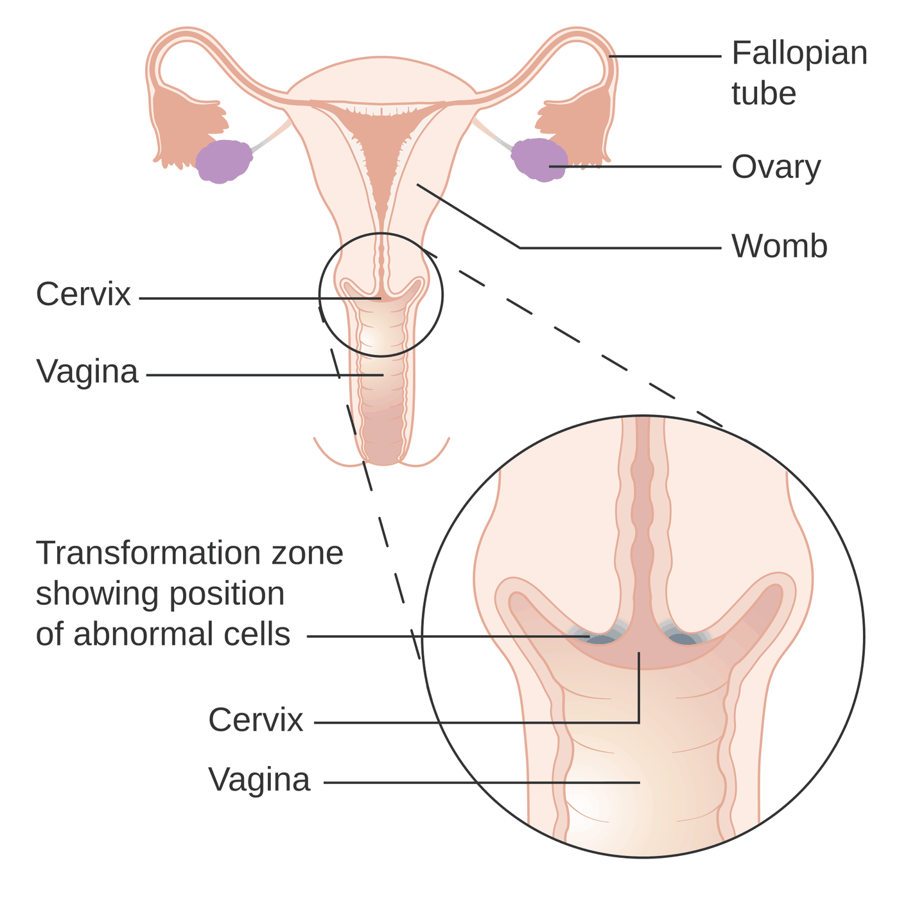
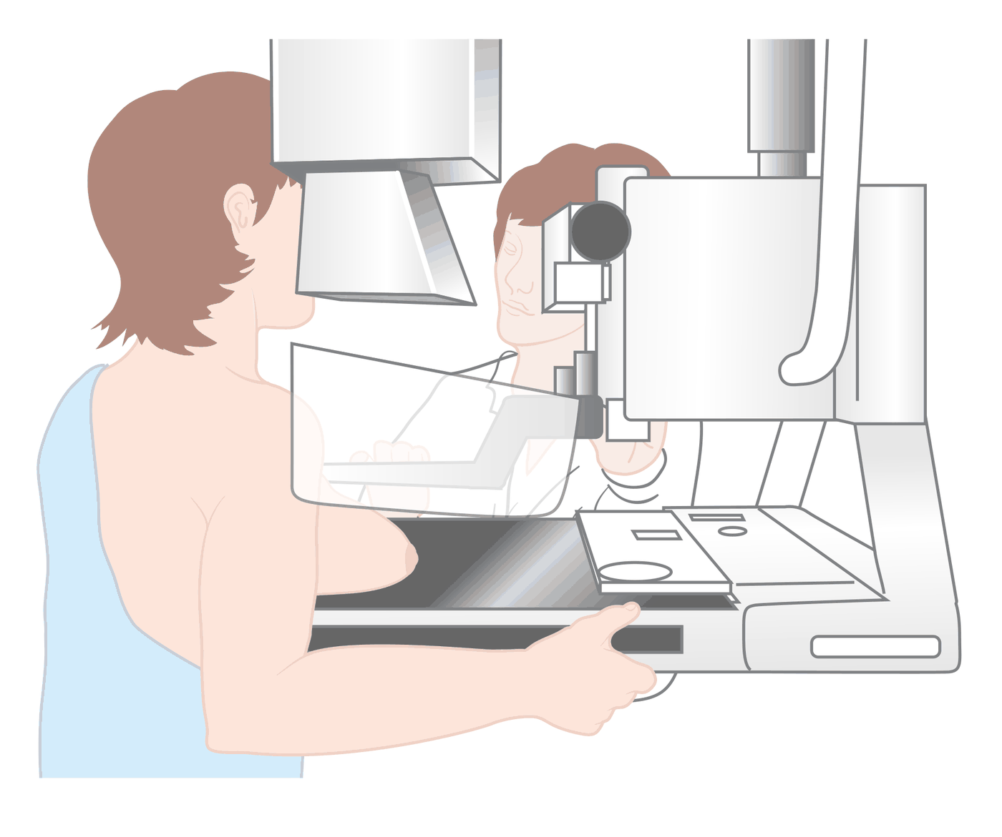
Figures 9.9–9.10 · Breast and cervical screening
WHAT TO NOTICE
Figure 9.9 the breast is compressed between a platform and a clear plate for a clear X-ray
Teaching prepare people for brief discomfort so they return
Figure 9.10 the transformation zone, a ring of tissue around the cervical opening
HPV test this is the area sampled
Figure 9.9. "Diagram showing a woman having a mammogram CRUK 089" by Cancer Research UK, via Wikimedia Commons, CC BY-SA 4.0.
Figure 9.10. "Diagram showing the transformation zone on the cervix CRUK 375" by Cancer Research UK, via Wikimedia Commons, CC BY-SA 4.0.
Ontario: book your own mammogram from age 40; HPV testing from age 25.
Notes:
Figure 9.9 shows screening mammography: the breast is positioned on a platform and compressed by a clear plate. Preparing people for the brief discomfort helps them return for repeat screening. Figure 9.10 shows the transformation zone of the cervix, where abnormal cells usually develop and where cells are sampled during cervical screening.
Figure credit: Figure 9.9: "Diagram showing a woman having a mammogram CRUK 089" by Cancer Research UK, via Wikimedia Commons, CC BY-SA 4.0. Figure 9.10: "Diagram showing the transformation zone on the cervix CRUK 375" by Cancer Research UK, via Wikimedia Commons, CC BY-SA 4.0.

Slide 29
Talking about screening and warning signs
9.3 PATIENT EDUCATION
Patient Education
The screening conversation
Don't wait for screening if you notice
Why screen finds problems before symptoms, when treatment is simpler
Mammogram ages 40–74 can book without a referral
FIT ages 45–74, every 2 years at home
Abnormal FIT not a diagnosis, but a colonoscopy is needed
a lump, or bleeding that is not normal for you
a change in bowel habit lasting more than a few weeks
a cough that will not go away, or a sore that does not heal
unexplained weight loss, or a mole that changes
Action: book an appointment with your primary care provider; screening tests are not for symptoms.
Notes:
Patient Education box. Use plain language: screening looks for problems before symptoms, when treatment is simpler and more successful. People aged 40 to 74 can book their own mammogram in Ontario without a referral. People aged 45 to 74 at average risk use the at-home FIT kit every two years; an abnormal result does not mean cancer but does mean a colonoscopy is needed. Most important: do not wait for the next screening test if a warning sign appears; book with your primary care provider.

Slide 30
Diagnosis: only tissue confirms cancer
9.3 DIAGNOSIS
History and examination lead to imaging, laboratory tests and a tissue sample
Biopsy
Imaging
Types FNA, core needle, excisional, endoscopic, bone marrow
Nursing check anticoagulants and platelets; monitor site; support the wait
Modalities ultrasound, CT, MRI, PET, bone scan
Purpose find the tumour, measure it, look for spread
Tumour markers
Molecular and genetic testing
Examples PSA, CEA, CA-125
Use not diagnostic alone; falling suggests response, rising suggests recurrence
Tumour hormone receptors, HER2, EGFR predict targeted therapy
Germline inherited variants affect the person and family
Notes:
Biopsy approaches: fine-needle aspiration, core needle biopsy, excisional biopsy, endoscopic biopsy, and bone marrow aspiration and biopsy for blood cancers. Nursing care: prepare the person, check anticoagulants and platelet count per protocol, monitor for bleeding and infection, and support them through the wait. Imaging (ultrasound, CT, MRI, PET, bone scans) finds, measures and looks for spread. Tumour markers such as PSA, CEA and CA-125 are not specific enough to diagnose alone, but trends show response or recurrence. Molecular testing identifies targets such as hormone receptors, HER2 or EGFR; germline testing looks for inherited variants.

Slide 31
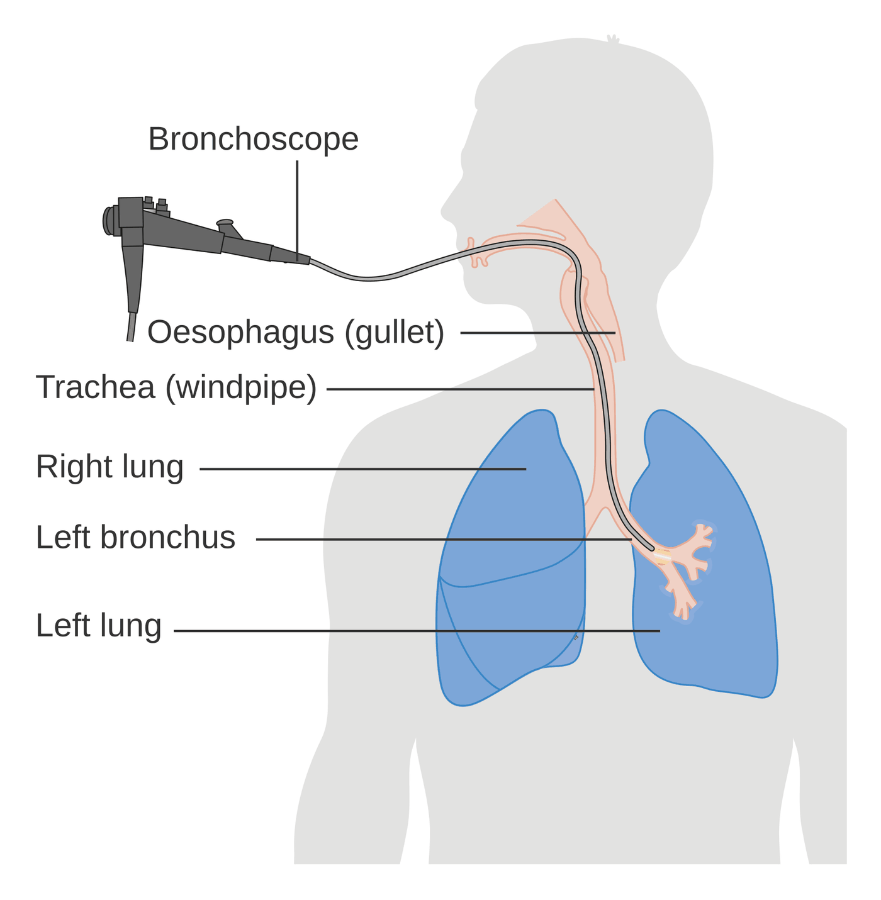
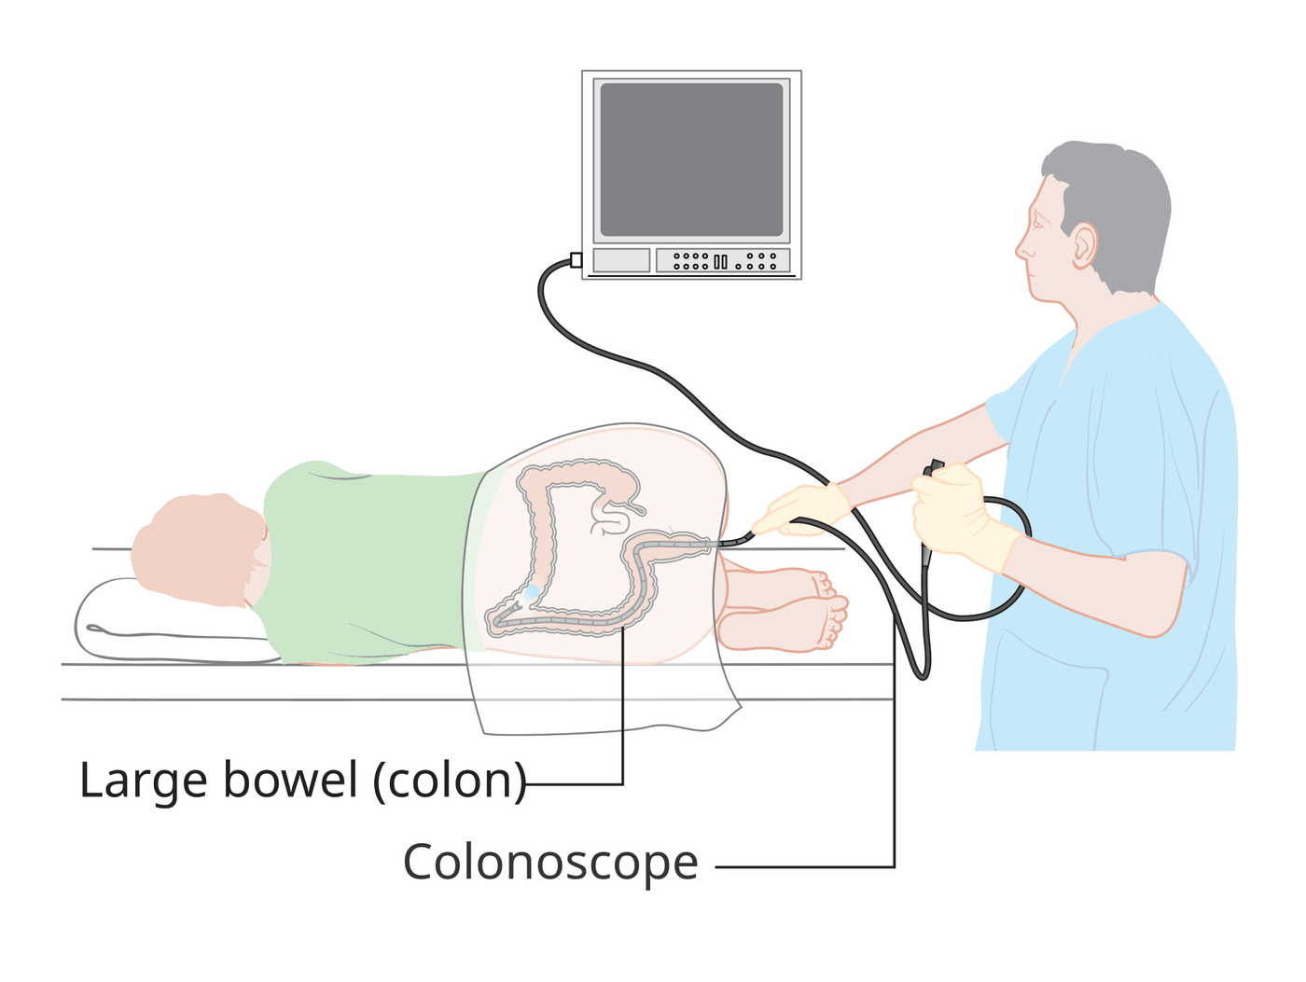
Figures 9.11–9.12 · Endoscopic diagnosis
WHAT TO NOTICE
Colonoscopy flexible scope passed through the anus and around the colon
Purpose view, biopsy and remove polyps; follows an abnormal FIT
Bronchoscopy scope through the mouth, down the trachea into a bronchus
Purpose view airways and biopsy suspected lung cancer
Figure 9.11. "Diagram showing a colonoscopy CRUK 060" by Cancer Research UK, via Wikimedia Commons, CC BY-SA 4.0.
Figure 9.12. "Diagram showing a bronchoscopy CRUK 053" by Cancer Research UK, via Wikimedia Commons, CC BY-SA 4.0.
Endoscopic biopsy provides tissue: the only way to confirm cancer, its type and its grade.
Notes:
Figure 9.11 shows colonoscopy with the person on their side; the scope is passed through the anus and around the large bowel so the lining can be viewed, biopsied and cleared of polyps. An abnormal FIT is followed up with this test. Figure 9.12 shows bronchoscopy: a flexible scope passes through the mouth, down the trachea and into a bronchus.
Figure credit: Figure 9.11: "Diagram showing a colonoscopy CRUK 060" by Cancer Research UK, via Wikimedia Commons, CC BY-SA 4.0. Figure 9.12: "Diagram showing a bronchoscopy CRUK 053" by Cancer Research UK, via Wikimedia Commons, CC BY-SA 4.0.

Slide 32
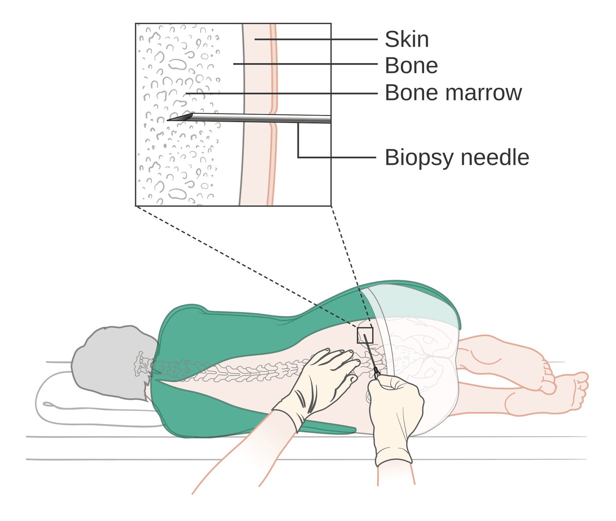
Figure 9.13 · Bone marrow biopsy
WHAT TO NOTICE
Position lying on the side
Site the back of the hip bone
Purpose diagnose and stage blood cancers
Afterward apply pressure; watch for bleeding, especially with low platelets
Before the procedure, check anticoagulants and the platelet count per protocol.
Figure 9.13. "Diagram showing a bone marrow biopsy CRUK 051" by Cancer Research UK, via Wikimedia Commons, CC BY-SA 4.0.
Notes:
Figure 9.13 shows a bone marrow biopsy: with the person on their side, a needle is passed through the skin into the back of the hip bone to sample marrow. Monitor the site for bleeding afterward, especially when platelets are low.
Figure credit: Figure 9.13: "Diagram showing a bone marrow biopsy CRUK 051" by Cancer Research UK, via Wikimedia Commons, CC BY-SA 4.0.

Slide 33
TNM staging describes how far the cancer has spread
9.3 STAGING
The most common staging system in Canada for solid tumours (Canadian Cancer Society, n.d.-a)
T · Tumour
N · Nodes
M · Metastasis
Describes size and local extent of the primary tumour
Range T1 to T4; Tis is carcinoma in situ
Describes spread to nearby lymph nodes
N0 no nodal spread
Describes spread to distant parts of the body
M0 / M1 absent / present
Stage groups: 0 in situ · 1 small and confined · 2–3 larger or into tissue or nodes · 4 distant spread. Prefix c = clinical, p = pathologic.
Blood cancers such as leukemia use different systems because they are widespread from the start.
Notes:
T describes the size of the primary tumour and whether it has grown into nearby tissue, usually numbered 1 to 4; Tis means carcinoma in situ. N describes spread to nearby lymph nodes; N0 means none. M describes distant spread; M0 none, M1 present. The categories combine into stage 0 to 4. Clinical staging, prefixed with c, is assigned before treatment; pathologic staging, prefixed with p, comes from tissue removed at surgery (Canadian Cancer Society, n.d.-a). Blood cancers use different systems because they are widespread from the start.

Slide 34
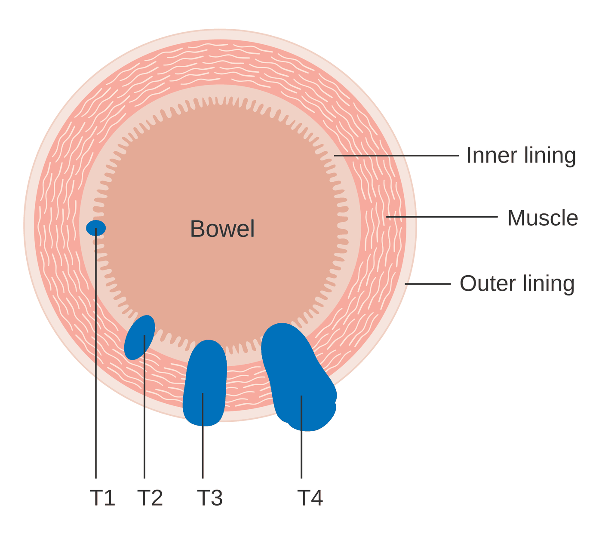
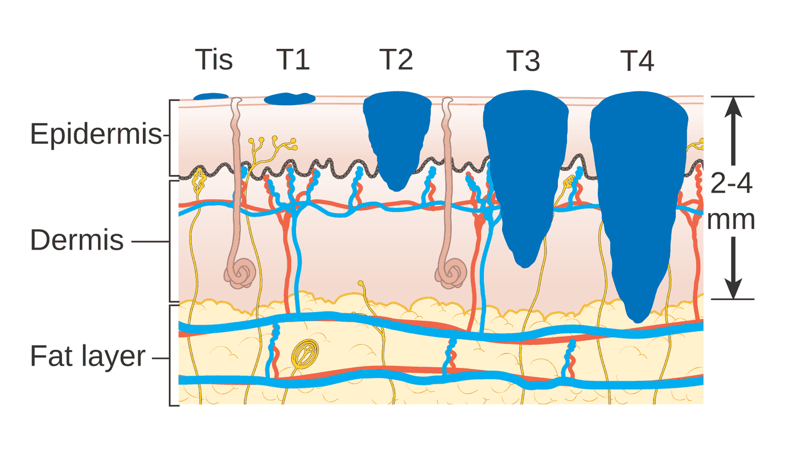
Figures 9.14–9.15 · T stages of bowel cancer and melanoma
WHAT TO NOTICE
Figure 9.14 T rises as the tumour grows through inner lining, muscle and outer lining
In the diagram T3 has grown through the muscle; T4 through the outer lining
Figure 9.15 melanoma T stage reflects depth from the skin surface, Tis to T4
Risk deeper tumours lie closer to dermal blood and lymph vessels
Figure 9.14. "Diagram showing T stages of bowel cancer CRUK 276" by Cancer Research UK, via Wikimedia Commons, CC BY-SA 4.0.
Figure 9.15. "Diagram showing the T stages of melanoma CRUK 373" by Cancer Research UK, via Wikimedia Commons, CC BY-SA 4.0.
Explain stage as "where the cancer is now": many stage 3 cancers are treated with the aim of cure.
Notes:
Figure 9.14 shows T stages of bowel cancer: the T category rises as the tumour grows more deeply through the bowel wall. Figure 9.15 shows T stages of melanoma, from in situ to T4; deeper tumours lie closer to blood and lymph vessels and carry a higher risk of spread. Remind students that stage 4 usually shifts the goal to control and quality of life, although some stage 4 cancers can still be cured.
Figure credit: Figure 9.14: "Diagram showing T stages of bowel cancer CRUK 276" by Cancer Research UK, via Wikimedia Commons, CC BY-SA 4.0. Figure 9.15: "Diagram showing the T stages of melanoma CRUK 373" by Cancer Research UK, via Wikimedia Commons, CC BY-SA 4.0.

Slide 35
Results, prognosis and the nurse's role
9.3 SCOPE IN PRACTICE
Scope in Practice
Who does what
"Is this curable?"
Physician or NP communicates the diagnosis, stage and prognosis
RN and RPN clarify, answer within knowledge, recognize distress, explain who to call
RPN consults the RN or team when the condition is complex, unpredictable or high risk (CNO, 2019b)
Avoid guessing and false reassurance
Acknowledge the question and the fear behind it
Ask what they have been told so far
Arrange for the right team member to answer
Stage 4: usually shifts the goal toward control and quality of life, although some stage 4 cancers can still be cured.
Notes:
Scope in Practice box. Communicating a new cancer diagnosis and the meaning of stage is the physician's or nurse practitioner's responsibility. RNs and RPNs clarify information already given, answer within their knowledge, recognize distress and make sure the person knows who to call. When asked 'Is this curable?' before the oncologist has discussed it, avoid guessing and false reassurance: acknowledge, ask what they have been told, and arrange for the right person to answer. RPNs caring for patients whose condition is complex, unpredictable or at high risk consult the RN or the most appropriate team member (CNO, 2019b).

Slide 36
Treatment and Its Effects
PART 3
Surgery and radiation · chemotherapy and the cell cycle · targeted, immune and hormone therapy · safe handling · side effects by mechanism (9.4, 9.5)
Notes:
Part 3 covers sections 9.4 and 9.5. The theme: side effects are not random. Each follows directly from what the treatment attacks.

Slide 37
Every treatment plan has a goal
9.4 TREATMENT GOALS
The goal sets how much toxicity is acceptable and how we frame teaching
Curative
Control
Palliative
Aim eliminate the cancer permanently
Example radiation for an early laryngeal cancer
Aim stop or slow growth and extend life
Duration often for years
Aim relieve symptoms, improve quality of life
Example radiation for a painful bone metastasis
Sequencing: neoadjuvant therapy is given before the main treatment to shrink the tumour; adjuvant therapy is given after it to destroy microscopic cells.
Notes:
Curative treatment aims to eliminate cancer permanently; control aims to stop or slow growth and extend life, often for years; palliative treatment relieves symptoms and improves quality of life. The same treatment can serve different goals: radiation can cure an early laryngeal cancer and also relieve pain from a bone metastasis. Neoadjuvant therapy is given before the main treatment, often to shrink a tumour before surgery; adjuvant therapy is given after it to destroy microscopic cells.

Slide 38
Surgery and radiation therapy
9.4 LOCAL TREATMENTS
Local treatments with local effects
Surgery
Radiation
Uses diagnosis, staging, cure, debulking, prevention, palliation, reconstruction
Best chance cure of a solid tumour that has not spread
Concerns impaired healing after chemo or radiation; higher VTE risk
Long term lymphedema after node removal or radiation
Mechanism free radicals break DNA; cells die at their next division
Fractionation normal cells repair between doses better than most cancer cells
Effects mostly local: skin, mucositis, diarrhea, esophagitis; fatigue
Types external beam (not radioactive), brachytherapy, radionuclides
Notes:
Surgery is the treatment most likely to cure a solid tumour that has not spread; it is used for diagnosis, staging, cure, debulking, prevention, palliation and reconstruction. Cancer-specific concerns: impaired healing after radiation or chemotherapy, higher thromboembolism risk, and lymphedema after node removal or radiation. Radiation splits water into free radicals that break DNA; cells die when they next divide, so effects appear over days to weeks. Oxygen makes damage more permanent. Fractionation widens the gap between tumour kill and normal tissue injury. Effects are mostly local, with fatigue as the main systemic effect. External beam radiation does not make the person radioactive.

Slide 39
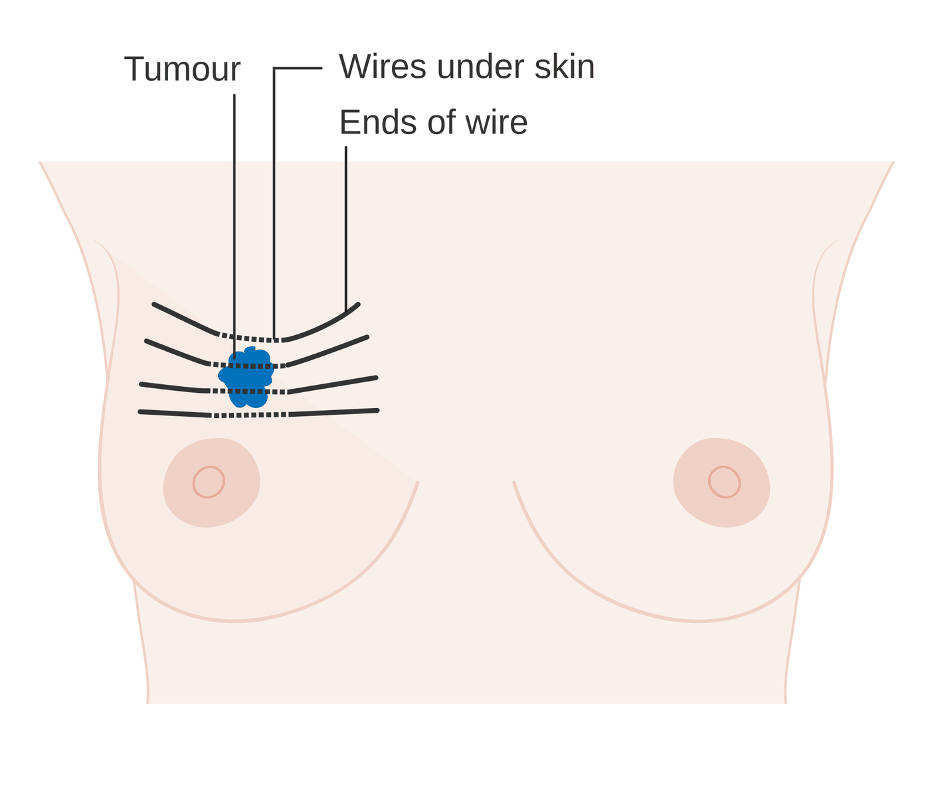
Figure 9.16 · Internal radiotherapy for breast cancer
WHAT TO NOTICE
Wires placed under the skin through the tumour area
Purpose bring the radiation source close to the target
While in place the person emits radiation
ALARA: limit time, maximize distance, use shielding. Never handle a dislodged source bare-handed.
Figure 9.16. "Diagram showing how you have internal radiotherapy for breast cancer CRUK 159" by Cancer Research UK, via Wikimedia Commons, CC BY-SA 4.0.
Notes:
Figure 9.16 shows brachytherapy for breast cancer: fine wires under the skin guide the radiation source close to the target. While a temporary source is in place, the person emits radiation. Apply ALARA by limiting time, maximizing distance and using shielding (Centers for Disease Control and Prevention, 2026): group care, stand at the foot of the bed when talking, follow visitor limits and radiation safety policy.
Figure credit: Figure 9.16: "Diagram showing how you have internal radiotherapy for breast cancer CRUK 159" by Cancer Research UK, via Wikimedia Commons, CC BY-SA 4.0.

Slide 40
Chemotherapy and the cell cycle
9.4 CHEMOTHERAPY
Cytotoxic drugs cannot tell a dividing cancer cell from a dividing normal cell
Phase-specific
Phase-nonspecific
Acts in one phase of the cell cycle
S phase 5-fluorouracil [antimetabolite], methotrexate [antimetabolite]
M phase vincristine [vinca alkaloid], paclitaxel [taxane]
Dosing prolonged infusion or repeated doses
Acts in any phase, including resting cells
Examples cyclophosphamide [alkylating agent]; cisplatin [platinum], oxaliplatin [platinum]; doxorubicin [anthracycline]
Dosing effect rises with dose
Oral drugs capecitabine [oral antimetabolite] is just as hazardous
Cycles and nadir: counts fall 7–10 days or longer after treatment; white cell and platelet nadir about 7–14 days; recovery begins at 2–4 weeks (Canadian Cancer Society, n.d.-b).
Notes:
Phase-specific drugs act in one phase: antimetabolites such as 5-fluorouracil [antimetabolite] and methotrexate [antimetabolite] in S phase; vinca alkaloids such as vincristine [vinca alkaloid] and taxanes such as paclitaxel [taxane] in M phase. These are often given by prolonged infusion or repeated doses. Phase-nonspecific drugs damage DNA in any phase: cyclophosphamide [alkylating agent], cisplatin [platinum-based chemotherapy] and oxaliplatin [platinum-based chemotherapy], doxorubicin [anthracycline]; their effect rises with dose. Combinations attack from several directions and avoid stacking toxicity. Cycles let normal tissue recover: counts start to fall 7–10 days or longer after treatment, white cells and platelets reach their nadir about 7–14 days after, and recovery begins 2–4 weeks after (Canadian Cancer Society, n.d.-b). Oral chemotherapy such as capecitabine [oral antimetabolite (fluoropyrimidine)] is just as potent and hazardous.

Slide 41
Targeted therapy, immunotherapy and hormone therapy
9.4 SYSTEMIC THERAPIES
Each acts on a specific pathway, so toxicity follows the pathway
Targeted therapy
Immunotherapy
Hormone therapy
Antibodies trastuzumab [HER2 antibody] blocks HER2
Small molecules imatinib [TKI] blocks BCR-ABL
First test the tumour for the target
Toxicity follows the target: rash, cardiac, hypertension
Drug pembrolizumab [PD-1 inhibitor] releases T-cell brakes
irAEs colitis, pneumonitis, hepatitis, rash, endocrine
Timing weeks to months; even after stopping
Serious hold drug, corticosteroids (Schneider et al., 2021)
Breast tamoxifen [SERM]; letrozole [aromatase inhibitor]
Prostate leuprolide [GnRH agonist]
Effects hot flashes, bone loss, joint pain; VTE with tamoxifen [SERM]
Adherence treatment often runs for years
Report the same day on immunotherapy: new diarrhea, cough, dyspnea, profound fatigue, headache or vision change.
Notes:
Targeted therapies act on a specific driver: monoclonal antibodies (-mab) such as trastuzumab [HER2-targeted monoclonal antibody], and small-molecule inhibitors (-nib) such as imatinib [tyrosine kinase inhibitor]. They work only when the target is present, which is why tumour testing comes first. Toxicity follows the target: rash with EGFR blockade, cardiac dysfunction with HER2 blockade, hypertension and impaired healing with angiogenesis blockade; infusion reactions with antibodies. Immune checkpoint inhibitors such as pembrolizumab [immune checkpoint inhibitor (PD-1)] release T-cell brakes; immune-related adverse events can affect any organ, weeks to months after starting or even after stopping, and serious events are generally managed by holding the drug and starting corticosteroids such as prednisone [corticosteroid] (Schneider et al., 2021). Hormone therapy: tamoxifen [selective estrogen receptor modulator], letrozole [aromatase inhibitor], leuprolide [gonadotropin-releasing hormone agonist].

Slide 42
Chemotherapy and targeted drugs: what to watch for
9.4 MEDICATIONS
From Table 9.6 and the Ontario drug monographs
5-FU [antimetabolite], capecitabine [oral antimetabolite] mucositis, diarrhea, marrow; hand-foot reaction
Cyclophosphamide [alkylating agent] hemorrhagic cystitis: fluids, voiding, morning dose
Oxaliplatin [platinum] cold-triggered dysesthesia (no ice chips); neuropathy
Vincristine [vinca alkaloid] vesicant; neuropathy; constipation → laxatives
Cisplatin [platinum] severe N/V, nephrotoxicity, ototoxicity
Trastuzumab [HER2 antibody] infusion reactions; reduced LV function
Doxorubicin [anthracycline] vesicant; cardiomyopathy; red urine 1–2 days
Pembrolizumab [PD-1 inhibitor] immune-related adverse events in any organ
Match toxicity to mechanism: ask which tissues the drug will hit, then confirm in the current monograph (Cancer Care Ontario, 2017, 2019, 2023a, 2023b).
Notes:
Table 9.6 in rows. 5-fluorouracil [antimetabolite] and capecitabine [oral antimetabolite (fluoropyrimidine)]: mucositis, diarrhea, myelosuppression, hand-foot reaction. Oxaliplatin [platinum-based chemotherapy]: acute cold-triggered dysesthesia, so teach cold avoidance and do not use ice chips, plus persistent neuropathy (Cancer Care Ontario, 2023b). Cisplatin [platinum-based chemotherapy]: severe nausea and vomiting, nephrotoxicity and ototoxicity. Doxorubicin [anthracycline]: vesicant, dose-dependent cardiomyopathy, red urine for 1–2 days (Cancer Care Ontario, 2023a). Cyclophosphamide [alkylating agent]: hemorrhagic cystitis, so fluids, frequent voiding and a morning dose (Cancer Care Ontario, 2019). Vincristine [vinca alkaloid]: vesicant, neuropathy, constipation and ileus, so routine laxatives (Cancer Care Ontario, 2017). Trastuzumab [HER2-targeted monoclonal antibody]: infusion reactions, reduced left ventricular function. Pembrolizumab [immune checkpoint inhibitor (PD-1)]: immune-related adverse events. Always confirm in the current monograph.

Slide 43
Protecting yourself from hazardous drugs
9.4 SAFE HANDLING
Ontario guideline: Safe Handling of Hazardous Drugs (Kennedy et al., 2022)
Gloves two pairs, chemo-tested; one pair for solid tablets
Spills spill kit wherever drugs are stored, moved or given
Gown disposable, low-permeability, long-sleeved, back closure
Excreta two pairs of gloves + gown for at least 48 hours
Eye and face when splashing is possible: bladder, feeding tube
Reproductive consider alternative duties: pregnant, breastfeeding, conceiving
Why it matters: hazardous drugs can cause cancer, birth defects, reproductive harm and organ toxicity in the people who handle them.
Notes:
Most cytotoxic drugs are hazardous drugs: they can cause cancer, birth defects, reproductive harm or organ toxicity in people who handle them through skin contact, inhalation or ingestion. From the Ontario guideline (Kennedy et al., 2022): two pairs of chemotherapy-tested, powder-free gloves for IV, subcutaneous, intramuscular, intravesical, intrathecal and liquid oral administration, one pair for solid tablets; a disposable, lint-free, low-permeability, long-sleeved gown with tight cuffs that fastens in the back; eye and face protection when splashing is possible; a spill kit wherever drugs are stored, transported or given; two pairs of gloves and a gown for blood, urine, stool, vomit and linen for at least 48 hours and longer for some drugs; soiled incontinence products as hazardous waste; and consideration of alternative duties for staff who are pregnant, breastfeeding or trying to conceive.

Slide 44
High-alert medications and extravasation
9.4 CLINICAL SAFETY
Clinical Safety
High-alert medications
Vesicants and extravasation
Dosing BSA or weight; an outdated weight changes the dose
Route vincristine [vinca alkaloid] is lethal intrathecally (Cancer Care Ontario, 2017)
Checks independent double check: order, calculation, drug, patient, route
Each cycle pre-treatment parameters met; fever or new symptom → consult
Definition leakage of fluid or drug into tissue (Pérez Fidalgo et al., 2012)
Vesicants doxorubicin [anthracycline], vincristine [vinca alkaloid]
Signs pain, burning, swelling, redness, no blood return, slowing rate
First stop the infusion; then follow the extravasation protocol
Prevention: vesicants are often given through a central venous access device to reduce risk.
Notes:
Clinical Safety box. Chemotherapy drugs are high-alert: a small error in dose, rate, route or patient can be fatal. Doses use body surface area or weight, so an outdated weight changes the dose. Vincristine [vinca alkaloid] is lethal if given intrathecally (Cancer Care Ontario, 2017). Independent double checks and confirming pre-treatment parameters before every cycle are standard. Extravasation is leakage of fluid or drug into tissue (Pérez Fidalgo et al., 2012); vesicants such as doxorubicin [anthracycline] and vincristine [vinca alkaloid] cause blistering and tissue death. Signs: pain, burning, swelling, redness, loss of blood return, slowing infusion, though some are painless at first. First stop the infusion, then follow the protocol: leave the device in place to aspirate, notify, drug-specific treatment, mark, photograph and document.

Slide 45
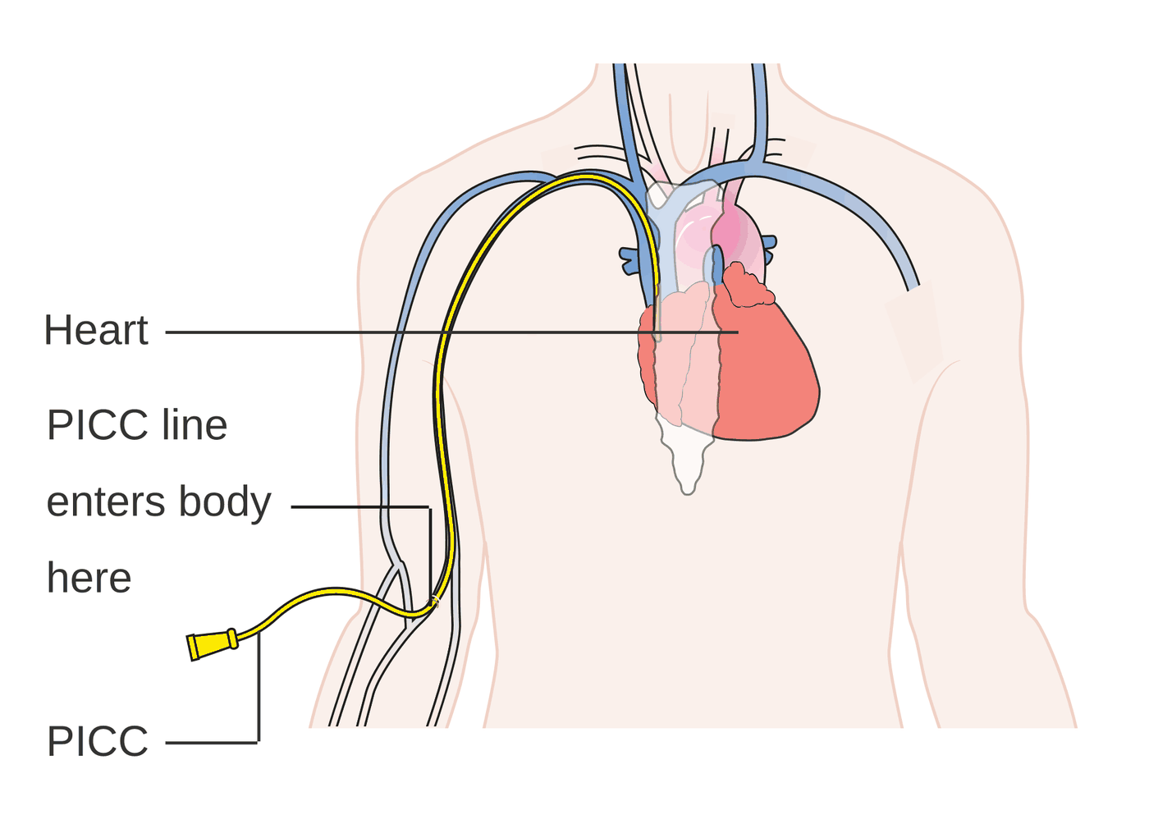
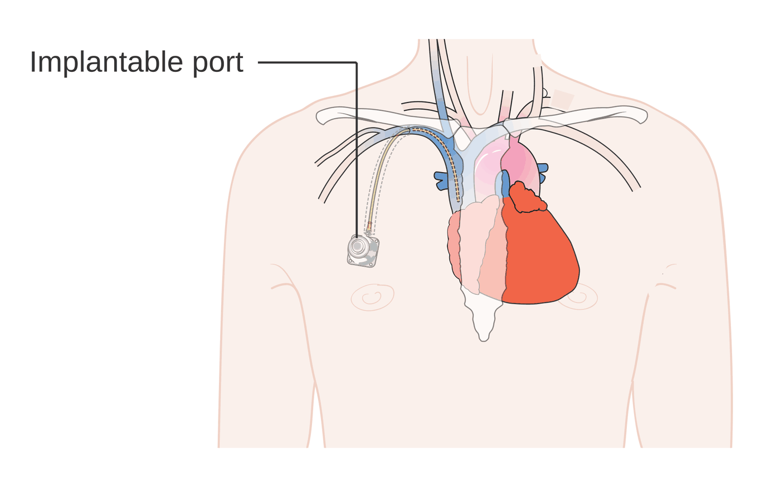
Figures 9.17–9.18 · PICC and implanted port
WHAT TO NOTICE
PICC enters an upper-arm vein; tip in a large central vein near the heart
Duration can remain for weeks to months
Implanted port reservoir entirely under the chest skin; non-coring needle, aseptic technique
Risks bloodstream infection, thrombosis, occlusion
Figure 9.17. "Diagram showing a PICC line CRUK 071" by Cancer Research UK, via Wikimedia Commons, CC BY-SA 4.0.
Figure 9.18. "Diagram showing an implantable port CRUK 101" by Cancer Research UK, via Wikimedia Commons, CC BY-SA 4.0.
Meticulous line care is infection prevention for the neutropenic patient.
Notes:
Figure 9.17 shows a PICC entering a vein in the upper arm with its tip in a large central vein near the heart. Figure 9.18 shows an implanted port beneath the skin of the upper chest, accessed with a non-coring needle using aseptic technique; it is preferred for long-term intermittent treatment because nothing is outside the body between treatments.
Figure credit: Figure 9.17: "Diagram showing a PICC line CRUK 071" by Cancer Research UK, via Wikimedia Commons, CC BY-SA 4.0. Figure 9.18: "Diagram showing an implantable port CRUK 101" by Cancer Research UK, via Wikimedia Commons, CC BY-SA 4.0.

Slide 46
Who gives systemic cancer treatment in Ontario?
9.4 SCOPE IN PRACTICE
Scope in Practice
RN: administering systemic treatment
RPN: caring for patients on treatment
Role the appropriate nurse role for parenteral systemic treatment
Initial standardized course + supervised practice and competency
Maintain renewal course every 2 years + annual self-assessment
Source Ontario Health (Cancer Care Ontario), n.d.-c
Common roles monitor toxicity, manage symptoms, teach
Safety hazardous-drug precautions with excreta
Depends on activity, competence, client condition, setting, policy
Consult when risk rises, such as fever after chemotherapy (CNO, 2019b)
Activity-specific: accessing a port or giving an oral cancer drug depends on competence, client condition, setting and employer policy.
Notes:
Ontario Health's oncology nursing standards identify the RN as the appropriate nurse role to administer parenteral systemic cancer treatment: chemotherapy, targeted therapy and immunotherapy. The RN completes a standardized course (the de Souza Institute Provincial Standardized Chemotherapy and Biotherapy course or the ONS/ONCC Chemotherapy Immunotherapy Certificate Course), supervised practice with demonstrated competency, a renewal course every two years and an annual self-assessment (Ontario Health [Cancer Care Ontario], n.d.-c). RPNs commonly monitor for toxicity, manage symptoms, apply hazardous-drug precautions and teach; whether a nurse may perform a specific activity depends on the activity, competence, client condition and setting. When risk rises, as with fever after chemotherapy, the RPN consults promptly (CNO, 2019b).

Slide 47
Myelosuppression: three cell lines, three risks
9.5 MYELOSUPPRESSION
White cells and platelets reach nadir about 7–14 days after treatment (Canadian Cancer Society, n.d.-b)
Neutropenia
Thrombocytopenia
Anemia
Risk infection rises steeply as the ANC falls
Trap little pus: fever may be the only sign
Support filgrastim [G-CSF] may shorten neutropenia; bone pain
Signs bruising, petechiae, gum or nose bleeding, black stools
Prevent soft brush, electric razor, no IM or rectal, no straining
Watch headache or LOC change: intracranial bleed
Signs fatigue, pallor, tachycardia, dizziness, dyspnea
Course falls slowly; compensated until reserve runs out
Nursing activity tolerance, orthostatics, transfuse as ordered
Why the timing differs: neutrophils live hours to days, platelets about a week, red cells about four months.
Notes:
Marrow precursors divide rapidly, so chemotherapy and radiation of large marrow-containing bones suppress them. Each line falls on a different schedule because mature cells survive for different lengths of time. Neutropenia blunts the signs of infection: little pus, few crackles, no pyuria; fever may be the only sign, and progression to septic shock can take hours. Filgrastim [granulocyte colony-stimulating factor] may be prescribed for high-risk regimens; bone pain is its most common side effect. Thrombocytopenia: bruising, petechiae, gum and nose bleeding, hematuria, black stools (Canadian Cancer Society, n.d.-b); prevent trauma and watch for headache or change in level of consciousness. Anemia: fatigue, pallor, tachycardia, dizziness, dyspnea; assess activity tolerance and orthostatics.

Slide 48
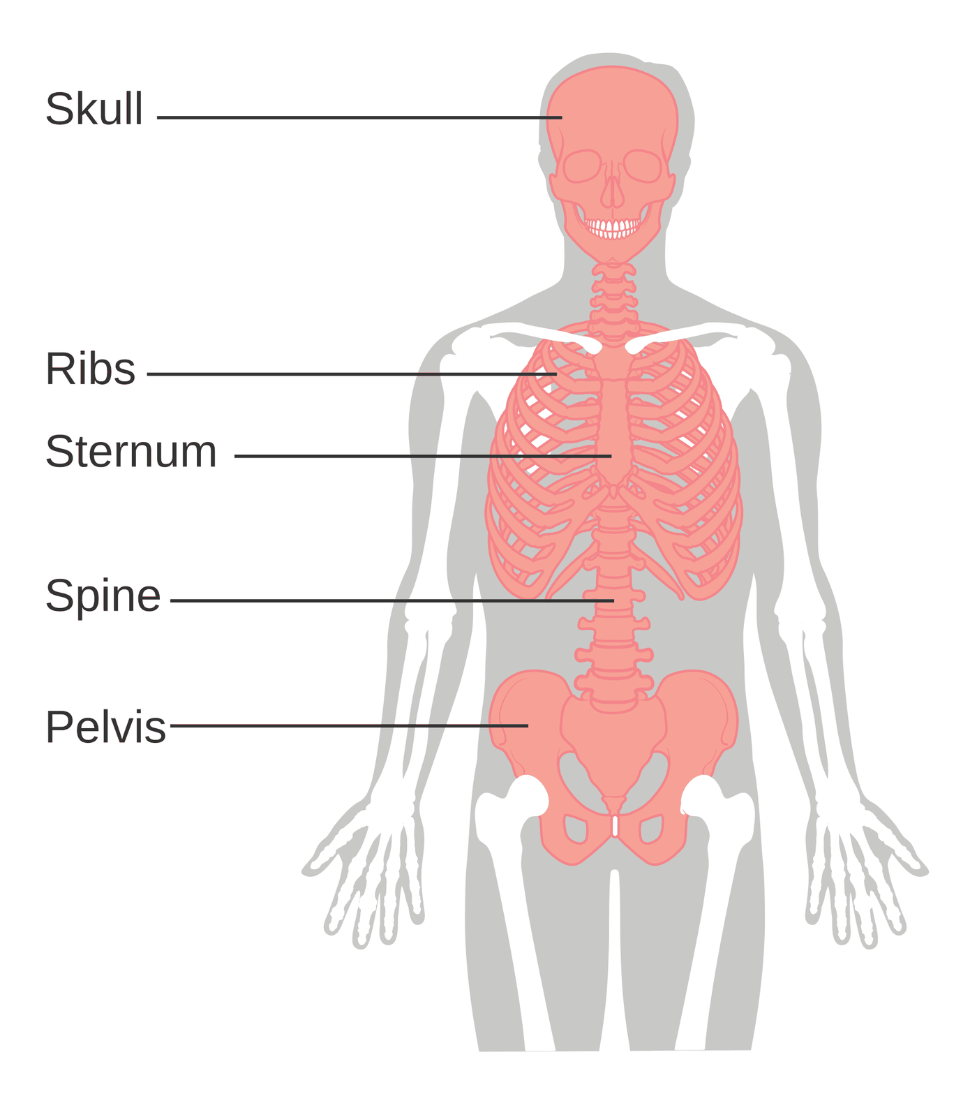
Figure 9.19 · Where blood cells are made
WHAT TO NOTICE
Active marrow skull, ribs, sternum, spine, pelvis
Limbs arm and leg bones shown without active marrow
Radiation to the pelvis or spine adds to chemotherapy myelosuppression
Radiation to large marrow-bearing bones adds to the myelosuppression caused by chemotherapy.
Figure 9.19. "Diagram showing where blood cells are made in the body CRUK 379" by Cancer Research UK, via Wikimedia Commons, CC BY-SA 4.0.
Notes:
Figure 9.19 shows where blood-forming marrow lies in adults: mainly the skull, ribs, sternum, spine and pelvis. Radiation to these areas adds to the myelosuppression caused by chemotherapy, which is why counts are checked closely in people receiving both.
Figure credit: Figure 9.19: "Diagram showing where blood cells are made in the body CRUK 379" by Cancer Research UK, via Wikimedia Commons, CC BY-SA 4.0.

Slide 49
Calculating the absolute neutrophil count
9.5 GOING DEEPER [RN]
Going Deeper · RN required, PN optional
The formula
Worked example
ANC WBC × (% segmented neutrophils + % bands) ÷ 100
Bands immature neutrophils: always included
Threshold below 0.5 × 10⁹/L defines neutropenia with fever (Alberta Health Services, 2014)
Trap a normal-looking WBC can hide severe neutropenia
WBC 1.8 × 10⁹/L
Differential 20% segmented neutrophils, 5% bands
ANC 1.8 × 25 ÷ 100 = 0.45 × 10⁹/L
Meaning below the 0.5 × 10⁹/L threshold
Before the next cycle: the oxaliplatin [platinum] and cyclophosphamide [alkylating agent] monographs advise no retreatment until the ANC is at least 1.5 × 10⁹/L (Cancer Care Ontario, 2019, 2023b).
Notes:
Going Deeper box. ANC equals WBC times the sum of segmented neutrophils and bands, divided by 100. Worked example from the chapter: WBC 1.8, segs 20%, bands 5%; ANC = 1.8 × 25 ÷ 100 = 0.45 × 10⁹/L, below 0.5 × 10⁹/L, the threshold commonly used to define neutropenia with fever (Alberta Health Services, 2014). A normal-looking WBC can hide severe neutropenia when most white cells are lymphocytes or blasts. Many regimens need recovered counts before the next cycle: the oxaliplatin [platinum-based chemotherapy] and cyclophosphamide [alkylating agent] monographs advise not retreating until the ANC is at least 1.5 × 10⁹/L (Cancer Care Ontario, 2019, 2023b).

Slide 50
Mucositis and chemotherapy-induced nausea and vomiting
9.5 TREATMENT EFFECTS
Prevention works far better than rescue
Mucositis
Nausea and vomiting (CINV)
Mechanism renewal stops while the surface wears away
Risk ulcers are a portal for bacteria in neutropenia
Care daily inspection, soft brush, bland rinses, no alcohol mouthwash, analgesia
Oxaliplatin [platinum] no ice chips: cold triggers neurotoxicity (Cancer Care Ontario, 2023b)
Acute gut serotonin → vagal signals; 0–24 h
Delayed substance P at NK1 receptors; about 25–120 h (Rapoport et al., 2024)
Prevention ondansetron [5-HT3 RA], aprepitant [NK1 RA], dexamethasone [corticosteroid], olanzapine [atypical antipsychotic] by emetic risk (Herrstedt et al., 2024)
Principle give on time; report breakthrough
Notes:
Mucositis: the lining is replaced every few days; treatment stops renewal while the surface wears away and inflammatory mediators deepen the damage, producing ulcers that are a portal for bacteria in neutropenia. MASCC/ISOO guidelines continue to support basic oral care and make specific recommendations such as oral cryotherapy and photobiomodulation in defined settings (Elad et al., 2020). Ice chips are not used with oxaliplatin [platinum-based chemotherapy] because cold can trigger neurotoxicity (Cancer Care Ontario, 2023b). CINV: gut serotonin drives the acute phase; substance P at NK1 receptors drives much of the delayed phase; studies define acute as 0–24 hours and delayed as roughly 25–120 hours (Rapoport et al., 2024). The 2023 MASCC/ESMO update builds prophylaxis from ondansetron [5-HT3 receptor antagonist], aprepitant [NK1 receptor antagonist], dexamethasone [corticosteroid] and olanzapine [atypical antipsychotic] by emetic risk (Herrstedt et al., 2024).

Slide 51
Bowel, skin and longer-term effects
9.5 TREATMENT EFFECTS
Each effect follows from the treatment's mechanism
Bowel
Skin and hair
Longer term
Diarrhea 5-FU [antimetabolite], capecitabine [oral antimetabolite], pelvic radiation, immune colitis
Risk dehydration, low potassium, kidney injury
Constipation vinca alkaloids, opioids, ondansetron [5-HT3 RA]
Alopecia within days to weeks; usually temporary
Radiation skin lukewarm water, mild soap, loose clothing, no sun
Other acne-like rash; hand-foot reaction
Neuropathy ask about buttons, writing, walking each cycle
Organs heart, kidney (cisplatin [platinum]), lungs
Fertility discuss preservation before treatment
Cognitive changes: difficulty concentrating and remembering is reported by many people and can persist after treatment.
Notes:
Diarrhea from 5-fluorouracil [antimetabolite], capecitabine [oral antimetabolite (fluoropyrimidine)], pelvic radiation and immune colitis can rapidly cause dehydration, hypokalemia and acute kidney injury. Diarrhea on immunotherapy is reported the same day (Schneider et al., 2021). Constipation comes from vinca alkaloids, opioids, ondansetron [5-HT3 receptor antagonist] and immobility. Alopecia usually begins within days to weeks of the first treatment (Cancer Care Ontario, 2023a) and is usually temporary. Radiation dermatitis care: lukewarm water, mild soap, loose clothing, no sun or heat, approved products only. Neuropathy: ask about buttoning, writing and walking before each cycle. Organ toxicity: heart with anthracyclines and HER2 drugs, kidney with cisplatin [platinum-based chemotherapy], lungs. Discuss fertility preservation before treatment.

Slide 52
Treatment effects at the bedside
9.5 PATHO-TO-BEDSIDE
Cue → mechanism → nursing action (Table 9.7)
38.4 °C on day 10 neutrophil nadir → febrile neutropenia until proven otherwise
Day-3 vomiting after cisplatin [platinum] delayed CINV (NK1) → check delayed antiemetics
Petechiae, bleeding gums platelet nadir → bleeding precautions, neuro checks
Six watery stools on immunotherapy immune colitis → report same day; no antidiarrheal unless directed
Mouth pain, ulcers mucositis ± infection → oral care, analgesia, swab
Numb fingertips neurotoxicity → report before next cycle; safety teaching
Remember: fever in a neutropenic person is an emergency, not an expected side effect.
Notes:
Table 9.7. A temperature of 38.4 °C on day 10 in someone who feels fine is the neutrophil nadir and is treated as febrile neutropenia until proven otherwise. Petechiae and bleeding gums are the platelet nadir. Mouth pain and ulcers are mucositis, sometimes with infection. Vomiting on day 3 after cisplatin [platinum-based chemotherapy] is delayed CINV, largely NK1-mediated; confirm delayed-phase antiemetics were taken. Six watery stools a day on immunotherapy is immune colitis: report the same day and do not give an antidiarrheal without direction. Numb fingertips are neurotoxicity; report before the next cycle.

Slide 53
Staying safe at home during low blood counts
9.5 PATIENT EDUCATION
Patient Education
Every day
Go now, or call the 24-hour line, if
Temperature oral, if unwell; no acetaminophen [analgesic] or ibuprofen [NSAID] first
Hands wash often; avoid crowds and sick people; food safety
Mouth soft toothbrush; rinse after meals
Bleeding electric razor, gentle nose-blowing, no contact sports
fever per your card: >38.3 °C once, or >38.0 °C for over an hour
chills or shaking, or suddenly very unwell even without fever
new cough, dyspnea, burning urination or redness at your line
you cannot keep fluids down, or bleeding will not stop
Bring: your chemotherapy card, and tell staff you are on chemotherapy.
Notes:
Patient Education box. Take an oral temperature if feeling unwell; do not take acetaminophen [non-opioid analgesic] or ibuprofen [nonsteroidal anti-inflammatory drug] before checking, because they can hide a fever. Wash hands often, avoid crowds and sick people, follow food safety (Canadian Cancer Society, n.d.-b). Brush gently and rinse after meals. Electric razor, gentle nose-blowing, no contact sports while platelets are low. Go to the emergency department or call the 24-hour line if the temperature reaches the fever number on the cancer centre's card (fever is usually a single reading above 38.3 °C, or above 38.0 °C for more than an hour; Alberta Health Services, 2014), with chills, feeling suddenly very unwell even without fever, new cough, dyspnea, burning urination or redness at the line, inability to keep fluids down, or bleeding that won't stop. Bring the chemotherapy card.

Slide 54
Oncologic Emergencies and Supportive Care
PART 4
Six emergencies to recognize early · symptom assessment and pain · culturally safe, palliative and survivorship care (9.6, 9.7)
Notes:
Part 4 covers sections 9.6 and 9.7. Oncologic emergencies can arise at any point, from first presentation to end-stage disease, and some appear years after treatment (Lewis et al., 2011). Nurses are often the first to notice the cue.

Slide 55
Febrile neutropenia
9.6 ONCOLOGIC EMERGENCIES
Fever may be the only early sign
Recognize
Act
Fever single oral >38.3 °C, or >38.0 °C sustained over 1 hour
Neutropenia ANC <0.5 × 10⁹/L, or <1.0 expected to fall below 0.5 within 48 h
Source Alberta Health Services, 2014
Why dangerous blunted inflammation; rapid progression to septic shock
Antibiotic first dose within 1 hour of triage (Taplitz et al., 2018)
Cultures including each central line lumen, without delaying antibiotics
First-line piperacillin-tazobactam [extended-spectrum penicillin] 4.5 g IV q8h
If unstable add an aminoglycoside and vancomycin [glycopeptide]
Avoid rectal exam; inspect the perianal area
Notes:
Definition from the Alberta guideline: fever is usually a single oral temperature above 38.3 °C or a sustained oral temperature above 38.0 °C for more than one hour; neutropenia is an ANC below 0.5 × 10⁹/L, or below 1.0 with an expected fall below 0.5 within 48 hours (Alberta Health Services, 2014). Without neutrophils, bacteria from the gut, skin and mouth cross damaged mucosa or enter through a central line. The ASCO/IDSA guideline: first dose of empirical antibacterial therapy within 1 hour of triage (Taplitz et al., 2018). Draw cultures, including from each lumen of a central line, without delaying the antibiotic. Alberta first-line: piperacillin-tazobactam [extended-spectrum penicillin with beta-lactamase inhibitor] 4.5 g IV every 8 hours; cefepime [fourth-generation cephalosporin] for penicillin allergy; add an aminoglycoside and vancomycin [glycopeptide antibiotic] if unstable. Avoid rectal examination but inspect the perianal area. The MASCC index identifies low-risk outpatients.

Slide 56
The "well-looking" patient with a fever
9.6 CLINICAL JUDGMENT
Clinical Judgment · NCSBN Clinical Judgment Measurement Model
1
2
3
Recognize cues
Analyze cues
Prioritize
Day 9 after chemotherapy, 38.5 °C, feels "basically fine."
Day 9 is nadir; blunted inflammation hides infection.
Febrile neutropenia with possible early sepsis.
4
5
6
Generate solutions
Take action
Evaluate
Same-hour assessment, CBC, cultures, antibiotics within an hour.
ED now (911 if dizzy, confused, short of breath); bring chemo card; call ahead.
Confirm arrival, urgent triage and antibiotic timing.
Notes:
Clinical Judgment box. A 58-year-old on day 9 after chemotherapy for breast cancer calls: 'I'm a bit tired, and my temperature was 38.5 °C,' with no cough or urinary symptoms. Day 9 is the expected nadir and neutropenia blunts inflammation, so the absence of localizing symptoms is not reassuring. The priority hypothesis is febrile neutropenia with possible early sepsis. She needs same-hour assessment, a CBC, cultures and antibiotics within an hour of arrival. Direct her to the nearest ED now, or 911 if dizzy, confused or short of breath; bring her chemotherapy card; call ahead. Then confirm she arrived, was triaged urgently and received antibiotics within the target time.

Slide 57
Tumour lysis syndrome
9.6 ONCOLOGIC EMERGENCIES
Rapid death of many cancer cells floods the blood with their contents (McBride & Westervelt, 2012)
Pathophysiology
Prevention and management
Who bulky, fast-growing cancers in the first days of treatment
Ions ↑ potassium, ↑ phosphate, ↑ uric acid, ↓ calcium
Kidney uric acid and calcium phosphate crystals → AKI
Cairo-Bishop ≥2 of: urate ≥476 µmol/L, K ≥6.0, PO₄ ≥1.45, Ca ≤1.75 mmol/L, or 25% change
Hydration aggressive IV fluids to keep urine output high
Monitor frequent labs, strict I&O, cardiac monitoring
Allopurinol [xanthine oxidase inhibitor] stops new uric acid; slow onset
Rasburicase [urate oxidase] clears uric acid fast; not in G6PD deficiency
Going Deeper [RN]: giving calcium for asymptomatic hypocalcemia or alkalinizing urine can both worsen calcium phosphate deposition.
Notes:
TLS occurs when large numbers of cancer cells die quickly, usually within days of starting treatment for a bulky, rapidly dividing cancer. Potassium, phosphate and nucleic acids (broken down to uric acid) are released; phosphate binds calcium, lowering it. Uric acid and calcium phosphate crystals block the tubules and cause AKI, which further reduces clearance. Cairo-Bishop laboratory TLS: two or more of uric acid ≥476 µmol/L, potassium ≥6.0 mmol/L, phosphate ≥1.45 mmol/L, calcium ≤1.75 mmol/L, or a 25% change, from 3 days before to 7 days after starting treatment (McBride & Westervelt, 2012). Management: aggressive IV hydration, frequent labs, strict I&O, cardiac monitoring; allopurinol [xanthine oxidase inhibitor] reduces new uric acid but is slow; rasburicase [recombinant urate oxidase] clears existing uric acid quickly and is contraindicated in G6PD deficiency. Going Deeper: calcium for asymptomatic hypocalcemia and urine alkalinization can both worsen calcium phosphate deposition; alkalinization is contraindicated with rasburicase [recombinant urate oxidase].

Slide 58
Hypercalcemia of malignancy
9.6 ONCOLOGIC EMERGENCIES
Early signs are easily blamed on cancer, opioids or age
Mechanisms and signs
Management (Baralo et al., 2023)
PTHrP mimics PTH: ↑ bone resorption, ↑ renal reabsorption
Osteolysis bone metastases, myeloma
Calcitriol some lymphomas ↑ gut absorption (Farooki, 2023)
Signs fatigue, constipation, polyuria, thirst, confusion, short QT
First isotonic saline, often a 1–2 L bolus
Later furosemide [loop diuretic] only once euvolemic
Bridge calcitonin [calcium-regulating hormone] works in 4–6 h
Definitive zoledronic acid [bisphosphonate] in 2–4 days; avoid if GFR <30
The spiral: polyuria → dehydration → less calcium excreted → calcium rises further. Mobilize: immobility increases bone resorption.
Notes:
Mechanisms often overlap (Farooki, 2023): PTHrP mimics parathyroid hormone, increasing bone resorption and renal calcium retention; bone metastases and myeloma cause local osteolysis; some lymphomas make excess calcitriol; ectopic PTH is rare. High calcium depresses nerve and muscle excitability and impairs urine concentration: fatigue, weakness, constipation, nausea, polyuria, thirst, confusion progressing to coma, and short QT and dysrhythmias. Management (Baralo et al., 2023): isotonic saline, often a 1–2 L bolus, then ongoing fluids; furosemide [loop diuretic] only once euvolemic; calcitonin [calcium-regulating hormone] works within 4–6 hours as a bridge; an IV bisphosphonate such as zoledronic acid [bisphosphonate] or pamidronate [bisphosphonate] is standard and takes effect in 2–4 days, renally dosed and generally avoided below a GFR of 30 mL/min; denosumab [RANKL inhibitor] if bisphosphonates fail. Calcium often recurs unless the cancer is controlled (Farooki, 2023). Nursing: I&O, daily weight, fluid overload watch, cognition, cardiac monitoring, safety, mobilize.

Slide 59
SIADH and superior vena cava syndrome
9.6 ONCOLOGIC EMERGENCIES
Water retention and venous obstruction (Baralo et al., 2023)
SIADH
Superior vena cava syndrome
Mechanism ADH despite low osmolality → water retention, Na <135
Causes small cell lung cancer; opioids, antidepressants, antiepileptics
Signs nausea, headache, confusion → seizures; no edema
Treatment restrict to 500–1,000 mL/day; hypertonic saline [crystalloid] if severe, ≤0.5 mmol/L/h
Causes lung cancer, lymphoma, other tumours; catheters
Signs face, neck, arm swelling; distended veins; worse lying down
Danger stridor or confusion: airway or cerebral edema
Care upright, oxygen, airway watch, no arm IVs; CT, stenting
Notes:
SIADH: ADH is released despite low plasma osmolality, so water is retained and sodium is diluted below 135 mmol/L; most common in small cell lung cancer, also with brain metastases, some chemotherapy and drugs such as opioids, antidepressants and antiepileptics. Low serum osmolality, concentrated urine, high urine sodium; edema usually absent. Fluid restriction to 500–1,000 mL a day for asymptomatic euvolemic patients; hypertonic saline [hypertonic crystalloid] for severe symptoms, corrected no faster than 0.5 mmol/L per hour; tolvaptan [vasopressin receptor antagonist] for some. SVC syndrome: the thin-walled SVC is compressed by tumour or nodes or blocked by thrombus; lung cancer, lymphoma, germ cell and thymic tumours, metastases, and catheters cause it. Swelling of the face, neck and arms, distended veins, cough, dyspnea and headache, worse lying down; stridor or altered mental status is life-threatening. Contrast CT; airway protection and stenting. Nursing: upright, oxygen, airway monitoring, avoid arm IVs and BP, remove rings.

Slide 60
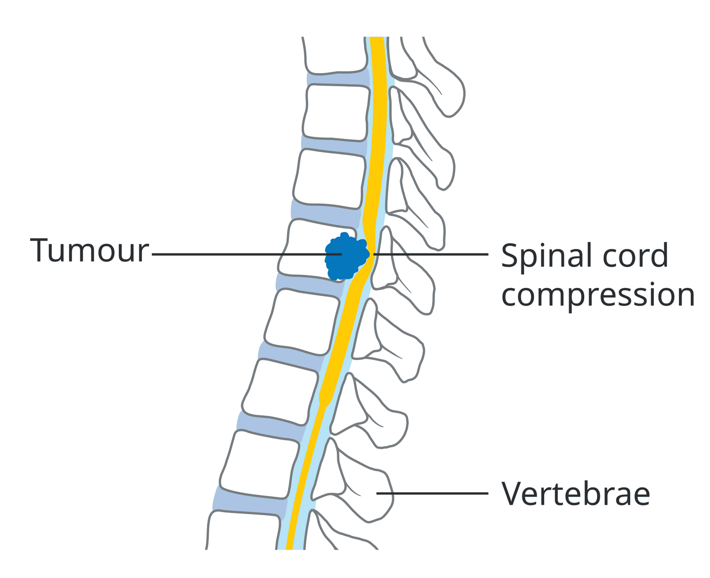
Figure 9.20 · Malignant spinal cord compression
WHAT TO NOTICE
Source vertebral metastasis from breast, lung, prostate or kidney cancer, or myeloma
Early new back pain, worse lying down or with coughing and straining
Late leg weakness, sensory level, retention or incontinence
Treatment MRI; dexamethasone [corticosteroid] 16 mg IV, then 4–6 mg q4–6h; radiation ± surgery
New back pain in a person with cancer is spinal cord compression until proven otherwise.
Figure 9.20. "Diagram showing a tumour causing spinal cord compression CRUK 081" by Cancer Research UK, via Wikimedia Commons, CC BY-SA 4.0.
Notes:
Figure 9.20 shows a tumour in a vertebral body growing backward into the spinal canal and pressing on the cord. Neurological function lost before treatment is often not regained. Dexamethasone [corticosteroid] example regimen: 16 mg IV bolus, then 4–6 mg every 4–6 hours, tapering once radiotherapy begins; evaluate within 24–48 hours if no deficits and urgently if deficits are present (Baralo et al., 2023).
Figure credit: Figure 9.20: "Diagram showing a tumour causing spinal cord compression CRUK 081" by Cancer Research UK, via Wikimedia Commons, CC BY-SA 4.0.

Slide 61
Back pain in a person with cancer
9.6 CLINICAL SAFETY
Clinical Safety · the most dangerous trap in oncology nursing
Every new back pain
If deficits are present
Legs strength, sensation and gait against baseline
Bladder and bowel retention or incontinence
Report promptly; evaluate within 24–48 h without deficits (Baralo et al., 2023)
Emergency bed rest, spine aligned until stability is known
Notify the prescriber immediately
Prepare urgent MRI and dexamethasone [corticosteroid]; monitor glucose
The trap: never chart "arthritis" or "slept funny" for new back pain in a person with cancer; lost function is often not regained.
Notes:
Clinical Safety box. By the time leg weakness or urinary retention appears, permanent paralysis may be under way. For any person with cancer who reports new back pain, check and document leg strength, sensation, gait, and bladder and bowel function against baseline and report promptly. People without deficits should be evaluated within 24–48 hours (Baralo et al., 2023). With deficits it is an emergency: bed rest with the spine aligned until stability is known, notify the prescriber immediately, prepare for urgent MRI and dexamethasone [corticosteroid], and monitor blood glucose on high-dose steroids.

Slide 62
Oncologic emergencies at a glance
9.6 SUMMARY
Who is at risk · early cue · priority action (Table 9.8)
Febrile neutropenia day 7–14 · fever may be the only sign · antibiotic within 1 h
SIADH small cell lung cancer · low sodium, no edema · fluid restriction
Tumour lysis syndrome bulky, fast cancers · ↑K ↑PO₄ ↑urate ↓Ca · fluids, I&O
SVC syndrome lung cancer, lymphoma, lines · facial swelling · upright
Hypercalcemia squamous, breast, myeloma · constipation, polyuria, confusion
Cord compression bone metastases · new back pain · neuro checks, urgent report
Common thread: each emergency starts with a cue that is easy to blame on cancer itself.
Notes:
Table 9.8 as a review. Febrile neutropenia: days 7–14 after myelosuppressive chemotherapy; fever may be the only sign; antibiotic within 1 hour of triage. TLS: bulky, fast-growing cancers early in treatment; rising potassium, phosphate, uric acid and creatinine, low calcium; fluids, I&O, frequent electrolytes. Hypercalcemia: squamous cancers, breast, myeloma, bone metastases; fatigue, constipation, polyuria, confusion; saline then calcitonin [calcium-regulating hormone] and a bisphosphonate. SIADH: small cell lung cancer; low sodium without edema; fluid restriction. SVC syndrome: lung cancer, lymphoma, lines; facial and arm swelling; upright, airway. Cord compression: bone metastases; new back pain; neuro and bladder assessment and urgent report.

Slide 63
Structured symptom assessment and pain management
9.7 SUPPORTIVE CARE
People under-report symptoms; structured screening makes them visible
ESAS-r: Your Symptoms Matter
WHO cancer pain guidance (2019)
Tool completed before each cancer centre visit (Ontario Health [Cancer Care Ontario], n.d.-b)
Symptoms pain, tiredness, sleepiness, nausea, appetite, breathlessness, depression, anxiety, wellbeing
Scale 0 (absent) to 10 (worst possible)
Use track trends; a score starts a conversation
Start NSAIDs, acetaminophen [analgesic] and opioids by severity
Maintain regular oral morphine [opioid agonist] where possible
Breakthrough immediate-release opioid, available to all
Route oral or transdermal; subcutaneous over IM
Bone pain bisphosphonate; single-dose radiotherapy
Notes:
In Ontario, people attending cancer centres complete the Your Symptoms Matter general symptoms questionnaire, based on ESAS-r, before each visit (Ontario Health [Cancer Care Ontario], n.d.-b). Nine symptoms rated 0 to 10: pain, tiredness, sleepiness, nausea, lack of appetite, shortness of breath, depression, anxiety and wellbeing; scores are tracked and can trigger referrals. A score starts a conversation. WHO cancer pain guideline (World Health Organization, 2019): start with NSAIDs, acetaminophen [non-opioid analgesic] and opioids alone or combined by severity; any opioid for maintenance, with regular oral morphine [opioid agonist] where possible; an immediate-release opioid for breakthrough pain; oral or transdermal routes, subcutaneous over intramuscular; corticosteroids as adjuvants; bisphosphonate and single-dose radiotherapy for painful bone metastases; taper rather than stop abruptly.

Slide 64
Opioids: expected effects, adverse effects and the bowel
9.7 MEDICATIONS
Medications
The bowel
Safety
Why gut mu receptors slow peristalsis; constipation does not fade
Routine regular laxatives; don't stop them while on opioids
Softeners alone do not help most constipation
Watch abdominal cancer or prior bowel surgery: assess for obstruction (Ontario Health [Cancer Care Ontario], 2023)
Sedation first drowsiness warns before respiratory depression
Act hold the dose, notify; naloxone [opioid antagonist] protocol
Toxicity confusion, hallucinations, myoclonus, worse with kidney decline
Addiction fear prescribed use for cancer pain differs from substance use disorder; store securely
Notes:
Medications box. Opioids such as morphine [opioid agonist] and hydromorphone [opioid agonist] act on mu-opioid receptors in the brain, spinal cord and periphery; the same receptors in the gut slow peristalsis, so constipation is nearly universal and does not fade the way nausea and sedation usually do. Regular laxatives are often needed as part of a bowel routine; stopping them while on opioids usually leads to constipation; stool softeners alone do not help most constipation; and people with abdominal cancer or prior bowel surgery need prompt assessment for obstruction (Ontario Health [Cancer Care Ontario], 2023). Sedation precedes respiratory depression; hold and notify for unusual sedation and follow the naloxone [opioid antagonist] protocol. Confusion, hallucinations or myoclonus can signal toxicity, especially with worsening kidney function. Address fear of addiction and teach secure storage.

Slide 65
Culturally safe cancer care for First Nations, Inuit and Métis people
9.7 CANADIAN CONTEXT
Canadian Context
Barriers and supports
OCAP® principles (FNIGC, n.d.)
Barriers colonial policies, racism in care, distance, underfunded services
Ontario Strategy 5 (2024–2028): relationships, prevention, screening, palliative care, survivorship, access (Ontario Health, 2024b)
Navigators travel, traditional healing, ceremony, navigation
Ownership communities collectively own their information
Control authority over how it is collected and used
Access to their information wherever it is held
Possession stewardship asserts and protects ownership
Cultural safety: ask how the person wishes to be supported; welcome family and community; accommodate ceremony and traditional medicines.
Notes:
Canadian Context box. Barriers stem from colonial policies, racism in health care, distance and underfunded services. Ontario Health's First Nations, Inuit, Métis and Urban Indigenous Cancer Strategy 5 (2024–2028) priorities include relationships with Indigenous partners, prevention and wellbeing, screening, palliative and end-of-life care, survivorship, education and equitable access (Ontario Health, 2024b). Indigenous navigators help with travel, traditional healing, ceremony and navigation. The First Nations principles of OCAP® assert that communities collectively own their information, control how it is collected and used, can access it wherever it is held, and assert ownership through stewardship (First Nations Information Governance Centre, n.d.). Cultural safety means asking how the person wishes to be supported and recognizing that reluctance may come from past harm.

Slide 66
Psychosocial care, end of life and survivorship
9.7 SUPPORTIVE CARE
A palliative approach can begin at diagnosis, alongside treatment aimed at cure or control
Psychosocial
End of life
Survivorship
Distress common; screen, listen, don't minimize
Refer social work, psychosocial oncology, spiritual care
Care partners include them; ask how they cope
Planning understanding, values, hopes, worries
Focus comfort, function, the person's goals
Anticipate pain, dyspnea, delirium, secretions
Prepare the family; respect place of death
After bereavement support
Late effects heart failure, second cancers, infertility
Long-term fatigue, neuropathy, lymphedema, cognition
Plan treatment summary shared with primary care
Prevent no smoking, less alcohol, activity, screening
Notes:
Distress, anxiety and depression are common and respond to support; screen, listen, normalize without minimizing, and refer to social work, psychosocial oncology, spiritual care and peers. Include care partners and ask how they cope. Open advance care planning by asking what the person understands, what matters most, and what they hope for and worry about. At the end of life, anticipate pain, dyspnea, delirium, reduced intake and secretions, have medications available in advance, prepare families and respect place of death; care continues into bereavement. Survivorship: surveillance, management of long-term effects (fatigue, neuropathy, lymphedema, sexual and cognitive changes) and late effects (heart failure after anthracyclines, second cancers, infertility, early menopause), a written treatment summary shared with primary care, and the same prevention advice as everyone else.

Slide 67
"His pain was better, but he was clearly worse"
9.7 PRACTICE STORY
Practice Story · an RPN and RN working together
What happened
Reflect
Cue pain score better, but dozing mid-sentence and repeating questions
More cues four days constipated, poor intake, intense thirst
Action RPN to RN Priya: "Could this be his calcium?"
Outcome calcium well above normal; IV fluids; opioid held; talking by morning
Which cues did the RPN cluster, and why did the improving pain score make things more concerning?
How did consulting Priya reflect collaborative practice when the condition became less predictable?
How might dehydration and rising calcium also raise the risk of opioid toxicity?
Notes:
Practice Story from section 9.7. An RPN on a medical unit cares for Mr. Daniels, 71, with metastatic prostate cancer admitted for pain control. His pain score improves to 4 out of 10, but he dozes mid-sentence and repeats questions. He has been constipated for four days, intake is poor, and he is very thirsty. The RPN brings these cues to Priya, the RN: 'Could this be his calcium?' Priya assesses with her and calls the physician; calcium is well above normal; IV fluids start and the evening opioid is held. By morning he is talking with his wife. Use the reflect questions: which cues were clustered and why the improving pain score made things more concerning; how the consultation reflects collaborative practice when a condition becomes less predictable; and how dehydration and rising calcium could also raise the risk of opioid toxicity.

Slide 68
Check your understanding
Elena's FIT result is abnormal and she feels fine. She asks, "Does this mean I have cancer?" How do you respond?
Her pathology reads pT3 N1 M0. What does N1 mean?
Before cycle 2 her ANC is 1.1 × 10⁹/L and she has no fever. What is the RN's action?
Joseph, 10 days after cisplatin [platinum], has chills and a temperature of 38.4 °C. What advice does his wife need?
Three weeks later his corrected calcium is 3.35 mmol/L and he is confused. Which order comes first, and why?
A woman with metastatic breast cancer has new mid-back pain, worse lying down, with normal leg strength. What is your priority?
Full cases and 31 practice questions with rationales are in the chapter.
Notes:
Suggested answers, drawn from the chapter's cases. 1: No; the FIT detected hidden blood, which has several possible causes, and the colonoscopy will show the cause (Case 1, Q1). 2: N1 means cancer was found in some nearby lymph nodes; distant spread is M, and M0 means none (Q2). 3: Hold treatment and notify the oncologist; the oxaliplatin [platinum-based chemotherapy] monograph advises no retreatment until the ANC is at least 1.5 × 10⁹/L (Cancer Care Ontario, 2023b; Q6). 4: Bring him to the nearest emergency department now with his chemotherapy card, or call 911 if he becomes confused, dizzy or short of breath; antibiotics are due within 1 hour of triage (Taplitz et al., 2018; Q16). 5: IV isotonic saline first, to correct dehydration from polyuria and increase renal calcium excretion; a loop diuretic only once euvolemic, and calcium supplements or fluid restriction would worsen things (Baralo et al., 2023; Q20). 6: Report promptly as possible spinal cord compression and document a baseline neurological and bladder assessment; evaluation is needed within 24–48 hours even without deficits (Baralo et al., 2023; Q28).

Slide 69
References (1 of 4)
REFERENCES
Alberta Health Services. (2014). Management of febrile neutropenia in adult cancer patients (Clinical Practice Guideline SUPP-004, Version 3). https://www.albertahealthservices.ca/assets/info/hp/cancer/if-hp-cancer-guide-adult-febrile-neutropenia.pdf
Baralo, B., Ramesh, N., Deshpande, S., Buragamadagu, B. C., Khanam, A., Paravathaneni, M., Mulla, S., Bedi, V., Thota, V., Baralo, R., Jain, A., Choi, E., & Thirumaran, R. (2023). Review of hematology-oncology emergencies for internal medicine residents. Cureus, 15(1), Article e33563. https://doi.org/10.7759/cureus.33563
Canadian Cancer Society. (2019, May 8). Media backgrounder: ComPARe study. https://cancer.ca/en/about-us/media-releases/2019/media-backgrounder-compare-study
Canadian Cancer Society. (2026). Cancer statistics at a glance. https://cancer.ca/en/research/cancer-statistics/cancer-statistics-at-a-glance
Canadian Cancer Society. (n.d.-a). Staging cancer. https://cdn.cancer.ca/en/cancer-information/what-is-cancer/stage-and-grade/staging
Canadian Cancer Society. (n.d.-b). Low blood cell counts. https://cancer.ca/en/treatments/side-effects/low-blood-cell-counts
Cancer Care Ontario. (2017). Drug monograph: Vincristine. CCO Formulary. https://www.cancercareontario.ca/sites/ccocancercare/files/vincristine.pdf
Cancer Care Ontario. (2019). Drug monograph: Cyclophosphamide. CCO Formulary. https://www.cancercareontario.ca/system/files_force/cyclophosphamide.pdf
Cancer Care Ontario. (2023a). Drug monograph: Doxorubicin. CCO Formulary. https://www.cancercareontario.ca/system/files_force/doxorubicin.pdf
Cancer Care Ontario. (2023b). Drug monograph: Oxaliplatin. CCO Formulary. https://www.cancercareontario.ca/system/files_force/oxaliplatin.pdf
Notes:
APA 7th edition reference list from Chapter 9, part 1 of 4. Every in-text citation on the slides and in these notes appears in this list.

Slide 70
References (2 of 4)
REFERENCES
Centers for Disease Control and Prevention. (2026). ALARA: As low as reasonably achievable. https://www.cdc.gov/radiation-health/safety/alara.html
College of Nurses of Ontario. (2019a). Entry-to-practice competencies for registered nurses (Pub. No. 41037). https://cno.org/Assets/CNO/Documents/Become-a-Nurse/41037-entry-to-practice-competencies-2020.pdf
College of Nurses of Ontario. (2019b). Entry-to-practice competencies for registered practical nurses (Pub. No. 41042). https://www.cno.org/Assets/CNO/Documents/Become-a-Nurse/41042_entrypracrpn-2020.pdf
Elad, S., Cheng, K. K. F., Lalla, R. V., Yarom, N., Hong, C., Logan, R. M., Bowen, J., Gibson, R., Saunders, D. P., Zadik, Y., Ariyawardana, A., Correa, M. E., Ranna, V., & Bossi, P. (2020). MASCC/ISOO clinical practice guidelines for the management of mucositis secondary to cancer therapy. Cancer, 126(19), 4423–4431. https://doi.org/10.1002/cncr.33100
Farooki, A. (2023). Refractory hypercalcemia of malignancy: A problem with many potential roots. Frontiers in Endocrinology, 14, Article 1088984. https://doi.org/10.3389/fendo.2023.1088984
Fearon, K., Strasser, F., Anker, S. D., Bosaeus, I., Bruera, E., Fainsinger, R. L., Jatoi, A., Loprinzi, C., MacDonald, N., Mantovani, G., Davis, M., Muscaritoli, M., Ottery, F., Radbruch, L., Ravasco, P., Walsh, D., Wilcock, A., Kaasa, S., & Baracos, V. E. (2011). Definition and classification of cancer cachexia: An international consensus. The Lancet Oncology, 12(5), 489–495. https://doi.org/10.1016/S1470-2045(10)70218-7
First Nations Information Governance Centre. (n.d.). The First Nations principles of OCAP® [Brochure]. https://fnigc.ca/wp-content/uploads/2022/10/OCAP_Brochure_20220927_web.pdf
Government of Ontario. (2026). Colorectal cancer screening and prevention. https://www.ontario.ca/page/colorectal-cancer-screening-and-prevention
Hanahan, D. (2022). Hallmarks of cancer: New dimensions. Cancer Discovery, 12(1), 31–46. https://doi.org/10.1158/2159-8290.CD-21-1059
Health Canada. (2018). Radon: Is it in your home? Information for health professionals. https://www.canada.ca/content/dam/hc-sc/documents/services/health/publications/radon/Radon-Is-It-in-Your-Home-PROF-EN.pdf
Notes:
APA 7th edition reference list from Chapter 9, part 2 of 4. Every in-text citation on the slides and in these notes appears in this list.

Slide 71
References (3 of 4)
REFERENCES
Herrstedt, J., Clark-Snow, R., Ruhlmann, C. H., et al. (2024). 2023 MASCC and ESMO guideline update for the prevention of chemotherapy- and radiotherapy-induced nausea and vomiting. ESMO Open, 9(2), Article 102195. https://doi.org/10.1016/j.esmoop.2023.102195
Kennedy, K., Vu, K., Coakley, N., Daley-Morris, J., Forbes, L., Hartzell, R., Lessels, D., & Nursing Guideline Development Group. (2022). Safe handling of hazardous drugs (Guideline No. 16-3, Version 3). Ontario Health (Cancer Care Ontario), Program in Evidence-Based Care. https://www.cancercareontario.ca/sites/ccocancercare/files/guidelines/full/pebc16-3v3f.pdf
Lewis, M. A., Hendrickson, A. W., & Moynihan, T. J. (2011). Oncologic emergencies: Pathophysiology, presentation, diagnosis, and treatment. CA: A Cancer Journal for Clinicians, 61(5), 287–314. https://doi.org/10.3322/caac.20124
McBride, A., & Westervelt, P. (2012). Recognizing and managing the expanded risk of tumor lysis syndrome in hematologic and solid malignancies. Journal of Hematology & Oncology, 5, Article 75. https://doi.org/10.1186/1756-8722-5-75
Medical Council of Canada. (2020). List of normal lab values. https://mcc.ca/examinations-assessments/resources-to-help-with-exam-prep/normal-lab-values/
Ontario Health. (2024a, October 8). Ontario increases access to breast cancer screening by lowering starting age. https://www.ontariohealth.ca/news/breast-cancer-screening-lowering-starting-age
Ontario Health. (2024b). First Nations, Inuit, Métis and Urban Indigenous Cancer Strategy 5 (2024–2028). https://www.cancercareontario.ca/sites/ccocancercare/files/assets/OH-Indigenous-cancer-strategy_EN.pdf
Ontario Health. (2025). Ontario introduces new cervical screening test to better prevent cervical cancer. https://www.ontariohealth.ca/news/ontario-introduces-new-cervical-screening-test-to-better-prevent-cervical-cancer
Ontario Health (Cancer Care Ontario). (2023). How to manage constipation for people with cancer [Patient education booklet]. https://www.grhosp.on.ca/assets/documents/HowToManageYourConstipationBOOKLET_CCO_2023_PEM_FINAL.pdf
Ontario Health (Cancer Care Ontario). (n.d.-a). Lung screening referral form & criteria. https://www.cancercareontario.ca/en/guidelines-advice/cancer-continuum/screening/lung-cancer-screening-information/referrals
Notes:
APA 7th edition reference list from Chapter 9, part 3 of 4. Every in-text citation on the slides and in these notes appears in this list.

Slide 72
References (4 of 4)
REFERENCES
Ontario Health (Cancer Care Ontario). (n.d.-b). Symptom assessment tools: Your Symptoms Matter. https://www.cancercareontario.ca/en/guidelines-advice/symptom-side-effect-management/symptom-assessment-tool
Ontario Health (Cancer Care Ontario). (n.d.-c). Systemic cancer treatment administration: Initial and continuing competence standards for registered nurses. Frequently asked questions. https://www.cancercareontario.ca/system/files_force/derivative/FAQRegisteredNurseCompetencyStandards.pdf
Pérez Fidalgo, J. A., García Fabregat, L., Cervantes, A., Margulies, A., Vidall, C., & Roila, F. (2012). Management of chemotherapy extravasation: ESMO–EONS clinical practice guidelines. Annals of Oncology, 23(Suppl. 7), vii167–vii173. https://esmo.org/guidelines/supportive-and-palliative-care/chemotherapy-extravasation
Rapoport, B. L., Herrstedt, J., Snow, R. C., et al. (2024). 2023 updated MASCC/ESMO consensus recommendations: Prevention of nausea and vomiting following multiple-day chemotherapy, high-dose chemotherapy, and breakthrough nausea and vomiting. Supportive Care in Cancer, 32, Article 36. https://doi.org/10.1007/s00520-023-08224-1
Schneider, B. J., Naidoo, J., Santomasso, B. D., et al. (2021). Management of immune-related adverse events in patients treated with immune checkpoint inhibitor therapy: ASCO guideline update. Journal of Clinical Oncology, 39(36). https://doi.org/10.1200/JCO.21.01440
Taplitz, R. A., Kennedy, E. B., Bow, E. J., et al. (2018). Outpatient management of fever and neutropenia in adults treated for malignancy: American Society of Clinical Oncology and Infectious Diseases Society of America clinical practice guideline update. Journal of Clinical Oncology, 36(14), 1443–1453. https://doi.org/10.1200/JCO.2017.77.6211
World Health Organization. (2019). WHO guidelines for the pharmacological and radiotherapeutic management of cancer pain in adults and adolescents. https://www.who.int/publications/i/item/9789241550390
Notes:
APA 7th edition reference list from Chapter 9, part 4 of 4. Every in-text citation on the slides and in these notes appears in this list.

Slide 73
Figure credits
FIGURE CREDITS
Figure 9.1. "Diagram showing how normal cells make up the tissue in our body CRUK 135" by Cancer Research UK, via Wikimedia Commons, CC BY-SA 4.0.
Figure 9.2. "Diagram showing how cells know when to stop dividing CRUK 128" by Cancer Research UK, via Wikimedia Commons, CC BY-SA 4.0.
Figure 9.3. "Diagram showing a malignant tumour CRUK 069" by Cancer Research UK, via Wikimedia Commons, CC BY-SA 4.0.
Figure 9.4. "Diagram showing cancer cells spreading into the blood stream CRUK 448" by Cancer Research UK, via Wikimedia Commons, CC BY-SA 4.0.
Figure 9.5. "Diagram showing the network of lymph nodes in and around the breast CRUK 315" by Cancer Research UK, via Wikimedia Commons, CC BY-SA 4.0.
Figure 9.6. "Diagram showing a primary and secondary cancer CRUK 074" by Cancer Research UK, via Wikimedia Commons, CC BY-SA 4.0.
Figure 9.7. "Diagram showing fluid in the abdomen CRUK 123" by Cancer Research UK, via Wikimedia Commons, CC BY-SA 4.0.
Figure 9.8. "Metastasis sites for common cancers" by Mikael Häggström, via Wikimedia Commons, CC0 1.0.
Figure 9.9. "Diagram showing a woman having a mammogram CRUK 089" by Cancer Research UK, via Wikimedia Commons, CC BY-SA 4.0.
Figure 9.10. "Diagram showing the transformation zone on the cervix CRUK 375" by Cancer Research UK, via Wikimedia Commons, CC BY-SA 4.0.
Figure 9.11. "Diagram showing a colonoscopy CRUK 060" by Cancer Research UK, via Wikimedia Commons, CC BY-SA 4.0.
Figure 9.12. "Diagram showing a bronchoscopy CRUK 053" by Cancer Research UK, via Wikimedia Commons, CC BY-SA 4.0.
Figure 9.13. "Diagram showing a bone marrow biopsy CRUK 051" by Cancer Research UK, via Wikimedia Commons, CC BY-SA 4.0.
Figure 9.14. "Diagram showing T stages of bowel cancer CRUK 276" by Cancer Research UK, via Wikimedia Commons, CC BY-SA 4.0.
Figure 9.15. "Diagram showing the T stages of melanoma CRUK 373" by Cancer Research UK, via Wikimedia Commons, CC BY-SA 4.0.
Figure 9.16. "Diagram showing how you have internal radiotherapy for breast cancer CRUK 159" by Cancer Research UK, via Wikimedia Commons, CC BY-SA 4.0.
Figure 9.17. "Diagram showing a PICC line CRUK 071" by Cancer Research UK, via Wikimedia Commons, CC BY-SA 4.0.
Figure 9.18. "Diagram showing an implantable port CRUK 101" by Cancer Research UK, via Wikimedia Commons, CC BY-SA 4.0.
Figure 9.19. "Diagram showing where blood cells are made in the body CRUK 379" by Cancer Research UK, via Wikimedia Commons, CC BY-SA 4.0.
Figure 9.20. "Diagram showing a tumour causing spinal cord compression CRUK 081" by Cancer Research UK, via Wikimedia Commons, CC BY-SA 4.0.
Notes:
All figures are open-licence images from Wikimedia Commons, credited here and on each figure slide. They carry their own licences (CC BY-SA 4.0 or CC0) and are not covered by the chapter licence. Each was rendered from its original SVG to PNG and resized; no other changes were made.

