Slide 1
Stroke
CHAPTER 31 · LECTURE
From the first minutes of symptoms through hyperacute treatment, the stroke unit, rehabilitation and preventing the next event
Andrew Lee, BEd, BN, MN, RN, CCN(C)
Aligned with the Canadian Stroke Best Practice Recommendations (7th ed.) and the 2023 AHA/ASA aneurysmal SAH guideline
opensourcenursing.ca (CC BY-NC-SA 4.0)
Notes:
Welcome. This lecture follows Chapter 31 of Pathophysiology for Nurses: A Canadian Open Text. We follow one client, Mr. Ouellet, from his kitchen to the stroke unit. Main sources: Canadian Stroke Best Practice Recommendations (Heran et al., 2024; HSF, 2020a, 2020b, 2022, 2025) and the 2023 AHA/ASA aSAH guideline (Hoh et al., 2023).

Slide 2
By the end of this session you will be able to
LEARNING OUTCOMES
Understand
Act
Lead and teach
RN: Clinician, Scholar, Communicator · RPN: Foundations of practice
RN: Clinician, Coordinator, Collaborator · RPN: Foundations, Legal, Collaborative
RN: Professional, Leader, Educator, Advocate · RPN: Professional, Ethical, Collaborative
Explain how ischemia or bleeding injures neurons: autoregulation, CPP, penumbra
Differentiate TIA, ischemic stroke, ICH and aSAH by mechanism and urgency
Relate deficits to the arterial territory and hemisphere injured
Apply Canadian best practice: BP thresholds, thrombolysis monitoring, dysphagia screening, complication prevention
Recognize deterioration and escalate with SBAR
Distinguish RPN and RN roles by complexity, predictability and risk
Plan culturally safe, equity-informed teaching with clients, families and caregivers
Notes:
Outcomes map to CNO entry-to-practice competencies (CNO, 2019 for RNs; CNO, 2018 for RPNs). Emphasize outcome 6: knowing when a stroke client moves from stable to unstable, which is the RPN consultation trigger.

Slide 3
Stroke in Canada: the numbers behind the urgency
WHY IT MATTERS
Every nurse is a stroke educator, in hospital and outside it
108,707
878,000
1 in 4
4th
strokes a year in Canada, roughly one every five minutes (HSF, 2024a)
people living with stroke; half need help with daily activities (HSF, 2024a)
Canadians living with stroke is younger than 65 (PHAC, n.d.)
leading cause of death in Canada, about 1 in 30 deaths (HSF, 2024b)
Recognition gap: only 16% of people in Canada know all three FAST signs, and 1 in 3 cannot name any (HSF, 2024b).
Notes:
Sources: HSF (2024a) for 108,707 strokes per year and 878,000 living with stroke, half needing help with daily activities; PHAC (n.d.) for one-quarter under 65; HSF (2024b) for fourth leading cause of death, 1 in 30 deaths, 34% more women than men died in 2020, and only 16% knowing all three FAST signs. Ask: how many of you could name all FAST signs before this course?

Slide 4
Meet Mr. Gilles Ouellet, 68
UNFOLDING CASE · STAGE 1
Stage 1 · Presentation
The story
Emergency department, 08:15
History: hypertension and paroxysmal atrial fibrillation; prescribed apixaban [DOAC] and ramipril [ACE inhibitor]
Setting: rural community, about 45 minutes by road from a regional stroke centre
07:40: wife Denise finds him unable to answer, right arm limp, mouth drooping on the right
Last seen normal: 06:50. EMS: FAST-positive; glucose 6.4 mmol/L (4.0–7.0, MEDIUM)
Vital signs: BP 194/106 mmHg; HR 112, irregularly irregular; RR 20; SpO₂ 95% on room air; 36.9°C
Neuro: eyes deviated to the left; right facial droop; right arm no movement against gravity
Language: cannot speak meaningfully or follow commands
Severity: NIHSS 16
First concern? Which single piece of history decides what we can offer him in the next hour?
Notes:
Anchor case, Stage 1. Read the story aloud. Ask the class what single piece of history decides what can be offered in the next hour. Answer: the last known well time, 06:50, which sets the 4.5-hour thrombolysis window and the 24-hour thrombectomy screening window (HSF, 2025). Note the irregularly irregular pulse: likely atrial fibrillation.

Slide 5
Understanding stroke
PART 1
How the brain keeps its blood supply steady, and what happens when a pipe blocks or bursts
Notes:
Part 1 covers normal cerebral physiology, classification, risk factors, the ischemic cascade, localization and complications.

Slide 6
The brain runs on a steady, protected blood supply
NORMAL BASELINE
Stroke is a failure of cerebral perfusion
High demand, no reserve
Perfusion pressure
Core and penumbra
2% of body weight, about 15% of cardiac output and 20% of oxygen use (Claassen et al., 2021)
Blood flow: about 50 mL/100 g/min; function fails near 20 mL/100 g/min
No stores: neurons need minute-by-minute supply to run their ion pumps
CPP = MAP − ICP: falls with hypotension or rising ICP
Autoregulation: arterioles constrict or dilate to keep flow steady, but not instantly
After stroke: injured tissue loses autoregulation, so flow follows BP
Core: flow so low that cells die within minutes
Penumbra: silent but still viable for a time; the target of every acute treatment
Collaterals: the circle of Willis and surface vessels slow core growth
Notes:
Source: chapter introduction (Claassen et al., 2021). Emphasize that injured tissue loses autoregulation, so flow follows BP passively. This explains why BP is not routinely lowered in most ischemic strokes and why sudden drops in BP are dangerous.

Slide 7
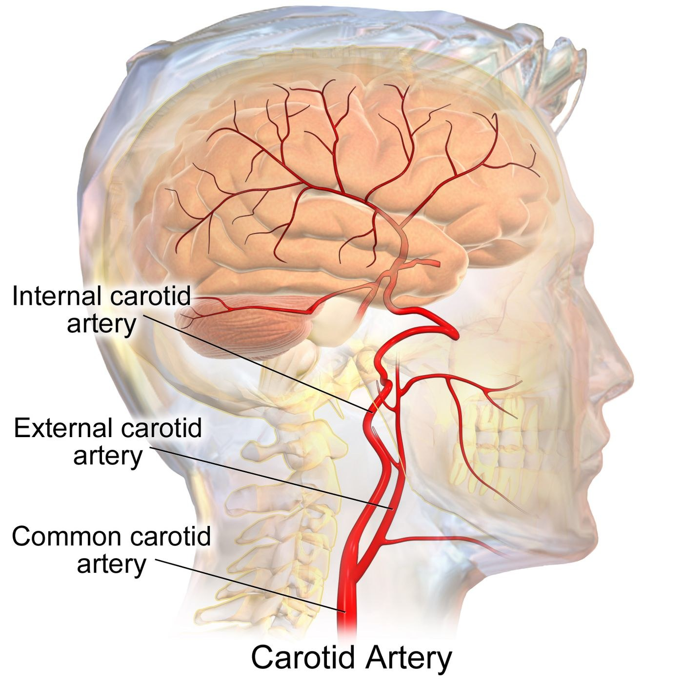
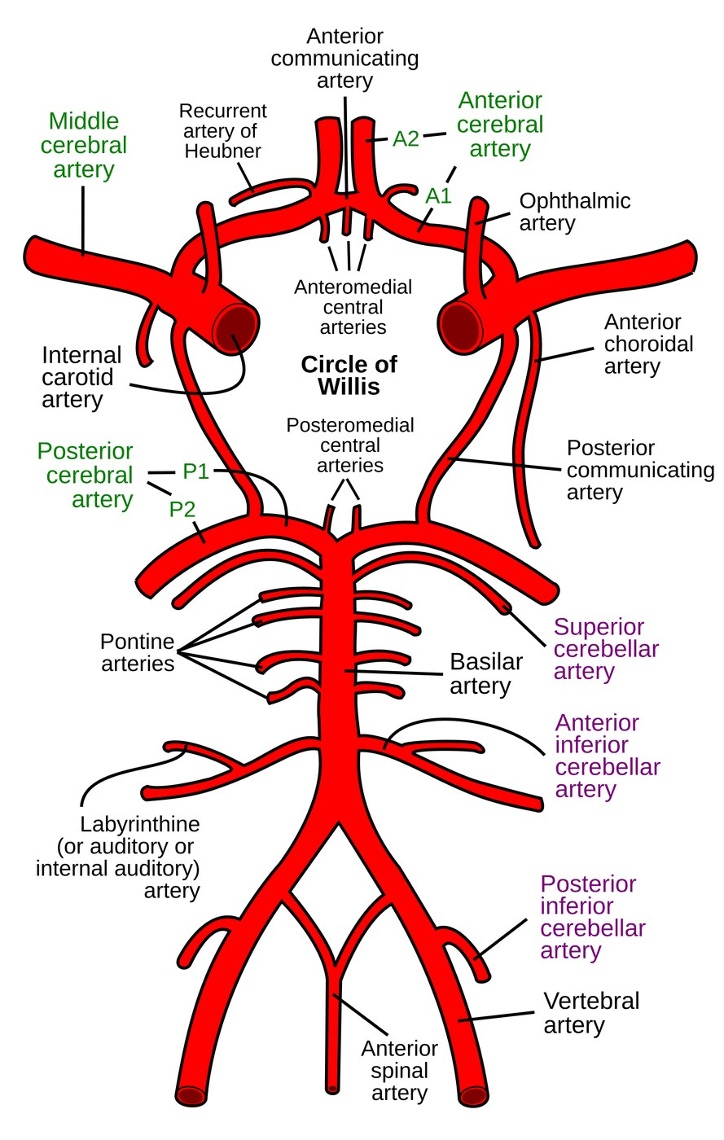
Figures 31.1–31.2 · Arterial supply to the brain
WHAT TO NOTICE
Carotids: the internal carotid feeds most of the anterior brain
ACA and MCA: branch from each internal carotid
Posterior: vertebral arteries join as the basilar, then the PCAs
Circle of Willis: can reroute flow around an occlusion, if complete
Teaching point: many people have an incomplete circle, so the same occlusion can cause very different strokes.
Figure 31.1. "Blausen 0170 CarotidArteries" by BruceBlaus (Blausen.com staff), via Wikimedia Commons, CC BY 3.0. Figure 31.2. "Circle of Willis en" by Rhcastilhos, via Wikimedia Commons, Public domain.
Notes:
Use these to anchor territories before slot 11. Ask students to trace a clot from a carotid plaque into the MCA.
Figure credit: Figure 31.1: "Blausen 0170 CarotidArteries" by BruceBlaus (Blausen.com staff), via Wikimedia Commons, CC BY 3.0. The carotid arteries. The common carotid divides into the external carotid, which supplies the face and scalp, and the internal carotid, which supplies most of the anterior brain. Plaque at this bifurcation is a major source of TIA and ischemic stroke. | Figure 31.2: "Circle of Willis en" by Rhcastilhos, via Wikimedia Commons, Public domain. The circle of Willis, viewed from below. The communicating arteries join the carotid (anterior) and vertebrobasilar (posterior) circulations and can reroute blood around an occlusion when the ring is complete.

Slide 8
Type determines treatment: three main kinds of stroke
DEFINITION AND CLASSIFICATION
Clot-dissolving drugs save the ischemic brain and harm the bleeding one
Ischemic stroke and TIA
Intracerebral hemorrhage
Aneurysmal SAH
Mechanism: an occluded artery causes infarction
TOAST causes: large-artery, cardioembolic, small-vessel (lacunar), other, undetermined
TIA: symptoms resolve fully, with no infarct on imaging
Severity: LVO versus branch; NIHSS 0–42
Deep: hypertensive rupture of small penetrating arteries
Lobar: cerebral amyloid angiopathy in older adults
Secondary: anticoagulants, AVM, tumour, stimulants
Burden: half or more of stroke deaths (HSF, 2020a)
Cause: a saccular aneurysm ruptures at a circle of Willis branch point
Hallmark: thunderclap headache
Grading: Hunt and Hess or WFNS scales (Hoh et al., 2023)
Course: phases over about three weeks
Stroke mimics: migraine, seizure, vertigo, syncope and, above all, hypoglycemia. Check glucose in every client with sudden deficits.
Notes:
Sources: section 31.1, 31.4, 31.5. ICH accounts for half or more of stroke deaths (HSF, 2020a). TIA is tissue-based: transient symptoms without infarction on imaging (Perry et al., 2022). Only imaging separates ischemic stroke from hemorrhage.

Slide 9
Risk factors for TIA and ischemic stroke
RISK FACTORS
Hypertension is the most important modifiable risk factor
Non-modifiable
Modifiable
Social determinants and equity
Increasing age
Prior stroke or TIA
Family history of early stroke
Sex-specific: pregnancy and postpartum, hypertensive disorders of pregnancy, menopause
Hypertension and atrial fibrillation
Dyslipidemia and diabetes
Smoking and vaping; inactivity; high-sodium diet
Obesity, heavy alcohol, sleep apnea, stimulants
Low income and food insecurity
Rural or remote residence, far from stroke services
Inequitable access to primary care and medications
Impacts of colonization and racism; language and literacy barriers
Notes:
Source: Table 31.5. Draw the link to Mr. Ouellet: hypertension plus atrial fibrillation, with anticoagulation stopped because of nosebleeds and cost, which is a social determinant of adherence.

Slide 10
Ischemic stroke, step by step: from occlusion to infarction
MECHANISM
Every step is a target: reperfusion and physiologic control
1
2
3
Occlusion
Energy failure
Excitotoxicity
A thrombus or embolus blocks a cerebral artery; downstream flow falls sharply.
ATP runs out within minutes; the sodium-potassium pump fails and cells swell (cytotoxic edema).
Depolarized neurons release glutamate; overstimulated receptors let calcium flood in.
4
5
6
Calcium-driven injury
Core expansion
Barrier breakdown
Enzymes, mitochondrial damage and free radicals trigger inflammation and apoptosis.
The core spreads into the penumbra over hours unless the artery is reopened.
Over 1 to 5 days, vasogenic edema and hemorrhagic transformation can develop.
Notes:
Source: section 31.3 pathogenesis. Steps 2–4 happen within minutes in the core and over hours in the penumbra. Step 6 explains why edema and hemorrhagic transformation peak over days 1 to 5.

Slide 11
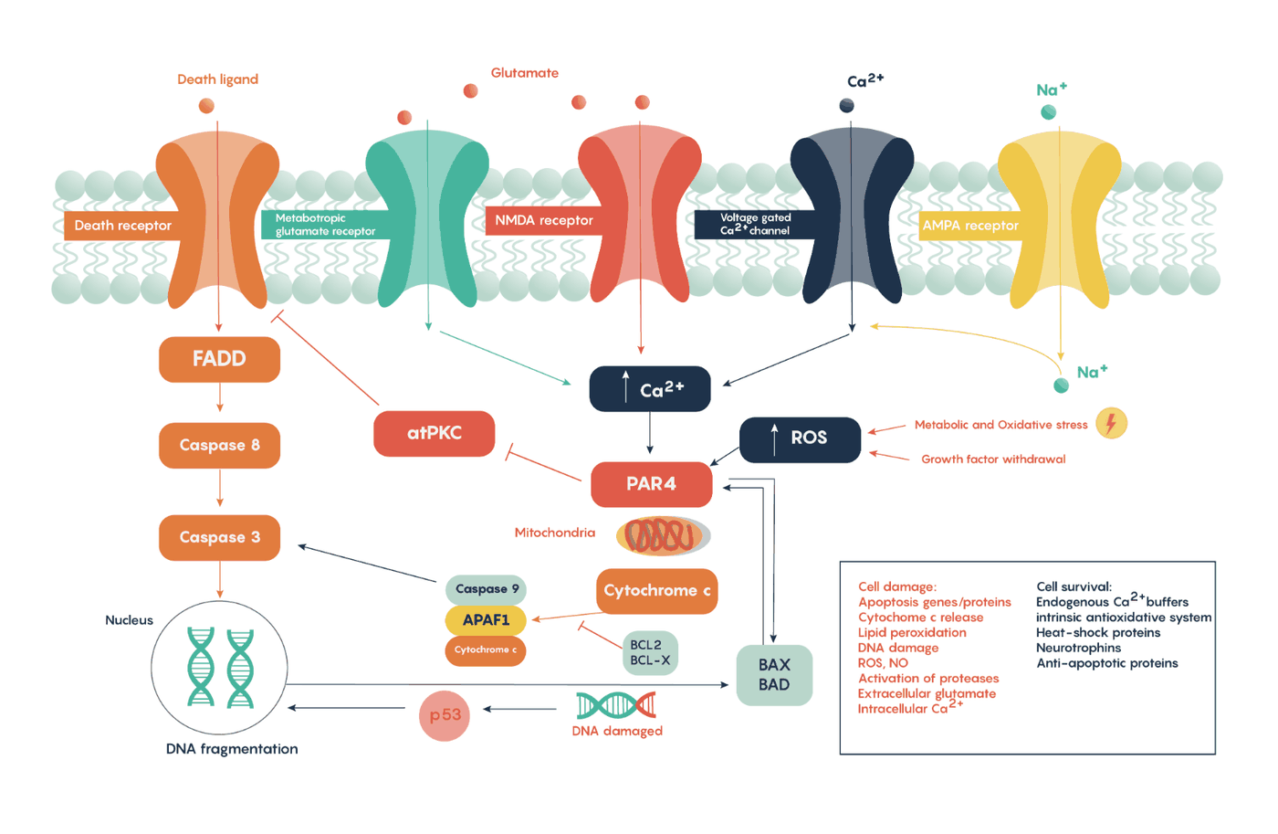
Figure 31.10 · The ischemic cascade at the cellular level
WHAT TO NOTICE
Glutamate: overstimulates its receptors at the membrane
Calcium influx: activates destructive enzymes
Downstream: mitochondrial injury, caspases and DNA fragmentation lead to cell death
Time: the cascade continues in the penumbra for hours
Why it matters: fever, hyperglycemia, hypotension and hypoxemia speed this cascade; nurses measure all four.
Figure 31.10. "Molecular pathways outlining the role of glutamate in excitoxicity following stroke" by Dr William Ju, University of Toronto, via Wikimedia Commons, CC BY-SA 4.0.
Notes:
Connect to the Going Deeper box in 31.3: neuroprotective drugs have not proven effective; reperfusion plus physiological control is the best protection.
Figure credit: Figure 31.10: "Molecular pathways outlining the role of glutamate in excitoxicity following stroke" by Dr William Ju, University of Toronto, via Wikimedia Commons, CC BY-SA 4.0. The ischemic cascade at the cellular level. Glutamate release overstimulates its receptors, calcium floods the neuron, and destructive enzymes and apoptotic pathways are activated. These events continue in the penumbra for hours, which is why rapid reperfusion saves tissue.

Slide 12
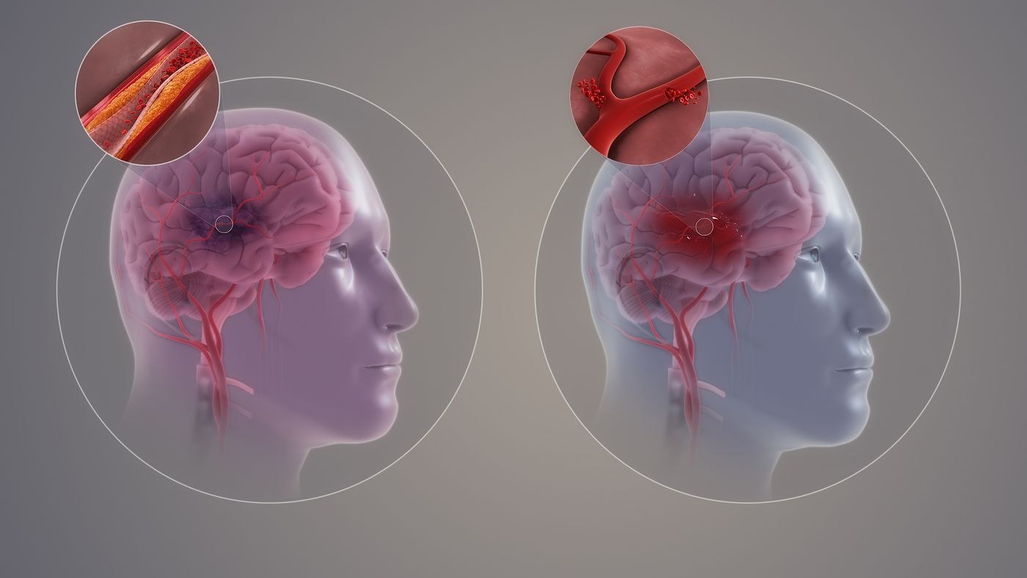
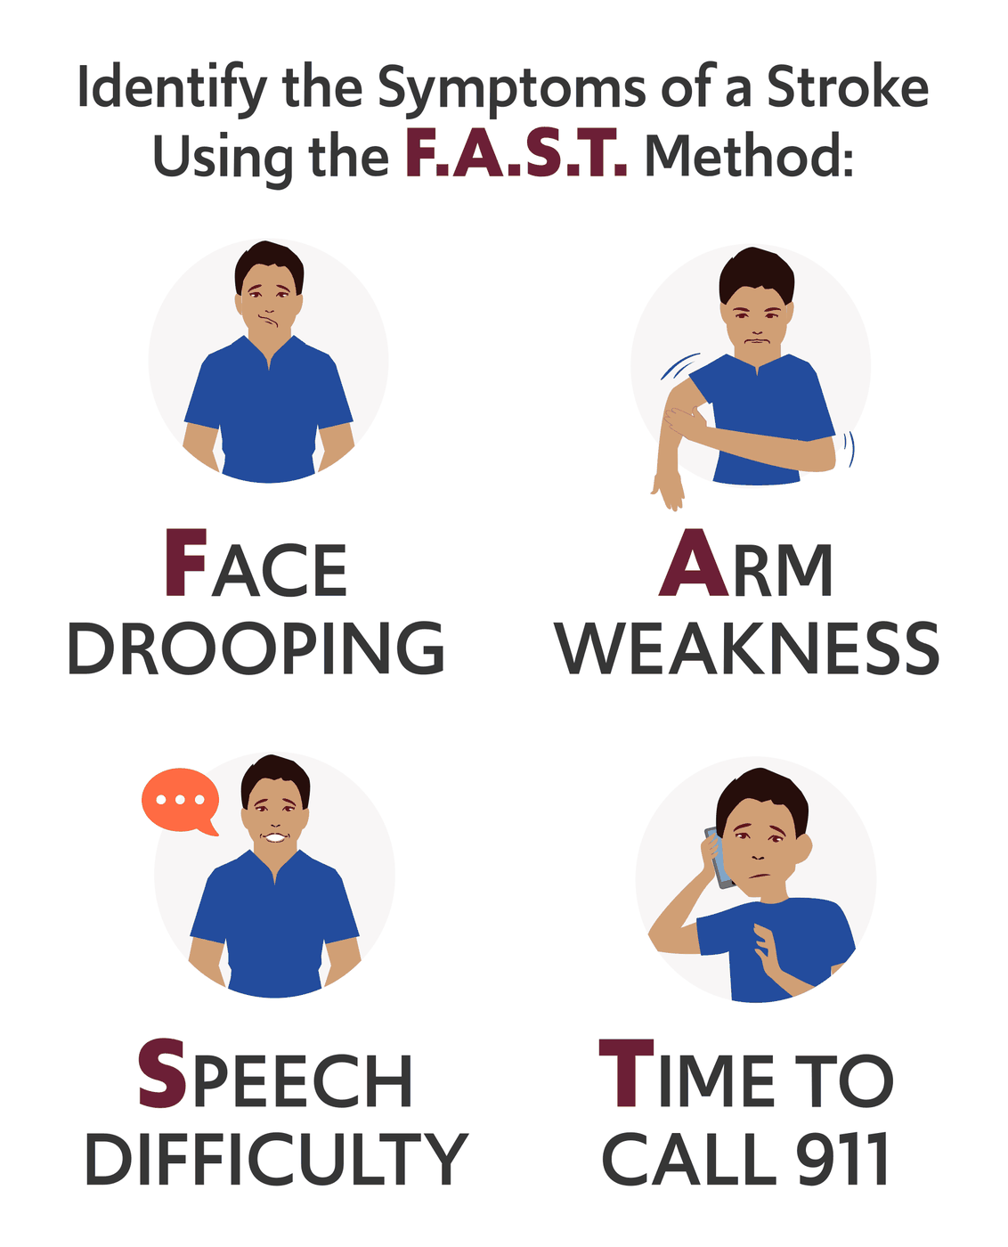
Figures 31.3 and 31.12 · Stroke types and warning signs
WHAT TO NOTICE
31.3, left: a clot blocks an artery; right: a vessel ruptures
Same symptoms: bedside assessment cannot tell them apart
Imaging first: non-contrast CT excludes hemorrhage before reperfusion
31.12: Face drooping, Arm weakness, Speech difficulty, Time to call 9-1-1
Safety: thrombolytics and antithrombotics are contraindicated in hemorrhage, so image before you treat.
Figure 31.3. "Types of Stroke" by Scientific Animations (scientificanimations.com), via Wikimedia Commons, CC BY-SA 4.0. Figure 31.12. "Identify the symptoms of a stroke using the FAST method" by U.S. Food and Drug Administration (vector by Fvasconcellos), via Wikimedia Commons, Public domain.
Notes:
Sources: sections 31.1 and 31.3. Clinical assessment cannot reliably distinguish ICH from ischemic stroke; brain imaging is required (HSF, 2020a). Heart & Stroke promotes the same FAST signs in Canada; clinicians also use FAST for screening (HSF, 2022).
Figure credit: Figure 31.3: "Types of Stroke" by Scientific Animations (scientificanimations.com), via Wikimedia Commons, CC BY-SA 4.0. Ischemic and hemorrhagic stroke compared. In ischemic stroke (left), a clot blocks a cerebral artery. In hemorrhagic stroke (right), a vessel ruptures and blood escapes into the brain. Because their treatments point in opposite directions, brain imaging must tell them apart before reperfusion therapy. | Figure 31.12: "Identify the symptoms of a stroke using the FAST method" by U.S. Food and Drug Administration (vector by Fvasconcellos), via Wikimedia Commons, Public domain. The FAST signs of stroke: Face drooping, Arm weakness, Speech difficulty, Time to call 9-1-1. Heart & Stroke promotes the same FAST signs in Canada, and paramedics and clinicians use FAST for rapid screening.

Slide 13
What you see, and why it is happening
PATHO-TO-BEDSIDE
Deficits follow arterial territories; motor and sensory pathways cross
Right weakness, word-finding trouble: left (dominant) MCA injury to motor cortex and language areas; use short yes/no questions.
BP 196/108 mmHg on arrival: hypertensive response may support collaterals; treat only for thrombolysis or above 220/120.
Left weakness, ignores left side: right parietal neglect; high fall risk, so supervise transfers.
Wet voice or cough with sips: bulbar weakness; stop oral intake until a swallowing screen is passed.
Eyes deviated to one side: frontal eye field injury; gaze looks toward the lesion, which suggests an LVO.
Headache, vomiting during thrombolysis: suspect symptomatic hemorrhage; stop the alteplase [thrombolytic] infusion.
Irregularly irregular pulse: atrial fibrillation as a cardioembolic source; get a 12-lead ECG without delaying imaging.
Falling LOC, day 2–4, large MCA stroke: malignant edema with mass effect; escalate immediately.
Key idea: a cortical stroke shows gaze deviation, hemiplegia and aphasia or neglect. Name the deficit, time and territory when you report.
Notes:
Sources: Tables 31.4 and 31.7. BP rule: below 185/110 mmHg only for thrombolysis candidates; otherwise not routinely treated up to 220 mmHg systolic (HSF, 2022). Swallow: NPO including medications until a screen is passed (HSF, 2022).

Slide 14
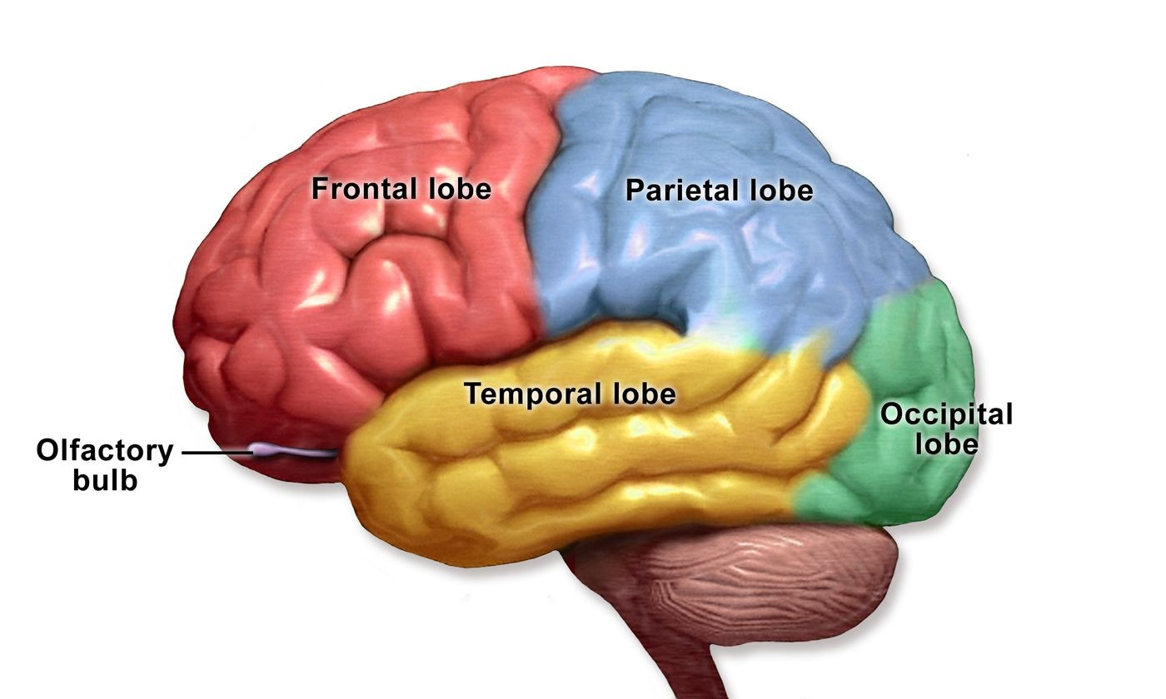
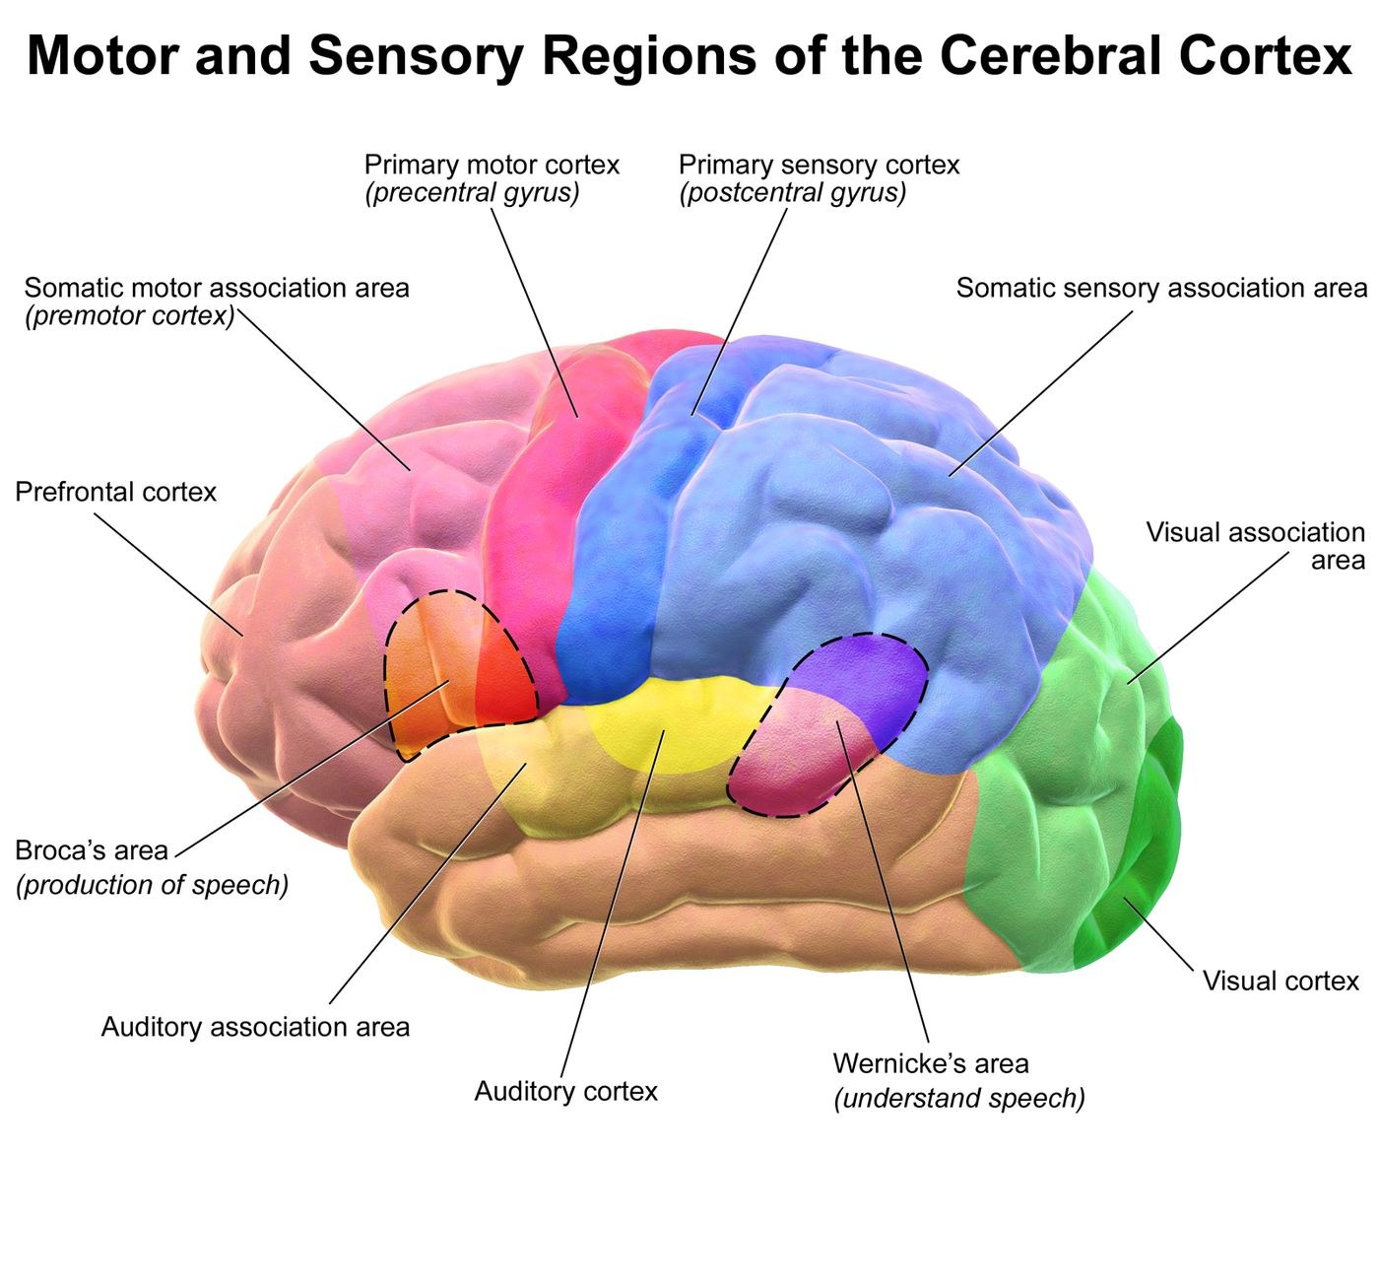
Figures 31.4–31.5 · Localizing the lesion
WHAT TO NOTICE
Frontal: movement and expressive language (Broca's area)
Parietal: sensation and spatial awareness; neglect
Temporal: hearing, memory, comprehension (Wernicke's area)
Occipital: vision
Use with Table 31.3: MCA spares the leg; ACA affects the leg; PCA affects vision.
Figure 31.4. "Blausen 0111 BrainLobes" by BruceBlaus (Blausen.com staff), via Wikimedia Commons, CC BY 3.0. Figure 31.5. "Blausen 0102 Brain Motor&Sensory" by BruceBlaus (Blausen.com staff), via Wikimedia Commons, CC BY 3.0.
Notes:
Source: section 31.1. In most people, including most left-handed people, the left hemisphere is dominant for language.
Figure credit: Figure 31.4: "Blausen 0111 BrainLobes" by BruceBlaus (Blausen.com staff), via Wikimedia Commons, CC BY 3.0. Lobes of the cerebral hemisphere. The lobe injured shapes the deficit: movement and expressive language (frontal), sensation and spatial awareness (parietal), hearing, memory and comprehension (temporal), and vision (occipital). | Figure 31.5: "Blausen 0102 Brain Motor&Sensory" by BruceBlaus (Blausen.com staff), via Wikimedia Commons, CC BY 3.0. Motor and sensory regions of the cerebral cortex. Injury to the primary motor cortex causes contralateral weakness. Injury to Broca's area causes expressive aphasia, and injury to Wernicke's area causes receptive aphasia.

Slide 15
Complications differ by stroke type
COMPLICATIONS
Know the time window when each one is most likely
Ischemic stroke
Intracerebral hemorrhage
Aneurysmal SAH
Hemorrhage: symptomatic ICH after reperfusion; hemorrhagic transformation
Edema: malignant MCA or cerebellar swelling, days 2–5
Seizures: usually early
Recurrence: carotid stenosis, untreated AF
Expansion: early deterioration in the first hours
Mass effect: edema, herniation
Hydrocephalus: ventricular extension
Recurrence: especially with CAA
Rebleeding: highest before the aneurysm is secured
DCI: about 30%, days 4–14 (Hoh et al., 2023)
Hydrocephalus: very common
Hyponatremia: salt wasting or SIADH
All types: aspiration pneumonia, VTE, urinary tract infection, falls, pressure injury and depression. Most are preventable on the stroke unit.
Notes:
Sources: 31.3, 31.4, 31.5. Malignant edema peaks around days 2 to 5. DCI affects about 30% of aSAH clients, days 4 to 14 (Hoh et al., 2023). Prophylactic antiseizure drugs are not recommended after ischemic stroke (HSF, 2022).

Slide 16
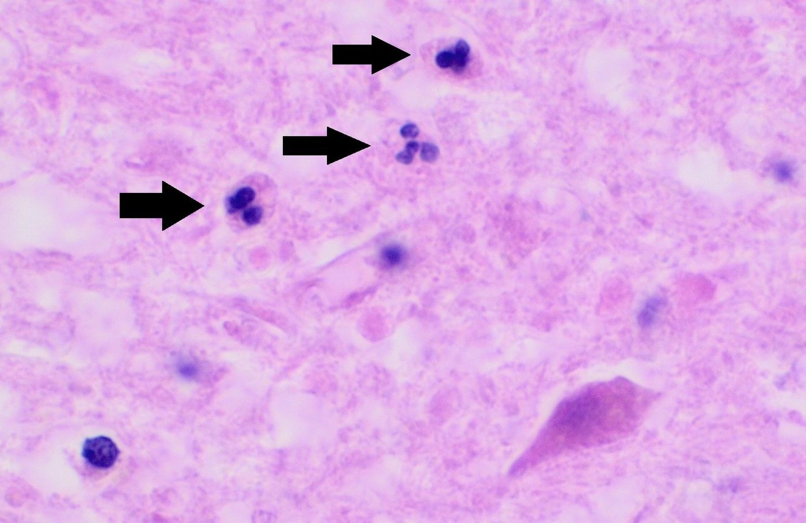
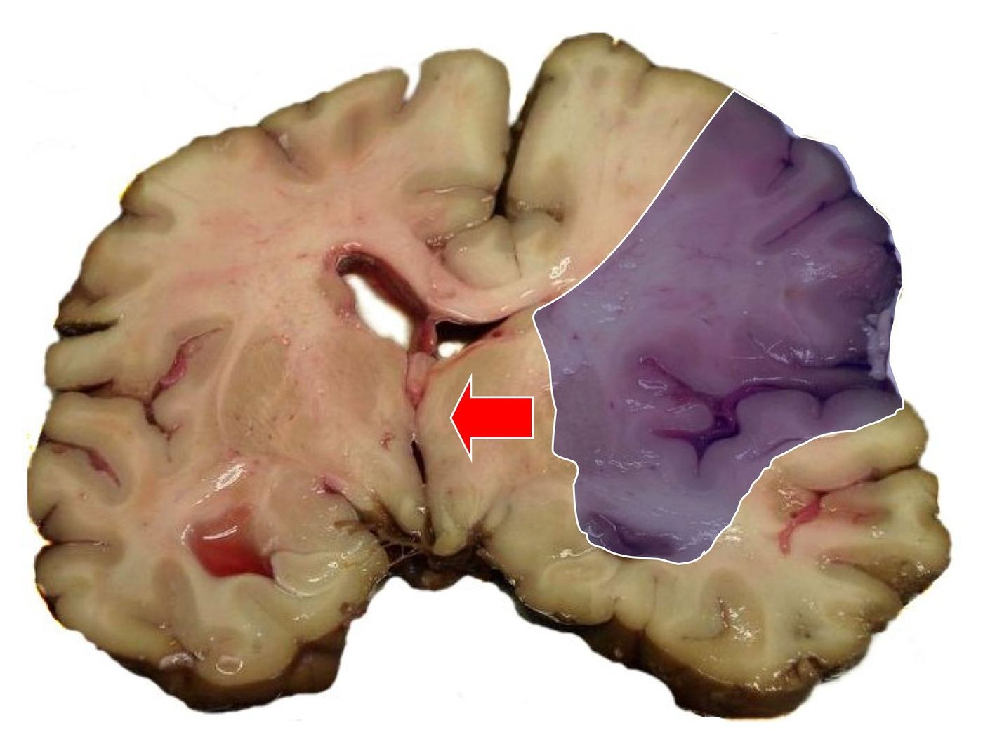
Figures 31.11 and 31.16 · Pathology of the infarct
WHAT TO NOTICE
Microscope (31.11): neutrophils infiltrate the infarct by about 24 hours
Autopsy (31.16): a swollen MCA infarct (blue)
Arrow: midline structures pushed to the opposite side
Link: inflammation drives edema in the first days
Bedside: a falling level of consciousness after a large MCA stroke means mass effect until proven otherwise.
Figure 31.11. "Histopathology of ischemic stroke of the thalamus at approximately 24 hours, annotated" by Mikael Häggström, M.D., via Wikimedia Commons, CC0 1.0. Figure 31.16. "MCA-Stroke-Brain-Humn-2A" by Marvin 101, via Wikimedia Commons, CC BY-SA 3.0.
Notes:
Sources: section 31.3. Use these together: the cellular inflammation and the gross mass effect are the same process at two scales.
Figure credit: Figure 31.11: "Histopathology of ischemic stroke of the thalamus at approximately 24 hours, annotated" by Mikael Häggström, M.D., via Wikimedia Commons, CC0 1.0. Microscopic appearance of an ischemic infarct of the thalamus about 24 hours after onset (H&E stain). Neutrophils (black arrows) infiltrate the injured tissue as part of the acute inflammatory response that contributes to cerebral edema in the first days. | Figure 31.16: "MCA-Stroke-Brain-Humn-2A" by Marvin 101, via Wikimedia Commons, CC BY-SA 3.0. Coronal brain slice at autopsy after an acute MCA stroke. The swollen infarct (blue shading) has pushed midline structures toward the opposite side (red arrow). This is the mass effect behind malignant cerebral edema.

Slide 17
Assessment and recognizing deterioration
PART 2
History, examination, diagnostics, and the red flags that cannot wait
Notes:
Part 2 builds the assessment toolkit and returns to Mr. Ouellet for Stage 2.

Slide 18
What to ask, and why it matters
FOCUSED HEALTH HISTORY
The diagnosis of TIA rests largely on the history
The event
Medications and background
"When were you last completely normal?" Time sets the treatment window and the triage urgency.
What happened? One-sided weakness or speech disturbance carries the highest early risk.
Sudden loss of function? Suggests ischemia; spreading tingling or shimmering lights suggest migraine or seizure.
Has it happened before? Repeated events suggest a critically narrowed artery.
Anticoagulants: which one, and the exact time of the last dose; this decides reversal and thrombolysis
Adherence: are medications actually being taken?
History: atrial fibrillation, hypertension, diabetes, prior stroke, memory problems
Also: alcohol and substance use; recent head injury
Notes:
Sources: 31.2 and 31.4 focused history. Women are more likely than men to present with less typical symptoms and are less likely to be diagnosed with TIA or minor stroke (Perry et al., 2022).

Slide 19
What to look, listen and feel for
FOCUSED PHYSICAL ASSESSMENT
Compare every finding with the last assessment
Capillary glucose: below 4.0 mmol/L suggests a mimic; correct immediately and reassess.
Gaze and visual fields: deviation toward the lesion; hemianopia; neglect.
Blood pressure: compare with the thresholds for thrombolysis, ICH or aSAH.
GCS and pupils: a falling GCS signals edema, expansion or hydrocephalus.
Pulse rhythm: irregularly irregular suggests atrial fibrillation.
Swallow cues: wet voice, coughing with drinks, food pocketed in the weak cheek.
FAST and NIHSS: face, arm, speech; standardized severity from 0 to 42.
Late signs: Cushing's triad: widening pulse pressure, bradycardia, irregular respirations.
Trend, not score: use the same tool each time, and report a decline with the vital signs and glucose taken at the same time.
Notes:
Sources: 31.2, 31.3, 31.4 and Table 31.16. Cushing's triad is a late sign of herniation. Every client with sudden neurologic symptoms gets a capillary glucose.

Slide 20
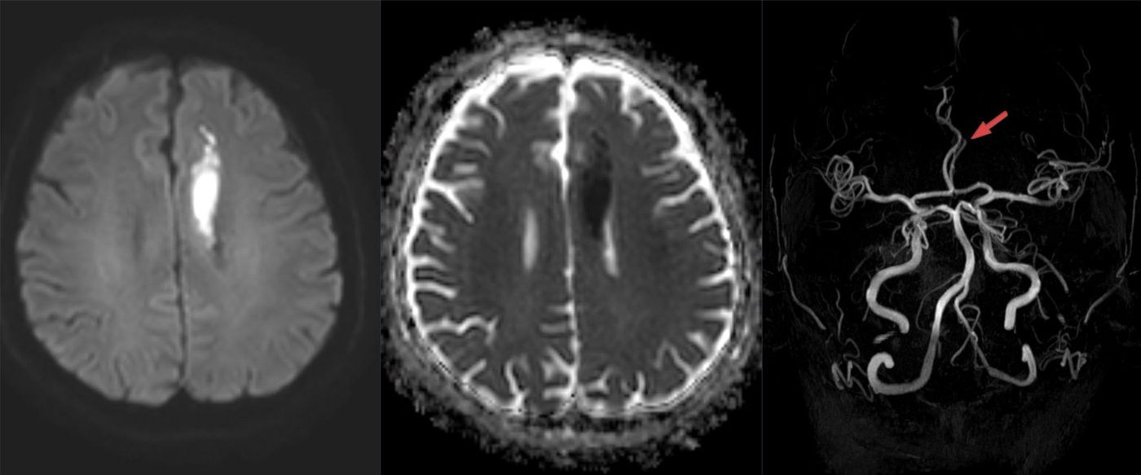
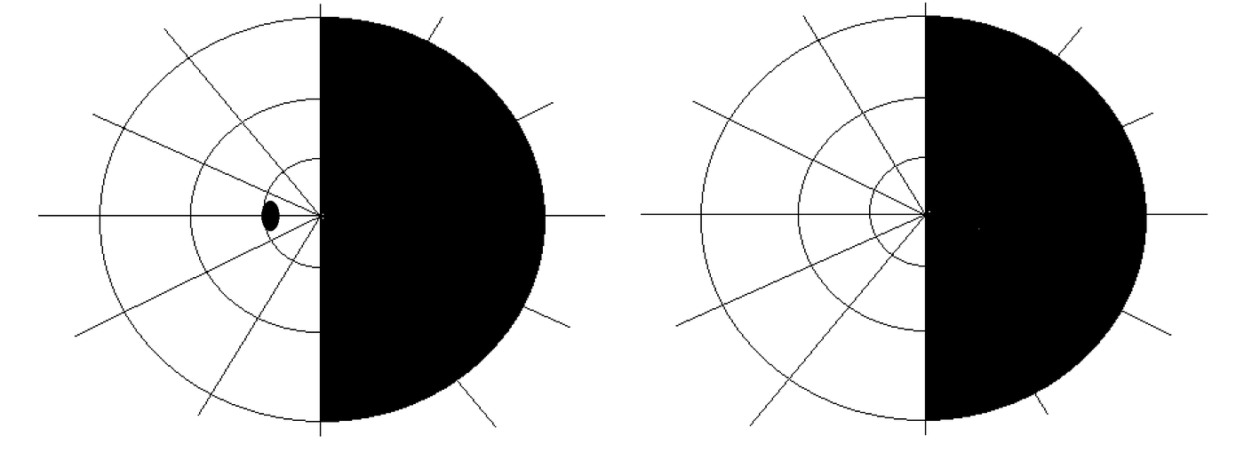
Figures 31.7 and 31.21 · Territory-specific injury
WHAT TO NOTICE
31.7: left ACA infarct: bright on DWI, dark on ADC, which means acute cell injury
ACA: leg weaker than arm
31.21: right homonymous hemianopia: the same half-field lost in both eyes
PCA: after a left posterior cerebral artery stroke; teach head-turning to scan
Link to Table 31.3: the territory predicts the deficit you will find at the bedside.
Figure 31.7. "Unilateraler Anteriorinfarkt 70M - MR DWI ADC TOF - 001" by Hellerhoff, via Wikimedia Commons, CC BY-SA 4.0. Figure 31.21. "Visual field homonymous hemianopia" by RobertB3009, via Wikimedia Commons, CC BY-SA 4.0.
Notes:
Sources: sections 31.2 (MRI is more sensitive than CT for small infarcts) and 31.7 (hemianopia). Clients often do not realize part of their vision is missing until they bump into things.
Figure credit: Figure 31.7: "Unilateraler Anteriorinfarkt 70M - MR DWI ADC TOF - 001" by Hellerhoff, via Wikimedia Commons, CC BY-SA 4.0. MRI of an acute left anterior cerebral artery infarct. The infarct is bright on diffusion-weighted imaging (left) and dark on the ADC map (middle), confirming acute cell injury; angiography is shown at right. Leg weakness greater than arm weakness is typical of ACA strokes. | Figure 31.21: "Visual field homonymous hemianopia" by RobertB3009, via Wikimedia Commons, CC BY-SA 4.0. Goldmann visual field charts showing a right homonymous hemianopia. The same (right) half of the visual field is lost in both eyes, as after a left posterior cerebral artery stroke. Teach the client to turn the head and scan toward the lost side.

Slide 21
Diagnostics: expected findings and nursing actions
DIAGNOSTICS AND LABS
Blood work and the ECG must not delay imaging or treatment
Imaging
Laboratory
Cardiac and vascular
NCCT + CTA: immediately for arrivals within 6 h; excludes hemorrhage, shows the occlusion (HSF, 2022)
CT perfusion: for suspected LVO at 6–24 h; core versus penumbra
MRI DWI: more sensitive for small infarcts; ideally within 7 days
SAH: CT shows cistern blood; LP for xanthochromia if CT is negative
Initial: glucose, CBC, INR and aPTT, electrolytes, creatinine (HSF, 2022)
Expected: INR 0.8–1.2; platelets 150–400 × 10⁹/L
Later: lipid profile, HbA1c
ICH: prolonged INR with warfarin [VKA]; draw at once
12-lead ECG: atrial fibrillation or flutter
Monitoring: 24 h or more; at least 2 weeks in selected clients 55 or older (HSF, 2020b)
Carotid: 50–99% symptomatic stenosis triggers urgent referral
aSAH: sodium below 135 mmol/L is common; track intake and output
Notes:
Sources: Tables 31.6, 31.8, 31.12, 31.14 (HSF, 2020b, 2022; Perry et al., 2013). CTA is the first-line vascular imaging test.

Slide 22
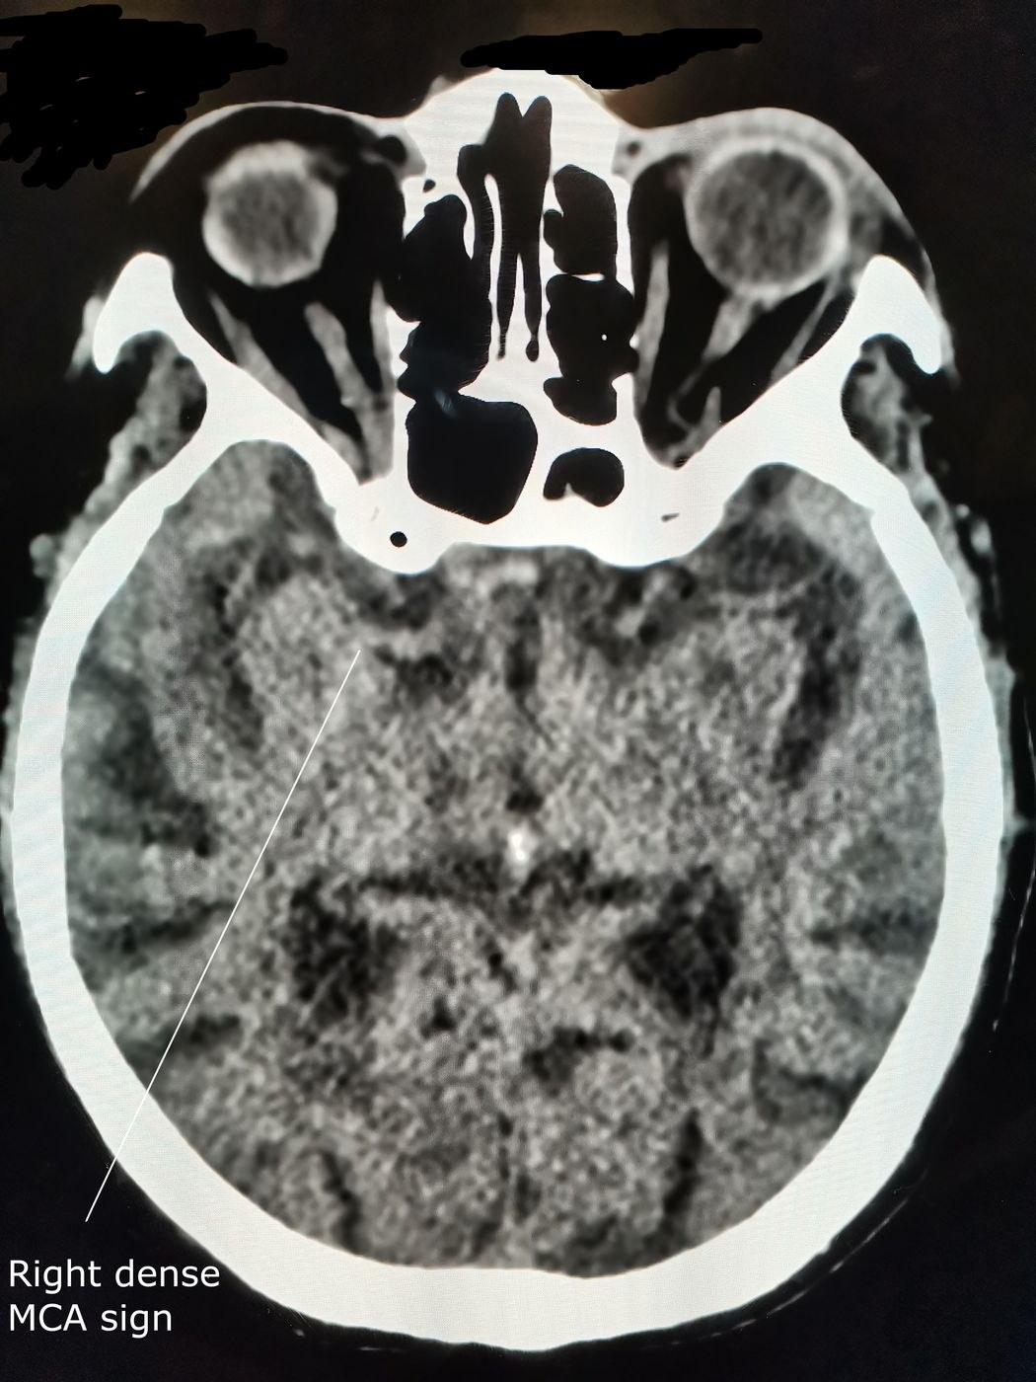
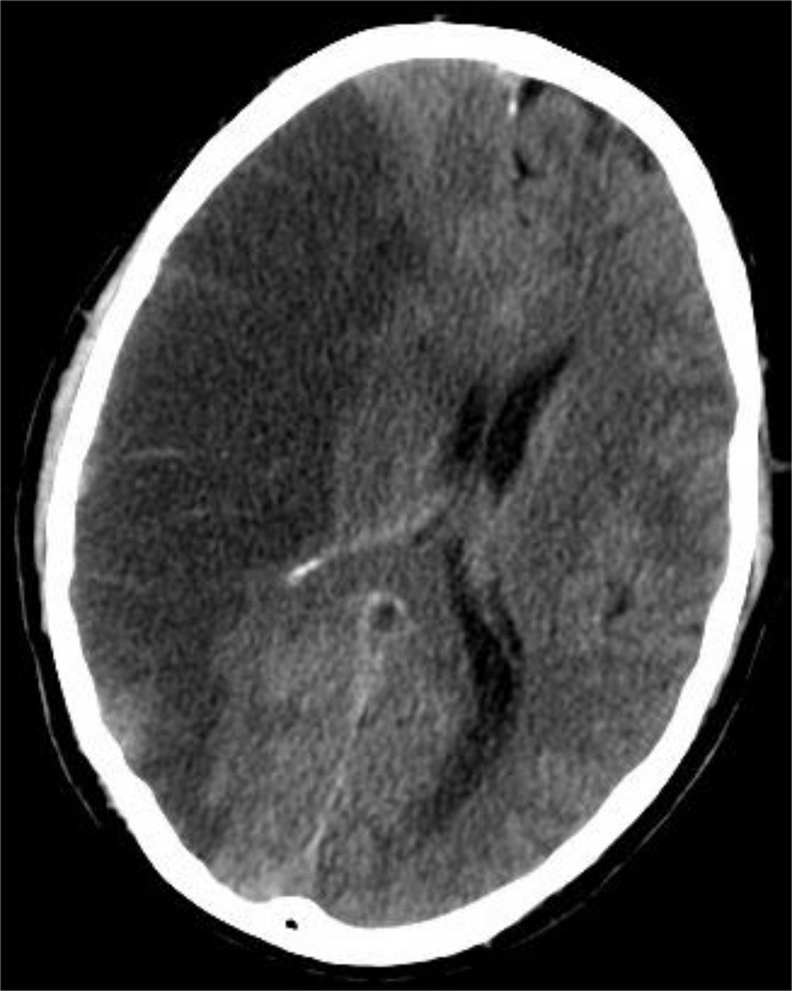
Figures 31.13–31.14 · CT in acute ischemic stroke
WHAT TO NOTICE
31.13: hyperdense right MCA: fresh clot inside the artery
Early: can appear before the infarct is visible
31.14: established MCA infarct is darker (hypodense)
Also: loss of grey-white differentiation and swelling
First job of CT: exclude hemorrhage before thrombolysis. Early CT may look normal.
Figure 31.13. "Right dense MCA sign as seen on CT brain" by Cerevisae, via Wikimedia Commons, CC BY-SA 4.0. Figure 31.14. "CT Brain MCA Infarct" by Lucien Monfils, via Wikimedia Commons, CC BY-SA 4.0.
Notes:
Source: section 31.3. Radiological convention: the patient's right is on the image's left.
Figure credit: Figure 31.13: "Right dense MCA sign as seen on CT brain" by Cerevisae, via Wikimedia Commons, CC BY-SA 4.0. Non-contrast head CT showing a hyperdense right middle cerebral artery (labelled). Fresh thrombus in the artery appears brighter than the opposite vessel and can be one of the earliest CT signs of acute ischemic stroke. | Figure 31.14: "CT Brain MCA Infarct" by Lucien Monfils, via Wikimedia Commons, CC BY-SA 4.0. Non-contrast CT showing an established MCA infarct. Infarcted tissue becomes darker (hypodense), with loss of grey-white differentiation and swelling. Early CT may look normal, and its first job in the emergency department is to exclude hemorrhage.

Slide 23
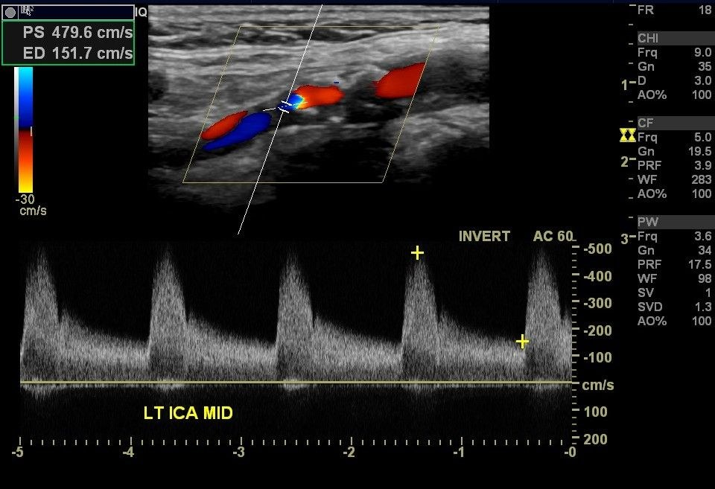
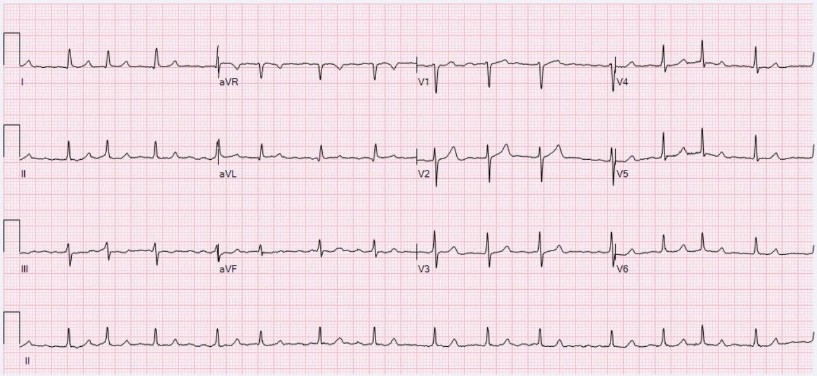
Figures 31.8 and 31.9 · Finding the embolic source
WHAT TO NOTICE
31.8: Doppler of a near-occluded left ICA: very high peak systolic velocity
Action: 50–99% symptomatic stenosis needs urgent surgical referral
31.9: atrial fibrillation: irregularly irregular, no distinct P waves
Monitoring: 24 h or more; at least 2 weeks in selected clients
Workup: vascular imaging and cardiac monitoring find the cause, and the cause guides prevention.
Figure 31.8. "Internal carotid artery stenosis in ultrasound near occlusion" by Mme Mim, via Wikimedia Commons, CC BY-SA 3.0. Figure 31.9. "ECG Atrial Fibrillation 90 bpm" by Ewingdo, via Wikimedia Commons, CC BY-SA 4.0.
Notes:
Sources: section 31.2 diagnostics (HSF, 2020b, 2022).
Figure credit: Figure 31.8: "Internal carotid artery stenosis in ultrasound near occlusion" by Mme Mim, via Wikimedia Commons, CC BY-SA 3.0. Colour and spectral Doppler ultrasound of a near-occluded left internal carotid artery. Very high peak systolic velocity reflects blood accelerating through a tight stenosis, a finding that triggers urgent referral for revascularization. | Figure 31.9: "ECG Atrial Fibrillation 90 bpm" by Ewingdo, via Wikimedia Commons, CC BY-SA 4.0. Twelve-lead ECG showing atrial fibrillation with a controlled ventricular rate. The irregularly irregular rhythm without distinct P waves identifies a major cardioembolic source of stroke.

Slide 24
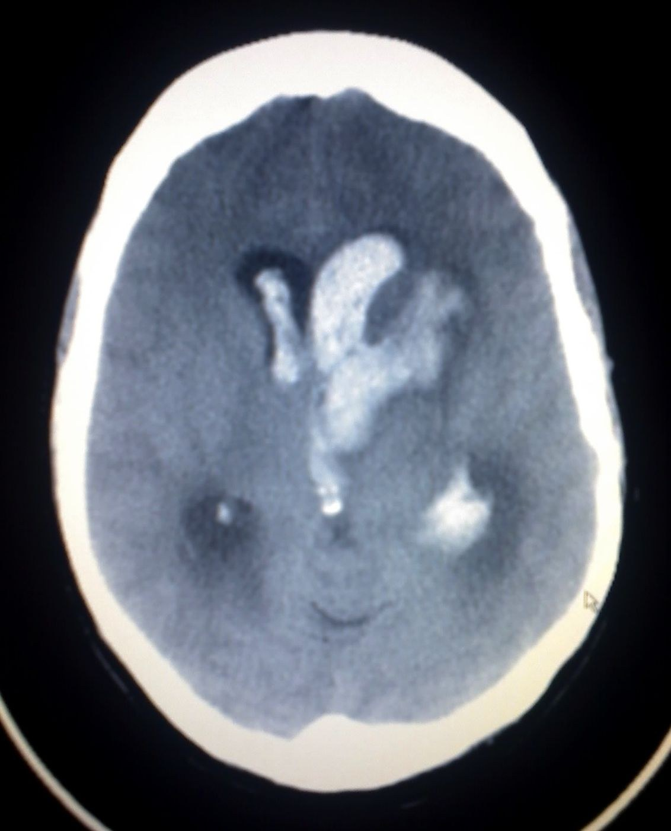
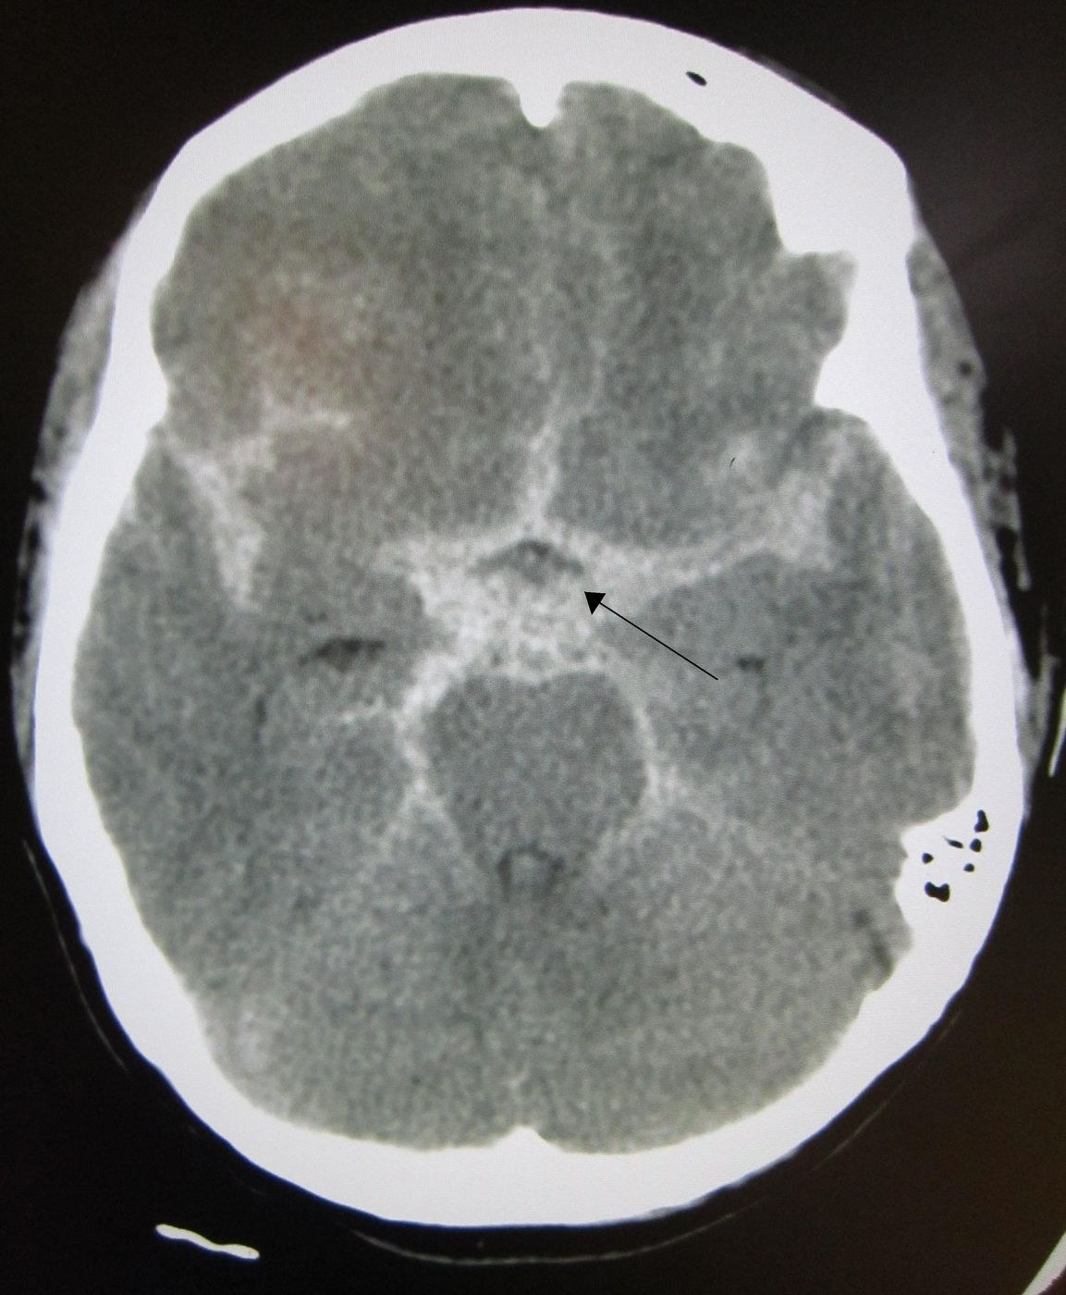
Figures 31.17 and 31.19 · Blood on CT
WHAT TO NOTICE
31.17: ICH with ventricular extension; fresh blood is bright
Risk: intraventricular blood can cause hydrocephalus
31.19: SAH: bright blood fills the basal cisterns (arrow)
Story: sudden thunderclap headache
Report at once: a falling level of consciousness after any hemorrhage.
Figure 31.17. "Intracerebral hemorrage (CT scan)" by Glitzy queen00 at English Wikipedia, via Wikimedia Commons, Public domain. Figure 31.19. "SAH1" by James Heilman, MD, via Wikimedia Commons, CC BY-SA 3.0.
Notes:
Sources: sections 31.4 and 31.5. Clinical assessment cannot reliably distinguish ICH from ischemic stroke (HSF, 2020a).
Figure credit: Figure 31.17: "Intracerebral hemorrage (CT scan)" by Glitzy queen00 at English Wikipedia, via Wikimedia Commons, Public domain. Non-contrast CT showing intracerebral hemorrhage with extension into the ventricles. Fresh blood is bright. Intraventricular blood can block CSF flow and cause hydrocephalus, so a falling level of consciousness must be reported at once. | Figure 31.19: "SAH1" by James Heilman, MD, via Wikimedia Commons, CC BY-SA 3.0. Non-contrast CT showing subarachnoid hemorrhage. Bright blood fills the basal cisterns around the brainstem (arrow). The classic presentation is a sudden thunderclap headache.

Slide 25
Red flags that cannot wait
RED FLAGS AND ESCALATION
Escalate by the type and timing of the stroke
New stroke symptoms, anywhere: activate code stroke or call 9-1-1; record last known well.
Airway threat: stridor, tongue swelling, SpO₂ below 92%: call rapid response.
NIHSS up more than 4, GCS down 2+: stop any running thrombolytic; notify; prepare for emergent CT.
After thrombectomy: expanding groin hematoma, or a cold, pulseless limb.
New headache or vomiting: after thrombolysis, suspect hemorrhage; after aSAH, suspect rebleeding.
aSAH days 4–14: new confusion or focal deficit suggests delayed cerebral ischemia.
BP outside prescribed limits: above 185/110 before thrombolysis, or above or below the ordered range.
ICH, first 24 hours: falling LOC suggests expansion or hydrocephalus.
Escalate when… any finding is worse than the last assessment. Stop, look, call: notify the most responsible provider with SBAR.
Notes:
Sources: Table 31.11 (AHS, n.d.; HSF, 2025), 31.4 and 31.5. An NIHSS increase of more than 4 points is a common protocol trigger. A GCS decrease of 2 or more is a DCI warning sign after aSAH.

Slide 26
Mr. Ouellet: recognize and analyze cues
UNFOLDING CASE · STAGE 2
Stage 2 · Recognize and analyze cues
Cues
What they mean
CT: no hemorrhage; hyperdense left MCA
CTA: left M1 occlusion, good collaterals; ASPECTS 8
Labs: INR 1.0 (0.8–1.2, MEDIUM); platelets 224 × 10⁹/L (150–400, MEDIUM)
Weight: 82 kg, measured
New history: stopped apixaban [DOAC] three weeks ago (nosebleeds, cost)
No bleed: reperfusion is possible
LVO with small core: thrombectomy candidate
Coagulation normal, off DOAC: thrombolysis not excluded
BP 192/104 mmHg: lower below 185/110 first
Tenecteplase [thrombolytic]: 0.25 mg/kg = 20.5 mg
Prioritize: lower BP, double-check the weight-based dose, give tenecteplase [thrombolytic] and activate thrombectomy. Target door-to-needle: median 30 minutes or less.
Notes:
Anchor case Stage 2. Ties to slots 17 and 18: CT excludes hemorrhage, and the hyperdense MCA is Figure 31.13's finding. Dose: 0.25 mg/kg × 82 kg = 20.5 mg (maximum 25 mg) (HSF, 2025). BP must be below 185/110 before and during thrombolysis and for 24 h (HSF, 2022). DOACs are not routinely given with thrombolysis, but he stopped apixaban [DOAC] three weeks ago.

Slide 27
TIA is an emergency, not a reassurance
TRANSIENT ISCHEMIC ATTACK
The highest-risk days come right after symptoms resolve
Triage by time since onset
Prevention starts in the ED
Within 48 h: especially motor or speech symptoms: send immediately to an ED with stroke capacity (HSF, 2022)
Within 4.5 h: emergent assessment
After 48 h: comprehensive evaluation as soon as possible, often in a stroke prevention clinic
Canadian TIA Score: low (below 1%), medium (1–5%) or high (above 5%) 7-day risk (Perry et al., 2022)
Antiplatelet: within 24 h after imaging excludes hemorrhage (HSF, 2020b)
DAPT: clopidogrel [P2Y12 inhibitor] plus ASA [antiplatelet] for 21 days in high-risk TIA or minor stroke (NIHSS 0–3)
Carotid: 50–99% symptomatic stenosis: surgery ideally within 14 days
Results: 90-day stroke risk has fallen from about 10% to as low as 1% (Perry et al., 2022)
Notes:
Fallback slot: no Canadian Context or Practice Story box was left unused, so this slot uses the TIA urgency content from 31.2 (HSF, 2022; HSF, 2020b; Perry et al., 2022). Median time to a subsequent stroke is about 24 hours. With fast, organized care, 90-day stroke risk has fallen from about 10% to as low as 1%.

Slide 28
Management and nursing care
PART 3
Reperfusion, stopping the bleeding, the stroke unit and the road home
Notes:
Part 3 covers collaborative management, medications, nursing priorities, safety, scope, teamwork, teaching, lifespan, equity and the Going Deeper content.

Slide 29
Management by stroke type
TREATMENT GOALS
Reopen the artery, stop the bleeding, or secure the aneurysm
Acute ischemic stroke
Intracerebral hemorrhage
Aneurysmal SAH
Thrombolysis: within 4.5 h; median door-to-needle 30 min or less
EVT: disabling stroke, last known well within 24 h; ASPECTS 6+ is a small core
BP: below 185/110 for thrombolysis; otherwise not treated routinely up to 220 systolic
Glucose: correct hypoglycemia immediately
BP: individual systolic target below 140–160 for 24–48 h
Reverse: anticoagulation immediately, agent-specific
EVD: for hydrocephalus with reduced LOC
Cerebellar 3 cm+: neurosurgical consultation
Secure: coil or clip the aneurysm, preferably within 24 h
Nimodipine [CCB]: 60 mg every 4 h for 21 days, enteral only
Fluids: euvolemia; avoid hypervolemia
Symptomatic DCI: raise BP while keeping euvolemia
Notes:
Sources: HSF (2025) for thrombolysis and EVT; HSF (2022) for BP; HSF (2020a) for ICH; Hoh et al. (2023) and ASHP (n.d.) for aSAH. Thrombolysis is given as a bridge; thrombectomy decisions must not wait to see if it works.

Slide 30
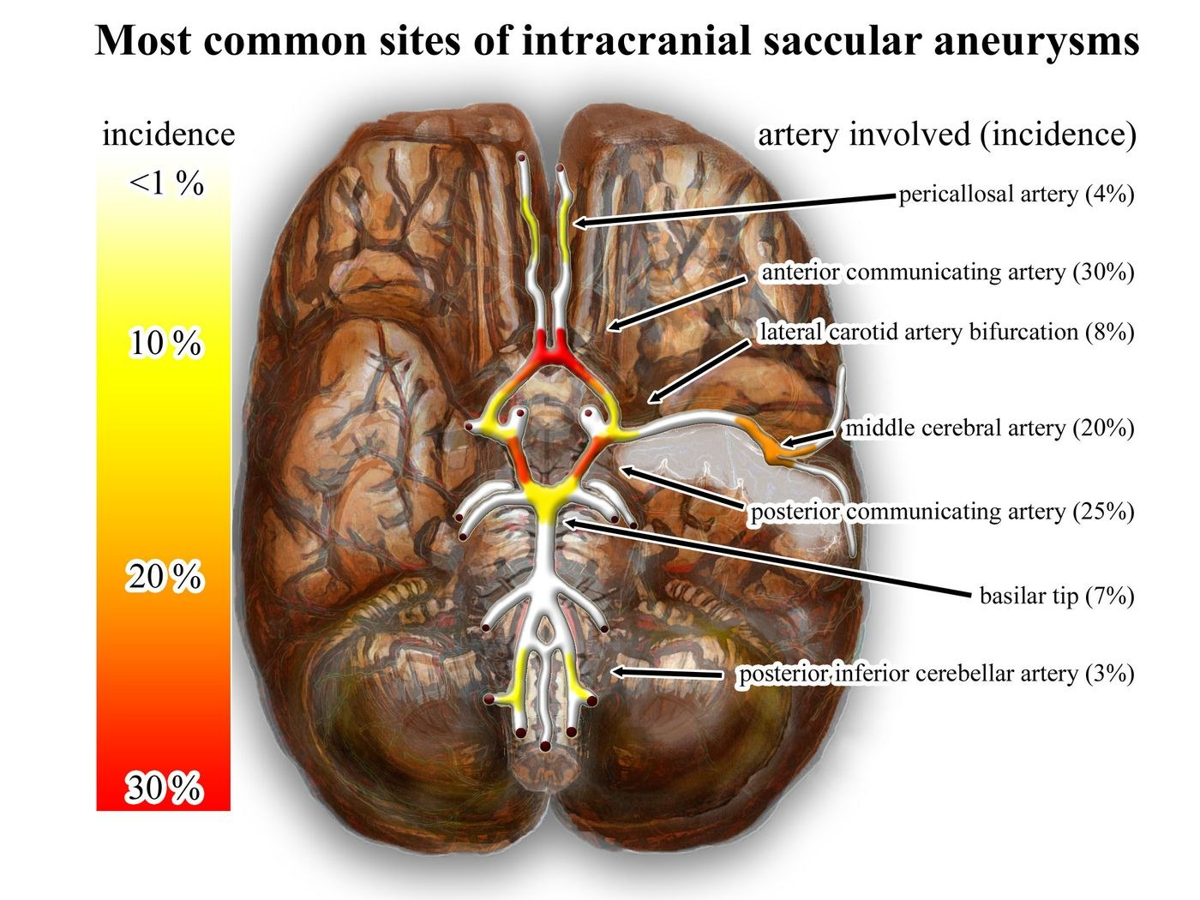
Figure 31.18 · Where aneurysms form
WHAT TO NOTICE
Branch points: most saccular aneurysms arise in the anterior circulation
Most common: anterior communicating (30%), posterior communicating (25%), MCA (20%)
Others: ICA bifurcation, basilar tip, pericallosal, PICA
Clinical link: a posterior communicating aneurysm can cause a third nerve palsy
Before securing: rebleeding is the main threat; keep the environment calm and prevent straining.
Figure 31.18. "Wikipedia intracranial aneurysms - inferior view - heat map" by Nicholas Zaorsky, M.D., via Wikimedia Commons, CC BY-SA 3.0.
Notes:
Source: section 31.5, Figure 31.18 legend and alt text.
Figure credit: Figure 31.18: "Wikipedia intracranial aneurysms - inferior view - heat map" by Nicholas Zaorsky, M.D., via Wikimedia Commons, CC BY-SA 3.0. The most common sites of intracranial saccular (berry) aneurysms, colour-coded by incidence. Most arise at branch points in the anterior circulation, especially the anterior communicating, posterior communicating and middle cerebral arteries.

Slide 31
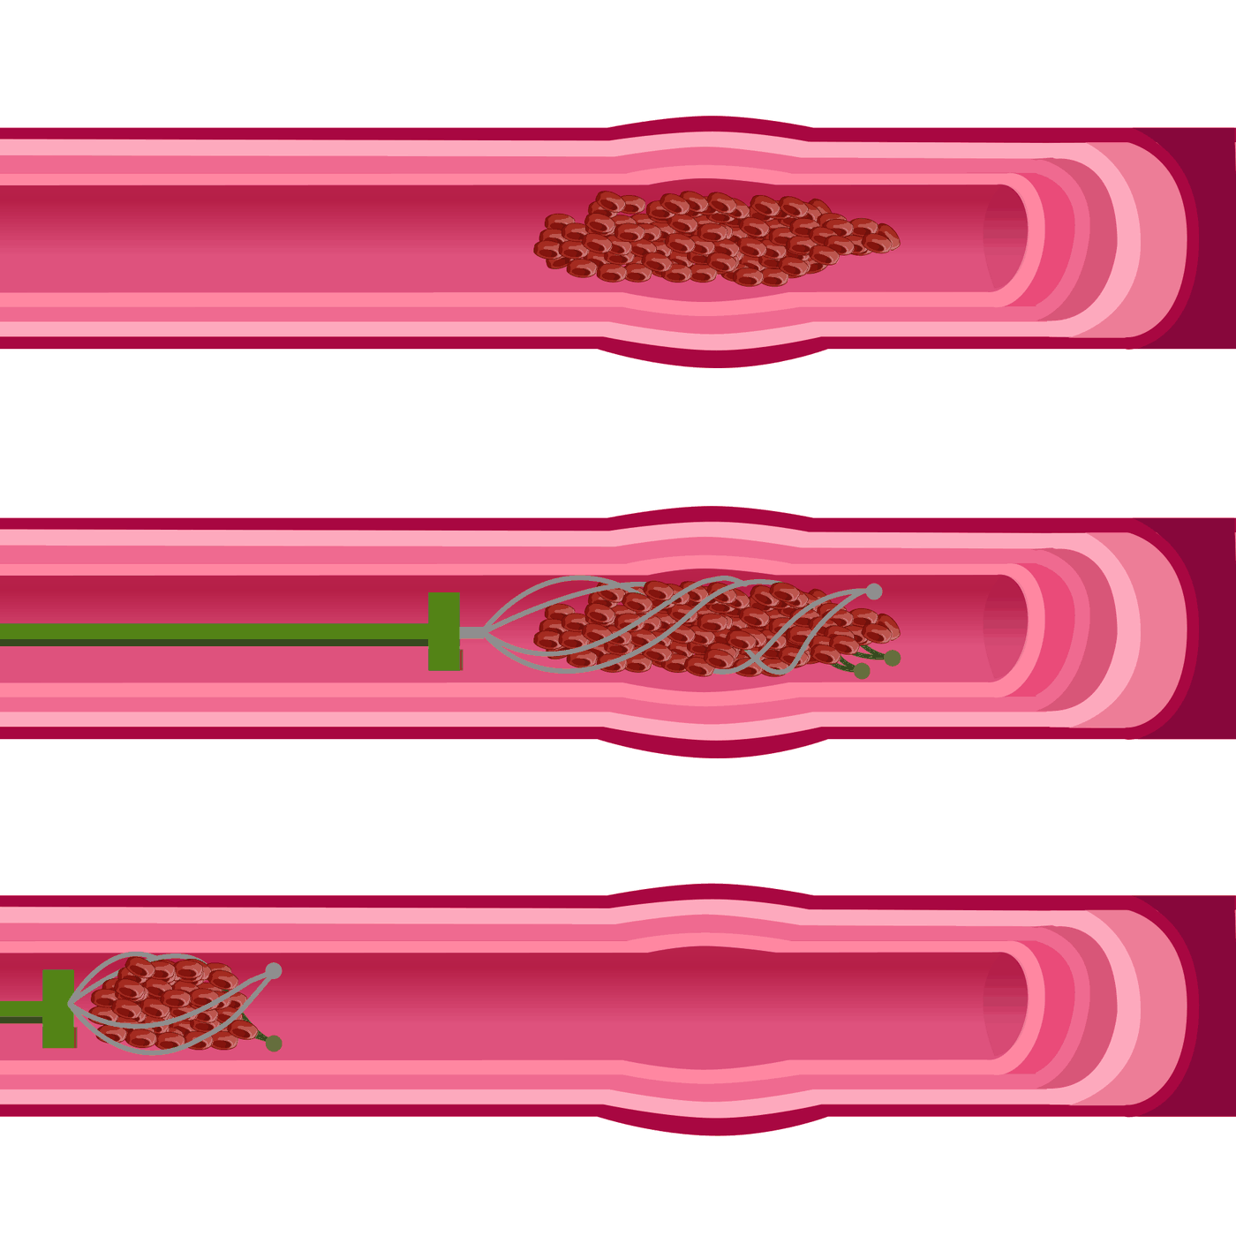
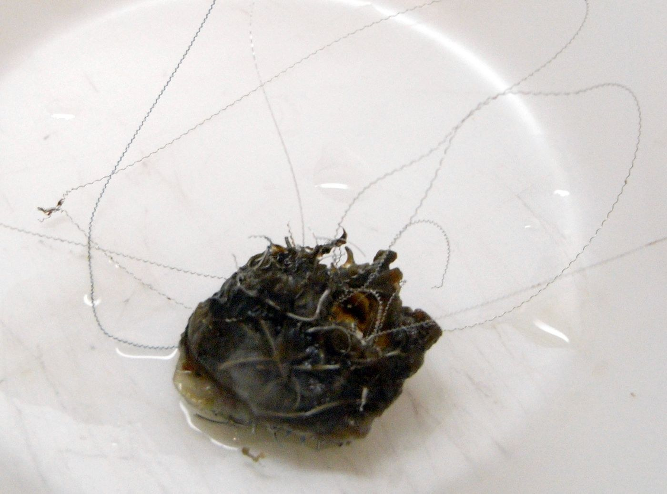
Figures 31.15 and 31.20 · Endovascular treatment
WHAT TO NOTICE
31.15: a stent retriever opens inside the clot and is withdrawn with it
After EVT: neuro checks, access site, distal pulses
31.20: a resected aneurysm packed with platinum coils
Coiling: the sac clots and is sealed off, preventing rebleeding
Choice: coiling or surgical clipping is decided by specialists for each client (Hoh et al., 2023).
Figure 31.15. "Thrombectomy by hariadhi dedicated to my dad" by Hariadhi, via Wikimedia Commons, CC BY-SA 4.0. Figure 31.20. "Aneurysma Coil" by Marvin 101, via Wikimedia Commons, CC BY-SA 3.0.
Notes:
Sources: sections 31.3 (HSF, 2025) and 31.5 (Hoh et al., 2023).
Figure credit: Figure 31.15: "Thrombectomy by hariadhi dedicated to my dad" by Hariadhi, via Wikimedia Commons, CC BY-SA 4.0. Endovascular thrombectomy with a stent retriever. The device is opened inside the clot and withdrawn with it, restoring flow in a large-vessel occlusion. After the procedure, the nurse monitors neurologic status, the access site and distal pulses. | Figure 31.20: "Aneurysma Coil" by Marvin 101, via Wikimedia Commons, CC BY-SA 3.0. A surgically resected middle cerebral artery aneurysm packed with platinum coils. Endovascular coiling fills the aneurysm sac so that it clots and is sealed off from the circulation, preventing rebleeding.

Slide 32
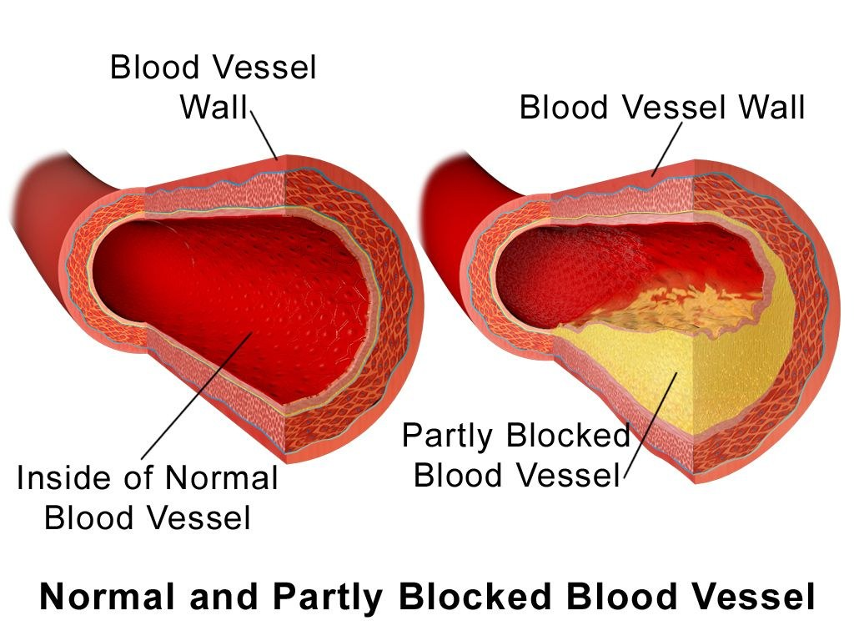
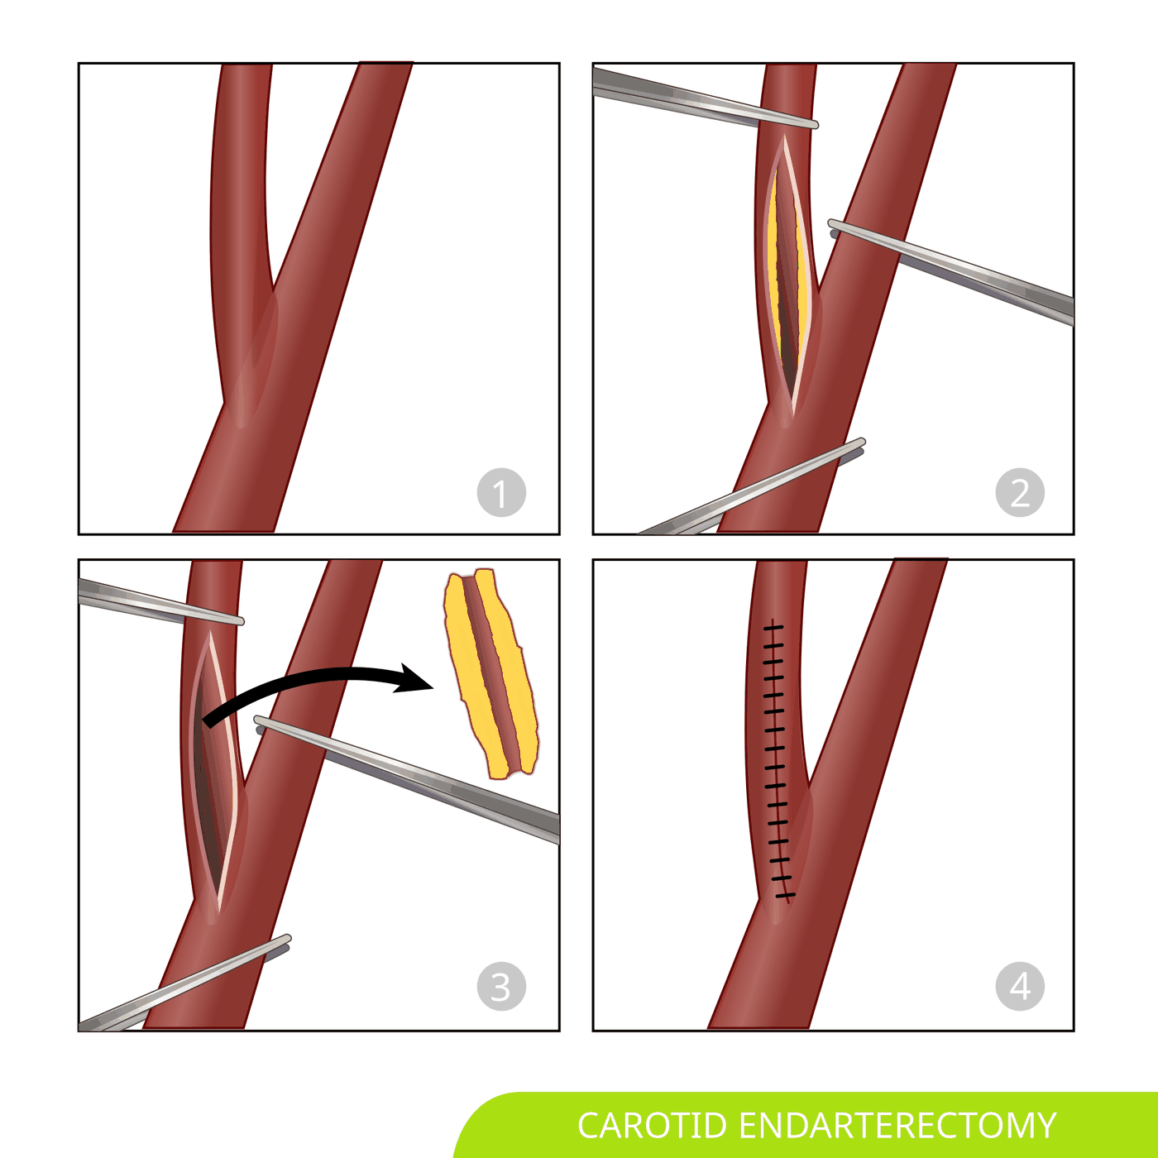
Figures 31.6 and 31.22 · Carotid plaque and endarterectomy
WHAT TO NOTICE
31.6: plaque narrows the lumen and gives clots a surface to form on
Rupture: triggers thrombosis or embolism downstream
31.22: clamp, open, remove the plaque, suture closed
Who: men 50–99%, women 70–99% symptomatic stenosis
Timing: as early as possible, ideally within 14 days of the event (HSF, 2020b).
Figure 31.6. "Blausen 0052 Artery NormalvPartially-BlockedVessel" by BruceBlaus (Blausen.com staff), via Wikimedia Commons, CC BY 3.0. Figure 31.22. "Carotid Endarterectomy svg hariadhi" by Hariadhi (adapted from Blausen Medical), via Wikimedia Commons, CC BY-SA 4.0.
Notes:
Sources: sections 31.2 and 31.7 (HSF, 2020b).
Figure credit: Figure 31.6: "Blausen 0052 Artery NormalvPartially-BlockedVessel" by BruceBlaus (Blausen.com staff), via Wikimedia Commons, CC BY 3.0. A normal artery compared with one partly blocked by atherosclerotic plaque. Plaque narrows the lumen, and plaque rupture triggers thrombus that can occlude the vessel or embolize downstream. | Figure 31.22: "Carotid Endarterectomy svg hariadhi" by Hariadhi (adapted from Blausen Medical), via Wikimedia Commons, CC BY-SA 4.0. Steps of carotid endarterectomy: the artery is clamped and opened, the plaque is removed, and the artery is sutured closed. For symptomatic 50% to 99% stenosis, surgery is ideally done within 14 days of the event.

Slide 33
What is used, and where it acts
MEDICATIONS I
Bracketed classes as in the chapter
Thrombolytics
Antithrombotics and statins
Reversal and aSAH
Tenecteplase [thrombolytic]: 0.25 mg/kg, maximum 25 mg, single bolus
Alteplase [thrombolytic]: 0.9 mg/kg, maximum 90 mg; 10% bolus, 90% over 60 min
Acts on: fibrin in the clot, reopening the artery
Caution: not routinely given to clients taking a DOAC
ASA [antiplatelet]: after imaging excludes bleeding
Clopidogrel [P2Y12 inhibitor]: with ASA for 21 days when eligible
Apixaban [DOAC]: preferred over warfarin [VKA] for AF; timed by severity
Atorvastatin [statin]: LDL below 1.8 mmol/L
Warfarin ICH: PCC [factor replacement] plus vitamin K [vitamin] 10 mg IV
Factor Xa inhibitor ICH: PCC 50 units/kg
Dabigatran ICH: idarucizumab [reversal antibody] 5 g IV
Nimodipine [CCB]: 60 mg every 4 h × 21 days
Notes:
Sources: Tables 31.10, 31.13, 31.15, 31.20 (HSF, 2020a, 2020b, 2025; ASHP, n.d.). Stroke thrombolytic doses differ from MI and PE doses. DOAC timing: brief TIA within 24 h; minor about day 3; moderate days 6–7; severe days 12–14 (HSF, 2020b).

Slide 34
Nursing responsibilities: monitoring, holds, high-alert cautions
MEDICATIONS II
High-alert: thrombolytics, anticoagulants, vasopressors
Tenecteplase [thrombolytic]: measured weight and double-check; hold if BP above 185/110 mmHg; no antithrombotics for 24 h.
DOACs: start only when the team confirms timing; report black stools or a fall with head strike.
Alteplase [thrombolytic]: stop the infusion for neuro decline, headache, vomiting or angioedema.
Warfarin [VKA]: INR target 2.0–3.0; consistent vitamin K intake; interactions.
Labetalol [alpha/beta blocker]: hold for HR below 60 or heart block; avoid overshooting the BP target.
Nimodipine [CCB]: BP before each dose; enteral only; avoid grapefruit.
ASA [antiplatelet]: swallowing screen first; not within 24 h of thrombolysis.
PCC [factor replacement], idarucizumab [reversal antibody]: record the time of the last anticoagulant dose; watch for thrombosis after reversal.
Question it: an order for platelets in an ICH client with a normal platelet count (HSF, 2020a).
Notes:
Sources: Tables 31.10, 31.13, 31.15, 31.20 (AHS, n.d.; ASHP, n.d.; HSF, 2020a, 2020b, 2025). Platelet transfusion for ICH is not recommended without significant thrombocytopenia and may be harmful.

Slide 35
Nursing priorities on the stroke unit, ranked
NURSING PRIORITIES
Airway first; then perfusion, surveillance and prevention
1
2
3
4
5
Airway and aspiration
Neurologic surveillance
Physiologic stability
Complication prevention
Recovery and family
Swallowing screen before anything by mouth; oral care; upright positioning.
Trended NIHSS or neuro checks, with timely escalation.
BP within limits; temperature 37.5°C or below; glucose; oxygenation.
IPC or anticoagulant prophylaxis, continence program, skin, falls.
Rehabilitation screening within 48 h; depression screening; caregiver teaching.
Notes:
Source: section 31.6 ranked priorities and section 31.3 ranked priorities. Aspiration pneumonia is a leading preventable complication.

Slide 36
Interventions with rationales
INTERVENTIONS
Canadian stroke unit best practice (HSF, 2022)
Swallowing screen before any oral intake: including medications; prevents aspiration.
Avoid routine indwelling catheters: remove as soon as possible; reduces UTI.
Oral care after meals and at bedtime: reduces bacteria carried into the lungs.
Short, supervised mobilization: avoid prolonged sessions in the first 24–48 h.
Temperature above 37.5°C: cooling, look for infection, antipyretics; fever speeds injury.
Support the hemiplegic arm: never pull on it during transfers; prevents shoulder injury.
Thigh-high IPC from admission: prevents VTE; not compression stockings.
Screen for depression: including history; untreated depression slows recovery.
Rehab is all day: nurses carry therapy goals into every hour, such as dressing the weak arm first at 07:00.
Notes:
Source: section 31.6 (HSF, 2022) and Table 31.18 (HSF, 2019). Graduated compression stockings are not recommended for DVT prevention. Early prolonged mobilization in the first 24–48 h is not recommended, especially after severe stroke.

Slide 37
High-alert moments in stroke care
CLINICAL SAFETY
Weight errors, missed reversal, and the wrong route
Thrombolytics
Anticoagulant-associated ICH
Weight errors kill: an estimate 20 kg too high is a 25% overdose
Right product and dose: tenecteplase [thrombolytic] 0.25 mg/kg is not the cardiac dose
Stop, look, call: stop the infusion; notify; emergent CT; CBC, INR, crossmatch
Airway: check tongue, lips and voice for angioedema
Minutes matter: anticoagulation increases hematoma expansion
Be ready: know where PCC [factor replacement] and idarucizumab [reversal antibody] are stored and who releases them
Document precisely: time of last dose, not "this morning"
After reversal: watch for new thrombotic events
Never IV: nimodipine [CCB] capsule contents must never be given IV or by any parenteral route (ASHP, n.d.).
Notes:
Sources: Clinical Safety boxes in 31.3 (HSF, 2025; AHS, n.d.) and 31.4 (HSF, 2020a); nimodipine [CCB] caution from Table 31.15 (ASHP, n.d.). Angioedema is more common in clients taking ACE inhibitors.

Slide 38
RPN and RN roles in stroke care
SCOPE IN PRACTICE
Match the client's complexity, predictability and risk to the nurse
RPN, with RN available
RN or critical care RN
Day 4 or later: minor ischemic stroke, neurologically stable
Swallowing: screen passed, or a texture-modified diet in place
Established plan: bladder program, mobility plan
Collaborates: with SLP, OT and PT
First 24 h: after thrombolysis or thrombectomy
Unstable: fluctuating LOC; large MCA infarct at risk of edema
Infusions: ICH with BP titration
Complex: aSAH in the DCI window; EVD
Consult when… LOC or GCS falls, a new deficit appears, headache or vomiting starts, vitals leave parameters, a swallow screen fails, or a seizure occurs.
Notes:
Source: Scope in Practice box, section 31.6. Consulting is not a handoff of accountability: the RPN continues to assess and documents the consultation and its outcome.

Slide 39
SBAR in action: "Something is different this morning"
INTERPROFESSIONAL TEAM
Practice Story, section 31.6
SBAR: RPN and RN to the stroke physician
Who does what
S: Mr. T., 72, day 3 after left MCA stroke: decreased LOC, new right leg loss since 07:30
B: tenecteplase [thrombolytic] and thrombectomy on admission; NIHSS 6 last evening; ASA [antiplatelet], atorvastatin [statin]
A: GCS 14 to 12; NIHSS 11; BP 168/94; glucose 6.8 mmol/L (4.0–7.0, MEDIUM); concern for edema or hemorrhage
R: assess now; urgent CT? NPO, HOB 30°, neuro checks every 15 min
RPN: recognized the change, held oral intake, consulted
RN: confirmed findings, called the physician, took over care
Stroke physician, radiology: ordered and performed CT
Pharmacist: reviewed antithrombotics in case of hemorrhage
SLP and team: adjusted the plan once he stabilized
Notes:
Source: Practice Story, section 31.6. Reflective questions: What baseline information made the change recognizable? Why was holding the breakfast tray important? What would you document?

Slide 40
Teaching for TIA and for going home after stroke
PATIENT EDUCATION
Plain language, a written plan, and family at the table
Understand
Do
Call
TIA: a warning stroke; the next clot may not go away
Stroke: a blocked or burst vessel; medicines lower the chance of another
Recovery: the brain keeps healing for months; practice helps it relearn
Medicines: take them daily; do not skip or stop without advice
Home BP: check and bring readings
Anticoagulant: soft toothbrush, electric razor
Swallowing: follow diet texture; sit upright for 30 min after eating
9-1-1 now: any FAST sign, sudden severe headache, confusion, loss of balance or vision, seizure
Same day: new bleeding, fever or cough with swallowing trouble, new leg swelling
Mood: low or tearful is common and treatable; tell us
Notes:
Sources: Patient Education boxes in 31.2 and 31.7. If cost is a barrier to medication, ask; there may be coverage programs. Driving is restricted until assessed; rules vary by province or territory.

Slide 41
Stroke across the lifespan
LIFESPAN
Children have strokes too; older adults need careful, inclusive decisions
Pediatric
Older adults
Any age: stroke occurs in newborns and children
Missed: often attributed to seizures, migraine or other causes
Same urgency: sudden one-sided weakness, new seizure with weakness or speech change
Guideline: dedicated CSBPR pediatric module
Most strokes: more atrial fibrillation, frailty and medications
Age alone: does not exclude thrombolysis or thrombectomy
Higher risk: delirium, falls, aspiration, pressure injury, VTE
Goals of care: involve family early after severe stroke; CAA makes lobar ICH more common
Notes:
Source: Lifespan Considerations box, section 31.6. The CSBPR include a dedicated pediatric stroke module.

Slide 42
Equity, cultural safety and Indigenous health
EQUITY AND CULTURAL SAFETY
Unequal risk and access are part of the stroke story in Canada
Unequal risk and treatment
Culturally safe practice
Métis people: about 40% more likely to have a stroke (Balabanski et al., 2024)
First Nations with diabetes, Ontario: more admissions; thrombolysis 6.3% vs 11.0% (Kapral et al., 2020)
Women: 34% more stroke deaths than men in 2020 (HSF, 2024b)
Remote: nursing station recognition and medevac speed
Ask: who should be involved in decisions and teaching, including an Elder
Interpreters: professional, not family, for clinical information
Traditional medicine: ask without judgment; include where safe
Trust: acknowledge past racism in health care; respect OCAP® principles
Equity is clinical: researchers link these gaps to inequitable access to prevention and stroke care (Balabanski et al., 2024).
Notes:
Sources: Canadian Context box, section 31.7 (Balabanski et al., 2024; Kapral et al., 2020; HSF, 2024b; Perry et al., 2022). In remote communities the nursing station is often the only source of care; recognition there and medevac speed can decide whether a client reaches thrombolysis in time.

Slide 43
Going deeper: perfusion pressure and the cascade
GOING DEEPER · RN
RN required, PN optional
Calculating CPP
Physiology that speeds the cascade
What protects the brain
MAP ≈ DBP + (SBP − DBP) ÷ 3
BP 150/80, ICP 22: MAP ≈ 103; CPP = 81 mmHg
After antihypertensive, 110/60: MAP ≈ 77; CPP = 55 mmHg
Lesson: perfusion fell by a third with no change in the brain
Fever: raises metabolic demand; act above 37.5°C (HSF, 2022)
Hyperglycemia: more lactate and acidosis; more bleeding after thrombolysis
Hypotension: lowers CPP where autoregulation is lost
Hypoxemia: less oxygen for cells already short of it
Reperfusion: still the most powerful neuroprotectant
Neuroprotective drugs: not proven effective in practice
Nursing: controls all four variables, minute by minute
Notes:
Sources: Going Deeper boxes in the introduction and section 31.3 (HSF, 2022 for the 37.5°C threshold). Work the CPP example on the board.

Slide 44
Mr. Ouellet: prioritize and act
UNFOLDING CASE · STAGE 3
Stage 3 · Prioritize and act
08:52: tenecteplase [thrombolytic] given; door-to-needle 37 minutes.
13:00 BP 188/102: above limit; treat per protocol and notify. Labetalol [alpha/beta blocker] brings it to 166/90.
10:05: left M1 reopened by thrombectomy via the right femoral artery.
Denise's pills and water: explain NPO until the swallowing screen; medications will be reviewed.
11:30: stroke unit; NIHSS 7; can say a few words; right arm lifts against gravity.
Watch for: new headache or vomiting; NIHSS up more than 4; a cool, pale, pulseless right foot.
Orders: protocol neuro and vital checks; BP below 180/105; access site and pulses; NPO.
Not urgent: BP 166/90; 37.3°C; glucose 7.4 mmol/L (4.0–7.0, HIGH): monitor and report per protocol.
SBAR update: prepare a concise update for the most responsible provider with times, NIHSS trend, BP and access-site findings.
Notes:
Anchor case Stage 3. Ties to slots 23–28: post-thrombolysis BP limit below 180/105 mmHg per protocol (AHS, n.d.), swallowing screen before any oral intake (HSF, 2022), and red flags after thrombolysis and thrombectomy (slot 19).

Slide 45
Mr. Ouellet: evaluate outcomes
UNFOLDING CASE · STAGE 4
Stage 4 · Evaluate outcomes
Improving
Report now (day 3)
24 h imaging: no hemorrhage
NIHSS: 7 down to 4
Started: ASA [antiplatelet] and atorvastatin [statin]
SLP, day 2: minced and moist foods; mildly thick fluids
Vital signs: 38.3°C; RR 24; SpO₂ 90% on room air
Chest: coarse crackles at the right base
WBC: 14.2 × 10⁹/L (4.0–11.0, HIGH)
LDL: 3.6 mmol/L (target below 1.8, HIGH)
Likely: aspiration pneumonia
Evaluate the teaching: apixaban [DOAC] starts around day 6–7. "Missing a few days is no big deal" needs correction.
Notes:
Anchor case Stage 4. Ties to slots 26–31. Aspiration pneumonia fits: fever, tachypnea, hypoxemia, right basal crackles, leukocytosis in a client with dysphagia. Anticoagulation timing for a moderate stroke: days 6–7 after repeat imaging (HSF, 2020b). DOACs have short half-lives, so missed doses leave him unprotected.

Slide 46
Six things to remember about stroke
KEY TAKEAWAYS
From the chapter summary
1
2
3
Perfusion failure
Type sets treatment
TIA is an emergency
Core dies fast; penumbra can be saved. Time is brain.
Reopen, stop the bleeding, or secure the aneurysm. Image first.
Within 48 h: ED the same day; DAPT 21 days; surgery within 14 days.
4
5
6
Precision in hyperacute care
Stroke unit prevents harm
Recovery and equity
Last known well; CT/CTA; weight-based tenecteplase [thrombolytic]; BP below 185/110.
Swallow screen; act above 37.5°C; IPC; trend neuro checks; SBAR.
Practice drives recovery; prevention targets; culturally safe care.
Notes:
Source: chapter Summary key takeaways. Saver (2006): about 1.9 million neurons lost each minute in an untreated large stroke.

Slide 47
Check your understanding
A client had right hand weakness and trouble speaking for 15 minutes, 6 hours ago, and now feels normal. Where should he go, and how fast?
Which feature of a headache most strongly suggests subarachnoid hemorrhage rather than migraine?
Name three nursing actions for nimodipine [CCB] after aneurysm coiling, and one thing you must never do.
Day 6 after aSAH: new drowsiness, new leg weakness, sodium 129 mmol/L (135–145, LOW). What do you do first?
An ICH client takes apixaban [DOAC]. Which reversal should you anticipate?
Name four stroke unit actions that follow Canadian best practice for an immobile client on day 2.
Full questions with rationales are in the chapter's practice sets and the Ms. Haddad case.
Notes:
Suggested answers (chapter questions 12, 18, 20, 22, 24, 25):
1. Immediately to an ED with stroke care capacity: within 48 h, motor or speech symptoms are highest risk (HSF, 2022).
2. A thunderclap headache that peaks instantly (Ottawa SAH Rule; Perry et al., 2013).
3. Enteral only, BP before each dose with hypotension reported, continue 21 days, avoid grapefruit; never give it IV (ASHP, n.d.).
4. Notify the neurosurgical team immediately with SBAR and prepare for urgent imaging; do not restrict fluids (Hoh et al., 2023).
5. Prothrombin complex concentrate [factor replacement] 50 units/kg (HSF, 2020a).
6. Thigh-high IPC; swallowing screen before oral medications; cooling and infection search for temperature above 37.5°C; oral care after meals and at bedtime; not compression stockings or routine catheters (HSF, 2022).

Slide 48
References (1 of 2)
REFERENCES
Alberta Health Services. (n.d.). Intravenous tenecteplase (TNKase) for acute ischemic stroke [Clinical order set, Form 22040].
American Society of Health-System Pharmacists. (n.d.). Nimodipine [AHFS drug monograph]. Drugs.com.
Balabanski, A. H., Dos Santos, A., Woods, J. A., Mutimer, C. A., Thrift, A. G., Kleinig, T. J., Suchy-Dicey, A. M., Siri, S. R. A., Boden-Albala, B., Krishnamurthi, R. V., Feigin, V. L., Buchwald, D., Ranta, A., Mienna, C. S., Zavaleta-Cortijo, C., Churilov, L., Burchill, L., Zion, D., Longstreth, W. T., . . . Katzenellenbogen, J. M. (2024). Incidence of stroke in Indigenous populations of countries with a very high Human Development Index: A systematic review. Neurology, 102(5), Article e209138.
Claassen, J. A. H. R., Thijssen, D. H. J., Panerai, R. B., & Faraci, F. M. (2021). Regulation of cerebral blood flow in humans: Physiology and clinical implications of autoregulation. Physiological Reviews, 101(4), 1487–1559.
College of Nurses of Ontario. (2018). Entry-to-practice competencies for Ontario registered practical nurses (Pub. No. 41042).
College of Nurses of Ontario. (2019). Entry-to-practice competencies for registered nurses (Pub. No. 41037).
Heart and Stroke Foundation of Canada. (2019). Canadian stroke best practice recommendations: Rehabilitation and recovery following stroke (6th ed.).
Heart and Stroke Foundation of Canada. (2020a). Canadian stroke best practice recommendations: Management of spontaneous intracerebral hemorrhage (7th ed.).
Heart and Stroke Foundation of Canada. (2020b). Canadian stroke best practice recommendations: Secondary prevention of stroke (7th ed.).
Heart and Stroke Foundation of Canada. (2022). Canadian stroke best practice recommendations: Acute stroke management (7th ed.).
Notes:
APA 7th edition reference list from Chapter 31. Full URLs and DOIs are in the chapter.

Slide 49
References (2 of 2)
REFERENCES
Heart and Stroke Foundation of Canada. (2024a, June 4). Stroke in Canada is on the rise [News release].
Heart and Stroke Foundation of Canada. (2024b). Stroke facts [Fact sheet].
Heart and Stroke Foundation of Canada. (2025). Acute ischemic stroke treatment (Canadian stroke best practice recommendations: Acute stroke management, 7th ed., Section 5, with 2025 endovascular thrombectomy interim update).
Heran, M., Lindsay, P., Gubitz, G., Yu, A., Ganesh, A., Lund, R., Arsenault, S., Bickford, D., Derbyshire, D., Doucette, S., Ghrooda, E., Harris, D., Kanya-Forstner, N., Kaplovitch, E., Liederman, Z., Martiniuk, S., McClelland, M., Milot, G., Minuk, J., . . . Shamy, M. (2024). Canadian stroke best practice recommendations: Acute stroke management, 7th edition practice guidelines update, 2022. Canadian Journal of Neurological Sciences, 51(1), 1–31.
Hoh, B. L., Ko, N. U., Amin-Hanjani, S., Chou, S. H.-Y., Cruz-Flores, S., Dangayach, N. S., Derdeyn, C. P., Du, R., Hänggi, D., Hetts, S. W., Ifejika, N. L., Johnson, R., Keigher, K. M., Leslie-Mazwi, T. M., Lucke-Wold, B., Rabinstein, A. A., Robicsek, S. A., Stapleton, C. J., Suarez, J. I., . . . Welch, B. G. (2023). 2023 guideline for the management of patients with aneurysmal subarachnoid hemorrhage: A guideline from the American Heart Association/American Stroke Association. Stroke, 54(7), e314–e370.
Kapral, M. K., Shah, B. R., Green, M. E., Porter, J., Griffiths, R., Frymire, E., Slater, M., Jacklin, K., Sutherland, R., & Walker, J. D. (2020). Hospital admission for stroke or transient ischemic attack among First Nations people with diabetes in Ontario: A population-based cohort study. CMAJ Open, 8(1), E156–E162.
Perry, J. J., Stiell, I. G., Sivilotti, M. L. A., Bullard, M. J., Hohl, C. M., Sutherland, J., Émond, M., Worster, A., Lee, J. S., Mackey, D., Pauls, M., Lesiuk, H., Symington, C., & Wells, G. A. (2013). Clinical decision rules to rule out subarachnoid hemorrhage for acute headache. JAMA, 310(12), 1248–1255.
Perry, J. J., Yadav, K., Syed, S., & Shamy, M. (2022). Transient ischemic attack and minor stroke: Diagnosis, risk stratification and management. CMAJ, 194(39), E1344–E1349.
Public Health Agency of Canada. (n.d.). Stroke in Canada. Government of Canada.
Saver, J. L. (2006). Time is brain—quantified. Stroke, 37(1), 263–266.
Notes:
APA 7th edition reference list from Chapter 31. Full URLs and DOIs are in the chapter.

Slide 50
Figure credits
FIGURE CREDITS
Figure 31.1. "Blausen 0170 CarotidArteries" by BruceBlaus (Blausen.com staff), via Wikimedia Commons, CC BY 3.0.
Figure 31.2. "Circle of Willis en" by Rhcastilhos, via Wikimedia Commons, Public domain.
Figure 31.3. "Types of Stroke" by Scientific Animations (scientificanimations.com), via Wikimedia Commons, CC BY-SA 4.0.
Figure 31.4. "Blausen 0111 BrainLobes" by BruceBlaus (Blausen.com staff), via Wikimedia Commons, CC BY 3.0.
Figure 31.5. "Blausen 0102 Brain Motor&Sensory" by BruceBlaus (Blausen.com staff), via Wikimedia Commons, CC BY 3.0.
Figure 31.6. "Blausen 0052 Artery NormalvPartially-BlockedVessel" by BruceBlaus (Blausen.com staff), via Wikimedia Commons, CC BY 3.0.
Figure 31.7. "Unilateraler Anteriorinfarkt 70M - MR DWI ADC TOF - 001" by Hellerhoff, via Wikimedia Commons, CC BY-SA 4.0.
Figure 31.8. "Internal carotid artery stenosis in ultrasound near occlusion" by Mme Mim, via Wikimedia Commons, CC BY-SA 3.0.
Figure 31.9. "ECG Atrial Fibrillation 90 bpm" by Ewingdo, via Wikimedia Commons, CC BY-SA 4.0.
Figure 31.10. "Molecular pathways outlining the role of glutamate in excitoxicity following stroke" by Dr William Ju, University of Toronto, via Wikimedia Commons, CC BY-SA 4.0.
Figure 31.11. "Histopathology of ischemic stroke of the thalamus at approximately 24 hours, annotated" by Mikael Häggström, M.D., via Wikimedia Commons, CC0 1.0.
Figure 31.12. "Identify the symptoms of a stroke using the FAST method" by U.S. Food and Drug Administration (vector by Fvasconcellos), via Wikimedia Commons, Public domain.
Figure 31.13. "Right dense MCA sign as seen on CT brain" by Cerevisae, via Wikimedia Commons, CC BY-SA 4.0.
Figure 31.14. "CT Brain MCA Infarct" by Lucien Monfils, via Wikimedia Commons, CC BY-SA 4.0.
Figure 31.15. "Thrombectomy by hariadhi dedicated to my dad" by Hariadhi, via Wikimedia Commons, CC BY-SA 4.0.
Figure 31.16. "MCA-Stroke-Brain-Humn-2A" by Marvin 101, via Wikimedia Commons, CC BY-SA 3.0.
Figure 31.17. "Intracerebral hemorrage (CT scan)" by Glitzy queen00 at English Wikipedia, via Wikimedia Commons, Public domain.
Figure 31.18. "Wikipedia intracranial aneurysms - inferior view - heat map" by Nicholas Zaorsky, M.D., via Wikimedia Commons, CC BY-SA 3.0.
Figure 31.19. "SAH1" by James Heilman, MD, via Wikimedia Commons, CC BY-SA 3.0.
Figure 31.20. "Aneurysma Coil" by Marvin 101, via Wikimedia Commons, CC BY-SA 3.0.
Figure 31.21. "Visual field homonymous hemianopia" by RobertB3009, via Wikimedia Commons, CC BY-SA 4.0.
Figure 31.22. "Carotid Endarterectomy svg hariadhi" by Hariadhi (adapted from Blausen Medical), via Wikimedia Commons, CC BY-SA 4.0.
Notes:
All figures are from Wikimedia Commons under their own open licences (public domain, CC0, CC BY 3.0, CC BY-SA 3.0 or 4.0). They are not covered by the deck's CC BY-NC-SA 4.0 licence.

