Slide 1
Pain: Nociception, Pain Mechanisms, and Pain Management
PATHOPHYSIOLOGY FOR NURSES: A CANADIAN OPEN TEXT · CHAPTER 5
How a stimulus becomes an experience, why some pain outlasts the injury, and how that shapes assessment, safe analgesia and support for people living with pain.
Andrew Lee, BEd, BN, MN, RN, CCN(C)
Aligned with the IASP definition of pain, ICD-11 chronic pain classification, Canadian Pain Society neuropathic pain guidance, the 2017 Canadian opioid guideline and CNO entry-to-practice competencies
opensourcenursing.ca (CC BY-NC-SA 4.0)
Notes:
Welcome. This session follows Chapter 5. Pain is the most common reason people seek care, and nurses are the professionals who sit with it hour by hour. We move from normal physiology (nociception) to pain mechanisms in disease, then assessment and management. Guidance used: IASP definition (Raja et al., 2020), ICD-11 chronic pain classification (Treede et al., 2019), Canadian Pain Society neuropathic pain statement (Moulin et al., 2014), 2017 Canadian opioid guideline (Busse et al., 2017), CNO entry-to-practice competencies (CNO, 2019a, 2019b).

Slide 2
By the end of this session you will be able to
LEARNING OUTCOMES
Eight outcomes, grouped into three themes
How pain works
Assess and act safely
Support and advocate
Outcomes 1–3
Outcomes 4–6
Outcomes 7–8
Nociception: describe transduction, transmission, perception and modulation; distinguish pain from nociception.
Classify: by duration and by mechanism (nociceptive, neuropathic, nociplastic).
Sensitization: link peripheral and central sensitization to hyperalgesia, allodynia and chronic pain.
CNO: RN Clinician, Scholar · RPN Foundations of Practice
Tools: choose a valid tool for self-report, children, dementia and critical illness.
Analgesics: where each drug class acts, its main adverse effects and safeguards.
Sedation: recognize advancing opioid-induced sedation and respiratory depression and act.
CNO: RN Clinician, Communicator, Advocate, Coordinator · RPN Foundations, Legal and Collaborative Practice
Self-management: plan nonpharmacologic care and teaching using Canadian chronic pain and opioid stewardship guidance.
Equity: identify inequities in pain care and advocate for respectful, unbiased assessment and treatment.
CNO: RN Educator, Collaborator, Advocate, Professional · RPN Professional, Ethical and Collaborative Practice
Notes:
Outcomes are mapped to CNO RN roles (CNO, 2019a) and RPN categories (CNO, 2019b). Emphasize that both RNs and RPNs assess pain, give analgesics on an order and teach; what changes is complexity, predictability and risk.

Slide 3
Pain in Canada: the numbers behind every caseload
CANADIAN CONTEXT
1 in 5
1 in 3
16.7%
5,608
Canadians live with chronic pain, about 7 million people
Canadians aged 65 and older live with chronic pain
of Canadians 15+ had a pain-related disability in 2022 (4.9 million)
opioid-related deaths in Canada in 2025, about 15 a day
Sources: Canadian Pain Task Force (2019); Statistics Canada (2024); Council of Chief Medical Officers of Health (2026).
Why it matters: almost every caseload includes people living with chronic pain, whatever their reason for admission. Half of those with chronic pain have had it for more than 10 years (Canadian Pain Task Force, 2019).
Notes:
Sources: Canadian Pain Task Force (2019) for the 1 in 5 (about 7 million) and 1 in 3 aged 65+; Statistics Canada (2024) for 16.7% (4.9 million) with a pain-related disability in 2022 (27.6% of those 65+; women 19.3% vs men 13.9%); Council of Chief Medical Officers of Health (2026) for 5,608 opioid-related deaths in 2025, about 15 a day, a 23% decrease from 2024. Most of these deaths involve the unregulated drug supply, but the crisis shapes prescribing.

Slide 4
How Pain Works: Nociception and Classification
PART 1 · INTRODUCTION AND SECTION 5.1
The normal pathway from stimulus to experience, the body's own volume control, and how we classify pain by duration and mechanism.
Notes:
Part 1 covers the Introduction and Section 5.1. Keep coming back to one question: where in transduction, transmission, perception or modulation has something changed?

Slide 5
Pain is an experience; nociception is a process
INTRODUCTION
The IASP definition (Raja et al., 2020)
Pain
Nociception
An unpleasant sensory and emotional experience
The neural process of detecting a noxious stimulus
Personal: shaped by biological, psychological and social factors.
Can occur without visible damage: "resembling" tissue damage is part of the definition.
Not dependent on words: inability to describe pain does not mean it is absent.
Self-report respected: the patient's report is the starting point.
Usually leads to pain, but not always (an athlete injured in a final).
Pain without much nociception: phantom limb pain.
Pain cannot be inferred from sensory neuron activity alone (Raja et al., 2020).
Protective purpose: acute pain prompts withdrawal, guarding and seeking help.
Bedside rule: the patient's report, not the size of the incision or the X-ray, is the starting point of pain assessment.
Notes:
IASP definition: an unpleasant sensory and emotional experience associated with, or resembling that associated with, actual or potential tissue damage (Raja et al., 2020). Three nursing points: pain is personal and shaped by biological, psychological and social factors; pain can exist without visible damage; inability to describe pain does not mean it is absent. Nociception usually leads to pain, but not always (the injured athlete), and pain can occur with little nociception (phantom limb).

Slide 6
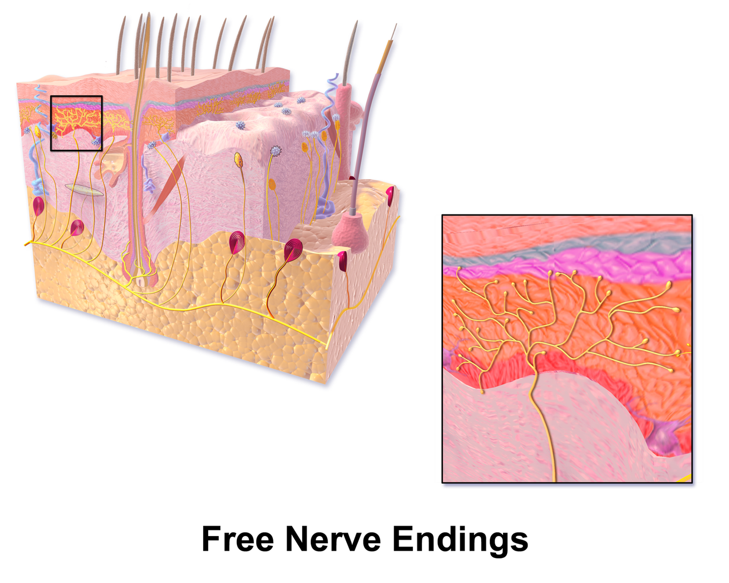
Figure 5.1 · Free nerve endings: where transduction begins
WHAT TO NOTICE
Free endings: nociceptors are unencapsulated nerve endings in skin, muscle, joints, bone and viscera.
Ion channels: TRPV1 (heat, capsaicin [TRPV1 agonist]), cold, stretch and acid channels open, depolarizing the ending.
Action potential: voltage-gated sodium channels fire once threshold is reached.
Chemical triggers: K⁺, H⁺, ATP, bradykinin, histamine, serotonin and prostaglandins from damaged cells.
Link: sensitized endings explain why inflamed tissue hurts more (Section 5.2).
Figure 5.1. “Blausen 0803 Skin FreeNerveEndings” by BruceBlaus (Blausen Medical), via Wikimedia Commons, CC BY 3.0.
Notes:
Transduction converts heat, pressure or chemical energy into an electrical impulse at the nociceptor. Many of the chemical triggers were met in Chapter 4 as inflammatory mediators. Credit: Figure 5.1: “Blausen 0803 Skin FreeNerveEndings” by BruceBlaus (Blausen Medical), via Wikimedia Commons, CC BY 3.0. Blausen.com staff (2014). "Medical gallery of Blausen Medical 2014". WikiJournal of Medicine 1 (2). DOI:10.15347/wjm/2014.010. ISSN 2002-4436

Slide 7
Nociception in four processes
INTRODUCTION
Each process is a place where disease amplifies pain and where treatment can interrupt it
1
2
3
4
Transduction
Transmission
Perception
Modulation
A noxious stimulus opens ion channels at the nociceptor and is converted into an action potential.
The signal travels to the dorsal horn, then up the spinothalamic tract to the thalamus.
A network of cortical regions builds location, intensity, unpleasantness and meaning.
Gate control and descending pathways turn signals up or down, mainly in the dorsal horn.
Exam tip: the withdrawal from a hot pan is a spinal reflex. The pain you feel afterwards is built by the brain from the transmitted signal.
Notes:
Walk the class through the four processes using the hot-pan example from the chapter: the withdrawal is a spinal reflex; the sharp sting and the later throb travel on different fibres; the experience is built by the brain. Modulation happens mainly in the dorsal horn.

Slide 8
Primary afferent fibres: first pain and second pain
INTRODUCTION · TABLE 5.1
A-beta (Aβ)
A-delta (Aδ)
C fibres
Large, thickly myelinated · about 35–75 m/s
Small, thinly myelinated · about 5–30 m/s
Smallest, unmyelinated · about 0.5–2 m/s
Carries: light touch, vibration, pressure.
Pain: none under normal conditions.
Key role: activity here can inhibit pain transmission in the dorsal horn (gate control).
Carries: sharp mechanical and thermal noxious stimuli.
Feels like: "first pain": sharp, pricking, well localized, brief.
Carries: polymodal heat, mechanical and chemical stimuli.
Feels like: "second pain": dull, burning, aching, poorly localized, lingering.
Releases: glutamate plus substance P and CGRP.
Hot pan: the sharp sting arrives first on Aδ fibres; the dull throb follows on slower C fibres.
Notes:
Table 5.1. Conduction speeds are approximate. A-beta fibres do not carry pain normally, but their activity can inhibit pain transmission (gate control). A-delta gives sharp 'first pain'; C fibres give dull, burning 'second pain'. Chemical transmitters at the first synapse: glutamate, and from C fibres substance P and CGRP.

Slide 9
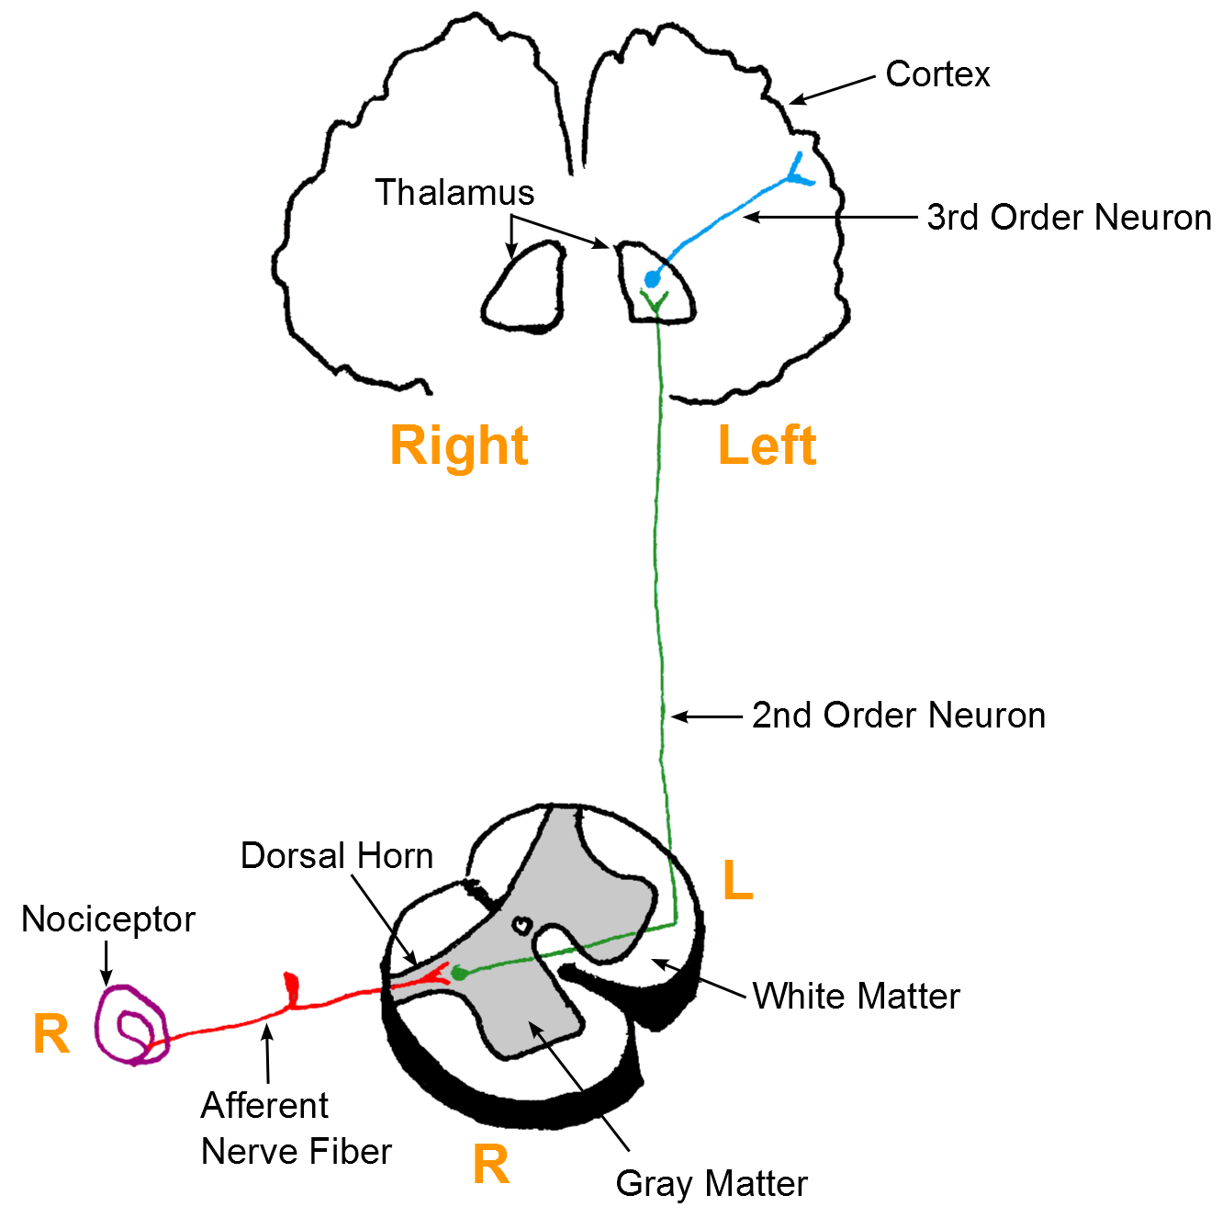
Figure 5.2 · The three-neuron nociceptive pathway
WHAT TO NOTICE
First-order neuron: nociceptor to the dorsal horn; cell body in the dorsal root ganglion.
Second-order neuron: crosses to the opposite side and ascends to the thalamus.
Third-order neuron: thalamus to the cortex, where pain is perceived.
Side: a stimulus on the right is processed in the left hemisphere.
Clinical link: a one-sided spinal cord lesion removes pain and temperature sense on the opposite side below the injury.
Figure 5.2. “Afferents” by Bettina Guebeli, via Wikimedia Commons, CC BY-SA 4.0.
Notes:
Trace the pathway on the figure. Most second-order axons cross within a segment or two and ascend in the spinothalamic tract (anterolateral system); others go to the reticular formation (arousal) and limbic structures (emotion). Credit: Figure 5.2: “Afferents” by Bettina Guebeli, via Wikimedia Commons, CC BY-SA 4.0

Slide 10
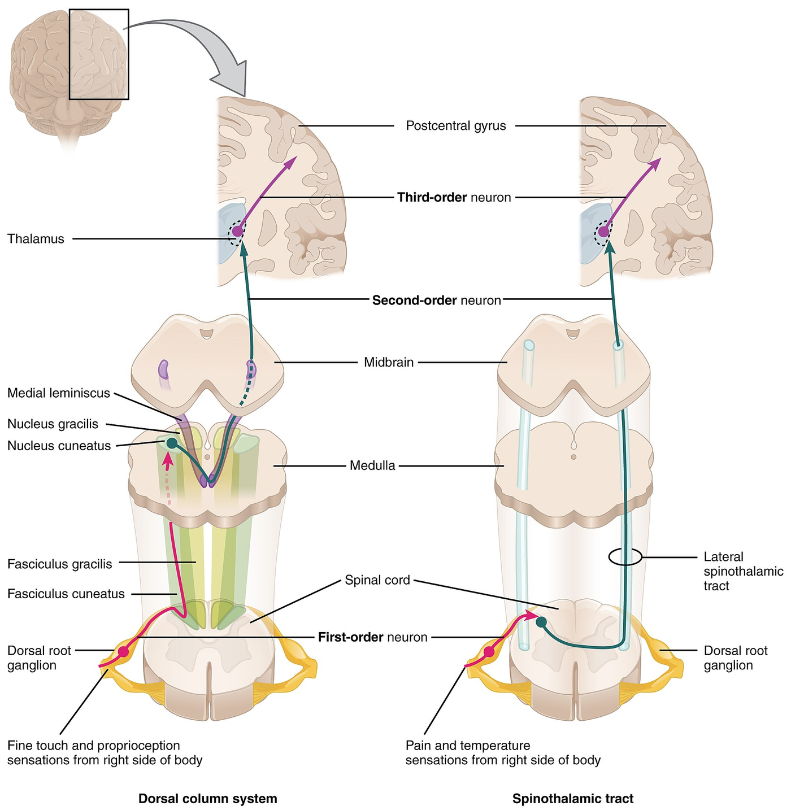
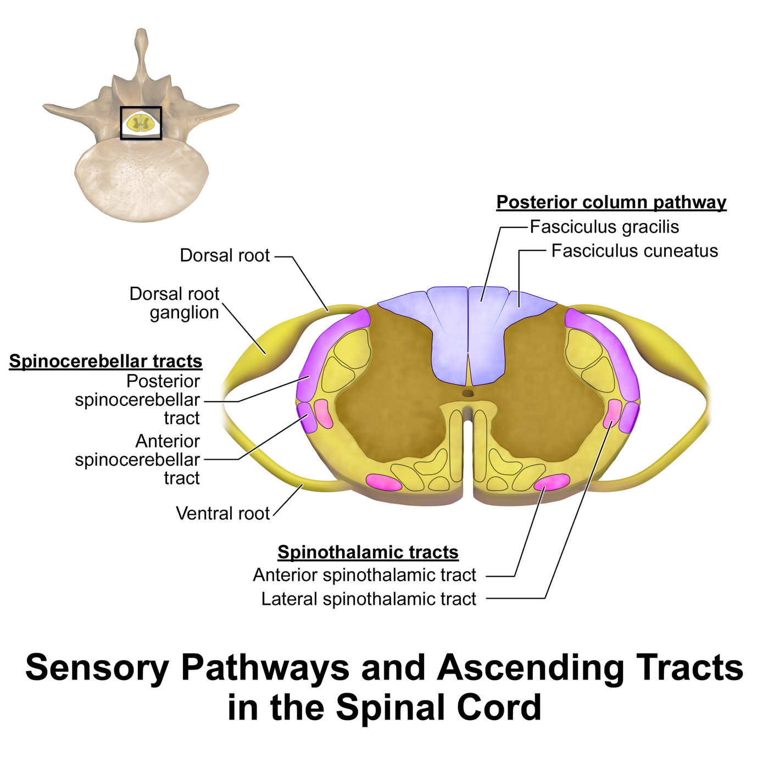
Figures 5.3–5.4 · Ascending pathways and spinal tracts
WHAT TO NOTICE
Spinothalamic tract: pain and temperature; crosses in the spinal cord near the level of entry.
Dorsal column system: fine touch and proprioception; crosses in the medulla.
Cross-section: anterior and lateral spinothalamic tracts lie in the anterolateral white matter.
Ask the class: why does a hemisection cause contralateral loss of pain sensation?
Figure 5.3. “1417 Ascending Pathways of Spinal Cord” by OpenStax College, via Wikimedia Commons, CC BY 3.0.
Figure 5.4. “Spinal Cord Sensory Pathways” by BruceBlaus (Blausen Medical), via Wikimedia Commons, CC BY-SA 4.0.
Notes:
Figure 5.3 compares the two pathways; Figure 5.4 shows where the tracts run in cross-section. Answer to the cue: spinothalamic fibres have already crossed below the lesion, so the damaged tract carries pain from the opposite side. Credits: Figure 5.3: “1417 Ascending Pathways of Spinal Cord” by OpenStax College, via Wikimedia Commons, CC BY 3.0 | Figure 5.4: “Spinal Cord Sensory Pathways” by BruceBlaus (Blausen Medical), via Wikimedia Commons, CC BY-SA 4.0. Blausen.com staff (2014). "Medical gallery of Blausen Medical 2014". WikiJournal of Medicine 1 (2). DOI:10.15347/wjm/2014.010. ISSN 2002-4436

Slide 11
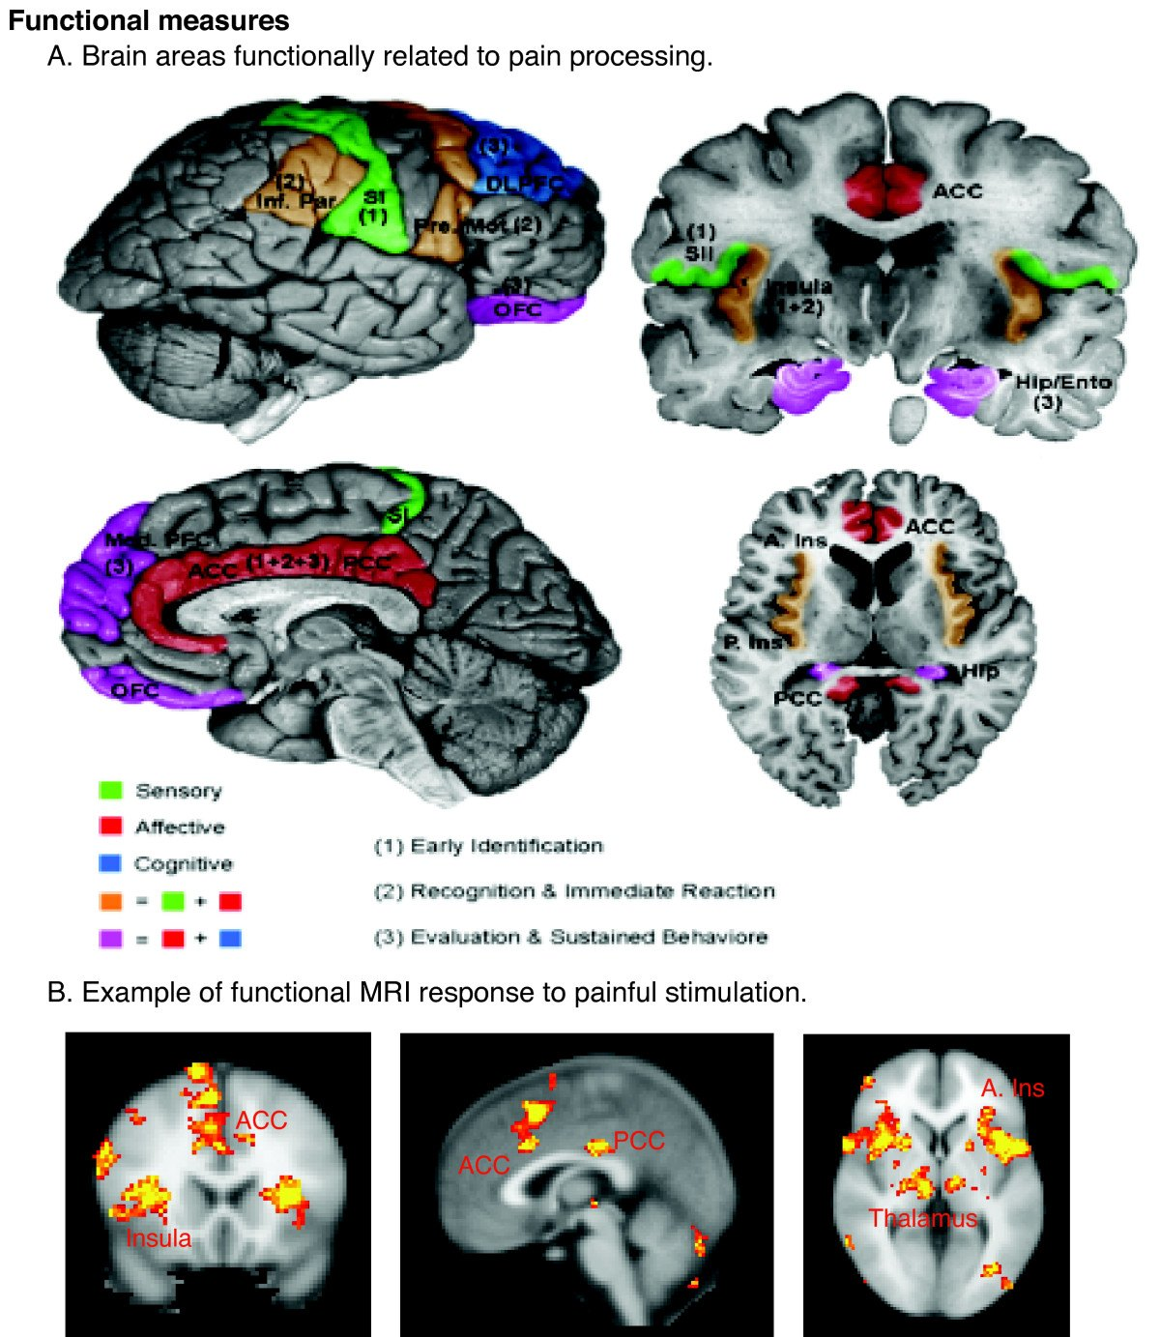
Figure 5.5 · Perception: the brain constructs the experience
WHAT TO NOTICE
Sensory regions: where the pain is and how intense it is.
Affective regions: anterior cingulate cortex and insula generate unpleasantness.
Cognitive regions: prefrontal cortex evaluates meaning ("Is this my heart?").
Threshold vs tolerance: threshold varies little between people; tolerance varies widely.
Key idea: there is no single pain centre. Fear, attention, sleep loss and past experience change how much pain a person feels.
Figure 5.5. “Schematic of cortical areas involved with pain processing and fMRI” by Borsook D, Moulton EA, Schmidt KF, Becerra LR, via Wikimedia Commons, CC BY 2.0.
Notes:
Perception is a pattern of activity across a network. Pain threshold is the point a stimulus is first felt as painful; pain tolerance is the most pain a person is willing or able to endure, which varies with culture, context and mood. Credit: Figure 5.5: “Schematic of cortical areas involved with pain processing and fMRI” by Borsook D, Moulton EA, Schmidt KF, Becerra LR, via Wikimedia Commons, CC BY 2.0

Slide 12
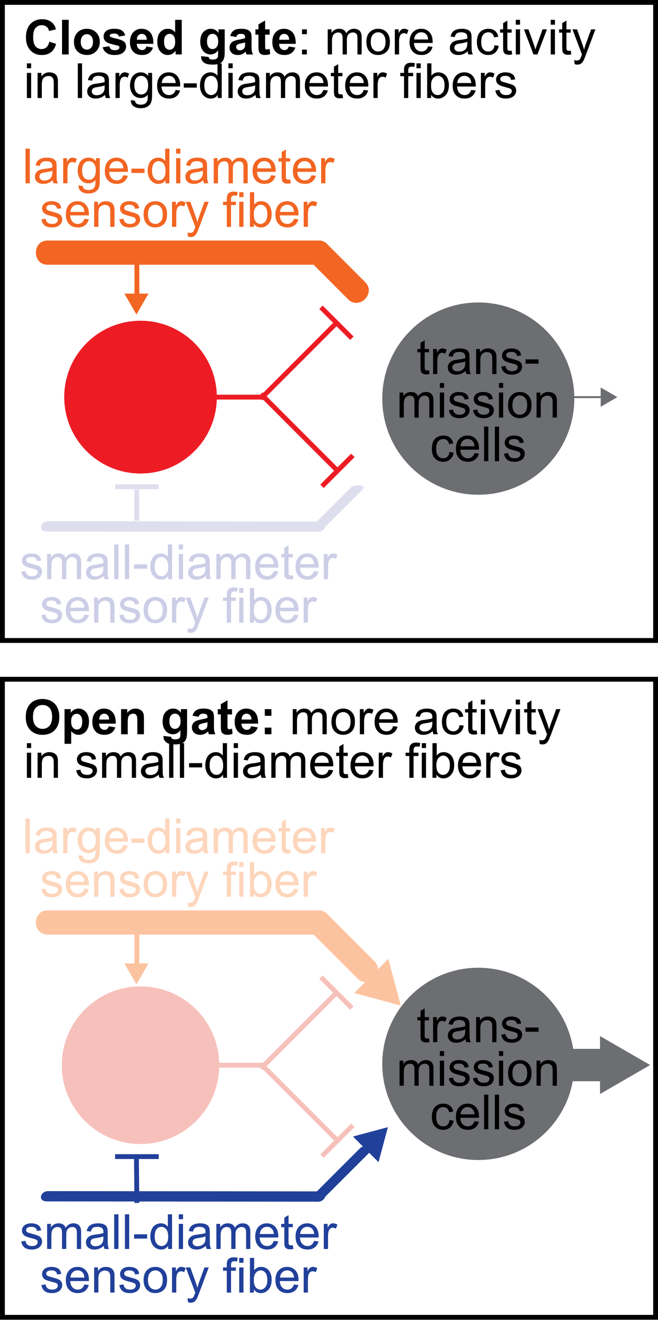
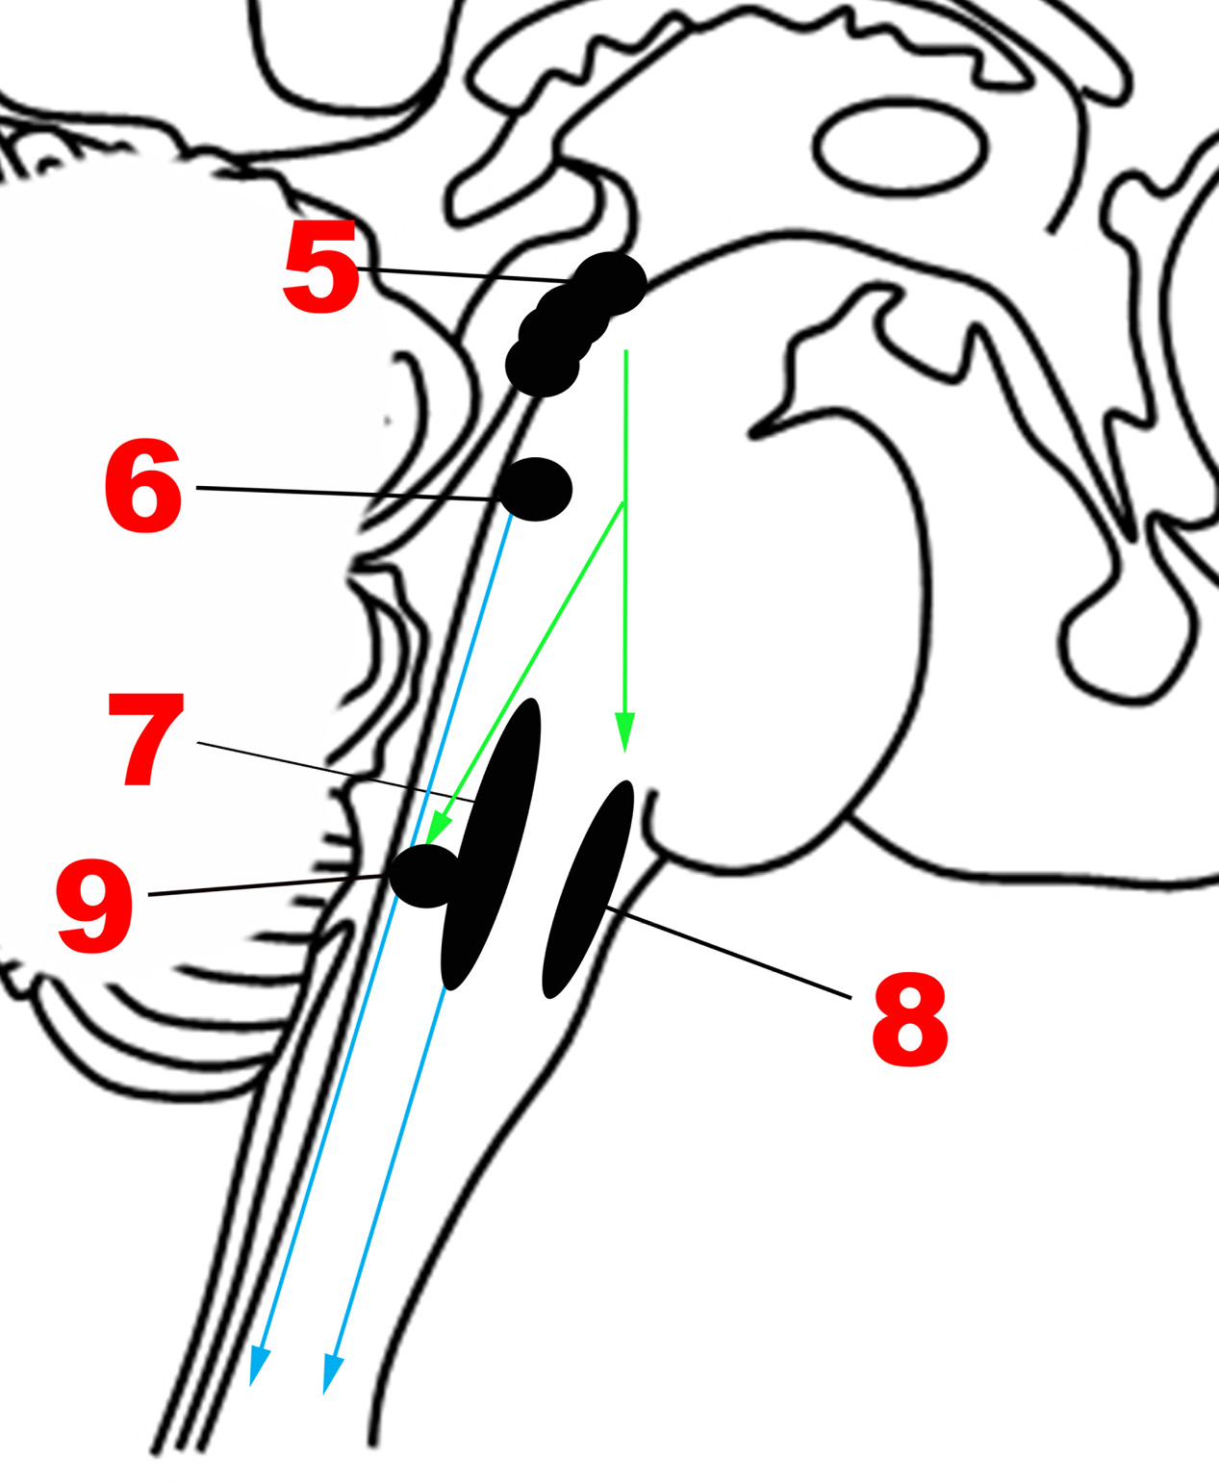
Figures 5.6–5.7 · Modulation: gate control and descending inhibition
WHAT TO NOTICE
Closed gate: Aβ touch input excites inhibitory interneurons that dampen transmission (Melzack & Wall, 1965).
Open gate: small-fibre (Aδ, C) activity predominates and transmission increases.
Descending inhibition: periaqueductal grey → rostral ventromedial medulla → dorsal horn, using serotonin, norepinephrine and endogenous opioids.
At the bedside: rubbing, massage and TENS close the gate; SNRIs and TCAs strengthen descending inhibition.
Figure 5.6. “Gate Theory Circuit Mechanism” by John.Tuthill, via Wikimedia Commons, CC BY-SA 4.0.
Figure 5.7. “Major structures involved in the Descending network” by Anand Venkatraman, Brian L. Edlow, Mary Helen Immordino-Yang, via Wikimedia Commons, CC BY 4.0.
Notes:
Gate control (Melzack & Wall, 1965): rubbing a bumped elbow increases A-beta input and partly closes the gate. Descending pathways release serotonin and norepinephrine and activate interneurons releasing endorphins, enkephalins and dynorphins, which act on mu, delta and kappa receptors. Descending pathways can also facilitate pain; an imbalance toward facilitation may contribute to chronic pain. Credits: Figure 5.6: “Gate Theory Circuit Mechanism” by John.Tuthill, via Wikimedia Commons, CC BY-SA 4.0 | Figure 5.7: “Major structures involved in the Descending network” by Anand Venkatraman, Brian L. Edlow, Mary Helen Immordino-Yang, via Wikimedia Commons, CC BY 4.0

Slide 13
[RN] Inside the dorsal horn synapse: from wind-up to sensitization
GOING DEEPER · RN REQUIRED, PN OPTIONAL
1
2
3
4
5
AMPA
NMDA unplugged
Calcium cascade
Wind-up
Central sensitization
Glutamate opens AMPA receptors at once: the fast excitatory signal of normal, acute pain.
Repetitive C-fibre firing plus substance P and CGRP expel the magnesium plug from NMDA channels.
Calcium activates kinases that phosphorylate and multiply AMPA and NMDA receptors.
Repeated C-fibre stimulation at constant intensity gives a progressively larger response.
Sustained amplification within the CNS produces pain hypersensitivity (Woolf, 2011).
Drug link: ketamine [NMDA receptor antagonist] blocks the NMDA channel, which is why small doses are sometimes added for opioid-tolerant surgical patients.
Notes:
Going Deeper box. AMPA gives the fast signal of normal acute pain. NMDA is blocked by magnesium until repetitive C-fibre firing (with substance P and CGRP) expels it; calcium entry activates kinases that increase receptor numbers and sensitivity. Wind-up is the experimental phenomenon; sustained, it becomes central sensitization (Woolf, 2011). Ketamine [NMDA receptor antagonist] blocks this channel.

Slide 14
Acute pain triggers the stress response, and it harms recovery
INTRODUCTION
The stress response
Why vital signs mislead
Helpful for minutes, harmful for days
Normal vital signs never rule out pain
Sympathetic: raised heart rate, blood pressure and respiratory rate; dilated pupils, sweating, pallor.
HPA axis: more cortisol, glucagon and catecholamines; higher glucose; catabolism.
If prolonged: more myocardial oxygen demand, impaired immunity and wound healing.
Splinting: shallow breathing, atelectasis and pneumonia; immobility raises VTE risk.
Adaptation: the sympathetic response fades within minutes to hours.
Chronic pain: usually no consistent vital sign changes.
Many patients in significant pain have a normal heart rate and blood pressure.
Use self-report or a validated behavioural tool instead (Section 5.5).
Remember: unrelieved acute pain is not only distressing; it is physiologically harmful (Chou et al., 2016).
Notes:
Unrelieved acute pain is physiologically harmful (Chou et al., 2016). But vital signs are a poor measure of pain: the sympathetic response adapts within minutes to hours, and chronic pain usually produces no consistent vital sign changes.

Slide 15
Canadian benchmarks used in this chapter
INTRODUCTION · TABLE 5.2
Interpret every result against your own laboratory's reference range
Respiratory rate 12–20/min: falls with opioid-induced respiratory depression; rate alone may miss shallow breathing.
Creatinine roughly 50–110 µmol/L: impaired kidneys accumulate morphine [opioid agonist] metabolites and gabapentinoids.
SpO₂ 95–100% on room air: may stay normal on oxygen while CO₂ rises.
eGFR 60 mL/min/1.73 m² or higher: guides dose reduction; NSAIDs can worsen kidney function.
PaCO₂ 35–45 mmHg: rises with opioid-related hypoventilation.
ALT roughly 7–40 U/L: rises in liver injury caused by acetaminophen [non-opioid analgesic and antipyretic].
Fasting glucose below 6.1 mmol/L: raised by the stress response; poor control drives neuropathic pain.
Note: ranges vary with sex, muscle mass and laboratory. Always use the range printed on your agency's report.
Notes:
Table 5.2. Ranges are typical adult values; laboratory ranges differ between Canadian labs. Point out the relevance column: oxygen can keep SpO2 normal while CO2 rises; reduced kidney function causes accumulation of morphine metabolites and gabapentinoids.

Slide 16
Classifying pain by duration: acute vs chronic
SECTION 5.1 · TABLE 5.3
Acute pain
Chronic pain
Recent onset · expected to resolve with healing
Persists or recurs beyond 3 months (Treede et al., 2019)
Cause: usually identifiable (surgery, trauma, renal colic, MI).
Role: protective: withdrawal, guarding, rest.
Signs: often tachycardia, hypertension, sweating; grimacing, guarding.
Goal: relieve pain to allow recovery; opioids short-term at lowest effective dose.
Cause: may be clear (secondary) or not explain its severity (primary).
Role: little or no protective role; reflects nervous system change.
Signs: fatigue, poor sleep, low mood, withdrawal; may appear calm.
Goal: function and quality of life; optimize nonopioid and nondrug therapy first (Busse et al., 2017).
ICD-11: chronic primary pain (the pain is the condition, e.g., fibromyalgia) vs six groups of chronic secondary pain (Treede et al., 2019).
Notes:
Chronic pain persists or recurs for longer than 3 months (Treede et al., 2019). ICD-11: chronic primary pain (the pain is the condition, e.g., fibromyalgia, nonspecific chronic low back pain) and six chronic secondary groups (cancer-related, postsurgical or posttraumatic, neuropathic, secondary headache or orofacial, secondary visceral, secondary musculoskeletal). The Canadian opioid guideline uses 'chronic noncancer pain': at least 3 months, not associated with malignancy (Busse et al., 2017).

Slide 17
Classifying pain by mechanism: three IASP descriptors
SECTION 5.1 · TABLE 5.4
Nociceptive
Neuropathic
Nociplastic
Tissue damage, normal nociceptors
Lesion or disease of the somatosensory system
Altered central processing
Somatic: sharp or aching; well localized.
Visceral: cramping, pressure; diffuse; often referred.
Examples: postoperative pain, fracture, renal colic.
Responds to: acetaminophen [non-opioid analgesic], NSAIDs, opioids for severe acute pain.
Words: burning, shooting, electric, tingling, numb.
Pattern: nerve, root, dermatome, stocking-glove.
Examples: diabetic neuropathy, postherpetic neuralgia.
Responds to: gabapentinoids, TCAs, SNRIs (Moulin et al., 2014).
Words: widespread aching, "hurts everywhere".
Pattern: regional or widespread; normal nerve testing.
Examples: fibromyalgia, irritable bowel syndrome.
Responds to: exercise, sleep and psychological therapies first.
Mixed pain is common: chronic low back pain may have nociceptive, neuropathic and nociplastic components in the same person.
Notes:
Kosek et al. (2016) introduced nociplastic as the third mechanistic descriptor, replacing stigmatizing labels like 'psychogenic'. Mixed pain is common: cancer pain often has nociceptive and neuropathic parts; chronic low back pain may have all three. First-line neuropathic drugs per Moulin et al. (2014).

Slide 18
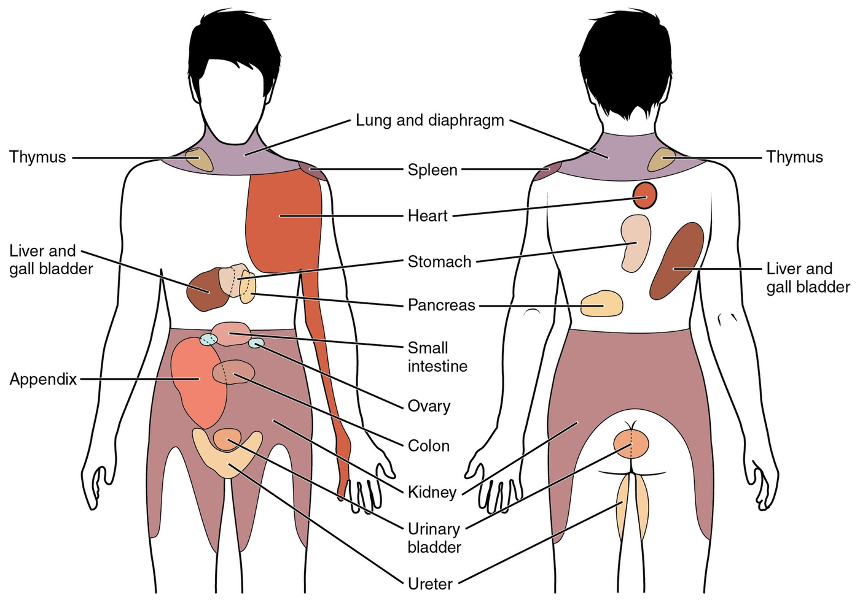
Figure 5.8 · Referred pain
WHAT TO NOTICE
Why: visceral and somatic afferents converge on the same dorsal horn neurons.
Heart: chest, left arm, jaw or upper back (about T1–T4).
Gallbladder: under the right scapula or at the right shoulder.
Diaphragm: shoulder tip (phrenic nerve, C3–C5).
Early appendicitis: around the umbilicus, shifting later to the right lower quadrant.
Safety: atypical ACS (jaw, back, epigastric pain) is more common in women, older adults and people with diabetes.
Figure 5.8. “1506 Referred Pain Chart” by OpenStax College, via Wikimedia Commons, CC BY 3.0.
Notes:
Referred pain is a frequent cause of missed diagnoses. Kidney and ureter pain is felt in the flank and radiates to the groin. Credit: Figure 5.8: “1506 Referred Pain Chart” by OpenStax College, via Wikimedia Commons, CC BY 3.0

Slide 19
Other descriptors you will hear in practice
SECTION 5.1
1
2
3
4
Breakthrough pain
Incident pain
End-of-dose failure
Radiating pain
A transient flare of moderate to severe pain on top of otherwise controlled persistent pain; common in cancer care.
Breakthrough pain predictably triggered by turning, coughing or dressing changes; anticipate with a pre-emptive dose.
Pain returns before the next scheduled long-acting dose is due; the dose or interval needs review.
Pain spreading along a nerve from its source, such as sciatica travelling down the leg.
Canadian Context: chronic pain affects an estimated 41% of Veterans and 31–55% of people who use drugs; Indigenous Peoples had the highest prevalence under age 65 (Canadian Pain Task Force, 2019).
Notes:
Incident pain can be anticipated with a pre-emptive dose. End-of-dose failure suggests the dose or interval needs review. The Canadian Context data are from the Canadian Pain Task Force (2019).

Slide 20
Pain Mechanisms: Inflammation, Nerve Injury and Chronic Pain
PART 2 · SECTIONS 5.2–5.4
How inflammation sensitizes the system, how damaged nerves generate pain, and why some pain persists.
Notes:
Part 2 covers Sections 5.2 (nociceptive and inflammatory pain), 5.3 (neuropathic pain) and 5.4 (chronic and nociplastic pain).

Slide 21
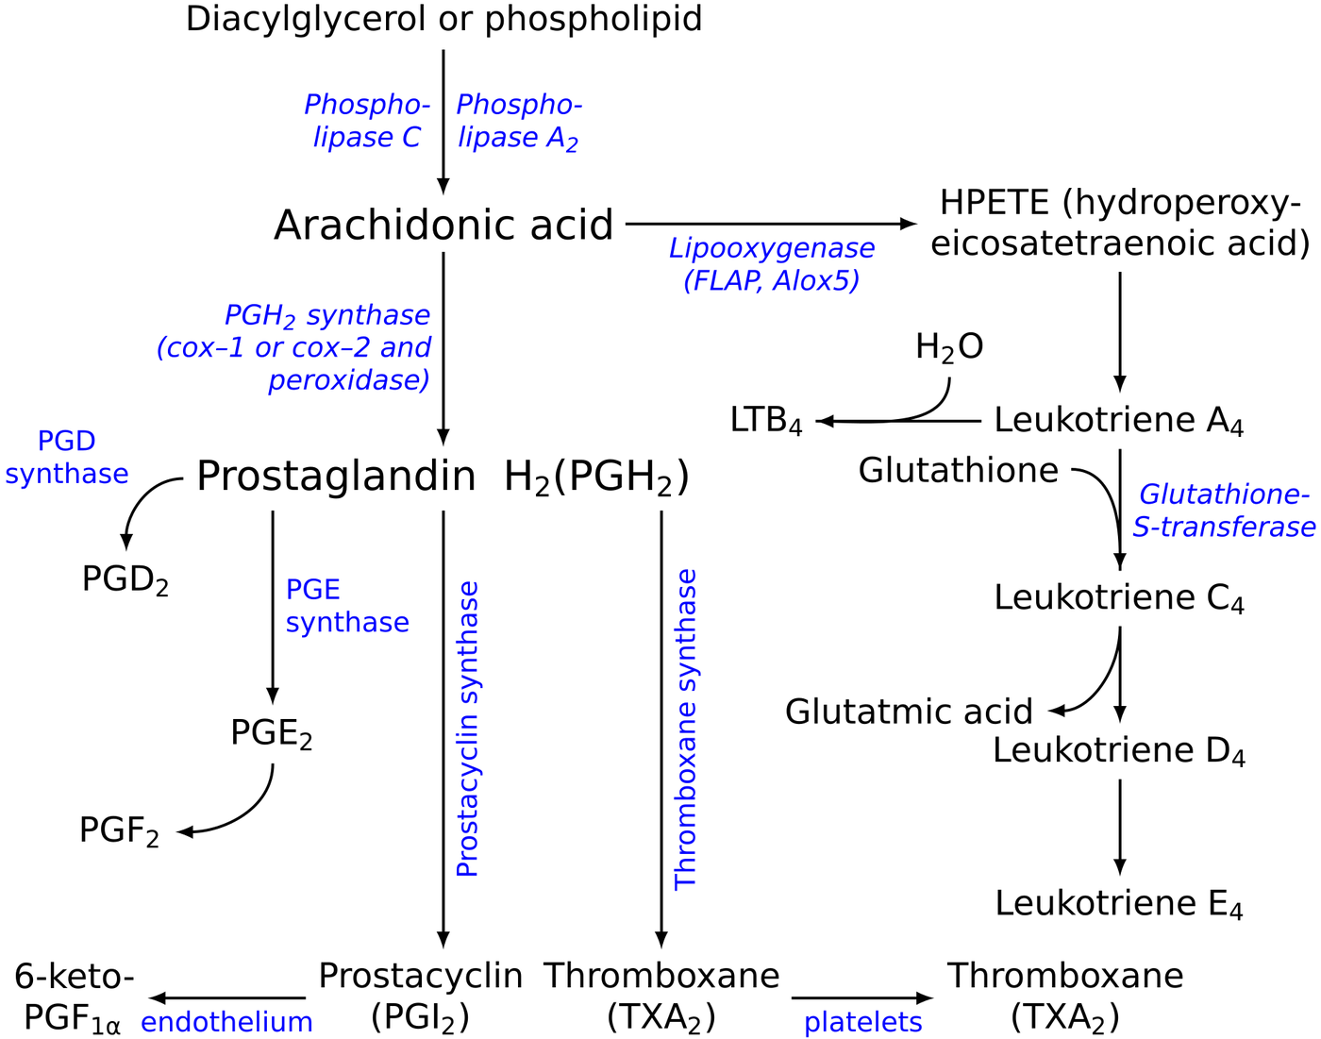
Figure 5.9 · From membrane phospholipid to prostaglandins
WHAT TO NOTICE
Arachidonic acid: released from membrane phospholipids in injured cells.
COX-1 and COX-2: convert it to prostaglandins; COX-2 is rapidly induced in inflamed tissue.
Prostaglandin E₂: little pain on its own, but makes nociceptors far more responsive.
Lipoxygenase branch: produces leukotrienes.
Drug link: NSAIDs inhibit COX; corticosteroids act further upstream by limiting arachidonic acid release.
Figure 5.9. “Eicosanoid synthesis” by Jfdwolff; vector version by Fvasconcellos and others, via Wikimedia Commons, CC BY-SA 3.0.
Notes:
Use this to anchor the mechanism of NSAIDs and corticosteroids before the medications slide. Credit: Figure 5.9: “Eicosanoid synthesis” by Jfdwolff; vector version by Fvasconcellos and others, via Wikimedia Commons, CC BY-SA 3.0

Slide 22
Inflammation sensitizes the nociceptor
SECTION 5.2
The inflammatory soup
Peripheral sensitization
Neurogenic inflammation
Direct activators: bradykinin, K⁺, H⁺, ATP.
Sensitizers: prostaglandin E₂, histamine, serotonin.
Also: cytokines (IL-1β, TNF-α) and nerve growth factor.
Mechanism: TRPV1 and sodium channels phosphorylated; thresholds fall.
Silent nociceptors are recruited.
Result: primary hyperalgesia in the injured area (sunburn under a warm shower).
C fibres release substance P and CGRP from their peripheral endings.
Effects: vasodilation, leaky capillaries, mast cell degranulation.
Loop: inflammation sensitizes the nerve; the nerve amplifies the inflammation.
Key term: primary hyperalgesia is increased pain from a painful stimulus within the injured area itself.
Notes:
Inflammatory soup: K+, H+, ATP, serotonin (platelets), histamine (mast cells), bradykinin, prostaglandins, cytokines (IL-1 beta, TNF-alpha), nerve growth factor. Peripheral sensitization: prostaglandins and bradykinin phosphorylate TRPV1 and sodium channels, lowering thresholds and recruiting silent nociceptors. Neurogenic inflammation: C fibres release substance P and CGRP peripherally, causing flare, swelling and warmth; pain and inflammation feed each other.

Slide 23
Central sensitization: when the spinal cord turns up the volume
SECTION 5.2
Two clinical signs
Visceral and ischemic pain
Woolf (2011)
Distension, traction, ischemia, chemical irritation
Secondary hyperalgesia: increased sensitivity in undamaged tissue surrounding the injury.
Allodynia: pain from a stimulus that is not normally painful, such as a bedsheet touching the skin near an incision.
Why: spinal neurons now respond to Aβ touch input.
Colic: distension of bowel or ureter causes waves of cramping pain.
Ischemia: lactate, H⁺, K⁺, bradykinin and adenosine activate nociceptors (angina, compartment syndrome).
Parietal involvement: pain becomes sharp and localized, worse with movement and coughing.
Why multimodal analgesia: controlling severe acute pain early, with drugs that act at different points in the pathway, limits sensitization (Chou et al., 2016).
Notes:
After an intense or prolonged barrage, dorsal horn neurons become hyperexcitable, receptive fields expand and they respond to A-beta input (Woolf, 2011). After uncomplicated surgery these changes fade; if they persist they contribute to chronic postsurgical pain. Multimodal analgesia (Chou et al., 2016). Visceral pain: distension, traction, ischemia; becomes sharp and localized when the parietal peritoneum or pleura is involved.

Slide 24
Patho-to-Bedside: nociceptive and inflammatory pain
SECTION 5.2 · TABLE 5.5
Incisional pain worse with coughing: sensitized nociceptors; give analgesia before mobilizing, splint with a pillow.
Tachycardia, hypertension, hyperglycemia: stress response; treat pain then reassess; check glucose in diabetes.
Spreading redness and warmth: neurogenic plus normal inflammation; watch temperature, drainage and WBC for infection.
Colicky flank pain to the groin with nausea: ureteric distension; analgesia, antiemetic, monitor output; report fever with obstruction urgently.
Pain from a sheet near the wound: allodynia; believe it, reduce handling, ensure multimodal analgesia.
Limb pain out of proportion, pain on passive stretch: rising compartment pressure; emergency; neurovascular checks, do not elevate above heart level, notify now.
Shallow breathing, refusing to cough: splinting causes atelectasis; treat pain, incentive spirometry, auscultate.
Normal vital signs with reported pain: adaptation of the stress response; the report still guides care.
Reassess: when the drug should be at peak effect (sooner after IV than oral), recording both the pain score and a functional goal such as coughing or walking.
Notes:
Table 5.5. Emphasize the compartment syndrome row: severe, increasing pain out of proportion, pain on passive stretch. Do not elevate the limb above heart level; loosen dressings or casts as permitted; notify immediately.

Slide 25
Where analgesics interrupt the nociceptive cascade
MEDICATIONS
1
2
3
4
At the nerve ending
Along the axon
Spinal cord and brain
Against sensitization
Ibuprofen [NSAID], naproxen [NSAID], celecoxib [COX-2 selective NSAID] reduce prostaglandins; dexamethasone [corticosteroid] acts upstream.
Lidocaine [amide local anaesthetic] and bupivacaine [amide local anaesthetic] block sodium channels: infiltration, nerve blocks, epidurals.
Morphine [opioid agonist] and hydromorphone [opioid agonist] act on mu receptors; acetaminophen [non-opioid analgesic] acts centrally.
Low-dose ketamine [NMDA receptor antagonist] blocks dorsal horn NMDA receptors, under specialist guidance.
Multimodal analgesia: drugs acting at different points give better control with lower doses and fewer opioid adverse effects (Chou et al., 2016).
Notes:
Medications box from Section 5.2. Combining drugs that act at different points gives better pain control with lower doses of each and fewer opioid-related adverse effects (Chou et al., 2016). Acetaminophen's exact mechanism is still debated.

Slide 26
Neuropathic pain: when the wiring itself is damaged
SECTION 5.3
Peripheral (diabetes, zoster, radiculopathy, chemotherapy) or central (spinal cord injury, stroke, MS)
1
2
3
4
5
Ectopic discharge
Calcium channels
Central sensitization
Loss of inhibition
Cortical reorganization
Sodium channels accumulate at the injury and neuromas fire without a stimulus.
More alpha-2-delta subunits boost glutamate and substance P release.
Constant abnormal input sensitizes dorsal horn neurons (Woolf, 2011).
Inhibitory interneurons die; descending inhibition weakens.
Deafferented neurons become hyperactive; neighbouring cortex takes over.
Recognize it: burning, shooting, electric pain with numbness in the same area, often worse at night.
Notes:
Mechanisms usually act together. Negative signs: numbness, reduced vibration and temperature sense, weakness. Positive signs: spontaneous burning, shooting or electric pain, paresthesia, dysesthesia, allodynia, hyperalgesia, pain in a numb area. Often worse at night; linked to sleep disturbance, depression and anxiety.

Slide 27
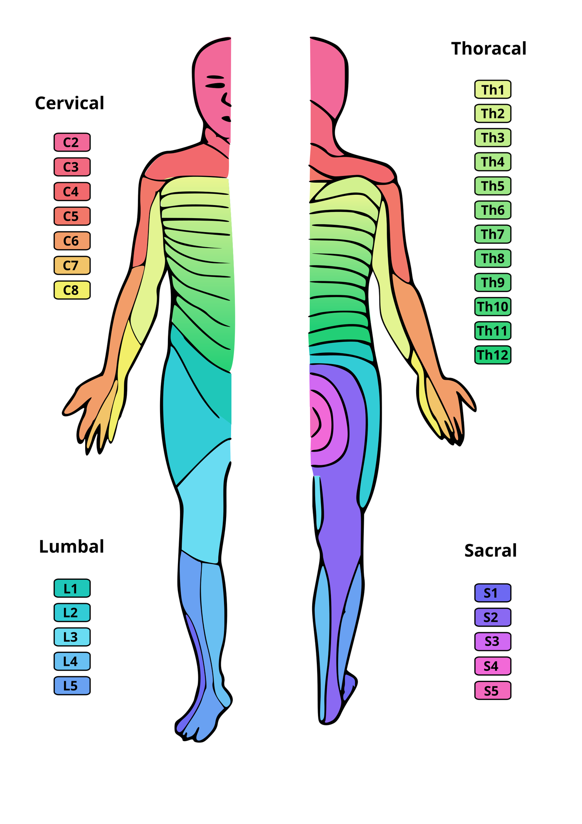
Figure 5.10 · Dermatome map
WHAT TO NOTICE
One root, one band: each band of skin is supplied by a single spinal nerve root.
Thoracic bands wrap horizontally around the trunk.
Lumbar and sacral bands run lengthwise down the legs.
Use it: to link radicular or zoster pain to the affected level.
Distribution clue: nerve, root or dermatome = neuropathic; stocking-and-glove = length-dependent polyneuropathy.
Figure 5.10. “Dermatoms” by Ralf Stephan, via Wikimedia Commons, Public domain.
Notes:
Neuropathic pain follows the lesion: a single nerve, a dermatome, a stocking-and-glove pattern, or a hemibody after stroke. Credit: Figure 5.10: “Dermatoms” by Ralf Stephan, via Wikimedia Commons, Public domain

Slide 28
Diabetic peripheral neuropathy and postherpetic neuralgia
SECTION 5.3
Diabetic peripheral neuropathy
Herpes zoster and postherpetic neuralgia
Longest fibres first: toes and feet, then upward
Varicella-zoster reactivation in a sensory ganglion
Causes: sorbitol and AGEs, oxidative stress, microvascular disease of nerve vessels.
Screen: 10-g monofilament on each great toe; neuropathy likely if 3 or fewer of 8 stimuli felt (Diabetes Canada, n.d.).
Risk: loss of protective sensation plus PAD leads to ulcers and amputation.
Treat: glycemic control, plus the drugs on the next slides (Bril et al., 2018).
Rash: one dermatome, does not cross the midline; pain often comes first.
PHN: pain after the rash heals; risk 6–45% in immunocompromise; about 17,000 cases a year in Canada.
Prevent: recombinant zoster vaccine (NACI) for adults 50+ and immunocompromised adults 18+ (Krishnan et al., 2026).
Topical lidocaine [amide local anaesthetic]: second-line for PHN.
Prevention first: vaccination is the most effective strategy against postherpetic neuralgia (Krishnan et al., 2026).
Notes:
Diabetes Canada recommends regular neuropathy screening (Bril et al., 2018); rapid screen with a 10-g monofilament four times on the dorsum of each great toe; neuropathy likely if 3 or fewer of 8 stimuli perceived (Diabetes Canada, n.d.). PHN: risk 6% to 45% across immunocompromising conditions; about 17,000 cases a year in Canada (Krishnan et al., 2026). NACI recommends recombinant zoster vaccine for immunocompetent adults 50+ and, since 2026, adults 18+ who are or will be immunocompromised. Topical lidocaine is second-line specifically for PHN (Moulin et al., 2014).

Slide 29
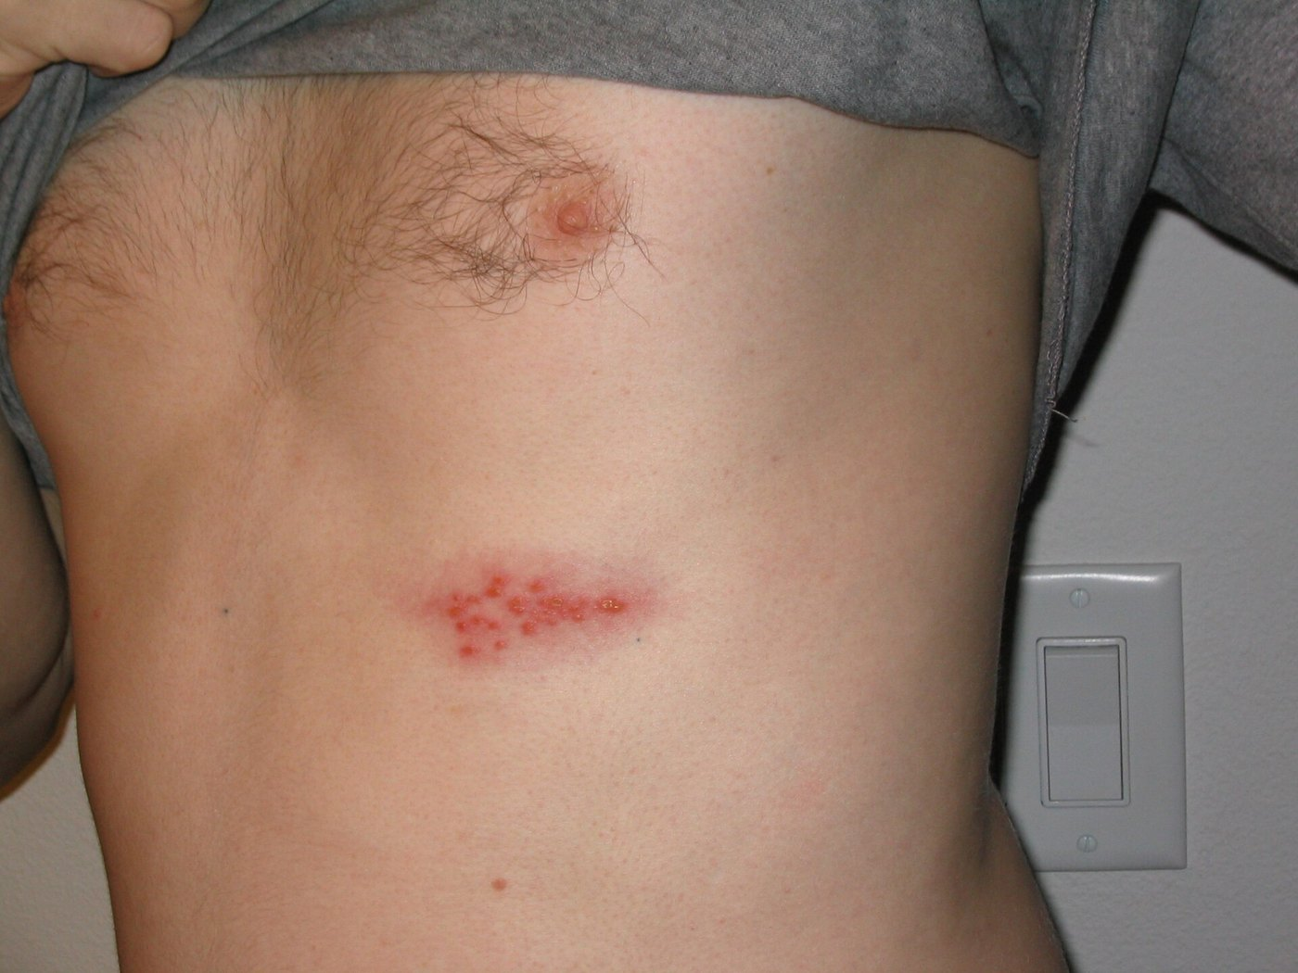
Figure 5.11 · Herpes zoster on the trunk
WHAT TO NOTICE
Dermatomal band: clustered papules and vesicles in a narrow horizontal stripe.
One side only: the rash does not cross the midline.
Pain first: pain often precedes the rash by several days.
After healing: persistent pain is postherpetic neuralgia.
Teach: older and immunocompromised adults about recombinant zoster vaccination.
Figure 5.11. “Shingles on the chest” by Preston Hunt, via Wikimedia Commons, CC BY 3.0.
Notes:
Inflammation and necrosis in the ganglion and nerve can leave lasting damage. Credit: Figure 5.11: “Shingles on the chest” by Preston Hunt, via Wikimedia Commons, CC BY 3.0

Slide 30
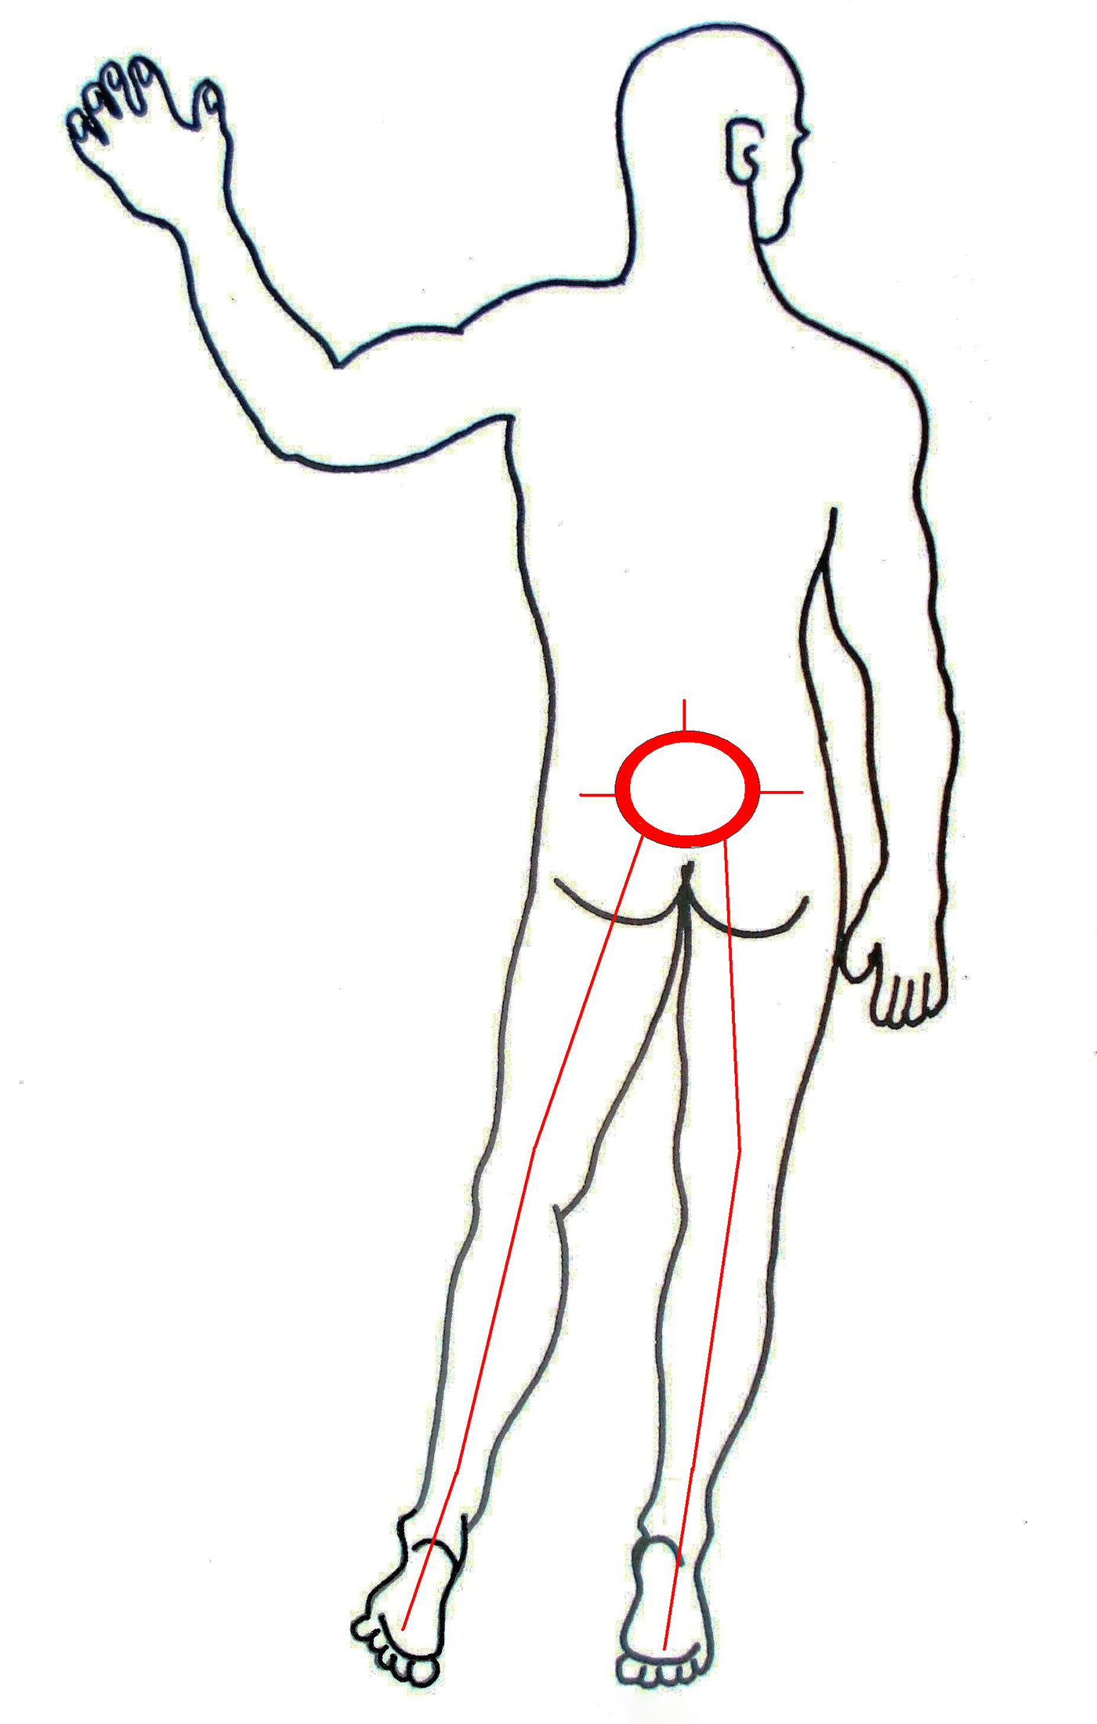
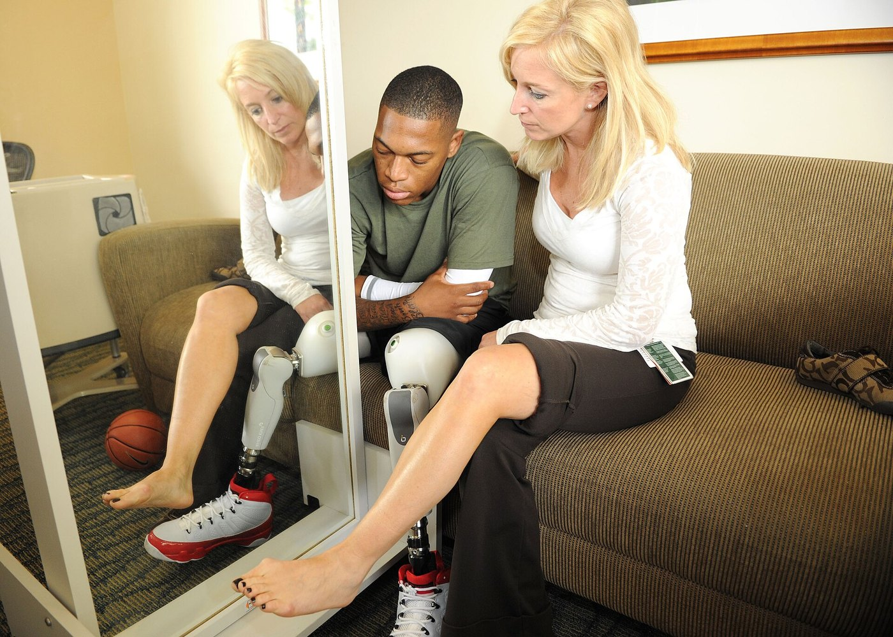
Figures 5.12–5.13 · Radicular pain and phantom limb pain
WHAT TO NOTICE
Sciatica: disc herniation or stenosis compresses an L5 or S1 root; pain radiates down the back of the leg.
Red flags: urinary retention or incontinence, saddle anaesthesia, progressive weakness (cauda equina).
Phantom limb pain: neuroma activity, spinal sensitization and cortical reorganization.
Mirror therapy: reduced phantom pain in a small randomized trial (Chan et al., 2007).
Distinguish: phantom limb pain (felt in the missing part) from residual limb pain (from the remaining tissue).
Figure 5.12. “LBP and sciatica” by Harrygouvas, via Wikimedia Commons, CC BY-SA 3.0.
Figure 5.13. “US Navy 110613-N-YM336-079 Lynn Boulanger, an occupational therapy assistant and certified hand therapist, uses mirror therapy to help address phan” by U.S. Navy (photo by a Mass Communication Specialist), via Wikimedia Commons, Public domain.
Notes:
Cauda equina red flags need urgent assessment. Credits: Figure 5.12: “LBP and sciatica” by Harrygouvas, via Wikimedia Commons, CC BY-SA 3.0 | Figure 5.13: “US Navy 110613-N-YM336-079 Lynn Boulanger, an occupational therapy assistant and certified hand therapist, uses mirror therapy to help address phan” by U.S. Navy (photo by a Mass Communication Specialist), via Wikimedia Commons, Public domain

Slide 31
Treating chronic neuropathic pain: Canadian Pain Society lines
SECTION 5.3 · TABLE 5.6
First line
Second line
Third and fourth line
Moulin et al. (2014)
Tramadol [weak opioid agonist and SNRI]: lowers seizure threshold; serotonin syndrome risk with SSRIs and SNRIs.
Controlled-release oxycodone [opioid agonist]: opioid adverse effects.
Topical lidocaine [amide local anaesthetic]: for postherpetic neuralgia.
Third: cannabinoids [cannabinoid]; avoid with a history of psychosis.
Fourth: methadone [opioid agonist], tapentadol [opioid agonist and NRI], capsaicin [TRPV1 agonist], lamotrigine [anticonvulsant], botulinum toxin [neurotoxin].
Methadone [opioid agonist]: ECG monitoring for QT prolongation.
Gabapentin [gabapentinoid], pregabalin [gabapentinoid]: dizziness, sedation, edema; reduce dose in kidney impairment.
Amitriptyline [TCA], nortriptyline [TCA]: anticholinergic effects; usually avoided in older adults.
Duloxetine [SNRI], venlafaxine [SNRI]: nausea, sweating; taper, don't stop abruptly.
Expect slow benefit: start low, titrate gradually, and allow several weeks at a therapeutic dose before judging a drug.
Notes:
Source: Moulin et al. (2014). Start low, increase gradually; an adequate trial takes several weeks at a therapeutic dose; partial benefit is common and first-line combinations from different classes are often used. Fourth line includes methadone, tapentadol, topical capsaicin, other anticonvulsants such as lamotrigine and botulinum toxin; specialist use. Diabetes Canada also lists anticonvulsants, antidepressants and opioid options for painful diabetic neuropathy (Bril et al., 2018).

Slide 32
Gabapentinoids with opioids, and teaching about neuropathy
CLINICAL SAFETY · PATIENT EDUCATION
Clinical Safety: additive CNS depression
Patient Education: diabetic neuropathy
Gabapentin [gabapentinoid] plus an opioid
Why: "Sugar has damaged your nerves; keeping it in range stops it getting worse."
Patience: "Nerve pain medicine can take a few weeks at the right dose."
Feet: check daily with a mirror, good shoes, never barefoot, test water with your elbow.
Act: same-day call for a blister or sore; emergency for a red, hot, swollen foot or fever.
Evidence: substantially higher odds of opioid-related death in Ontario, highest at moderate to high gabapentin [gabapentinoid] doses (Gomes et al., 2017).
Beers 2023: avoid the combination in older adults except in specific situations; reduce dose with kidney impairment.
Safeguards: flag it to prescriber and pharmacist; assess sedation before each opioid dose and at peak.
Teach too: dizziness and drowsiness are expected when starting a gabapentinoid; alcohol and other sedatives add to the risk; don't drive until you know how it affects you.
Notes:
Gomes et al. (2017): Ontario population study, people taking opioids who were also prescribed gabapentin had substantially higher odds of opioid-related death, greatest at moderate to high gabapentin doses. Beers Criteria (2023): avoid opioids plus gabapentinoids in older adults except in specific situations; reduce gabapentinoid dose with impaired kidney function. Patient education is from the DPN box in Section 5.3.

Slide 33
Why pain persists: the biopsychosocial model
SECTION 5.4
Biological
Psychological
Social
Ongoing pathology such as osteoarthritis.
Nerve injury and persistent central sensitization.
Genetics, poor sleep and deconditioning.
Pain catastrophizing: rumination, magnification, helplessness.
Fear-avoidance: avoiding movement for fear of harm.
Depression, anxiety, post-traumatic stress.
Poverty, unstable housing, loss of work.
Isolation and discrimination in health care.
Access: difficulty getting timely treatment.
Self-reinforcing cycles: fear → inactivity → stiffness → more pain; pain → poor sleep → lower thresholds and low mood → weaker descending inhibition.
Notes:
Pain is always influenced to varying degrees by biological, psychological and social factors (Raja et al., 2020). Cycles: fear of movement leads to inactivity, weakness and stiffness, so movement hurts more; pain disrupts sleep, sleep loss lowers thresholds and mood, low mood weakens descending inhibition. Treatments addressing only one strand rarely succeed.

Slide 34
Nociplastic pain and fibromyalgia
SECTION 5.4
Nociplastic mechanisms
Fibromyalgia
Kosek et al. (2016)
Fitzcharles et al. (2013)
Central sensitization: normal input amplified; pain area expands.
Impaired descending inhibition with possible increased facilitation.
Altered brain processing of emotional and attentional aspects of pain.
Clues: widespread pain; sensitivity to touch, light, sound; fatigue, poor sleep, "brain fog".
Features: diffuse fluctuating pain, sleep disturbance, fatigue, mood and cognitive change.
Diagnosis: clinical; no defining physical abnormality or biomarker.
Cornerstone: healthy lifestyle and active participation; drugs offer only modest benefit.
In practice: graded aerobic exercise, sleep hygiene, pacing, CBT.
Language matters: "nociplastic" replaced stigmatizing labels such as "psychogenic". The pain is real and has a biological basis.
Notes:
Nociplastic pain: altered nociception without tissue damage or a somatosensory lesion (Kosek et al., 2016). Mechanisms: central sensitization (Woolf, 2011), impaired descending inhibition, altered brain processing, neuroendocrine and sleep disturbance. Fibromyalgia: chronic diffuse fluctuating pain with sleep disturbance, fatigue, mood and cognitive changes; clinical diagnosis with no defining physical abnormality or biomarker; Canadian guidelines emphasize individualized, symptom-based care, healthy lifestyle and active participation as the cornerstone, drugs of modest benefit (Fitzcharles et al., 2013).

Slide 35
Living with chronic pain in a toxic drug crisis
SECTION 5.4
The wider burden
2017 Canadian opioid guideline
Canadian Pain Task Force (2019)
Busse et al. (2017)
Mental health: depression, anxiety and increased suicide risk.
Veterans: about two-thirds with past-year suicidal ideation also had chronic pain.
Cost: roughly $56–60 billion a year in direct and indirect costs.
Assess: sleep, mood, work, relationships, goals and fears; ask directly about suicidal thoughts.
First: optimize nonopioid and nondrug therapy.
Avoid opioids with an active substance use disorder.
Starting dose: below 50 mg morphine [opioid agonist] equivalents a day; stay below 90 mg.
Harm of stricter prescribing: abrupt reductions and loss of access to care.
In 2025: 5,608 opioid-related deaths in Canada, about 15 a day, a 23% decrease from 2024 (Council of Chief Medical Officers of Health, 2026).
Notes:
Effects: depression, anxiety, increased suicide risk; among Veterans with past-year suicidal ideation, about two-thirds had chronic pain; combined costs about $56 to $60 billion a year (Canadian Pain Task Force, 2019). 5,608 opioid-related deaths in 2025, about 15 a day, 23% decrease from 2024 (Council of Chief Medical Officers of Health, 2026). Busse et al. (2017) recommendations; abrupt reductions and loss of access identified as harms by the Canadian Pain Task Force (2019).

Slide 36
Equity in pain care, and the "drug-seeking" label
CANADIAN CONTEXT · PRACTICE STORY
Canadian Context: equity and Indigenous health
Practice Story: "She's just drug-seeking"
Disproportionately affected: Indigenous Peoples, people in poverty, women, Veterans, older adults, some racialized communities.
Barriers: racism, dismissed pain, stereotypes about substance use, distance from services.
Culturally safe care: believe the report; ask about healing practices; involve family, navigators or Elders.
OCAP®: ownership, control, access and possession of First Nations data.
Situation: fibromyalgia, long-acting opioid at home; rates pain 8/10 at night.
RPN action: sat with her, found the evening dose omitted on admission.
Collaboration: RN reviewed sedation and breathing and called the physician.
Outcome: home regimen reinstated, acetaminophen [non-opioid analgesic] and heat added; pain 4 by morning.
Reflect: which part of the IASP definition applies, why was RN consultation appropriate, and how could the handover have been more objective?
Notes:
Canadian Context box: groups disproportionately affected (Canadian Pain Task Force, 2019). OCAP: ownership, control, access and possession guide First Nations data. Practice Story: RPN and RN collaboration. Reflective questions: (1) Which part of the IASP definition applies? (2) Why was consulting the RN appropriate? (3) How could handover language have been more objective?

Slide 37
Pain Assessment: Self-Report, Behaviour and Sedation
PART 3 · SECTION 5.5
When and how to assess, tools for people who cannot self-report, and the sedation scale that keeps opioid therapy safe.
Notes:
Part 3 covers Section 5.5. Principle: pain is what the person says it is. When they cannot say, use a validated behavioural tool and assume pain is present if the condition would cause it.

Slide 38
Comprehensive pain assessment: OPQRSTUV
SECTION 5.5 · TABLE 5.7
Assess on admission, with new or changed pain, around procedures, and at each analgesic's peak
Onset: when did it start; sudden or gradual?
Severity: 0–10 now, at worst and at best.
Provoking / Palliating: what makes it worse or better?
Timing / Treatment: constant or intermittent; what helped?
Quality: burning or shooting suggests neuropathic; cramping visceral.
Understanding / Impact: cause in their view; effect on sleep, mood, movement.
Region / Radiation: point to it; does it spread?
Values: their goal and the level that lets them do what matters.
Functional goals: cough effectively, walk to the bathroom and sleep after surgery; walk the dog or return to part-time work with chronic pain.
Notes:
New or unexpected pain may signal a complication (compartment syndrome, anastomotic leak, MI) and must be investigated, not simply treated. Document functional goals as well as the score.

Slide 39
Choosing the right tool
SECTION 5.5 · TABLE 5.8
Self-report
Behavioural tools
When self-report fails
Always try first
Each item scored 0–2
Try any form of self-report: nod, point, blink.
Look for causes; use a tool; ask family.
Trial an analgesic and observe the response.
NRS 0–10: most adults.
Verbal descriptor: none, mild, moderate, severe; older adults.
FPS-R: six faces scored 0–10, from about age 4 (Hicks et al., 2001).
FLACC (0–10): young children (Merkel et al., 1997).
PAINAD (0–10): advanced dementia (Warden et al., 2003).
CPOT (0–8): critically ill and ventilated adults (Gélinas et al., 2006).
Interpret with care: a behavioural score shows pain is likely present, not how intense it is; hunger, a full bladder, fear or delirium can look similar.
Notes:
Self-report tools: NRS, verbal descriptor scale, FPS-R (six faces scored 0, 2, 4, 6, 8, 10; Hicks et al., 2001). Behavioural tools (each item 0–2): FLACC (Merkel et al., 1997), PAINAD (Warden et al., 2003), CPOT (Gélinas et al., 2006). A behavioural score indicates likely presence of pain, not its precise intensity. Hierarchy when self-report is impossible: attempt self-report in any form, search for causes, use a tool, ask family, try an analgesic and observe.

Slide 40
Pasero Opioid-Induced Sedation Scale (POSS)
SECTION 5.5 · TABLE 5.9
Sedation almost always comes before respiratory depression (Jungquist et al., 2020)
S
1
2
3
4
Sleeping, easy to arouse
Awake and alert
Slightly drowsy, easily aroused
Drifts off during conversation
Minimal or no response
Acceptable; no action needed.
Acceptable; continue to monitor.
Acceptable; continue to monitor.
Unacceptable: hold or reduce opioid, monitor closely, notify.
Unacceptable: stop opioid, call for help, support breathing, give naloxone [opioid antagonist].
Priority: a low pain score never makes a patient at POSS 3 or 4 safe. Sedation and breathing come first (Pasero, 2009).
Notes:
POSS (Pasero, 2009). Levels S, 1 and 2 are acceptable. Level 3: hold or reduce the opioid as per orders, monitor closely until below 3 and stable, consider nonsedating analgesics, notify. Level 4: stop the opioid, stimulate and call for help, support airway and breathing, give naloxone [opioid antagonist] as ordered, notify prescriber and rapid response team.

Slide 41
Monitoring breathing during opioid therapy
SECTION 5.5
What to assess
Risk factors
Respiratory rate, depth and rhythm for a full minute.
Snoring: a sign of upper airway obstruction.
SpO₂: but oxygen can keep it normal while CO₂ accumulates.
Capnography (end-tidal CO₂): detects hypoventilation earlier; recommended for high-risk patients.
Jungquist et al. (2020)
Patient: obstructive sleep apnea, obesity, older age, opioid-naive.
Timing: recent surgery, especially the first 24 hours.
Drugs: benzodiazepines or gabapentinoids alongside opioids.
Organs: kidney or liver impairment; lung or heart disease.
False reassurance: a normal SpO₂ on supplemental oxygen does not mean ventilation is adequate.
Notes:
Jungquist et al. (2020): continuous capnography detects hypoventilation earlier and is recommended for high-risk patients; risk factors listed. Count respirations for a full minute, assess depth and rhythm, listen for snoring.

Slide 42
The comfortable patient who is too sleepy
CLINICAL JUDGMENT
64-year-old, 10 hours after knee replacement, hydromorphone [opioid agonist] SC as needed
Recognize cues: pain 3/10; drifts off mid-answer; RR 10 and shallow; snoring; SpO₂ 92% on 2 L/min.
Generate solutions: hold opioid, keep awake, deep breaths, raise head of bed, check other sedatives and sleep apnea.
Analyze cues: POSS 3; snoring suggests airway obstruction; oxygen may mask rising CO₂.
Take action: stimulate, reposition, assess airway, SBAR to prescriber, increase monitoring, naloxone [opioid antagonist] at hand.
Prioritize hypotheses: advancing opioid-induced sedation with early respiratory depression comes before pain control.
Evaluate outcomes: reassess until consistently POSS 2 or less with normal respiratory rate and depth.
Lesson: a comfortable patient can still be in danger. Assess sedation and breathing with every opioid dose.
Notes:
Clinical Judgment box, NCSBN CJMM. Findings at 0200: pain 3/10, falls asleep twice while answering, RR 10 shallow with snoring, SpO2 92% on 2 L/min. Drifting off mid-conversation is POSS 3; snoring suggests obstruction; oxygen may mask rising CO2. Evaluate until consistently POSS 2 or less with normal respiratory rate and depth.

Slide 43
Barriers to assessment, and when RPNs consult
SECTION 5.5 · SCOPE IN PRACTICE
Barriers to accurate assessment
Scope in Practice: RPN consults the RN when
Patients under-report: not wanting to bother staff, fear of addiction, stoicism.
Clinicians underestimate: assumptions about age, gender, race or diagnosis; "drug-seeking" labels.
At particular risk: people who use drugs, people with mental illness, Indigenous and racialized patients.
Sedation: POSS 3 or 4, or a falling respiratory rate.
Pain: new, unexplained, or not responding to the ordered regimen.
Therapy: continuous opioid infusion, epidural, or high respiratory risk.
Emergency: any nurse protects the airway, calls for help and gives naloxone [opioid antagonist] per order or directive.
Document: pain score, sedation level, respiratory findings, actions taken and the response.
Notes:
Barriers paragraph and Scope in Practice box. IASP note that a person's report should be respected applies to everyone (Raja et al., 2020). RPN consultation triggers per CNO complexity, predictability and risk; in an emergency any nurse protects the airway, calls for help and gives naloxone according to orders or medical directive.

Slide 44
Pain Management: Analgesics, Opioid Safety and Nondrug Care
PART 4 · SECTIONS 5.6–5.7
Non-opioids, opioids and their adverse effects, delivery systems, opioid reversal, nonpharmacologic strategies and special populations.
Notes:
Part 4 covers Sections 5.6 and 5.7.

Slide 45
Six principles of analgesic therapy
SECTION 5.6
1
2
3
Match
Combine
Prevent
the drug to the mechanism.
drugs acting at different sites.
with scheduled dosing for predictable pain.
4
5
6
Choose
Limit
Individualize
oral when possible; avoid IM injections.
opioids to the lowest dose, shortest time.
for kidneys, liver, apnea, drugs, substance use.
Sources: Moulin et al. (2014); Chou et al. (2016).
Notes:
Principles: match to mechanism (Moulin et al., 2014); multimodal (Chou et al., 2016); prevent rather than chase; oral preferred, IM avoided (Chou et al., 2016); lowest effective opioid dose for shortest time with a plan for stopping; individualize for age, kidney and liver function, other drugs, sleep apnea and substance use history.

Slide 46
Non-opioid analgesics: foundation drugs with real risks
SECTION 5.6 · TABLE 5.10
Acetaminophen [non-opioid analgesic]
Ibuprofen [NSAID], naproxen [NSAID]
Health Canada (2016)
Adverse effects follow from blocking prostaglandins
Acts: centrally; little anti-inflammatory effect; no gastric or platelet effects.
Maximum: 4,000 mg in 24 h on adult labels; single doses no more than 1,000 mg.
Liver risk: above the maximum, with other products containing it, or 3+ drinks daily.
Nurse: total the daily dose from all sources, including combination products.
GI: dyspepsia, ulcers, bleeding; COX-2 selective celecoxib [NSAID] has less.
Renal: acute kidney injury, especially with diuretics, ACE inhibitors or ARBs.
CV and blood: MI, stroke, heart failure; reduced platelet aggregation.
Beers 2023: avoid chronic use in older adults without gastroprotection; avoid in poor kidney function.
Ketorolac [NSAID]: strictly short-term for moderate to severe acute pain; high GI and renal risk.
Notes:
Health Canada (2016) labelling standard: maximum 4,000 mg in 24 h; single dose no more than 1,000 mg; liver damage warnings for exceeding the maximum, taking other acetaminophen products, or three or more alcoholic drinks daily. Lower maximums often prescribed in liver disease, chronic alcohol use, malnutrition or low body weight. NSAIDs: Beers 2023 advise avoiding chronic use in older adults unless alternatives are ineffective and gastroprotection is taken, and avoiding NSAIDs with significantly reduced kidney function.

Slide 47
How opioids work, and drug-specific cautions
SECTION 5.6
Mu receptor actions
Drug-specific points
Presynaptic: less calcium entry, less glutamate and substance P release.
Postsynaptic: potassium channels open; the neuron hyperpolarizes.
Brain: activates descending inhibition and reduces distress: "I can still feel it, but it doesn't bother me."
Classes: full agonists, partial agonist buprenorphine [partial opioid agonist], antagonist naloxone [opioid antagonist].
Morphine [opioid agonist]: active metabolites accumulate in kidney impairment.
Hydromorphone [opioid agonist]: far more potent by weight; high-alert (ISMP Canada, 2013).
Codeine [opioid agonist; prodrug]: needs CYP2D6; poor or ultra-rapid metabolizers.
Fentanyl [opioid agonist] patch: opioid-tolerant only. Meperidine [opioid agonist]: avoid in older adults.
Tramadol [weak opioid agonist and SNRI]: lowers seizure threshold and adds serotonin syndrome risk.
Notes:
Mu receptor: presynaptic reduction of calcium entry (less glutamate and substance P), postsynaptic potassium channel opening (hyperpolarization); in the brain they activate descending inhibition and reduce distress. Hydromorphone high-alert (ISMP Canada, 2013). Fentanyl patch: opioid-tolerant only (Canadian Virtual Hospice, n.d.; Greenall et al., 2008). Meperidine not recommended in older adults (Beers 2023).

Slide 48
Patho-to-Bedside: opioid adverse effects
SECTION 5.6 · TABLE 5.11
Sedation: reticular activating system depression; POSS before and after doses.
Itching: central effect and histamine release (morphine [opioid agonist]); rule out allergy.
Slow, shallow breathing, snoring: brainstem CO₂ response blunted; stimulate, support airway, naloxone [opioid antagonist].
Urinary retention: sphincter tone up; bladder scan; common with epidurals.
Constipation: enteric mu receptors; no tolerance; senna [stimulant laxative] plus PEG [osmotic laxative].
Orthostatic hypotension: dangle first, assist with first walk, falls precautions.
Nausea and vomiting: chemoreceptor trigger zone; ondansetron [5-HT₃ antagonist].
Rising pain despite rising doses: possible opioid-induced hyperalgesia or tolerance; report.
Miosis: pinpoint pupils are an expected sign of opioid effect, not a measure of how well pain is controlled.
Notes:
Table 5.11. Tolerance does not develop to constipation, so start a bowel regimen with the opioid. Miosis is an expected sign of opioid effect, not a measure of analgesic adequacy. Opioid-induced hyperalgesia: report; team may reduce dose, rotate or add nonopioid and NMDA strategies.

Slide 49
[RN] Tolerance, dependence, hyperalgesia and opioid use disorder
GOING DEEPER · RN REQUIRED, PN OPTIONAL
1
2
3
4
Tolerance
Physical dependence
Opioid-induced hyperalgesia
Opioid use disorder
Reduced response with repeated use; develops to analgesia, sedation, nausea and respiratory depression, not constipation or miosis.
Expected with regular use; abrupt stop or an antagonist causes withdrawal. Not addiction.
Loss of control, craving, use despite harm; buprenorphine-naloxone [partial agonist + antagonist] first line (Bruneau et al., 2018).
Pain sensitivity rises with opioid exposure, likely NMDA-mediated (Moulin et al., 2014).
Opioid rotation: incomplete cross-tolerance means the calculated dose of the new opioid is reduced as a safety margin. Check for that reduction.
Notes:
Going Deeper box. Withdrawal signs: anxiety, yawning, sweating, rhinorrhea, dilated pupils, gooseflesh, cramps, diarrhea, aches, tachycardia. Opioid-induced hyperalgesia (Moulin et al., 2014). OUD treatment: opioid agonist treatment, buprenorphine-naloxone preferred first line where appropriate (Bruneau et al., 2018). Incomplete cross-tolerance: equianalgesic calculation then a reduced dose of the new drug.

Slide 50
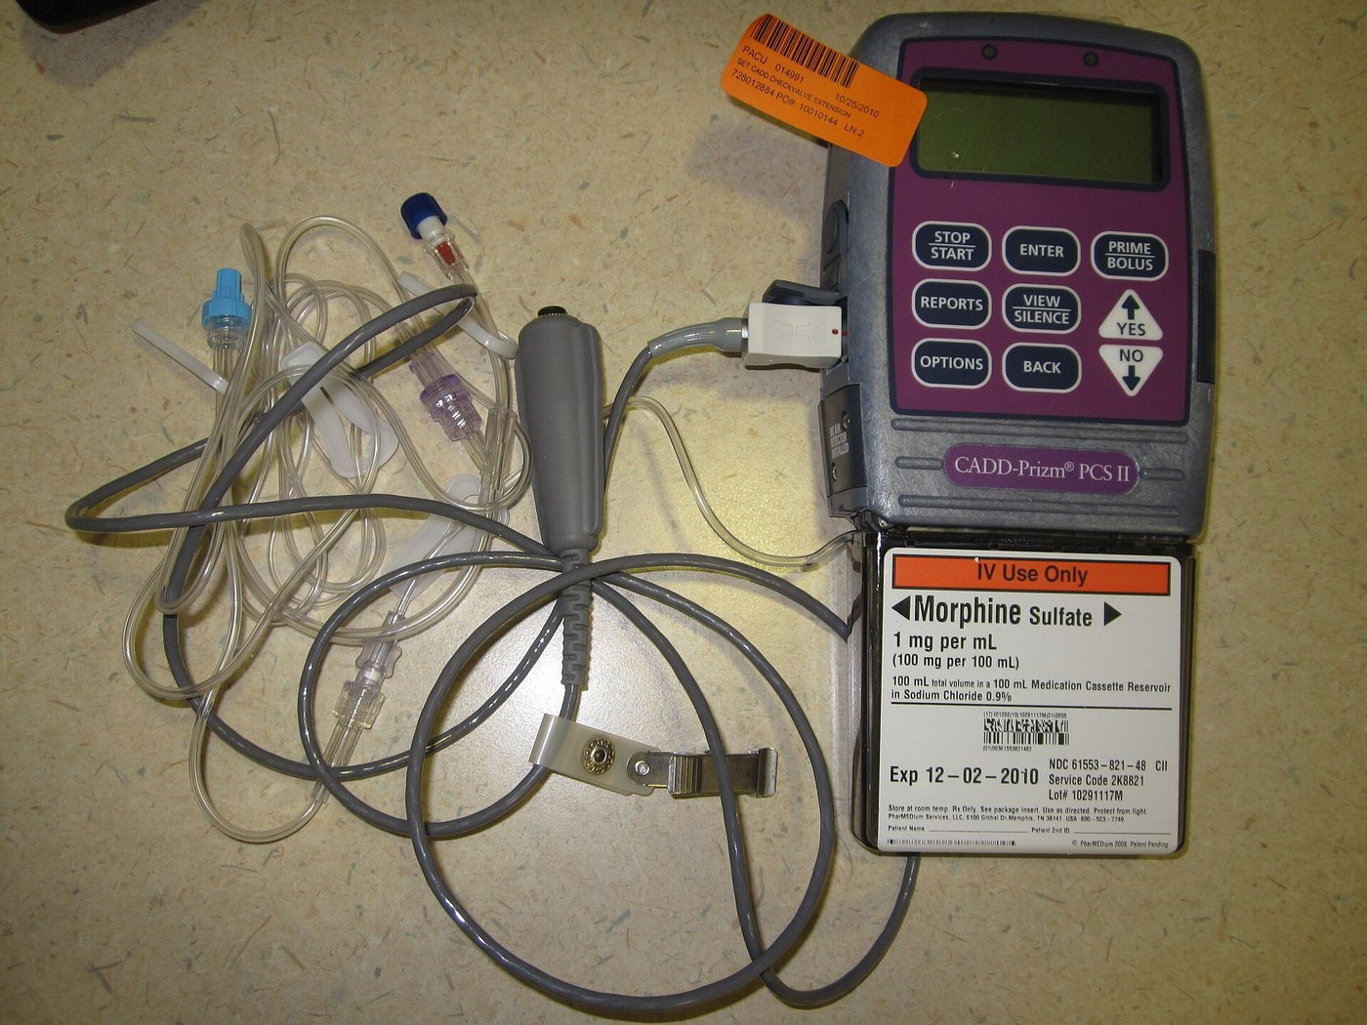
Figure 5.14 · Patient-controlled analgesia (PCA)
WHAT TO NOTICE
Demand dose: a preset dose when the patient presses the button.
Lockout and limit: prevent another dose until the last has worked; cap the total.
Built-in safety: a sleepy patient stops pressing.
No basal infusion routinely in opioid-naive adults (Chou et al., 2016).
PCA by proxy: family or staff pressing the button removes the safety feature. Only the patient presses.
Figure 5.14. “PCA-02” by DiverDave, via Wikimedia Commons, CC BY-SA 3.0.
Notes:
Nurses verify pump programming with an independent double check, assess pain, sedation and respirations per policy, and teach the patient. Credit: Figure 5.14: “PCA-02” by DiverDave, via Wikimedia Commons, CC BY-SA 3.0

Slide 51
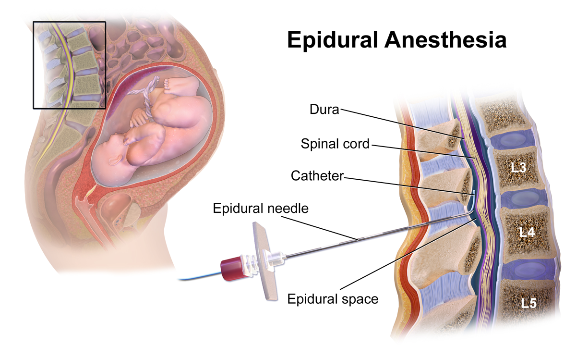
Figure 5.15 · Epidural analgesia
WHAT TO NOTICE
Catheter: local anaesthetic, often with an opioid, infused into the epidural space.
Monitor: sedation, respirations, blood pressure, sensory level and motor block.
Also: catheter site, urinary retention, local anaesthetic systemic toxicity.
Anticoagulants: strict timing around insertion and removal.
Emergency: new or increasing leg weakness may signal an epidural hematoma or abscess. Report immediately.
Figure 5.15. “Epidural Anesthesia” by BruceBlaus (Blausen Medical), via Wikimedia Commons, CC BY-SA 4.0.
Notes:
Epidurals provide excellent relief after major abdominal, thoracic and orthopaedic surgery and in labour. Peripheral nerve blocks and site-specific regional techniques are recommended where they suit the surgery (Chou et al., 2016). Sympathetic blockade causes hypotension. Credit: Figure 5.15: “Epidural Anesthesia” by BruceBlaus (Blausen Medical), via Wikimedia Commons, CC BY-SA 4.0. Blausen.com staff (2014). "Medical gallery of Blausen Medical 2014". WikiJournal of Medicine 1 (2). DOI:10.15347/wjm/2014.010. ISSN 2002-4436

Slide 52
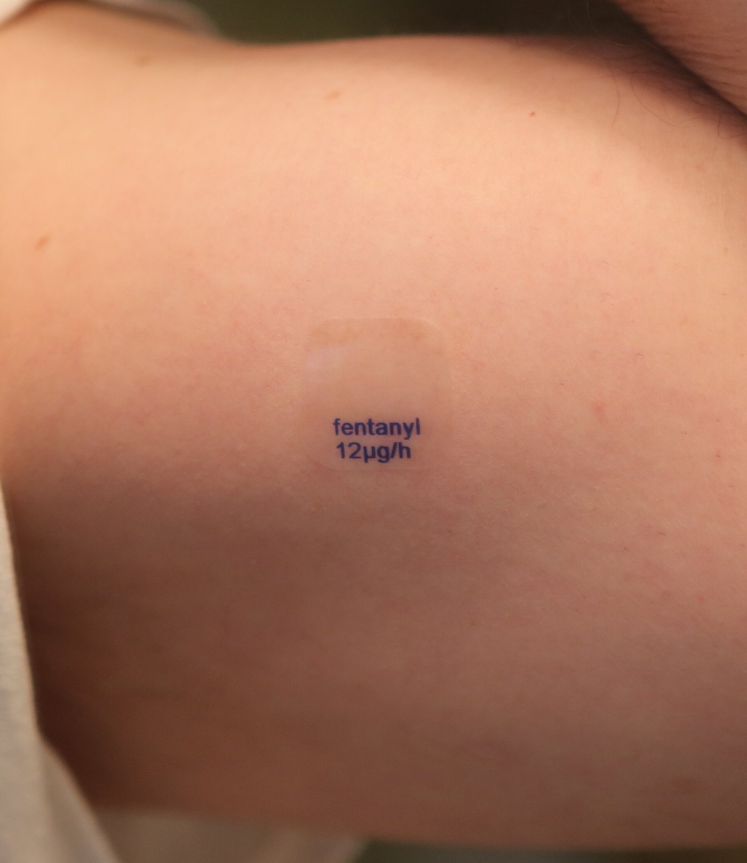
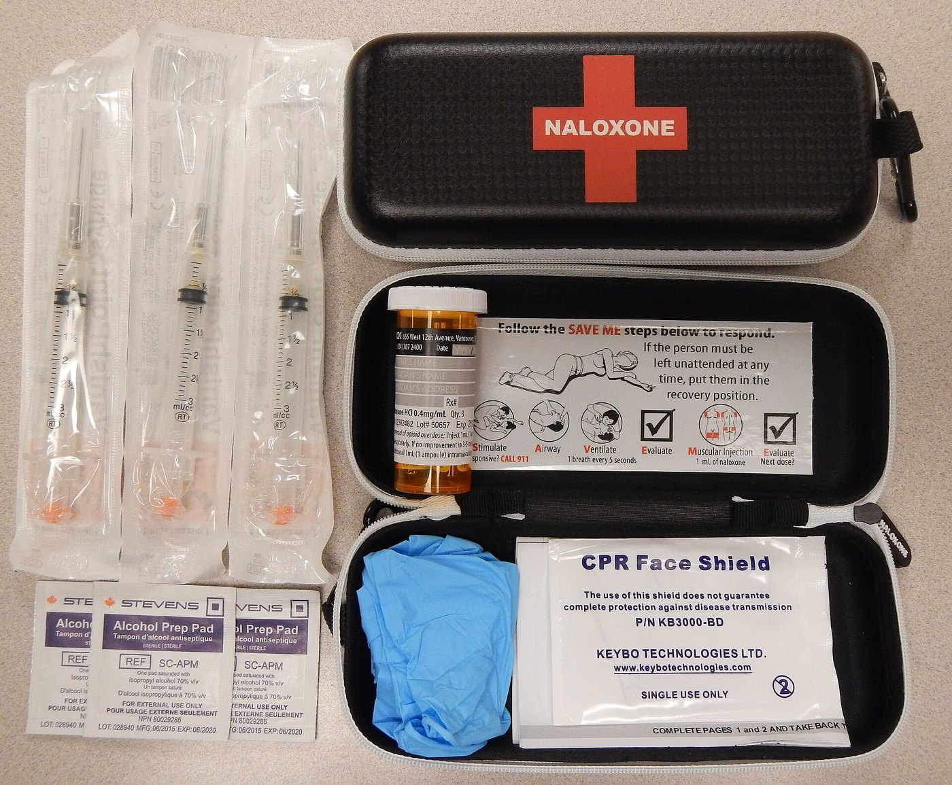
Figures 5.16–5.17 · Transdermal opioids and take-home reversal kits
WHAT TO NOTICE
Fentanyl [opioid agonist] patch: opioid-tolerant, stable pain only; slow onset and offset.
Heat: pads, blankets, hot tubs or fever increase absorption and toxicity.
Patch care: label date and time, remove the old one first, rotate sites, gloves, safe disposal.
Naloxone [opioid antagonist]: take-home kits widely available across Canada.
Re-sedation: naloxone [opioid antagonist] often wears off before the opioid, especially long-acting ones and patches. Keep monitoring.
Figure 5.16. “A generic fentanyl transdermal patch, with a release rate of 12mcg per hour, applied to the skin (cropped)” by DanielTahar, via Wikimedia Commons, CC BY-SA 4.0.
Figure 5.17. “NaloxoneKit” by James Heilman, MD, via Wikimedia Commons, CC BY-SA 4.0.
Notes:
Fentanyl patch safety (Canadian Virtual Hospice, n.d.; Greenall et al., 2008). Naloxone displaces opioids from mu receptors; in postoperative patients titrate small incremental IV doses to restore breathing and arousal without reversing all analgesia. Credits: Figure 5.16: “A generic fentanyl transdermal patch, with a release rate of 12mcg per hour, applied to the skin (cropped)” by DanielTahar, via Wikimedia Commons, CC BY-SA 4.0 | Figure 5.17: “NaloxoneKit” by James Heilman, MD, via Wikimedia Commons, CC BY-SA 4.0

Slide 53
High-alert opioids and reversing toxicity
CLINICAL SAFETY · SECTION 5.6
HYDROmorphone [opioid agonist]
Naloxone [opioid antagonist]
ISMP Canada (2013)
Restore breathing, not all analgesia
Incident: a 10-fold overdose (4 mg instead of 0.4 mg) drawn from a 10 mg/mL vial.
System safeguards: remove high-strength vials, pharmacy-prepared doses, dose charts.
At the bedside: independent double check; never treat morphine [opioid agonist] and hydromorphone [opioid agonist] doses as interchangeable.
Action: displaces opioids from mu receptors within minutes IV.
Postoperative: titrate small incremental doses per protocol.
Large bolus: severe pain, agitation, vomiting, hypertension, acute withdrawal.
After: watch for re-sedation; repeat doses or infusion may be needed.
Opioid stewardship: nonopioids first, start below 50 mg morphine [opioid agonist] equivalents a day, and taper slowly and collaboratively from 90 mg or more (Busse et al., 2017).
Notes:
ISMP Canada (2013): hydromorphone among the top drugs in harmful incidents; a 10-fold overdose (4 mg instead of 0.4 mg) from a 10 mg/mL vial. Safeguards listed. Naloxone: titrate small IV increments per protocol; large boluses cause pain, agitation, vomiting, hypertension and acute withdrawal; observe for re-sedation.

Slide 54
A multimodal postoperative plan, and who manages it
MEDICATIONS · SCOPE IN PRACTICE
Medications: after major abdominal surgery
Scope in Practice
Scheduled: acetaminophen [non-opioid analgesic] plus ibuprofen [NSAID] or celecoxib [NSAID] if safe.
Regional: epidural bupivacaine [amide local anaesthetic] or a wound catheter.
As needed: hydromorphone [opioid agonist] by PCA for moderate to severe pain.
Support: senna [stimulant laxative]; ondansetron [5-HT₃ antagonist].
Both RNs and RPNs administer ordered analgesics.
PCA, infusions, epidurals: depends on stability, competence and agency policy.
Often assigned to RNs or with RPN consultation, because risk is higher and less predictable.
Pump changes and naloxone [opioid antagonist] titration: governed by protocols and medical directives.
Step down: IV and regional routes first, then the opioid, leaving acetaminophen [non-opioid analgesic] and an NSAID for the last days of acute pain (Chou et al., 2016).
Notes:
Medications box: typical plan after major abdominal surgery; step down as the person recovers: IV and regional routes first, then the opioid, leaving acetaminophen and an NSAID (Chou et al., 2016). Scope in Practice: RPN care of PCA, opioid infusion or epidural depends on stability, competence and agency policy; many Ontario agencies assign epidurals and infusions to RNs or require RPN consultation.

Slide 55
Nonpharmacologic strategies act on modulation and perception
SECTION 5.7 · TABLE 5.12
Physical
Gate and movement
Mind and brain
Cold: reduces swelling, slows conduction; barrier, timed, not with poor circulation.
Heat: relaxes spasm; burn risk with neuropathy, dementia or sedation.
Positioning, splinting, early mobilization.
Massage, touch, vibration: Aβ input closes the gate.
TENS: not over the anterior neck, eyes, broken skin or a pacemaker.
Graded exercise: restores function, reduces fear-avoidance.
Relaxation, imagery, music, distraction: for procedures and acute pain.
CBT, ACT, mindfulness: reduce catastrophizing and distress.
Mirror therapy: phantom limb pain, CRPS (Chan et al., 2007).
Use together: nondrug strategies work best alongside analgesics, not instead of them in severe acute pain.
Notes:
Table 5.12. Nonpharmacologic strategies work best alongside analgesics, not as a replacement in severe acute pain; offering them restores a sense of control. Never apply heat over a fentanyl patch. TENS contraindications: anterior neck, eyes, broken skin, pacemaker. Mirror therapy (Chan et al., 2007).

Slide 56
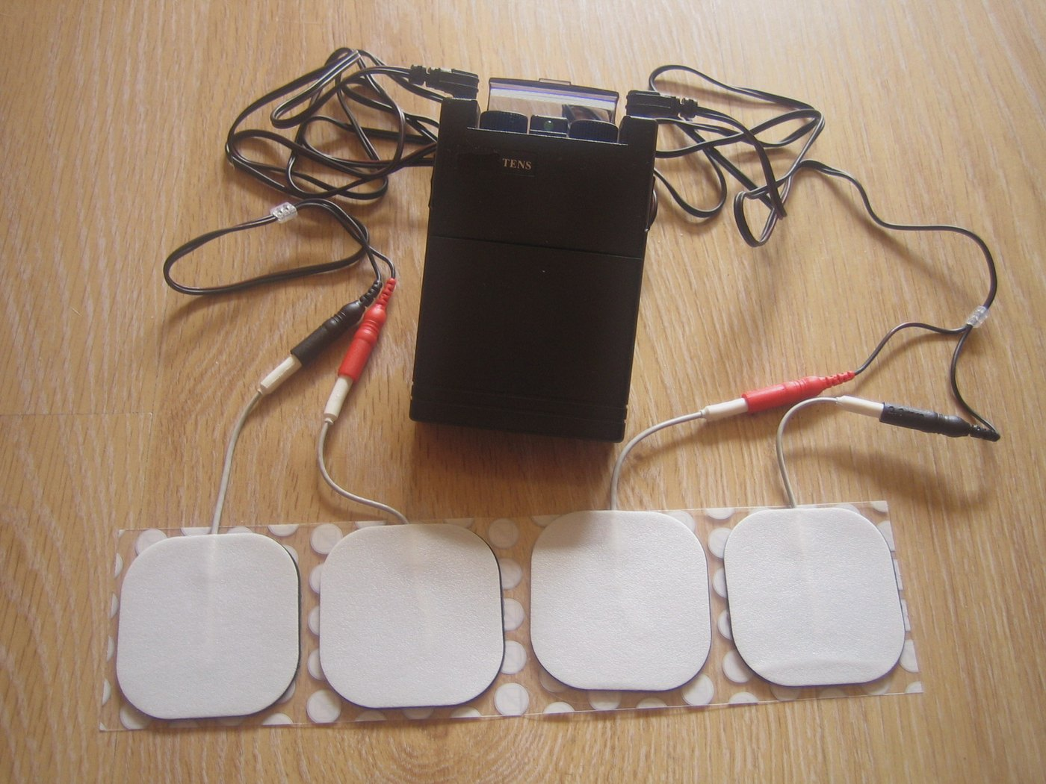

Figures 5.18–5.19 · TENS and superficial heat
WHAT TO NOTICE
TENS: electrical stimulation of Aβ fibres closes the gate; may release endogenous opioids.
Placement: teach correct electrode placement over or near the painful area.
Heat: increases blood flow and relaxes muscle.
Heat safety: barrier, timed use; avoid on acute inflammation or over a fentanyl [opioid agonist] patch.
Burn risk: never apply heat to feet with neuropathy or to people who cannot report a burn.
Figure 5.18. “Tens” by Yeza, via Wikimedia Commons, CC BY-SA 4.0.
Figure 5.19. “Electric heating pad” by Jen, via Wikimedia Commons, CC BY-SA 3.0.
Notes:
Credits: Figure 5.18: “Tens” by Yeza, via Wikimedia Commons, CC BY-SA 4.0 | Figure 5.19: “Electric heating pad” by Jen, via Wikimedia Commons, CC BY-SA 3.0

Slide 57
Pain across the lifespan
LIFESPAN CONSIDERATIONS
Newborns and children
Older adults
People living with dementia
Newborns feel pain; descending inhibition is immature.
Sucrose for single procedures (Stevens et al., 2016); skin-to-skin, breastfeeding, swaddling.
Tools: FPS-R from about age 4; FLACC for younger children.
Under-reported: seen as normal aging, fear of addiction or burden.
Tools: verbal descriptor scale; PAINAD in advanced dementia.
Beers 2023: avoid meperidine [opioid agonist]; flag amitriptyline [TCA].
Start low, go slow; watch confusion, constipation, falls.
Pain shows as: agitation, resisting care, calling out, poor appetite.
Look for causes: arthritis, constipation, retention, pressure injury.
Trial scheduled acetaminophen [non-opioid analgesic] before psychotropics.
Remember: untreated pain is itself a cause of delirium, agitation, poor sleep and functional decline in older adults.
Notes:
Lifespan box. Oral sucrose for single procedures (Stevens et al., 2016). FPS-R (Hicks et al., 2001), FLACC (Merkel et al., 1997), PAINAD (Warden et al., 2003). Beers 2023: avoid meperidine, chronic NSAIDs without gastroprotection, opioids with gabapentinoids or benzodiazepines; tricyclics flagged for anticholinergic effects. Untreated pain causes delirium, agitation, poor sleep and functional decline.

Slide 58
Opioid tolerance, substance use, and cancer pain
SECTION 5.7
Opioid tolerance and substance use
Cancer pain and palliative care
Still feel acute pain, and often need higher doses because of tolerance.
Continue usual opioid or OAT: methadone [opioid agonist] or buprenorphine-naloxone [partial agonist + antagonist].
Add multimodal and regional analgesia; involve addiction medicine.
Offer a take-home naloxone [opioid antagonist] kit at discharge.
Different principles: the 2017 Canadian opioid guideline excludes cancer pain (Busse et al., 2017).
Around the clock for persistent pain, plus doses for breakthrough pain.
Adjuvants for neuropathic and bone pain.
Goal: comfort as the person defines it.
Why continue OAT: it is the recommended first-line treatment for opioid use disorder in Canada; interrupting it destabilizes recovery (Bruneau et al., 2018).
Notes:
People with opioid tolerance need higher analgesic doses; continue usual opioid or OAT in consultation; OAT is first-line for OUD in Canada (Bruneau et al., 2018). People who use drugs have high rates of chronic pain (Canadian Pain Task Force, 2019). Cancer pain is excluded from the 2017 guideline (Busse et al., 2017).

Slide 59
Going home with an opioid
PATIENT EDUCATION
Schedule the basics: acetaminophen [non-opioid analgesic] and the anti-inflammatory on schedule; opioid only for pain they don't control.
Driving: don't drive or operate machinery until you know how it affects you.
Bowels: daily stool softener or laxative, fluids and walking while on the opioid.
Storage: locked, out of sight; never share; return leftovers to a pharmacy.
No mixing: no alcohol, sleeping pills, anxiety medicines or cannabis unless the prescriber says it is safe.
Naloxone [opioid antagonist]: keep a kit at home and show your family how to use it.
Call 911 if: very hard to wake, very slow or no breathing, blue or grey lips, or snoring or gurgling sounds. Give naloxone [opioid antagonist] and stay.
Notes:
Patient Education box from Section 5.7. Ask students to role-play this teaching in pairs using teach-back.

Slide 60
Check your understanding
A man 8 hours after laparotomy rates pain 8/10, lies still and refuses to cough; HR 108, BP 158/92. What type of pain is this, and what risk does it create?
At 0300 he drifts off mid-sentence, RR 9 and shallow, snoring, SpO₂ 93% on 2 L. What do you do first, and why is more oxygen not the answer?
His daughter pressed the PCA button while he slept. Why does that matter?
A 79-year-old with dementia and diabetes is restless at night and pulls sheets off her feet. Which tool would you use, what pain type is likely, and which first-line drug fits her eGFR of 38?
A man on methadone [opioid agonist] for opioid use disorder fractures his tibia. What is the right analgesic plan?
Hydromorphone [opioid agonist] 0.5 mg IV is ordered and the only vial is 10 mg/mL. What is the risk and what do you do?
Full cases, practice questions and rationales are in Chapter 5 on opensourcenursing.ca
Notes:
Suggested answers. 1) Acute nociceptive pain (somatic and visceral) with a sympathetic stress response; splinting raises atelectasis risk (Case 1, Q1). 2) Pause the PCA, stimulate, raise the head of the bed, coach deep breaths, notify; POSS 3 precedes respiratory depression, and oxygen can mask rising CO2 (Q3). 3) PCA by proxy removes the safety that a sedated patient stops pressing (Q2, Q4). 4) PAINAD; neuropathic pain from diabetic peripheral neuropathy (allodynia, 3 or fewer of 8 monofilament stimuli); pregabalin [gabapentinoid] at a renally adjusted dose, avoiding amitriptyline [TCA] because of anticholinergic effects (Case 2, Q16–19). 5) Continue methadone [opioid agonist] and add multimodal analgesia with extra opioid as needed; stopping causes withdrawal and more pain (Q30). 6) 0.5 mL of 10 mg/mL is 5 mg, a 10-fold overdose; request a lower concentration or pharmacy-prepared dose and an independent double check (Q24; ISMP Canada, 2013).

Slide 61
References (1 of 4)
REFERENCES
American Geriatrics Society Beers Criteria Update Expert Panel. (2023). American Geriatrics Society 2023 updated AGS Beers Criteria® for potentially inappropriate medication use in older adults. Journal of the American Geriatrics Society, 71(7), 2052–2081. https://doi.org/10.1111/jgs.18372
Bril, V., Breiner, A., Perkins, B. A., & Zochodne, D. (2018). Neuropathy. Canadian Journal of Diabetes, 42(Suppl. 1), S217–S221. https://doi.org/10.1016/j.jcjd.2017.10.028
Bruneau, J., Ahamad, K., Goyer, M.-È., Poulin, G., Selby, P., Fischer, B., Wild, T. C., & Wood, E. (2018). Management of opioid use disorders: A national clinical practice guideline. CMAJ, 190(9), E247–E257. https://doi.org/10.1503/cmaj.170958
Busse, J. W., Craigie, S., Juurlink, D. N., Buckley, D. N., Wang, L., Couban, R. J., Agoritsas, T., Akl, E. A., Carrasco-Labra, A., Cooper, L., Cull, C., da Costa, B. R., Frank, J. W., Grant, G., Iorio, A., Persaud, N., Stern, S., Tugwell, P., Vandvik, P. O., & Guyatt, G. H. (2017). Guideline for opioid therapy and chronic noncancer pain. CMAJ, 189(18), E659–E666. https://doi.org/10.1503/cmaj.170363
Canadian Pain Task Force. (2019). Chronic pain in Canada: Laying a foundation for action. Health Canada. https://www.canada.ca/en/health-canada/corporate/about-health-canada/public-engagement/external-advisory-bodies/canadian-pain-task-force/report-2019.html
Canadian Virtual Hospice. (n.d.). What should I know to use fentanyl safely with palliative care patients? Retrieved November 7, 2026, from https://www.virtualhospice.ca/en_US/Main+Site+Navigation/Home/For+Professionals/For+Professionals/Quick+Consults/Medications/What+should+I+know+to+use+fentanyl+safely+with+palliative+care+patients_.aspx
Chan, B. L., Witt, R., Charrow, A. P., Magee, A., Howard, R., Pasquina, P. F., Heilman, K. M., & Tsao, J. W. (2007). Mirror therapy for phantom limb pain. New England Journal of Medicine, 357(21), 2206–2207. https://doi.org/10.1056/NEJMc071927
Chou, R., Gordon, D. B., de Leon-Casasola, O. A., Rosenberg, J. M., Bickler, S., Brennan, T., Carter, T., Cassidy, C. L., Chittenden, E. H., Degenhardt, E., Griffith, S., Manworren, R., McCarberg, B., Montgomery, R., Murphy, J., Perkal, M. F., Suresh, S., Sluka, K., Strassels, S., … Wu, C. L. (2016). Management of postoperative pain: A clinical practice guideline from the American Pain Society, the American Society of Regional Anesthesia and Pain Medicine, and the American Society of Anesthesiologists' Committee on Regional Anesthesia, Executive Committee, and Administrative Council. The Journal of Pain, 17(2), 131–157. https://doi.org/10.1016/j.jpain.2015.12.008
College of Nurses of Ontario. (2019a). Entry-to-practice competencies for registered nurses. https://cno.org/globalassets/docs/reg/41037-entry-to-practice-competencies-2020.pdf
College of Nurses of Ontario. (2019b). Entry-to-practice competencies for registered practical nurses. https://www.cno.org
Notes:
APA 7th edition reference list for Chapter 5. All slide statistics and recommendations trace to these sources.

Slide 62
References (2 of 4)
REFERENCES
Council of Chief Medical Officers of Health. (2026, June 15). Statement from the Council of Chief Medical Officers of Health – Latest national data on substance-related harms. Public Health Agency of Canada. https://www.canada.ca/en/public-health/news/2026/06/statement-from-the-council-of-chief-medical-officers-of-health-latest-national-data-on-substance-related-harms.html
Diabetes Canada. (n.d.). Appendix 11A: Rapid screening for diabetic neuropathy using the 10 g Semmes-Weinstein monofilament. Retrieved November 7, 2026, from https://www.diabetes.ca/for-professionals/appendices/appendix-11a
Fitzcharles, M.-A., Ste-Marie, P. A., Goldenberg, D. L., Pereira, J. X., Abbey, S., Choinière, M., Ko, G., Moulin, D. E., Panopalis, P., Proulx, J., & Shir, Y. (2013). 2012 Canadian guidelines for the diagnosis and management of fibromyalgia syndrome: Executive summary. Pain Research and Management, 18(3), 119–126. https://doi.org/10.1155/2013/918216
Gélinas, C., Fillion, L., Puntillo, K. A., Viens, C., & Fortier, M. (2006). Validation of the Critical-Care Pain Observation Tool in adult patients. American Journal of Critical Care, 15(4), 420–427.
Gomes, T., Juurlink, D. N., Antoniou, T., Mamdani, M. M., Paterson, J. M., & van den Brink, W. (2017). Gabapentin, opioids, and the risk of opioid-related death: A population-based nested case-control study. PLOS Medicine, 14(10), Article e1002396. https://doi.org/10.1371/journal.pmed.1002396
Greenall, J., Koczmara, C., Cheng, R., & Hyland, S. (2008). Safety issues with fentanyl patches require pharmaceutical care. Canadian Journal of Hospital Pharmacy, 61(1). https://doi.org/10.4212/cjhp.v61i1.11
Harden, N. R., Bruehl, S., Perez, R. S. G. M., Birklein, F., Marinus, J., Maihofner, C., Lubenow, T., Buvanendran, A., Mackey, S., Graciosa, J., Mogilevski, M., Ramsden, C., Chont, M., & Vatine, J.-J. (2010). Validation of proposed diagnostic criteria (the "Budapest Criteria") for complex regional pain syndrome. Pain, 150(2), 268–274. https://doi.org/10.1016/j.pain.2010.04.030
Health Canada. (2016). Revised guidance document: Acetaminophen labelling standard. https://www.canada.ca/en/health-canada/services/drugs-health-products/drug-products/applications-submissions/guidance-documents/revised-guidance-document-acetaminophen-labelling-standard.html
Hicks, C. L., von Baeyer, C. L., Spafford, P. A., van Korlaar, I., & Goodenough, B. (2001). The Faces Pain Scale–Revised: Toward a common metric in pediatric pain measurement. Pain, 93(2), 173–183. https://doi.org/10.1016/S0304-3959(01)00314-1
Institute for Safe Medication Practices Canada. (2013). HYDROmorphone remains a high-alert drug. Ontario Critical Incident Learning, (2). https://www.ismp-canada.org/download/ocil/ISMPCONCIL2013-2_HYDROmorphoneRemainsAHighAlertDrug.pdf
Notes:
APA 7th edition reference list for Chapter 5. All slide statistics and recommendations trace to these sources.

Slide 63
References (3 of 4)
REFERENCES
Jungquist, C. R., Quinlan-Colwell, A., Vallerand, A., Carlisle, H. L., Cooney, M., Dempsey, S. J., Dunwoody, D., Maly, A., Meloche, K., Meyers, A., Sawyer, J., Singh, N., Sullivan, D., Watson, C., & Polomano, R. C. (2020). American Society for Pain Management Nursing guidelines on monitoring for opioid-induced advancing sedation and respiratory depression: Revisions. Pain Management Nursing, 21(1), 7–25. https://doi.org/10.1016/j.pmn.2019.06.007
Kosek, E., Cohen, M., Baron, R., Gebhart, G. F., Mico, J.-A., Rice, A. S. C., Rief, W., & Sluka, A. K. (2016). Do we need a third mechanistic descriptor for chronic pain states? Pain, 157(7), 1382–1386. https://doi.org/10.1097/j.pain.0000000000000507
Krishnan, R., Baclic, O., Howarth, A., Tuite, A. R., & Andrew, M. K., on behalf of the National Advisory Committee on Immunization. (2026). Summary of the National Advisory Committee on Immunization (NACI) statement: Updated recommendations on herpes zoster vaccination for adults who are immunocompromised. Canada Communicable Disease Report, 52(1/2), 1–7. https://doi.org/10.14745/ccdr.v52i0102a01
Melzack, R., & Wall, P. D. (1965). Pain mechanisms: A new theory. Science, 150(3699), 971–979. https://doi.org/10.1126/science.150.3699.971
Merkel, S. I., Voepel-Lewis, T., Shayevitz, J. R., & Malviya, S. (1997). The FLACC: A behavioral scale for scoring postoperative pain in young children. Pediatric Nursing, 23(3), 293–297.
Moulin, D. E., Boulanger, A., Clark, A. J., Clarke, H., Dao, T., Finley, G. A., Furlan, A., Gilron, I., Gordon, A., Morley-Forster, P. K., Sessle, B. J., Squire, P., Stinson, J., Taenzer, P., Velly, A., Ware, M. A., Weinberg, E. L., & Williamson, O. D. (2014). Pharmacological management of chronic neuropathic pain: Revised consensus statement from the Canadian Pain Society. Pain Research and Management, 19(6), 328–335. https://doi.org/10.1155/2014/754693
Pasero, C. (2009). Assessment of sedation during opioid administration for pain management. Journal of PeriAnesthesia Nursing, 24(3), 186–190. https://doi.org/10.1016/j.jopan.2009.03.005
Raja, S. N., Carr, D. B., Cohen, M., Finnerup, N. B., Flor, H., Gibson, S., Keefe, F. J., Mogil, J. S., Ringkamp, M., Sluka, K. A., Song, X.-J., Stevens, B., Sullivan, M. D., Tutelman, P. R., Ushida, T., & Vader, K. (2020). The revised International Association for the Study of Pain definition of pain: Concepts, challenges, and compromises. Pain, 161(9), 1976–1982. https://doi.org/10.1097/j.pain.0000000000001939
Statistics Canada. (2024, November 6). Pain-related disabilities, 2022 (Catalogue No. 11-627-M). https://www150.statcan.gc.ca/n1/pub/11-627-m/11-627-m2024050-eng.htm
Stevens, B., Yamada, J., Ohlsson, A., Haliburton, S., & Shorkey, A. (2016). Sucrose for analgesia in newborn infants undergoing painful procedures. Cochrane Database of Systematic Reviews, (7), Article CD001069. https://doi.org/10.1002/14651858.CD001069.pub5
Notes:
APA 7th edition reference list for Chapter 5. All slide statistics and recommendations trace to these sources.

Slide 64
References (4 of 4)
REFERENCES
Treede, R.-D., Rief, W., Barke, A., Aziz, Q., Bennett, M. I., Benoliel, R., Cohen, M., Evers, S., Finnerup, N. B., First, M. B., Giamberardino, M. A., Kaasa, S., Korwisi, B., Kosek, E., Lavand'homme, P., Nicholas, M., Perrot, S., Scholz, J., Schug, S., … Wang, S.-J. (2019). Chronic pain as a symptom or a disease: The IASP Classification of Chronic Pain for the International Classification of Diseases (ICD-11). Pain, 160(1), 19–27. https://doi.org/10.1097/j.pain.0000000000001384
Warden, V., Hurley, A. C., & Volicer, L. (2003). Development and psychometric evaluation of the Pain Assessment in Advanced Dementia (PAINAD) scale. Journal of the American Medical Directors Association, 4(1), 9–15. https://doi.org/10.1097/01.JAM.0000043422.31640.F7
Woolf, C. J. (2011). Central sensitization: Implications for the diagnosis and treatment of pain. Pain, 152(3 Suppl.), S2–S15. https://doi.org/10.1016/j.pain.2010.09.030
Notes:
APA 7th edition reference list for Chapter 5. All slide statistics and recommendations trace to these sources.

Slide 65
Figure credits (1 of 2)
FIGURE CREDITS
Figure 5.1. “Blausen 0803 Skin FreeNerveEndings” by BruceBlaus (Blausen Medical), via Wikimedia Commons, CC BY 3.0. Blausen.com staff (2014). "Medical gallery of Blausen Medical 2014". WikiJournal of Medicine 1 (2). DOI:10.15347/wjm/2014.010. ISSN 2002-4436
Figure 5.2. “Afferents” by Bettina Guebeli, via Wikimedia Commons, CC BY-SA 4.0
Figure 5.3. “1417 Ascending Pathways of Spinal Cord” by OpenStax College, via Wikimedia Commons, CC BY 3.0
Figure 5.4. “Spinal Cord Sensory Pathways” by BruceBlaus (Blausen Medical), via Wikimedia Commons, CC BY-SA 4.0. Blausen.com staff (2014). "Medical gallery of Blausen Medical 2014". WikiJournal of Medicine 1 (2). DOI:10.15347/wjm/2014.010. ISSN 2002-4436
Figure 5.5. “Schematic of cortical areas involved with pain processing and fMRI” by Borsook D, Moulton EA, Schmidt KF, Becerra LR, via Wikimedia Commons, CC BY 2.0
Figure 5.6. “Gate Theory Circuit Mechanism” by John.Tuthill, via Wikimedia Commons, CC BY-SA 4.0
Figure 5.7. “Major structures involved in the Descending network” by Anand Venkatraman, Brian L. Edlow, Mary Helen Immordino-Yang, via Wikimedia Commons, CC BY 4.0
Figure 5.8. “1506 Referred Pain Chart” by OpenStax College, via Wikimedia Commons, CC BY 3.0
Figure 5.9. “Eicosanoid synthesis” by Jfdwolff; vector version by Fvasconcellos and others, via Wikimedia Commons, CC BY-SA 3.0
Figure 5.10. “Dermatoms” by Ralf Stephan, via Wikimedia Commons, Public domain
Notes:
Figures are reproduced unchanged under their original open licences, which apply to each image individually and are not changed by the chapter's CC BY-NC-SA 4.0 licence.

Slide 66
Figure credits (2 of 2)
FIGURE CREDITS
Figure 5.11. “Shingles on the chest” by Preston Hunt, via Wikimedia Commons, CC BY 3.0
Figure 5.12. “LBP and sciatica” by Harrygouvas, via Wikimedia Commons, CC BY-SA 3.0
Figure 5.13. “US Navy 110613-N-YM336-079 Lynn Boulanger, an occupational therapy assistant and certified hand therapist, uses mirror therapy to help address phan” by U.S. Navy (photo by a Mass Communication Specialist), via Wikimedia Commons, Public domain
Figure 5.14. “PCA-02” by DiverDave, via Wikimedia Commons, CC BY-SA 3.0
Figure 5.15. “Epidural Anesthesia” by BruceBlaus (Blausen Medical), via Wikimedia Commons, CC BY-SA 4.0. Blausen.com staff (2014). "Medical gallery of Blausen Medical 2014". WikiJournal of Medicine 1 (2). DOI:10.15347/wjm/2014.010. ISSN 2002-4436
Figure 5.16. “A generic fentanyl transdermal patch, with a release rate of 12mcg per hour, applied to the skin (cropped)” by DanielTahar, via Wikimedia Commons, CC BY-SA 4.0
Figure 5.17. “NaloxoneKit” by James Heilman, MD, via Wikimedia Commons, CC BY-SA 4.0
Figure 5.18. “Tens” by Yeza, via Wikimedia Commons, CC BY-SA 4.0
Figure 5.19. “Electric heating pad” by Jen, via Wikimedia Commons, CC BY-SA 3.0
Notes:
Figures are reproduced unchanged under their original open licences, which apply to each image individually and are not changed by the chapter's CC BY-NC-SA 4.0 licence.

