Slide 1
CARDIOVASCULAR PATHOPHYSIOLOGY · CHAPTER 12
Hypertension: Regulation of Blood Pressure and Its Failure
Normal blood pressure control and how it is reset, target organ damage, Hypertension Canada 2025 treatment, hypertensive emergencies, and hypertension in pregnancy.
Pathophysiology for Nurses: A Canadian Open Text
Aligned with CNO Entry-to-Practice Competencies (RN 2019a & RPN 2019b), Hypertension Canada (2025, 2020), SOGC Guideline No. 426 (2022), and AOM (2023)
Andrew Lee, BEd, BN, MN, RN, CCN(C) · opensourcenursing.ca (CC BY-NC-SA 4.0)
Notes:
Welcome to Chapter 12: Hypertension. Hypertension is the most common chronic condition nurses manage, and it rarely causes symptoms until an organ has been damaged. The chapter starts with normal blood pressure control, explains how that control is reset in primary and secondary hypertension, follows the damage to the heart, brain, kidneys, eyes, and arteries, and then applies Hypertension Canada's 2025 primary care guideline (Goupil et al., 2025). It closes with hypertensive emergencies and the hypertensive disorders of pregnancy, including RN–RPN scope distinctions.

Slide 2
CHAPTER 12 · LEARNING OUTCOMES & CNO COMPETENCIES
Learning outcomes for hypertension
Mapped to CNO Entry-to-Practice Competencies for RNs (CNO, 2019a) and RPNs (CNO, 2019b).
Regulation & Diagnosis
Mechanisms & Organ Damage
Treatment & Emergencies
1. Explain how cardiac output, SVR, the baroreflex, the RAAS, and pressure–natriuresis regulate blood pressure.
2. Apply Hypertension Canada criteria to measure blood pressure, confirm the diagnosis out of office, and recognize white-coat and masked hypertension.
CNO: Clinician, Scholar, Educator (RN); Foundations & Professional Practice (RPN).
3. Describe the interacting mechanisms of primary hypertension and link them to modifiable risk factors.
4. Identify clues to secondary hypertension and the conditions and medications that cause it.
5. Explain target organ damage and interpret baseline investigations in SI units.
CNO: Clinician, Scholar, Collaborator, Coordinator (RN); Foundations & Collaborative Practice (RPN).
6. Apply Canadian lifestyle and first-line drug recommendations, including each class's mechanism and adverse effects.
7. Recognize a hypertensive emergency and explain why pressure is lowered gradually.
8. Describe hypertensive disorders of pregnancy, magnesium sulfate [anticonvulsant / electrolyte] care, and RPN–RN consultation.
CNO: Clinician, Educator, Advocate, Professional (RN); Legal & Collaborative Practice (RPN).
Pathophysiology for Nurses: A Canadian Open Text
Chapter 12 · Hypertension
Notes:
Review the eight learning outcomes and the Table 12.1 mapping. RN competencies are organized under nine roles (Clinician, Professional, Communicator, Collaborator, Coordinator, Leader, Advocate, Educator, Scholar); RPN competencies under five categories (Professional, Legal, Ethical, Foundations of, and Collaborative Practice). Outcomes 1, 3, and 5 map mainly to the RN Clinician and Scholar roles and RPN Foundations of Practice. Outcome 6 adds the Educator and Advocate roles and RPN Legal Practice. Outcomes 7 and 8 add Communicator, Coordinator, Professional, and Collaborator roles and RPN Collaborative Practice.

Slide 3
CANADIAN CONTEXT · SURVEILLANCE DATA
Hypertension in Canada by the numbers
Canadian Health Measures Survey data show a large burden, and treatment and control rates have declined in recent years.
130/80
40% · 32%
66%
2,760 mg
mmHg: Hypertension Canada's 2025 threshold defining hypertension with a validated device and standardized technique
Males and females aged 20–79 with hypertension when the 130/80 threshold is applied (CHMS 2012–2015)
Share of Canadians with hypertension whose pressure was controlled below 140/90 mmHg; young adults fared worst
Average daily sodium intake in 2017, compared with the treatment target of less than 2,000 mg a day
Sources: Goupil et al. (2025); DeGuire et al. (2019, Statistics Canada CHMS); Health Canada (2018); WHO (2023).
Pathophysiology for Nurses: A Canadian Open Text
Chapter 12 · Hypertension
Notes:
Four anchors from section 12.1 and 12.5. (1) 130/80 mmHg: the 2025 Hypertension Canada primary care definition, lower than the 2020 method-specific thresholds (Goupil et al., 2025; Rabi et al., 2020). (2) CHMS 2012–2015: using 140/90 or medication, about 24% of males and 23% of females aged 20–79 had hypertension; at 130/80 the figures rose to 40% and 32% (DeGuire et al., 2019). (3) 66% of those with hypertension were controlled below 140/90; adults aged 20–39 were least likely to be aware, treated, or controlled. Control has since declined (Goupil et al., 2025). (4) Canadians averaged about 2,760 mg of sodium a day in 2017, and about half came from bakery products, mixed dishes, and processed meats (Health Canada, 2018). Discuss who misses out: people without a primary care provider, rural and remote communities, and people facing drug-cost barriers.

Slide 4
PART ONE · INTRODUCTION & SECTION 12.1
Normal Regulation, Measurement & Diagnosis
Blood pressure = cardiac output × SVR; the baroreflex, RAAS, pressure–natriuresis, endothelium, and autoregulation; standardized measurement; the 2025 Canadian definition; home and ambulatory confirmation.
Notes:
Part One builds the normal physiology every later section depends on, then applies it to measuring and diagnosing hypertension in Canada.

Slide 5
INTRODUCTION · NORMAL BASELINE
How the body holds blood pressure in a narrow range
Blood pressure = cardiac output × systemic vascular resistance (SVR); every cause of hypertension raises one or both.
Seconds: the baroreflex
Hours: the RAAS
Long term: the kidney
Sensors: Stretch receptors in the carotid sinuses and aortic arch signal the medulla.
Pressure up: More vagal output, less sympathetic output, so cardiac output and SVR fall.
Pressure down: Heart rate, contractility, and arteriolar and venous tone rise within seconds.
Resetting: If pressure stays high for days, baroreceptors defend the new, higher level.
Trigger: Low renal perfusion, beta-1 stimulation, or low distal NaCl releases renin.
Cascade: Angiotensinogen → angiotensin I → (ACE) → angiotensin II.
Angiotensin II: Constricts arterioles, releases aldosterone, retains sodium, stimulates thirst and ADH, and boosts sympathetic activity.
Long term: Drives growth and fibrosis of the heart and vessels.
Pressure–natriuresis: Higher pressure → more sodium and water excreted → volume and pressure fall.
Key principle: Sustained hypertension requires a shift in this relationship, so the kidney needs a higher pressure to excrete the day's sodium.
Counter-regulation: Stretched heart muscle releases natriuretic peptides that dilate vessels and promote sodium excretion.
Pathophysiology for Nurses: A Canadian Open Text
Chapter 12 · Hypertension
Notes:
Walk through the three time scales. Seconds: the baroreflex corrects sudden changes but resets if pressure stays high for days, one reason chronic hypertension is self-sustaining. Hours: renin release produces angiotensin II, which constricts arterioles, releases aldosterone, increases proximal sodium reabsorption, stimulates thirst and ADH, and enhances sympathetic activity. ACE also breaks down bradykinin. Weeks to years: pressure–natriuresis. Key teaching point: sustained hypertension cannot develop unless the kidney's pressure–natriuresis relationship has shifted. MAP = diastolic + one-third of pulse pressure; for 120/80, MAP is about 93 mmHg.

Slide 6
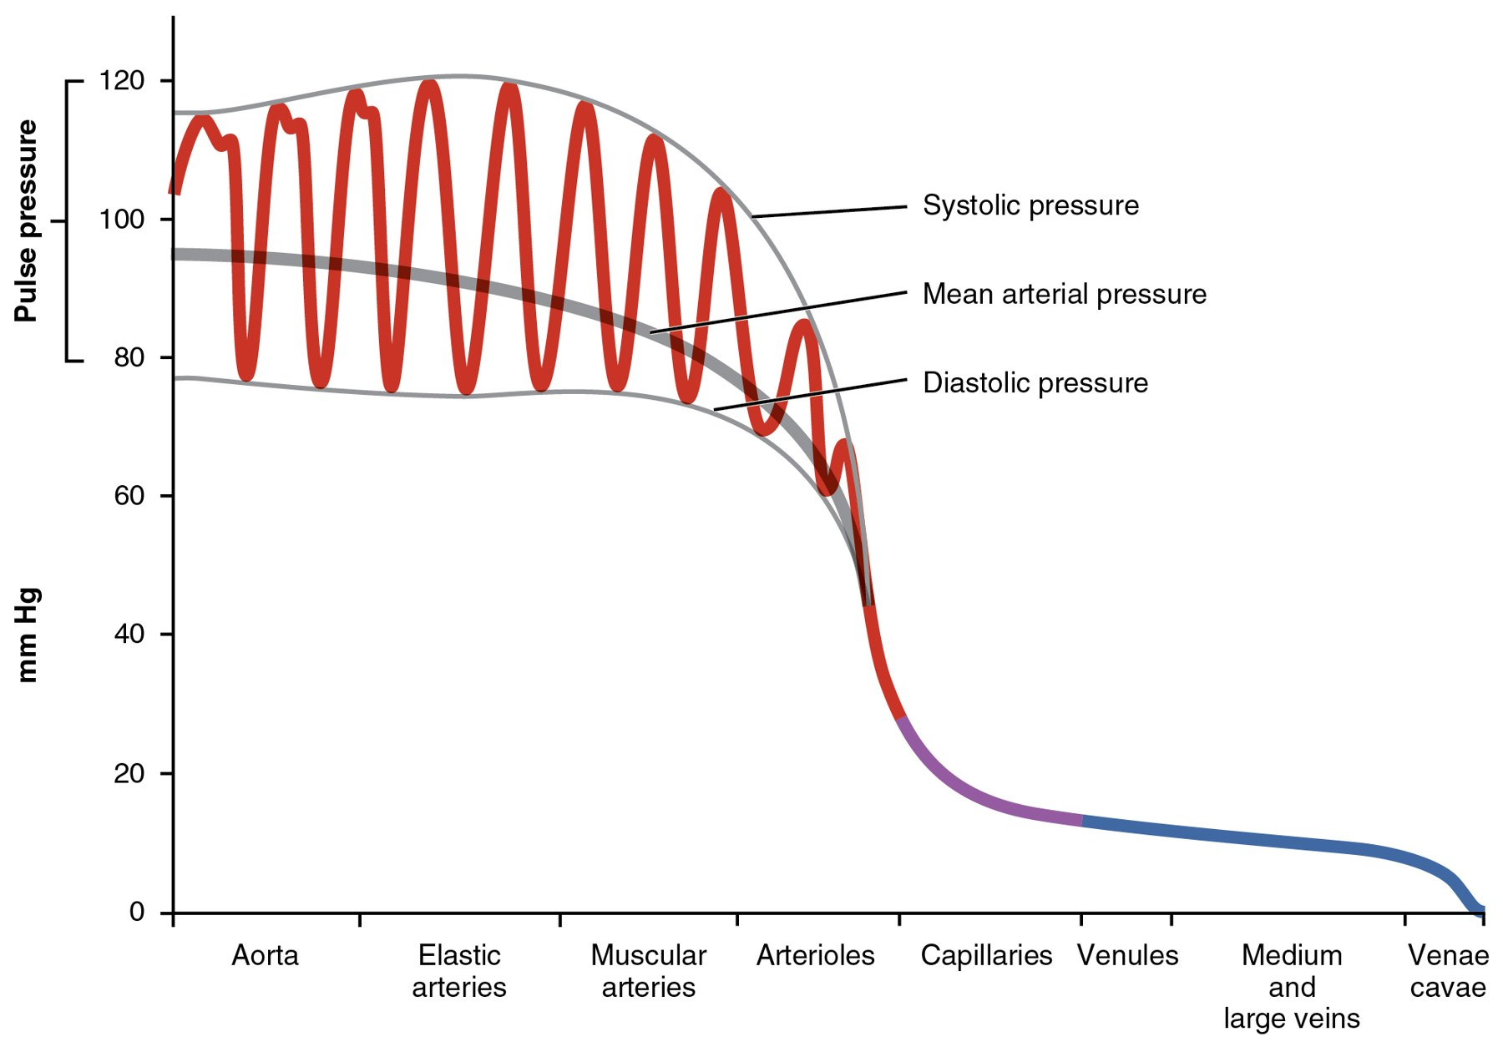
Figure 12.1 · Blood Pressure Along the Circulation
WHAT TO NOTICE
Systolic, diastolic & pulse pressure: Pressure swings with every beat in the aorta and large arteries; the gap between peak and trough is the pulse pressure.
Mean arterial pressure (grey line): MAP = diastolic + ⅓ pulse pressure; for 120/80 mmHg, MAP ≈ 93 mmHg.
Steepest fall across the arterioles: Arterioles are the resistance vessels that set SVR; a small decrease in radius raises pressure a great deal.
Capillaries see almost no pulsation: By the time blood reaches the capillaries, the arterial swings have been damped out.
Stiff large arteries: With age and disease, the aorta cushions less, so systolic and pulse pressures rise while diastolic falls.
Why it matters: Every mechanism that raises blood pressure works by increasing cardiac output, increasing SVR, or both.
“2109 Systemic Blood Pressure” by OpenStax College, Wikimedia Commons, CC BY 3.0.
Pathophysiology for Nurses: A Canadian Open Text
Chapter 12 · Hypertension
Notes:
Use Figure 12.1 to anchor MAP, pulse pressure, and the role of the arterioles in SVR. Link the stiff-aorta point forward to isolated systolic hypertension in older adults (section 12.2).

Slide 7
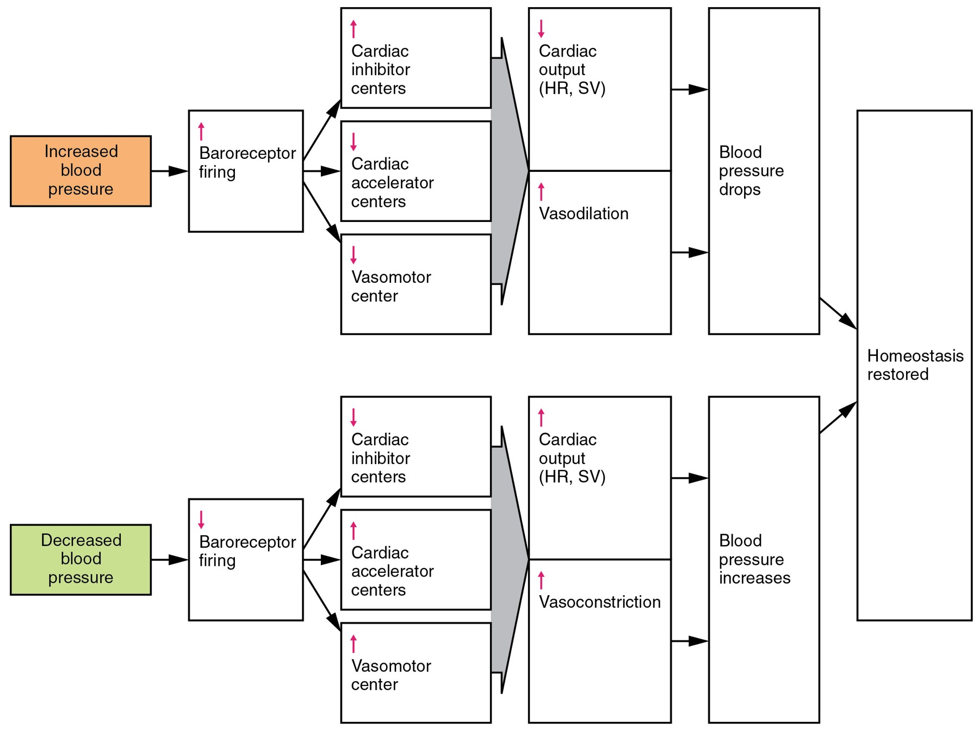
Figure 12.2 · The Baroreceptor Reflex
WHAT TO NOTICE
Rising pressure: More baroreceptor firing stimulates the cardiac inhibitory centre and suppresses the cardiac accelerator and vasomotor centres.
Result: Cardiac output (heart rate and stroke volume) falls and arterioles dilate, so pressure drops.
Falling pressure: The reverse: more sympathetic drive, vasoconstriction, and higher cardiac output, as on standing.
Speed vs. persistence: Superb for seconds-to-minutes correction; poor at setting long-term pressure.
Clinical link: Because baroreceptors reset to a high pressure, a client with long-standing hypertension may feel dizzy at first when pressure is lowered to normal.
“2116 Baroreceptor Reflex Flow Art” by OpenStax College, Wikimedia Commons, CC BY 3.0.
Pathophysiology for Nurses: A Canadian Open Text
Chapter 12 · Hypertension
Notes:
Figure 12.2 shows both arms of the reflex. Ask students to predict the response to standing (orthostatic challenge) and connect resetting to dizziness when treatment starts, especially in older adults.

Slide 8
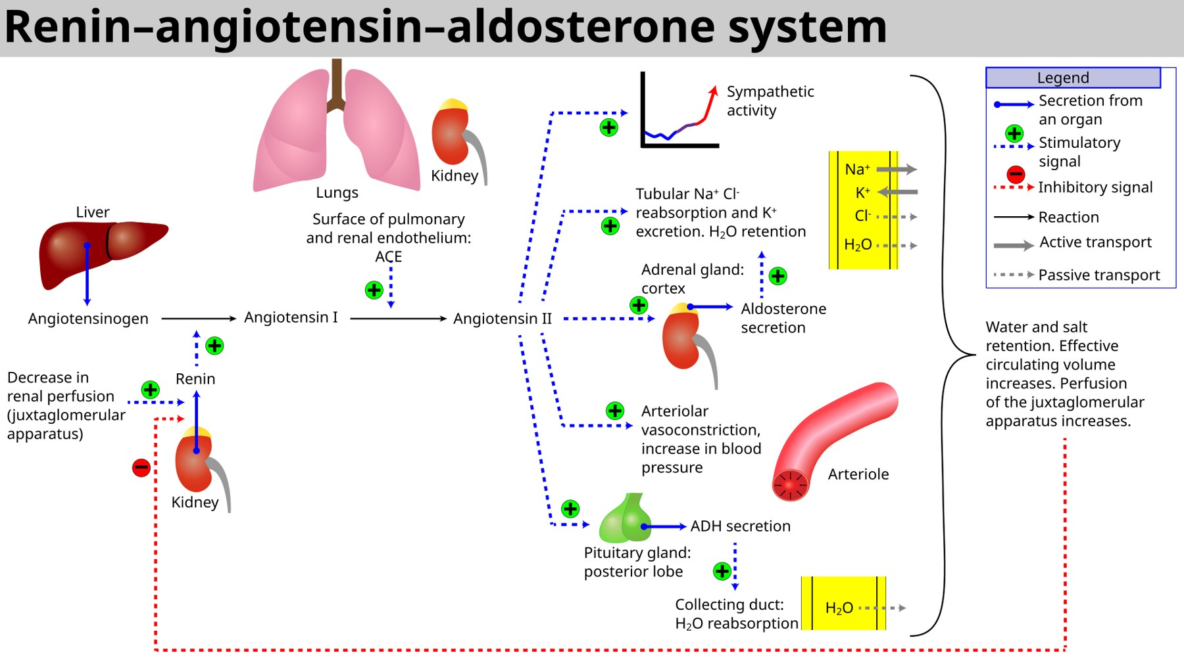
Figure 12.3 · The Renin–Angiotensin–Aldosterone System
WHAT TO NOTICE
Start: Reduced renal perfusion at the juxtaglomerular apparatus releases renin; renin converts liver-made angiotensinogen to angiotensin I.
ACE: Pulmonary and renal endothelium convert angiotensin I to angiotensin II (ACE also breaks down bradykinin).
Angiotensin II effects: Sympathetic activity, tubular Na⁺ reabsorption and K⁺ excretion, aldosterone and ADH secretion, arteriolar constriction.
Feedback (red dashed line): Restored perfusion switches renin release off.
Where drugs act: ACE inhibitors block conversion; ARBs block angiotensin II at the AT1 receptor; spironolactone [mineralocorticoid receptor antagonist / potassium-sparing diuretic] blocks aldosterone.
“Renin-angiotensin-aldosterone system” by Soupvector, Wikimedia Commons, CC BY-SA 4.0.
Pathophysiology for Nurses: A Canadian Open Text
Chapter 12 · Hypertension
Notes:
Figure 12.3 is the map for the pharmacology in section 12.5. Point out the bradykinin link to ACE inhibitor cough and angioedema, and that aldosterone explains why RAAS blockers raise potassium.

Slide 9
INTRODUCTION · LOCAL CONTROL
The endothelium and autoregulation
Local control explains both how hypertension damages vessels and why emergencies must be treated carefully.
Local control: the endothelium
Autoregulation of organ blood flow
Healthy vessels favour dilation
Brain, kidney, and heart protect their own flow
Dilators: Shear stress releases nitric oxide (NO) and prostacyclin, which relax smooth muscle.
Constrictor: Endothelin-1 is a potent vasoconstrictor.
Healthy endothelium: Favours dilation and resists inflammation, clotting, and smooth muscle growth.
Endothelial dysfunction: High pressure, smoking, high glucose, and abnormal lipids lower NO and raise endothelin and oxidative stress, raising resistance and accelerating atherosclerosis.
Normal: Brain, kidney, and heart arterioles constrict when pressure rises and dilate when it falls, keeping flow nearly constant across a wide MAP range.
In chronic hypertension: Arterioles thicken and the whole autoregulatory range shifts upward.
Double edge: Organs tolerate high pressure better, but become vulnerable to underperfusion at pressures safe for others.
Key concept for section 12.6: A rapid drop to a "normal" pressure can cause stroke, myocardial infarction, or acute kidney injury in a client whose autoregulation has shifted upward.
Pathophysiology for Nurses: A Canadian Open Text
Chapter 12 · Hypertension
Notes:
Endothelium: nitric oxide and prostacyclin dilate; endothelin-1 constricts. Damage from high pressure, smoking, high glucose, or abnormal lipids shifts the balance toward constriction and accelerates atherosclerosis. Autoregulation: the brain, kidneys, and heart keep flow constant across a range of MAP. In long-standing hypertension the whole curve shifts upward. This is the key concept for section 12.6: a pressure that is safe for most people can cause ischemia in someone whose autoregulation has shifted.

Slide 10
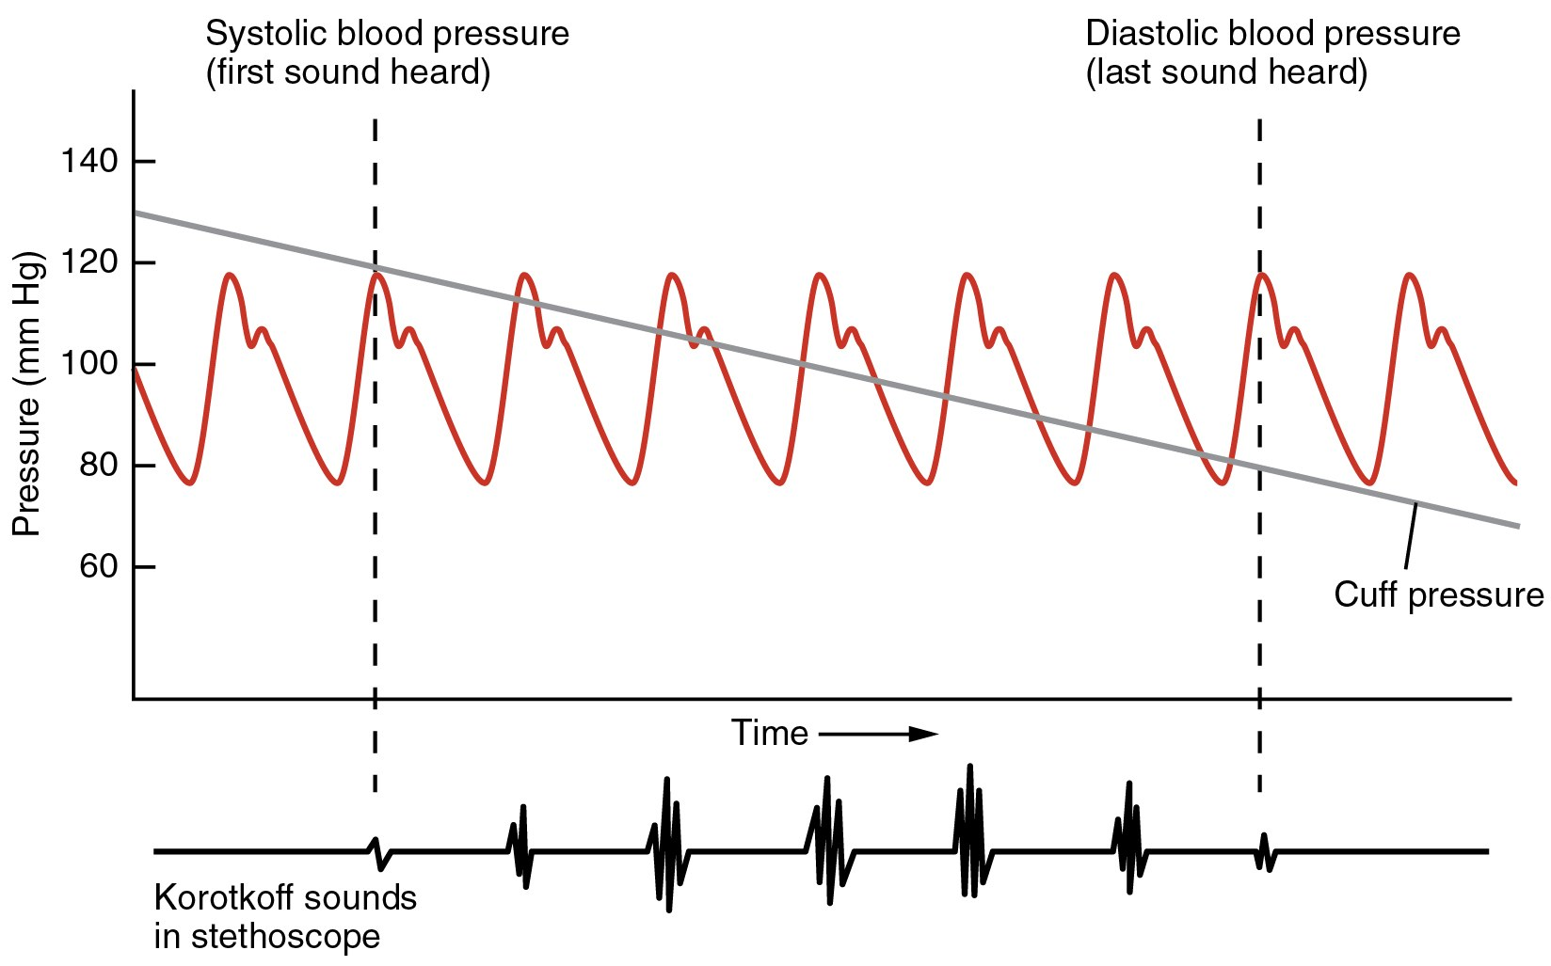
Figure 12.4 · Measuring Blood Pressure Accurately
WHAT TO NOTICE
Standardized technique (Goupil et al., 2025): No caffeine, tobacco, or exercise for 30 min; back supported, feet flat, legs uncrossed, arm at heart level; correct cuff on bare skin ~3 cm above the elbow crease.
Automated office readings: After 1 to 5 min of quiet rest, take three readings 1 min apart and average them. No one talks.
Auscultation (figure): As the cuff deflates, the first Korotkoff sound marks systolic pressure (phase I); disappearance of sounds marks diastolic (phase V), also used in pregnancy.
Validated devices: About 90% of devices sold in Canadian pharmacies are validated, compared with about 45% from online retailers.
Reading the graph: Pressure in the artery peaks above the falling cuff pressure → turbulent spurts → sounds; flow becomes smooth below diastolic → silence.
“2111 Blood Pressure Graph” by OpenStax College, Wikimedia Commons, CC BY 3.0.
Pathophysiology for Nurses: A Canadian Open Text
Chapter 12 · Hypertension
Notes:
Figure 12.4 explains where systolic and diastolic readings come from. Reinforce that Hypertension Canada prefers a validated automated device with standardized technique; manual auscultation is used when automated measurement is not available. The device statistics are from Goupil et al. (2025); phase V in pregnancy is from Carnegie et al. (2023).

Slide 11
SECTION 12.1 · DEFINING & DIAGNOSING HYPERTENSION
The 2025 Canadian definition and out-of-office confirmation
Hypertension is 130/80 mmHg or higher with a validated device and standardized technique, confirmed outside the office (Goupil et al., 2025).
2025 definition
Confirming outside the office
White-coat vs. masked
Threshold: 130/80 mmHg or higher, measured with a validated device under optimal conditions.
Before 2025: Method-specific cut-offs, such as 135/85 (automated office) or 140/90 (other office methods).
Why lower: Risk rises steadily below 140/90, and treatment in this range prevents strokes and heart attacks.
Scope: Adults 18+; not children or people who are or may become pregnant.
HBPM: Validated upper-arm device; duplicate readings morning and evening for one week. Mean ≥130/80 confirms.
ABPM: 24-hour portable monitor every 20–30 min, day and night; shows whether pressure dips during sleep.
Non-dipping: No nighttime fall is linked to higher cardiovascular risk.
Neither available: Repeat standardized office measurement at a separate visit.
White-coat hypertension: High in the office, normal at home or on ABPM. No drug treatment; re-measure periodically, as many progress.
Masked hypertension: Normal in the office, high outside it. Risk similar to sustained hypertension; easily missed.
Masked is more likely in: Older adults, men, people who smoke, and people with diabetes (Rabi et al., 2020).
Pathophysiology for Nurses: A Canadian Open Text
Chapter 12 · Hypertension
Notes:
Contrast 2025 with 2020: the 2020 comprehensive guidelines used method-specific cut-offs (for example 135/85 for automated office and 140/90 for other office methods) (Rabi et al., 2020). The 2025 guideline applies to adults 18 and older and not to children or people who are pregnant or trying to conceive. Out-of-office confirmation: HBPM duplicate morning and evening readings for a week (mean ≥130/80 confirms) or 24-h ABPM; if neither is available, repeat standardized office measurement at a separate visit. White-coat: high in office, normal outside; no drug treatment but periodic re-measurement. Masked: normal in office, high outside; risk similar to sustained hypertension; more likely in older adults, men, people who smoke, and people with diabetes.

Slide 12
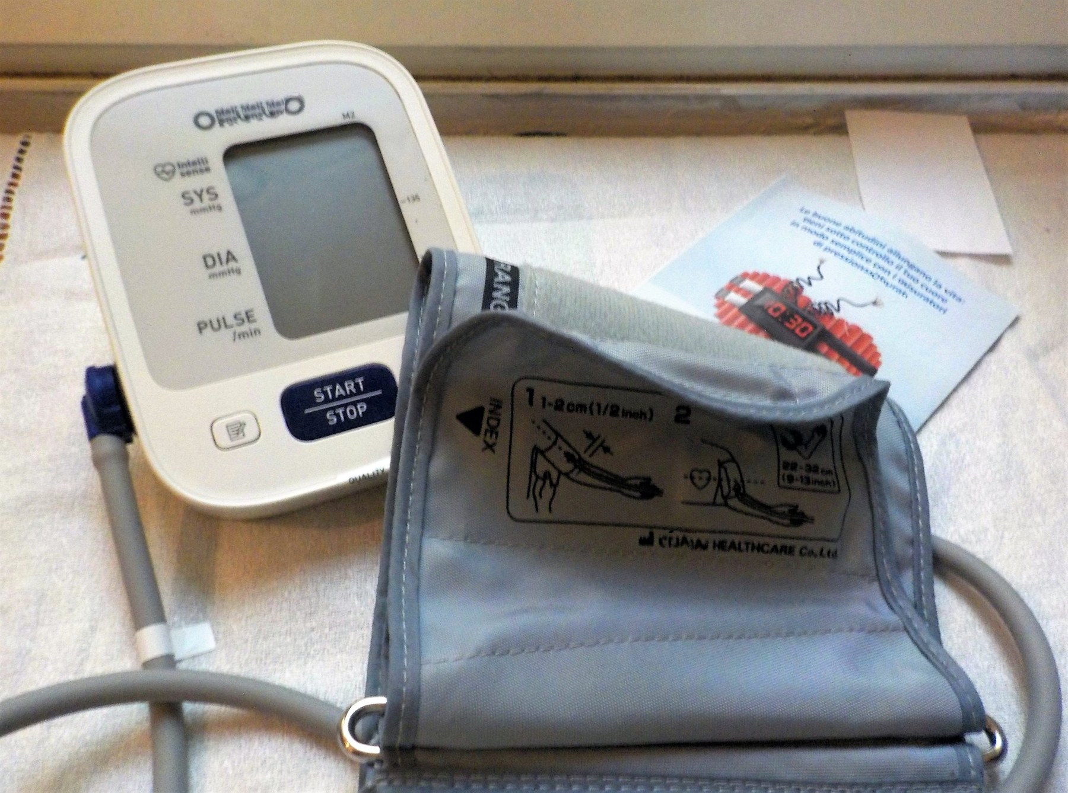
Figure 12.5 · Home Monitoring & Measurement Errors
WHAT TO NOTICE
Cuff fit (figure): The cuff is printed with the arm range it fits (here 22–32 cm). A cuff too small reads falsely high; too large reads falsely low.
Falsely high readings: Arm hanging below heart level (hydrostatic pressure), unsupported back or crossed legs, talking, caffeine or nicotine within 30 min, full bladder.
Single unrested reading: Usually high and variable from the alerting response; rest 1–5 min and average three readings.
Home protocol: Two readings morning and evening for 7 days; bring the device to an appointment once to check it against a clinic reading.
Table 12.3: Most errors raise the reading, which can lead to a wrong diagnosis or unnecessary medication.
“Sphygmomanometer, automatic blood pressure monitor. Oscillometric measurements, millimeter of mercury (mmHg) unit” by Albarubescens, Wikimedia Commons, CC BY-SA 4.0.
Pathophysiology for Nurses: A Canadian Open Text
Chapter 12 · Hypertension
Notes:
Use Figure 12.5 with Table 12.3. Have students predict the direction of each error and its mechanism, and rehearse the home monitoring teaching from the Patient Education box in section 12.5.

Slide 13
SECTION 12.1 · FROM DIAGNOSIS TO TREATMENT DECISIONS
Cardiovascular risk decides when to start medication
Once hypertension is confirmed, ask how high overall cardiovascular risk is and whether organs are already damaged.
High cardiovascular risk (Goupil et al., 2025)
Lifespan considerations
Target for most adults: systolic below 130 mmHg if tolerated
Rabi et al. (2020); Goupil et al. (2025)
Established cardiovascular disease (coronary, heart failure, cerebrovascular, or peripheral artery disease)
Type 1 or type 2 diabetes
Chronic kidney disease: eGFR below 60 mL/min/1.73 m² or ACR 3 mg/mmol or more
10-year Framingham risk score of 20% or more, or age 75 or older
Treat with medication: ≥140/90 mmHg, or SBP 130–139 with high risk. Otherwise lifestyle and reassess in 3–6 months.
Children: Measure regularly from age 3. Simplified thresholds: above 120/80 (ages 6–11) and above 130/85 (ages 12–17). Young children more often have secondary causes; adolescents, obesity-related hypertension.
Older adults: Isolated systolic hypertension from arterial stiffening; higher risk of orthostatic hypotension, falls, and frailty.
Individualize: Target as low as reasonably achievable; measure lying or sitting, then standing.
Scope in practice: Measuring pressure, teaching home monitoring, and supporting lifestyle change are within RN and RPN scope. Nurses report accurate data; they do not diagnose (CNO, 2023).
Pathophysiology for Nurses: A Canadian Open Text
Chapter 12 · Hypertension
Notes:
High cardiovascular risk (Goupil et al., 2025): established cardiovascular disease, diabetes, CKD (eGFR <60 or ACR ≥3 mg/mmol), Framingham ≥20%, or age ≥75. Medication at ≥140/90, or SBP 130–139 with high risk. Not high risk with SBP 130–139: lifestyle and reassess in 3–6 months. Target SBP <130 if tolerated. Lifespan: children 3+ should have pressure measured regularly; simplified thresholds >120/80 (ages 6–11) and >130/85 (12–17) (Rabi et al., 2020). Older adults: isolated systolic hypertension, orthostatic hypotension, falls, and frailty; individualized target as low as reasonably achievable.

Slide 14
PART TWO · SECTIONS 12.2 TO 12.4
Primary Hypertension, Secondary Causes & Target Organ Damage
Interacting renal, neurohormonal, and vascular mechanisms; clues to an identifiable cause; and how pressure silently damages the heart, brain, kidneys, eyes, and arteries.
Notes:
Part Two explains why pressure rises in most people without a single cause, when to look for a secondary cause, and how target organ damage develops.

Slide 15
SECTION 12.2 · PRIMARY HYPERTENSION
Primary hypertension is a set of interacting loops
No single cause: small influences together reset the kidney, the nervous system, and the arteries to defend a higher pressure.
1
2
3
4
Kidney & sodium
Neurohormonal overactivity
Vessels: endothelium & stiffness
Obesity & sleep apnea
The kidney reabsorbs slightly more sodium at any pressure, so pressure settles higher.
Salt-sensitive: Pressure rises with sodium and falls with restriction.
Causes: inherited transporters, fewer nephrons, subtle injury, excess angiotensin II.
Sympathetic: Raises heart rate, contractility, arteriolar tone, renin, and sodium reabsorption.
RAAS: Renin is "inappropriately normal" despite high pressure.
Common in young adults and with obesity or sleep apnea.
Less NO, more endothelin-1; immune cells promote sodium retention.
Remodelling: Thick-walled arterioles lock in high SVR.
Stiff aorta: Early reflected wave raises systolic pressure (isolated systolic hypertension).
Visceral fat: leptin-driven sympathetic activation, insulin-driven sodium retention, renal compression.
Sleep apnea: Nightly hypoxia and arousals keep sympathetic activity high by day.
Pathophysiology for Nurses: A Canadian Open Text
Chapter 12 · Hypertension
Notes:
Walk through the loops. Kidney: inherited transporter differences, fewer nephrons from birth (low birth weight), subtle injury, or excess angiotensin II and aldosterone shift pressure–natriuresis. Salt sensitivity is more common in older adults, people of African descent, and people with diabetes, CKD, or obesity. Neurohormonal: sympathetic overactivity (young adults, obesity, sleep apnea) and an 'inappropriately normal' RAAS. Vascular: endothelial dysfunction, immune infiltration, arteriolar remodelling, and large-artery stiffening with early wave reflection. Obesity: leptin-driven sympathetic activation, hyperinsulinemia, renal compression by fat, adipose angiotensinogen; sleep apnea causes nightly sympathetic surges. Most people feel well; headache and nosebleeds are unreliable symptoms.

Slide 16
SECTION 12.2 · TABLE 12.4
Risk factors and how they raise pressure
Most risk factors are modifiable, and each acts through a mechanism nurses can target.
Risk factor | Main mechanism | Modifiable?
Increasing age | Large-artery stiffening; declining kidney function; cumulative exposure | No
Family history and genetics | Many small variants affecting renal sodium handling, vascular tone, neurohormones | No
High sodium intake | Volume expansion in salt-sensitive people; arterial stiffness; sympathetic activity | Yes
Low potassium intake | Less renal sodium excretion and less vasodilation | Yes
Excess body weight | Sympathetic and RAAS activation, insulin resistance, renal compression by visceral fat | Yes
Physical inactivity | Less endothelial NO; weight gain; higher sympathetic tone | Yes
Alcohol (> 2 drinks/day) | Sympathetic and RAAS activation; reverses with reduction | Yes
Obstructive sleep apnea | Nightly hypoxia and arousals drive sustained sympathetic activity | Yes (treatable)
Stress, low income, food insecurity | Sympathetic and cortisol activation; limited access to healthy food and care | Partly; social action
Diabetes and insulin resistance | Insulin-driven sodium retention and sympathetic activity; endothelial dysfunction | Partly
Pathophysiology for Nurses: A Canadian Open Text
Chapter 12 · Hypertension
Notes:
Use Table 12.4 to link risk factors to mechanisms and to the lifestyle targets in section 12.5. Emphasize the social determinants row: chronic stress, low income, and food insecurity act through sympathetic and cortisol activation and through limited access to healthy food, safe activity, and care, so they need social as well as individual action.

Slide 17
SECTION 12.2 · GOING DEEPER [RN REQUIRED, PN OPTIONAL]
Angiotensin II at the cellular level and ACE inhibitor cough
AT1 signalling explains vascular remodelling and LVH; ACE = kininase II explains cough and angioedema.
Clinical manifestations of primary hypertension
Going Deeper [RN]: AT1 & bradykinin
Usually silent: Most people feel well; diagnosis depends on measurement.
Unreliable symptoms: Headache, nosebleeds, and flushing are usually unrelated to pressure except at very high levels.
The central clinical problem: People may resist daily medication for a condition they cannot feel.
When symptoms occur: They usually reflect target organ damage: breathlessness from heart failure, chest pain from coronary disease, or neurological symptoms of stroke (section 12.4).
AT1 receptor (Gq): Phospholipase C → IP₃ releases calcium (contraction) and DAG activates protein kinase C.
Oxidative stress: NADPH oxidase makes reactive oxygen species that inactivate NO.
Growth: Hypertrophy of smooth muscle and heart cells and collagen deposition: the basis of LVH and remodelling.
ACE = kininase II: Ramipril [ACE inhibitor] lowers angiotensin II and raises bradykinin → dry cough and rare angioedema.
ARBs: Irbesartan [angiotensin II receptor blocker] blocks AT1 directly and rarely causes cough.
Pathophysiology for Nurses: A Canadian Open Text
Chapter 12 · Hypertension
Notes:
AT1 is a Gq-coupled receptor: phospholipase C → IP3 (calcium release, contraction) and DAG (protein kinase C). NADPH oxidase produces reactive oxygen species that inactivate NO, and growth pathways cause hypertrophy and fibrosis. ACE is identical to kininase II, so ACE inhibitors raise bradykinin: vasodilation, but also sensitized airway cough receptors and increased permeability (cough and angioedema). ARBs block AT1 directly without affecting bradykinin, which is why switching to an ARB usually resolves ACE inhibitor cough.

Slide 18
SECTION 12.3 · SECONDARY HYPERTENSION
Clues that point to an identifiable cause
Finding the cause matters: treating it can lower pressure dramatically and sometimes cure the hypertension.
Clues to report
Major causes
Rabi et al. (2020) screening criteria
Kidney, endocrine, structural, and drug causes
Onset before age 30, or new or sharply worse after 55
Resistant hypertension: above target on three drugs at good doses, including a diuretic
Unexplained low potassium, or very low potassium after a diuretic
Episodes of very high pressure with headache, sweating, and palpitations
Creatinine rise of 30% or more after starting an ACE inhibitor or ARB
Loud snoring with daytime sleepiness, endocrine features, abdominal bruit, or a pressure-raising drug
Chronic kidney disease: Most common; impaired sodium excretion plus RAAS and sympathetic activation.
Renovascular: Narrowed renal artery → renin release (atherosclerosis in older adults; fibromuscular dysplasia in younger women).
Primary aldosteronism: Autonomous aldosterone → hypertension, suppressed renin, often low K⁺.
Pheochromocytoma: Catecholamine surges; alpha-block before any beta blocker.
Also: Cushing syndrome, thyroid disease, sleep apnea, coarctation of the aorta.
Nursing action: Document and report a secondary-cause clue clearly. Otherwise the client may start a lifelong regimen for a condition that could be corrected.
Pathophysiology for Nurses: A Canadian Open Text
Chapter 12 · Hypertension
Notes:
Clues: onset before 30 or new or sharply worse after 55; resistant hypertension (above target on three drugs including a diuretic); unexplained low potassium; paroxysmal headache, sweating, palpitations; creatinine rise ≥30% after starting an ACE inhibitor or ARB; endocrine features, snoring with daytime sleepiness, abdominal bruit; a medication that raises pressure (Rabi et al., 2020). Primary aldosteronism screening: unexplained K <3.5 mmol/L or diuretic-induced K <3.0, resistance to three drugs, or an incidental adrenal mass; screen with aldosterone-to-renin comparison. Pheochromocytoma: alpha-blockade before any beta blocker. Coarctation: compare arm and leg pressures and femoral pulses.

Slide 19
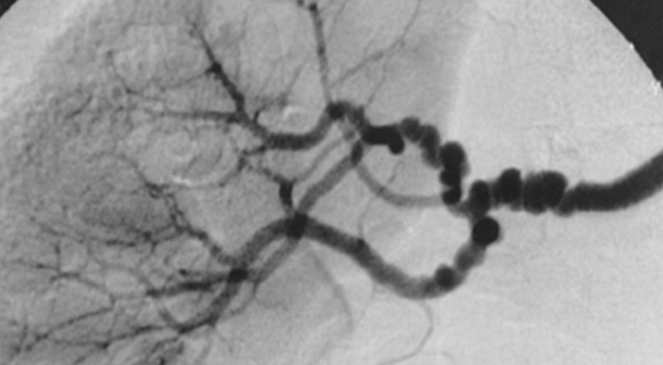
Figure 12.6 · Renovascular Hypertension
WHAT TO NOTICE
String of beads (figure): Alternating narrowings and small dilations of the renal artery in fibromuscular dysplasia, a non-inflammatory arterial disease of younger people, especially women.
Mechanism: Low pressure beyond the narrowing makes the juxtaglomerular cells release renin, so angiotensin II and aldosterone rise even though body volume is normal or high.
Clues: Onset before 30 or after 55, abdominal bruit, resistance to three drugs, sudden pulmonary edema with pressure surges.
The creatinine clue: Behind a narrowed artery, filtration depends on angiotensin II constricting the efferent arteriole; blocking it drops GFR, so creatinine rises ≥30%.
Age matters: In older adults, renal artery narrowing is usually atherosclerotic rather than fibromuscular dysplasia.
“Fibr” by author not identified on the Commons file page, Wikimedia Commons, CC BY 2.0.
Pathophysiology for Nurses: A Canadian Open Text
Chapter 12 · Hypertension
Notes:
Figure 12.6 shows the classic angiographic sign of fibromuscular dysplasia. Use the creatinine clue to reinforce why potassium and creatinine are checked after starting an ACE inhibitor or ARB.

Slide 20
SECTION 12.3 · TABLE 12.5
Medications and substances that raise blood pressure
Ask about over-the-counter products, prescriptions, and substances at every hypertension visit.
Agent [class] | Mechanism | Nursing point
Ibuprofen, naproxen [NSAIDs] | Block renal prostaglandins; sodium and water retention | Blunt antihypertensives; AKI risk with ACE inhibitor/ARB + diuretic
Pseudoephedrine, phenylephrine [sympathomimetic decongestants] | Alpha-adrenergic vasoconstriction | Advise checking cold products with a pharmacist
Prednisone [systemic corticosteroid] | Mineralocorticoid effect; sodium retention | Monitor pressure on long courses
Combined oral contraceptives [hormonal contraceptive] | Estrogen increases angiotensinogen | Measure before and during use
Cyclosporine, tacrolimus [calcineurin inhibitors] | Renal vasoconstriction; sodium retention | Common in transplant recipients
Venlafaxine [SNRI]; methylphenidate [CNS stimulant] | Increased noradrenergic / sympathetic activity | Monitor pressure and heart rate
Epoetin alfa [erythropoiesis-stimulating agent] | Higher viscosity and vascular reactivity | Common in chronic kidney disease
Cocaine, amphetamines, alcohol, black licorice | Sympathetic stimulation; RAAS activation; mineralocorticoid excess | Ask non-judgmentally
Pathophysiology for Nurses: A Canadian Open Text
Chapter 12 · Hypertension
Notes:
Highlight NSAIDs: they inhibit renal prostaglandins, retain sodium, blunt most antihypertensives, and, combined with an ACE inhibitor or ARB and a diuretic, can precipitate acute kidney injury. Decongestants are common in cold and allergy products. Estrogen increases hepatic angiotensinogen. Black licorice contains glycyrrhizin, which blocks cortisol inactivation and produces mineralocorticoid excess. Ask about substance use without judgment.

Slide 21
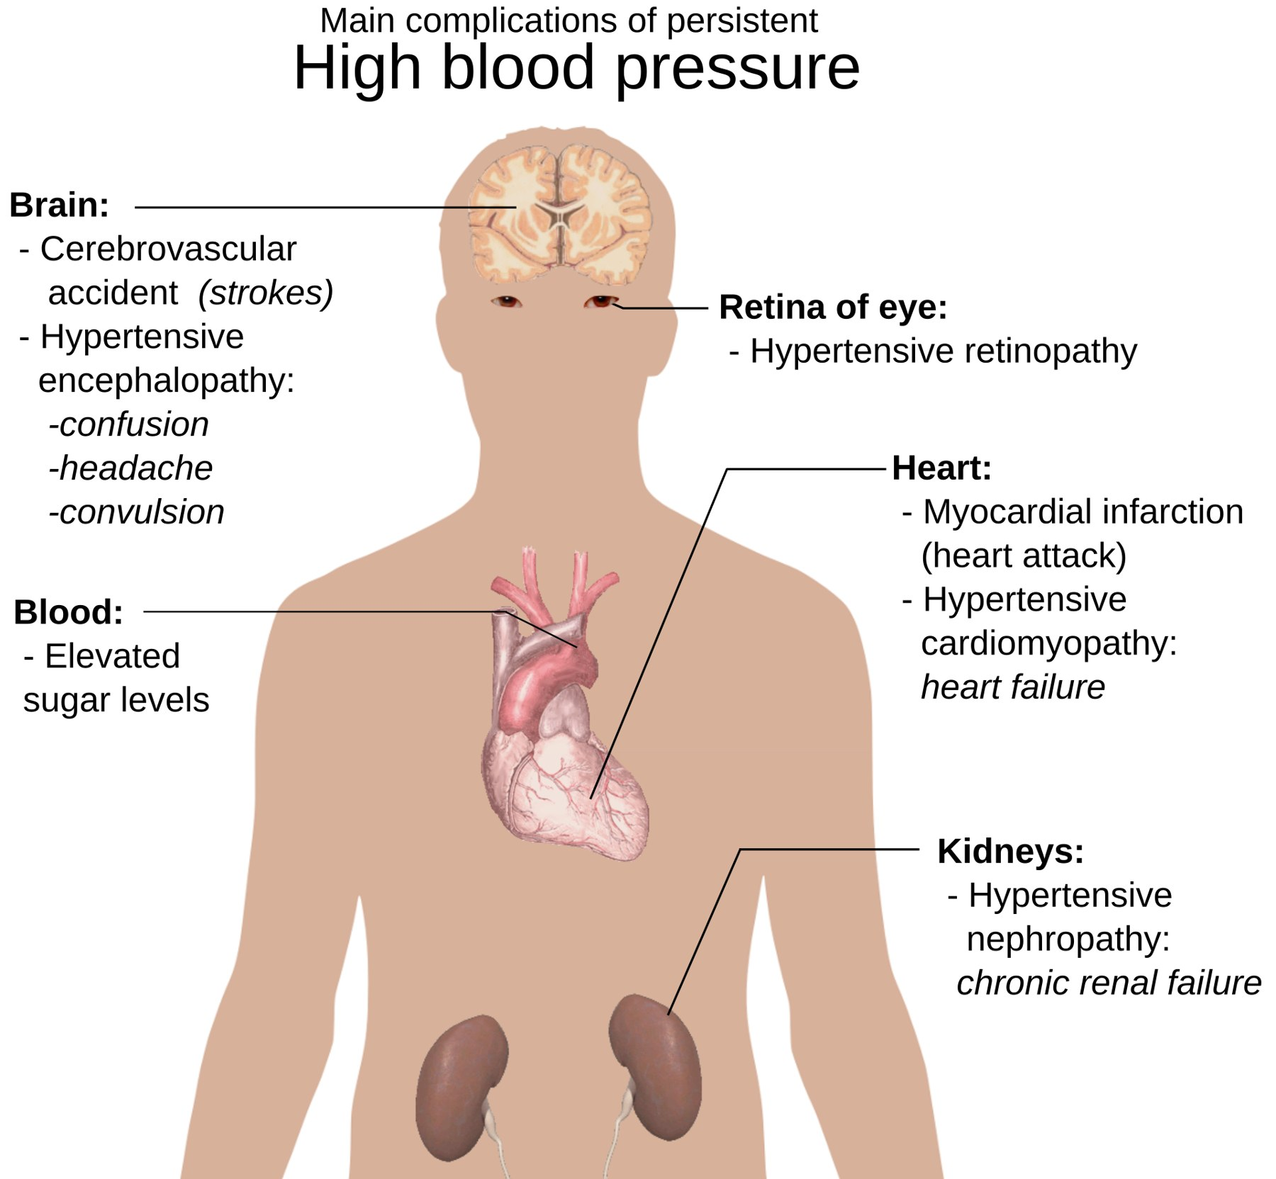
Figure 12.7 · Target Organ Damage
WHAT TO NOTICE
Two mechanisms: Mechanical (pressure and pulsatile stress injure the endothelium and thicken walls) and atherosclerotic (accelerated plaque in medium and large arteries).
Brain: Stroke, lacunar infarcts, intracerebral hemorrhage, vascular cognitive impairment, hypertensive encephalopathy.
Heart: LVH, heart failure, coronary disease, atrial fibrillation.
Kidneys & eyes: Albuminuria and CKD; hypertensive retinopathy and papilledema.
Note: The figure's "elevated blood sugar" label reflects shared metabolic risk, not damage caused by hypertension.
Why it matters: Hypertension leads to stroke, heart attack, heart failure, and kidney damage, making it a leading preventable cause of death worldwide (WHO, 2023).
“Main complications of persistent high blood pressure” by Mikael Häggström, Wikimedia Commons, Public domain.
Pathophysiology for Nurses: A Canadian Open Text
Chapter 12 · Hypertension
Notes:
Figure 12.7 previews section 12.4. Point out that the figure omits the aorta and peripheral arteries, which are also target organs (aneurysm, dissection, peripheral artery disease).

Slide 22
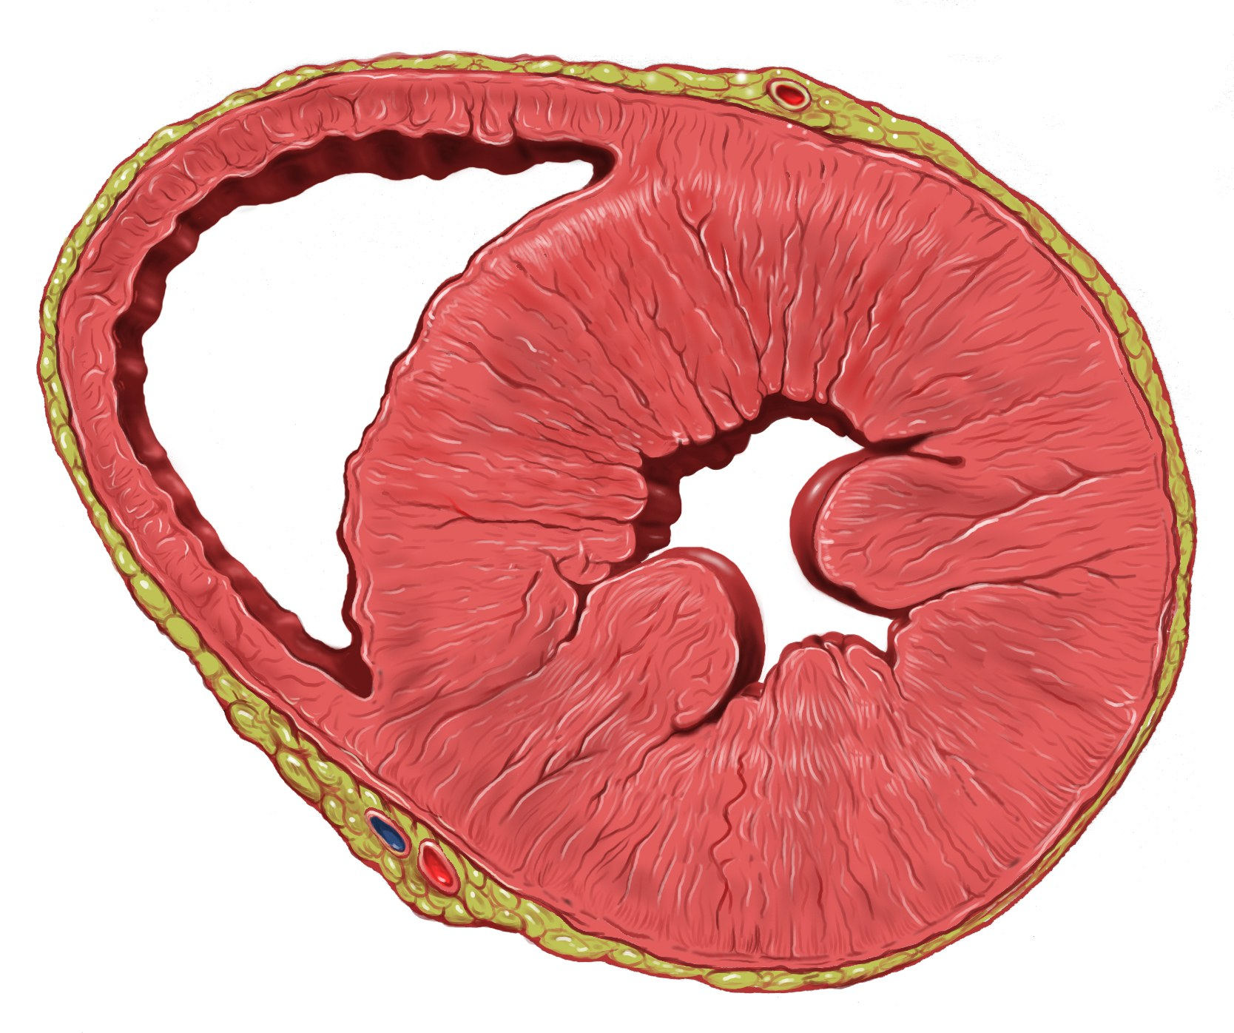
Figure 12.8 · Left Ventricular Hypertrophy
WHAT TO NOTICE
Law of Laplace: Wall stress rises with pressure and radius and falls with wall thickness, so the ventricle thickens against a high afterload.
Concentric LVH (figure): Thick left ventricular wall and septum with a small cavity; the thin-walled right ventricle is on the left of the image.
The price: Stiff, fibrotic walls relax poorly, so filling pressures rise (HF with preserved EF); oxygen demand outstrips capillary supply.
Over time: Infarction and fibrosis can lead to a dilated ventricle with reduced EF; atrial stretch predisposes to atrial fibrillation.
Prognosis: LVH is an independent risk factor for heart failure, arrhythmias, and sudden death, and it can regress with effective treatment.
“Heart left ventricular hypertrophy sa” by Patrick J. Lynch, medical illustrator, Wikimedia Commons, CC BY 2.5.
Pathophysiology for Nurses: A Canadian Open Text
Chapter 12 · Hypertension
Notes:
Figure 12.8 shows concentric hypertrophy. Connect the angiotensin II and aldosterone growth effects (Going Deeper) to fibrosis, and explain why RAAS blockers are favoured when LVH is present.

Slide 23
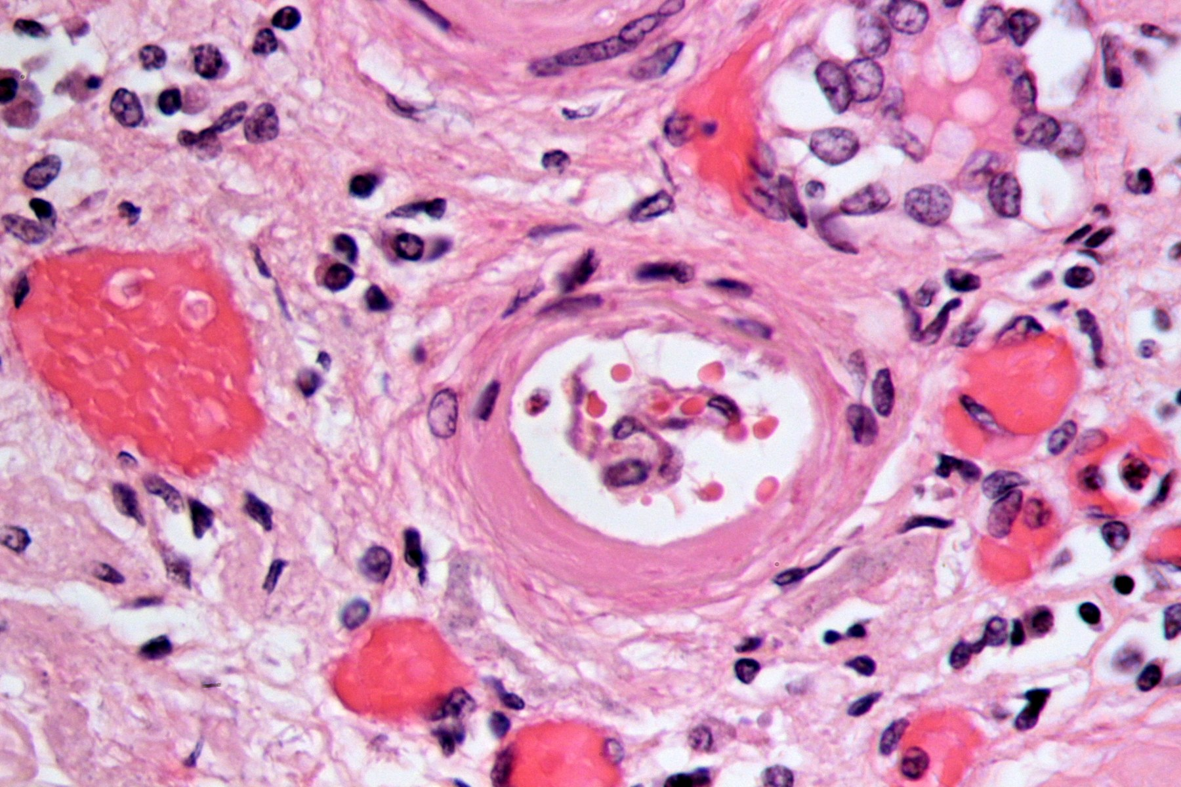
Figure 12.9 · The Kidney as Cause and Victim
WHAT TO NOTICE
Arteriolosclerosis (figure): A small renal artery wall thickened by glassy pink material and layered cells narrows its lumen: hypertensive nephrosclerosis.
Glomerular injury: Transmitted pressure injures capillaries and podocytes, so albumin leaks into the urine.
Vicious cycle: Nephron loss → remaining nephrons hyperfilter → further injury → less sodium excretion → higher pressure.
Markers: ACR ≥3 mg/mmol or eGFR <60 mL/min/1.73 m² indicates CKD and high cardiovascular risk (Goupil et al., 2025).
Leading causes: Hypertension and diabetes are the leading causes of end-stage kidney disease.
“Arteriolosclerosis, kidney, HE 3” by Patho, Wikimedia Commons, CC BY-SA 3.0.
Pathophysiology for Nurses: A Canadian Open Text
Chapter 12 · Hypertension
Notes:
Figure 12.9 shows the arteriolar narrowing behind nephrosclerosis. Stress that albuminuria is an early, measurable marker of damage and a reason to choose an ACE inhibitor or ARB.

Slide 24
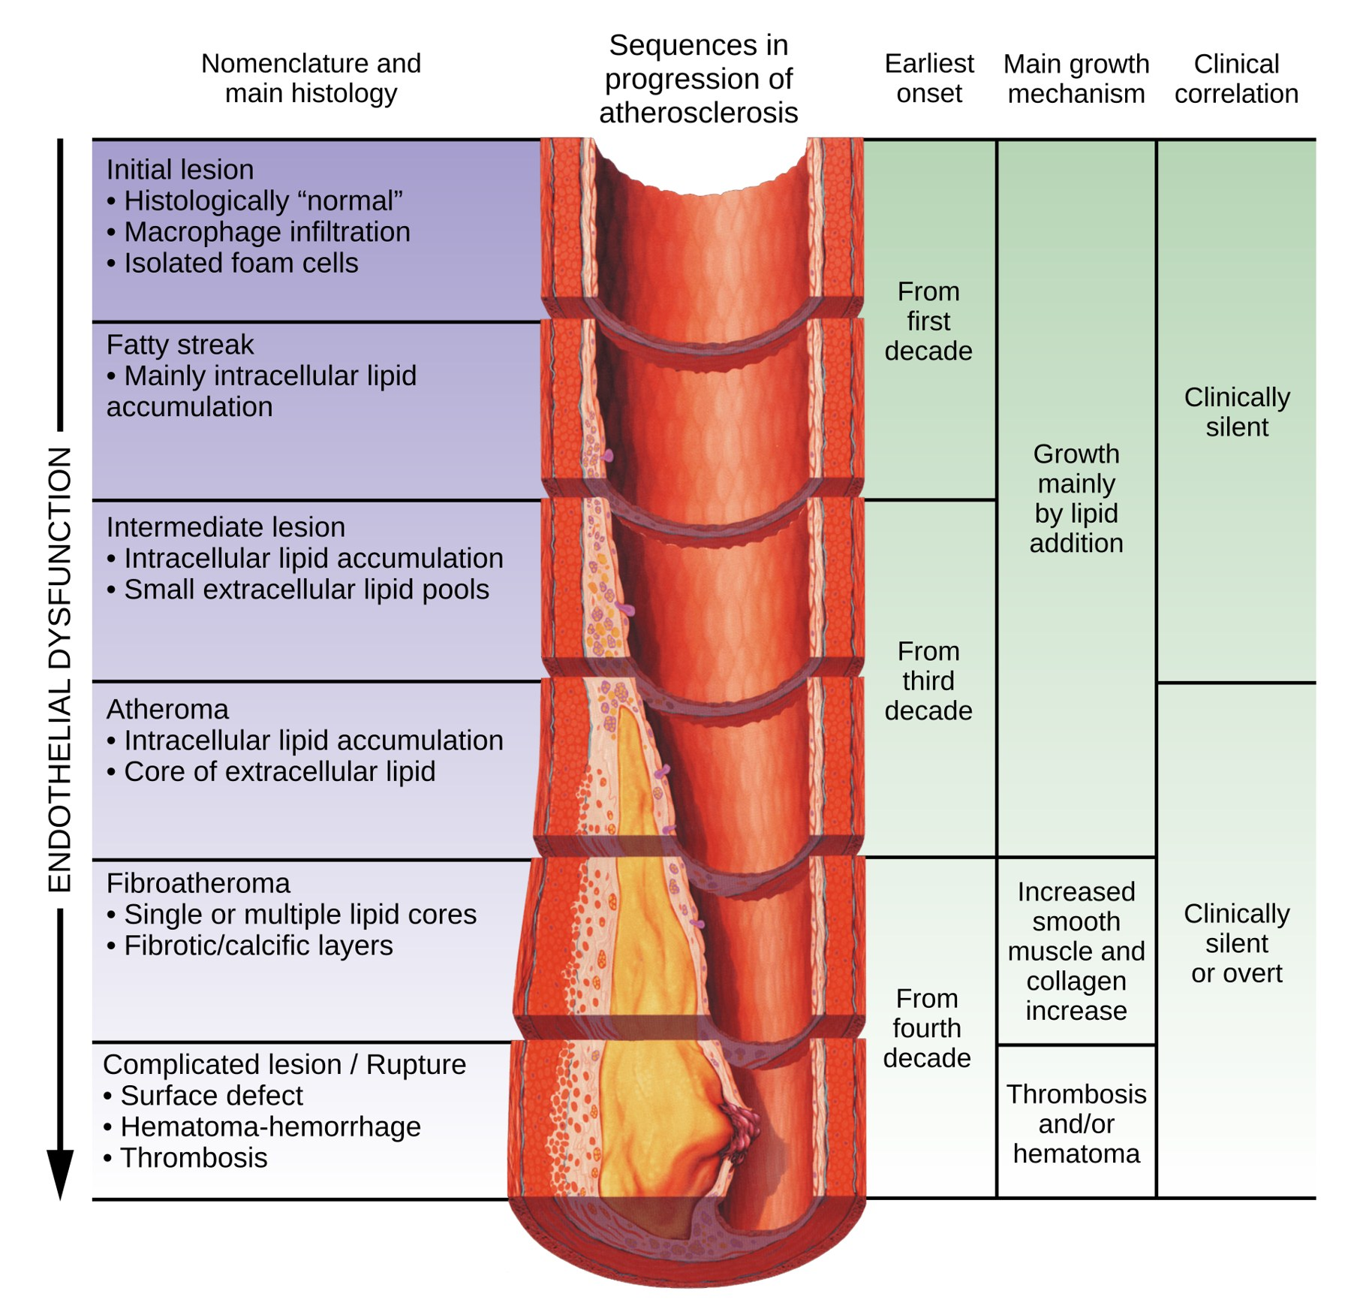
Figure 12.10 · Accelerated Atherosclerosis
WHAT TO NOTICE
Stages (figure): Initial lesion and fatty streak → atheroma → fibroatheroma → complicated lesion with rupture, hemorrhage, and thrombosis.
Endothelial dysfunction: Runs through every stage; hypertension accelerates it by injuring the endothelium.
Clinically silent: Most stages cause no symptoms until a plaque narrows an artery or ruptures and triggers a clot.
Arterial outcomes: Peripheral artery disease with claudication, abdominal aortic aneurysm, and aortic dissection.
Red flag: Sudden, severe, tearing chest or back pain suggests aortic dissection, a surgical emergency.
“Atherosclerosis timeline - endothelial dysfunction” by YitzhakNat, Wikimedia Commons, CC BY-SA 4.0.
Pathophysiology for Nurses: A Canadian Open Text
Chapter 12 · Hypertension
Notes:
Figure 12.10 links hypertension to atherosclerosis alongside smoking, diabetes, and high LDL cholesterol. Use the red flag to bridge to the aortic dissection content in section 12.6.

Slide 25
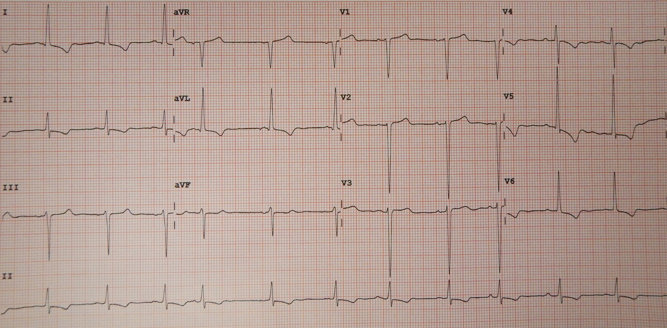
Figure 12.11 · ECG of LVH with Strain
WHAT TO NOTICE
Voltage (figure): Very deep S waves in V2 and V3 and tall R waves in the lateral leads reflect the thick ventricle.
Strain pattern: Downsloping ST depression with asymmetric T-wave inversion in I, aVL, V5, and V6 reflects abnormal repolarization.
Limits: A normal ECG does not rule out hypertrophy.
Baseline tests (Rabi et al., 2020): Urinalysis; sodium, potassium, creatinine (eGFR); fasting glucose and/or A1C; lipid profile; 12-lead ECG; urine albumin in diabetes.
Why baselines: Baseline potassium and creatinine also matter for safety, because several antihypertensives change both.
“Left ventricular hypertrophy with secondary repolarization” by James Heilman, MD, Wikimedia Commons, CC BY-SA 4.0.
Pathophysiology for Nurses: A Canadian Open Text
Chapter 12 · Hypertension
Notes:
Figure 12.11 shows LVH with strain. Pair with the Table 12.6 entry: ensure the ECG is reviewed by the prescriber and reinforce adherence.

Slide 26
SECTION 12.4 · TABLE 12.6
Patho-to-bedside: recognizing target organ damage
Link each cue to its mechanism and the nursing action it calls for.
Cue / clinical finding | Mechanism | Nursing assessment & action
Exertional breathlessness, orthopnea, crackles, edema | Stiff hypertrophied LV; heart failure | Daily weight, SpO₂, lung sounds; report new findings
Chest pain on exertion | Coronary atherosclerosis + high O₂ demand | Assess pain; ECG per protocol; escalate if at rest or prolonged
Irregularly irregular pulse | Atrial enlargement → atrial fibrillation | Full-minute apical pulse; report; stroke risk
Sudden facial droop, arm weakness, speech difficulty | Ischemic or hemorrhagic stroke | Activate stroke protocol; time last known well
Gradual memory or executive difficulty | Small-vessel cerebral disease | Screen cognition; involve family; simplify regimen
ACR ≥3 mg/mmol; falling eGFR | Glomerular injury and nephron loss | Trend results; report rising creatinine or K⁺; avoid NSAIDs
Blurred vision, visual field loss | Retinal hemorrhage, exudates, papilledema | Visual acuity; urgent report if acute with very high pressure
Tearing chest/back pain; unequal arm pressures | Aortic dissection | Emergency: both arms, call for help, prepare for rapid control
Pathophysiology for Nurses: A Canadian Open Text
Chapter 12 · Hypertension
Notes:
Walk through Table 12.6. Distinguish findings that need routine reporting (ACR, ECG changes, gradual cognitive change) from those that need emergency escalation (stroke signs, tearing chest or back pain, acute vision loss with very high pressure).

Slide 27
PART THREE · SECTIONS 12.5 TO 12.7
Management, Hypertensive Emergencies & Pregnancy
Lifestyle targets, single-pill combinations and drug safety, controlled lowering when autoregulation has shifted, and the hypertensive disorders of pregnancy.
Notes:
Part Three applies the physiology to treatment: the Hypertension Canada algorithm, emergencies, and pregnancy.

Slide 28
SECTION 12.5 · LIFESTYLE CHANGE
Lifestyle targets that treat the mechanisms directly
Recommended for every adult with hypertension, and the first step for lower-risk, mildly raised pressure (Goupil et al., 2025).
< 2 g
> 3.5 g
150–300
≤ 2
Sodium per day (2,000 mg). Read labels: 5% Daily Value or less is a little; 15% or more is a lot
Potassium per day, mainly from fruit and vegetables, unless CKD or potassium-raising drugs
Minutes of moderate aerobic activity per week, improving endothelial nitric oxide
Drinks a day at most; also lose weight if living with obesity and stop smoking
Sources: Goupil et al. (2025); Health Canada (2018).
Pathophysiology for Nurses: A Canadian Open Text
Chapter 12 · Hypertension
Notes:
Each target acts on a mechanism: sodium restriction reduces the volume a reset kidney retains; potassium promotes sodium excretion and vasodilation (monitor in CKD or with potassium-raising drugs); activity improves endothelial NO and lowers sympathetic tone; weight loss reduces sympathetic activity, insulin resistance, and renal compression. Also reduce alcohol (especially above 2 drinks a day) and stop smoking. About half of Canadians' sodium comes from bakery products, mixed dishes, and processed meats, so label reading matters more than the salt shaker (Health Canada, 2018).

Slide 29
SECTION 12.5 · HYPERTENSION CANADA TREATMENT STEPS
Start with a low-dose single-pill combination
Two of three first-line classes: ACE inhibitor or ARB, thiazide or thiazide-like diuretic, long-acting dihydropyridine CCB (Goupil et al., 2025).
1
2
3
4
Half tablet
Full tablet
Add the third class
Resistant hypertension
Irbesartan-hydrochlorothiazide [angiotensin II receptor blocker / thiazide diuretic combination] 300/25 mg, half tablet (150/12.5 mg) once daily.
If not at target, increase to one full tablet daily.
Reassess every 1 to 3 months.
Add amlodipine [dihydropyridine calcium channel blocker] 5 mg, increasing to 10 mg.
Add spironolactone [mineralocorticoid receptor antagonist / potassium-sparing diuretic] 12.5 → 25 mg, and/or refer to a specialist.
Remember: Beta blockers are not first-line without a specific indication, and an ACE inhibitor and an ARB are never combined.
Pathophysiology for Nurses: A Canadian Open Text
Chapter 12 · Hypertension
Notes:
Why combinations: two drugs at low doses lower pressure more than doubling one, with fewer side effects, and they offset each other's compensation (a diuretic activates the RAAS; an ARB blocks it). One tablet improves adherence. Reassess every 1–3 months until at target, then every 6–12 months. Starting with one drug is reasonable when symptomatic hypotension is a concern. Beta blockers are not first-line without a specific indication (heart failure, angina, prior MI, rate or rhythm control). Never combine an ACE inhibitor and an ARB.

Slide 30
SECTION 12.5 · TABLE 12.7
Antihypertensive drug classes: where each one acts
Know the mechanism, the expected effect, and the adverse effect each class is known for.
Class [examples] | Mechanism | Key adverse effects & nursing points
ACE inhibitors [ramipril, perindopril] | Block angiotensin II formation; raise bradykinin | Dry cough; angioedema (emergency); ↑K⁺; ↑creatinine; avoid in pregnancy
ARBs [irbesartan, candesartan] | Block angiotensin II at the AT1 receptor | ↑K⁺; ↑creatinine; dizziness; avoid in pregnancy; never with an ACE inhibitor
Thiazide / thiazide-like diuretics [hydrochlorothiazide, chlorthalidone, indapamide] | Block NaCl reabsorption in the distal tubule; later ↓SVR | ↓K⁺, ↓Na⁺, ↑uric acid (gout), ↑glucose; dehydration in older adults; give in the morning
Dihydropyridine CCBs [amlodipine, nifedipine XL] | Block L-type Ca²⁺ channels in arteriolar muscle | Ankle edema, flushing, headache, gingival overgrowth; do not crush XL tablets
Mineralocorticoid receptor antagonist [spironolactone] | Blocks aldosterone in the distal nephron | ↑K⁺: check 2–4 weeks after starting and each dose change; gynecomastia
Beta-1 selective blockers [bisoprolol, metoprolol] | Lower heart rate, contractility, and renin | Not first-line; bradycardia, fatigue; mask hypoglycemia; apical pulse first; don't stop abruptly
Pathophysiology for Nurses: A Canadian Open Text
Chapter 12 · Hypertension
Notes:
Use Table 12.7 with Figure 12.3. Highlight pairs students confuse: thiazides lower potassium while spironolactone and RAAS blockers raise it; CCB ankle edema is arteriolar, so diuretics help little. ACE inhibitors and ARBs are contraindicated in pregnancy. Check apical pulse before beta blockers and never stop them abruptly.

Slide 31
SECTION 12.5 · MEDICATION SAFETY & SPECIFIC CONDITIONS
Safety with RAAS blockers and drug choice by condition
Some conditions favour particular drugs because of their effects beyond blood pressure (Rabi et al., 2020).
Medications box: RAAS blockers & diuretics
Preferred drugs by condition
Expected vs. adverse effects
Rabi et al. (2020); Goupil et al. (2025)
After starting or increasing: Check potassium and creatinine as ordered. A small creatinine rise is expected; report a large one.
Triple whammy: ACE inhibitor or ARB + diuretic + ibuprofen [NSAID] threatens the kidneys.
Angioedema: Lips, tongue, or throat swelling, even after years of use; airway emergency; stop the ACE inhibitor permanently.
Potassium direction: Thiazides push K⁺ down; spironolactone and RAAS blockers push it up.
Diabetes with CVD, CKD, or albuminuria: ACE inhibitor or ARB.
Proteinuric CKD: ACE inhibitor (ARB if not tolerated).
After stroke: ACE inhibitor + thiazide-like diuretic.
Coronary disease / recent MI: ACE inhibitor or ARB; after recent MI, beta blocker + ACE inhibitor.
LVH: ACE inhibitor, ARB, CCB, or thiazide-like; avoid hydralazine [direct-acting arteriolar vasodilator].
Pregnancy or planning it: Avoid ACE inhibitors and ARBs (section 12.7).
Before calling it treatment failure: Check technique, adherence, sodium and alcohol intake, and drugs that raise pressure (Table 12.5).
Pathophysiology for Nurses: A Canadian Open Text
Chapter 12 · Hypertension
Notes:
RAAS blockers reduce aldosterone (potassium retention) and relax the efferent arteriole (lower filtration pressure). A small creatinine rise is expected; a large rise must be reported (renal artery narrowing or volume depletion). The 'triple whammy' of ACE inhibitor or ARB + diuretic + NSAID is especially risky. Angioedema can occur after years of therapy and is an airway emergency; the ACE inhibitor is stopped permanently. Condition-specific choices (Rabi et al., 2020): diabetes with CVD/CKD or albuminuria → ACE inhibitor or ARB; proteinuric CKD → ACE inhibitor (ARB if not tolerated); after stroke → ACE inhibitor + thiazide-like diuretic; CAD → ACE inhibitor or ARB; recent MI → beta blocker + ACE inhibitor; LVH → avoid direct vasodilators; pregnancy → avoid ACE inhibitors and ARBs (Goupil et al., 2025).

Slide 32
SECTION 12.5 · PATIENT EDUCATION & PRACTICE STORY
Living with a condition you cannot feel
Adherence and safe follow-up are nursing work: teaching, home monitoring, and noticing what a seated reading misses.
Patient Education
Practice Story: "He wasn't clumsy, he was dizzy"
Plain-language teaching and red flags
RPN–RN collaboration in a family health team
Why treat? "Pressure too high in the pipes wears them out over time. Treatment protects your heart, brain, kidneys, and eyes."
Home readings: Validated upper-arm device; sit quietly, back supported, arm at heart level; two readings morning and evening for a week.
Sodium: 5% Daily Value or less is a little; 15% or more is a lot. Go easy on bread, deli meats, soups, sauces, and restaurant meals.
Pills: Same time daily; never stop because you feel well; report side effects.
Call 911: Sudden severe headache, chest pain, trouble breathing, one-sided weakness, trouble speaking, confusion, or vision loss.
Cue: Mr. A., 81, seated BP 124/70 mmHg, "tripped twice getting out of bed."
Assessment: Lying-to-standing systolic fell from 132 to 104 mmHg with dizziness.
Collaboration: The RPN consulted the RN; the NP reduced the dose; a sedating sleep aid was found on review.
Teaching: Sit on the bed edge before standing; home safety assessment.
Reflect: Why is a seated reading not enough in older adults? Which client, nurse, and environment factors called for RN consultation?
Pathophysiology for Nurses: A Canadian Open Text
Chapter 12 · Hypertension
Notes:
Patient Education box: the water-pressure analogy, home monitoring, sodium labels, adherence, and when to call 911. Practice Story: Mr. A., 81, three weeks after starting a single-pill combination. Seated 124/70; two 'clumsy' falls. Lying-to-standing systolic fell from 132 to 104 with dizziness. The RPN consulted the RN, the NP reduced the dose, and an over-the-counter sedating sleep aid was found. Reflective questions: What question uncovered the problem? How do individualized targets apply? Which client, nurse, and environment factors made RN consultation appropriate?

Slide 33
SECTION 12.6 · HYPERTENSIVE EMERGENCIES & URGENCIES
Organ injury, not the number, defines an emergency
Pressure is typically above 180/110 mmHg, often above 220/110, but the emergency is acute or worsening organ injury (Miller et al., 2024).
Severe hypertension (urgency)
Hypertensive emergency
Severe elevation without acute organ injury
Acute or worsening injury to brain, heart, aorta, kidneys, or retina
Presentation: Very high pressure without new organ injury; often missed medications, pain, anxiety, or substances.
Management: Resume or start oral medications; recheck; arrange close follow-up.
Avoid: Emergency department referral, IV drugs, and as-needed doses to chase asymptomatic spikes.
Organ injury: Encephalopathy, stroke, pulmonary edema, acute coronary syndrome, aortic dissection, AKI, retinopathy with papilledema, eclampsia.
Mechanism: Autoregulation overwhelmed → forced vasodilation, endothelial leak, fibrinoid necrosis; RAAS feed-forward loop.
Controlled lowering: MAP down no more than 25% at first (encephalopathy: 20–25% in hour 1), then gradually over 24–48 h in a monitored unit.
Exception, aortic dissection: Lower systolic pressure below 120 mmHg and heart rate below 60/min as quickly as possible, with a beta blocker first or together with the vasodilator.
Pathophysiology for Nurses: A Canadian Open Text
Chapter 12 · Hypertension
Notes:
Severe elevation without organ injury is far more common: usually stopped medications, pain, anxiety, or substances. It is managed with oral medication and close follow-up; ED referral, IV drugs, and as-needed doses to chase spikes are not recommended (Miller et al., 2024). Pathophysiology: an abrupt rise in vasoconstrictors overwhelms autoregulation → forced vasodilation, endothelial leak and edema, fibrinoid necrosis, microangiopathic hemolysis, and pressure-natriuresis volume loss that further activates the RAAS. Initial lowering: MAP by no more than 25%; for encephalopathy 20–25% in the first hour, hold 2–6 h, then toward about 160/110 over 48 h.

Slide 34
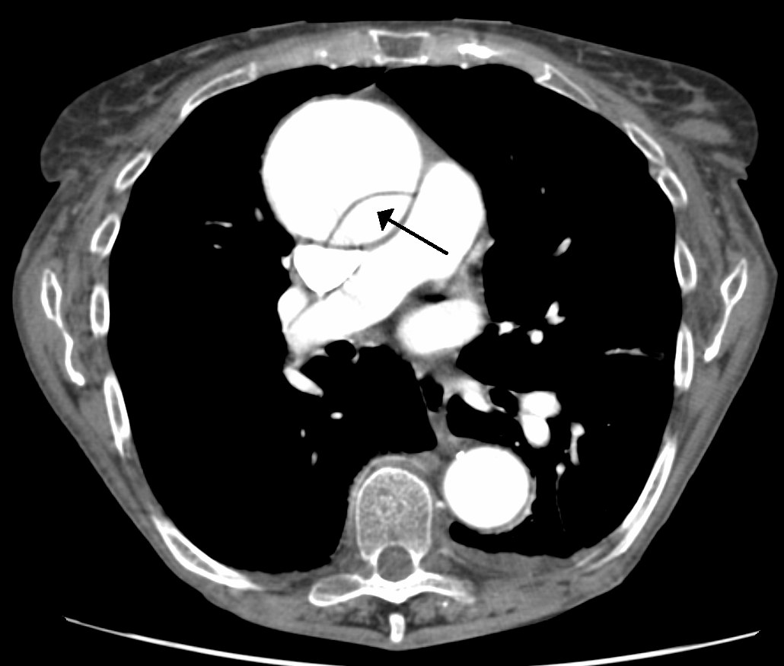
Figure 12.12 · Aortic Dissection & Special Targets
WHAT TO NOTICE
CT (figure): The arrow shows the intimal flap separating true and false lumens in the ascending aorta; the descending aorta beside the spine looks normal.
Dissection: SBP <120 mmHg and HR <60/min fast; esmolol [beta-1 selective blocker] first or with the vasodilator.
Ischemic stroke: Lower only if >220/120; before thrombolysis or clot retrieval <185/110, then <180/105 for 24 h.
Intracerebral hemorrhage: Systolic about 140 for most; more cautious above 220.
ACS or pulmonary edema: MAP down 15–25%, preferably with nitroglycerin [nitrate vasodilator].
Pheochromocytoma or stimulants: Phentolamine [alpha-adrenergic blocker]; never a beta blocker alone first.
Surgical emergency: Dissection involving the ascending aorta needs emergency surgery. Targets on this slide are from Miller et al. (2024).
“DissectionCT” by James Heilman, MD, Wikimedia Commons, CC BY-SA 3.0.
Pathophysiology for Nurses: A Canadian Open Text
Chapter 12 · Hypertension
Notes:
Figure 12.12 shows a dissection of the ascending aorta, a surgical emergency. Walk through each condition-specific target and the reason behind it.

Slide 35
SECTION 12.6 · IV AGENTS & CLINICAL SAFETY [RN]
Lowering pressure is where harm happens
Short-acting IV drugs are titrated minute by minute in a monitored setting; choice depends on the emergency and the formulary.
Titratable IV agents (Miller et al., 2024)
Clinical Safety: during titration
Labetalol [alpha- and beta-adrenergic blocker]: No reflex tachycardia; avoid in decompensated HF, bradycardia, heart block, asthma.
Nicardipine, clevidipine [dihydropyridine CCBs]: Arteriolar dilators by infusion; reflex tachycardia, headache.
Esmolol [beta-1 selective blocker]: Ultrashort-acting; with a vasodilator in dissection.
Nitroglycerin [nitrate vasodilator]: ACS and pulmonary edema; sharp drop if volume-depleted.
Nitroprusside [nitric oxide donor vasodilator]: Potent; cyanide risk; largely replaced.
Hydralazine [direct-acting arteriolar vasodilator]: Unpredictable; not for most emergencies outside pregnancy.
Do not normalize quickly: Confirm each period's target; report a MAP fall >25% in hour 1 (except dissection).
High-alert infusions: Smart pump with drug library, independent double checks, dedicated line, never flush or bolus.
Measure often: Every 5–15 min or arterial line, with heart rate, neuro status, urine output, chest pain.
Hypoperfusion: New confusion, weakness, chest pain, or low urine output → slow or stop per order and report.
Avoid: Short-acting nifedipine [dihydropyridine CCB] capsules (Rabi et al., 2020).
Pathophysiology for Nurses: A Canadian Open Text
Chapter 12 · Hypertension
Notes:
IV agents (Miller et al., 2024): labetalol (avoid in decompensated HF, bradycardia, heart block, asthma); nicardipine and clevidipine (reflex tachycardia, headache); esmolol (dissection); nitroglycerin (ACS, pulmonary edema); nitroprusside (cyanide; largely replaced); hydralazine (unpredictable; not recommended for most emergencies outside pregnancy). Clinical safety: confirm targets; report MAP fall >25% in hour 1 (except dissection); smart pump, double checks, dedicated line, no flushing; measure q5–15 min or arterial line; watch for hypoperfusion; avoid short-acting nifedipine (Rabi et al., 2020). Titrated IV infusions call for RN care or RPN consultation (CNO, 2023).

Slide 36
SECTION 12.6 · CLINICAL JUDGMENT (NCSBN CJMM)
Two clients, the same number: 196/112 mmHg
On a surgical unit, two clients have the same reading on the evening of surgery. Who is the priority?
Client A, 58: severe elevation
Client B, 71: probable emergency
Pain + missed medication, no organ injury
New neurological deficit = organ injury
Recognize: Grimacing; incisional pain 8/10; usual amlodipine [dihydropyridine calcium channel blocker] not given since admission; alert, oriented, clear lungs, no chest pain.
Analyze: No sign of acute organ injury; pressure driven by pain and missed medication.
Act: Analgesia and his usual oral antihypertensive as ordered.
Evaluate: Recheck after analgesia; it often falls substantially on its own.
Recognize: "Worst headache of my life"; vomiting; cannot recall why she is in hospital; weaker left grip.
Analyze & prioritize: New neurological deficits: stroke, hemorrhage, or encephalopathy. She is the priority.
Act: Rapid response or stroke protocol; time last known well; NPO; protect airway; neuro checks; urgent imaging; controlled lowering.
Evaluate: Neuro status with every reading; worsening as pressure falls suggests hypoperfusion.
Take-home: Call for help for Client B first, then treat Client A's pain and give his medication. The same number can mean two very different priorities.
Pathophysiology for Nurses: A Canadian Open Text
Chapter 12 · Hypertension
Notes:
Walk through the six CJMM steps. Recognize cues: Client A, 58, grimacing, pain 8/10, missed his usual amlodipine, alert, clear lungs. Client B, 71, 'worst headache of my life', vomiting, disoriented, weaker left grip. Analyze: A has no organ injury (pain and missed medication); B has new neurological deficits. Prioritize: B probable hypertensive emergency. Generate and take action: rapid response or stroke protocol, time last known well, NPO, airway positioning, neuro checks; then A's analgesia and usual oral medication. Evaluate: B's neuro status with each pressure reading (worsening as pressure falls suggests hypoperfusion); A's pressure after analgesia.

Slide 37
SECTION 12.7 · HYPERTENSION IN PREGNANCY
Definitions and the two-stage model of preeclampsia
Pregnancy thresholds differ: hypertension is 140/90 mmHg or higher; severe is 160/110 mmHg or higher (Carnegie et al., 2023).
Classification
Stage 1: the placenta
Stage 2: maternal endothelium
Chronic: Before pregnancy or before 20 weeks.
Gestational: New at 20 weeks or later, without preeclampsia features.
Preeclampsia: Gestational hypertension + new proteinuria or adverse conditions (low platelets, kidney or liver involvement, pulmonary edema, new headache, visual symptoms).
HELLP: Hemolysis, elevated liver enzymes, low platelets.
Eclampsia: Seizures with preeclampsia.
Normal: Trophoblast remodels spiral arteries into wide, low-resistance channels.
Preeclampsia: Remodelling is incomplete; arteries stay narrow and reactive.
Result: Placental underperfusion, ischemia–reoxygenation, and oxidative stress.
Angiogenic imbalance: High sFlt-1 and low PlGF (Poon et al., 2021).
Vasoconstriction: Less NO and prostacyclin; more endothelin and thromboxane.
Capillary leak: Edema and pulmonary edema despite reduced intravascular volume.
Organs: Glomerular endotheliosis (proteinuria), liver injury (RUQ pain), platelet consumption, cerebral edema.
Fetus: Growth restriction, low fluid, abruption.
Pathophysiology for Nurses: A Canadian Open Text
Chapter 12 · Hypertension
Notes:
Normal pregnancy: volume and cardiac output rise, but SVR falls sharply, so pressure dips in the second trimester; this can hide chronic hypertension. Measurement: average of ≥2 readings ≥15 min apart, same arm, after 5 min rest; severe = ≥160/110 on ≥2 readings within 15 min. Classification: chronic (<20 weeks), gestational (≥20 weeks), preeclampsia (gestational hypertension + proteinuria or adverse conditions); HELLP; eclampsia (Carnegie et al., 2023; Magee et al., 2022). Two-stage model: failed spiral artery remodelling → placental ischemia and oxidative stress → high sFlt-1, low PlGF (Poon et al., 2021) → maternal endothelial dysfunction. The only cure is delivery of the placenta.

Slide 38
SECTION 12.7 · PREVENTION, TREATMENT & MAGNESIUM SULFATE
Preventing and managing preeclampsia safely
Treat non-severe hypertension to prevent progression; treat severe hypertension urgently in a monitored setting.
Prevention & antihypertensive treatment
Clinical Safety: magnesium sulfate
ASA [antiplatelet / NSAID]: 81–162 mg at bedtime for increased risk, ideally from before 16 weeks, stopping at 36 weeks (Carnegie et al., 2023).
Calcium carbonate [calcium supplement]: 1,000–2,500 mg daily if dietary calcium is below 1,000 mg/day.
Non-severe: Target diastolic about 85 mmHg; labetalol [alpha- and beta-adrenergic blocker], nifedipine XL [dihydropyridine CCB], or methyldopa [centrally acting alpha-2 agonist] (Poon et al., 2021).
Severe (≥160/110): Urgent oral nifedipine, oral/IV labetalol, or IV hydralazine [direct-acting arteriolar vasodilator]; lower gradually with fetal monitoring.
Avoid: ACE inhibitors and ARBs (Goupil et al., 2025).
After birth: Pressure peaks on days 3–6; lifelong cardiovascular risk, with review at 6–12 weeks and yearly.
Use: Prevents and treats eclampsia; 4 g IV load, then infusion for 24 h (Poon et al., 2021). Not an antihypertensive.
Toxicity sequence: Loss of deep tendon reflexes → respiratory depression → cardiac conduction problems.
Monitor: Reflexes, RR, SpO₂, LOC, BP; hourly urine output (renal excretion).
Act: Stop the infusion and call for help; calcium gluconate [calcium salt / magnesium antidote] at the bedside.
Scope: RPNs consult the RN or transfer care (CNO, 2023).
Pathophysiology for Nurses: A Canadian Open Text
Chapter 12 · Hypertension
Notes:
Prevention (Carnegie et al., 2023): ASA 81–162 mg at bedtime from before 16 weeks to 36 weeks for people at increased risk; calcium 1,000–2,500 mg if dietary intake is below 1,000 mg/day. Treatment (Poon et al., 2021): target diastolic about 85; first-line labetalol, nifedipine XL, methyldopa; severe ≥160/110 urgently with oral nifedipine, oral or IV labetalol, or IV hydralazine, lowering gradually with fetal monitoring. Avoid ACE inhibitors and ARBs (Goupil et al., 2025). Magnesium sulfate: 4 g IV load then 24-h infusion; toxicity: reflexes lost first, then respiratory depression, then cardiac effects; calcium gluconate at bedside. Postpartum: pressure peaks days 3–6; lifelong cardiovascular risk; review at 6–12 weeks and yearly. RPN consults RN for severe preeclampsia or magnesium (CNO, 2023).

Slide 39
UNFOLDING CASES · QUESTIONS 1–5 AND 16–20
Applying the chapter: two unfolding cases
Use the cases to rehearse measurement, risk-based treatment decisions, and controlled lowering.
Case 1: Daniel Tremblay (52)
Case 2: Lorraine Bouchard (58)
New diagnosis in primary care
Hypertensive emergency after stopping medication
Presentation: Truck driver, pharmacy reading 152/96; father had a stroke; fast food, 3–4 beers nightly, loud snoring with apneas.
Measurement: 38 cm arm → large cuff; home monitoring to confirm.
Decision: Home 136/86, no high-risk features → lifestyle and reassess in 3–6 months.
Later: 146/94 → irbesartan-hydrochlorothiazide [ARB / thiazide combination]; labs; avoid NSAIDs and decongestants.
Trigger: Stopped amlodipine [CCB] and ramipril [ACE inhibitor] after losing her drug plan.
Organ injury: 228/132, confusion, papilledema, creatinine 168 µmol/L (baseline 90), CT negative → encephalopathy.
MAP: 132 + 96 ÷ 3 = 164 mmHg; first-hour target about 123–131 mmHg.
Trap: MAP falls 37% and she becomes drowsy → slow or stop infusion and report (hypoperfusion).
Equity lesson: Lorraine's emergency began with a drug-cost barrier. Discharge planning addresses coverage, home monitoring, and follow-up within days.
Pathophysiology for Nurses: A Canadian Open Text
Chapter 12 · Hypertension
Notes:
Case 1 (Daniel Tremblay, 52): cuff 38 cm arm → large cuff; HBPM teaching; home 136/86 with no high-risk features → lifestyle and reassess in 3–6 months; lifestyle targets including a sleep study; later 146/94 → irbesartan-hydrochlorothiazide with lab follow-up and avoidance of NSAIDs and decongestants. Case 2 (Lorraine Bouchard, 58): stopped amlodipine and ramipril after losing her drug plan; 228/132, confusion, papilledema, creatinine 168 µmol/L → hypertensive encephalopathy. MAP = 132 + 96/3 = 164; first-hour target about 123–131. MAP falls 37% with new drowsiness → slow or stop and report. Discharge: drug coverage (e.g., Trillium Drug Program), home monitor, follow-up within days.

Slide 40
Check your understanding
Why must the kidney's pressure–natriuresis relationship shift for hypertension to be sustained?
A client's office average is 128/78 mmHg and home average 142/90 mmHg. What pattern is this, and why does it matter?
Which findings should prompt you to report a possible secondary cause of hypertension?
Why does Hypertension Canada start most clients on a low-dose single-pill combination?
A client in hypertensive encephalopathy has a MAP of 164 mmHg. What is a reasonable MAP after the first hour, and why not lower?
A client receiving magnesium sulfate [anticonvulsant / electrolyte] has absent reflexes and a respiratory rate of 10/min. What do you do first?
Chapter 12 synthesis · Complete rationales are in the chapter's case studies and practice question sets (30 questions).
Notes:
Use these as think-pair-share prompts. Answers: (1) a normal kidney would excrete sodium and water until pressure returned to normal; (2) masked hypertension, which carries a risk similar to sustained hypertension; (3) onset before 30 or after 55, resistant hypertension, unexplained low potassium, paroxysmal adrenergic symptoms, creatinine rise ≥30% after an ACE inhibitor or ARB, sleep apnea features, pressure-raising drugs; (4) complementary mechanisms lower pressure more with fewer dose-related adverse effects, and one pill improves adherence; (5) about 123–131 mmHg (20–25% reduction); lower risks ischemia because autoregulation has shifted upward; (6) stop the infusion, call for urgent help, and prepare calcium gluconate.

Slide 41
References
Carnegie, C., MacDonald, T., & Minichiello, A. (2023). Hypertensive disorders of pregnancy (Clinical Practice Guideline No. 15). Association of Ontario Midwives.
College of Nurses of Ontario. (2019a). Entry-to-practice competencies for registered nurses.
College of Nurses of Ontario. (2019b). Entry-to-practice competencies for registered practical nurses.
College of Nurses of Ontario. (2023). Scope of practice [Practice standard].
DeGuire, J., Clarke, J., Rouleau, K., Roy, J., & Bushnik, T. (2019). Blood pressure and hypertension. Health Reports, 30(2), 14–21. https://doi.org/10.25318/82-003-x201900200002
Goupil, R., Tsuyuki, R. T., Santesso, N., Terenzi, K. A., Habert, J., Cheng, G., Gysel, S. C., Bruneau, J., Leung, A. A., Campbell, N. R. C., Schiffrin, E. L., & Hundemer, G. L. (2025). Hypertension Canada guideline for the diagnosis and treatment of hypertension in adults in primary care. CMAJ, 197(20), E549–E564. https://doi.org/10.1503/cmaj.241770
Health Canada. (2018). Sodium intake of Canadians in 2017.
Magee, L. A., Smith, G. N., Bloch, C., Côté, A.-M., Jain, V., Nerenberg, K., von Dadelszen, P., Helewa, M., & Rey, E. (2022). Guideline No. 426: Hypertensive disorders of pregnancy. Journal of Obstetrics and Gynaecology Canada, 44(5), 547–571.e1. https://doi.org/10.1016/j.jogc.2022.03.002
Miller, J. B., Hrabec, D., Krishnamoorthy, V., Kinni, H., & Brook, R. D. (2024). Evaluation and management of hypertensive emergency. BMJ, 386, e077205. https://doi.org/10.1136/bmj-2023-077205
Poon, L. C., Magee, L. A., Verlohren, S., et al. (2021). A literature review and best practice advice for second and third trimester risk stratification, monitoring, and management of pre-eclampsia. International Journal of Gynecology & Obstetrics, 154(S1), 3–31. https://doi.org/10.1002/ijgo.13763
Rabi, D. M., McBrien, K. A., Sapir-Pichhadze, R., et al. (2020). Hypertension Canada's 2020 comprehensive guidelines for the prevention, diagnosis, risk assessment, and treatment of hypertension in adults and children. Canadian Journal of Cardiology, 36(5), 596–624. https://doi.org/10.1016/j.cjca.2020.02.086
World Health Organization. (2023). Global report on hypertension: The race against a silent killer.
Pathophysiology for Nurses: A Canadian Open Text
Chapter 12 · Hypertension
Notes:
All references are in APA 7th edition and were verified for the chapter. Full URLs and DOIs appear in the chapter's reference list.

