Slide 1
Substance Use in Acute Care
CHAPTER 11 · PATHOPHYSIOLOGY FOR NURSES: A CANADIAN OPEN TEXT
What substances do to the body, why stopping them can be dangerous, and how those mechanisms show up at the bedside on medical and surgical units.
Andrew Lee, BEd, BN, MN, RN, CCN(C)
Aligned with the 2024 national opioid use disorder guideline, the Canadian guideline for high-risk drinking and alcohol use disorder, Canada's Guidance on Alcohol and Health, and CNO entry-to-practice competencies (RN and RPN)
opensourcenursing.ca (CC BY-NC-SA 4.0)
Notes:
Welcome. Every acute care unit in Canada cares for people who use substances. Some are admitted because of a substance (an overdose, alcohol-related pancreatitis, an abscess); many more are admitted for something unrelated, and their substance use only becomes visible when withdrawal or poorly controlled pain appears. The bedside nurse is usually first to notice. This session moves from the brain to alcohol, opioids, stimulants and other substances, then to injection-related complications and safe discharge.
Sources: Yakovenko et al. (2024); Wood et al. (2023); CCSA (2023); CNO (2019a, 2019b).

Slide 2
By the end of this session you will be able to
LEARNING OUTCOMES
Explain the mechanisms
Recognize and respond
Plan safe care
Reward and neuroadaptation: tolerance, dependence, withdrawal, craving
Stimulants: sympathomimetic cardiovascular, thermal and muscle injury
Other syndromes: sedative–hypnotics, GHB, cannabis and nicotine
CNO mapping: RN Clinician, Scholar · RPN Foundations of Practice
Screen on admission with validated tools and person-first language
Alcohol: CIWA-Ar, Wernicke encephalopathy, organ injury
Opioids: overdose response and opioid agonist treatment
CNO mapping: RN Clinician, Communicator, Leader, Collaborator · RPN Foundations, Collaborative, Legal Practice
Harm reduction built into every care plan
Trauma-informed and culturally safe practice
Discharge planning that reduces patient-initiated discharge and overdose risk
CNO mapping: RN Advocate, Educator · RPN Ethical Practice, Professional Practice
Layered for two audiences: Going Deeper content is required for RN students and optional for PN students; Scope in Practice shows where RN and RPN roles differ.
Notes:
These group the chapter's eight learning outcomes. Outcomes 1, 6 and 7 are about mechanisms; 2, 3, 4 and 5 are about recognition and response; 8 is about harm reduction and safe transitions. Each maps to RN roles (CNO, 2019a) and RPN categories (CNO, 2019b) as shown in the chapter's Table 11.0. Point out that Going Deeper content is required for RN students and optional for PN students, and that Scope in Practice boxes show where RN and RPN roles differ.

Slide 3
The burden of substance use in Canada
CANADIAN DATA
Legal substances cause most illness on the wards; opioids cause most of the preventable deaths in younger adults
$49.1B
73,994
5,608
6.7×
cost of substance use in Canada, 2020; alcohol was the largest share at $19.7 billion
deaths attributed to substance use in 2020, including 46,366 from tobacco and 17,098 from alcohol
opioid toxicity deaths in 2025, about 15 every day, down 23% from 2024
higher toxic drug death rate for First Nations people in BC, 2024
Sources: Canadian Substance Use Costs and Harms Scientific Working Group (2023); Council of Chief Medical Officers of Health (2026); First Nations Health Authority (n.d.)
The supply has changed: benzodiazepine-type drugs were involved in 34% of opioid toxicity deaths in 2024, up from 8% in 2018 (Council of Chief Medical Officers of Health, 2026).
Notes:
Statistics: $49.1 billion total cost in 2020; alcohol $19.7 billion, tobacco $11.2 billion, opioids $7.1 billion; 73,994 deaths attributed to substance use in 2020 (46,366 tobacco, 17,098 alcohol, 6,491 opioids) (Canadian Substance Use Costs and Harms Scientific Working Group, 2023). Opioid toxicity deaths in 2025: 5,608, about 15 per day, a 23% decrease from 2024 (Council of Chief Medical Officers of Health, 2026). First Nations people in BC died of toxic drug poisoning at 6.7 times the rate of other residents in 2024 (First Nations Health Authority, n.d.). Emphasize that these gaps reflect colonial policies and racism, not anything about Indigenous people.

Slide 4
The brain, stigma and screening
PART 1
The reward circuit, neuroadaptation, normal baselines, stigma-free care, harm reduction and admission screening.
Notes:
Part 1 covers the chapter Introduction and section 11.1. The goal is a shared mechanism we will reuse for every substance: substances raise dopamine in the reward circuit by different routes, and the nervous system adapts, so withdrawal mirrors intoxication.

Slide 5
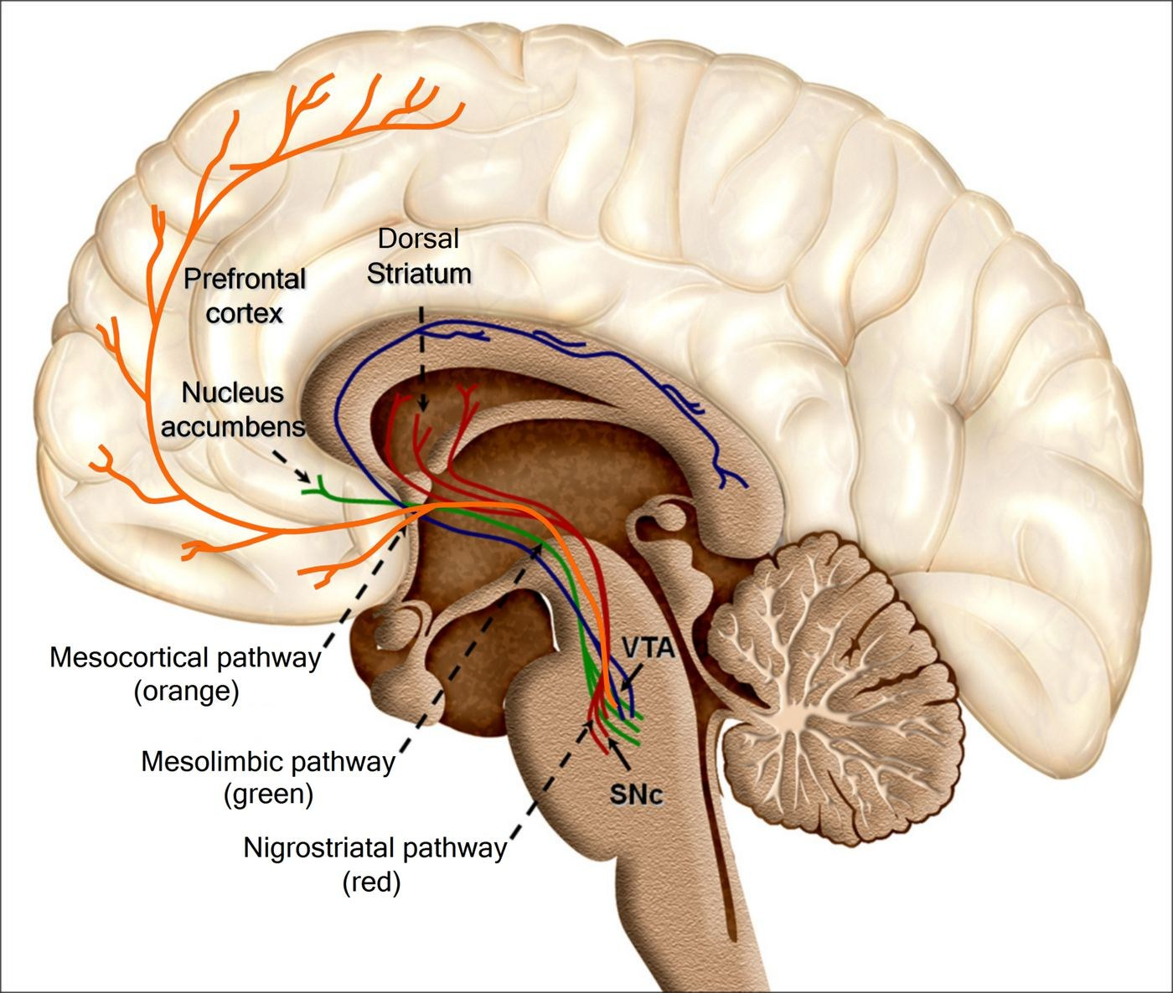
Figure 11.1 · The brain's dopamine reward pathways
WHAT TO NOTICE
Mesolimbic (green): VTA to nucleus accumbens, the main route by which substances reinforce further use
Mesocortical (orange): VTA to prefrontal cortex, which shapes judgement and impulse control
Nigrostriatal (red): substantia nigra to dorsal striatum
Dopamine is a teaching signal: it marks an event, and the cues before it, as worth repeating
Key idea: in a healthy brain, reward and prefrontal control stay balanced, so a person can want something and still decide not to act.
Figure 11.1. "Recolored Overview of reward structures in the human brain2.png" by Oscar Arias-Carrión, Maria Stamelou, Eric Murillo-Rodríguez, Manuel Menéndez-González & Ernst Pöppel, via Wikimedia Commons, CC BY 2.0.
Notes:
Walk through the three colour-coded pathways. Natural rewards raise dopamine in the nucleus accumbens modestly and briefly; almost every substance people use raises it more steeply and for longer. The prefrontal cortex is the brain's brake and planning system. Source: chapter Introduction.
Figure credit: Figure 11.1: "Recolored Overview of reward structures in the human brain2.png" by Oscar Arias-Carrión, Maria Stamelou, Eric Murillo-Rodríguez, Manuel Menéndez-González & Ernst Pöppel, via Wikimedia Commons, CC BY 2.0.

Slide 6
Different substances, different routes to dopamine
INTRODUCTION
Each route explains a different toxicity and withdrawal syndrome
Opioids inhibit the GABA neurons that hold VTA neurons in check, so dopamine neurons fire more
Nicotine stimulates nicotinic acetylcholine receptors on the dopamine neurons themselves
Alcohol and benzodiazepines enhance inhibitory GABA signalling and indirectly increase dopamine release
Cannabis acts on CB1 receptors that modulate the release of other transmitters
Cocaine blocks the dopamine transporter, so dopamine stays in the synapse longer
Glutamate is the main excitatory transmitter (NMDA receptors); GABA is the main inhibitory one (GABA-A)
Amphetamines reverse the transporter and push dopamine out of the neuron
The balance of excitation and inhibition sets alertness, sleep, heart rate, blood pressure and temperature
Tipping the balance: alcohol, benzodiazepines and GHB push toward inhibition; stimulants push toward excitation; opioids suppress the brainstem centres for breathing and arousal.
Notes:
From the chapter Introduction. Each substance raises dopamine in the nucleus accumbens by a different mechanism, which is why each has its own toxic and withdrawal syndrome. Opioids disinhibit VTA neurons; alcohol and benzodiazepines enhance GABA; cocaine blocks the dopamine transporter; amphetamines reverse it; nicotine stimulates nicotinic receptors on the dopamine neurons; cannabis acts on CB1 receptors.

Slide 7
Neuroadaptation: tolerance, dependence and withdrawal
INTRODUCTION
The nervous system defends its set points
Tolerance
Physical dependence
Withdrawal
More drug, same effect: receptors are reduced, less sensitive, or opposed by compensating systems
Clinical impact: people with tolerance can look alert at levels that would sedate others
Body needs the drug to function near normal
Predictable state: also develops with prescribed opioids or benzodiazepines taken as directed
Not the same as a substance use disorder
Compensations unopposed when the substance stops
Usually the mirror image of intoxication: sedation leaves excitation; a stimulant leaves exhaustion and low mood
Craving: dopamine responses shift to cues that predict the substance, natural rewards shrink and prefrontal control weakens. Addiction is a chronic, treatable condition, not a moral failing.
Notes:
If a substance is present day after day, neurons adjust to restore balance with it on board. Physical dependence is a predictable physiological state and also develops with prescribed opioids or benzodiazepines taken exactly as directed. A substance use disorder needs loss of control, use despite harm, craving and giving up important activities. Someone taking a prescribed opioid for cancer pain can be physically dependent with none of the other features. Addiction is a chronic, treatable health condition, not a moral failing.

Slide 8
Why withdrawal mirrors intoxication
GOING DEEPER [RN]
RN required · PN optional
Alcohol: GABA–glutamate rebound
Opioids: cyclic AMP rebound
Adaptation: fewer, altered GABA-A receptors; more NMDA receptors and glutamate release
Withdrawal: weak inhibition, strong excitation, noradrenergic surge (tachycardia, hypertension, tremor, sweating)
Kindling: each episode leaves the brain more excitable; prior seizures or DTs predict severe withdrawal
Adaptation: opioids inhibit adenylyl cyclase in locus coeruleus neurons; chronic use drives it up
Withdrawal: cAMP and noradrenergic firing overshoot: restlessness, sweating, diarrhea, piloerection, dilated pupils
Risk: rarely seizures in adults, but drives patients to leave and is followed by lost tolerance
Bedside link: ask about prior withdrawal seizures and delirium tremens on admission; they are the strongest clues that this withdrawal will be severe.
Notes:
Going Deeper box from section 11.1. Alcohol: fewer and altered GABA-A receptors, more NMDA receptors and glutamate release; removing alcohol leaves weak inhibition and strong excitation, plus a noradrenergic surge from the locus coeruleus. Each repeated episode leaves the brain more excitable (kindling), so prior withdrawal seizures or DTs predict severe withdrawal now. Opioids: chronic exposure drives up adenylyl cyclase in locus coeruleus neurons; when the opioid is removed, cAMP and noradrenergic firing overshoot. Opioid withdrawal rarely causes seizures or delirium in adults but causes intense suffering, drives patients to leave hospital, and is followed by lost tolerance and high overdose risk.

Slide 9
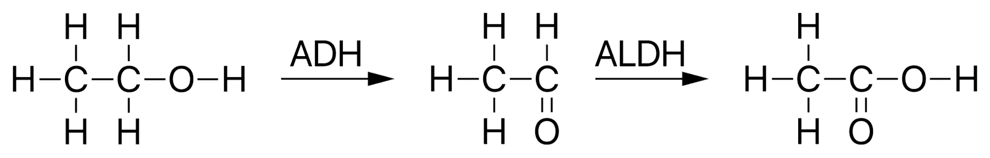
Figure 11.2 · Hepatic metabolism of ethanol
WHAT TO NOTICE
Step 1: alcohol dehydrogenase (ADH) converts ethanol to acetaldehyde, the toxic intermediate
Step 2: aldehyde dehydrogenase (ALDH) converts acetaldehyde to acetic acid (acetate)
Both steps generate NADH which shifts liver metabolism away from gluconeogenesis and fat oxidation
Result: fatty liver, hypoglycemia in people not eating, and alcoholic ketoacidosis
Figure 11.2. "Ethanol metabolism.svg" by Vaccinationist, via Wikimedia Commons, Public domain.
Why it matters: this metabolic shift explains several alcohol-related problems we will meet in Part 2.
Notes:
From the Introduction (normal metabolism and the liver). Most substances are cleared by the liver, and several, alcohol especially, damage it. The excess NADH from heavy drinking is the starting point for fatty liver, hypoglycemia and alcoholic ketoacidosis (section 11.2).
Figure credit: Figure 11.2: "Ethanol metabolism.svg" by Vaccinationist, via Wikimedia Commons, Public domain.

Slide 10
Bedside baselines used in this chapter
INTRODUCTION
Adult SI reference values; use the range on your own laboratory's report
Arterial pH 7.35–7.45 falls with hypoventilation and with ketoacidosis or lactic acidosis
Magnesium 0.65–1.05 mmol/L often low in alcohol use disorder; raises seizure and dysrhythmia risk
PaCO2 35–45 mm Hg rises when ventilation is depressed; the most direct measure of hypoventilation
Phosphate 1.0–1.5 mmol/L drops with refeeding and the respiratory alkalosis of withdrawal
Bicarbonate 23–29 mmol/L falls with alcoholic ketoacidosis and stimulant-related lactic acidosis
Creatine kinase 20–215 IU/L (males), 20–160 IU/L (females); rises sharply in rhabdomyolysis
Potassium 3.5–5.1 mmol/L often low in alcohol use disorder; high with rhabdomyolysis
INR 0.9–1.1 rises when the liver cannot make clotting factors
Watch the patient, not just the numbers: count the respiratory rate properly and score sedation; sleepiness usually worsens before breathing does (Gupta & Edwards, 2018).
Notes:
From Table 11.1 (Royal College of Physicians and Surgeons of Canada, 2018). Reference intervals vary slightly between laboratories. Respiratory rate and depth are the vital signs most often missed and most often decisive in substance-related deterioration. In patients receiving opioids, increasing sleepiness is the most common warning sign before respiratory depression (Gupta & Edwards, 2018).

Slide 11
Unequal harms: equity and cultural safety
11.1 · CANADIAN CONTEXT
Unequal harms
Culturally safe care
Rural and remote
6.7× toxic drug death rate for First Nations people in BC, 2024
11.6× for First Nations women
Root causes: residential schools, the Sixties Scoop, ongoing racism in health care
Start with yourself: examine your own assumptions
Offer: an Indigenous patient navigator, Elder or traditional healer, and accept the answer
OCAP®: First Nations govern how their own data are gathered and used
Fewer prescribers of opioid agonist treatment
Long travel to withdrawal management services
Slower response to overdose; plan discharge around what is available close to home
Source: First Nations Health Authority (n.d.), First Nations and the toxic drug poisoning crisis in BC, January–December 2024.
Notes:
Canadian Context box, section 11.1. In BC, First Nations people died of toxic drug poisoning at 6.7 times the rate of other residents in 2024, and 11.6 times for First Nations women (First Nations Health Authority, n.d.). The chapter is explicit that these gaps reflect colonial policies (residential schools, the Sixties Scoop, ongoing racism in health care) that caused intergenerational trauma, not anything about Indigenous people. OCAP® principles: ownership, control, access and possession. Rural and remote communities have fewer OAT prescribers, longer travel to withdrawal services and slower overdose response.

Slide 12
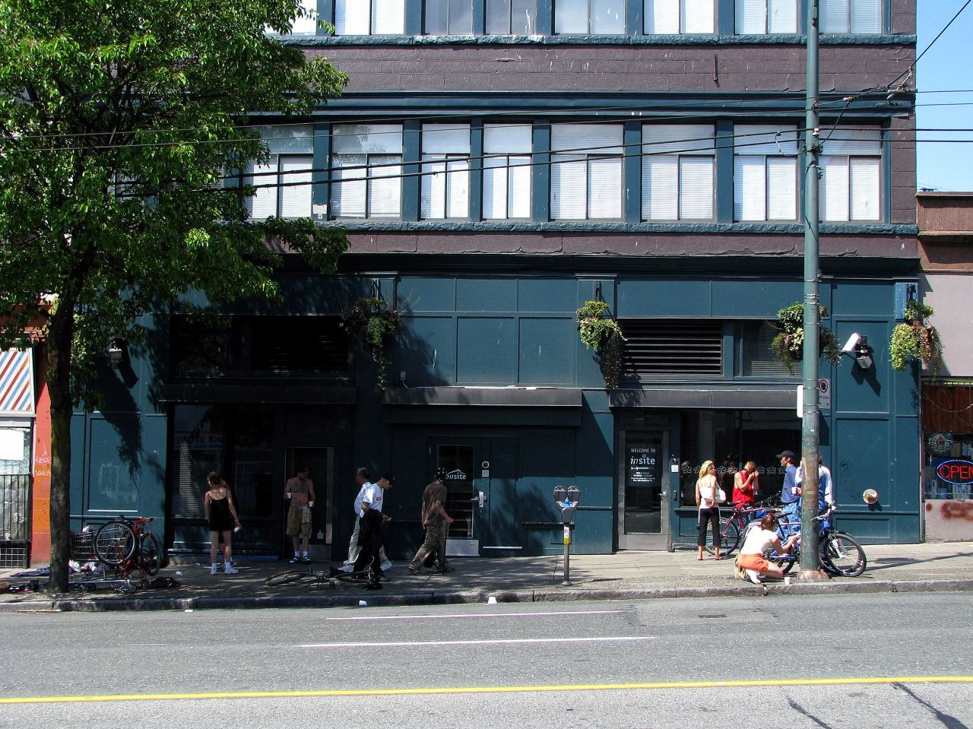
Figure 11.3 · Insite, Vancouver's supervised injection site
WHAT TO NOTICE
Opened in 2003 as North America's first sanctioned supervised injection site
Supervised consumption services prevent overdose deaths and connect people with health and social care
One of many harm reduction tools: naloxone [opioid antagonist] kits, sterile supplies, drug checking, opioid agonist treatment
Hospital link: teams can refer patients at discharge
Harm reduction reduces harm without requiring the person to stop using; it keeps people alive and connected to care.
Figure 11.3. "Controversial Safe Injection Site.jpg" by Name invalid (Wikimedia Commons user), via Wikimedia Commons, Public domain.
Notes:
From section 11.1. Harm reduction meets people where they are and is not opposed to treatment. The RN entry-to-practice competencies expect new graduates to build harm reduction principles into care plans (CNO, 2019a), and the national OUD guideline places harm reduction within the continuum of care (Yakovenko et al., 2024).
Figure credit: Figure 11.3: "Controversial Safe Injection Site.jpg" by Name invalid (Wikimedia Commons user), via Wikimedia Commons, Public domain.

Slide 13
Stigma, language and trust
11.1 · STIGMA-FREE CARE
Words in handover and the chart shape how others see the patient
Instead of
Use
addict, junkie, user
drug abuse, substance abuser
former addict; clean
problem drug use
drug-seeking
person who uses drugs; person with a substance use disorder
substance use; addiction or substance use disorder
person in recovery; not currently using
higher-risk substance use
describe the request and context: "requests analgesia; pain 8/10"
Trauma-informed care: explain before touching, offer choices, avoid unnecessary restraint and searches, and be consistent and predictable (Health Canada, 2022; Ling, 2023).
Notes:
Stigma shows up as delayed pain assessment, assumptions of drug-seeking, security searches, and judging words in the chart. Patients who leave hospital early often describe untreated withdrawal, untreated pain and feeling judged (Ling, 2023). Language examples are from Table 11.2, adapted from Health Canada (2022). Trauma-informed care: explain before touching, offer choices, avoid unnecessary restraint and searches, and be consistent and predictable. None of this requires disclosure.

Slide 14
Screening on admission predicts withdrawal
11.1 · SCREENING
Ask every patient, the same way, and record the time of last use
1
2
3
4
5
How much alcohol?
When was your last drink?
Ever had shakes or seizures?
Other substances?
Daily pharmacy medications?
Days per month, and how much on a typical day
The time, not just the day: it anchors the withdrawal timeline
Prior withdrawal, seizures or hallucinations predict severity
How used, and when last used
Methadone [full opioid agonist] or buprenorphine [partial opioid agonist]
Canada's Guidance on Alcohol and Health: ≤2 drinks/week low risk, 3–6 moderate, ≥7 increasingly high; no more than 2 on any day (CCSA, 2023).
Notes:
RNAO (2015) recommends screening all clients for substance use, using motivational interviewing and offering brief intervention. In acute care, screening also predicts withdrawal. Canada's Guidance on Alcohol and Health: 2 or fewer standard drinks per week low risk, 3 to 6 moderate, 7 or more increasingly high; no more than 2 on any day (CCSA, 2023). More than half of Canadians aged 15+ drink more than the guidance recommends, and nearly 18% will meet criteria for alcohol use disorder in their lifetime (BCCSU, 2023). Missed OAT doses are a common, avoidable cause of in-hospital withdrawal.

Slide 15
Recognizing toxidromes before the toxicology result
11.1 · TOXIDROMES
Toxicology screens often miss fentanyl analogues, novel benzodiazepines and veterinary sedatives
Opioid toxicity
Sedative–hypnotic toxicity
Sympathomimetic toxicity
Consciousness: decreased, may be unrousable
Breathing: slow, shallow, apneic
Pupils: constricted (miosis)
HR/BP: normal or low; skin may be cool
alcohol, benzodiazepines, GHB
cocaine, methamphetamine
Consciousness: decreased; slurred speech, ataxia
Breathing: normal to depressed; severe with opioids
Pupils: usually normal
Consciousness: agitated, anxious, may be psychotic
Pupils: dilated (mydriasis)
HR/BP: high / high
Skin: hot, sweaty
Withdrawal mirrors intoxication: alcohol and sedative withdrawal look sympathomimetic; opioid withdrawal brings dilated pupils, gooseflesh, yawning and tearing.
Notes:
From Table 11.3. A toxidrome lets you act before a toxicology result, and mixed pictures are common because of the contaminated supply. Withdrawal patterns: alcohol or sedative withdrawal looks like sympathetic overdrive (anxious, tremulous, fast breathing, high HR and BP, sweaty, fever in DTs). Opioid withdrawal: alert, restless, dilated pupils, mild tachycardia, gooseflesh, yawning, tearing, runny nose.

Slide 16
Alcohol: intoxication, withdrawal and organ injury
PART 2 · SECTION 11.2
Withdrawal timeline, PAWSS and CIWA-Ar, thiamine [vitamin B1] and Wernicke encephalopathy, electrolytes, liver and pancreas.
Notes:
Alcohol causes more hospital admissions than any other substance in Canada (Canadian Substance Use Costs and Harms Scientific Working Group, 2023), and its withdrawal syndrome is one of the few in this chapter that can kill.

Slide 17
The alcohol withdrawal timeline
11.2 · ALCOHOL WITHDRAWAL
Stages overlap; withdrawal can start while blood alcohol is still measurable
6–12 hours
12–24 hours
24–48 hours
48–72 hours
Minor withdrawal
Alcoholic hallucinosis
Withdrawal seizures
Delirium tremens
Insomnia, tremulousness, anxiety, nausea, headache, sweating, palpitations
Visual, auditory or tactile hallucinations with clear consciousness
Generalized tonic-clonic, often single or a brief cluster; possible from 2 hours
Disorientation, hallucinations, agitation, tachycardia, hypertension, fever; up to 5 days
Delirium tremens: estimated mortality 5% to 10%, from dysrhythmias, hyperthermia, aspiration, fluid and electrolyte disturbances and injury (Gortney et al., 2016).
Notes:
From Table 11.4 (Gortney et al., 2016). Seizures are possible from 2 hours, and DTs as late as 5 days. Hallucinosis differs from DTs: a patient with hallucinosis is oriented and knows the experiences are unusual; DTs bring fluctuating, disordered consciousness. DT mortality is estimated at 5% to 10% (Gortney et al., 2016), from dysrhythmias, hyperthermia, aspiration, fluid and electrolyte disturbances and injuries. Withdrawal depends on the fall from the person's usual level, not on reaching zero.

Slide 18
PAWSS predicts risk; CIWA-Ar measures severity
11.2 · PREDICT AND MEASURE
PAWSS: predicting severe withdrawal
CIWA-Ar: measuring withdrawal
Who: anyone who drank in the past 30 days or has a positive blood alcohol on admission
Items: recent intoxication, prior treatment, prior withdrawal, blackouts, prior seizures or DTs, mixing with sedatives or other substances, high blood alcohol, autonomic signs
Score ≥4: high risk; sensitivity 93.1%, specificity 99.5% (Maldonado et al., 2015)
10 items, score 0–67: nausea, tremor, sweats, anxiety, agitation, tactile, auditory and visual disturbances, headache, orientation
Drives symptom-triggered dosing in most medical patients
Unreliable when the patient cannot communicate, is immediately post-op, or is delirious from another cause
Prefer scheduled dosing for patients with a history of delirium tremens, or whose symptoms cannot be reliably assessed (Gortney et al., 2016).
Notes:
PAWSS (Maldonado et al., 2015): applies to anyone who drank in the past 30 days or has a positive blood alcohol on admission; 10 items, one point each; score of 4 or more = high risk of complicated withdrawal; at that cut-off sensitivity 93.1% and specificity 99.5%. CIWA-Ar (Sullivan et al., 1989), developed at the Addiction Research Foundation in Toronto: 10 items, total 0 to 67. Six of the ten items depend on the patient describing their experience, so it is unreliable in patients who are intubated, deeply sedated, immediately post-op, aphasic, or delirious from another cause; scores can be falsely raised by sepsis, hyperthyroidism or pain. Scheduled dosing is preferred for a history of DTs or when symptoms cannot be assessed (Gortney et al., 2016).

Slide 19
CIWA-Ar symptom-triggered benzodiazepine dosing
11.2 · SYMPTOM-TRIGGERED THERAPY
Example tiers only; your facility's order set governs the actual doses
0–7
8–10
11–15
16–19
≥20
No medication
Mild
Moderate
Severe
Escalate
Reassess every 2 hours per protocol
chlordiazepoxide [benzodiazepine] 25⁠–⁠50 mg or lorazepam [benzodiazepine] 1⁠–⁠2 mg; reassess every 2 h
chlordiazepoxide [benzodiazepine] 50⁠–⁠75 mg or lorazepam [benzodiazepine] 2⁠–⁠3 mg; every 1⁠–⁠2 h
chlordiazepoxide [benzodiazepine] 75⁠–⁠100 mg or lorazepam [benzodiazepine] 3⁠–⁠4 mg; every 1⁠–⁠2 h
Notify the prescriber; evaluate for a higher level of care; continuous observation
Lower starting doses for older adults and people on other liver-metabolized drugs; space out monitoring once scores stay below 8 on three checks (Gortney et al., 2016).
Notes:
From Table 11.5 (Gortney et al., 2016). Lower starting doses are advised for older adults and people taking other liver-metabolized drugs. Monitoring is spaced out once scores remain below 8 on three consecutive checks. Benzodiazepines bind the GABA-A receptor and increase its response to GABA, replacing the inhibition alcohol used to supply. Long-acting agents (diazepam [benzodiazepine], chlordiazepoxide [benzodiazepine]) self-taper; lorazepam [benzodiazepine] has no active metabolites and does not depend on oxidative liver metabolism.

Slide 20
Who manages alcohol withdrawal?
11.2 · SCOPE IN PRACTICE
Complexity, predictability and risk decide, not the task itself
RPN can independently care for
RPN consults the RN and prescriber when
Low PAWSS score and stable, mild withdrawal
Responding to treatment with CIWA-Ar falling as expected
Both RNs and RPNs score CIWA-Ar and give medications under an order or directive
CIWA-Ar is rising despite dosing, or reaches the notification range
New disorientation, fever, a seizure, or vital signs outside parameters
The patient cannot participate in the CIWA-Ar
High PAWSS, prior DTs, liver failure, heart disease or recent surgery
Delirium tremens is unstable and unpredictable; care generally falls to the RN, often in step-down or critical care, with the RPN contributing within the team.
Notes:
Scope in Practice box, section 11.2. Both RNs and RPNs perform CIWA-Ar assessments and give medications under an order or medical directive, within individual competence and organizational policy. Patients with delirium tremens are unstable and unpredictable; their care generally falls to the RN, often in step-down or critical care, with the RPN contributing within a collaborative team.

Slide 21
Thiamine before glucose, and the two faces of benzodiazepines
11.2 · CLINICAL SAFETY
Give thiamine first
Watch for oversedation
Thiamine [vitamin B1] is a cofactor for enzymes that metabolize glucose
Dextrose [carbohydrate] first can precipitate or worsen Wernicke encephalopathy in a deficient patient
Hypoglycemia: never delay treatment; give thiamine [vitamin B1] alongside it
Doses accumulate as the patient settles, especially long-acting agents in older adults and liver disease
Before every dose: check sedation level and respiratory rate
Hold and notify if the patient is difficult to rouse; no dose is needed to "stay ahead"
Adjuncts only: haloperidol [first-generation antipsychotic] does not treat withdrawal and lowers the seizure threshold; restraints are a last resort.
Notes:
Clinical Safety box, section 11.2. Thiamine [vitamin B1] is a cofactor for glucose-metabolizing enzymes; a dextrose [carbohydrate] infusion in a thiamine-deficient person increases demand and can precipitate or worsen Wernicke encephalopathy. Never delay treating documented hypoglycemia, but give thiamine [vitamin B1] alongside it (Gortney et al., 2016). Benzodiazepine doses in severe withdrawal can be large and accumulate, especially long-acting agents in older adults and people with liver disease. Antipsychotics such as haloperidol [first-generation antipsychotic] are only adjuncts: they do not treat withdrawal and lower the seizure threshold. Restraints increase agitation, hyperthermia and injury.

Slide 22
Wernicke encephalopathy and Korsakoff syndrome
11.2 · WERNICKE–KORSAKOFF
Treat on suspicion; the classic triad is often incomplete and late
Mechanism
Recognize
Treat
Thiamine deficiency from poor intake, absorption, storage and activation
High-demand regions (mammillary bodies, thalamus, periaqueductal grey) cannot metabolize glucose
Lactate builds, cells swell and neurons die
Classic triad: confusion, nystagmus or ophthalmoplegia, ataxia
Often incomplete and late (Ganatra et al., 2023)
Confusion alone is easily blamed on intoxication or withdrawal
Parenteral thiamine [vitamin B1] for several days; IV for the first 2–5 days
Folic acid [vitamin B9] because folate deficiency is common
Correct magnesium, a cofactor for thiamine-dependent enzymes
Stakes: untreated Wernicke encephalopathy is fatal in up to 20%; more than half of survivors develop Korsakoff syndrome (Ganatra et al., 2023).
Notes:
Heavy drinking reduces thiamine [vitamin B1] intake, absorption, storage and activation. High-demand regions (mammillary bodies, thalamus around the third ventricle, periaqueductal grey) cannot metabolize glucose; lactate builds, cells swell and neurons die. The full triad is present in only a minority and often late (Ganatra et al., 2023). Untreated Wernicke encephalopathy is fatal in up to 20%; more than half of survivors develop Korsakoff syndrome. No consensus on the best dose; IV thiamine [vitamin B1] is usually given for the first 2 to 5 days with folic acid (Gortney et al., 2016; Ganatra et al., 2023) [vitamin B9]. Magnesium is a cofactor for thiamine-dependent enzymes.

Slide 23
Phosphate, magnesium and potassium in alcohol use disorder
11.2 · ELECTROLYTES
Low phosphate in up to 50%; low magnesium in up to 27% (Bianda et al., 2025)
Why levels fall
What they cause
What the nurse does
Poor intake and vomiting, diarrhea, tubular losses
Shifts into cells: catecholamines, respiratory alkalosis, glucose and refeeding
Vicious cycle: low magnesium drives phosphate and potassium loss
Low magnesium: tremor, neuromuscular irritability, seizures, dysrhythmias
Severe low phosphate: weakness including the diaphragm, respiratory failure, dysrhythmias, seizures, coma
Replace as ordered: magnesium sulfate [electrolyte replacement], potassium chloride [electrolyte replacement], phosphate [electrolyte replacement]
Recheck at least daily during withdrawal and refeeding
Ionized calcium when albumin is low
Remember: low potassium will not correct until magnesium is replaced, because the kidney keeps wasting potassium (Bianda et al., 2025).
Notes:
From section 11.2 (Bianda et al., 2025). Causes are layered: poor intake; vomiting, diarrhea and tubular losses; shifts into cells from catecholamines, the respiratory alkalosis of hyperventilation, glucose and refeeding; correcting acidosis can unmask low magnesium; and a vicious cycle in which low magnesium promotes kidney phosphate loss and keeps potassium hard to correct. Monitor at least daily during withdrawal and refeeding; use ionized calcium when albumin is low.

Slide 24
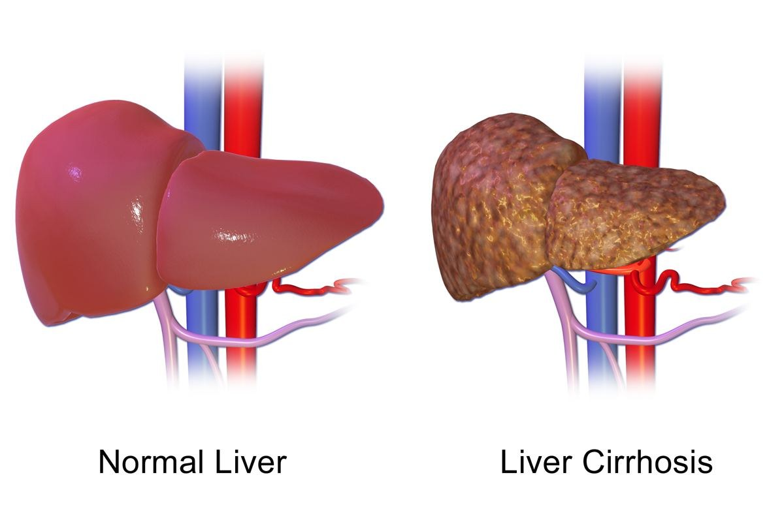
Figure 11.4 · Normal liver compared with cirrhosis
WHAT TO NOTICE
Fatty liver: excess NADH and acetaldehyde shift metabolism to fat synthesis; usually silent and reversible
Alcohol-related hepatitis: jaundice, fever, tender hepatomegaly, rising bilirubin and INR
Cirrhosis: activated stellate cells lay down collagen; scar bands surround regenerating nodules
Result: loss of liver function plus portal hypertension
Three overlapping stages: steatosis → hepatitis → cirrhosis; abstinence can reverse the early stages.
Figure 11.4. "Liver Cirrhosis.png" by BruceBlaus, via Wikimedia Commons, CC BY-SA 4.0.
Notes:
From section 11.2 (Liver). Gut-derived bacterial products reaching the liver through a leaky intestinal barrier add to the inflammation of alcohol-related hepatitis, which carries a high short-term mortality when severe.
Figure credit: Figure 11.4: "Liver Cirrhosis.png" by BruceBlaus, via Wikimedia Commons, CC BY-SA 4.0.

Slide 25
Two families of problems in cirrhosis
11.2 · CIRRHOSIS
Loss of liver function
Portal hypertension
Low albumin: edema and ascites
Fewer clotting factors: raised INR
Jaundice and reduced ammonia clearance, causing hepatic encephalopathy
Estrogen not broken down: spider angiomas, palmar erythema, gynecomastia
Blood diverts through collateral veins
Esophageal varices, caput medusae and rectal varices
Splenomegaly traps platelets
RAAS-driven sodium retention adds to ascites
Variceal bleed: airway, two large-bore IVs, blood products, octreotide [somatostatin analogue], ceftriaxone [third-generation cephalosporin], then band ligation.
Notes:
From section 11.2. Variceal bleeding: airway, two large-bore IVs, blood products, hemodynamic monitoring; octreotide [somatostatin analogue] reduces portal inflow; prophylactic antibiotic such as ceftriaxone [third-generation cephalosporin]; then endoscopic band ligation. Lactulose [osmotic laxative] traps ammonia in the colon; titrate to two to three soft stools daily and watch for dehydration and hypokalemia. Hepatic encephalopathy and DTs can look alike, and long-acting benzodiazepines can accumulate and precipitate encephalopathy.

Slide 26
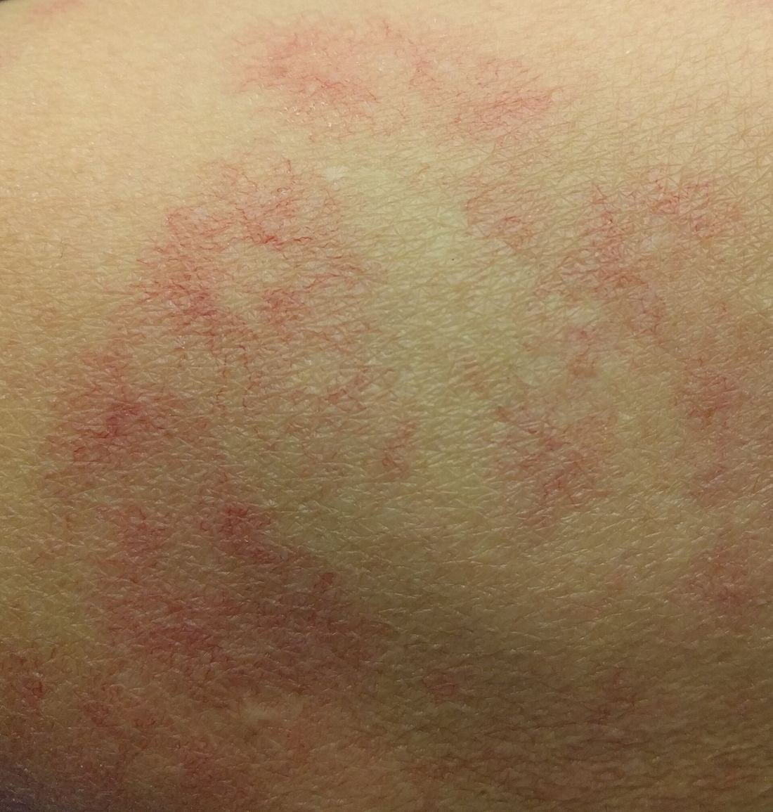
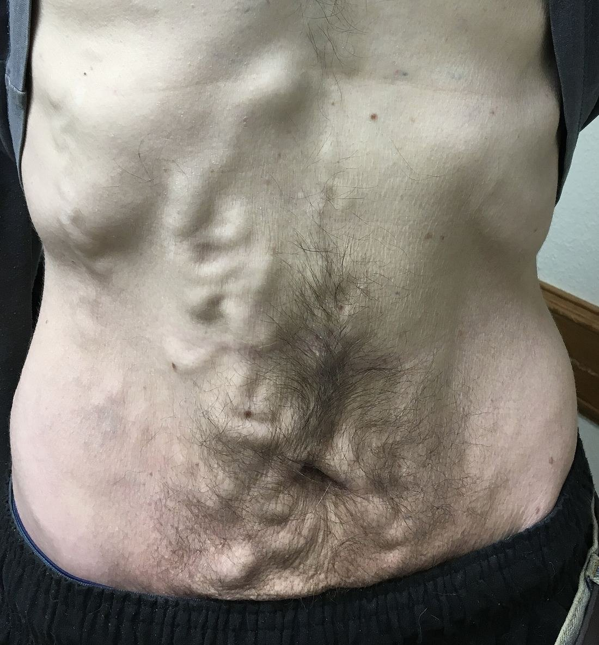
Figures 11.5–11.6 · Skin signs of chronic liver disease
WHAT TO NOTICE
Spider angiomas (11.5): central arteriole with radiating vessels that blanches with pressure
Why: a failing liver cannot break down estrogen
Caput medusae (11.6): large, tortuous veins around the umbilicus
Why: portal hypertension diverts blood through abdominal wall collaterals; the same flow creates varices
Figure 11.5. "SpiderAngioma.jpg" by James Heilman, MD, via Wikimedia Commons, CC BY-SA 4.0.
Figure 11.6. "ఉదరకుడ్యంలో ఉబ్బుసిరలు ( Caput Medusae ).jpeg" by Dr. Gannavarapu Narasimha Murthy (డా. గన్నవరపు నరసింహమూర్తి), via Wikimedia Commons, CC0.
Assessment link: these findings on inspection point to cirrhosis and portal hypertension before any lab result.
Notes:
From section 11.2. Spider angiomas are a common skin finding in chronic liver disease; caput medusae shows the collateral circulation that also produces esophageal varices.
Figure credit: Figure 11.5: "SpiderAngioma.jpg" by James Heilman, MD, via Wikimedia Commons, CC BY-SA 4.0. Figure 11.6: "ఉదరకుడ్యంలో ఉబ్బుసిరలు ( Caput Medusae ).jpeg" by Dr. Gannavarapu Narasimha Murthy (డా. గన్నవరపు నరసింహమూర్తి), via Wikimedia Commons, CC0.

Slide 27
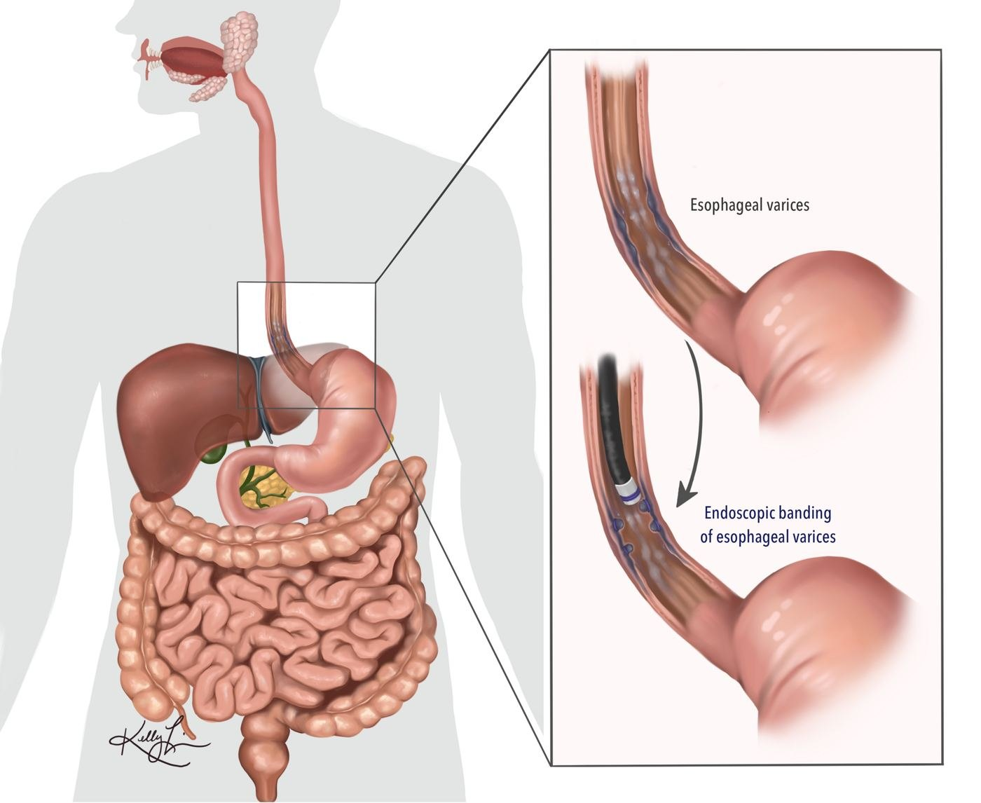
Figure 11.7 · Endoscopic band ligation of esophageal varices
WHAT TO NOTICE
Varices: dilated collateral veins in the lower esophagus from portal hypertension
Banding: an elastic band placed through an endoscope cuts off flow; the vessel thromboses and scars
Used to stop active bleeding and to prevent rebleeding
Before endoscopy: airway, two large-bore IVs, blood products, octreotide [somatostatin analogue], antibiotic
Variceal bleeding is an emergency: hematemesis with tachycardia and hypotension needs immediate escalation.
Figure 11.7. "Endoscopic Banding for Esophageal Varices.png" by Kel898, via Wikimedia Commons, CC BY-SA 4.0.
Notes:
From section 11.2 and the Patho-to-Bedside table: hematemesis with HR 125 and BP 88/50 signals a ruptured varix. Call for help, protect the airway, two large-bore IVs, blood products, octreotide [somatostatin analogue] and antibiotic as ordered, prepare for endoscopy.
Figure credit: Figure 11.7: "Endoscopic Banding for Esophageal Varices.png" by Kel898, via Wikimedia Commons, CC BY-SA 4.0.

Slide 28
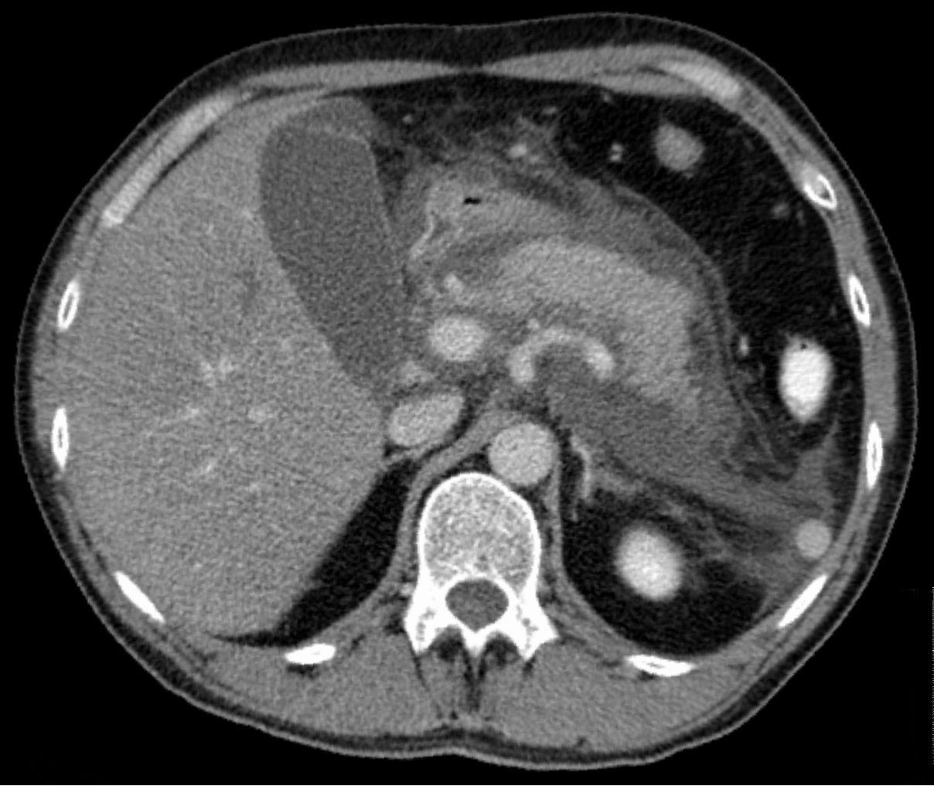
Figure 11.8 · Acute exudative pancreatitis on CT
WHAT TO NOTICE
Mechanism: alcohol sensitizes acinar cells so enzymes activate inside the gland
Presentation: severe epigastric pain radiating to the back, vomiting, raised lipase
CT: a swollen pancreas surrounded by inflammatory fluid
Nursing care: pain relief, early fluids, monitor calcium, glucose and breathing
Anticipate withdrawal: it often begins just as a patient with alcohol-related pancreatitis is admitted.
Figure 11.8. "Akute exsudative Pankreatitis - CT axial.jpg" by Hellerhoff, via Wikimedia Commons, CC BY-SA 3.0.
Notes:
From section 11.2 (Pancreas). Alcohol is a leading cause of acute and chronic pancreatitis. Activated enzymes digest pancreatic tissue and trigger systemic inflammation and capillary leak. Repeated attacks lead to chronic pancreatitis with persistent pain, malabsorption and diabetes.
Figure credit: Figure 11.8: "Akute exsudative Pankreatitis - CT axial.jpg" by Hellerhoff, via Wikimedia Commons, CC BY-SA 3.0.

Slide 29
Alcohol withdrawal: cue, mechanism, action
11.2 · PATHO-TO-BEDSIDE
Tremor, sweating, HR 115, BP 160/95 at 12 h: loss of GABA inhibition; score CIWA-Ar, treat per protocol
Confusion, unsteady gait, abnormal eye movements: Wernicke; confirm parenteral thiamine [vitamin B1] before glucose
Sees insects but is oriented: hallucinosis; reassure, reduce stimulation, watch for delirium
Mg 0.52 mmol/L, phosphate 0.6 mmol/L: losses and shifts; replace as ordered, cardiac monitoring if very low
Generalized seizure on day 2: protect the airway, time it, check glucose and electrolytes, notify
Hematemesis, HR 125, BP 88/50: ruptured varix; airway, two large-bore IVs, blood, octreotide [somatostatin analogue]
Day 3 confusion, fever 38.4 °C, HR 130: delirium tremens, or infection, encephalopathy, hypoglycemia; escalate urgently
Hepatic encephalopathy: lactulose [osmotic laxative] to two to three soft stools daily; watch K+ and fluids
Think broadly: delirium on day 3 may be DTs, but sepsis, hepatic encephalopathy, hypoglycemia or a head injury can look identical.
Notes:
From Table 11.6. Fine tremor, sweating, HR 115 and BP 160/95 about 12 hours after the last drink: score CIWA-Ar and treat per protocol. Hallucinosis: oriented, reassure, reduce stimulation. Seizure on day 2: protect airway, time it, check glucose and electrolytes. Day 3 confusion, fever 38.4 °C and HR 130: DTs, but infection, hepatic encephalopathy, hypoglycemia and head injury can look identical. Confusion with unsteady gait and abnormal eye movements: Wernicke encephalopathy. Mg 0.52 and phosphate 0.6 on day 2: replace and recheck.

Slide 30
Treating alcohol use disorder, across the lifespan
11.2 · AFTER WITHDRAWAL
Alcohol use disorder medications
Older adults
Youth and pregnancy
naltrexone [opioid antagonist]: dampens alcohol reward; not with opioids; caution in liver disease
acamprosate [glutamate modulator]: calms glutamate overactivity; kidney-cleared
Fewer than 2% of eligible Canadians receive medication (BCCSU, 2023)
Less body water, more brain sensitivity, more interacting drugs
Withdrawal mimics postoperative delirium or dementia
Lower starting doses; lorazepam [benzodiazepine] often preferred (Gortney et al., 2016)
Adolescents: more binges, intoxication and injury than withdrawal
Pregnancy: no amount of alcohol is known to be safe (CCSA, 2023)
Dependent in pregnancy: still needs supervised, medically managed withdrawal
Use the admission: withdrawal management should lead into treatment; start the conversation and connect the patient with follow-up (Wood et al., 2023).
Notes:
Withdrawal management alone does not treat alcohol use disorder; fewer than 2% of eligible people in Canada receive evidence-based medication (BCCSU, 2023). The Canadian guideline recommends medications such as naltrexone [opioid antagonist] and acamprosate [glutamate modulator] and cautions that SSRIs can worsen drinking outcomes in some people with AUD (BCCSU, 2023; Wood et al., 2023). Naltrexone [opioid antagonist] is contraindicated with opioids; acamprosate [glutamate modulator] is renally cleared. Lifespan box: older adults have less body water and more sensitivity; lower starting doses and agents such as lorazepam [benzodiazepine] are preferred (Gortney et al., 2016). No amount of alcohol is known to be safe in pregnancy (CCSA, 2023).

Slide 31
Opioids: overdose, withdrawal and opioid agonist treatment
PART 3 · SECTION 11.3
How opioids stop breathing, the changing supply, overdose response, COWS, starting buprenorphine [partial opioid agonist] in hospital, and pain care.
Notes:
Opioids are among the most useful drugs in medicine and the leading cause of drug toxicity deaths in Canada. You will meet them as analgesics, in patients with opioid use disorder or on opioid agonist treatment, and in overdose.

Slide 32
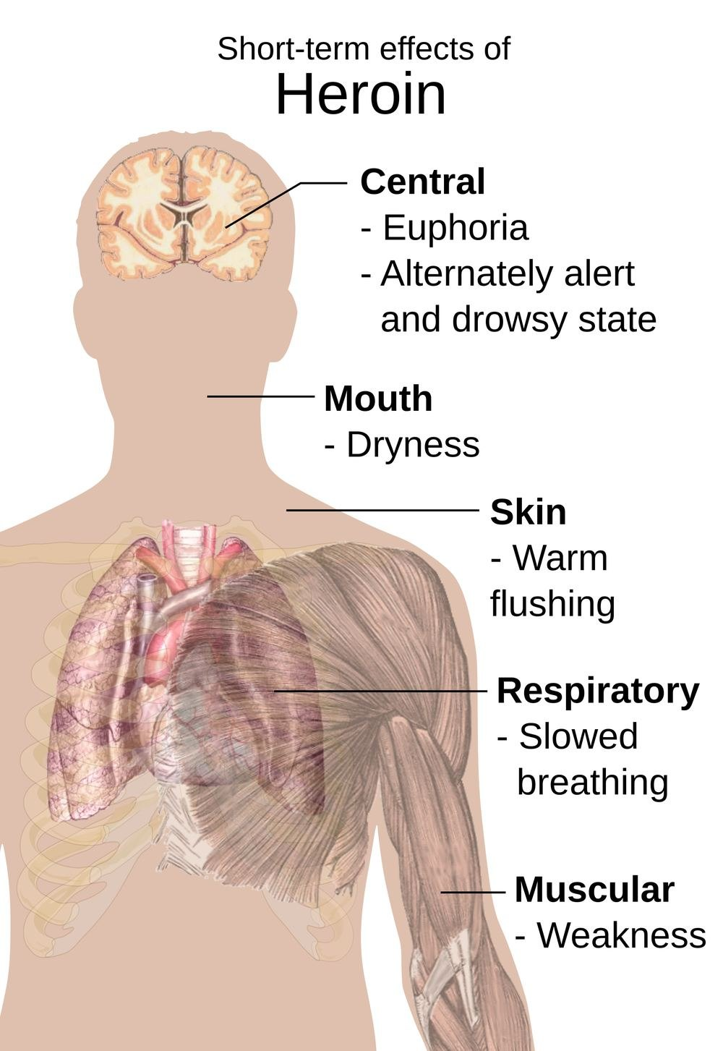
Figure 11.9 · Short-term effects of heroin
WHAT TO NOTICE
Mu-opioid receptor: analgesia, euphoria, sedation, constipation, miosis, respiratory depression
Full agonists: morphine [opioid agonist], hydromorphone [opioid agonist], fentanyl [opioid agonist]; effects keep rising with dose
Partial agonist: buprenorphine [partial opioid agonist] has a ceiling, including on respiratory depression
Antagonist: naloxone [opioid antagonist] displaces agonists without activating the receptor
The effect that kills: slowed breathing, from mu receptors in the brainstem respiratory centres.
Figure 11.9. "Short-term effects of heroin.svg" by Mikael Häggström, via Wikimedia Commons, Public domain.
Notes:
From section 11.3. Mu receptors are coupled to inhibitory G proteins: the neuron reduces cAMP, opens potassium channels and closes calcium channels, becoming less excitable and releasing less transmitter. Heroin (diacetylmorphine) [opioid agonist] is a typical full mu agonist.
Figure credit: Figure 11.9: "Short-term effects of heroin.svg" by Mikael Häggström, via Wikimedia Commons, Public domain.

Slide 33
Why opioids stop breathing
11.3 · RESPIRATORY DEPRESSION
Pulse oximetry falls late, and later still on supplemental oxygen
1
2
3
4
5
Sedation
Slow, shallow breathing
Hypercapnia
Hypoxemia
Apnea
Increasing sleepiness is the first warning
With snoring as the airway partly obstructs
Rising PaCO2 deepens sedation further
SpO2 falls late, especially on oxygen
Then bradycardia and cardiac arrest
Don't be reassured by SpO2: oxygen keeps saturation normal while CO2 accumulates; score sedation and count breathing (Gupta & Edwards, 2018).
Notes:
From section 11.3. Opioids slow the respiratory rhythm generated in the brainstem (including the pre-Bötzinger complex) and blunt the response to rising CO2. Sedation removes the wakeful drive and upper airway tone. SpO2 falls late, very late on supplemental oxygen, so pulse oximetry alone can miss serious hypoventilation (Gupta & Edwards, 2018). Use sedation scoring, a properly counted respiratory rate and capnography where available.

Slide 34
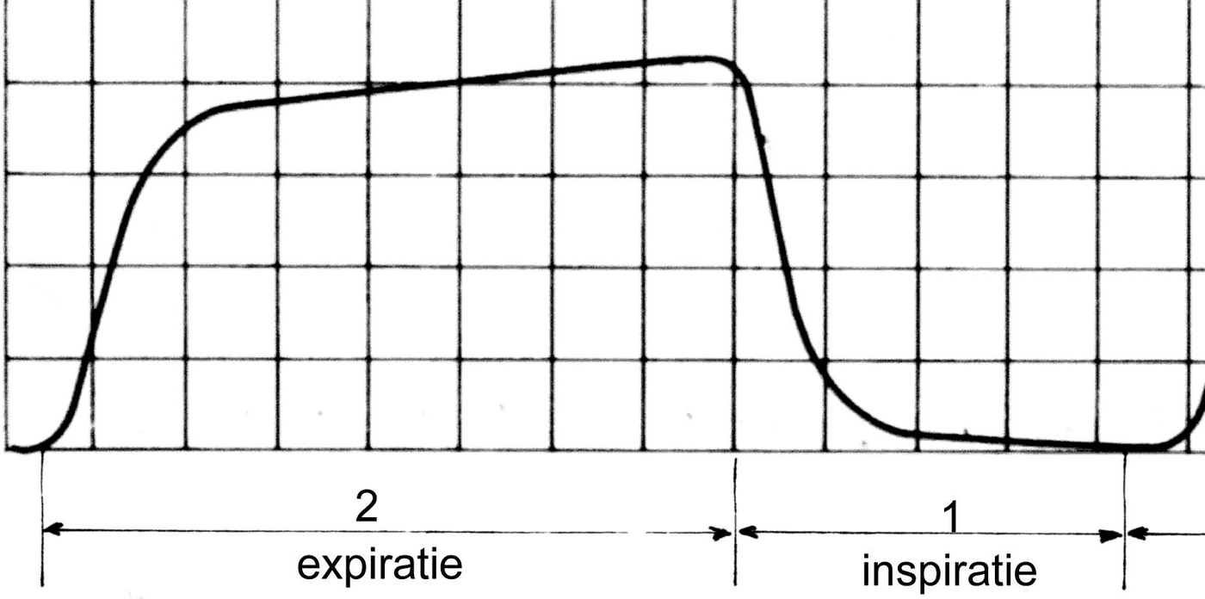
Figure 11.10 · Capnography and the blood gas in opioid toxicity [RN]
WHAT TO NOTICE
Normal waveform: sharp rise, plateau of alveolar gas, fall to baseline (Dutch labels: expiratie, inspiratie)
Hypoventilation: end-tidal CO2 rises; waveform flattens and becomes irregular, then disappears with apnea
Acute respiratory acidosis: HCO3 rises only ~1 mmol/L per 10 mm Hg rise in PaCO2
Example: PaCO2 40 → 80 mm Hg gives HCO3 ≈ 28 and pH ≈ 7.10; a lower HCO3 means a second, metabolic acidosis
Figure 11.10. "Capnogram1.jpg" by Rschiedon (Dutch Wikipedia), via Wikimedia Commons, CC BY-SA 3.0.
Going Deeper: the treatment for acute respiratory acidosis is ventilation, then reversal of the cause.
Notes:
Going Deeper box, section 11.3 (RN required, PN optional). If alveolar ventilation halves, PaCO2 roughly doubles. Kidney compensation (about 3.5 to 4 mmol/L per 10 mm Hg over days) is too slow to help in an acute overdose. Capnography often shows trouble minutes before the oximeter alarms.
Figure credit: Figure 11.10: "Capnogram1.jpg" by Rschiedon (Dutch Wikipedia), via Wikimedia Commons, CC BY-SA 3.0.

Slide 35
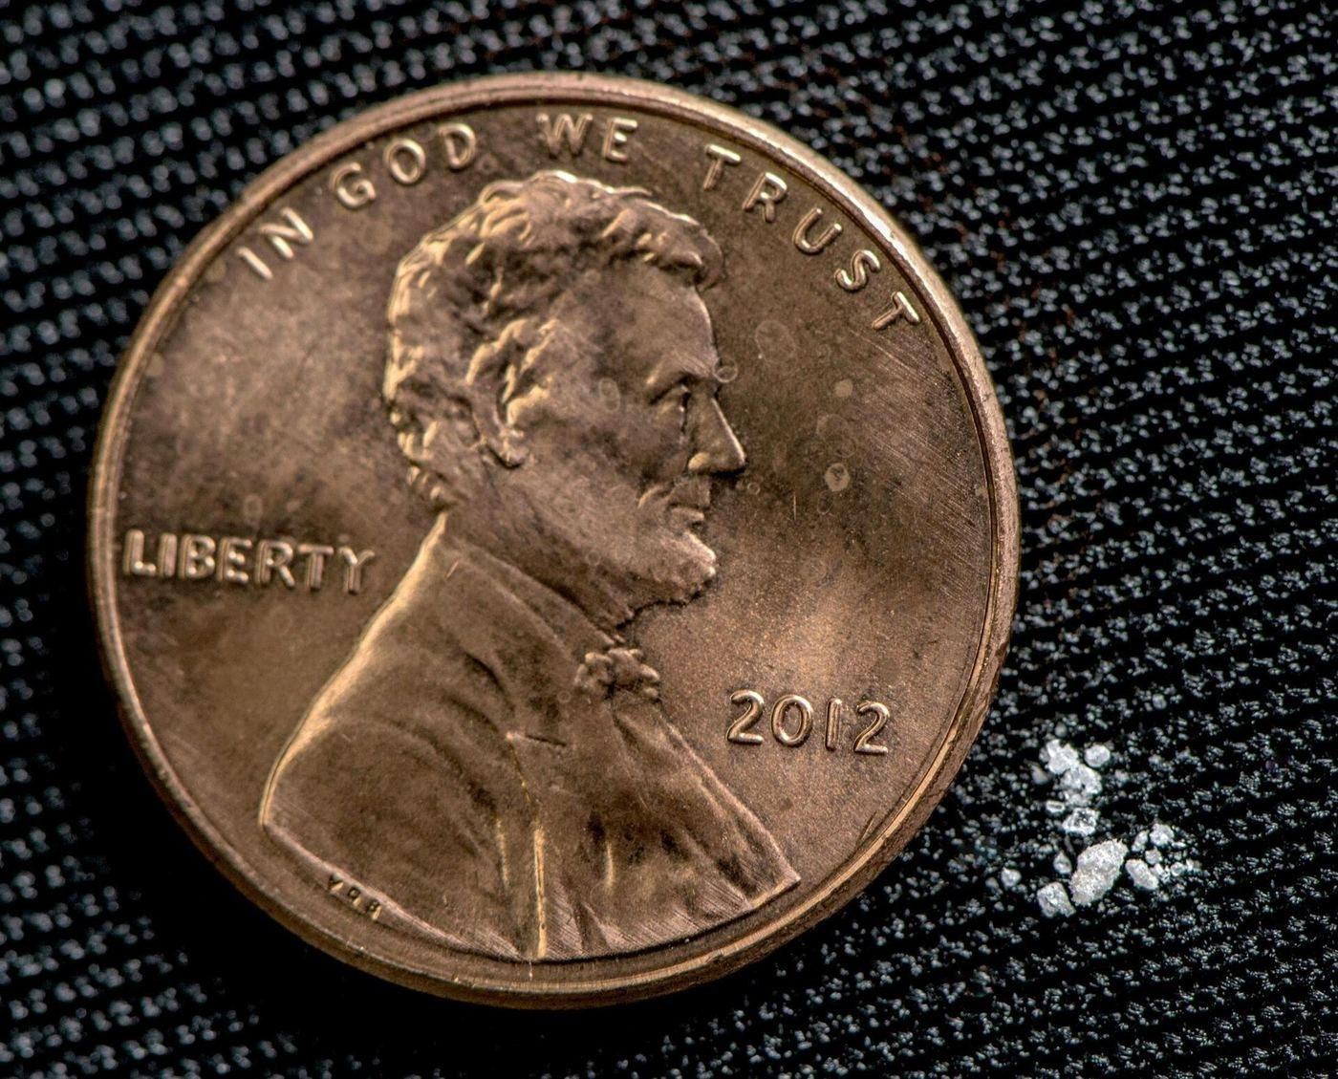
Figure 11.11 · About 2 mg of fentanyl
WHAT TO NOTICE
Fentanyl [opioid agonist] now dominates the unregulated opioid supply in much of Canada
Highly potent and lipid-soluble: reaches the brain within minutes; rapid, profound respiratory depression
Chest wall rigidity can follow rapid, high-dose IV fentanyl [opioid agonist]
Adulterants: benzodiazepine-type drugs and medetomidine deepen sedation; naloxone [opioid antagonist] does not reverse them
Unpredictable doses: a lethal amount is this small, so mixing in the unregulated supply causes unexpected overdose.
Figure 11.11. "Fentanyl. 2 milligrams. A lethal dose in most people.jpg" by United States Drug Enforcement Administration (DEA), via Wikimedia Commons, Public domain.
Notes:
From section 11.3 (the changing drug supply). The US Drug Enforcement Administration describes about 2 mg of fentanyl [opioid agonist] as potentially lethal for most people (figure source). Adulterants are noted by the Council of Chief Medical Officers of Health (2026).
Figure credit: Figure 11.11: "Fentanyl. 2 milligrams. A lethal dose in most people.jpg" by United States Drug Enforcement Administration (DEA), via Wikimedia Commons, Public domain.

Slide 36
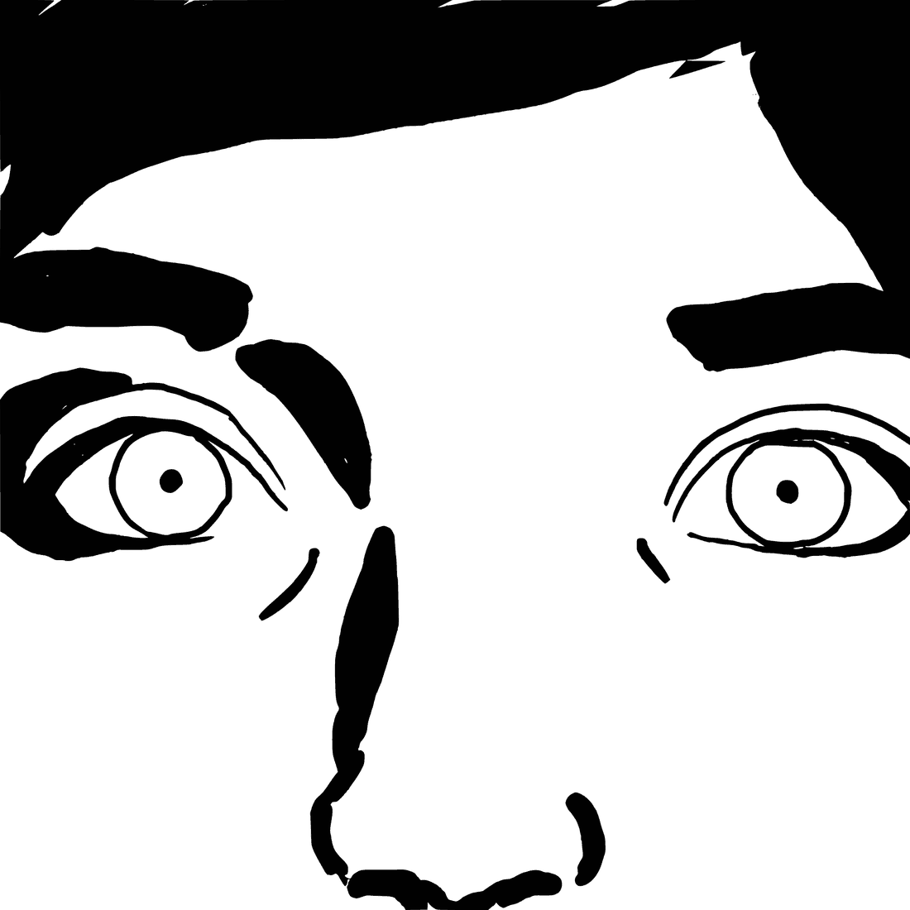
Figure 11.12 · Pinpoint pupils (miosis)
WHAT TO NOTICE
Opioid toxidrome: decreased consciousness, respiratory depression, miosis
Respiratory depression is the feature that kills
Miosis can be absent with severe hypoxia, a co-ingested stimulant, or anticholinergic substances
Decide on breathing and level of consciousness, not on pupils alone
Recognize early: sedation and slow breathing are the deciding findings.
Figure 11.12. "Figure65Pinprick.svg" by Silentplanetart, via Wikimedia Commons, CC BY-SA 4.0.
Notes:
From section 11.3 (Recognizing and responding to opioid overdose).
Figure credit: Figure 11.12: "Figure65Pinprick.svg" by Silentplanetart, via Wikimedia Commons, CC BY-SA 4.0.

Slide 37
Responding to opioid overdose in hospital
11.3 · OVERDOSE RESPONSE
Oxygenation first; naloxone [opioid antagonist] titrated to breathing
1
2
3
4
Check and call
Ventilate
Give naloxone [opioid antagonist]
Monitor
Shout, painful stimulus, check breathing; call for help and the emergency team
Open the airway; bag-valve-mask with oxygen; CPR if no pulse
Small IV increments to restore breathing; IM or intranasal without IV access; repeat after 2⁠–⁠3 min
Continuous observation, oximetry, capnography; check glucose, injury, aspiration
Renarcotization: naloxone [opioid antagonist] lasts about 30–120 minutes, many opioids last longer, so breathing can stop again (Health Canada, 2024a).
Notes:
From section 11.3. Check responsiveness and breathing; call for help and the emergency team; open the airway and ventilate with a bag-valve-mask and oxygen; CPR if no pulse. Give naloxone [opioid antagonist] as ordered or per directive: in hospital usually small IV increments, aiming for adequate breathing, not full wakefulness; IM or intranasal without IV access; more doses after 2 to 3 minutes if no response (Health Canada, 2024a). Naloxone [opioid antagonist] acts within about 2 minutes and lasts about 30 to 120 minutes (Health Canada, 2024a). Renarcotization is why monitoring continues.

Slide 38
After naloxone: titrate, watch and escalate
11.3 · CLINICAL SAFETY AND SCOPE
Titrate naloxone
Pulmonary edema
Scope in Practice
Goal: adequate breathing, not full wakefulness
Large rapid doses cause vomiting, aspiration risk, agitation
Still sedated? think benzodiazepines, alcohol, adulterants, hypoglycemia, head injury
After 2%–10% of heroin [opioid agonist] overdoses (Farney, 2018)
Timing: immediately after reversal, up to 4 hours
Signs: dyspnea, pink frothy sputum, persistent hypoxemia; treat with oxygen and ventilation
Every nurse: recognize, call, ventilate, give naloxone [opioid antagonist] per order or directive
RN coordinates repeat doses and infusions with the team
RPN escalates for rising sedation, low RR, flattened capnography, or in-hospital use
Hospital patients overdose too: check bathrooms and closed curtains, and don't delay because someone "was fine 20 minutes ago".
Notes:
Clinical Safety and Scope in Practice boxes, section 11.3. Large rapid naloxone [opioid antagonist] doses in a dependent person cause abrupt withdrawal with vomiting and aspiration risk. Noncardiogenic pulmonary edema follows an estimated 2% to 10% of heroin [opioid agonist] overdoses, usually immediately but up to 4 hours later (Farney, 2018). Hospital patients overdose too: check bathrooms and closed curtains. Every nurse recognizes overdose, ventilates and gives naloxone [opioid antagonist] under order, directive or policy; ongoing titration is generally coordinated by the RN with the prescriber and rapid response team.

Slide 39
Opioid withdrawal and the COWS
11.3 · OPIOID WITHDRAWAL
Rarely life-threatening, but a leading reason patients leave hospital
Signs of withdrawal
COWS: 11 mostly observed items
Behaviour: anxiety, restlessness, insomnia
Autonomic: sweating, tachycardia, dilated pupils, gooseflesh
Mucous membranes: yawning, tearing, runny nose
Body: muscle and bone aches, cramping, vomiting, diarrhea
5–12: mild
13–24: moderate
25–36: moderately severe
>36: severe (Wesson & Ling, 2003)
Symptom relief while OAT is arranged: clonidine [alpha-2 agonist], loperamide [antidiarrheal], ondansetron [5-HT3 antagonist], acetaminophen [non-opioid analgesic] or ibuprofen [NSAID].
Notes:
From section 11.3. After short-acting opioids, withdrawal usually begins within the first day; after methadone [full opioid agonist], onset is later and the course longer; fentanyl [opioid agonist]'s timeline is less predictable because it is stored in fat. COWS ranges from Wesson & Ling (2003). Untreated withdrawal is one of the main reasons patients leave before treatment is complete (Ling, 2023). The best treatment is usually an opioid agonist; symptomatic medications help but are not substitutes.

Slide 40
Opioid agonist treatment (OAT)
11.3 · OPIOID AGONIST TREATMENT
The most effective treatment for opioid use disorder
buprenorphine–naloxone
methadone
slow-release oral morphine
[partial opioid agonist + opioid antagonist]
[full opioid agonist]
[opioid agonist]
Ceiling on respiratory depression
Sublingual: dissolve fully; naloxone [opioid antagonist] discourages injection
Lower overdose risk and fewer QTc effects (Bruneau et al., 2018)
Long, variable half-life: dose increases accumulate
Higher risk in the first month
QTc prolongation and many interactions; confirm the last dose with the pharmacy
Second-line; off-label for OAT in Canada
Daily witnessed dosing with close early monitoring (Yakovenko et al., 2024)
First-line: buprenorphine [partial opioid agonist] and methadone [full opioid agonist]; withdrawal management alone is not recommended (Yakovenko et al., 2024).
Notes:
OAT replaces unpredictable short-acting opioids with a long-acting pharmaceutical opioid taken once daily, preventing withdrawal and craving and reducing overdose and death. 2024 national guideline: buprenorphine [partial opioid agonist] and methadone [full opioid agonist] are first-line; drop-out higher with buprenorphine [partial opioid agonist] after the first month; mortality higher in the first month of methadone [full opioid agonist]; slow-release oral morphine [opioid agonist] second-line; withdrawal management alone not recommended (Yakovenko et al., 2024). Buprenorphine–naloxone [partial opioid agonist + opioid antagonist] has lower overdose risk and fewer QTc effects; take-home doses once stable (Bruneau et al., 2018). Injectable OAT (e.g., hydromorphone [opioid agonist]) has its own guideline and programs.

Slide 41
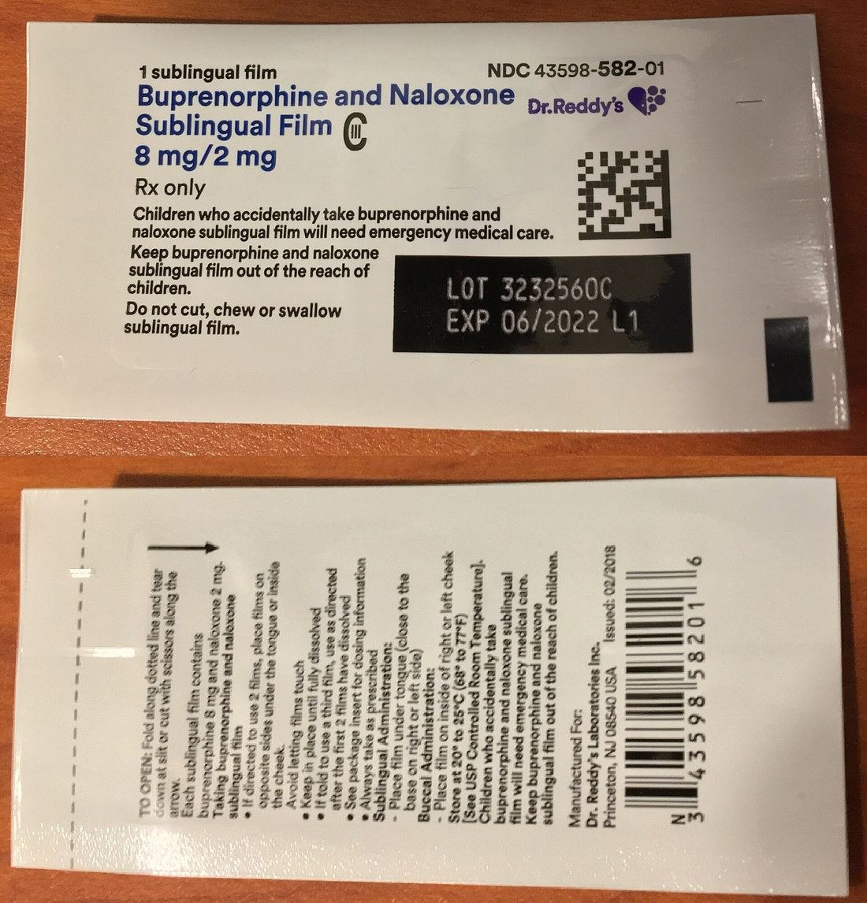
Figure 11.13 · Buprenorphine–naloxone sublingual film
WHAT TO NOTICE
High-affinity partial agonist: binds mu receptors tightly but activates them less
Precipitated withdrawal: given while a full agonist is on board, it displaces it and the net effect drops suddenly
Film or tablet: dissolve fully under the tongue; do not swallow or chew
US packaging shown; Canadian packaging differs but use is the same
Starting dose: 2 mg/0.5 mg sublingually, titrated over hours (BCCSU, 2025).
Figure 11.13. "Buprenorphine-Naloxone-8-2-strip-packacge.jpg" by Sintegral, via Wikimedia Commons, CC BY-SA 4.0.
Notes:
From section 11.3 (Starting buprenorphine [partial opioid agonist] in hospital). Buprenorphine–naloxone [partial opioid agonist + opioid antagonist].
Figure credit: Figure 11.13: "Buprenorphine-Naloxone-8-2-strip-packacge.jpg" by Sintegral, via Wikimedia Commons, CC BY-SA 4.0.

Slide 42
Starting buprenorphine–naloxone in hospital
11.3 · STARTING BUPRENORPHINE
Standard initiation waits for at least moderate withdrawal (BCCSU, 2025)
COWS >12
≥12 h
≥24 h
48–72 h
2 mg/0.5 mg
At least moderate withdrawal before the first dose
Since short-acting opioids such as heroin [opioid agonist] or hydromorphone [opioid agonist]
Since fentanyl [opioid agonist]; longer if tolerable (precipitated withdrawal up to 48 h)
Since methadone [full opioid agonist]
Start, then titrate to about 12/3⁠–⁠16/4 mg on day 1
Can't wait in withdrawal? Low-dose (micro-dose) initiation adds tiny buprenorphine [partial opioid agonist] doses while the full agonist continues, then stops it (BCCSU, 2025).
Notes:
From section 11.3 (BCCSU, 2025): COWS above 12; at least 12 hours since short-acting opioids such as heroin [opioid agonist] or hydromorphone [opioid agonist]; at least 24 hours since fentanyl [opioid agonist], longer if tolerable, because precipitated withdrawal can occur up to 48 hours after fentanyl [opioid agonist]; 48 to 72 hours since methadone [full opioid agonist]. Start 2 mg/0.5 mg sublingually, titrate in small doses to a first-day total of about 12 mg/3 mg to 16 mg/4 mg. Low-dose (micro-dose) initiation introduces very small doses while the patient continues a full agonist.

Slide 43
Pain management for patients on OAT
11.3 · PAIN MANAGEMENT
Patients on OAT feel pain, often more intensely
Continue the OAT dose unless the prescriber decides otherwise; confirm it with the community pharmacy
Add multimodal analgesia: scheduled acetaminophen [non-opioid analgesic], ketorolac [NSAID] if safe, regional anesthesia
OAT is not pain control: the daily dose treats the opioid use disorder
Add short-acting full agonists when needed; higher doses may be required with buprenorphine [partial opioid agonist]
Continuing buprenorphine [partial opioid agonist] around surgery appears safe; stopping risks relapse (Goel et al., 2019)
Assess and document pain the same way as for any patient
Why it matters: undertreated pain is a leading reason patients leave before treatment is complete (Ling, 2023).
Notes:
From section 11.3. Tolerance and opioid-induced changes in pain processing mean patients on OAT usually need higher opioid doses for acute pain. Continue the OAT dose unless the prescriber decides otherwise; confirm with the community pharmacy. The daily OAT dose treats the OUD; it is not the patient's pain control. Continuing buprenorphine [partial opioid agonist] around surgery appears safe, and stopping it is not without risk, including relapse (Goel et al., 2019). Undertreated pain is a leading reason for patient-initiated discharge (Ling, 2023).

Slide 44
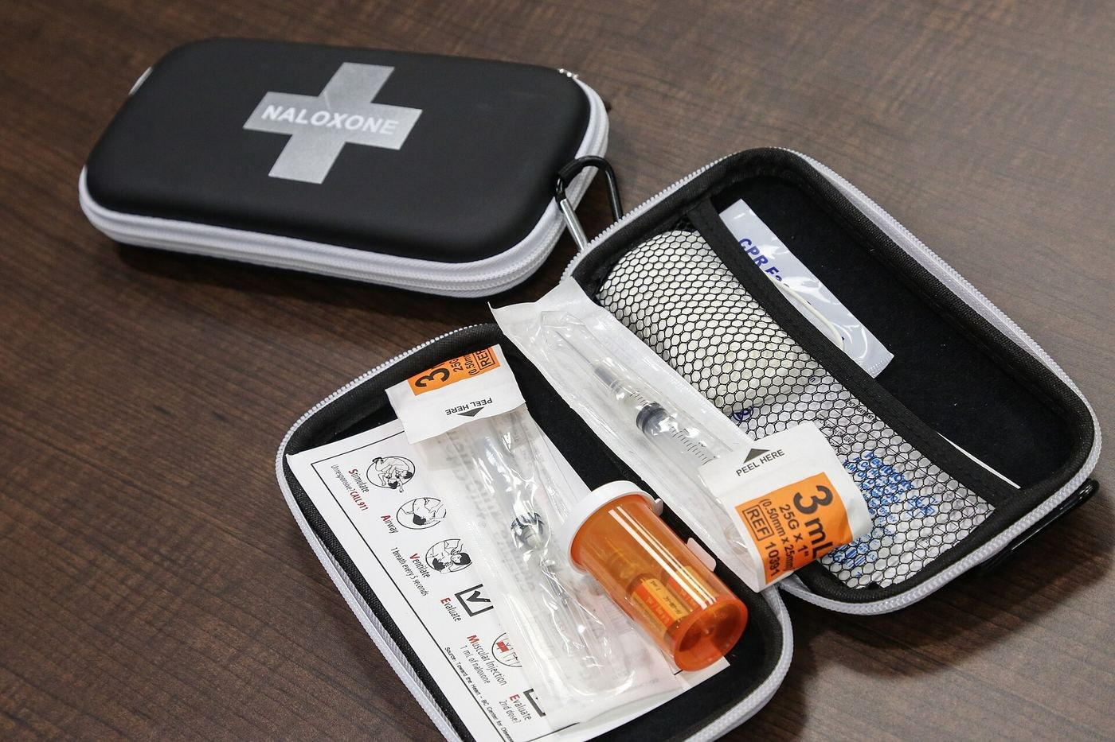
Figure 11.14 · A take-home naloxone kit
WHAT TO NOTICE
Offer a kit to every patient who uses opioids, or lives with someone who does
Available without a prescription at most pharmacies and local health authorities
Teach: signs of overdose; call 9-1-1; give naloxone [opioid antagonist]; repeat after 2–3 minutes; stay with the person
Lost tolerance: after a hospital stay, the usual amount can stop breathing; don't use alone
Patient Education: check the kit's expiry date and replace it when it runs out (Health Canada, 2024a).
Figure 11.14. "Naxolone kit.jpg" by Government of New Brunswick / Gouvernement du Nouveau-Brunswick, via Wikimedia Commons, CC0.
Notes:
Patient Education box, section 11.3 (Health Canada, 2024a). The kit shown was distributed in New Brunswick. Plain-language points: the person won't wake when you shout or rub the breastbone, breathing is very slow or stopped, lips or nails blue or grey, pupils tiny. Naloxone [opioid antagonist] can wear off before the drugs do.
Figure credit: Figure 11.14: "Naxolone kit.jpg" by Government of New Brunswick / Gouvernement du Nouveau-Brunswick, via Wikimedia Commons, CC0.

Slide 45
Stimulants, sedatives, cannabis, tobacco and injection-related harm
PART 4 · SECTIONS 11.4–11.7
Sympathomimetic toxicity, GHB and benzodiazepine withdrawal, cannabinoid hyperemesis, nicotine replacement, endocarditis and safe discharge.
Notes:
Part 4 covers sections 11.4 to 11.7. Stimulant deaths fell in 2025, but more deaths still involve stimulants than opioids in Ontario and six other jurisdictions (Council of Chief Medical Officers of Health, 2026).

Slide 46
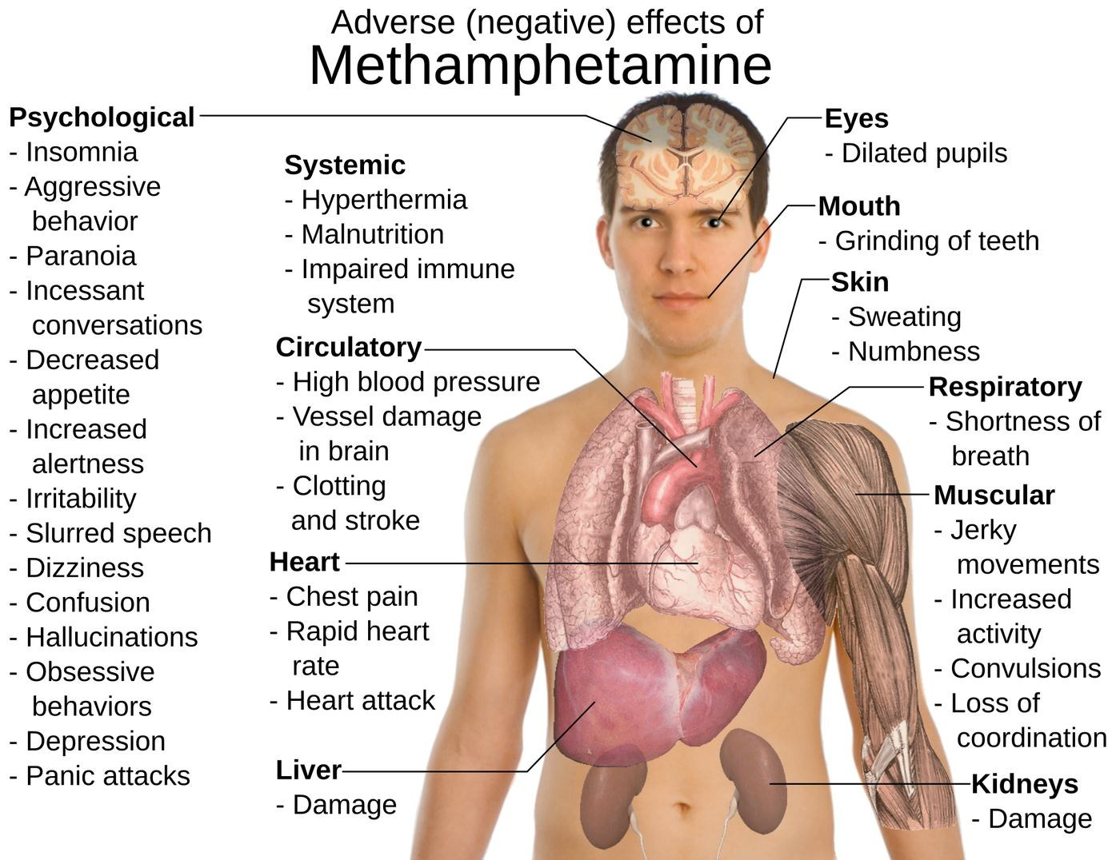
Figure 11.15 · Adverse effects of methamphetamine
WHAT TO NOTICE
Cocaine: blocks reuptake of dopamine, norepinephrine and serotonin; brief, intense effects
Methamphetamine: reverses monoamine transporters; effects last many hours
Sympathomimetic toxidrome: agitation, hypertension, tachycardia, dilated pupils, sweating, hyperthermia, seizures
Most dangerous: ventricular dysrhythmias, status epilepticus, hyperthermia (Chary, 2026)
Mechanism: excess catecholamine activity explains most of the adverse effects shown.
Figure 11.15. "Effects of metamphetamine.svg" by Mikael Häggström, via Wikimedia Commons, Public domain.
Notes:
From section 11.4. Cocaine is also a local anesthetic: it blocks fast sodium channels, which in overdose can widen the QRS and trigger ventricular dysrhythmias.
Figure credit: Figure 11.15: "Effects of metamphetamine.svg" by Mikael Häggström, via Wikimedia Commons, Public domain.

Slide 47
Heart, heat, muscle and mind
11.4 · STIMULANT TOXICITY
Heart and vessels
Heat and muscle
Psychosis and agitation
Ischemia: more demand, vasoconstriction, thrombosis
Benzodiazepines first-line; avoid beta-blockers acutely (McCord et al., 2008)
nitroglycerin [nitrate vasodilator] for ongoing pain; phentolamine [alpha antagonist] if no response
Hyperthermia >40 °C: start active cooling immediately
Rhabdomyolysis: potassium (dysrhythmia), myoglobin (kidney injury), CK
Care: IV fluids, strict I&O, urine colour, potassium and ECG
Paranoia, hallucinations, aggression, usually resolving as the drug clears
Benzodiazepines first-line (Chary, 2026)
Avoid restraint: struggling worsens heat, acidosis and rhabdomyolysis
Caution: some sources advise against haloperidol [first-generation antipsychotic] for agitation in acute amphetamine toxicity; it can mask excitation without treating hyperthermia (Chary, 2026).
Notes:
From section 11.4. Cocaine ischemia: higher demand, coronary vasoconstriction, platelet aggregation and thrombosis, accelerated atherosclerosis. AHA: benzodiazepines first-line; avoid beta-blockers in the acute phase (unopposed alpha effects); nitroglycerin [nitrate vasodilator] for ongoing pain; calcium channel blocker or phentolamine [alpha antagonist] if no response (McCord et al., 2008). Hyperthermia above 40 °C is an emergency: active cooling. Rhabdomyolysis: potassium, myoglobin and CK. Benzodiazepines first-line for agitation, hypertension, tachycardia and seizures (Chary, 2026); the same source cautions against haloperidol [first-generation antipsychotic] for agitation in acute amphetamine toxicity.

Slide 48
The agitated patient in bed 4
11.4 · CLINICAL JUDGMENT
27-year-old with a hand infection: HR 138, BP 176/98, RR 24, T 38.9 °C, dilated pupils, "used something"
1
2
3
4
5
6
Recognize cues
Analyze cues
Prioritize
Generate solutions
Take action
Evaluate
Agitation, tachycardia, hypertension, fever, mydriasis, recent use, infection
Sympathomimetic toxidrome vs withdrawal, sepsis, thyroid storm
Hyperthermia, dysrhythmia, injury; sepsis still possible
Rapid response, safety, core temp, glucose, ECG; plan sedation and cooling
Calm voice, low stimulation, avoid restraint; give medications, begin cooling
HR, BP, temp falling; calm without respiratory depression; urine output, CK
Sepsis does not exclude stimulant toxicity: treat the immediate threats, then reassess the infection once he is calm.
Notes:
Clinical Judgment box, section 11.4 (NCSBN CJMM). The picture fits the sympathomimetic toxidrome, but alcohol or sedative withdrawal, sepsis from the hand infection and thyroid storm can look similar. Sepsis does not exclude stimulant toxicity. Generate solutions: call for help and rapid response, make the environment safe, full vital signs including core temperature, glucose, 12-lead ECG; anticipate benzodiazepine sedation, active cooling, blood cultures and lactate. Evaluate: falling HR, BP and temperature; agitation settling without respiratory depression; acceptable urine output and CK; reassess the hand infection.

Slide 49
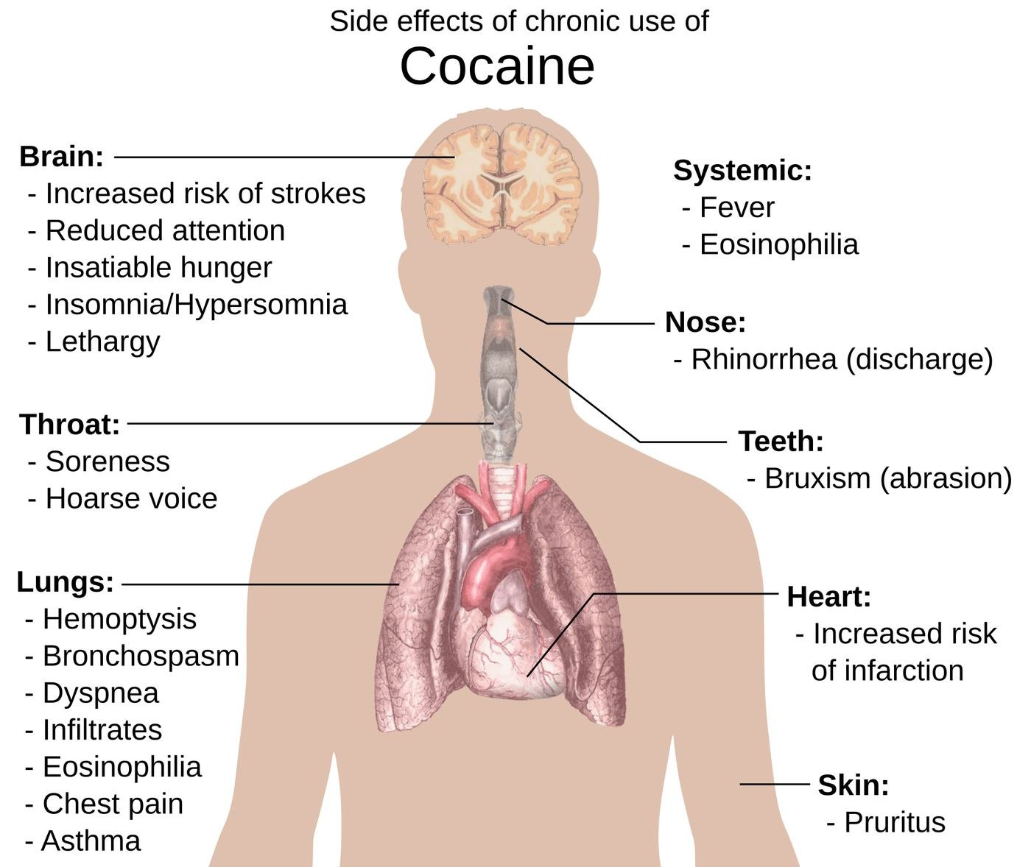
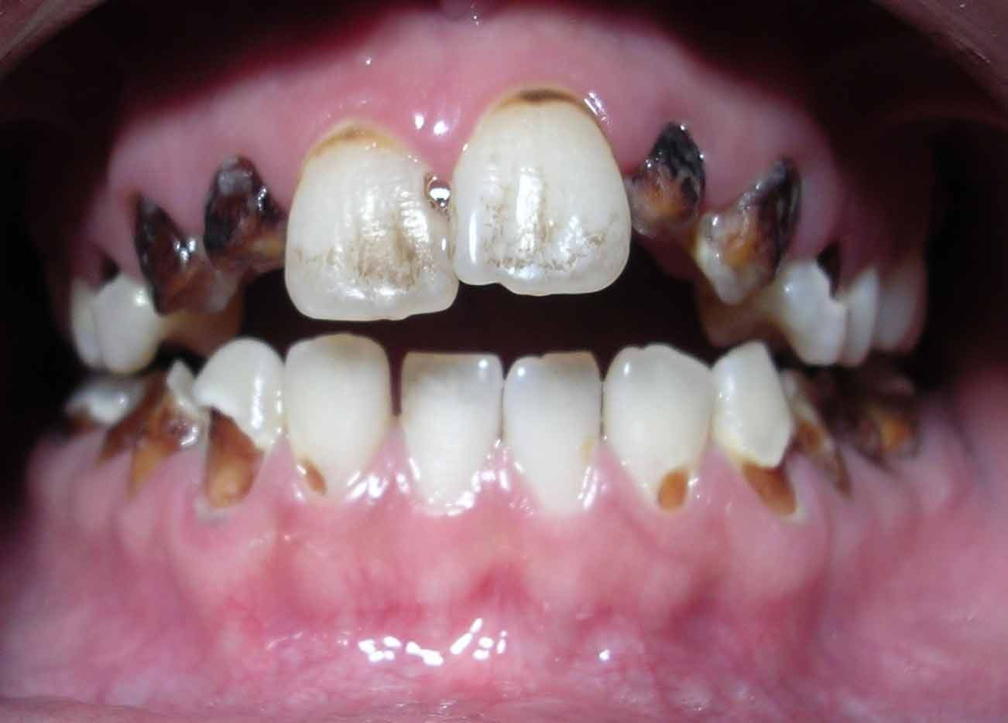
Figures 11.16–11.17 · Chronic stimulant effects
WHAT TO NOTICE
Methamphetamine (11.16): severe dental decay, weight loss, skin sores, persistent cognitive problems
Cocaine (11.17): septal perforation, lung injury from crack, cardiomyopathy, stroke and infarction risk
Withdrawal: dysphoria, fatigue, sleep disturbance, increased appetite, irritability within about a day
Assess suicide risk: withdrawal can unmask or worsen depression (Chary, 2026)
Figure 11.16. "Suspectedmethmouth09-19-05.jpg" by Dozenist, via Wikimedia Commons, CC BY-SA 3.0.
Figure 11.17. "Side effects of chronic use of Cocaine.svg" by Mikael Häggström, via Wikimedia Commons, Public domain.
Oral assessment during admission may reveal pain, infection and difficulty eating.
Notes:
From section 11.4 (Chronic effects). Stimulant withdrawal is not usually medically dangerous but can unmask depression.
Figure credit: Figure 11.16: "Suspectedmethmouth09-19-05.jpg" by Dozenist, via Wikimedia Commons, CC BY-SA 3.0. Figure 11.17: "Side effects of chronic use of Cocaine.svg" by Mikael Häggström, via Wikimedia Commons, Public domain.

Slide 50
Benzodiazepines, GHB and cannabis compared
11.5 · SEDATIVES, GHB AND CANNABIS
Two of these withdrawal syndromes can kill
Benzodiazepines
GHB
Cannabis
GABA-A
GABA-B and GHB receptors
CB1
Dangerous mainly combined with opioids or alcohol
Withdrawal: can include seizures and delirium
Plan tapers; never stop abruptly on admission (ASAM, 2025)
Half-life 20–30 min; withdrawal within 1–6 hours
Delirium, seizures, death; may last up to 15 days
High-dose benzodiazepines, baclofen [GABA-B agonist], phenobarbital [barbiturate] if resistant (Weaver et al., 2023)
32% past-year use in Canada, 2023 (Health Canada, 2024b)
Edibles: delayed onset; profound sedation in young children
Withdrawal: irritability, insomnia, restlessness; not dangerous
Ask on admission: GHB withdrawal begins within hours, so the time of the last dose is the most important question.
Notes:
From section 11.5 and Table 11.10. Benzodiazepines amplify GABA-A; alone they rarely stop breathing, but combined with alcohol or opioids the effects multiply. Benzodiazepine-type drugs contaminate the unregulated supply. A long-term benzodiazepine should not be stopped abruptly on admission without a plan (ASAM, 2025). Flumazenil [benzodiazepine antagonist] can precipitate seizures in dependent patients. GHB: half-life 20–30 minutes; withdrawal within 1–6 hours, can last up to 15 days; high-dose benzodiazepines, baclofen [GABA-B agonist] adjunct, phenobarbital [barbiturate] if resistant (Weaver et al., 2023). Cannabis: CB1; 32% past-year use in 2023 (Health Canada, 2024b).

Slide 51
Cannabinoid hyperemesis syndrome (CHS)
11.5 · CANNABINOID HYPEREMESIS
A diagnosis of exclusion that is frequently missed
Recognize
Manage
Cyclic vomiting with severe nausea and abdominal pain
Use: at least weekly, often daily, for more than a year
Clue: relief from hot showers or baths
Complications: dehydration, AKI, hypokalemia, metabolic alkalosis
IV fluids, electrolytes and kidney function
haloperidol [first-generation antipsychotic] and topical capsaicin [TRPV1 agonist]
Pain: acetaminophen [non-opioid analgesic] or ibuprofen [NSAID]; avoid opioids
Often ineffective: ondansetron [5-HT3 antagonist]
Definitive treatment: stopping cannabis resolves CHS in about 97% of people; symptoms return if use resumes (Emergency Care BC, 2021).
Notes:
From section 11.5 (Emergency Care BC, 2021). Repeated cycles of severe nausea, profuse vomiting and abdominal pain in people using cannabis at least weekly, often daily, for more than a year. Relief from hot showers is characteristic. Complications: dehydration, acute kidney injury, hypokalemia, metabolic alkalosis. Management: IV fluids and electrolytes; haloperidol [first-generation antipsychotic] most commonly used; topical capsaicin [TRPV1 agonist]; hot showers; acetaminophen [non-opioid analgesic] or ibuprofen [NSAID]; avoid opioids; ondansetron [5-HT3 antagonist] often ineffective. Stopping cannabis resolves the syndrome in about 97%.

Slide 52
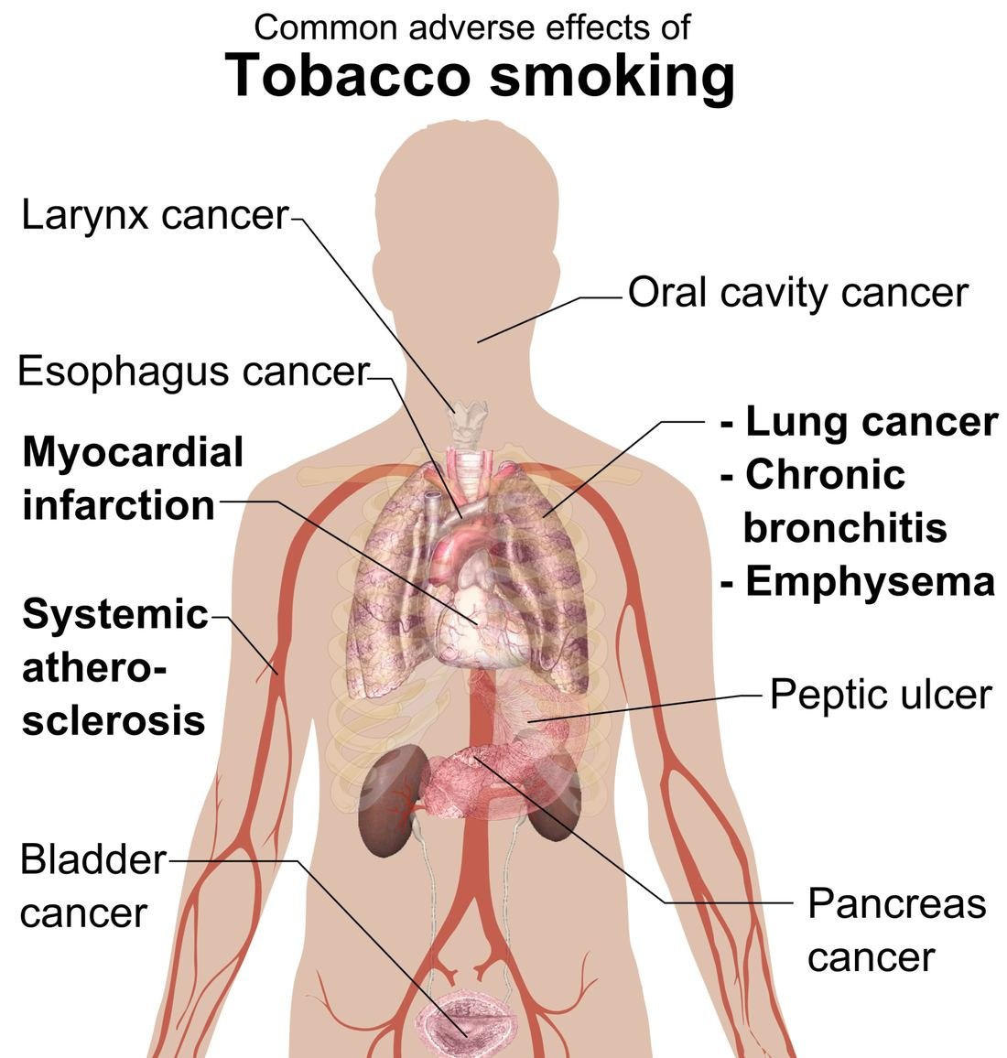
Figure 11.18 · Common adverse effects of tobacco smoking
WHAT TO NOTICE
Leading cause: 46,366 of 73,994 substance-attributed deaths in 2020
Carbon monoxide: reduces oxygen delivery; standard oximeters read falsely reassuring SpO2
Nicotine: catecholamine release and vasoconstriction; less wound perfusion
Airways and healing: paralysed cilia, more mucus, more wound infection and breakdown
Hidden disease: admitted patients may carry atherosclerotic and pulmonary disease that affects anesthesia and healing.
Figure 11.18. "Adverse effects of tobacco smoking.png" by Mikael Häggström, via Wikimedia Commons, Public domain.
Notes:
From section 11.6 (Canadian Substance Use Costs and Harms Scientific Working Group, 2023). Some benefits of stopping begin quickly: carbon monoxide levels fall within a day; cilia and wound healing improve over weeks.
Figure credit: Figure 11.18: "Adverse effects of tobacco smoking.png" by Mikael Häggström, via Wikimedia Commons, Public domain.

Slide 53
Nicotine withdrawal and replacement therapy
11.6 · NICOTINE IN HOSPITAL
Admission is a teachable moment
Nicotine withdrawal
Treatment
Begins within hours: irritability, anxiety, poor concentration, cravings
Looks like agitation; drives requests to leave the unit
Safety: patients who go out to smoke leave monitoring, lines and oxygen
Combination NRT: patch [nicotine replacement therapy] plus gum or lozenge [nicotine replacement therapy] for breakthrough cravings
varenicline [nicotinic receptor partial agonist] or bupropion [aminoketone antidepressant] with a quit date
Vaping: same withdrawal assessment and NRT offer
Nurse's role: ask everyone about tobacco and vaping, offer NRT early, advocate for an order, and refer to a quit program at discharge.
Notes:
From section 11.6. Nicotine binds nicotinic acetylcholine receptors on VTA dopamine neurons; receptors desensitize and increase in number, and recovery between cigarettes is felt as craving. Withdrawal begins within hours: irritability, anxiety, poor concentration, restlessness, appetite, low mood, insomnia. Patients who go outside to smoke may be away from monitoring, disconnect lines or oxygen, or fall. Combination NRT is usually more effective than a single product. Varenicline [nicotinic receptor partial agonist] and bupropion [aminoketone antidepressant] are usually started with a planned quit date and continued after discharge.

Slide 54
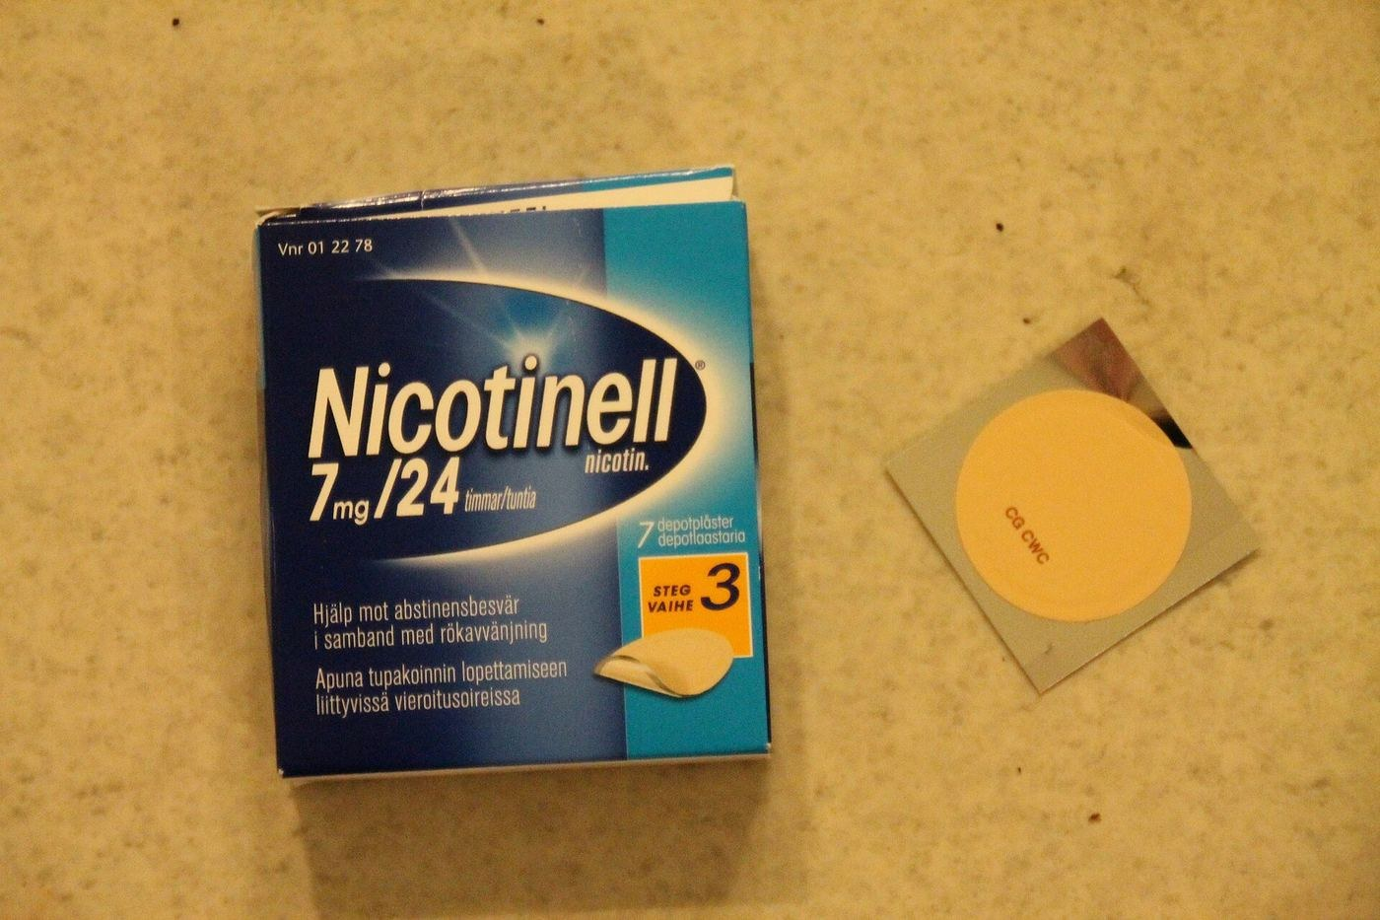
Figure 11.19 · Transdermal nicotine patches
WHAT TO NOTICE
Apply to clean, dry, hairless skin on the upper body
Rotate sites; remove the old patch before applying a new one
Before MRI: remove patches that contain metal
Vivid dreams: removing the patch at bedtime can help, as ordered
Teaching: "Using NRT is not cheating. It's the smoke, not the nicotine, that causes most of the harm."
Figure 11.19. "NicotinePatch.jpg" by Styroks, via Wikimedia Commons, CC BY-SA 4.0.
Notes:
From section 11.6 (nursing points for nicotine patches [nicotine replacement therapy] and Patient Education box). Cravings usually pass within a few minutes; call the provider about chest pain, mood changes or thoughts of self-harm after starting a quit medication.
Figure credit: Figure 11.19: "NicotinePatch.jpg" by Styroks, via Wikimedia Commons, CC BY-SA 4.0.

Slide 55
Complications of injection drug use
11.7 · INJECTION-RELATED HARM
Assess every injection site, with permission and an explanation
Cellulitis and abscess: mark borders, assess fluctuance, pain, signs of sepsis
Septic arthritis: hot, swollen, painful joint with reduced movement
Necrotizing fasciitis: pain out of proportion, crepitus, bullae, dusky skin; urgent surgery
Thrombosis and pseudoaneurysm: limb swelling; never incise a pulsatile groin mass
Infective endocarditis: fever, new murmur, septic pulmonary emboli, neurological change
HIV, hepatitis B and C: offer testing and hepatitis B vaccine; hepatitis C is curable
Vertebral osteomyelitis, epidural abscess: back pain and fever; weakness is an emergency
Usual pathogens: Staphylococcus aureus, including MRSA, and streptococci
Ontario trend: injection-related endocarditis admissions rose from a mean of 13.4 to 35.1 per quarter, 2006–2015 (Weir et al., 2019).
Notes:
From section 11.7 and Table 11.11. Skin and soft tissue infections are the most common reason people who inject drugs are admitted; usual pathogens are S. aureus (including MRSA) and streptococci. Pain out of proportion, rapidly spreading redness, crepitus, bullae or systemic toxicity suggest necrotizing infection. Never incise a pulsatile groin mass (pseudoaneurysm). Back pain with fever needs urgent assessment; new weakness, numbness or bladder change is an emergency. Offer testing for HIV and hepatitis B and C; hepatitis C is curable.

Slide 56
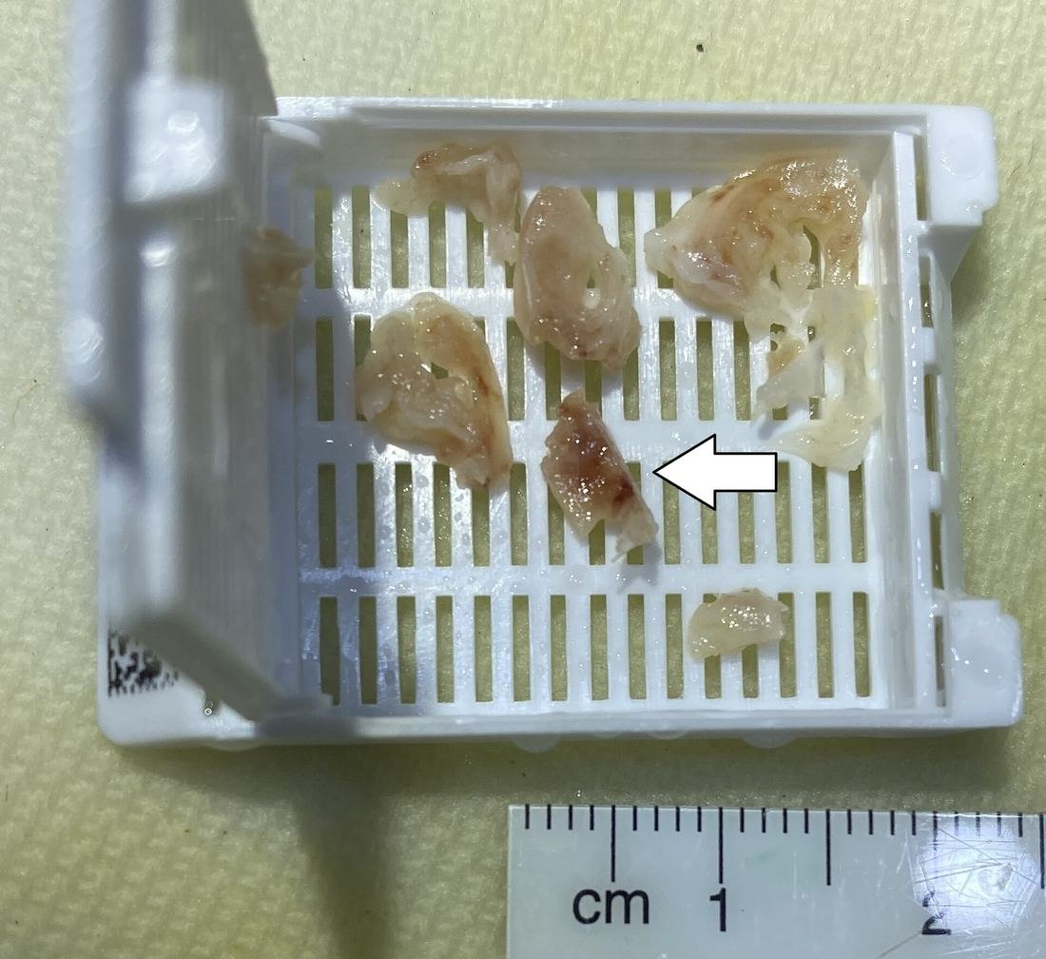
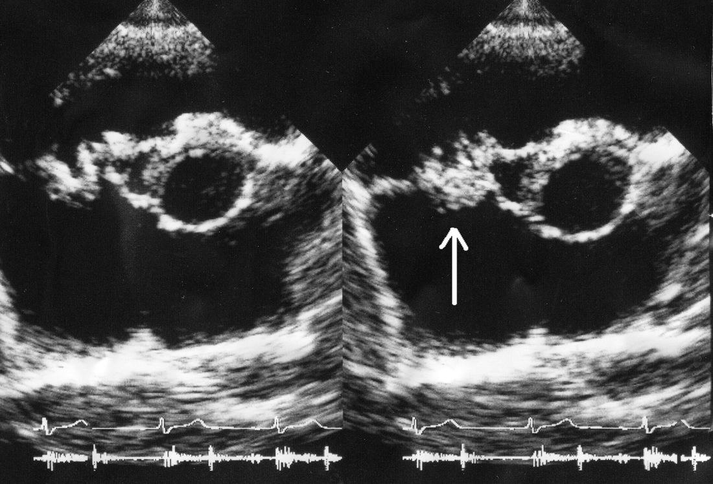
Figures 11.20–11.21 · Infective endocarditis
WHAT TO NOTICE
Vegetation: platelets, fibrin and bacteria on a damaged valve
Right-sided: the tricuspid valve is affected far more often in people who inject drugs
Septic emboli: to the lungs (cough, pleuritic pain, hemoptysis, nodules); from left-sided valves to brain, kidneys, skin
Diagnosis: multiple blood cultures before antibiotics, then echocardiography
Figure 11.20. "Endocarditis ultrasound.JPG" by Daisuke Koya, Kazuyuki Shibuya, Ryuichi Kikkawa & Masakazu Haneda, via Wikimedia Commons, CC BY 2.0.
Figure 11.21. "Gross pathology of vegetation of infective endocarditis, annotated.jpg" by Mikael Häggström, MD, via Wikimedia Commons, CC0.
Weeks of IV antibiotics: treat OUD early with OAT, manage pain, plan vascular access with the patient.
Notes:
From section 11.7. Figure 11.20 is an echocardiogram with a tricuspid vegetation (arrow); Figure 11.21 is an excised vegetation in a tissue cassette. Some patients need valve surgery.
Figure credit: Figure 11.20: "Endocarditis ultrasound.JPG" by Daisuke Koya, Kazuyuki Shibuya, Ryuichi Kikkawa & Masakazu Haneda, via Wikimedia Commons, CC BY 2.0. Figure 11.21: "Gross pathology of vegetation of infective endocarditis, annotated.jpg" by Mikael Häggström, MD, via Wikimedia Commons, CC0.

Slide 57
Patient-initiated discharge and safe transitions
11.7 · SAFE TRANSITIONS
About 1% of acute discharges in Canada are patient-initiated (Ling, 2023)
Why patients leave
If a patient decides to leave
Planned discharge
Untreated withdrawal and interrupted OAT
Undertreated pain, a leading reason patients leave
Feeling judged, searched or watched; labelled drug-seeking
Make sure they understand the risks
Offer naloxone [opioid antagonist] and teaching
Arrange OAT continuity and oral antibiotics if the prescriber agrees
Invite them back at any time
No gap between the last hospital and first community OAT dose
Take-home naloxone [opioid antagonist] kit and harm reduction services
Follow-up, housing and income supports
High-risk days: tolerance falls during admission, so overdose risk is high after discharge; leaving early does not end the duty of care.
Notes:
From section 11.7 (Ling, 2023). People with substance use disorders are among the most likely to leave early, which is linked to readmission and death. Reasons are largely within the team's control. Approaches: addiction medicine consultation, harm reduction policies, nurses who understand OAT and advocate for withdrawal and pain management, non-stigmatizing language. Leaving early does not end the duty of care. The days after discharge are high risk because tolerance has fallen. Pregnancy: offer first-line OAT as soon as possible (Yakovenko et al., 2024).

Slide 58
"He's not drug-seeking. He's in withdrawal."
11.7 · PRACTICE STORY
An RPN on a surgical unit reflects
What happened
Reflect
Handover: "drug-seeking, asking for hydromorphone [opioid agonist] every hour"
At the bedside: sweating, yawning, runny nose, restless; daily fentanyl [opioid agonist] use; planning to leave
Action: COWS 16; RPN went to the RN; addiction consult requested; clonidine [alpha-2 agonist] and acetaminophen [non-opioid analgesic] given
Outcome: buprenorphine–naloxone [partial opioid agonist + opioid antagonist] started; next morning COWS 4; completed antibiotics
Which findings are objective signs of opioid withdrawal?
Why involve the RN, and what could the RPN do independently?
How could the handover describe the situation without stigma?
Lesson: the label "drug-seeking" made everyone stop looking. Once the RPN looked, every finding had a physiological explanation.
Notes:
Practice Story box, section 11.7. Use the three reflective questions for discussion. Suggested answers: 1) objective signs: sweating, yawning, runny nose, restlessness, COWS 16. 2) The patient was unstable and planning to leave, with no OUD treatment ordered; the RPN independently assessed with COWS, gave ordered clonidine [alpha-2 agonist] and acetaminophen [non-opioid analgesic], and explained the plan; the RN contacted the prescriber and requested an addiction consult. 3) e.g., "Requesting analgesia hourly; sweating, yawning, rhinorrhea; reports daily fentanyl [opioid agonist] use; plans to leave tonight."

Slide 59
Check your understanding
Raymond drinks daily, had "the shakes" twice, a withdrawal seizure three years ago and blackouts. What is his PAWSS score, and what does it mean?
Why must thiamine [vitamin B1] be given before a dextrose [carbohydrate] infusion in a patient who drinks heavily?
A post-op patient on oxygen has SpO2 96%, RR 7 and is hard to keep awake. What do you do first, and why is the SpO2 misleading?
Seventy minutes after naloxone [opioid antagonist], a patient is drowsy again with RR 8. What explains this?
Daniel's COWS is 9, ten hours after fentanyl [opioid agonist]. Why not start buprenorphine–naloxone [partial opioid agonist + opioid antagonist] now?
Why are beta-blockers avoided in acute cocaine-associated chest pain?
Full cases and 30 practice questions with rationales are in the online chapter at opensourcenursing.ca
Notes:
Suggested answers (from the chapter's cases and practice sets):
1. PAWSS 4 (recent intoxication, prior withdrawal, blackouts, prior seizure): high risk of complicated withdrawal; discuss prophylaxis and closer monitoring (Maldonado et al., 2015).
2. Thiamine [vitamin B1] is a cofactor for glucose metabolism; glucose in a deficient patient can precipitate or worsen Wernicke encephalopathy (Gortney et al., 2016).
3. Stimulate, hold opioids, notify or call rapid response, prepare naloxone [opioid antagonist]. Oxygen keeps SpO2 normal while CO2 accumulates (Gupta & Edwards, 2018).
4. Renarcotization: naloxone [opioid antagonist] lasts about 30-120 minutes, shorter than many opioids (Health Canada, 2024a).
5. Standard initiation needs COWS above 12 and at least 24 hours since fentanyl [opioid agonist]; otherwise buprenorphine [partial opioid agonist] displaces fentanyl [opioid agonist] and precipitates withdrawal. Low-dose initiation is an alternative (BCCSU, 2025).
6. Beta-blockade leaves cocaine's alpha-adrenergic effects unopposed, worsening coronary vasoconstriction and hypertension; benzodiazepines are first-line (McCord et al., 2008).

Slide 60
References (1 of 3)
REFERENCES
American Society of Addiction Medicine. (2025, March 3). New guideline on benzodiazepine tapering [News release]. https://www.asam.org/news/detail/2025/03/03/new-guideline-on-benzodiazepine-tapering
BC Centre on Substance Use. (2023). Treating high-risk drinking, alcohol use disorder: New Canadian guideline [News release]. https://www.bccsu.ca/blog/news-release/treating-high-risk-drinking-alcohol-use-disorder-new-canadian-guideline/
BC Centre on Substance Use. (2025). Appendix 4: Emergency department buprenorphine/naloxone induction. https://bccsu.helpjuice.com/appendix-4-emergency-department-buprenorphinenaloxone-induction
Bianda, D., Huber, L. C., Trachsler, J., & Arrigo, M. (2025). Effects of chronic alcohol use disorder and alcohol withdrawal on phosphate, magnesium, and calcium. Swiss Medical Weekly, 155(5), Article 4072. https://doi.org/10.57187/s.4072
Bruneau, J., Ahamad, K., Goyer, M.-È., Poulin, G., Selby, P., Fischer, B., Wild, T. C., & Wood, E. (2018). Management of opioid use disorders: A national clinical practice guideline. CMAJ, 190(9), E247–E257. https://doi.org/10.1503/cmaj.170958
Canadian Centre on Substance Use and Addiction. (2023). Canada's guidance on alcohol and health. https://ccsa.ca/more-6-drinks-week-puts-your-health-risk-new-canadas-guidance-alcohol-and-health
Canadian Substance Use Costs and Harms Scientific Working Group. (2023). Canadian substance use costs and harms 2007–2020. Canadian Centre on Substance Use and Addiction. https://movendi.ngo/wp-content/uploads/2023/04/Canadian-Substance-Use-Costs-and-Harms-Report-2023-en.pdf
Chary, M. (2026). Amphetamines (methamphetamine). Merck Manual Professional Version. https://www.merckmanuals.com/en-ca/professional/special-subjects/illicit-drugs-and-intoxicants/amphetamines
College of Nurses of Ontario. (2019a). Entry-to-practice competencies for registered nurses. https://cno.org/globalassets/docs/reg/41037-entry-to-practice-competencies-2020.pdf
College of Nurses of Ontario. (2019b). Entry-to-practice competencies for registered practical nurses. https://cno.org/en/learn-about-standards-guidelines/list-of-all-publications
Council of Chief Medical Officers of Health. (2026, June 15). Statement from the Council of Chief Medical Officers of Health – Latest national data on substance-related harms. Public Health Agency of Canada. https://www.canada.ca/en/public-health/news/2026/06/statement-from-the-council-of-chief-medical-officers-of-health-latest-national-data-on-substance-related-harms.html
Emergency Care BC. (2021). Cannabinoid hyperemesis syndrome (CHS): Diagnosis and treatment. https://emergencycarebc.ca/clinical_resource/clinical-summary/cannabinoid-hyperemesis-syndrome-chs-diagnosis-and-treatment/
Notes:
APA 7th edition reference list from the chapter. Full links are in the online chapter.

Slide 61
References (2 of 3)
REFERENCES
Farney, A. (2018, September 14). Not your typical wake up: A review of opioid related noncardiogenic pulmonary edema. National Association of EMS Physicians. https://naemsp.org/2018-9-13-not-your-typical-wake-up-a-review-of-opioid-related-noncardiogenic-pulmonary-edema/
First Nations Health Authority. (n.d.). First Nations and the toxic drug poisoning crisis in BC: January–December 2024. https://www.fnha.ca/Documents/FNHA-First-Nations-and-the-Toxic-Drug-Poisoning-Crisis-in-BC-Jan-Dec-2024.pdf
Ganatra, R. B., Breu, A. C., & Ronan, M. V. (2023). Which patients hospitalized with alcohol withdrawal syndrome should receive high-dose parenteral thiamine? Cleveland Clinic Journal of Medicine, 90(1), 22–24. https://doi.org/10.3949/ccjm.90a.22026
Goel, A., Azargive, S., Lamba, W., Bordman, J., Englesakis, M., Srikandarajah, S., Ladha, K., Di Renna, T., Shanthanna, H., Duggan, S., Peng, P., Hanlon, J., & Clarke, H. (2019). The perioperative patient on buprenorphine: A systematic review of perioperative management strategies and patient outcomes. Canadian Journal of Anesthesia, 66, 201–217. https://doi.org/10.1007/s12630-018-1255-3
Gortney, J. S., Raub, J. N., Patel, P., Kokoska, L., Hannawa, M., & Argyris, A. (2016). Alcohol withdrawal syndrome in medical patients. Cleveland Clinic Journal of Medicine, 83(1), 67–79. https://doi.org/10.3949/ccjm.83a.14061
Gupta, R. K., & Edwards, D. A. (2018). Monitoring for opioid-induced respiratory depression. APSF Newsletter. https://www.apsf.org/article/monitoring-for-opioid-induced-respiratory-depression/
Health Canada. (2022). Stigma: Why words matter [Fact sheet]. https://www.canada.ca/en/health-canada/services/publications/healthy-living/stigma-why-words-matter-fact-sheet.html
Health Canada. (2024a). Naloxone: Save a life [Fact sheet]. https://www.canada.ca/en/health-canada/services/publications/healthy-living/naloxone-save-a-life-fact-sheet.html
Health Canada. (2024b). Canadian Substance Use Survey (CSUS): Summary of results for 2023. https://www.canada.ca/en/health-canada/services/canadian-alcohol-drugs-survey/2023-summary.html
Ling, S. (2023, October 30). Evidence-based addictions treatment and harm reduction in hospitals are key to reducing patient-initiated discharges. Canadian Nurse. https://www.canadian-nurse.com/blogs/cn-content/2023/10/30/reducing-patient-initiated-discharges
Maldonado, J. R., Sher, Y., Das, S., Hills-Evans, K., Frenklach, A., Lolak, S., Talley, R., & Neri, E. (2015). Prospective validation study of the Prediction of Alcohol Withdrawal Severity Scale (PAWSS) in medically ill inpatients: A new scale for the prediction of complicated alcohol withdrawal syndrome. Alcohol and Alcoholism, 50(5), 509–518. https://doi.org/10.1093/alcalc/agv043
McCord, J., Jneid, H., Hollander, J. E., de Lemos, J. A., Cercek, B., Hsue, P., Gibler, W. B., Ohman, E. M., Drew, B., Philippides, G., & Newby, L. K. (2008). Management of cocaine-associated chest pain and myocardial infarction: A scientific statement from the American Heart Association Acute Cardiac Care Committee of the Council on Clinical Cardiology. Circulation, 117(14), 1897–1907. https://doi.org/10.1161/CIRCULATIONAHA.107.188950
Notes:
APA 7th edition reference list from the chapter. Full links are in the online chapter.

Slide 62
References (3 of 3)
REFERENCES
Registered Nurses' Association of Ontario. (2015). Engaging clients who use substances. https://rnao.ca/node/3246
Royal College of Physicians and Surgeons of Canada. (2018). Internal medicine: Appendix A – Clinical laboratory tests – Reference values. https://www.royalcollege.ca/content/dam/documents/ibd/internal-medicine/internal-medicine-appendix-a-clinical-laboratory-tests-reference-values-e.pdf
Sullivan, J. T., Sykora, K., Schneiderman, J., Naranjo, C. A., & Sellers, E. M. (1989). Assessment of alcohol withdrawal: The revised Clinical Institute Withdrawal Assessment for Alcohol scale (CIWA-Ar). British Journal of Addiction, 84(11), 1353–1357. https://doi.org/10.1111/j.1360-0443.1989.tb00737.x
Weaver, V. K., Ickowicz, S., & Fairbairn, N. (2023). Management of γ-hydroxybutyrate intoxication and withdrawal. CMAJ, 195(22), E786. https://doi.org/10.1503/cmaj.221564
Weir, M. A., Slater, J., Jandoc, R., Koivu, S., Garg, A. X., & Silverman, M. (2019). The risk of infective endocarditis among people who inject drugs: A retrospective, population-based time series analysis. CMAJ, 191(4), E93–E99. https://doi.org/10.1503/cmaj.180694
Wesson, D. R., & Ling, W. (2003). The Clinical Opiate Withdrawal Scale (COWS). Journal of Psychoactive Drugs, 35(2), 253–259.
Wood, E., Bright, J., Hsu, K., Goel, N., Ross, J. W. G., Hanson, A., Teed, R., Poulin, G., Denning, B., Corace, K., Chase, C., Halpape, K., Lim, R., Kealey, T., & Rehm, J. (2023). Canadian guideline for the clinical management of high-risk drinking and alcohol use disorder. CMAJ, 195(40), E1364–E1379. https://doi.org/10.1503/cmaj.230715
Yakovenko, I., Mukaneza, Y., Germé, K., Belliveau, J., Fraleigh, R., Bach, P., Poulin, G., Selby, P., Goyer, M.-È., Brothers, T. D., Rehm, J., Hodgins, D. C., Stewart, S. H., Wood, E., & Bruneau, J. (2024). Management of opioid use disorder: 2024 update to the national clinical practice guideline. CMAJ, 196(38), E1280–E1290. https://doi.org/10.1503/cmaj.241173
Notes:
APA 7th edition reference list from the chapter. Full links are in the online chapter.

Slide 63
Figure credits
FIGURE CREDITS
Figure 11.1. "Recolored Overview of reward structures in the human brain2.png" by Oscar Arias-Carrión, Maria Stamelou, Eric Murillo-Rodríguez, Manuel Menéndez-González & Ernst Pöppel, via Wikimedia Commons, CC BY 2.0.
Figure 11.2. "Ethanol metabolism.svg" by Vaccinationist, via Wikimedia Commons, Public domain.
Figure 11.3. "Controversial Safe Injection Site.jpg" by Name invalid (Wikimedia Commons user), via Wikimedia Commons, Public domain.
Figure 11.4. "Liver Cirrhosis.png" by BruceBlaus, via Wikimedia Commons, CC BY-SA 4.0.
Figure 11.5. "SpiderAngioma.jpg" by James Heilman, MD, via Wikimedia Commons, CC BY-SA 4.0.
Figure 11.6. "ఉదరకుడ్యంలో ఉబ్బుసిరలు ( Caput Medusae ).jpeg" by Dr. Gannavarapu Narasimha Murthy (డా. గన్నవరపు నరసింహమూర్తి), via Wikimedia Commons, CC0.
Figure 11.7. "Endoscopic Banding for Esophageal Varices.png" by Kel898, via Wikimedia Commons, CC BY-SA 4.0.
Figure 11.8. "Akute exsudative Pankreatitis - CT axial.jpg" by Hellerhoff, via Wikimedia Commons, CC BY-SA 3.0.
Figure 11.9. "Short-term effects of heroin.svg" by Mikael Häggström, via Wikimedia Commons, Public domain.
Figure 11.10. "Capnogram1.jpg" by Rschiedon (Dutch Wikipedia), via Wikimedia Commons, CC BY-SA 3.0.
Figure 11.11. "Fentanyl. 2 milligrams. A lethal dose in most people.jpg" by United States Drug Enforcement Administration (DEA), via Wikimedia Commons, Public domain.
Figure 11.12. "Figure65Pinprick.svg" by Silentplanetart, via Wikimedia Commons, CC BY-SA 4.0.
Figure 11.13. "Buprenorphine-Naloxone-8-2-strip-packacge.jpg" by Sintegral, via Wikimedia Commons, CC BY-SA 4.0.
Figure 11.14. "Naxolone kit.jpg" by Government of New Brunswick / Gouvernement du Nouveau-Brunswick, via Wikimedia Commons, CC0.
Figure 11.15. "Effects of metamphetamine.svg" by Mikael Häggström, via Wikimedia Commons, Public domain.
Figure 11.16. "Suspectedmethmouth09-19-05.jpg" by Dozenist, via Wikimedia Commons, CC BY-SA 3.0.
Figure 11.17. "Side effects of chronic use of Cocaine.svg" by Mikael Häggström, via Wikimedia Commons, Public domain.
Figure 11.18. "Adverse effects of tobacco smoking.png" by Mikael Häggström, via Wikimedia Commons, Public domain.
Figure 11.19. "NicotinePatch.jpg" by Styroks, via Wikimedia Commons, CC BY-SA 4.0.
Figure 11.20. "Endocarditis ultrasound.JPG" by Daisuke Koya, Kazuyuki Shibuya, Ryuichi Kikkawa & Masakazu Haneda, via Wikimedia Commons, CC BY 2.0.
Figure 11.21. "Gross pathology of vegetation of infective endocarditis, annotated.jpg" by Mikael Häggström, MD, via Wikimedia Commons, CC0.
Notes:
All figures are from Wikimedia Commons and carry their own open licences or public domain status; they are not covered by the chapter's CC BY-NC-SA 4.0 licence.

