Slide 1
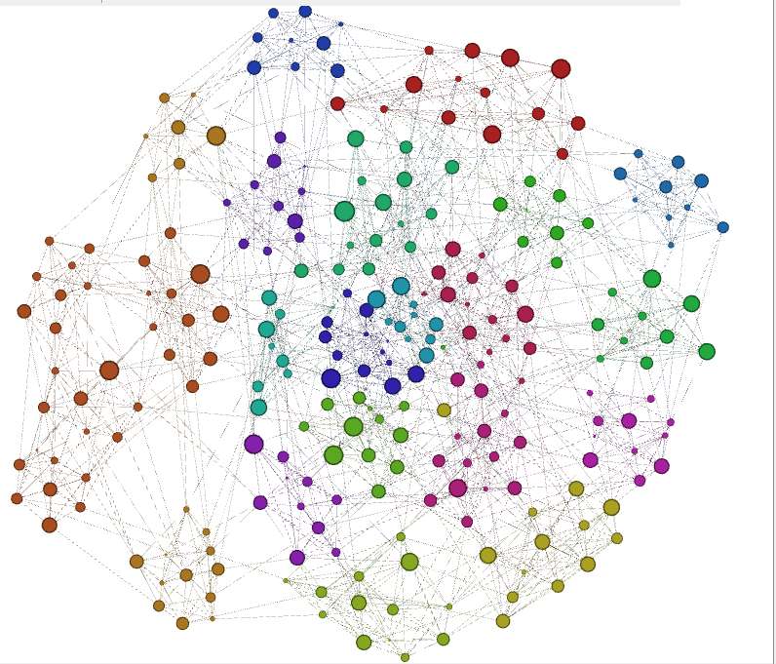
Southern
SEC
MEAC
MEAC
ACC
C-USA
CAA
American
Patriot
MAC
OVC
Ivy
Big Ten

